Slide 1
GenBioCELL: Generalizable, Training-Free Biological Image Analysis via Collaborative and Self-Evolving Large Language Model Agents
Yuewei Lin
Brookhaven National Laboratory

Slide 2
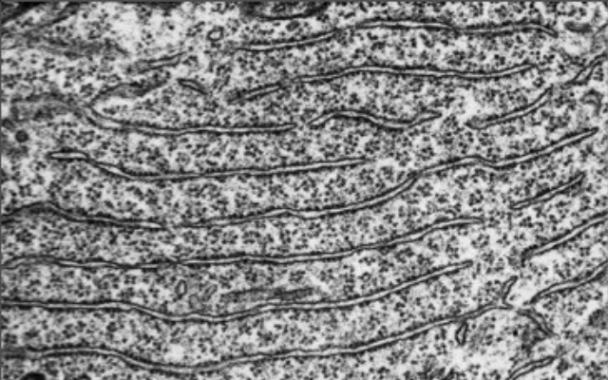
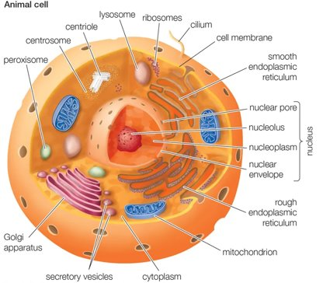
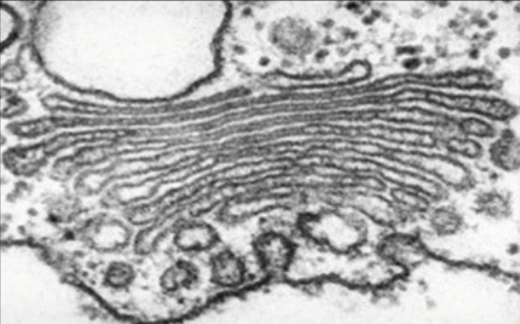
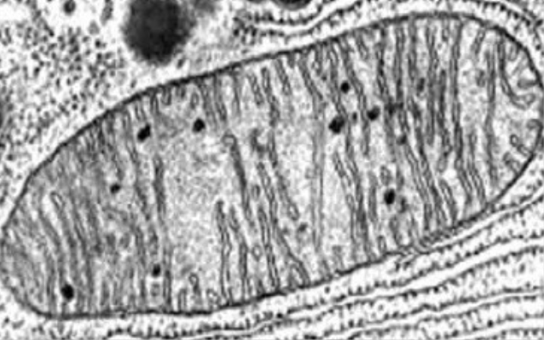
Background & Motivation
Biological image analysis is essential for modern life sciences, enabling breakthroughs and deeper insights.
Object segmentation is a core technique, critical for researchers to measure shapes and track changes in biological samples.
Existing models:
Require large-scale training data
Restricted to specific organelles -- poor generalizability
Endoplasmic
reticulum
Golgi
Mitochondria
Organelles
Our goal: develop a generalizable, training-free system for organelle segmentation.

Slide 3
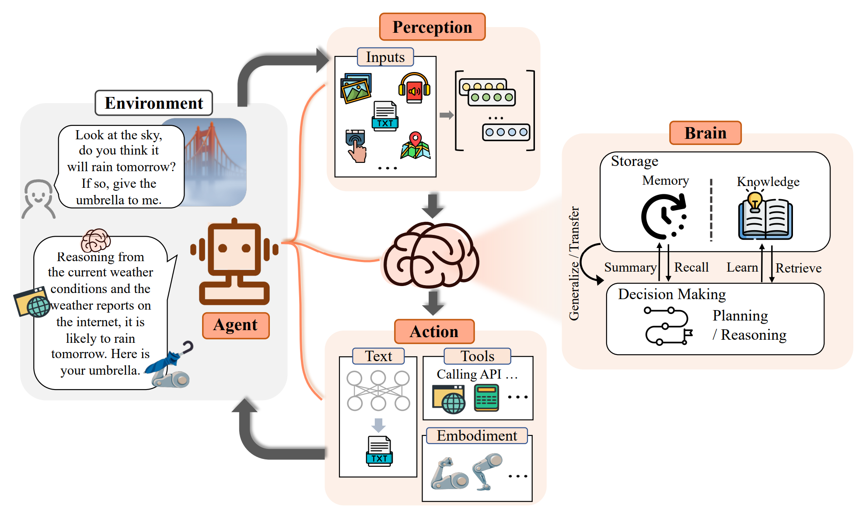
Background & Motivation
Multi-LLM agent system
Inputs
Query
LLM serves as the controller for the system and is able to call multiple external tools.
Multiple LLM agents serve as different roles, (e.g., planner, executor, evaluator, etc.) and collaborate to tackle various tasks.
Workflow
LLM
LLM agent
External Tools
Agent Response

Slide 4


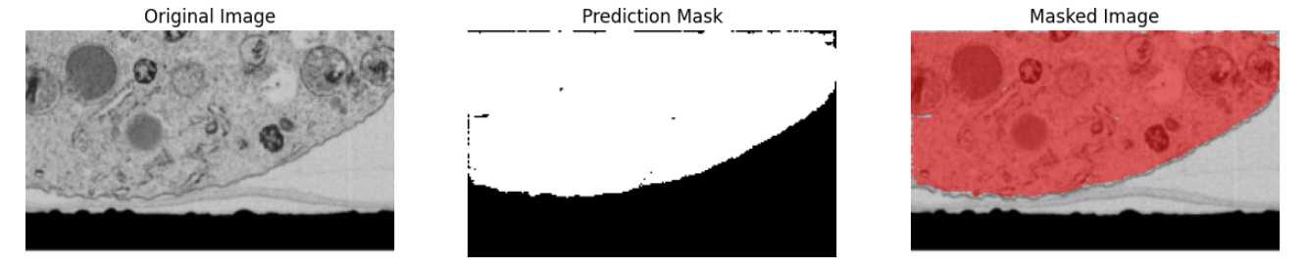
Overall Framework
Planning Agent
Task parsing, Memory retrieval External information retrieval Existing tool pool retrieval …
User Inputs
User Inputs: User provides an input image and query e.g. “Help me segment the mitochondrion in the provided image."
Planning Agent:
Given the user’s input, the available tools and data, the memory and external information retrieval, to generate the basic plan.
Existing tool
available?
Yes
Specific
Tool
User Query: "Help me segment the mitochondrion in the provided image.."
No
Yes
Prev. runs/Existing data available?
In-Context
General Tool
No
Text-Input
General Tool
Summarize
External information retrieval
Existing Tool Pool

Slide 5

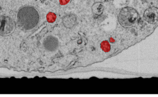
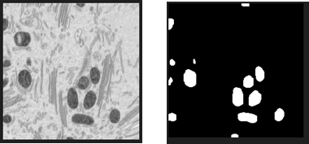
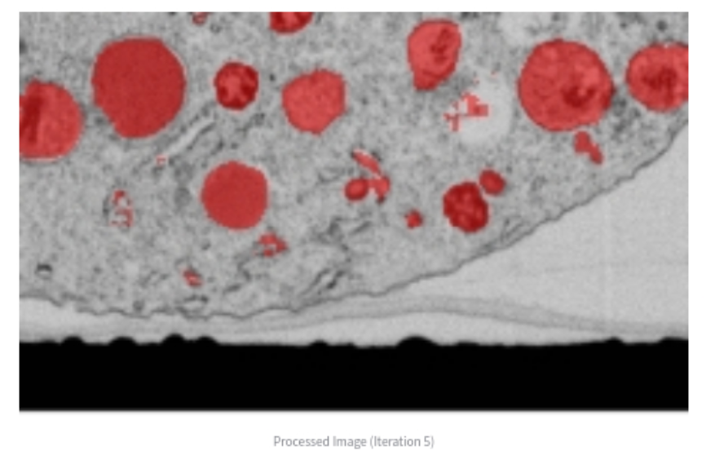
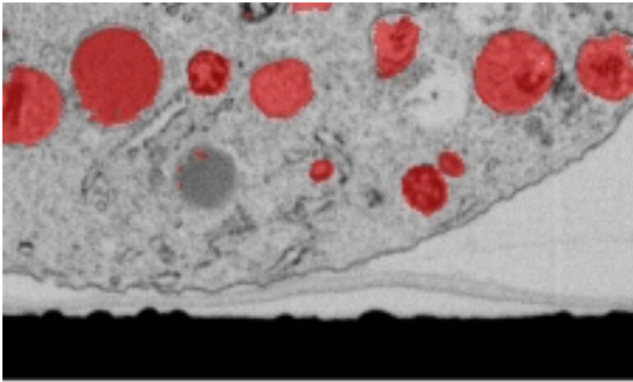
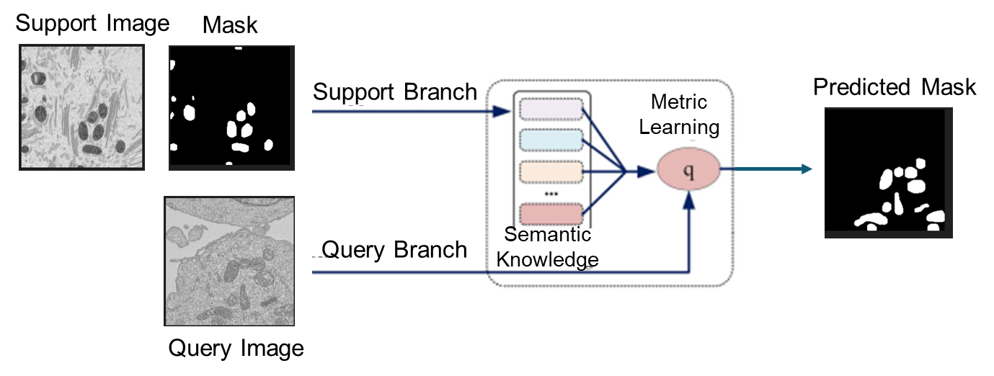
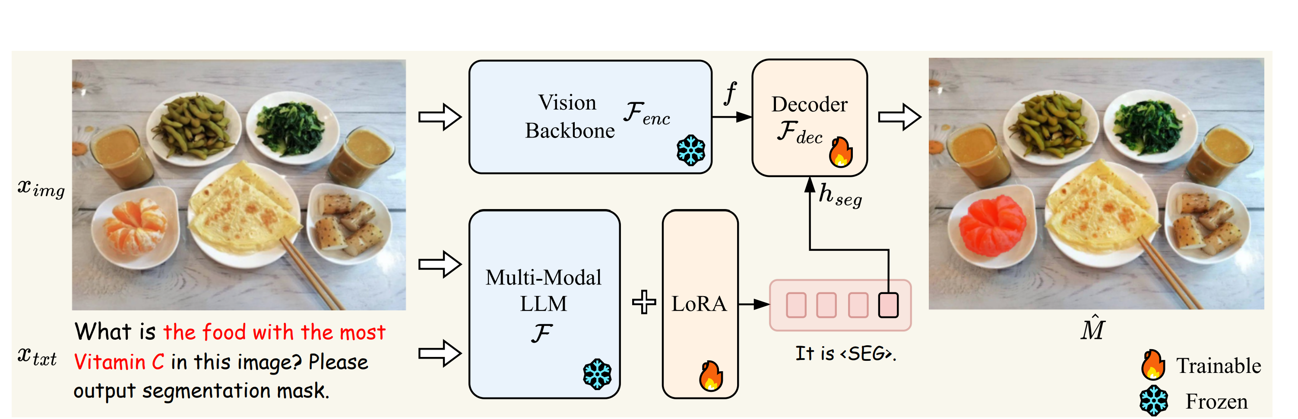
Overall Framework
Planning Agent
Execution Agent
Input
Task parsing, Memory retrieval External information retrieval Existing tool pool retrieval …
Existing Specific Tool
User Inputs
In-Context General Tool
Existing tool
available?
Yes
Specific
Tool
Reference pair
User Query: "Help me segment the mitochondrion in the provided image.."
Mitochondria are organelles with a double membrane, often appearing as bean-shape or rod-shape structures.
Text-Input General Tool
No
Database/
web search
Yes
Prev. runs/Existing data available?
In-Context
General Tool
No
Execution Agent: runs the best‑fit tool chain.
Text-Input
General Tool
Summarize
Specific Tool: Designed for specific task. Likely highly optimized or pretrained for a particular organelles, e.g., MitoNet for mitochondria, Cellpose and µSAM for cell/nuclei.
In-context Tools: Provide a reference image/mask pair as the example
Text-Guided Tools: provide the text description of the object.
External information retrieval
Existing Tool Pool
Image input
Text guidance
“Segment the food with the most Vitamin C.”
Orange is segmented

Slide 6

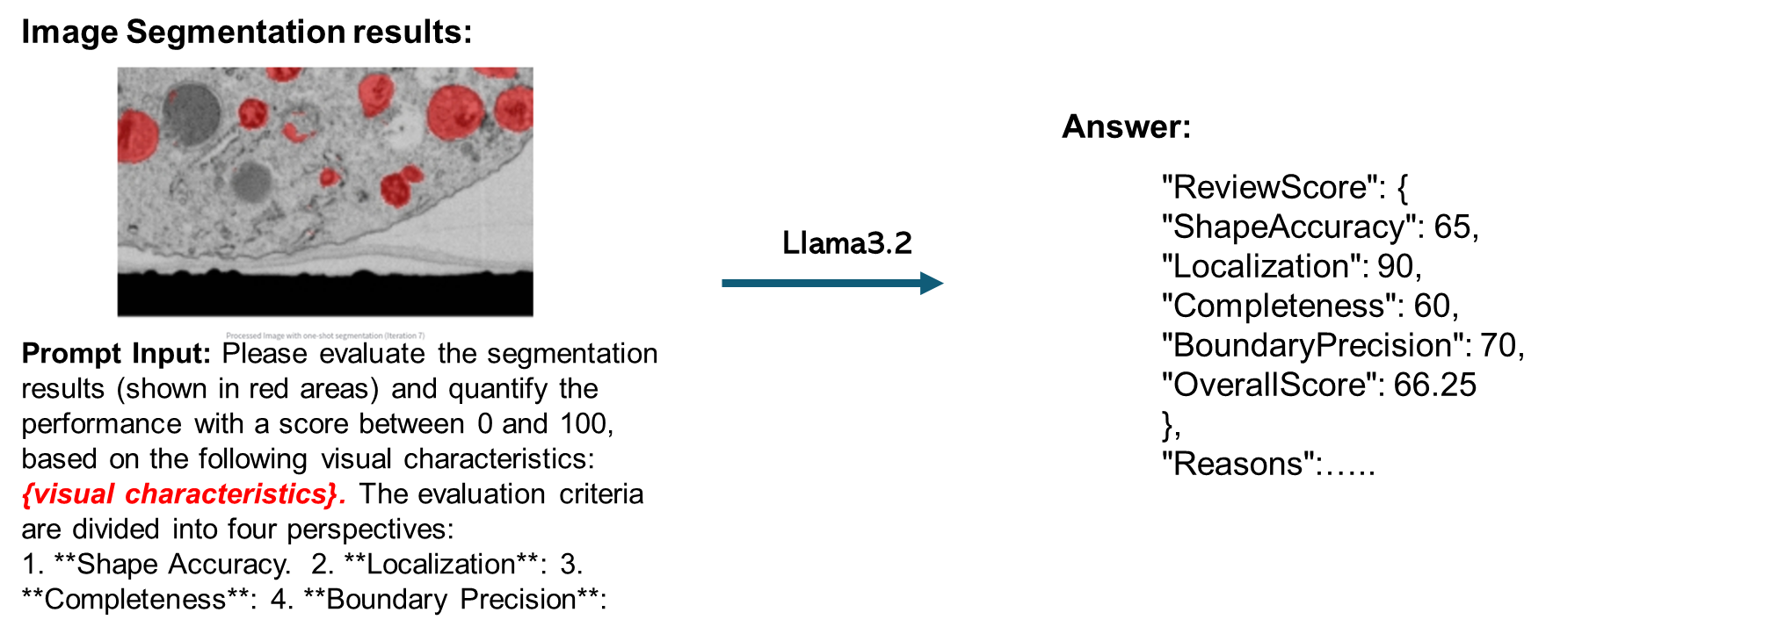
Overall Framework
Planning Agent
Execution Agent
Input
Task parsing, Memory retrieval External information retrieval Existing tool pool retrieval …
Existing Specific Tool
User Inputs
In-Context General Tool
Existing tool
available?
Yes
Specific
Tool
Reference pair
User Query: "Help me segment the mitochondrion in the provided image.."
Mitochondria are organelles with a double membrane, often appearing as bean-shape or rod-shape structures.
Text-Input General Tool
No
Database/
web search
Multi-agent
Interaction
Loop
Yes
Prev. runs/Existing data available?
In-Context
General Tool
No
Evaluation Agent
Text-Guided
General Tool
Summarize
Based on the evaluation results
Evaluation
Tool
Modified the Tool’s Inputs.
Focus more on the boundary of the object.
Provide more examples.
Using other Tools.
No
Evaluation
Performance?
Yes
Ask help from human.
Change the planning.
Correct the outputs of tool
External information retrieval
Existing Tool Pool
Evaluation Agent: Uses a visual-language model to assess segmentation based on text description, which is from the external information retrieval.

Slide 7

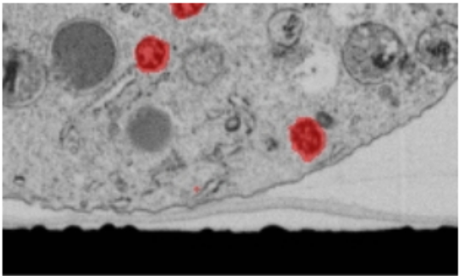
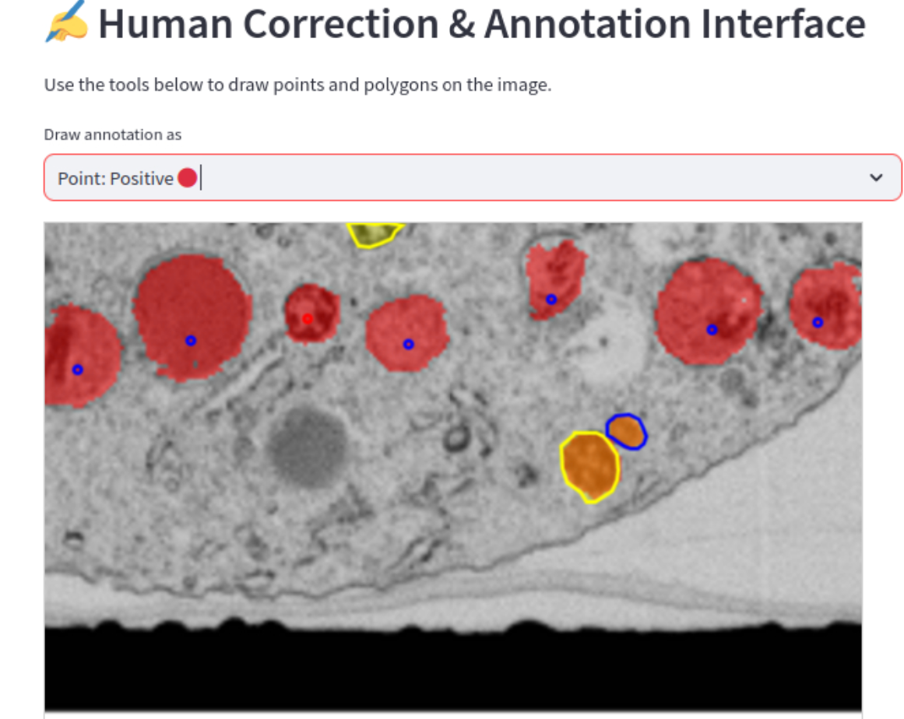
Overall Framework
Planning Agent
Execution Agent
Input
Task parsing, Memory retrieval External information retrieval Existing tool pool retrieval …
Existing Specific Tool
User Inputs
In-Context General Tool
Existing tool
available?
Yes
Specific
Tool
Reference pair
User Query: "Help me segment the mitochondrion in the provided image.."
Mitochondria are organelles with a double membrane, often appearing as bean-shape or rod-shape structures.
Text-Input General Tool
No
Database/
web search
Multi-agent
Interaction
Loop
Yes
Prev. runs/Existing data available?
In-Context
General Tool
No
Evaluation Agent
Text-Input
General Tool
Summarize
Based on the evaluation results
Evaluation
Tool
Modified the Tool’s Inputs.
Focus more on the boundary of the object.
Provide more examples.
Human-in-the-loop
Using other Tools.
No
Evaluation
Performance?
Yes
Directly correct segmentation results
Ask help from human.
Change the planning.
Correct the outputs of tool
External information retrieval
Existing Tool Pool
Interrupt the loop and replanning
Human interaction: Directly correct the segmentation results or interrupting the loop and replanning.
Skip the Ensemble tool and use the Summarize tool to generate the final report

Slide 8


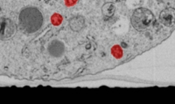
Overall Framework
Planning Agent
Execution Agent
Input
Task parsing, Memory retrieval External information retrieval Existing tool pool retrieval …
Existing Specific Tool
User Inputs
In-Context General Tool
Existing tool
available?
Yes
Specific
Tool
Reference pair
User Query: "Help me segment the mitochondrion in the provided image.."
Mitochondria are organelles with a double membrane, often appearing as bean-shape or rod-shape structures.
Text-Input General Tool
No
Database/
web search
Memory
Multi-agent
Interaction
Loop
Yes
Prev. Runs:
Object name
Visual Characteristic
Tools used
Tools execution order
Evaluation score of each tool
Results
User Profile:
User Inputs
User provide example
User Interactions
Prev. runs/Existing data available?
In-Context
General Tool
No
Evaluation Agent
Text-Input
General Tool
Summarize
Based on the evaluation results
Evaluation
Tool
Modified the Tool’s Inputs.
Final Result & Reports
Focus more on the boundary of the object.
Provide more examples.
Object Name : Mitochondria
Visual Characteristics: Mitochondria, typically round to oval-shaped organelles, often described as bean-like, with a double membrane structure.
Tool Usage and Performance ...
Human-in-the-loop
Using other Tools.
No
Evaluation
Performance?
Yes
Directly correct segmentation results
Ask help from human.
Change the planning.
Correct the outputs of tool
External information retrieval
Existing Tool Pool
Interrupt the loop and replanning
Skip the Ensemble tool and use the Summarize tool to generate the final report
If the results are satisfied, all the information, including segmentation masks, visual features, and tool execution sequences, are recorded and stored in memory.

Slide 9
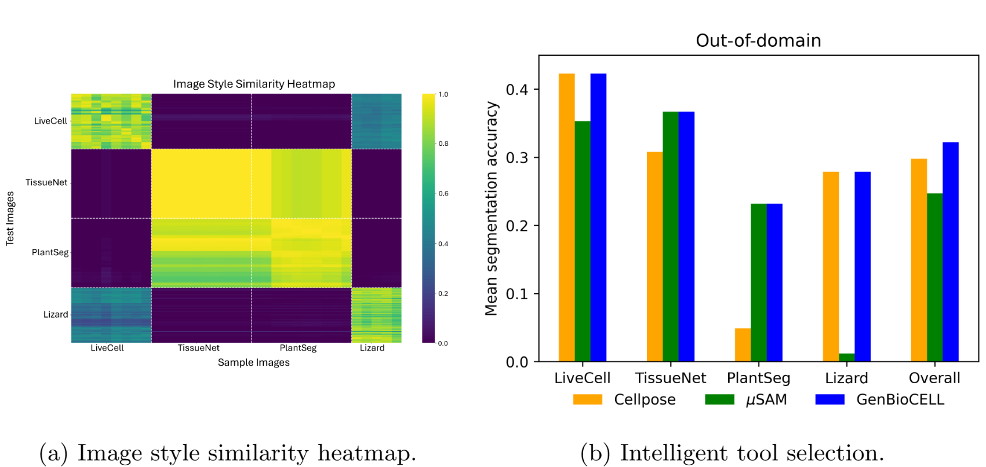
Results
Scenario I: Existing Tools Available
Intelligent specific tool selection
Each specific tool comes with its tasks, training datasets, and the datasets it handles best, e.g., Cellpose on LiveCell/Lizard, μSAM on TissueNet/PlantSeg
Measure the style similarity between the test image and samples from known datasets, select the tool that historically performs best on the most similar dataset.
Our model performs the same as the best model for each dataset, while overall it outperforms any of the single tools.

Slide 10
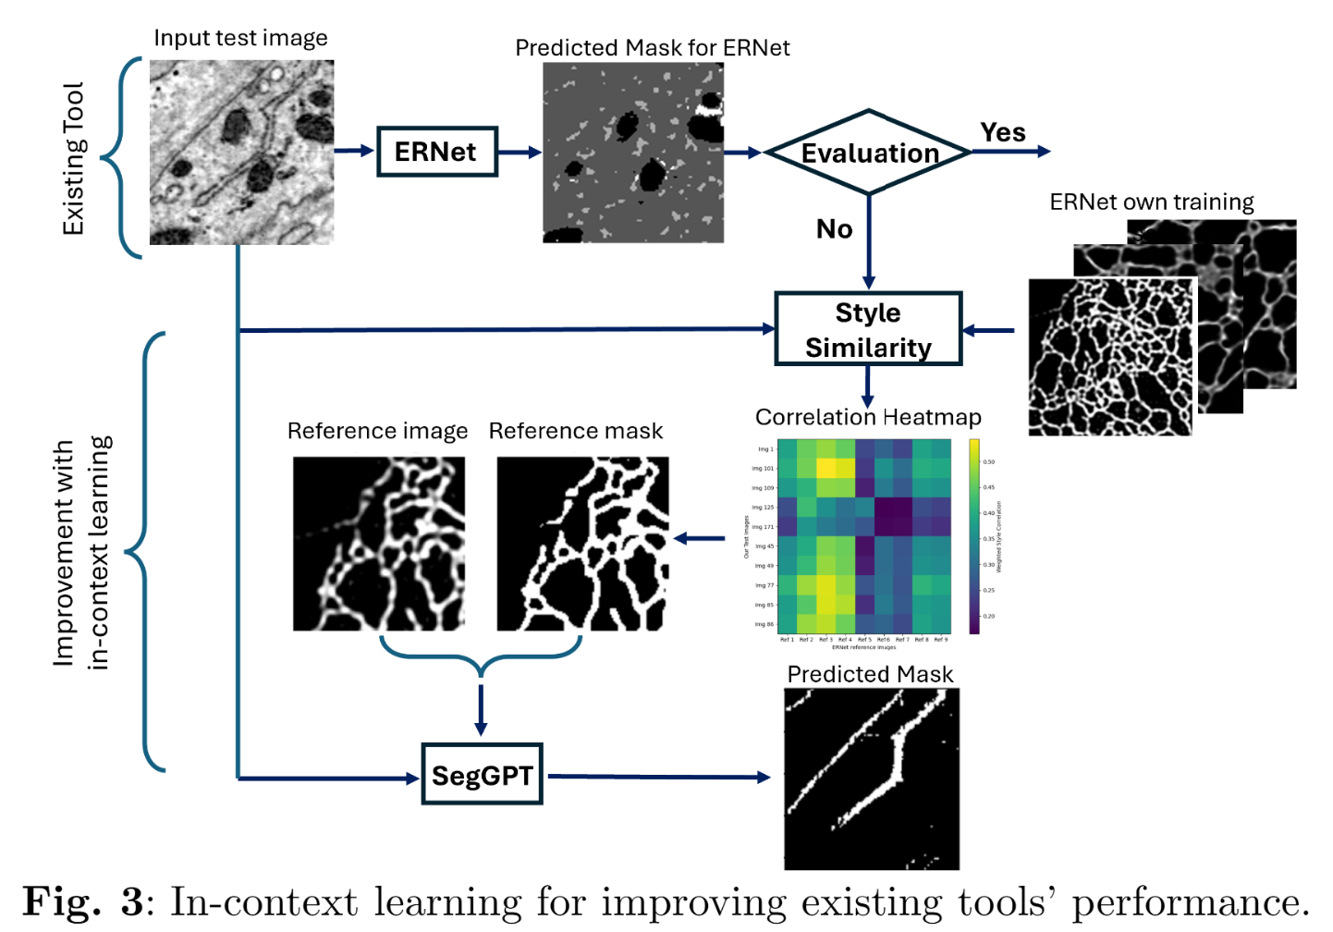
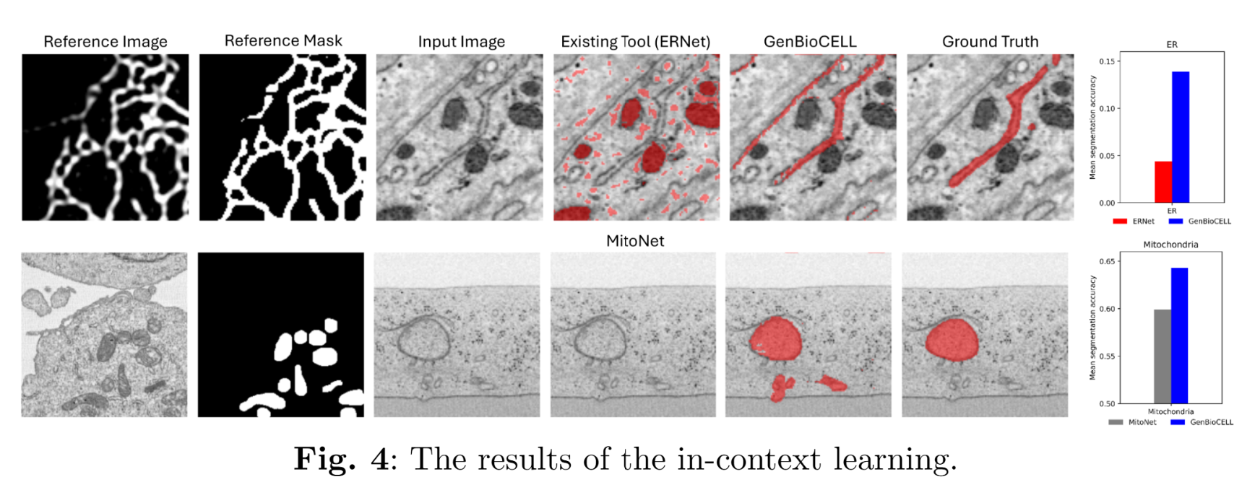
Results
Scenario I: Existing Tools Available
Improvement when existing tools (e.g., MitoNet, ERNet) underperformed in out-of-distribution (OOD) conditions.
Using the image and mask in the training set of existing tool and consider them as examples for in context learning to improve the OOD performance.
Notes:
While GenBioCELL selects the most suitable segmentation tool, existing methods often fail under out-of-distribution (OOD) conditions, i.e., test images deviate substantially from the training data. To address this, if a specialist tool (e.g., ERNet) underperforms, we will integrates SegGPT, which adapts to unseen domains using in-context learning with the most similar image–mask pair.
On unseen ER and mitochondria datasets, GenBioCELL outperformed ERNet and MitoNet, recovering accurate structures and achieving higher IoU scores, demonstrating strong robustness to distribution shifts.

Slide 11
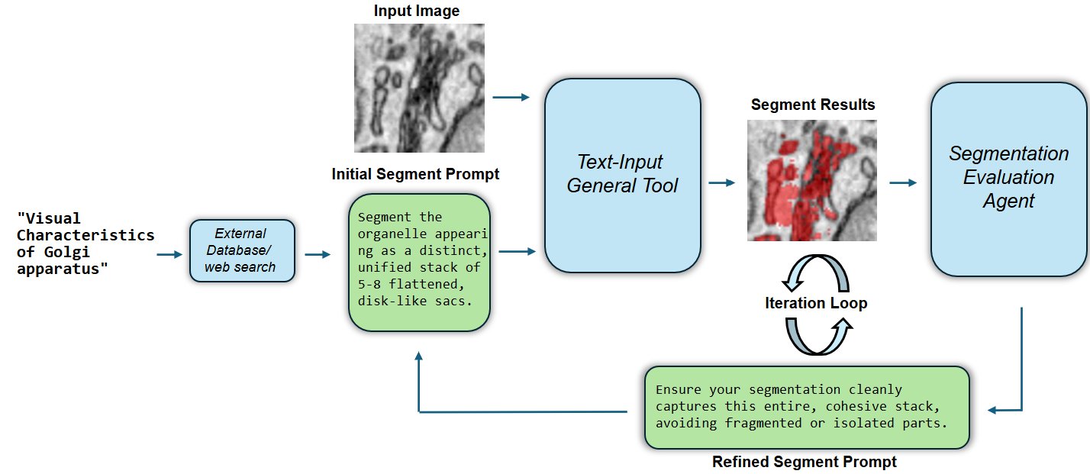
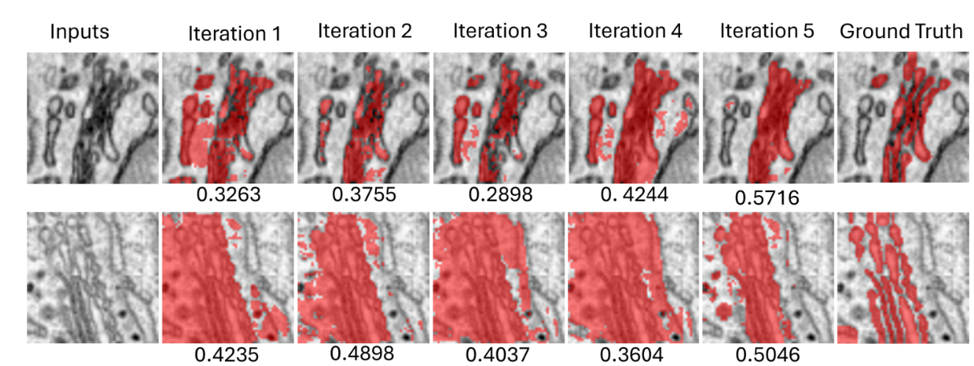
Results
Scenario II: Full Automated Segmentation
Novel object, i.e., no existing tools/data, e.g., “Golgi”
Pipeline for full automated segmentation
Utilizing the text-guided segmentation model, the segmentation performance is iteratively improved through collaboration with an evaluation agent, which provides feedback to refine the results progressively.

Slide 12
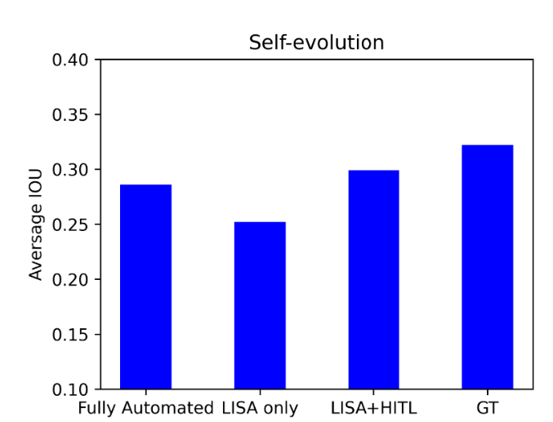
Results
Scenario III: Self Evolution
Novel Capability Emergence. For the tasks of novel organells, like “segment Golgi”, GenBioCELL begins with automated segmentation, refined when needed by human correction and then stores corrected examples to enable in-context general tool reuse. After one process, it can quickly handle new images using fast single-example in-context learning, without re-running the full process.
We test self-evolution using one example image and apply in-context learning to the others.
LISA only: Using reference from automated segmentation
LISA+HITL: Using human correction results as reference.
GT: Using ground truth as reference.

Slide 13
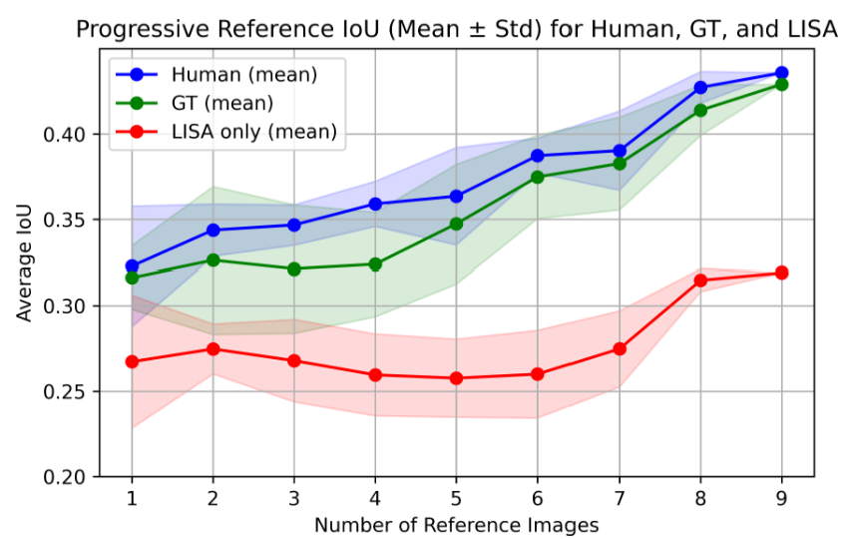
Results
Scenario III: Self Evolution
Progressive Performance Improvement, where performance improves as experience accumulates.
We treat one image as the input. The remaining images become progressively available for in-context reference.
Minimally corrected masks outperformed ground truth, likely because simplified boundaries provided more generalizable examples. It suggests that lightweight human-in-the-loop input, rather than extensive curation, can yield strong results, making GenBioCELL scalable and practical for biological research.

Slide 14
Conclusion
Key points:
Training-Free: Works without labeled data or extra training.
Intelligent Tool Selection: Selects the best tools for each task and dataset.
Generalization: Handles unseen biological structures through text-based features.
Self-Evolving: Continuously enhances itself by experience accumulates.
Future work:
Develop more powerful in-context learning and text-guided models specifically for biological images.
Develop more powerful and stable evaluation agent.
Extend it to more complex tasks beyond segmentation.

Slide 15
Questions?

