Slide 1
Autonomous Agent Creation, Memory, and Self-Improvement
September 2025

Slide 2
Agenda
What is CRAFT?
Challenges
Solutions
Results
What next?

Slide 3

Design, test, publish, deploy, and govern Agentic Solutions for ​automated machine-scale data intelligence
What is CRAFT?
Create
Remember
Assemble
Finetune
Trust

Slide 4
Challenges: Abstracted from several recent client projects
Consistency
LLMs are unreliable and stochastic while enterprises thrive on deterministic workflows
Accuracy
Enterprises require systems to be highly accurate to be trustworthy
Reliability
Should never fail or behave in an unexpected manner whereas LLMs tend to hallucinate to be creative
Domain knowledge
Domain specific knowledge of data semantics and computations are not machine-readable
Scaling up learning
Learning via human interaction is critical, but limited in scale
Need to generalize to unseen and long-tail scenarios

Slide 5
Solutions
Agents-creating-agents (ACA)
Autonomous agent creation for unseen and long-tail scenarios
Leverage code-writing strengths of LLMs
Agentic memory
Extract semantic and domain knowledge from conversational interactions with users
Persist lessons and workflows (chains of agents/code) that is verified
Self-improvement
Autonomous experience collection, self-reflection and planning
Learn from failures and feedback to over-fit to the enterprise

Slide 6
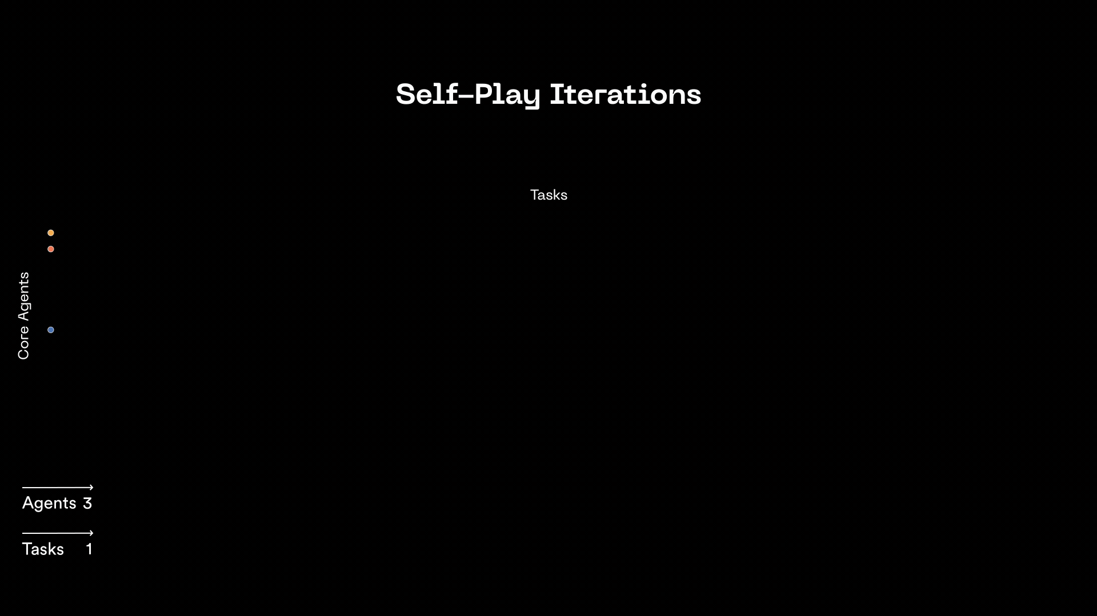
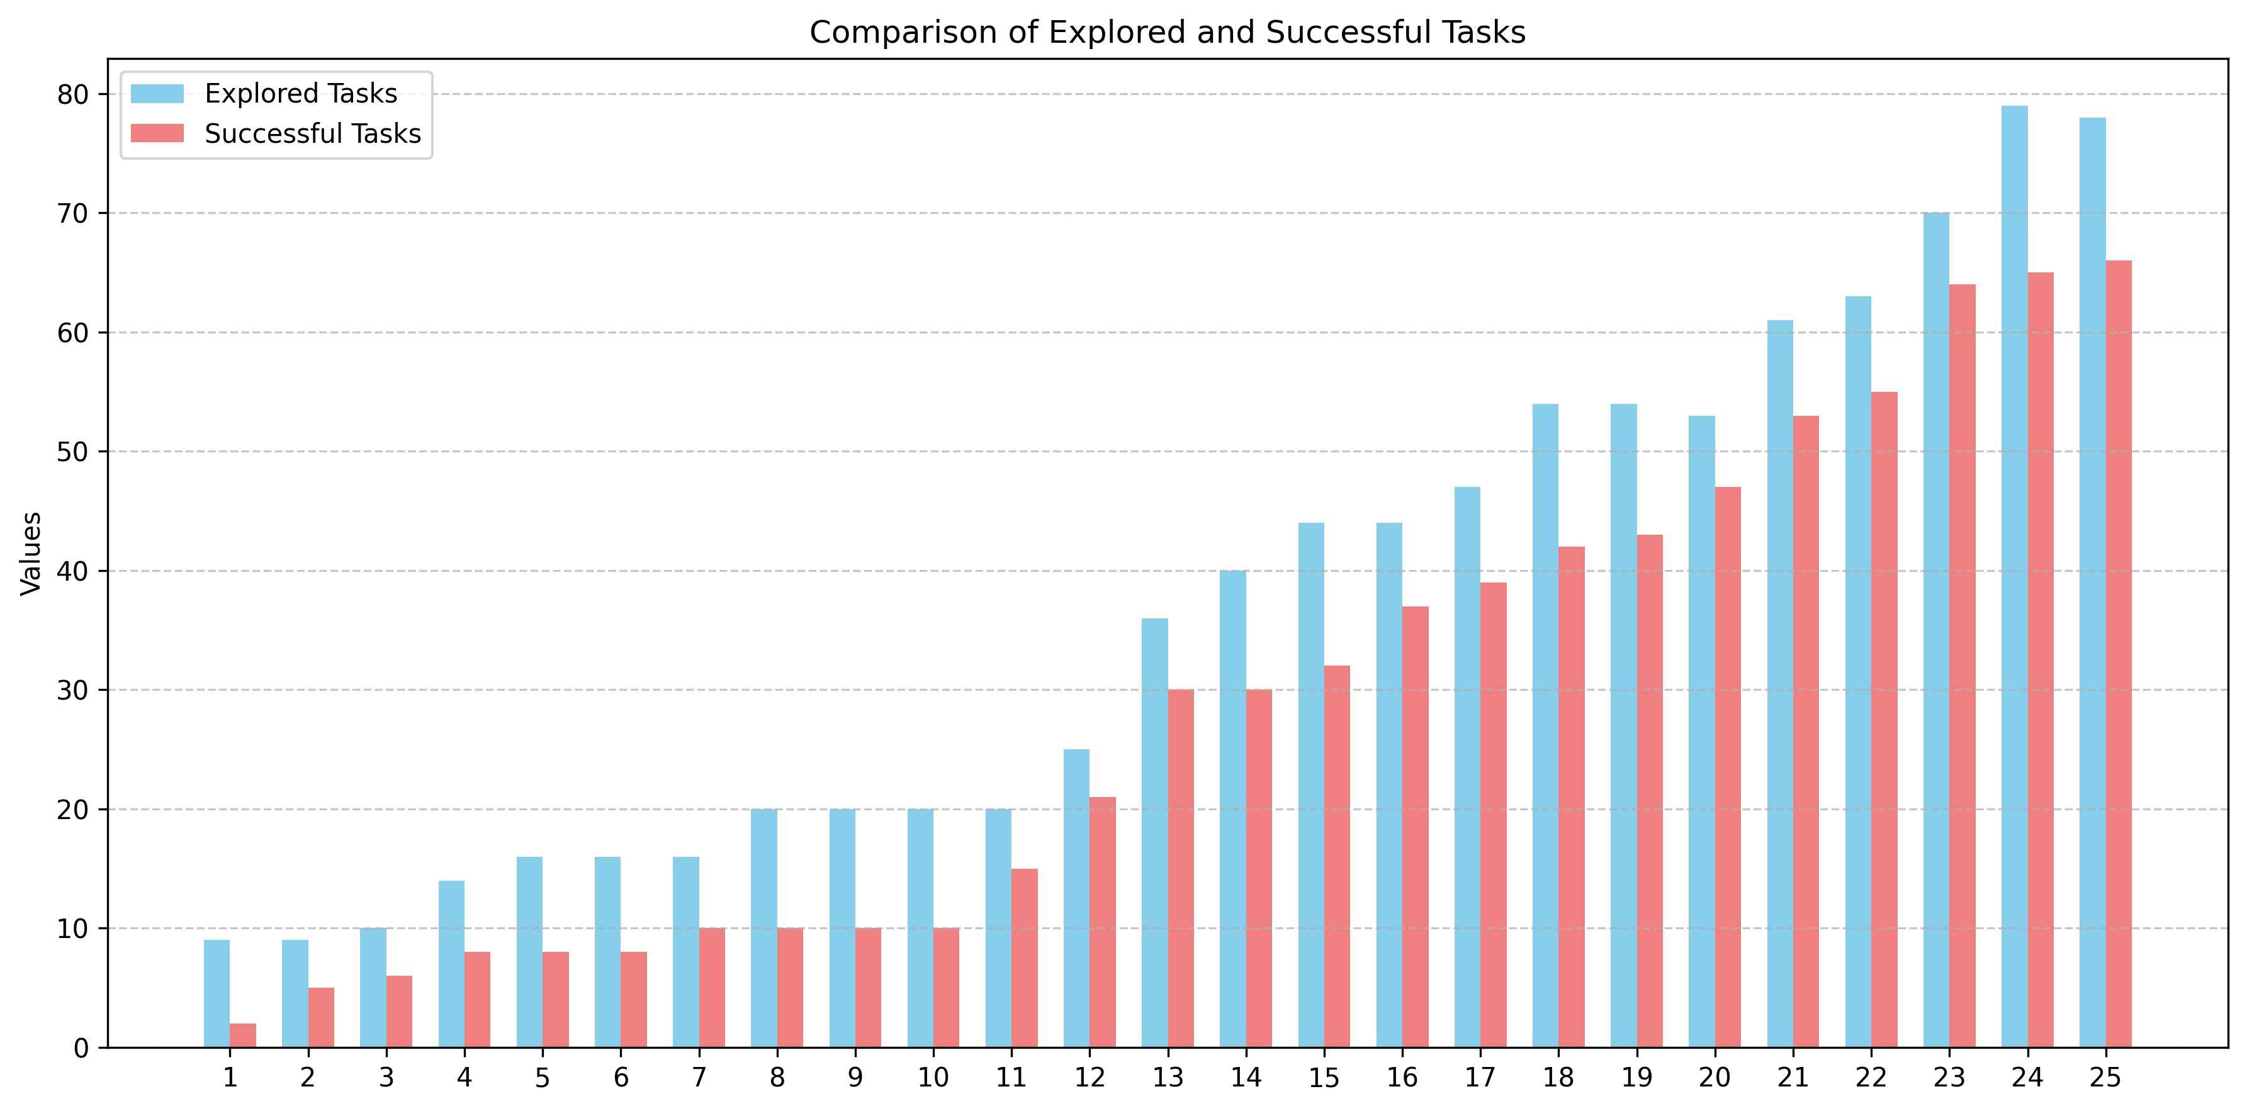
Agents-Creating-Agents (ACA)
https://www.emergence.ai/blog/towards-autonomous-agents-and-recursive-intelligence

Slide 7
Agentic Memory: SOTA on LongMemEval
Method | Accuracy | Latency (s/item) | Knowledge Update | Multi Session | Single Session Assistant | Single Session Preference | Single Session User | Temporal Reasoning
Naive RAG | 52.00% | 1.48 | 61.54% | 36.84% | 73.21% | 23.33% | 81.43% | 51.88%
Zep | 71.20% | 3.20 | 83.30% | 57.90% | 80.40% | 56.70% | 92.90% | 62.40%
Full context GPT o3 | 76.00% | 19.23 | 78.21% | 64.66% | 98.21% | 30.00% | 92.86% | 78.20%
EmergenceMem Simple Faster | 76.80% | 2.97 | 82.05% | 63.91% | 100.00% | 63.33% | 94.29% | 70.68%
EmergenceMem Simple Fast | 79.00% | 3.59 | 80.77% | 70.68% | 100.00% | 46.67% | 94.29% | 76.69%
EmergenceMem Simple | 82.40% | 7.12 | 79.49% | 73.68% | 100.00% | 70.00% | 95.71% | 81.20%
EmergenceMem Internal | 86.00% | 5.65 | 83.33% | 81.20% | 100.00% | 60.00% | 98.57% | 85.71%
https://www.emergence.ai/blog/emergence-is-the-new-new-state-of-the-art-in-agent-memory

Slide 8
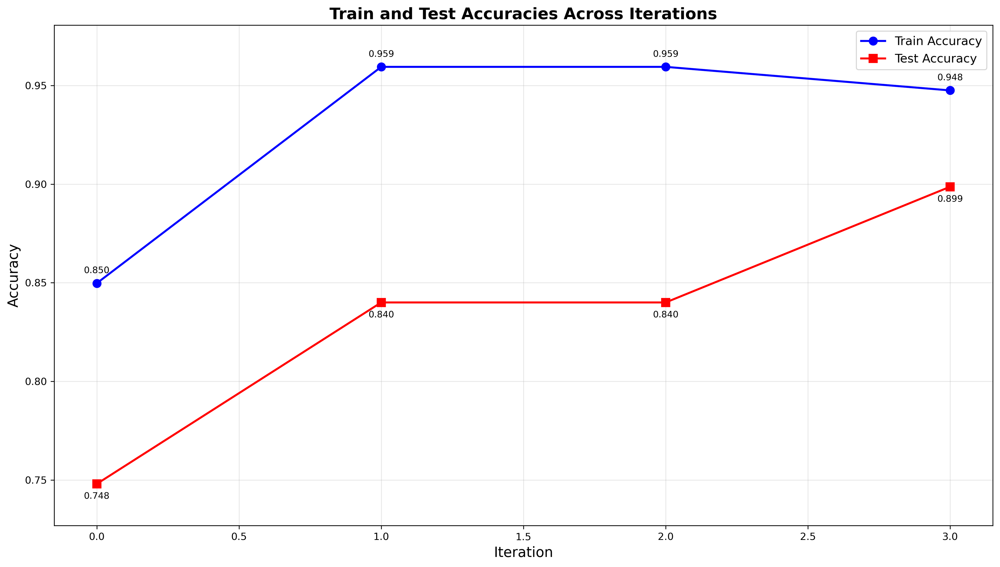
Self-improvement
Auto-extracting domain knowledge from failure analysis
Promising early results on small dataset

Slide 9
What next?
Bring together all the previous threads
Reliable agentic code-gen is at the heart of automated agent creation
Agentic experience is gathered in LTM, from persisted code, to harvested skills, to human demos, to insights from self-exploration
Recursive self-improvement with automated self-exploration enables continuous evolution

Slide 10
Thank you!
aditya@emergence.ai

