Slide 1
Integrated AI for Science Infrastructure and the Upcoming NERSC "Doudna" System
Wahid Bhimji
September 12th 2025
New York Scientific Data Summit 2025

Slide 2
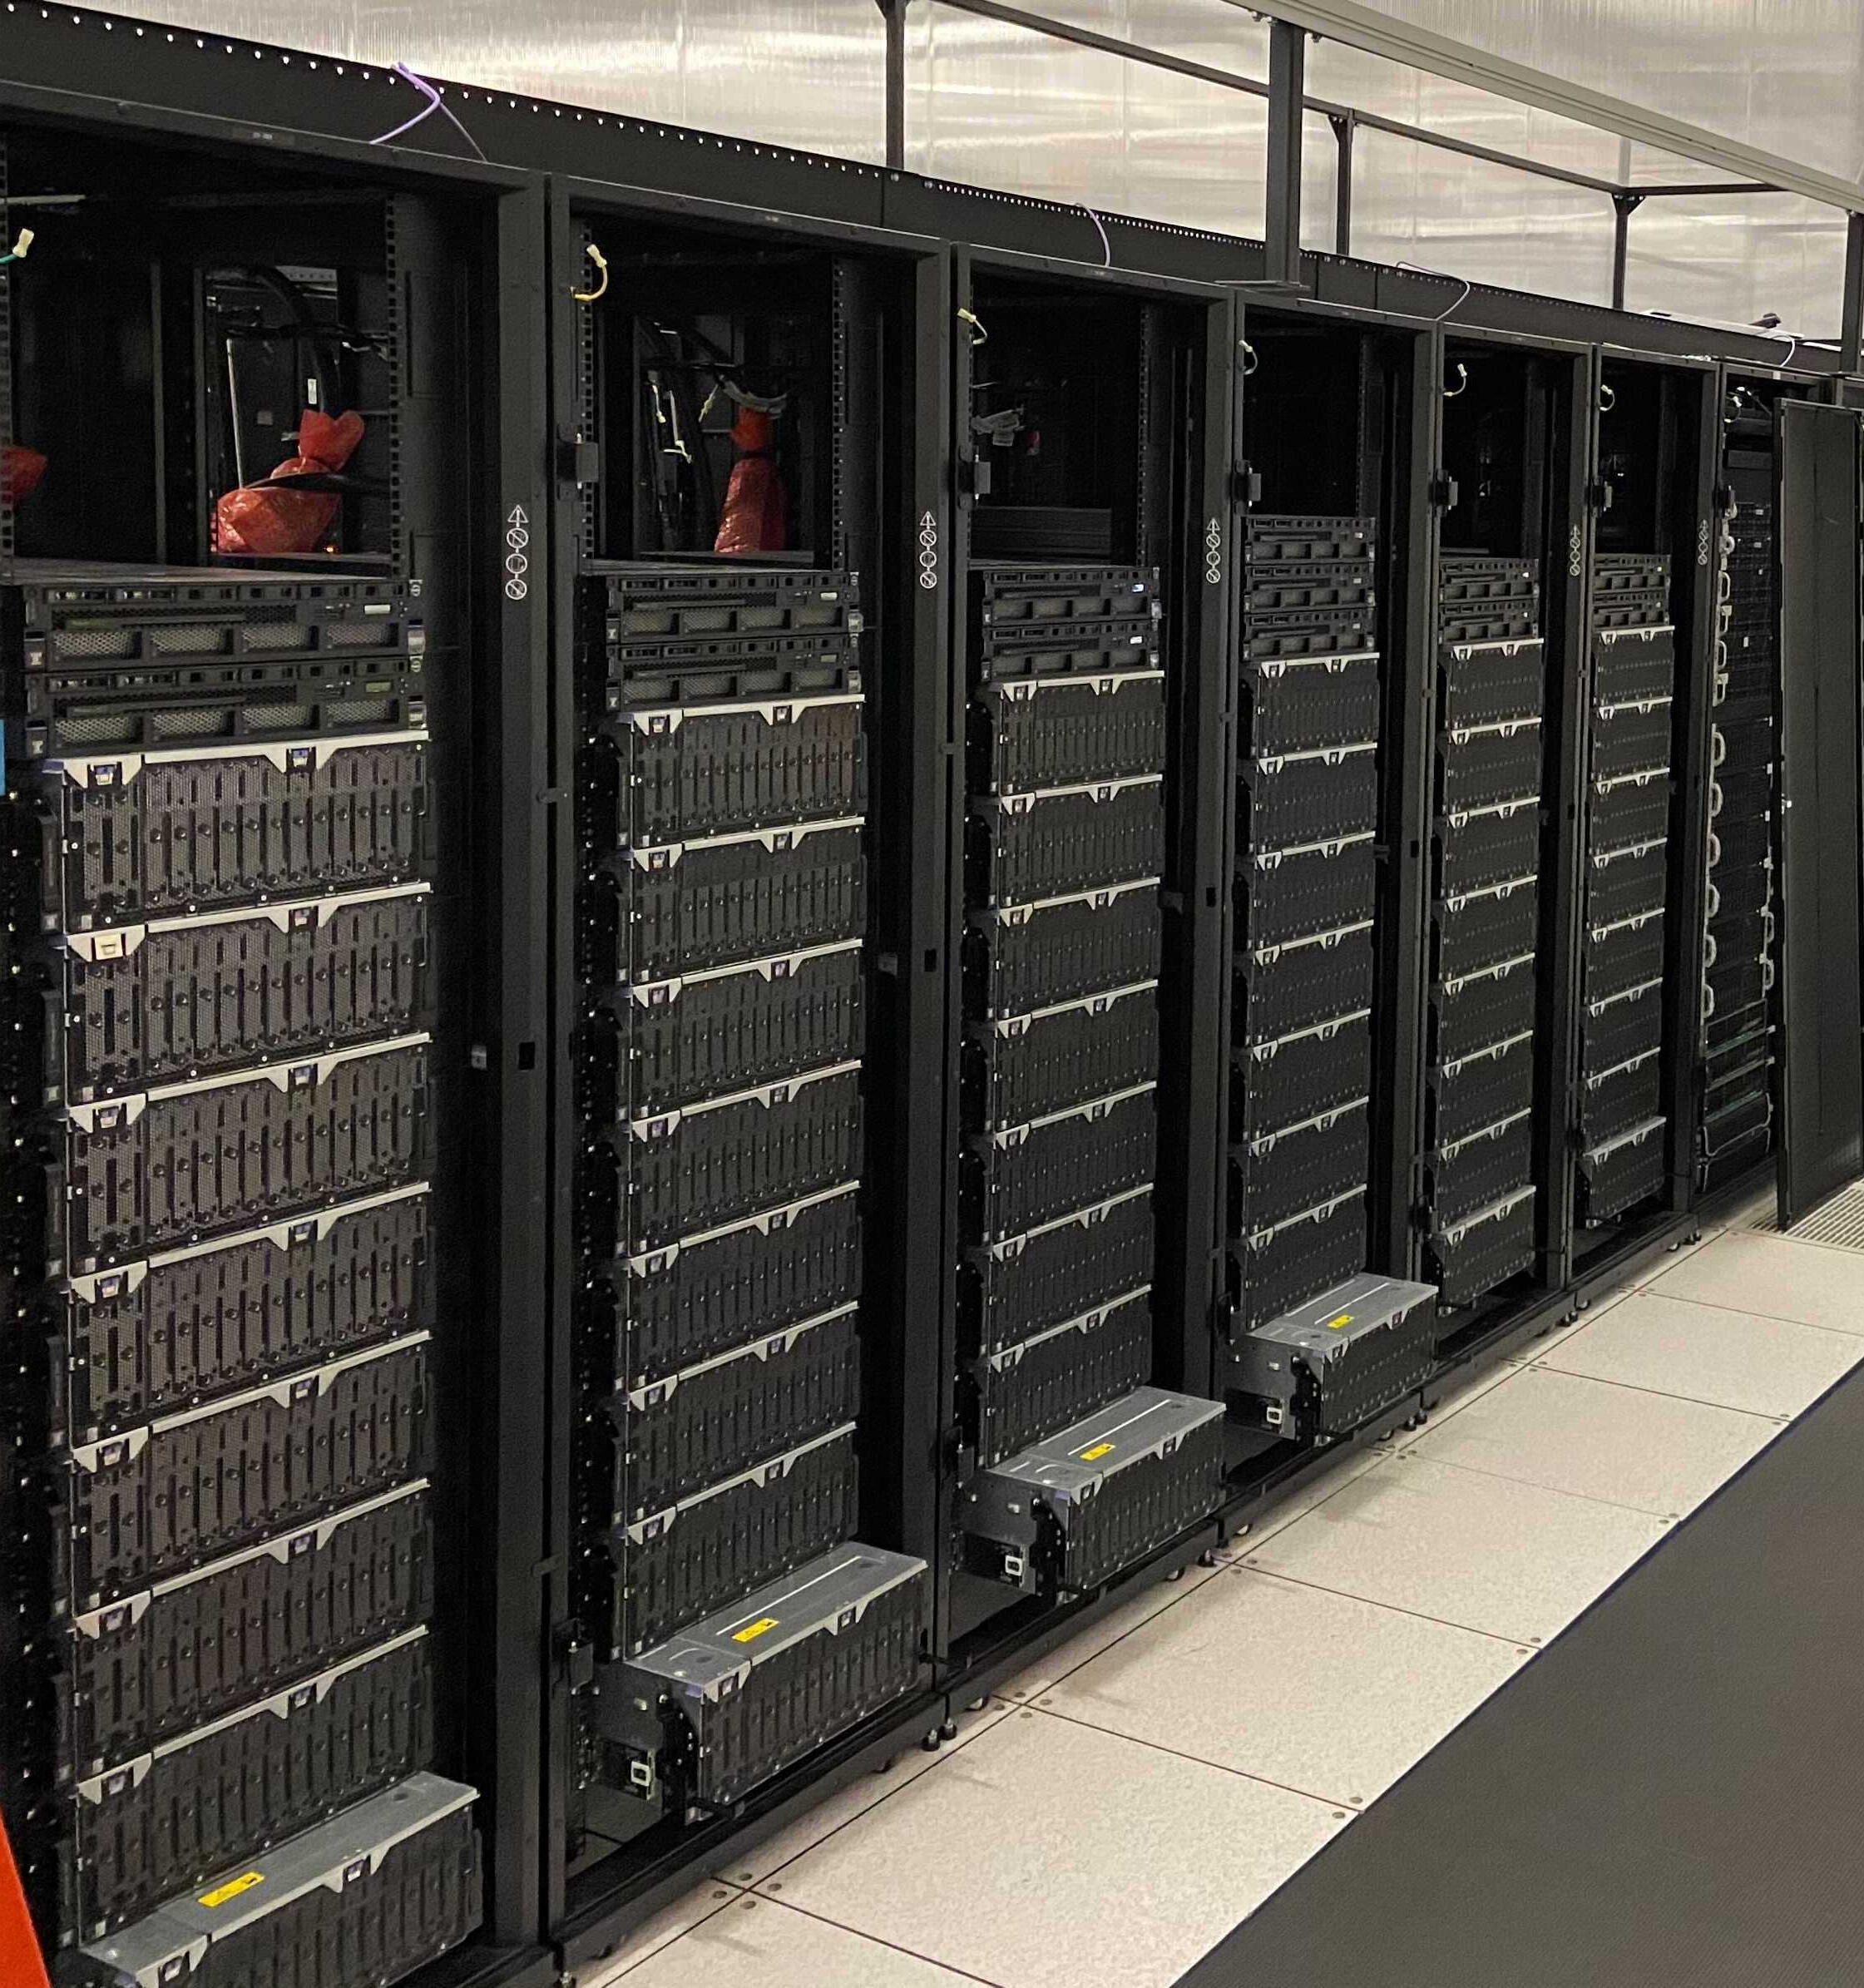
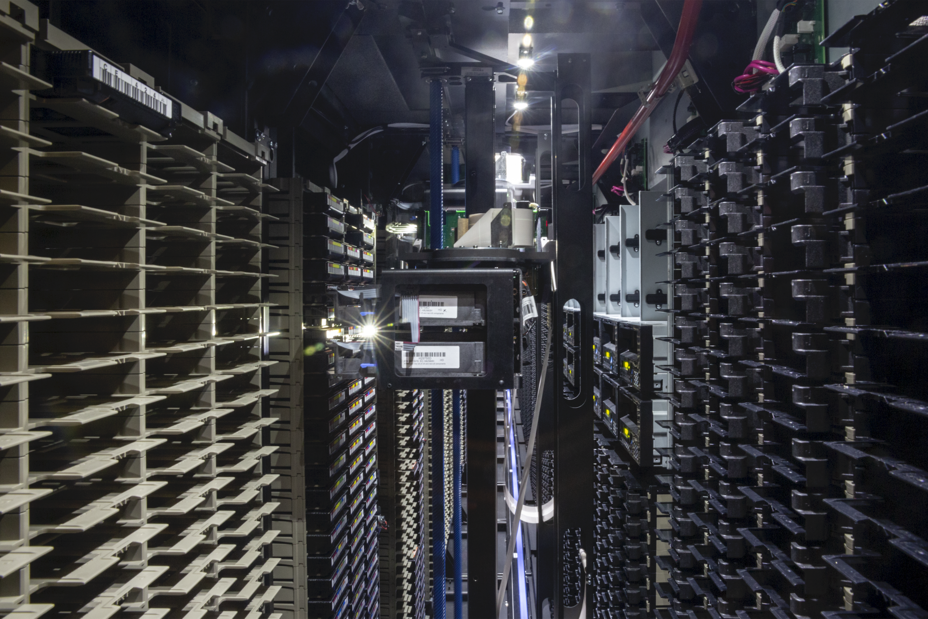
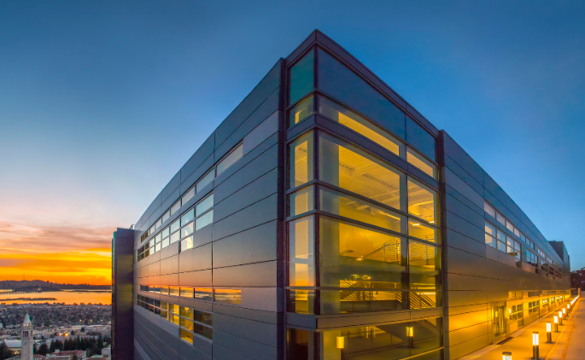
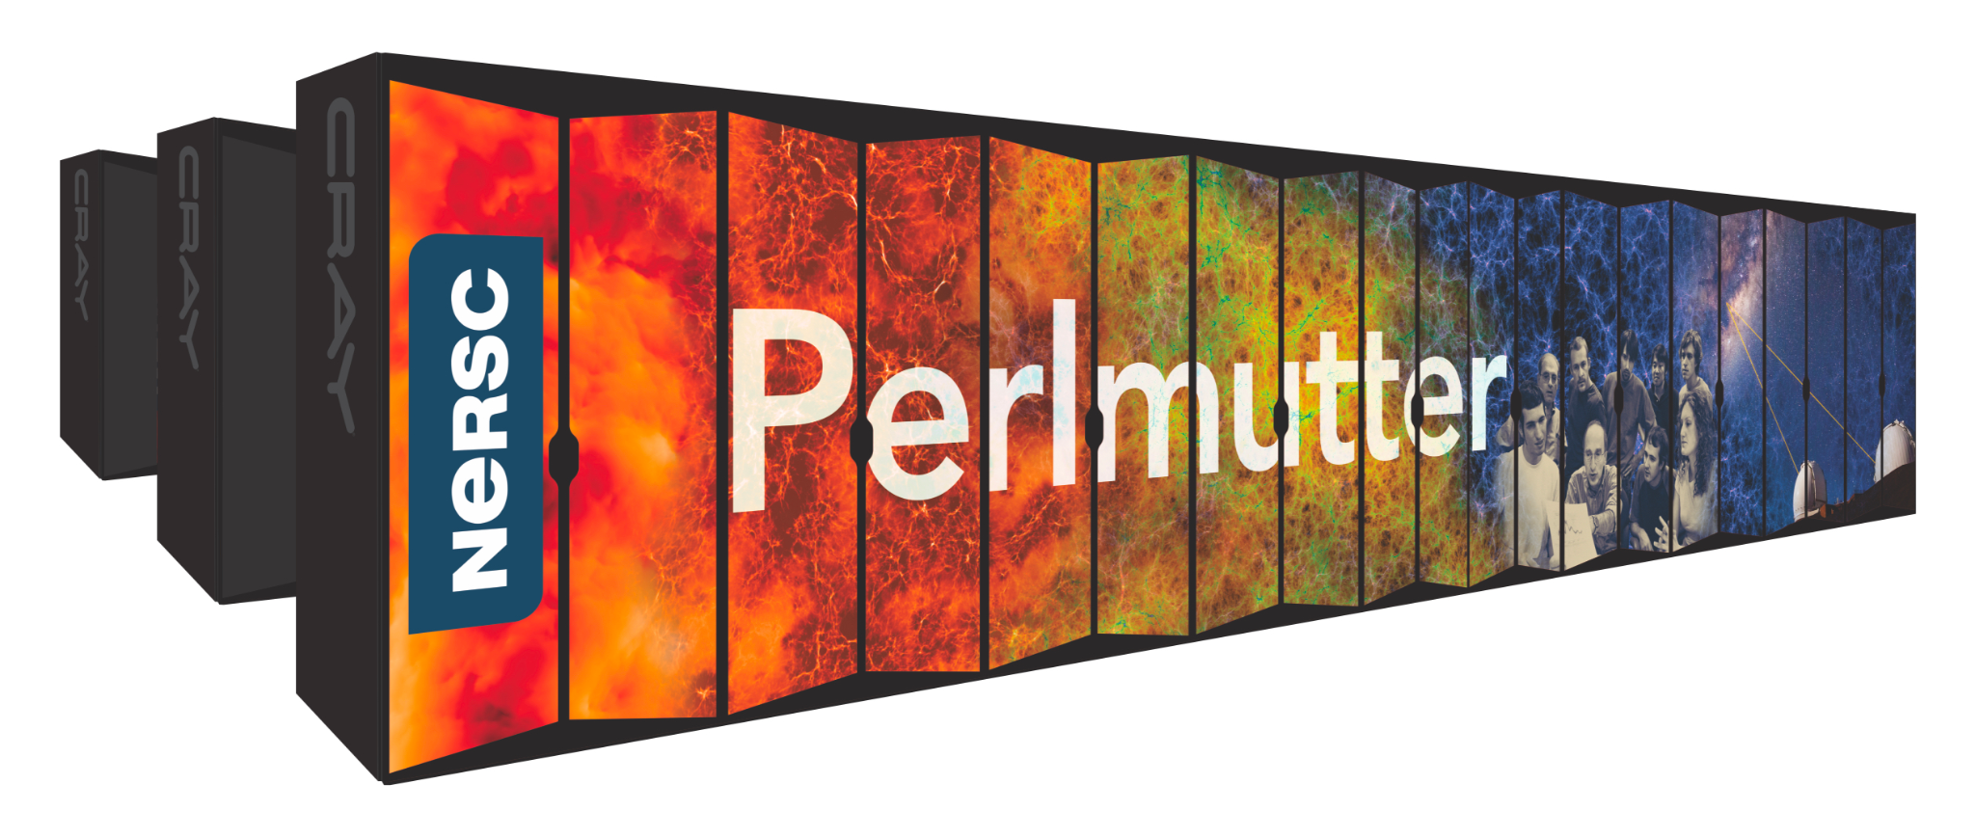

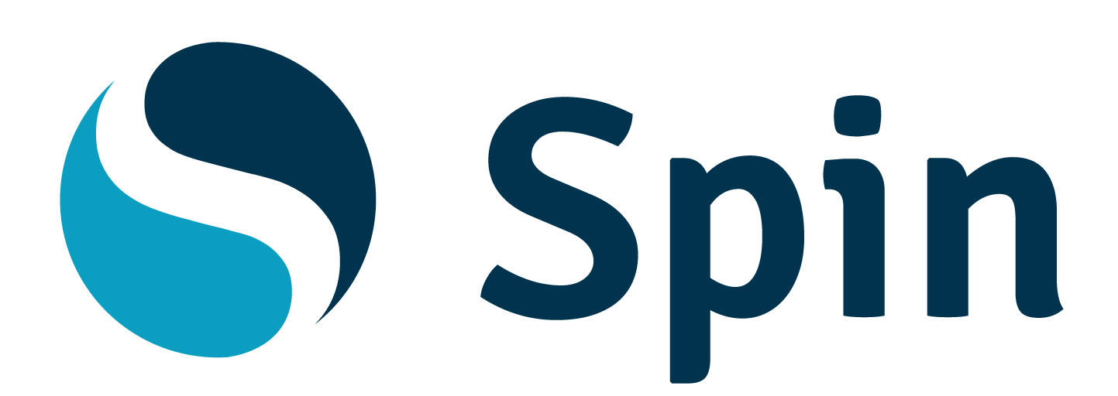
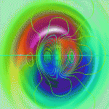
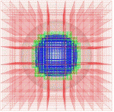
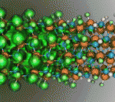
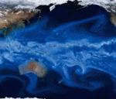
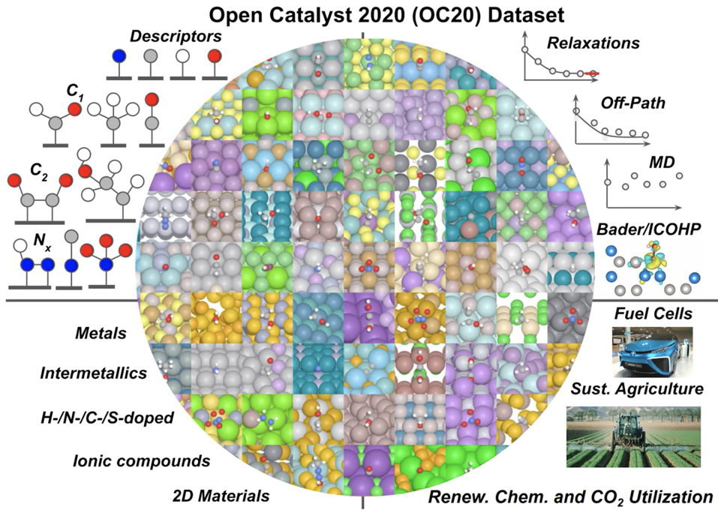
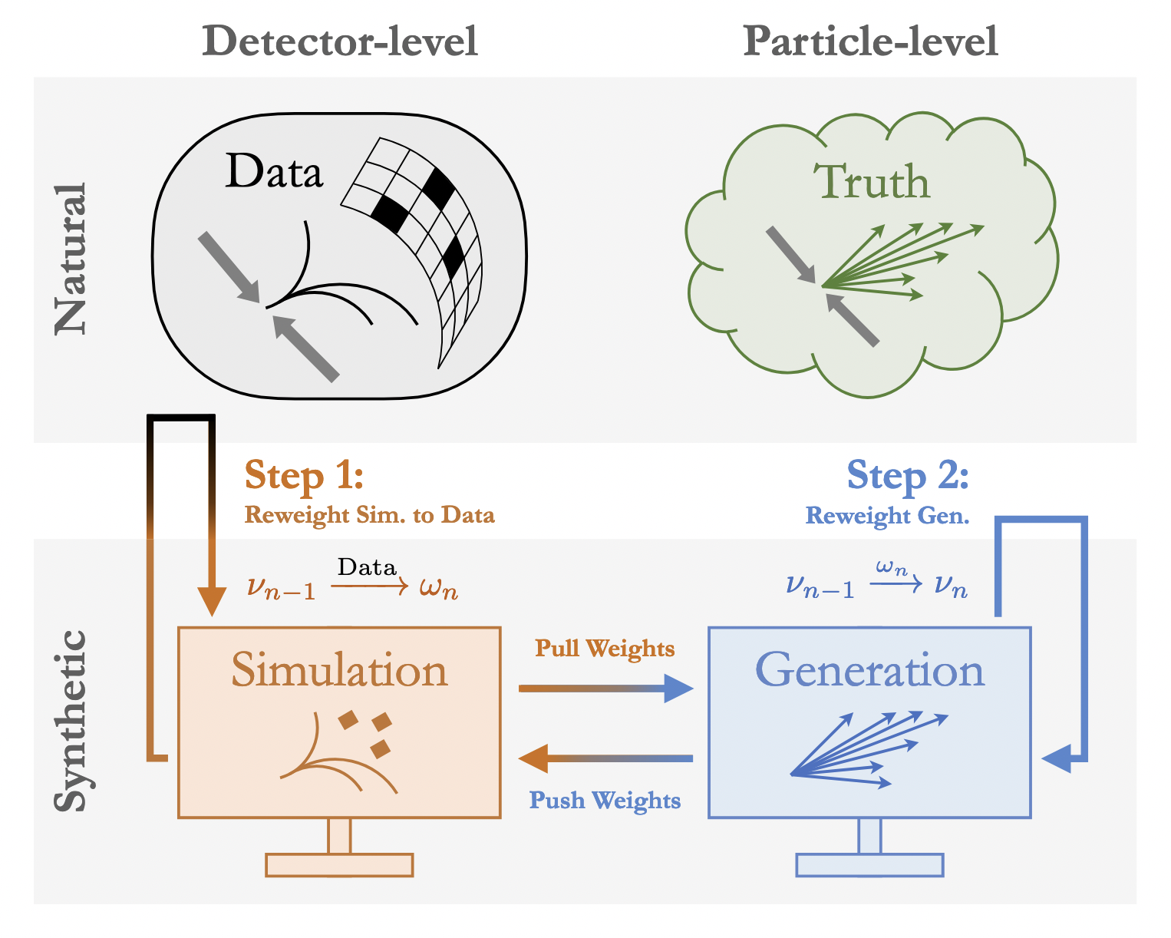
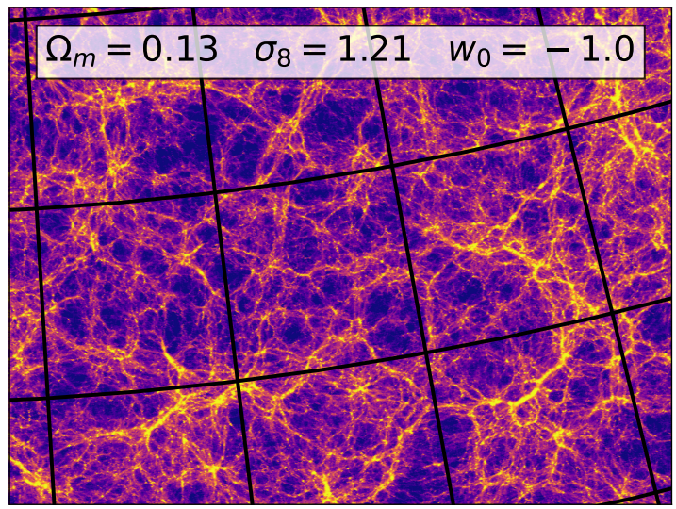
NERSC: Mission HPC Infrastructure for Department of Energy Office of Science
Broad Scientific User Base: > 10,000 Users, 1000 Projects
Current system - Perlmutter (launched 2021): ~ 7,000 A100 GPUs, 35PB All-flash Scratch File System, 128PB Community File System

Slide 3
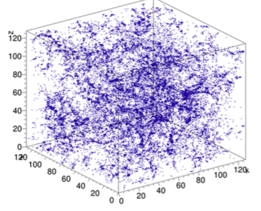
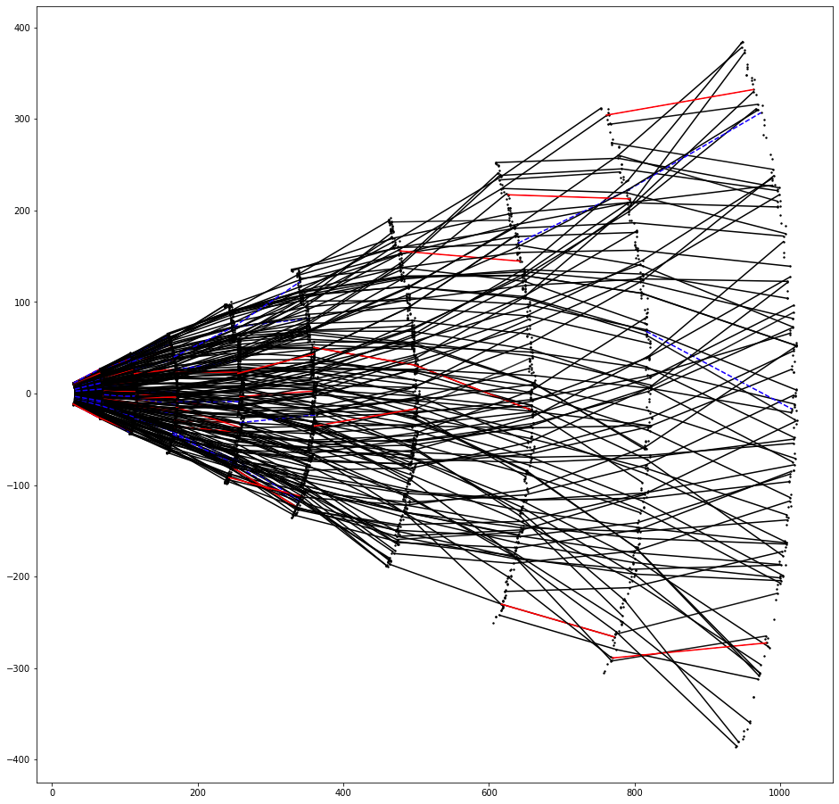
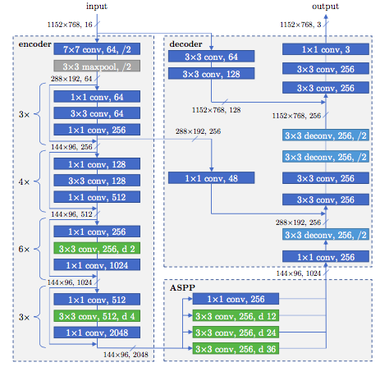
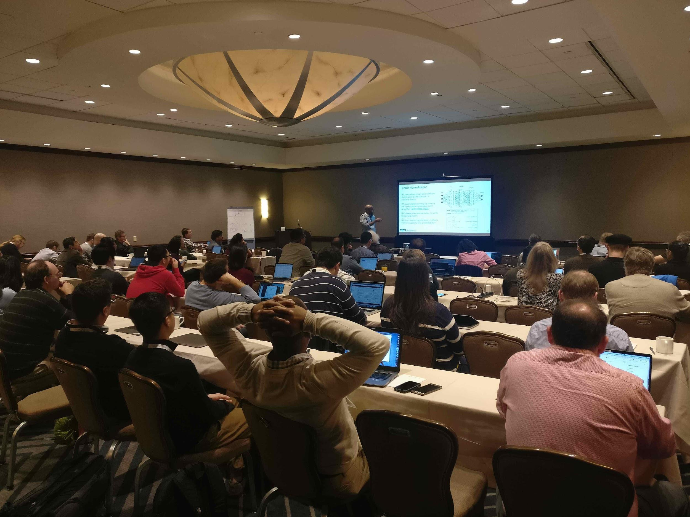
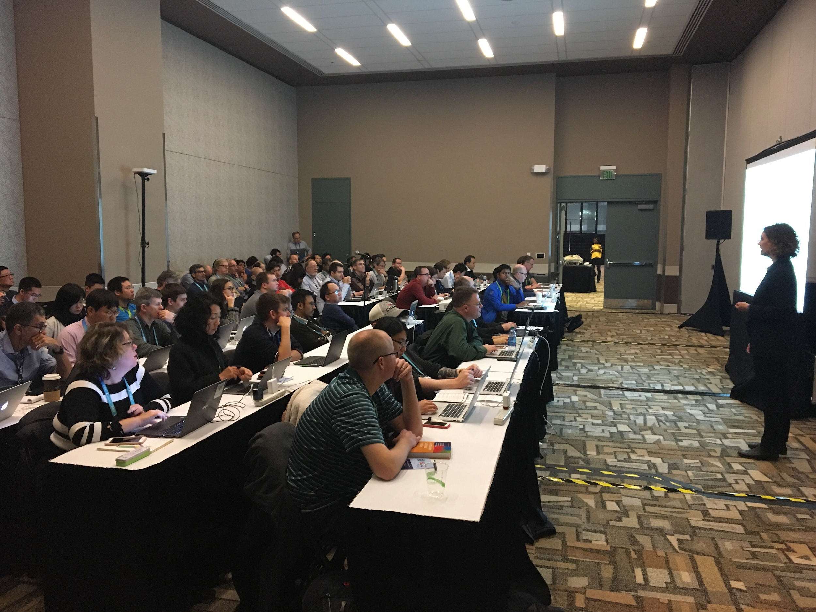
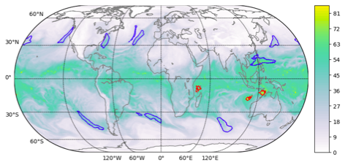
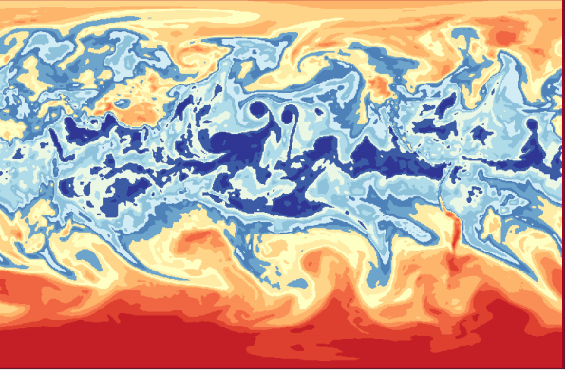
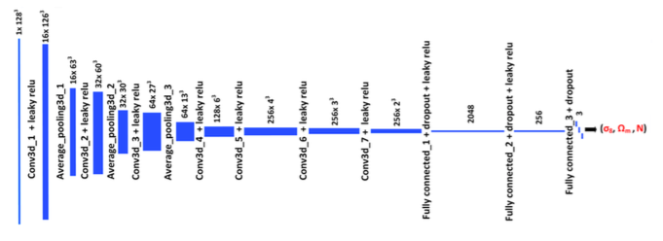
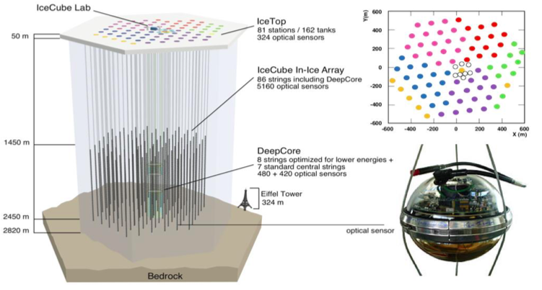
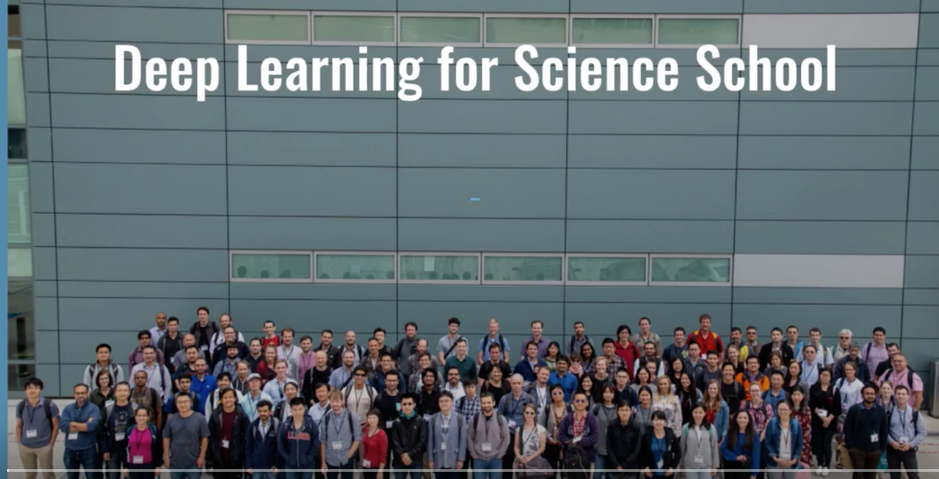
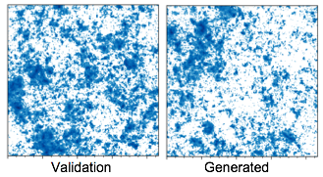
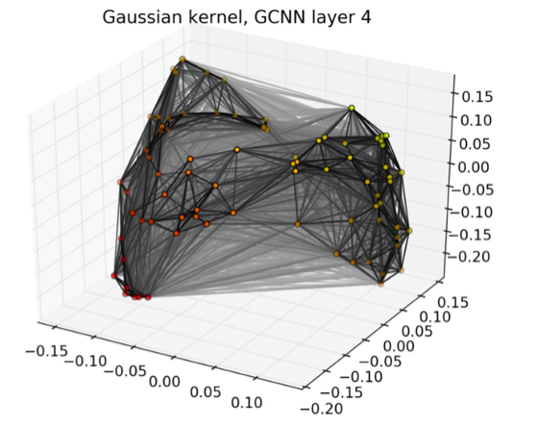
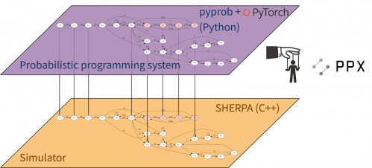
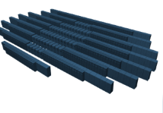
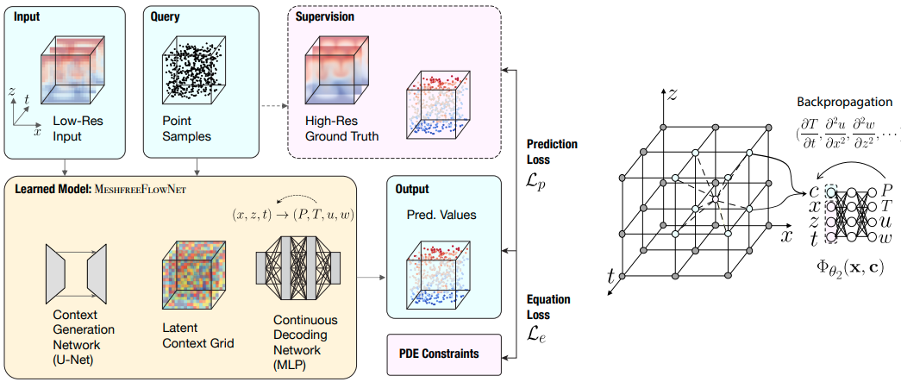
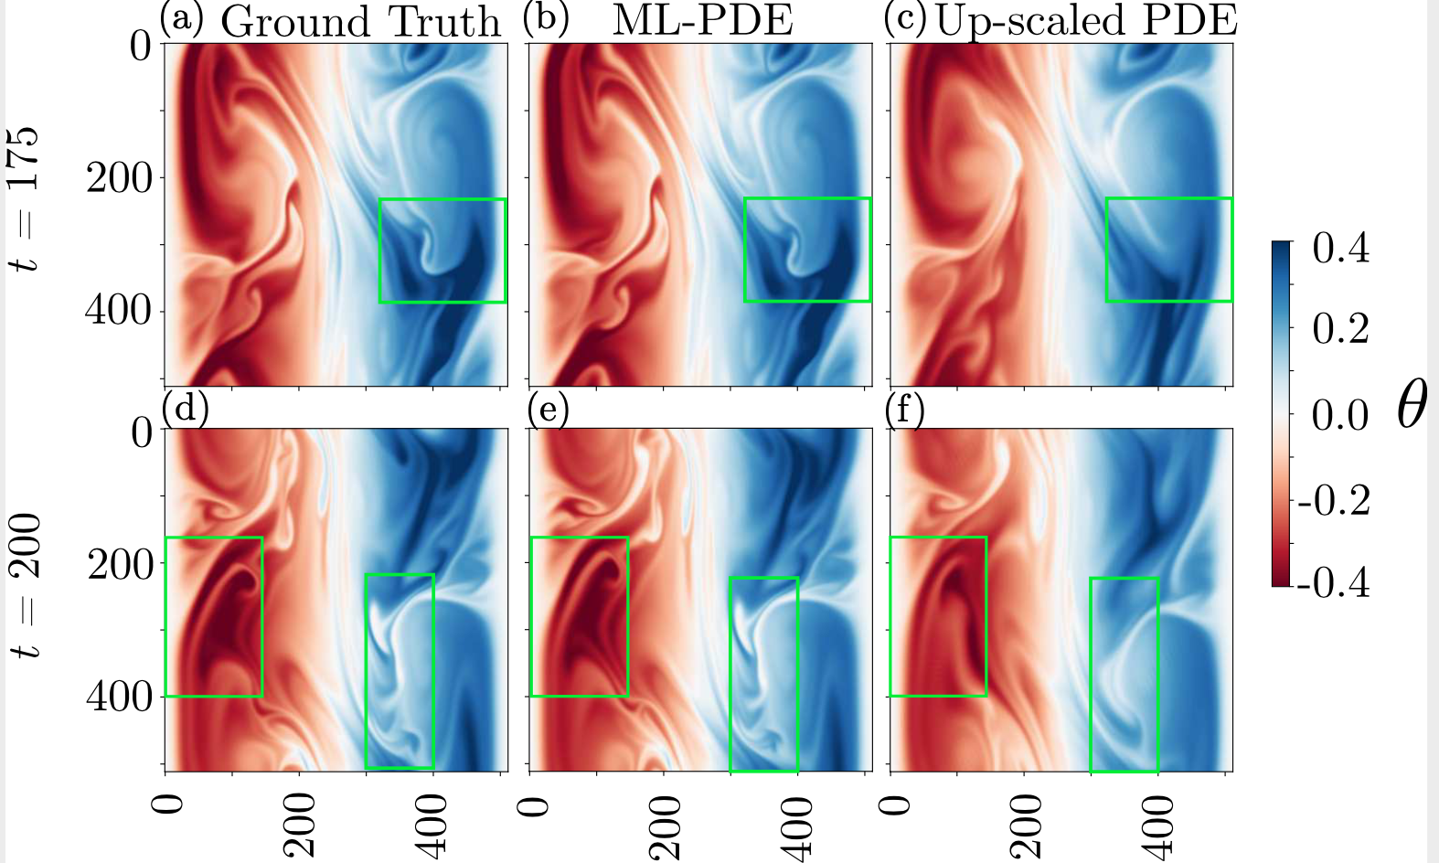
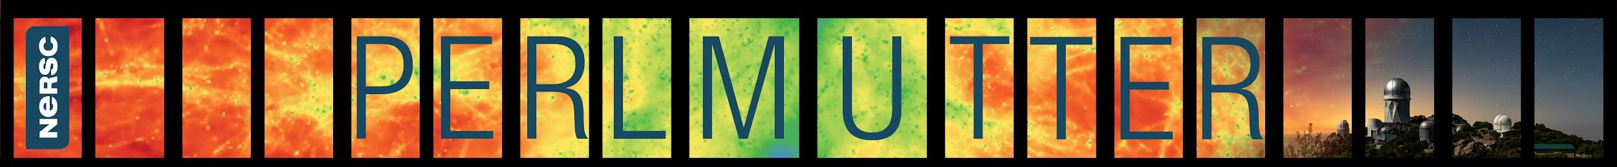
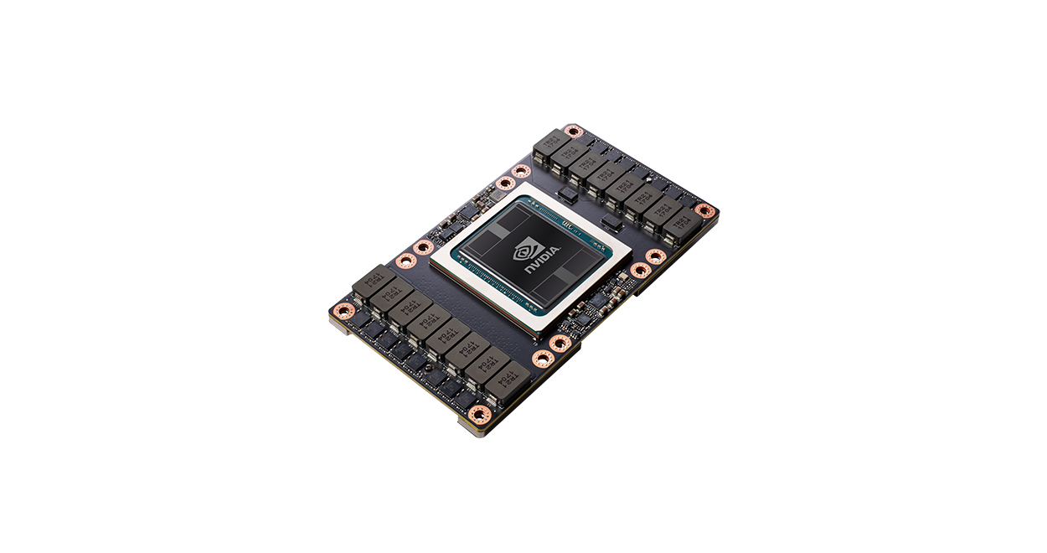
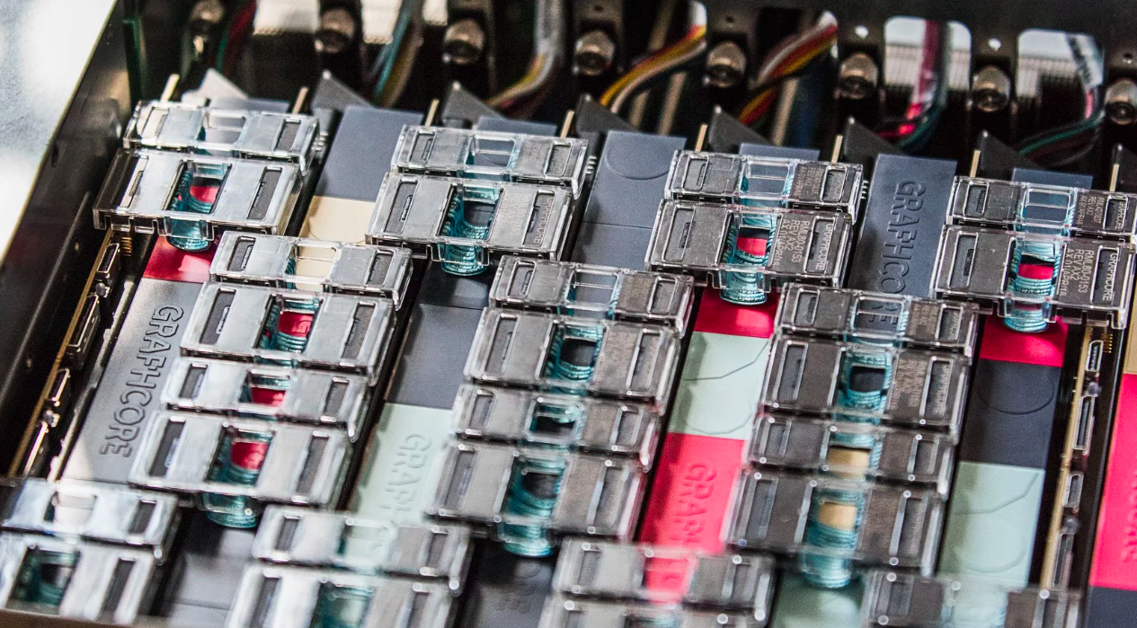

NERSC AI infrastructure involves a broad ecosystem
Methods and Applications
Infrastructure Deployment
Community Empowerment
Automation
Interactivity
Software Frameworks and Libraries
Large Scale Systems w/
Accelerators
APPLY AI FOR SCIENCE USING CUTTING-EDGE TECHNIQUES
Lesson learned from strategic projects are leveraged to expand impact to the broad scientific ecosystem
DEPLOY OPTIMIZED HARDWARE AND SOFTWARE SYSTEMS
Perlmutter is an incredible system for AI - supported by NERSC-wide data infrastructure.
NERSC collaborates closely with vendors for optimized AI software
EMPOWER AND DEVELOP THE WORKFORCE
Seminars, training and schools; Student and postdoc programs
Over 20 DL@Scale tutorials (e.g. SC18-24), 1000s of participants
Deep Learning at Science Summer School since 2019

Slide 4
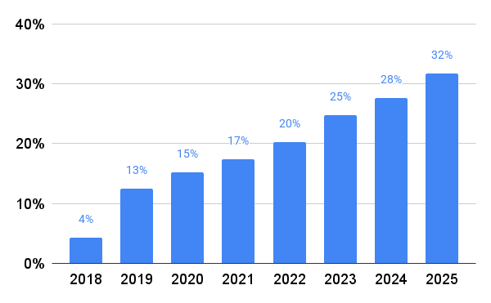
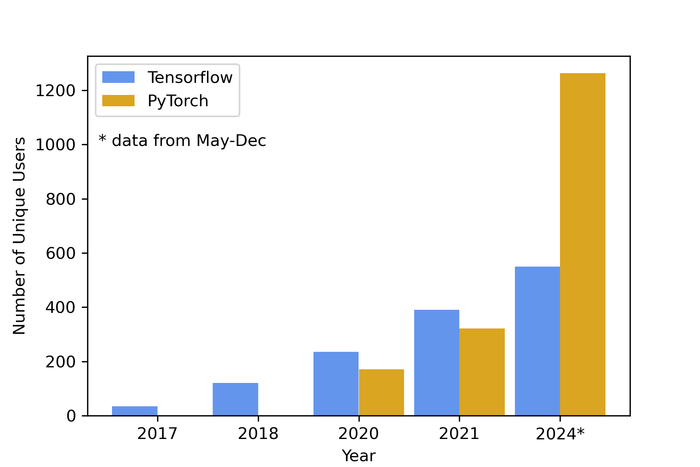
Understanding the evolving AI for Science workload
Can draw insights from
Monitoring and analyzing the AI workload running today
Tracking community requirements though the ML@NERSC user survey
Every 2 years since 2018
Working deeply with scientists through NERSC Science Acceleration Program (NESAP) and other collaborations
Engaging broadly through directors reserve awards like GenAI 2024 and AI4Sci 2025
Performance modeling and benchmarking
Engagement with wider community through e.g. tutorials and schools
Projects with ‘learning’ in description
Directly catching user imports of python libraries
Unique users over time
>30 x increase

Slide 5
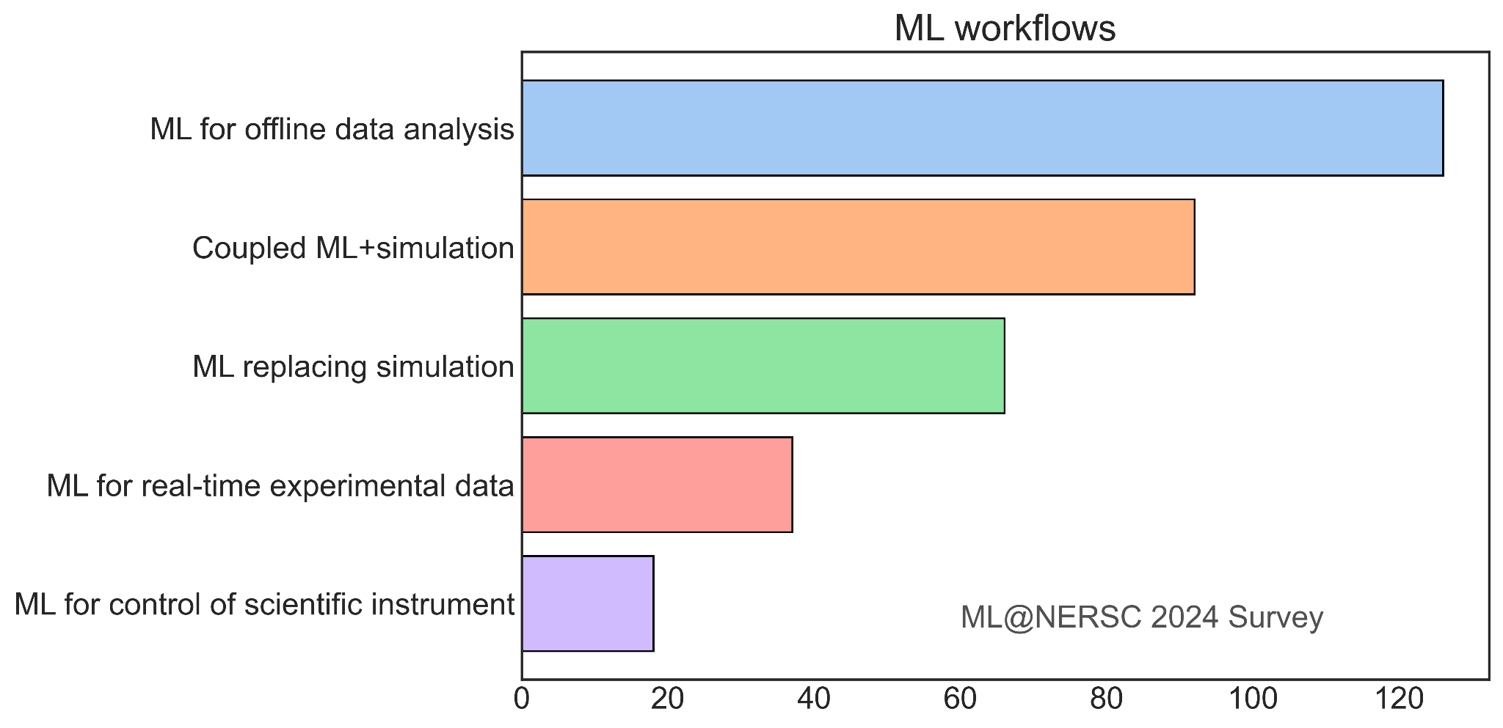
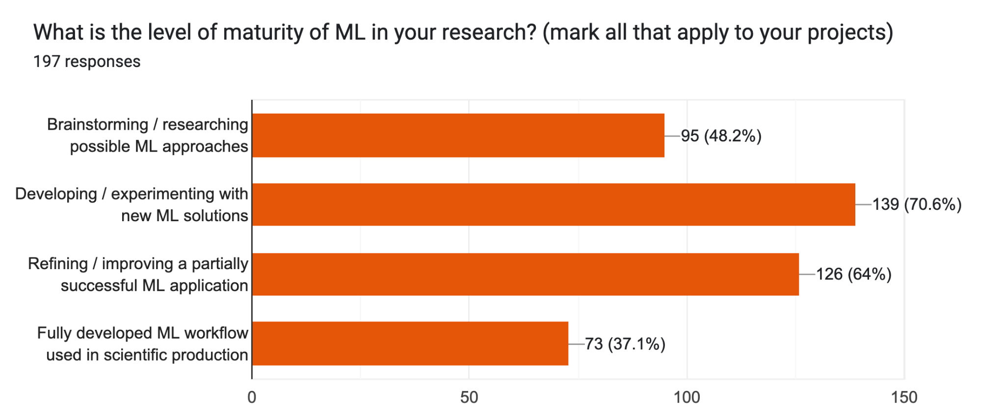
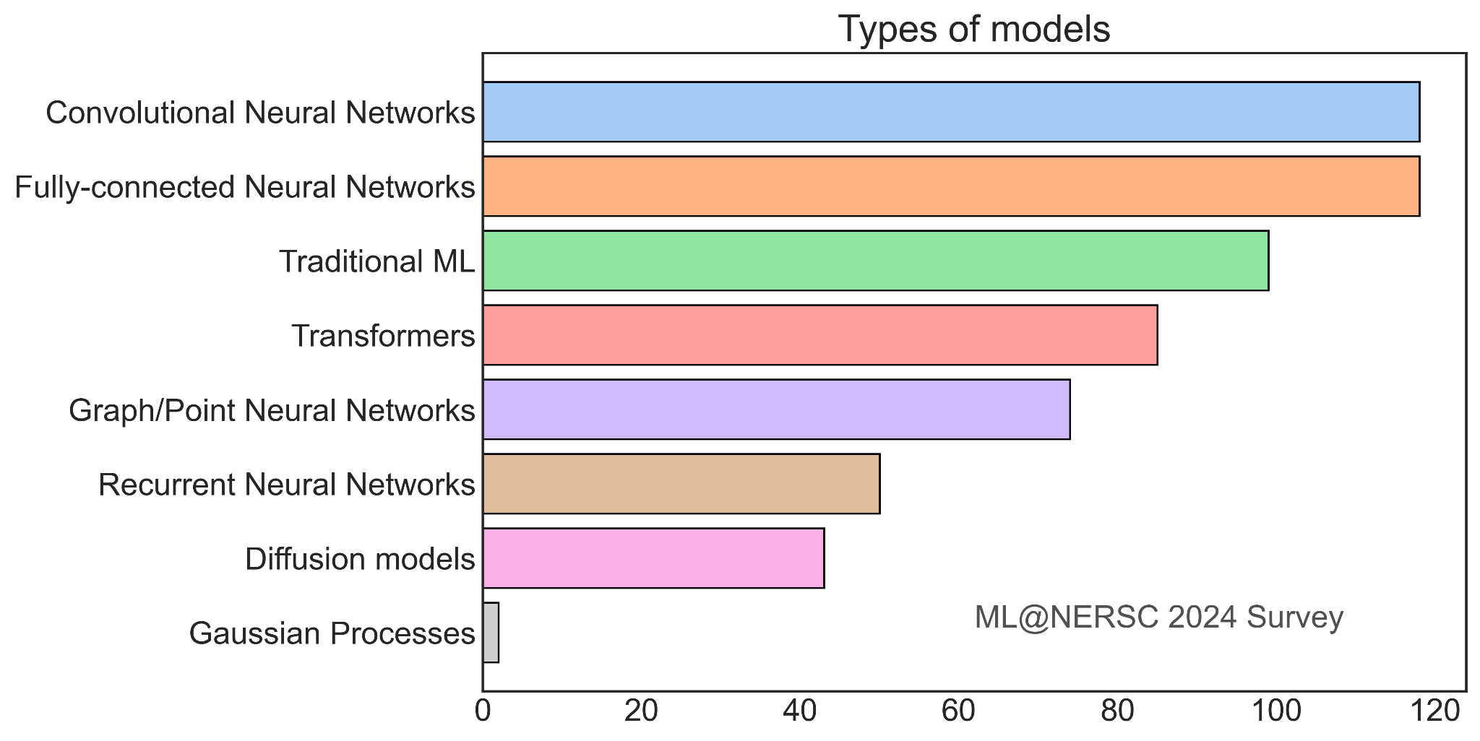
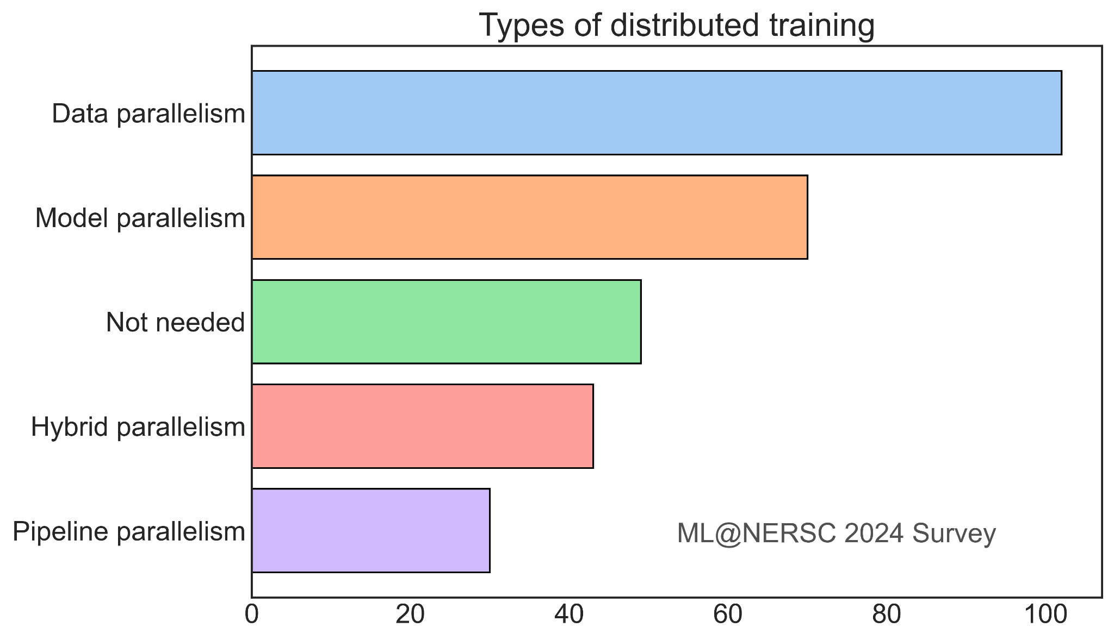
Some insights from ML@NERSC 2024 survey
more results …
Growth in maturity: 37% ‘in production’
Coupling of AI/ML with sim or experiment
Range of models - transformers growth
Large problems and at-scale training

Slide 6
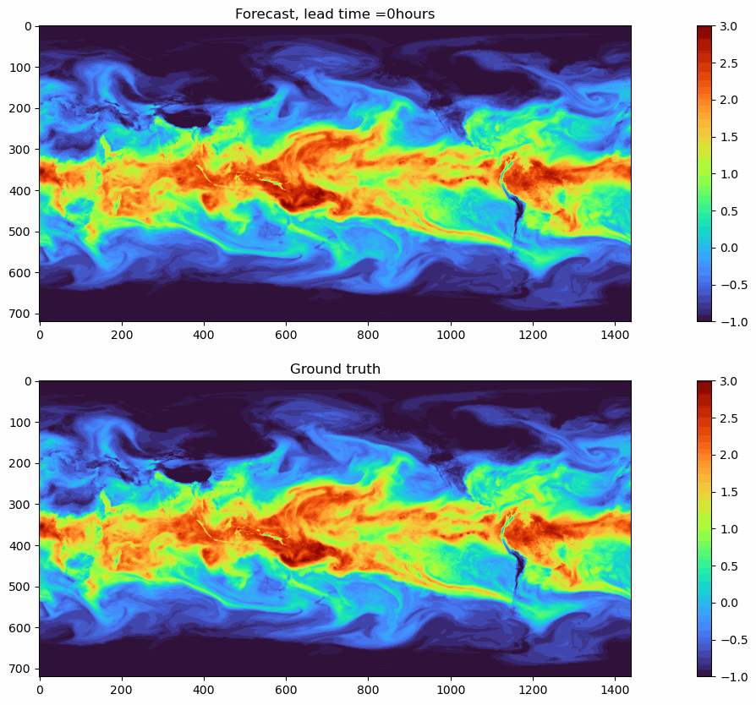
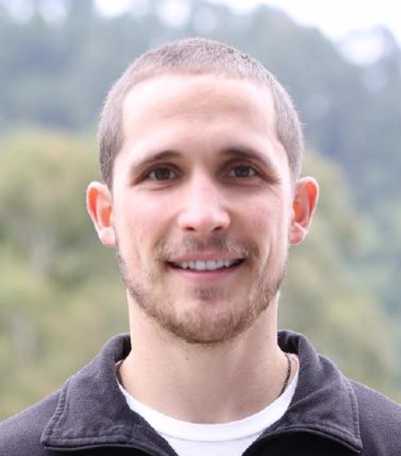
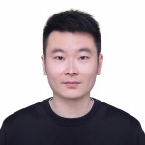
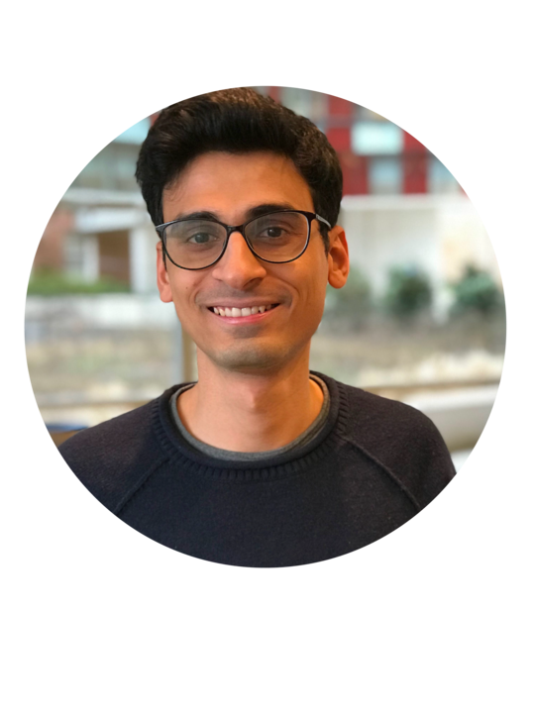


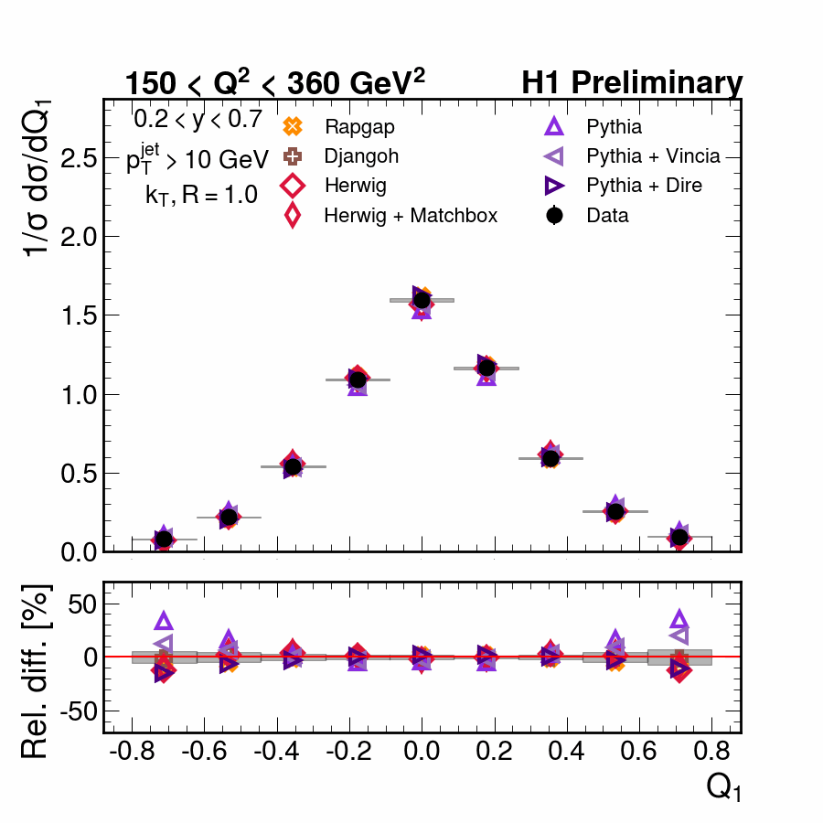

Deep engagements through NESAP program with Perlmutter infrastructure saw emergence of transformative AI for science
FourCastNet
Pathak et al. 2022 arXiv:2202.11214
Collab with Nvidia, Caltech, …
Forecasted global weather at high-resolution.
Prediction skill of numerical model; 10000s times faster
CatalysisDL
Chanussot et al. 2021
Collab with CMU, MetaAI, …
arXiv:2010.09990
NeurIPS 2021-23 Competitions
Pre-trained models used to accelerate DFT
Brandon Wood
former NERSC Postdoc now Meta AI
Wenbin Xu
NERSC postdoc
Shashank Subramanian
Former NERSC Postdoc now Staff
HEP-ML
Collab with LBL Physics division (and H1 Collaboration)
Jaideep Pathak
former NERSC Postdoc now NVIDIA
Jared Willard
NERSC Postdoc
AI “Unfolding” extracts new physics insights from data
Requires Perlmutter for 1000s of UQ runs
Vinicius Mikuni NERSC Postdoc
Notes:
FourCastNet - 25km grid, (720 x 1440 pixels), initially 20 variables,

Slide 7
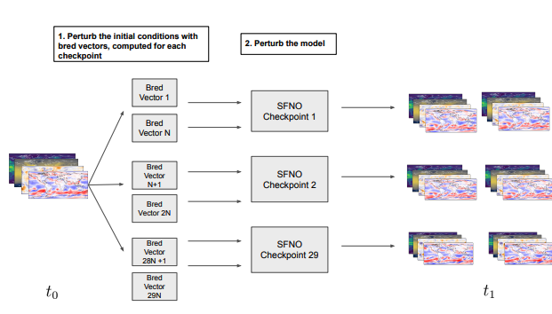
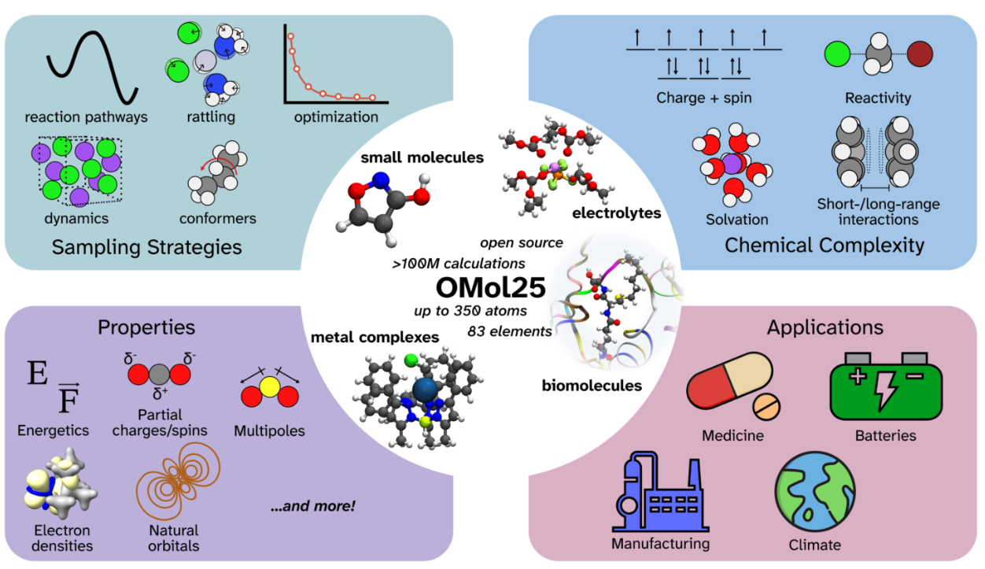
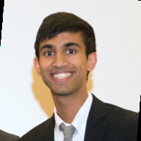
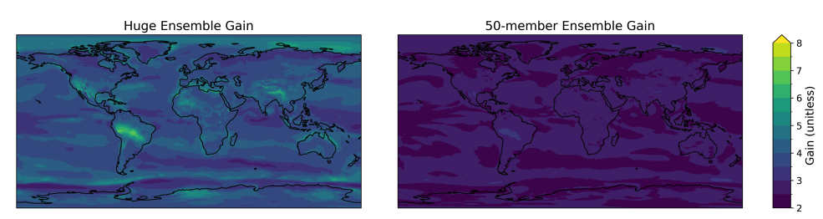
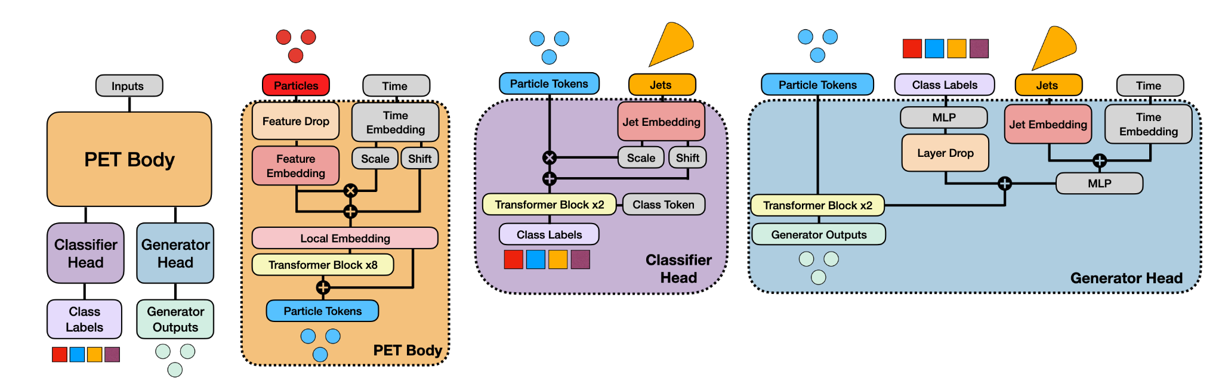
Recent activity shows AI for science has emerged! Domain science involvement and large scale datasets and models
Open Molecules (OMol) 25
Levine et. al 2025
arXiv:2505.08762
Collab. of Meta
with LBL Energy Tech and CS Areas etc.
Basis for Universal Models for Atoms
Ankur Mahesh
EESA Grad Student
Jared Willard
NERSC Postdoc
Brandon Wood
former NERSC Postdoc
now FAIR @ Meta
Huge Ensembles of Hindcasts (HENS) (Mahesh et. al Part I and II Aug 2024) (Led by LBNL EESA also with Nvidia)
Vinicius Mikuni NERSC Postdoc
OmniLearn A Method to Simultaneously Facilitate All Jet Physics Tasks (Mikuni et. al Apr 2024 with LBL Physics)

Slide 8
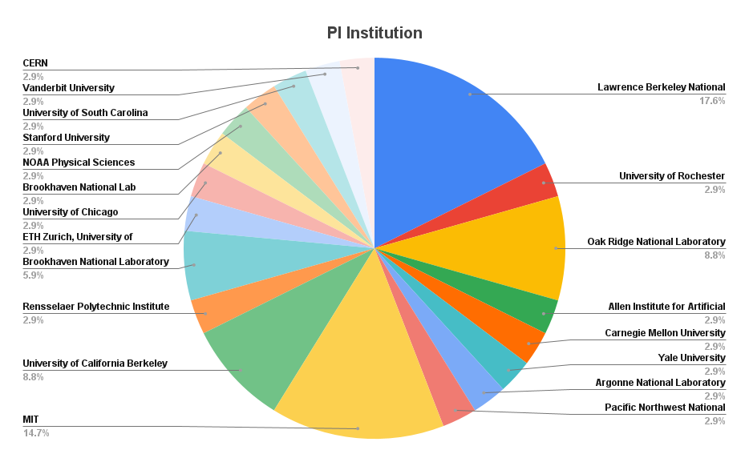
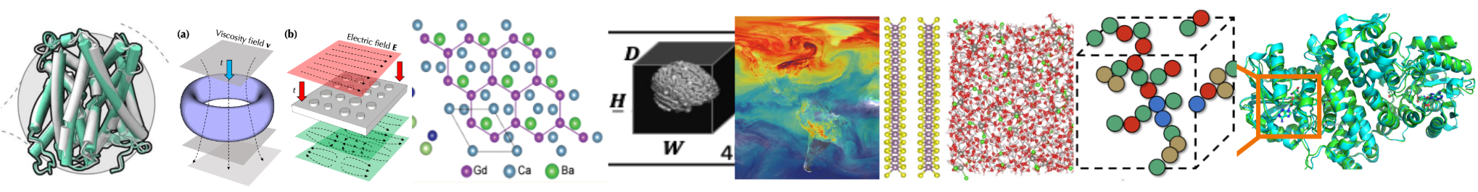
Learning from broader workload - GenAI/AI4Sci program
Growing maturity of community - new call from 2024 for directors reserve compute time
Teams with expertise in AI and domain science and production ready for novel science outcomes.
38 teams in 2024, further 53 for 2025
100s of applications - demand across organizations
Dozens of papers - highlights including:
Large models, task parallelism and scaling laws for atomistic materials with graph foundation models ¹
Open-sourced model with AlphaFold3-level accuracy for 3D biomolecular structures ²
Trends include: Large ‘foundation’ AI models for science; Incorporating science structures; Open data and models; Productionisation inc. required studies such as UQ and neural scaling
1. arXiv:2506.21788” 2. Boltz-1 biorXiv

Slide 9
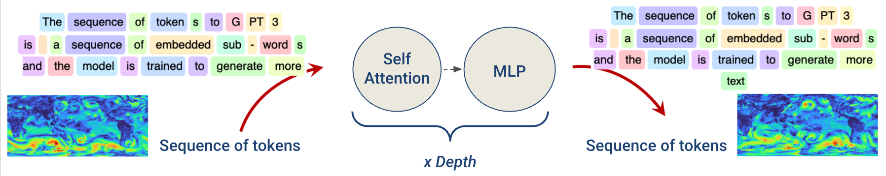


Performance modelling gives further insights on infrastructure
Many science AI apps use transformers (e.g. weather, fusion, fluids, proteins, high-energy physics) as foundations for downstream tasks inc. forecasting, superresolution, inversion.
Science transformers can have many tokens (e.g. high-res image) - performance less well understood and small model can be as expensive as trillion parameter LLM
Performance modelling can shape infrastructure choices and guide users
Comprehensive Performance Modeling and System Design Insights for Foundation Models, PMBS, SC24, arXiv, Github
Science transformer
scaling
GPUs

Slide 10








Learning from community engagement
The Deep Learning for Science School at Berkeley Lab (https://dl4sci-school.lbl.gov/) since 2019
Lectures from leading practitioners from industry and academia
2025 lectures: https://dl4sci-school.lbl.gov/agenda
150 participants - over 500 applications
The Deep Learning at Scale Tutorial
Jointly organized with NVIDIA (+ previously Cray, ORNL,Intel)
Detailed lectures + hands-on material covering distributed training, scaling, profiling, and optimization on Perlmutter. Upcoming at SC25 (See the full SC24 material here)
Growing appetite and sophistication of community for more advanced topics such as model parallelism

Slide 11

Science requirements for a next-generation AI infrastructure ..
Large “Foundation” AI models for scientific problems
Increasing and diverse compute demands across current workloads and AI
Move to production AI: MLOps, inference, intelligent agents
Integration of AI with Scientific Simulation and Data Pipelines
Persistent services for inference, workload orchestration etc.
Experimentation and interactivity

Slide 12





Doudna - announced May 2025
>10x performance increase over Perlmutter
Infrastructure for integrated AI for science
Large-scale AI model training and fine-tuning to particular science needs
Services for deep workflow integration of models into simulation and data pipelines

Slide 13


Doudna: Advanced Workflow Capabilities

Slide 14





Working towards Infrastructure for Pervasive AI
System hardware and software that liberates scientists in application of large AI models
Integrated AI+Data+Sim accelerators, workflow and data management
Highly-instrumented,“Self-driving” systems
Service platform for seamless experimentation and integration of AI with simulation and data
Host foundational AI models and datasets
Intelligent agentic interfaces to compute
Applications for science with large-scale, science-informed, robust, transferable models
Ecosystem to make all DoE science AI-enabled
Centers of expertise with engineering staff resources
Human and AI-driven assistance
AI-assisted user
Intelligent Interfaces
AI Augmented simulations
AI integrated data pipelines
Integrated AI+Sim+Data Supercomputer
Self-driving AI-Operations
Notes:
Pervasive AI - means all science that needs AI can use it
Removing Barriers for scientists in training large models on HPC (beyond the industry focus on LLMs)
Enable the development and sharing of large foundation models that can be leveraged across experiments, applications and science domains
Build standard frameworks and approaches for optimization, UQ and sharing
Develop adaptable capabilities for integration of AI with HPC simulations or experimental data pipelines

Slide 15


Integrated AI Infrastructure for Transformative AI for Science

Slide 16

NERSC seen emergence of modern AI for Science in last decade
Learn lessons from workload monitoring, surveys, in-depth partnerships, broad science projects, detailed performance analysis, and community engagement
Potential clearly demonstrated. Work still needed to fully exploit
AI+Sim+Data optimized compute capabilities and data infrastructure
Hosting and exploitation of vast DoE datasets
Development and sharing of large science-specific models that can be leveraged across experiments and science domains
Capabilities for integration of AI with simulations and experimental data
Engineering staff working deeply with scientists and AI experts
Doudna - Next generation AI4Sci infrastructure
NVIDIA Vera-Rubin GPUs; High speed interconnect and external network
Platform (IBM) and QoS (VAST) Storage. Integrated workflow nodes
Advanced workflow capabilities and new NESAP deep engagements
An integrated infrastructure for pervasive AI will transform science
Contact:
nersc.gov/aiml
wbhimji@lbl.gov

Slide 17
Extras

Slide 18







Pervasive AI can transform science
Extreme scale surrogate models
Fast novel experiment design
Nuclear Physics: Instrument design
Weather: hindcasting with large ensembles
(ref: Nature 626:746–751 (2024))
AI knowledge discovery agents
AI-driven
automation
Fusion: Plasma instability avoidance
Systems biology: KBase knowledge assistant
Inference with full science models
Unsupervised
detection of new science
High-energy physics: “Anomaly” detection for LHC
Materials science: pixel-level analysis at LCLS-II x-ray laser
(ref: SciPost Phys. 13, 087 (2022) )
Notes:
AI can transform science - work still needed on integration and new ways of working. One way is through language models and AI agents e.g “discovery assistants”
Many other ways include
extreme scale surrogates - 10000x faster simulations opens completely new approaches - such as evaluating weather risks in detail
experiment design and automation - opening door to fast feedback (e.g for fusion)
Uncovering secrets of the universe in surprising places that wouldn’t otherwise discovered in vast datasets such as the LHC
Integration with simulation and AI - allows use of full science models
[All projects highlighted except fusion had LBL involvement and/or used Perlmutter]

Slide 19




NERSC infrastructure responds to evolving mission
NERSC-11:
Beyond Moore
NERSC-10: Doudna Accelerating end-to-end workflows
NERSC-9: Perlmutter
CPU and GPU nodes
Expanded Simulation, Learning & Data
2030+
2026
HPC
Workflows Running Seamlessly in IRI
NERSC-8: Cori
Manycore CPU
architectures
2020
Simulation & Modeling
2016
Simulation & Modeling
AI
Training & Inference
Experiment
Data Analysis
Simulation & Modeling
Quantum Computing
Pervasive AI
AI
Expt
Data
AI
Expt
Data

