Slide 1
Tenstorrent High Performance Computers for HPC & AI
Sep 12 2025

Slide 2
Highlights:

Slide 3












AI and Classical HPC Software Development
Compiler
ANY AI MODEL
AI HPC
ANY HPC Code
Classical HPC
Any MLIR Compiler
OPEN
SOURCE
OPEN
SOURCE
OPEN
SOURCE
OPEN
SOURCE
OPEN
SOURCE
OPEN
SOURCE
BUILD ANYTHING
OPEN
SOURCE
BUILD ANYTHING
CUSTOM OPS
CUSTOM OPS
OPTIMIZED ML RESULTS
OPEN
SOURCE
OPEN
SOURCE
OPEN
SOURCE
OPTIMIZED COMPILER IR
OPEN
SOURCE
OPEN
SOURCE

Slide 4
AI HPC
Leverage work from "Pure" AI stack
Flexible entry points for high level model and Python developers
Open standards
Open source software stack
Compiler
ANY AI MODEL
OPEN
SOURCE
OPEN
SOURCE
BUILD ANYTHING
CUSTOM OPS
OPTIMIZED ML RESULTS
OPEN
SOURCE
OPEN
SOURCE

Slide 5
HPC Software roadmap – AI HPC
Developers are tired of needing to understand everything before they get started
Enable users to use the models they have to get reasonable performance
Focus on enabling perfomance at every level, and meet developers where they are
More Models!!!
Jax
Models
PyTorch
TF
ONNX
LLM inference
models
PyTorch models
Jax
TT-Forge
Manually optimized
models
vLLM
PyTorch
2.0
backend
3rd party training compiler
TT-MLIR
TT-NN
TT-Metalium
TT-Fabric
(unified scale-up and scale-out
TT-LLK
(low-level-kernels)

Slide 6


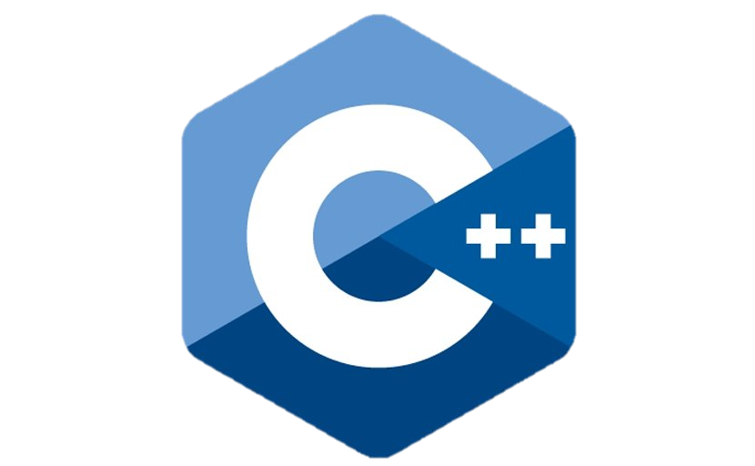


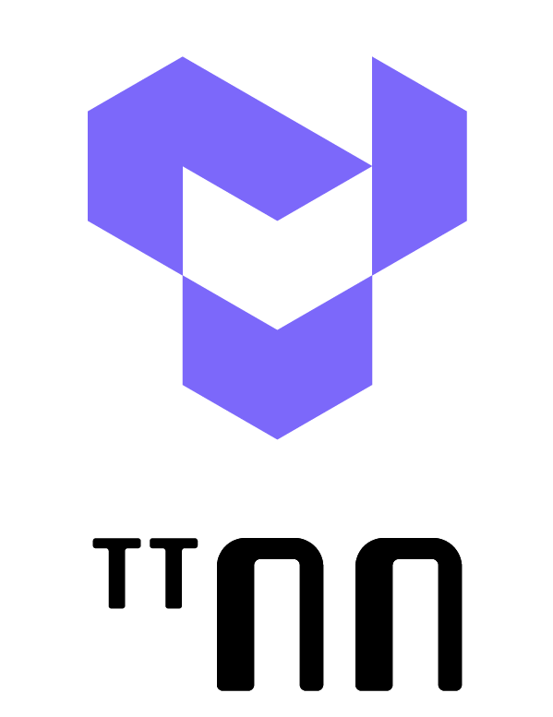

ANY HPC Code
Classical HPC
Leverage work from AI stack - MLIR
Flexible entry points for developers
Leverage and contribute to the Open Source community
Provide users a friendly, familiar baseline to start, enable tooling to go further
OPEN
SOURCE
OPEN
SOURCE
OPEN
SOURCE
OPEN
SOURCE
BUILD ANYTHING
CUSTOM OPS
OPEN
SOURCE
OPEN
SOURCE
OPTIMIZED COMPILER IR
OPEN
SOURCE

Slide 7
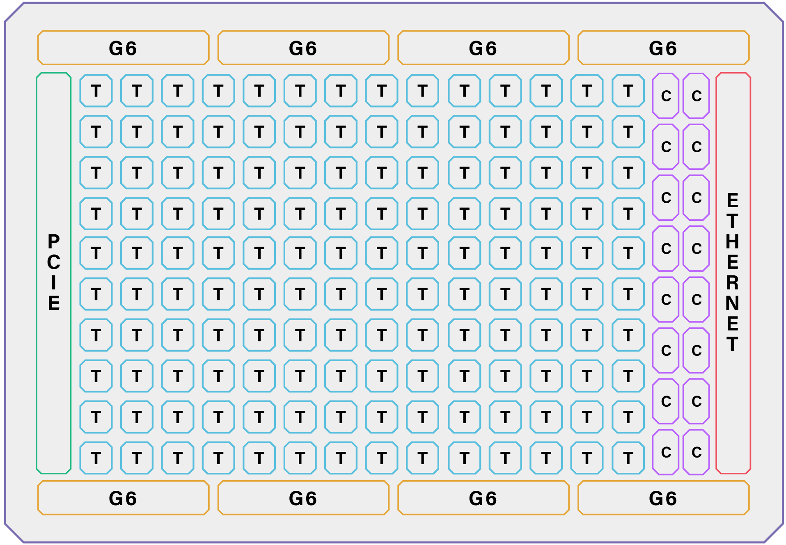
Why AI Needs Both RISC-V Cores and AI Accelerators
Tensix cores are ideal for big math operations:
Vector calculations
Matrix arithmetic
Large data sets
CPU cores are ideal for:
Conditionality
Traditional math
High performance
Robust programmability
Merging Tensix cores and CPU cores on the same die:
Lowers latency
Boosts utilization
Increases ML performance
ML Developers need both CPU and AI cores to build dynamic models of the future that are not possible today due to latency and utilization problems of using the host CPU.

Slide 8
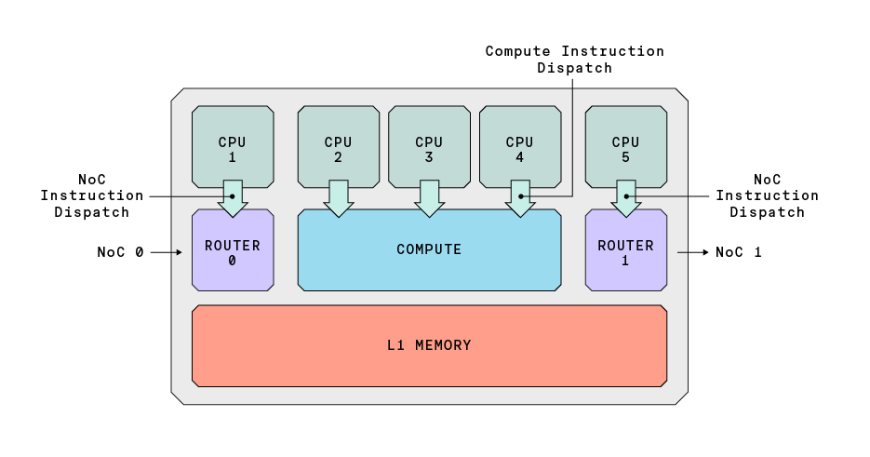
TT-Metalium™: Tenstorrent’s Low-Level Programming Framework
TT-Metalium™ is a groundbreaking low-level programming framework designed to harness the power of Tenstorrent’s parallel processing cores
Each processing core in our Tensix architecture contains 5 “baby RISC-V” cores: 3 programmable cores and 2 cores for Network-on-Chip (NoC) management
Our framework aims to maximize performance, efficiency, and flexibility

Slide 9
Tensix Core – Data Movement
83 GB/s
83 GB/s
Tensix Core
RISC-V
1
RISC-V
2
RISC-V
3
RISC-V
4
RISC-V
5
Compute
Feature | Spec
Independent NoCs | 2
NoC type | 2-dimensional torus
NoC link width | 64 Bytes
NoC link BW | 83 GB/s
Tensix -> NoC I/O BW | 665 GB/s
SRAM <-> NoCs | 333 GB/s
SRAM <-> NoC aggregate BW | 47 TB/s
333 GB/s
2x 83
GB/s
2x 83
GB/s
L1 Memory
83 GB/s
Router
0
83 GB/s
83 GB/s
Router
1
83 GB/s
83 GB/s
83 GB/s

Slide 10
Micro-Architecture: All RISC-V Programmable

Slide 11
All RISC-V Programmable Baby RISC-Vs
user
kernel
user
kernel
user
kernel
user
kernel
user
kernel
Feature | Spec
Total Baby RISC-Vs | 752
Compute | 32-bit Int multiplier / divider Floating point (FP32 / BFLOAT16) 128-bit vector (1 per Tensix)
I-cache | 4 KB
D-scratch | 8 KB
RISC-V
RISC-V
RISC-V
RISC-V
RISC-V
Tile
Math
Engine
Vector
Math
Engine
Router
ETH
controller
DRAM
Bank
controller
Compute
Data Movement
Storage

Slide 12
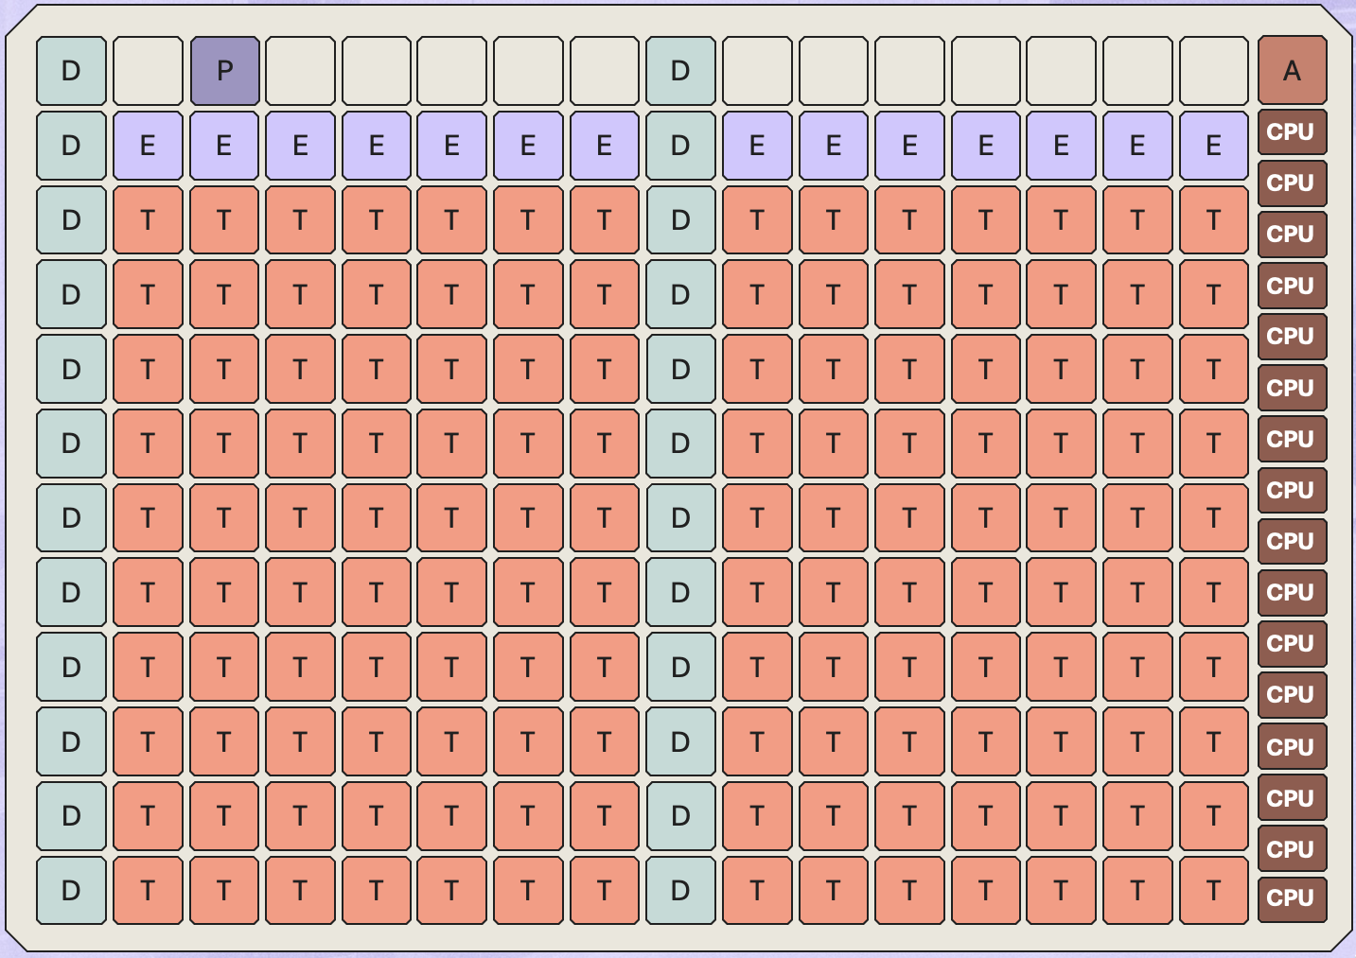
All RISC-V Programmable Within the Tensix Core
5 baby RISC-Vs
32-bit RISC-V ISA
RISC-V
1
RISC-V
2
RISC-V
3
RISC-V
4
RISC-V
5
Router
0
Compute
Router
1
L1 Memory

Slide 13
All RISC-V Programmable Within the Tensix Core
5 baby RISC-Vs
32-bit RISC-V ISA
RISC-V
1
RISC-V
2
RISC-V
3
RISC-V
4
RISC-V
5
Router
0
Compute
Router
1
L1 Memory

Slide 14
All RISC-V Programmable Within the Tensix Core
3 user C kernels program a single Tensix core
1 compute kernel
2 data movement kernels
RISC-V
1
compute
kernel
data
movement
kernel
RISC-V
2
RISC-V
3
RISC-V
4
RISC-V
5
data
movement
kernel
Router
0
Compute
Router
1
L1 Memory

Slide 15
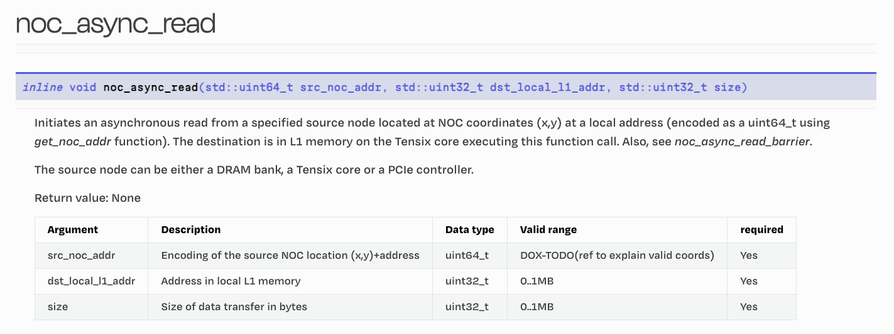
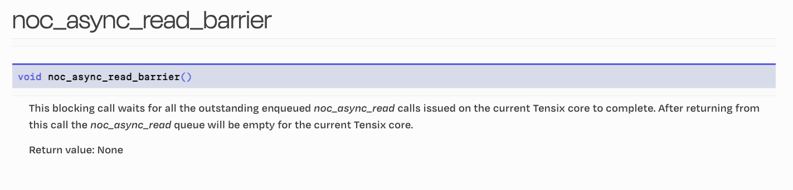
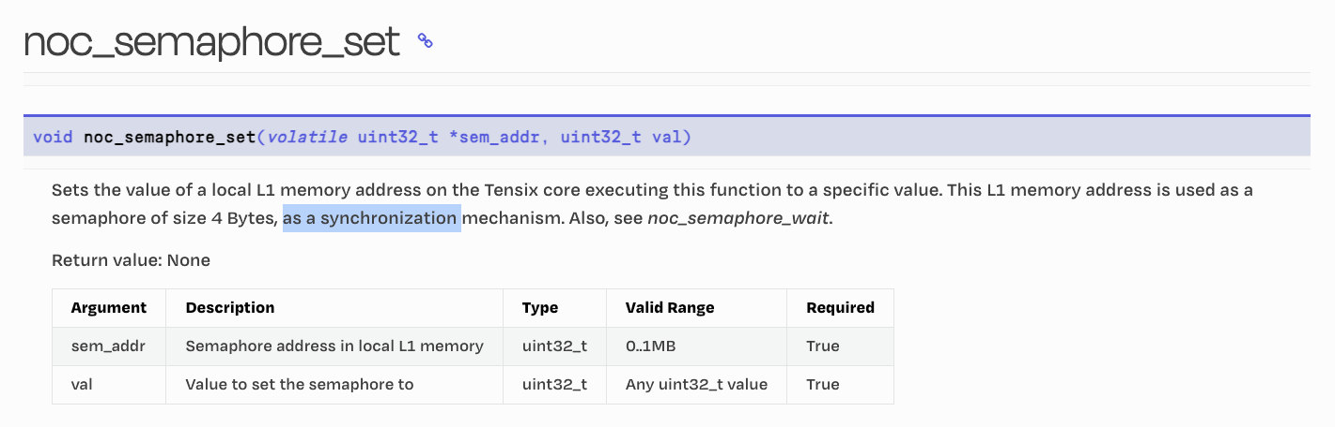
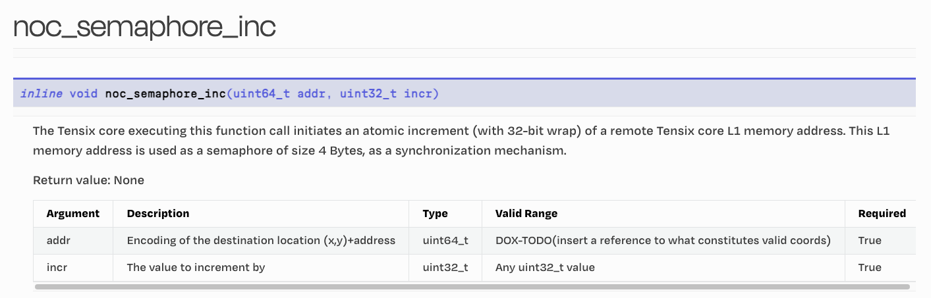
Tensix Core – Data Movement
2 data movement kernels
Asynchronous reads & writes
Access to all SRAM & DRAM banks
Memory barriers
Atomic semaphores
NoC
Instruction
Dispatch
NoC
Instruction
Dispatch
RISC-V
1
RISC-V
2
RISC-V
3
RISC-V
4
RISC-V
5
data
movement
kernel
data
movement
kernel
Router
0
Compute
Router
1
NoC 0
NoC 1
L1 Memory

Slide 16
Tensix Core – Data Movement
83 GB/s
83 GB/s
Tensix Core
RISC-V
1
RISC-V
2
RISC-V
3
RISC-V
4
RISC-V
5
Compute
Feature | Spec
Independent NoCs | 2
NoC type | 2-dimensional torus
NoC link width | 64 Bytes
NoC link BW | 83 GB/s
Tensix -> NoC I/O BW | 665 GB/s
SRAM <-> NoCs | 333 GB/s
SRAM <-> NoC aggregate BW | 47 TB/s
333 GB/s
2x 83
GB/s
2x 83
GB/s
L1 Memory
83 GB/s
Router
0
83 GB/s
83 GB/s
Router
1
83 GB/s
83 GB/s
83 GB/s

Slide 17
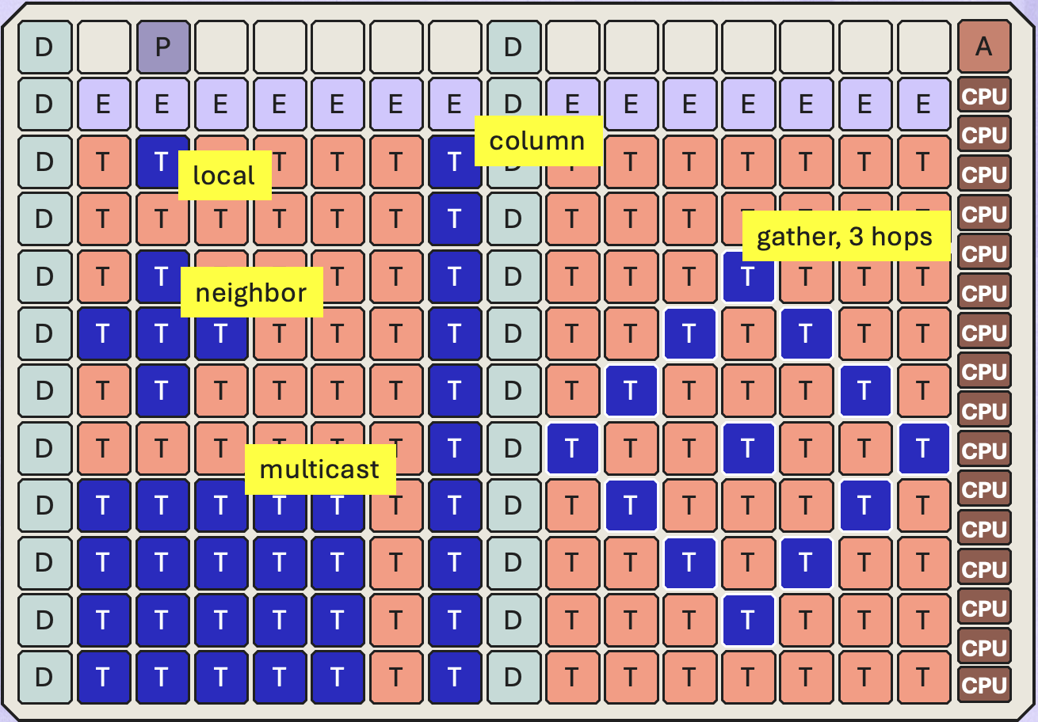
Blackhole: Built for AI Data Movement Patterns
Data patterns in MatMuls, Convolutions, and Sharded Data Layouts are regular.
They have a great mapping to Mesh Architecture
Memory & I/O | Data Movement Pattern | Bandwidth
SRAM | Local / Sharded | 94 TB/s
SRAM | Neighbor (Halo) | 47 TB/s
SRAM | Row / Column / Mesh Multicast | 24 TB/s
SRAM | Gather / Scatter (3 hops) | 16 TB/s
SRAM | Gather / Scatter (10 hops) | 5 TB/s
DRAM | Row | 512 GB/s
Ethernet | Column | 1 TB/s

