Slide 1
Efficient Programming on Heterogeneous Accelerators
Peipei Zhou

Slide 2

2025/09/12, New York Scientific Data Summit 2025 Peipei Zhou, Assistant Professor
Experience:
2008-2012: ECE B.Sc. @ Southeast University
2012-2019: CS Ph.D. @ UCLA with Prof. Jason Cong
2019-2021: Staff Software Engr. @ Enflame, AI ASIC Startup
2021/09-2024/08: Assistant Professor @ Pitt-ECE
2024/09/01-Now: Assistant Professor @ Brown
Research:
Architecture: FPGA, AI ASIC, GPU, Chiplet, etc.
Abstraction: Compiler Support
Application: Artificial Intelligence, Genome (Medical), etc.
Peipei Zhou’s Group
https://peipeizhou-eecs.github.io/
Teaching:
G: Reconfigurable Computing, 2022 Spring, 2023 Spring, 2024/2025 Fall
UG: Computer Organization and Architecture, 2022 Fall, 2023 Fall, 2024 Spring
UG: Embedded System Design, 2023 Spring; UG: VLSI Design, 2025 Spring

Slide 3



Why Customized Computing?
Challenge with Processor Design – Power Barrier:
From Parallelism to Customization and Specialization
sun’s surface
1000
Power doubles every 4 years
rocket nozzle
nuclear reactor
Parallelization
100
Pentium® 4
Customization
Watts/cm²
Pentium III®
hot plate
Pentium II®
Adapt the architecture to application domain
10
Pentium Pro®
Pentium®
i386
i486
1
1.5µ
1.0µ
0.7µ
0.5µ
0.35µ
0.25µ
0.18µ
0.13µ
0.10µ
0.07µ
Based on Fred Pollack (Intel) and Michael Taylor (UW)
3
“New Microarchitecture Challenges in the Coming Generations of CMOS Process Technologies”, Fred J. Pollack (Intel Fellow)
Notes:
Muhuan: figure from Michael Taylor, UCSD; data is from Intel
https://pdfs.semanticscholar.org/6a82/1a3329a60def23235c75b152055c36d40437.pdf

Slide 4
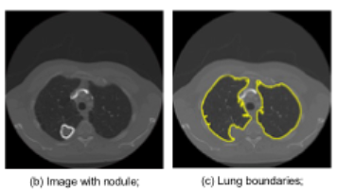

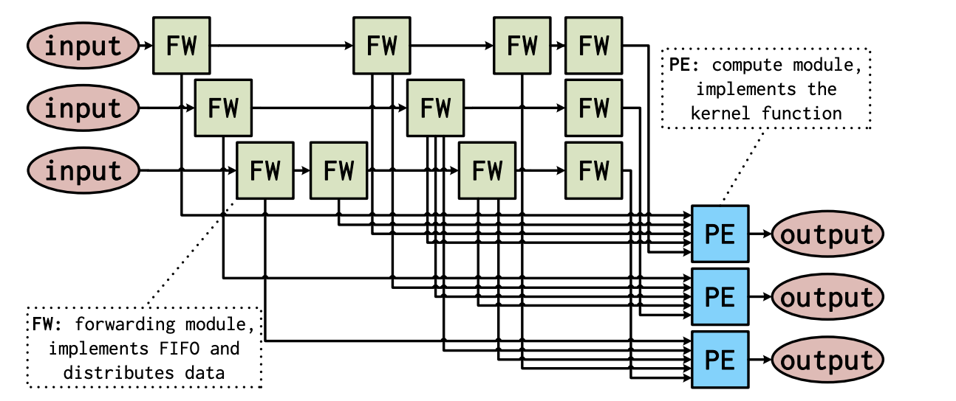
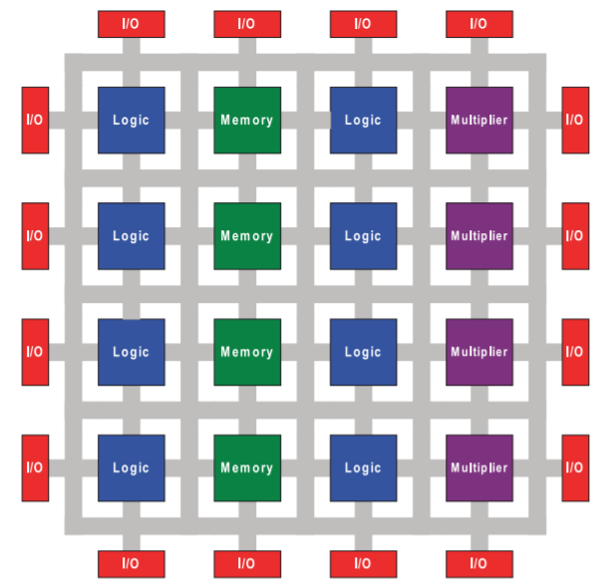
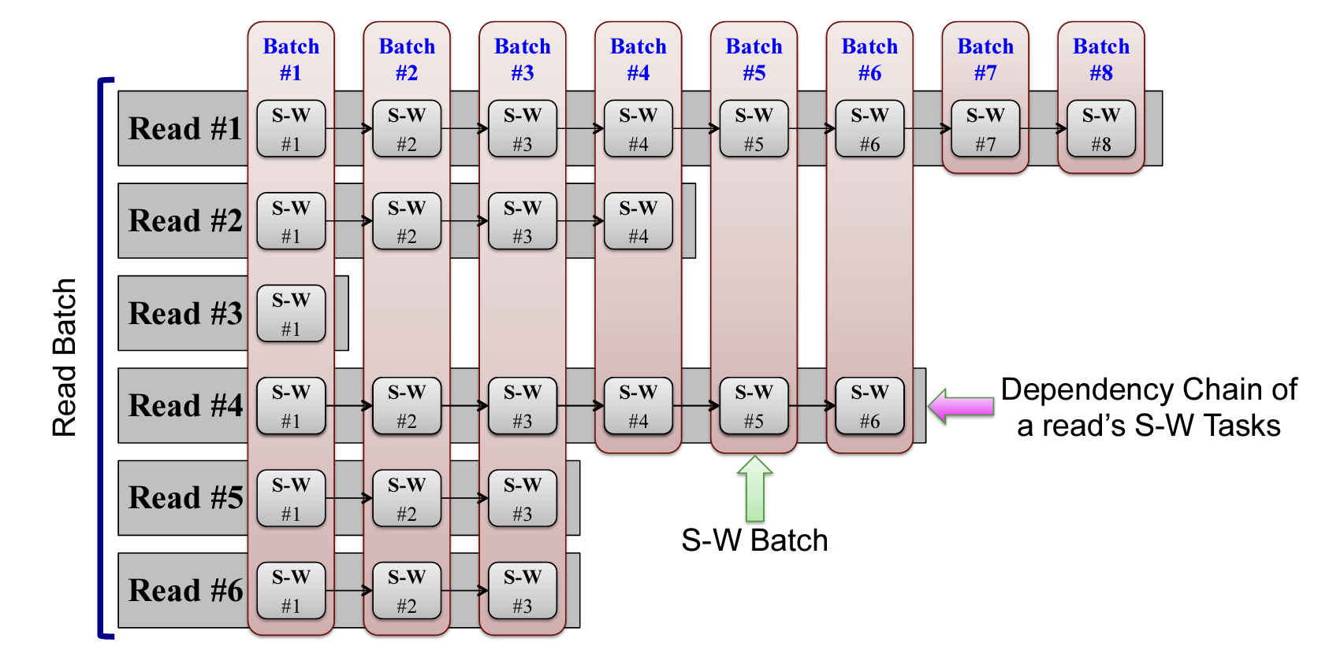
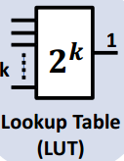
Customized Computing on FPGAs
FPGA (Field Programmable Gate Arrays)
Energy efficiency, 10-100X than CPUs
Domain-Specific Accelerators (DSA) for various applications: genomics, image/video, GNN, etc.
Stencil for Image/Video Processing [ICCAD’18 SODA]
Source: I. Kuon, R. Tessier, J. Rose. FPGA Architecture: Survey and Challenges. 2008.
Genomics Acceleration [FPGA’21 Mocha]
Use of FPGAs trade-off performance for design cost, flexibility, and time-to-silicon

Slide 5

Re-examine FPGA vs. GPU vs. CPU: Deep Learning Inference
Vision Transformer, INT8 inference, batch = 6
Energy efficiency comparison
Energy Efficiency (GOPS/Watt)
Why FPGA becomes the most inefficient platform in deep learning inference?

Slide 6
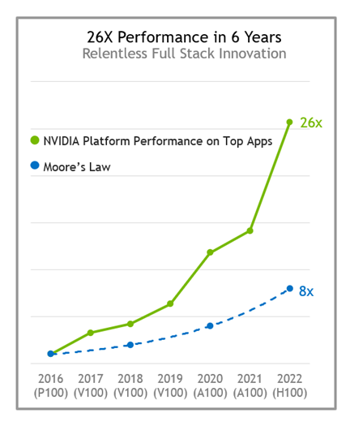
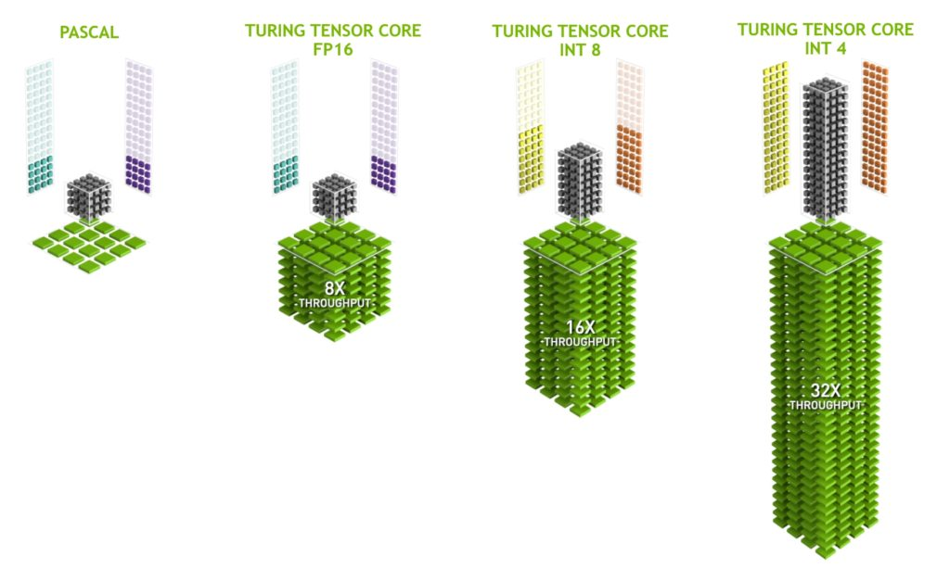
Re-examine FPGA vs. GPU vs. CPU: Deep Learning Inference
A -> B, Volta GPU introduces Tensor Core
B’-> C, Tensor Core Upgrade
C’-> D, Tensor Core Upgrade
D
C’
C
B’
B
A
What if “FPGA + Tensor Core”?

Slide 7

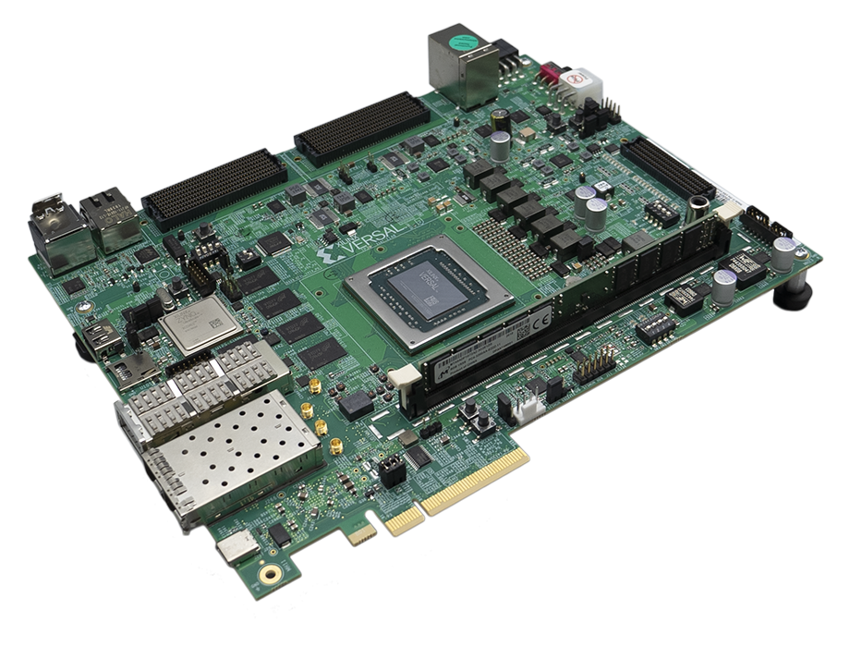
“Game Changer” in Deep Learning Inference
Vision Transformer, INT8 inference, batch = 6
Energy efficiency comparison
Energy Efficiency (GOPS/Watt)
“X FPGA”

Slide 8
“X FPGA” => Versal ACAP Architecture
AMD ACAP
Heterogeneous SoC
FPGA + AI Tensor Cores + CPU
Combine the best of both worlds? How?
Can we generalize this?
Notes:
Versal ACAP Architecture Overview

Slide 9
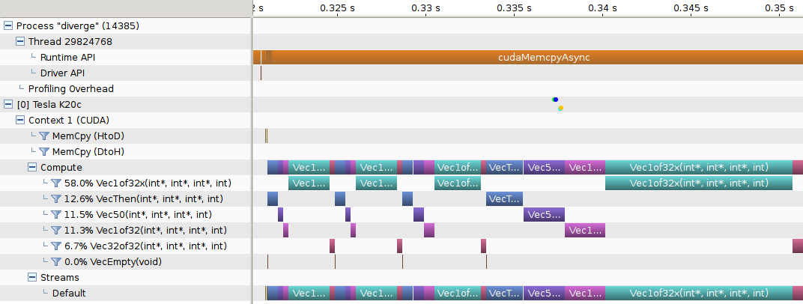
Secret Sauce => Partition & Compose
Monolithic Programming Model: 49.5 GFLOPS
32.5x
Partition & Compose : 1609 GFLOPS
768 Layers
ACC0
L0
L1
L2
L3
Scheduling
Batch 0
-3
ACC0
B0L0
B1L0
B2L0
B3L0
B0L0
ACC1
B0L1
B1L1
B2L1
B3L1
B0L1
B0L2
ACC2
B0L2
B1L2
B2L2
B3L2
B0L3
ACC3
B0L3
B1L3
B2L3
B3L3
Image Classification: Vision Transformer

Slide 10
Monolithic Programming Model
AIE Array
VLIW
Processor
32KB
Mem
AIE
PLIO
1.2 TB/s
Processor System
(ARM)
PL
DMA
Sender
Receiver
Matrix With Large Size
0
1
2
3
0
1
2
3
0
0
DDR Space
4
5
6
7
4
5
6
7
Sending
LHS
RHS
Output
NOC
25.6 GB/s
LHS
RHS
DDR4

Slide 11
Monolithic Programming Model
AIE Array
0
1
2
0
1
2
0
1
2
0
1
2
0
1
2
0
1
2
0
1
2
0
1
2
0
1
0
2
1
0
2
1
2
0
1
2
0
1
0
2
0
0
0
0
0
0
0
0
0
0
0
0
0
0
0
0
0
0
0
0
0
0
0
0
0
0
0
0
0
0
0
0
0
0
0
0
0
VLIW
Processor
32KB
Mem
0
0
AIE
1
2
0
1
2
0
1
2
0
1
0
2
1
0
2
1
2
0
1
2
0
1
2
0
1
2
0
1
0
2
1
2
0
1
2
0
1
0
2
0
0
0
0
0
0
0
0
0
0
0
0
0
0
0
0
0
0
0
0
0
0
0
0
0
0
0
0
0
0
0
0
0
0
0
0
0
0
PLIO
1
0
1.2 TB/s
Processor System
(ARM)
PL
DMA
Sender
Receiver
Matrix With Large Size
0
1
2
0
1
2
3
0
0
1
0
0
3
0
0
2
DDR Space
4
5
6
7
4
5
6
7
Sending
LHS
RHS
Output
NOC
25.6 GB/s
LHS
RHS
DDR4

Slide 12
Monolithic Programming Model
AIE Array
VLIW
Processor
32KB
Mem
AIE
Invalid Computation
PLIO
Processor System
(ARM)
PL
DMA
Sender
Receiver
Matrix With Small Size
Invalid communication
Valid Data
DDR Space
LHS
RHS
Output
NOC
Padding
LHS
RHS
DDR4

Slide 13
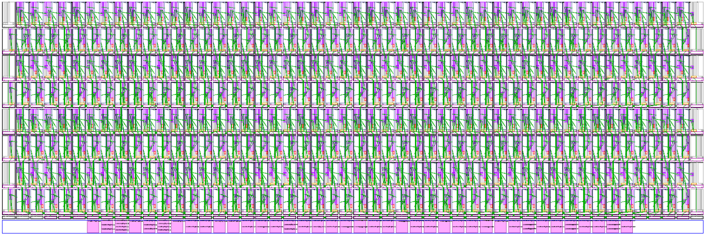
Monolithic Programming Model
Huge computation resources in one monolithic accelerator vs. MM layers of small sizes
Matrix Multiply on 384 AIEs

Slide 14
Monolithic Programming Model
Huge computation resources in one monolithic accelerator vs. MM layers of small sizes
Explore data reuse by allocating large on-chip buffers
A
10⁴
X
2821.14 GFLOPS
10³
10²
Throughput (GFLOPs)
10¹
10⁰
X
B
0.41 GFLOPS
10⁻¹
64 128 256 512 1K 1.5K 2K 3K
Square Matrix Size
Shape mismatch, waste on both computation and communication

Slide 15
Partition & Compose Programming Model
Composing Diverse Accs
Accelerator 0
AIE Array
VLIW
Processor
32KB
Mem
AIE
PLIO
Matrix With Both Large and Small Size
Processor System
(ARM)
PL
DMA
PL←→AIE
DDR Space
Buffer
NOC
DDR4-DIMM

Slide 16
Partition & Compose Programming Model
Composing Diverse Accs
Accelerator 0
Accelerator 1
VLIW
Processor
32KB
Mem
AIE
PLIO
Matrix With Both Large and Small Size
Processor System
(ARM)
DMA
PL←→AIE
DMA
PL←→AIE
DDR Space
Buffer
Buffer
NOC
DDR4-DIMM

Slide 17
Secret Sauce => Partition & Compose
Monolithic Programming Model: 49.5 GFLOPS
32.5x
Partition & Compose : 1609 GFLOPS
768 Layers
ACC0
L0
L1
L2
L3
Scheduling
Batch 0
-3
ACC0
B0L0
B1L0
B2L0
B3L0
B0L0
ACC1
B0L1
B1L1
B2L1
B3L1
B0L1
B0L2
ACC2
B0L2
B1L2
B2L2
B3L2
B0L3
ACC3
B0L3
B1L3
B2L3
B3L3
Image Classification: Vision Transformer

Slide 18
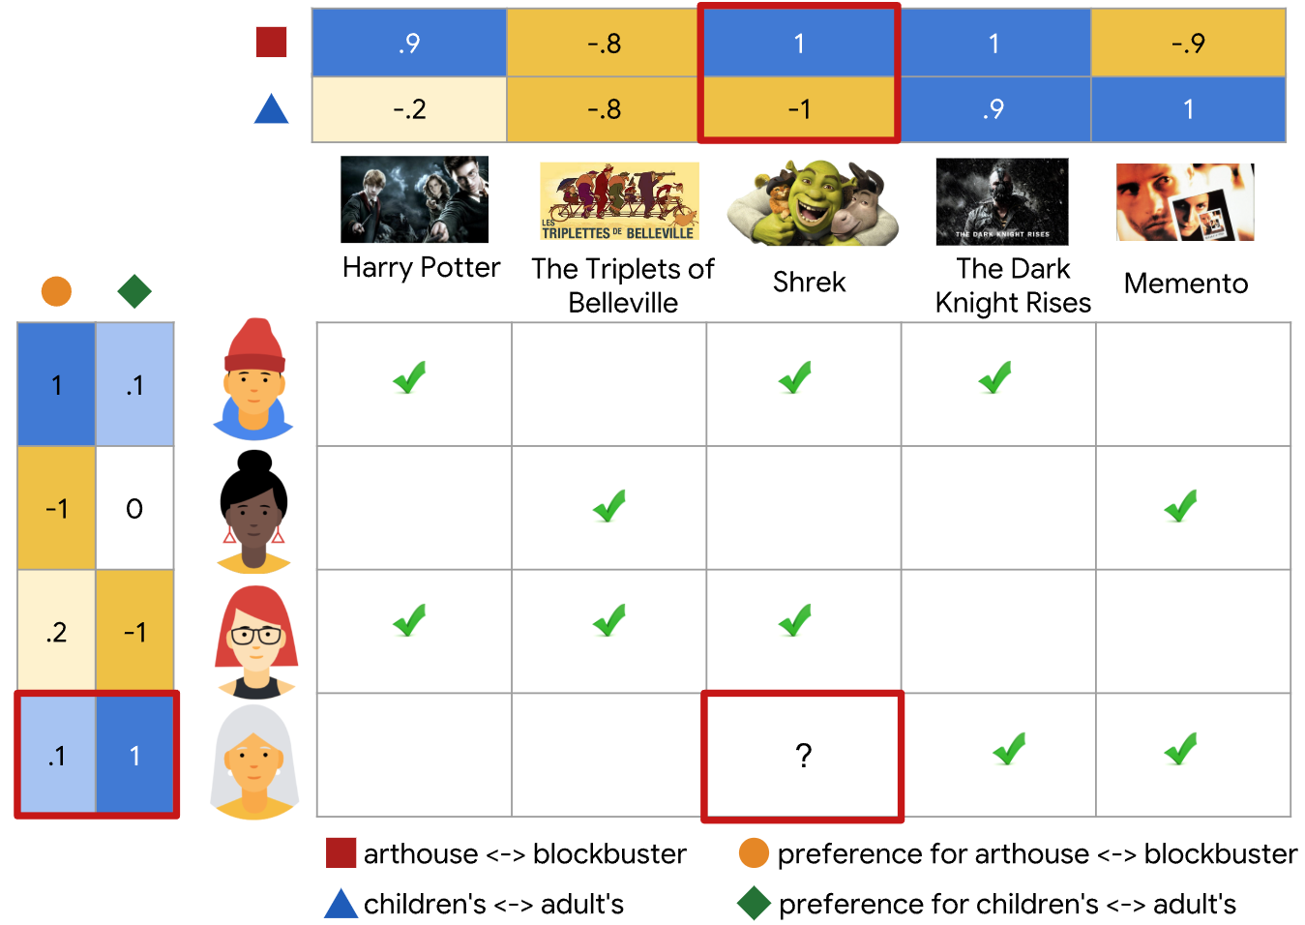
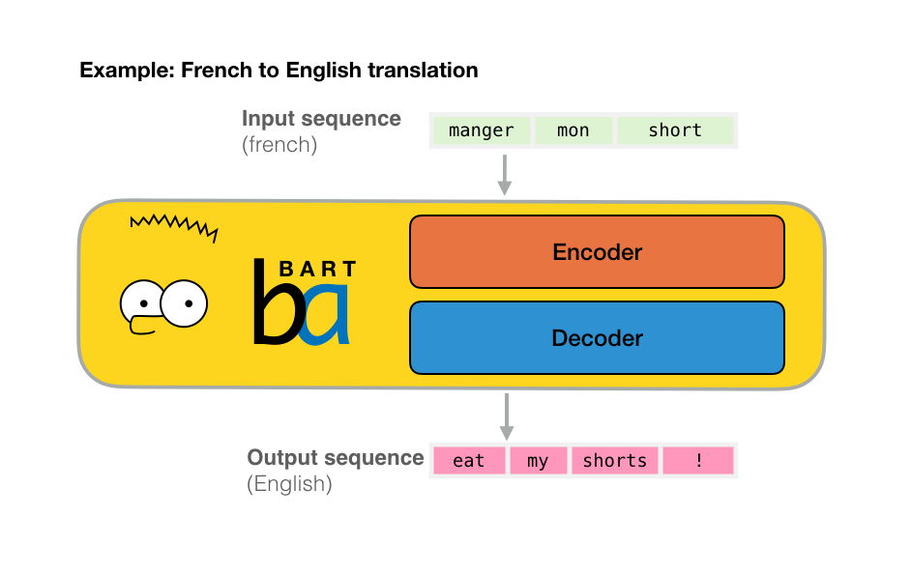
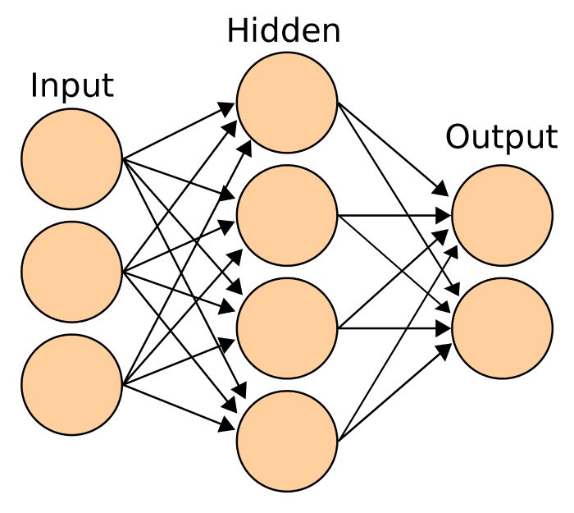

Experiment Results
Neural Collaborative Filtering (Recommendation)
Applications
Bert-Large (Natural Language Processing)
Multilayer Perceptrons (Regression, Classification)
Vision Transformer (Classification)

Slide 19
Experiment Results
Applications Characteristics
Even Larger Shape Variance
Obvious Shape Variance
96 Layers
768 Layers
Large layers Dominate the Application
BERT
ViT
NCF
MLP

Slide 20
Experiment Results
Composing Diverse Accelerators
Throughput Comparison Among Different CHARM Strategies
BERT: 1.46 TFLOPS, 5.3x gain over one monolithic design
NCF: 1.74 TFLOPS for one accelerator design
ViT: 1.61 TFLOPS, 32.5x gain over one monolithic design
MLP: 2.94 TFLOPS for one accelerator design
Throughput (GFLOPS)
32.5x
5.3x
BERT ViT NCF MLP

Slide 21
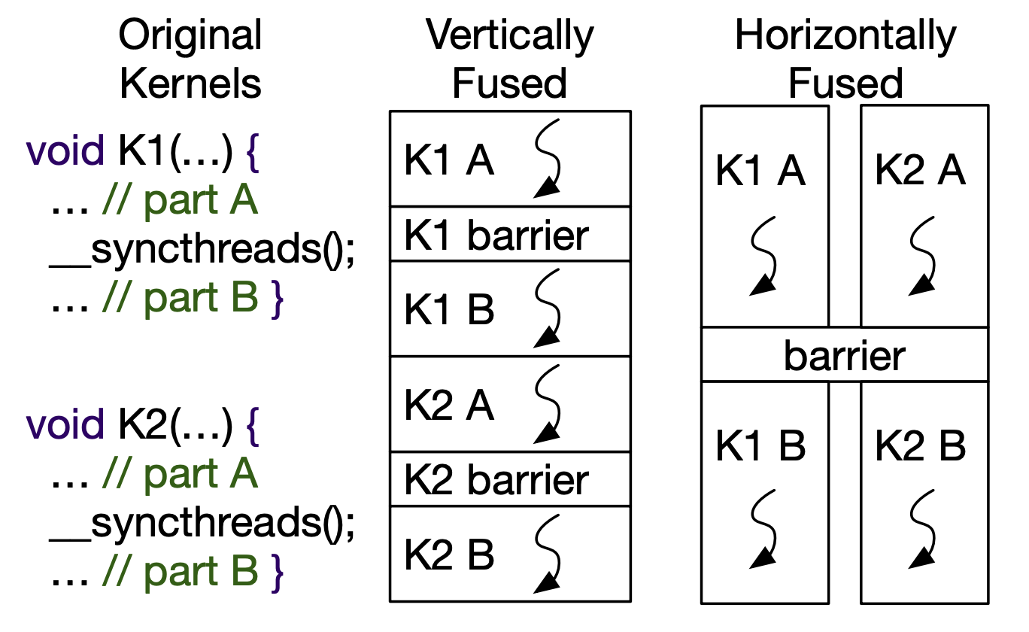
Apply this to Other Platforms, GPUs?
Provided spatial flexibility, combine communication-bound MM with computation-bound MM
Nvidia A10
Throughput (TOPS)
CTC Ratio
1.37x Gain
Vertical and horizontal kernel fusion in GPU.

Slide 22
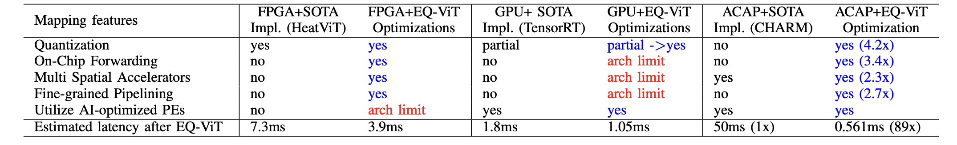
Apply this to Other Platforms, GPUs?
Can we design “GPU” better than current GPU?
Shall we introduce FPGA or reconfigurable architecture in broader GPU architecture to improve latency?
If FPGA is too fine-grained, what is the least reconfigurability needed in future architecture to balance performance and adaptability? ⬄ <=> Microarchitecture support to enable flexible mapping & execution model

Slide 23
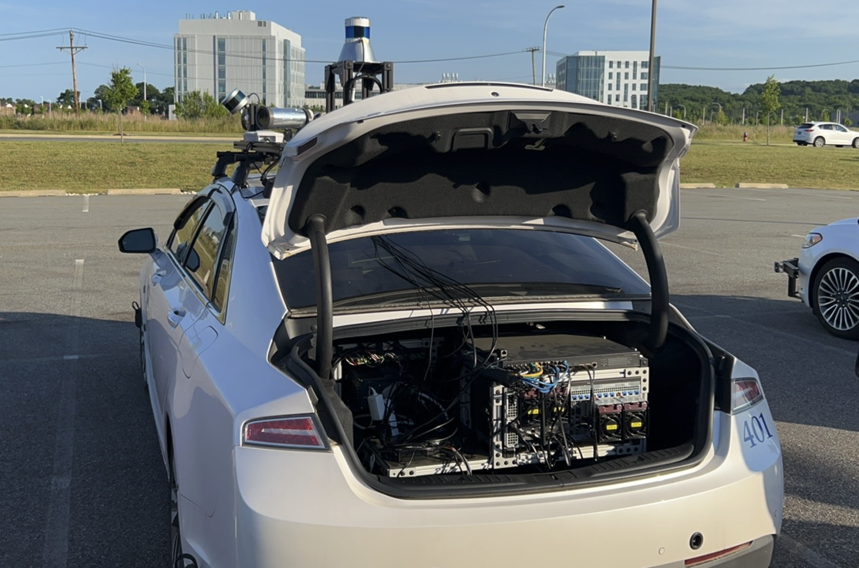
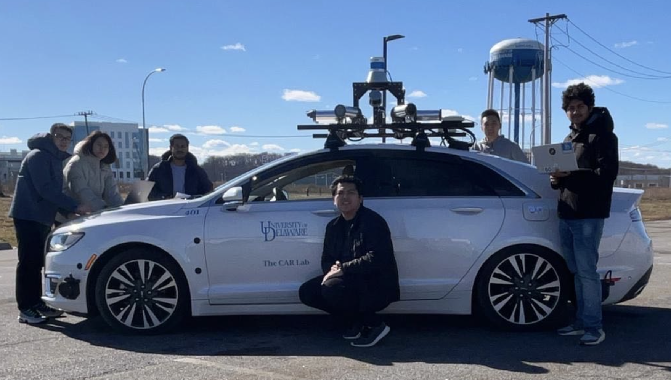
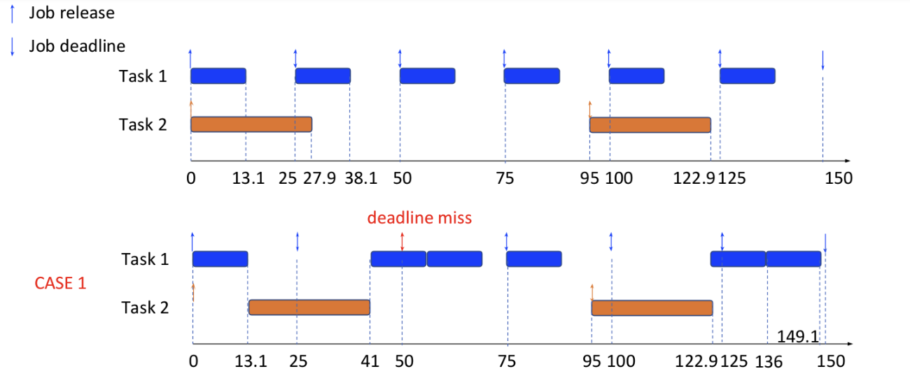
Collaboration with Domain Experts: ART: Accelerator Customization in Real-Time System for Autonomous Driving
Before ART, accelerators can not guarantee to meet the task deadline, causing severe safety concerns.
After ART, meeting the task deadline is guaranteed, & performance is optimized
Collaboration with the CAR Lab (University of Delaware NSF IUCRC Center), Wayne State University
Notes:
adaptive compute acceleration platforms (ACAPs)
Efficient Number Theoretic Transform
NSF #2213701: Collaborative Research: CCRI: New: A Scalable Hardware and Software Environment Enabling Secure Multi-party Learning NSF #2217003: Collaborative Research: PPoSS: LARGE: Co-designing Hardware, Software, and Algorithms to Enable Extreme-Scale Machine Learning Systems

Slide 24
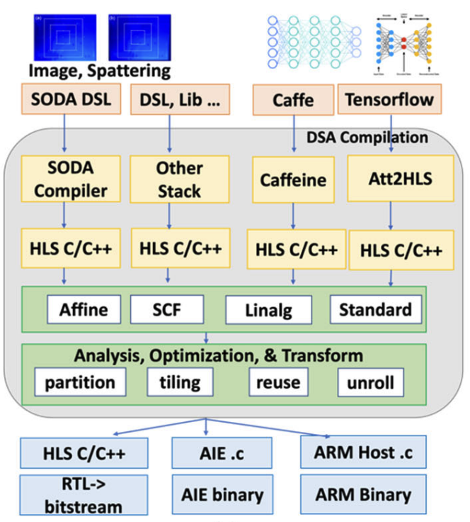
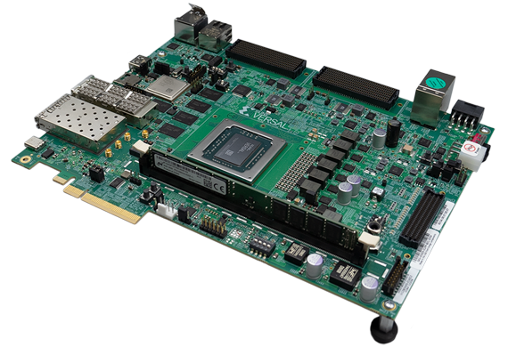
Collaboration with Domain Experts: Real-Time Flaw Detection in Additive Manufacturing (3D printing)
US Navy Naval Engineering Education Consortium (NEEC) Fund: “Enabling Real-Time Flaw Detection in Laser Powder Bed Fusion Using In-Situ Infrared Monitoring by Integrating Image Processing, Machine Learning, and Hardware/Software Co-Design”, Collaboration with Prof. Albert To (PITT)
Notes:
There is no denying that camera-based facial recognition technology enhances public places’ security and reduces the cost of manual surveillance, but the widespread use of facial recognition technology has raised privacy concerns around the world
Changes in the physical or chemical parameters around the fiber can modify the properties of the guided light, such as its intensity, phase, or wavelength. By detecting and analyzing the changes in these light properties, the information about the environment around the optical fiber can be measured. DAS is a type of fiber-optic sensor that achieves distributed vibration measurement by interrogating a special sensing fiber with pulsed light.
After the preliminary test, the sensing area in this work is configured to 3 meters, and the reflectivity of the sensing fiber is represented in Figure 5. This fiber contains six Rayleigh enhancement points, collectively constituting five individual fiber-optic sensors, and each sensor has its sensing area. This distributed arrangement enables precise and comprehensive monitoring of ground vibrations, facilitating the system’s capability to recognize and analyze various environmental disturbances.

Slide 25
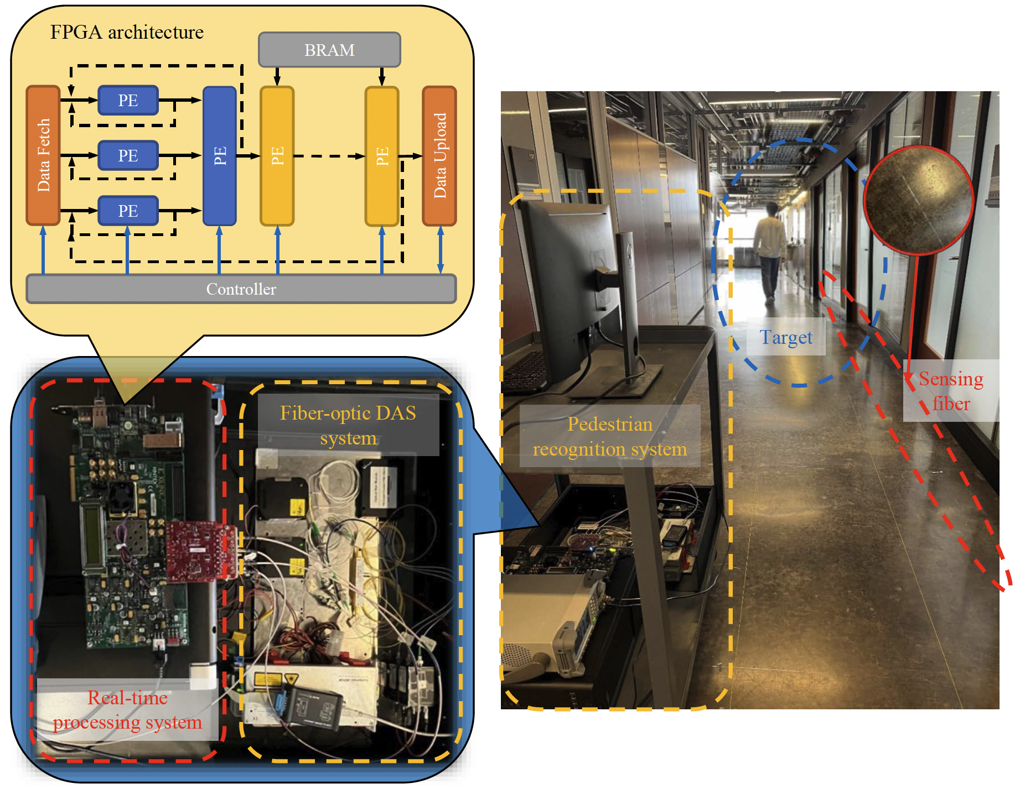
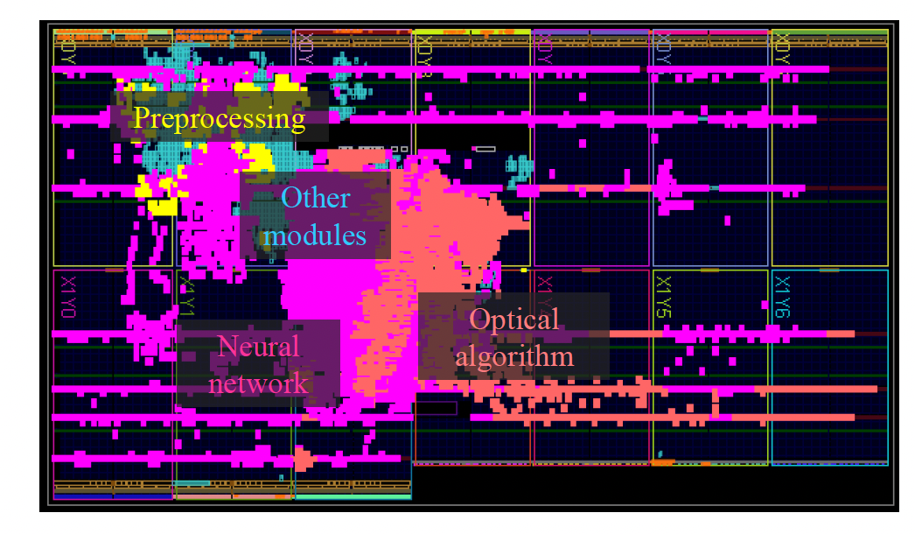
Collaboration with Domain Experts: FiberFlex: FPGA-based Intelligent & Distributed Fiber Sensor System for Pedestrian Recognition
Reduced impact on personal privacy, No limitations on line-of-sight detection, Lower cost in mass surveillance situations
Open-source framework on GitHub
Python APIs, ready to use
9x perf gain, 91x energy effi. gain over CPU+GPU
ACM TRETS’ 2024: FiberFlex: Real-time FPGA-based Intelligent & Distributed Fiber Sensor System for Pedestrian Recognition Collaboration with Dr. Nageswara Lalam (DOE National Energy Technology Laboratory), Prof. Kevin Chen (PITT)
Notes:
There is no denying that camera-based facial recognition technology enhances public places’ security and reduces the cost of manual surveillance, but the widespread use of facial recognition technology has raised privacy concerns around the world
Changes in the physical or chemical parameters around the fiber can modify the properties of the guided light, such as its intensity, phase, or wavelength. By detecting and analyzing the changes in these light properties, the information about the environment around the optical fiber can be measured. DAS is a type of fiber-optic sensor that achieves distributed vibration measurement by interrogating a special sensing fiber with pulsed light.
After the preliminary test, the sensing area in this work is configured to 3 meters, and the reflectivity of the sensing fiber is represented in Figure 5. This fiber contains six Rayleigh enhancement points, collectively constituting five individual fiber-optic sensors, and each sensor has its sensing area. This distributed arrangement enables precise and comprehensive monitoring of ground vibrations, facilitating the system’s capability to recognize and analyze various environmental disturbances.

Slide 26

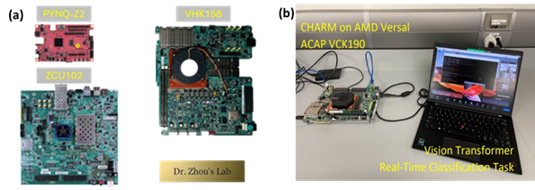
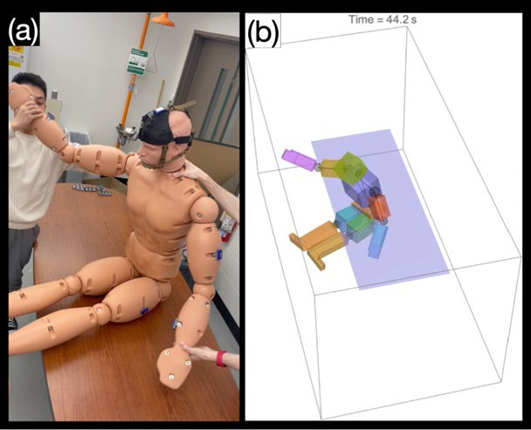
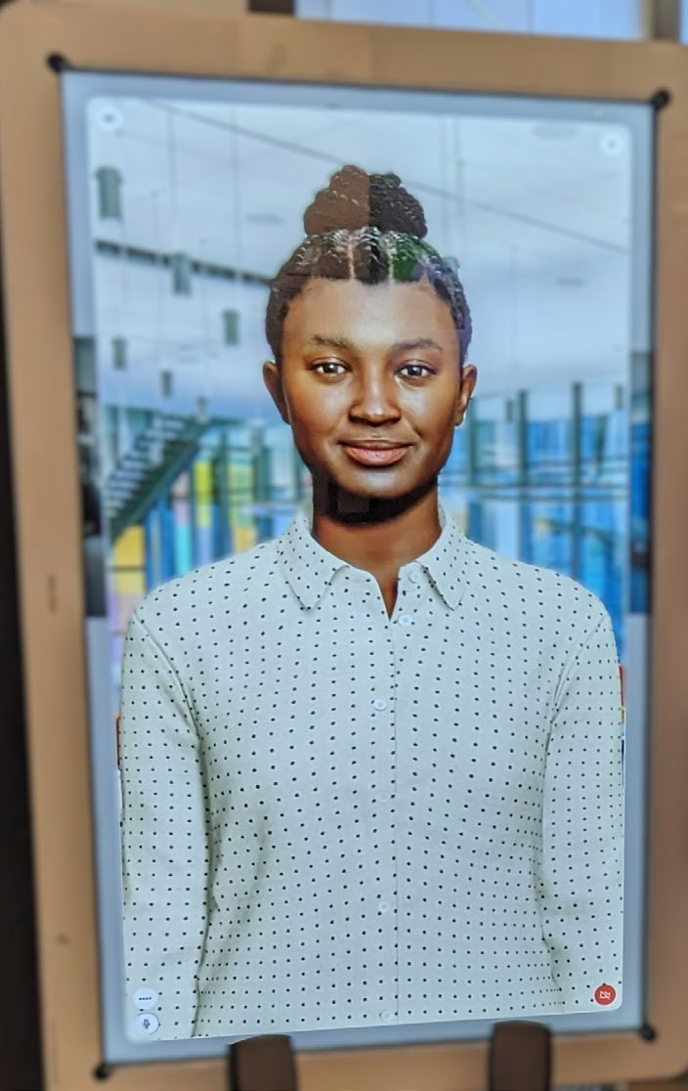
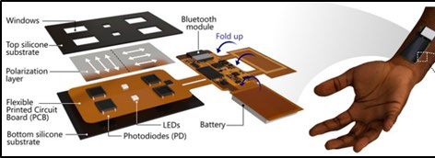
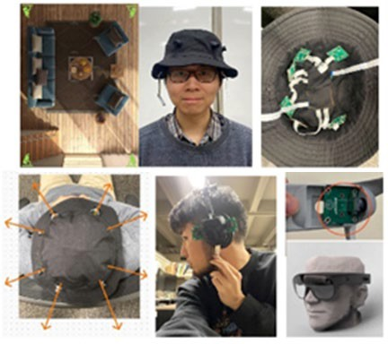
Technology Core Areas (Peipei, Ben, Haneesh, Kimani)
AI-powered interactive Avatar AI-enabled embedded computing platforms (Zhou lab) (courtesy: A. Blumenthal)
Kinematic sensors (Kesari lab)
Optical wearable sensor (Toussaint lab)
Computer vision (Kimia lab)
Sandbox features will include:
Wearable sensors, AI-powered technologies
Approved multiyear “general” IRB to provide constant participant feedback
Input from partner communities, e.g., medicine, public health, computer science, and data science

Slide 27



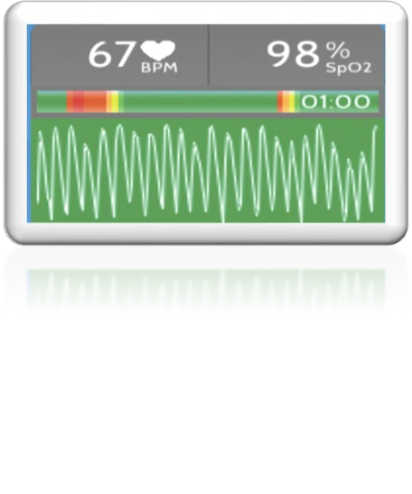





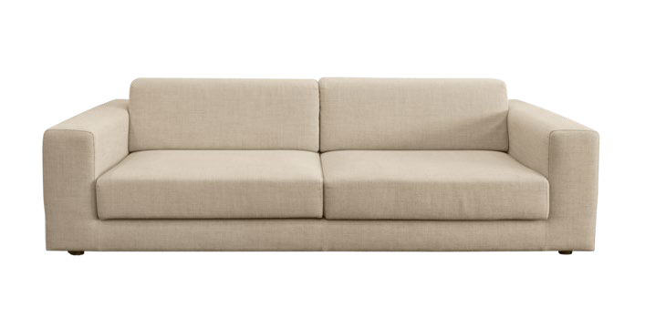


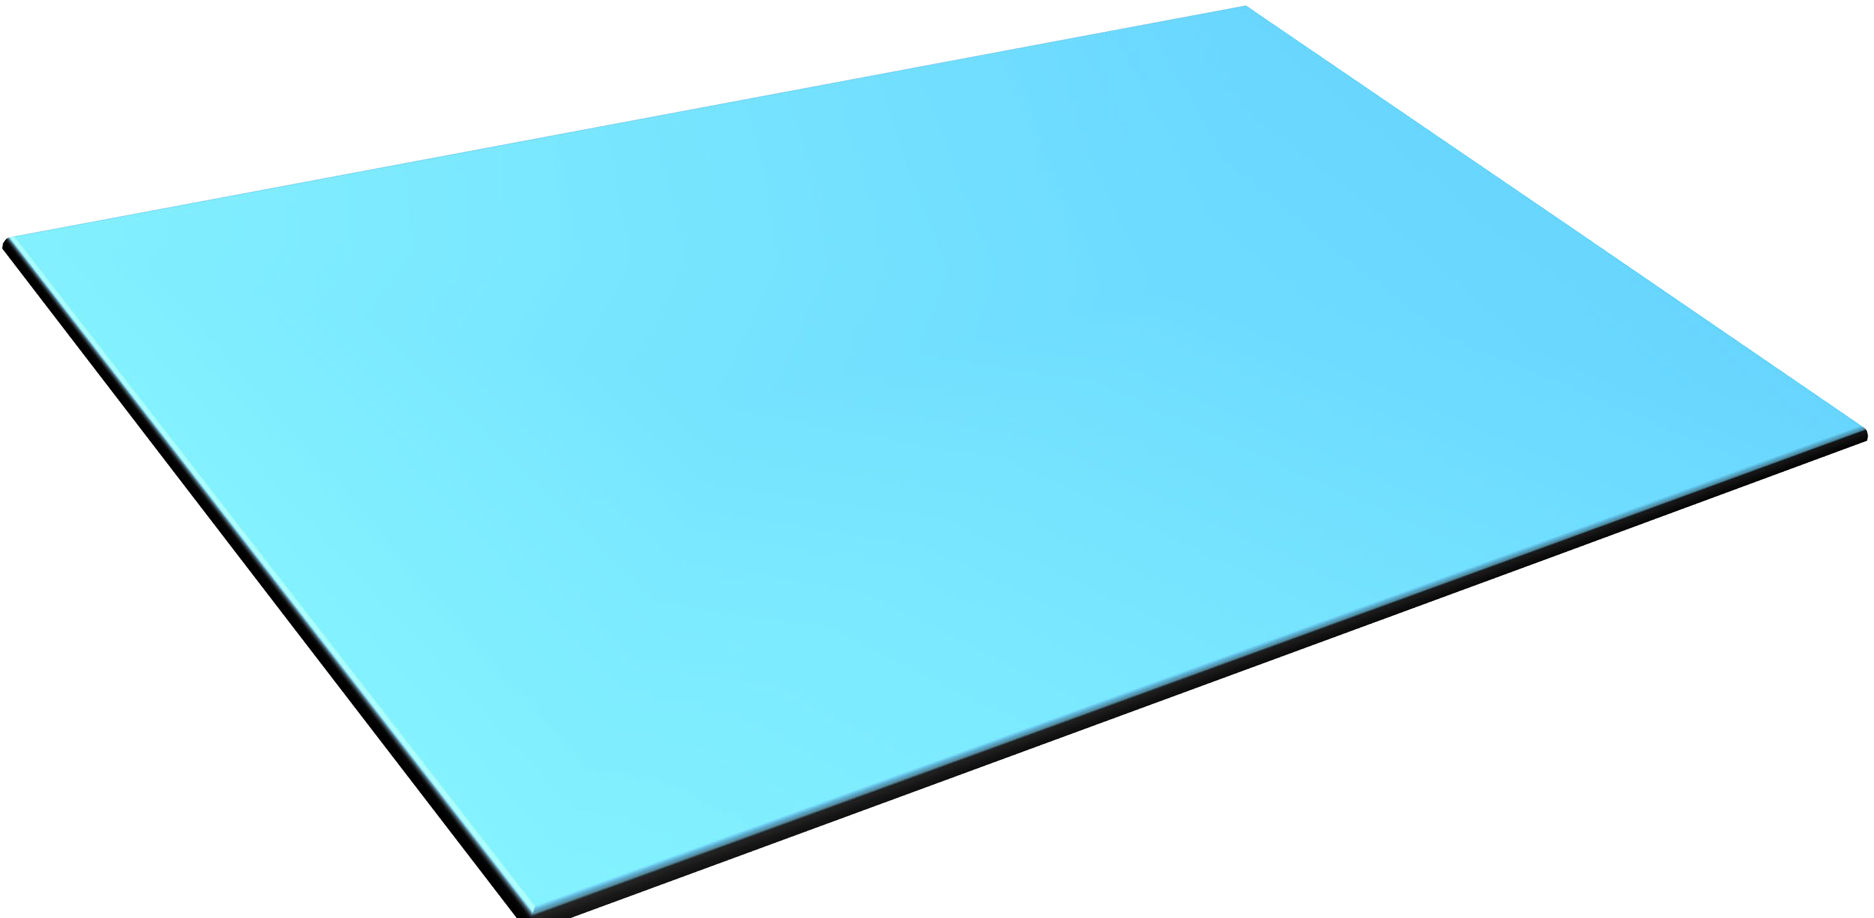

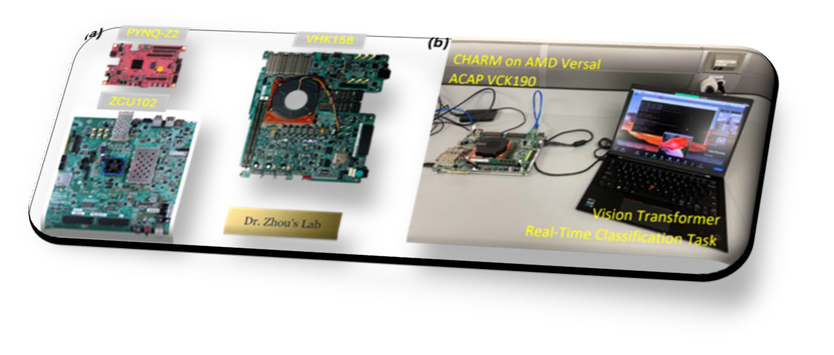


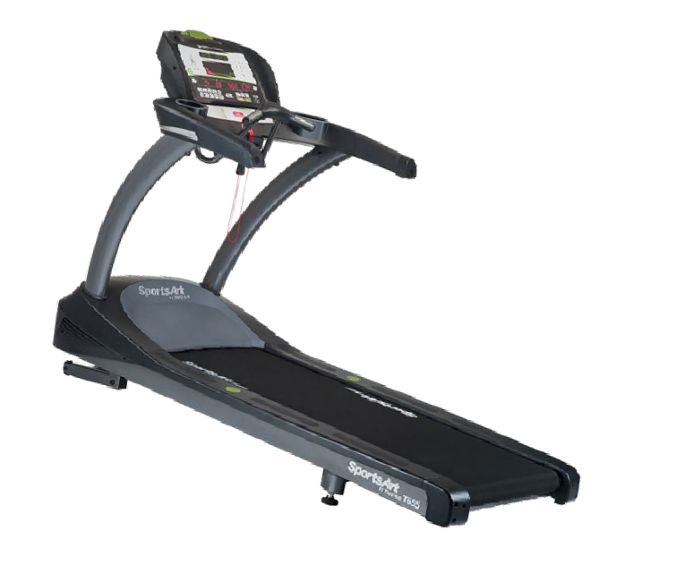



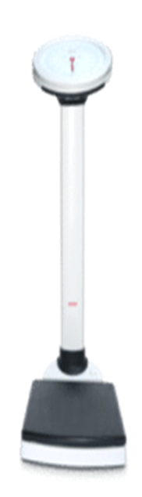


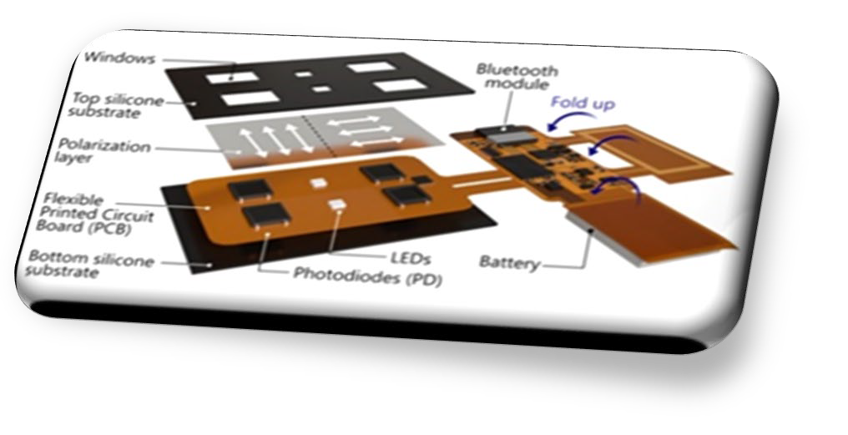

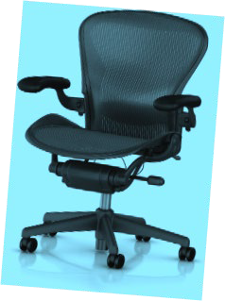

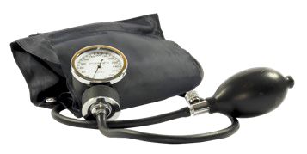


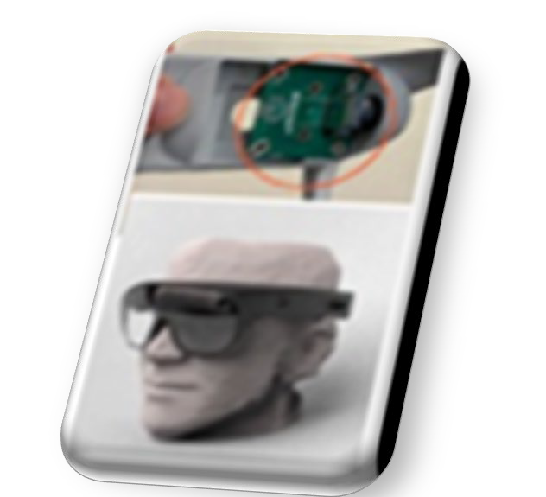

Health Innovation Sandbox Lab Space
105
EHR

Slide 28
NSF Projects: POSE: Phase I: Enabling Open-source Ecosystem for Rapid System-on-Chip Design and Programming
Notes:
adaptive compute acceleration platforms (ACAPs)
Efficient Number Theoretic Transform

Slide 29
NSF Project: MRI Consortium: Track 1: Development of SPECTRUM: An Evolutionary Rapid-Prototyping Testbed for Low Latency Multi-Domain Computing
Notes:
adaptive compute acceleration platforms (ACAPs)
Efficient Number Theoretic Transform

Slide 30
Thank you & Questions?

Slide 31
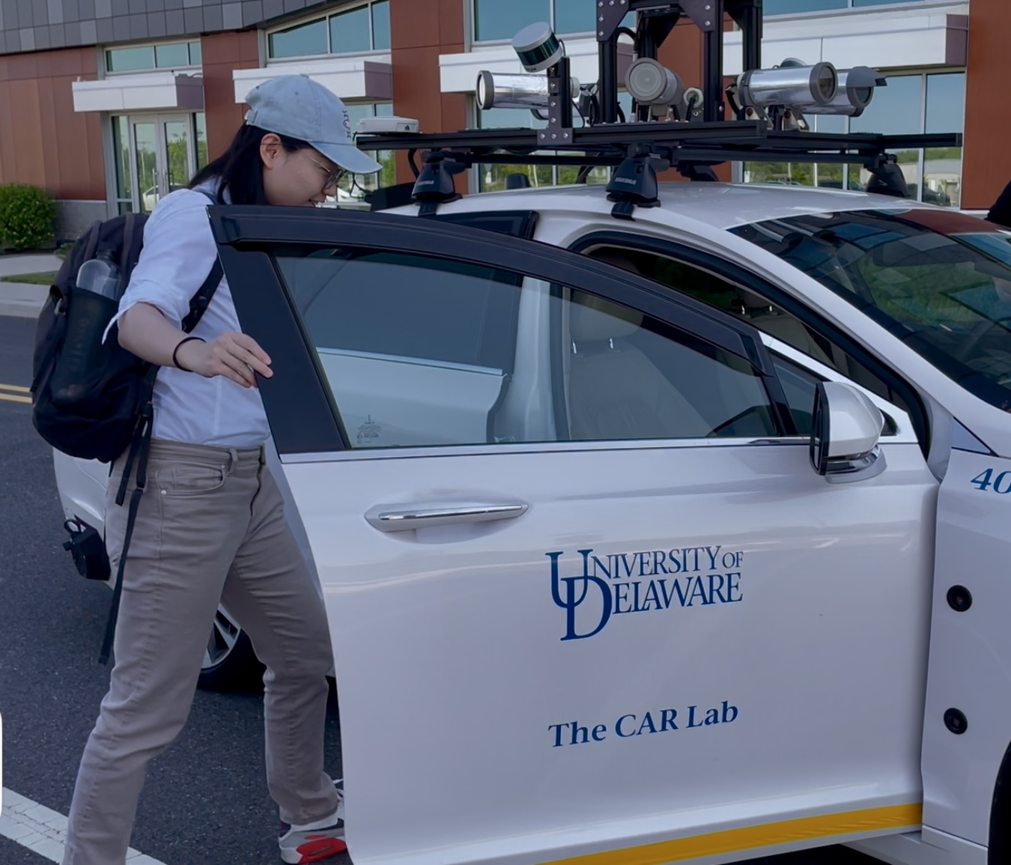
Impacts
Impacts (Application): Smart Health, Smart Transportation, AIoT & IoS,
Impacts (Architecture): Heterogeneous Domain Specific Architecture
Impacts (Programming): GitHub Open-source, No.1 Downloaded (>4100) Paper in FPGA’23
ART: Accelerator Customization for Safety-Critical Autonomous System
Collaboration with the CAR Lab, University of Delaware, Wayne State University
NSF #2213701: Collaborative Research: CCRI: New: A Scalable Hardware and Software Environment Enabling Secure Multi-party Learning NSF #2217003: Collaborative Research: PPoSS: LARGE: Co-designing Hardware, Software, and Algorithms to Enable Extreme-Scale Machine Learning Systems
Notes:
adaptive compute acceleration platforms (ACAPs)
Efficient Number Theoretic Transform

Slide 32
Ongoing Research: MLIR-based HeteroCompose Compilation Framework
C/C++
Tensorflow
Pytorch
Polygeist
Passes
Stencil + GEMM IR
MLIR IR
e.g.
Loop IR Level
Loop.opt
Affine
Vector
MemRef
Exploit general optimizations across-kernel
Hetero.opt
HeteroCompose IR
Graph.opt
Different HW backend
HW-related IR
CPUs
GPUs
FPGAs
CGRAs
ACAPs
PIMs
New

Slide 33
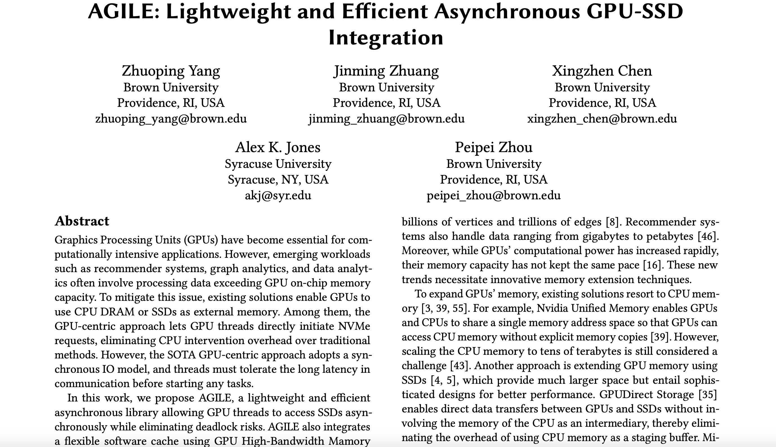
Supercomputing 25 Just Accepted Paper: GPU+SSD -> What are Next Steps?
https://arxiv.org/pdf/2504.19365

Slide 34
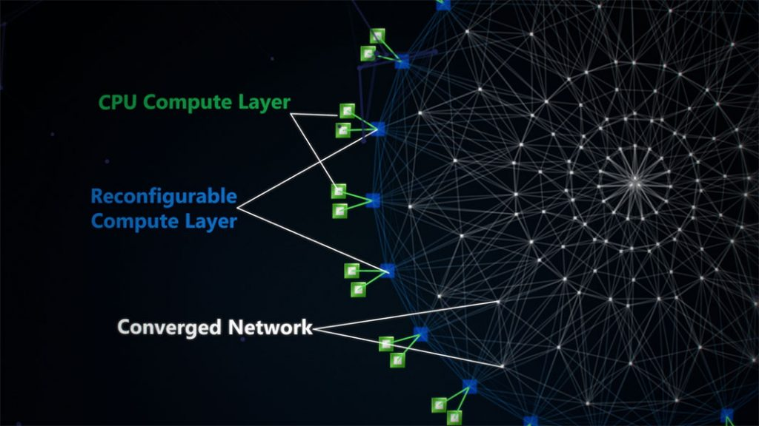
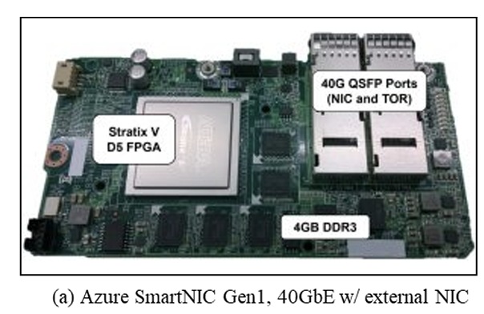
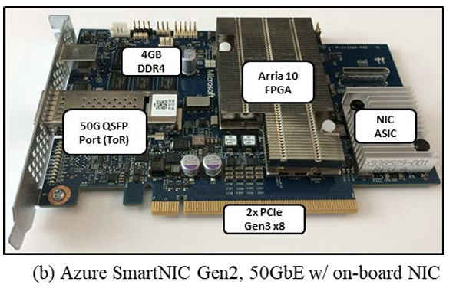
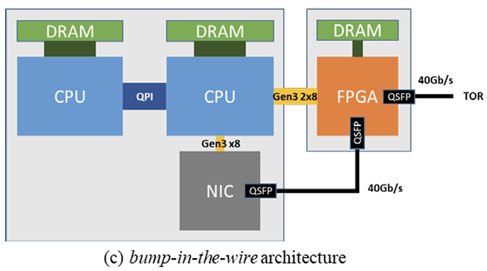

Customized Computing on FPGAs Deployed in Cloud Scale
Microsoft programmable hardware/software "fabric" on more than 5,760 Microsoft datacenter servers running Intel Xeon processors and Altera FPGA chips.
Apps: Bing Search, Azure Machine Learning, SmartNIC
ISCA’14, IEEE Micro’15, MICRO’16, NSDI’18, NeurIPS’20

Slide 35
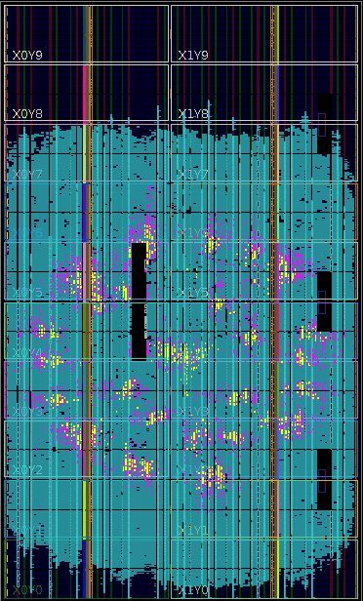
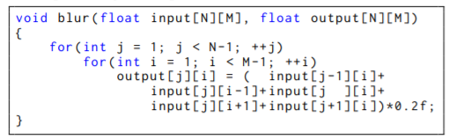
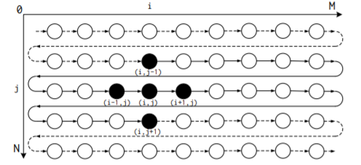
Customized Computing on FPGAs
Can Every Programmer Easily Design DSAs?
Yes! We can create circuits from C/C++ with high-level synthesis (HLS)
Example Code:
Use of FPGAs trade-off performance for design cost, flexibility, and time-to-silicon

Slide 36
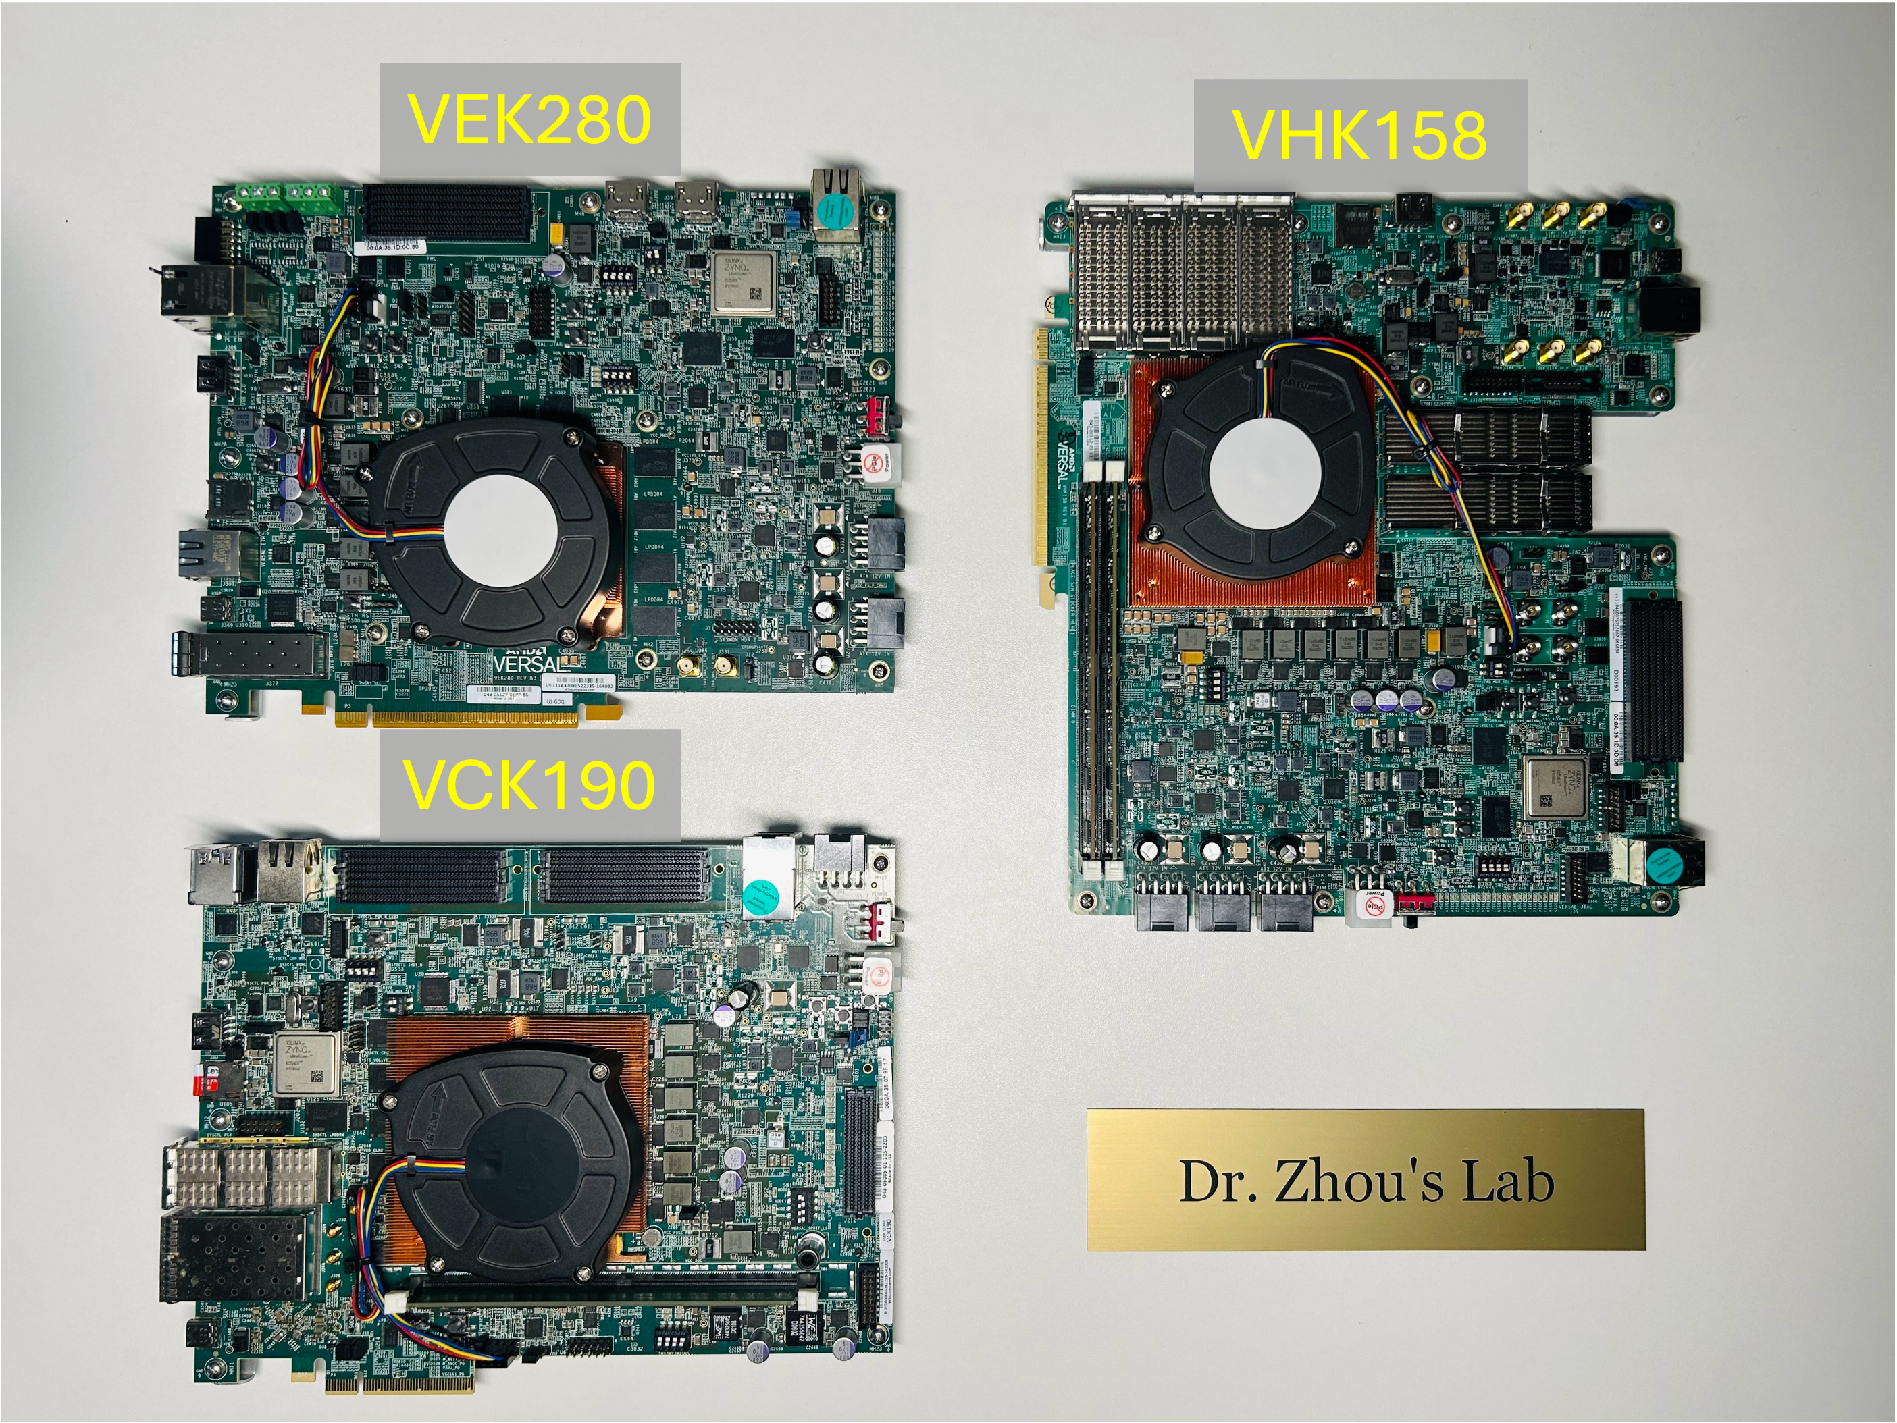
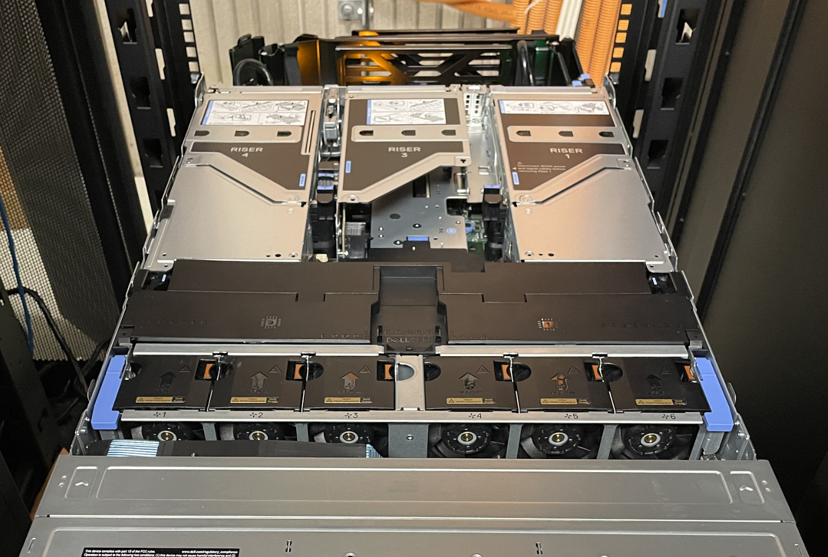
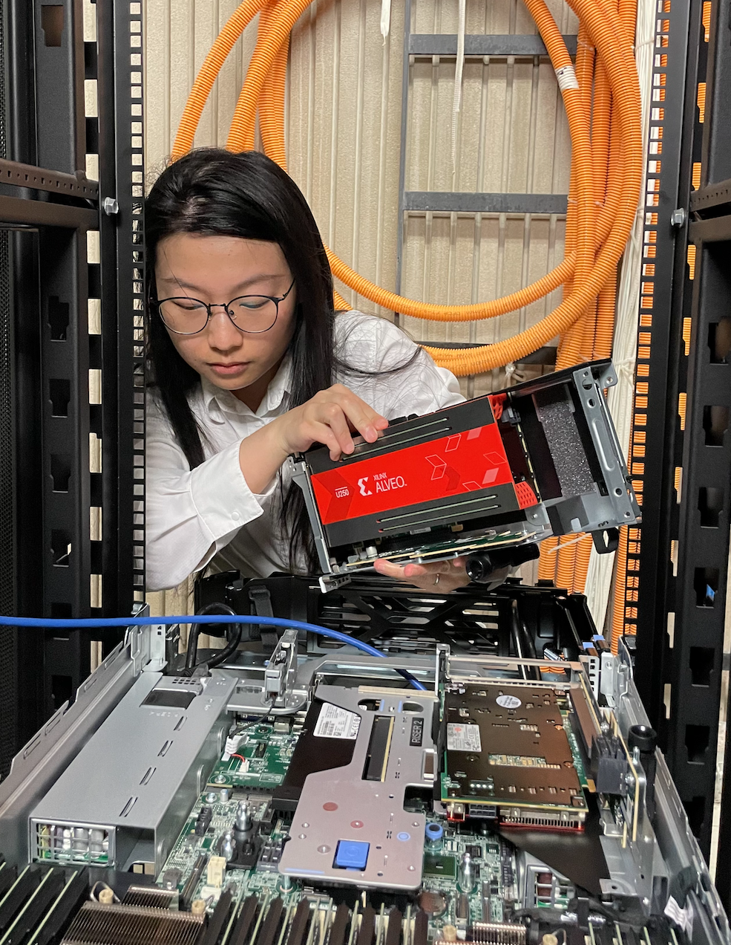
Advanced Computing - Software and Hardware - from Edge to Datacenter
Network Switch
QSFP
QSFP
AMD Versal ACAP
VCK5000
Nvidia GPU RTX 5000 Ada
Dell R750 with 512GB memory

Slide 37
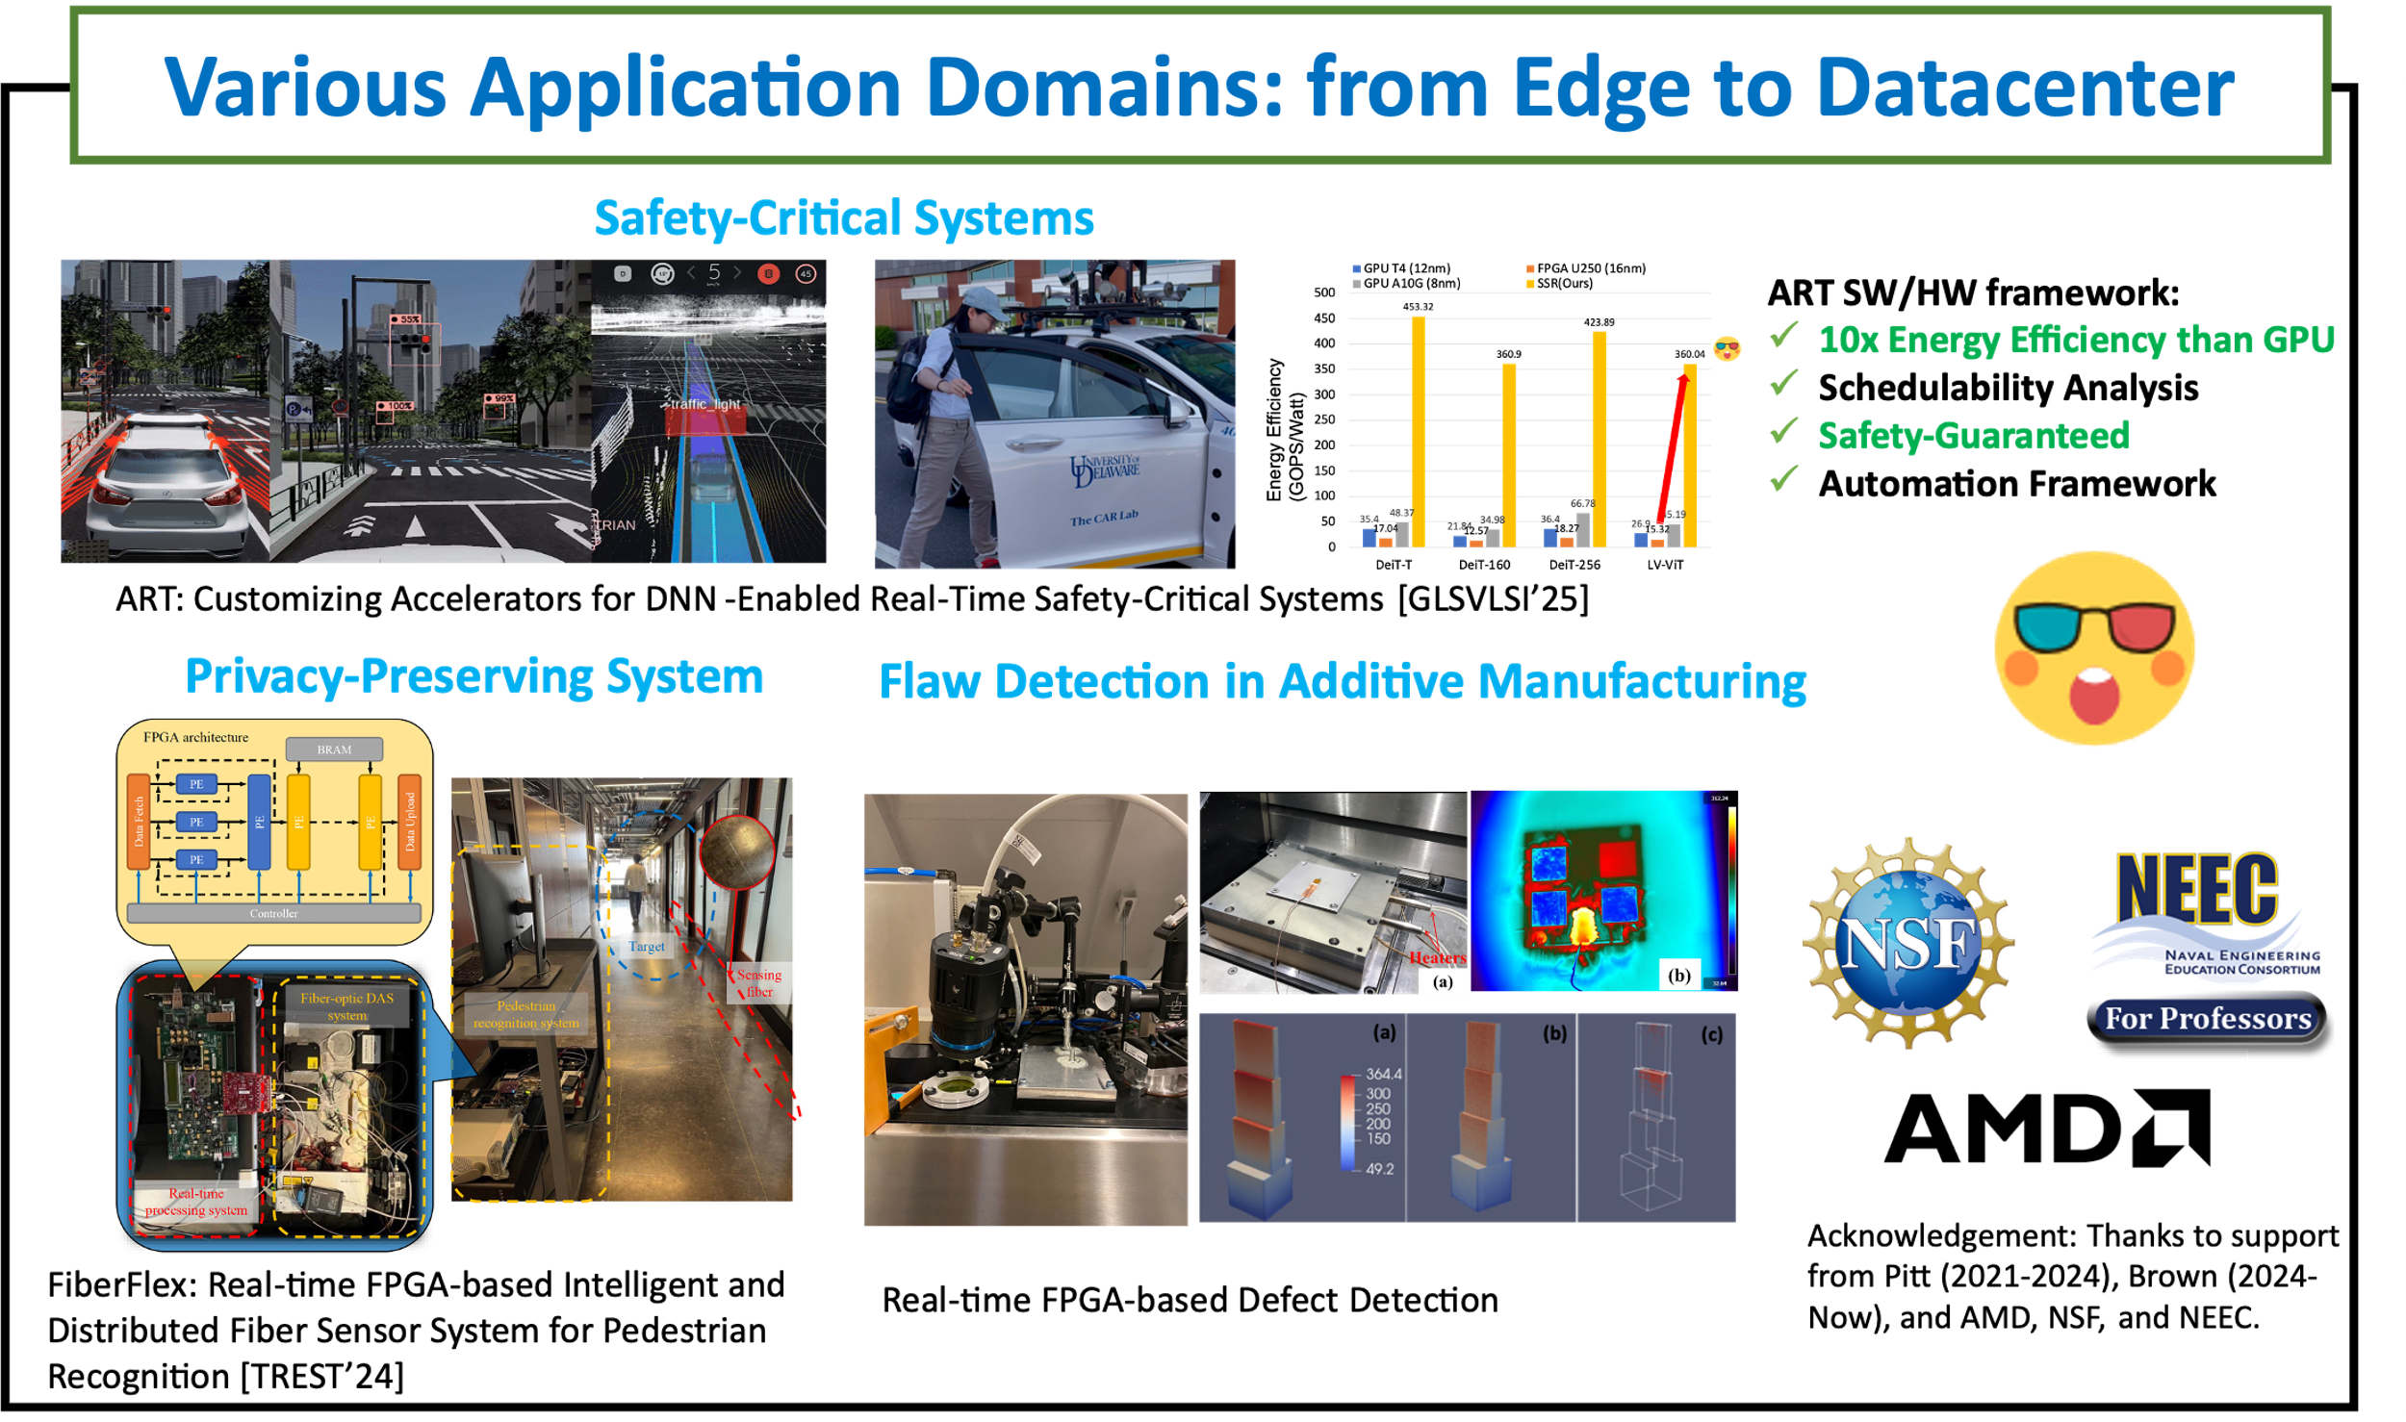

Slide 38
Challenge 1
The computation scaling vs. off-chip communication scaling
FP32 Performance
DDR Bandwidth
U250 (PL:300MHz)
VCK190 (AIE:1GHz)
U250
VCK190
7
4.3x
80
6
70
5
60
Throughput (TFLOPS)
50
4
3.0x
6.4
40
Bandwidth (GB/s)
76.8
3
30
2
20
1
25.6
1.0x
1.47
10
0
0
16nm
7nm
16nm
7nm
FPGAs
FPGAs

Slide 39


Challenge 3
High level complexity
Increasing Programming Efforts
AIE Array
AIE C/C++
HLS C/C++
Host C/C++
AIE
IO
300 LOC
Processor System
(ARM)
Programmable Logic
900 LOC
1000 LOC
CLB
BRAM
URAM
DSP
NOC
25.6 GB/s
DDR4-DIMM

Slide 40
CHARM: Composing Heterogeneous Accelerators for Matrix Multiply on Versal ACAP Architecture
Challenges
Solutions
Off-chip bandwidth doesn’t scaling as fast as computation
Hugely explore the on-chip reuse
High parallelism makes one-size-fit-for-all solution inefficient
Two-step Accelerator Composing Algorithm
Heterogeneity makes it non-trivial to program a system like Versal with good performance
White-box open-sourced Framework
https://github.com/arc-research-lab/CHARM

Slide 41







CHARM Compilation Flow
CHARM Input and Output
Input 1) MM-based AI Model ; 2) Profiling of Off-chip Bandwidth ; 3) Hardware resource constrains ;
Output 1) Bitstream Running on the AIE and PL (AIE/V++ Compiler) 2) Executable Running on ARM CPU (GCC Cross Compilation)
AI Models
XCLBIN
EXE
DDR-Profiler
Hardware Constraints
RAM
PLIO
AIE

Slide 42
CHARM Framework Overview
CHARM Components
① Single Accelerator Design Space Exploration ② Diverse Accelerator Composer
③ Runtime Configuration
④ Automatic Code Generator
AI Models
②
④
XCLBIN
EXE
①
DDR-Profiler
③
Hardware Constraints
RAM
PLIO
AIE

Slide 43
CHARM Framework Overview
CHARM Components
① Single Accelerator Mathematical-Modeling Based Design Space Exploration 1) Fully-pipelined AIE Processor Design 2) Hugely IO Reused AIE Array Design
3) On-chip Buffer Reused PL Design
AI Models
XCLBIN
EXE
①
DDR-Profiler
Hardware Constraints
RAM
PLIO
AIE

Slide 44

CHARM Framework Components
① Single Accelerator Design Space Exploration
EST: 2.8 TFLOPs
URAM: 384, 83%
BRAM: 764, 80%
AIE: 384, 96%
PLIO Strategy:
A=6, B=4, C=16
Acc0
Single Accelerator Analytical Model
L1
L1
L2
L2
L0
Throughput
Platform
Acc 0
Hardware Configuration
EST: 1.2 TFLOPs
URAM: 192, 41%
BRAM: 256, 26%
AIE: 192, 48%
PLIO Strategy:
A=6, B=4, C=8
RAM
PLIO
AIE
RAM
PLIO
AIE

Slide 45
CHARM: Diverse Accelerator Composing
Two-step Search Algorithm
①
②
1st Step: Workload Assignment
How to assign M layers in one AI Model to N accelerators?
2nd Step: Hardware Resource Partitioning
5 layers
L0
L1
L2
L3
L4
2 ACCs
ACC0
ACC1
URAM
AIE
BRAM
PLIO
LUT

Slide 46

CHARM: Diverse Accelerator Composing
Two-step Search Algorithm
①
②
1st Step: Workload Assignment
How to assign M layers in one AI Model to N accelerators?
2nd Step: Hardware Resource Partitioning
5 layers
L4
L4
L2
L2
L3
L0
L3
L1
L0
L1
Single Accelerator Analytical Model
EST: 2.5 TFLOPs
URAM: 200
BRAM: 500
AIE: 256, 64%
PLIO Strategy:
A=4, B=4, C=16
2 ACCs
Overall
ACC1
ACC0
ACC1
ACC0
1.8 TFLOPs
ACC0
ACC1
URAM
URAM
URAM
URAM
EST: 0.4 TFLOPs
URAM: 16
BRAM: 32
AIE: 32, 8%
PLIO Strategy:
A=2, B=4, C=4
URAM
AIE
AIE
AIE
AIE
AIE
BRAM
PLIO
PLIO
PLIO
LUT
PLIO
PLIO

Slide 47
CHARM: Diverse Accelerator Composing
Two-step Search Algorithm
①
②
1st Step: Workload Assignment
How to assign M layers in one AI Model to N accelerators?
2nd Step: Hardware Resource Partitioning
5 layers
Record Optimized Solution
L4
L1
L0
L2
L3
Single Accelerator Analytical Model
EST: 2.9 TFLOPs
URAM: 256
BRAM: 384
AIE: 288, 72%
PLIO Strategy:
A=4, B=4, C=18
2 ACCs
Overall
ACC0
ACC1
2.0 TFLOPs
ACC0
ACC1
URAM
URAM
URAM
URAM
EST: 0.8 TFLOPs
URAM: 64
BRAM: 64
AIE: 64, 16%
PLIO Strategy:
A=4, B=4, C=4
AIE
AIE
AIE
AIE
PLIO
PLIO
PLIO
PLIO

Slide 48
“X FPGA” => Versal ACAP Architecture
AMD ACAP
Heterogeneous SoC
FPGA + AI Tensor Cores + CPU
Composing Diverse Accs for Matrix Multiply -> Throughput Optimal [FPGA’23 CHARM]
Composing Diverse Accs for End-to-end Applications, Latency-Throughput Pareto [FPGA’24 SSR]
Notes:
Versal ACAP Architecture Overview

Slide 49

End-to-end Deep Learning, e.g., Transformer
Element-wise & Non-linear Kernels (CTC <=1)
Non-MM kernels <1% total FLOPS, ~ 50% execution time in GPU
Transpose

Slide 50
End-to-end Deep Learning, e.g., Transformer
Computation-Intensive Kernels
Matrix-Multiply (MM)
Batch MM

Slide 51









Latency & Throughput Driven Scenarios
Latency-Driven
Throughput-Driven
Autonomous Driving
…
Google
Video Conferencing
Data Center Services

Slide 52
Motivation: Sequential or Spatial Arch?
Sequential-only Accelerator → Hardware Under-utilization
Mismatch between shape of the layers & size of the accelerator
Directed acyclic graph (DAG)
Vector Processors
1
Scheduling
0
2
3
PE
PE
PE
PE
PE
PE
PE
PE
ACC0
Corresponding Workloads
8 : 4 : 4 : 16
PE
PE
PE
PE
Timeline
PE
PE
PE
PE

Slide 53
Motivation: Sequential or Spatial Arch?
Sequential-only Accelerator → Hardware Under-utilization
Mismatch between shape of the layers & size of the accelerator
Directed acyclic graph (DAG)
Vector Processors
1
Scheduling Layer 0
PE
PE
PE
PE
PE
PE
PE
0
2
3
PE
PE
PE
PE
PE
PE
PE
PE
PE
ACC0
L0
Corresponding Workloads
PE
PE
PE
PE
PE
PE
PE
8 : 4 : 4 : 16
PE
Timeline
PE
PE
PE
PE
PE
PE
PE
PE
Padding → Invalid Computation

Slide 54
Motivation: Sequential or Spatial Arch?
Sequential-only Accelerator → Hardware Under-utilization
Mismatch between shape of the layers & size of the accelerator
Directed acyclic graph (DAG)
Tiled Architecture
1
Scheduling Layer 1-2
PE
PE
PE
PE
PE
PE
PE
0
2
3
PE
PE
PE
PE
PE
PE
PE
PE
PE
ACC0
L0
L1
L2
Corresponding Workloads
PE
PE
PE
PE
PE
PE
PE
8 : 4 : 4 : 16
PE
Timeline
PE
PE
PE
PE
PE
PE
PE
PE

Slide 55
Motivation: Sequential or Spatial Arch?
Sequential-only Accelerator → Hardware Under-utilization
Mismatch between shape of the layers & size of the accelerator
Directed acyclic graph (DAG)
Vector Processors
1
Scheduling Layer 3
0
2
3
PE
PE
PE
PE
PE
PE
PE
PE
ACC0
L0
L1
L2
L3
Corresponding Workloads
8 : 4 : 4 : 16
PE
PE
PE
PE
Timeline
PE
PE
PE
PE

Slide 56
Motivation: Sequential or Spatial Arch?
Spatial-only Accelerator → Longer Latency (Multiple batches)
Directed acyclic graph (DAG)
Vector Processors
1
1
Scheduling
Batch 0
-3
0
PE
PE
PE
PE
0
2
3
2
3
ACC0
B0L0
B1L0
B2L0
B3L0
ACC0
B0L0
ACC1
B0L1
B1L1
B2L1
B3L1
B0L1
PE
PE
PE
PE
B0L2
ACC2
B0L2
B1L2
B2L2
B3L2
B0L3
Corresponding Workloads
ACC3
B0L3
B1L3
B2L3
B3L3
ACC1
PE
PE
PE
PE
8 : 4 : 4 : 16
Timeline
PE
PE
PE
PE
ACC2
ACC3

Slide 57

Motivation: Sequential or Spatial Arch?
ACC0
L0
L1
L2
L3
Scheduling
Batch 0
-3
ACC0
B0L0
B1L0
B2L0
B3L0
B0L0
ACC1
B0L1
B1L1
B2L1
B3L1
B0L1
B0L2
ACC2
B0L2
B1L2
B2L2
B3L2
B0L3
ACC3
B0L3
B1L3
B2L3
B3L3

Slide 58
Solution: Sequential + Spatial Hybrid
SSR-Hybrid → Pareto front in Latency throughput tradeoff
Directed acyclic graph (DAG)
Vector Processors
1
1
Scheduling
Batch 0-1
0
PE
PE
PE
PE
0
2
3
2
3
ACC0
B0L0
B1L0
B0L3
B1L3
PE
PE
PE
PE
ACC1
B0L1
B0L2
B1L1
B1L2
Corresponding Workloads
8 : 4 : 4 : 16
PE
PE
PE
PE
Timeline
PE
PE
PE
PE
ACC0
ACC1

Slide 59
SSR-Hybrid Solution
SSR-Hybrid → Pareto front in Latency throughput tradeoff
Less execution time in each stage
Low latency
Low throughput
Directed acyclic graph (DAG)
1
Sequential
0
2
3
ACC0
L0
L1
L2
L3
Longer time
High Throughput
High Latency
ACC0
B0L0
B1L0
B2L0
B3L0
B0L0
1
ACC1
B0L1
B1L1
B2L1
B3L1
B0L1
B0L2
Spatial
0
2
3
ACC2
B0L2
B1L2
B2L2
B3L2
B0L3
ACC3
B0L3
B1L3
B2L3
B3L3
1
Latency-Throughput
Tradeoff
ACC0
B0L0
B1L0
B0L3
B1L3
Hybrid
0
2
3
ACC1
B0L1
B0L2
B1L1
B1L2
Timeline

Slide 60
SSR Architecture, Designs & Software
Challenges
Solutions
Spatial-Only → High Latency
Sequential-Only → Low Throughput
Feature: Multi Spatial Accelerators; Apply hybrid architecture to explore latency throughput tradeoff
Non-linear & elementwise kernels takes Non-negligible time
Feature: Enable Inter-Acc aware on-chip data forwarding and fine-grained pipeline
The large design space & heterogeneity of ACAP motivates an automation tool
SSR two-phase DSE tool & automatic workflow for implementation on ACAP https://github.com/arc-research-lab/SSR

Slide 61
SSR Design Methodology
SSR Architecture
3D-Parallelism on two hierarchy: 3D-AIE Array (A, B, C), 3D-SIMD Instruction (PI, PK, PJ)
A Spatial Accelerator
AIE Region
AIE₀
AIE₁
AIE₂
AIE₃
AIE₀
AIE₁
AIE₂
AIE₃
AIE Core
HMM Unit
HMM Unit
HMM Unit
Local
RAM
AIE₄
AIE₅
AIE₆
AIE₇
AIE₄
AIE₅
AIE₆
AIE₇
PLIO IN
PLIO Interface
PLIO Interface
PLIO Interface
…
PLIO Interface
PLIO Interface
PLIO OUT
PL Region
Cascade
Layernorm
Transpose
Layernorm
Transpose
FIFO
Stream
SSR-HCE
SSR-HCE
SSR-HCE
Softmax
Control Logic
Softmax
Control Logic
DDR
Access
Network-on-Chip
DDR4-DIMM

Slide 62
SSR Design Methodology
SSR Programming Model & Dataflow
Chained Graph
A Spatial Accelerator
AIE Region
Batch 0
0
1
2
2
R
AIE Cores
MM 0
1
MM 1
MM 2
0
1
2
Batch 1
PLIO IN
0
1
2
Batch 2
PLIO OUT
PLIO Interface
PLIO Interface
PLIO Interface
FIFO
Stream
PL Region
DDR
Access
Non-MM 0
Non-MM 1
Non-MM N
Network-on-Chip
DDR4-DIMM
0
0
0

Slide 63









SSR Design Methodology
Fine-grained pipeline for element-wise and non-linear kernels
Element-wise Kernels
Non-linear Kernels
Embed Dim
$$LN=\frac{(x−u)}{σ}∗γ+β$$
$$\text{σ} \text{=} \sqrt{\text{Σ}\left(x−u\right)2}$$
$$u \text{=}\frac{\text{Σ}\left(x\right)}{n}$$
Efficiently and conveniently done by PL than using VLIW instructions
X₀, X₁, …X_{n}
X₀, X₁, …X_{n}
Σ(x)
u
u
Sequence Length
+
/
$$\sqrt{{\text{σ}}^{2}}$$
x
$$\text{σ}$$
……
AIE0
$\frac{(x−u)γ}{\text{σ}}$+β
x
x
HMM
Line-buffers
Transpose
SRAM
(Store for later use)
Dependency
HMM
x
HMM
x
Dequan
Avg
Avg
u
u
…
…
Var
$$σ$$
Var
$$σ$$
LN
Final
LN
$$\text{Final}$$
(Load SRAM)

Slide 64
Experiment Results
Latency & Throughput Tradeoff Analysis of DeiT-T across Different Strategies
Sequential-Only
Spatial-only
SSR-Hybrid (Including Spatial & Sequential)
BS = 6 0.54ms, 26.7 TOPS
BS = 6
1.3ms, 11.2TOPS
Throughput (TOPS)
BS = 1
0.22ms, 10.9TOPS
BS = 1 0.43ms, 5.66TOPS
Latency (ms)

Slide 65
Experiment Results
Latency & Throughput Tradeoff Analysis of DeiT-T across Different Strategies
Sequential-Only
Spatial-only
SSR-Hybrid (Including Spatial & Sequential)
BS = 6 0.54ms, 26.7 TOPS
BS = 6
1.3ms, 11.2TOPS
Throughput (TOPS)
BS = 1
0.22ms, 10.9TOPS
Latency (ms)

Slide 66
Experiment Results
Latency & Throughput Tradeoff Analysis of DeiT-T across Different Strategies
Sequential-Only
Spatial-only
SSR-Hybrid (Including Spatial & Sequential)
BS = 6 0.54ms, 26.7 TOPS
BS = 3 0.39ms, 18.6TOPS
BS = 6
1.3ms, 11.2TOPS
Throughput (TOPS)
BS = 1
0.22ms, 10.9TOPS
Latency (ms)

Slide 67
Experiment Results
SSR (ours) vs TensorRT on GPU A10G
Sequential-Only
Spatial-only
SSR-Hybrid (Including Spatial & Sequential)
GPU-TensorRT
BS = 6
Throughput (TOPS)
BS = 6
BS = 1
BS = 9
BS = 6
BS = 1
Latency (ms)

Slide 68

Experiment Results Further Analysis
SSR (ours) vs TensorRT on GPU A10G
Multiple Spatial Accs -> Improve tensor core utilization
On-chip Forwarding & Fine Grained Pipeline ->
Overlap execution of MM & non-MM kernels

