Slide 1

Robotics and Embodied AI at Brookhaven Lab
September 12, 2025
Carlos Soto
AI Department

Slide 2
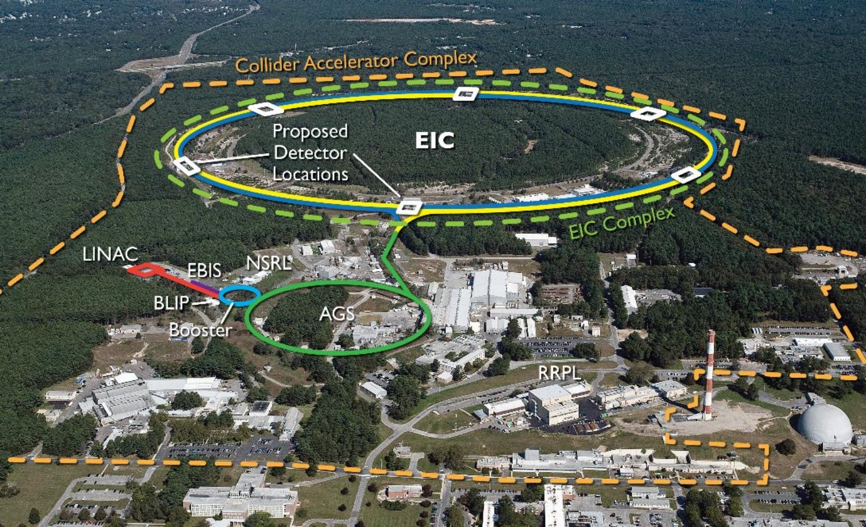
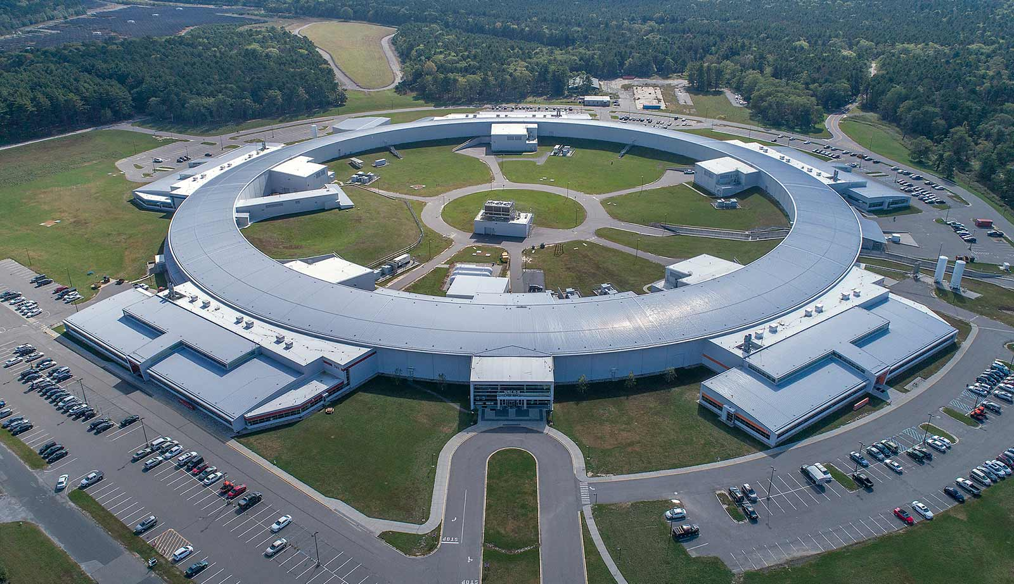
Scientific Research at BNL
Experiments
physics, biology, material science, energy, chemistry, instruments, quantum sciences, isotopes, etc.
World-class user facilities
1000s of users per year
100s of PB of scientific data
Big opportunities for automation, robotics, AI
Accelerating scientific discovery, but also more...

Slide 3
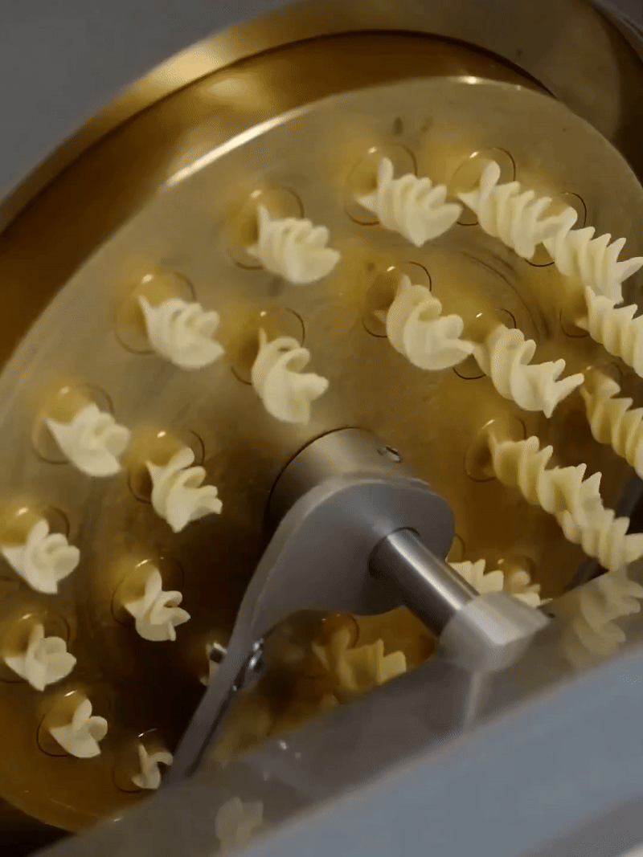
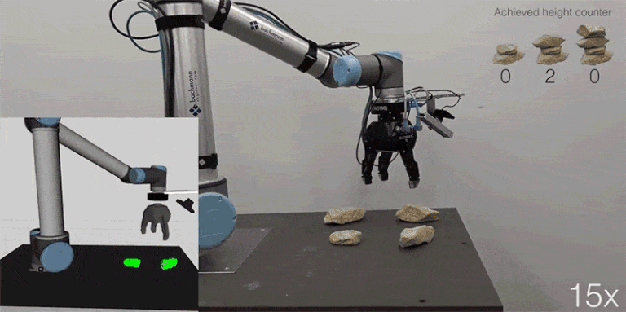
Automation & Robotics in plain language
Automation
We want to do something faster, for longer, and consistently
That "something" has to look pretty similar every time
Robotics (one way to think about it)
The thing we want to automate isn't the same every time
Or we want to automate more than one thing with the same machine
Re-programmable automation

Slide 4
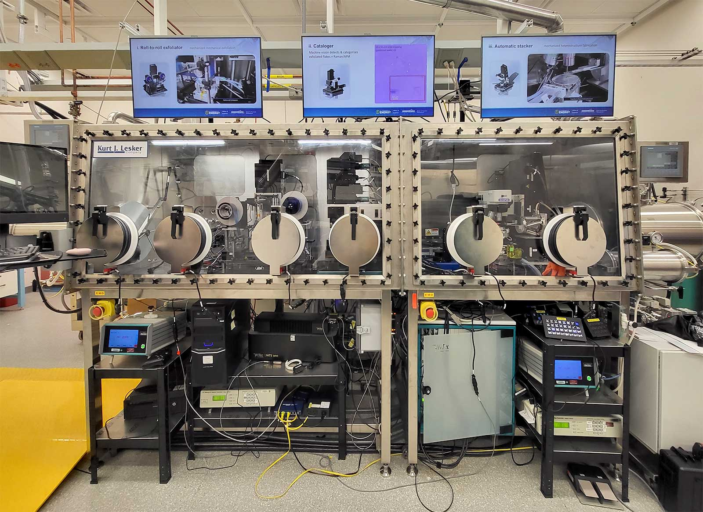
Automation & Robotics for scientific experiments
→ the facility is the robot
Instrument the experiment
Sensors, Actuators, Controllers, Interfaces
High investment, specialized
If you can't instrument your facility, turn to external robots
Also if you want to reuse the automation hardware/ investments

Slide 5
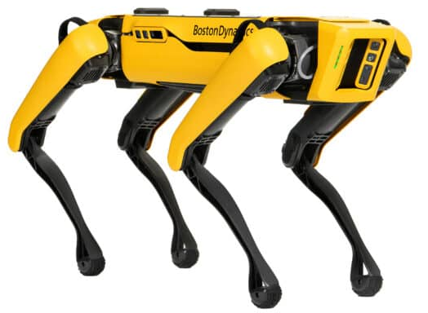
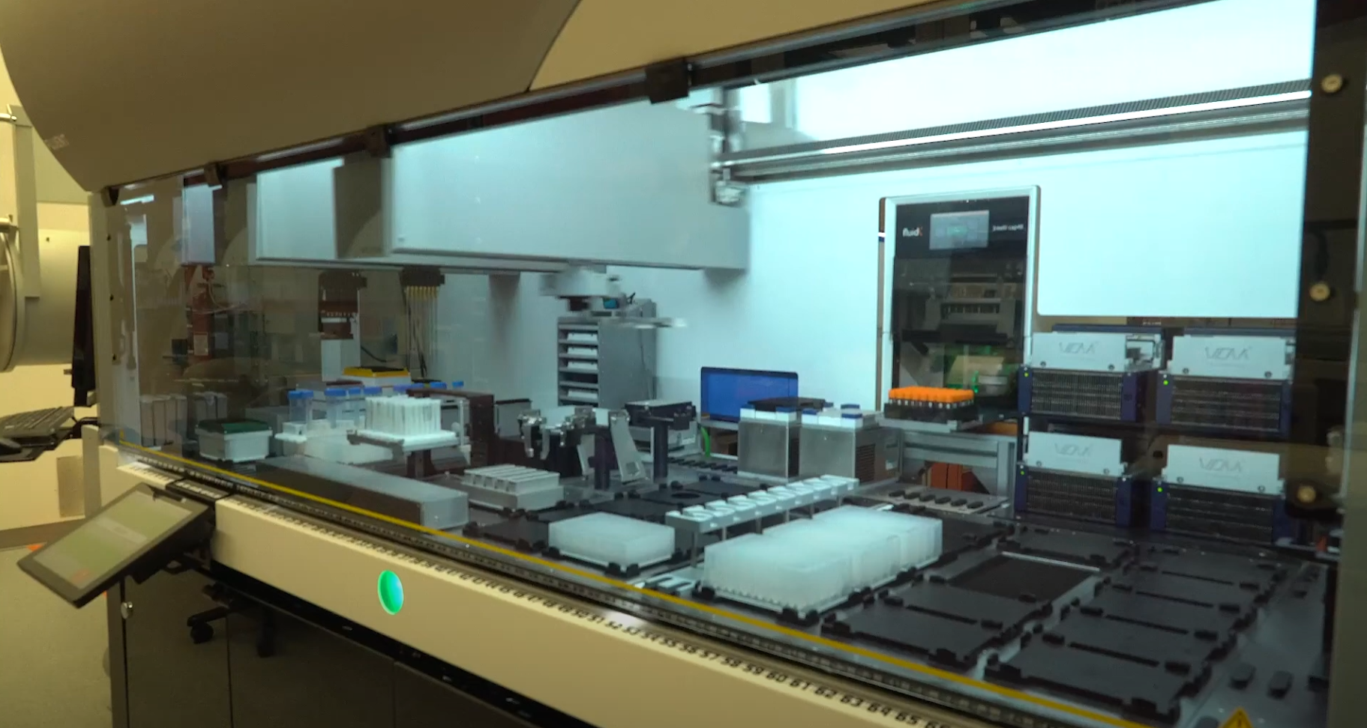
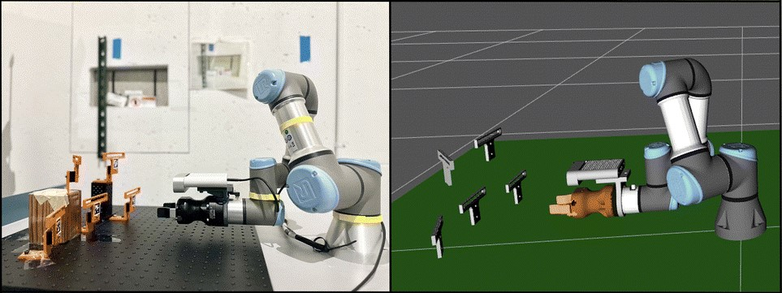
Automation & Robotics at BNL
~20 automation and robotics platforms are being used and studied by groups across the lab
Accelerate workflows
Improve cycle consistency
Mitigate hazards
Spot robot used for studying nuclear security applications at NN
Investigating robotic sample handling at NSLS-II
Automated Liquid Handing at CFN

Slide 6
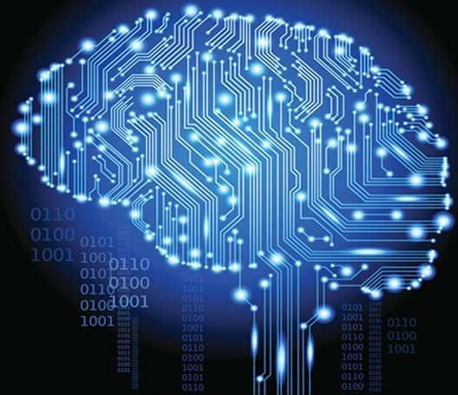
Where does AI fit in?
Science is not a factory, it's a workshop
Novelty is the point → automation needs to support dynamism
Closing experimental loops → multiple AI roles
Perception
Analysis & inference
Ideation/hypothesis generation
Simulation surrogates
Design & control of experiments
Inverse modeling
Data management, filtering, compression
...
Notes:
AI is used in science as parts of these experimental loop closures. It is used to accelerate discoveries, search solution spaces faster and broader, and the current promise of AI is that it will help answer questions and solve problems we CANNOT currently address.

Slide 7
AI research at BNL
AI Applications
Collaborations with all scientific directorates at BNL
AI Fundamentals
Less common among national labs
Quiz:
NeurIPS, ICLR, ICML, ACL, EMNLP, COLING, CVPR, ICCV, ECCV
Computer Science, AI as Sciences, not just technologies

Slide 8
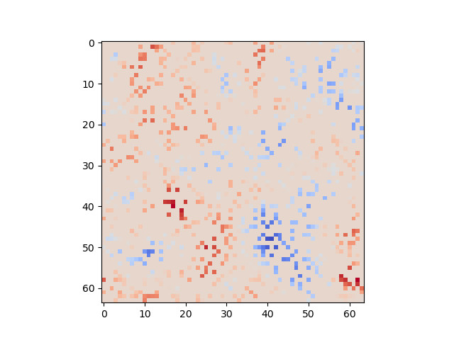
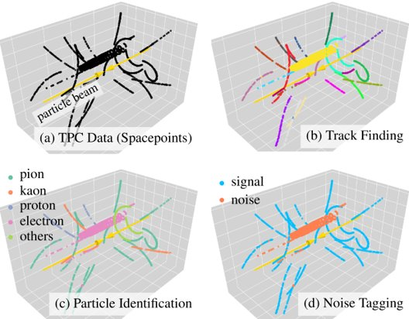
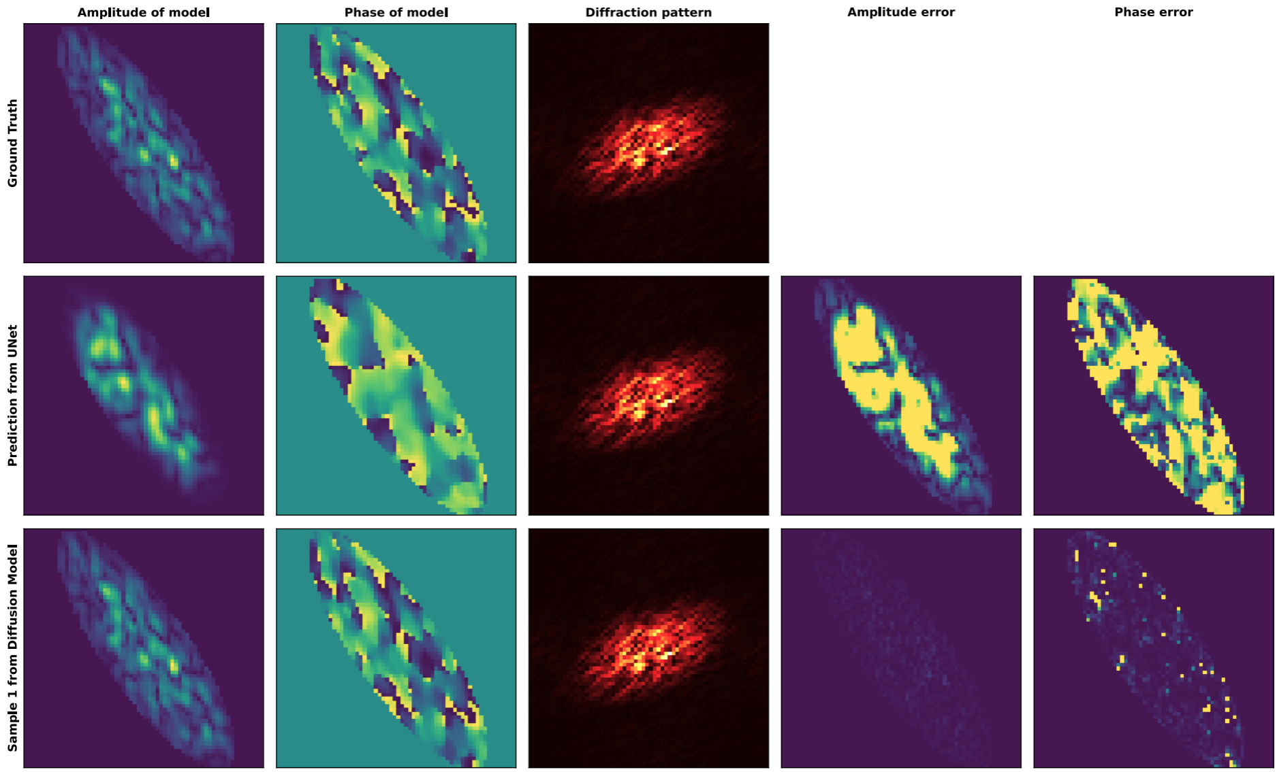
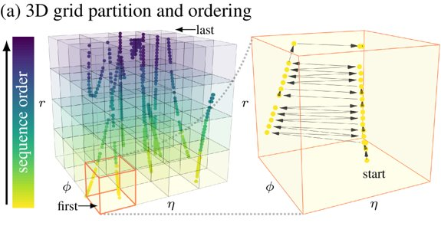
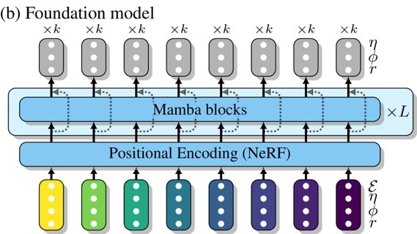
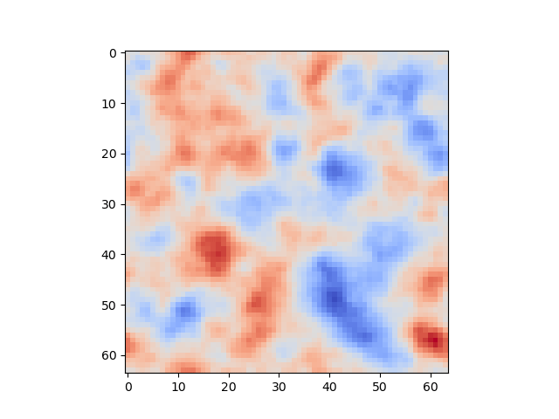
Designing AI for Unique Data Needs
Scientific Data
Massive datasets
Streaming analysis
Heterogenous, multi-source
Spatiotemporal, dynamic
High sparsity
Foundational developments, state of the art results
Novel algorithms and innovations in
Foundation model design
Training and optimization strategies
Physics integration
Experimental results
Outperform competing methods
Regularly publish in top AI conferences (NeurIPS, ICML, ICLR, AAAI, etc.)
Ground truth
UNet baseline
Ours
Particle collision tracks from RHIC (above), data transformations (above right), part of BNL's novel AI model design (right).
Robustly learning continuous scientific data with scalable conditional neural fields (left), physics-constrained diffusion models for x-ray coherent diffractive imaging (above).

Slide 9
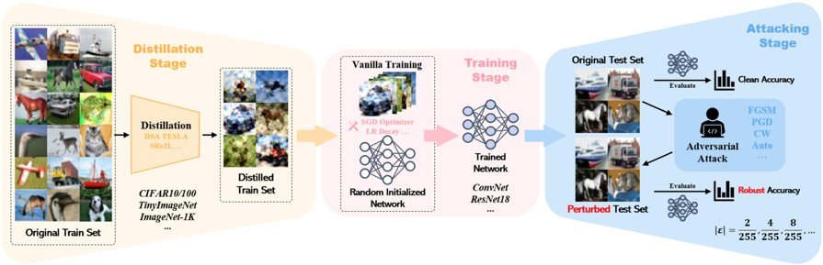
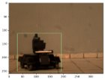
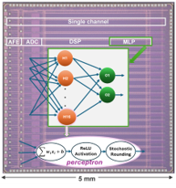
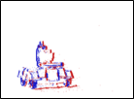
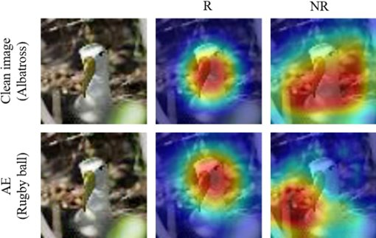
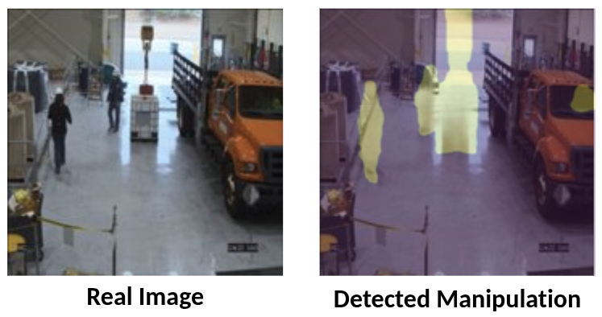
Bringing AI into the Real World
AI Co-design – identify and exploit synergies between hardware and algorithms
Dataflow architectures
Efficient edge inference
Designing algorithms and accelerators for future data needs
Novel sensors and data modalities
Trustworthy & Secure AI – address the vulnerabilities and limitations that impede AI uses for science, security
Robust adversarial defenses
Explainable AI
Data and model lifecycles
Embodied AI...
Benchmark design for evaluating dataset distillation vulnerability (above), learning features that are robust against adversarial attacks (below left), detecting data manipulation in the wild (below right).
AI model deployment on dataflow AI accelerator architecture (left), sparse pixel updates in event-based camera, requiring novel AI design (right).

Slide 10
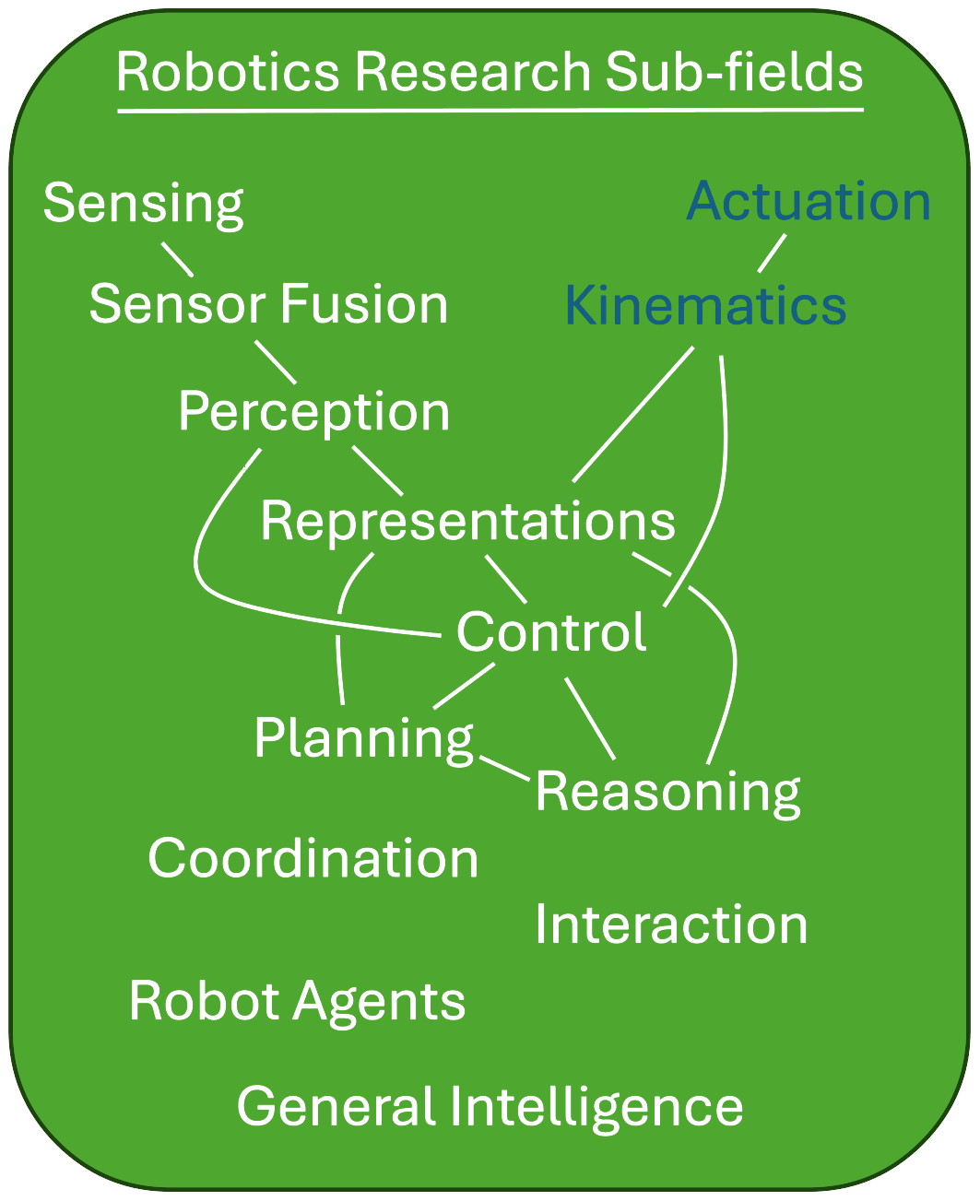
Robotics Research
Complex mixture of
Mechanical Engineering
Electrical Engineering
Computer Science
AI (CV, NLP, RL, etc)
Control Theory
Operations
Human factors
...

Slide 11
Why is AI exciting for Robotics now?
Foundation Models – AI models pretrained on massive data
Scaling laws
Generalization
Multi-modality
Emergent capabilities
AI Agents – intelligent programs that persist, and demonstrate reasoning and planning to pursue objectives
Taskability
Tool use
Memory
Interaction

Slide 12
Embodied AI
Physical extension of AI into an embodied, agentic form.
Agents that are situated in,
perceive, learn about,
respond to,
act upon, and affect the real world
multimodality
Embodiment
action, control, objectives

Slide 13

SEAL: The Scientific Embodied Agents Lab
Currently being established at BNL
Will investigate embodied AI for
accelerated scientific discovery
robust knowledge capture and transfer
experimental challenges not met by traditional automation
high dynamism in closed experimental loops
anomalies and maintenance affecting facility uptime
complex physical interactions

Slide 14
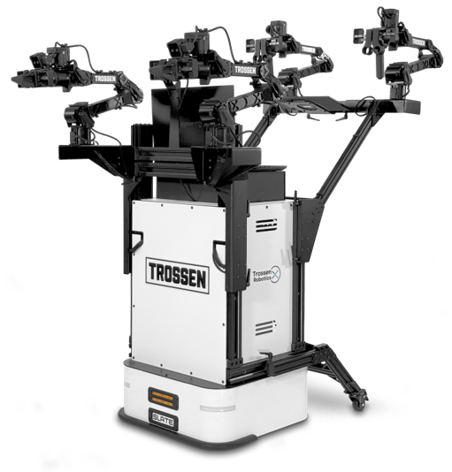
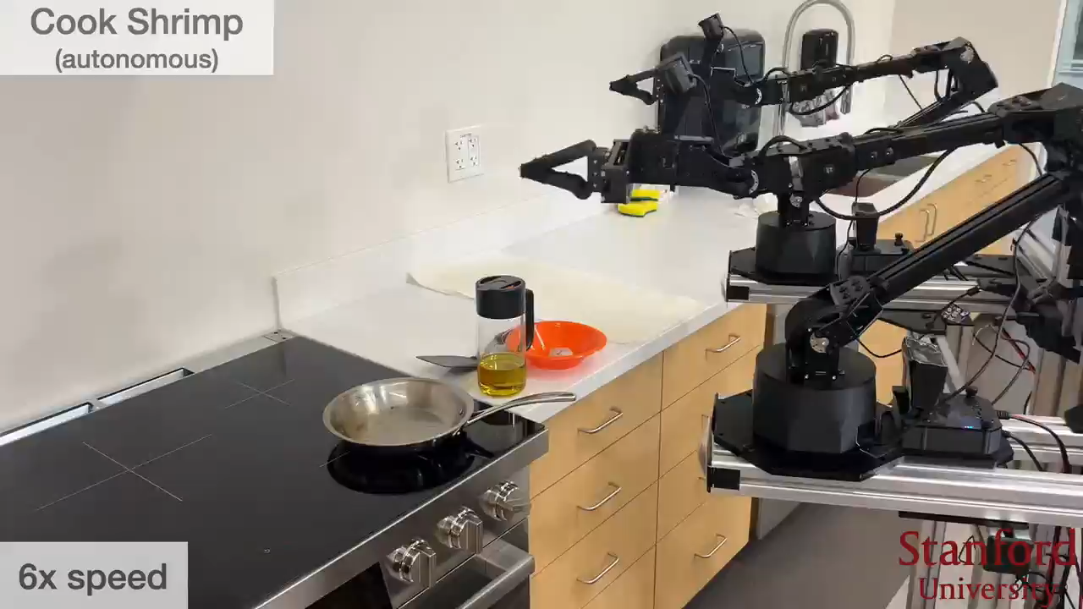
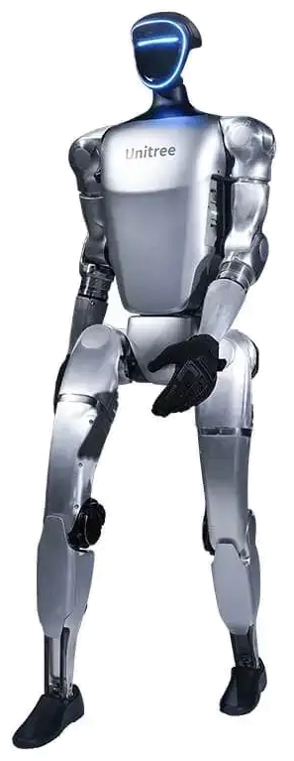
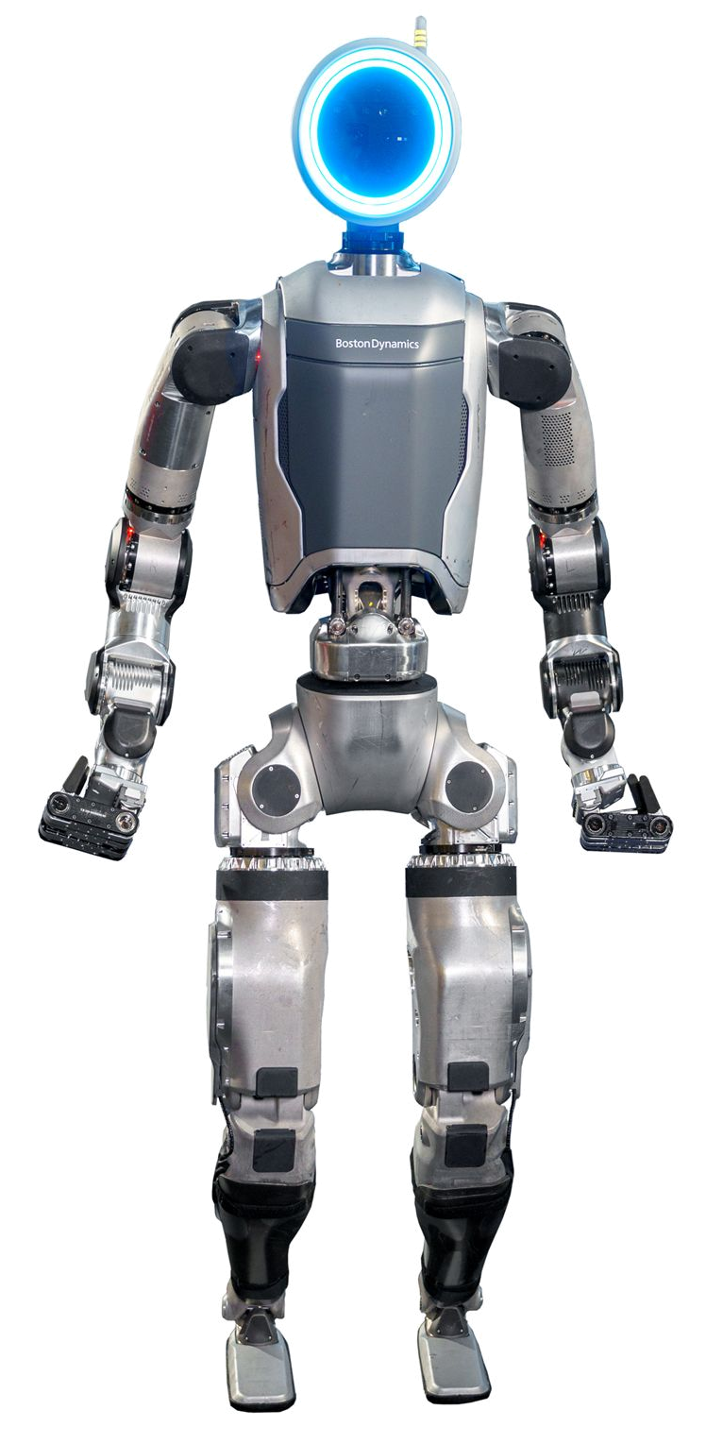
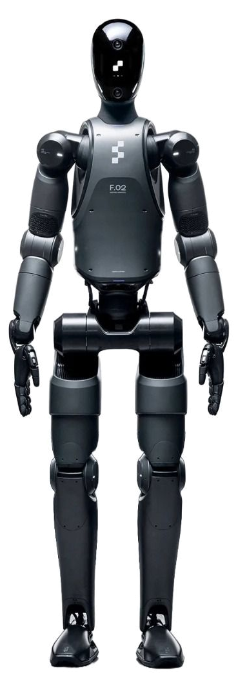
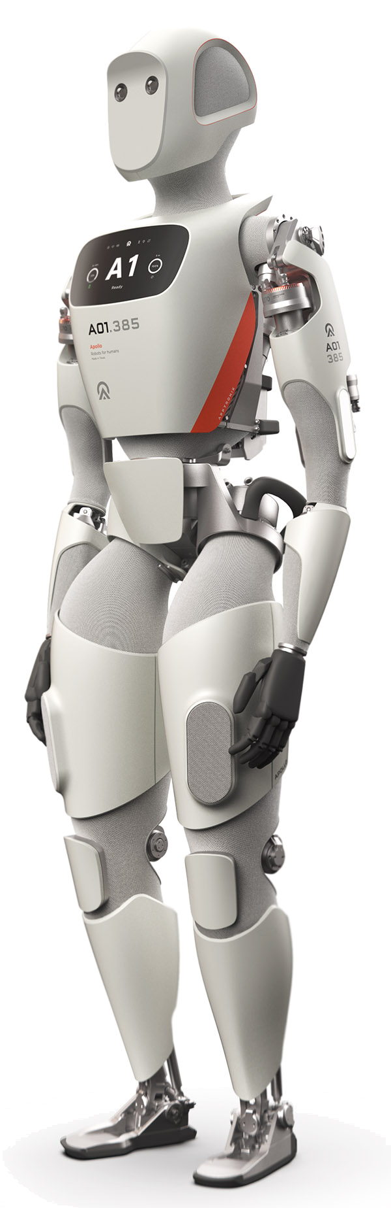
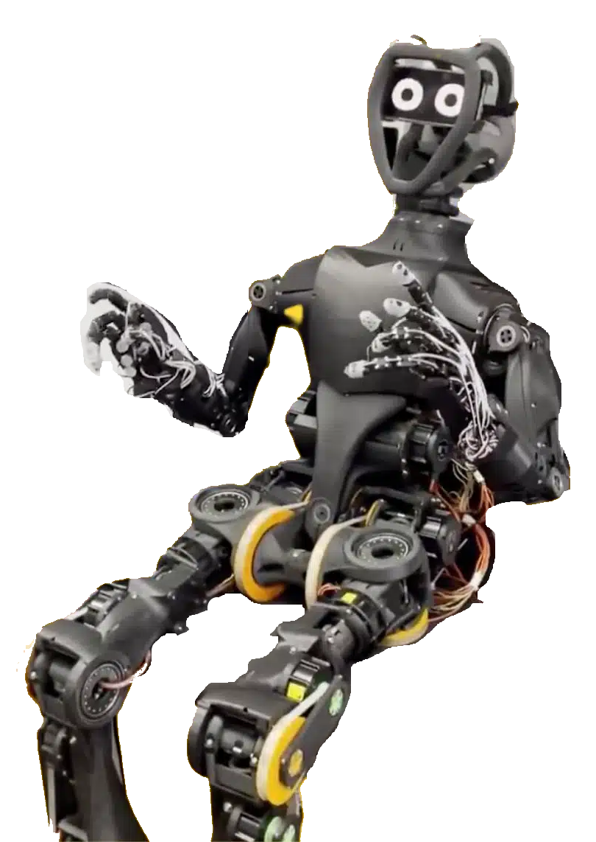
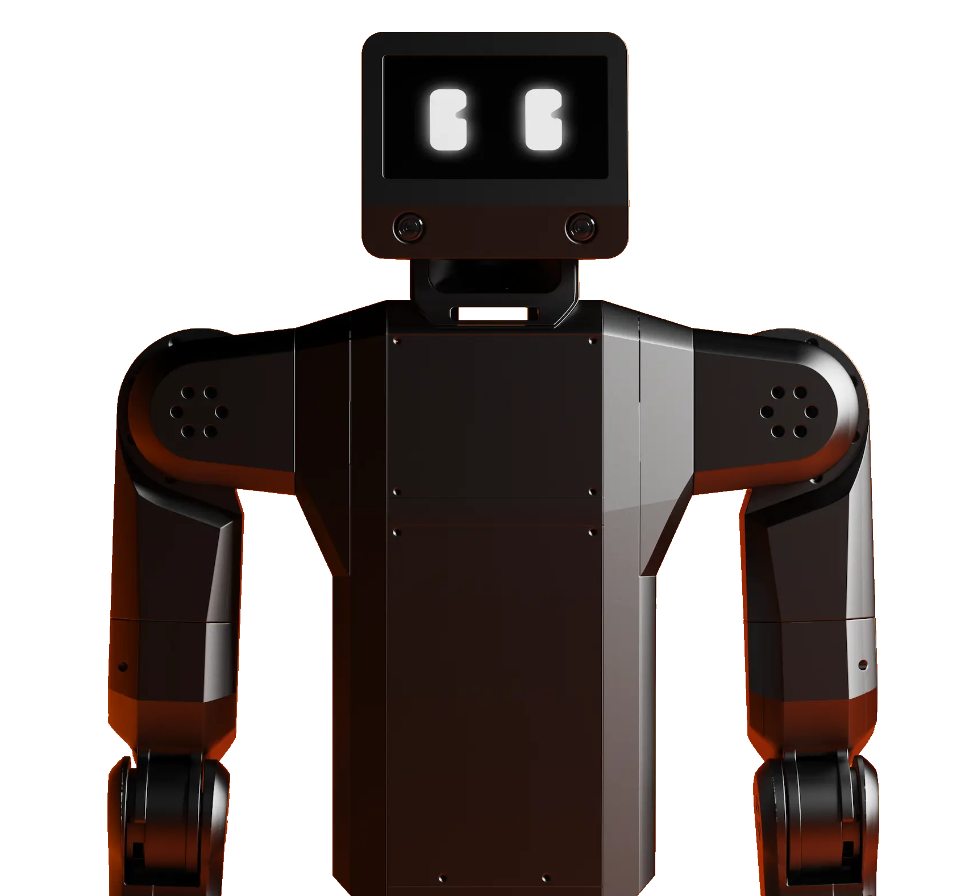
SEAL Robots
First robot – Trossen Mobile AI
mobile​
multiple dexterous actuators​
human-scale
based on ALOHA platform
Toward a full testbed
emphasis on humanoids and other complex, highly flexible platforms
study embodied AI challenges for science
Trossen Mobile AI
ALOHA Mobile research platform
Boston Dynamics Atlas
Hugging Face, The Robot Studio HopeJr
K-Scale Labs K-Bot
Apptronik Apollo
Figure AI Figure 02
Unitree G1 available through academic partners
Other robot platforms currently being explored

Slide 15
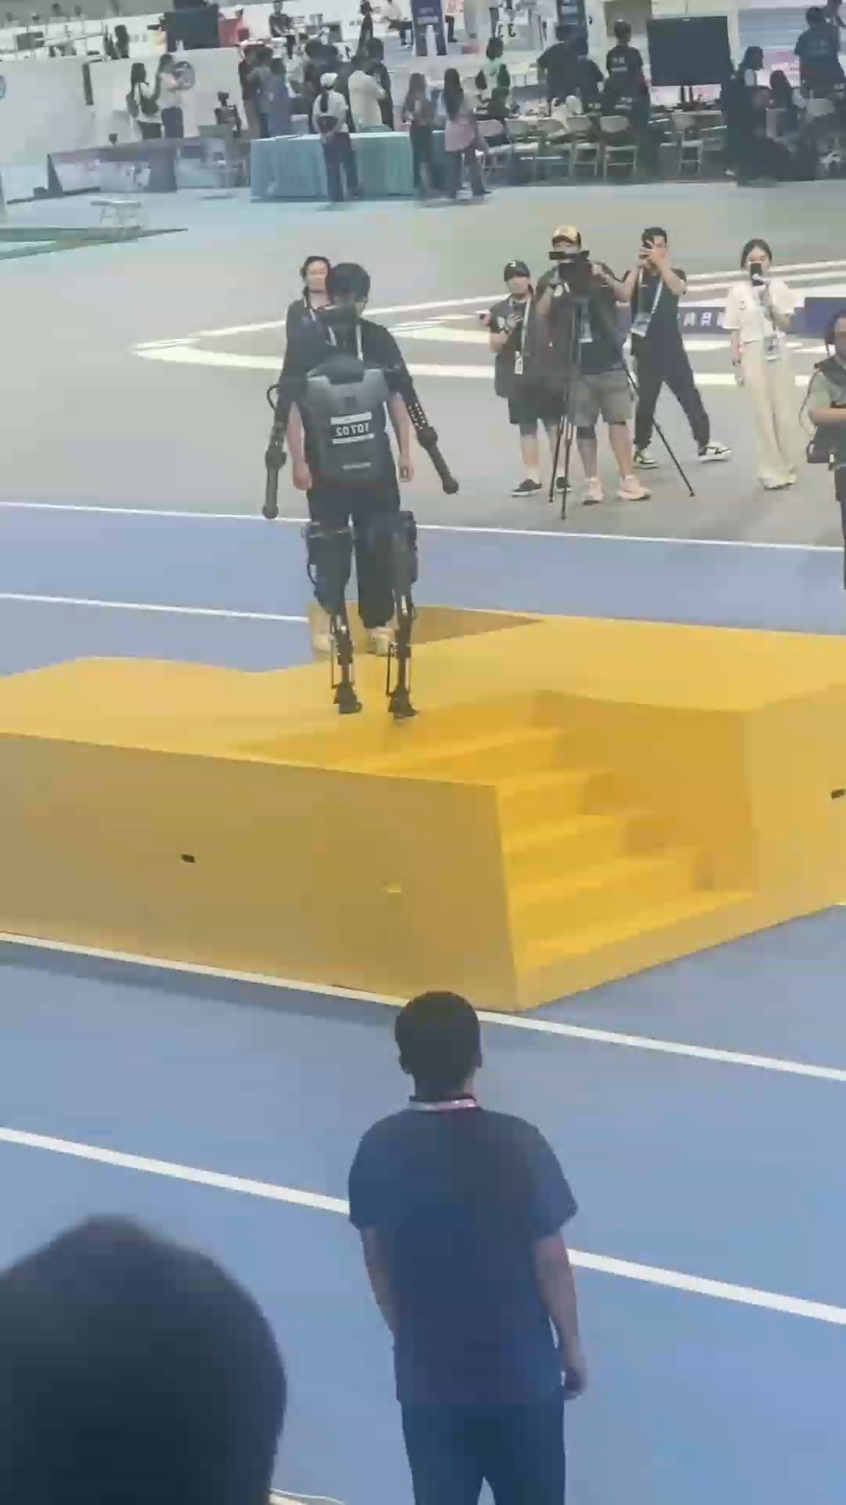
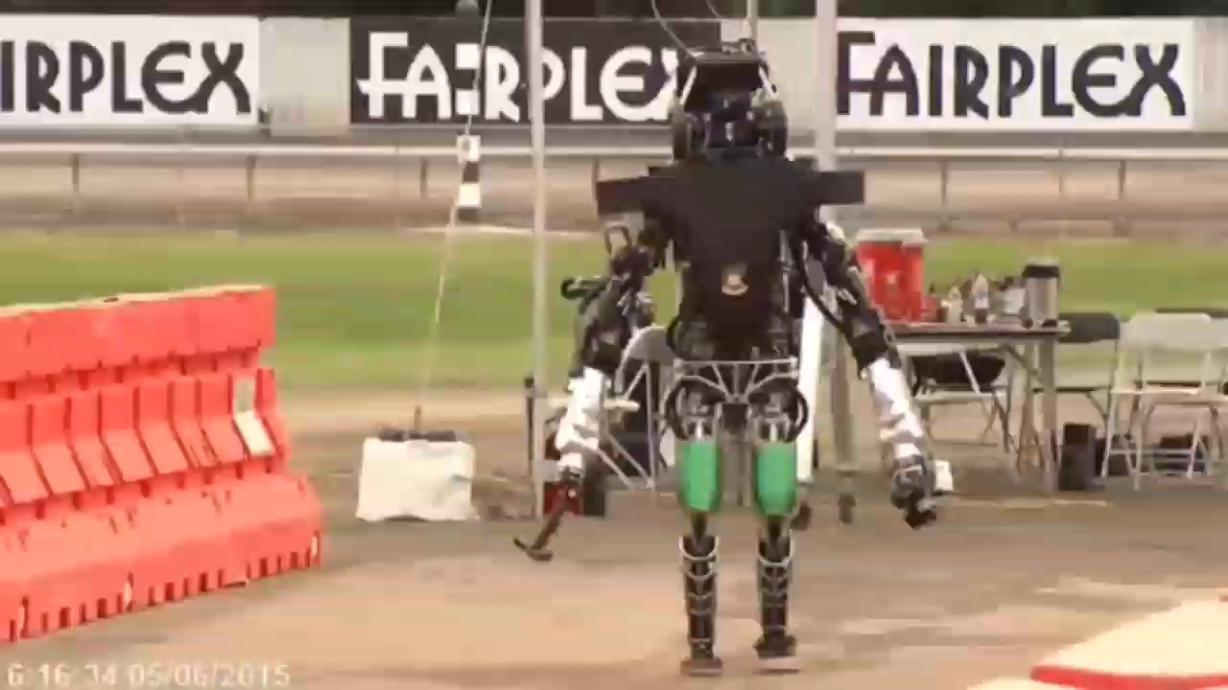
Humanoid Robots, then and now

Slide 16
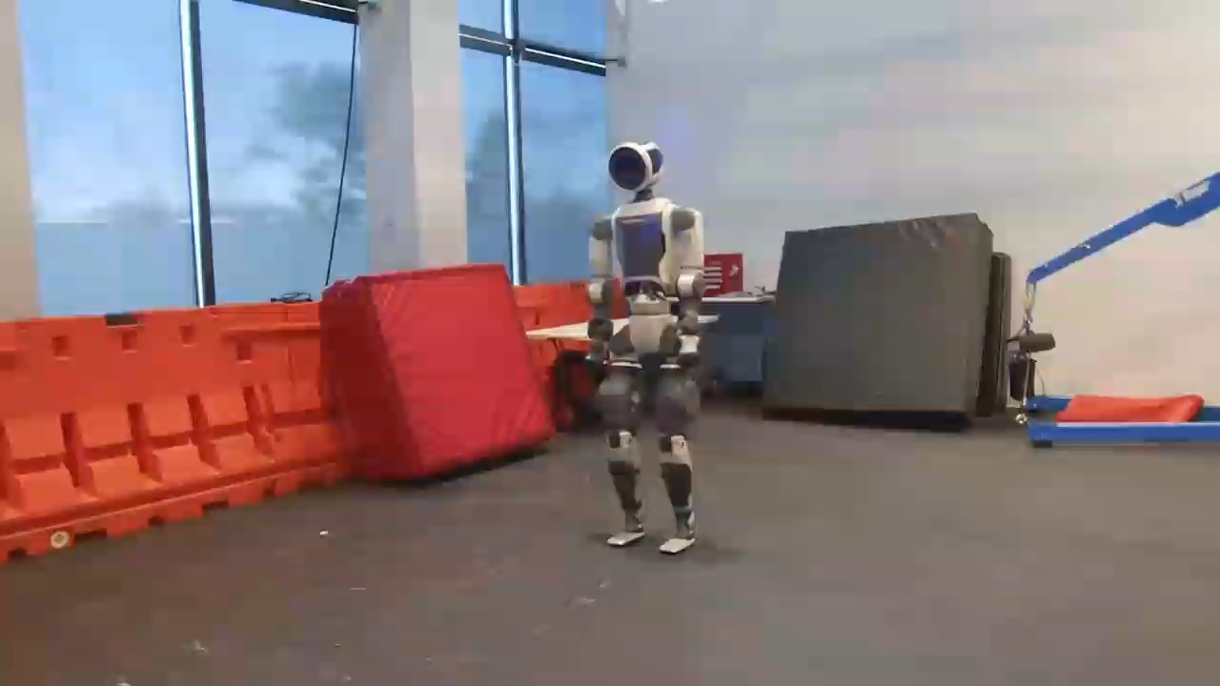
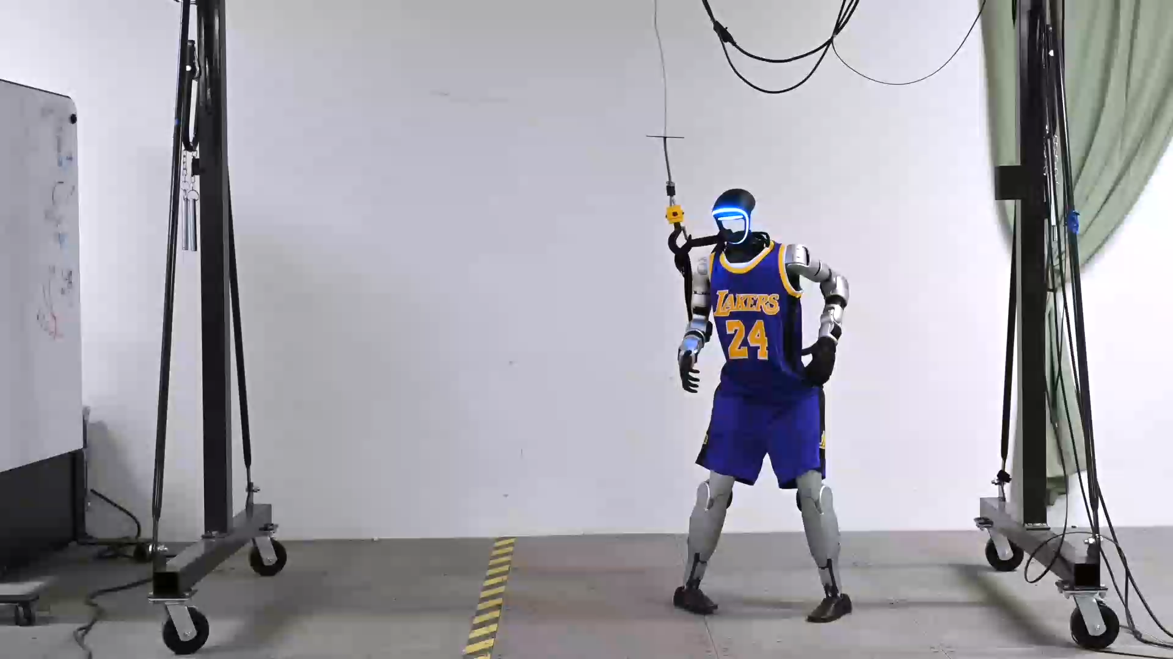
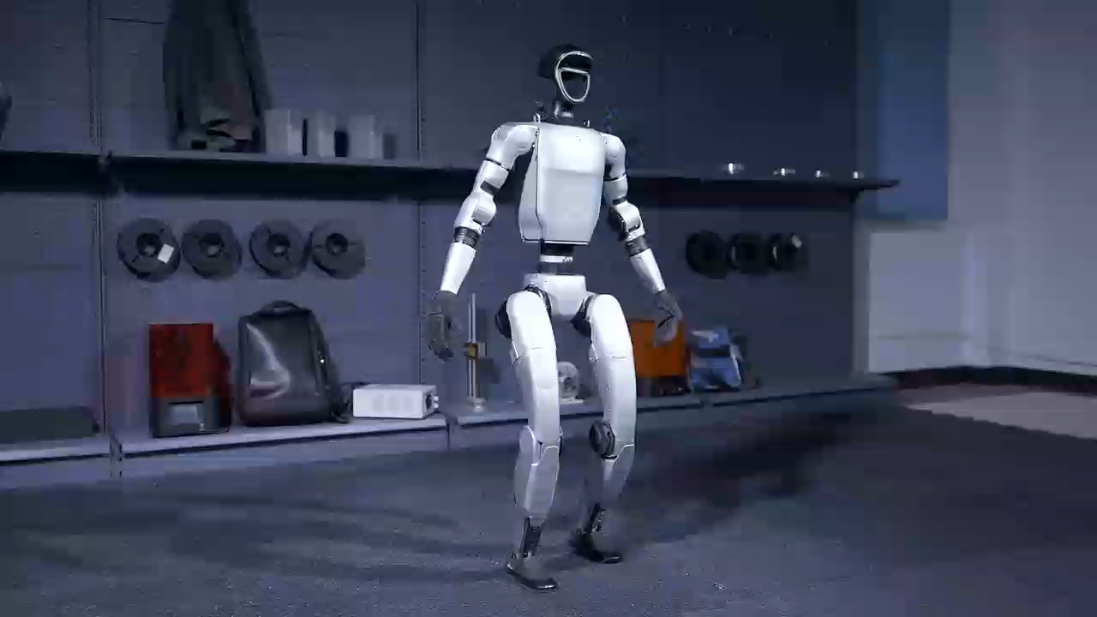
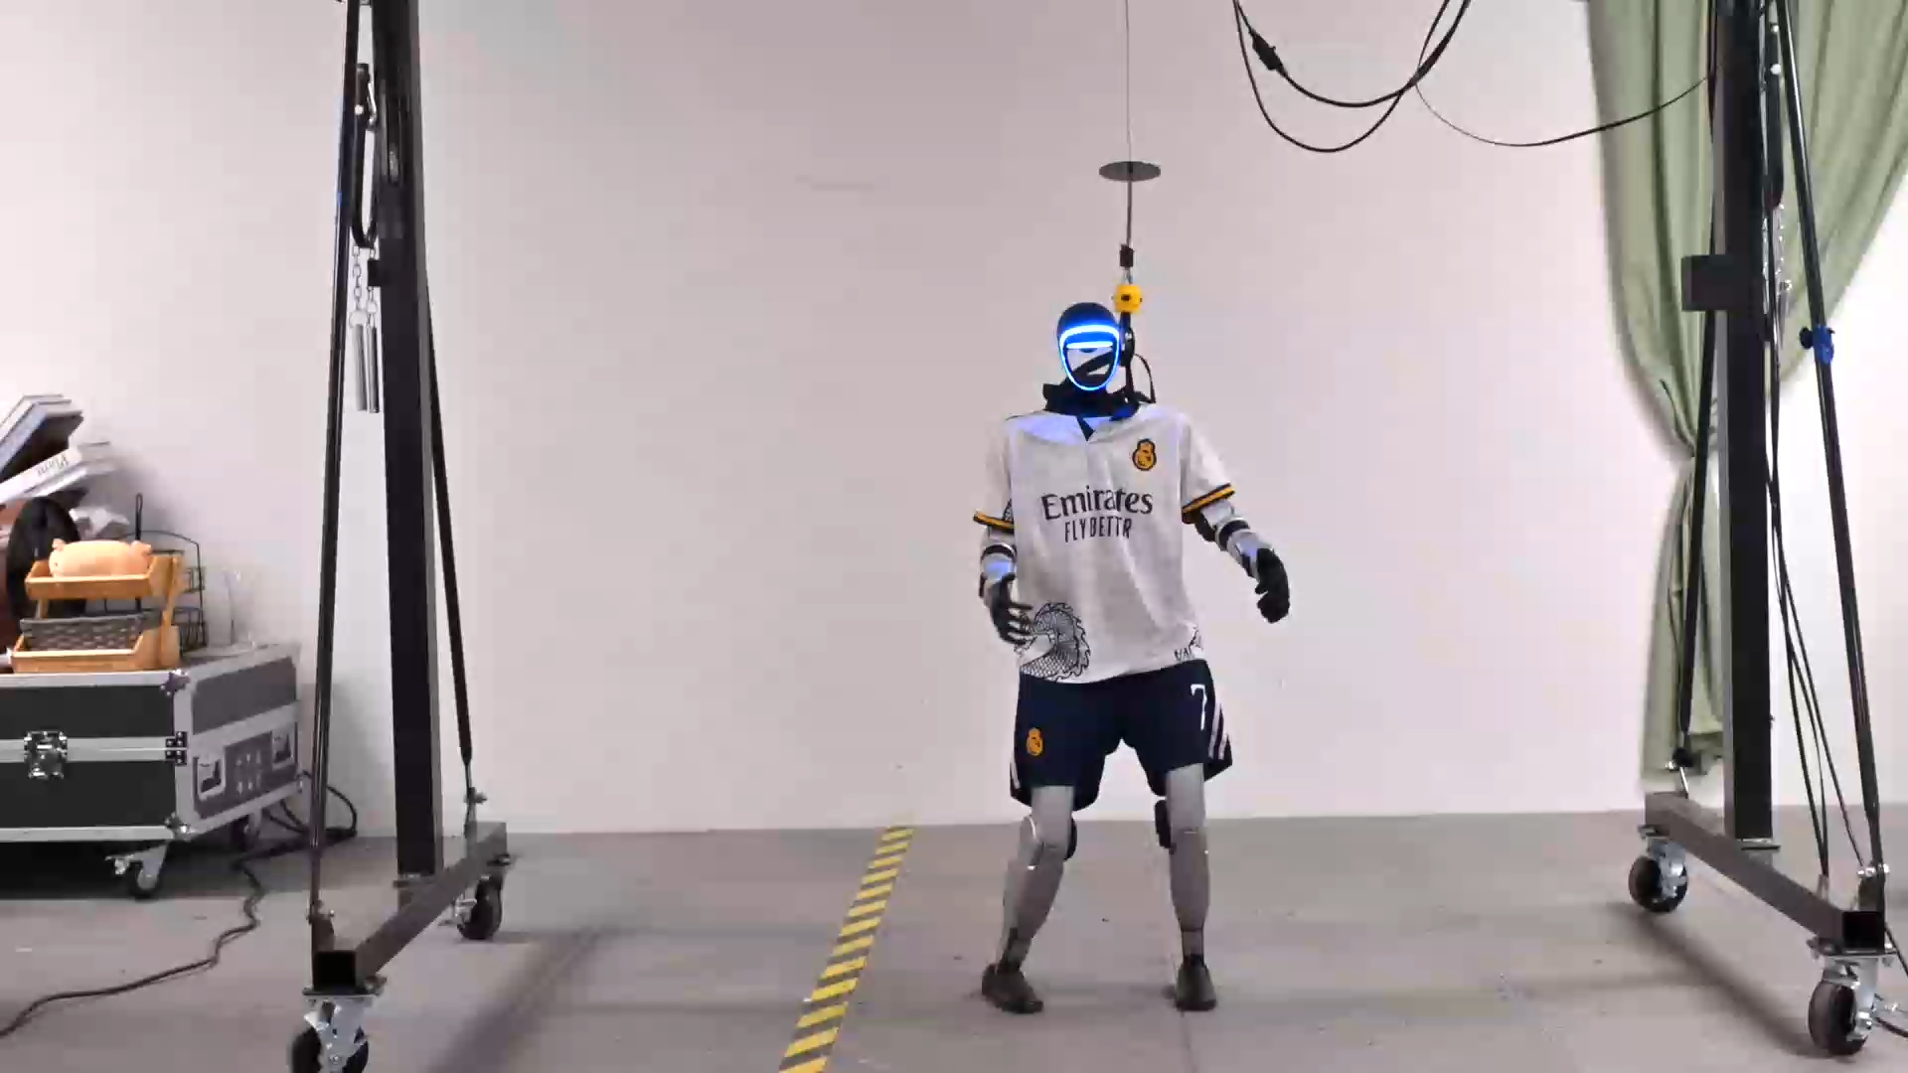
Humanoid robot, also now

Slide 17
SEAL Research
SEAL will focus on CS, AI research needed to make scientifically useful embodied AI a reality​
Generalizable robotic skills
Knowledge capture & transfer​
Constrained optimization​
Representations, control, planning​
Robust adaptation (sim to real)​
Fault detection & recovery​
→
AID's year one objective
Robot skill abstraction
Dexterous manipulation
Physical & sim training and eval
Domain relevance (RHIC)

Slide 18








Partnerships
SEAL is collaborating with academic and industry partners to execute on its vision

