Slide 1
Reinforcement Learning for Humanoid Locomotion in Isaac Lab with VR Evaluation
New York Scientific Data Summit 2025
Jasmin Lin, Wei (Celia) Xu
Artificial Intelligence Department, Computing and Data Sciences Directorate
Brookhaven National Laboratory
September 11, 2025
Notes:
Good afternoon everyone. My name is Jasmin Lin, and I’m excited to share with you my work at Brookhaven National Laboratory, alongside my mentor, Dr. Wei Xu. Our project looks into evaluating the baseline reinforcement learning algorithm to train policies in simulation with the support of virtual reality for evaluation.

Slide 2
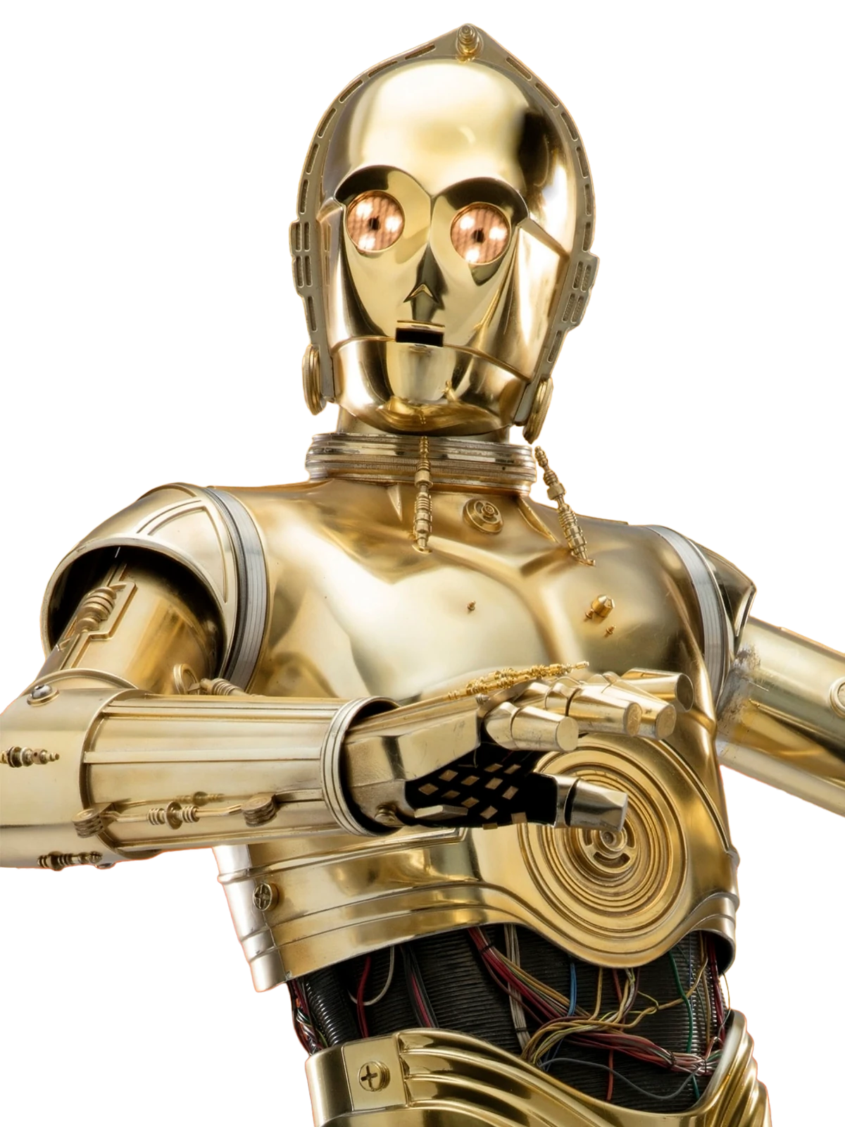
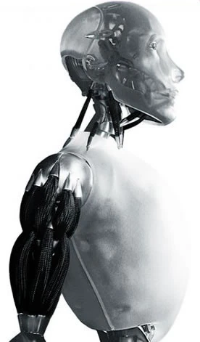
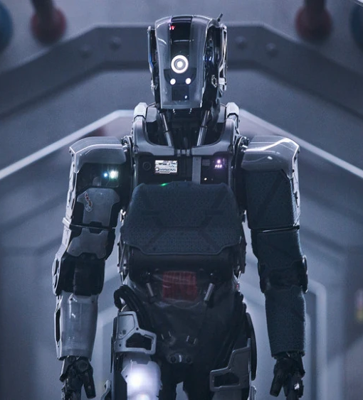
C-3PO from the Star Wars series [1].
Sonny from the I, Robot movie [2].
Mother, from the I am Mother movie [3].
Notes:
We’ve all seen those science-fiction movies where humanoid robots take over human roles, or over the world. You might recognize these characters on the screen. C-3PO from Star Wars, Sonny from I, Robot, and my personal favorite, Mother from I am Mother. Mother is a humanoid robot that plays the roles of a mother and mentor to a human girl. She can walk, talk, and almost think like a human. She’s just another fictional robot in a movie, but what if we could make her real?

Slide 3
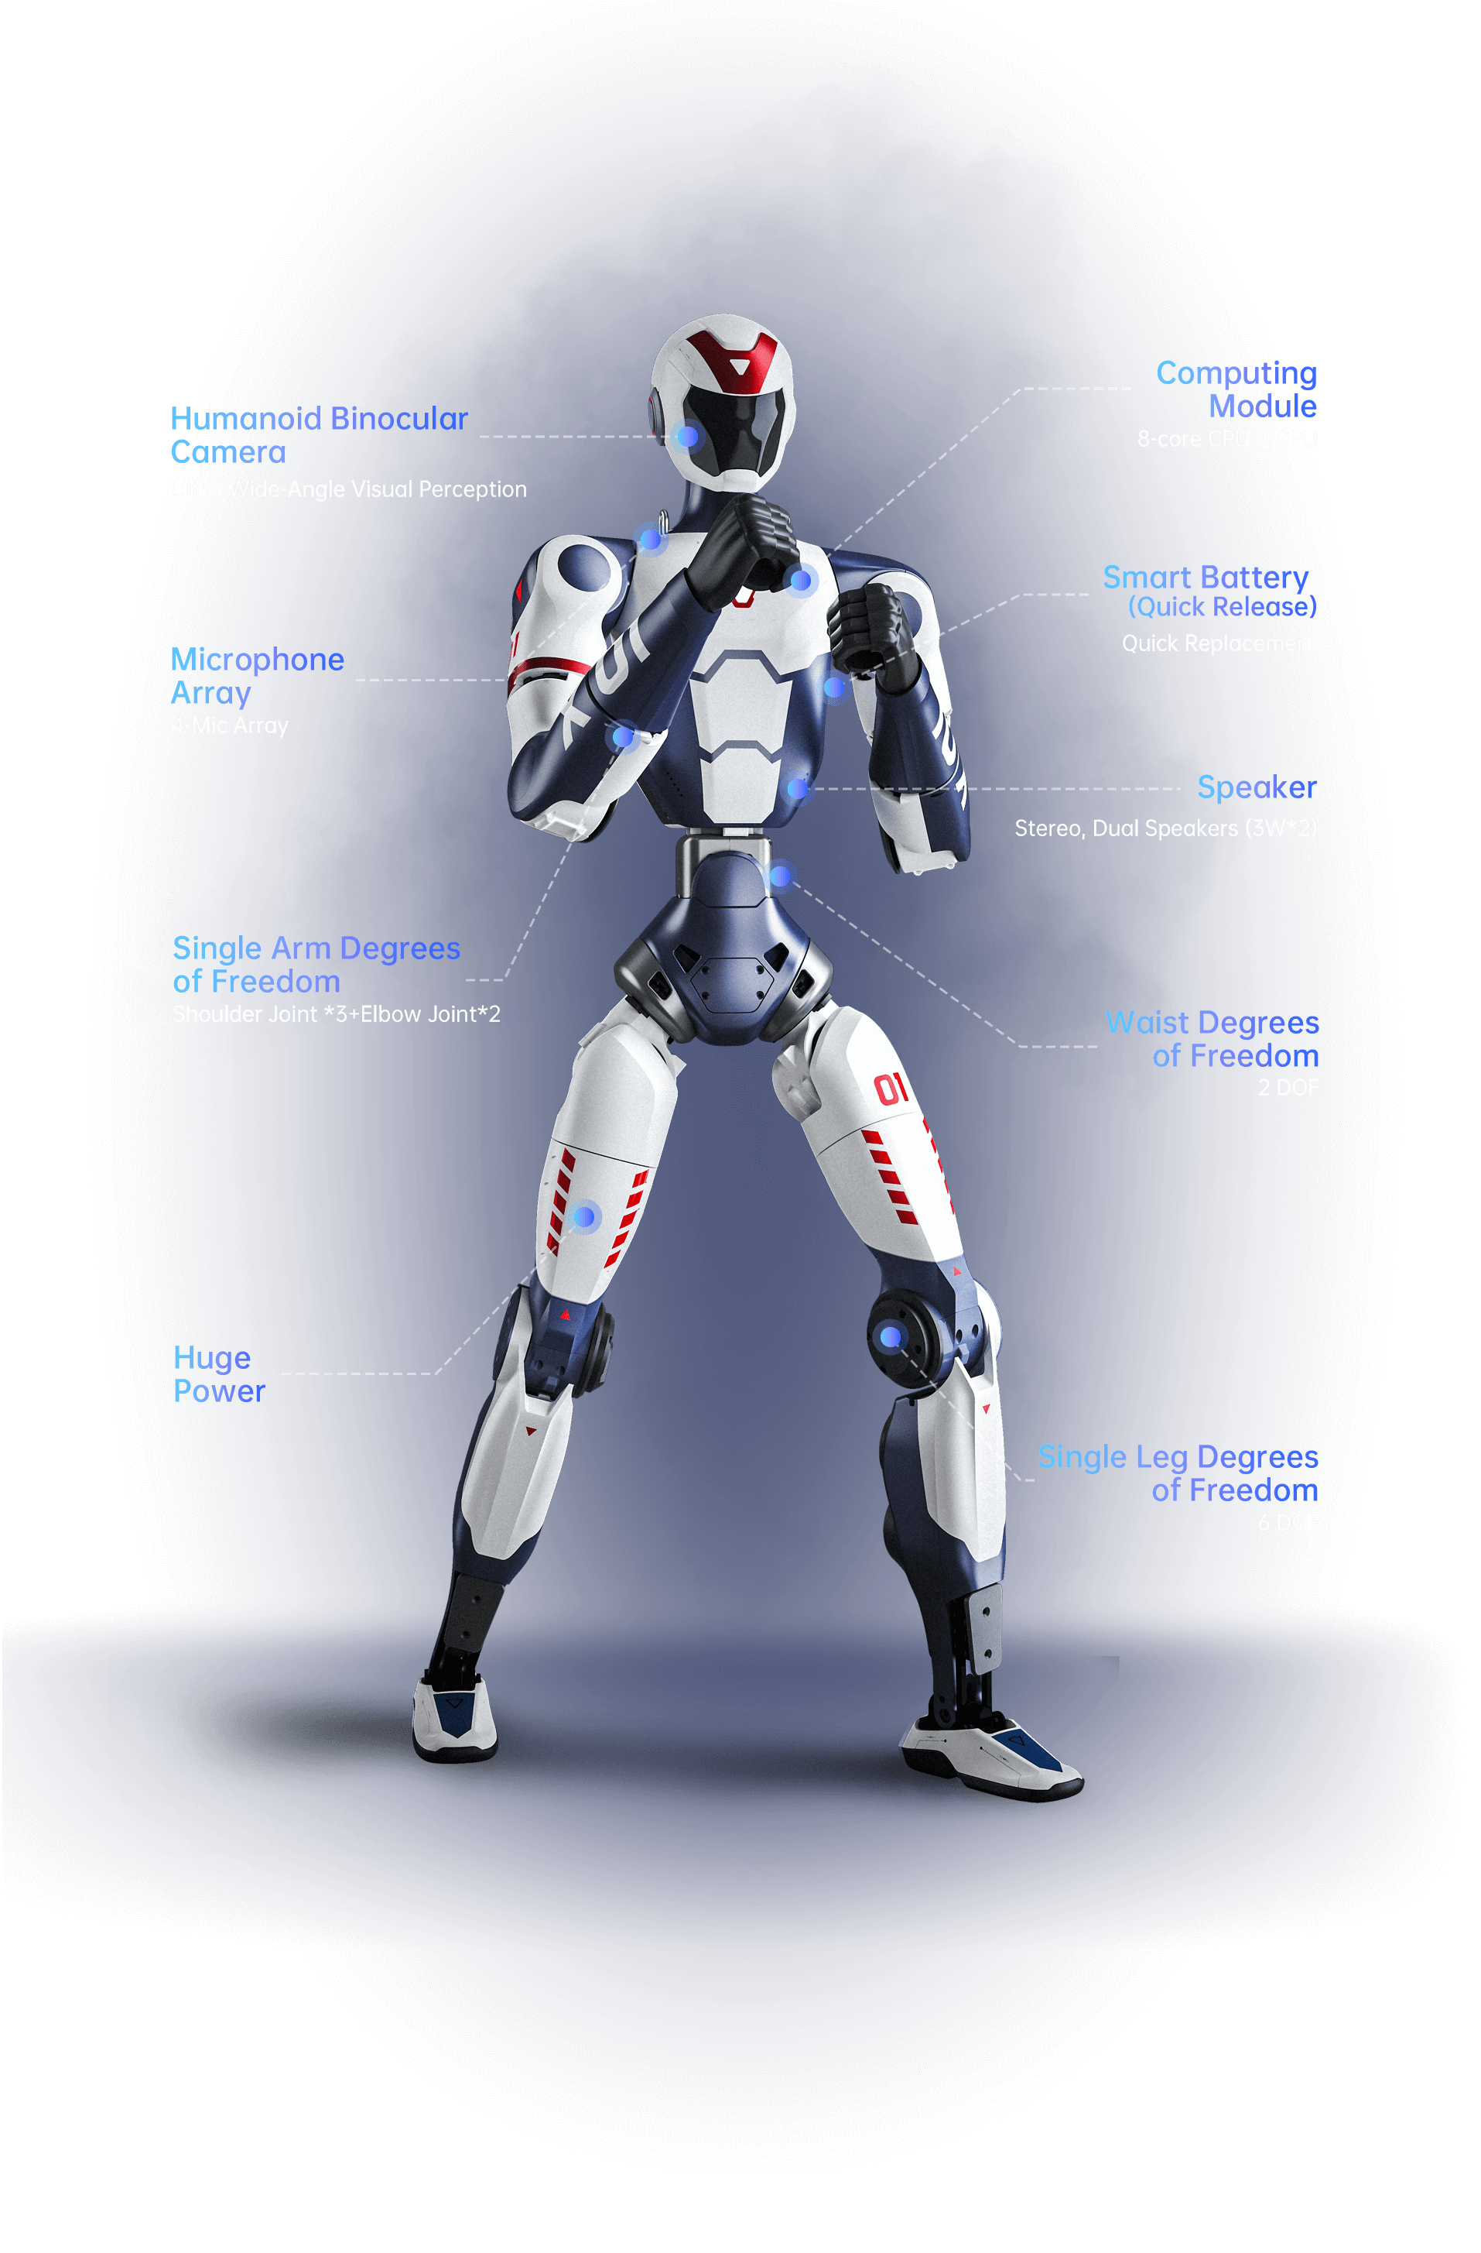
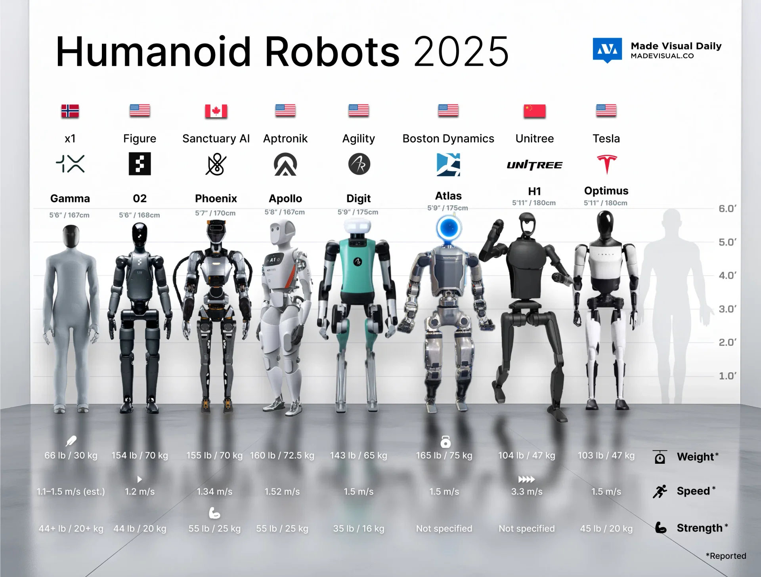
Why Humanoid Robots Need Robust Control Policies
Humanoids excel in human-centered environments without modifications.
assistive robots, industry, exploration.
Challenges arise: locomotion and balance require robust low-level control.
VLAs → strong in high-level reasoning, weak in low-level motor skills.
RL can provide stable, adaptable low-level control policies.
A portrayal of recent humanoid robots [4].
The new Unitree R1 robot [5].
Notes:
In our current human-centric world, humanoid robots are uniquely valuable because of their ability to operate alongside us without the need for majot modifications. To be useful, they require reliable control policies. Recently, vision-language-action models have made breakthroughs in high-level planning, but lack precise lower-level motor control. To this, we asked, “to what extent can reinforcement learning produce stable humanoid walking policies out-of-the-box? As new platforms like the Unitree R1 are released, the development of baseline locomotion policies becomes more important. I’m going to play a video, which some of you may have seen before.

Slide 4
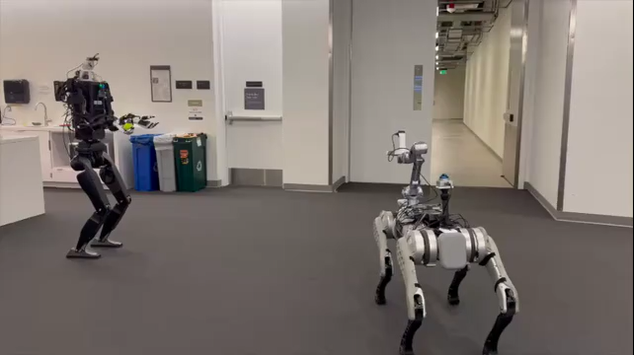
A video from the paper, “Mobile-TeleVision: Predictive Motion Priors for Humanoid Whole-Body Control”, depicting a humanoid robot tossing a ball to a quadruped [6].
Notes:
This work was done by some remarkable researchers at UC San Diego, MIT, and NVIDIA, who all came together with expertise in robotics, reinforcement learning, and simulation. The impressive part is how the robot can toss the ball while maintaining balance. My research builds on top of this by exploring reinforcement learning in locomotion, testing their capabilities, and finding ways to extend them for more complex tasks.

Slide 5
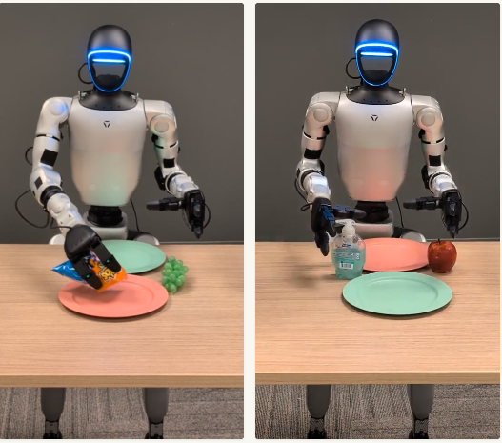
From High-Level Models to Low-Level Control Challenges
Vision-Language-Action models:
translate visual and language input into actions.
GR00T N1 (NVIDIA): dual-system design (System 2 = reasoning, System 1 = smooth action) [8].
OpenVLA: open-source 7B model, trained on 970k robot episodes [9].
Strengths: generalization, natural language grounding, task planning [7].
Weaknesses: rely on scripted policies, poor low-level control, lack physical grounding [7].
Screenshots from the paper, “GR00T N1.5: An Improved Open Foundation Model for Generalist Humanoid Robots,” showing the Unitree G1 robot performing tasks given GR00T-N1.5 instructions [8].
Notes:
Vision-language-action models aim to translate both visual and language input directly into action. For instance, NVIDIA’s GR00T-N1.5 has a dual-system architecture that mimics the human nervous system to produce actions in response to instruction. OpenVLA has been trained on over a million robot data to have increased understanding of tasks. Both models excel at generalization, understanding natural language, and planning multi-step tasks.

Slide 6
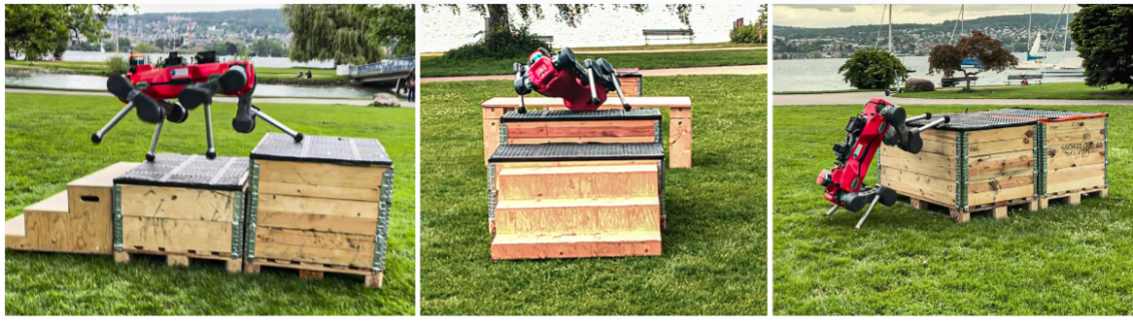
Reinforcement Learning for Low-level Control
Reinforcement Learning allows for the discovery of its own gait and strategies for movement.
ANYmal robot can perform complex maneuvers [10].
High-level RL navigation policy selects which locomotion skill to use based on terrain.
Adaptively responds to different obstacle heights, gaps, and layouts.
Eliminates need for hand-coded trajectories or pre-mapped paths.
Demonstrated real-world agility in complex parkour- like environments.
The ANYmal robot performing dexterous tasks, from the paper, “ANYmal Parkour: Learning Agile Navigation for Quadrupedal Robots” [10].
Notes:
Reinforcement learning takes trial-and-error to the next level, allowing robots to discover their own gait & movement strategies. A great example is the ANYmal robot, a quadruped whose reinforcement learning navigation policy adapts its locomotive behaviors to the environment. The robot is able to navigate through varying obstacles without relying on hand-coded trajectories or pre-mapped paths, demonstrating its versatility in the real-world. Unlike the ANYmal robot, humanoids have their own set of challenges and complexity due to their body shape. We study the baseline evaluation of reinforcement learning in humanoid robots to help us understand how well these methods translate to more challenging robots.

Slide 7


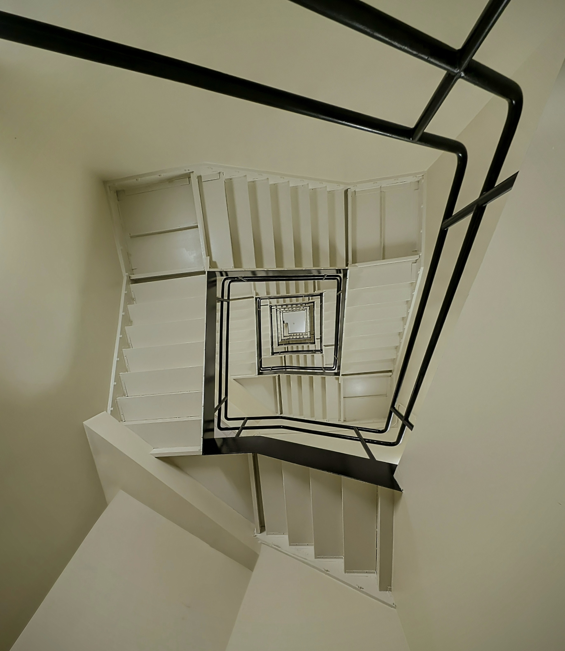
Stony Brook University.
Stony Brook Earth & Space Sciences building.
Fulton Center, Manhattan.
Notes:
One of the most common obstacles in our everyday lives are stairs. What may come easily to some of us is difficult for humanoid robots due to their need to determine varying stair height and translate it into leg raising, balancing, and stepping. To understand strair climbing in humanoids, we must first begin with something less complex—walking.

Slide 8
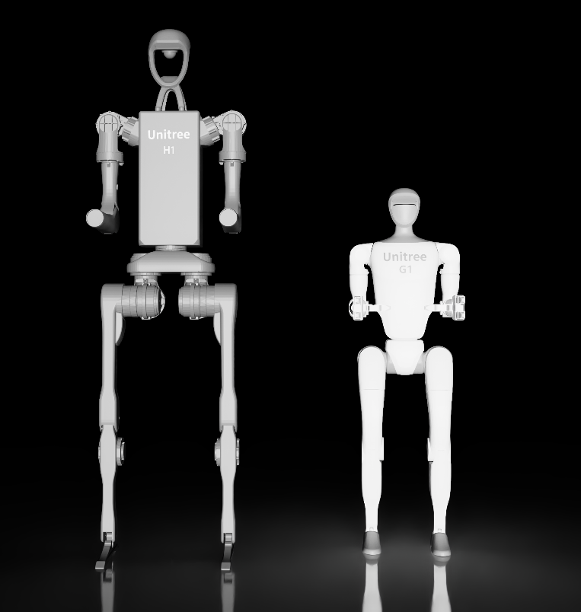
Experimental Design: PPO + VR
Benchmark RL’s baseline performance in humanoid locomotion.
Simulation is performed using NVIDIA Isaac Sim + Isaac Lab framework.
The RL library is skrl, with the Proximal Policy Optimization (PPO) algorithm [11].
Compare G1 and H1 under identical conditions.
Use VR for evaluation.
Virtual Reality was used via a Meta Quest Pro headset to assess gait, posture, and spatial realism.
Side-by-side comparison of the Unitree G1 and H1 models, imported via Omniverse Nucleus.
Notes:
First, we aim to benchmark the baseline performance of walking in humanoid locomotion by running simulations in NVIDIA Isaac Sim using the Isaac Lab framework & the skrl library, alongside the Proximal Policy algorithm. We compare Unitree G1 & H1 robots under identical conditions to understand how their designs affect stability. We bring in virtual reality evaluation via a Meta Quest Pro to allow us to step inside the robot’s world and observer gait, posture, and spatial realism up close. Altogether, we work to understand the limits and potential of reinforcement learning for complex robot behaviors so that future work can build on the foundations for more advanced interactions.

Slide 9
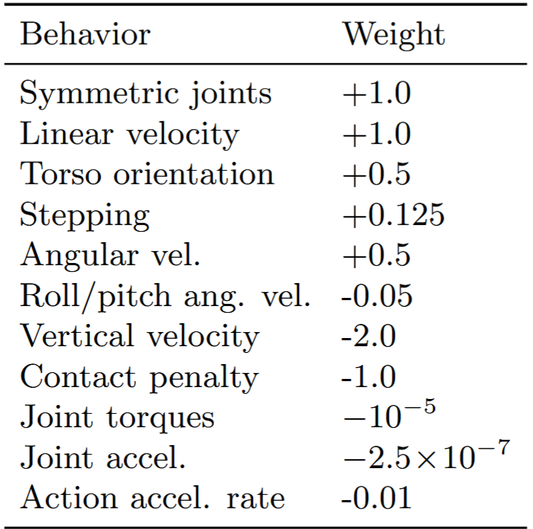
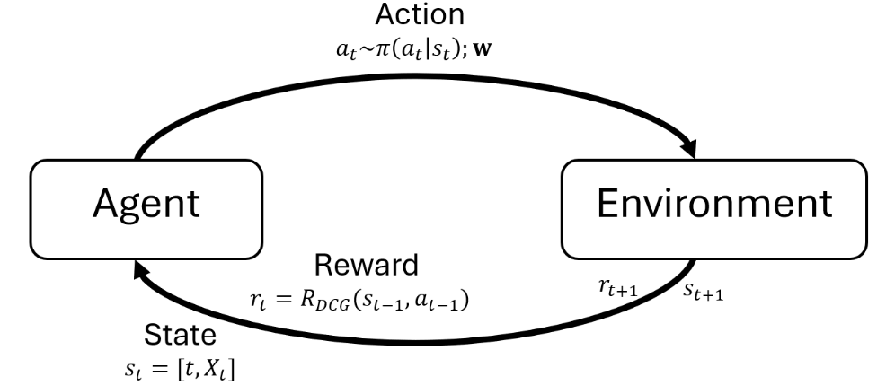
Robot Environment Setup and Training Pipeline
The observation space included joint angles, velocities, foot contact, IMU.
The action space included joint angles, torques, positions.
This environment setup enabled reinforcement learning to explore and optimize locomotion behaviors.
Markov Decision Process (MDP) was used:
Observations + Rewards → Policy Updates [12].
Penalties were applied for destabilizing behaviors.
Rewards were issued for stable locomotion.
Table displaying reward metrics.
Relationship between agent and environment in MDP, adopted from “Reinforcement learning to rank with markov decision process” [12].
Notes:
We added minor adjustments to the algorithm, such as rewards for joint symmetry and correct torso orientation to promote proper human-like locomotive behaviors. The observation space for both robots included joint angles, velocities, foot contacts, and Intertial Measurement Unit readings. The action space allowed for the control of joint angles, torques, and positions, so robots could experiment with movement. Penalties and rewards were the driving force for achieving stable locomotion.

Slide 10
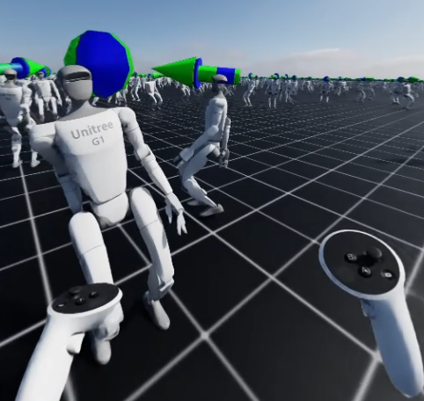
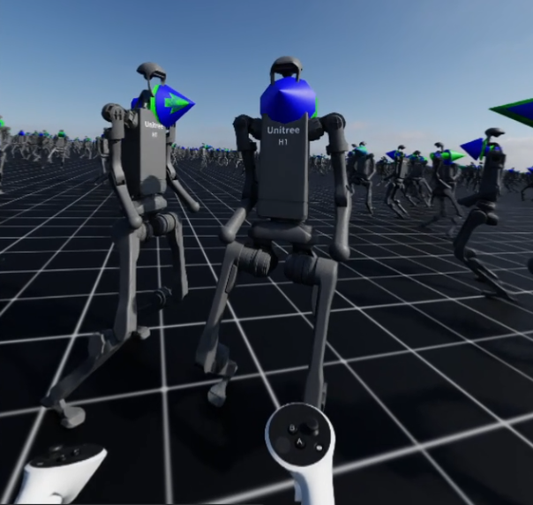
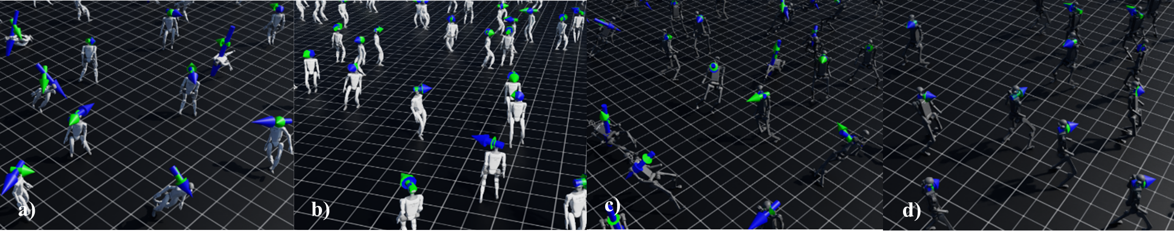
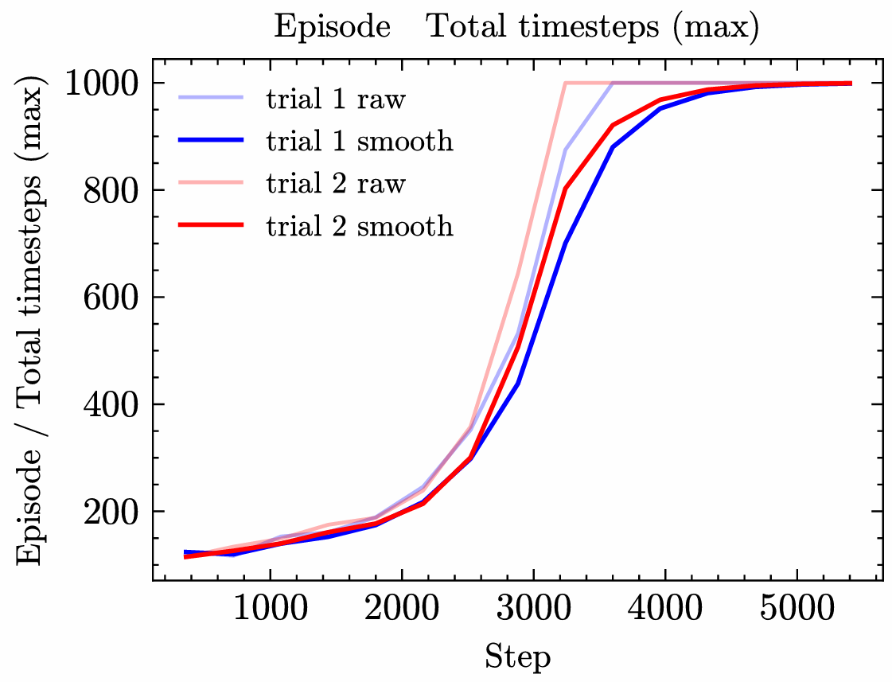
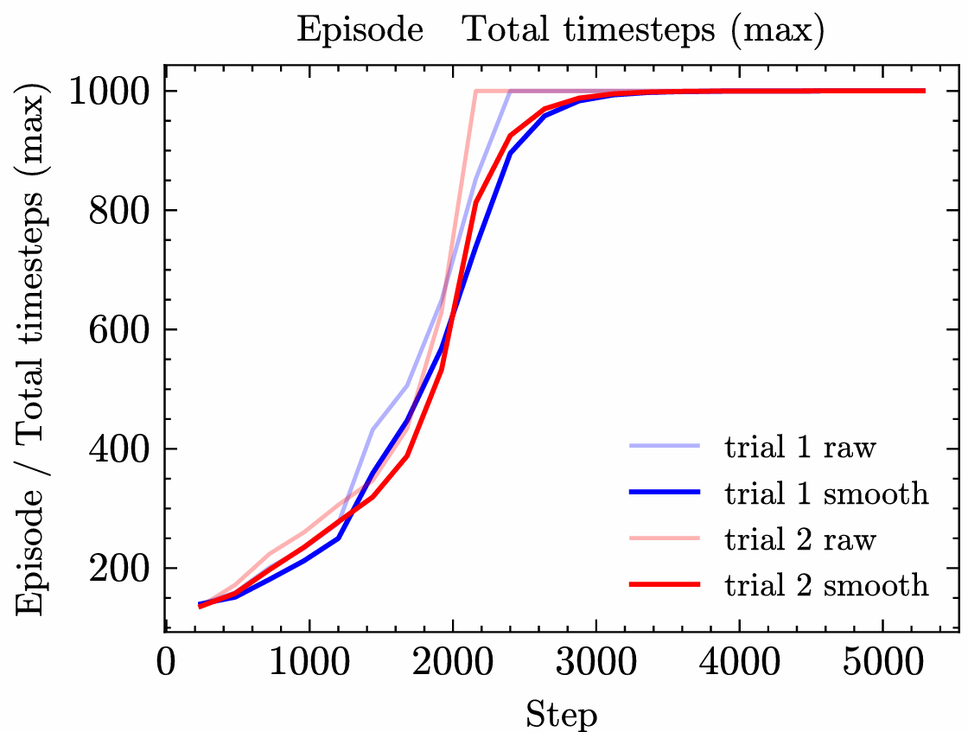
Learned Behaviors in Humanoid Navigation
Beginning of training:
Loss of balance, erratic limb motion, frequent falling.
G1 robot training:
~3,420 steps
Alternating bipedal stepping
H1 robot training:
~2,250 steps
Smoother stepping, improved posture
Point-of-view of the user when immersed in the environment via VR (above).
Training curves for the Unitree robots: G1 (left) and H1 (right).
Training of Unitree: G1 after (a) 100, (b) 3,420, and H1 after (c) 100, (d) 2,250 steps
Notes:
We found that the initial behaviors of the robots were erratic and unstable, reflective of typical reinforcement learning behavior. By approximately step 3, 420, the G1 robot was exhibiting stable alternating bipedal stepping. The H1 robot achieved this sooner, at approximately 2, 250 steps, with smoother stepping and improved posture. This significant difference may be attributed to the difference in shape & height of the robots, as well as the H1 robot having higher degrees-of-freedom.

Slide 11
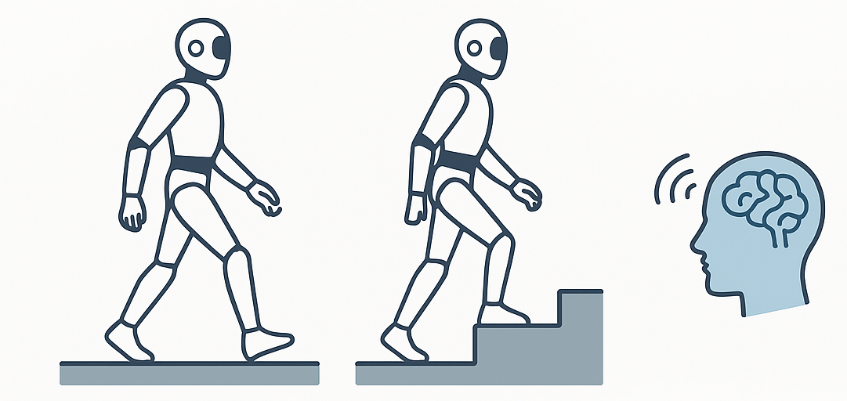
Advancing Humanoid Autonomy with RL
Extend framework to variable terrains for robust locomotion
Apply curriculum learning for more stable policy development
Explore upper-limb coordination to improve walking efficiency
Enable real-time adaptability in dynamic environments
Deploy on physical robots to assess real-world performance
Integrate with Vision-Language-Action (VLA) models to combine:
High-level planning
Low-level motor control
Image generated with assistance from AI (ChatGPT).
Notes:
Looking forward, we plant to extend this framework to variable terrains, apply curriculum learning for more stable policy development, and explore upper-limb coordination in tandem with walking efficiency. We aim to bridge the sim-to-real gap to improve real-time adaptability in dynamic environments and deploy the policies on physical robots. Finally, integration with vision-language-action models can unify high-level planning with low-level motor control, advancing humanoid autonomy and embodied intelligence.

Slide 12

Acknowledgements
This project was supported in part by the U.S. Department of Energy, Office of Science, Office of Workforce Development & Science Education (WDSE) under the Science Undergraduate Laboratory Internships Program (SULI).
I would like to extend my gratitude to my mentor, Wei (Celia) Xu, for allowing me the opportunity to work alongside her on the project. I would also like to thank the Computing and Data Sciences Directorate for its resources and staff.
12

Slide 13
Citations
[1] Image of C-3PO, Wookieepedia, Fandom, [Online]. Available: https://starwars.fandom.com/wiki/C-3PO
[2] Sonny, I, Robot Wiki, Fandom. https://irobot.fandom.com/wiki/Sonny
[3] Mother, Villains Wiki, Fandom. https://villains.fandom.com/wiki/Mother_(I_Am_Mother)
[4] “The Current Generation of Humanoid Robots (2025).” VoronoiApp (Visual Capitalist), 15 Apr. 2025, https://www.voronoiapp.com/technology/The-Current-Generation-of-Humanoid-Robots-2025-4656.
[5] Unitree Robotics. (n.d.). R1 Robot. Retrieved September 4, 2025, from https://www.unitree.com/R1
[6] Lu, C., Cheng, X., Li, J., Yang, S., Ji, M., Yuan, C., Yang, G., Yi, S., & Wang, X. (2024). Mobile-TeleVision: Predictive Motion Priors for Humanoid Whole-Body Control. arXiv preprint arXiv:2412.07773.
[7] R. Sapkota, Y. Cao, K. I. Roumeliotis, and M. Karkee, Vision-language-action models: Concepts, progress, applications and challenges, 2025, https://arxiv.org/abs/2505.04769. arXiv preprint arXiv:2505.04769.
[8] NVIDIA, Gr00t n1.5: An improved open foundation model for generalist humanoid robots, 2025, https: //research.nvidia.com/labs/gear/gr00t-n1_5/
[9] M. J. Kim, K. Pertsch, S. Karamcheti, T. Xiao, A. Balakrishna, S. Nair, R. Rafailov, E. Foster, G. Lam, P. Sanketi, Q. Vuong, T. Kollar, B. Burchfiel, R. Tedrake, D. Sadigh, S. Levine, P. Liang, and C. Finn, Openvla: An open-source vision-language-action model, 2024, https://arxiv.org/abs/2406.09246. arXiv preprint arXiv:2406.09246.
[10] J. Hwangbo, J. Lee, A. Dosovitskiy, D. Bellicoso, V. Tsounis, V. Koltun, and M. Hutter, Learning agile and dynamic motor skills for legged robots, Science Robotics, 4 (2019), https://doi. org/10.1126/scirobotics.aau5872.
[11] A. Serrano-Mu˜ noz, N. Arana-Arexolaleiba, D. Chrysostomou, and S. Bøgh, skrl: Modu lar and flexible library for reinforcement learning, 2022, https://arxiv.org/abs/2202.03825. arXiv preprint arXiv:2202.03825.
[12] Z. Wei, J. Xu, Y. Lan, J. Guo, and X. Cheng, Reinforcement learning to rank with markov decision process, in Proceedings of the 40th International ACM SIGIR Conference on Research and Development in Information Retrieval (SIGIR ’17), ACM, 2017, pp. 945–948, https://doi.org/10.1145/3077136. 3080685

Slide 14
Thank you!
NYSDS 2025

