Slide 1

Neural Network Memory Criticality: from Echo-State to HiPPO and Beyond
Authors: Evan Coats and Lav Varshney

Slide 2
Outline
Inspiration
Background: Recurrence and Lyapunov Exponent
Defining Memory Criticality
Echo-State Property and Criticality
Vanishing Gradients and LSTM solution
HiPPO generalizes and preserves criticality
Conclusion and Future Work
Acknowledgements

Slide 3
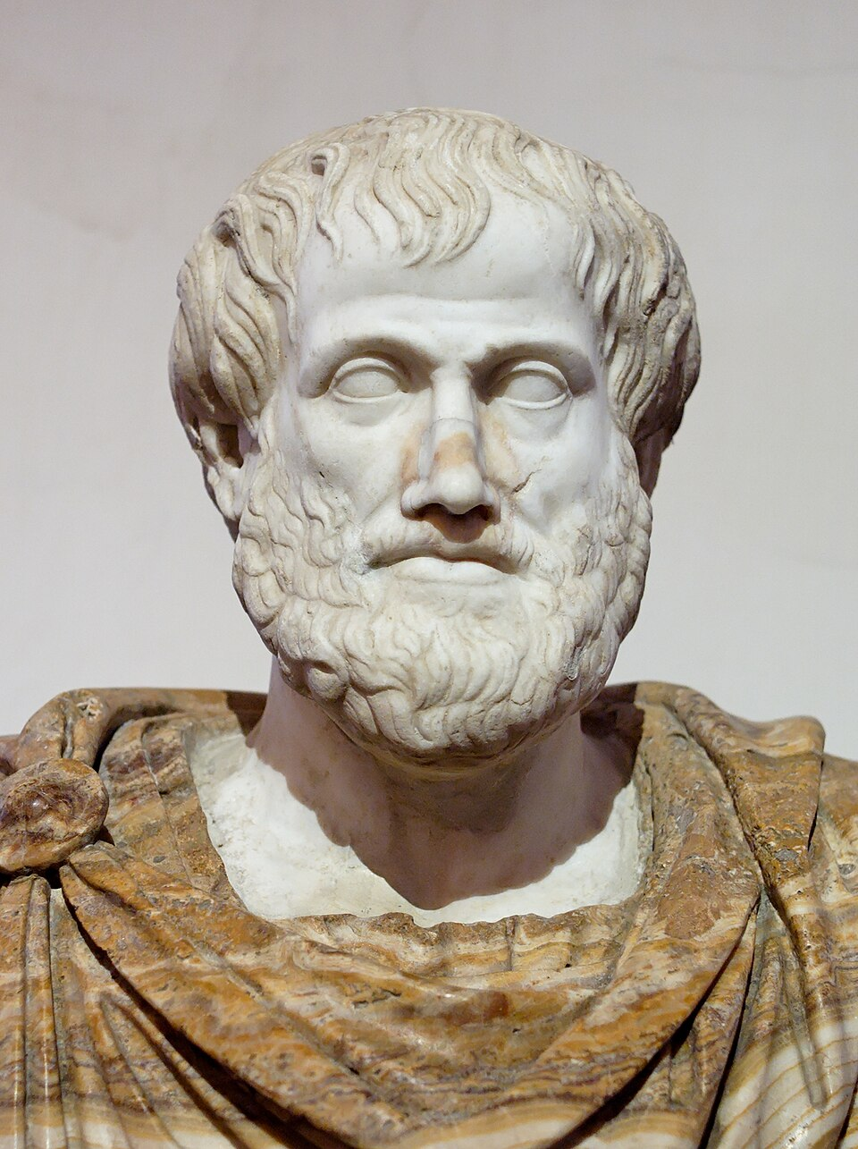
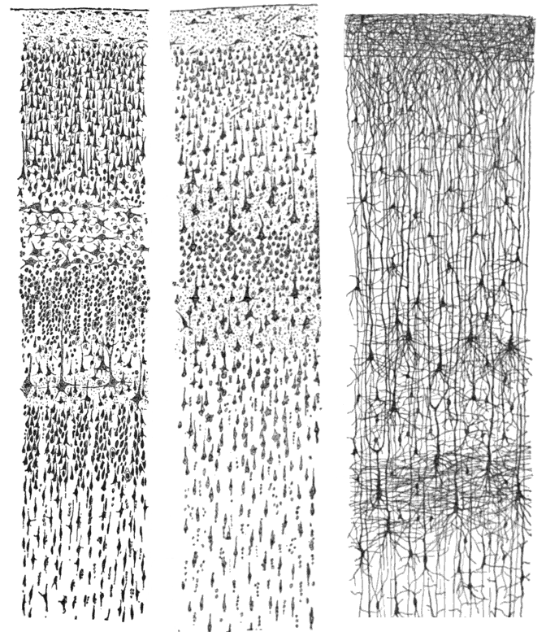
Inspiration
Philosophy of Balance
“Virtue is the golden mean between two vices, the one of excess and the other of deficiency”
Aristotle
Critical Brain Hypothesis in Neuroscience
Hypothesis: some information processing functions in the brain occur at a critical state at the edge between order and disorder
Source: Wikipedia
Source: Wikipedia
(Santiago Ramón y Cajal)

Slide 4
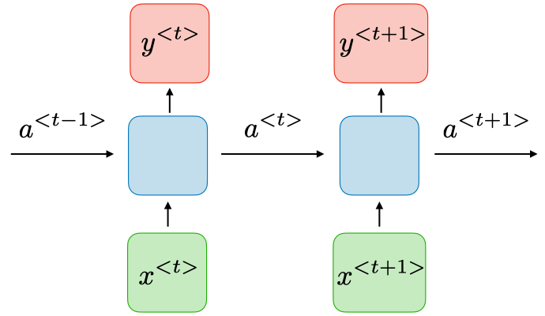
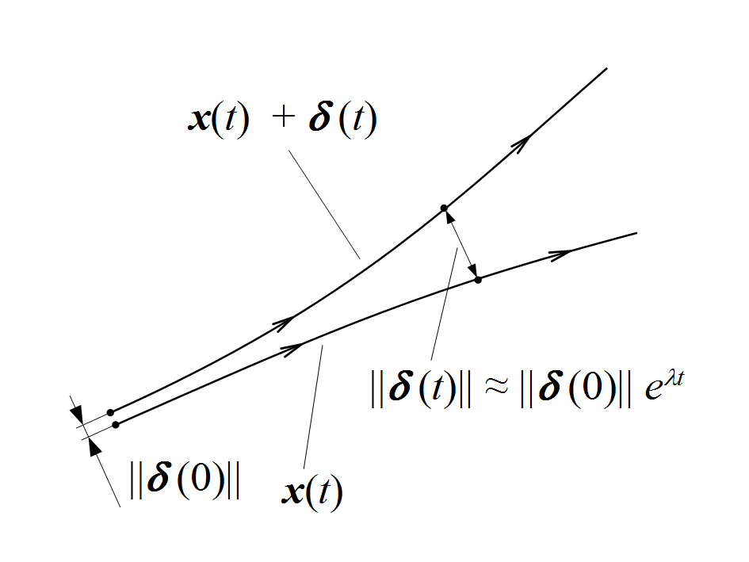
Background
Recurrent Neural Network Model:
Sequential model with hidden-to-hidden propagating memory of information through time
Maximal Lyapunov Exponent:
Characterizes the (exponential) rate λ at which initial differences in a trajectory diverge

Slide 5
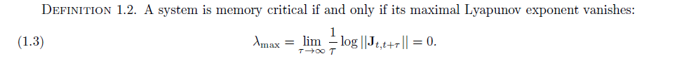
Memory Criticality
We connect memory criticality of a system relative to the maximal Lyapunov exponent of the Jacobian
of the hidden state transition
We also say memory is exponentially vanishing when its maximal Lyapunov exponent is less than 0 and is
chaotic when its maximal Lyapunov exponent is greater than 0
Such a definition is useful to analyze innovations in recurrent models

Slide 6
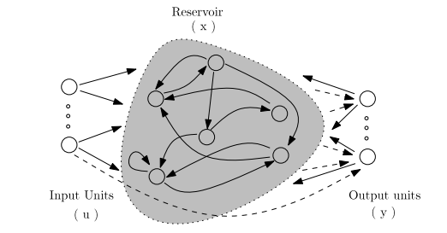
Echo State Networks (ESN) and Criticality
The ESN, an early RNN and reservoir computer model, aims to maintain the echo state property (ESP), with a sufficient condition being scaling the spectral radius of the reservoir below 1
Applying our definition of criticality, ESP ensures that ESN is non-critical, meaning the memory decays

Slide 7

Vanishing Gradient Problem and LSTM Solution
The vanishing gradients problem is an example of a case where non-critical properties lead to training problems.
The backpropagated error signal in a simple case with as the hidden-to-hidden matrix obeys
Errors signals grow or decay exponentially to past timesteps according to the spectral radius of the hidden-to-hidden matrix
Long Short-Term Memory helps by fixing self-weights in a part of the network, the “constant error carousel” and training the “gate” input/output weights to / from the cell
This can be abstracted as the approach of maintaining criticality in a
sub-network where it is needed

Slide 8
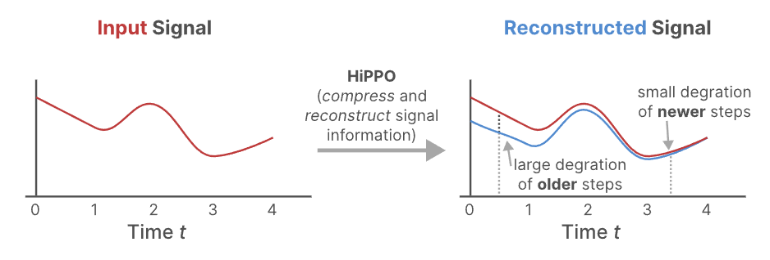
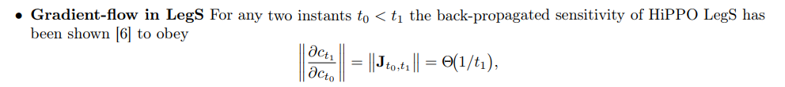
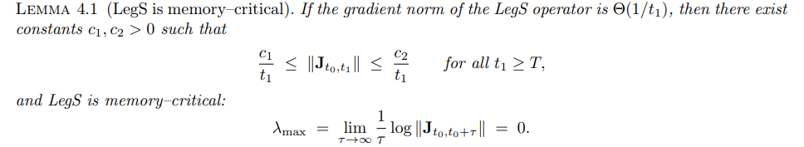
HiPPO and Memory Criticality
HiPPO matrices such as LegS, prominent elements of modern-day recurrent models including Mamba and S4, represent the history of their input using optimal approximations
Given its gradient norm and measure, LegS is memory critical

Slide 9
Conclusions and Future Work
In conclusion, the Lyapunov-style analysis is a useful way to characterize memory criticality. In applying this method to different recurrent models, we can understand the transformations that occur in memory propagation.
Future Work:
Apply numerical methods for computing Lyapunov exponents to analyze the criticality of instantiated models
Utilize the analysis method to categorize novel architectures (for example, Transformer-XL or Transformer-SSM hybrids) for their memory criticality
Extend theory of memory criticality to include other definitions from dynamical systems or neuroscience

Slide 10
Acknowledgements
Thank you to organizers of NYSDS 2025: Stony Brook, Brookhaven National Lab, and others
Research funded through NSF Expeditions: Mind in Vitro project at the University of Illinois at Urbana-Champaign

