Slide 1
AI-Powered Assistant for Long-Term Access to RHIC Knowledge
Mohammad Atif*, Vincent Garonne#, Eric Lancon#, Jerome Lauret#, Alexandr Prozorov$, Michal Vranovsky$
*Computational Science Department, Brookhaven National Lab, Upton, NY (USA)
#Physics Department, Brookhaven National Laboratory, Upton, NY (USA)
$FNSPE, Czech Technical University, Prague, Czech Republic
New York Scientific Data Summit
Sept 11-12, 2025

Slide 2
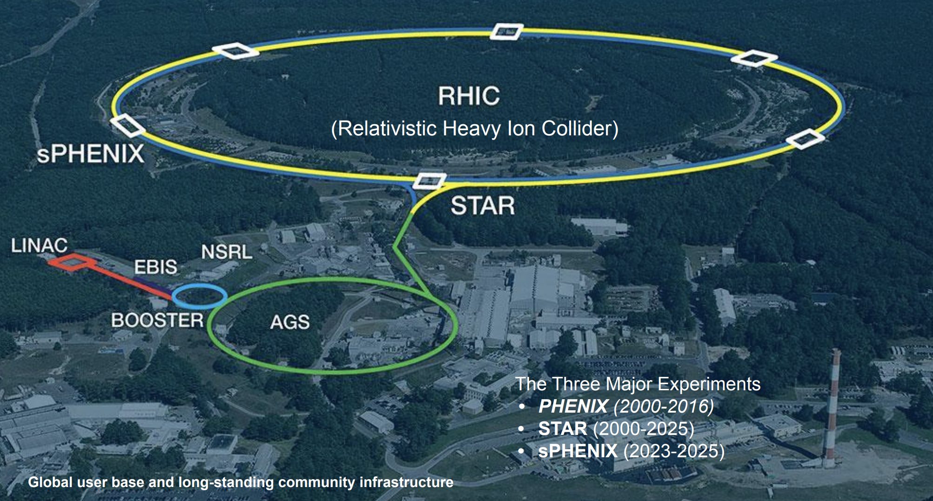
What is RHIC?
Relativistic Heavy Ion Collider: 25 years of
operations
Historical significance for nuclear physics and QCD studies
The only facility to achieve polarized proton-proton collisions
The datasets, representing several billions of DOE investment, cannot be reproduced
Knowledge loss risk as experts transition away
Future users of RHIC Data will lack historical context and knowledge

Slide 3
Why we need (yet another) AI Assistant
RHIC has a 25-year scientific legacy
Risk of losing tacit knowledge and experimental expertise
Preserving knowledge for future users for next decades
Inefficient manual search for new users
Chatbot provides quick access to relevant information
Facilitates quicker onboarding for new collaborators
General LLMs
Lack domain context: can't access private data
Local LLM deployment provides:
Separation of sensitive/private data
Tailored responses: general LLMs too verbose or hallucinate

Slide 4
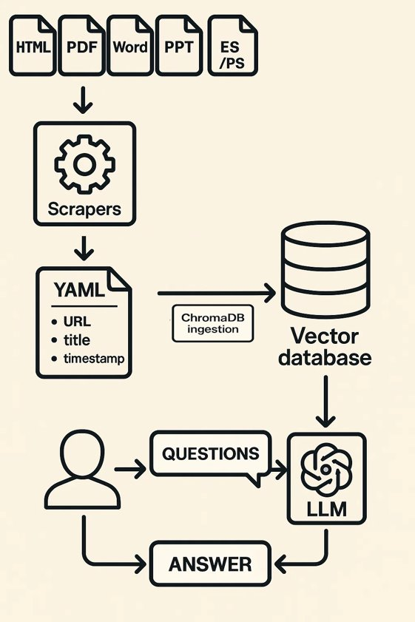
Our Solution: Domain-Specific AI Assistant
Designing Modular Architecture with Standards
- Local LLM + RHIC knowledge base + Authentication
- Key benefits: secure, tailored, domain-aware
To keep pace with rapid domain evolution while maintaining stability
Model Context Protocol (MCP): Ensure interoperability across LLM providers, AI tools, and public/restricted knowledge
Retrieval-Augmented Generation (RAG)
Vector Storage - Semantic search

Slide 5
RHIC Database
Database
Text
www.bnl.gov/public, www.star.bnl.gov, www.sphenix.bnl.gov, www.phenix.bnl.gov
Inputs include internal documents, mailing lists, chats, and websites.
160,000+ and growing
Custom Scraper Framework:
Multi-format Scraping: Parses HTML, PDF, Word, PowerPoint, EPS/PS; converts to text with metadata (URL, title, timestamp).
Smart Filtered Crawl: Domain-focused traversal with configurable path exclusions.
Rate-limited Access: Configurable delays prevent server overload.
Analytics Reporting: Tracks processed/skipped links with grouped statistics.
Public Archives (arXiv) and Journals
Analysis Notes, Mailing Lists Threads, Collaboration Chats, ...
Codes*
Multimedia* (images, graphs, ...)
Metadata
[title, url, timestamp, visibility, collaboration, filepath, type]
*Under development
_______
_ _ _ _
Public data
Private data

Slide 6
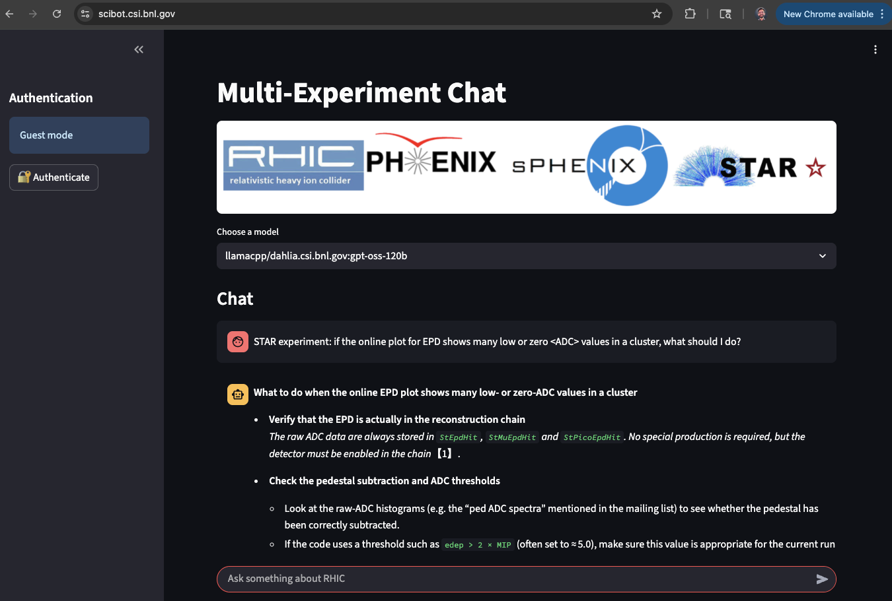
ChatBot
Frontend
Accessible on BNL Network
Default guest mode (access to public data only)
Authentication provides access to internal information
Various models and inference engines

Slide 7
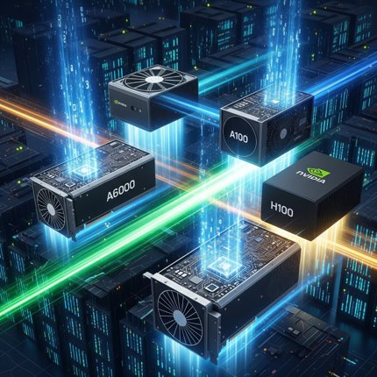
Performance Comparison of Inference Engines
MCP client is an inference engine
LlamaCpp, vLLM, Ollama, …
Need to understand their scaling behavior
Reduce latency
Enhance user experience
Minimize operational costs
Relevant metric is throughput (tokens/sec)
% GPU Utilization
Stochasticity of token generation
Fixed model Qwen3-8B (common denominator)
Observe scaling behavior for 1, 2, 4 GPUs
GPUs: A6000, A100, H100

Slide 8
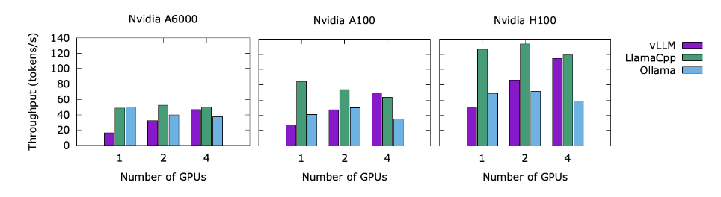
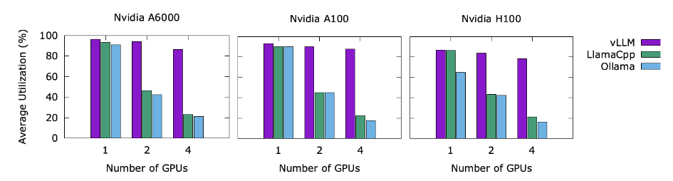
Performance Comparison of Inference Engines
New GPUs are generally better (!)
Ollama does not always benefit from more GPUs
vLLM increases throughput while keeping utilization similar.

Slide 9
Performance Comparison of Inference Engines
New GPUs are generally better (!)
Ollama does not always benefit from more GPUs
vLLM increases throughput while keeping utilization similar.
LlamaCpp keeps throughput similar while reducing GPU utilization.

Slide 10
Evaluating Responses: why local domain knowledge matters
Llama3.3 (RHIC Scibot)
The STAR experiment considers space charge effects by using a numerical relaxation method to solve for the electrical potential due to space charge. This is done by integrating the effect of continual collision contributions along the distance from the endcap to any point in space, representing the effect of space charge on the TPC gas volume. The amplitude of this distortion is directly proportional to the quantity of space charge. Additionally, the STAR experiment uses an event-by-event space charge correction procedure to account for the effects of space charge on charged particle tracks.
References:
https://drupal.star.bnl.gov/STAR/files/Kapitan_MSc.pdf
https://www.star.bnl.gov/HyperNews-star/protected/get/starops/1133.html
https://drupal.star.bnl.gov/STAR/starnotes/public/sn0456
https://arxiv.org/abs/0907.2213v2
How are space charge effects considered in the STAR experiment?​
ChatGPT o3 (Commercial Enterprise)
Below is an outline of the way STAR treats space-charge (SC) from first principles all the way through the final track‐reconstruction pass. Citations point either to the original 2006 Nucl. Instr. Meth. note that laid out the algorithm, or to more recent Run-22 calibration material and internal studies of the gating grid.
1. What the “space-charge problem” is
Source of SC – every RHIC collision floods the TPC gas with slow-drifting positive ions. They build up on ~½-s time-scales (an ion drift across the 210 cm chamber). The accumulated charge modifies the otherwise uniform E-field. The dominant effect is an azimuthal (φ) twist of all hit positions that is roughly proportional to the average charge density ρₛ꜀. (ar5iv)
Magnitude – before corrections, offsets of 1 cm in signed DCA (sDCA) for central Au+Au events were observed, large enough to spoil momentum resolution and primary-vertex finding. (ar5iv)
2. Hardware mitigations built into STAR
3. Simulation framework
A numerical relaxation of Poisson’s equation is solved for a realistic ρₛ꜀(r,z) (∝ 1/r² from HIJET and uniform in z). The resulting potential gives a 3-D distortion map Δrφ(r,z; ρₛ꜀) used by the offline calibration software. (ar5iv)
4. How STAR measures ρₛ꜀ in data
5. Applying the correction
Determine ρₛ꜀ for each event (running average seeded with first-event pre-pass).
Look up Δrφ(r,z; ρₛ꜀) and subtract it from every hit.
Re-fit tracks.
Iterate once; the procedure is self-correcting because sDCA → 0 when the map is right. (ar5iv)
6. Performance and recent improvements
With the iTPC upgrade (full‐pad inner sectors & lower ion back-flow), grid-leak distortions have become negligible and SC corrections converge in ≤8 passes for an entire run. (drupal.star.bnl.gov)
The event-plane detector (EPD) now supplies an independent luminosity-like scaler that is being evaluated as an even better real-time predictor of ρₛ꜀ for high-rate p+p running. (drupal.star.bnl.gov)
Take-away
Space-charge is an ever-present, rate-dependent distortion in the STAR TPC. STAR combats it with a three-layer defence:
Prevent as much ion back-flow as possible (gating grid, iTPC design).
Model the residual field distortions with detailed electrostatic simulations.
Measure & correct them in real time using track-based observables and fast scaler proxies, with periodic laser and fill-by-fill calibrations to keep the model tied to reality.
The net result is that, even at today’s highest RHIC luminosities, the residual tracking bias after correction is ≲ 100 µm—well below the intrinsic TPC hit resolution—so physics analyses are not limited by space-charge.
Mistral (RHIC Scibot) ​
Space charge effects are a significant consideration in the STAR (Solenoidal Tracker at RHIC) experiment due to their impact on track reconstruction and momentum measurements. Here’s how these effects are addressed:​
Understanding Space Charge Sources: The space charge in the Time Projection Chamber (TPC) arises from various sources, including beam gas interactions and the collisions themselves. These interactions leave a distribution of charge that can distort the electric field within the TPC.​
Modeling and Correction: To correct for these distortions, STAR uses numerical models to calculate the electrical potential due to space charge. This involves solving for the potential on a grid with assumed azimuthal symmetry and interpolating the results. The perturbing field is then used to calculate the distortions to the measured positions of electron clusters.
​Event-by-Event Corrections: Given the variability in space charge effects, STAR employs event-by-event corrections. This approach adjusts for the specific conditions of each collision, ensuring more accurate track reconstruction and momentum measurements. The amplitude of the distortion is directly proportional to the quantity of space charge, which depends on operating conditions.
​Impact Assessment: The impact of space charge effects on particle identification and mass measurements has been evaluated. For example, studies using Hijing events have shown that a ±2% per GeV correction for negative/positive charged tracks does not significantly alter the rho mass, indicating that the corrections are effective within acceptable limits.​
Continuous Improvement: The performance of space charge corrections is continuously studied and improved. This includes evaluating the effects on various particle species and refining the models used to predict and correct for distortions.​
References:​
STAR TPC Space Charge Corrections​
Space Charge Effects in STAR​
Event-by-Event Space Charge Corrections​
Hardware element | Role in limiting or measuring SC | Notes
Gating grid (1 mm-pitch wires, ±115 V open / −40 V,−190 V closed) | Blocks ion back-flow from MWPC anodes between triggers; operation parameters have been optimised in dedicated studies. | Streaming/open-grid modes were tested in Run-16 to quantify residual ion back-flow (IBF). (drupal.star.bnl.gov)
Central membrane & field-cage resistors | Provide a highly uniform nominal field against which distortions are computed. | —
UV-laser track system | Generates straight “reference” tracks every 90 s that sample the full drift volume; used to anchor long-term alignment of the correction maps. | System design described in the TPC technical papers. (ScienceDirect)

Slide 11
Evaluating Responses: why local domain knowledge matters
Llama3.3 (RHIC Scibot)
The STAR experiment considers space charge effects by using a numerical relaxation method to solve for the electrical potential due to space charge. This is done by integrating the effect of continual collision contributions along the distance from the endcap to any point in space, representing the effect of space charge on the TPC gas volume. The amplitude of this distortion is directly proportional to the quantity of space charge. Additionally, the STAR experiment uses an event-by-event space charge correction procedure to account for the effects of space charge on charged particle tracks.
References:
https://drupal.star.bnl.gov/STAR/files/Kapitan_MSc.pdf
https://www.star.bnl.gov/HyperNews-star/protected/get/starops/1133.html
https://drupal.star.bnl.gov/STAR/starnotes/public/sn0456
https://arxiv.org/abs/0907.2213v2
How are space charge effects considered in the STAR experiment?​
ChatGPT o3 (Commercial Enterprise)
Below is an outline of the way STAR treats space-charge (SC) from first principles all the way through the final track‐reconstruction pass. Citations point either to the original 2006 Nucl. Instr. Meth. note that laid out the algorithm, or to more recent Run-22 calibration material and internal studies of the gating grid.
1. What the “space-charge problem” is
Source of SC – every RHIC collision floods the TPC gas with slow-drifting positive ions. They build up on ~½-s time-scales (an ion drift across the 210 cm chamber). The accumulated charge modifies the otherwise uniform E-field. The dominant effect is an azimuthal (φ) twist of all hit positions that is roughly proportional to the average charge density ρₛ꜀. (ar5iv)
Magnitude – before corrections, offsets of 1 cm in signed DCA (sDCA) for central Au+Au events were observed, large enough to spoil momentum resolution and primary-vertex finding. (ar5iv)
2. Hardware mitigations built into STAR
3. Simulation framework
A numerical relaxation of Poisson’s equation is solved for a realistic ρₛ꜀(r,z) (∝ 1/r² from HIJET and uniform in z). The resulting potential gives a 3-D distortion map Δrφ(r,z; ρₛ꜀) used by the offline calibration software. (ar5iv)
4. How STAR measures ρₛ꜀ in data
5. Applying the correction
Determine ρₛ꜀ for each event (running average seeded with first-event pre-pass).
Look up Δrφ(r,z; ρₛ꜀) and subtract it from every hit.
Re-fit tracks.
Iterate once; the procedure is self-correcting because sDCA → 0 when the map is right. (ar5iv)
6. Performance and recent improvements
With the iTPC upgrade (full‐pad inner sectors & lower ion back-flow), grid-leak distortions have become negligible and SC corrections converge in ≤8 passes for an entire run. (drupal.star.bnl.gov)
The event-plane detector (EPD) now supplies an independent luminosity-like scaler that is being evaluated as an even better real-time predictor of ρₛ꜀ for high-rate p+p running. (drupal.star.bnl.gov)
Take-away
Space-charge is an ever-present, rate-dependent distortion in the STAR TPC. STAR combats it with a three-layer defence:
Prevent as much ion back-flow as possible (gating grid, iTPC design).
Model the residual field distortions with detailed electrostatic simulations.
Measure & correct them in real time using track-based observables and fast scaler proxies, with periodic laser and fill-by-fill calibrations to keep the model tied to reality.
The net result is that, even at today’s highest RHIC luminosities, the residual tracking bias after correction is ≲ 100 µm—well below the intrinsic TPC hit resolution—so physics analyses are not limited by space-charge.
Factually, all produce valid responses
Mistral (RHIC Scibot) ​
Space charge effects are a significant consideration in the STAR (Solenoidal Tracker at RHIC) experiment due to their impact on track reconstruction and momentum measurements. Here’s how these effects are addressed:​
Understanding Space Charge Sources: The space charge in the Time Projection Chamber (TPC) arises from various sources, including beam gas interactions and the collisions themselves. These interactions leave a distribution of charge that can distort the electric field within the TPC.​
Modeling and Correction: To correct for these distortions, STAR uses numerical models to calculate the electrical potential due to space charge. This involves solving for the potential on a grid with assumed azimuthal symmetry and interpolating the results. The perturbing field is then used to calculate the distortions to the measured positions of electron clusters.
​Event-by-Event Corrections: Given the variability in space charge effects, STAR employs event-by-event corrections. This approach adjusts for the specific conditions of each collision, ensuring more accurate track reconstruction and momentum measurements. The amplitude of the distortion is directly proportional to the quantity of space charge, which depends on operating conditions.
​Impact Assessment: The impact of space charge effects on particle identification and mass measurements has been evaluated. For example, studies using Hijing events have shown that a ±2% per GeV correction for negative/positive charged tracks does not significantly alter the rho mass, indicating that the corrections are effective within acceptable limits.​
Continuous Improvement: The performance of space charge corrections is continuously studied and improved. This includes evaluating the effects on various particle species and refining the models used to predict and correct for distortions.​
References:​
STAR TPC Space Charge Corrections​
Space Charge Effects in STAR​
Event-by-Event Space Charge Corrections​
ChatGPT included irrelevant details (convoluted answers - would never be provided by science domain experts)
Local RAG-based LLMs
Retrieve unpublished content
Respond with a community-appropriate "tone"
Hardware element | Role in limiting or measuring SC | Notes
Gating grid (1 mm-pitch wires, ±115 V open / −40 V,−190 V closed) | Blocks ion back-flow from MWPC anodes between triggers; operation parameters have been optimised in dedicated studies. | Streaming/open-grid modes were tested in Run-16 to quantify residual ion back-flow (IBF). (drupal.star.bnl.gov)
Central membrane & field-cage resistors | Provide a highly uniform nominal field against which distortions are computed. | —
UV-laser track system | Generates straight “reference” tracks every 90 s that sample the full drift volume; used to anchor long-term alignment of the correction maps. | System design described in the TPC technical papers. (ScienceDirect)
ChatGPT can only cite public information.

Slide 12
Standardized Benchmark Scores (WIP)
Question 1
Expert Answer 1
Question 2
Expert Answer 2
Question 3
Expert Answer 3
.
.
.
Question n
Expert Answer n

Slide 13
Standardized Benchmark Scores (WIP)
RHIC Scibot 1
(LLM1,temp,…)
RHIC Scibot 2
(LLM2,temp,…)
Commercial
LLM
Question 1
Expert Answer 1
Response 1
Response 1
Response 1
Question 2
Expert Answer 2
Response 2
Response 2
Response 2
. . .
Question 3
Expert Answer 3
Response 3
Response 3
Response 3
.
.
.
Question n
Expert Answer n
Response n
Response n
Response n

Slide 14


Standardized Benchmark Scores (WIP)
SME Rating (Human)
RHIC Scibot 1
(LLM1,temp,…)
RHIC Scibot 2
(LLM2,temp,…)
Commercial
LLM
Question 1
Expert Answer 1
Response 1
Response 1
Response 1
Question 2
Expert Answer 2
Response 2
Response 2
Response 2
. . .
Question 3
Expert Answer 3
Response 3
Response 3
Response 3
.
.
.
Question n
Expert Answer n
Response n
Response n
Response n
Correctness
Completeness
Clarity
Relevance
...

Slide 15
Standardized Benchmark Scores (WIP)
SME Rating (Human)
Lexical (ROUGE, BLEU, ...)
Semantic similarity, BERTScore-like rating
RHIC Scibot 1
(LLM1,temp,…)
RHIC Scibot 2
(LLM2,temp,…)
Commercial
LLM
Question 1
Expert Answer 1
Response 1
Response 1
Response 1
Question 2
Expert Answer 2
Response 2
Response 2
Response 2
. . .
Question 3
Expert Answer 3
Response 3
Response 3
Response 3
.
.
.
Question n
Expert Answer n
Response n
Response n
Response n
Correctness
Completeness
Clarity
Relevance
...

Slide 16
Standardized Benchmark Scores (WIP)
SME Rating (Human)
Lexical (ROUGE, BLEU, ...)
Semantic similarity, BERTScore-like rating
G-Eval: Ensemble of LLM-as-a-Judge
Rate [True/False]
Calculate Majority
Average
RHIC Scibot 1
(LLM1,temp,…)
RHIC Scibot 2
(LLM2,temp,…)
Commercial
LLM
Question 1
Expert Answer 1
Response 1
Response 1
Response 1
Question 2
Expert Answer 2
Response 2
Response 2
Response 2
. . .
Question 3
Expert Answer 3
Response 3
Response 3
Response 3
.
.
.
Question n
Expert Answer n
Response n
Response n
Response n
Correctness
Completeness
Clarity
Relevance
Judge 1
True/False
...
...
...
Judge 2
True/False
...
...
...
Judge 3
True/False
...
...
...
Majority
True/False
...
...
...
Average

Slide 17
Standardized Benchmark Scores (WIP)
SME Rating (Human)
Lexical (ROUGE, BLEU, ...)
Semantic similarity, BERTScore-like rating
G-Eval: Ensemble of LLM-as-a-Judge
Rate [True/False]
Calculate Majority
Average
Weighted average of all the above
RHIC Scibot 1
(LLM1,temp,…)
RHIC Scibot 2
(LLM2,temp,…)
Commercial
LLM
Question 1
Expert Answer 1
Response 1
Response 1
Response 1
Question 2
Expert Answer 2
Response 2
Response 2
Response 2
. . .
Question 3
Expert Answer 3
Response 3
Response 3
Response 3
.
.
.
Question n
Expert Answer n
Response n
Response n
Response n
Correctness
Completeness
Clarity
Relevance
Judge 1
True/False
...
...
...
Judge 2
True/False
...
...
...
Judge 3
True/False
...
...
...
Majority
True/False
...
...
...
Average

Slide 18
Summary and Future Work
Summary
In-house ChatBot ensures secure, domain-specific Q&A with answers matching the community “style”
RAG + MCP enables robust, modular answer generation.
Local models excel with private or sensitive information.
Local models are a safe path in dealing with multi-experiments public / private information requiring AA (roles)
Future work
Complete benchmarking, tune parameters
Extend the support to additional experiments (PHENIX, sPHENIX, and EIC)
Pilot service has been delivered
Develop a robust horizontal scaling strategy
Implement role-based authentication and authorization
Onboard beta users, get feedback ("like-dislike")
Leverage MCP for a hybrid approach by augmenting with real-time web search

Slide 19
Thank you!

