Slide 1

SciAidanBench: Evaluating LLM Scientific Creativity
Shray Mathur, Noah van der Vleuten, J. Anibal Boscoboinik, Esther Tsai, Kevin Yager

Slide 2
Introducing SciAidanBench
Benchmark of 155 open-ended scientific questions
Covers 6 domains:
  Physics (Fundamental, Astro, Synchrotron, and Condensed Matter)
  Chemistry
  Biology
  Neuroscience
  Nanoscience
  Environmental Science
Work inspired from AidanBench (general creativity)
McLaughlin, Aidan, Anuja Uppuluri, and James Campbell. "AidanBench: Evaluating Novel Idea Generation on Open-Ended Questions." Language Gamification-NeurIPS 2024 Workshop.

Slide 3
How does this work?
SciAidanBench poses these open-ended questions and requires models to generate as many answers as possible while:
Avoiding repetition (judged by an embedding model and an LLM),
2. Maintaining coherence and plausibility (assessed by separate LLM).
Creativity Score = Total valid answers per question
Notes:
"number of ideas" to be the ideal measure of creativity; instead we view this as a proxy measure (that can be measured/quantified) that we believe is correlated to "actual creativity". (This is the core idea of the original AB.)

Slide 4

Suggest a practical, real-world application for Bose-Einstein condensates
Provide an answer you HAVE NOT given previously
SciAidanBench
Atomic interferometers used in high-precision inertial sensors for navigation and fundamental physics experiments.
Novelty:
100%
Coherence:
90%
Utilizing Bose-Einstein condensates as quantum simulators to model complex quantum systems for the development and optimization of novel energy-efficient materials..
Novelty:
35%
Coherence:
85%
Utilize Bose–Einstein condensates to study and harness quantum turbulence, enabling the engineering of frictionless fluid transport systems for advanced microfluidic and aerospace applications.
Novelty:
13%
Coherence:
70%
Full question list - https://gisaxs.com/index.php/Creativity_Prompts

Slide 5
Implementation Details
Evaluated 19 state-of-the-art LLMs from 7 vendors
Both standard and reasoning-enhanced model variants
Stopping conditions:
  Embedding dissimilarity threshold
    Compare the embedding vector of each new idea with all previous ones. Stop generating when it is too similar to existing ideas.
  LLM novelty judgment
    Use a LLM to decide if a new idea is novel compared to the previous ones. If not, stop exploring further.
  Coherence threshold
    Use an LLM to check whether outputs are coherent; stop once coherence falls below a set bar.

Slide 6
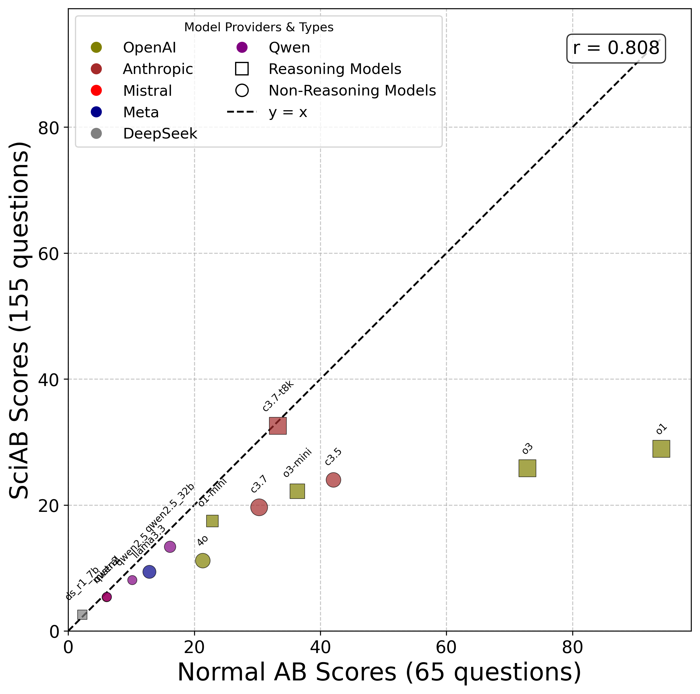
Results – Scientific Creativity vs General Creativity
Strong correlation between general and scientific creativity (r = 0.81)
But most models produce fewer scientific ideas than general ones
Reasoning-enhanced models outperform standard counterparts
Notes:
the "gap" is less a measure of the LLMs (or our metric) and more a measure of the actual problem-space (science is harder)
as models are getting better, their capabilities are growing heterogeneualy across different axis.

Slide 7
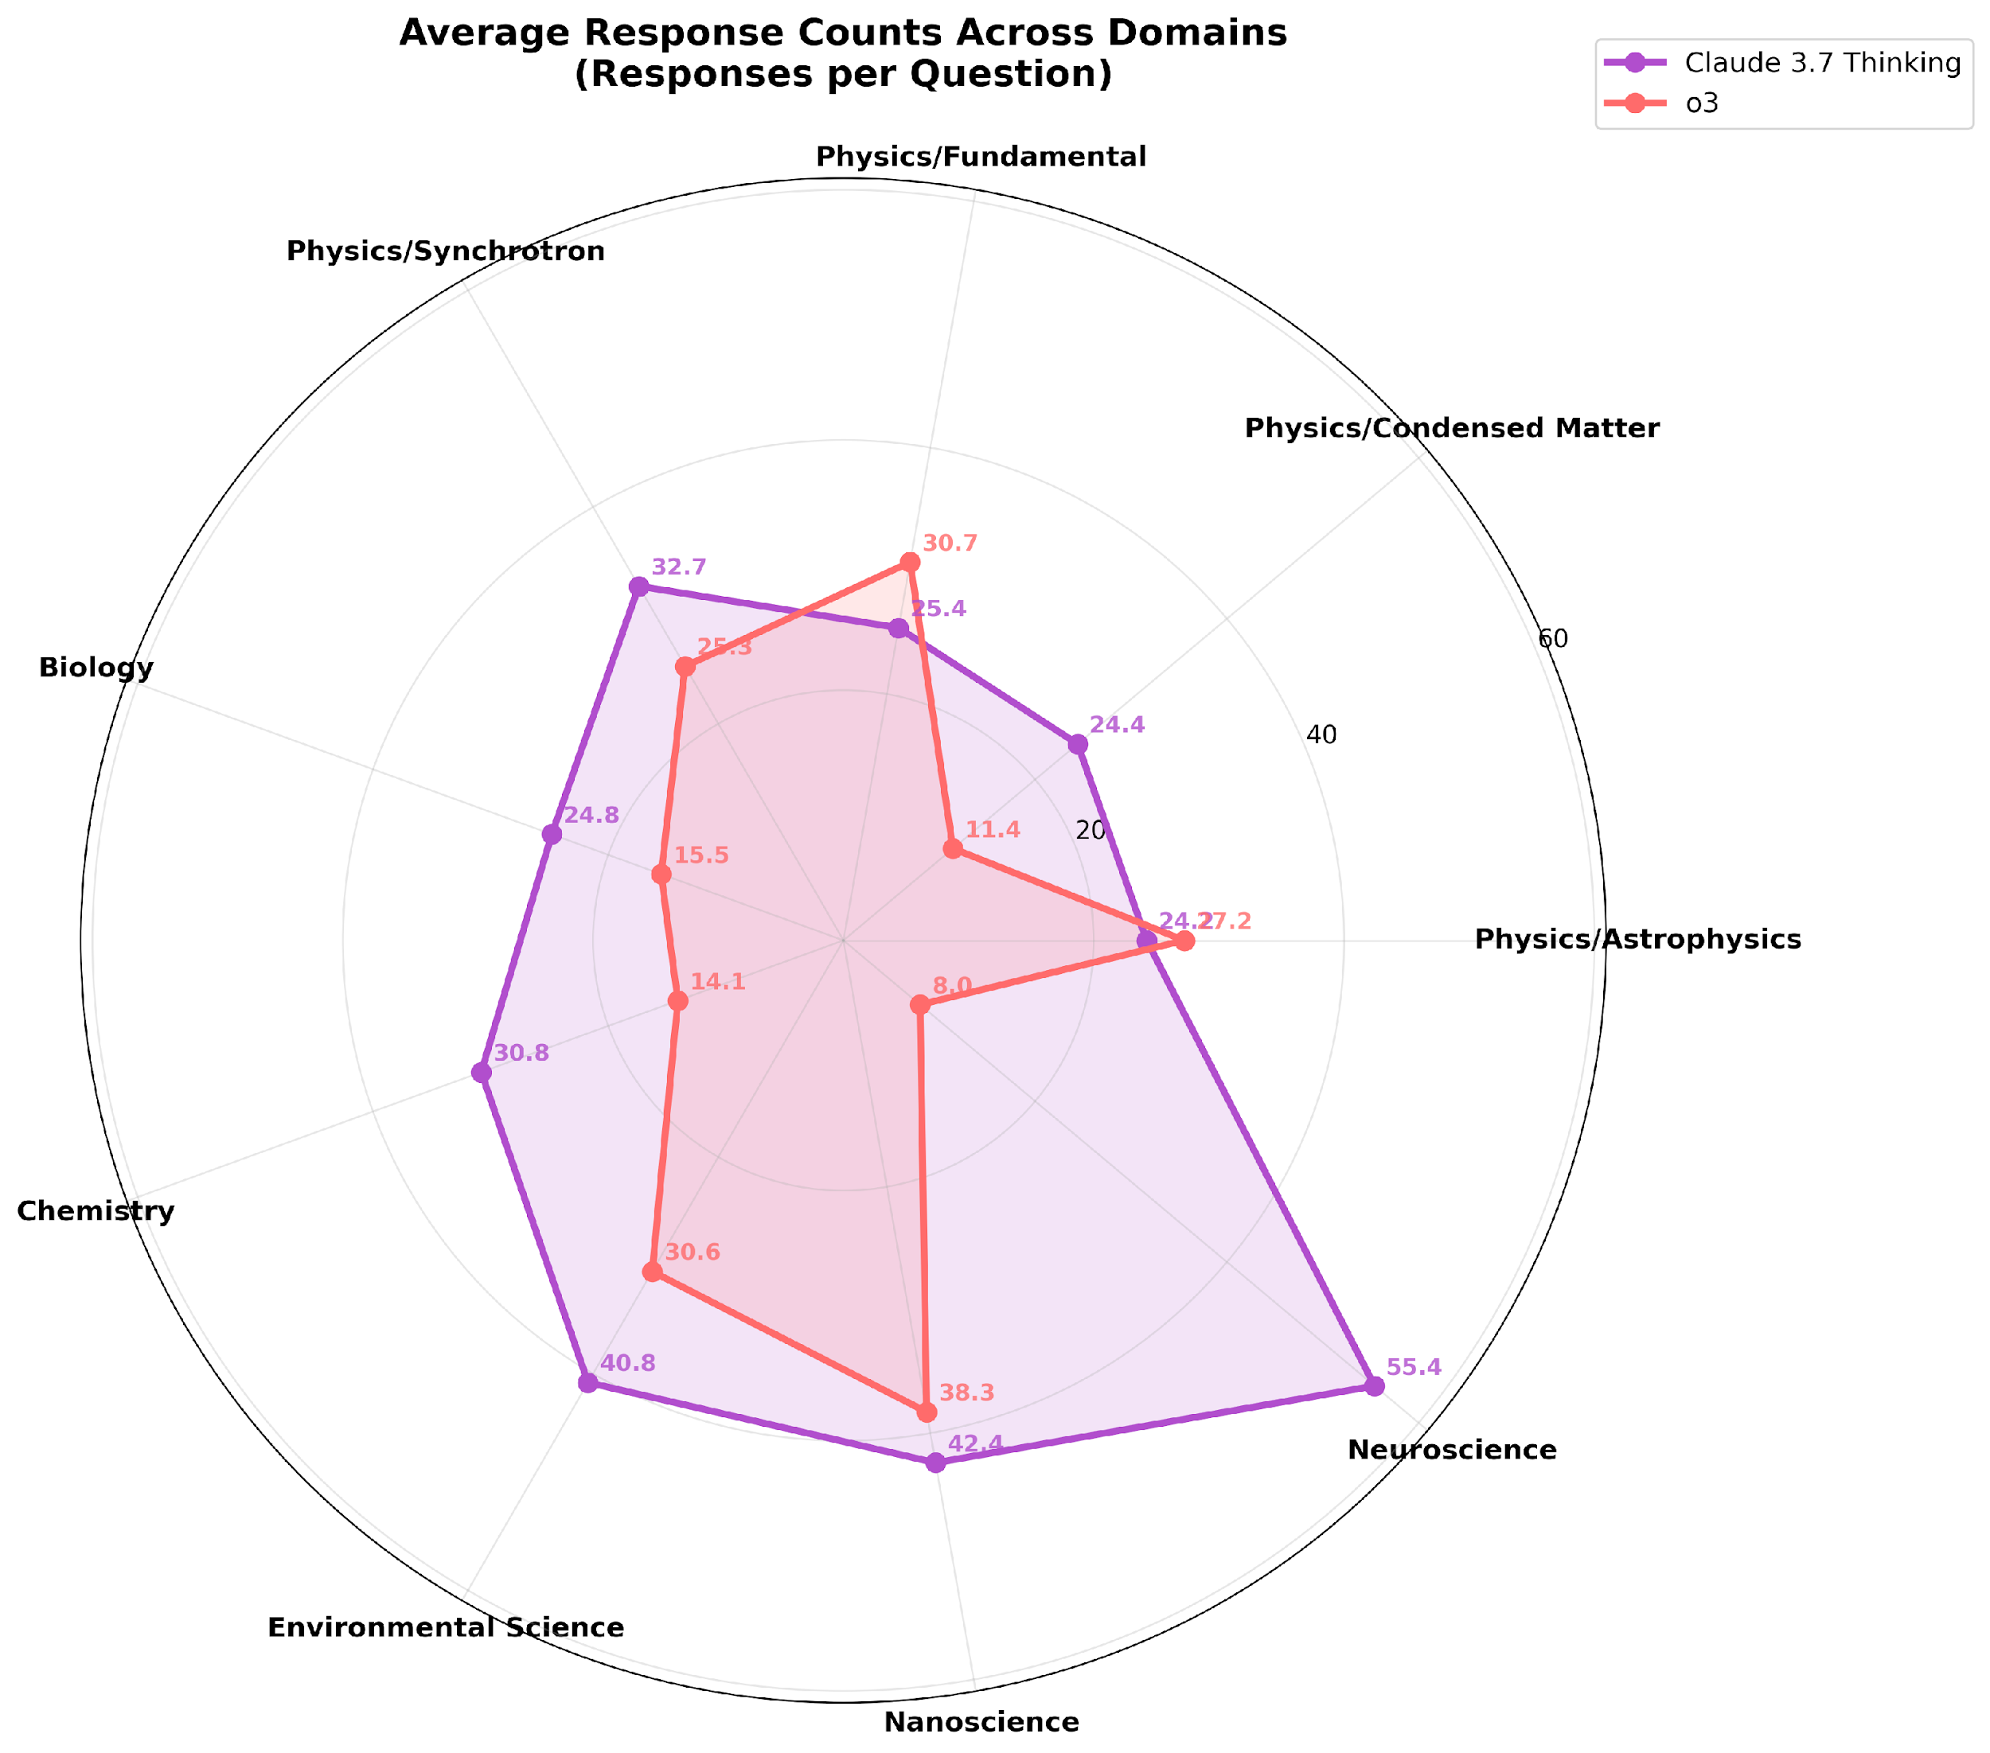
Results – Category Wise
Model specific trends: Different models better at different categories

Slide 8
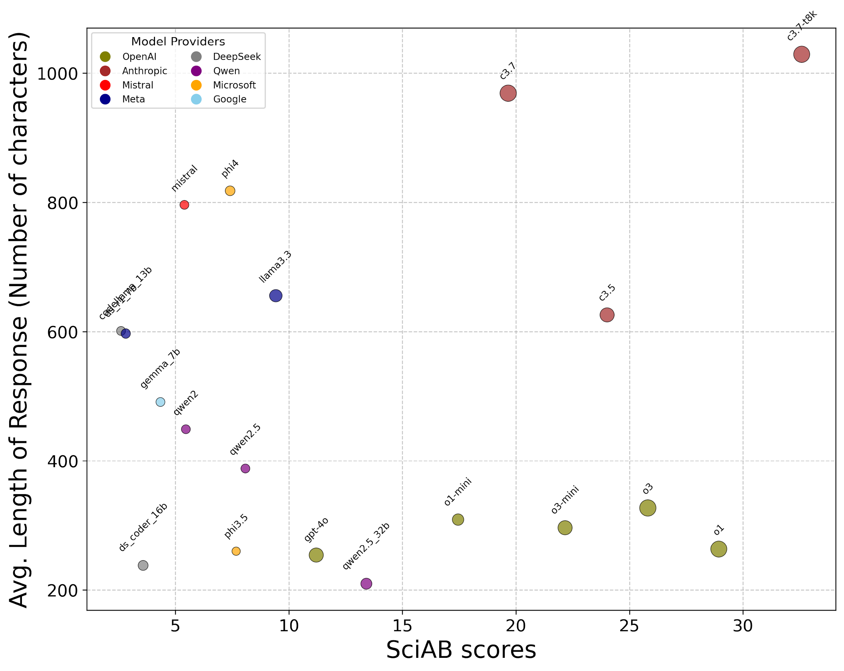
Results – Analyzing Response Verbosity
Vendor-specific trends: OpenAI concise, Anthropic verbose;

Slide 9
Conclusion
This work represents an initial exploration into evaluating the scientific creativity of LLMs.
We observe a heterogeneity in capabilities—both within and across models—suggesting a jagged frontier of performance.
An interesting direction: Can creativity be enhanced by enabling models to pool knowledge and engage in collective brainstorming?

