Slide 1
Boundary Informed Method of Lines for
Physics Informed Neural Networks
An ML framework for enhanced PDE approximation
Maximilian Cederholm, Siyao Wang, Haochun Wang, Ruichen Xu, Yuefan Deng
Department of Mathematics of Stony Brook University

Slide 2
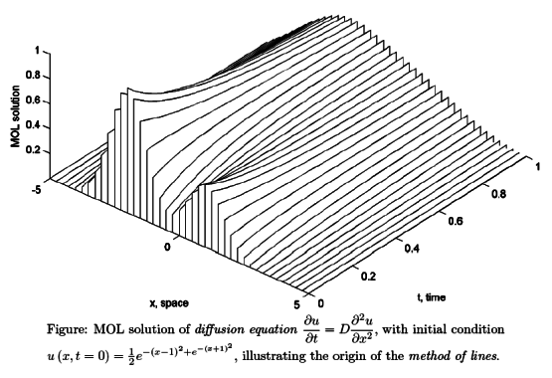
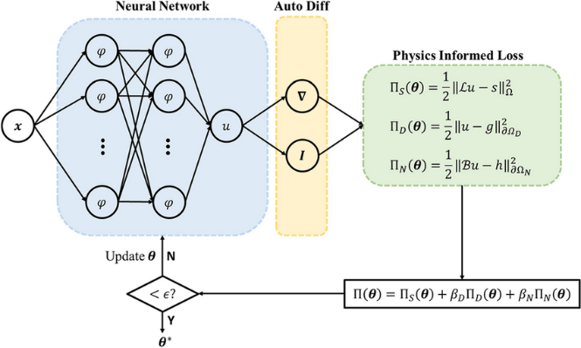
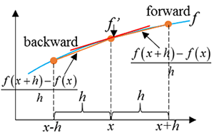
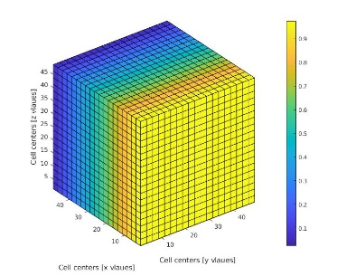
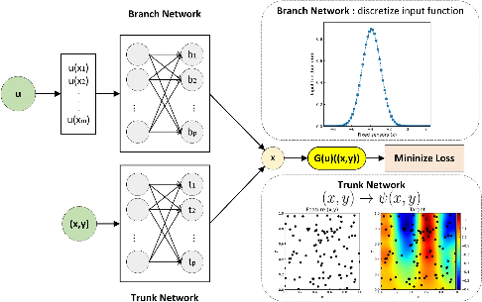
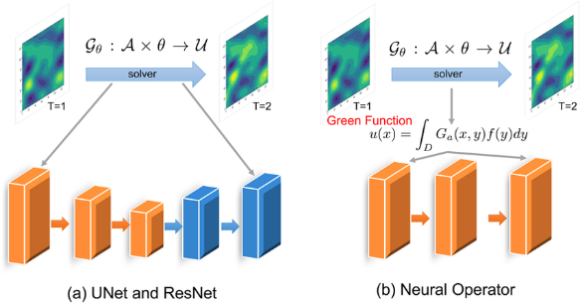
Solving Partial Differential Equations
Classical Methods
Modern Methods
Method of Lines
Physics Informed Neural Networks
Finite Difference Method
Finite Volume Method
DeepONet
Fourier Neural Operators

Slide 3
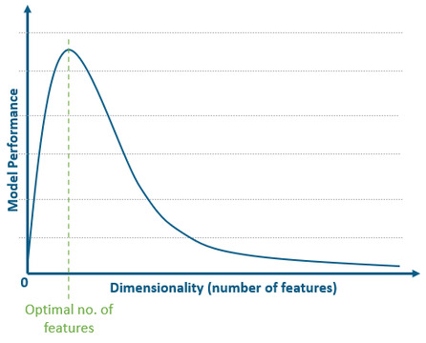
Curse of Dimensionality
Method of Lines:
Reduces dimensionality by converting to a system
Physics Informed Neural Networks:
Can approximate solutions to systems of ODEs/PDEs
MOL-PINN:
Can solve PDEs by reducing dimensionality and then approximating solutions

Slide 4
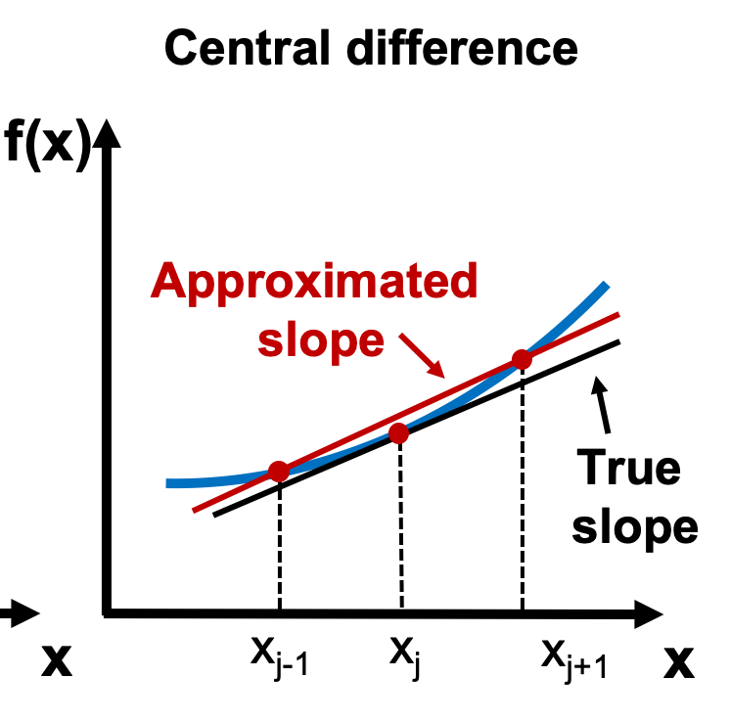
Fixing Grid Dependence
Finite Differences
MOL
Showcasing the evenly spaced structure of Finite differences for derivative approximations, forcing grids
Requires derivatives at the boundaries
Finite Differences
Are inaccurate and force
rigid grid structures
Automatic Differentiation
Is accurate and point-based, removing grid reliance

Slide 5
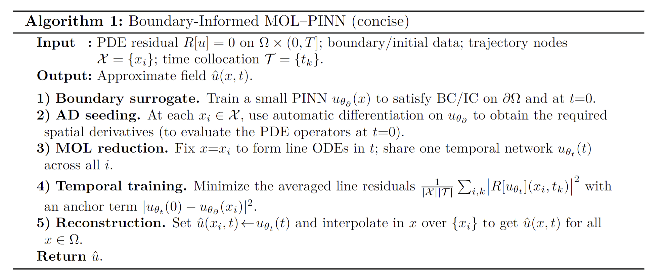
The Algorithm

Slide 6
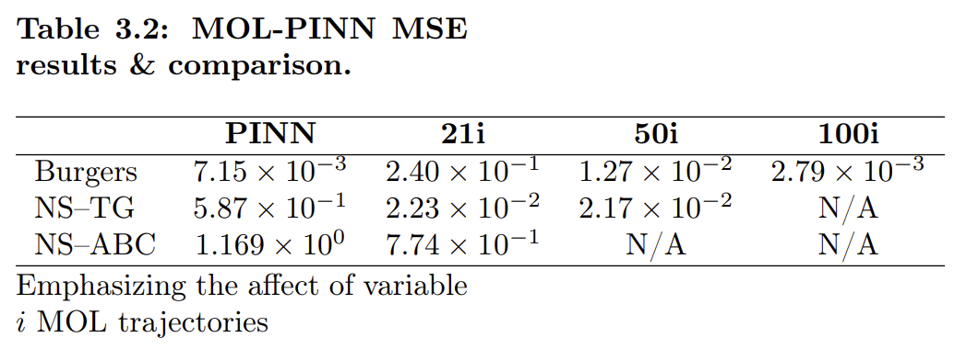
Results
Underperformed for 1D
Succeeded for 2D
Succeeded for 3D
Showcases an astounding Complexity Robustness

Slide 7
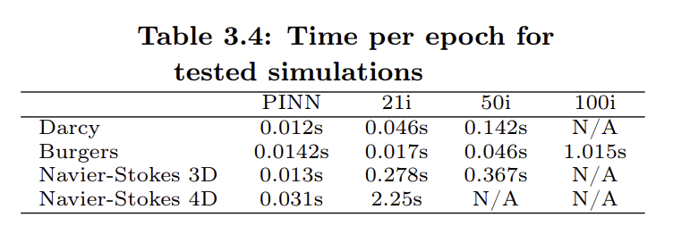
Fault 1:
Time Scalability
More computations
required in parallel
Increase in Dimensions
More Information
per MOL trajectory
Greater time per epoch

Slide 8
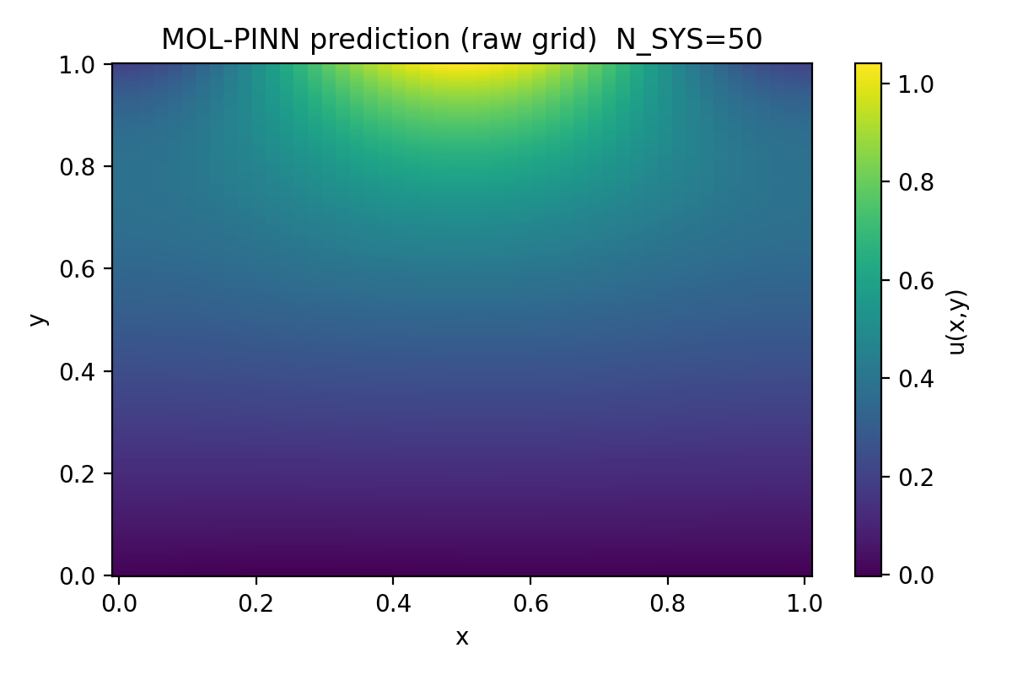
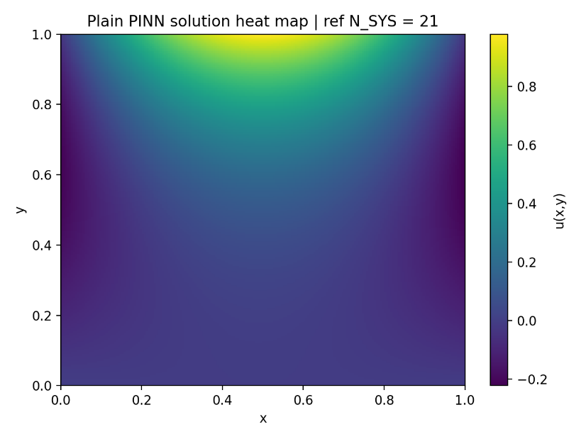
Fault 2: Directional Grain Bias
Perpendicular Continuity is only enforced at the Boundaries
Forms a bias in line with the grain
Likely the primary cause of failure for the low dimensional examples

Slide 9

Accomplishments & Future Work
Resists the Curse of Dimensionality
Improves accuracy with AD over FD
Opens the door to future frameworks
For Time Scalability:
RAR Scheme for efficiency
For Grain Bias:
Multidirectional MOL-PINN

Slide 10
Thanks for Listening!
Acknowledgements:
Professor Yuefan Deng, Ruichen Xu,
NYSDS, Stony Brook Math Department

