Slide 1



The MicroEleX simulation package
Zhi (Jackie) Yao, Andy Nonaka, Francois Leonard (Sandia), Yingheng Tang
and the NanoHybrid Team
Zhi (Jackie) Yao
Research Scientist
Applied Mathematics & Computational Research Division
Lawrence Berkeley National Lab
jackie_zhiyao@lbl.gov
May 28, 2025
NanoHybrids, LBNL
DOE MSRC MEERCAT Meetings

Slide 2
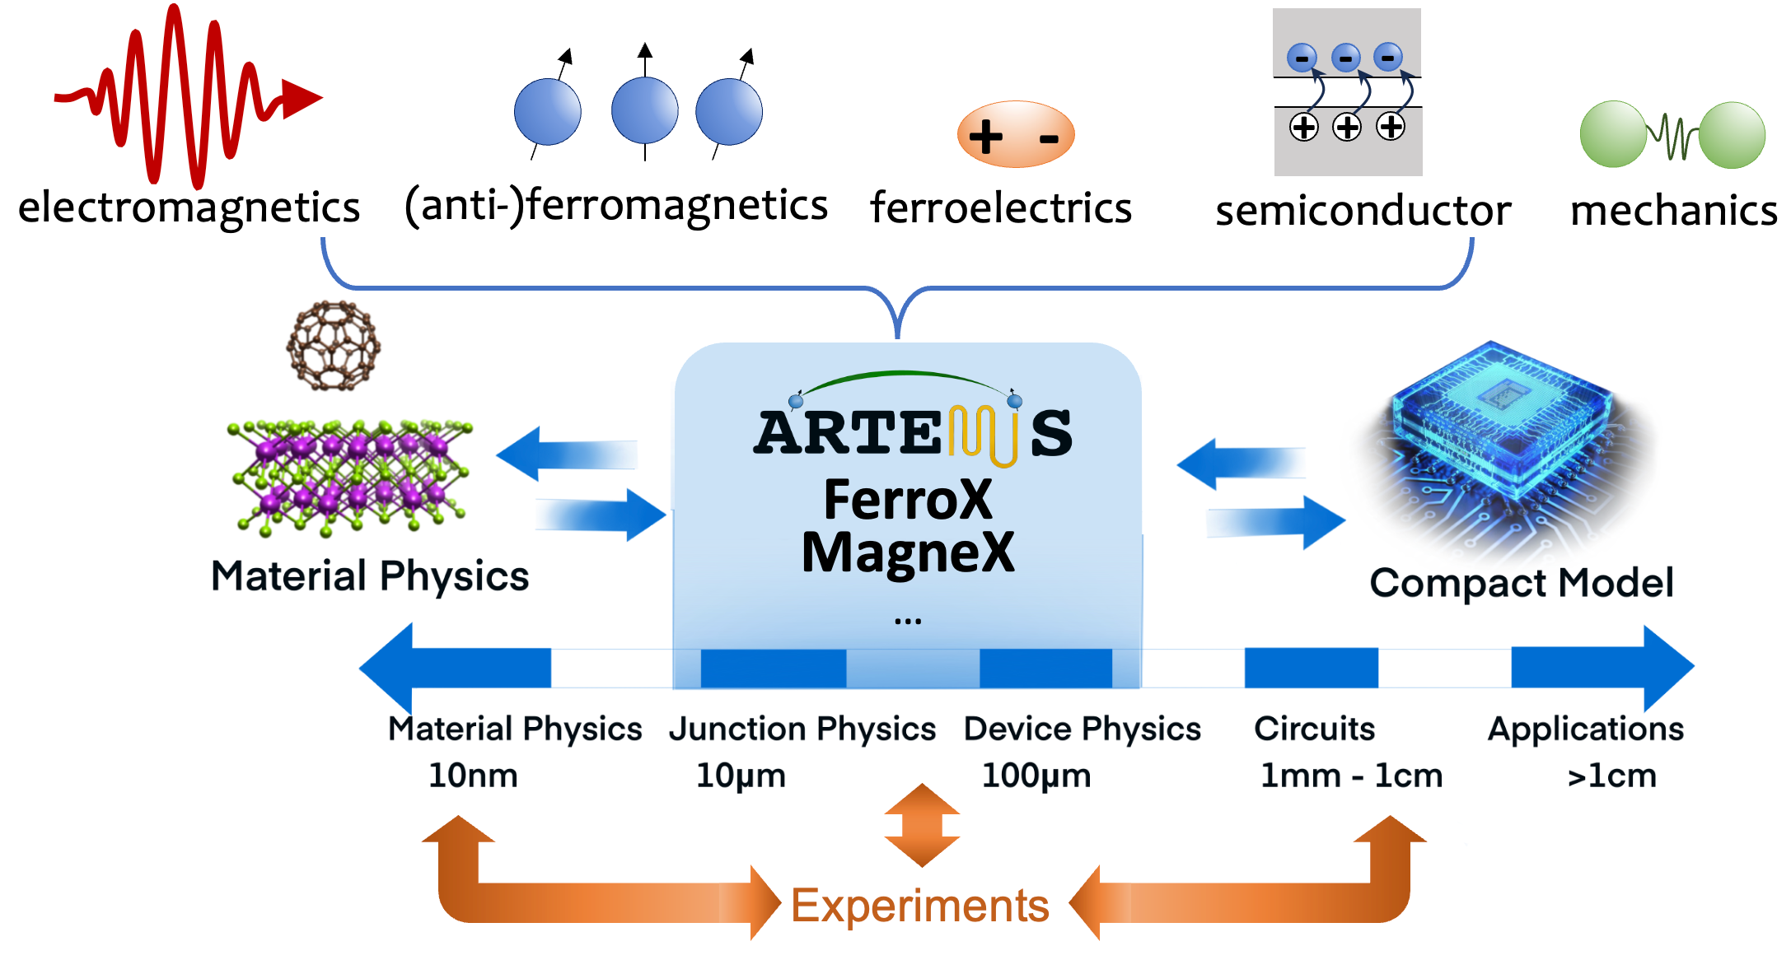

MicroEleX : Flexible, Portable, Open-Source & Massively Parallel
ELEQTRONeX FerroX
MagneX
Z. Yao, et al., International Journal of High Performance Computing Applications, 36(2), pp.167-181, 2022.
S. Sawant, et al. npj Comput Mater 11, 110 (2025). https://doi.org/10.1038/s41524-025-01604-7
P. Kumar, …, Z. Yao*, Computer Physics Communications, 290, p.108757, 2023.
P. Meisenheimer, …, Z. Yao, R. Ramesh,. Adv. Mater., 2024, 36, 2404639.
S. Sawant, Z. Yao, R. Jambunathan, and A. Nonaka, IEEE J. Multiscale & Multiphysics Comput. Techn., 8, 31-39, 2022.

Slide 3
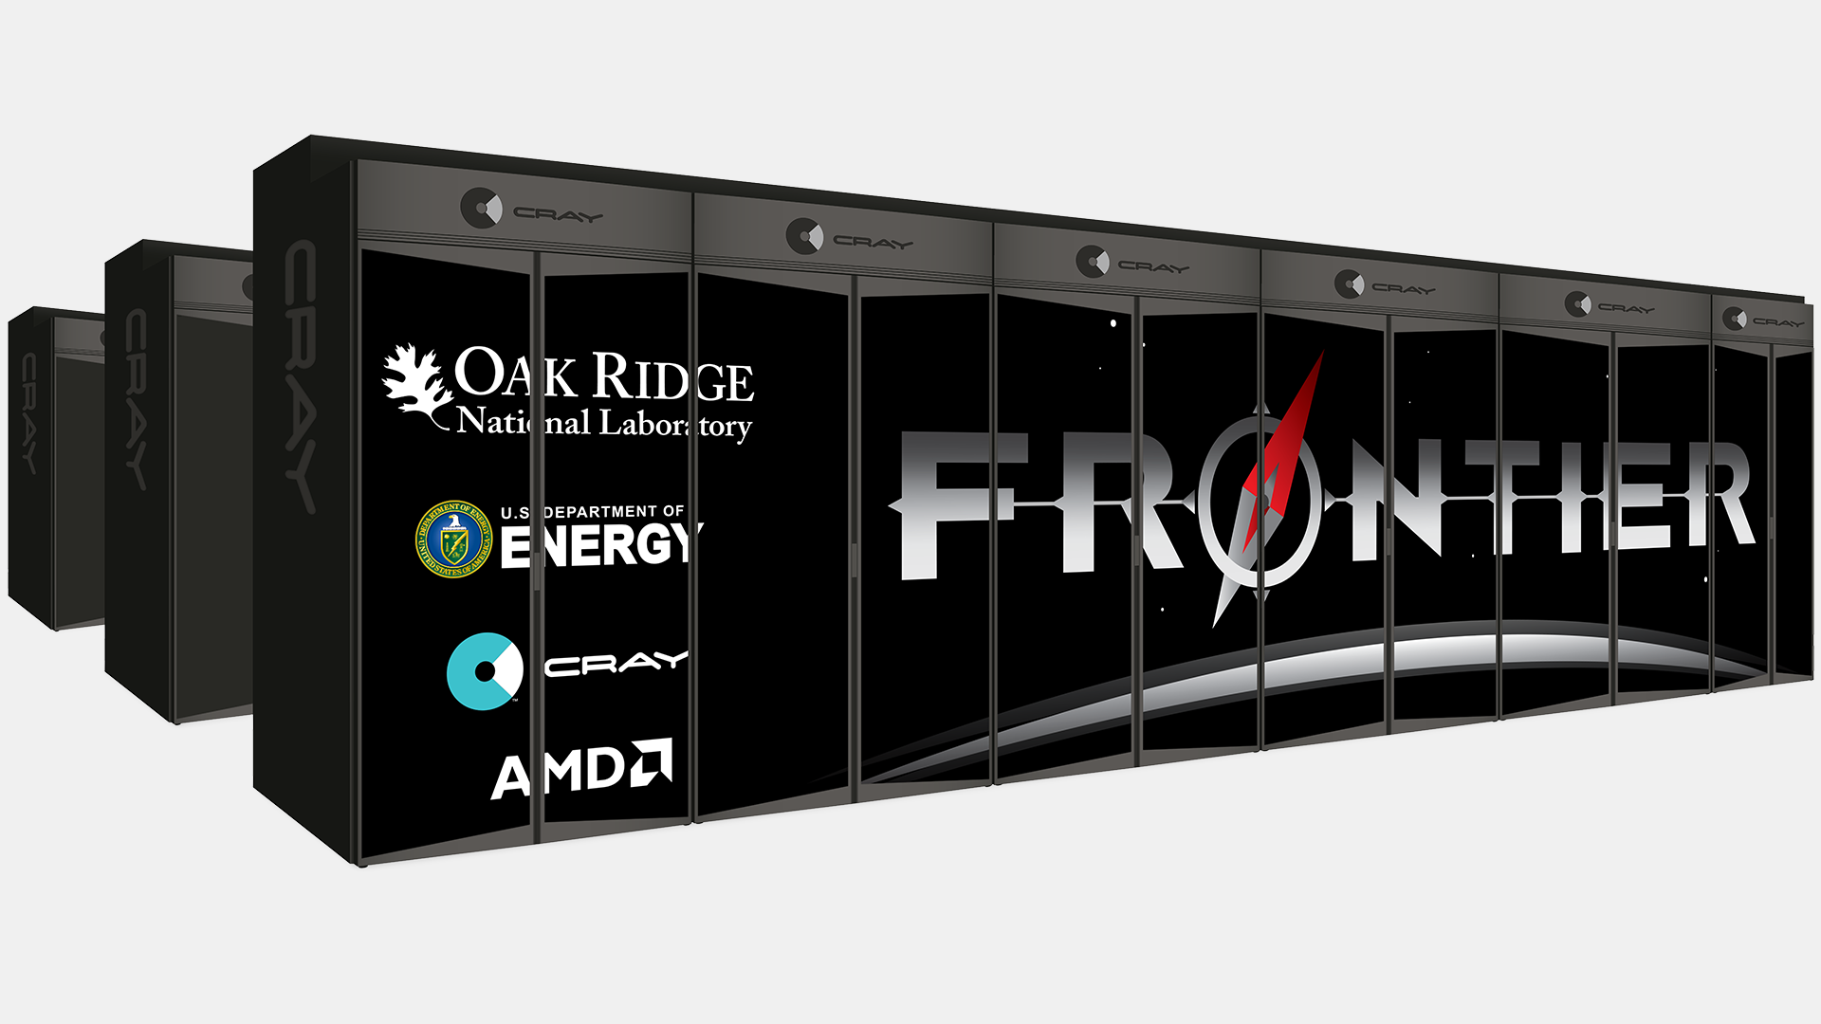
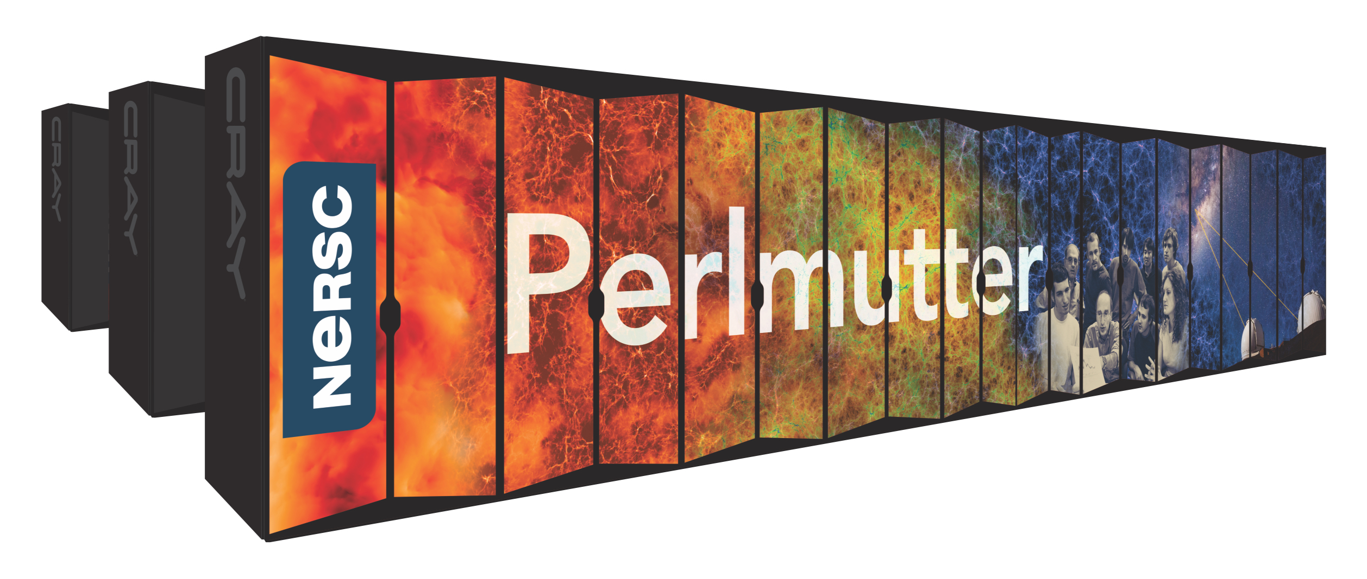

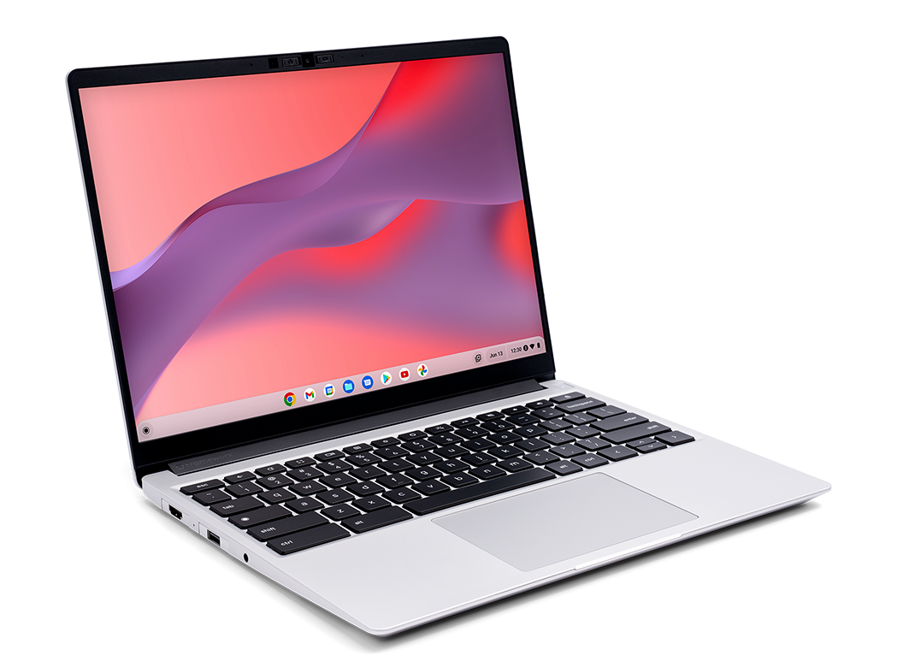
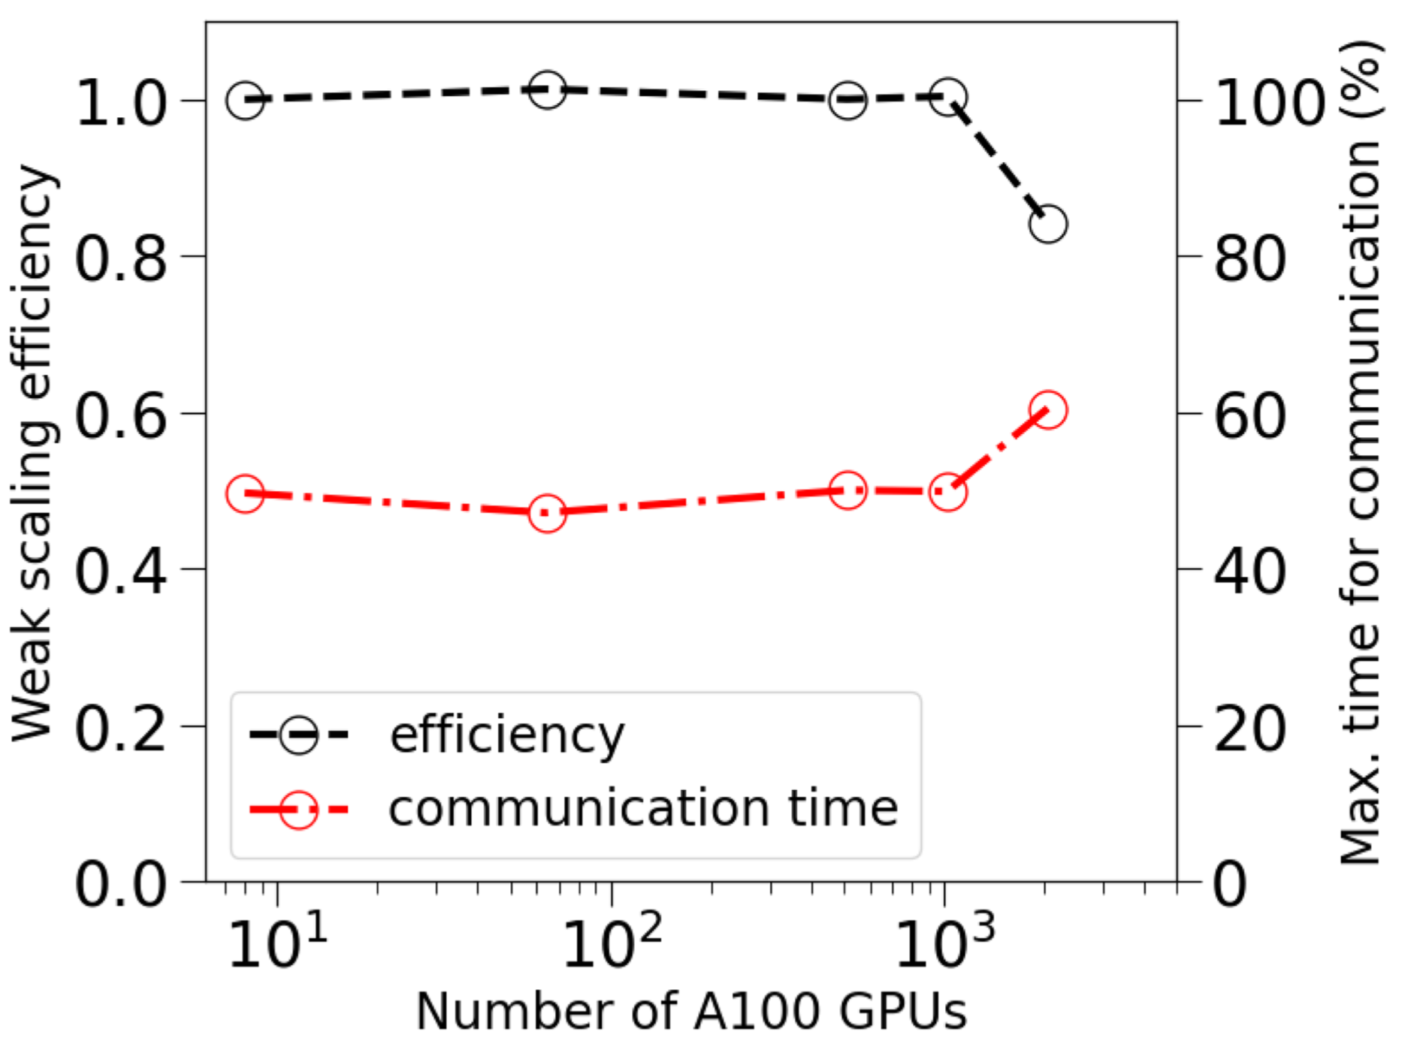
MicroEleX : Flexible, Portable, Open-Source & Massively Parallel
Performance portability
Almost Ideal Scalability
Massively GPU/CPU parallelization
Leverages exascale computing package, AMReX
MPI+X (X = OpenMP/CUDA/DPC++/HIP )
MicroEleX
GPU thread 1
Nvidia GPU
AMD GPU
ELEQTRONeX FerroX
MagneX
GPU thread n
GPU thread 2
GPU thread n+1
GPU thread 3
…
intel GPU
No overhead runtime from GPU communication
Nvidia GPU
Algorithmic flexibility
Modularized packages: Artemis, FerroX, MagneX, ELEQTRONeX
Ready for coding additional physical coupling
Time-domain algorithms suitable for nonlinear problems
Accessibility
Open-source on GitHub
https://github.com/AMReX-Microelectronics
Z. Yao, et al., International Journal of High Performance Computing Applications, 36(2), pp.167-181, 2022.
S. Sawant, et al. npj Comput Mater 11, 110 (2025). https://doi.org/10.1038/s41524-025-01604-7
P. Kumar, …, Z. Yao*, Computer Physics Communications, 290, p.108757, 2023.
P. Meisenheimer, …, Z. Yao, R. Ramesh,. Adv. Mater., 2024, 36, 2404639.
S. Sawant, Z. Yao, R. Jambunathan, and A. Nonaka, IEEE J. Multiscale & Multiphysics Comput. Techn., 8, 31-39, 2022.

Slide 4
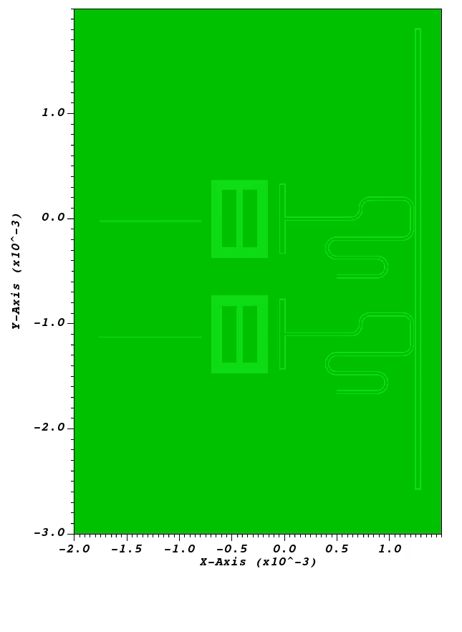
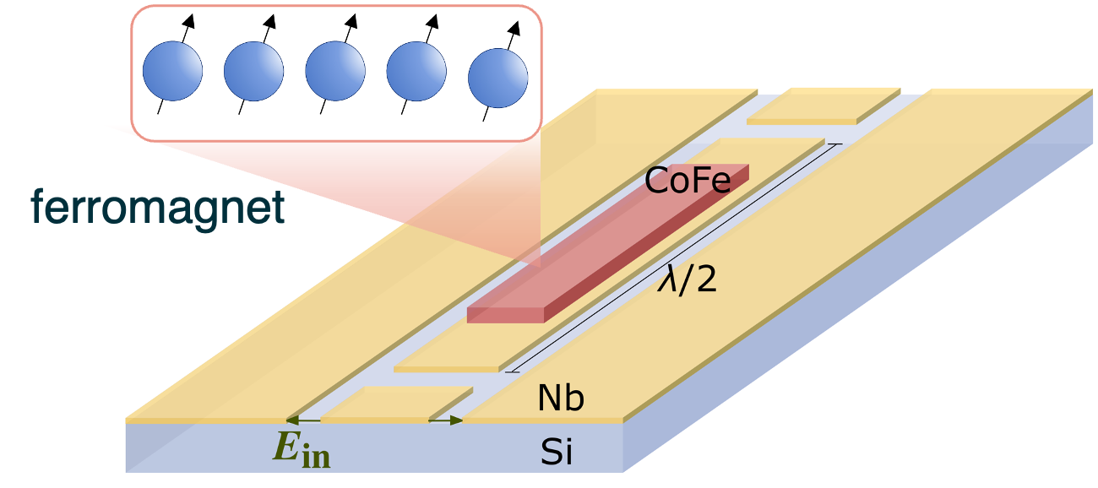
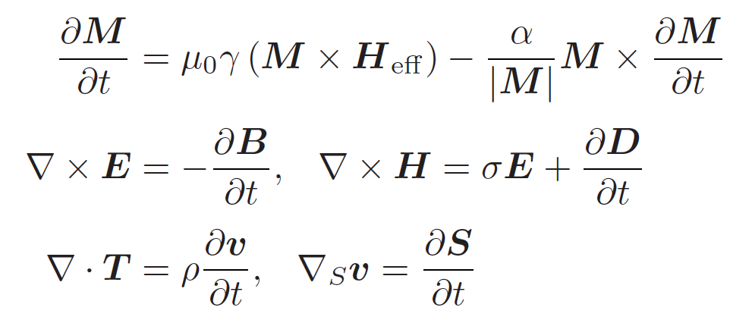
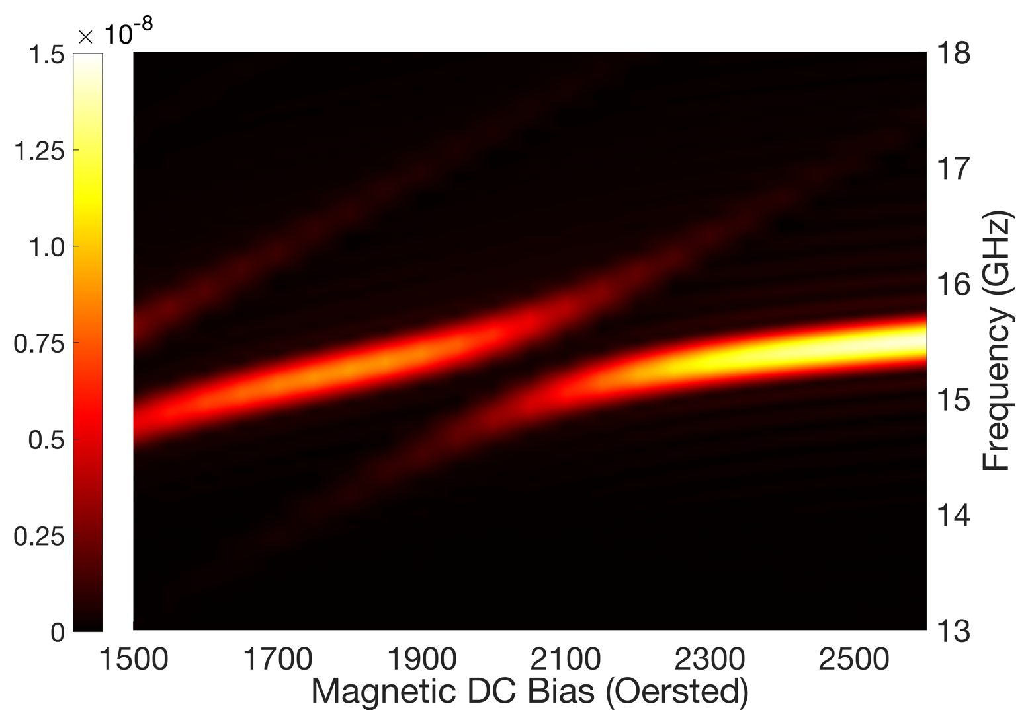
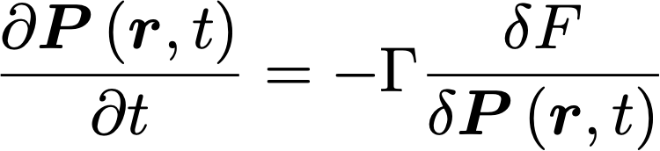
Artemis: Adaptive mesh refinement electromagnetic solver
Model Architecture
Model Use Case
Electrodynamics Maxwell’s Equation
+
Micromagnetic Dynamics
Landau-Lifshitz-Gilbert Equation
OR
Ferroelectric Ginzburg-Landau Equation
Hybrid quantum circuits
Superconducting quantum circuits

Slide 5
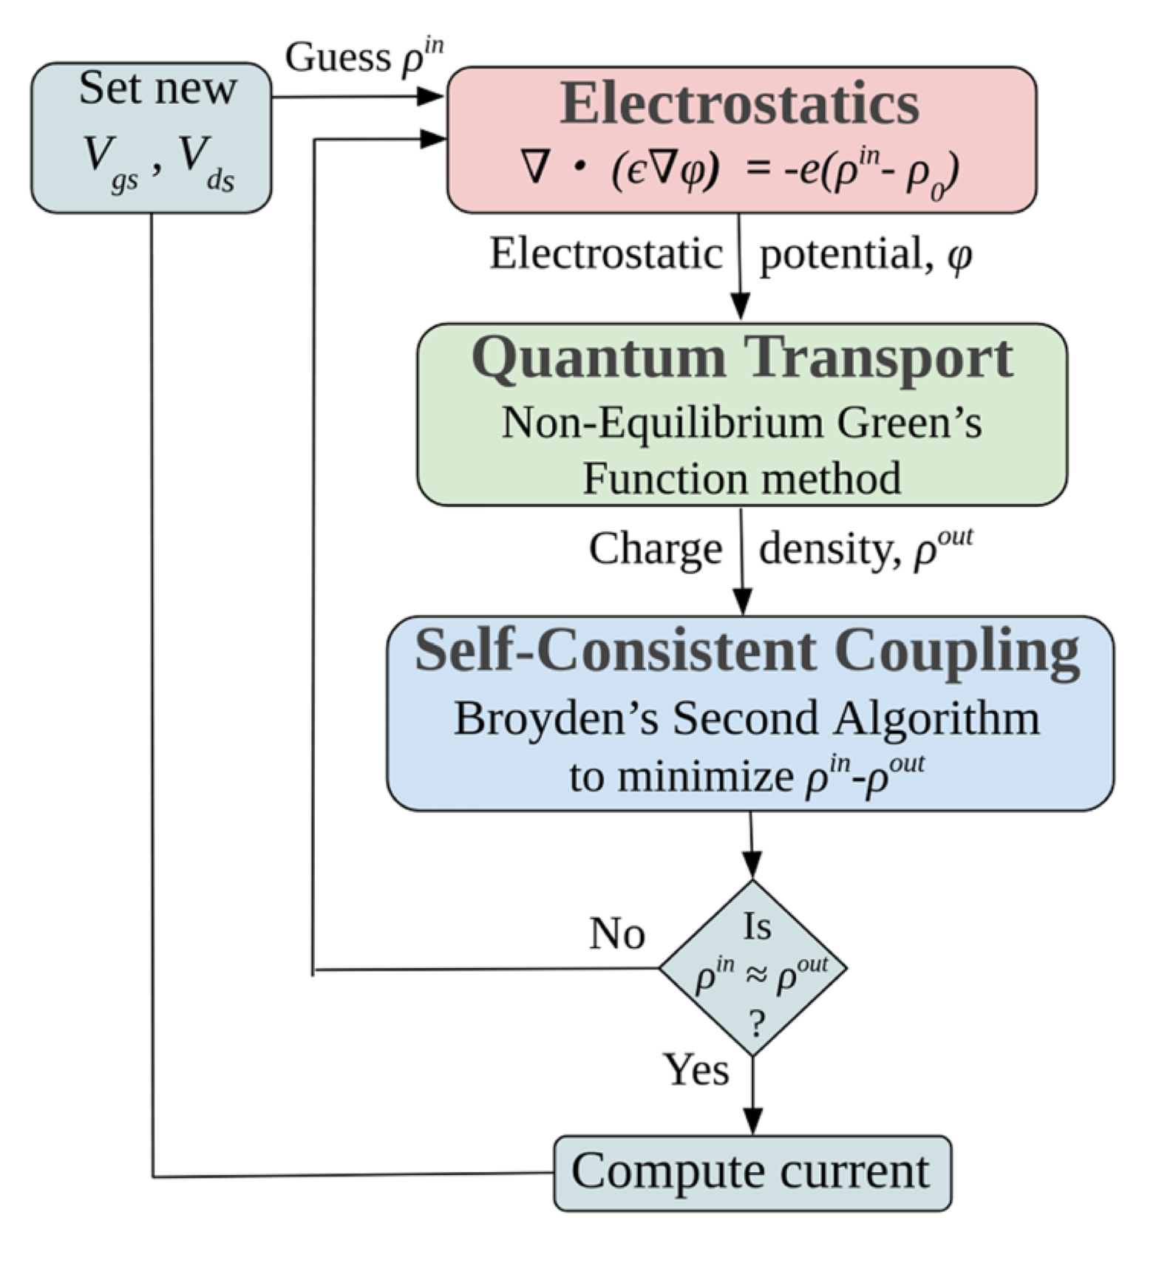
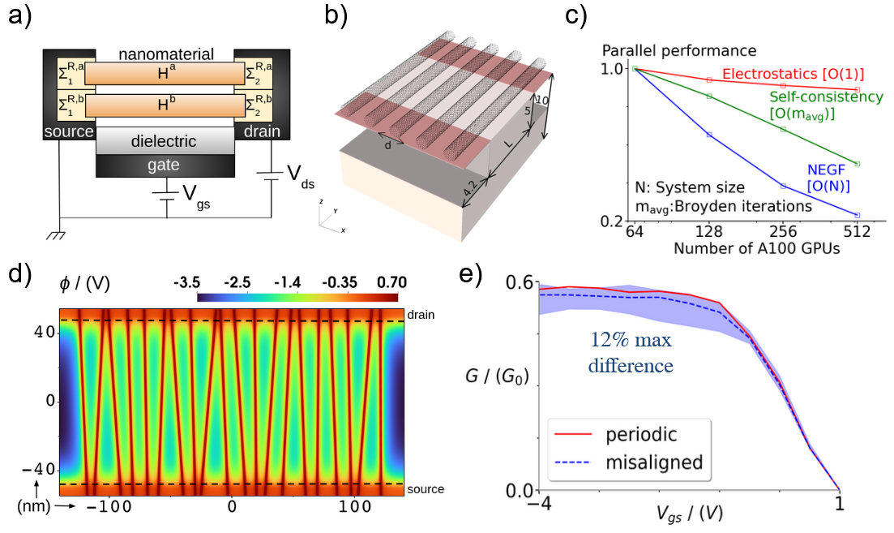
The ELEQTRONeX Framework for Nonequilibrium Quantum Transport in Nanomaterials
Model Architecture
Model Use Case
S. S. Sawant, F. Léonard, Z. Yao, A. Nonaka, “ELEQTRONeX: A GPU-Accelerated Exascale Framework for Non-Equilibrium Quantum Transport in Nanomaterials,” NPJ Computational Materials (accepted, March 2025. doi:10.48550/arXiv.2407.14633
Notes:
The ELEQTRONeX framework is capable of self-consistently solving coupled electrostatic / quantum transport physics in nanodevices.
We have modeled 3D configurations of carbon nanotube field effect transistors (CNTFETs) with multiple nanotubes and non-idealities to characterize performance degradation due to angular misalignment and pitch variation, addressing common experimental concerns.
Understanding quantum transport in nanomaterials can lead to improved design an optimization of more energy-efficient electronic and optoelectronic devices, including sensors.
Electron transport is modeled using the nonequilibrium Green’s function method, coupled self-consistently with the electrostatics module via Broyden’s second algorithm.
ELEQTRONeX uses the AMReX library for HPC-scalable electrostatics, real-space atom representation, and parallelization, with an optional hypre library for electrostatics.
Low-level parallelization strategies are developed for the NEGF and Broyden’s methods.
(a) Schematic of a multi-channel FET. (b) Bottom-gate planar CNTFET configuration with 5 parallel CNTs. Dimensions in nm. (c) Parallel performance of three main modules in ELEQTRONeX – electrostatics, NEGF, and self-consistency using Broyden’s algorithm. (d) Planar CNTFET with 20 misaligned CNTs with channel length L=100 nm, average pitch d=3.2 nm– electrostatic potential shown at V_{gs}=-4V (Open state) on a Z-plane passing through CNTs. (e) Effect of CNT misalignment on conductance normalized by quantum of conductance compared to an ideal periodic setup.

Slide 6
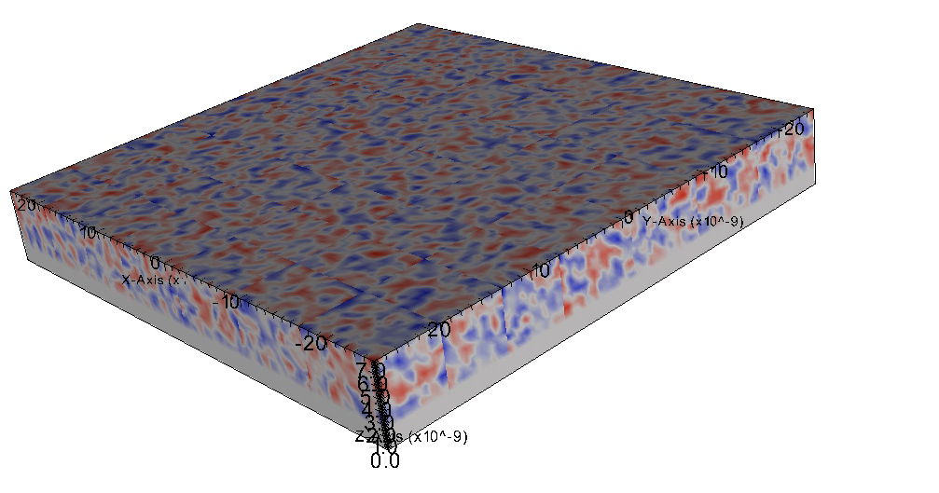
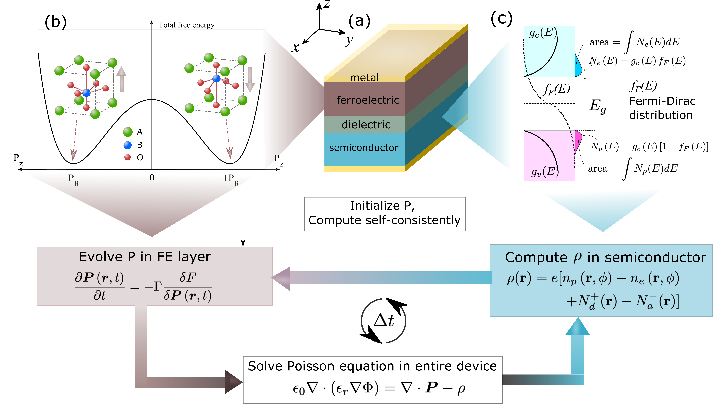
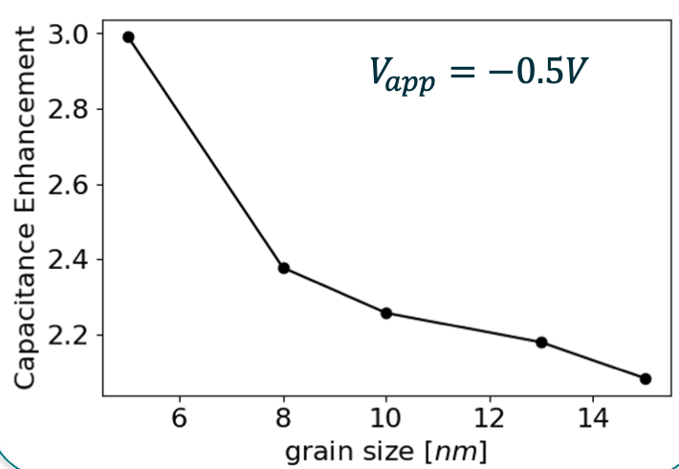
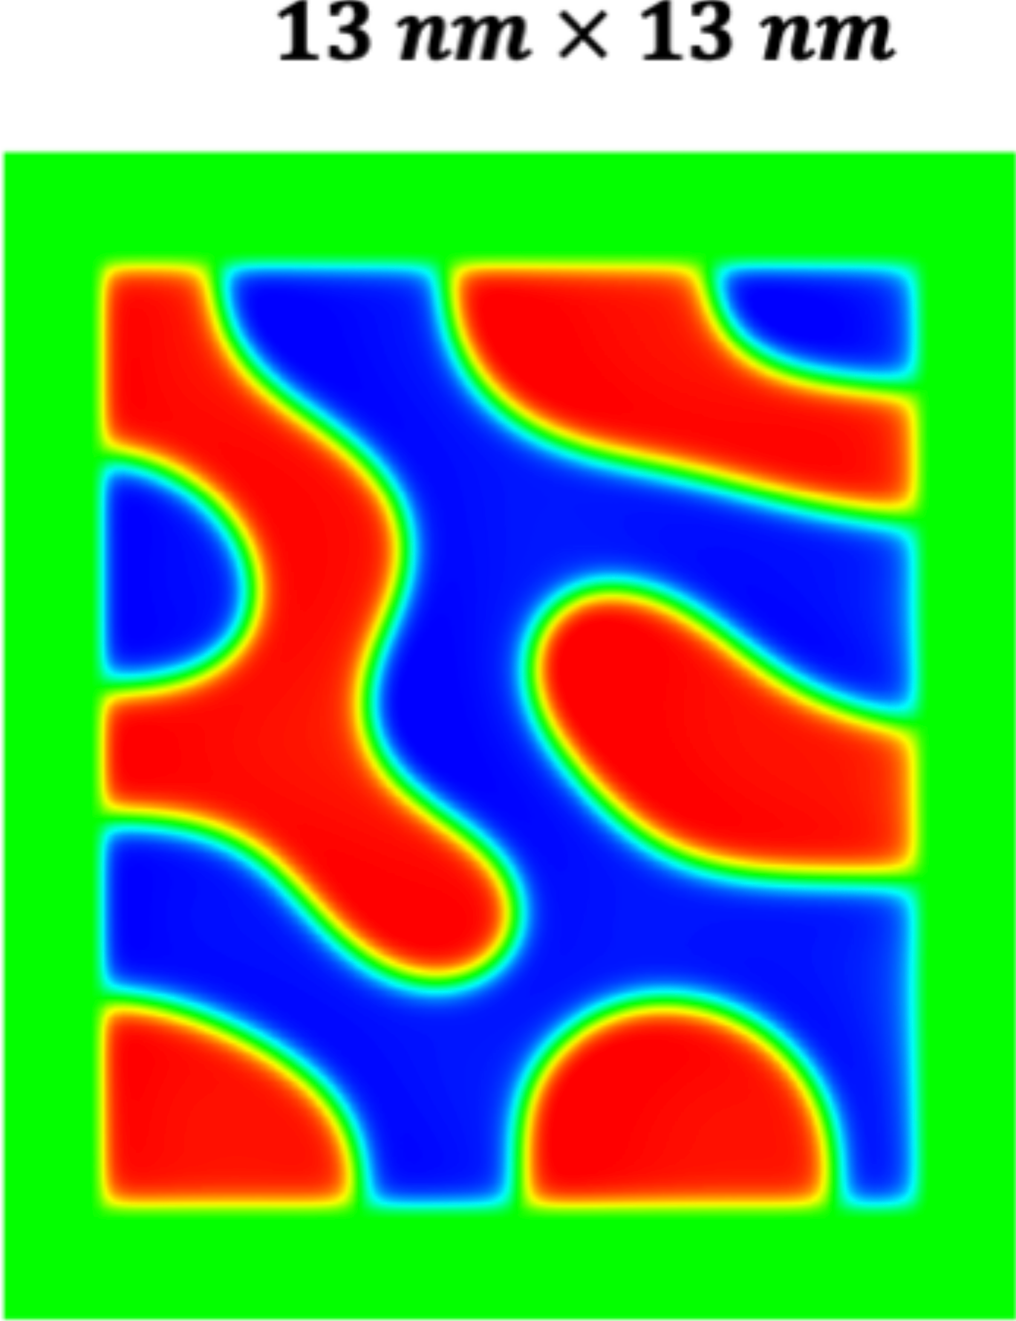
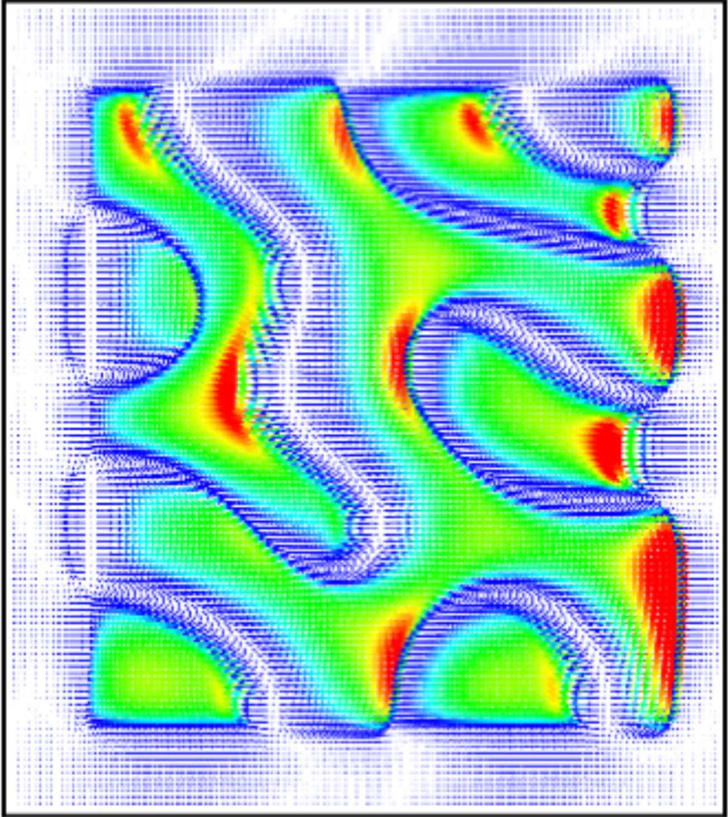
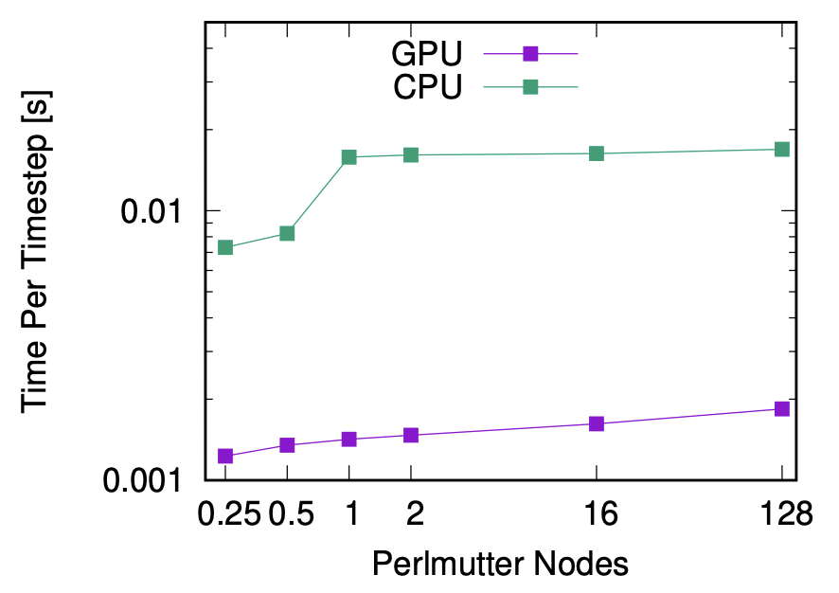
FerroX Phase Field Module for Ferroelectric Devices
Model Architecture
Model Use Case
Polarization evolution
FET gate capacitance enhancement
13 nm x 13 nm
polarization
E field
GPU scaling:
P. Kumar, et al.,Computer Physics Communications 290, 108757, 2023.
P. Kumar, et al., Adv. Electron. Mater., 10, 2400085, 2024.

Slide 7
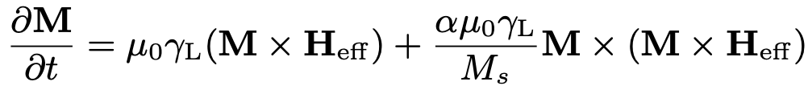
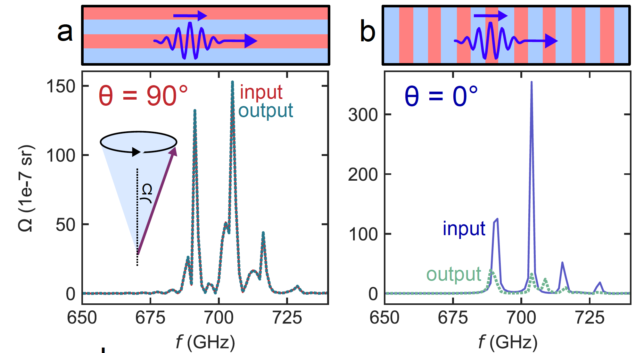
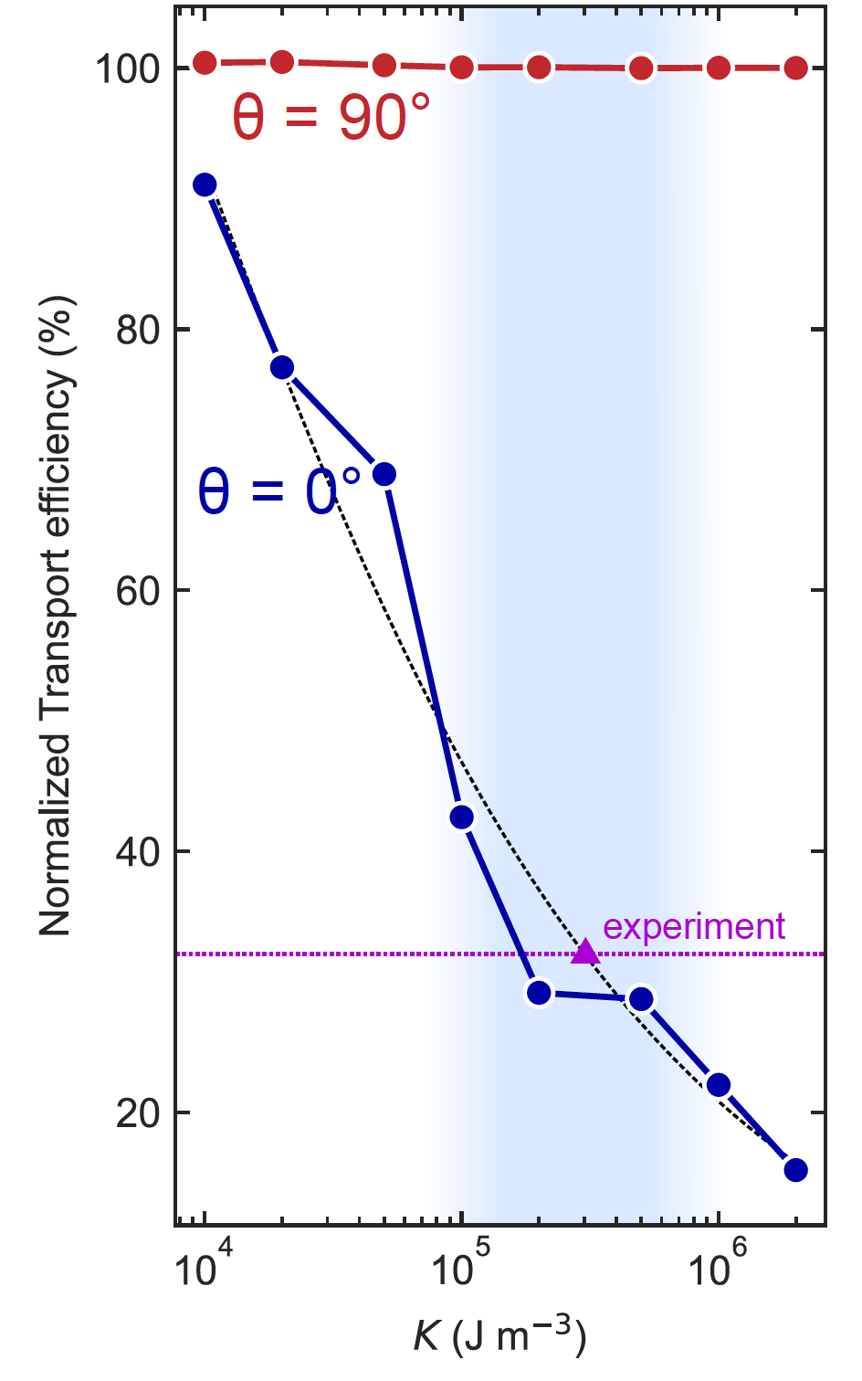
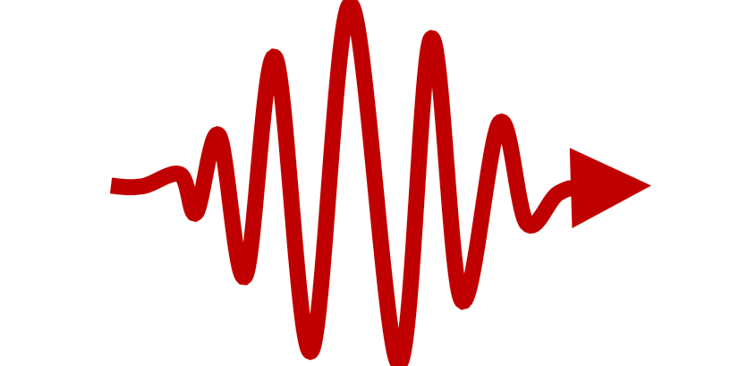
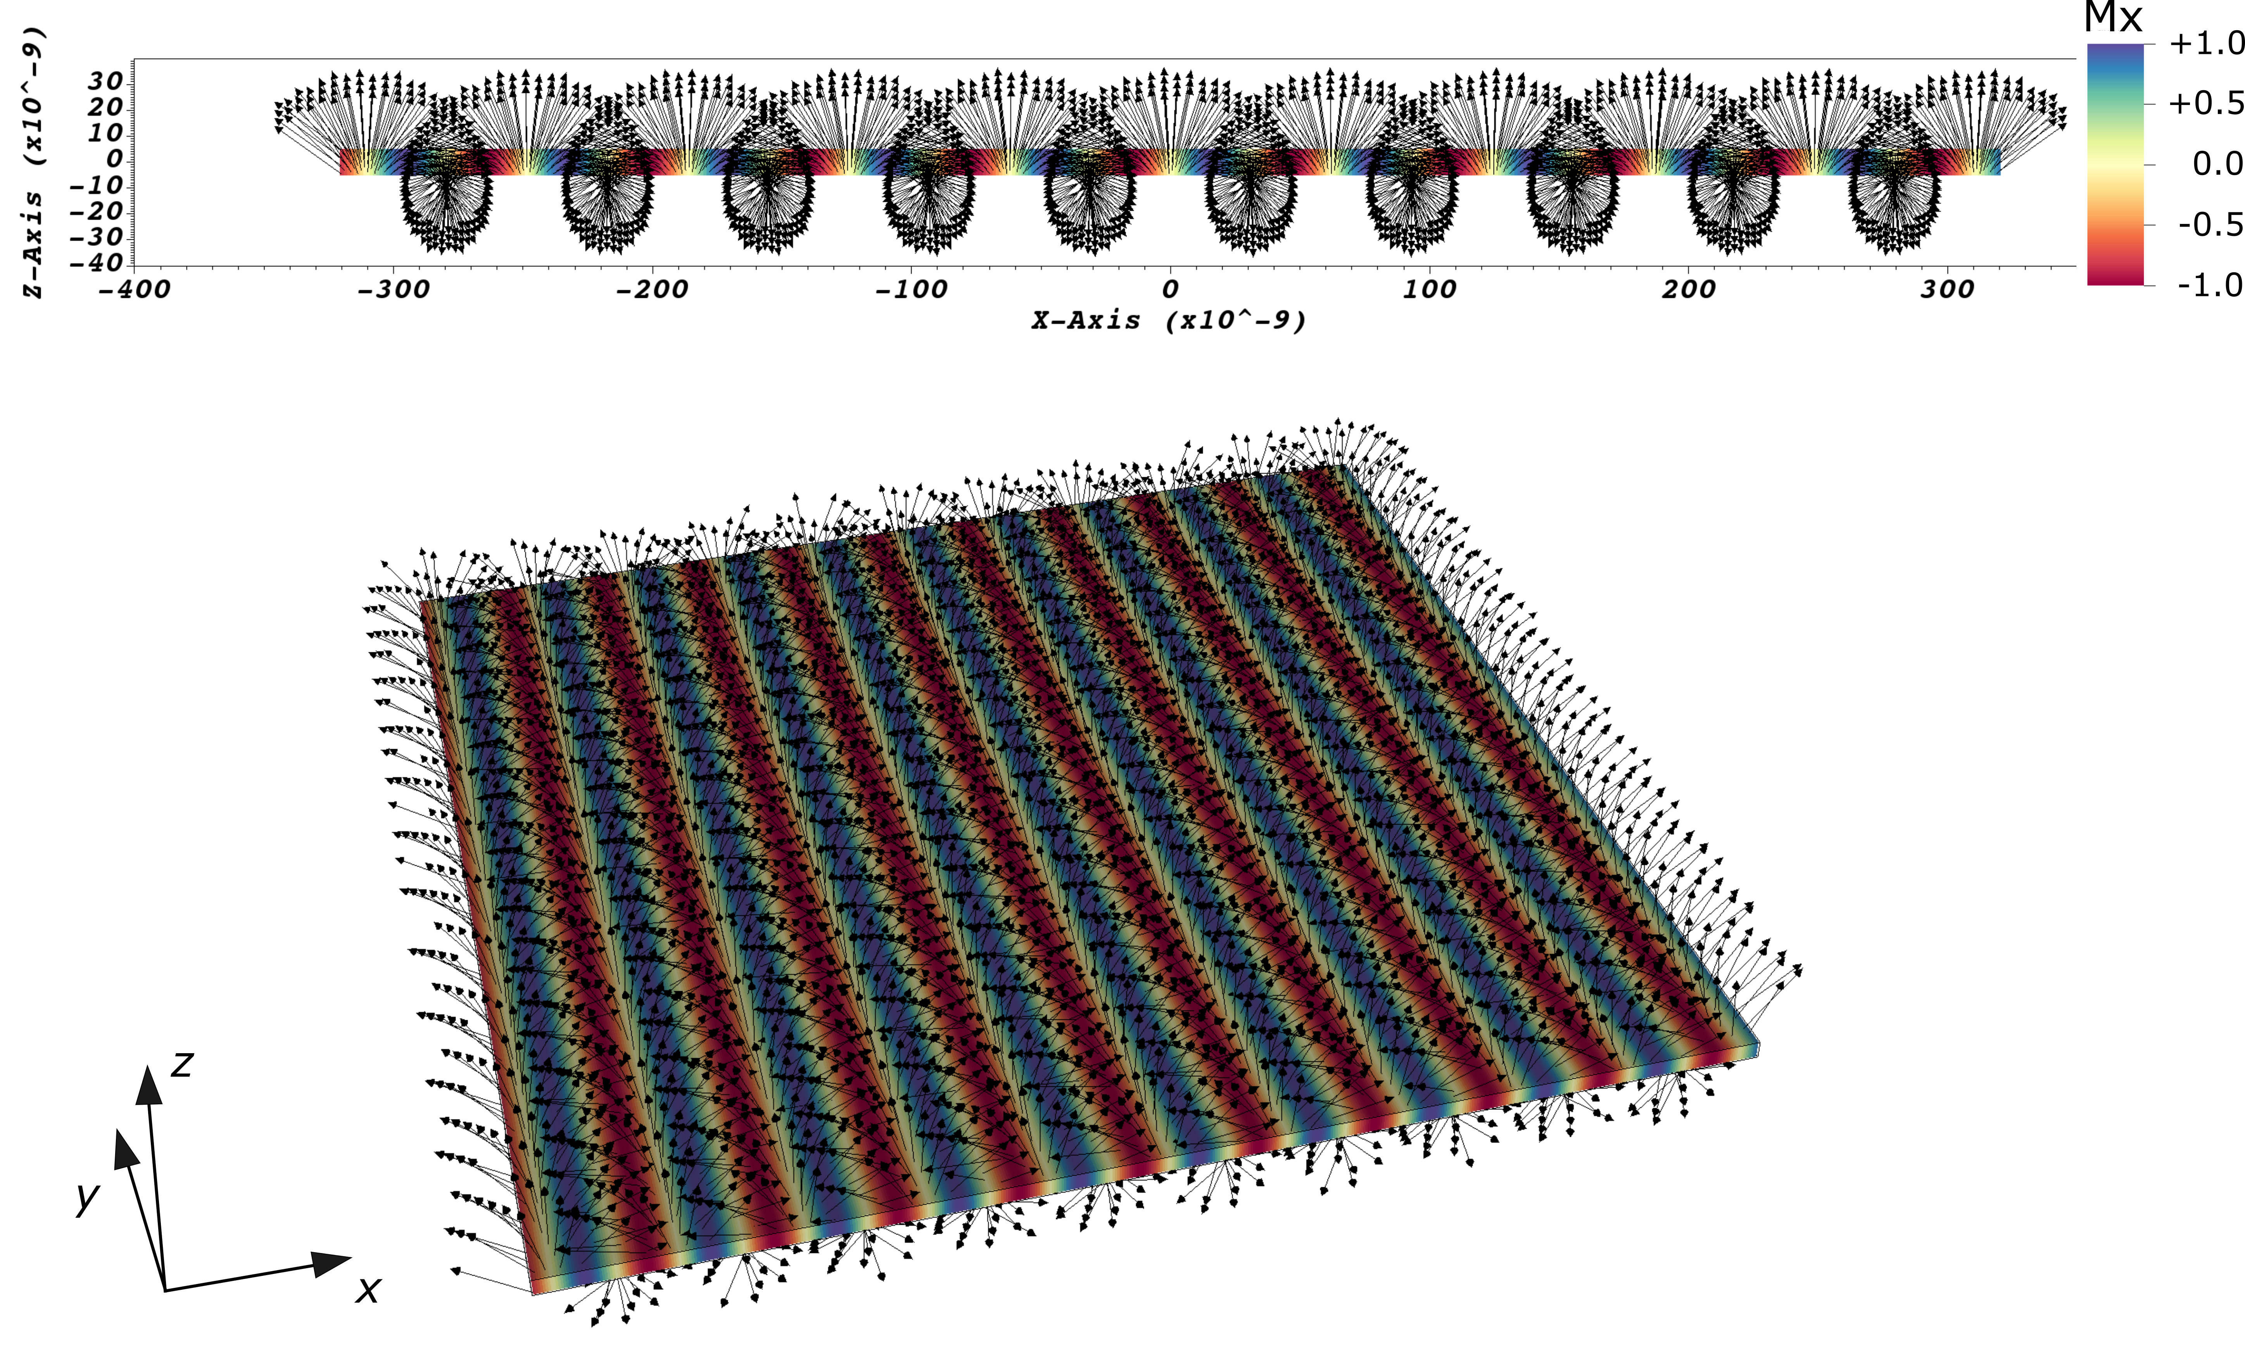
MagneX Micromagnetic Module Magnetic Devices
Model Architecture
Model Use Case
Micromagnetic simulation validates experimentally observed anisotropic magnon transport in spin cycloid texture
(Dzyaloshinskii–Moriya interaction)
Performs with consistent speed on > 500 GPU
2nd order accurate for all field variables
Validated against mumag standard problem set (https://www.ctcms.nist.gov/~rdm/toc.html)
Spin cycloid texture and magnon excitation setup in MagneX
x
P. Meisenheimer, et al., Adv. Mater., 2024, 36, 2404639.

Slide 8
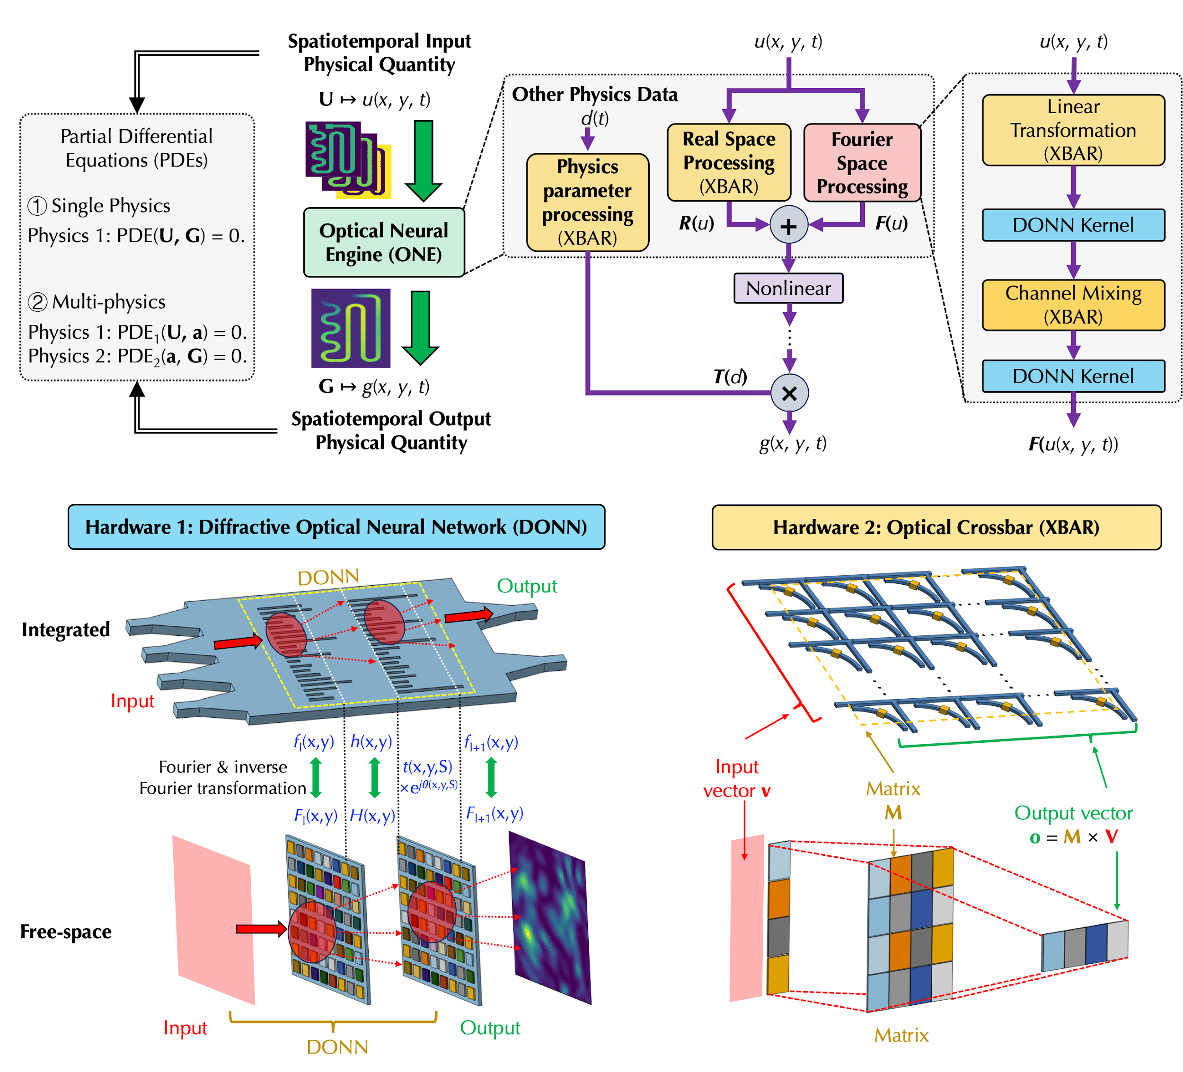
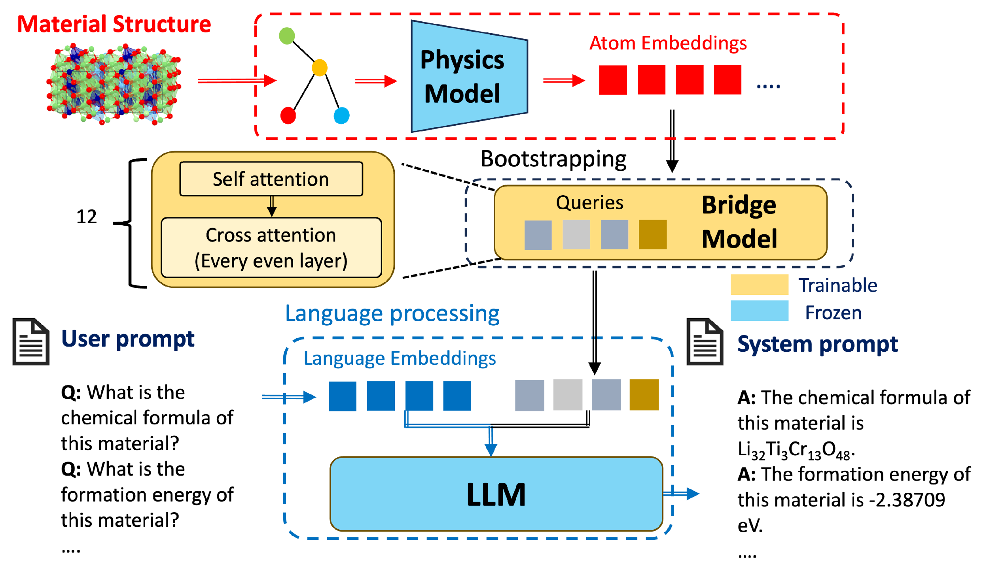
AI-enabled Scientific Discoveries
Optical Neural Engine for Solving Scientific Partial Differential Equations
MatterChat: Multimodal Large Language Model for Material Discovery
Y. Tang, et al. Optical neural engine for solving scientific partial differential equations. Nat Commun 16, 4603 (2025).
Y. Tang, et al., “MatterChat: A Multi-Modal LLM for Material Science,” submitted for publication (2025) doi:10.48550/arXiv.2502.13107
Notes:
Developed an Optical Neural Engine (ONE) architecture to solve Partial Differential Equations (PDEs) in diverse disciplines.
The demonstrated architecture offers a low-energy and highly parallel platform for large-scale scientific and engineering problem utilizing emerging computation technology.
First to demonstrate using optical neural network for sophisticated scientific problems like PDE solving.
Numerically and experimentally demonstrate the capability of the ONE architecture in solving a broad range of PDEs in diverse disciplines including fluid dynamics, micromagnetics, aerodynamics and nanophotonics.
Aligns with DOE’s mission in cutting-edge computing research, & AI for science.
Spatial-Spectral Processing: ONE models spatial field information in PDEs by jointly leveraging Fourier-space insights and Real-space computations, capturing both global spectral structure and local spatial dynamics
Hybrid Optical hardware Acceleration: Utilizes Diffractive Optical Neural Networks (DONNs) for Fourier-space processing and optical crossbar (XBAR) arrays for Real-space computation.
Developed MatterChat, a structure-aware, multi-modal large language model that unifies material atomic graph data with natural language.
MatterChat enables interactive scientific reasoning, accurate material property prediction, and step-by-step synthesis planning—bridging the gap between graph-based models and LLMs.
First to combine full-resolution structure data with a general-purpose LLM.
Enables interactive, structure-aware AI for materials science beyond text-only LLM.
Accelerates materials discovery via accurate property prediction & reasoning.
Cross-disciplinary potential: applicable to chemistry, drug design, and engineering.
Supports DOE mission goals in energy efficient materials & AI for science.
Leverages advancements in both pretrained LLMs and material foundation models.
Use a lightweight training strategy (bootstrapping) to align the two modalities.
Add a retrieval mechanism (RAG) to make predictions more accurate and stable.

