Slide 1
On the way to understanding detector requirements for polarimetry
E Shulga

Slide 2
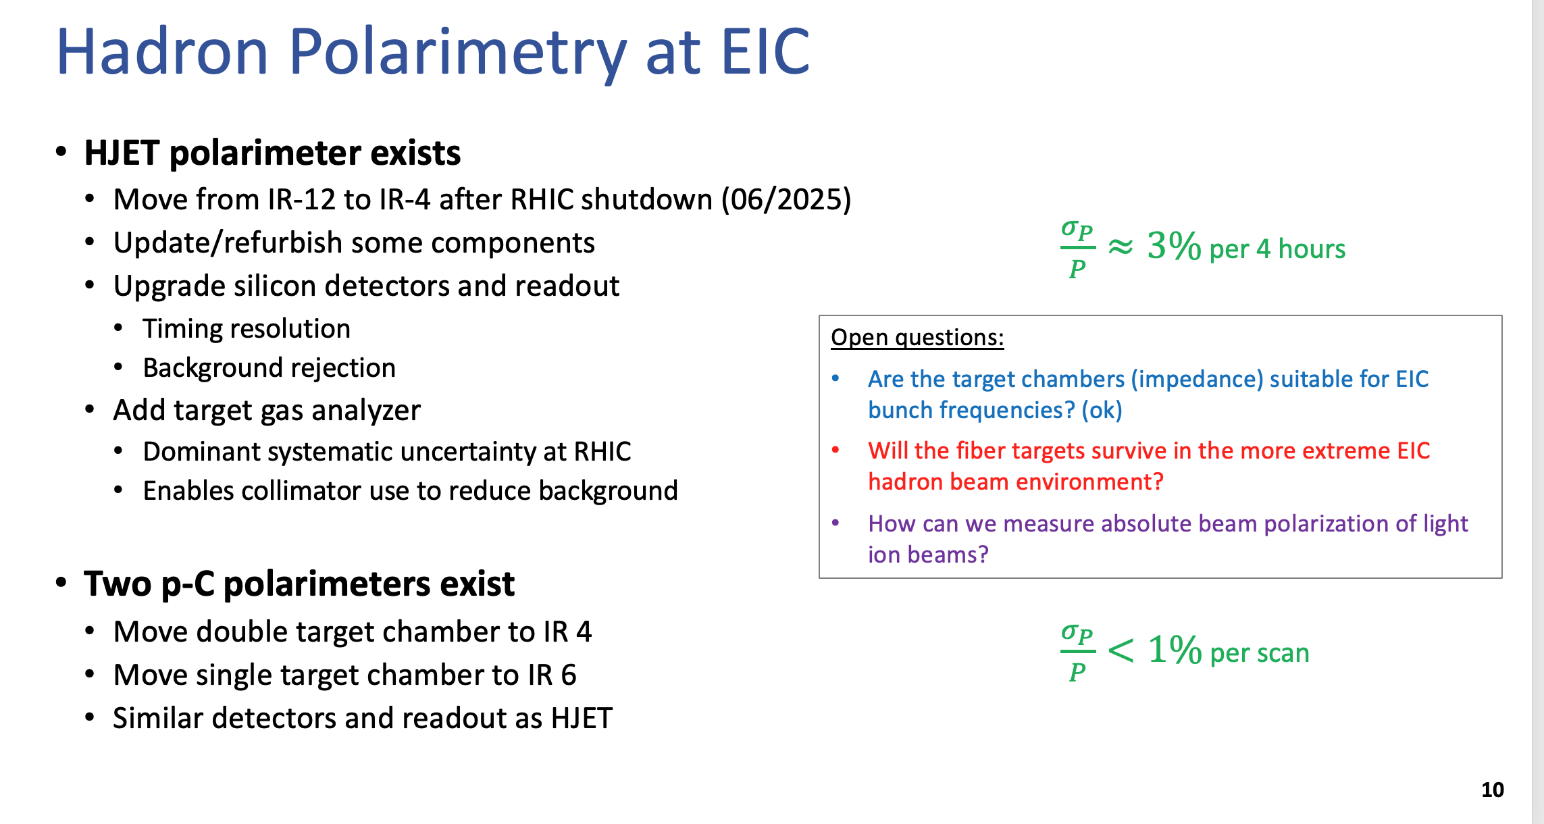
Motivation
EIC will operate at higher frequencies and with higher backgrounds, thus it is important to check detector capabilities and workout improvements to provide accurate measurements
çç
From: “Polarimetry at EIC” on July 25, 2023

Slide 3
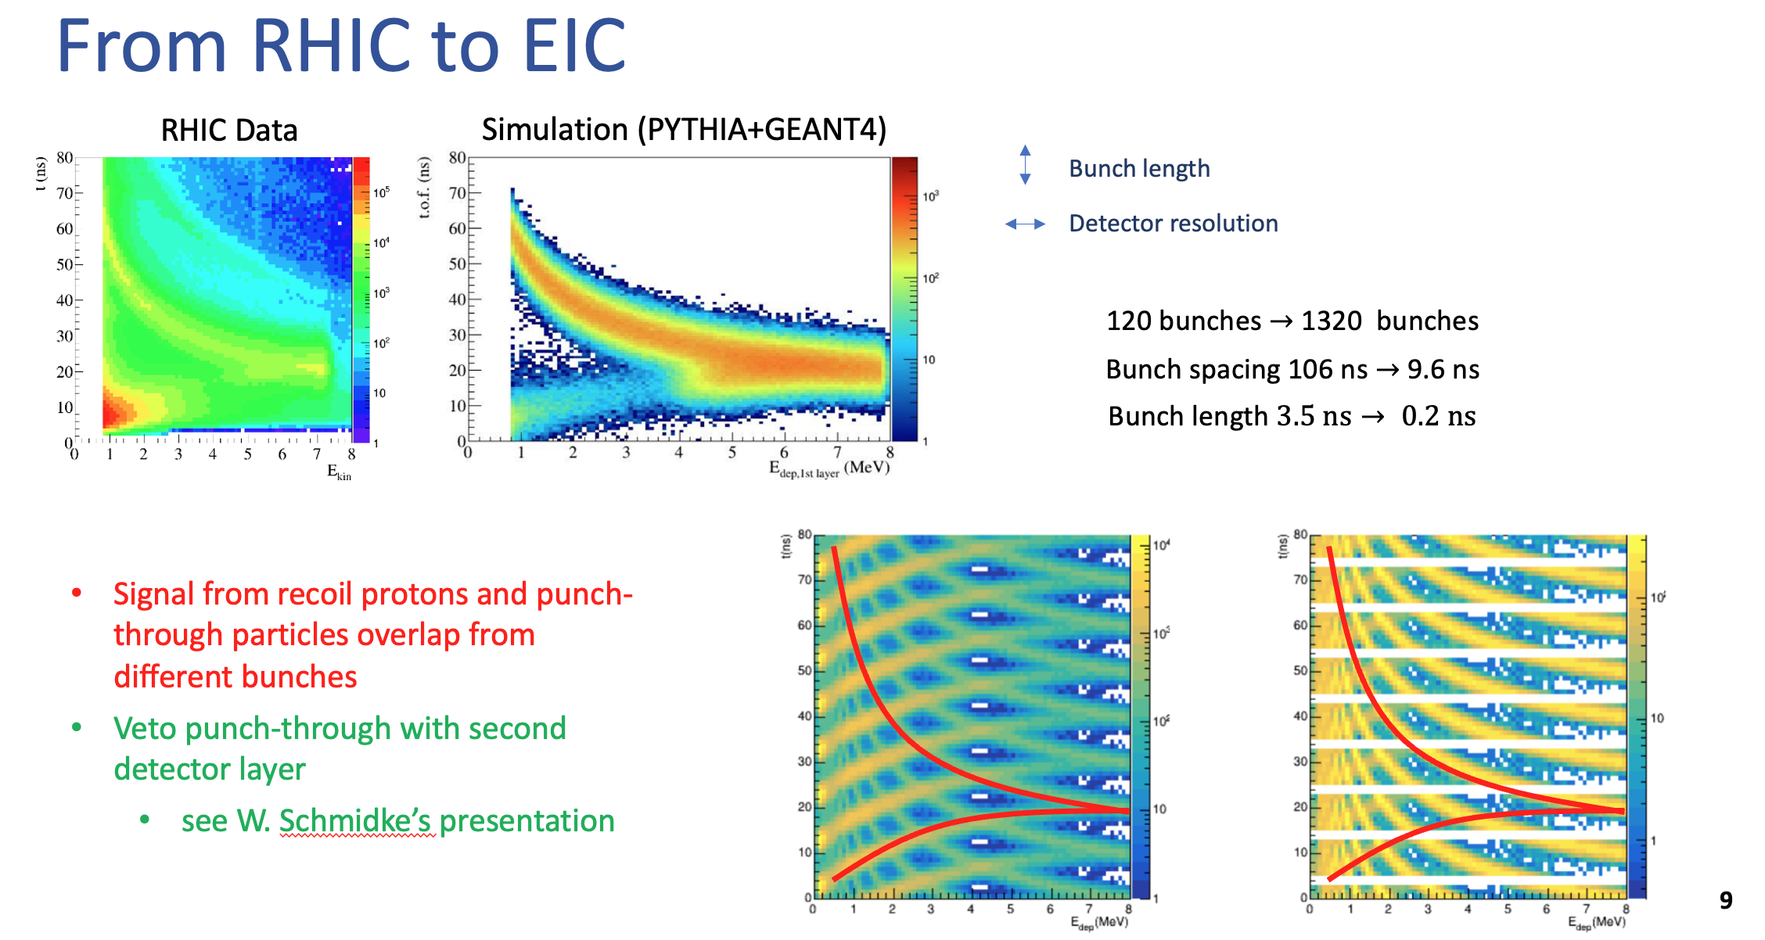
Expected differences
Main objectives: Increase time & energy resolution, Suppress backgrounds (with veto detector following the main)
From: “Polarimetry at EIC” on July 25, 2023

Slide 4
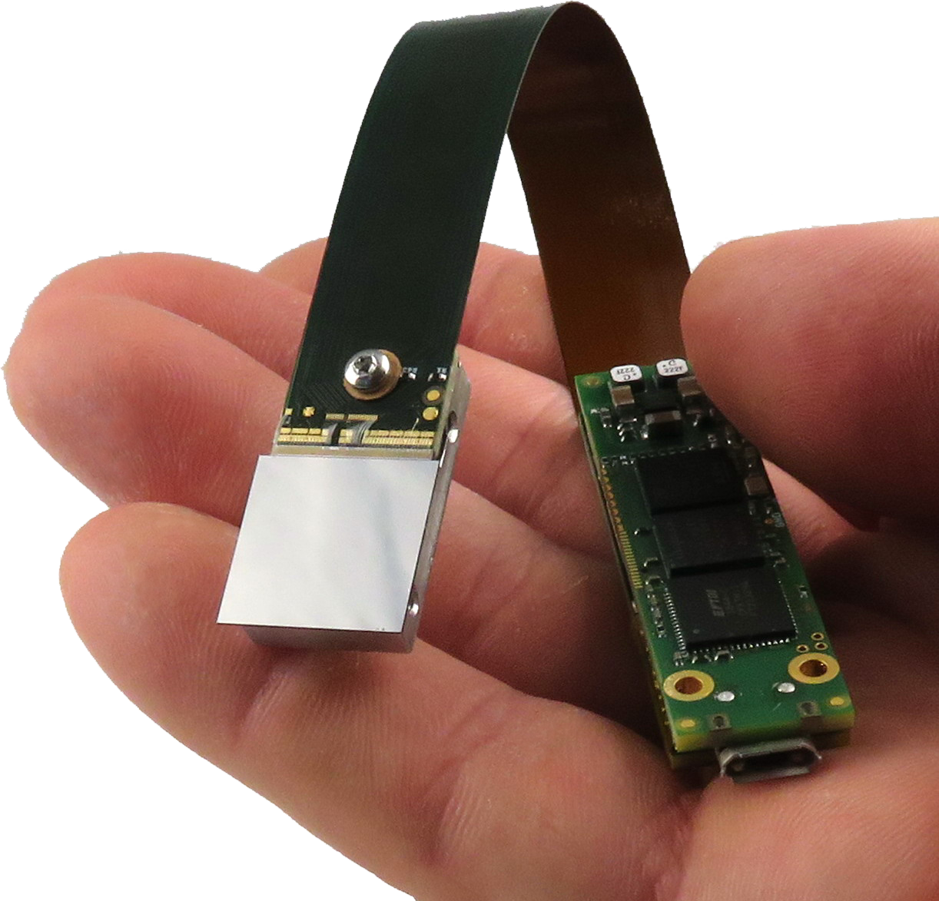
First thoughts on technology
The MiniPIX TPX3 Flex is a miniaturized and low-power radiation camera with particle tracking and imaging detector Timepix3 (256 x 256 square pixels with a pitch of 55 μm). The device’s chip is equipped with a sensor according to customer preference (standardly 300 μm thick silicon).
https://advacam.com/camera/minipix-tpx3-flex/ $16,496
+:
Well established technology
Readout and DAQ provided
There are also collaborators from UK bringing similar detectors to EIC
-:
Small size for HJET
Not clear if 55 μm pitch is needed, starting various simulations (toy-MC, Geat4)

Slide 5
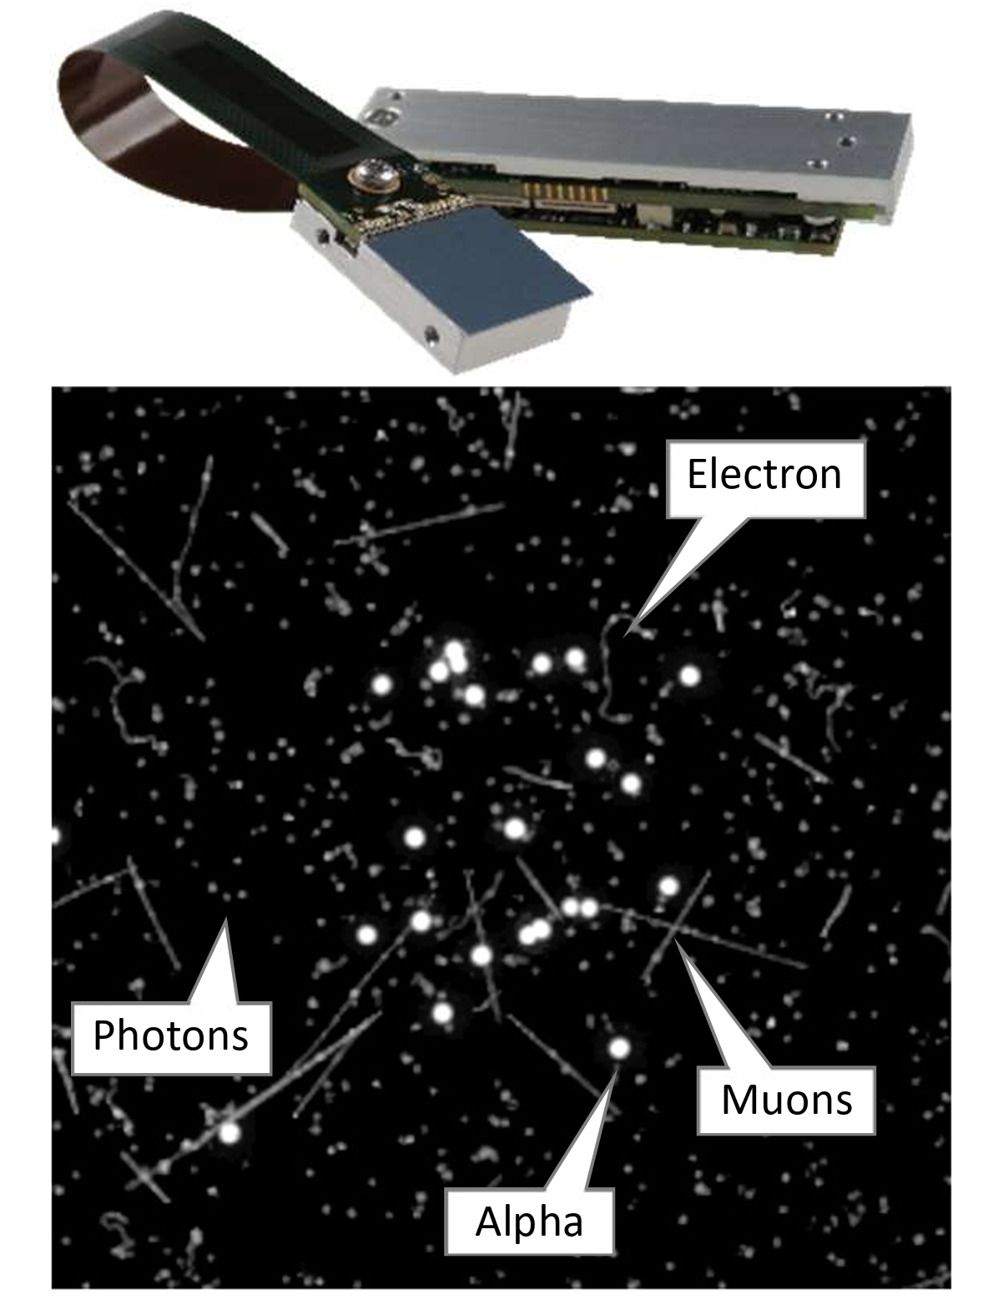
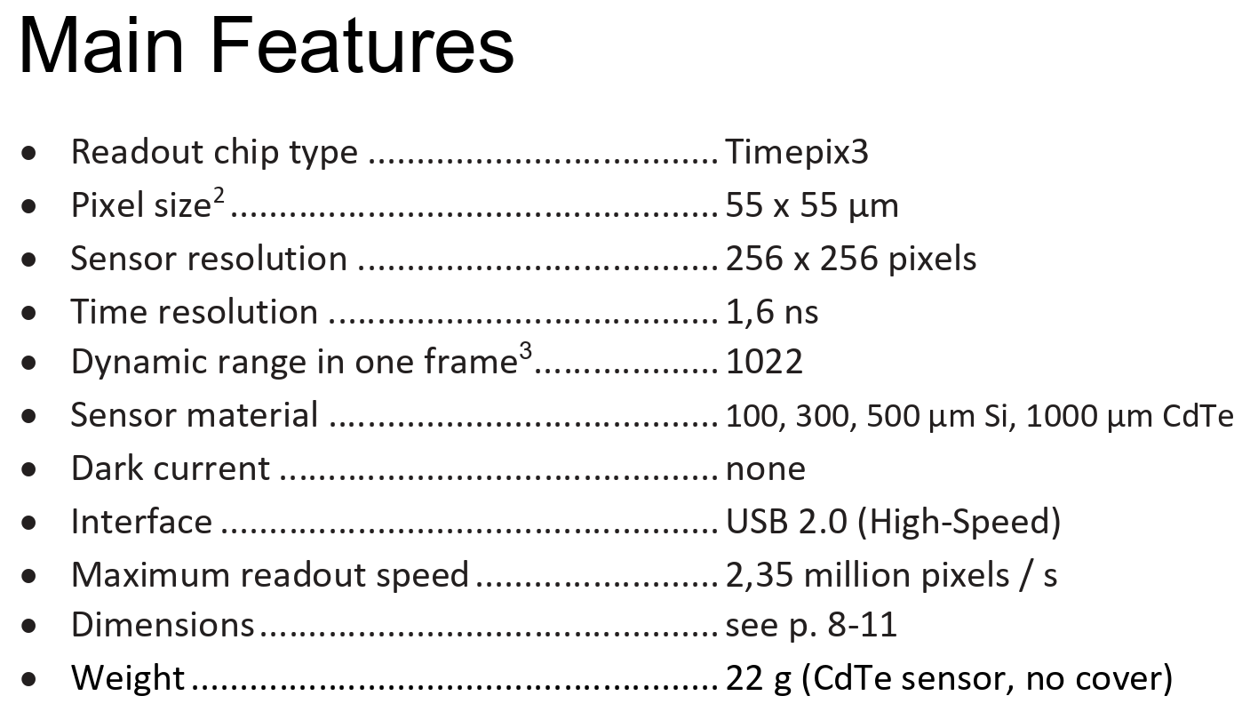
First thoughts on technology
https://advacam.com/content/uploads/2024/08/MiniPIX-TPX3-Flex-Datasheet-2024-07-23-1.pdf

Slide 6
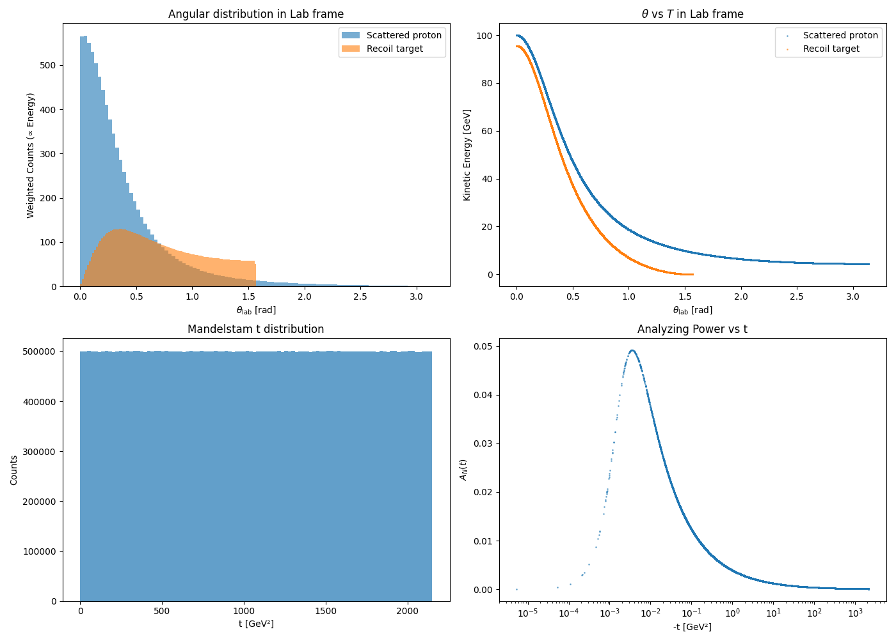
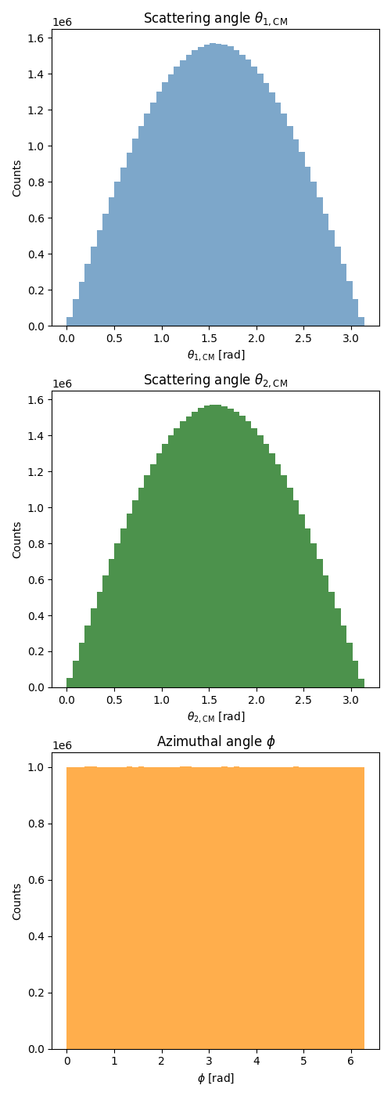
Toy MC for pp 100 GeV (first steps)
A_{N}(t) is from: I Alekseev et al ”Polarized proton collider at RHIC” 2003 Nucl. Instrum. Methods A 499 392-414

Slide 7
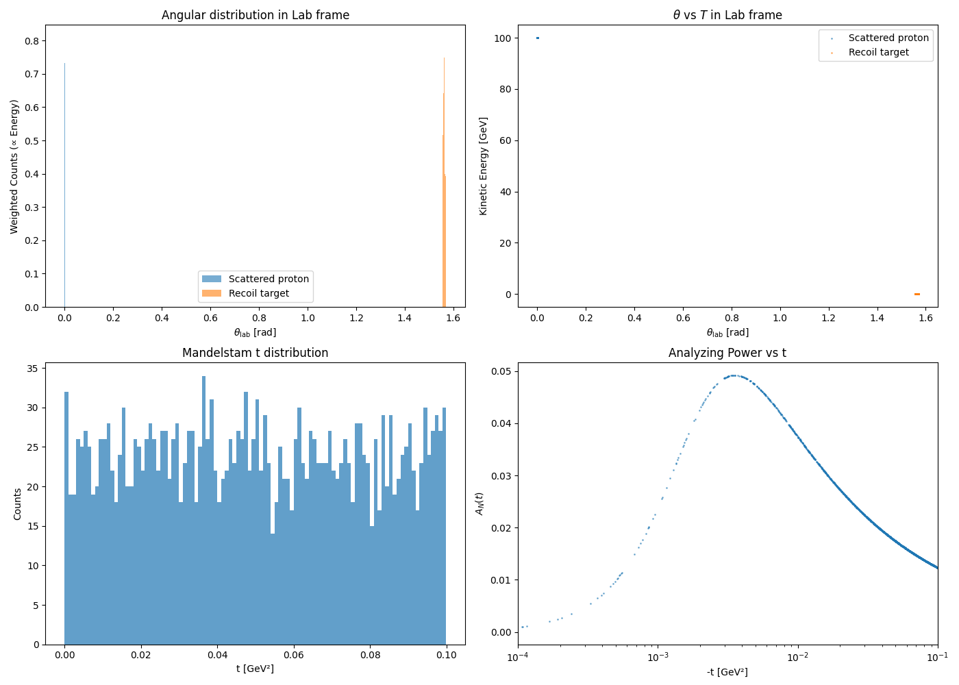
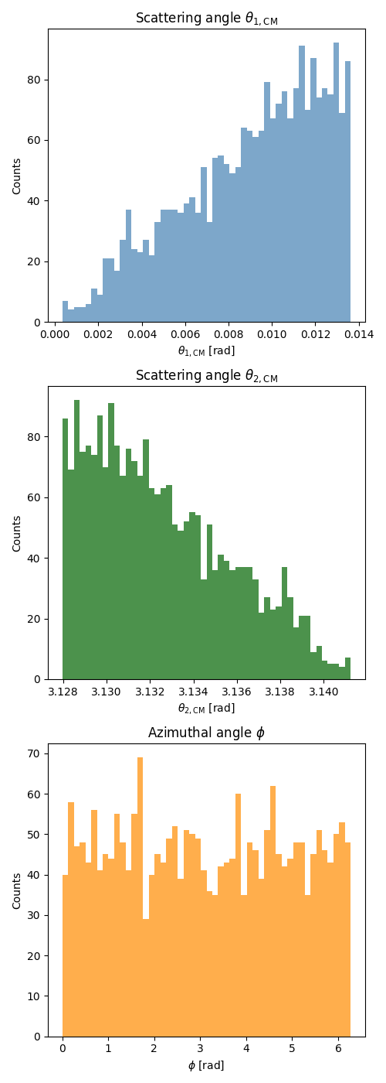
Toy MC for pp 100 GeV CNI region –t<0.1 GeV(first steps)
A_{N}(t) is from: I Alekseev et al ”Polarized proton collider at RHIC” 2003 Nucl. Instrum. Methods A 499 392-414

Slide 8
Conclusion & Plans
Slowly learning/understanding the systems and requirements
Next steps:
Understand the measurement procedure
Estimate background contribution -> compare to RHIC data -> predict for EIC
Develop detector system suitable for the high intensity measurement at EIC and background subtracktion

