Slide 1

Critical and non-critical fluctuations
at RHIC BES
Huichao Song
宋慧超
Peking University
CPOD 2017, Stony Brook, Aug. 7-11th
Aug. 10, 2017

Slide 2
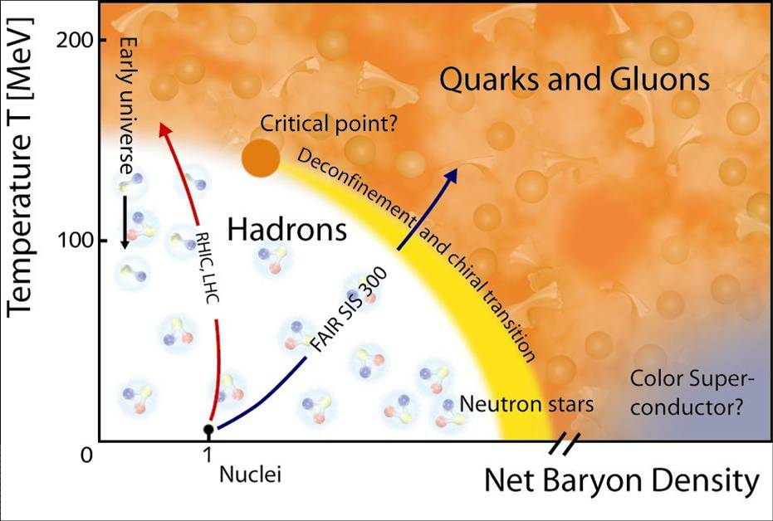

Slide 3
QGP
S.Bass
Correlations & fluctuations
-Correlated fluctuations near
the QCD critical point
-Non-critical (thermal)
fluctuations

Slide 4
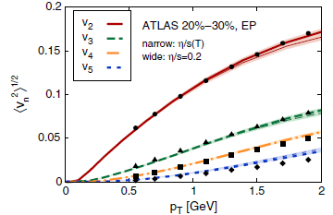
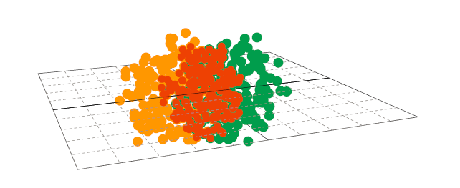
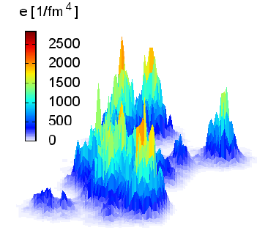
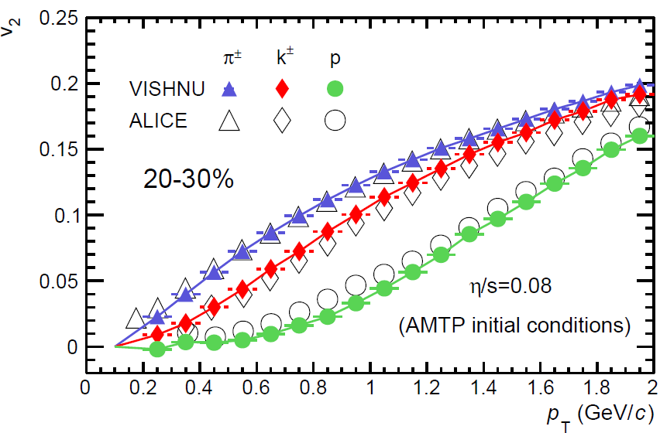
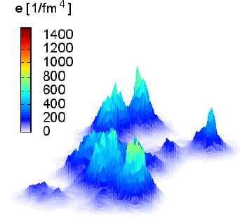
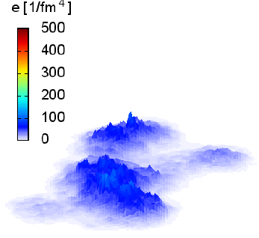
Initial state fluctuations & final state Correlations
C. Gale, PRL2013
Xu, Li & Song, PRC 2016

Slide 5
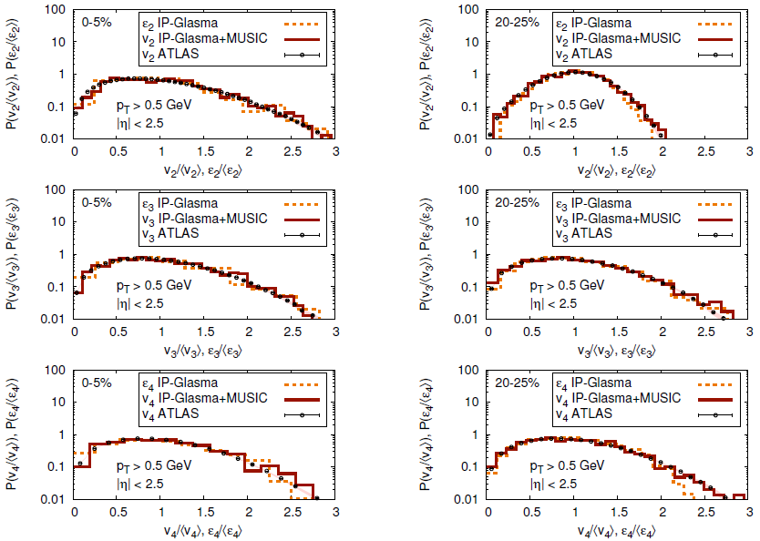
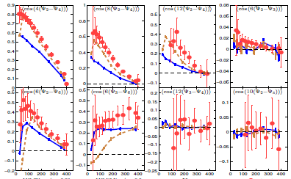
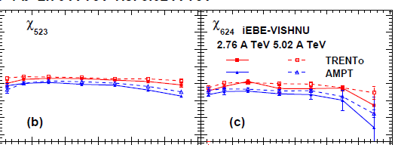
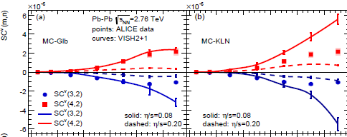
More observables for initial state fluctuations
Gale, et al, PRL2013
-Vn distributions
-non-linear response coeff.
-Correlations of Flow Harmonics
Qiu & Heinz, PLB 2012
Zhao, Xu, Song, 1703.10792
Zhu, Zhou, Xu, Song, PRC2017
-Various flow data reflect the information of initial state fluctuations, some of them provide strong constraint for initial conditions

Slide 6
Correlated fluctuations near
the QCD critical point
Initial State Fluctuations
-QGP fireball evolutions smear-out the initial fluctuations
RHIC BES
-uncorrelated (in general)
Fluctuations near the critical point
-dramatically increase near Tc
-Strongly correlated
-Static vs dynamical critical fluct.

Slide 7
Static critical fluctuations

Slide 8






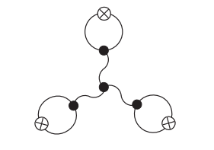
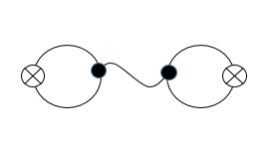
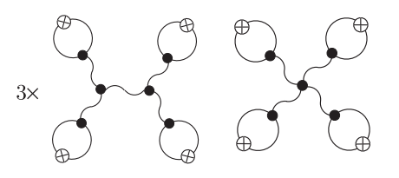
Theoretical predictions on critical fluctuations
Stephanov PRL 2009
Critical Fluctuations of particles :
Higher cummulants (ratios) of net protons are sensitive observables to probe the QCD critical point

Slide 9
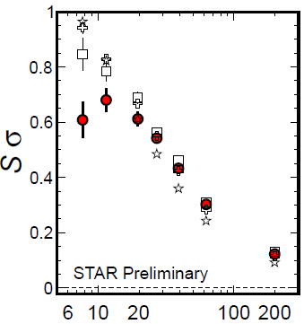
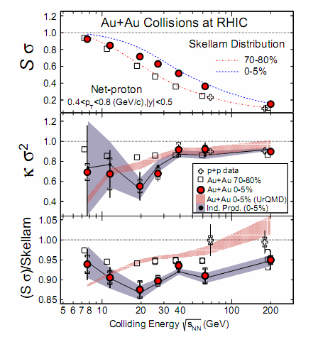
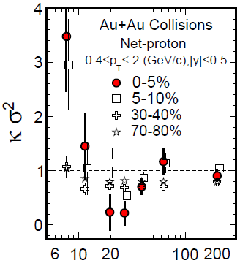
STAR BES: Cumulant ratios
STAR PRL 2014
Xiaofeng Luo CPOD 2014
PT=(0.4-2) GeV
PT=(0.4-0.8) GeV
-Non-monotonic behavior, large deviation from the Poisson baseline
How to systematically describe the collision energy, centrality and acceptance cut dependence ?

Slide 10
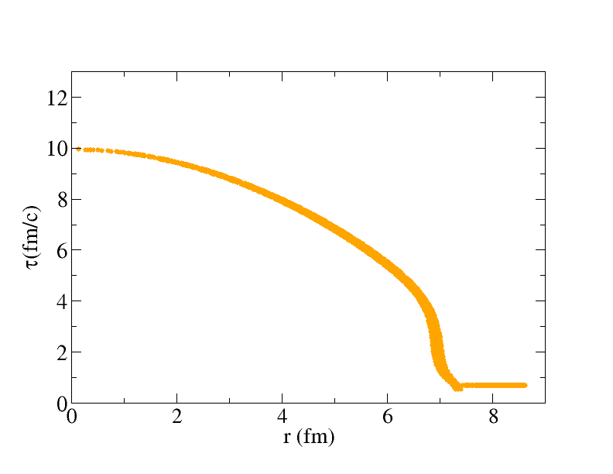
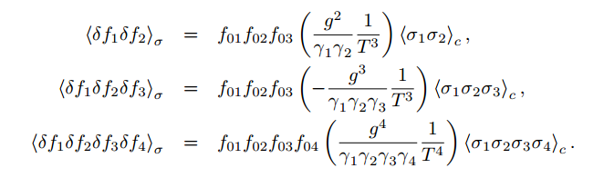
Freeze-out Scheme near the Critical Points
Jiang, Li & Song, PRC 2016
Hydro freeze-out surface
Particle emissions in traditional hydro
Particle emissions near Tcr

Slide 11
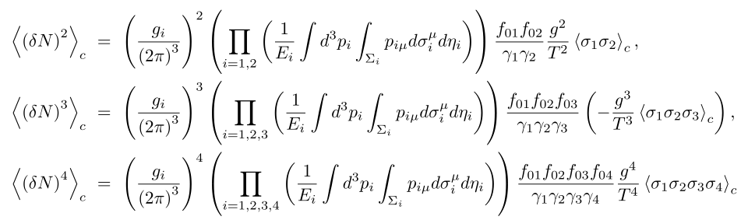



CORRELATED particle emissions along the freeze-out surface
Hydro freeze-out surface
-- Static critical fluctuations along the freeze-out surface
Note: for static & infinite medium, the results in Stephanov PRL09 can
be reproduced

Slide 12
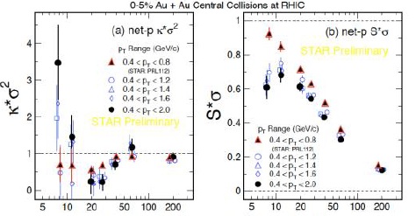
Static critical fluctuations
-comparison with the exp.data
-Acceptance dependence
-Cumulants & cummulant ratios

Slide 13
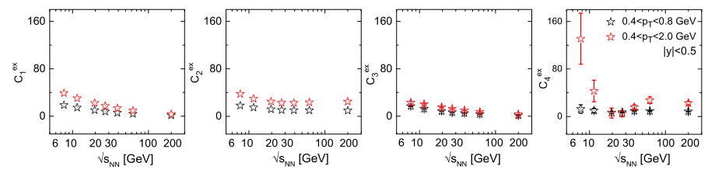
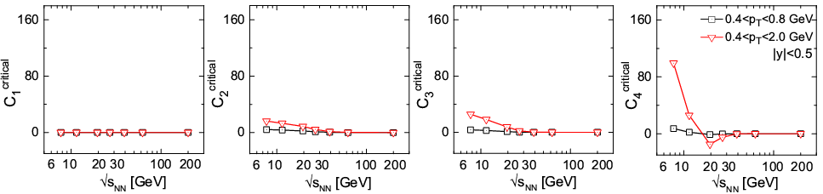
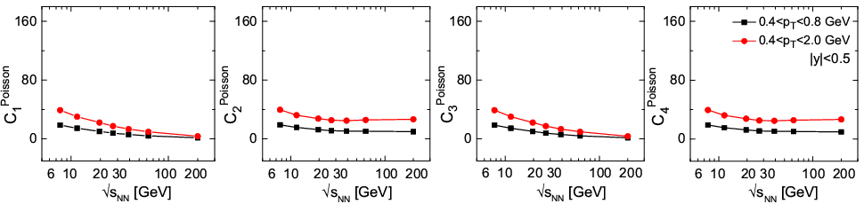
Acceptance dependence
Jiang, Li & Song, PRC2016
STAR Data
Static critical fluctuations
Poisson Baselines
-Static critical fluctuations can qualitatively explain the acceptance dependence of the STAR data

Slide 14
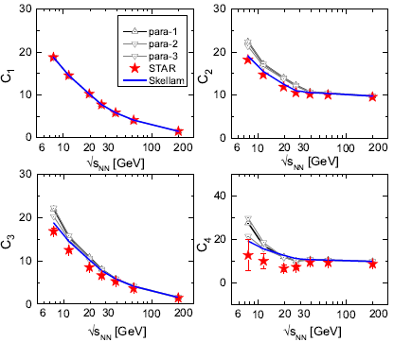
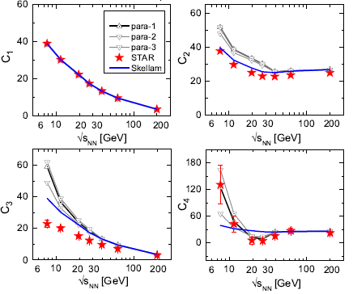
Cumulants of net protons
Net Protons 0-5%
Jiang, Li & Song, PRC2016
PT=(0.4-0.8) GeV
PT=(0.4-2) GeV
Static critical fluctuations give positive contribution to C2 , C3; well above the poisson baselines, can NOT explain/describe the C2 , C3 data

Slide 15
Dynamical Critical Fluctuations
-Static (equilibrium) universality class
-QCDmatter, 3-D Ising model, gas-liquid
-Dynamical universality class
-whether or not the order parameter is conserved
-other conserved quantities in the system
-Model A: non-conserved order parameter
-Model B: conserved order parameter;
-Model H: conserved energy and baryons density,
non-conserved order parameter
… … … ….

Slide 16
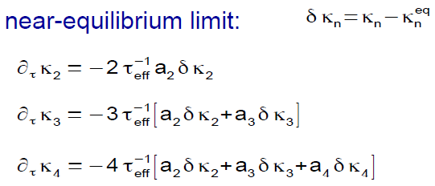
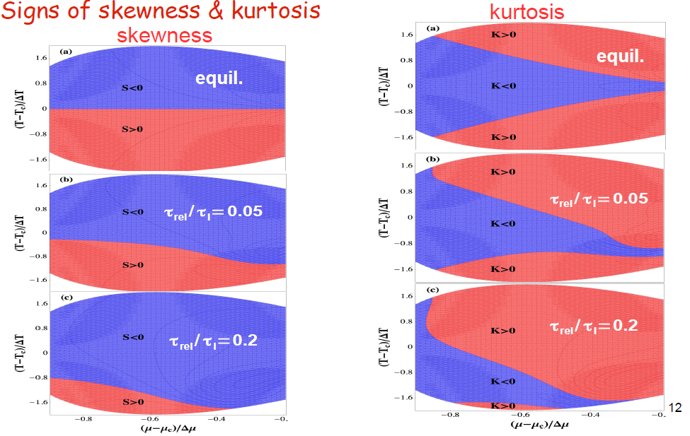
Effects from dynamical evolutions
-Model A
S. Mukherjee, R. Venugopalan, Y. Yin, PRC92 (2015)
sign of non-Gaussian cumulants can be different from equilibrium one

Slide 17
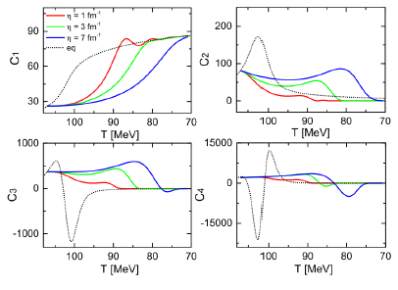
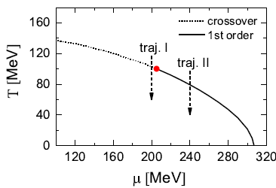
Dynamical critical fluctuations of the sigma field
Langevin dynamics:
-Model A
with effective potential from linear sigma model with constituent quarks
Jiang, Wu, Song, NPA 2017, paper in preparation
-The signs of C3 & C4 are different from the equil. ones due to memory effects
-in the near future: maping with 3D Ising model; extend to model B;
dynamical universal behavior

Slide 18
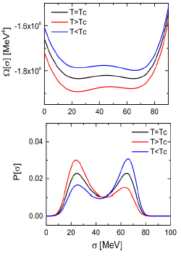
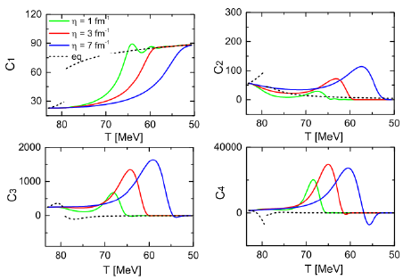
Dynamical critical fluctuations of the sigma field
Langevin dynamics:
-Model A
with effective potential from linear sigma model with constituent quarks
Jiang, Wu, Song, NPA 2017, paper in preparation
-Super cooling & bubble formations:
C3 & C4 are largely enhanced compared
with the equil. ones

Slide 19
Non-Critical (Thermal) Fluctuations
Detection and analysis technology
The efficiency corrections and acceptance of the detector
Bzdak A, Holzmann R, Koch V. arXiv preprint arXiv:1603.09057, 2016…
Bin width effect and centrality dependence
McDonald D, STAR Collaboration. Nuclear Physics A, 2013, 904: 907c-910c…
Auto-correlation effects(ACE)
Luo X, Xu J, Mohanty B, et al. JPG, 2013, 40(10): 105104…
Acceptance dependence of fluctuation
Ling B, Stephanov M A. arXiv preprint arXiv:1512.09125, 2015; Bzdak A, Koch V. Phys. Rev. C, 2012, 86(4): 044904;
Masayuki Asakawa and Masakiyo Kitazawa. arXiV:1512.0038…
physical effect
Conservations law for charges and baryons
Bzdak A, Koch V, Skokov V. PRC, 2013, 87(1): 014901…
Volume fluctuations
Xu H..arXiv:1602.07089, 2016; Xu H. arXiv:1602.06378, 2016; S. Jeon, hep-ph/0304012; M. I. Gorenstein, Phys.Rev. C 78, 041902; V. Skokov, Phys.Rev. C 88, 034911…
Hadronic evolution & rescattering
X.Luo,J. Xu, B. Mohanty,and N. Xu, J.P.G 40,105104(2013); Xu, Ji; Yu, Shili; Liu, Feng; Luo, Xiaofeng arXiv:1606.03900 …
Resonance decay
Garg P, Mishra D K, et al. Phys. Lett. B, 2013, 726(4): 691-696; Andronic A, Braun-Munzinger P, Stachel J. Nucl. Phys. A , 2006, 772(3): 167-199; Andronic A, Braun-Munzinger P. Phys. Lett. B, 2009, 673(2): 142-145;
Cleymans J, Kämpfer B, Kaneta M, et al.. Phys. Rev. C, 2005, 71(5): 054901…

Slide 20
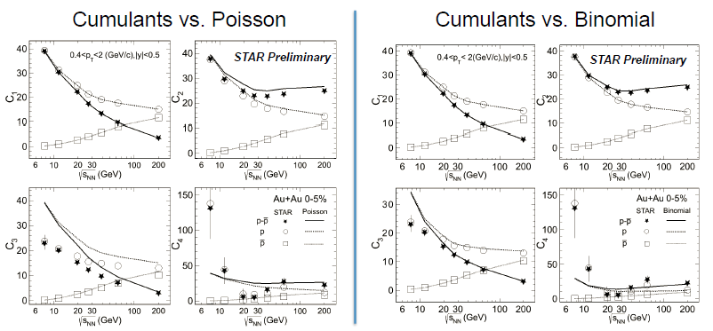
-In experiment, Poisson fluctuations are generally served as the thermal fluctuation baselines, especially for the multiplicity fluct. of (anti)protons
-Where does the Poisson baselines come from?
-How various factors influence / destroy Poisson distributions
(volume fluctuations, hadronic evolution, resonance decays … …)

Slide 21





Hadron Resonance Gas Model
-Grand canonical ensemble(GCE)
-With Boltzmann approximation
-The susceptibilities
Poisson Baselines!
Garg P, Mishra D K, Netrakanti P K, et al. Phys. Lett. B, 2013, 726(4): 691-696.

Slide 22


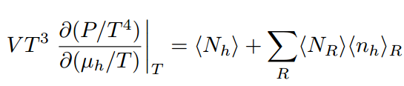
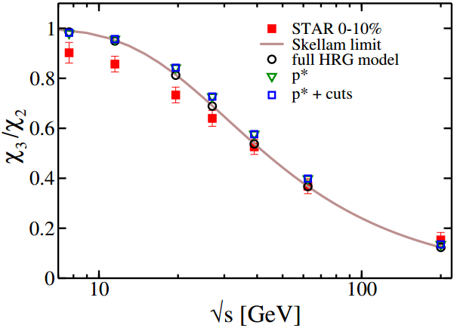
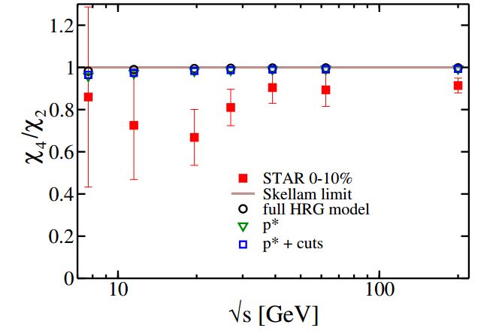
Improved Hadron Resonance Gas Model
-Acceptance cut:
[Nahrgang, et al. EPJC75 (2015) no.12, 573]
-Resonance decays:

Slide 23
Improved Hadron Resonance Gas Model
-Acceptance cut:
[Nahrgang, et al. EPJC75 (2015) no.12, 573]
-Resonance decays:
-For static and equilibrium medium
-Not apple to apple comparison with the data
- A realistic heavy ion collision: dynamical evolutions
- late hadronic evolution:
Chemical and thermal equilibrium can not be maintained

Slide 24
Multiplicity fluctuations of (net) Charges
and (net) protons from iEBE-VISHNU
Li, Xu, Song, 1707.09742

Slide 25
iEBE-VISHNU
QGP
HRG
HRG
Initial conditions viscous hydro hadron cascade
Various fluctuations in the hybrid model
-Initial state fluctuations
-Thermal fluctuations in viscous hydrodynamics
-Thermal fluctuations during the switching between hydro & UrQMD
(statistical hadronization, GCE; → Poisson fluctuations )
-fluctuations from UrQMD hadron cascade

Slide 26



Particle event generator:
QGP
hydro
HRG
UrQMD
Poisson fluctuations：
freeze-out/switching
Various fluctuations in the hybrid model
-Initial state fluctuations
-Thermal fluctuations in viscous hydrodynamics
-Thermal fluctuations during the switching between hydro & UrQMD
(statistical hadronization, GCE; → Poisson fluctuations )
-fluctuations from UrQMD hadron cascade

Slide 27
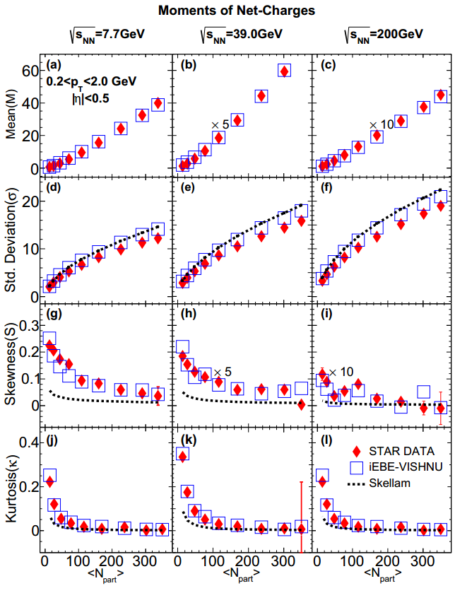
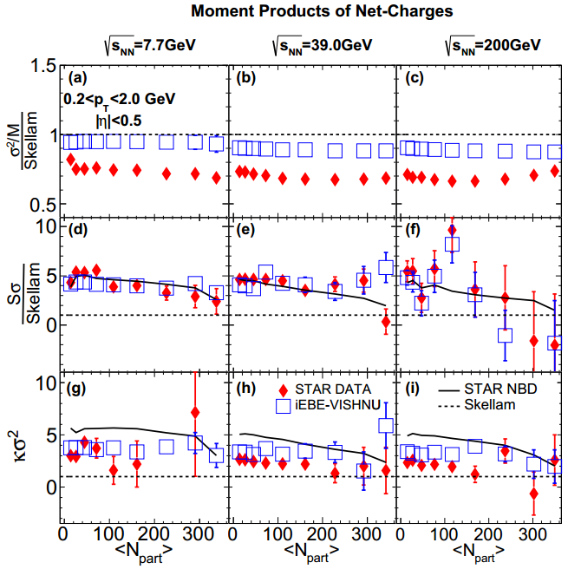
Moments and Moment products of net-charges
-For net charges, IEBE-VISHNU roughly describes the data of S and κ and the
related ratios, shows large deviations from the Poisson baselines.
Li, Xu, Song, 1707.09742

Slide 28
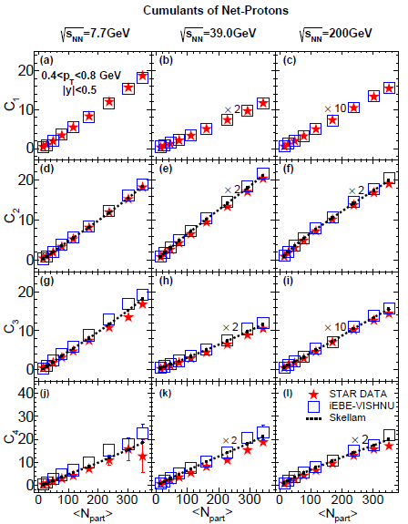
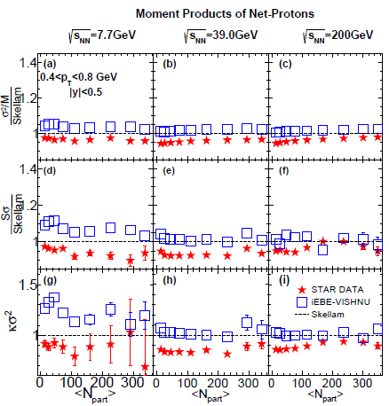
Cumulants and Cumulant ratios of Net-protons
Li, Xu, Song, 1707.09742
-iEBE-VISHNU: small deviation from the Poisson baselines, roughly describe the data.
-at lower collision energy, larger gap between data and model
--charge conservation, critical fluct. first order phase transition

Slide 29
Multiplicity fluctuations of (net) Charges
and (net) protons from iEBE-VISHNU
Li, Xu, Song, 1707.09742
-iEBE-VISHNU roughly describe most of the moments &
moments products of (net) charges and (net) protons
- What are dominant factors to influence the multiplicity fluct.
-volume fluctuations?
-resonance decays ?
-hadronic Scatterings ?
… …

Slide 30
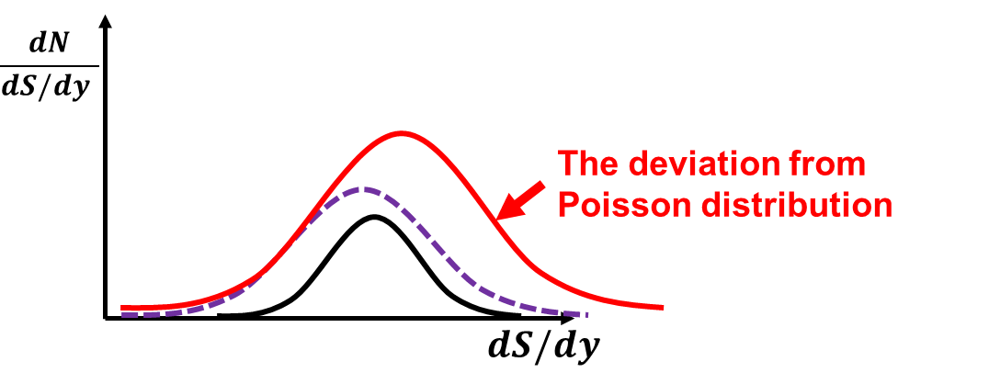
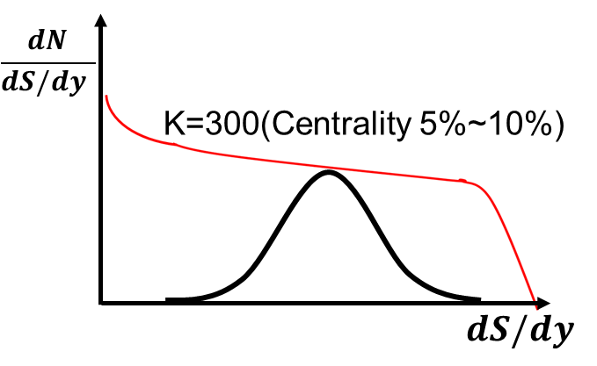
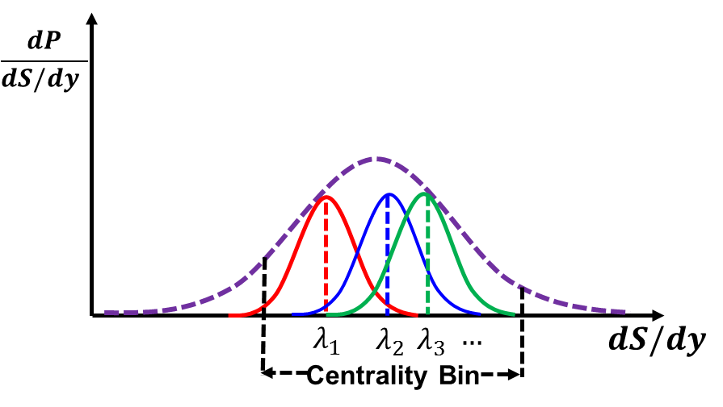
What is Volume Fluctuations /Corrections?
Single hydro + many many UrQMD
- Poisson fluctuations, no volume fluct/correc
2) In a certain centrality bins:
Many (Single hydro + many many UrQMD)
- many Poisson fluctuations are superimposed together
--> volume fluct /correc & wide centrality bin effect
3) In a fine centrality bins: --> volume fluct /correc

Slide 31
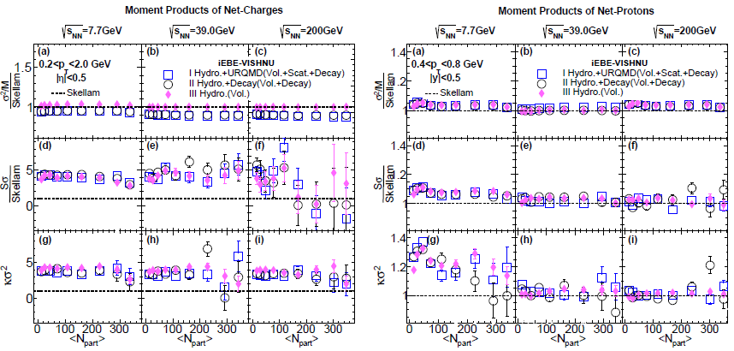
Volume corrections, resonance decays & hadronic evolution
-The effects of hadronic scatterings and resonance decays are very small
-Volume fluctuations plays the dominant role for multiplicity fluctuations
-For net protons, the effects of volume fluctuations are relatively small
–>close to Poisson fluctuations
Li, Xu, Song, 1707.09742

Slide 32
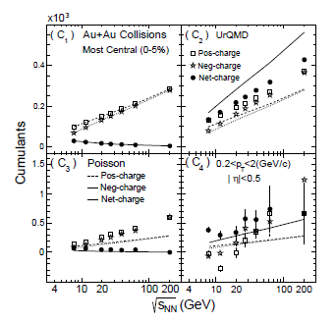
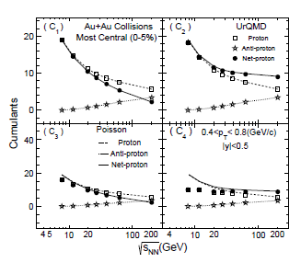
Non-Critical fluctuations
-results from UrQMD
J. Xu, S. Yu, F. Liu and X. Luo, Phys. Rev. C 94, no. 2, 024901 (2016); S. He and X. Luo, arXiv:1704.00423 [nucl-ex].Z. Yang, X. Luo and B. Mohanty, Phys. Rev. C 95, no. 1, 014914 (2017)

Slide 33
Non-Critical fluctuations
---iEBE-VISHNU vs. UrQMD
iEBE-VISHNU
QGP
HRG
HRG
UrQMD
HRG
HRG

Slide 34
Non-Critical fluctuations
---iEBE-VISHNU vs. UrQMD
iEBE-VISHNU
QGP
HRG
HRG
Initialization of UrQMD: statistical hadronization, independent particle production,
Poisson fluctuations
UrQMD
HRG
HRG
Initialization of UrQMD: projectile & target nuclei, charge conservation

Slide 35
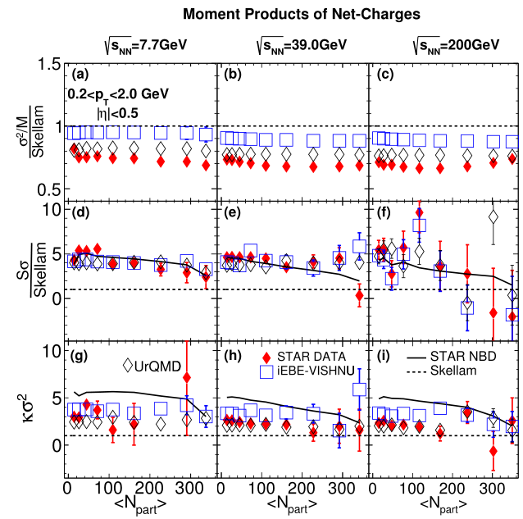
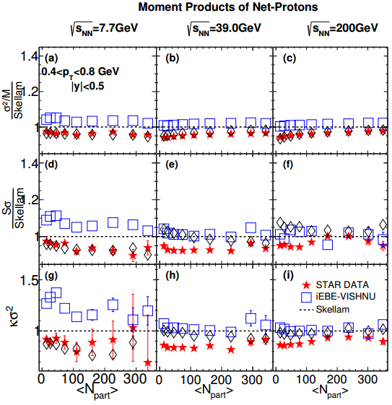
iEBE-VISHNU vs UrQMD
-Li, Luo, Xu & Song, unpublished notes
-Volume fluctuations is the main factors to influence the multiplicity fluct. of (net)
charges and (net) protons
-Charge/baryon conservation should be further included in iEBE-VISHNU

Slide 36
Summary
It is important to study both critical and non-critical fluctuations for BES and the search of the critical point
Critical fluctuations near the QCD critical point
-Static (equilibrium) critical fluctuation
-qualitatively explain the acceptance dependence of critical fluctuations
-C4 and κσ2 can be reproduced through tuning the parameters of the model
-C2 , C3 are well above the poisson baselines, which can NOT describe the data
-dynamical critical fluctuation
-Sign of the C3, C4 cumulants can be different from the equilibrium one due to the memory effects
-model A , model B, model H …
Non-critical (thermal) Fluctuations
-At higher collision energy, (net) charge distributions deviate from Poisson,
(net) protons distributions are pretty close to Poisson
-Volume correction is the main factors to influence the multiplicity fluct. Of
(net) charges and (net) protons
- Charge conservations need to be further included in iEBE-VISHNU

Slide 37
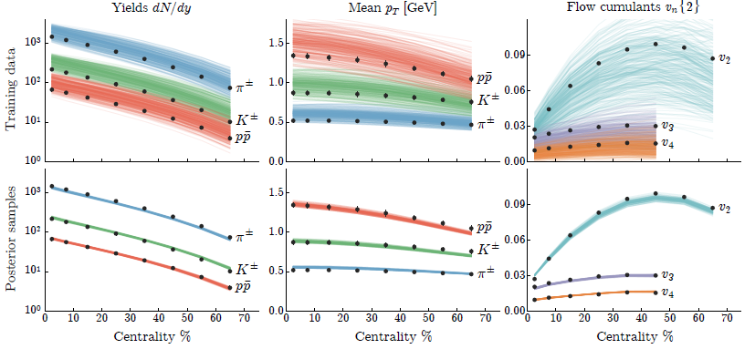
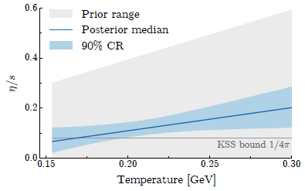
Initial State Fluctuations
- Hydrodynamics and hybrid model has been fully developed
-Lots of efforts from both exp and theory to study the initial state fluctuations
and final state correlations
-the QGP shear viscosity has been extracted with massive data evaluations!
To do list of critical Fluctuations
-Better understanding for dynamical (non-equilibrium) critical fluctuations
- Full development of the dynamical model near the critical point
-More realistic non-critical fluct baselines
-Interactions between critical & non-critical fluctuations
-where is the critical points located in the (T μ) plane ?
-what is the effective correlation length ξ ?

Slide 38
Thank You

Slide 39

Cumulants of Protons/Anti-protons
-iEBE-VISHNU roughly describe the experimental data.
-Small deviation from the Poisson baselines.
Li, Xu, Song, paper in preparation

Slide 40

Moments of Positive/Negative Charges
-iEBE-VISHNU model give a good description of M and σ
-For S and κ, the iEBE-VISHNU results shows cetrain deviations from the
Poisson baseline.
Li, Xu, Song, paper in preparation

Slide 41





Boltzmann approach with external field
Stephanov PRD 2010
-analytical solution with perturbative expansion, please refer to Stephanov PRD 2010
Stationary solution for the Boltamann equation with external field
Effective particle mass:

