Slide 1
Beam energy dependence of Levy fit parameters of the HBT correlation functions measured by PHENIX at RHIC Vicki Greene for the PHENIX Collaboration Vanderbilt University
CPOD 2017

Slide 2
With thanks to…
Mate Csanad
Daniel Kincses
Sandor Lokos
Marton Nagy
Tamás Csörgő

Slide 3
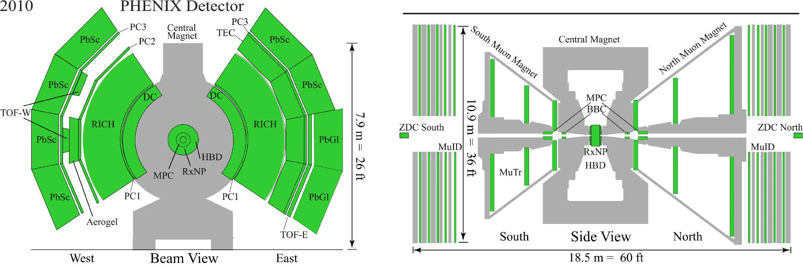
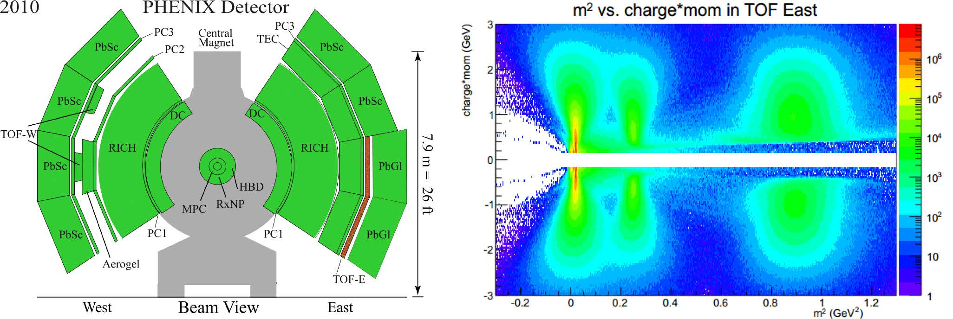
The PHENIX Experiment
Versatile detector, operated through 2016
Tracking via Drift Chambers and Pad Chambers
Charged pion ID with TOF, 0.2 $≤$ p $≤$ 2 GeV/c
This analysis: PID also with EMCal (PbSc and PbGl)

Slide 4
PHENIX runs at a glance

Slide 5
Bose-Einstein correlations in heavy ion physics
Quantum statistics connects spatial and momentum space distributions
Spatial source S(x) versus momentum correlation function C₂(q):
Final state interactions distort the simple Bose-Einstein picture
Coulomb interaction important, handled via two-particle wave function
Resonance pions: Halo around primordial Core
Bolz et al, Phys.Rev. D47 (1993) 3860-3870 Csörgő, Lörstad, Zimányi, Z.Phys. C71 (1996) 491-497

Slide 6
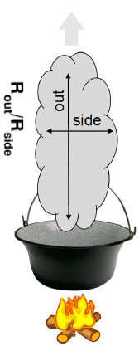
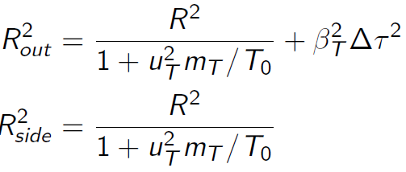
The out-side-long system, HBT radii
C(q) usually measured in the Bertsch-Pratt pair coordinate-system
out: direction of the average transverse momentum
long: beam direction
side: orthogonal to the latter two
R_{out}, R_{side}, R_{long} : HBT radii
Out-side difference → ∆τ emission duration
From a simple hydro calculation:
RHIC: ratio is near one → no strong 1st order phase transition
Plus lots of other details (pre-eq flow, initial state, EoS, ...)
S. Chapman, P. Scotto, U. Heinz, Phys.Rev.Lett. 74 (1995) 4400
T. Csörgő and B. Lörstad, Phys.Rev. C54 (1996) 1390
S. Pratt, Nucl.Phys. A830 (2009) 51C

Slide 7
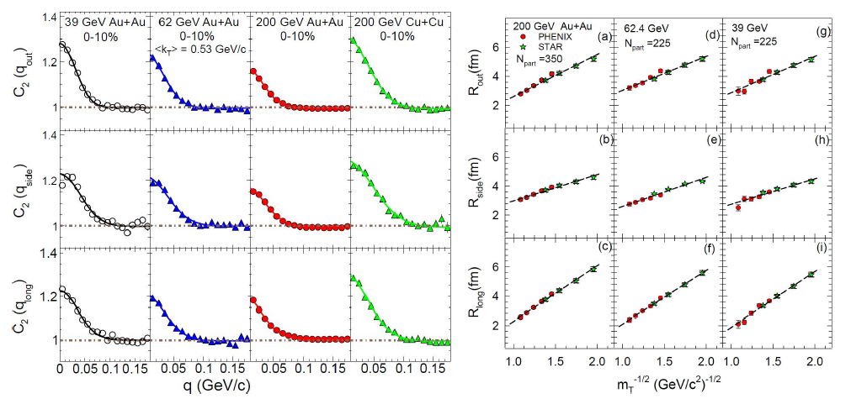
Example: recent PHENIX HBT measurements
Correlation function in Bertsch-Pratt system, radii from Gaussian fit
Linear 1/√m_{T} scaling of HBT radii for all systems and energies
Interpolation to common m_{T} , PHENIX and STAR consistent
PHENIX:arXiv:1410.2559 STAR : Phys. Rev. C92 014904

Slide 8
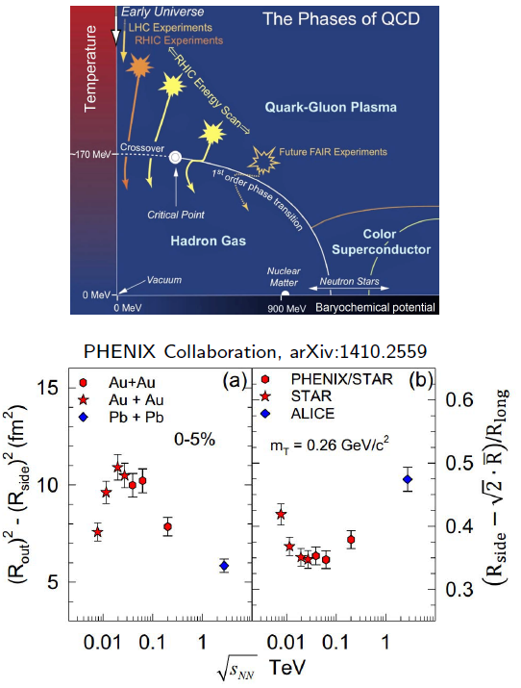
HBT radii and the search for the critical endpoint
Signals of QCD CEP: softest point, long emission
R_{o}²-R_{s}²: related to emission duration
(R_{s}-√2Rbar)=R_{l} : related to expansion velocity, Rbar characteristic initial transverse size
Non-monotonic patterns
Indication of the CEP?
Further detailed studies done in Roy Lacey, arXiv:1606.08071 & arXiv:1411.7931 (PRL114)
Maybe Levy exponent gives further insight?

Slide 9
Levy distributions in heavy ion physics
Expanding medium, increasing mean free path: anomalous diffusion Metzler, Klafter, Physics Reports 339 (2000) 1-77, Csanad, Csörgő, Nagy, Braz.J.Phys. 37 (2007) 1002
Levy-stable distribution:
Generalized Gaussian from generalized central limit theorem
α = 2 Gaussian, α = 1 Cauchy
Shape of the correlation functions with Levy source:
Critical behavior → described by critical exponents
Spatial correlation ~ r^{-(d-2-η)} → defines critical exponent
Symmetric stable distributions (Levy) → spatial corr. ~ r^{-1-α}
α alpha can be associated with the critical exponent eta
Csörgő, Hegyi, Zajc, Eur.Phys.J. C36 (2004) 67, nucl-th/0310042

Slide 10
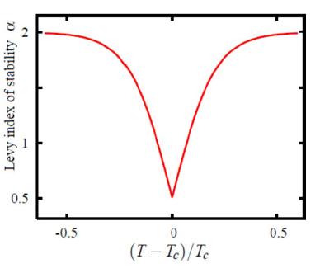
A possible way of finding the critical point
QCD universality class ↔ 3D Ising
Halasz et al., Phys.Rev.D58 (1998) 096007
Stephanov et al., Phys.Rev.Lett.81 (1998) 4816
At the critical point:
Random field 3D Ising: η = 0.50±0.05 Rieger, Phys.Rev.B52 (1995) 6659
3D Ising: η = 0.03631(3) El-Showk et al., J.Stat.Phys.157 (4-5): 869
Modulo finite size effects
Distance from the critical point?
Motivation for precise Levy HBT!
Change in α_{Levy} proximity of CEP?
Non-static system, finite size effects may modify all this

Slide 11
PHENIX Levy HBT analysis
Dataset used for the analysis:
Run-10, Au+Au, √s_{NN} = 200 GeV, 7.3∙10⁹ events
Primarily minimum bias results so far; some results presented as function of centrality
Additional offline requirements: vertex less than 30 cm away from center
Particle identification:
time-of-flight data from PbSc East/West, TOF East/West, momentum, flight length
2σ cuts on m² distribution
Single track cuts: 2 σ matching cuts in TOF & PbSc for pions
Pair-cuts:
A random member of pairs assoc. with hits on same tower were removed
customary shaped cuts in Δφ - Δz plane for Drift Chamber, PbSc East/West, TOF East/West
1D corr. func. as a function of |k|_{LCMS} in various m_{T} bins
k_{LCMS} is 3-momentum difference in longitudinal co-moving system
Levy fits for 31 m_{T} bins with Coulomb effect incorporated
0.228 < m_{T} < 0.871 GeV/c

Slide 12
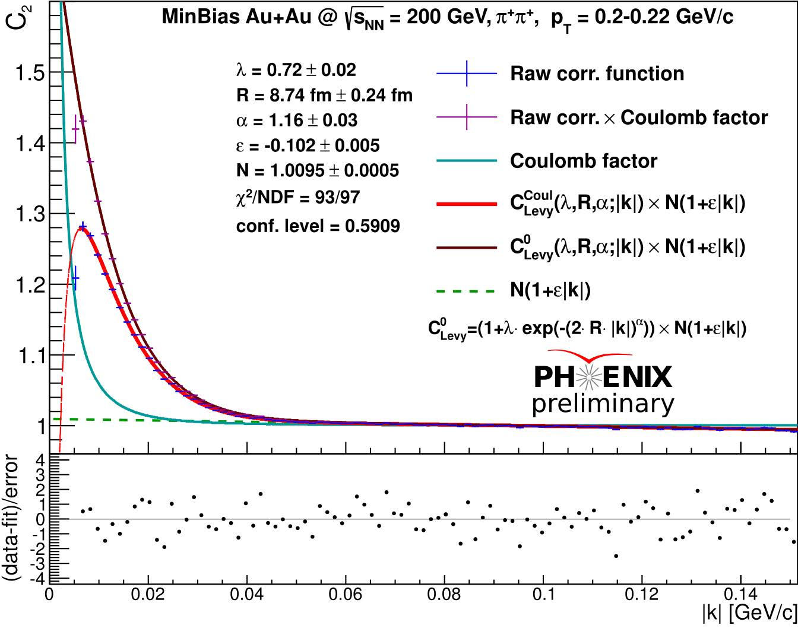
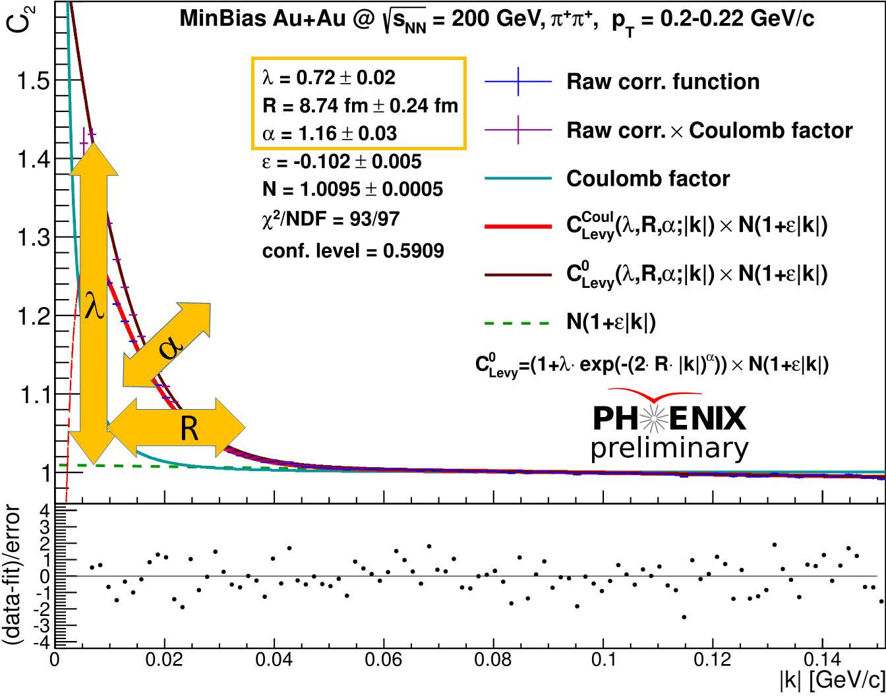
Example C(|k|_{LCMS}) measurement result
Measured in 31 m_{T} bins
Fitted with Coulomb- incorporated function
Coulomb-factor displayed separately
All fits converged
Confidence levels all acceptable
χ values scatter around 0 properly
Physical parameters: R, λ, α measured versus pair m_{T}

Slide 13
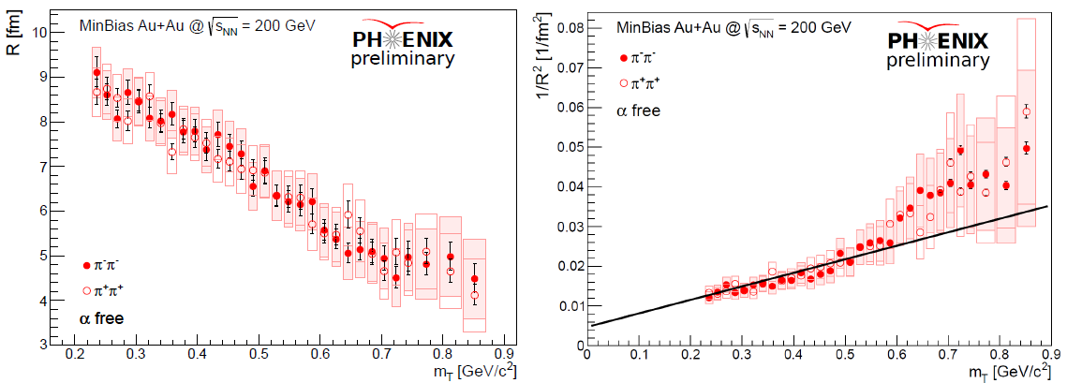
Levy scale parameter R
Similar decreasing trend as Gaussian HBT radii
Hydro behavior not invalid
The linear scaling of 1/R², breaks for high m_{T}

Slide 14
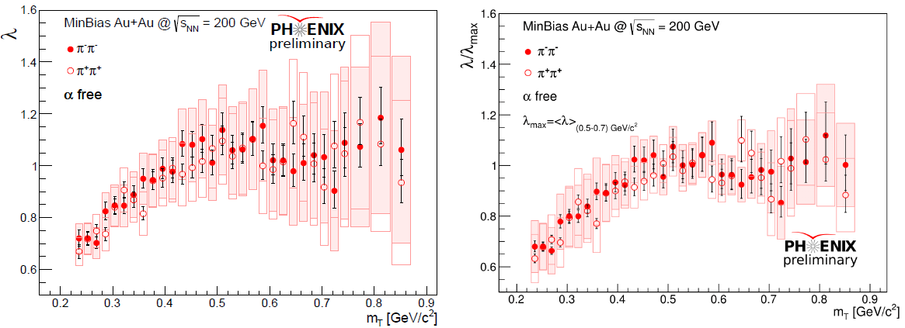
Correlation strength λ
From the Core-Halo model: λ=(core/(core+halo))²
Observed decrease (“hole”) at small m_{T} → increase of halo fraction
Different effects can cause changes in λ
λ/λ_{max} saturates with smaller systematic uncertainties

Slide 15
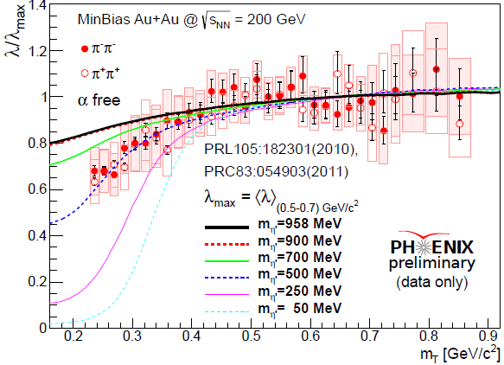
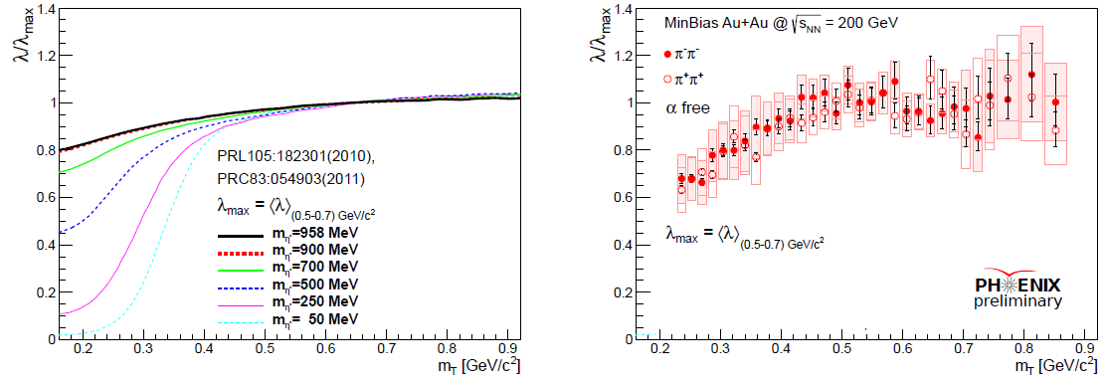
A possible (?) interpretation of λ(m_{T})
λ(m_{T}) measures core/(core+halo) fraction
May be connected to mass modifications (c.f. chiral restoration)
Decreased η’ mass → η’ enhancement → halo enhancement
Kinematics: η’ decay pions will have low m_{T} → decreased λ(m_{T}) at low m_{T}
Compatibility with unmodified in-medium η’ mass? Kapusta, Kharzeev, McLerran, Phys.Rev. D53 (1996) 5028, hep-ph/9507343 Vance, Csörgő, Kharzeev, Phys.Rev.Lett. 81 (1998) 2205, nucl-th/9802074 Csörgő, Vértesi, Sziklai, Phys.Rev.Lett. 105 (2010) 182301, arXiv:0912.5526

Slide 16
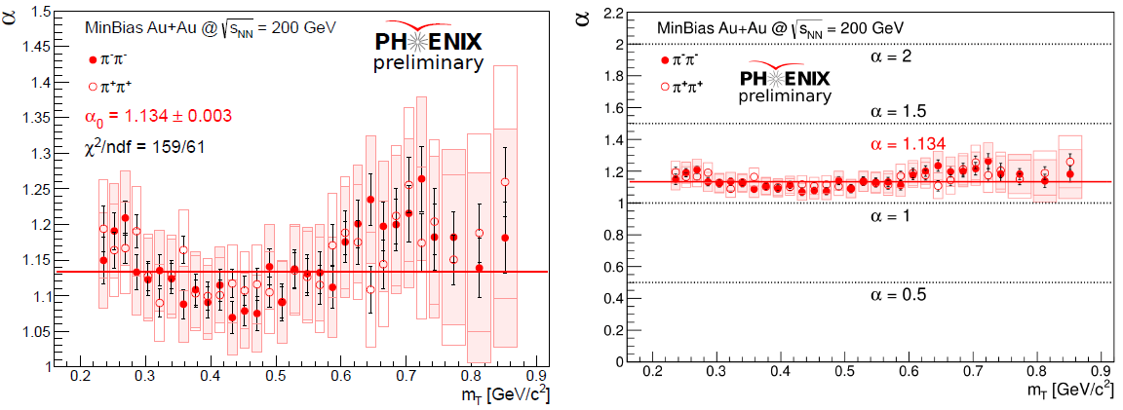
Lévy exponent α
The measured value is far from Gaussian (α = 2) and inconsistent with exponential (α = 1)
Also far from the random field 3D Ising value at CEP (α = 0.5)
More or less constant (at least within systematic uncertainties)
Motivation to do fits with fixed α = 1.134

Slide 17
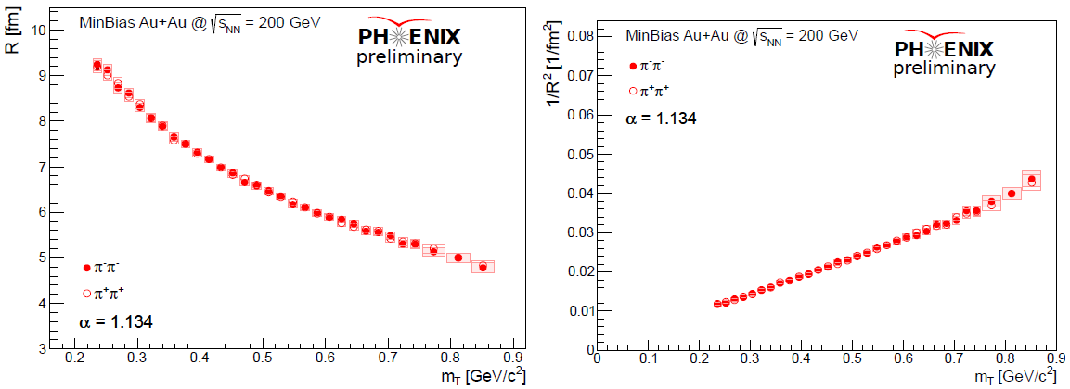
Levy scale parameter R with fixed α = 1.134
Smoother trend with fixed α
Remarkable linearity of 1/R²
Hydro behavior valid, despite α < 2

Slide 18
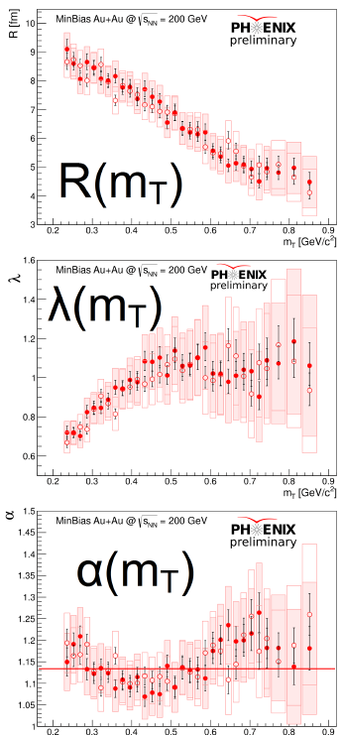
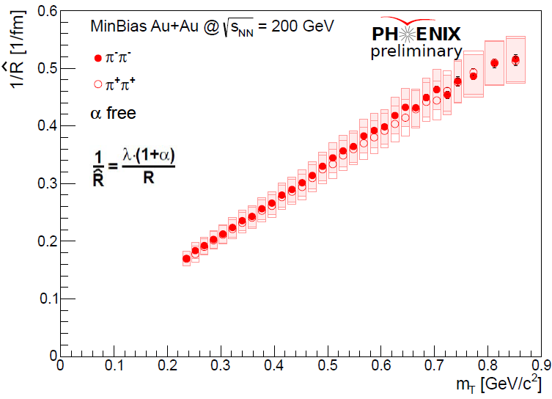
Newly discovered scaling parameter Rhat
Empirically found scaling parameter
Linear in m_{T}
Physical interpretation: open question

Slide 19
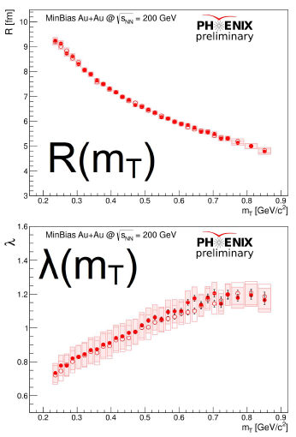
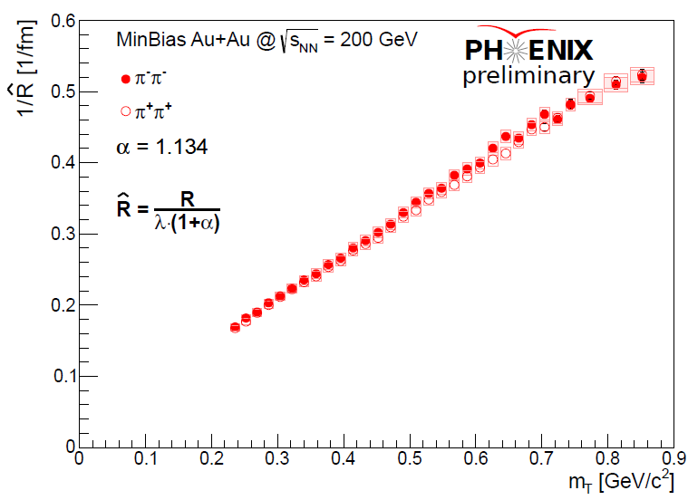
Newly discovered scaling parameter Rhat
α=1.134 fixed
Empirically found scaling parameter
Linear in m_{T}
Physical interpretation: open question

Slide 20
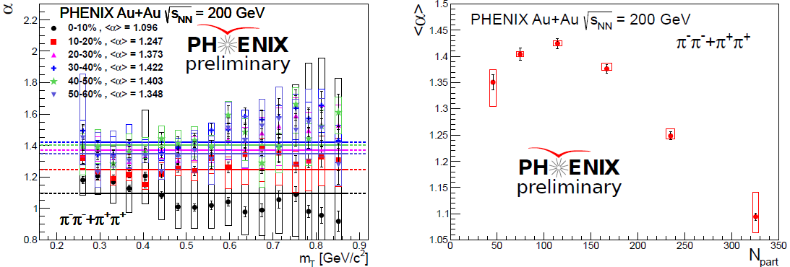
Levy exponent α at 200 GeV
Slightly non-monotonic behavior as a function of m_{T}
Average <α> non-monotonic behavior versus N_{part}
α = <α> constant fits were performed

Slide 21
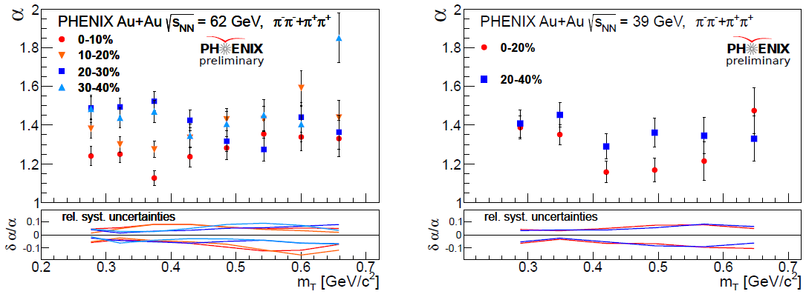
Levy exponent α at 39 and 64 GeV
Levy exponent : no significant change vs √s_{NN} at 39-62-200 GeV
Usual values between 1 and 1.5
Non-monotonicity in m_{T}

Slide 22
Levy R: similar trends for all energies and centralities
$α$ free
$α$ fixed
$α$ free
$α$ free

Slide 23
“Hole” in λ: all energies and centralities
$α$ fixed
$α$ free
$α$ free

Slide 24
Rhat scaling: all energies and centralities
$α$ free
$α$ fixed
$α$ free
$α$ free

Slide 25
Summary
Bose-Einstein correlation functions, run-10 200 GeV Au+Au, ~7 billion events
Levy fits yield statistically acceptable description
Fine m_{T} binned Levy source parameters (R, λ, α)
Nearly constant α, away from 2, 1 and 0.5 ↔ distance to CEP?
Linear scaling of 1/R² vs m_{T} ↔ hydro?
Low-m_{T} decrease in λ(m_{T}) ↔ resonances, in-medium η’ mass?
New, empirically found scaling parameter Rhat=R/(λ∙(1+α))
Centrality and collision energy dependence also explored
No α decrease down to 39 GeV
Non-monotonic α vs N_{part} dependence
“Hole” in λ(m_{T}) present down to 39 GeV (c.f. SPS result without hole!)
No change in 1/R² and 1/Rhat scaling with centrality and Collision energy

