Slide 1
ePIC Stave Installation

Slide 2
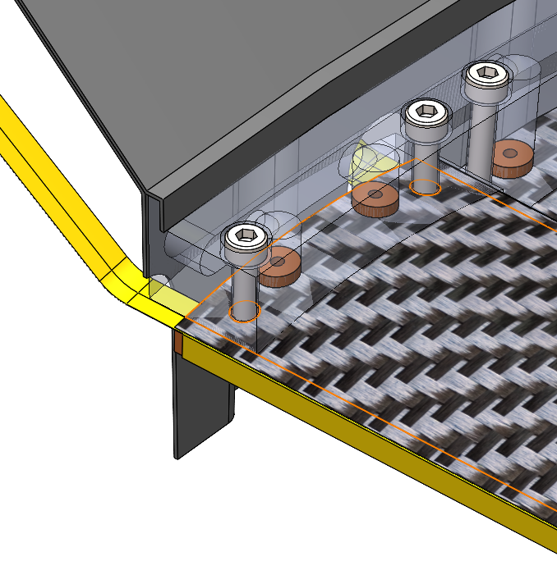
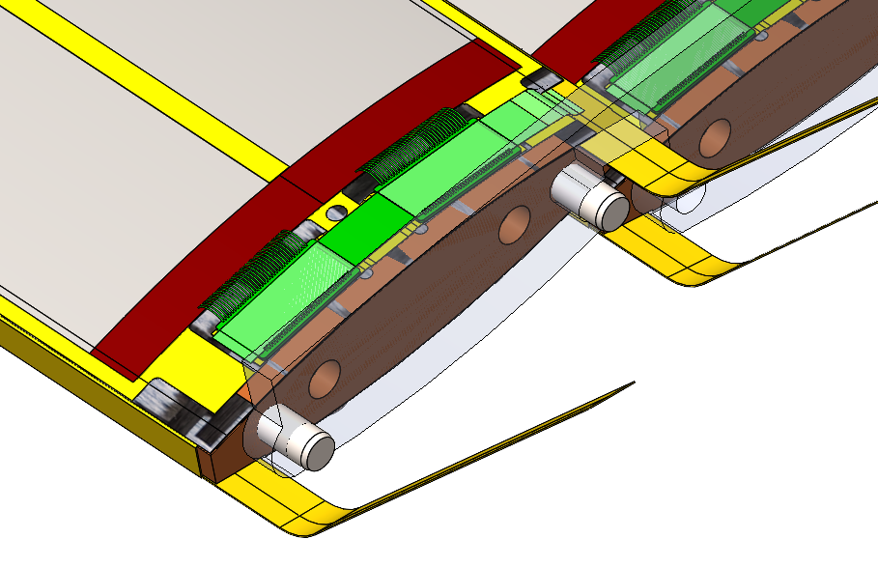
Stave Mounting
Staves are mounted from the underside (inside)
Fastener access from outer side (through cutouts in service cone)
As modelled:
Coolant flows from one end of the stave (co-current flow)
Mounting interface on same face as coolant inlet
Coolant channel integrated into mounting manifold
Constraint in axial direction
Fixed on one end
Second end floating on pins

Slide 3
ePIC L4 & L3 Services

Slide 4
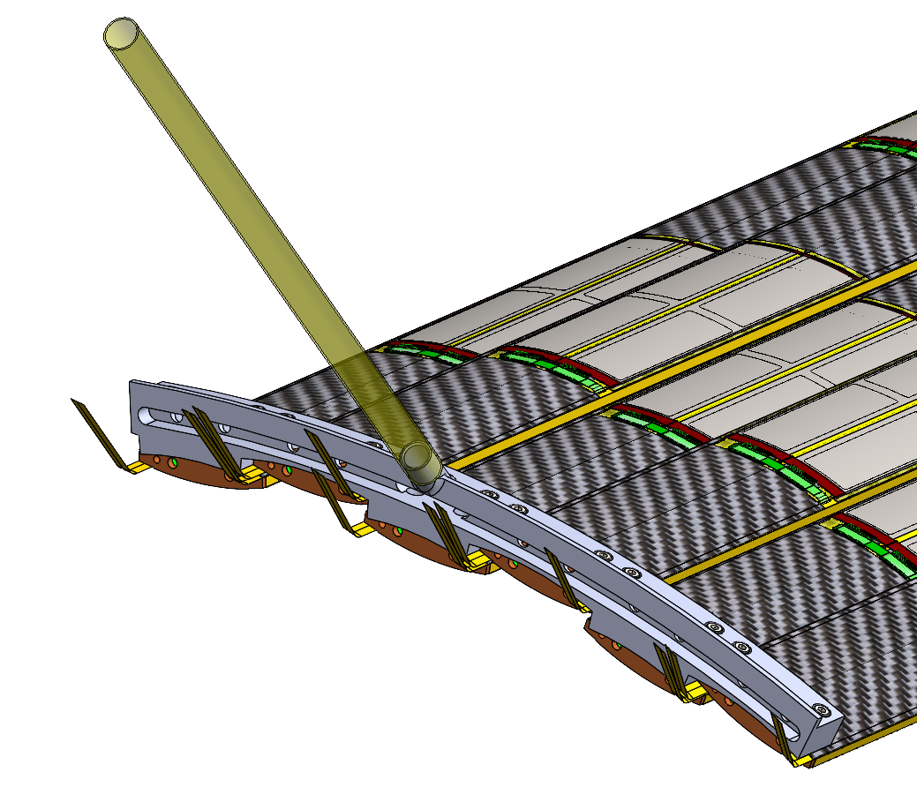
Power Requirements
L4
72 (assumed 70 elsewhere) Staves
@48 W = 3.45 kW
Total mass flow rate for ΔT of 10°C = 0.34 kg/s
Air Supply (assumed pressurised)
Staves manifolded into groups of 6
6 manifolds per half
QTY 12 - 10 mm ID
Supply Pressure - 8 Bar
Velocity 38 m/s
Pressure drop – 0.08 Bar/m

Slide 5
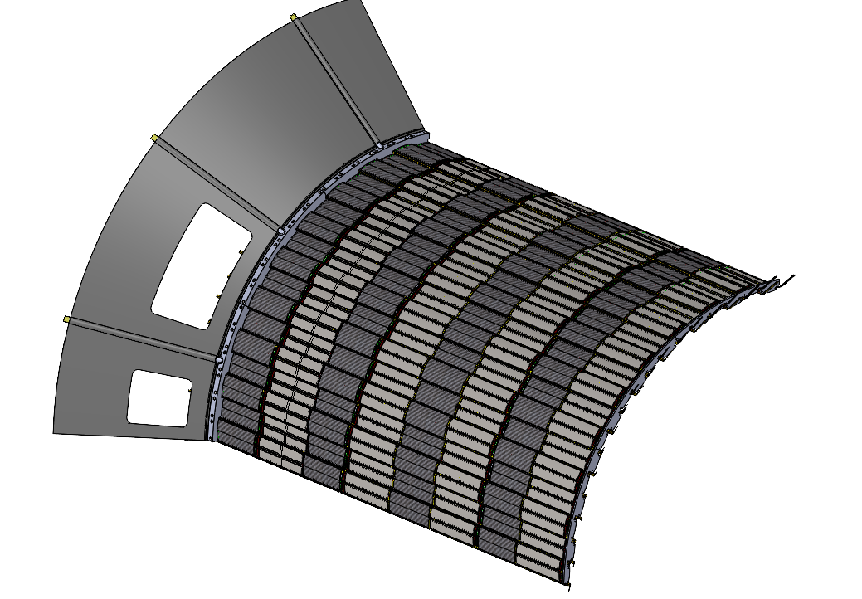
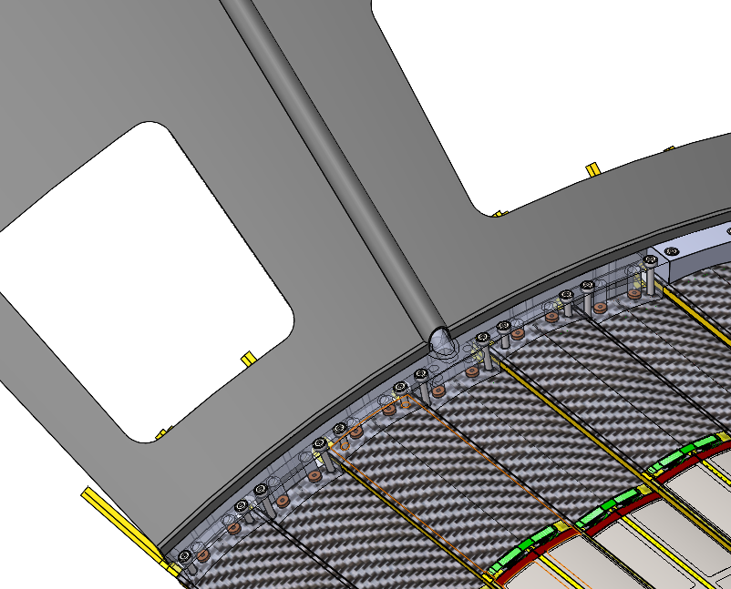
Half a Half Barrel

Slide 6
High Pressure Supply
Digital regulator using stave inlet pressure as control variable, adjusting proportional flow valve
Inlet pressure set point based on known stave flow vs. pressure curve
Upstream flow meter for global flow measurement (per 6 staves)
Comparison between flow meter reading and inlet pressure can be used to monitor stave health.
JT expansion of gas gives some cooling effect
Approx 6.8 bar pressure drop gives approx. 1.8°C ΔT

Slide 7
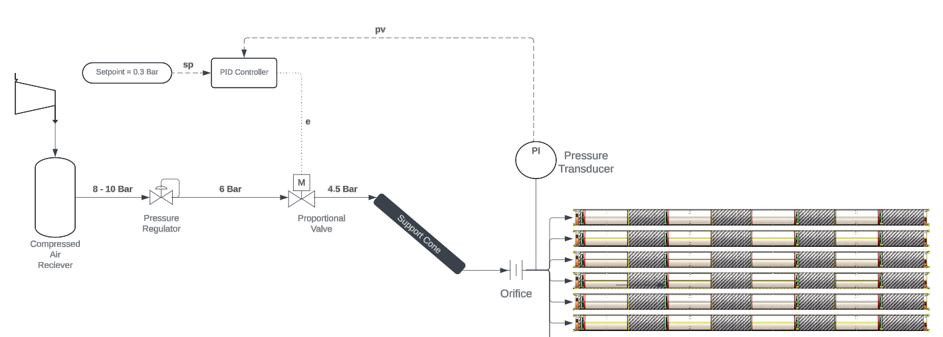
High Pressure Supply

Slide 8
High Pressure Supply
To minimise the effect of stave internal flow resistance on flow rate, a high pressure loss flow restriction (orifice) should be added to each stave inlet
Flow through staves will be managed based on measured inlet pressure
Inlet block of some staves will need to be instrumented (capillary with pressure sensor further out
Global flow rate can be measured upstream

Slide 9
Testing Plans
Part of Oxford test setup, using for DAQ controlled testing of flow at different flow rates
Using a proportional flow valve to manage upstream pressure
PID controller drives valve position (and outlet pressure) based on measure from flow controller

