Slide 1
Issues with SiPM Holdes
E.J. Mannel
BHCal Meeting
June 20, 2025

Slide 2
Issues with new SiPM boards and holders
New SiPM boards use a connector, sPHENIX had a signal/bias cable soldered on the board, resulting in the cable not being centered on the board.
Miscommunication on polarity being used to bias the BHCal SiPMs. Solution was to rotate the connector on the SiPM board.
This resulted in the connector possible not being entirely on the board.
The new bias/signal cables have a slightly larger diameter, does not fit in the rettaiing slot on the holder.

Slide 3
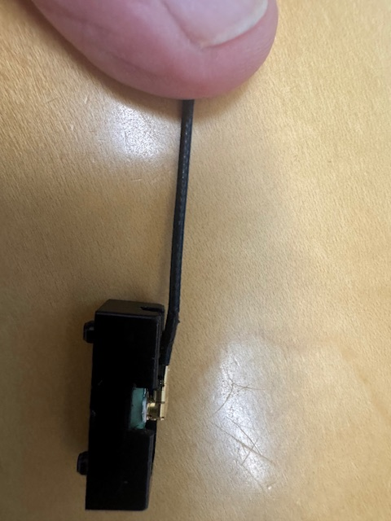
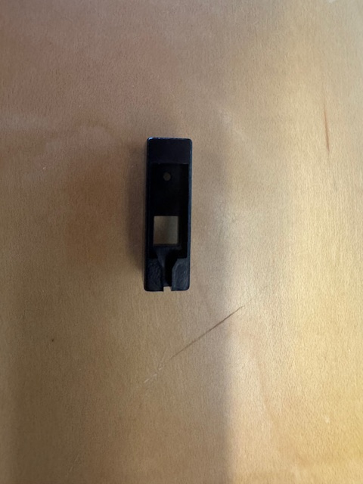
Solutions
Working with techs to modify the current holders for the test stand
Long terms solution is to revisit the design of the PCB, holder and cable.
Cut opening in the side of the holder
where the connector is.
File the slot open on side where the connector
is located.

