Slide 1
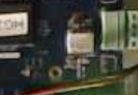
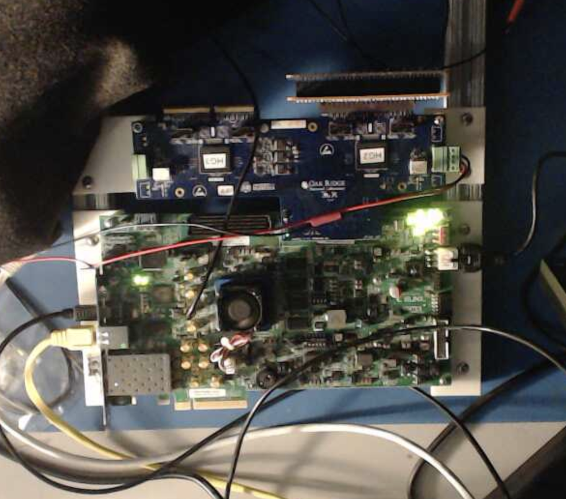
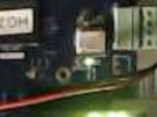
This week’s (and some of last week’s) activities
Eric has two summer interns, Jeremy and Noah
I worked with them to get them up to speed with the 5-now-4 tile data taking and analysis
Status –
Both of them have access to caloroc2 DAQ machine, the VNC, the Elog, the camera
Both of them are set up to do offline analysis at the SDCC (we have identified a few “golden runs” to look at)
Next steps: a more detailed waveform analysis, behavior with the longer cable lengths (the reflections due to what we think is inadequate termination)
Norbert had a longer laundry list what to test/check
The cam picture, mostly to visually confirm the status, like the “Bias On” LED, remotely

Slide 2
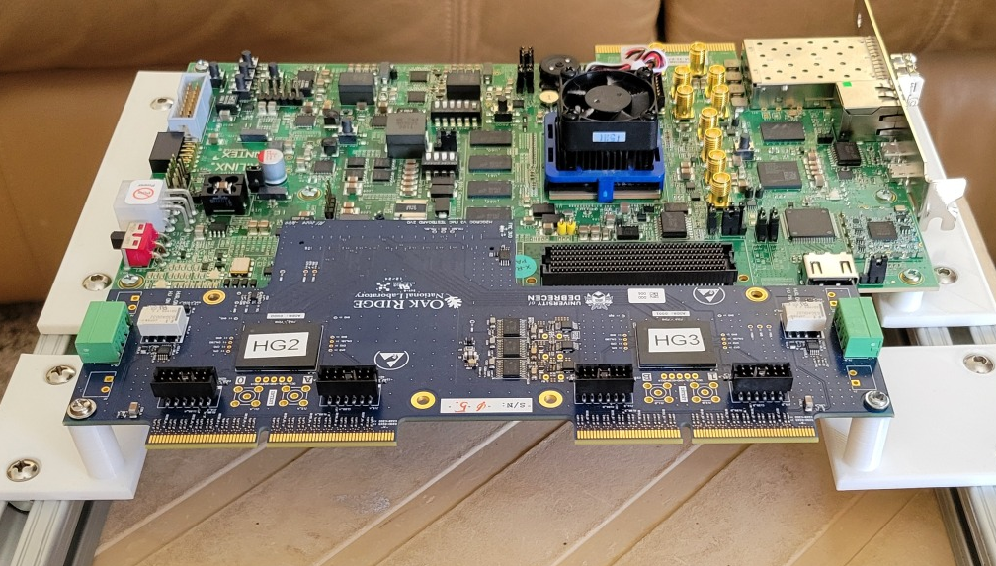
This week’s (and some of last week’s) activities
New Hampshire:
Nathaly & Co have everything in hand to replicate the setup we have (I’ll let them report)
I was working with Olaiya to get their DAQ machine ready yesterday
Unfortunately (my misunderstanding, I thought that was different) the PC isn’t set up at all (running Windows)
We’ll make a VM to get going instead, but that will take a bit of time.
My hopes that we could make it so that I can log in there myself and not have to relay all the actions have been squashed (but hey, outside groups have been running RCDAQ and analysis on their own without me being involved at all)
I also sent them the STL files to 3D-print the same supports that I made for our setup.

