Slide 1
Integration, Installation and Infrastructure (Triple I Group)

Slide 2
EPIC Maintenance Goals
The resent request to change the ToF and Cymbal was to make the inner detectors more maintainable during a normal shutdown.
There are 4 scenarios we consider for maintaining detectors:
  Scenario 1 - Detectors are maintainable in IR, without breaking vacuum
    ~ 90 days (18 weeks) for maintenance
    This is the ideal scenario, however in most cases only minimal inner detector maintenance can be done.
    May be possible to do some work on the ToF and CYMBAL, but would be technically challenging.
  Scenario 2 - Detectors are maintainable in IR, with breaking vacuum
    ~ 75 days (15 weeks) for maintenance
    This is a middling scenario, allowing for more access to inner detectors, though not complete.
    Goal is for ToF and Cymbal to be included in this scenario.
  Scenario 3 - Detectors are maintainable in AH, without uninstalling GST
    ~ 50 days (10 weeks) for maintenance
    This is a middling scenario, allowing for more space in Z for detector removal.
    If no ToF/Cymbal are on rails and, can’t be split in Z.
  Scenario 4 - Detectors are maintainable in AH, with uninstalling GST
    ~ 20 days (4 weeks) for maintenance
    The is the least desirable scenario, however we will have access to all aspects of the detector.
    If no ToF/Cymbal rails. Required for SVT and Disks.

Slide 3
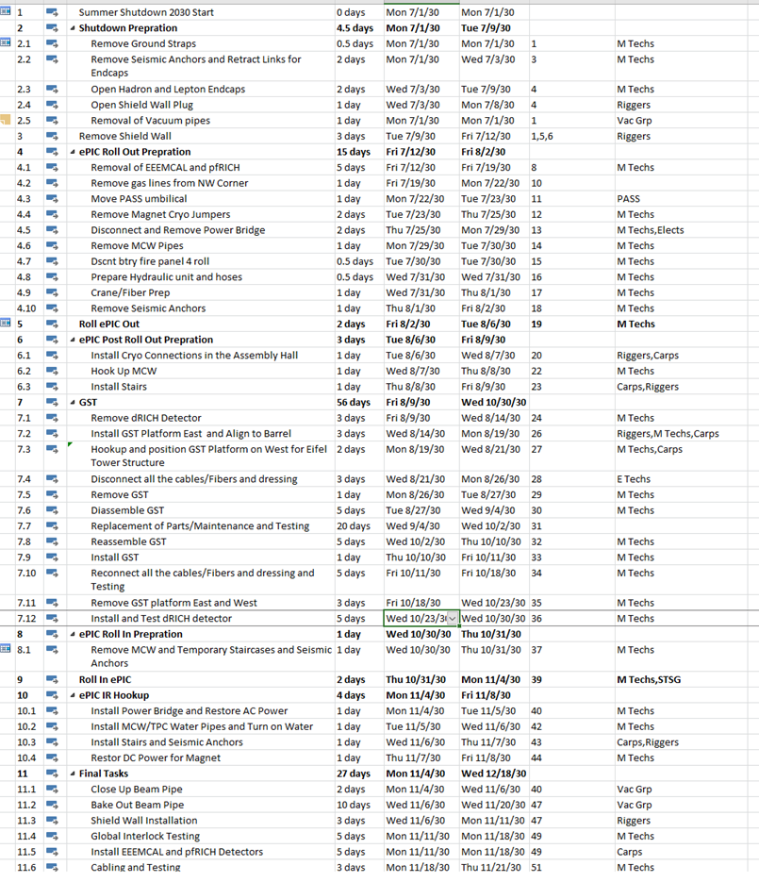
EPIC Maintenance Schedule
EPIC shutdown is 6 months (26 weeks) long
The schedule shown is optimistic, and assumes:
  Everything goes as expected
  Support from BNL groups/collaboration exactly when needed
  1 week for holidays and 2 weeks for cosmics
  Working one shift on weekdays
To service inner most detectors we need to break vacuum and roll into the AH. After accounting for this process and its reversal, we only get 20 days for maintenance of all the inner detectors
Time saved by eliminating need to preform task:
  Bakeout the beam pipe: ~3 weeks
  Roll out of the hall: ~5 weeks
  Remove GST: ~6 weeks

Slide 4
Second Half of Slides

Slide 5
Global Design Considerations
We put together a list of options and decisions that need to be made within the detector. A few options remain, and decisions will be made (None of these affect the ToF or CYMBAL envelopes).
Scope | Options | Choices | Description | Pros | Cons
Backward Service Trays |  | EEEMCAL stays 12 sided | We attach (12) cable trays to the outside of the EEEMCAL. pfRICH services are then routed into the trays which are attached to the EEEMCAL. | No changes for EEEMCAL group; pfRICH services have enough space | Most likely have to install pfRICH and EEEMCAL together
CYMBAL Segmentation |  | CYMBAL becomes (12) sectors | CYMBAL becomes (12) sectors. Will need to be redesigned either way for rails and to made into (12) independent sectors. Full hermetic coverage is possible. | Services routing flows well on backward end around DIRC and on forward end around dRICH. Segmentation matches DIRC/oMPGD, EEEMCAL and rails, and dRICH for services. | CYMBAL would have an increase in services
EEEMCal and pfRICH rail locations | Option 3A | EEEMCAL & pfRICH are installed on (2) rails at 3 & 9 O'clock | EEEMCAL & pfRICH are installed on (2) rails at 3 & 9 O'clock. These rails are mounted onto the GST | EEEMCAL moves with the GST requiring less clearances | 2 sectors of cable tray lose most of their space, remaining 10 are left untouched
 | Option 3B | EEEMCAL & pfRICH are installed on (4) rails | EEEMCAL & pfRICH are installed on (4) rails at 2, 5, 7, and 10 O'Clock. These rails would reach in-between the DIRC bar boxes and would be supported by the barrel EMCAL. | Space lost to rails is better distributed among the service's trays | Has to go to barrel EMCAL
Beam pipe adjustment clearance location | Option 4A | Beampipe stays with no adjustment and 5mm clearance | Beampipe clearance stays the same at 5mm for the inner trackers. All adjustment for the beampipe is don’t via the cradle first then the GST. After the GST is adjusted then services can be connected. Once services are attached the GST will no longer be adjustable. | Keeps detector coverage around the beampipe | Most likely no adjustment in GST after services are connected; needs more clearances for GST
 | Option 4B | Beampipe get adjustment and 10mm clearance | Beampipe clearance for the inner trackers is increased to 1cm. Gross adjustments are still done via cradle. The GST will no longer have adjustment capabilities and can be installed on rails. This gives us back space that was used for the GST clearance and we can use that space for services. | Beam pipe moveable within disks for alignment; Adjustment can easily meet +/-1mm; Can be done at any point; GST/PST can be installed on rails with less clearance; Potentially better for bakeout insulation; Less sensitive to future beampipe changes | Loss in detector coverage around the beampipe

Slide 6
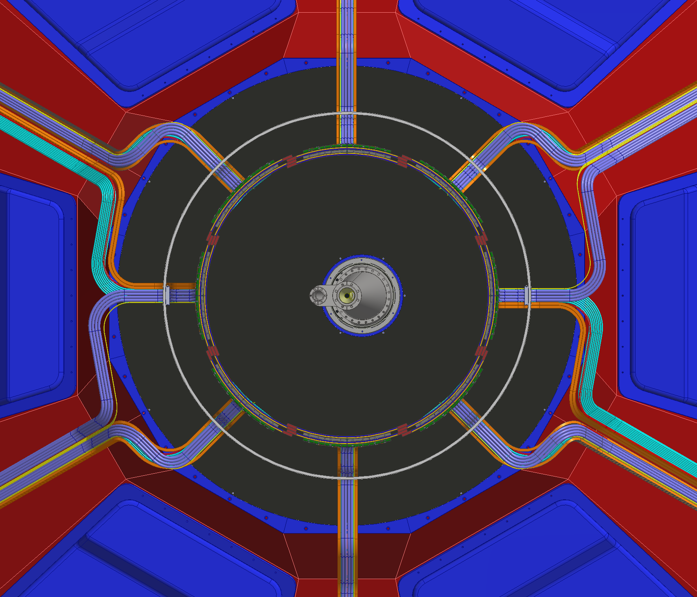
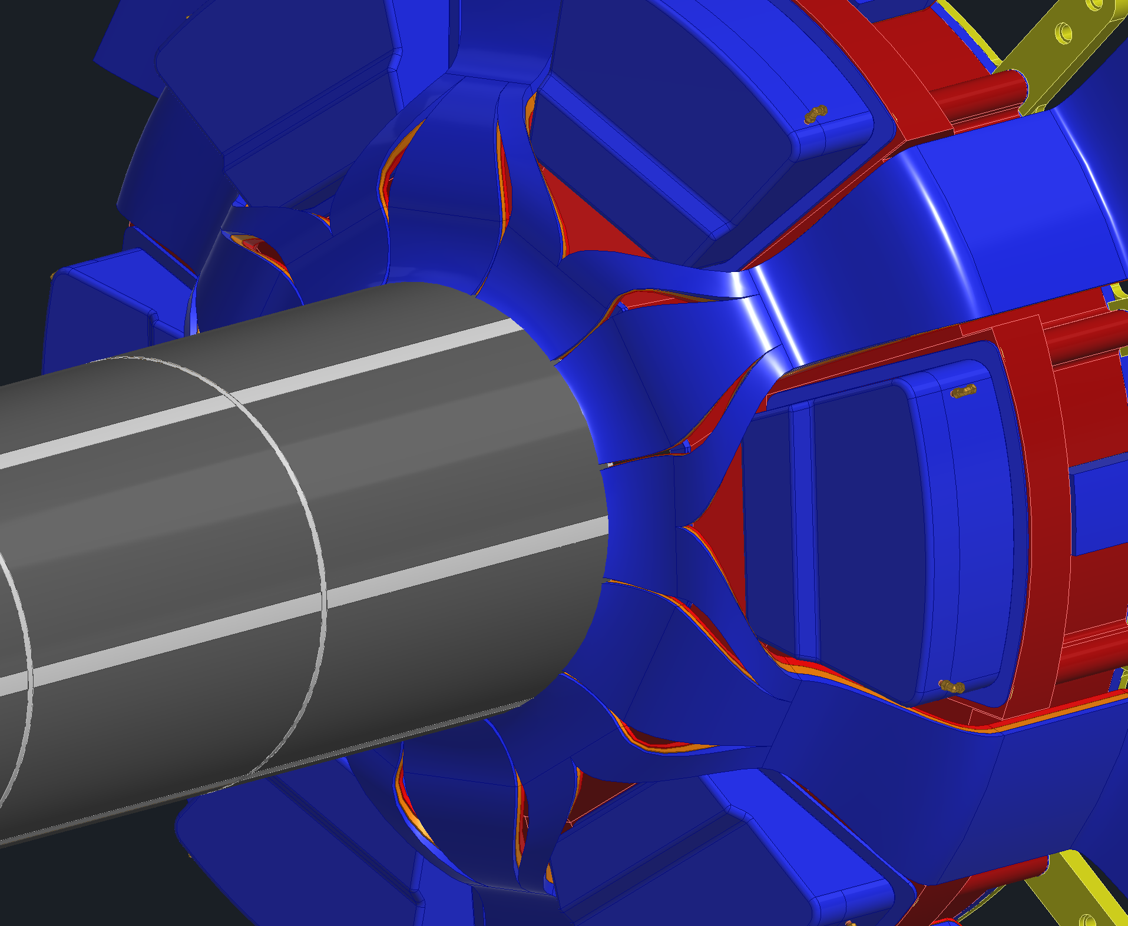
Forward Service Routing

Slide 7
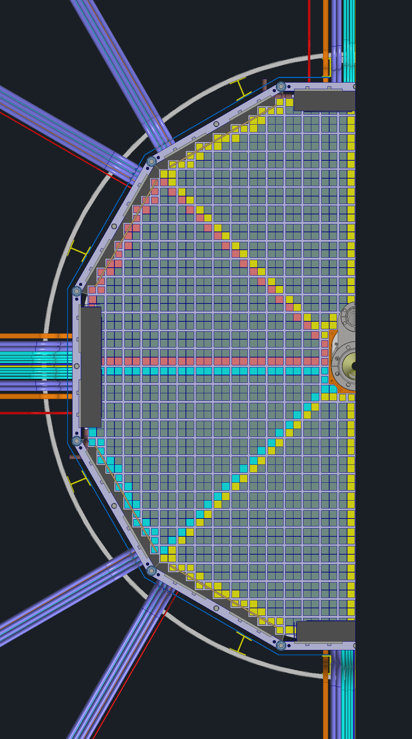
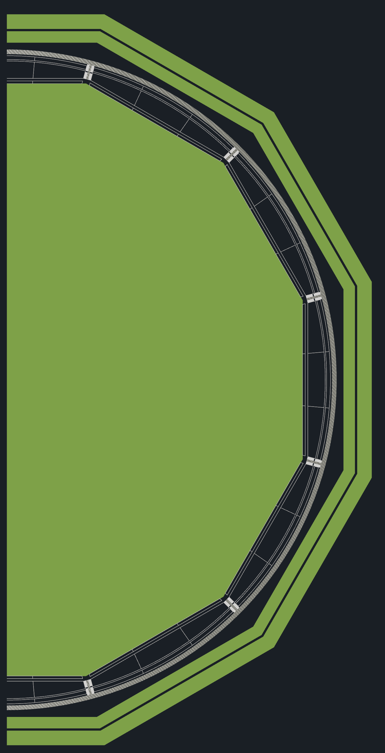
Backward Service Routing

Slide 8
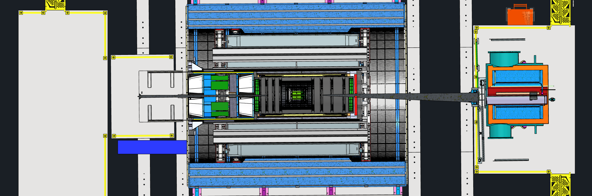
Serviceability Considerations
TOF and Cymbal connectors on backward side take up more space than cables.
  Need connectors to see how we can get them to pass EEEMCal.
B0 to GST is 3.6m, forward half of barrel TOF and Cymbal are 1.75m and backward half of barrel TOF and Cymbal are 3.4m. May need to terminate backwards services earlier.
3.4m
1.75m
3.6m

Slide 9
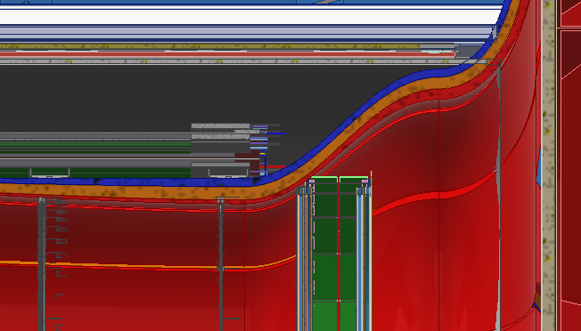
Envelope Change
+3cm CYMBAL ID shift out radially or -3cm MPGD Disks OD shift in radially
  CYMBAL inner radius is 55cm
    We need clearance to slide in and out, so we use 54cm for the outer radius of services
  MPGD disks outer radius is 50cm
  Need a total of 6.5cm between Cymbal and MPGD disks for SVT & MPGD disk services
  We have 1cm of space between CYMBAL and ToF that we can push CYMBAL out radially
  CYMBAL’s envelope goes to 56cm to 61cm radially
  MPGD Disk outer radius would go to 48cm

Slide 10
Backup Slides

Slide 11
Requested Changes
12 segments
  Allows for clean cable routing around:
    6 segmented dRICH in forward direction
    12 segmented EEEMCal in backwards direction
    12 segmented DIRC, 12 segmented oMPGD and 48 segmented BIC in both directions
  Allows for pfRICH and EEEMCal services to be supported by GST.
  Maintenance considerations for more segmentation:
    Reduced inactive area in event of module failure
    Reduced disturbing other detectors and reduced work for repair
  Reduced module deflection and stress
  ToF and Cymbal must match.

Slide 12
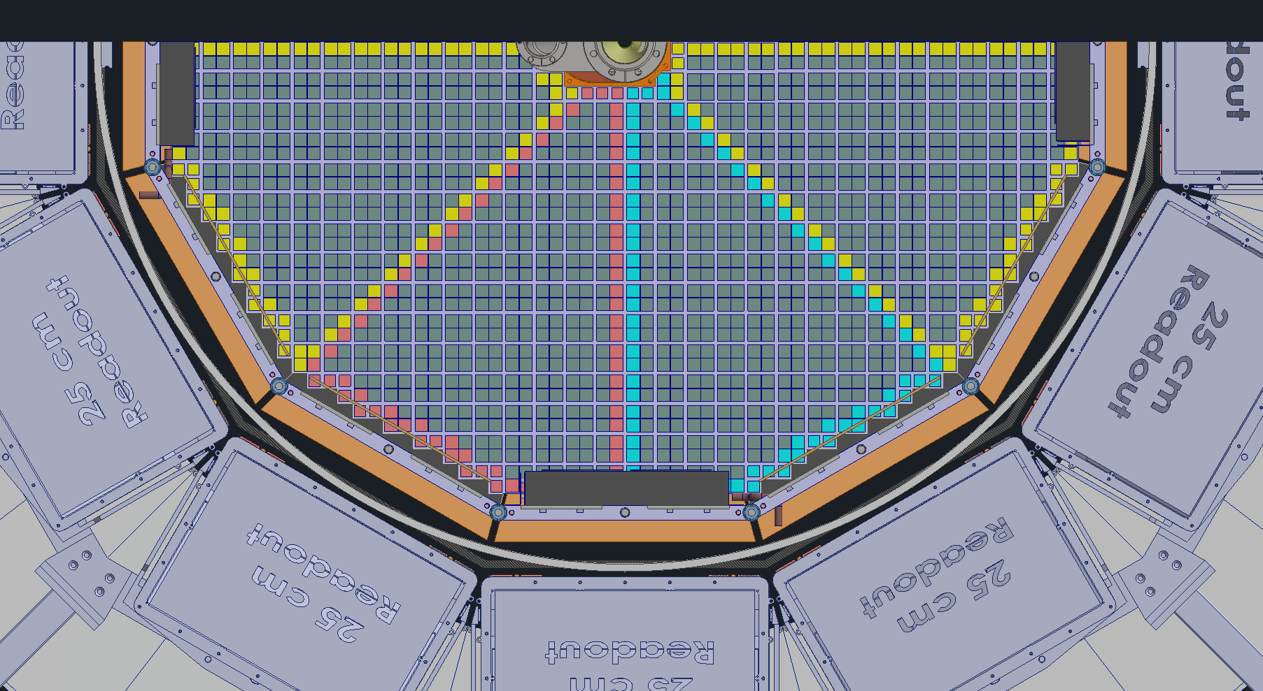
Option 1- 12 Sided Everything
Pros –
  Gain space back in corners that were lost due to circular GST (2,251cm² vs 2,623cm², 17% increase)
  Cable routing and management is kept uniform and clean. The forward side flows nicely into the dRICH and the backward side fits around the EEMCAL and inside the hpDIRC well.
Cons –
  CYMBAL will have more services and has to be redesign for 12 sides, most likely needs to be flat (could still be curved?)
  Loses some services space for clearances between trays
Neutral –
  Have to check if the GST can hold EEEMCAL as this shape

Slide 13
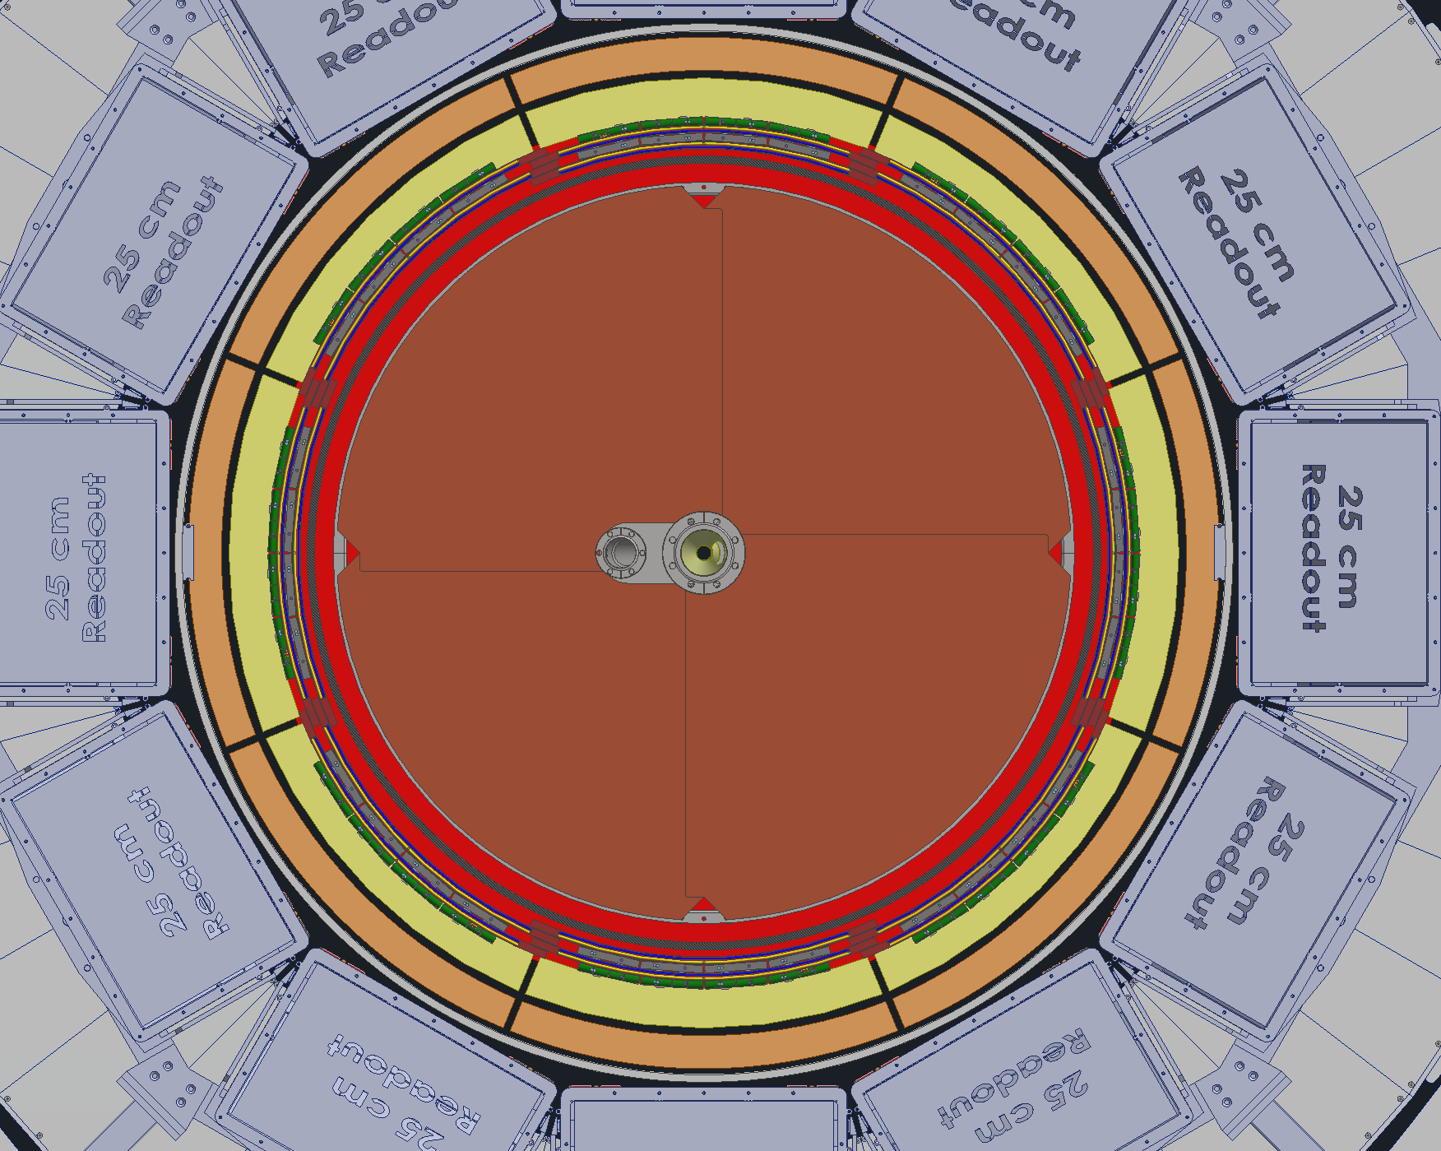
Option 2- Everything Circular
Detectors that stay Circular –
  GST
  PST
  CYMBAL
Detectors that become Circular –
  ToF
  EEEMCAL
Detectors that stay 12 sided –
  hpDIRC
  oMPGD
Tof and CYMBAL would remain segmented
Needs 3 sets of cable trays on backward side, 1 for pfRICH, 1 for SVT and 1 for Tof & CYMBAL
ToF
CYMBAL

Slide 14
Option 2- Everything Circular
Pros –
  No lost space between different shaped detectors (space will be lost on outside of GST)
  CYMBAL can stay as curved panels
Cons –
  Space lost in corners by hpDIRC due to circular GST
  Loses some services space for clearances between trays
Neutral -
  EEEMCAL shape needs to be looked at. Julien proposed a circular shape a few months ago, we’d have to talk with him again.
  Would still prefer that ToF and CYMBAL are broken up into 12 sections, this makes the cable routing much nicer for the previously mentioned reasons.

Slide 15
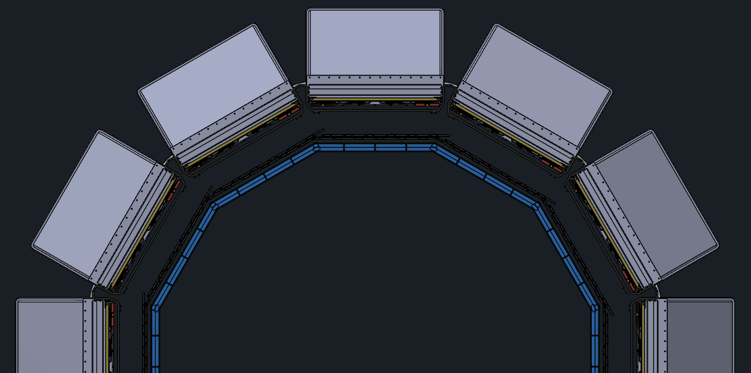
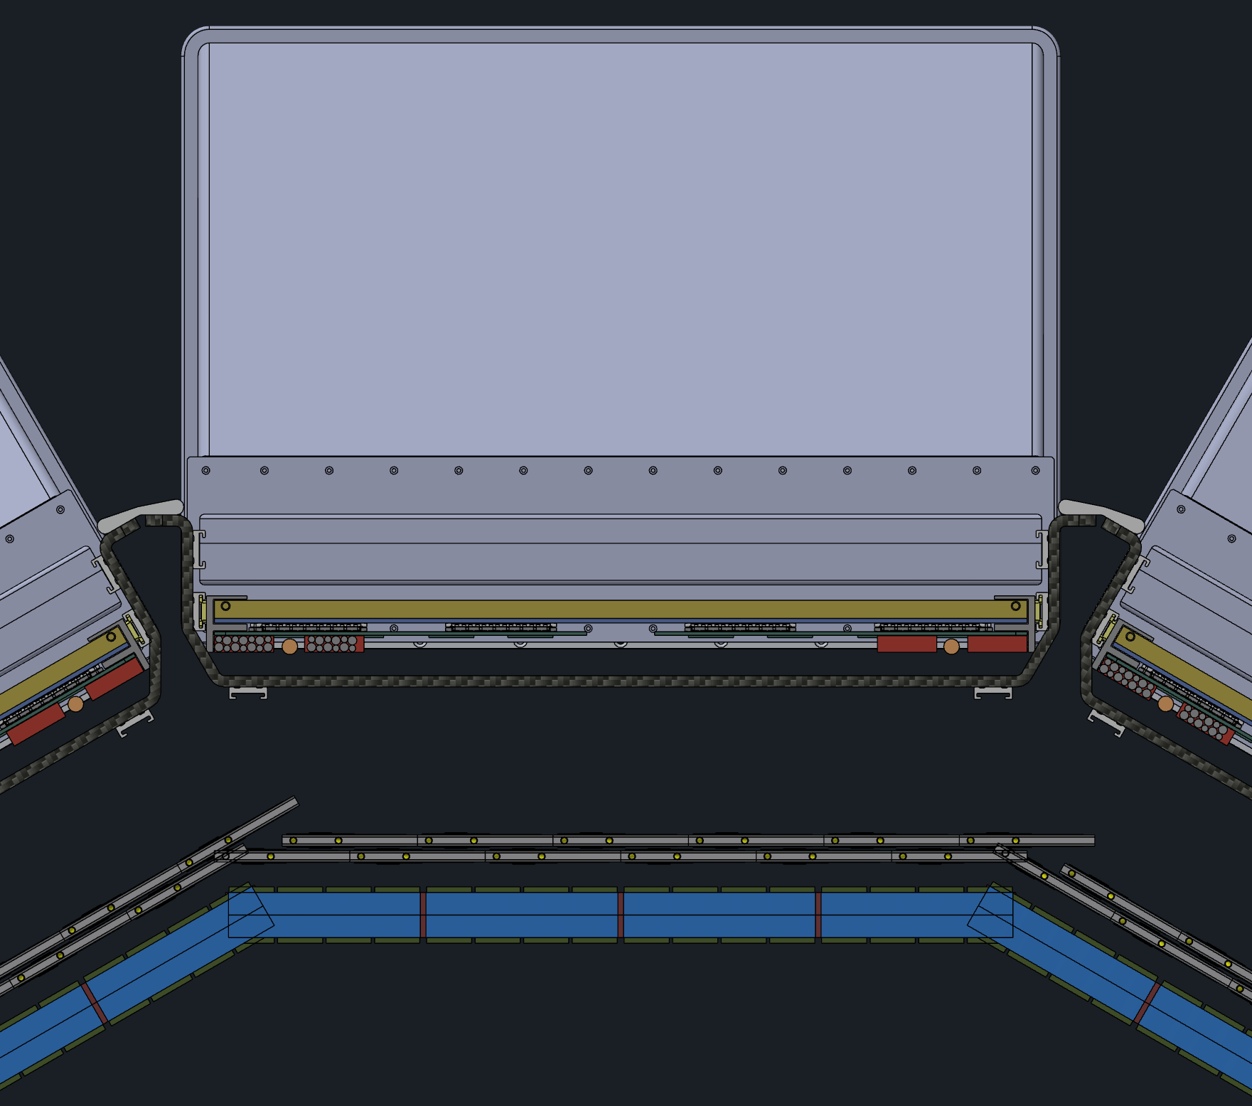
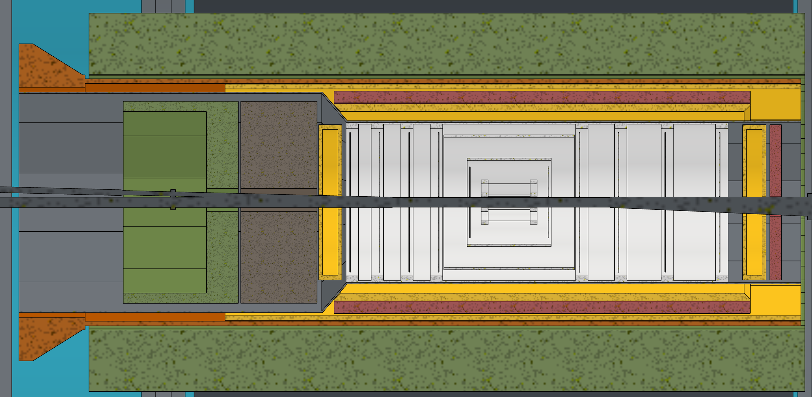
Option 3- Everything 12 sided, No GST
Detectors that stay 12-sided –
  hpDIRC
  oMPGD
  EEEMCAL
Detectors that become 12-sided –
  ToF
  CYMBAL
No GST
PST extended backwards, can be either circular or 12-sided

Slide 16
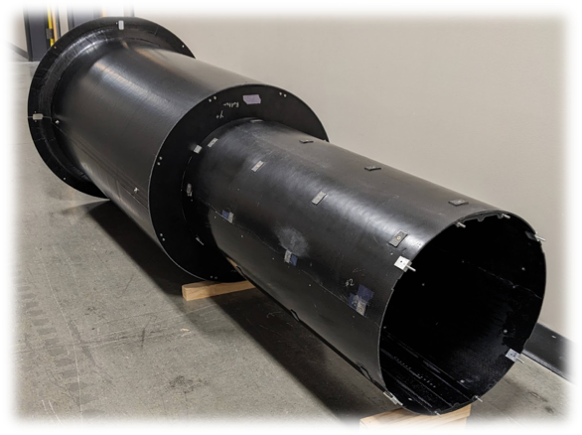
Option 3- Everything 12 sided, No GST
Pros –
  Gain space back in corners that were lost due to circular GST (2,251cm² vs 2,623cm², 17% increase)
  Cable routing and management is kept uniform and clean.
  More space available for cables due to less clearance gaps needs
  DIRC, oMPGD, TOF, iMPGD can all use same install tooling
  SVT can be installed on rails, less complicated installation tooling
  SVT uninstall doesn’t require TOF and iMPGD uninstall
Cons –
  CYMBAL increase services 12.5% or 50%
  Have check if stepped PST is strong enough
Neutral –
  Have to check that barrel EMCAL can hold the EEEMCAL
  Gain space from GST, but lose it to additional EEEMCal clearance and PST

Slide 17
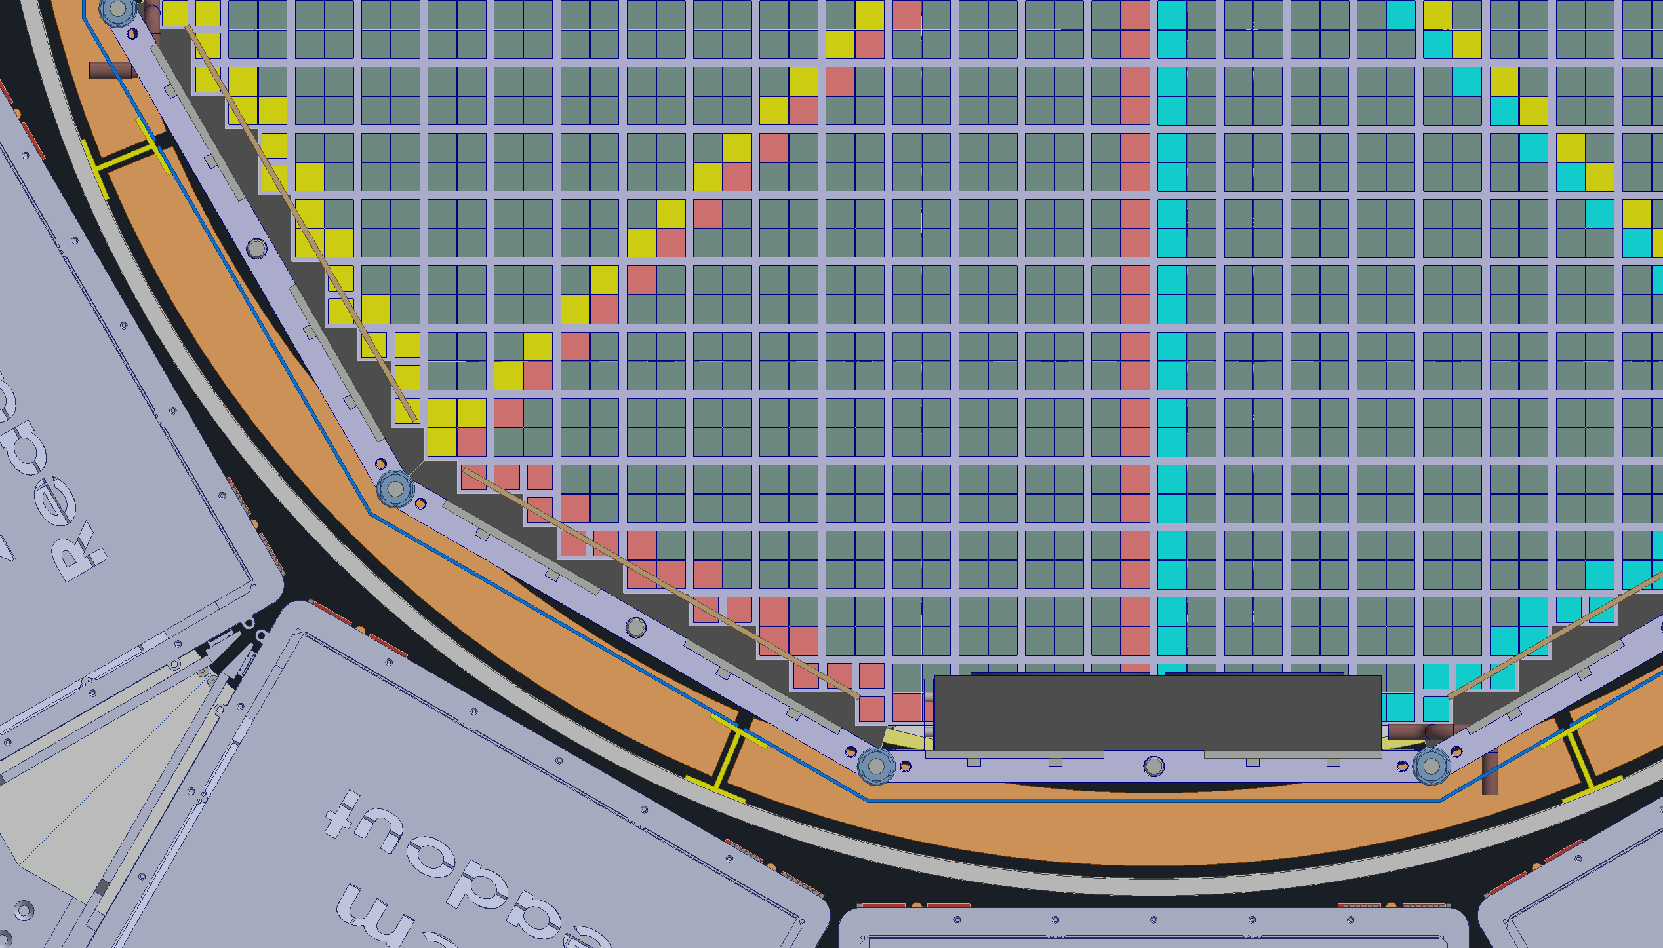
8 sides doesn’t work well
Breaking the backward cable trays up into 8ths results in these odd shapes that wont work well when we have to slide the trays in and out.
On the forward side we have to split the services into 6ths to fit in-between the dRICH sensor boxes. With 12 sided shapes this works well but for 8 it gets messy.

Slide 18
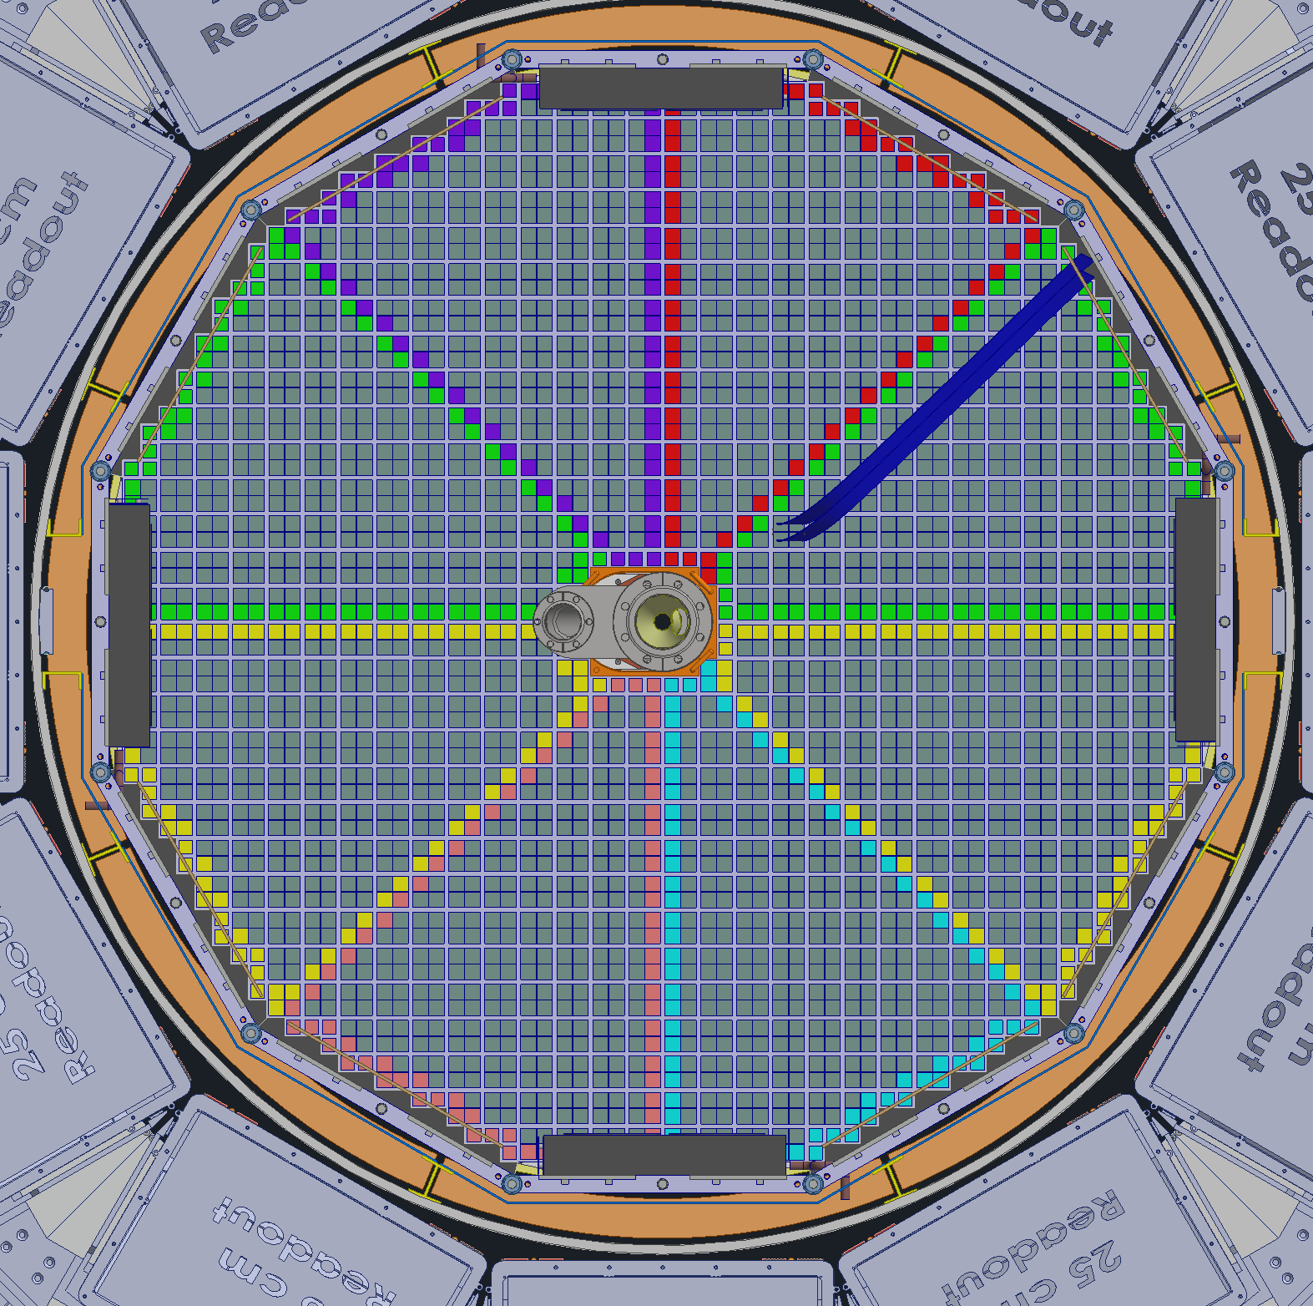
8 sides doesn’t work well

Slide 19
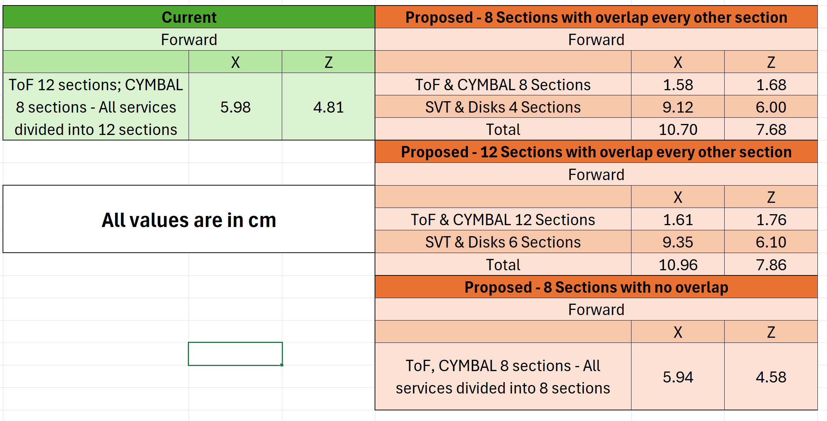
Overlapping the services for maintenance

Slide 20
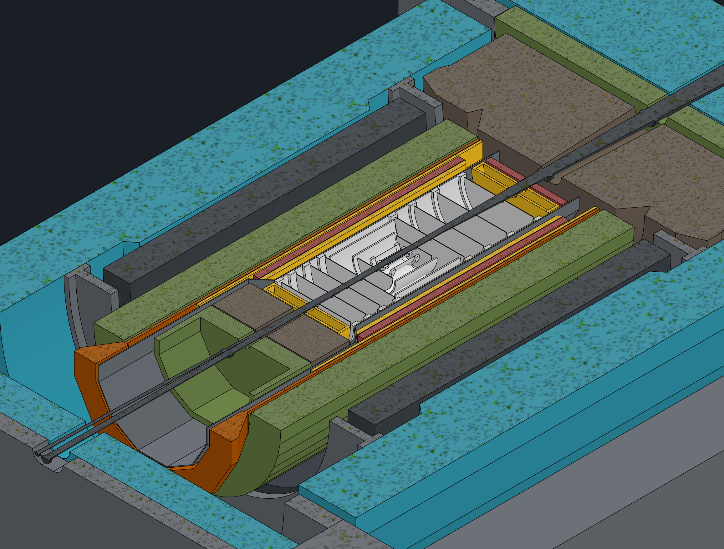
Move GST Adjustment to Beam pipe
Make 5mm gap between detectors and beam pipe 10mm instead
Pros –
  Beam pipe moveable within disks for alignment
    Adjustment is relatively trivial, simple mechanisms and very accessible, easy to meet +/-1mm
    Can be done at any point, no concern about services
    It’s unclear if GST can achieve +/-1mm and GST can not be adjusted once services are connected
  GST/PST adjustment space can be used for services
    Option 1/2: 2,251cm² vs 2,717cm², 21% increase
    Option 3: 2,251cm² vs 3138cm², 40% increase
  GST/PST can be installed on rails
  Potentially better for bakeout insulation
  Less sensitive to future beampipe changes
Cons –
  Loss in detector coverage

Slide 21
GST Options
Option 2a
Make EEEMCAL Circular
CYMBAL can be 8 or 12 sectors
  CYMBAL must change their layout accommodate for rails
  Will likely get shifted outward in radius slightly
  Will be increasing their services regardless?
8 makes forward direction messy
12 is not as messy
Option 2a’
Keep EEEMCAL 12 sided
Make the cable tray for the pfRICH that sits outside the EEEMCAL circular, thus making the EEEMCAL ‘circular’
CYMBAL can be 8 or 12 sectors
  CYMBAL must change their layout accommodate for rails
  Will likely get shifted outward in radius slightly
  Will be increasing their services regardless?
8 makes forward direction messy
12 is not as messy

