Slide 1
LGAD clusters

Slide 2
Work done: Digitization work-flow
Start
Geant hit
Edep in cells
Charge sharing
Pulse Generation
Pulse Combiner
ADC and TDC values
Pulse Digitization
Pulse Discretization
Clustering
Calibration
Measurement2D
Cluster
Association
Tracking

Slide 3
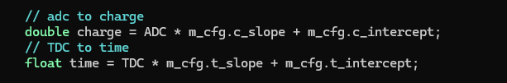
LGADHitCalibration
Convert ADC/TDC values back into time and charge.
Currently it’s just a linear function. Time work correction TBD.

Slide 4
LGADClustering
Cluster 1
Group hits into clusters.
Two hits belong to the same cluster if:
Their cells are neighbors.
Time difference between the 2 hits < 1 ns.
Use union-find by rank algorithm with path compression to group all hits
Cluster 2
Cluster 3
Time axis not shown

Slide 5
LGADClustering
Cluster 1
Weighted average for cluster location.
Weighted by Edep.
Edep of a cluster is the sum of Edep from all hits in that cluster.
Time of a cluster is the earliest hit time of all hits in that clusters.
TBD: edge correction
Cluster 2
Cluster 3
Time axis not shown

Slide 6
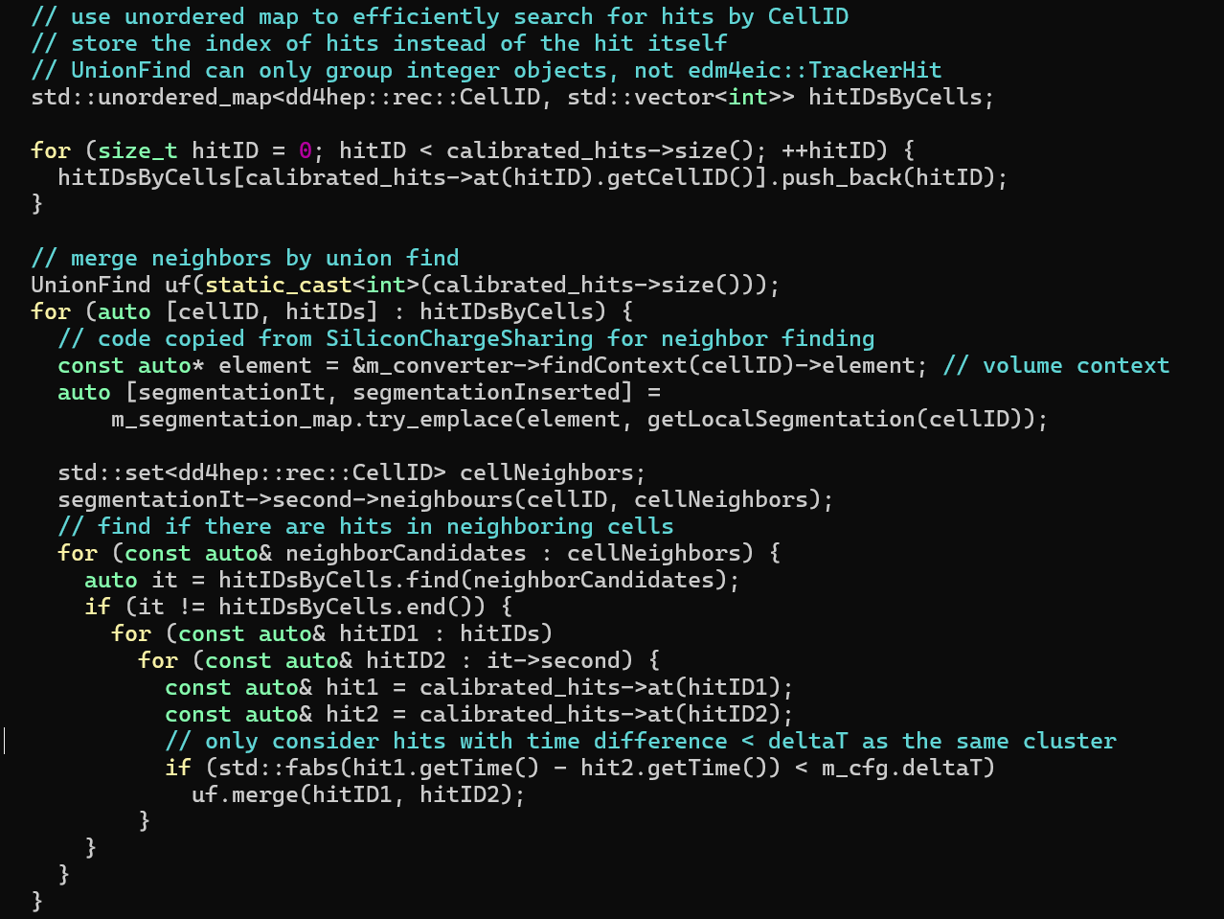
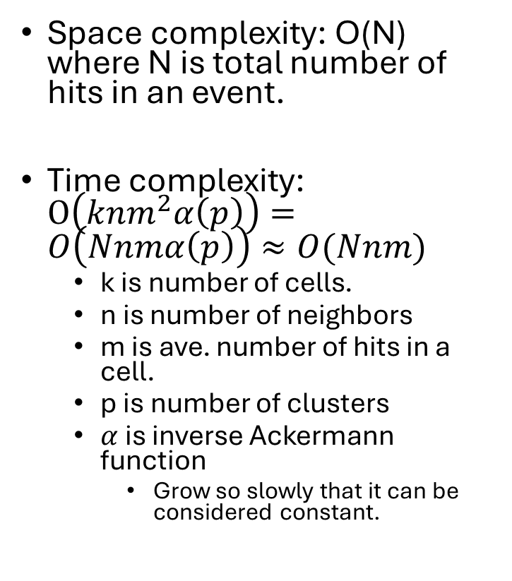

Complexity
Space complexity: O(N) where N is total number of hits in an event.
Time complexity: $O\left(knm^{2}α\left(p\right)\right)=O\left(Nnmα\left(p\right)\right)≈O(Nnm)$
k is number of cells.
n is number of neighbors
m is ave. number of hits in a cell.
p is number of clusters
$α$ is inverse Ackermann function
Grow so slowly that it can be considered constant.
k
nlog(n)??
n
m
m
$$α(p)$$

Slide 7
LGADClusterAssociation
Convert Measurement2D to TrackerHit
Associate TrackHit with raw hit by temporal proximity in the same sensor.
For debugging: TrackerHit stores global hit location, Measurement2D only store local hit.
Make plotting reco position vs true position much easier with TTree::Draw
Also make some benchmarks happy

Slide 8
Performance (No charge sharing)

Slide 9
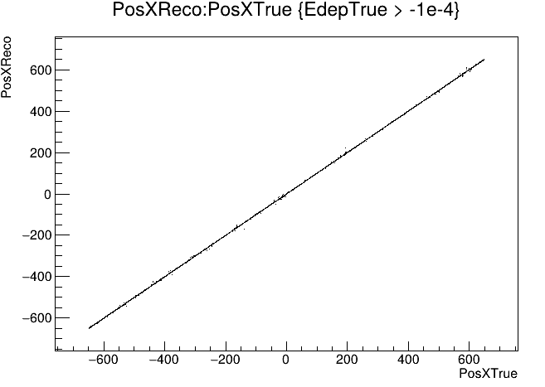

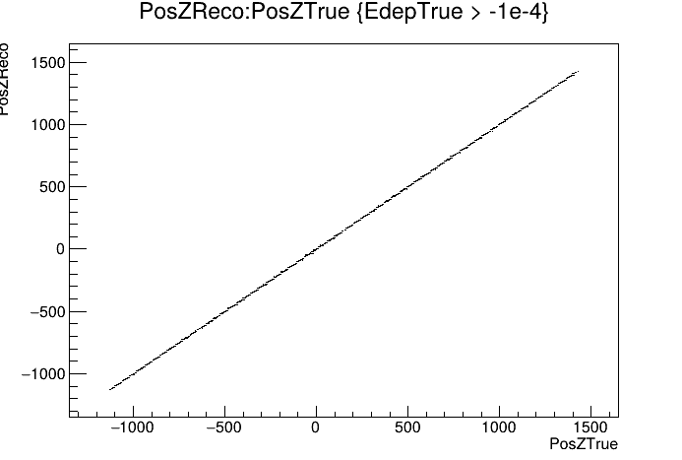
Performance (Position resolution)
Tested with 5000 uniformly distributed pi+.

Slide 10
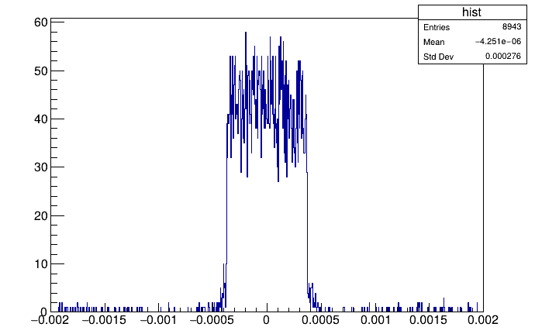
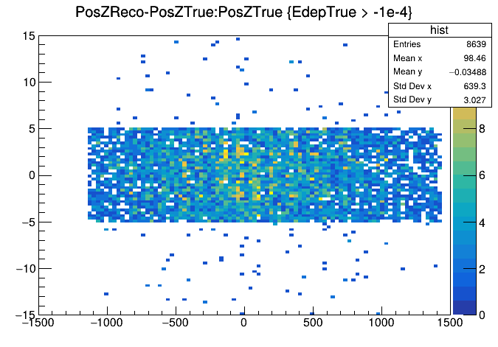

Performance (Position resolution)
Tested with 5000 uniformly distributed pi+.
Z (reco) – Z (true)
Z (true)
$$φ_{reco}−φ_{true} (rad)$$

Slide 11
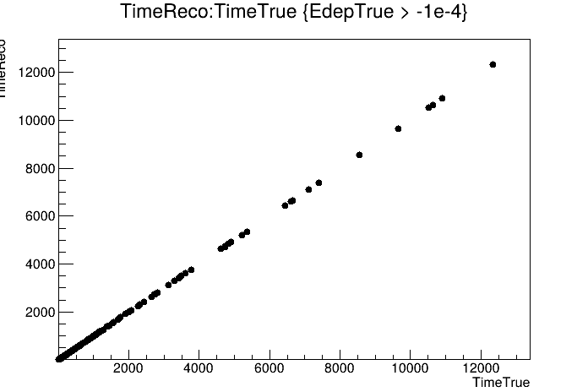
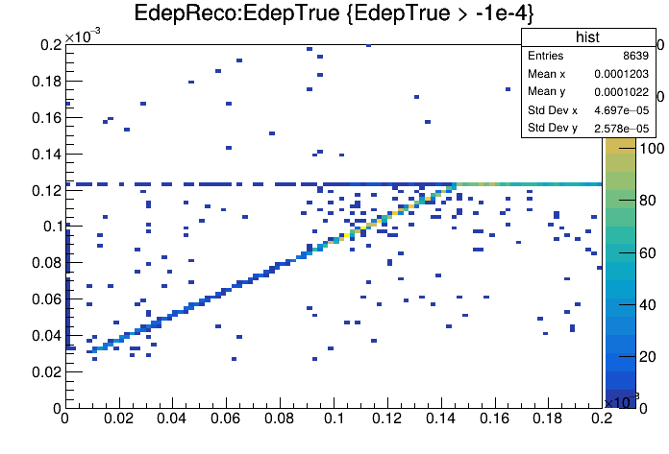
Performance (time and Edep resolution)
Tested with 5000 uniformly distributed pi+.
T(reco) (ns)
E(reco) (GeV)
T(true) (ns)
E(true) (GeV)

Slide 12
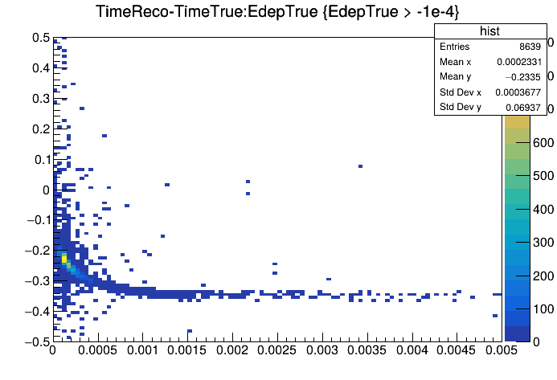
Performance (time sluewing)
Tested with 5000 uniformly distributed pi+.
T(reco)-T(true) (ns)
E(true) (GeV)

Slide 13
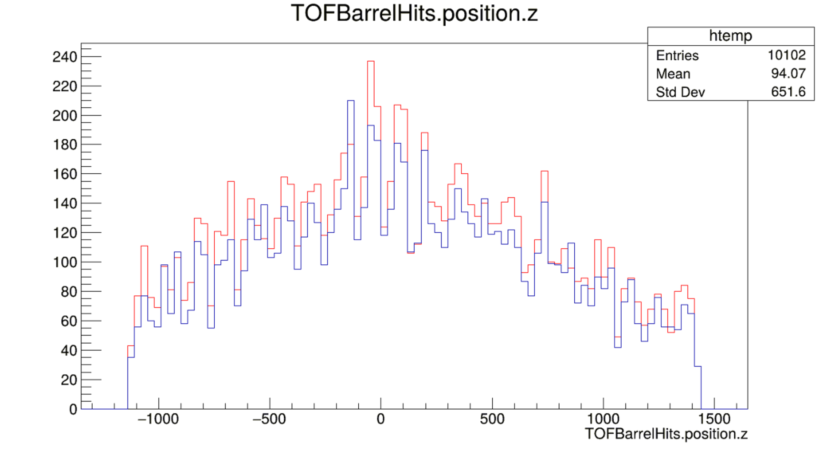
Performance (number of clusters)
Red: True hits
Blue: Reco hits
Z (mm)

Slide 14
Performance (default charge sharing)
sigma_sharingx = 1e-5 * dd4hep::cm,
sigma_sharingy = 1e-5 * dd4hep::cm,

Slide 15
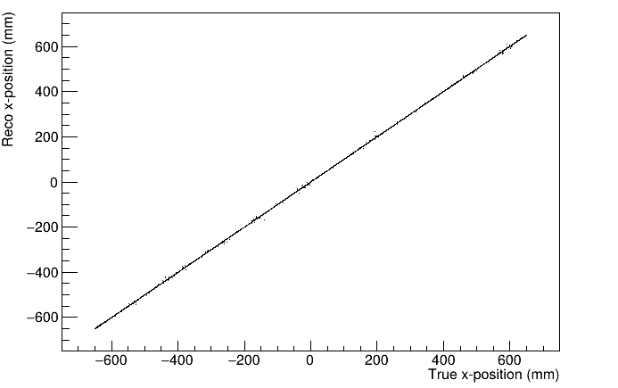
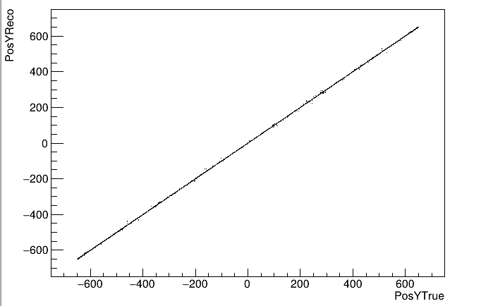
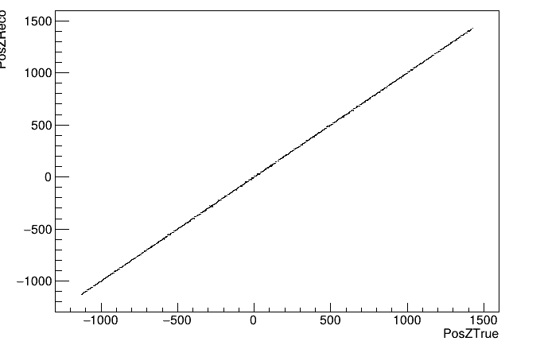
Performance (Position resolution)
Tested with 5000 uniformly distributed pi+.

Slide 16
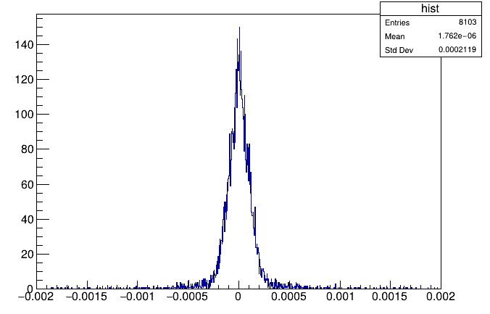
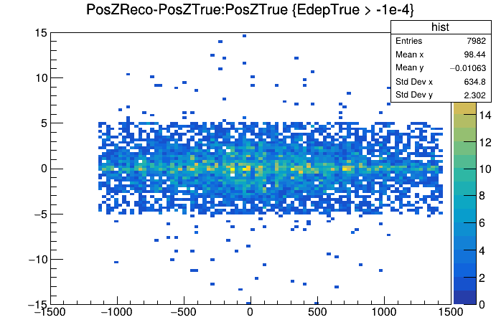

Performance (Position resolution)
Tested with 5000 uniformly distributed pi+.
Z (reco) – Z (true)
$$φ_{reco}−φ_{true} (rad)$$
Z (true)

Slide 17
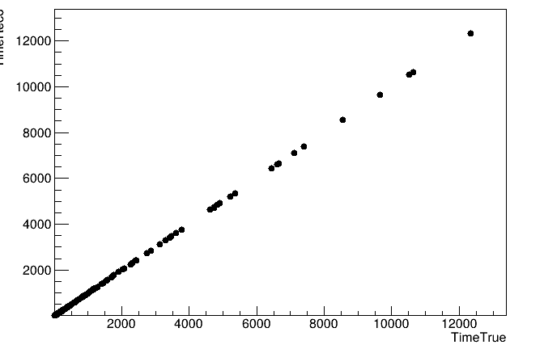
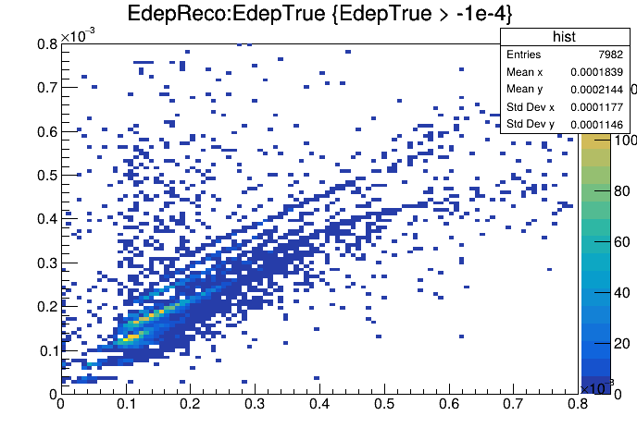
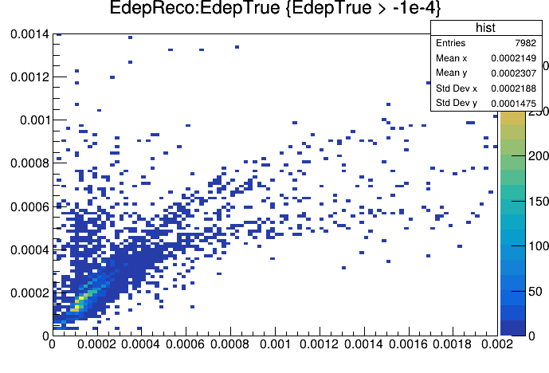
Performance (time and Edep resolution)
Tested with 5000 uniformly distributed pi+.
T(reco) (ns)
E(reco) (GeV)
E(reco) (GeV)
T(true) (ns)
E(true) (GeV)
E(true) (GeV)

Slide 18
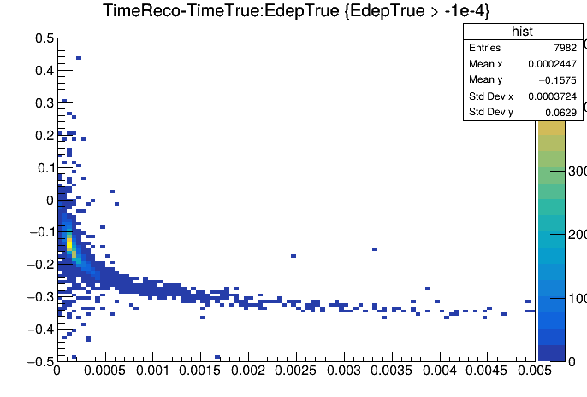
Performance (time sluewing)
Tested with 5000 uniformly distributed pi+.
T(reco)-T(true) (ns)
E(true) (GeV)

Slide 19
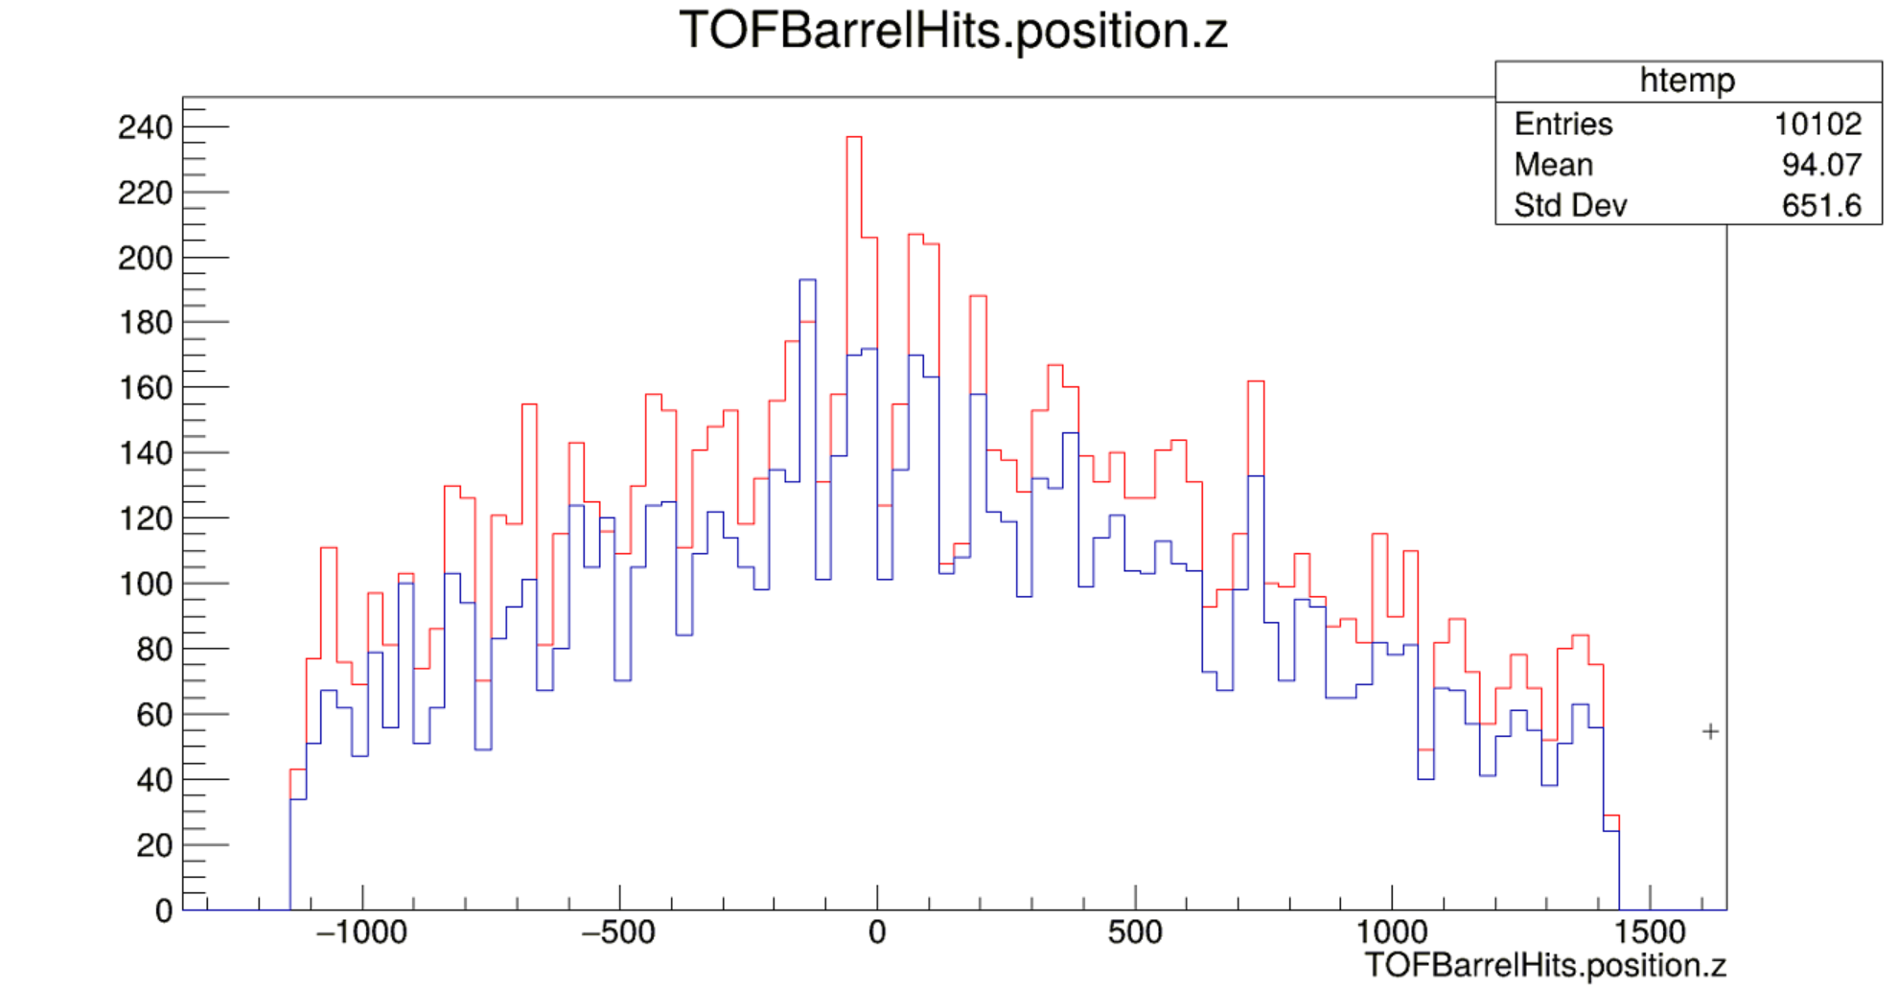
Performance (number of clusters)
Red: True hits
Blue: Reco hits
Z (mm)

Slide 20
Things to do after this pull request
Implement clustering algorithm that my advisor’s students are working on.
Add noise to pulses
Apply everything to ETOF.

