Slide 1
ePIC Electronics and DAQ WG – 6/26/2025
News / Announcements
  Since last meeting
    June 2-3 : ASIC meeting in Paris
    June 10: Met with EIC Controls regarding common platform / timing
    June 12-13: DAC Review
    Updated background’s From A. Natochii including SR, Touschek, Coulomb, Bremsstrahlung (Bethe-Heitler)
    June 24: Met with Taku Gunji, Shinsuke Ota / to discuss collaboration with SPADI
    June 25: (2 prior / 1 follow up): Calorimeters relationship between thresholds/radiation damage/ & noise/
  Upcoming
    July 14-18: Collaboration Meeting at JLAB
    PreTDR update deadline (July 14th?)
    Sept ~4th-5th DAQ PDR 3 (60%)
Agenda
  Additional Details on above
  Laundry list of open topics

Slide 2
Comments on ASIC meeting
Fernando gave a summary at the TIC Meeting on Monday the 23rd
Points I want to reiterate or add
  One of the needs is to check and document the details of each ASIC, and in particular the details of the streaming of the ASICs with unfinished digital sections. To this end we want to hold “internal mini-reviews” of each ASIC (+ discrete) to define and document the details.
  The original assumption that hits will be of O(64 bits) – 20 bits to locate the position, ~20 bits to define a high granularity time, and ~20 bits to define an ADC is too low by an order of magnitude
    Causes:
      Sampled ADCs (sometimes in inefficient structures)
      Granularity of ASIC readout
    Data volumes, and component and fiber counts need to be re-visited with the actual data formats in mind
    Data rate limitations and behaviors need to be documented and understood. (The meeting was a start…)
  ITS3, Astropix, & Timepix need to be brought into the discussion as per the ASICs.

Slide 3
Meetings with EIC Controls
Two sets of meetings:
  There is a plan to install a networking room int the hall, likely to go in the DAQ room in 1006. This will service 1006 as well as some of the new planned buildings in the immediate vicinity. This adds more reason to split echelon 0 between facilities.
  Discussion of the Common Platform and it’s timing characteristics
    The jitter requirement should be easily met
    A phase drift of ~<8ps is potentially possible from the common platform, but not yet certain.
    The Beam Position Monitors have outputs which will be used for a reference time for the crab cavities. It is not clear how to make use of them
    The timing requirement for physics needs to be broken down to achievable requirements for specific components…

Slide 4
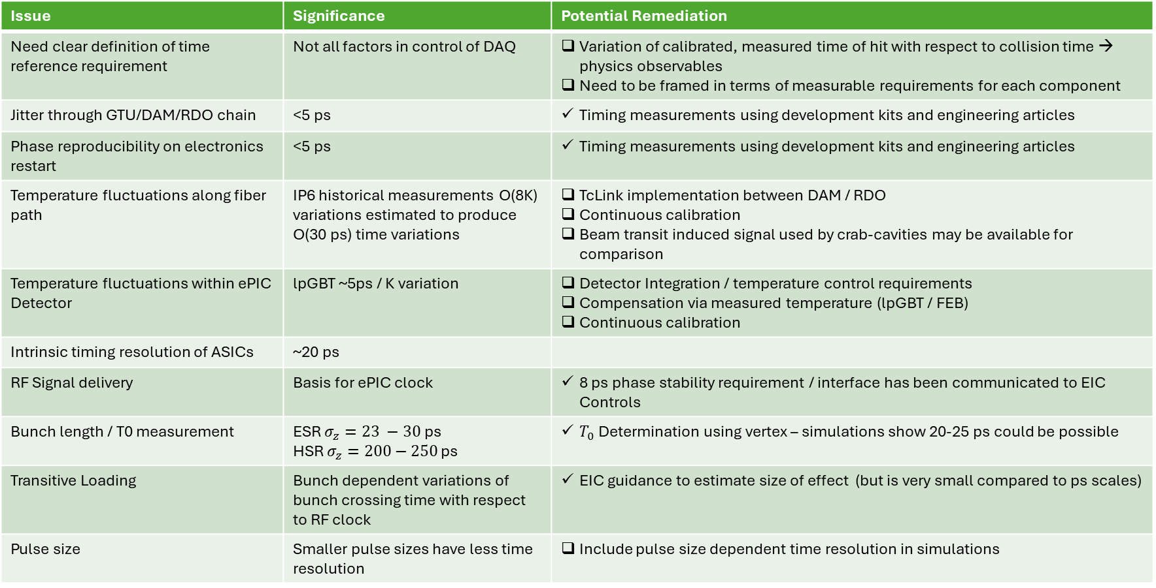
ePIC requires 25-30 ps timing for most sensitive detectors. This is an integration challenge.
Issue | Significance | Potential Remediation
Need clear definition of time reference requirement | Not all factors in control of DAQ | Variation of calibrated, measured time of hit with respect to collision time → physics observables Need to be framed in terms of measurable requirements for each component
Jitter through GTU/DAM/RDO chain | <5 ps | Timing measurements using development kits and engineering articles
Phase reproducibility on electronics restart | <5 ps | Timing measurements using development kits and engineering articles
Temperature fluctuations along fiber path | IP6 historical measurements O(8K) variations estimated to produce O(30 ps) time variations | TcLink implementation between DAM / RDO Continuous calibration Beam transit induced signal used by crab-cavities may be available for comparison
Temperature fluctuations within ePIC Detector | lpGBT ~5ps / K variation | Detector Integration / temperature control requirements Compensation via measured temperature (lpGBT / FEB) Continuous calibration
Intrinsic timing resolution of ASICs | ~20 ps
RF Signal delivery | Basis for ePIC clock | 8 ps phase stability requirement / interface has been communicated to EIC Controls
Bunch length / T0 measurement | ESR $σ_{z}=23 −30$ps HSR $σ_{z}=200−250$ ps | $T_{0}$ Determination using vertex – simulations show 20-25 ps could be possible
Transitive Loading | Bunch dependent variations of bunch crossing time with respect to RF clock | EIC guidance to estimate size of effect (but is very small compared to ps scales)
Pulse size | Smaller pulse sizes have less time resolution | Include pulse size dependent time resolution in simulations

Slide 5
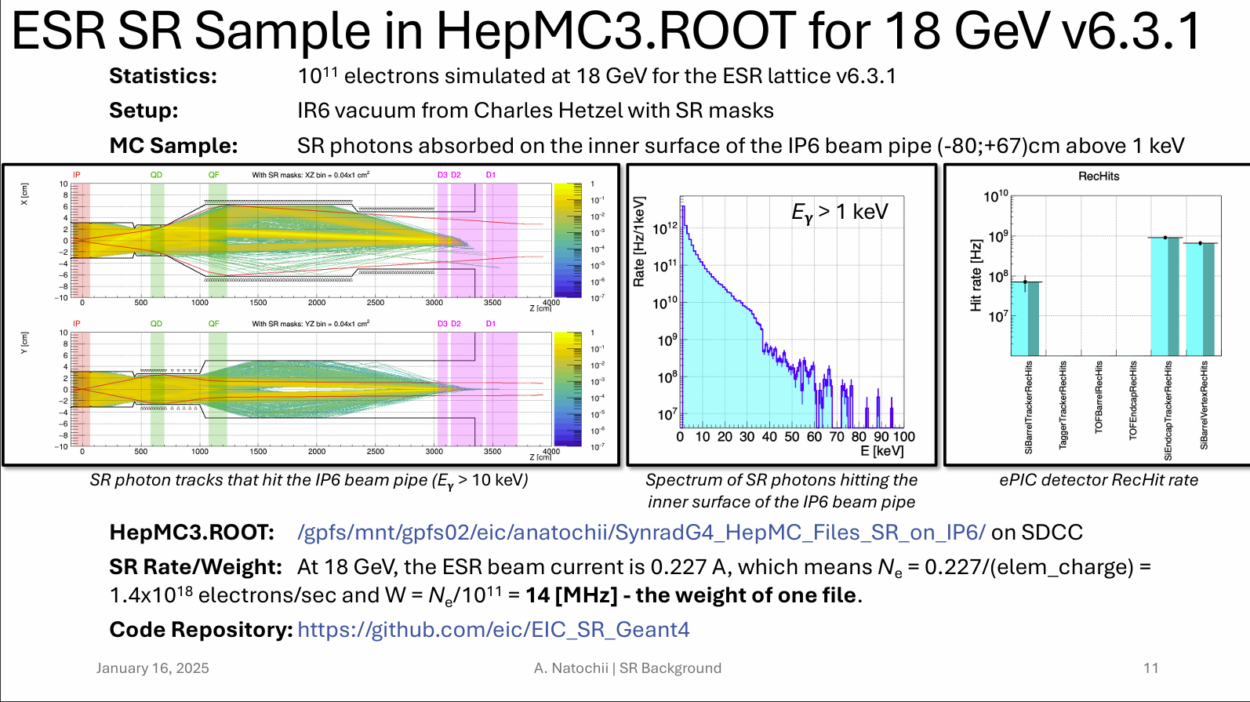

Slide 6
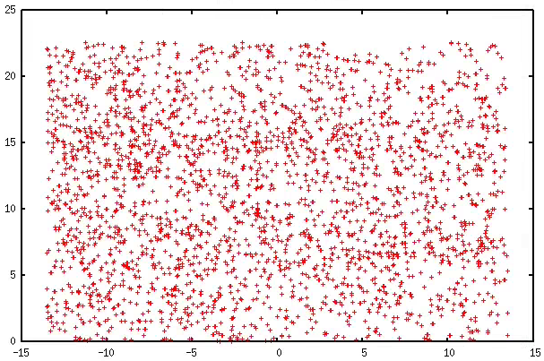
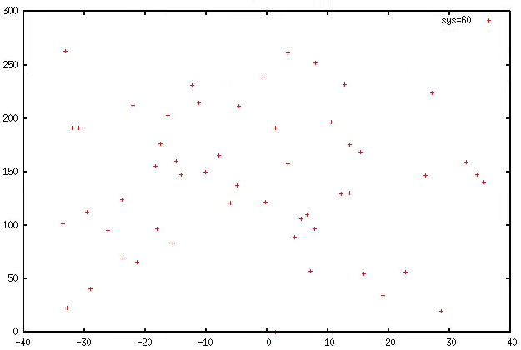
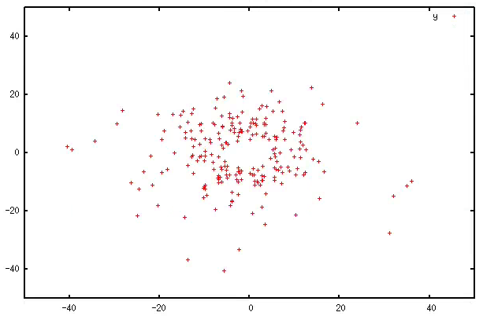
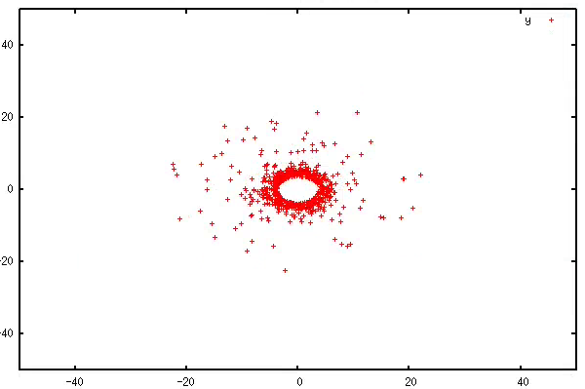
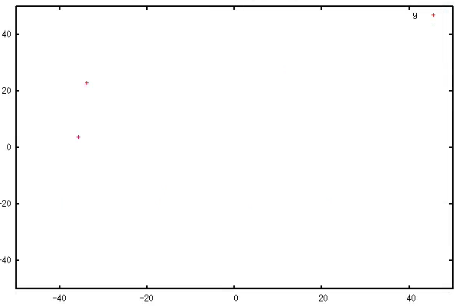
Synchrotron Radiation (MAPS)
Barrel Inner / Outer
R*phi vs Z
DISKS
Negative…Positive
X vs Y
Each hit represents 14 MHz!

Slide 7
Synchrotron Radiation (MAPS)
Divide into 4 sections: Record hits & hits per cm^2 for each section
layer 1: 1631/10.682384 1484/9.719594 1274/8.344180 1156/7.571328
layer 2: 324/1.591551 217/1.065946 227/1.115068 132/0.648410
layer 3: 47/0.092349 47/0.092349 43/0.084490 37/0.072700
layer 4: 32/0.013972 38/0.016592 22/0.009606 17/0.007423
layer 5: 18/0.003560 17/0.003362 20/0.003955 12/0.002373
148 MHz / cm^2
49 KHz / cm ^2
135 MHz / cm^2
47 KHz / cm^2
116 MHz / cm^2
39 KHz / cm^2
105 MHz / cm^2
33 KHz / cm^2
Total For Section 22 GHz 20 GHz 17 GHz 16 GHz
Minimum for entire epic: 4000 gb/sec Synchrotron radiation! (20 gb/sec data + other backgrounds)

Slide 8
Synchrotron Radiation (MAPS)
Andrii’s numbers are an order of magnitude lower than mine, though I use the same files…. Which still needs to be understood,
On the other hand, this is for 18GeV electrons that run at 0.23 Amps Beam current
At 5GeV and 10GeV we run at a full 2.5Amps, and the Synchrotron radiation will be worse yet.
Assume these rates are needed:
  72 output fibers from innermost layer
  75 GHz * 20 bits --> 1500 Gb/sec
  1500 Gb/sec / 72 output fibers = 20 Gb/s / fiber. (~4x > MAPS sensor capability)

Slide 9
Collaboration Meeting Plans
Tuesday Morning: SRO Working Group:
  Planned Test Beds
    Orchestration
    Reconstruction
    Calibration
  DAQ summary talk (focused on SRO related subjects including echelon 1 interface)
Wednesday Morning: Electronics and DAQ I
  Session overlaps with AC-LGAD
  Pico-daq plans
  Calorimeter Data Volumes / Radiation Damage / Noise
  Backgrounds (including synchrotron radiation)
Thursday Afternoon: Electronics and DAQ II
Timing
  GTU
  Integration (detector groups, particularly TOF)
ASICs & ASIC Support hardware status and plans

