Slide 1
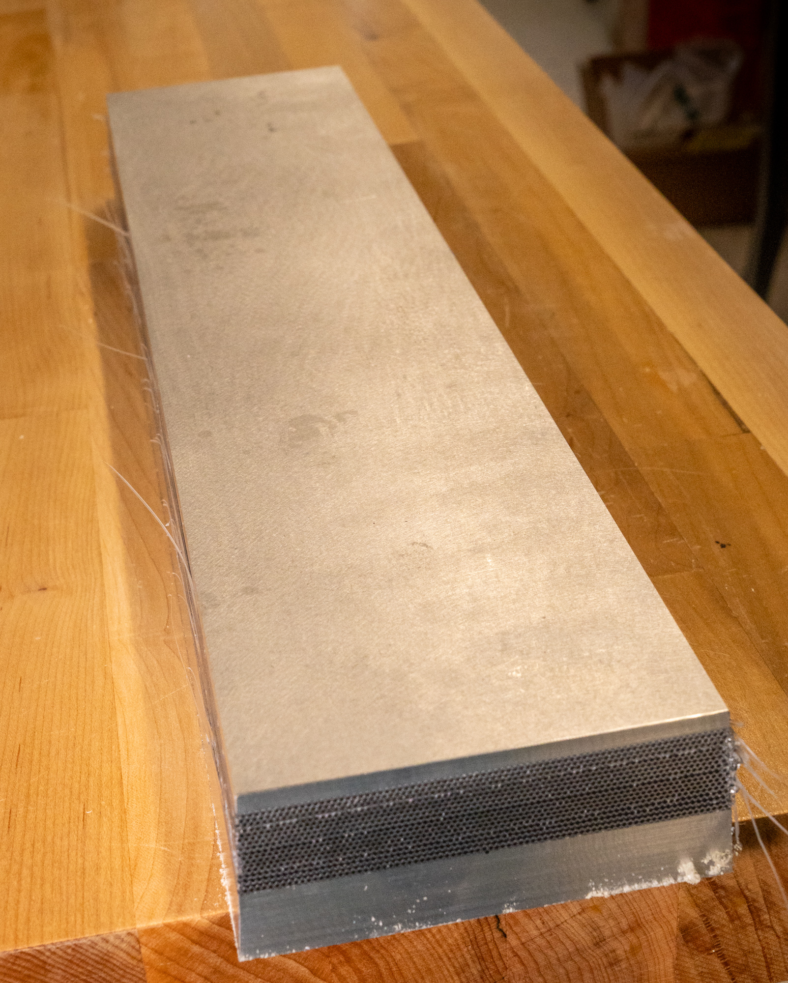
BIC SECTOR DEVELOPMENT Update
JUNE 26 2025
Kevin G. Bailey & Tom O’Connor

Slide 2
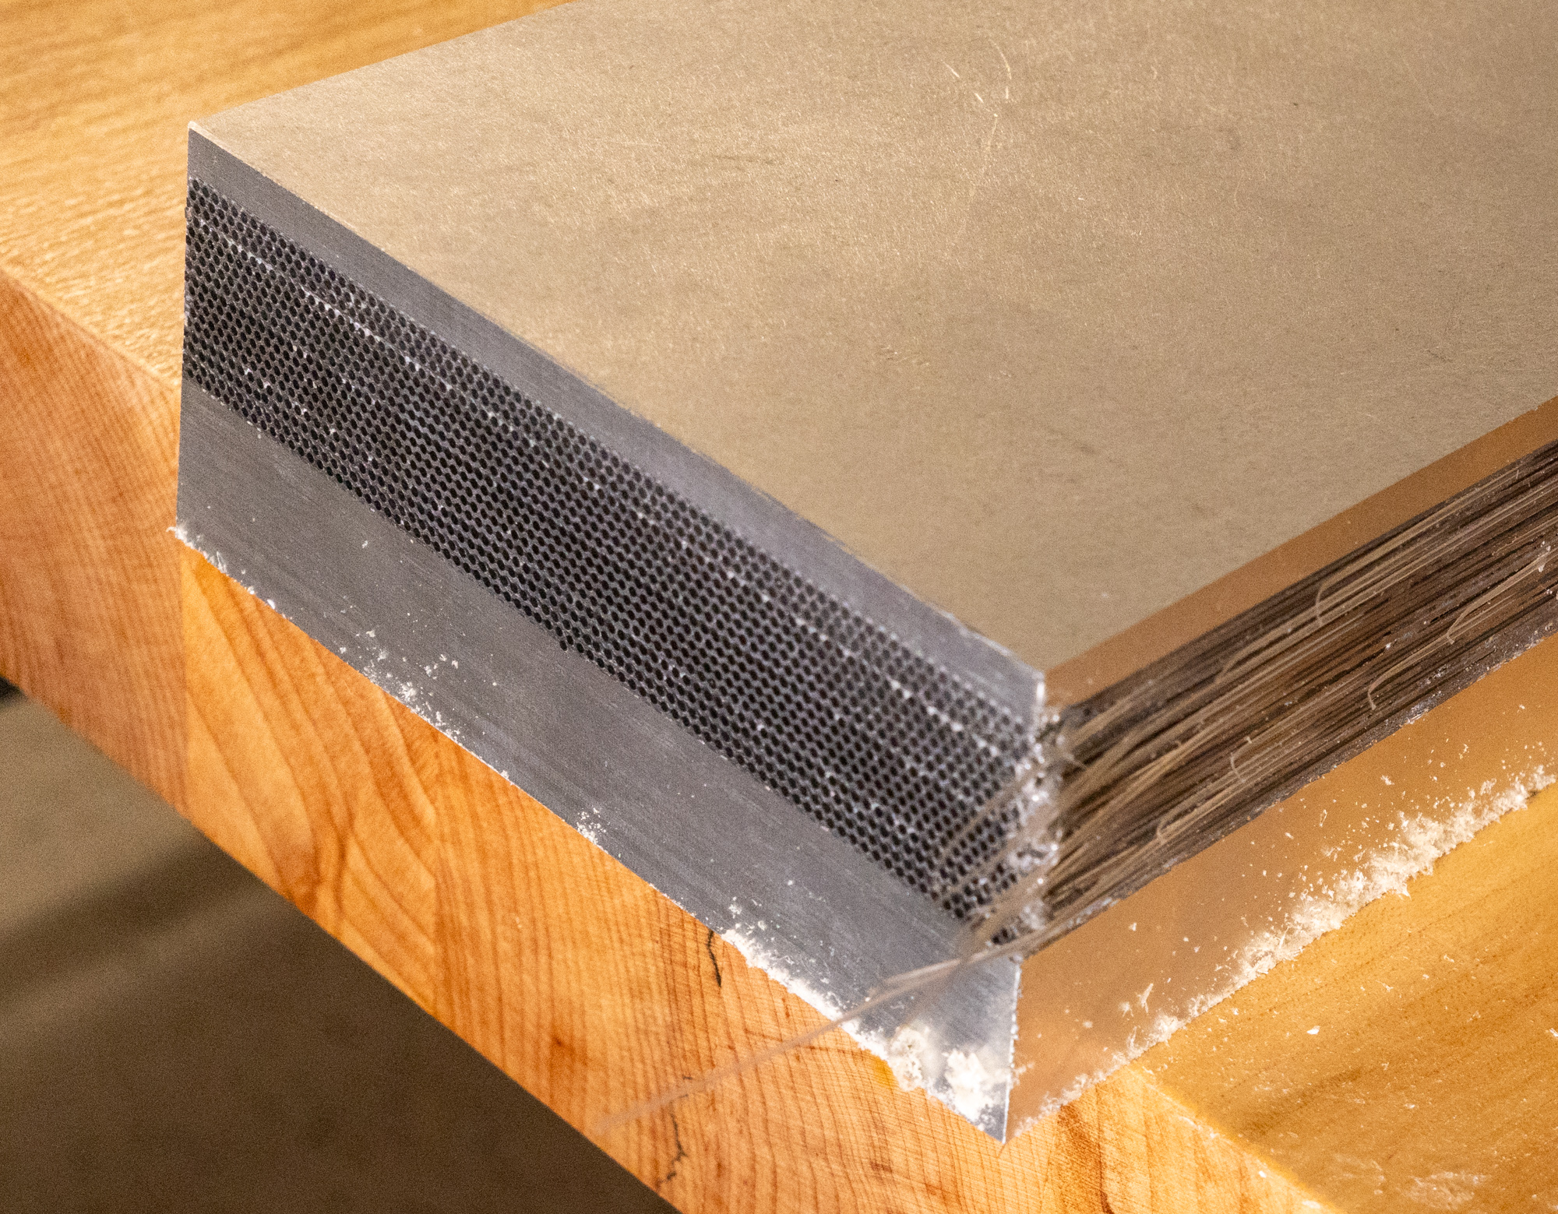
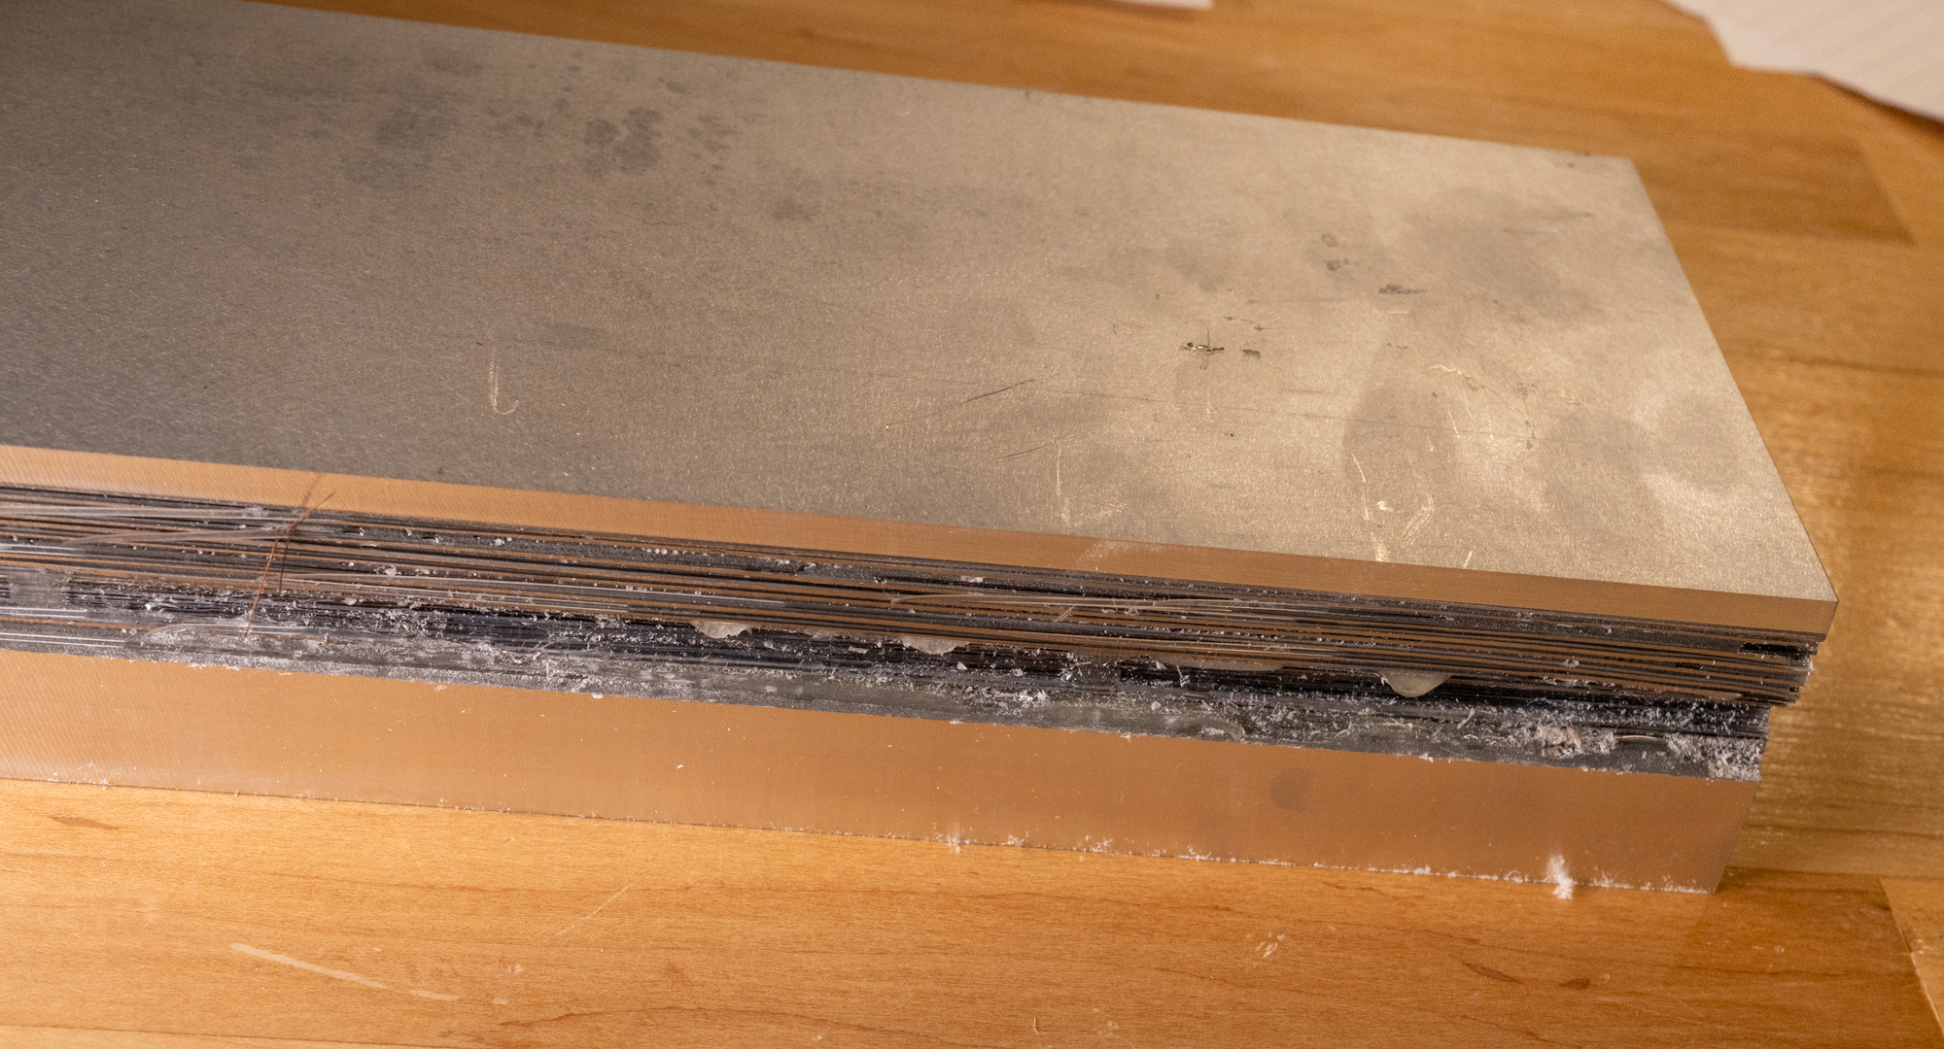
This Week
First 18 layer test article back from the shops (Thank you Frank!)

Slide 3
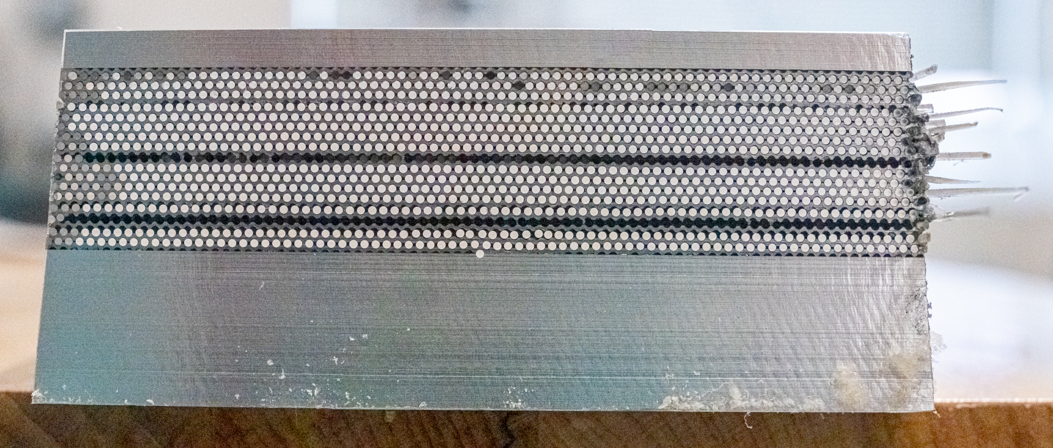
How’d we do…

Slide 4
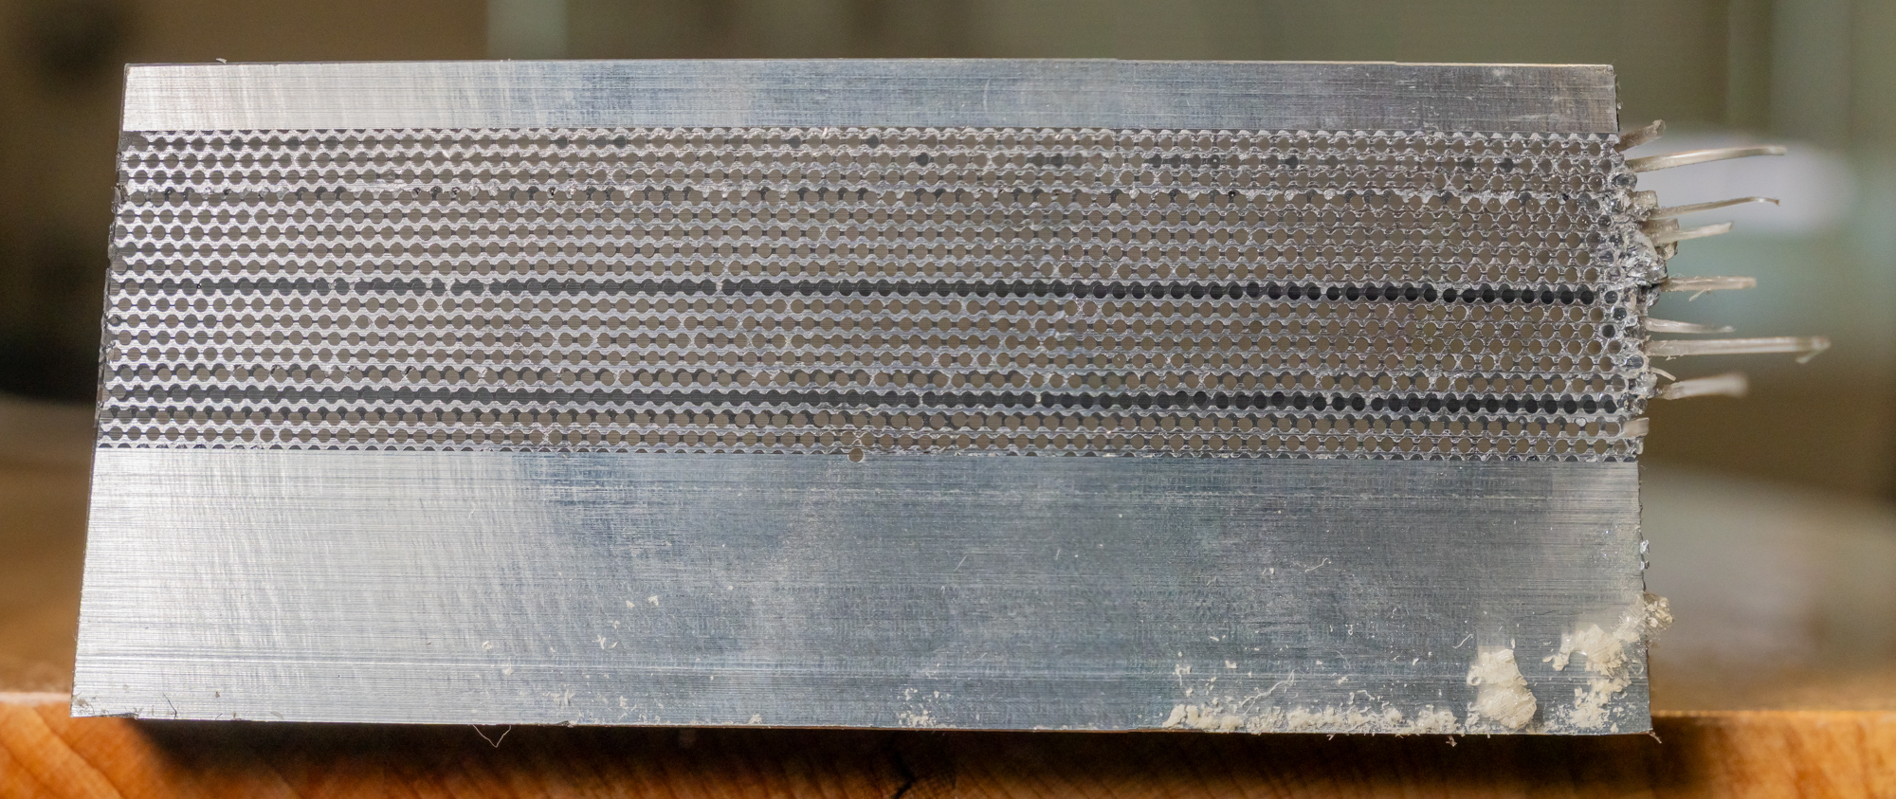
Ok, for a first try of more than 3 layers
Front lit only

Slide 5
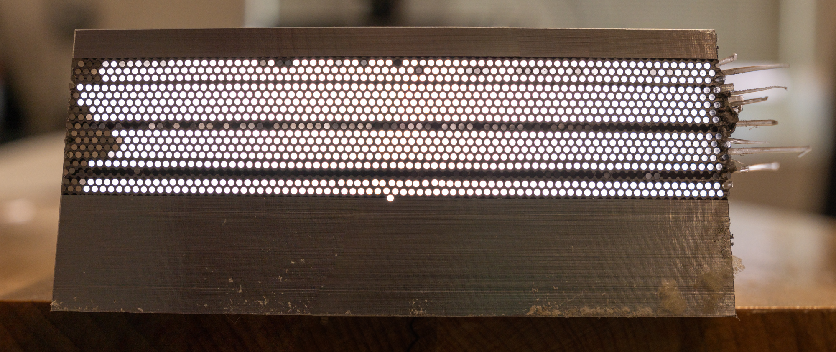
Missed a few
Back lit only.
The two dark rows are blocked on the other end by epoxy in the lead grooves. This should be solved now.

Slide 6
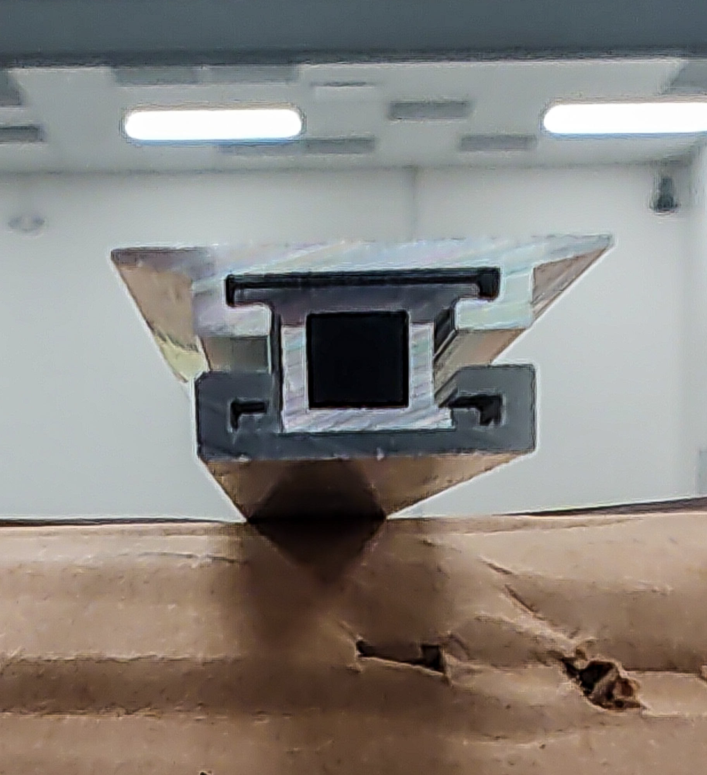
Extrusions measured

Slide 7
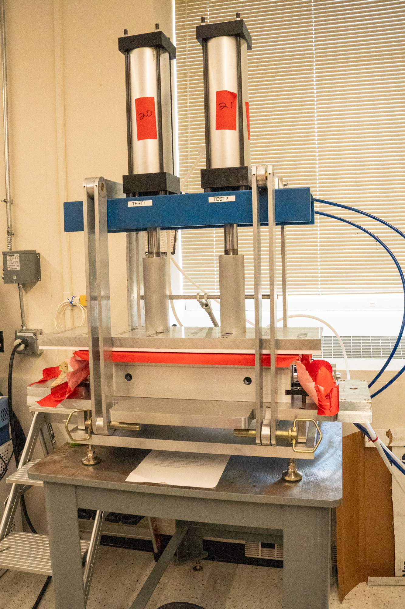
second layup on the press
Expect to have this one ready for machining by 7/4/25
Frank plans to machine it starting 7/7/25

Slide 8
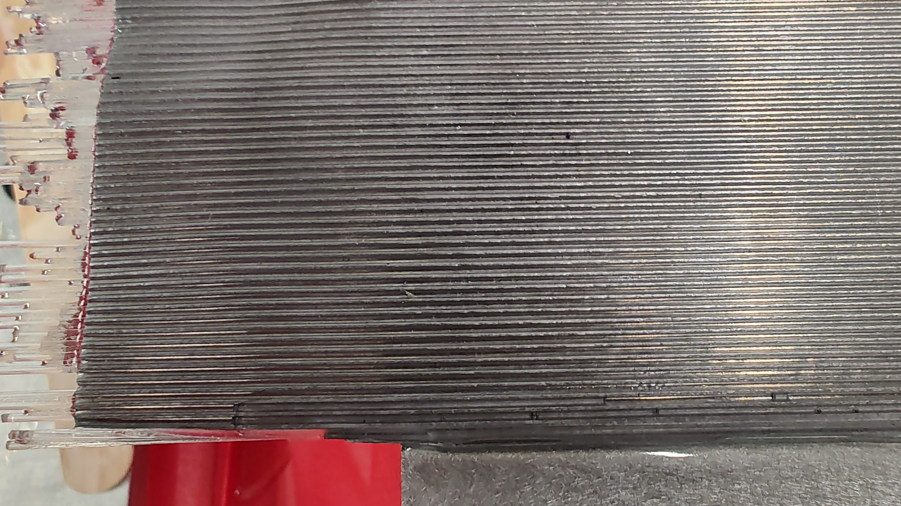
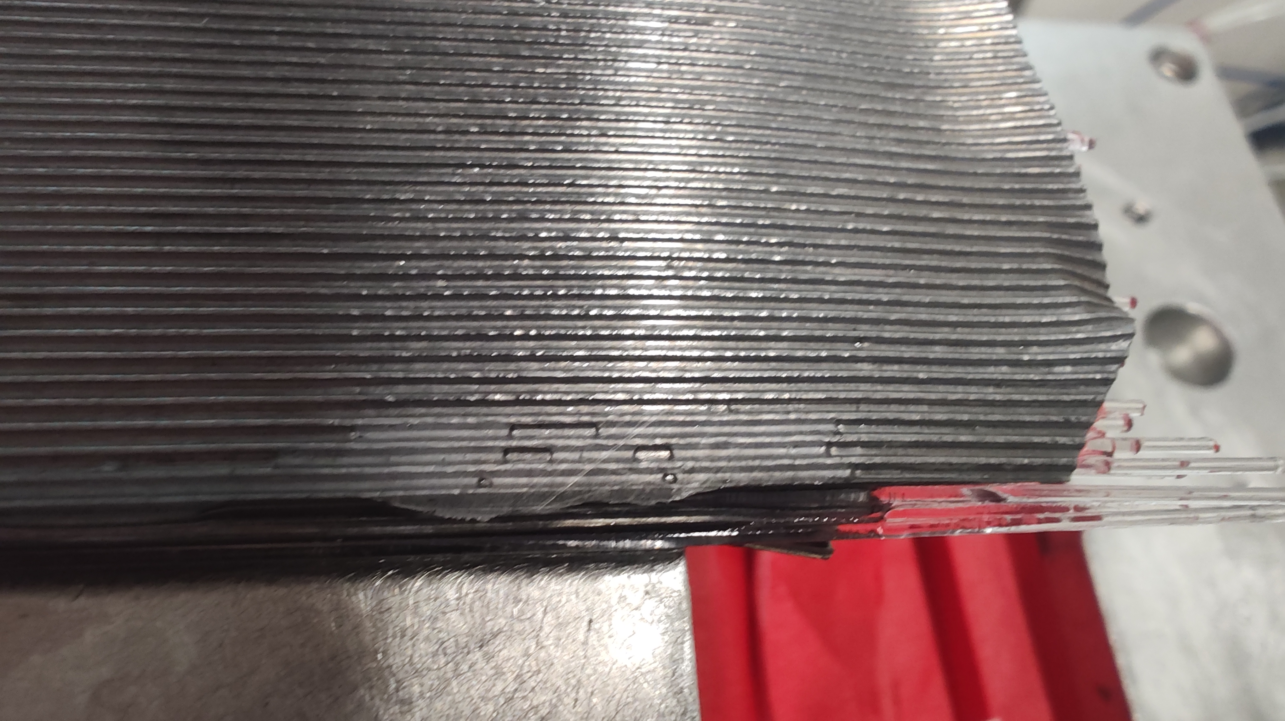
Better but not perfect

Slide 9
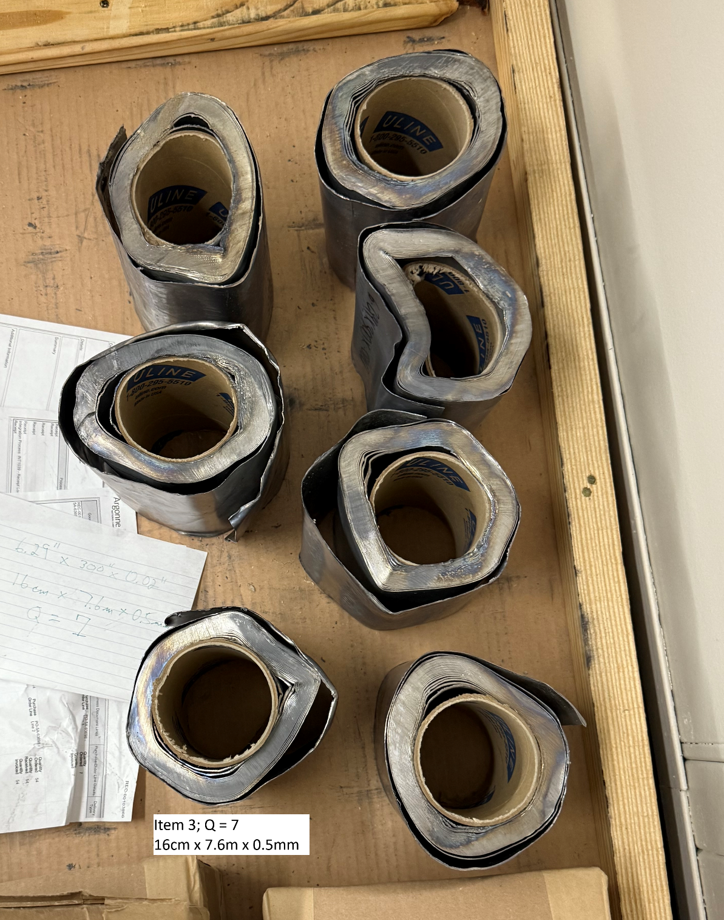
New Lead

Slide 10
Lead/Swaging Update
June 27, 2025

Slide 11
Vulcan Prototype Lead
Lead is damaged. Some rolls are crushed and nearly all of them have some damage to the edges
Lead is dirty but we didn’t ask for degreasing or any sort of cleaning.
All lead is too thick. Specification is 0.50mm and actual is 0.59mm.
RMA in process
Alternate suppliers may be an option

Slide 12
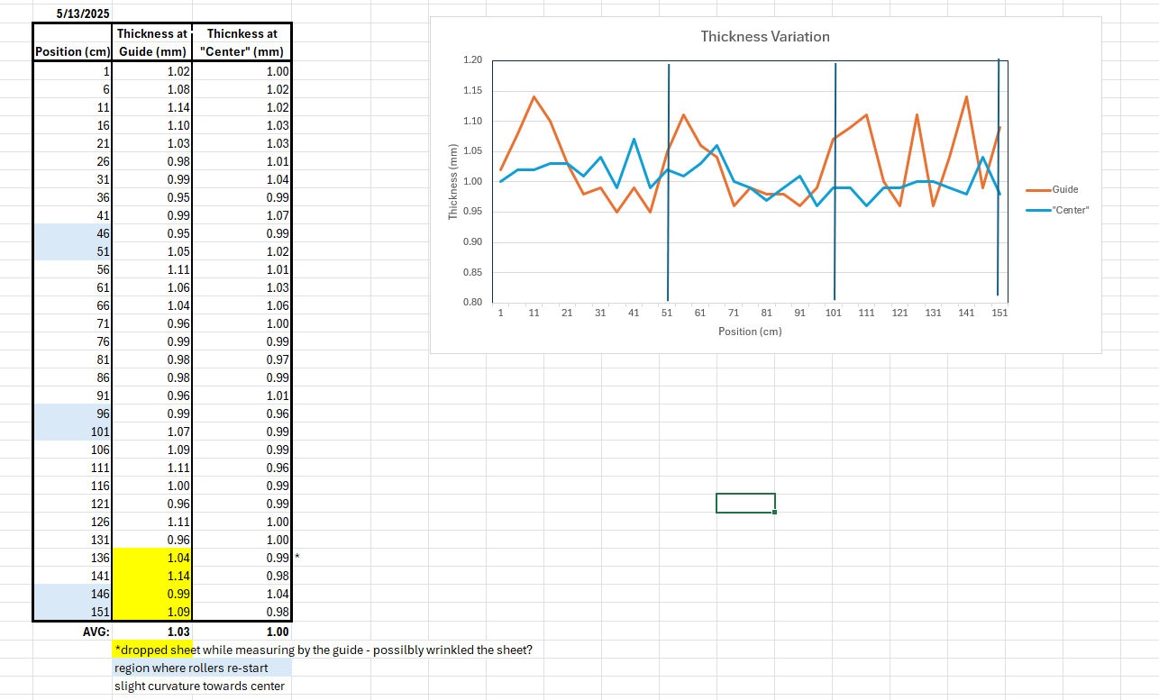
Last Swager Adjustment 5/13/25

Slide 13
GLueX lead
13 rolls 10cm wide
7 rolls 11cm wide
Use 11cm roll for 2nd prototype SFIL

Slide 14
2nd Prototype SFIL

Slide 15
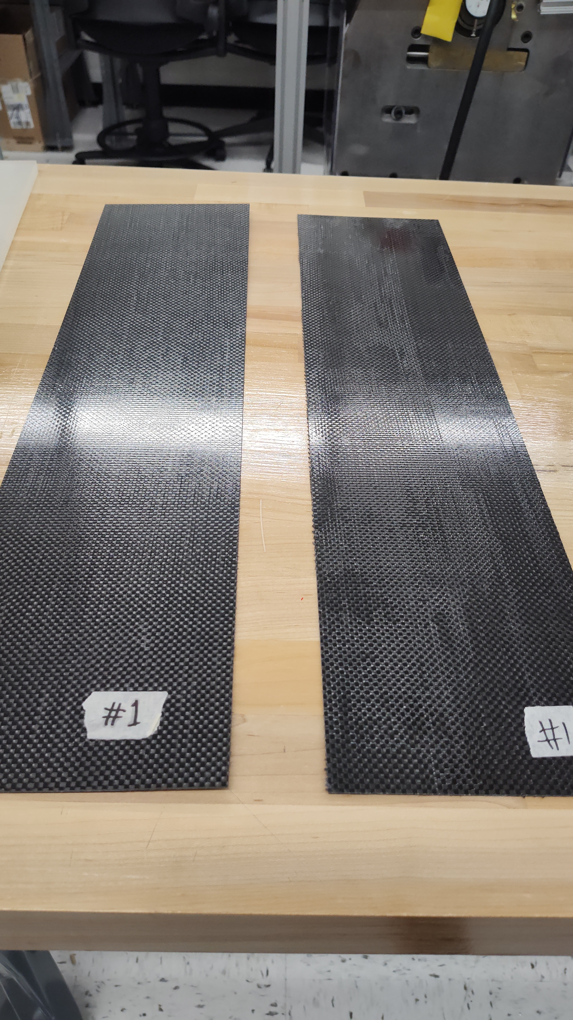
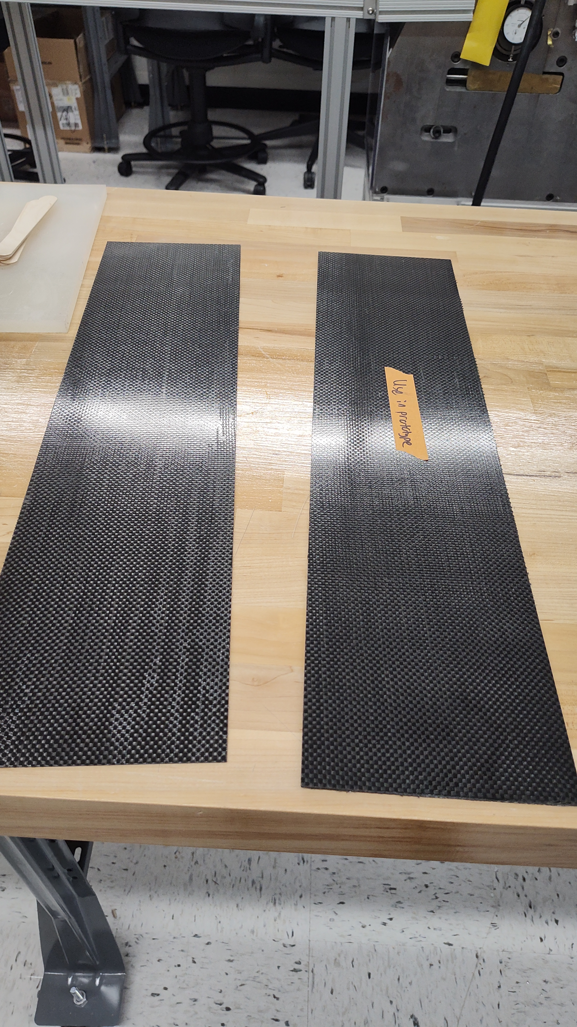
Purdue cfrp
These two have the most voids

Slide 16
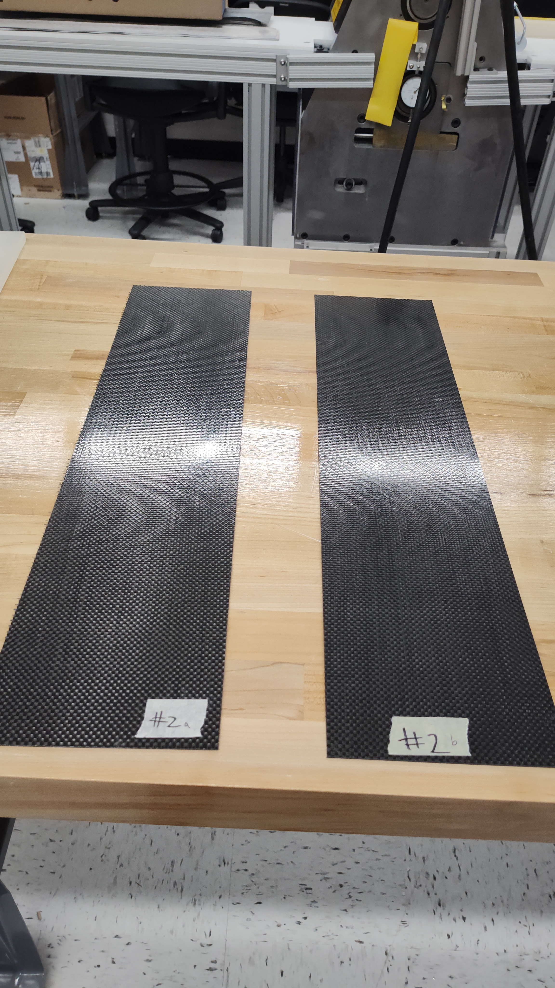
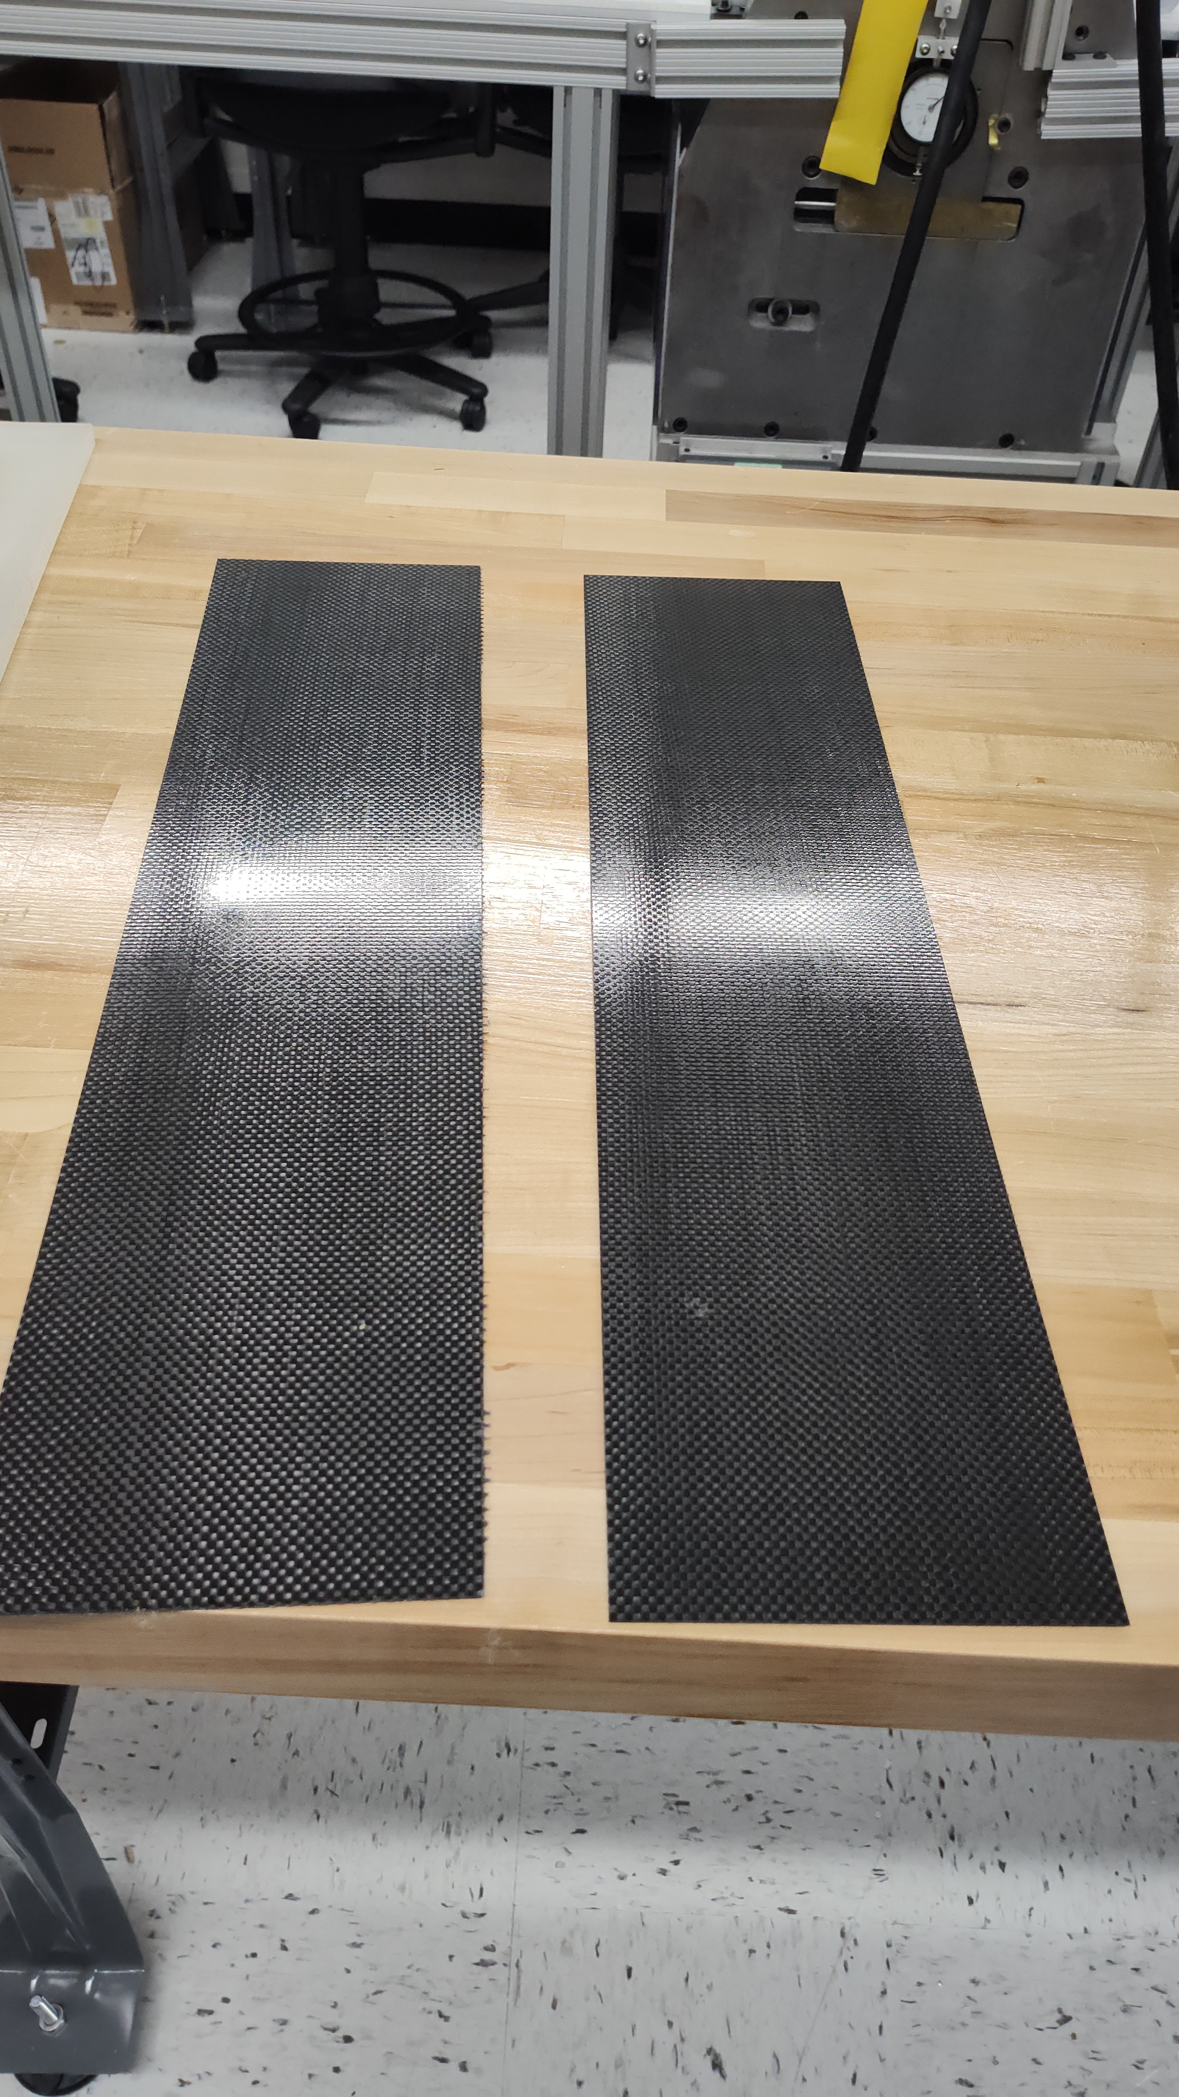
Cfrp #2
Best pair

Slide 17
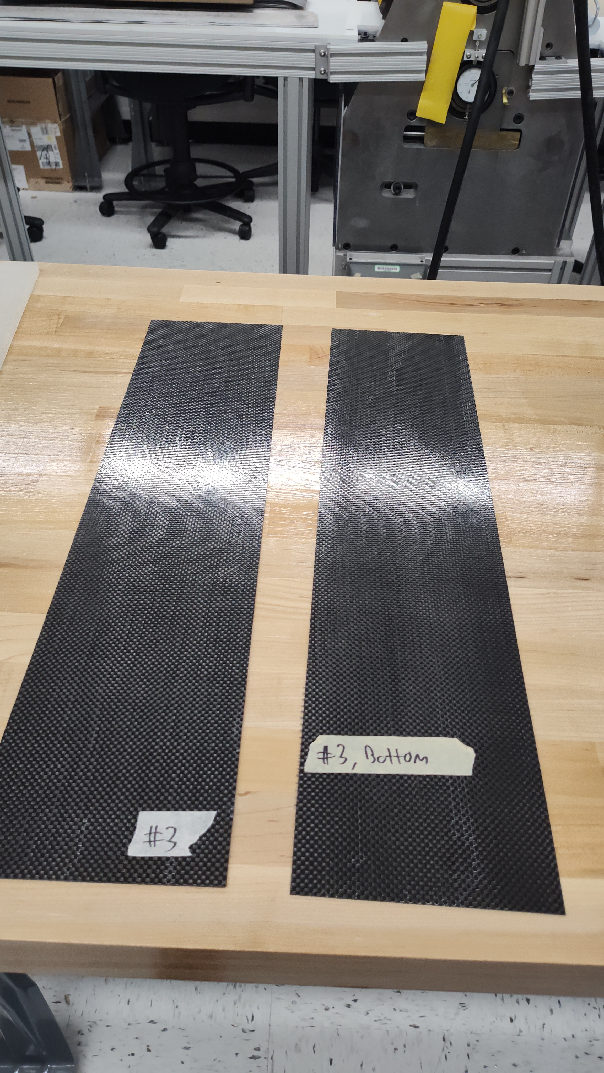
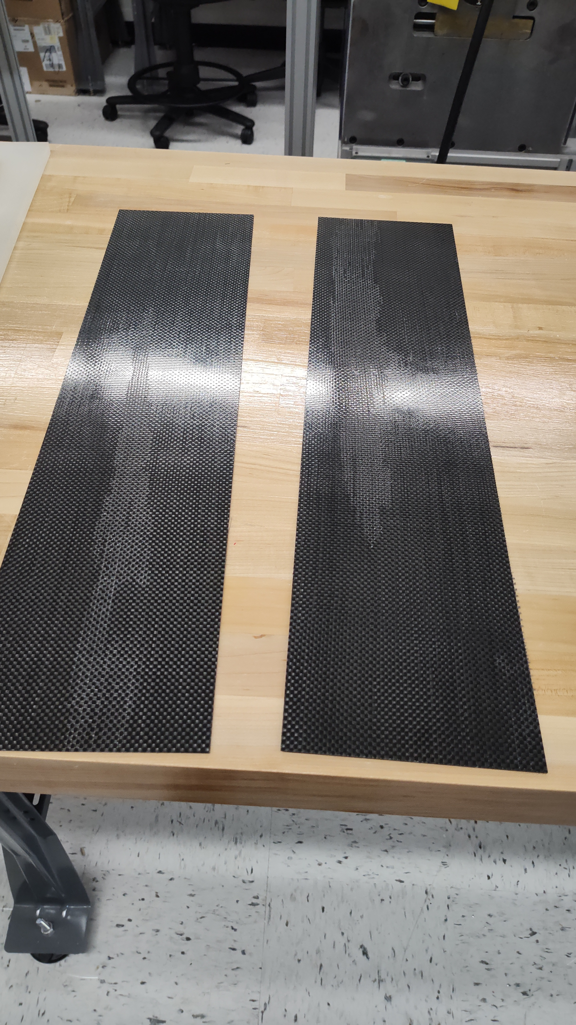
Cfrp #3
Also some significant voids

Slide 18
Testing Lead Fiber interface ??

Slide 19
Tssting Lead CFRP interface ??

Slide 20
Other
Tables arrived in 369
Pallet jack arrived in 369
works…used to move tables!
Cart arrived in 369
More tools soon.

