Slide 1
BIC Update
Triple I Engineering Meeting Update
Kevin Bailey & Tom O’Connor
July 21, 2025

Slide 2
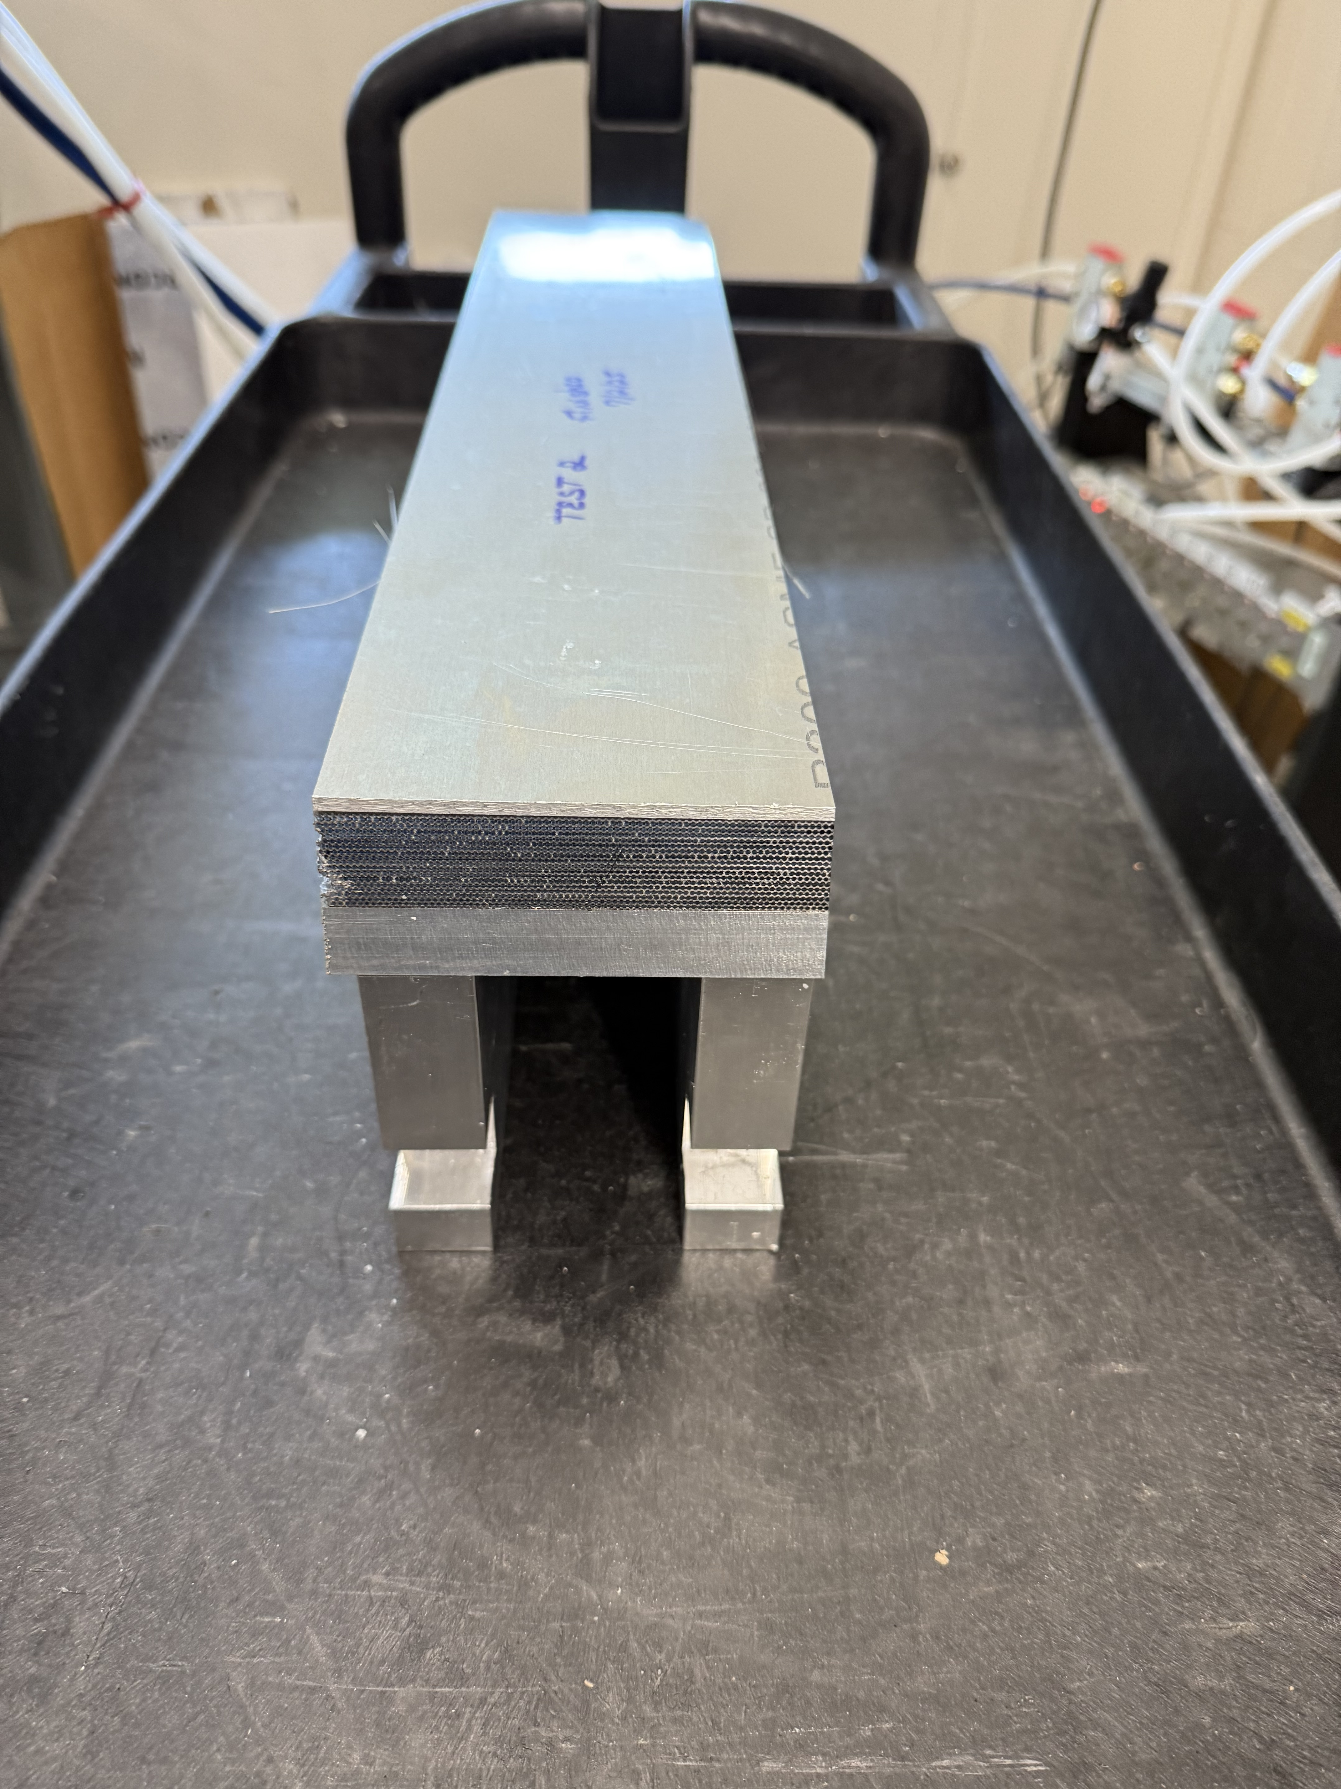
2nd SFIL
Using GlueX lead 11cm wide
Using dummy fiber
No glue is fiber grooves

Slide 3
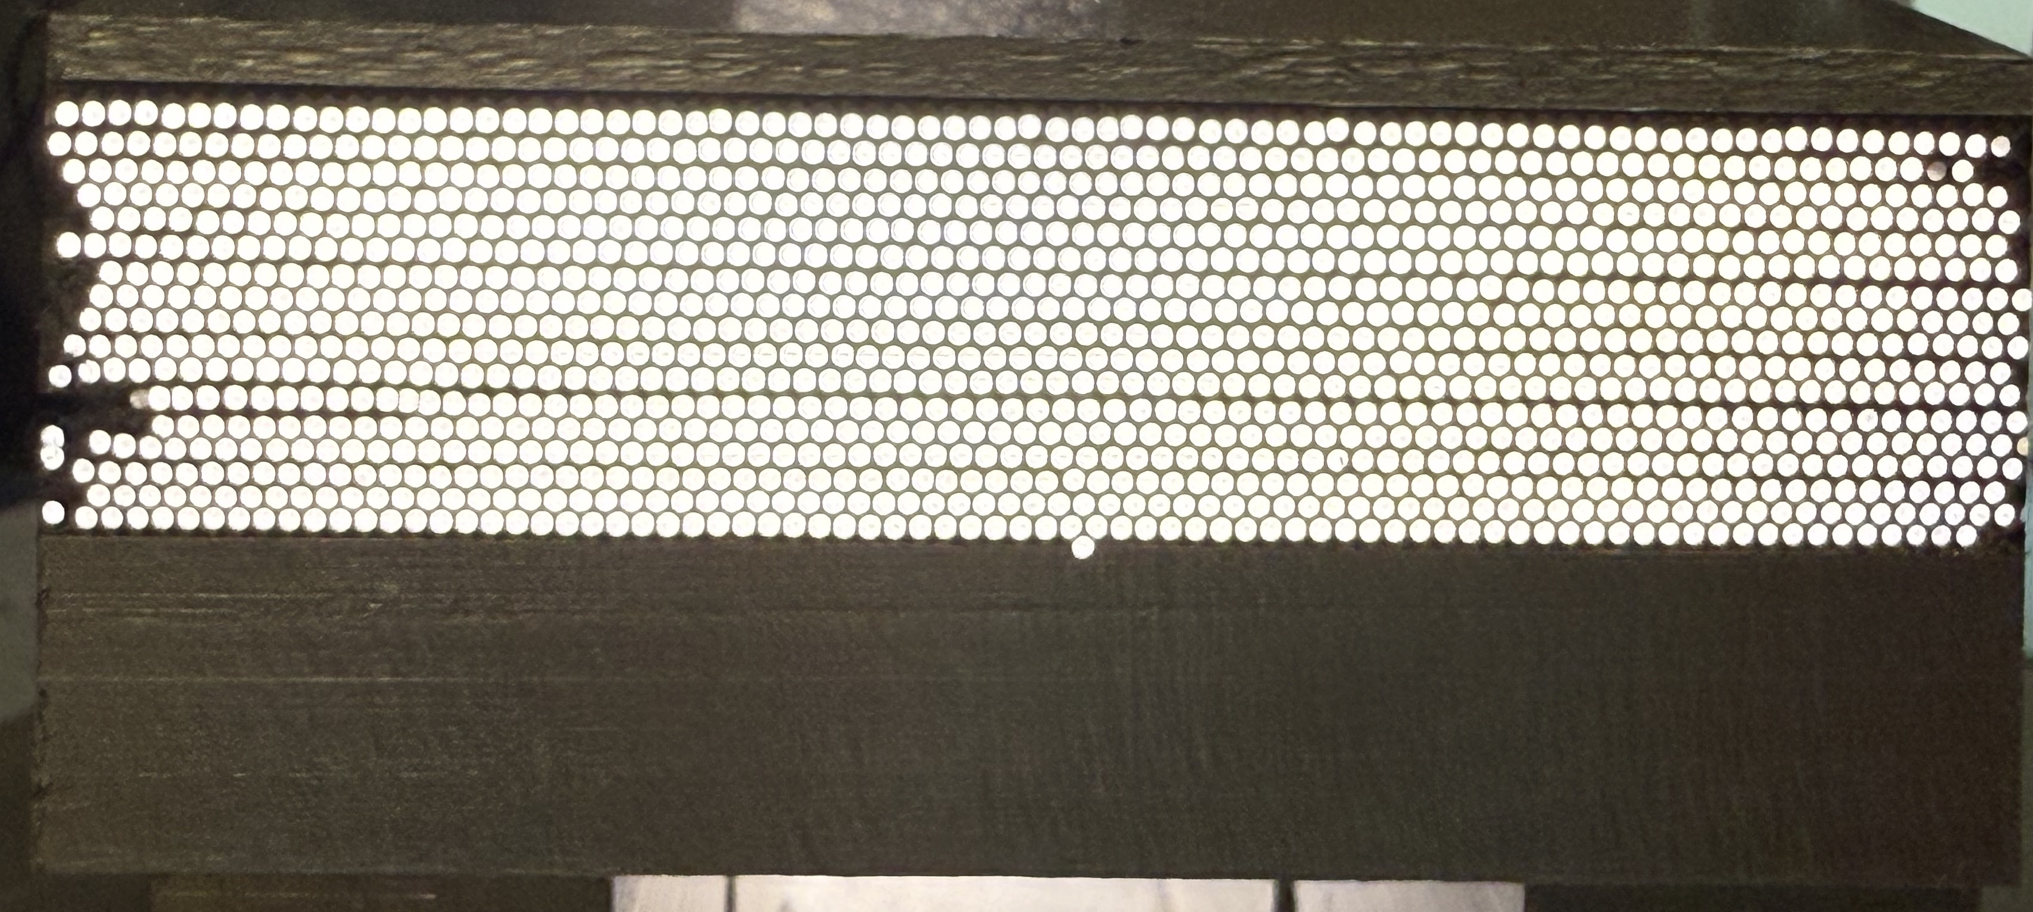
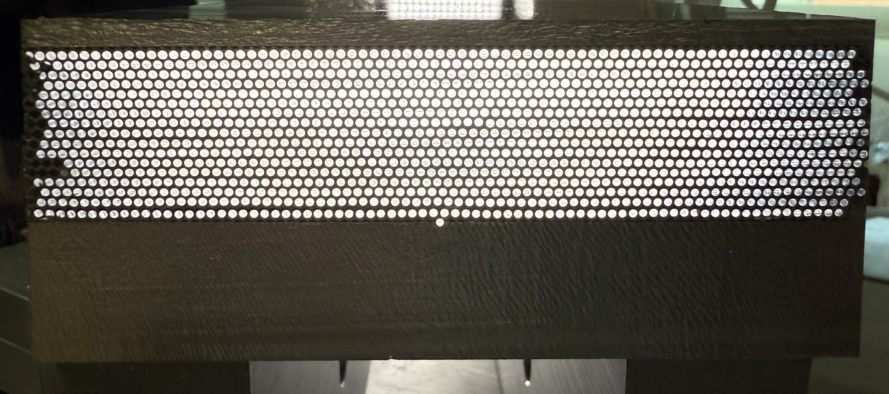
2nd SFIL
View of each end
18 Lead/17 Fiber = Imaging Layer
More consistent fiber layout than
1st SFIL
Day 2
Day 1

Slide 4
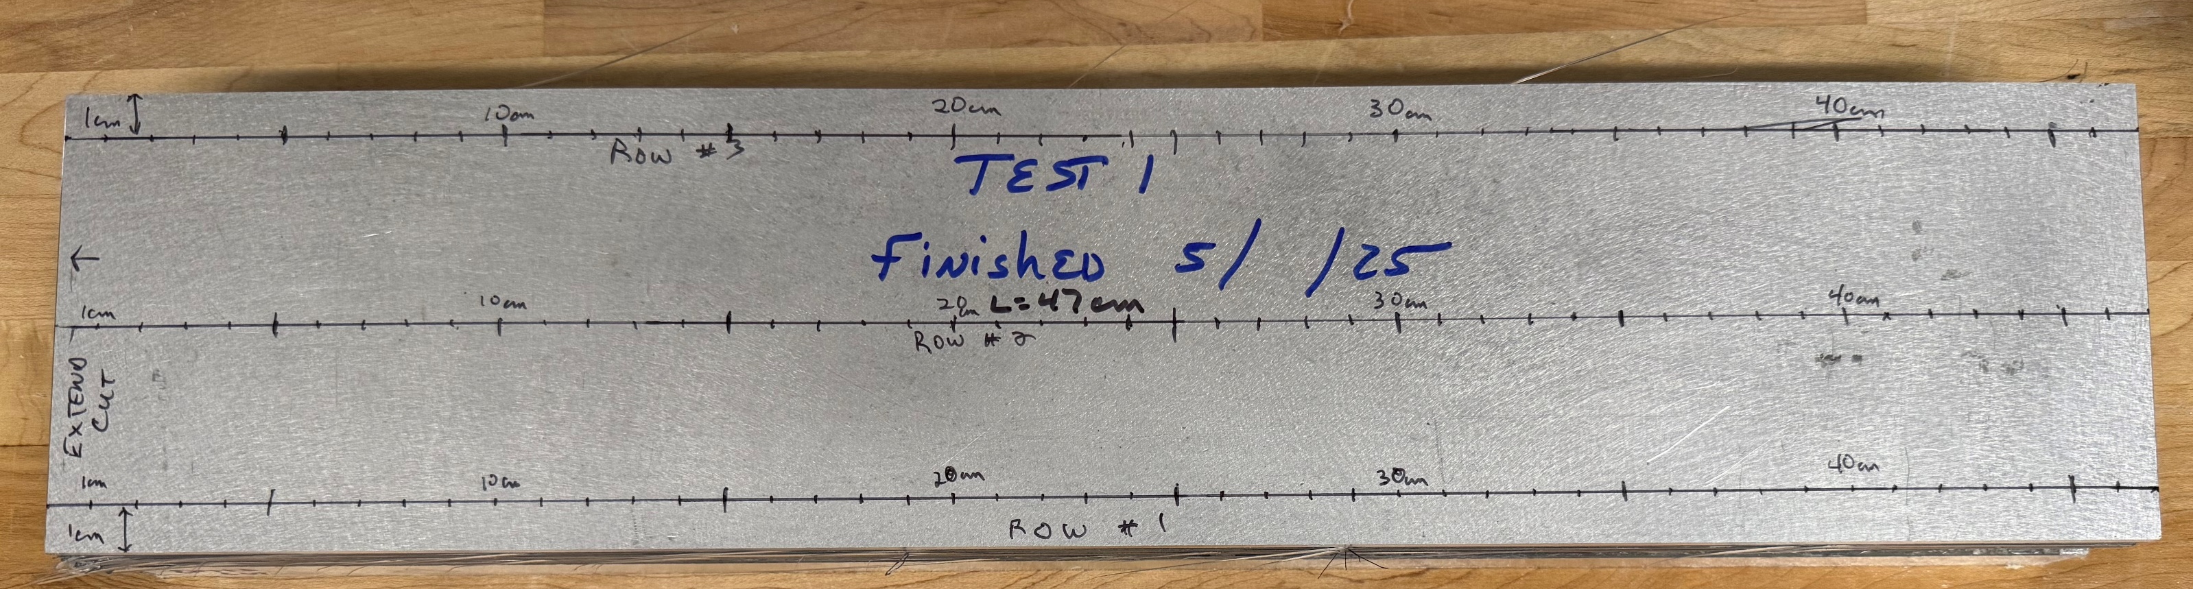
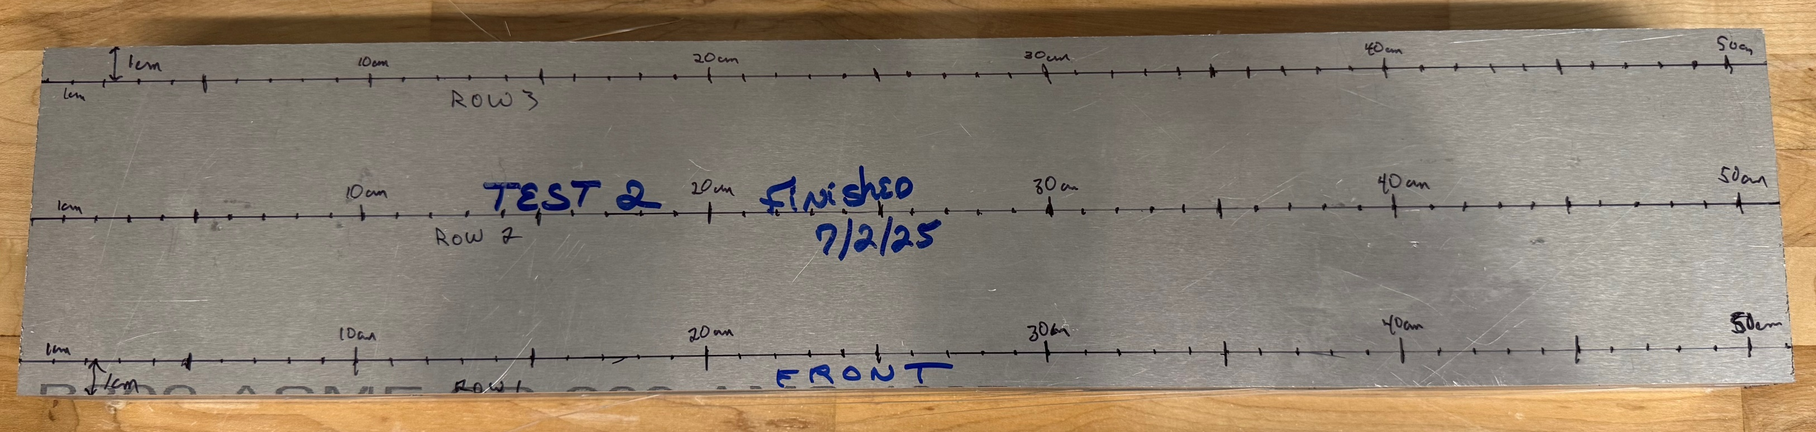
2nd SFIL Flatness/Thickness
Thickness at 1cm increments along three lines

Slide 5
2nd SFIL Flatness/Thickness

Slide 6
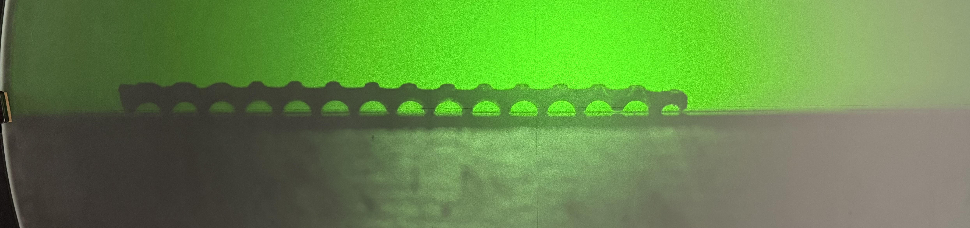
Swaged Lead Measurements on Comparator
Horizontal Spacing 1.35mm
Overall Thickness 1mm
Vertical Spacing ~ 1.1mm (hard to focus)
Re-measure using tip/tilt platform

Slide 7
Carbon Fiber Testing
Material is at Argonne
Two configurations for destructive testing
Fabricate test strips this week

Slide 8
Drawer Design
Weekly Meetings with Purdue with Pau and Andy
Original plan was for 4-piece design
Single piece design now under consideration

