Slide 1

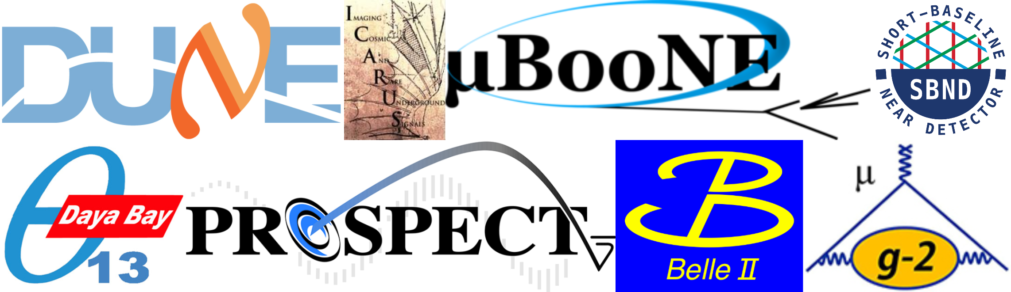
Applying LLM Across Physics Workflows: EDG Group Highlights
Xin Qian
EDG, BNL
Thanks to Chao, Nitish, Brett, and others for their input

Slide 2
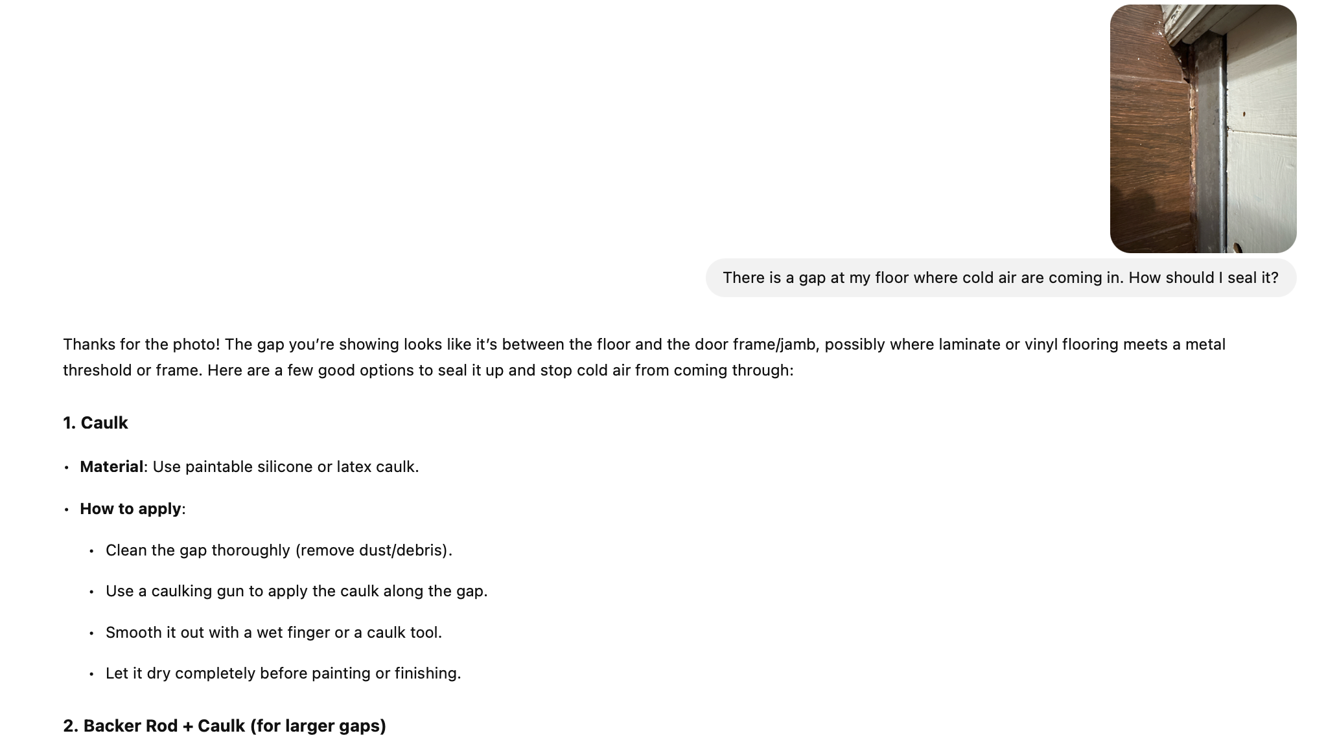
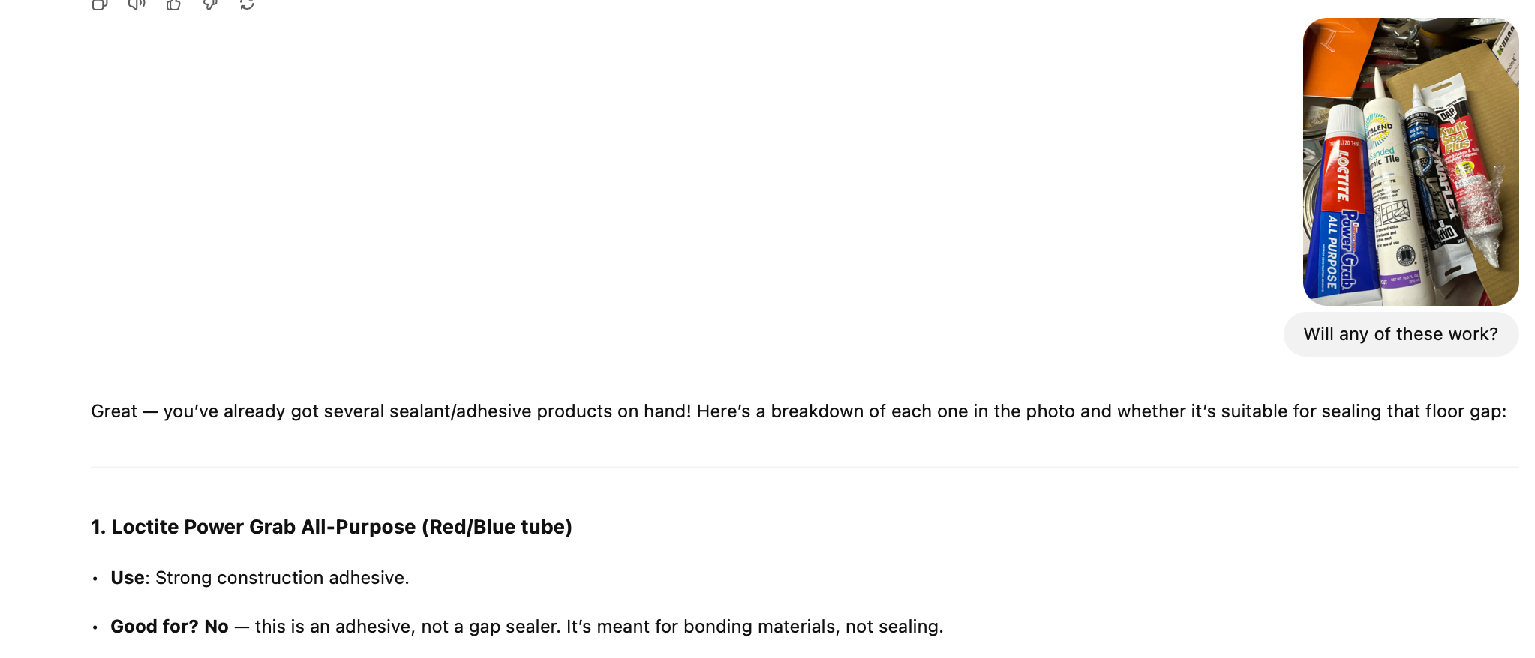
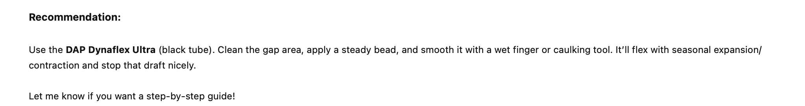
Introduction
OpenAI – ChatGPT (4o, o3 …)
Widely used in 2C; good daily usage, with web UI context limits (32k)
Anthropic – Claude (sonnet …)
Widely used in 2B and 2D; robust in professional usage; 200k context with Project feature in web UI
Google – Gemini (flash, pro)
Pioneer in AI, currently defending position; Longest context window 2M context; weaker user experience
Others (DeepSeek → cost effective, Mistral …)
Web-based interface

Slide 3
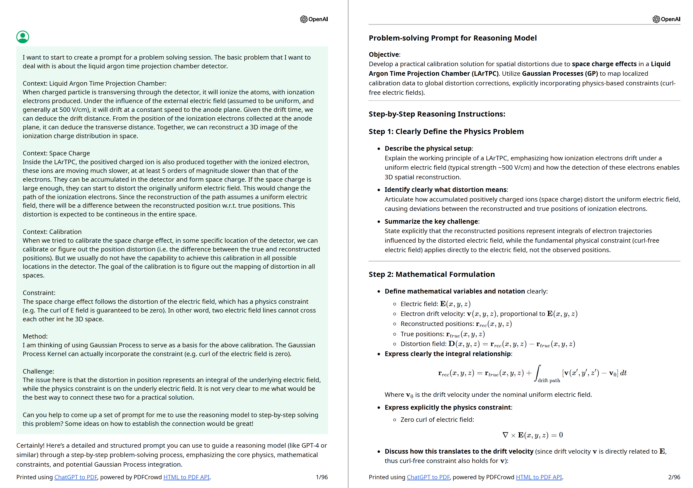
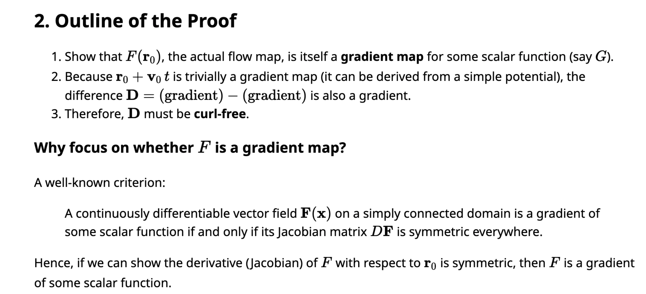
Reasoning Models (1000 Scientists AI Jam)
The model pointed us to some nice and immediate mathematical results that could make computing these more easily
Provide detailed proofs as well that are rigorous and reasonable
Wanted to understand space-charge distortion effects of the electric field in LArTPCs
I had a hypothesis, but lacked a clear way to validate it

Slide 4
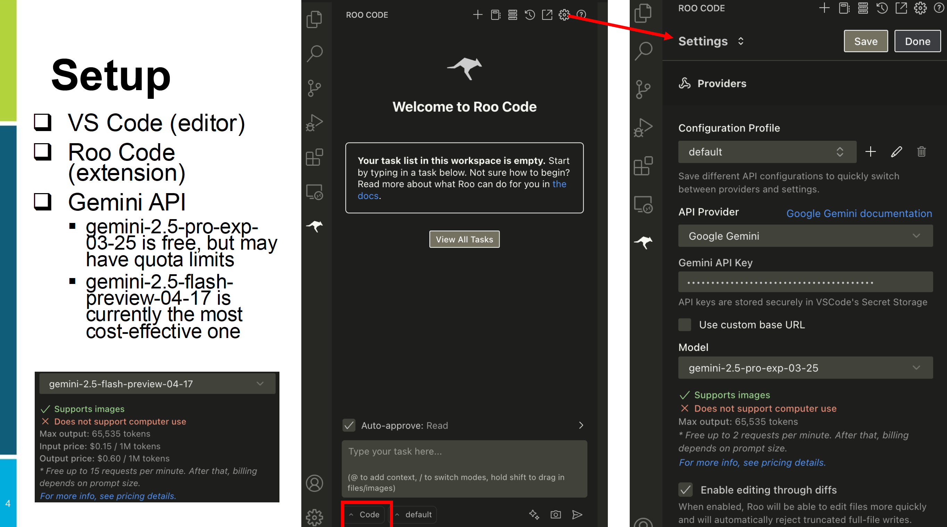
API access (RooCode, Continue Dev, AnythingLLM, OpenWebUI …)
From Chao Zhang

Slide 5
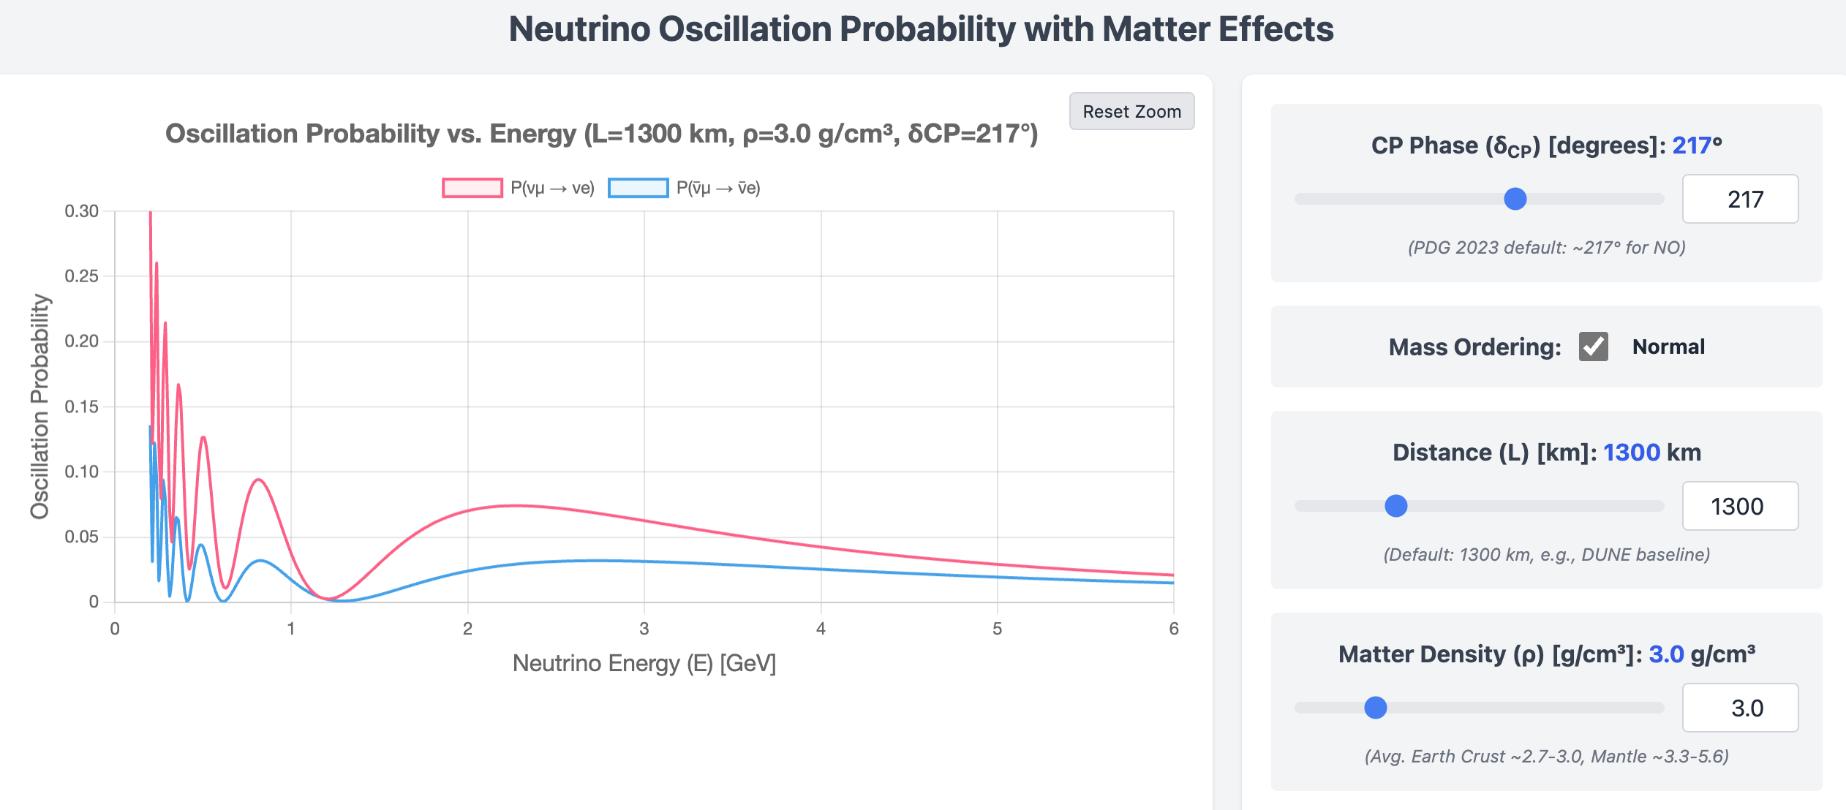
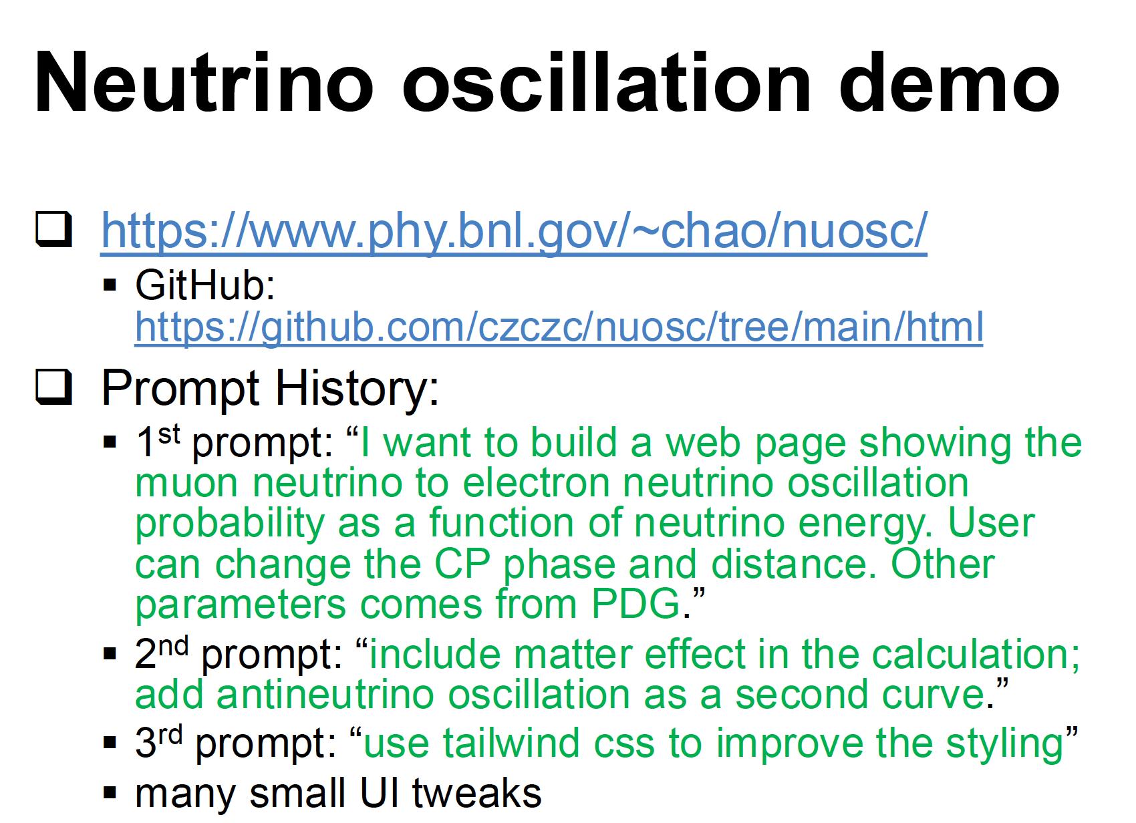
Vibe Coding for Front-End Website(s)
Other examples:
Water Cerenkov demo: https://www.phy.bnl.gov/~chao/wc-demo/
EDG publications: https://www.phy.bnl.gov/~chao/edg-publications/
DUNE publication website: https://dune-data.fnal.gov/dunepublicplot/#/

Slide 6
Examples of Using LLM
Case I: Geometry Construction Translation: Perl → Python
Case II: Information Search/Generation: Deep Wiki, Deep Research …
Case III: LLM tools used in Wire-Cell development

Slide 7
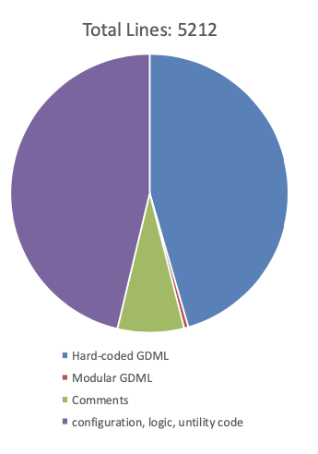
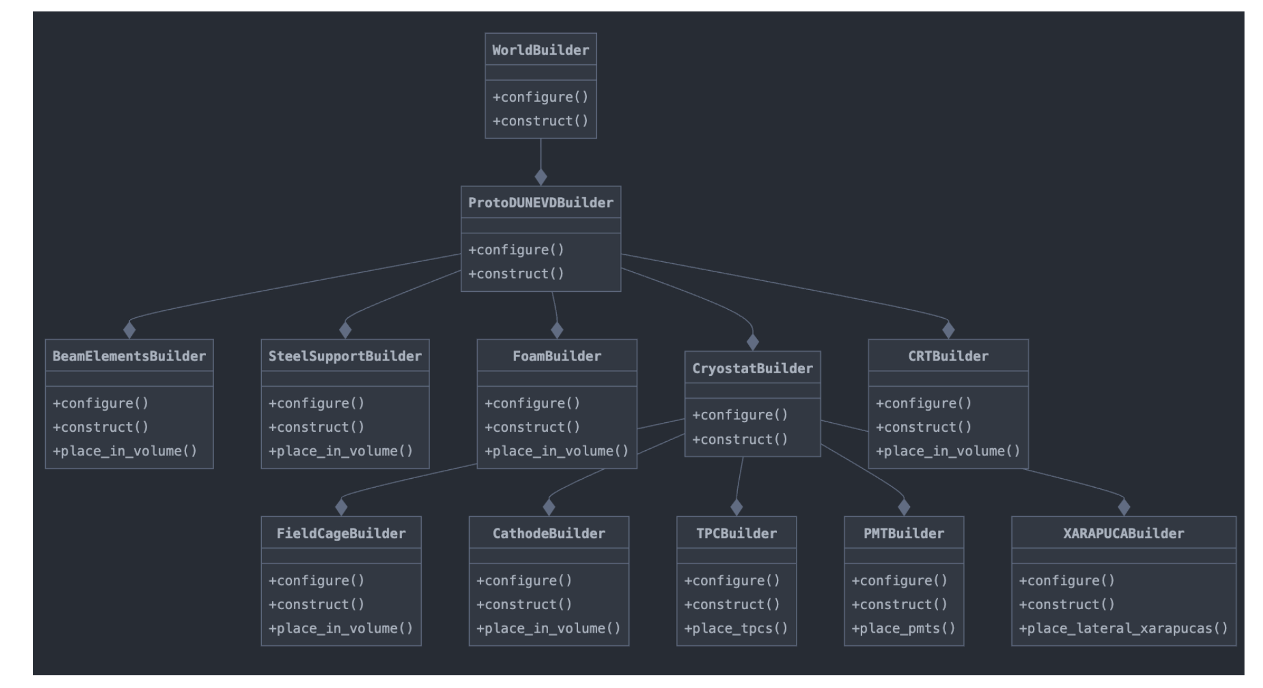
Case I: ProtoDUNE Geometry: PERL → Python
At DUNE, we uses various workspace geometries in simulation
Used large PERL scripts that can be cumbersome to maintain
At BNL, Brett Viren developed a nice python-based geometry builder + GDML schema wrapper:
GGD: https://github.com/brettviren/gegede
LLM is very good at translating script from PERL to Python-based GGD
Originally estimated effort: ~half year for one person
Able to achieve this using Claude 3.5 + Copilot in a week (including validations)

Slide 8
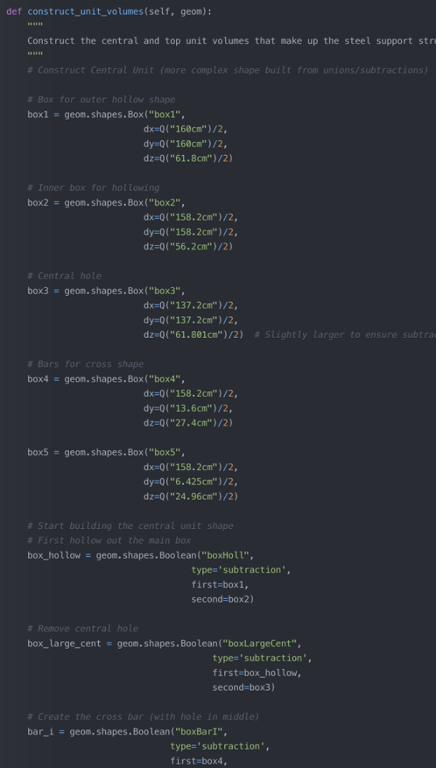
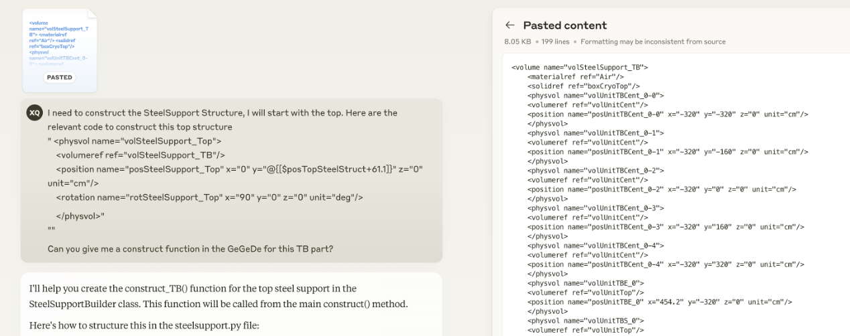
Human-AI Workflow
Able to construct and validate ProtoDUNE-VD geometry within 1 week
Very little prior knowledge of either PERL implementation or GGD
Using GGD package as context input for LLM
LLM able to understand the design and intention of both code bases
A key strategy is to decompose tasks into steps that stay within the context window limits

Slide 9
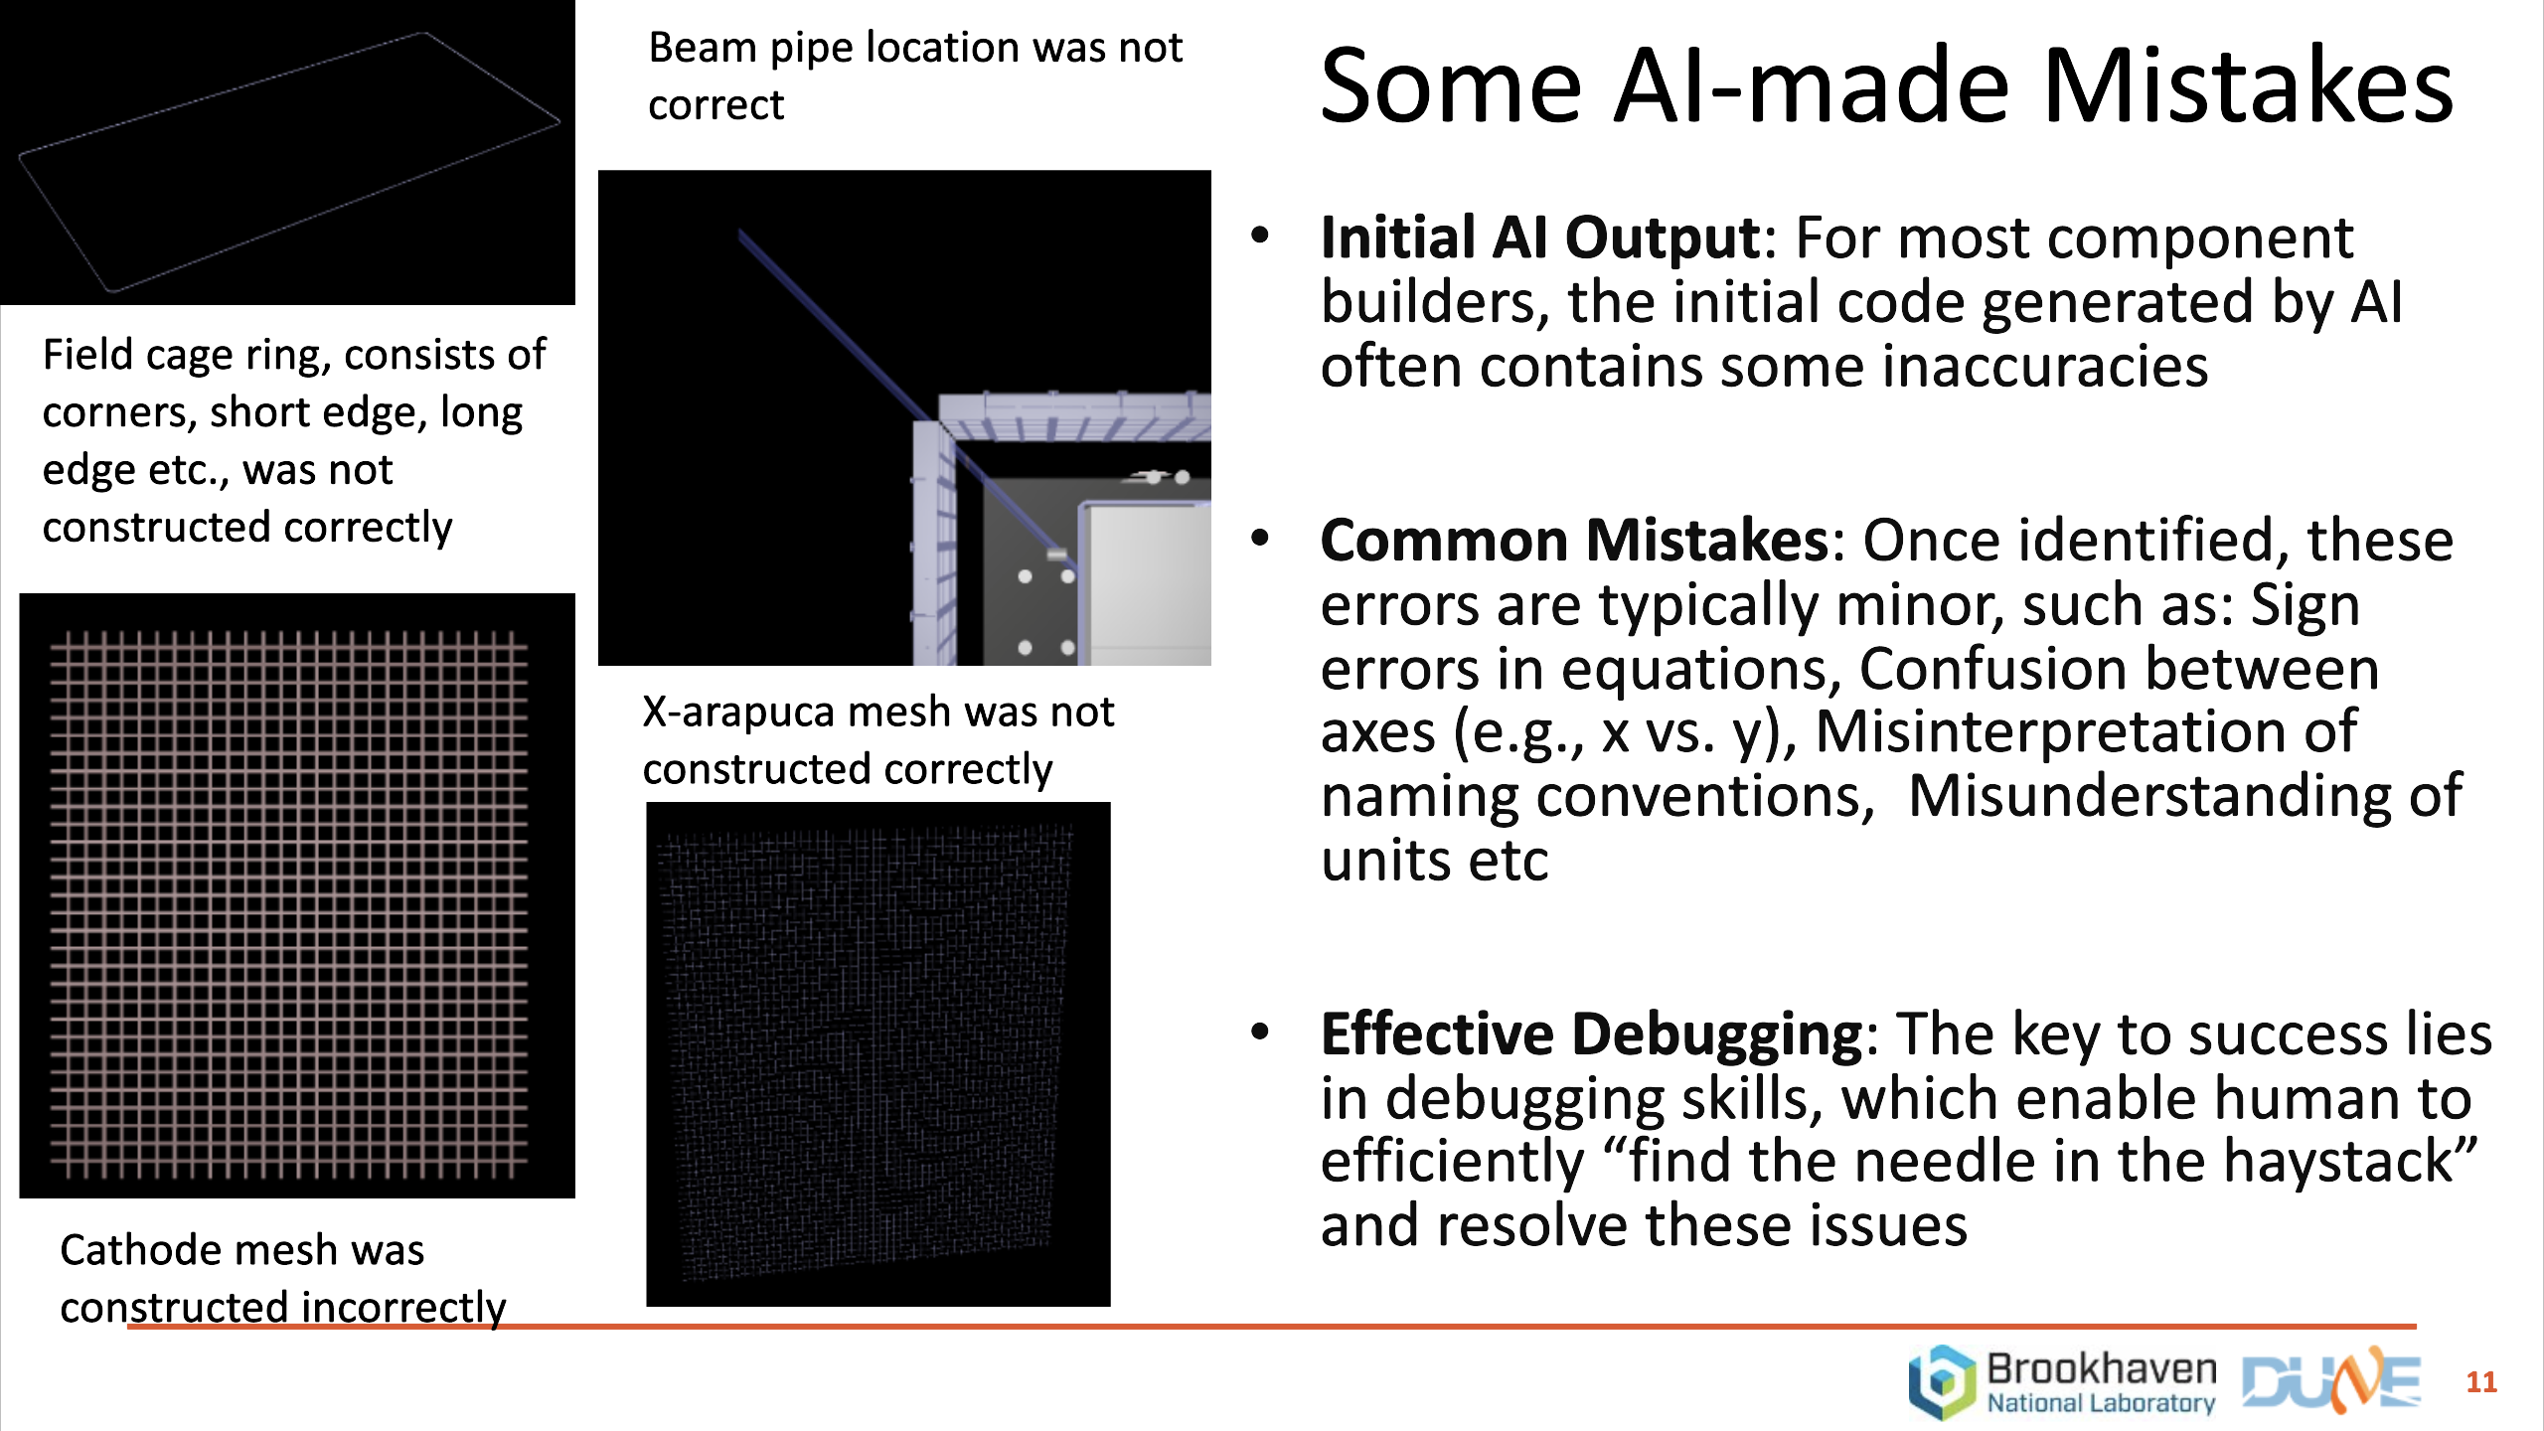
Validation & AI Mistakes

Slide 10
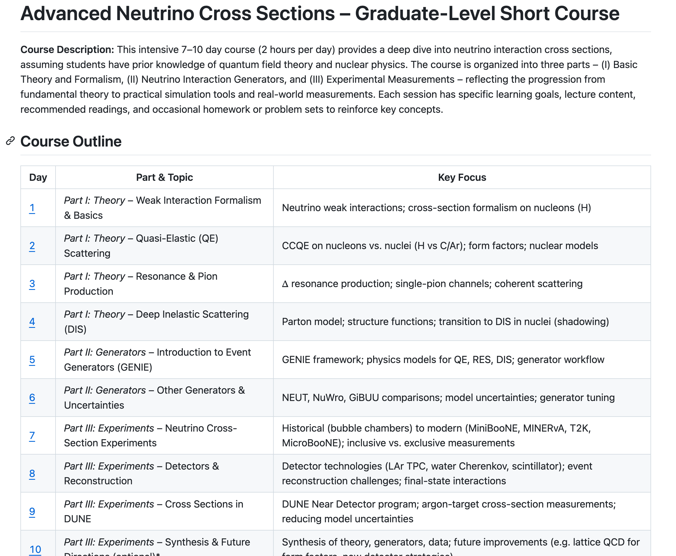
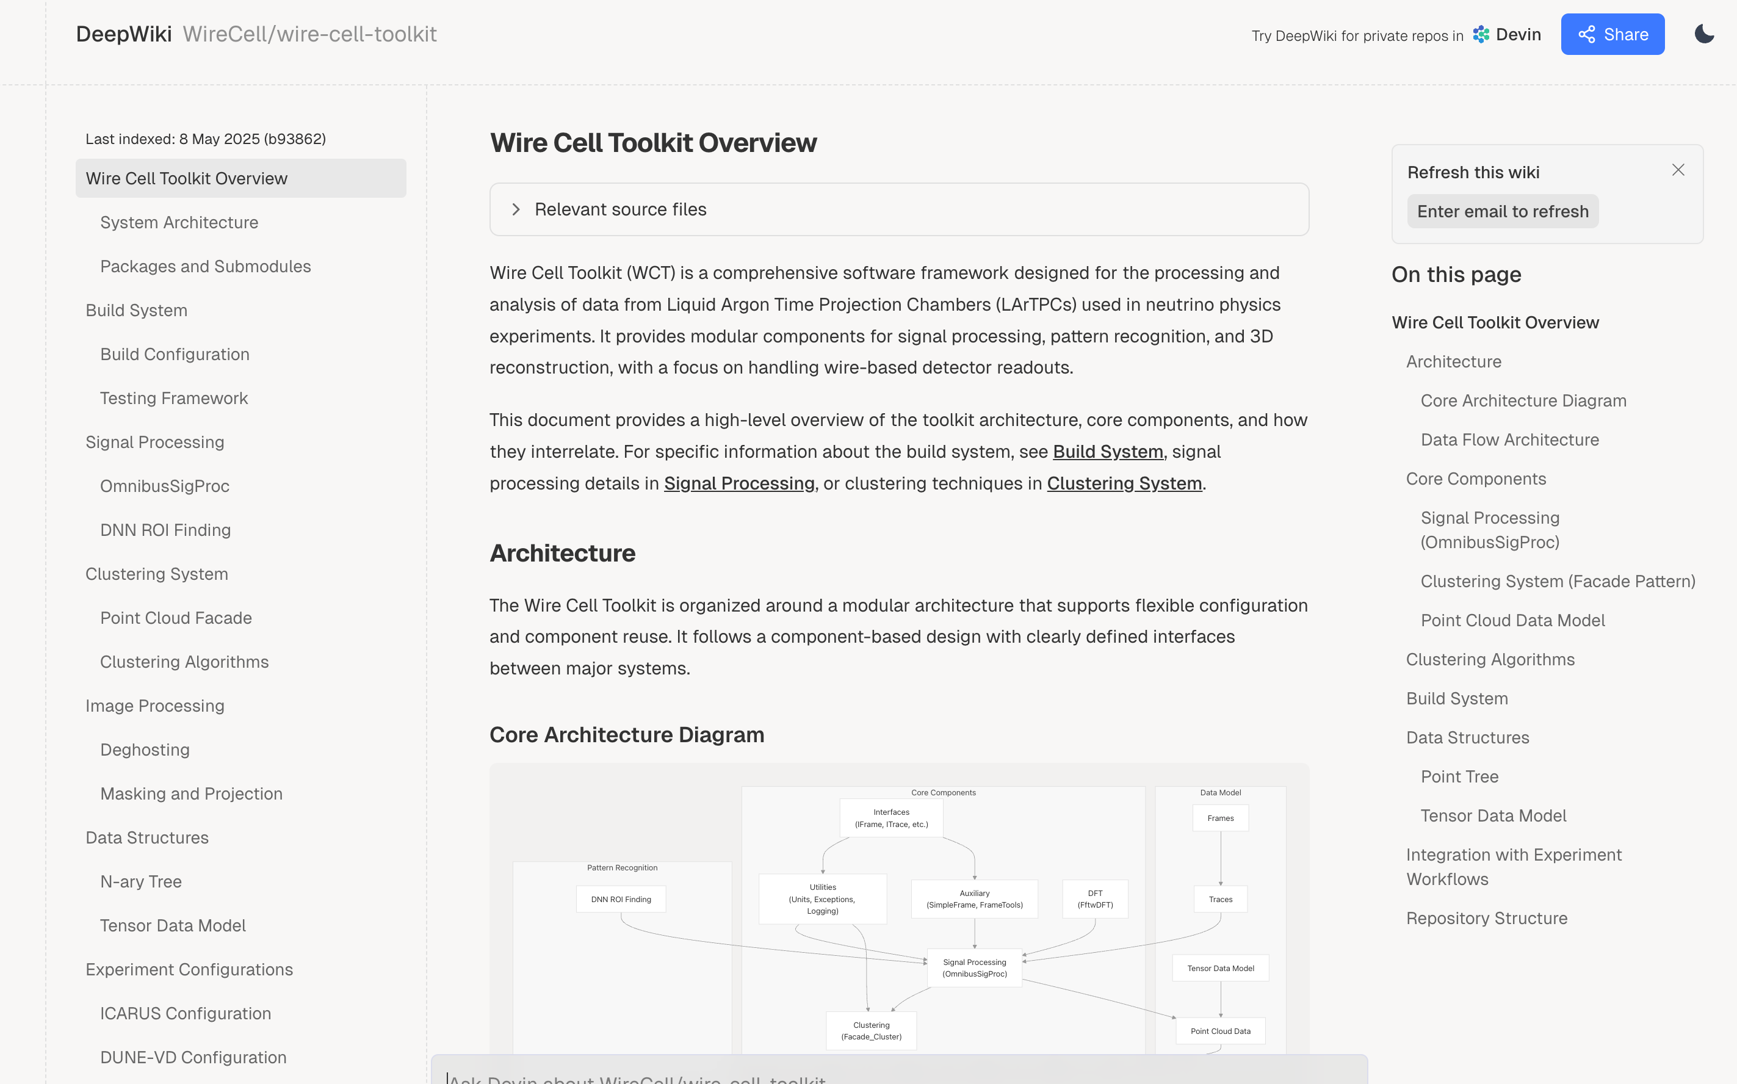
Case II: Information Search/Generation
DeepWiki : https://deepwiki.com/WireCell
DeepResearch: https://github.com/czczc/notebooks/tree/master/xs
Automatically generates wiki pages from a GitHub repo — reduces documentation effort
Automatically generates 10-day courses about neutrino-nuclei interactions

Slide 11
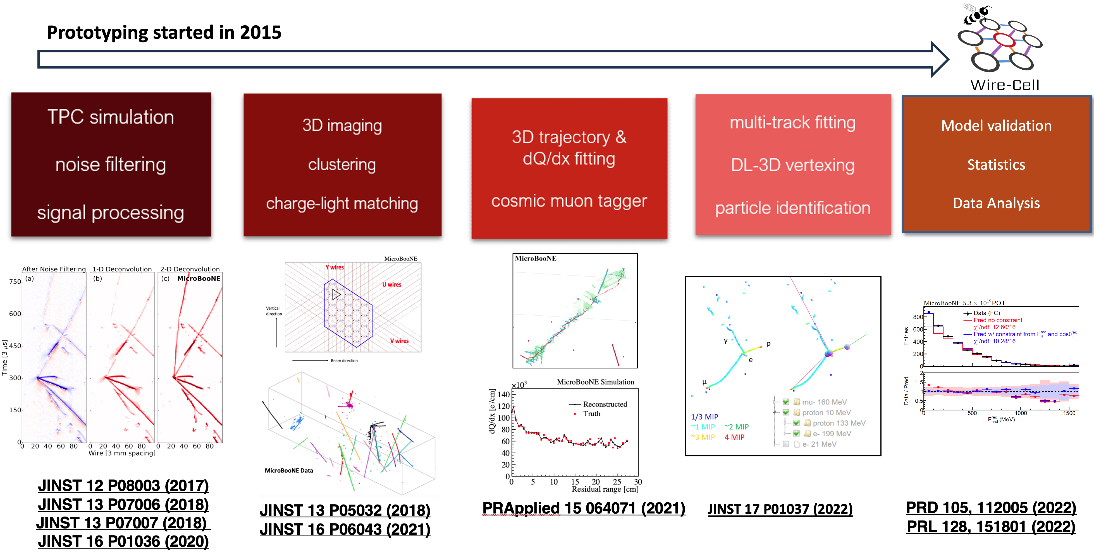
Case III: LLM Tools in Wire-Cell development
Wire-Cell is a reconstruction paradigm for the event reconstruction of large liquid argon time projection chamber detectors (LArTPCs)
Initiated by XQ, Brett Viren, and Chao Zhang in MicroBooNE experiment
Addressed a long-standing challenge in LArTPC event reconstruction — converting high-resolution event images to physics-ready histograms, arguably for the first time
Ongoing effort to transition from Prototype to Wire-Cell Toolkit (maintained by Brett and Haiwang) for greater generality

Slide 12
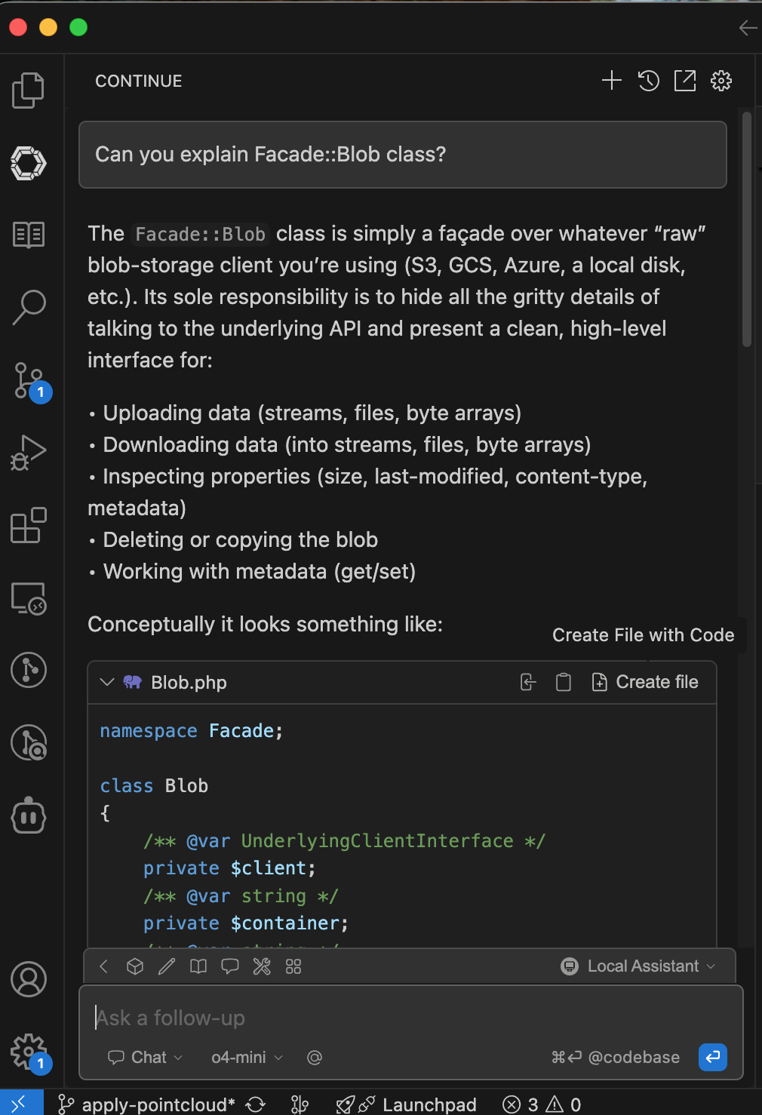
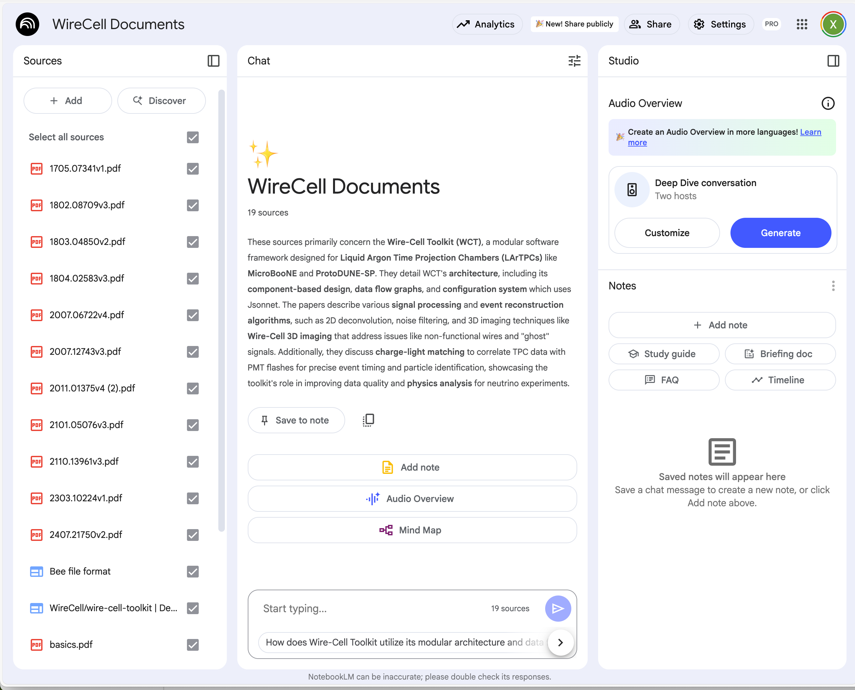
LLM Tools used in Wire-Cell
Continue Dev: RAG based
NoteBook LM
Wire-Cell code base is huge
> 1 million tokens in Prototype
> 2 million tokens in Toolkit
Finding information used to be a headache
Especially in toolkit for me
Continue Dev includes Retrieval-Augmented Generation (RAG) support natively; requires:
APIs for embedding and re-ranking models
An LLM API endpoint
We uses a Google NoteBook LM to store Wire-Cell documentation for new users
Papers, Code, technotes
Also using Google Gemini — notable for its ultra-long context window

Slide 13
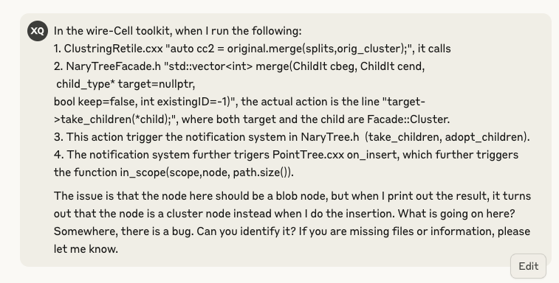
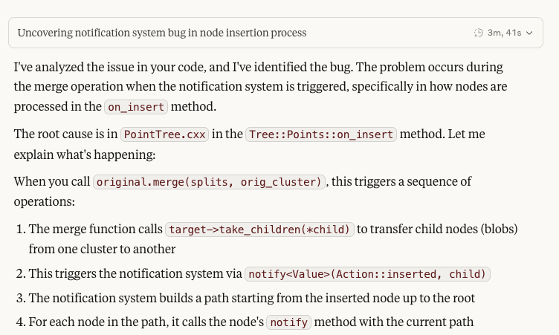
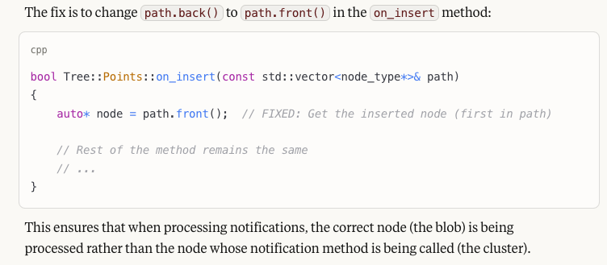
LLM used in Wire-Cell: Claude
Brett and I discussed for one afternoon and half morning about this observed bug
For some Wire-Cell porting work, when dedicated test data is missing for intermediate steps, LLMs assist with code review and validation
…

Slide 14
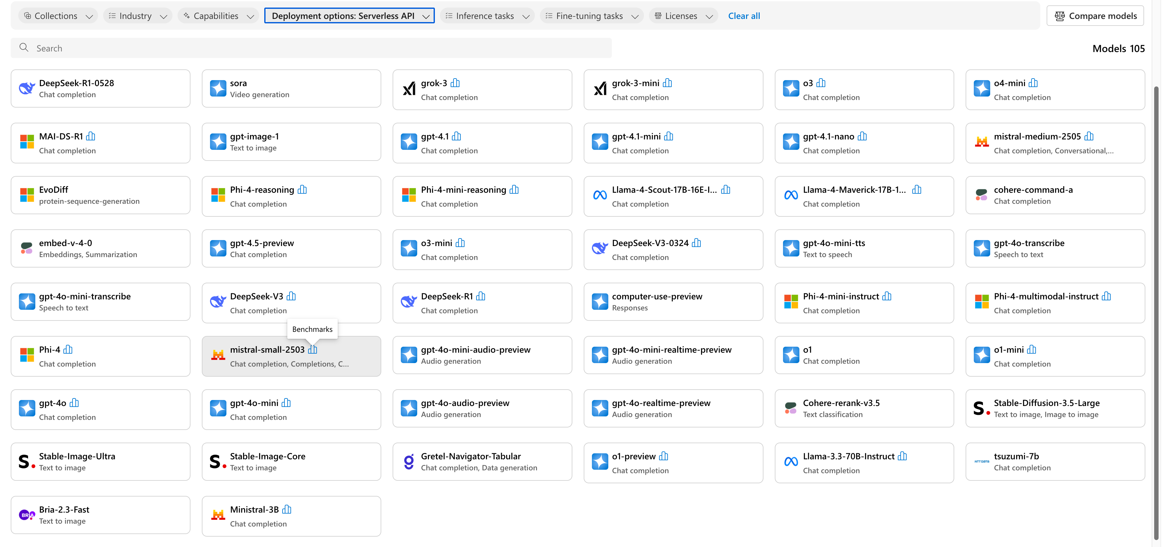
Azure API access from BNL
LLMs available @ Azure
Instruction
Open AI models, Open-source models
Other than LLMs, also have embedding models (for RAG)
Also models for code completion (e.g. offered in Github Copilot)
Get an account from ITD (Horvath, Eva) to access Azure cloud service
Payment is charged to group account every month
Group can share the resources
Usage of Azure API includes virtual network fee
Enables many tools: RooCode, Cline, Continue Dev, Anything LLM, Claude code/bridge, etc
The experience is decent, though not yet on par with commercial tools in speed and smoothness; the gap narrows for expert users with prompt engineering

Slide 15
Closing Remarks
Integrating LLMs has significantly improved my personal workflow efficiency
They have enabled me to accomplish tasks I previously couldn’t complete alone
They helped turn tedious tasks into more engaging ones
Current limitations include context window size and available computing resources.
While LLMs can take over specific tasks, humans must still decompose large projects into smaller, well-scoped subtasks
Since LLMs, like humans, often make mistakes, validation and experience remain essential
I hope this presentation is useful for you
As more users share their experiences, we’ll learn how to better leverage LLMs in our work

