Slide 1
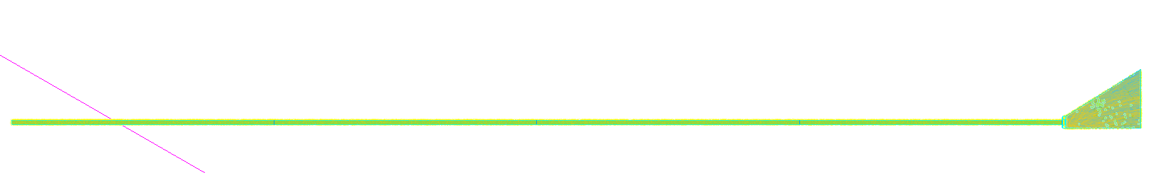
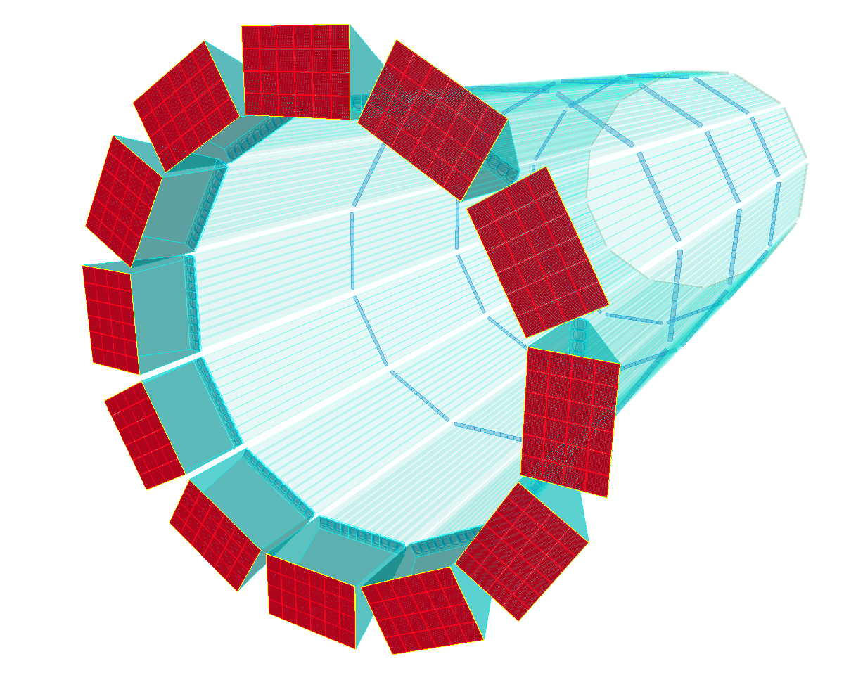






The hpDIRC Simulation Status
Greg Kalicy
ePIC Collaboration Meeting
July 15th, 2025

Slide 2
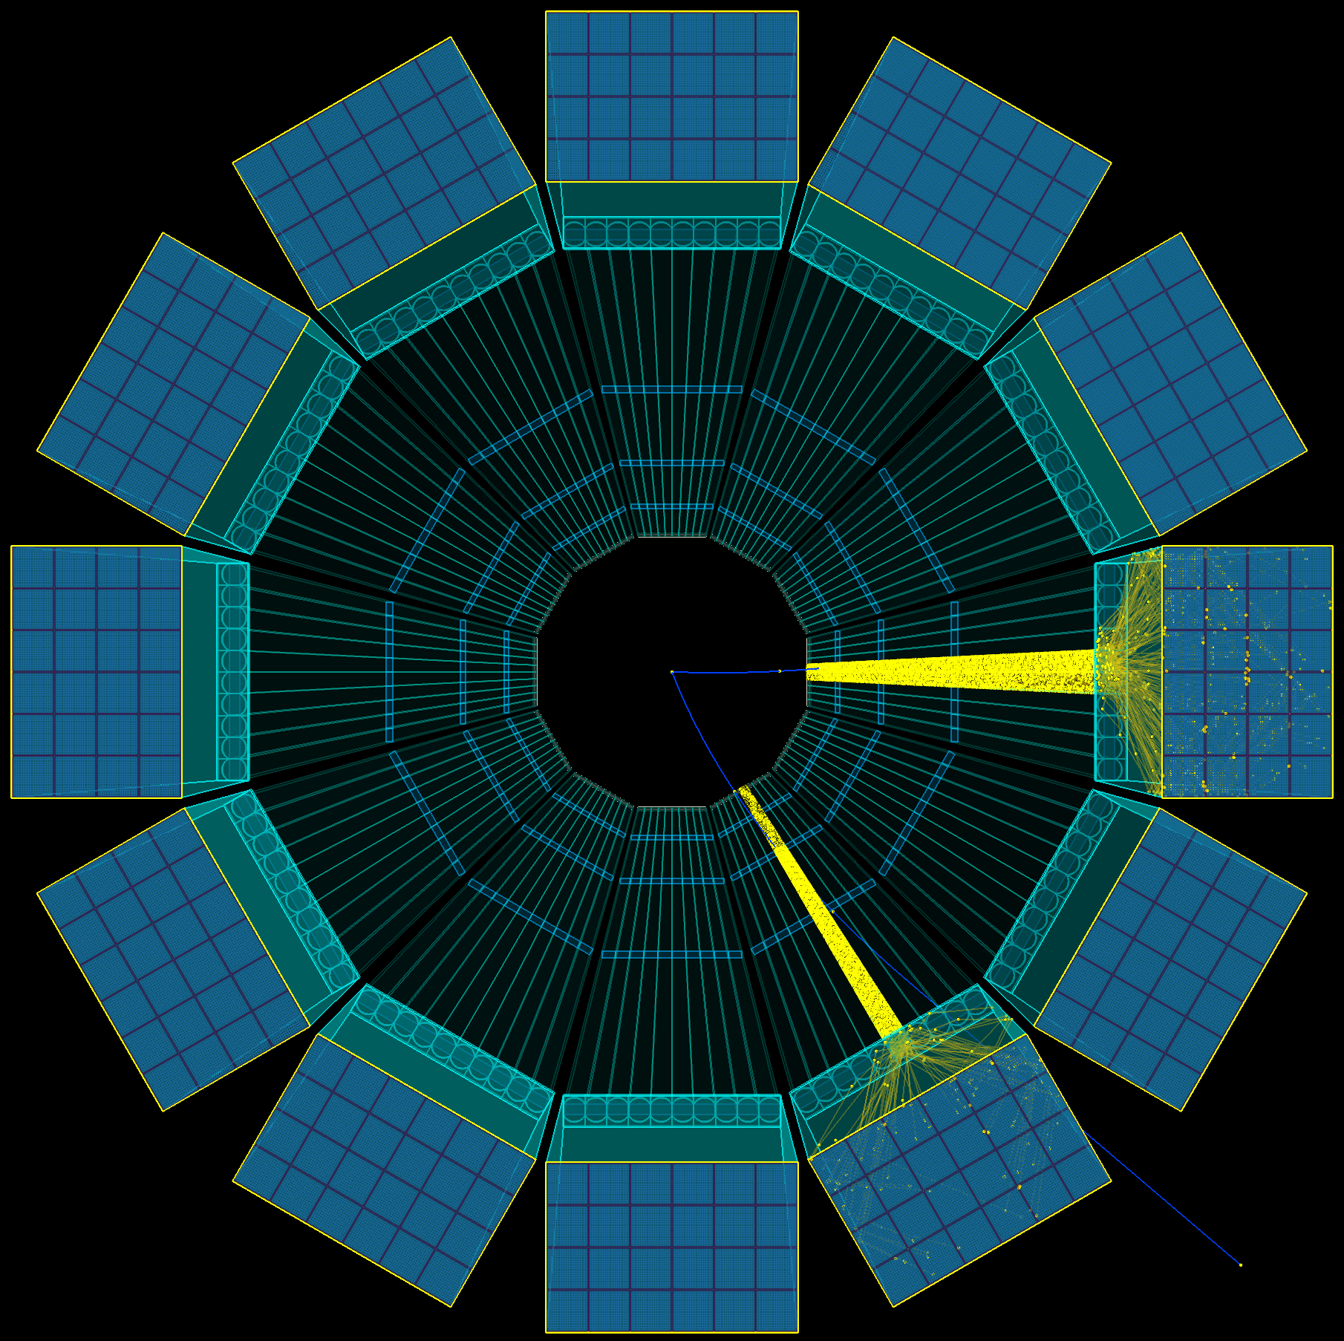
hpDIRC Simulation
Stand-alone Geant4 Simulation
Realistic optics, geometry, and material properties – based on prototypes and experimental data, wavelength-dependent material properties and processes
Validated with test beam data
Used for design optimization studies and to test novel design options
Full ePIC Simulation:
Functionality of Stand-alone simulation imported and integrated
Repeat physics background and detector impact study in the full software stack
Reconstruction and PID methods:
Geometrical (BABAR-like), robust and fast method based on Look-Up Tables, delivers Cherenkov angle per particle and Single Photon Resolution (useful for calibration and in prototype tests), does not depend on precise time measurement
Time Imaging (Belle II TOP-like), uses Probability Density Functions (analytical or simulation-based), makes optimum use of precision of position and time information
Machine Learning based – in preparation, using Foundation Model
Pythia events in hpDIRC simulation

Slide 3
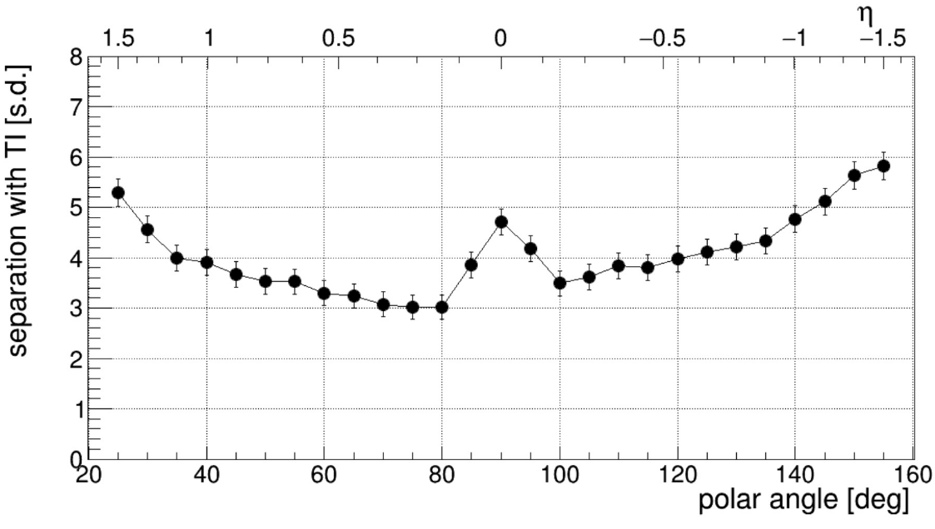
hpDIRC Simulation
Recent hpDIRC related studies:
Confirmed robust performance in magnetic field, using physics events (Pythia) to include backgrounds, multiple tracks per bar (WSU)
Adopting hpDIRC reconstruction methods into full ePIC Simulation Stack (WSU)
Performance with latest ePIC angular track resolution maps (GSI) → High-precision angular resolution crucial for reaching required hpDIRC performance.
Verifying optimal sensor coverage (CUA, GSI)
Study of the impact of bar imperfections on the hpDIRC performance relevant for the BaBar bar refurbishment (GSI)
Impact of bar/lens misalignments on performance (Jazan)
Machine Learning approach to reconstruction and generating PDFs (W&M)
Preparation for hpDIRC full chain test setup operation at CRT (SBU, GSI, ODU)
Roman Dzhygadlo (GSI)
Bill Llope (WSU)
π/K separation power at 6 GeV/c
Geant4
time imaging reconstruction
0.5 mrad tracking, 100 ps photon timing
Simulation studies performed with
Stand-alone Geant4 simulation
Single particles from particle gun
1.7T magnetic field, no other ePIC subsystems
0.5 mrad tracking resolution
100ps time resolution
→ Performance requirements reached: ≥ 3 s.d. π/K separation at 6 GeV/c for all angles

Slide 4
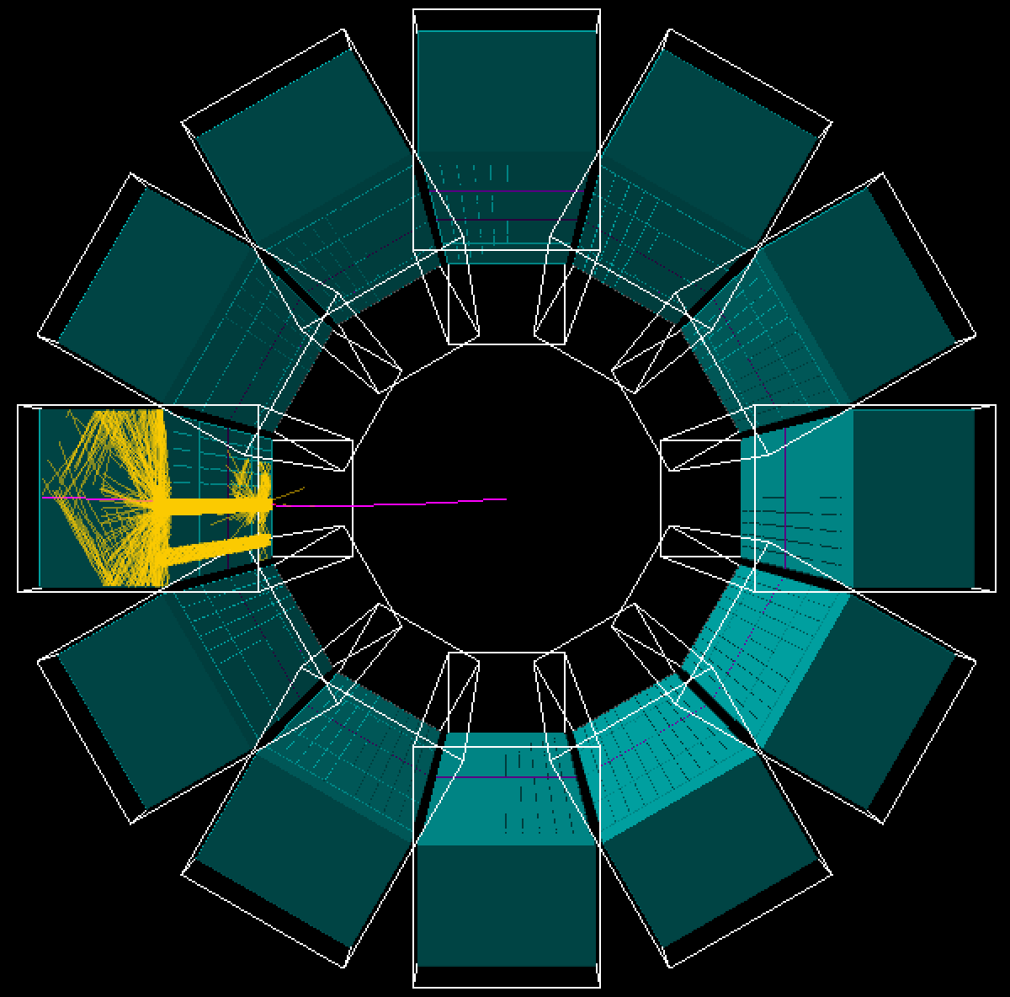
hpDIRC Simulation
Recent hpDIRC related studies:
Confirmed robust performance in magnetic field, using physics events (Pythia) to include backgrounds, multiple tracks per bar (WSU)
Adopting hpDIRC reconstruction methods into full ePIC Simulation Stack (WSU)
Performance with latest ePIC angular track resolution maps (GSI) → High-precision angular resolution crucial for reaching required hpDIRC performance.
Verifying optimal sensor coverage (CUA, GSI)
Study of the impact of bar imperfections on the hpDIRC performance relevant for the BaBar bar refurbishment (GSI)
Impact of bar/lens misalignments on performance (Jazan)
Machine Learning approach to reconstruction and generating PDFs (W&M)
Preparation for hpDIRC full chain test setup operation at CRT (SBU, GSI, ODU)
Bill Llope (WSU)
hpDIRC in stand-alone and ePIC simulation

Slide 5
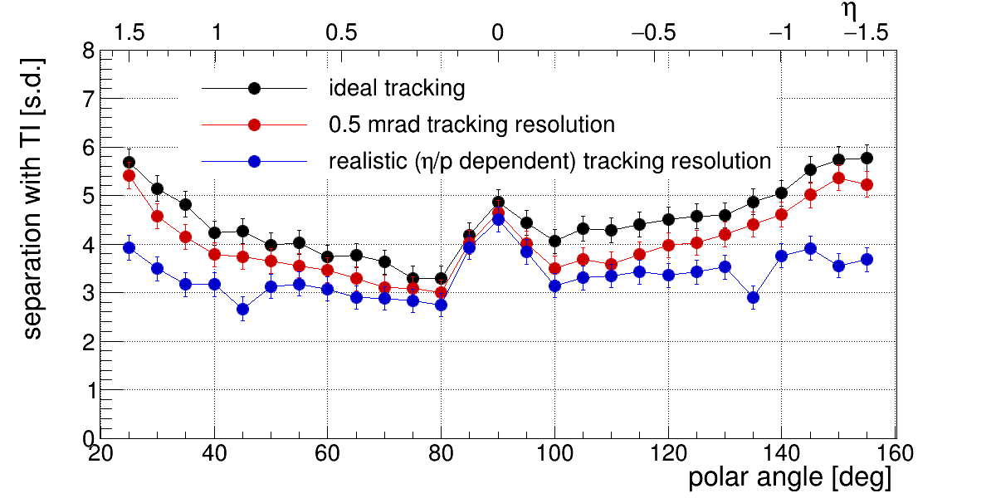
hpDIRC Simulation
Recent hpDIRC related studies:
Confirmed robust performance in magnetic field, using physics events (Pythia) to include backgrounds, multiple tracks per bar (WSU)
Adopting hpDIRC reconstruction methods into full ePIC Simulation Stack (WSU)
Performance with latest ePIC angular track resolution maps (GSI) → High-precision angular resolution crucial for reaching required hpDIRC performance.
Verifying optimal sensor coverage (CUA, GSI)
Study of the impact of bar imperfections on the hpDIRC performance relevant for the BaBar bar refurbishment (GSI)
Impact of bar/lens misalignments on performance (Jazan)
Machine Learning approach to reconstruction and generating PDFs (W&M)
Preparation for hpDIRC full chain test setup operation at CRT (SBU, GSI, ODU)
Roman Dzhygadlo (GSI)
Matt Posik (TU)
π/K separation power at 6 GeV/c
Geant4
time-based imaging reconstruction

Slide 6
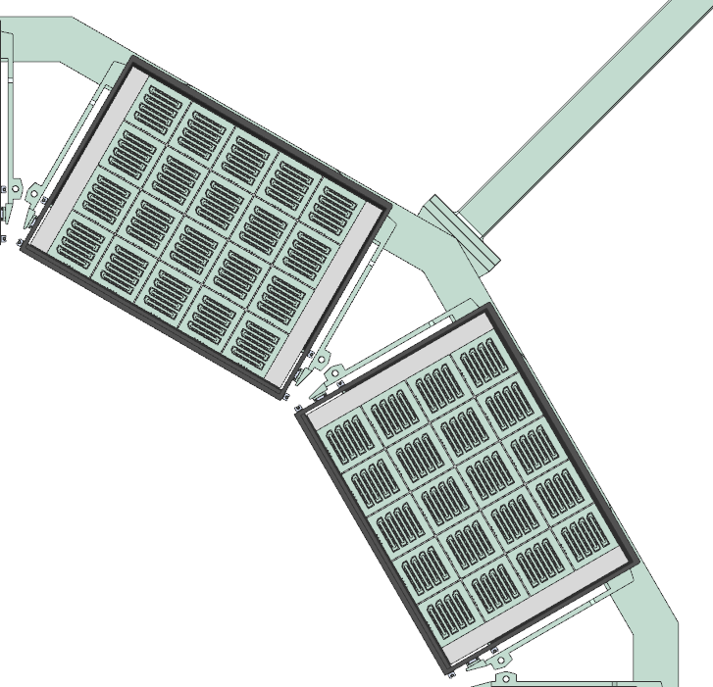
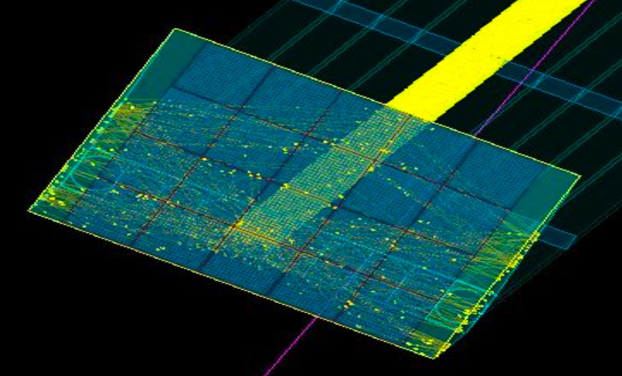
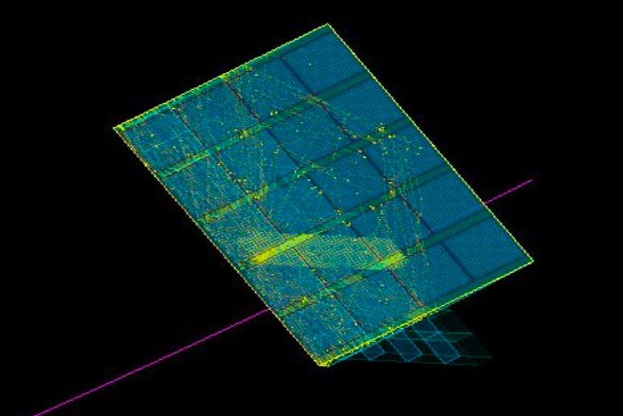
hpDIRC Simulation
Recent hpDIRC related studies:
Confirmed robust performance in magnetic field, using physics events (Pythia) to include backgrounds, multiple tracks per bar (WSU)
Adopting hpDIRC reconstruction methods into full ePIC Simulation Stack (WSU)
Performance with latest ePIC angular track resolution maps (GSI) → High-precision angular resolution crucial for reaching required hpDIRC performance.
Verifying optimal sensor coverage (CUA, GSI)
Study of the impact of bar imperfections on the hpDIRC performance relevant for the BaBar bar refurbishment (GSI)
Impact of bar/lens misalignments on performance (Jazan)
Machine Learning approach to reconstruction and generating PDFs (W&M)
Preparation for hpDIRC full chain test setup operation at CRT (SBU, GSI, ODU)
Roman Dzhygadlo (GSI)
Imran Hossain (CUA)
Kris Cleveland (JLab)
Backplane of hpDIRC readout box
Two arrangements of 5x4 array of sensors

Slide 7
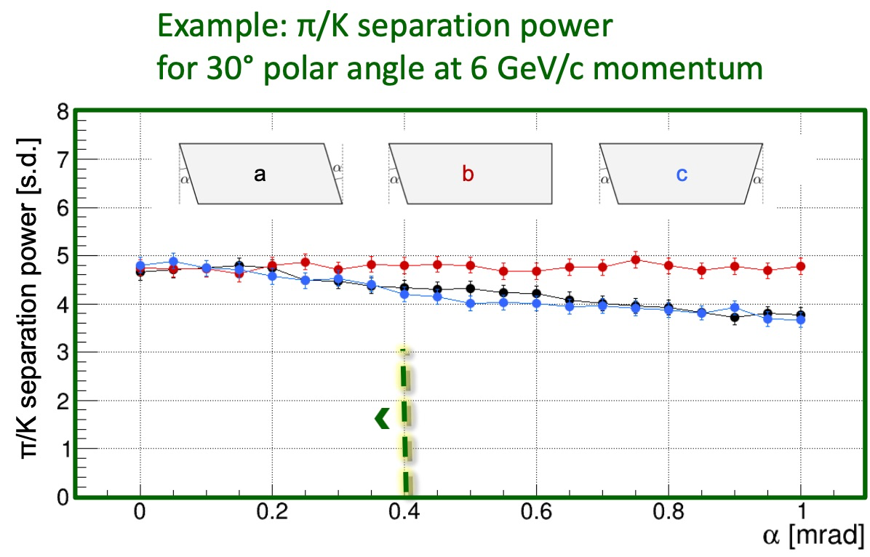
hpDIRC Simulation
Recent hpDIRC related studies:
Confirmed robust performance in magnetic field, using physics events (Pythia) to include backgrounds, multiple tracks per bar (WSU)
Adopting hpDIRC reconstruction methods into full ePIC Simulation Stack (WSU)
Performance with latest ePIC angular track resolution maps (GSI) → High-precision angular resolution crucial for reaching required hpDIRC performance.
Verifying optimal sensor coverage (CUA, GSI)
Study of the impact of bar imperfections on the hpDIRC performance relevant for the BaBar bar refurbishment (GSI)
Impact of bar/lens misalignments on performance (Jazan)
Machine Learning approach to reconstruction and generating PDFs (W&M)
Preparation for hpDIRC full chain test setup operation at CRT (SBU, GSI, ODU)
Roman Dzhygadlo (GSI)

Slide 8
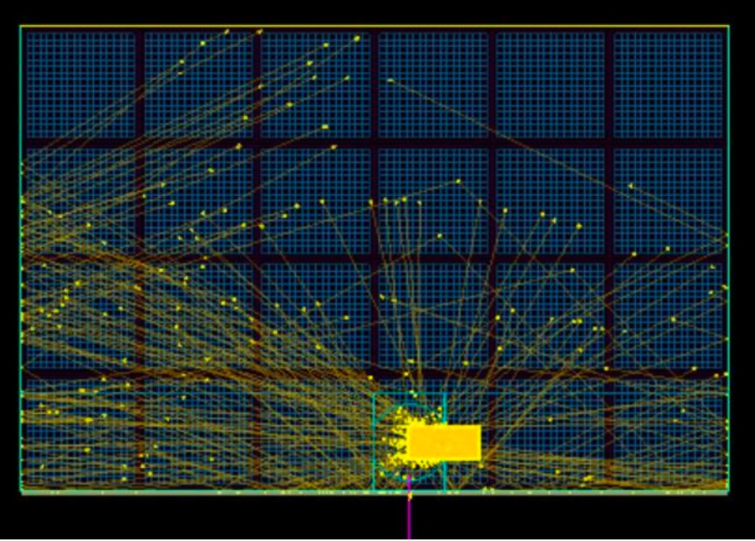
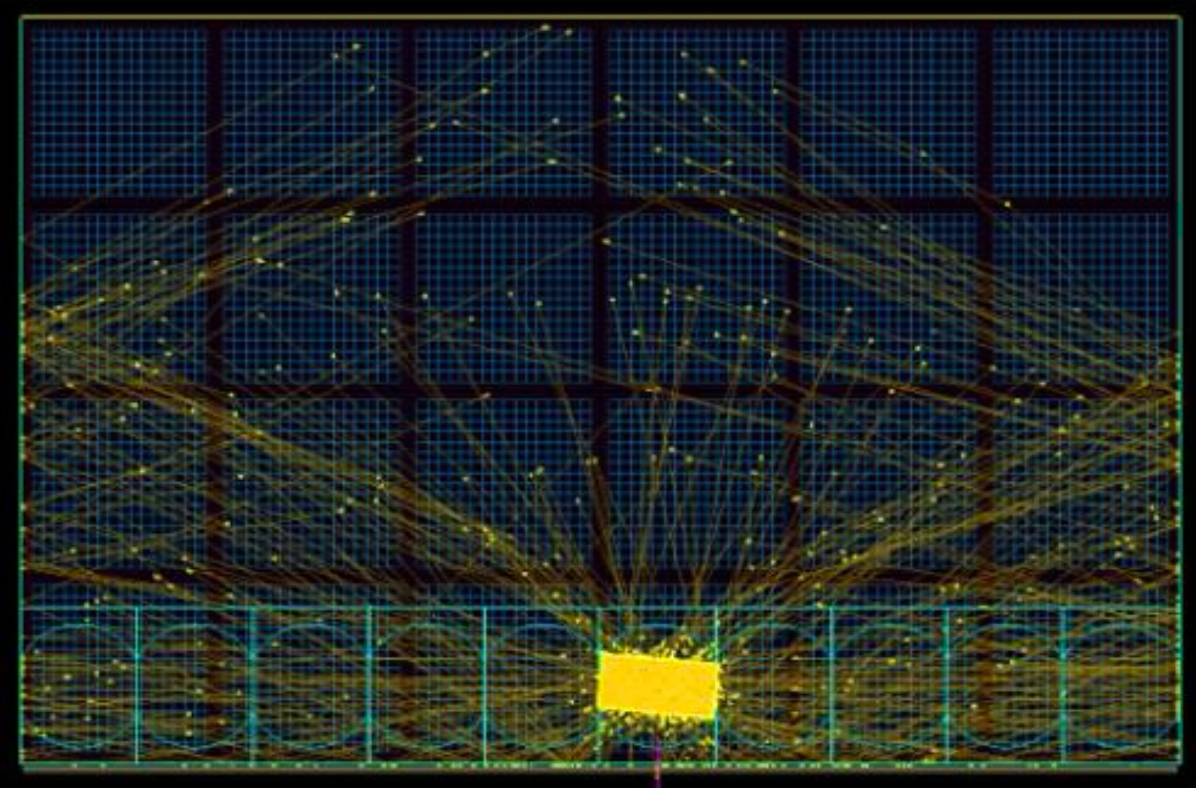
hpDIRC Simulation
Recent hpDIRC related studies:
Confirmed robust performance in magnetic field, using physics events (Pythia) to include backgrounds, multiple tracks per bar (WSU)
Adopting hpDIRC reconstruction methods into full ePIC Simulation Stack (WSU)
Performance with latest ePIC angular track resolution maps (GSI) → High-precision angular resolution crucial for reaching required hpDIRC performance.
Verifying optimal sensor coverage (CUA, GSI)
Study of the impact of bar imperfections on the hpDIRC performance relevant for the BaBar bar refurbishment (GSI)
Impact of bar/lens misalignments on performance (Jazan)
Machine Learning approach to reconstruction and generating PDFs (W&M)
Preparation for hpDIRC full chain test setup operation at CRT (SBU, GSI, ODU)
Afaf Wasili (Jazan)
Horizontal bar misalignment
Bar rotation

Slide 9

hpDIRC Simulation
Recent hpDIRC related studies:
Confirmed robust performance in magnetic field, using physics events (Pythia) to include backgrounds, multiple tracks per bar (WSU)
Adopting hpDIRC reconstruction methods into full ePIC Simulation Stack (WSU)
Performance with latest ePIC angular track resolution maps (GSI) → High-precision angular resolution crucial for reaching required hpDIRC performance.
Verifying optimal sensor coverage (CUA, GSI)
Study of the impact of bar imperfections on the hpDIRC performance relevant for the BaBar bar refurbishment (GSI)
Impact of bar/lens misalignments on performance (Jazan)
Machine Learning approach to reconstruction and generating PDFs (W&M)
Preparation for hpDIRC full chain test setup operation at CRT (SBU, GSI, ODU)
James Giroux (W&M)
Cristiano Fanelli (W&M)

Slide 10
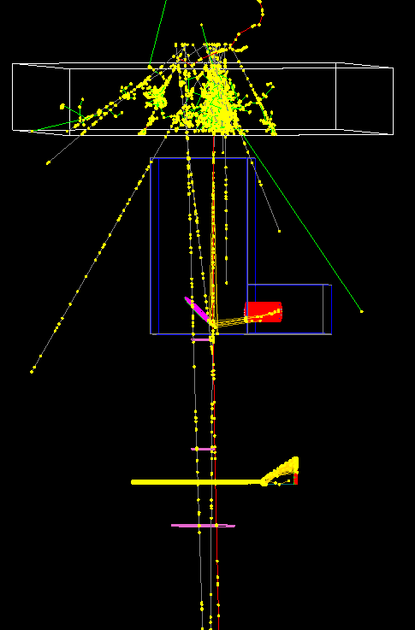
hpDIRC Simulation
Recent hpDIRC related studies:
Confirmed robust performance in magnetic field, using physics events (Pythia) to include backgrounds, multiple tracks per bar (WSU)
Adopting hpDIRC reconstruction methods into full ePIC Simulation Stack (WSU)
Performance with latest ePIC angular track resolution maps (GSI) → High-precision angular resolution crucial for reaching required hpDIRC performance.
Verifying optimal sensor coverage (CUA, GSI)
Study of the impact of bar imperfections on the hpDIRC performance relevant for the BaBar bar refurbishment (GSI)
Impact of bar/lens misalignments on performance (Jazan)
Machine Learning approach to reconstruction and generating PDFs (W&M)
Preparation for hpDIRC full chain test setup operation at CRT (SBU, GSI, ODU)
Nathan Shankman (SBU)
Jaydeep Datta (SBU)
Carlos Ayerbe Gayoso (ODU)

Slide 11
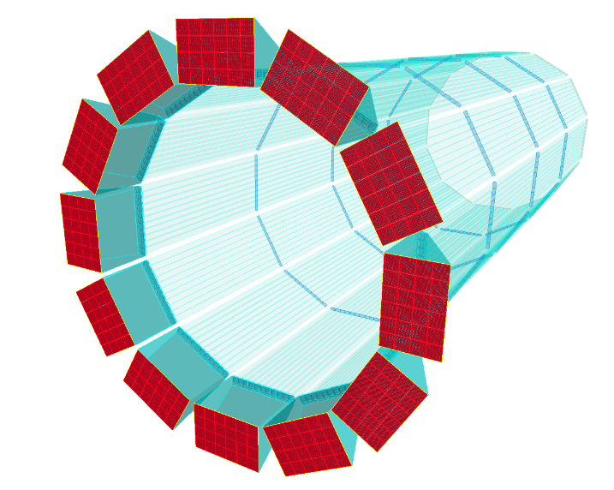
Summary
Stand-alone hpDIRC simulation, validated in particle beams in 2018, still essential for many studies
Important progres in understanding realistic tracking resolution and its impact on hpDIRC performnce
Effort on finishing integrstion of hpDIRC into the ePIC simulation software restarted

Slide 12
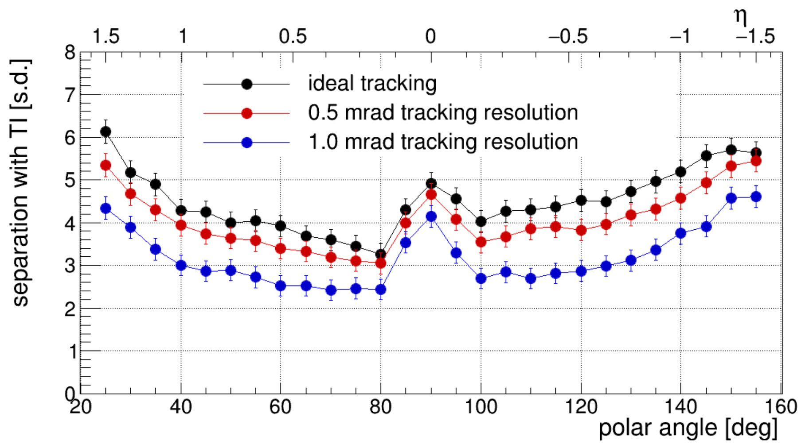
Expected hpDIRC Performance vs. Tracking
Impact of tracking angular resolution on hpDIRC performance
π/K Cherenkov angle difference at 6 GeV/c: ΔΘ_{c}≈3 mrad
Yellow Report tracking requirement: 0.5 mrad resolution at 6 GeV/c
π/K separation power at 6 GeV/c
→ High-precision angular resolution crucial for
reaching required hpDIRC performance.
Geant4
time-based imaging reconstruction
Simulation studies performed with
Stand-alone Geant4 simulation
Single particles from particle gun
6 GeV/c momentum
1.7T magnetic field, no other ePIC subsystems
100ps time resolution

Slide 13
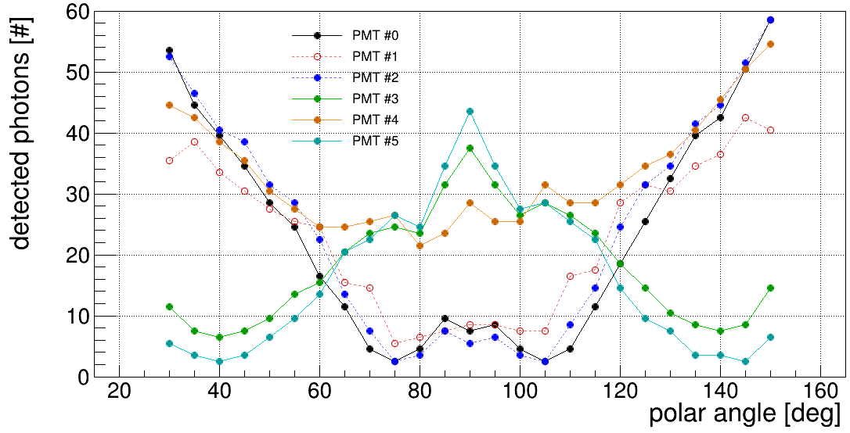
Photosensors
hpDIRC sensor requirements
Single photon sensitivity in ePIC magnetic field: 10⁶ gain at ~ 1T
Fast timing for single photons: timing precision (rms) < 100 ps
Large active area ratio for tiled sensors: goal > 75%
High PDE in visible range: goal > 25% at 400 nm
Small pixels: anode pixel size < 3.5 mm
Tolerance for high photon rates: goal > 0.5 MHz/cm²
Tolerance for high occupancies: up to 200+ photoelectrons per particle, need DC-coupled anodes
Long lifetime: goal > 10 C/cm²
Photek MAPMT 253
6 μm pores 8x8 anodes (PANDA)
PHOTONIS XP85012-S
10 μm pores 8x8 anodes (PANDA)
S. Krauss, RICH2022
Expected number of photoelectrons per particle per 12 cm x 12 cm sensor
Geant4 single particles

