Slide 1
Use AI to Retrieve Plots Effectively
Cheng-Juei (Fish) Yu
fishyu@iii.org.tw
Institute for Information Industry, Taipei, Taiwan

Slide 2
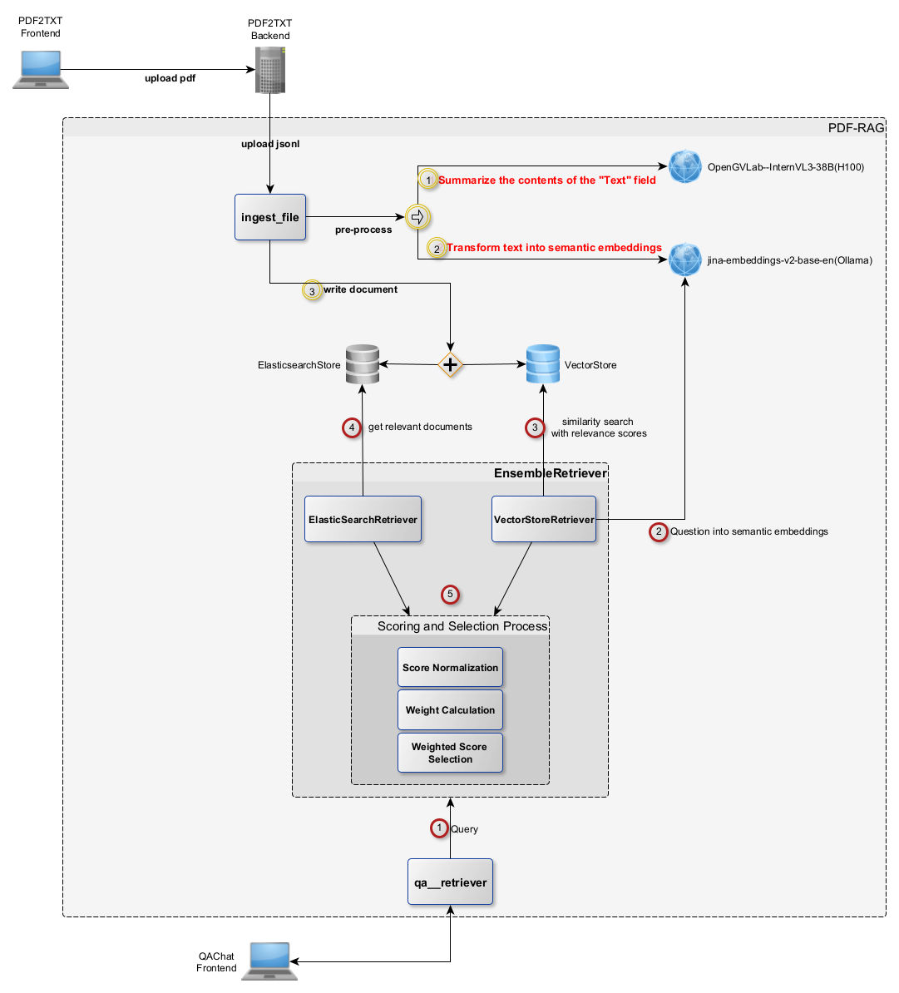
Give a try
Context Diagram
Demo site: https://pdf2txt.eastus.cloudapp.azure.com/qabot
Username (Web Portal): PDFsphenix (no password required)

Slide 3
What we did
Data Collection and Cleaning
PDF Conversion and Text Extraction
Content Summarization
Storage and Indexing
Question-Answering (QA) Workflow

Slide 4
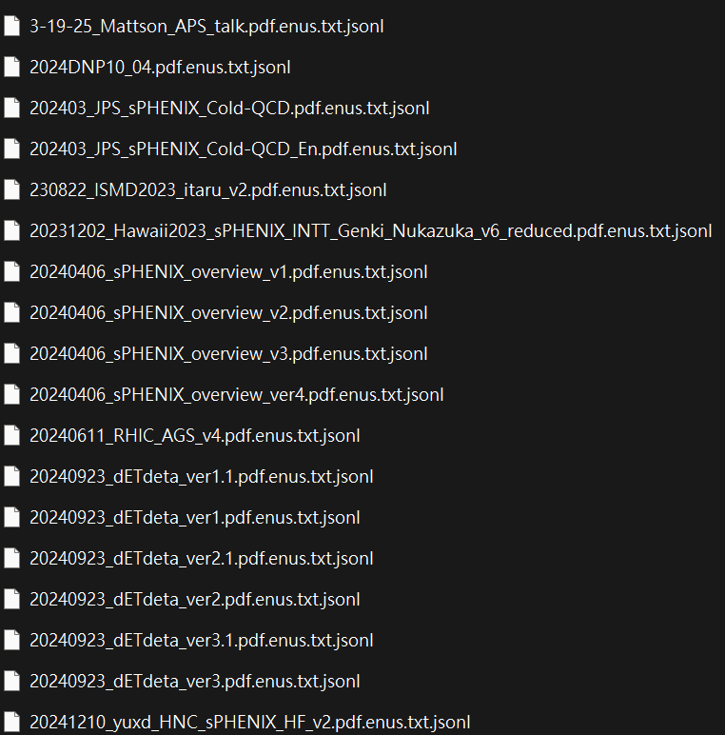
Data Collection and Cleaning
Collected 601 PDF files from the Invenio website.
Identified versioned files using patterns such as 20yy-mm-dd, mm-dd-20yy, ver, or v, and removed older versions.
Retained a final set of 429 PDF files.

Slide 5
PDF Conversion and Text Extraction
Used from unstructured.partition.pdf import partition_pdf to convert each PDF into a corresponding TXT file.
Images and tables within the PDFs were transformed into clickable URLs.
FileName
{"FileName": "[ZDC_SMD_Local_Polarimeter_Analysis_Note_for_AUM_v5.pdf](https://pdf2txt.eastus.cloudapp.azure.com/PDF-demo-iii/api/v1/pdf2txt/assets/6daed0eb-a462-4a4c-862f-43fe8bedba54/ZDC_SMD_Local_Polarimeter_Analysis_Note_for_AUM_v5.pdf)", "PageNum": "1", "Text": "1 tag: sPH-LPOL-2024-001 version: 0.1 DOI: unspecified date: June 6, 2024 Local polarimetry commissioning 3 6 8 9 Vincent Andrieux (UIUC), Jaein Hwang (Korea University), Devon Loomis (Michigan), Gregory Mattson (UIUC), Ejiro Umaka (BNL), Athira Vijayakumar (UIUC), Caroline Riedl, Matthias Perdekamp (UIUC), Itaru Nakagawa, Ralf Seidl, Yuji Goto, Yasuyuki Akiba, Genki Nukazuka, Akitomo Enokizono, Takahiro Kikuchi, Tomoki Harada (RIKEN), Chia-Ming Kuo, Cheng-Wei Shih (National Central University), Byungsik Hong (Korea University), Nicole D'Hose, Audrey Francisco, Dylan Neff, Virgile Mahaut (Saclay), Sanghoon Lim, Jeongsu Bok (Pusan National University), Christine Aidala, Dillon Fitzgerald, Manuel Ramirez Garcia, Desmond Shangase (University of Michigan), John Lajoie, Derek Anderson (lowa State University and Oak Ridge National Lab.) Abstract This note details the commissioning of the sPHENIX local polarimeter. Plots that show the raw transverse single spin asymmetry of forward neutrons in the ZDC/SMD are presented. The procedure for calculating these asymmetries, which is dependant on both reliable bunch- by-bunch spin information and neutron hit selection, will be discussed. ", "Image": "![](https://pdf2txt.eastus.cloudapp.azure.com/PDF-demo-iii/api/v1/pdf2txt/assets/PDF_demo_iii/6daed0eb-a462-4a4c-862f-43fe8bedba54/ZDC_SMD_Local_Polarimeter_Analysis_Note_for_AUM_v5/images/1/figure-1-1.jpg) "}{"FileName": "[ZDC_SMD_Local_Polarimeter_Analysis_Note_for_AUM_v5.pdf](https://pdf2txt.eastus.cloudapp.azure.com/PDF-demo-iii/api/v1/pdf2txt/assets/6daed0eb-a462-4a4c-862f-43fe8bedba54/ZDC_SMD_Local_Polarimeter_Analysis_Note_for_AUM_v5.pdf)", "PageNum": "2", "Text": "16 1 Experimental Setup 17 1.1 ZDC The Zero Degree Calorimeter is a Cherenkov light sampling calorimeter. The ZDCs are located in series at +18 m away from the collision point, each side of the beam direction. Mechanically, each arm of the ZDC is subdivided into 3 identical modules with 2 interaction length each. The active medium is made from clear PMMA fibers interleaved with Tungsten absorber plates. This sandwich structure is tilted at 45 degree to the beam to align the optical fibers with the Cherenkov angle of forward particles in the shower. The energy resolution of the ZDC for 100 GeV neutrons is 21%. Time resolution is around 120 ps for 100 GeV neutrons which may be translated into a vertex position resolution of around 2.5cm. 26 1.2 SMD 27 28 29 30 31 32 33 34 35 36 The SMD is an X-Y scintillator strip detector inserted between ist and 2nd ZDC modules. This location corresponds (approximately) to hadronic shower maximum position. The horizontal x coordinate is sampled by 7 scintillator strips of 15 mm width each, while the vertical y coordinate is sampled by 8 strips of 20 mm width each, tilted by 45 degrees. The active area covered by SMD is 105 mm x 110 mm. The SMD position resolution depends on energy deposited in the scintillator and varies from around 10 mm at small number of charged particles crossing the SMD to values smaller than 3 mm when number of particles exceed 100. For comparison, the spread of neutrons due to of nucleon Fermi motion is about 2.2 cm at 100 GeV. The scintillation lights generated in the SMD strips are trasmitted through lignt guides to the multianode photomultiplier model H6568-10 (Hamamatsu Photonics K.K.). 37 1.3. Veto Counters 38 A pair of scintillator paddles with matching acceptance with ZDC was implemented upstream 39 and down- stream of ZDC, respectively. It is called charge veto (CV) counters. The veto counters 40 employ 60.0 mm diameter photomultiplier, model H7195 (Hamamatsu Photonics K.K.). 41 1.4 Readout Electronics 42 The SMD raw signals generated in the tunnel are transmitted to the electronics room in 1008B 43 using RG58 coaxial cables. The length of cables of each detectors are tabulated in Table 1. The 44 raw SMD signals are amplified in the model 776 16-channel photomultiplier preamplifier (Phillips 45 Scientific) by factor of 10. The amplified signals are then converted to the differential signal in the unbalranced to differnetial module. The output signals of the differential module are then 46 47 transmitted to an ADC module using 55 pin 2mm HardMetric cable. 48 49 50 On the othe hand, the signal amplitude of the veto counters are directly plugged into the differential module without the amplifier since they are sufficient to fit within the dynamic range of the ADC module. aS ) "}{"FileName": "[ZDC_SMD_Local_Polarimeter_Analysis_Note_for_AUM_v5.pdf](https://pdf2txt.eastus.cloudapp.azure.com/PDF-demo-iii/api/v1/pdf2txt/assets/6daed0eb-a462-4a4c-862f-43fe8bedba54/ZDC_SMD_Local_Polarimeter_Analysis_Note_for_AUM_v5.pdf)", "PageNum": "3", "Text": "Table 1: Cable length and transmission time for each detectors Schematics of the readout electronics of ZDC/SMD/Veto after May 14th, 2024. Two ADC’s were 51 52 implemented in order to acquire different signal timings among these detectors as a consequence 53 of aforementioned different RG58 cable length. Figure 1: Schematics of the readout electronics of ZDC/SMD/Veto after May 14th, 2024. Two ADC’s were implemented in order to acquire different signal timings among these detectors. 54 1.5 Beam Optics 55 56 57 58 59 60 In order to have narrower collision z-vertex, the blue and yellow beam are to be crossing with opening angle of 2 mrad as depicted in Fig. 2. Due to the angled beam tune from the central orbit, the neutron scattered off at zero degree from a collision will be landed 1.8 cm outward from the center of the ZDC acceptance. Given the limited fiducial acceptance of the ZDC (-4< r <4 cm), prior to Run24, both South and North ZDC compartments were moved outward (positive x direction) by 1.8cm in order to detect neutrons scattered at zero degrees in the center of the ZDC ~ ", "Image": "![](https://pdf2txt.eastus.cloudapp.azure.com/PDF-demo-iii/api/v1/pdf2txt/assets/PDF_demo_iii/6daed0eb-a462-4a4c-862f-43fe8bedba54/ZDC_SMD_Local_Polarimeter_Analysis_Note_for_AUM_v5/images/3/figure-3-1.jpg) ![](https://pdf2txt.eastus.cloudapp.azure.com/PDF-demo-iii/api/v1/pdf2txt/assets/PDF_demo_iii/6daed0eb-a462-4a4c-862f-43fe8bedba54/ZDC_SMD_Local_Polarimeter_Analysis_Note_for_AUM_v5/images/3/figure-3-2.jpg) ", "Table": "![](https://pdf2txt.eastus.cloudapp.azure.com/PDF-demo-iii/api/v1/pdf2txt/assets/PDF_demo_iii/6daed0eb-a462-4a4c-862f-43fe8bedba54/ZDC_SMD_Local_Polarimeter_Analysis_Note_for_AUM_v5/images/3/table-3-1.jpg) "}{"FileName": "[ZDC_SMD_Local_Polarimeter_Analysis_Note_for_AUM_v5.pdf](https://pdf2txt.eastus.cloudapp.azure.com/PDF-demo-iii/api/v1/pdf2txt/assets/6daed0eb-a462-4a4c-862f-43fe8bedba54/ZDC_SMD_Local_Polarimeter_Analysis_Note_for_AUM_v5.pdf)", "PageNum": "4", "Text": "61 acceptance. 6 Fig. 3 shows the the North ZDC compartments position. They are shifted towards yellow beam 6s pipe by 1.8cm leaving more room between the North ZDC and the blue beam pipe. Figure 2: Beam trajectory at 1008 in 2mrad crossing angle setting. Prior to Run24, both South and North ZDC compartments were shifted towards outer (positive x direction) by 1.8cm in order to detect neutrons scattered at zero degrees in the center of the ZDC acceptance. Figure 3: The North ZDC compartment position for Run24. They are shifted towards yellow beam pipe by 1.8cm leaving more room between the North ZDC and the blue beam pipe. ae 8 ) ", "Image": "![](https://pdf2txt.eastus.cloudapp.azure.com/PDF-demo-iii/api/v1/pdf2txt/assets/PDF_demo_iii/6daed0eb-a462-4a4c-862f-43fe8bedba54/ZDC_SMD_Local_Polarimeter_Analysis_Note_for_AUM_v5/images/4/figure-4-1.jpg) ![](https://pdf2txt.eastus.cloudapp.azure.com/PDF-demo-iii/api/v1/pdf2txt/assets/PDF_demo_iii/6daed0eb-a462-4a4c-862f-43fe8bedba54/ZDC_SMD_Local_Polarimeter_Analysis_Note_for_AUM_v5/images/4/figure-4-2.jpg) "}
Image
Text

Slide 6
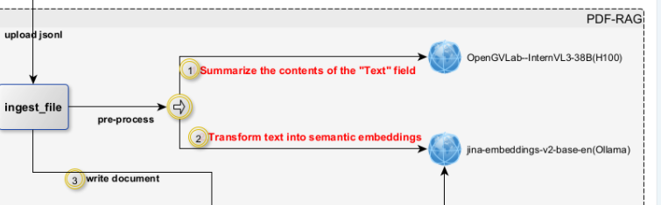
Content Summarization
Applied the OpenGVLab/InternVL3-38B LLM to generate summaries of each TXT file.

Slide 7
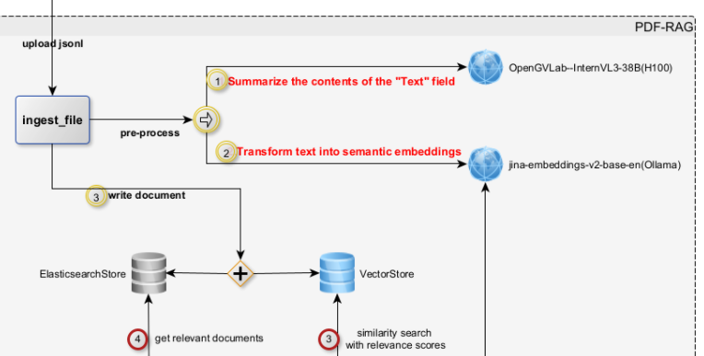
Storage and Indexing
Saved the summarized content into Elasticsearch for keyword-based retrieval.
Generated text embeddings using jina-embeddings-v2-base-en.
Stored embedding vectors into ChromaDB.

Slide 8
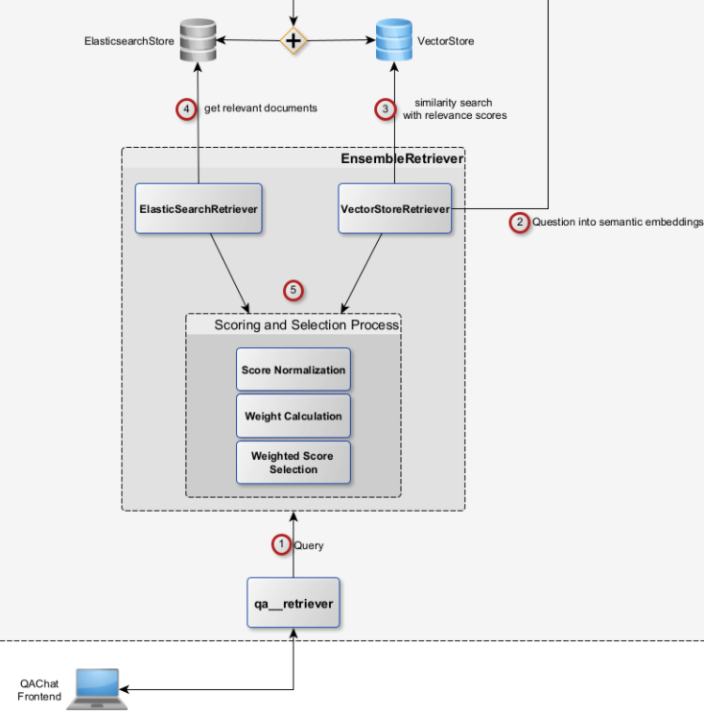
Question-Answering (QA) Workflow
During QA, query texts are compared against both Elasticsearch (for text search) and ChromaDB (for vector similarity search) to deliver optimal results.

Slide 9
Next steps
Many search platforms today are outdated — they lack semantic search and still rely on basic keyword matching. Supporting the reading and searching of Greek letters (e.g., ε, η, θ) also needs to be tested and implemented.
We should also take into account different document types — drafts, notes, manuals, papers, preprints, and posters. The key is metadata: if each document is assigned a document-type label, users can filter and sort results much more effectively.

