Slide 1


Considerations for Data and Analysis Preservation
RHIC DAP Round Table
30 October, 2025
Laura Biven
Chief Data Officer, Jefferson Lab
Notes:
30 mins
https://indico.bnl.gov/event/28843/

Slide 2
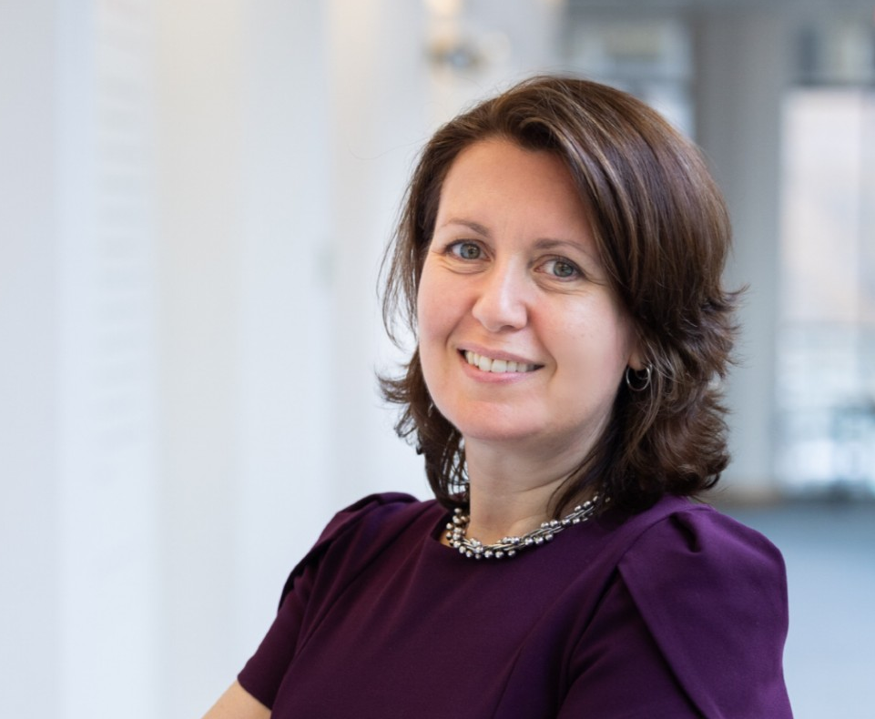
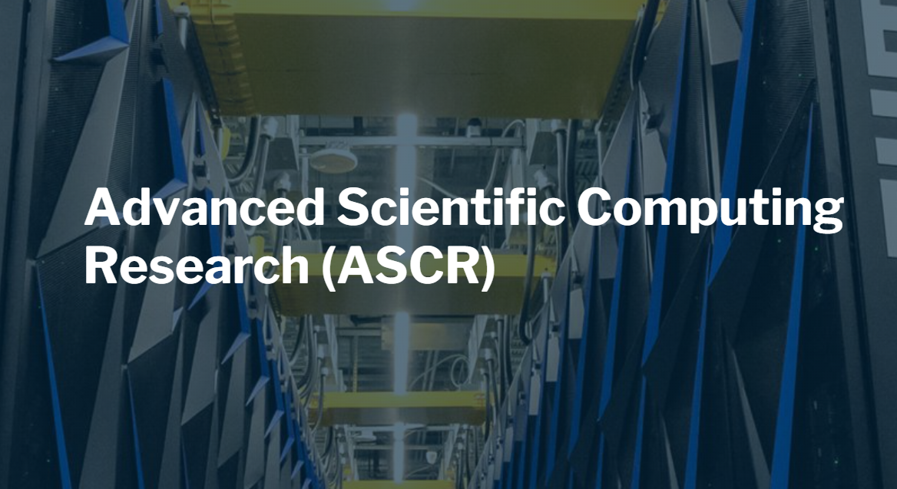
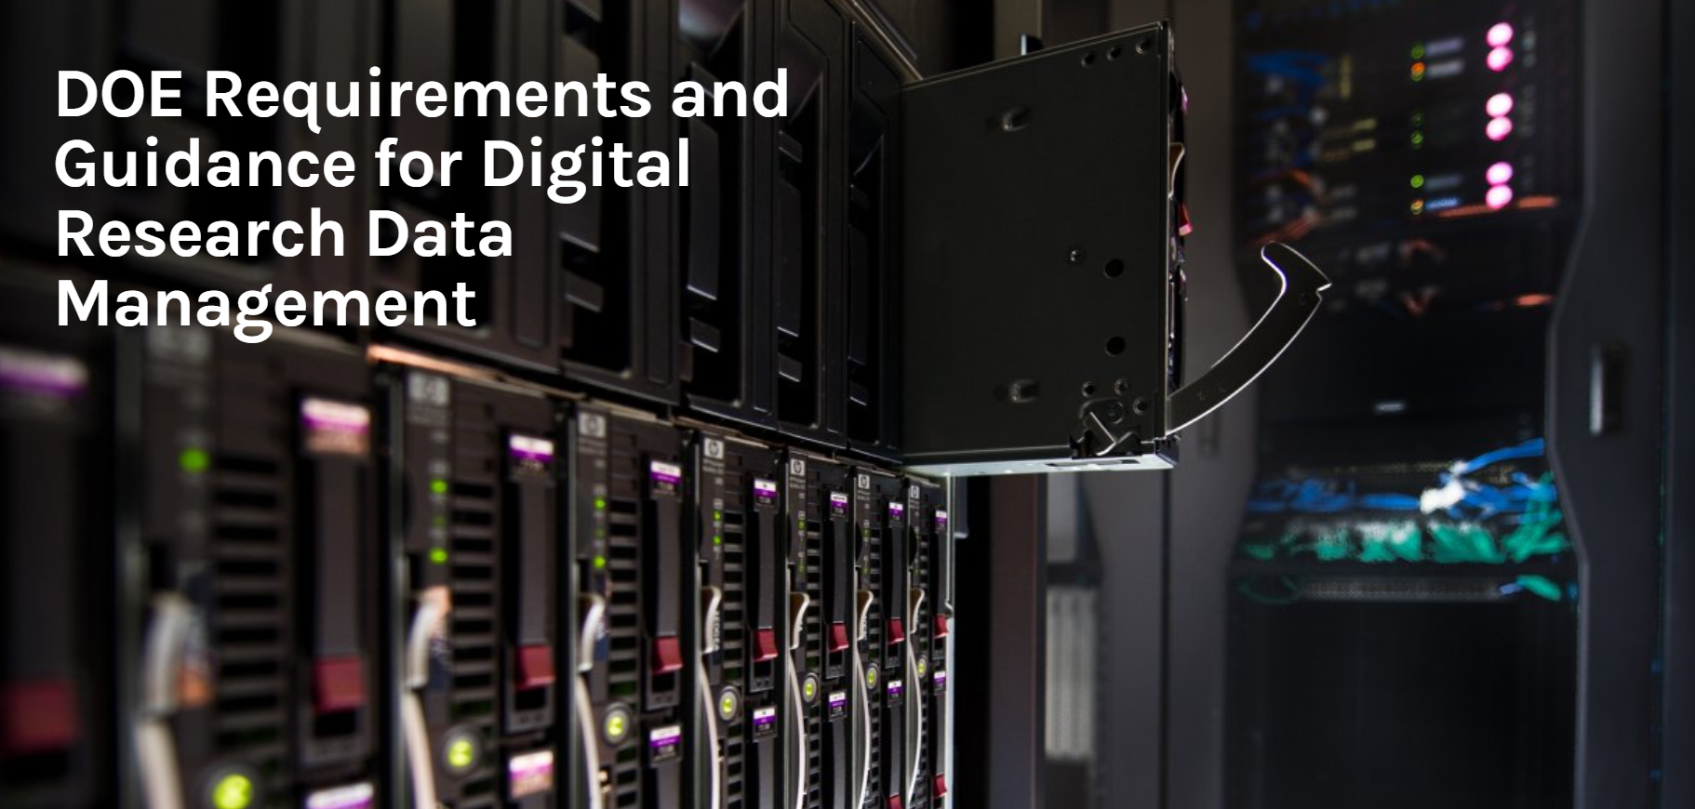

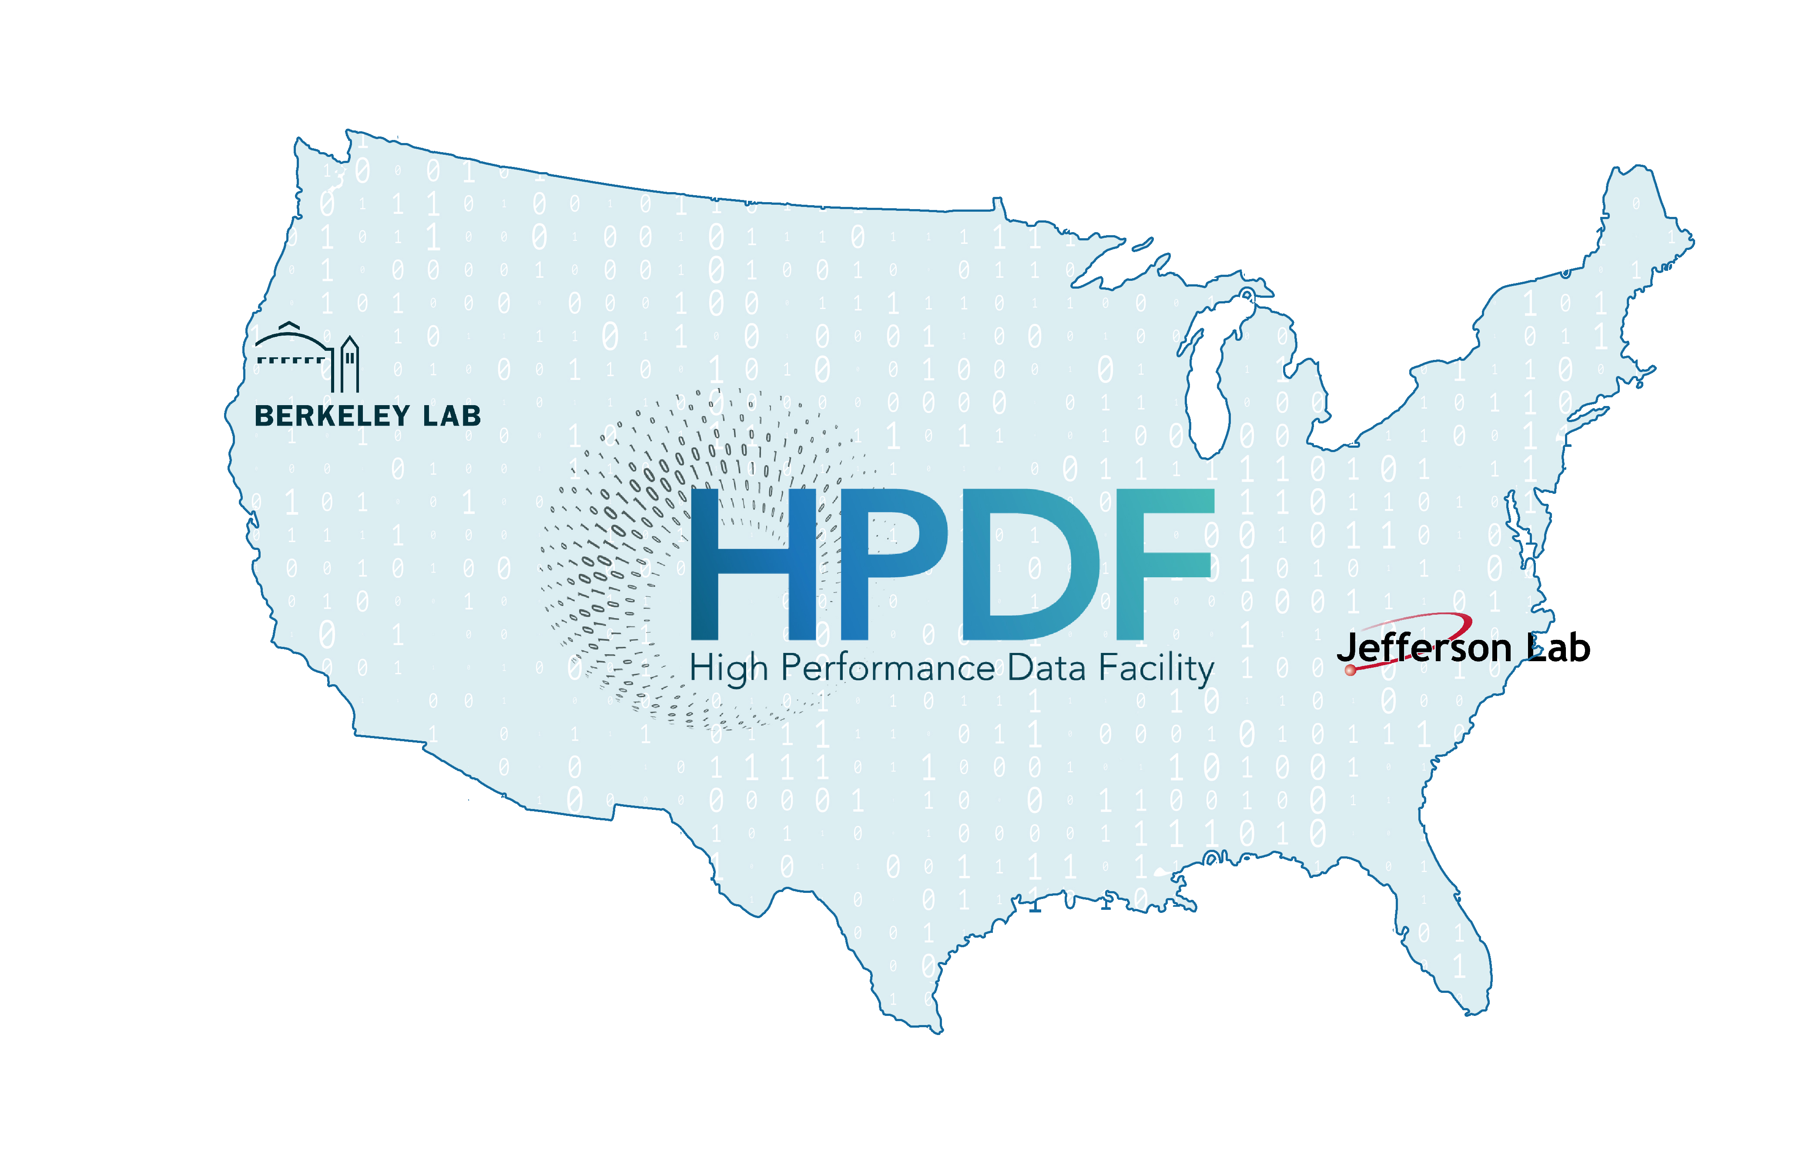
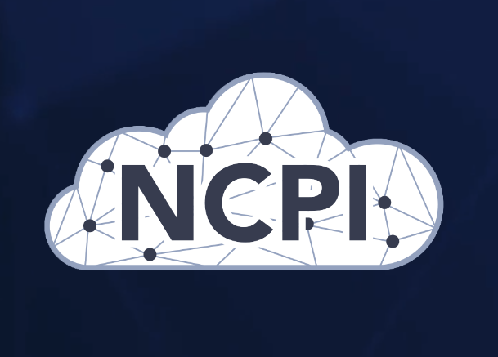


Laura Biven Chief Data Officer biven@jlab.org
My interests:
Enhancing innovation and integrity in science through the data lens
Building data infrastructure for creative, inquisitive research

Slide 3
Considerations for Data and Analysis Preservation
Data Management Drivers
Where is this going?
Importance of the value proposition and use cases
Principled Approach to {Data, Code, Workflow…} Management
Final Thoughts

Slide 4
Data Management Drivers

Slide 5
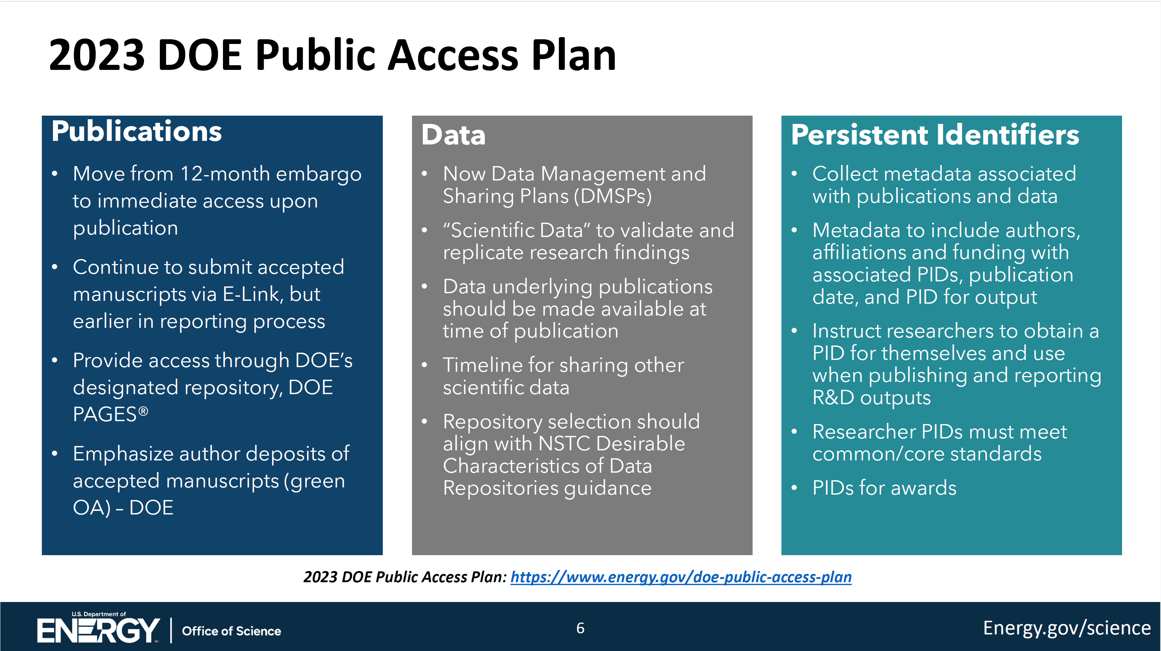
DOE O241.C New Requirements
?
Michael Cooke’s Slide from ASCAC Jan, 2025
Notes:
https://www.osti.gov/stip/about/supporting-documentation/2411C

Slide 6
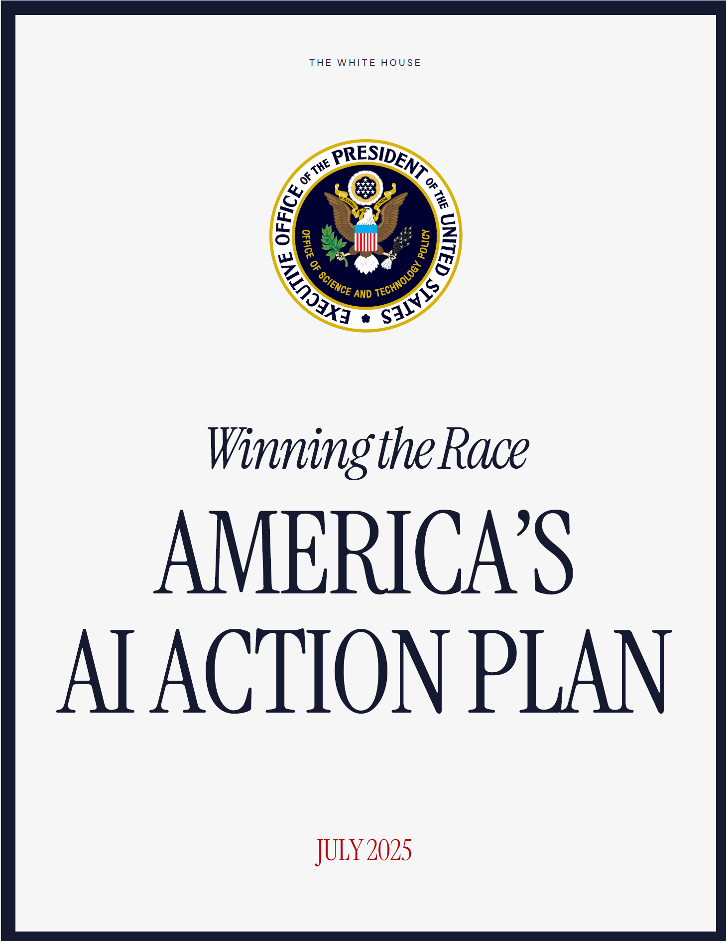
AI Action Plan
“Build World-Class Scientific Datasets
High-quality data has become a national strategic asset as governments pursue AI innovation goals and capitalize on the technology’s economic benefits. Other countries, including our adversaries, have raced ahead of us in amassing vast troves of scientific data. The United States must lead the creation of the world’s largest and highest quality AI-ready scientific datasets, while maintaining respect for individual rights and ensuring civil liberties, privacy, and confidentiality protections.
Recommended Policy Actions
Direct the National Science and Technology Council (NSTC) Machine Learning and AI Subcommittee to make recommendations on minimum data quality standards for the use of biological, materials science, chemical, physical, and other scientific data modalities in AI model training.”

Slide 7
Public Law No: 119-21
SEC. 50404. TRANSFORMATIONAL ARTIFICIAL INTELLIGENCE MODELS.
AMERICAN SCIENCE CLOUD.—The term ‘‘American science cloud’’ means a system of United States government, academic, and private sector programs and infrastructures utilizing cloud computing technologies to facilitate and support scientific research, data sharing, and computational analysis across various disciplines while ensuring compliance with applicable legal, regulatory, and privacy standards.
TRANSFORMATIONAL MODELS.—The Secretary of Energy shall—
(1) mobilize National Laboratories to partner with industry sectors within the United States to curate the scientific data of the Department of Energy across the National Laboratory complex so that the data is structured, cleaned, and preprocessed in a way that makes it suitable for use in artificial intelligence and machine learning models; and
(2) initiate seed efforts for self-improving artificial intelligence models for science and engineering powered by the data described in paragraph (1).

Slide 8
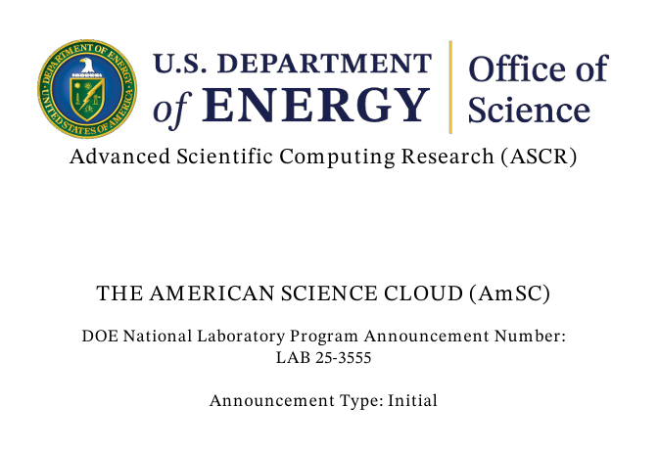
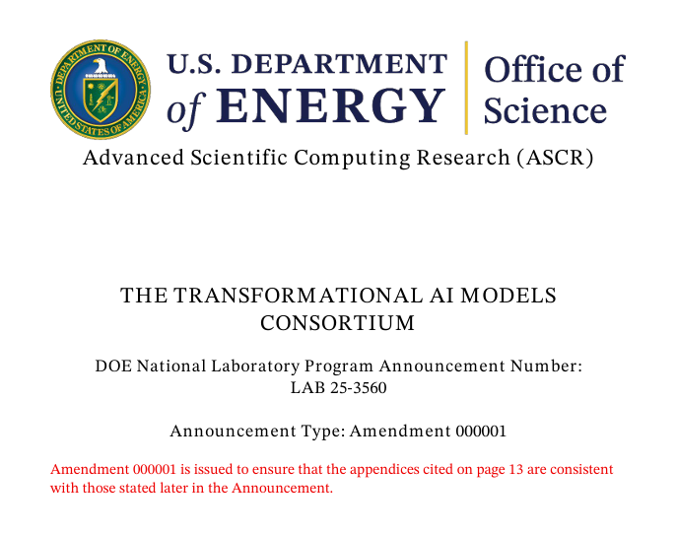
The American Science Cloud at DOE
“AI is the next Manhattan Project. AI technology will define the future of the world, and it is essential that the U.S. leads in the development of this technology. DOE has a significant role to play in driving AI innovation for scientific discovery, energy innovation, and national security.”
- Secretary of Energy, Chris Wright (May 2025)
https://www.appropriations.senate.gov/imo/media/doc/secretary_wright_testimony.pdf

Slide 9
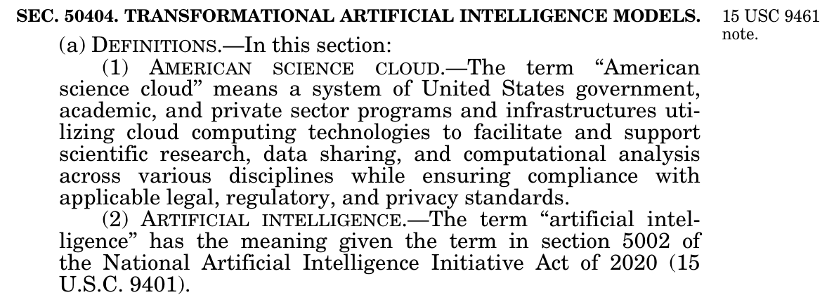
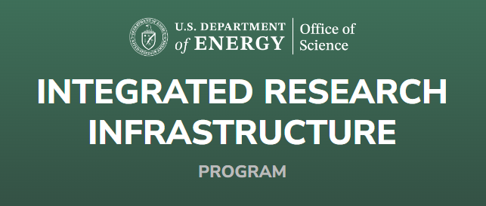
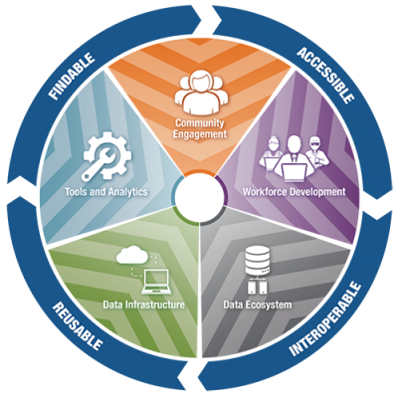
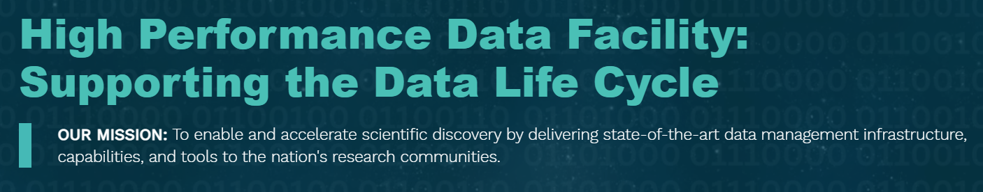
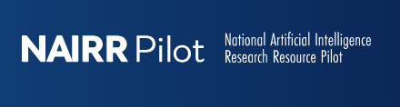
National-scale data and computing infrastructures
NIH

Slide 10
Where is this going?

Slide 11
Where is this going? (Laura’s predictions)
Increasing expectations for {data, code, documentation…} sharing
More data, more immediate sharing, more context,
Publications, data, and code are fully integrated, FAIR and AI-ready.
Enhanced interplay between humans and AI
Assumptions and underlying theories (conceptual models) are described and shared along with research findings, data, and other research artifacts.
Increasing need for validation and resiliency for AI in the scientific process
Tensions continue between protecting data and openness
Emergence of global frameworks and standards for data and metadata

Slide 12
Importance of the Value Proposition and Use Cases

Slide 13
Value Proposition and Use Cases
Preservation is not a value proposition
Knowledge transfer is a value proposition
Identify use cases and users broadly
For your own collaborations: reproducibility, reusability, reinterpretability, automated generation of analyses.
For other nuclear scientists, future nuclear scientists, students, AI agents, AI researchers, public,…
For cross experiment analysis
Everything is data for AI
Opportunity to consider the full corpus of data, information, and knowledge for AI
Test, Test, Test

Slide 14
Principled Approach to {Data, Code, Workflow…} Management

Slide 15
Consider the Full Data Lifecycle and Steward the Scientific Record
Consider the full data lifecycle
metadata, provenance, documentation (and which is which), curated repos,
persistent identifiers for data, code, people (ORCID), institutions, detector components
reusable, modular, interoperable software and workflow components.
standards and interoperability
Steward the full scientific record
Define what’s needed: publication, code, data, provenance, documentation (datasheets, model cards), citation tree?
… and how to package / reconstitute it.
Consider sustainability: Especially when the components are distributed across repositories.

Slide 16
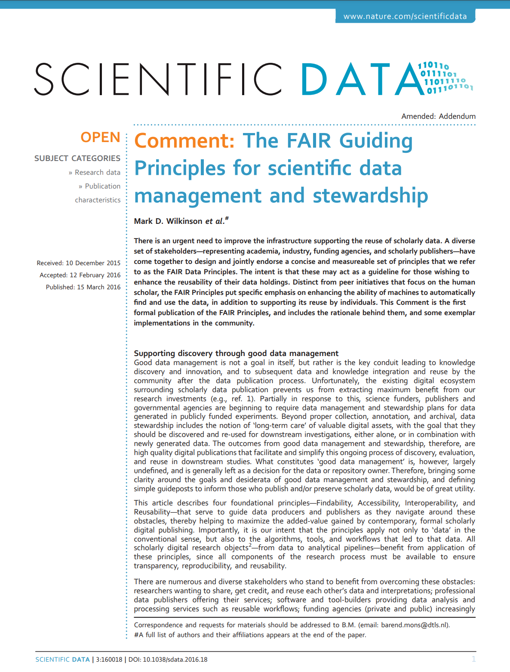
FAIR Principles
Wilkinson, M., Dumontier, M., Aalbersberg, I. et al. The FAIR Guiding Principles for scientific data management and stewardship. Sci Data 3, 160018 (2016). https://doi.org/10.1038/sdata.2016.18

Slide 17
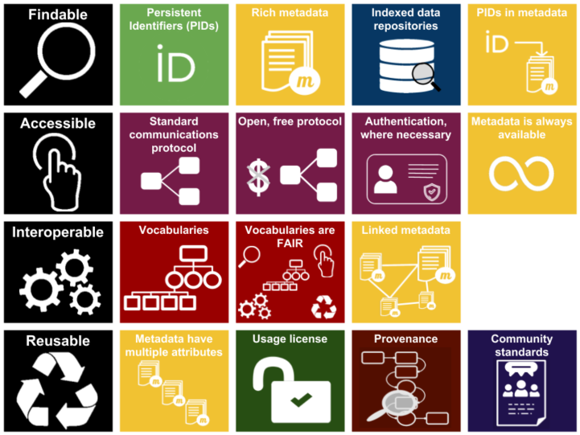

FAIR Principles for Data
https://www.gofair.foundation/interpretation
FAIR data infographic (CC-BY except F.A.I.R logos CC-BY-SA by Sangya Pundir

Slide 18
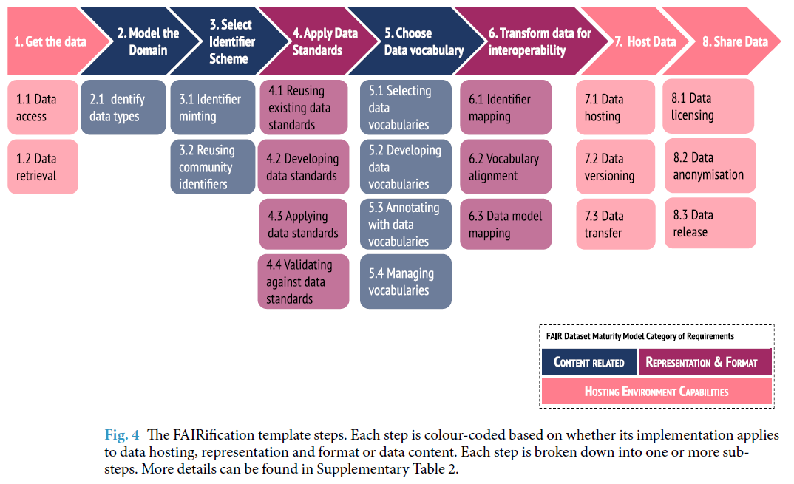
FAIRification
Welter, D., Juty, N., Rocca-Serra, P. et al. FAIR in action - a flexible framework to guide FAIRification. Sci Data 10, 291 (2023). https://doi.org/10.1038/s41597-023-02167-2

Slide 19
FAIR4…
FAIR4Workflows: https://workflows.community/groups/fair/
FAIR4HEP: https://fair4hep.github.io/ , https://fairos-hep.org/
FAIR4RS: https://www.researchsoft.org/blog/2024-03/
FAIR4AI: https://doi.org/10.1038/s41597-023-02298-6; https://doi.org/10.5281/zenodo.15681158
FAIR4HPC: https://hpc-fair.github.io/ , https://doi.org/10.1145/3708035.3736097
FAIR training Materials https://doi.org/10.1371/journal.pcbi.1007854
FAIRDO – Digital Objects https://fairdo.org/
FAIR Principles for Research Hardware https://www.rd-alliance.org/groups/fair-principles-research-hardware
Desirable Characteristics for Repositories https://www.whitehouse.gov/wp-content/uploads/2022/05/05-2022-Desirable-Characteristics-of-Data-Repositories.pdf

Slide 20
Final Thoughts
Leverage national-scale infrastructures and initiatives
Align our value propositions and use cases
Articulate needs wrt infrastructure, standards, interoperability
Value of common approaches across facilities, across Labs.
Let’s work together!

Slide 21
Thank you

