Slide 1
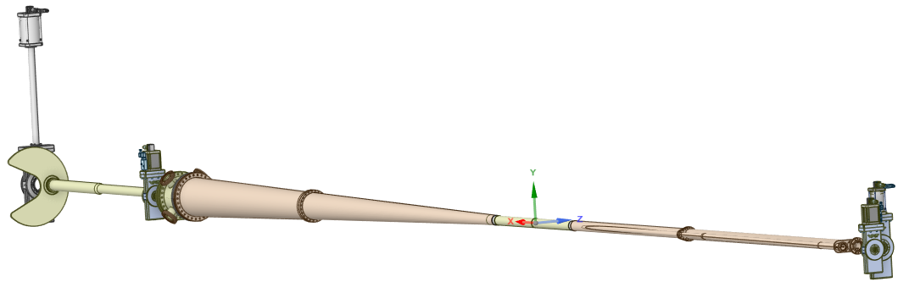
Analysis on Baking IR6 Vacuum Pipe with 200C Nitrogen Gas
Total Length: ~ 10m
Center (Beryllium) ID=64mm (L=~1.5m)
Required flow Speed @ center > 6m/sec
Two inlet & two outlets
July 7, 2025
Chang Jun, EIC Vacuum Team

Slide 2
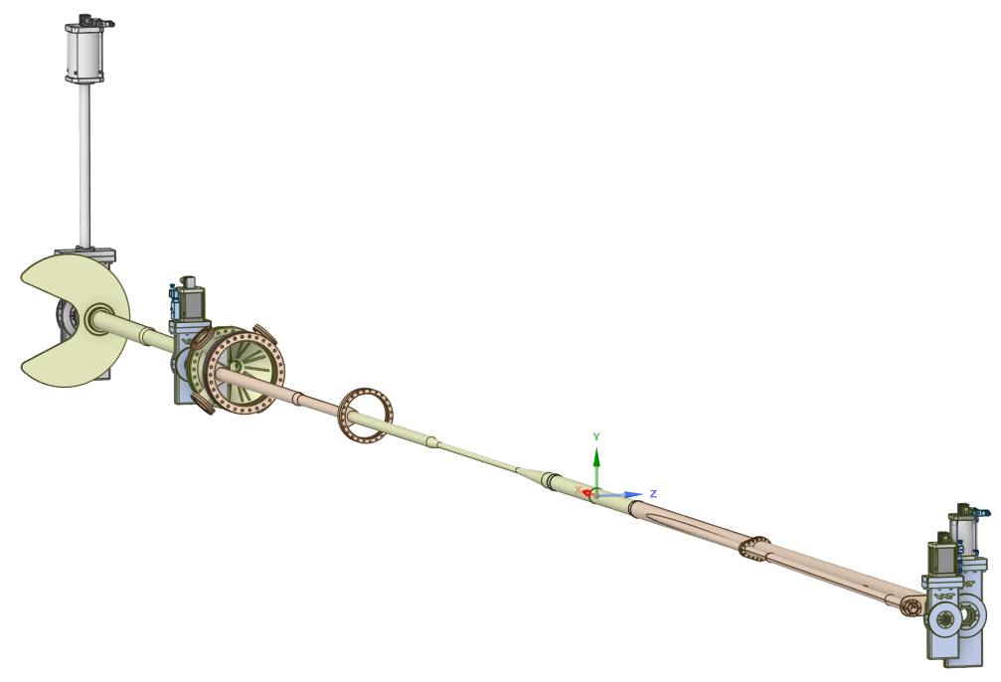
Most Big Part:
HB Cone: ID~250
Most Narrow Part:
EB Pipe: ID=20 & OD=22mm (L~1.1m)
Total Length ~10m

Slide 3
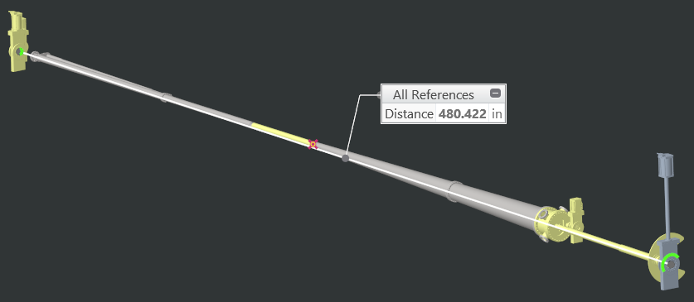

Slide 4
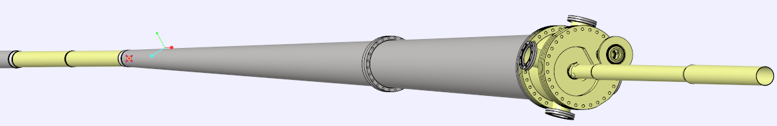
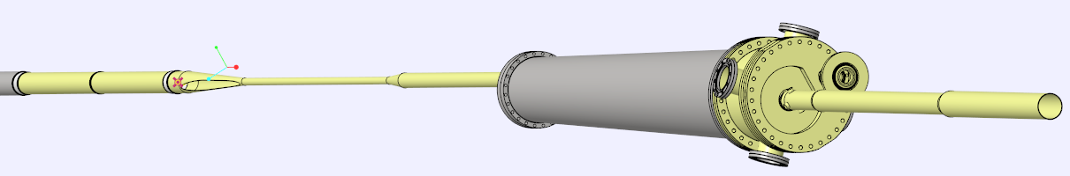
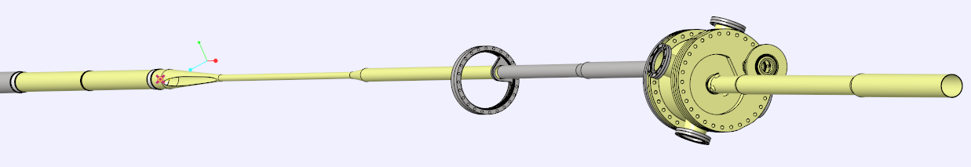

Slide 5
Goal & Method to evaluate the Baking Process
Goals: To verify how much pumping pressure we will need to have required minimum N2 velocity (=6m/sec) & flow quantity @ the beam cross region (Beryllium pipe part).
Method: Since the 2 flow pipes are enveloped & crossed each other along long line, FEA with whole model could be taken too long without guarantee of the precise results,
Reasonable approach would be a simple CFD analysis with a similar or conservative model conditions with Air. Analytic solutions in Internet site can also be compared.
(Pressure drop & Pipe Length is linear.)

Slide 6
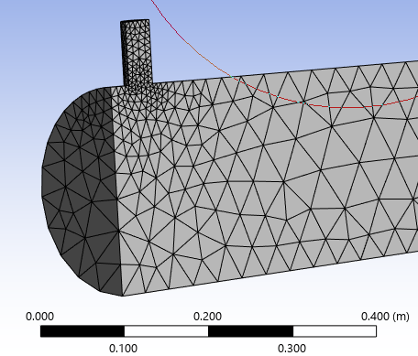
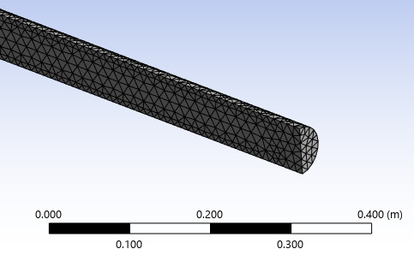
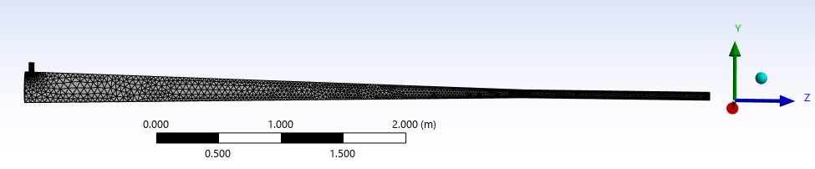
CFD Analysis with ANSYS Fluent
Half Symmetric: Total L= 5.5m (Cone=4m & Straight=1.5m)
Inlet D=40mm & Outlet D=64mm: Cone D= 250mm
Flow is Just air in Room Temperature
Inlet (Air)
4m
1.5m
Outlet (Air)

Slide 7
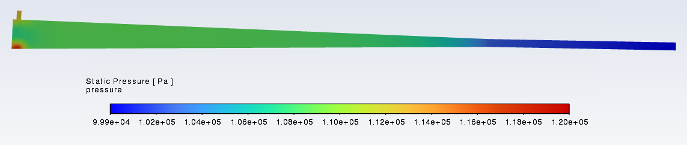
Pressure Distribution on Symmetric Plane
(Input Date: Inlet = 150,000 Pa & Outlet = 100,000 Pa)
Pressure Drop is 0.5 ATM (=50,000 Pa or 7.5 psi)

Slide 8
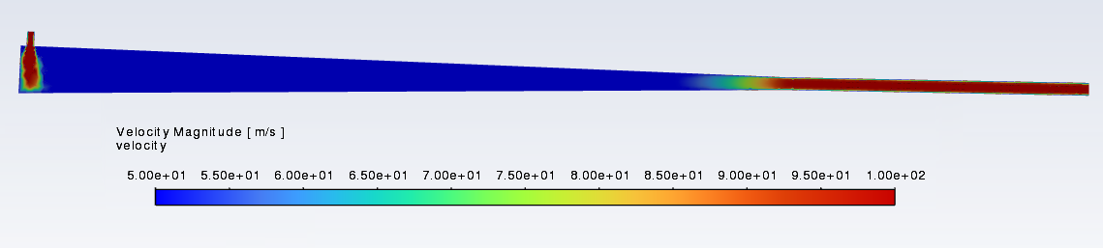
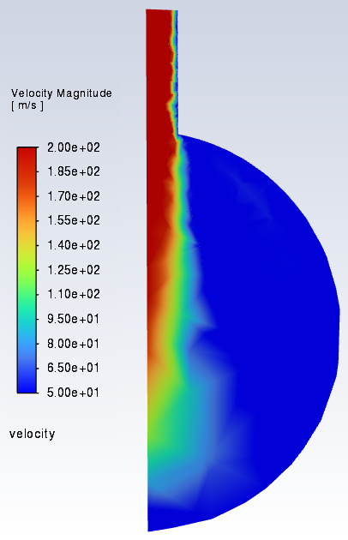
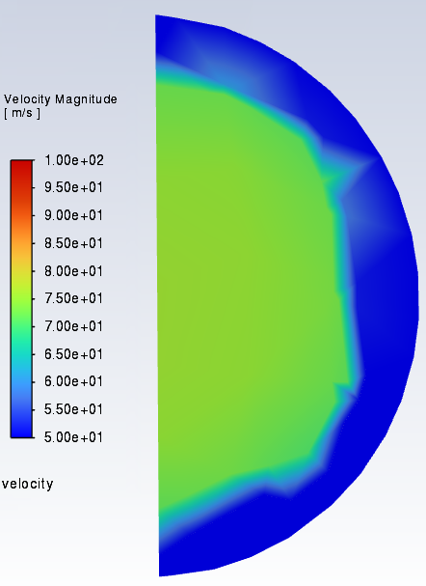
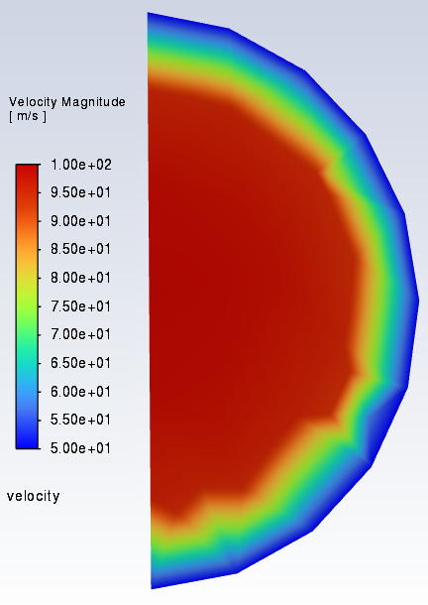
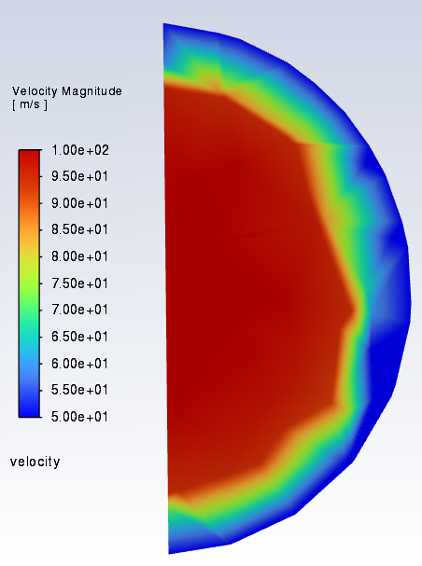
Velocity Distribution on Symmetric Plane
(Input Date: Inlet = 150,000 Pa & Outlet = 100,000 Pa)
Here, around 100m/s.
@ z=0.05m
@ z=3.8m
@ z=4m
@ z=5m

Slide 9
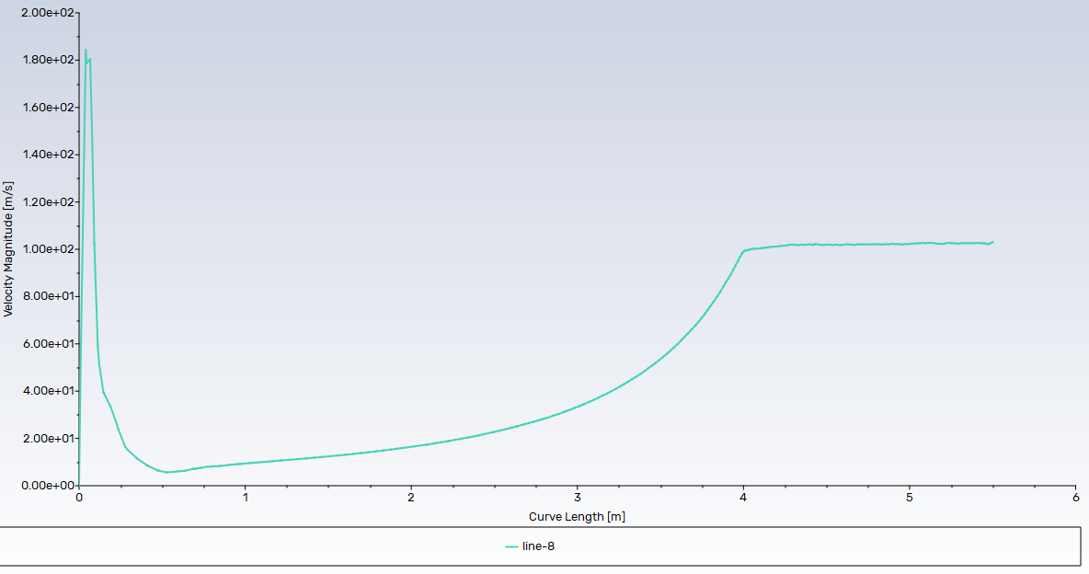
Velocity along Center (@ end ~100m/sec & Average > 50m/sec)

Slide 10
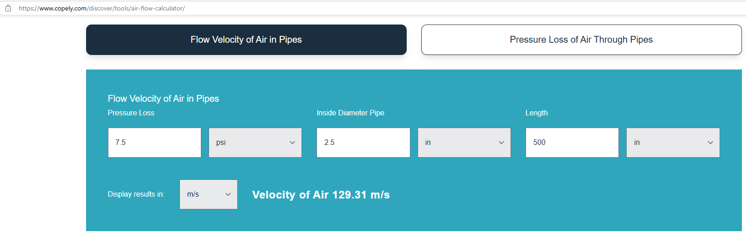
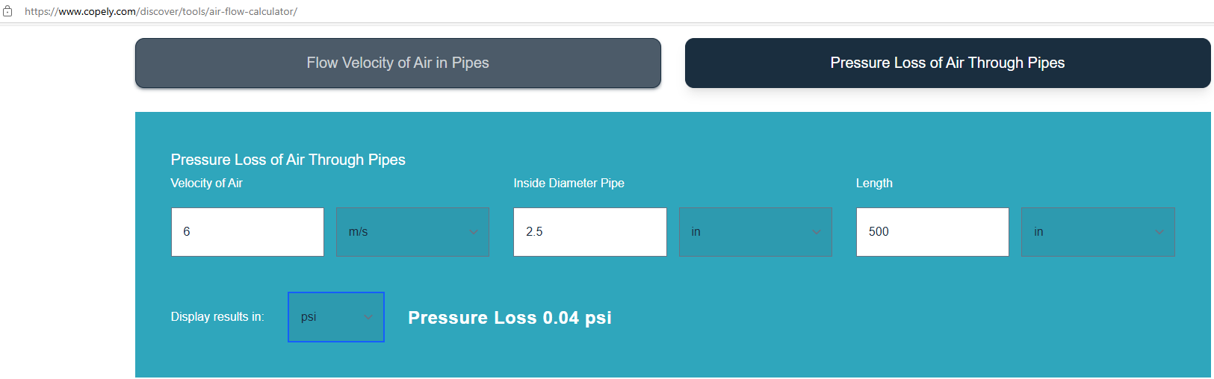
Analytic Solution with Simple Pipe air flow: ID=2.5”

Slide 11
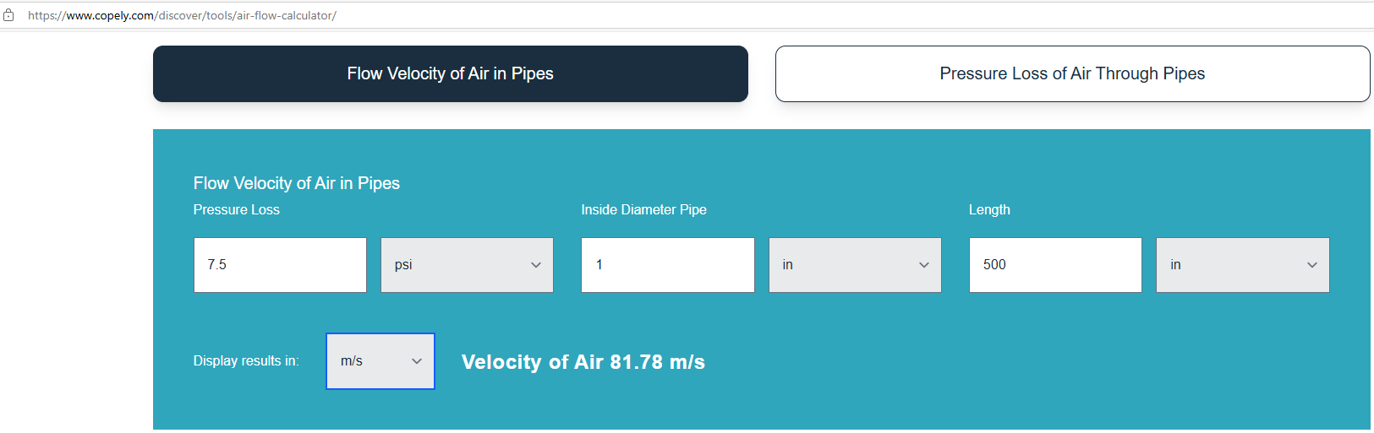
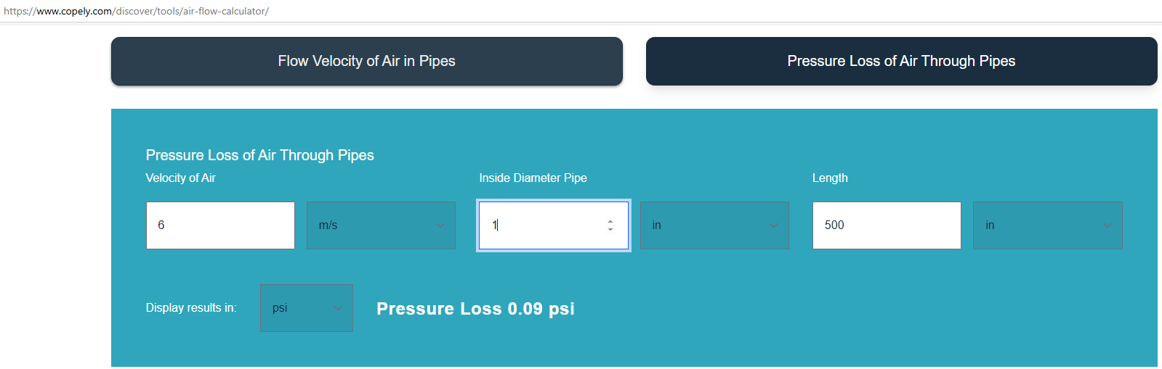
Analytic Solution with Simple Pipe air flow: ID=1.0”

Slide 12

Analytic Solution with Simple Pipe air flow: ID=2.5”
This reasonable number of Pressure Drop (dP=0.5 psi) requires the flow rate of 120 liter/sec (33.4m/sec)

Slide 13
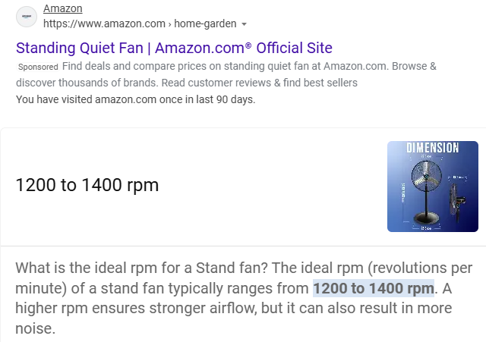
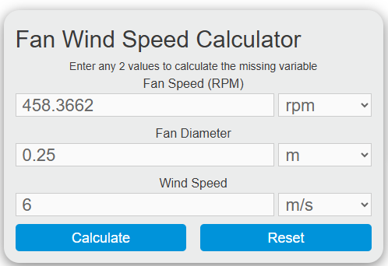
Comparison with Normal Fans

Slide 14
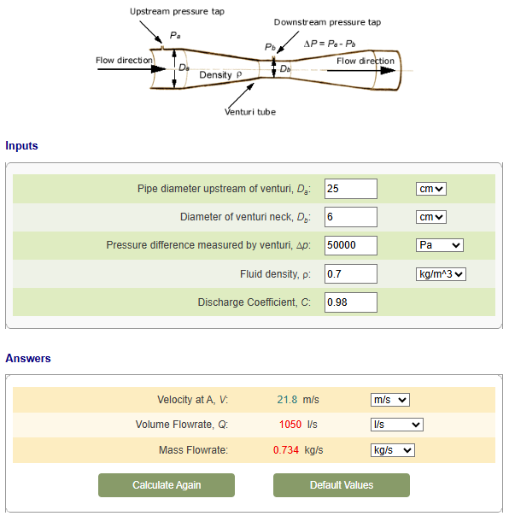
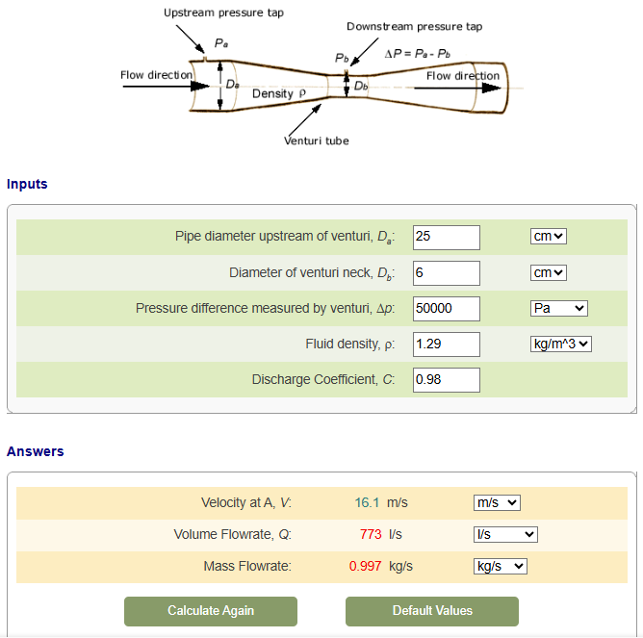
Verification (To compare Two Temperatures)
Flowrate Calculation for a Venturi
@ 200C
@ 20C
Average 280.0m/sec at b (Neck)

Slide 15
Conclusions
To achieve N2 velocity of 6 m/sec @ Beam Cross area, we need very small pressure drop. (<1 psi in Steady state)
The CFD analysis & analytic solutions show very high margin: → pumping power would not be problem.
The N2 flow rate will be around 20 liters/s @ 6m/sec (ID=65mm):
→ The N2 supply capacity should be checked.
4. The N2 supply system will not be bounded by Pressure drop: → It may be bounded by minimum Flow rate of 20 l/s.

