Slide 1
Far-Forward / Far-Backward
Detector Integration
Jonathan Smith (JLAB), Ron Lassiter (JLAB),
India Krehbiel (JLab), David Powell (JLAB)
July 14th, 2025

Slide 2
Primary Updates Outline
Roman Pot Detector Arrangement
Off-Momentum Detectors Update
Far-Backward Calorimeter
  Lumi Calorimeter Stand
  Low Q2 Tagger Calorimeter Stand
B0 3D Model
Upcoming Updates

Slide 3
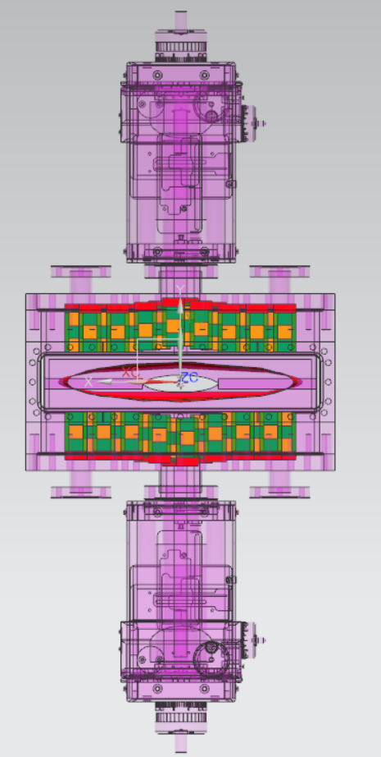
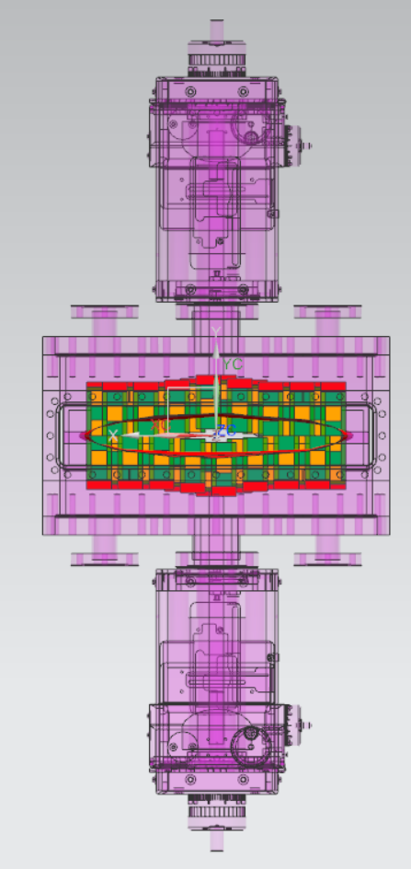
Roman Pot Detector Arrangement
Current configuration moves the top and bottom row of detectors in the +/- Y-axis.
Investigating the ability to have outer-most detectors to move in +/- X-Axis
  Concerns about cooling (Rapheal Dupre, IJCLab)
  Current Roman Pot design is assumed to be a ‘placeholder’.

Slide 4
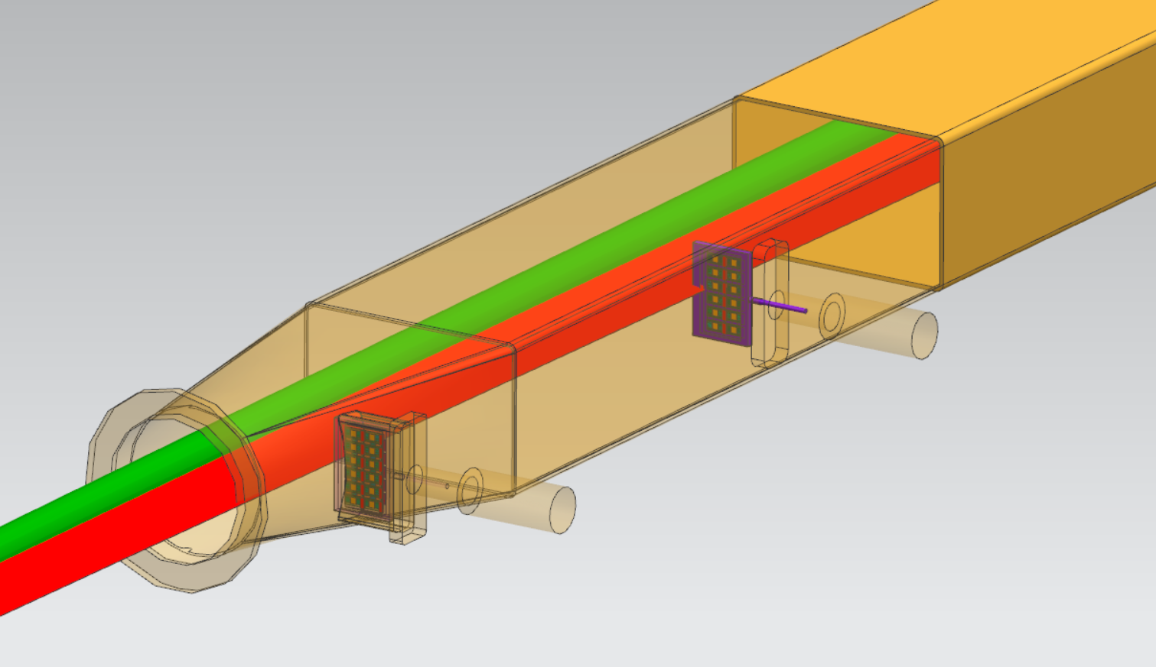
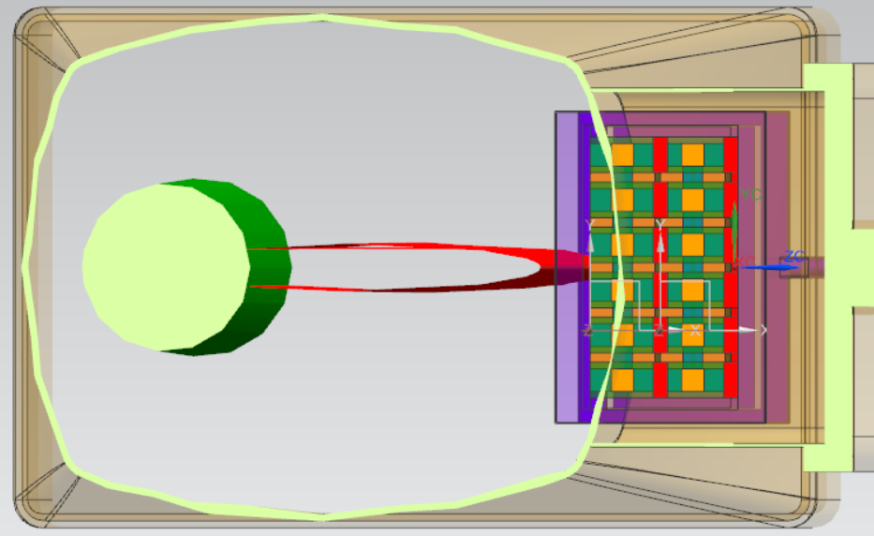
Off-Momentum Detectors
Utilizating the same detector staves as used on the Roman Pots
(2) rows, front-and-back

Slide 5
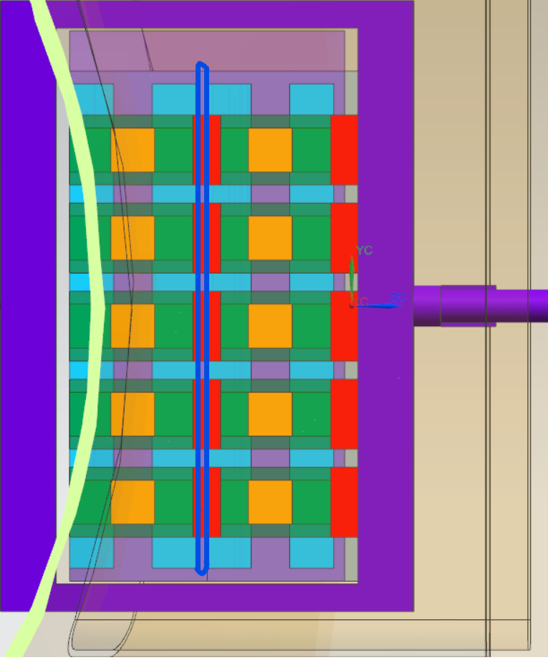
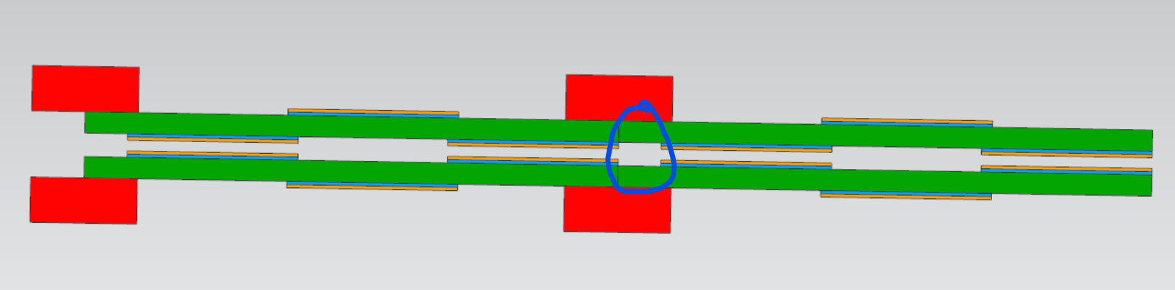
Off-Momentum Detectors
There’s a small gap between the detector layers where there will not be coverage (circled in BLUE). Yulia and Alex Jentsch investigating

Slide 6
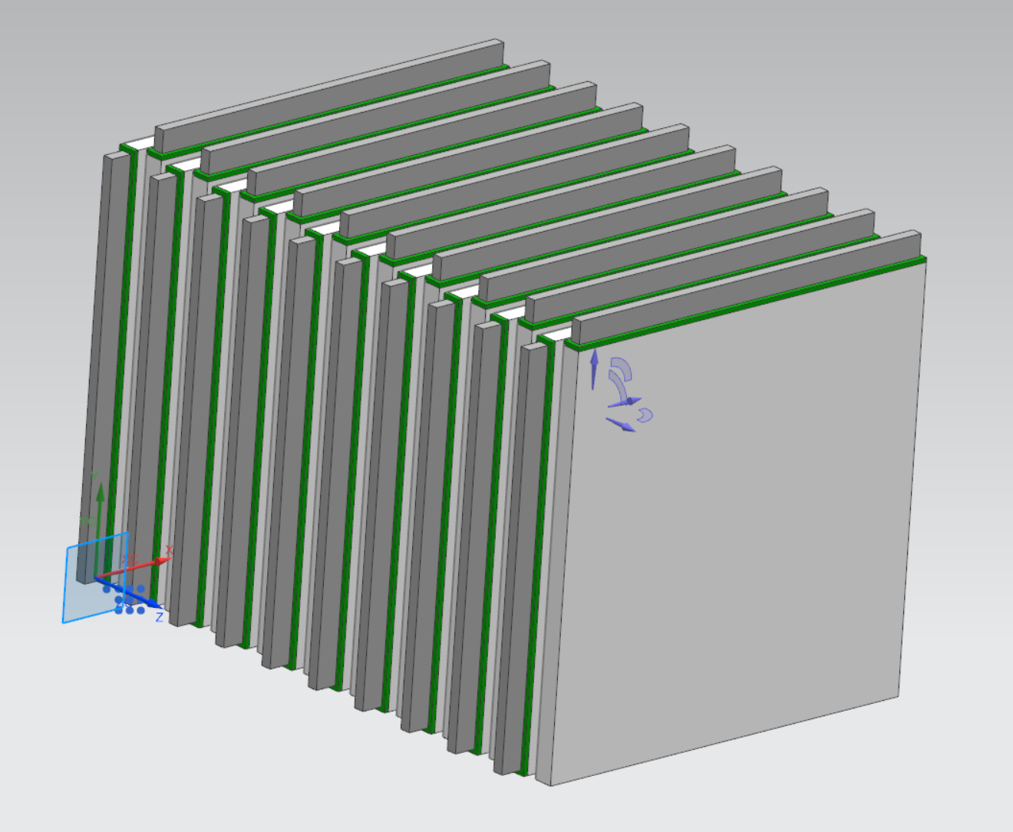
Far-Backwards Calorimeter
Tungsten Powder in epoxy with scintillating fibers with ratio 4:1
(20) layers with air gaps between layers and alternating readouts
Overall Size 18.6 cm x 18.6cm x 27.5cm
Weight = 150lbs
Used on Lumi Spectrometer Calorimeters and Low Q2 Tagger Stations

Slide 7
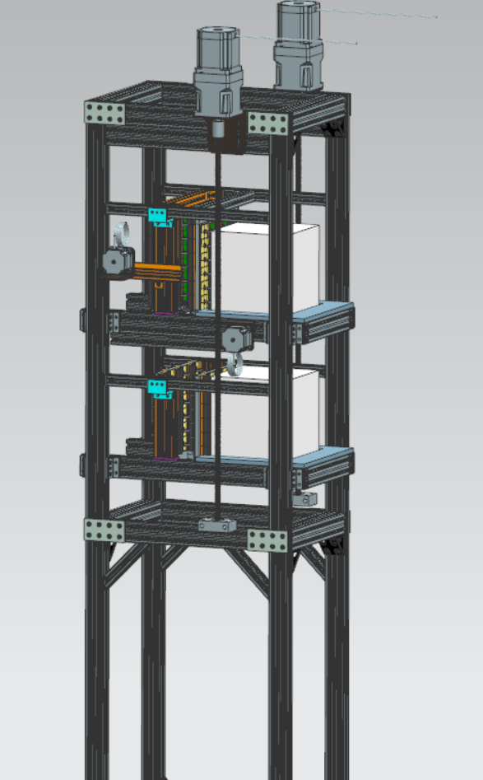
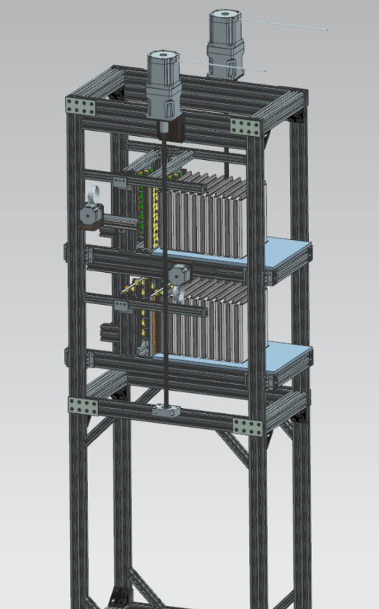
Lumi Calorimeter (work in progress)
Overall increased size of support frame
Re-evaluating stepper motor configuration given increased payload weight
Update framing required to allow for cabling
Previous
Current
(as of July 2025)

Slide 8
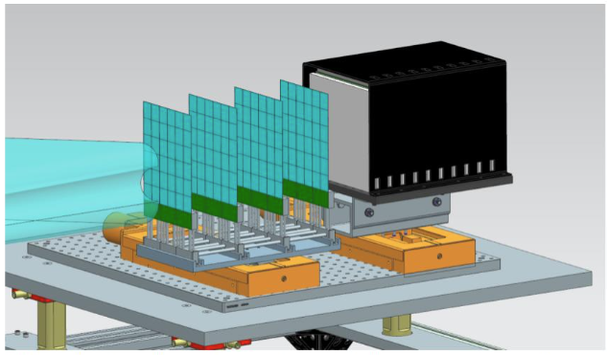
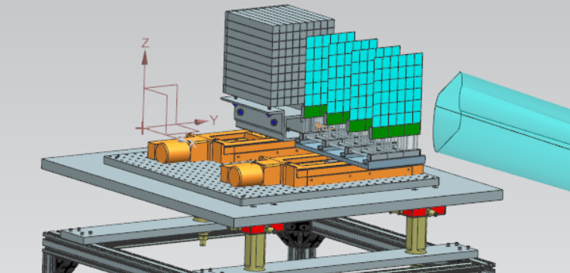
Low Q2 Tagger (Work in Progress)
Overall increased size of support frame
Re-evaluating motor configuration given increased payload weight
Updating the Calorimeter stand-off to accommodate new size
Current
(as of July 2025)
Previous

Slide 9
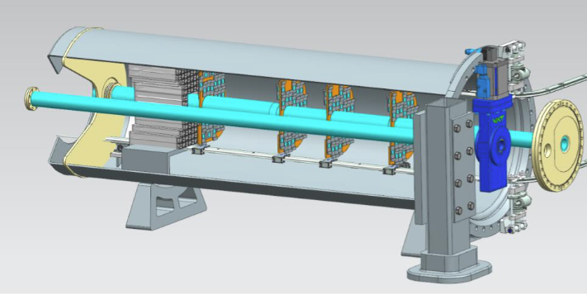
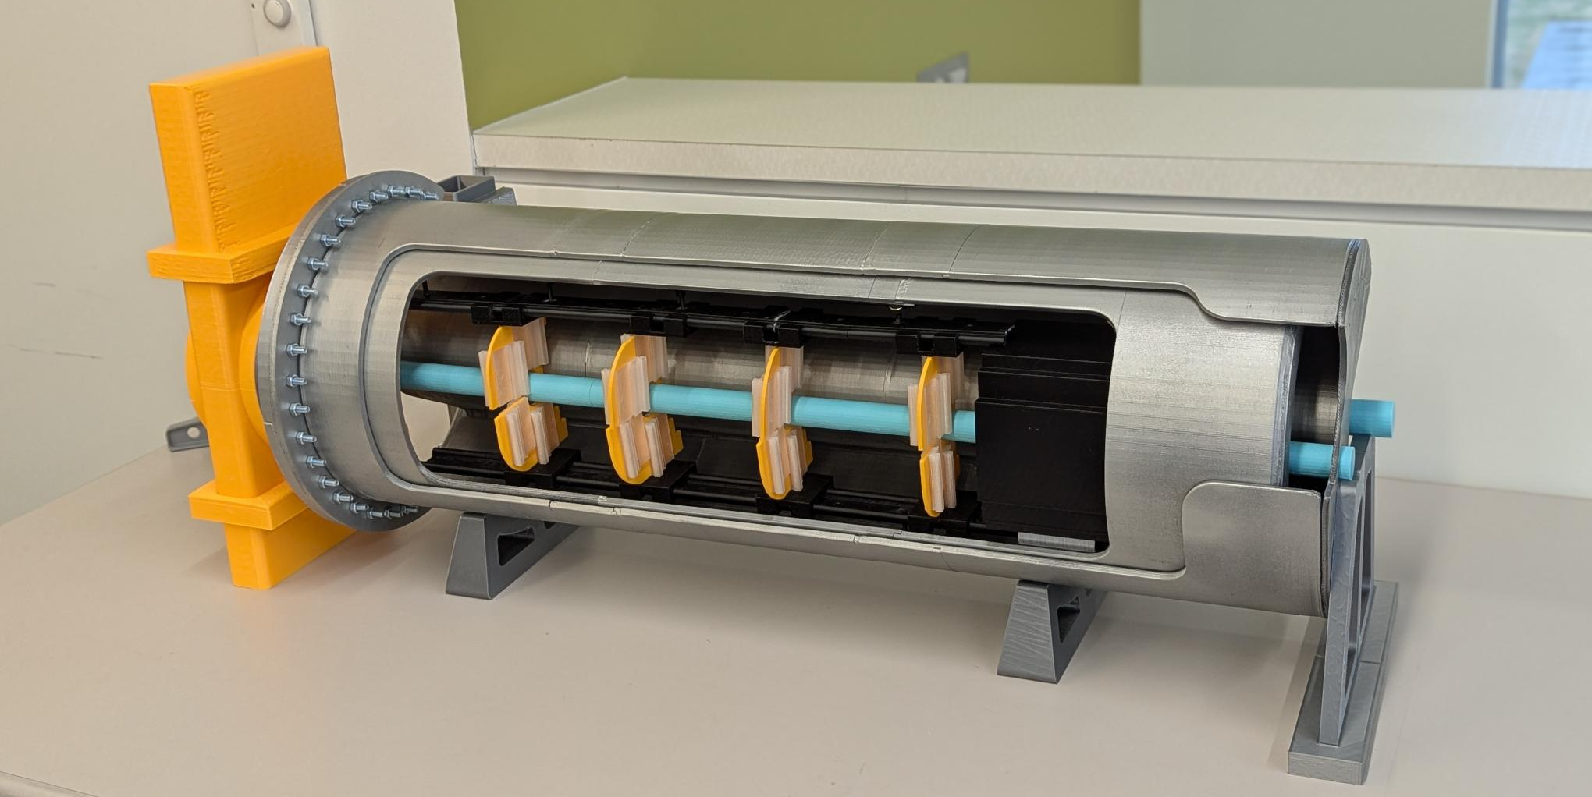
Preparing B0 3D Print Model
We ordered new material including a flexible TPU to replicate cabling
  Material delivered last week (July 7th)
New Beampipe printed
New Calorimeter in progress
Researching alternative installation methods
  Considered curved rail with motorized carriages (pictured)
  Clamshell external installation
  Rail turntables

Slide 10
Current Work
B0 Tooling
Researching vendors to potentially provide hardware for tooling
(Estimated Completion Date: Tentatively Mid-July, ongoing as design matures)
Low Q2 Tagger and Lumi Stand Updates
(Estimated Completion Date August 2025)
Preliminary Low Q2 Tagger Table 2D Drawing
(Estimated drawing completion Late 3rd Quarter 2025)

