Slide 1
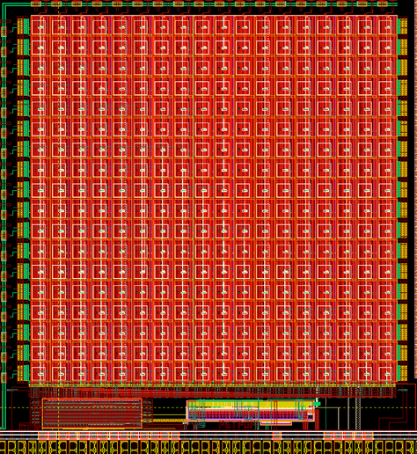
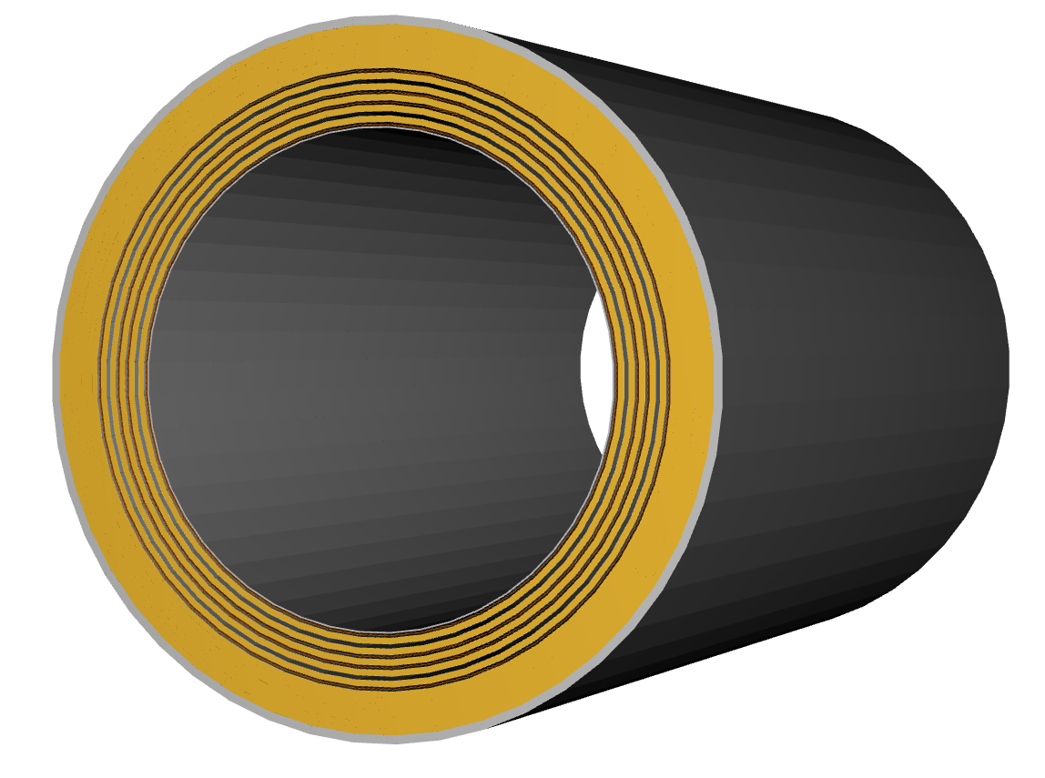

News
The ePIC Barrel Imaging Calorimeter
Jessica Metcalfe
BIC General Meeting
Argonne National Laboratory
July 25, 2025

Slide 2
News
EIC/ePIC Collaboration Meeting was held at JLab July 14-18
AstroPix Workshop hosted by NASA August 18-20
BIC Preliminary Design Review (PDR) September 17-18

Slide 3
Preliminary Design Review (PDR
September 17-18
Scope: preliminary design → 60% of the production design
Complete conceptual design implemented in CAD or equivalent
Individual test articles that demonstrate key technical challenges
Actual test articles that are similar to the production design
Preparation
Work with project to define an agenda, assign presentations
Need inputs from everyone
Approximate dates:
PDR: September 17-18
Materials uploaded for reviewers: September 5
Dry run: September 3

Slide 4
PDR Agenda
Very preliminary
Agenda:
Project overview
BIC overview AstroPix
Wafers
AstroLinx
Module assembly/QC
Staves/trays Fibers–CD3a
Sector fabrication
Global mechanics–CF, interfaces, weight ESB (include cooling)
Readout (SciFi)
9-chip PCB/quad chip
AstroPix system testing & synchronization
SciFi (+SFIL) testing TBD: Management: production plans, etc.
Documents:
Interface Specifications Document
Merlin schedule through preproduction
Presentations:
Design
Technical work on test articles
QA/QC plans
Possibly some production planning (depends on the charge)
Plans for final design and preproduction

Slide 5
AstroPix Workshop
August 18-20
University of Maryland
Hi all,
This is the 2nd announcement for the upcoming AstroPix workshop which will be held at UMD August 18-20, 2025. This is open to everyone: AstroPix veterans, those who are new to the project, and those interested in learning more/getting involved!If you plan to attend please fill out this form: https://forms.gle/mQfvrLQc5uWiuYgr9Details on the workshop can be found in our google drive: August 18-20, 2025. This includes:
Logistics: https://docs.google.com/document/d/11U1wtKKSqZRvzlW3dKlp7KwlleecKKoy0vIAa_7aFGY/edit?usp=share_link
Suggestions for topics: https://docs.google.com/document/d/1uQotQH5zRemZsMfLfL23IF3QRm423UyEJc_dGVcVEMA/edit?usp=share_link
And a sign up for a GSFC tour on Thursday: https://docs.google.com/document/d/14rHAzDIJ31Zk_wSuJSbWZ4-DhjhKIOe_EWh0inwLjj0/edit?usp=share_link
If you have any questions, please don’t hesitate to reach out. Looking forward to seeing you all in August!
Best, Regina

Slide 6
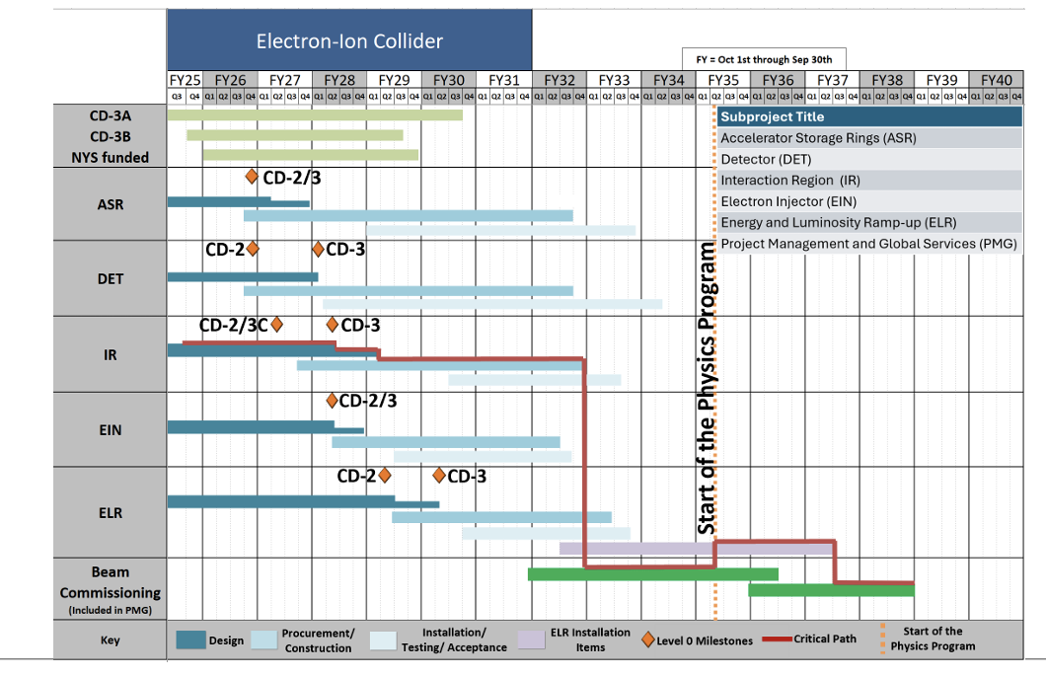
EIC Project Status
Link to presentation by Jim Yeck

Slide 7
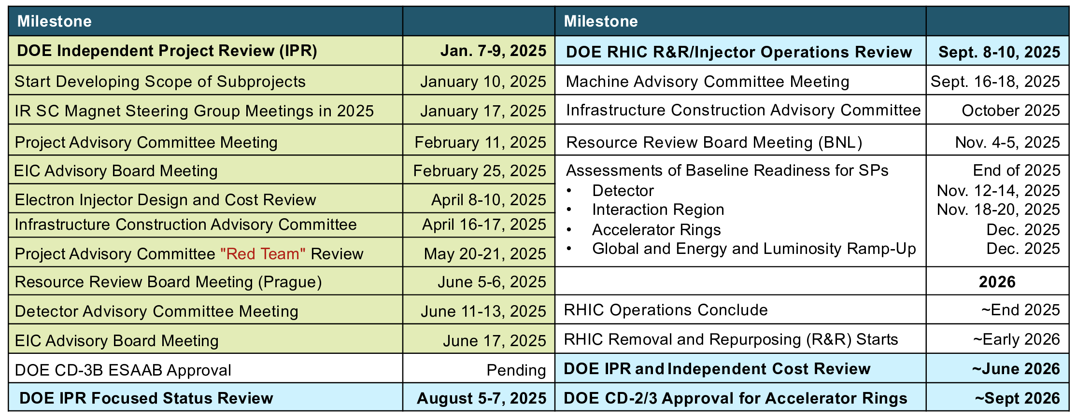
EIC Project Dates
Link to presentation by Jim Yeck

Slide 8
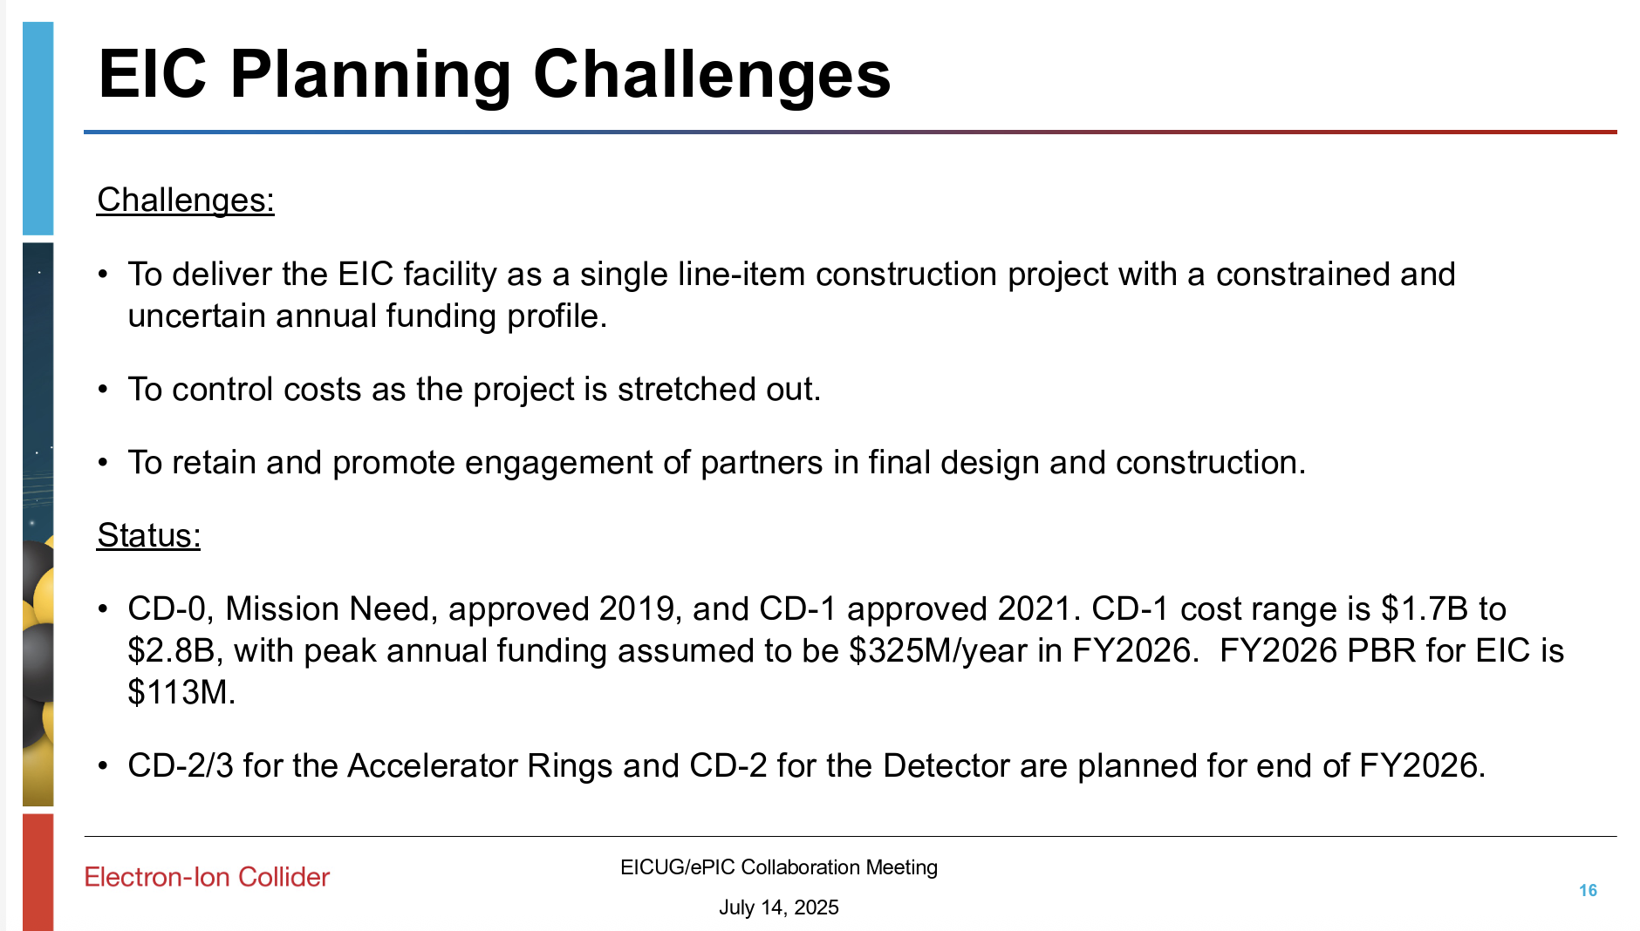
EIC Project
Link to presentation by Jim Yeck

Slide 9
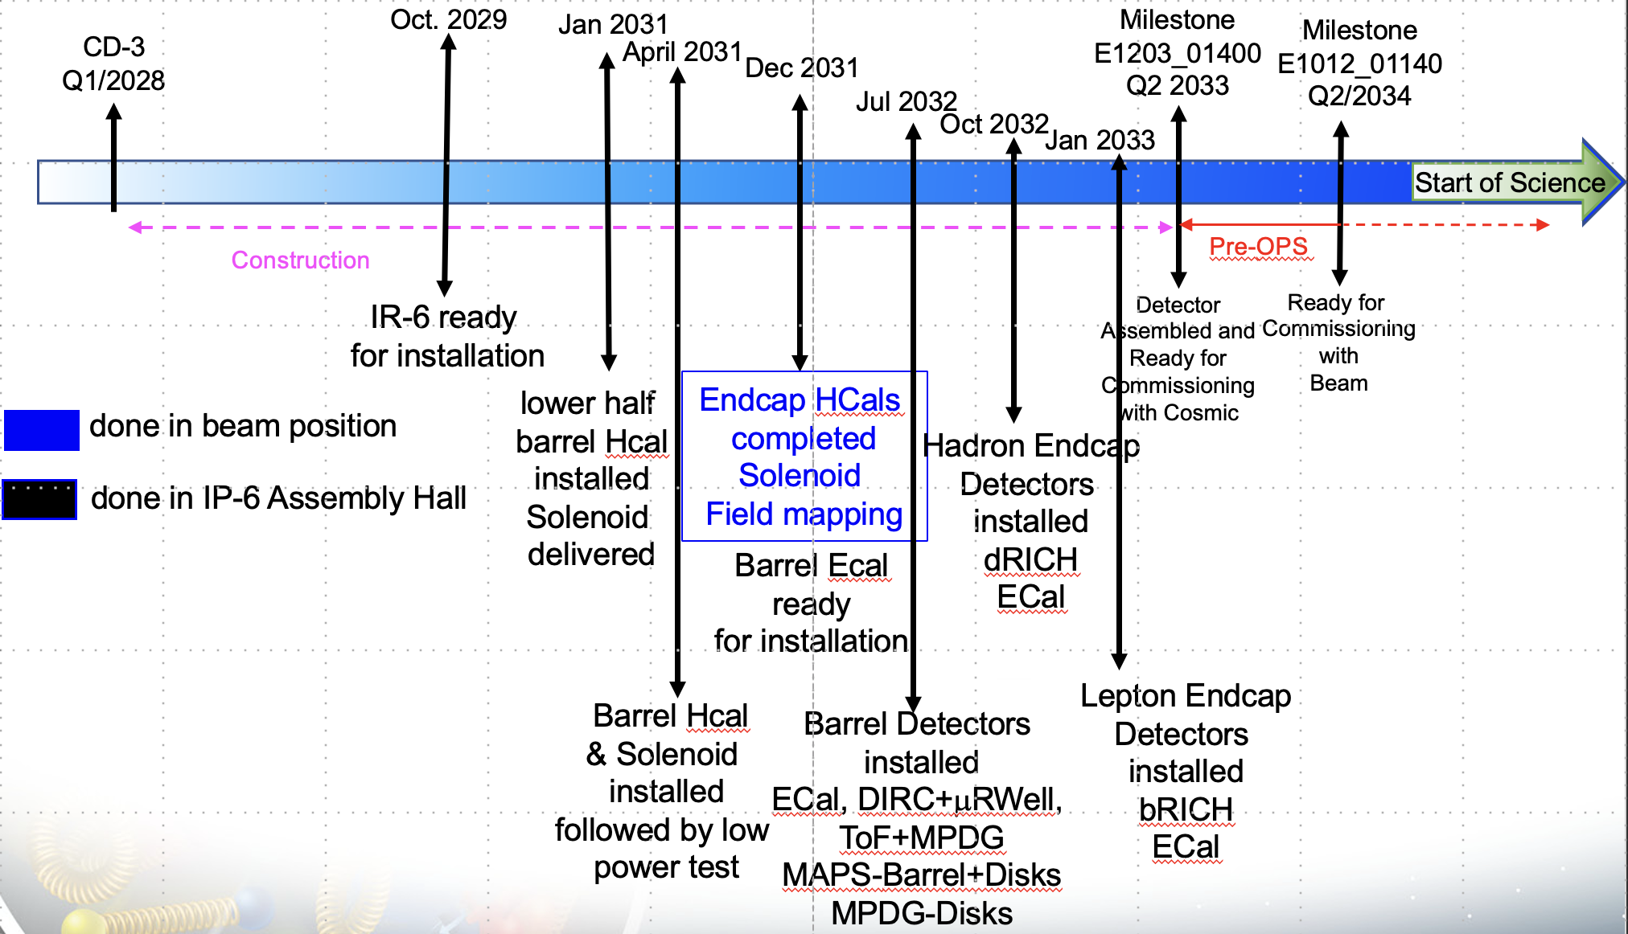
Detector Schedule
Detector Status slides by Elke

Slide 10

BIC Project Phases
PED: Preliminary Design
PED: Final Design
Preproduction
Production
Preliminary Design Review
August 2025
Final Design Review
Spring/Summer 2026
Need CD3 approval to start production articles
~early 2027
Production Readiness Review
Deliver BIC to BNL
Dec 2031
AstroPix v3
BabyBCal & Lanky BCal
Individual components
First (second) test articles
AstroPix v5
One full sector
Final designs (90%)
Production style procedures
AstroPix v6 tests
AstroPix v6
48 sectors

Slide 11

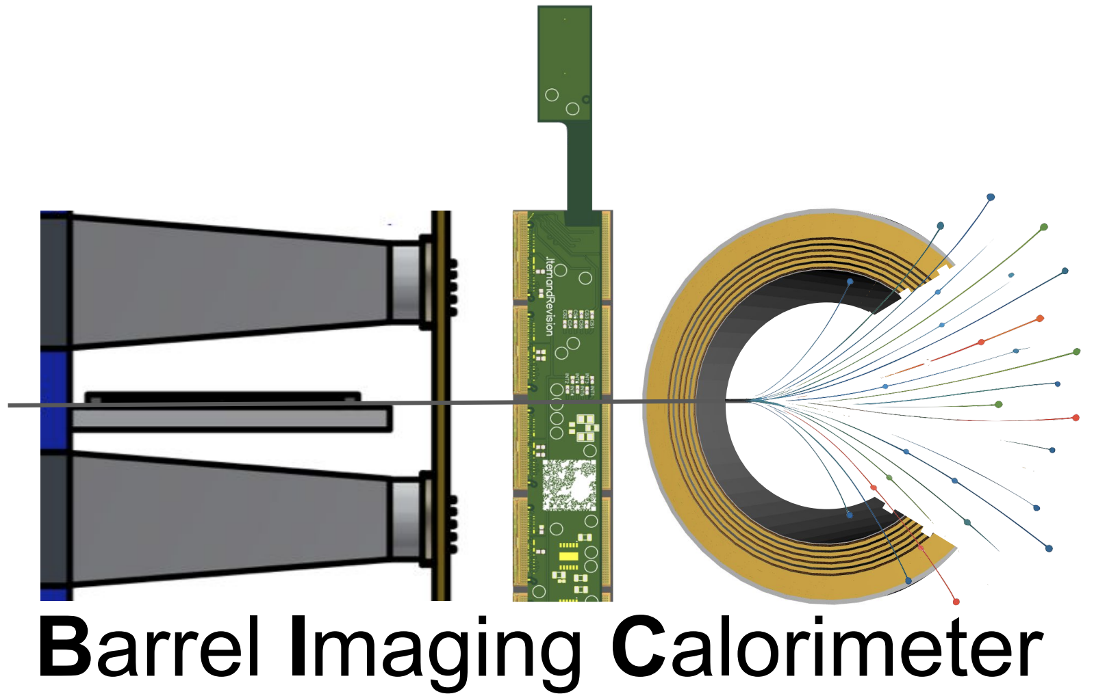

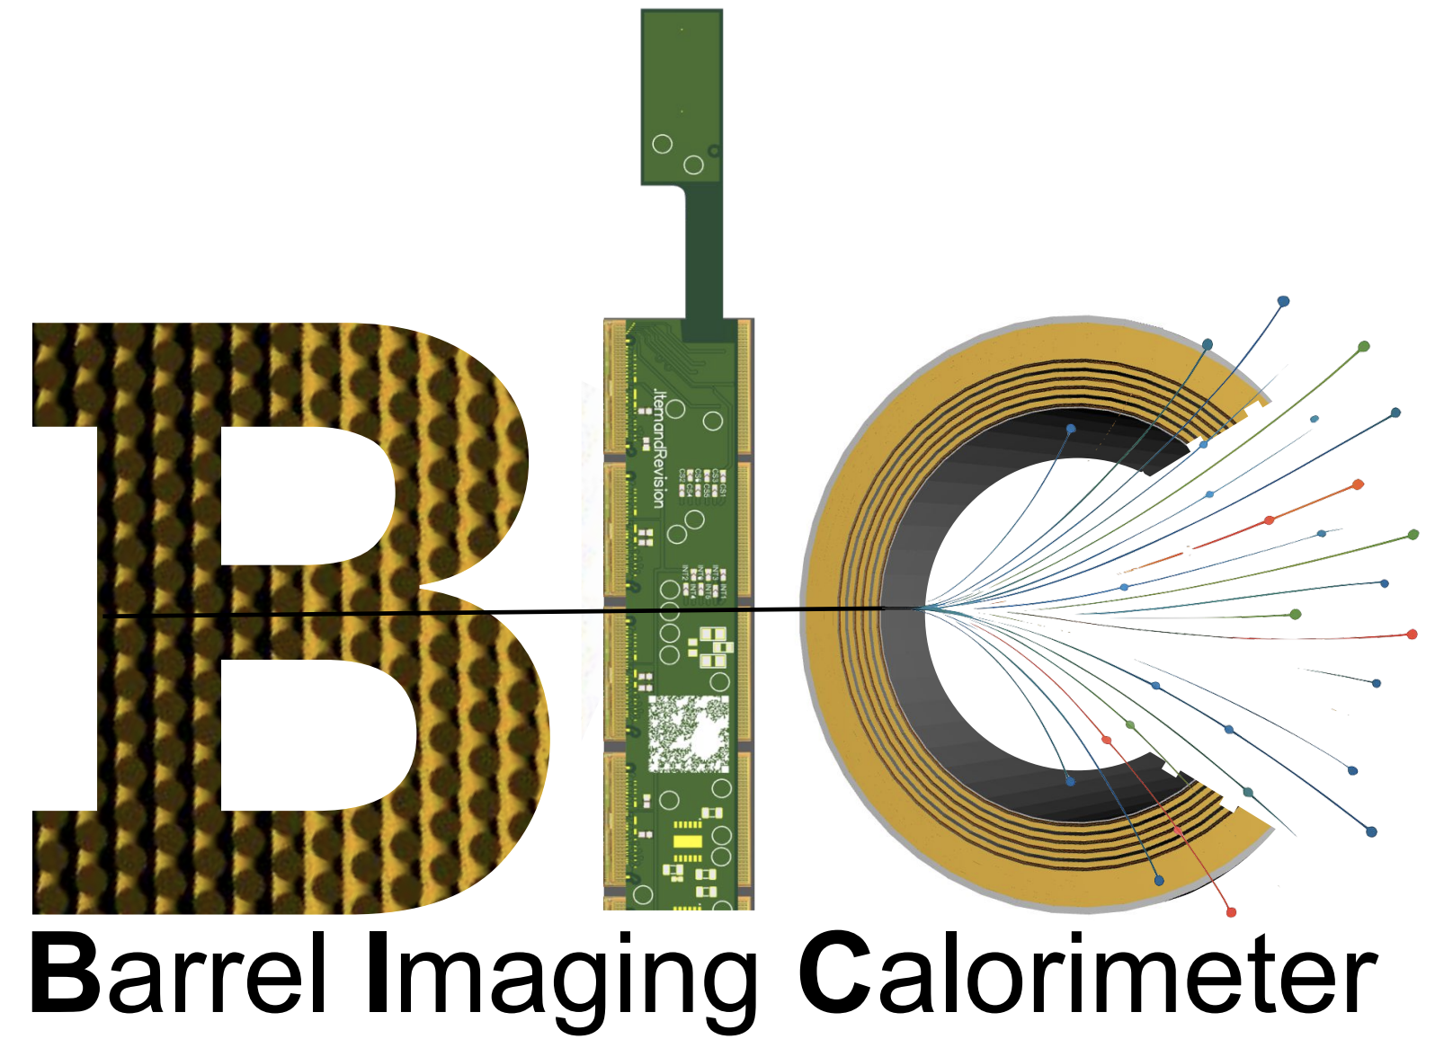
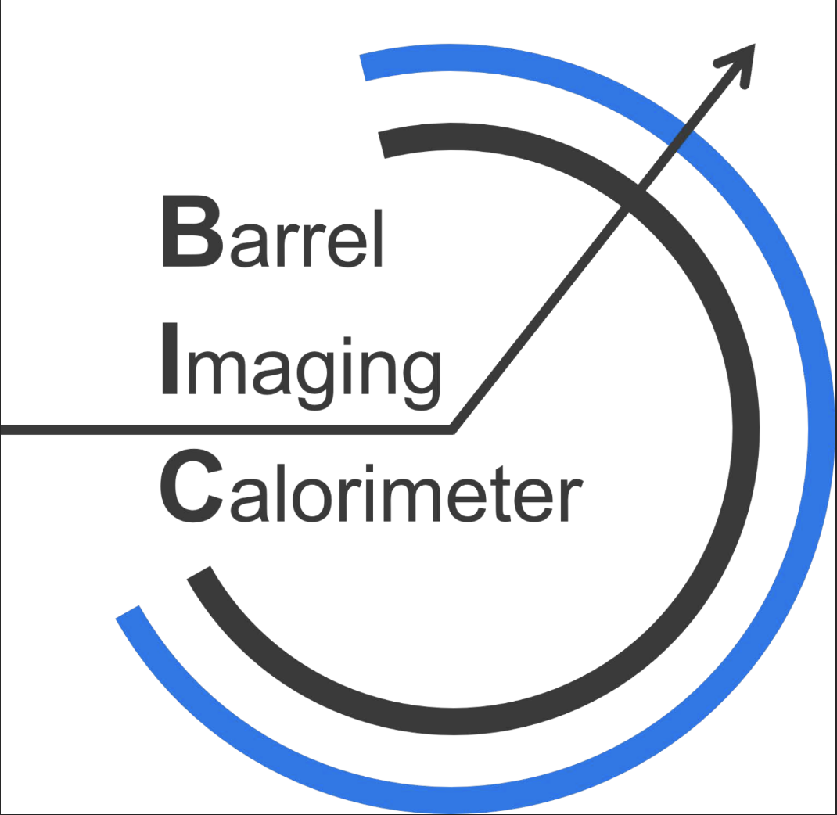
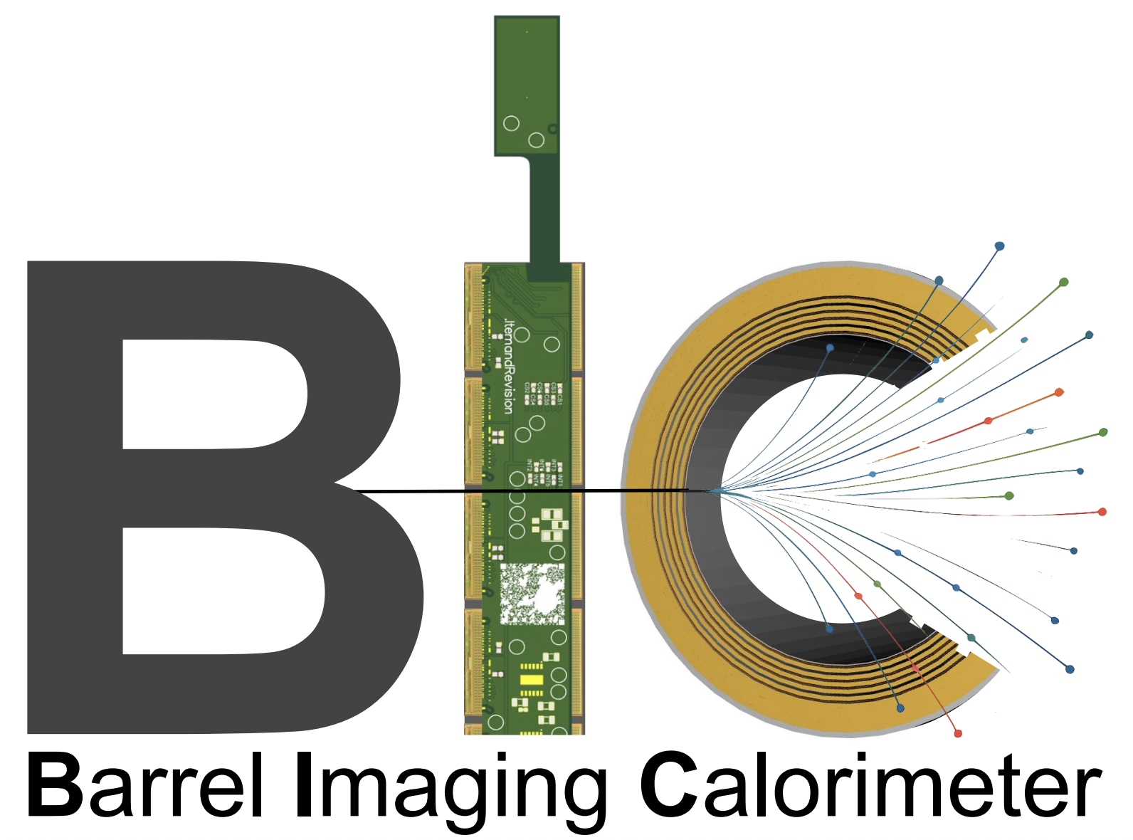
BIC Logo Contest
Pick your favorite—voting link sent after meeting

Slide 12
BIC Organization

Slide 13
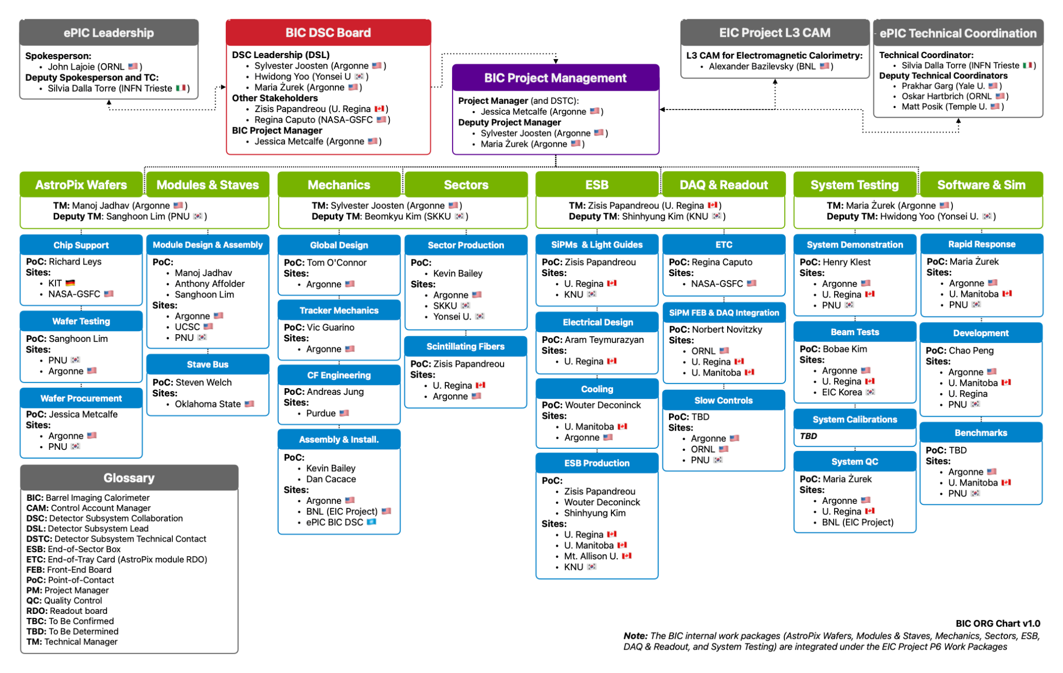
BIC Organization Chart

Slide 14
BIC Organization Chart
ePIC Collaboration:
international user organization
responsible for community needs, physics performance
Detector Subsystem Collaboration → Red Team
DSL’s Detector Subsystem Leads
provide oversight to the BIC collaboration
Detector Subsystem Technical Contact
also BIC project manager

Slide 15
BIC Organization Chart
EIC Project:
DOE funded project
accelerator & detector
responsible for building/delivering
US funds for the project are controlled by the Project
BIC reports to the EM Calorimeter Control Account Manager (CAM)
Institutes receive funds via a contract with Statement of Work (SOW)

Slide 16
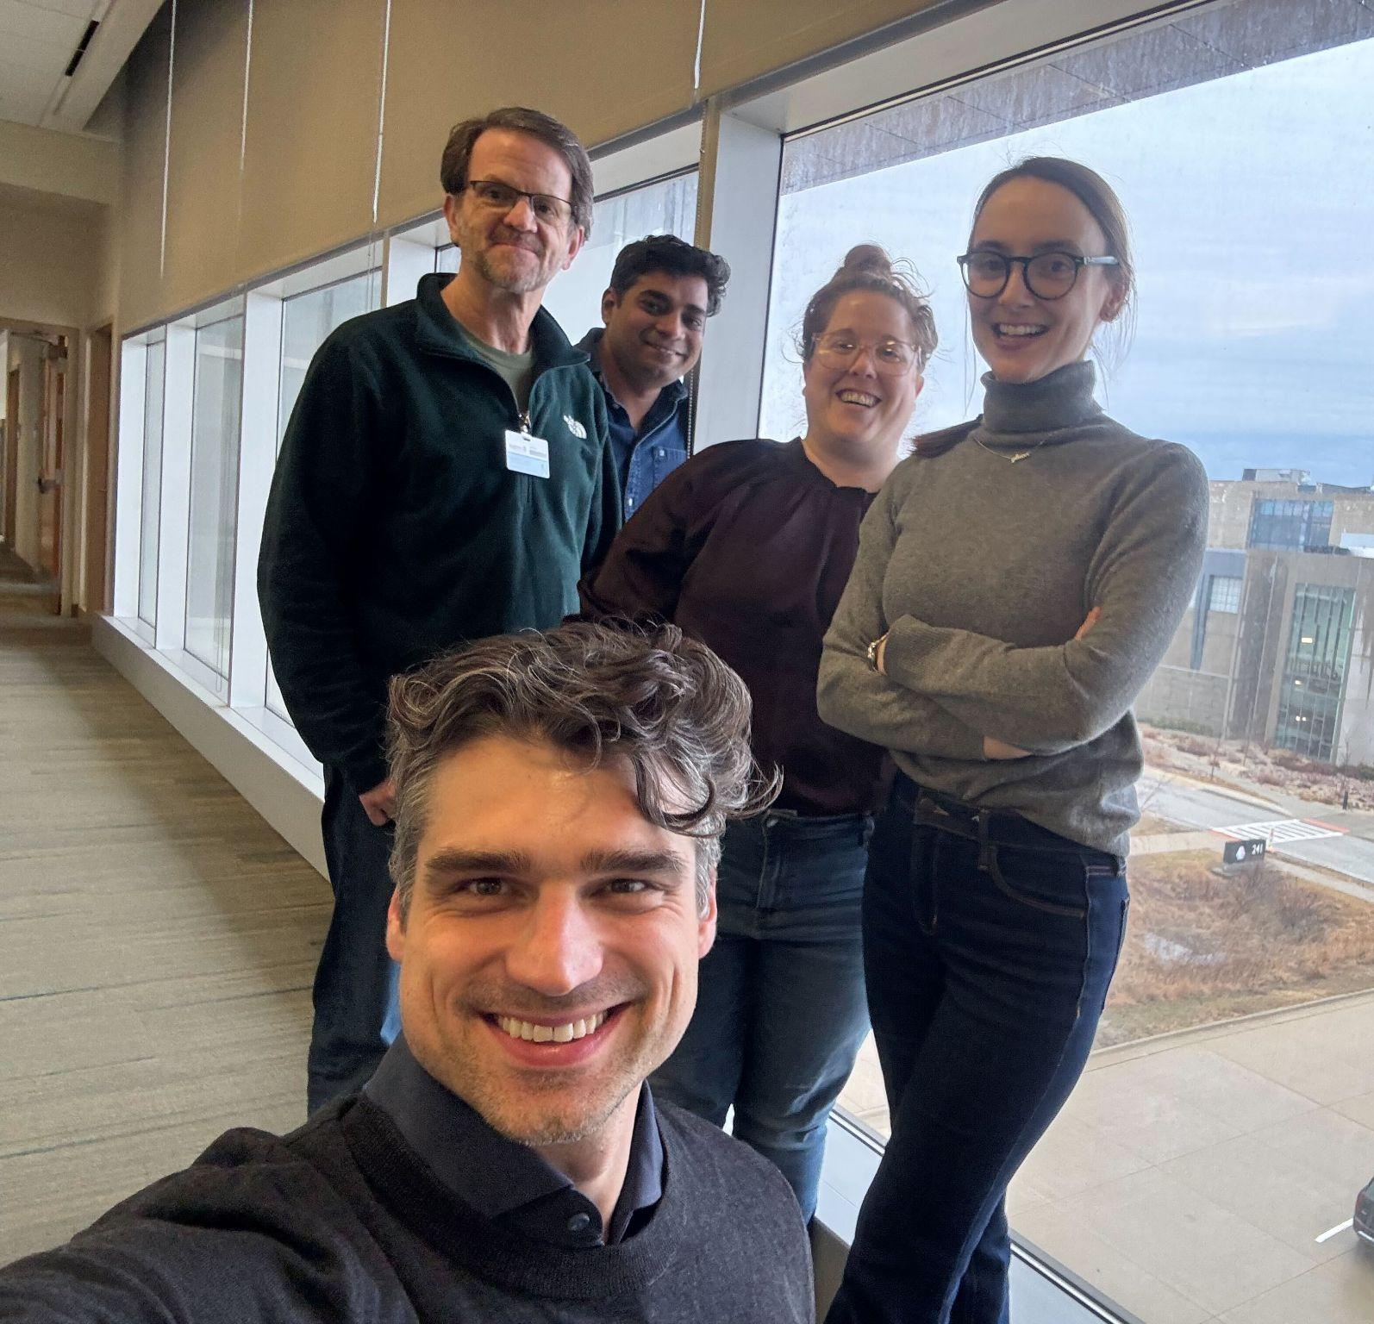
BIC Project Management Team
BIC Project Management Team
Purple Team:
manage and support the BIC community
deliver the BIC detector
Green Team Leaders:
manage a major technical area
contact for the BIC community in that technical area
meet key deliverables and milestones within their area
BIC Management Roles & Responsibilities

Slide 17
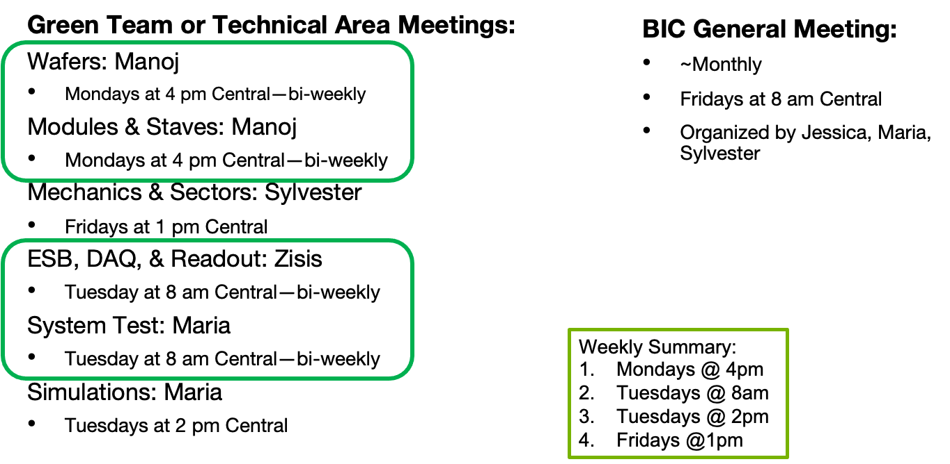
Meeting Schedule

Slide 18
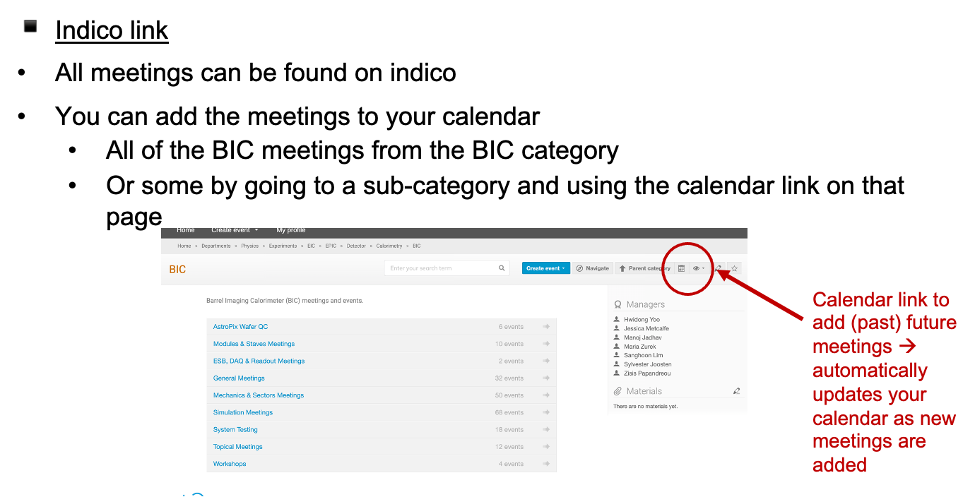
BIC Meeting Indico Calendar

Slide 19
Documents
Zenodo
BOX
Google Drive
-ePIC endorsed file management system hosted by CERN
-version controlled
-share with collaboration
-searchable by keywords
-critical to get correct keywords
-epic-eic & bic
-BOX folder for sharing technical drawings
-Argonne hosted
-request access permissions to anyone in the Purple Team
-collaborative documents → shared editing
-presentations for reviews
-reference documents

Slide 20
Design Document Review/Approval
Review key designs before fabrication
Review/Approval Log
1) Make the design available on the google drive and fill in description, links, and deadline in the log. Define required approvers.
2) Present at a relevant meeting that is announced 1 week in advance (prefer if documents ready in advance, but not required)
3) Email BIC list and required approvers with request to review by deadline (minimum 1 week after presentation). Provide links to documents, presentation, comment collection document
4) Respond to comments
5) Final approval is logged

Slide 21
Presentation/Paper Review Process
For ALL BIC (or ePIC/EIC) related presentations or paper that will be shared outside the collaboration:
review process to ensure the quality and consistency of results
Instructions:
submit document via zenodo
request approval in zenodo and send an email notification
approvers for BIC should include Green Team Leader and/or Purple Team

Slide 22
Backup

Slide 23
Reference Documents
BIC Management Roles & Responsibilities
Interface Document
Organization Chart
Risk Register/RAID log
Presentation/Paper Approval Instructions
Design Review/Approval Log

