Slide 1
(My) highlights from the Stony Brook meeting

Slide 2
Introduction
Purpose of the meeting was to
  Establish a regular (6 months) in-person meeting of SVT community
  Achieve in-person participation of BNL engineers
  Allow for site visit at BNL
  Succeeded in first two, failed on last
Around 15-20 people attended in person
  In-person participation from Europe was weak
Agenda (https://indico.bnl.gov/event/28216/) had a strong emphasis on integration and mechanics discussion
  Motivated by goal to get BNL engineers involved
Discussion notes (contributed by several people) here

Slide 3
(My) major conclusions
One of the main outcomes was that we agree that 1 link @ 5Gb/s per LAS is sufficient (with safety factor of 40)
We need to identify the need for wafer probers (number and type)
We do have a reasonable idea how the readout boards look like, and how far away they can go now need to find locations, incl. water cooling
We have been told where the breakpoints for the services are
  We agreed that we will take care of the services up to the breakpoints on the outside of the SVT (because we will install them as part of the integration
  These are significantly further out than the PST
We need to get a lot more detailed on cable and duct designs (i.e. talk to manufacturers)
  First we need to get our requirements from
  Split out in different sections
  Then we can define envelopes and detailed designs
We need to do a failure analysis and then decide on possible redundancies
Specify placement requirements including reference points (anchors) and beampipe placement
We have to sort our system of sharing drawings
Air cooling needs more work
  Input side: distributions and pressure reduction
  Output side: how to collect return air, individually per local support or for the whole of the SVT volume

Slide 4
Further material

Slide 5
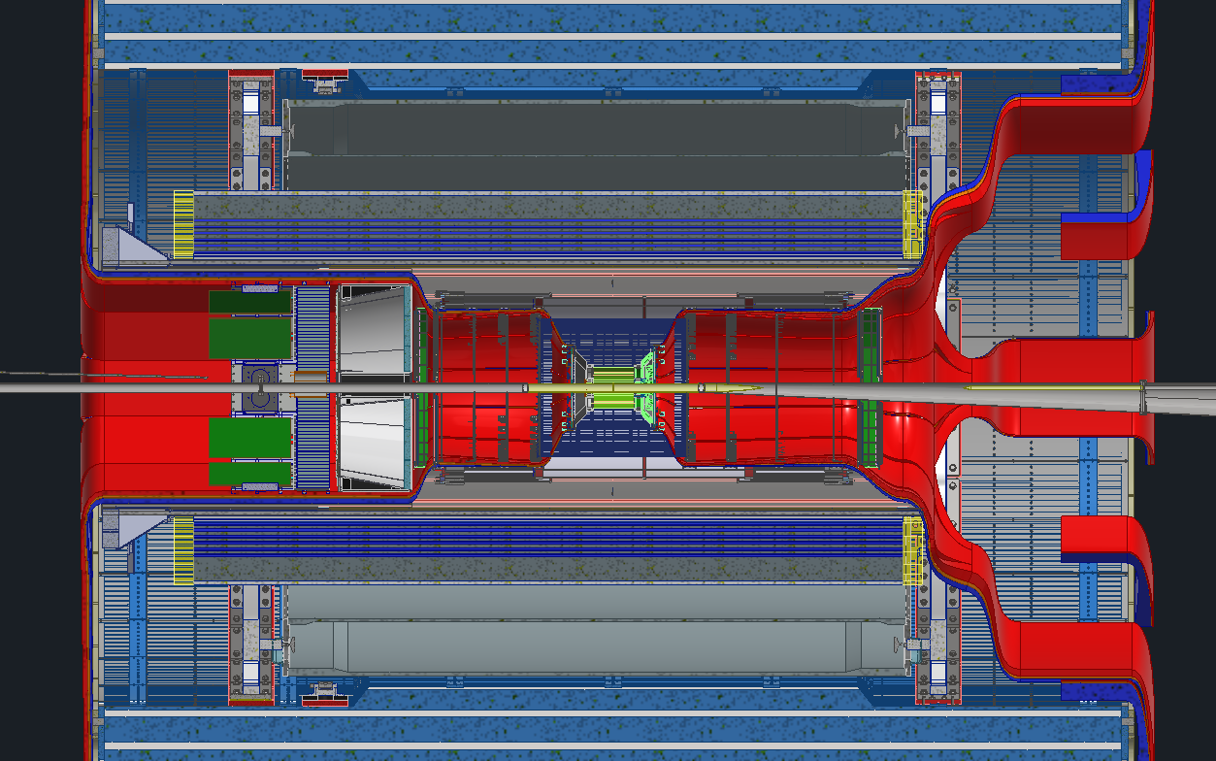
Planned Disconnect Locations
Planning on having 1 disconnect location on each side of the detector
Backward disconnect will be just past the DIRC electronics
Forward disconnect will be between the barrel EMCAL and the dRICH
These are the 2 “earliest” locations with potentially enough space for connectors
Rule of thumb is connectors take twice the amount of space as the cable itself. Finding enough space will be extremely difficult

