Slide 1
Applications of Laser and Synchrotron Based ARPES to Photocathode Research
Example: Mechanism of NEA Emission from H:C[100]
Jon Rameau
Condensed Matter Physics and Materials Science Department
Brookhaven National Lab
Collaborators:
John Smedley
Eric Muller
Tim Kidd
Peter Johnson
Helpful Discussions:
Phil Allen
Larry Carr
Toni Valla

Slide 2
Outline of My Talk
BNL Electron Spectroscopy – Who We are and What We Do
A Very Brief Intro to Angle Resolved Photoelectron Spectroscopy (ARPES)
Relevance to Photocathode Research + Examples
ARPES at Beamline U13B of NSLS
Diamond Sample Characteristics, Prep and Handling
Synchrotron and Laser Based ARPES of Boron Doped, Hydrogen Terminated [100] Diamond
Summary of Present Results

Slide 3
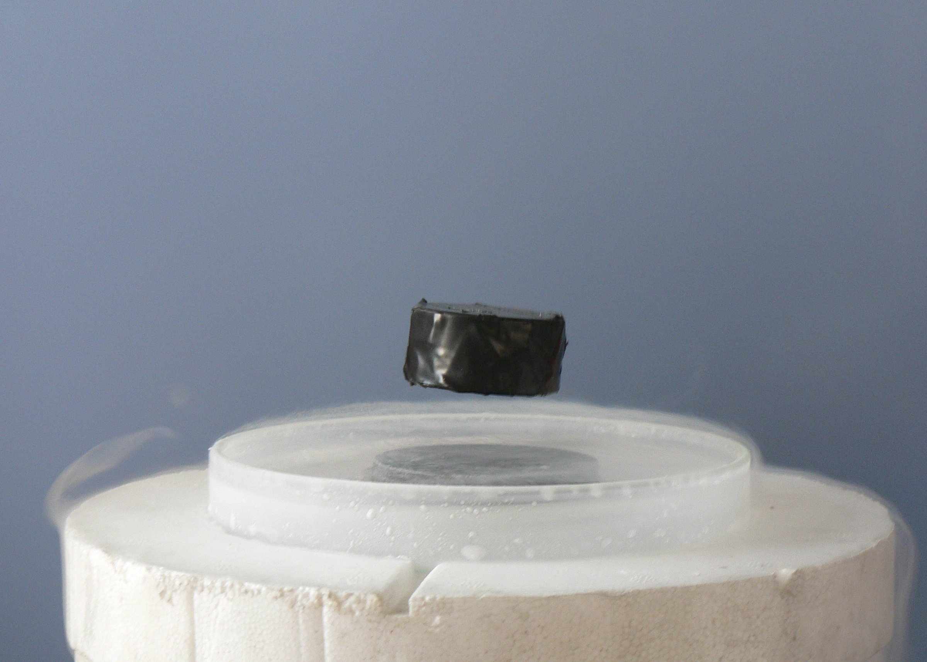

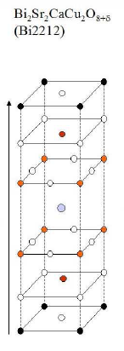
(Photo)Electron Spectroscopy at BNL
Correlated Electron Materials
  Topological Insulators, Graphene (Toni Valla)…
High T_{c} Superconductivity (Cuprates, Pnictides…)
Development of ARPES technique
  light sources, spectrometers, analysis…

Slide 4
Quantum Mechanics of ARPES
The Spectral Function, A(k,ω), is the probability of finding an electron of energy ω and momentum k when probing the system, in a QM sense. In principle, what is measured is
for a non-interacting electron gas
for a system with interactions
Dipole transition matrix elements:
Intensity of photocurrent depends on photon beam polarization, angle of incidence, energy, symmetry of electronic states…

Slide 5
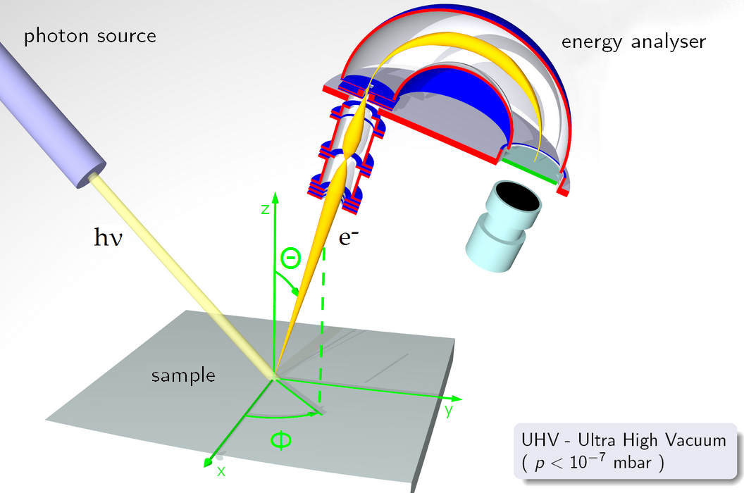
Kinematics of ARPES (For 2D Emission)
Experimentally, we access I(Θ,Φ,KE)
Work backwards from (Θ, KE) to (k, E_{B})
Our analyzer takes Θ=±6º, small slices in Φ (∼.1º−1º)
Latest Models can take Θ=±30º in one scan!

Slide 6
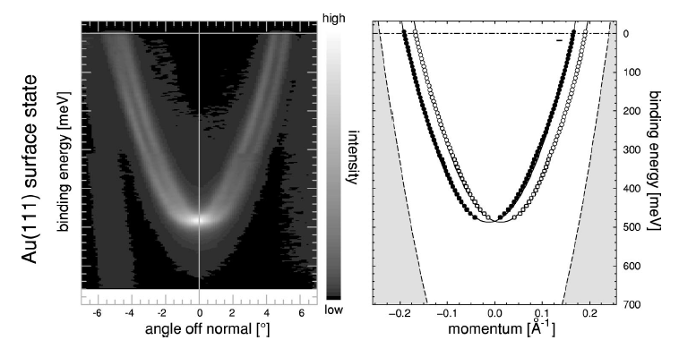
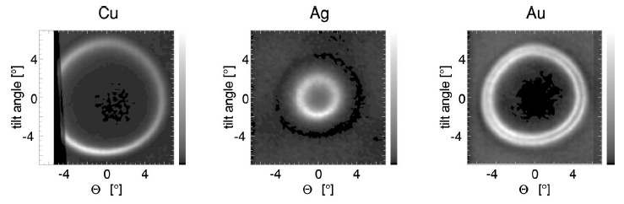
Example 2 – Metals (He lamp)

Slide 7
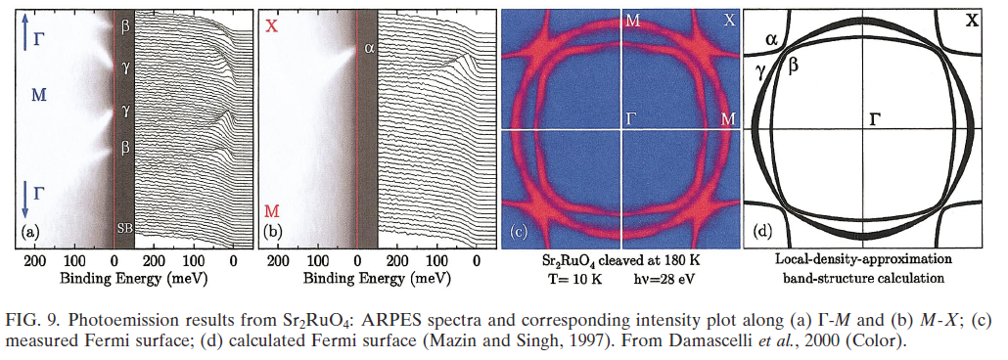
Example 1 – Oxide (Synchrotron)
Fermi Surface
From momentum distribution curves (MDC’s)
Energy Distribution Curves (EDC’s)

Slide 8
Relevance to Photocathodes
Assuming emission is the same at every point illuminated by the photon spot, the total phase space occupied by the photoelectron beam at the surface of the photocathode, on the FS, can be expressed as:
(mm x mrad)
The proportionality can be made equality by combining ARPES with a photocurrent measurement and photon flux to give an overall scale (Quantum Efficiency).
For a crystal, the total emittance will generally be a highly nontrivial function of energies and angles.
For simple systems ARPES gives an “instant” answer

Slide 9
Photoemission at BNL

Slide 10
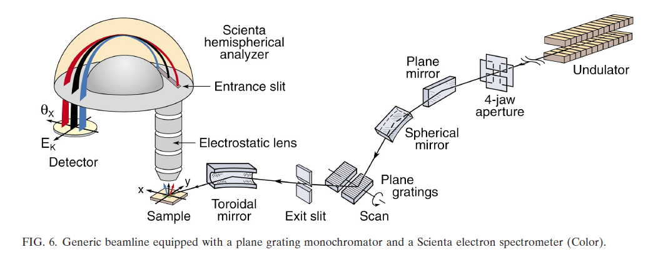
Synchrotron Based ARPES at U13B
(Figure From Damascelli, Hussain & Shen, RMP 75, 473 (2003)

Slide 11
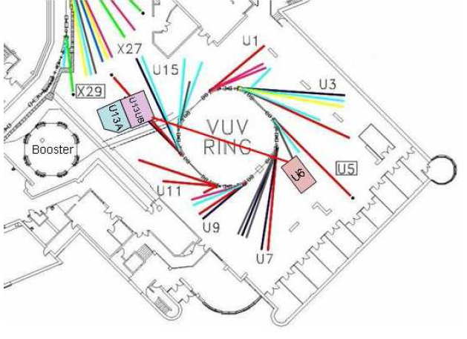
6 eV Laser Based ARPES at U13B
1

Slide 12
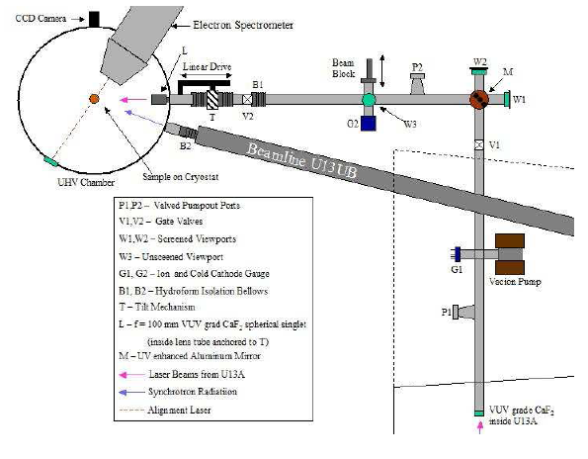
6 eV Laser Based ARPES at U13B
1
2

Slide 13
6 eV Laser Based ARPES at U13B
1
2
3

Slide 14
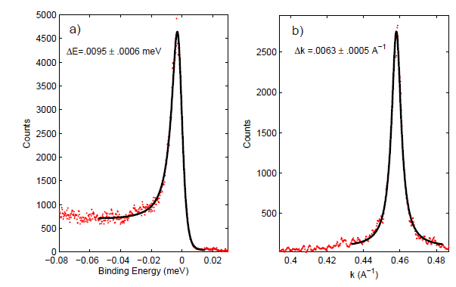
6 eV Laser Based ARPES at U13B
1
2
3
4
EDC
MDC

Slide 15
SR Beamline
Laser Beamline

Slide 17
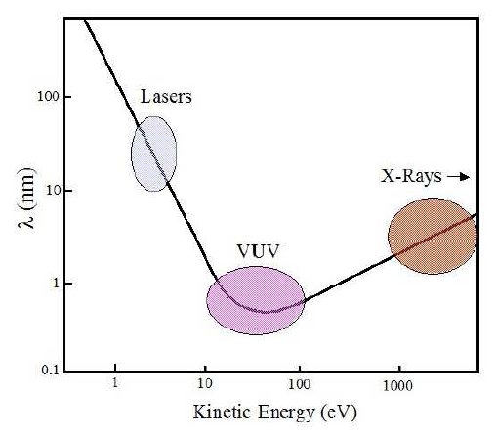
One Reason to Use Both Light Sources
“Universal” Photoelectron Escape Depth Curve
Electron Escape Depth

Slide 18
H:C(B)[100] – Hydrogen Terminated, Boron Doped Diamond

Slide 19
Our Boron Doped Diamond Sample
Bulk Single Crystal CVD Type IIb (Element 6)
Dimensions: 3.5 mm² X 500 μm thick
Boron Doping 1-2 x 10¹⁹/cm³ (~.01% B/C) Sub.
Confirmed by RT ρ=6 Ωcm, SQUID (No T_{c})
[100] Orientation, H terminated ex situ
in situ prep by annealing to 400 ⁰C with button heater for ~1 hour. Measurements taken at RT
Most likely unreconstructed surface (LEED)

Slide 20
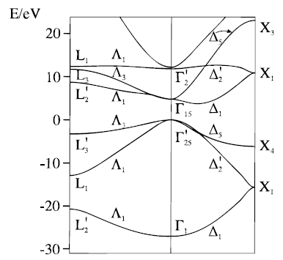
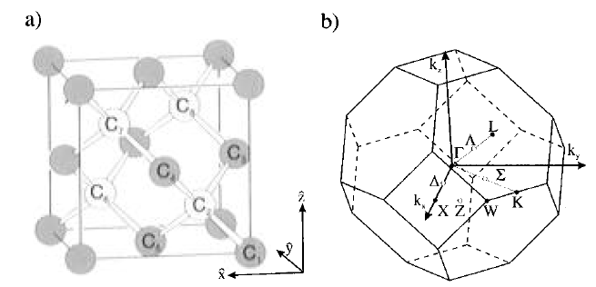
Crystal, Band Structure and BZ
a=3.57 Å
Δ₁=1.34 Å⁻¹
k_{max ||}~.51 Å⁻¹ @ 1 eV KE!

Slide 21

Projection of k-space onto [100] Surface
[100]
Kinematically
Allowed Region
For Low KE
k_{CBM} Kinematically
Forbidden
Γ
This is the crux of the problem for NEA Diamond

Slide 22
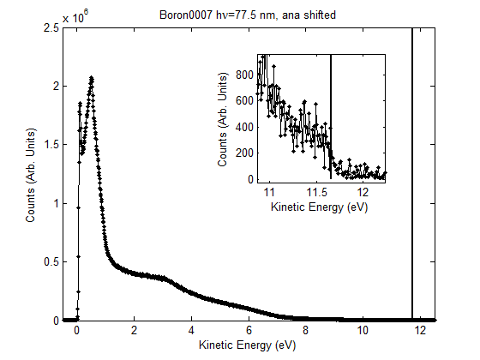
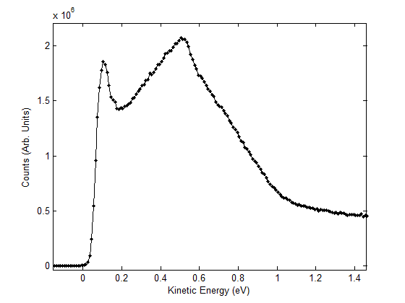
Synchrotron Measurement of BDD
Photon Energy 16 eV (p-polarized)
-10 V Bias between sample and ground
Fermi Edge Detected (Au referenced) – Past MIT
Typical features associated with NEA (LE peak…)

Slide 23
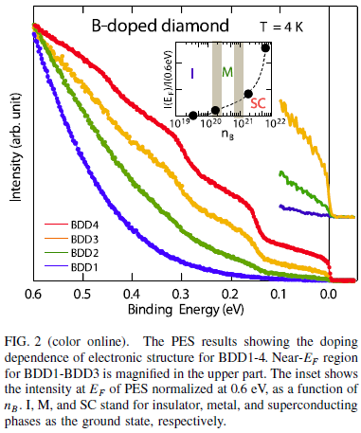
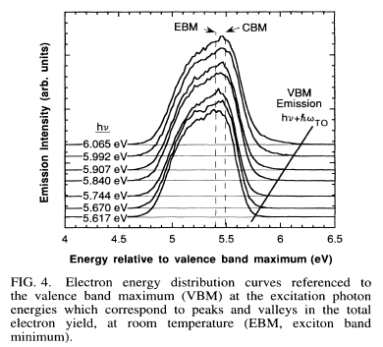
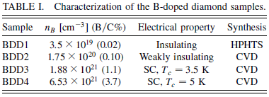
Earlier Low Energy PES on Diamond
7 eV Laser, “H”C[100]
Valence Band Emission
RT!
H:C[111] (Bandis & Pate, PRL)
Largele NEA Emission

Slide 24
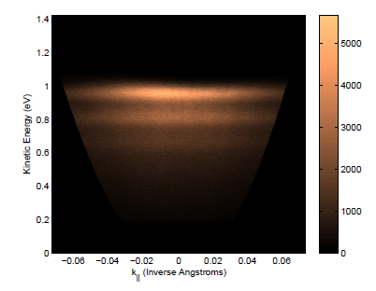
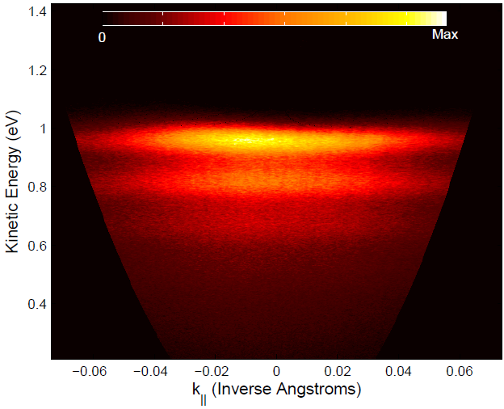
Laser ARPES on BDD at Room Temp
E_{F} located at 1.662 eV according to Au reference!
Very efficient process (scan is short, slits are SMALL)
KE scale referenced to E_{vac} for NEA material

Slide 25
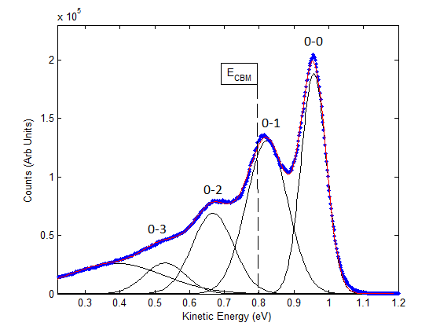
EDC at Normal Emission
Data Points
Total Fit
Decomposition
χ_{peak} = .955 eV
ΔE_{peak} = ħΩ₀ ~ 145 meV
Narrow cut around normal emission
Gaussian fits for all peaks
No Background (e.g. from A_{inc}, “bad” secondaries)

Slide 26
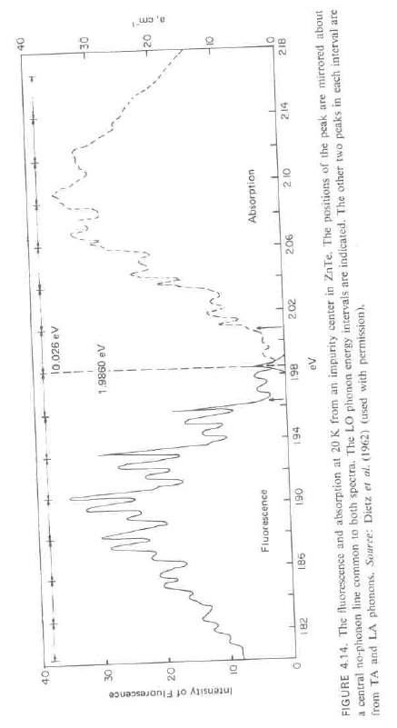
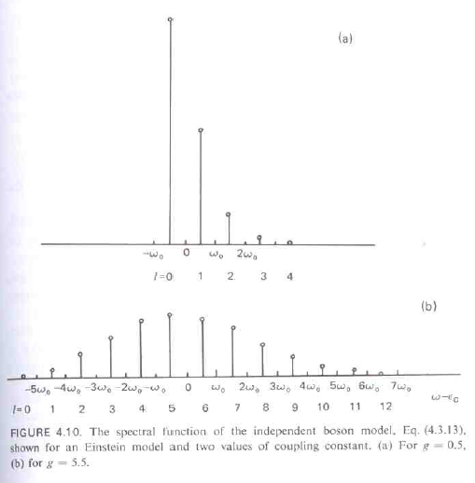
This is (Almost) a Text Book Analysis
b=.5
b=5.5
Mahan, “Many-Particle Physics”

Slide 27
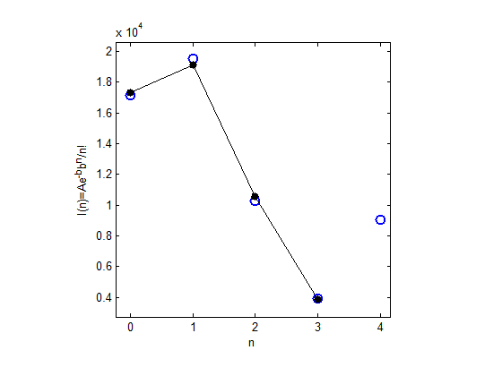
Franck-Condon Analysis
b = 1.1±.01
Franck-Condon Factor:
n = peak index
b = effective electron-phonon coupling constant
A = overall scale factor
Fano peak?
E_{CBM} = CBM energy
Σ = bħΩ₀ is the real part of the electron self energy
ħΩ₀ = phonon energy
Peak Integrated Intensity
Intensities from F-C Fit
Use T=0 theory because ħΩ₀/k_{B}= 1682 Kelvin!
Only optical phonon emission can play a role at RT in Diamond

Slide 28
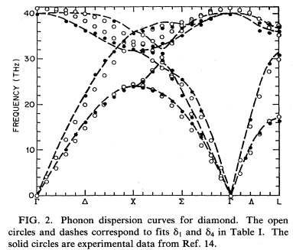
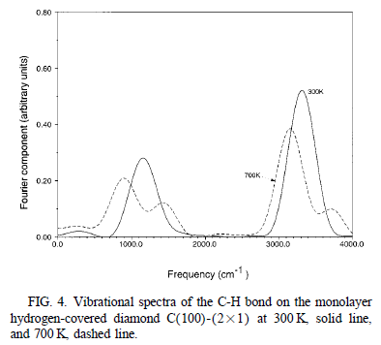
Find the Boson (Optical Phonon)
ħΩ₀ = 145 meV
(1169.5 cm⁻¹)
k_{CBM}
ħΩ₀ = 145 meV
E.O. Kane PRB 31, 7865 (1984)
Bulk
Surface, Zone Center

Slide 29
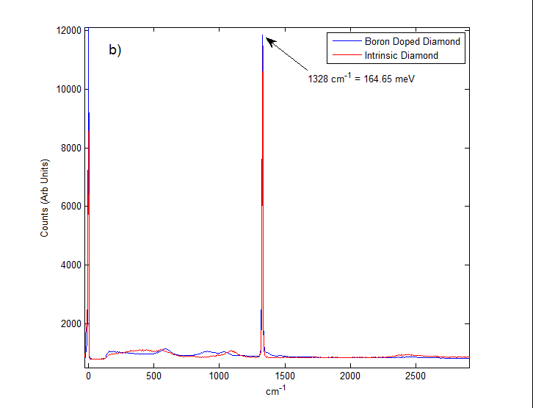
Our Raman Data
Measurement in the Bulk – Zone Center phonon cannot account for the ARPES data. No significant softening of modes with doping. Cannot account for mode energy we observe in ARPES

Slide 30
Excitation in the Bulk
Conduction
Band
hν
E_{CBM}
ħΩ₀{
k_{CBM}
χ
E_{vac}
5.5 eV
μ
E_{VBM}
Valence
Band

Slide 31
Emission at the Surface
Conduction
Band
E_{CBM}
ħΩ{
χ_{eff}
E_{vac}
5.5 eV
μ
E_{VBM}
Valence
Band

Slide 32
Quantum Mechanics
In the Franck-Condon picture, the many-body wavefunction of the N electron conduction band state strongly overlaps with the many-body wavefunction of the N-1 electron final state including phonons of momentum k and a free electron in the vacuum.
The N electron state, the new “ground state”, is metastable due to strong e-ph coupling, inhibition of decay to the original ground state by photon emission (NEA surface) and inhibition of direct emission to the vacuum due to kinematic constraints.

Slide 33
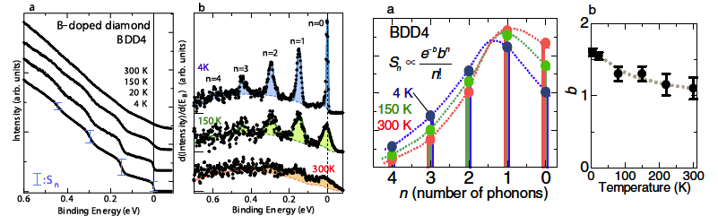
The Surface/Sample is Important for NEA!
Difficult
Analysis
Bad Surf?
Same Answer!
We find the SAME e-ph coupling at RT in our .01% B/C
sample as they find in a 3.7% sample! With MUCH
better data.

Slide 34
Summary & Conclusions
(Laser) ARPES provides unique information about angle and energy distribution of photoelectrons
Laser ARPES gives unique insight into how NEA materials work
ARPES combined with some ancillary measurements gives a very complete picture of system electronic physics
For H:C[100] there is now a clear program for engineering as well as developing analogous systems
ARPES well suited for identifying “ideal” photocathodes with intrinsically low emittance and high QE

Slide 35
Useful ARPES References
“Photoelectron Spectroscopy, Principles and Applications”, Third Edition, Stefan Hüfner, Springer
“Angle-resolved photoemission studies of the cuprate superconductors”, Andrea Damascelli, Zahid Hussain, Zhi-Xun Shen, Rev. Mod. Phys. 75, 473 (2003)
“High Resolution ARPES”, Stefan Hüfner, Springer

Slide 36
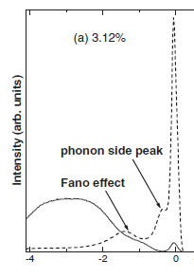
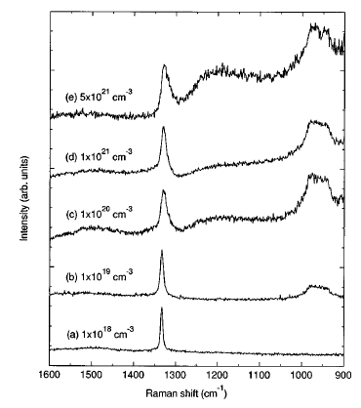
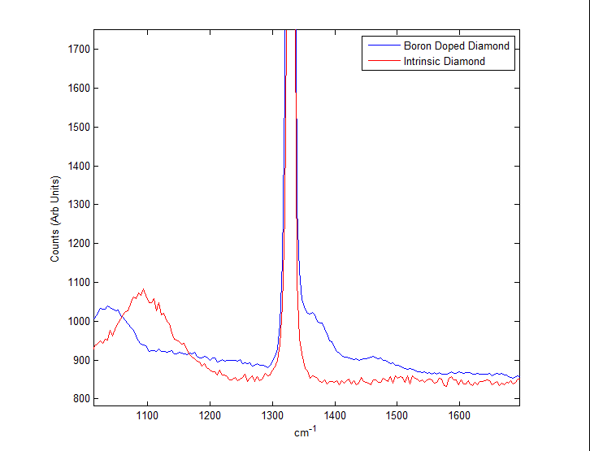
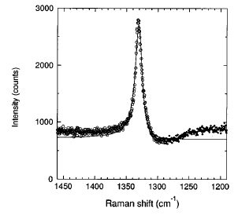
Fano Resonance Effects?
Raman

Slide 37
Synchrotron vs. Laser By the Numbers
U13UB – Undulator + NIM
6 eV Laser
<=10¹³ photons/second
At ~5-10 meV resolution (for bright samples at peak ring current)
15-25 eV photon energy
~100 μm² spot size
~10 Angstrom Probing Depth
>=.01 Inv Angstrom k resolution
300 ps to 2 ns pulse duration
52.5 MHz rep rate
Horizontal Polarization
Lives at a large, communal facility
Multiple BZ Coverage
~10¹⁵ photons/second
At .5 meV resolution
~6.05 eV photon energy
~10 μm² spot size
Up to 10 nm probing depth (?)
>.001 Å⁻¹ k resolution
2 ps pulses
105 MHz rep rate or integer fractions thereof
Any polarization we want!
Coherent, Gaussian Beam!
Can live on a table top!
~.62 Å⁻¹ max k point reachable
~

