Slide 1
Simulations for Detector Cooling Requirements
EIC User Group & ePIC Joint Collaboration Meeting
Girish Gowda

Slide 2
Introduction – Detector Cooling
Cooling Performance Considerations :
Temperature Stability
Minimising thermal noise
Preventing Radiation damage
Cooling Design Considerations :
Heat Load
Material Cost
Maintenance & Reliability

Slide 3
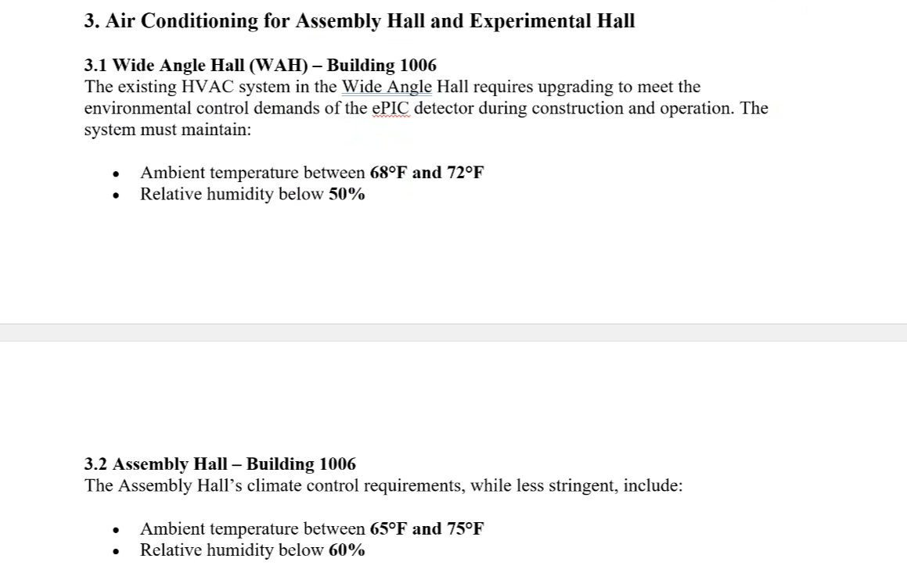
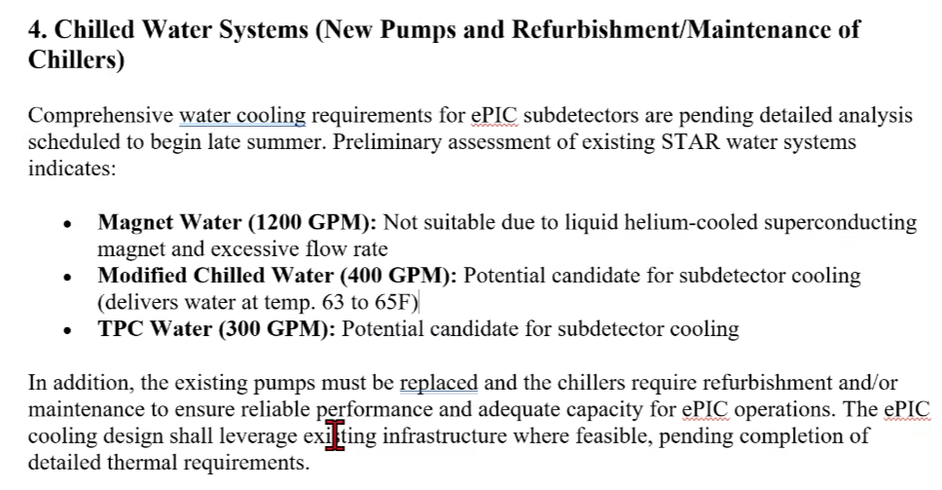
ePIC Detector – Cooling Requirements

Slide 4
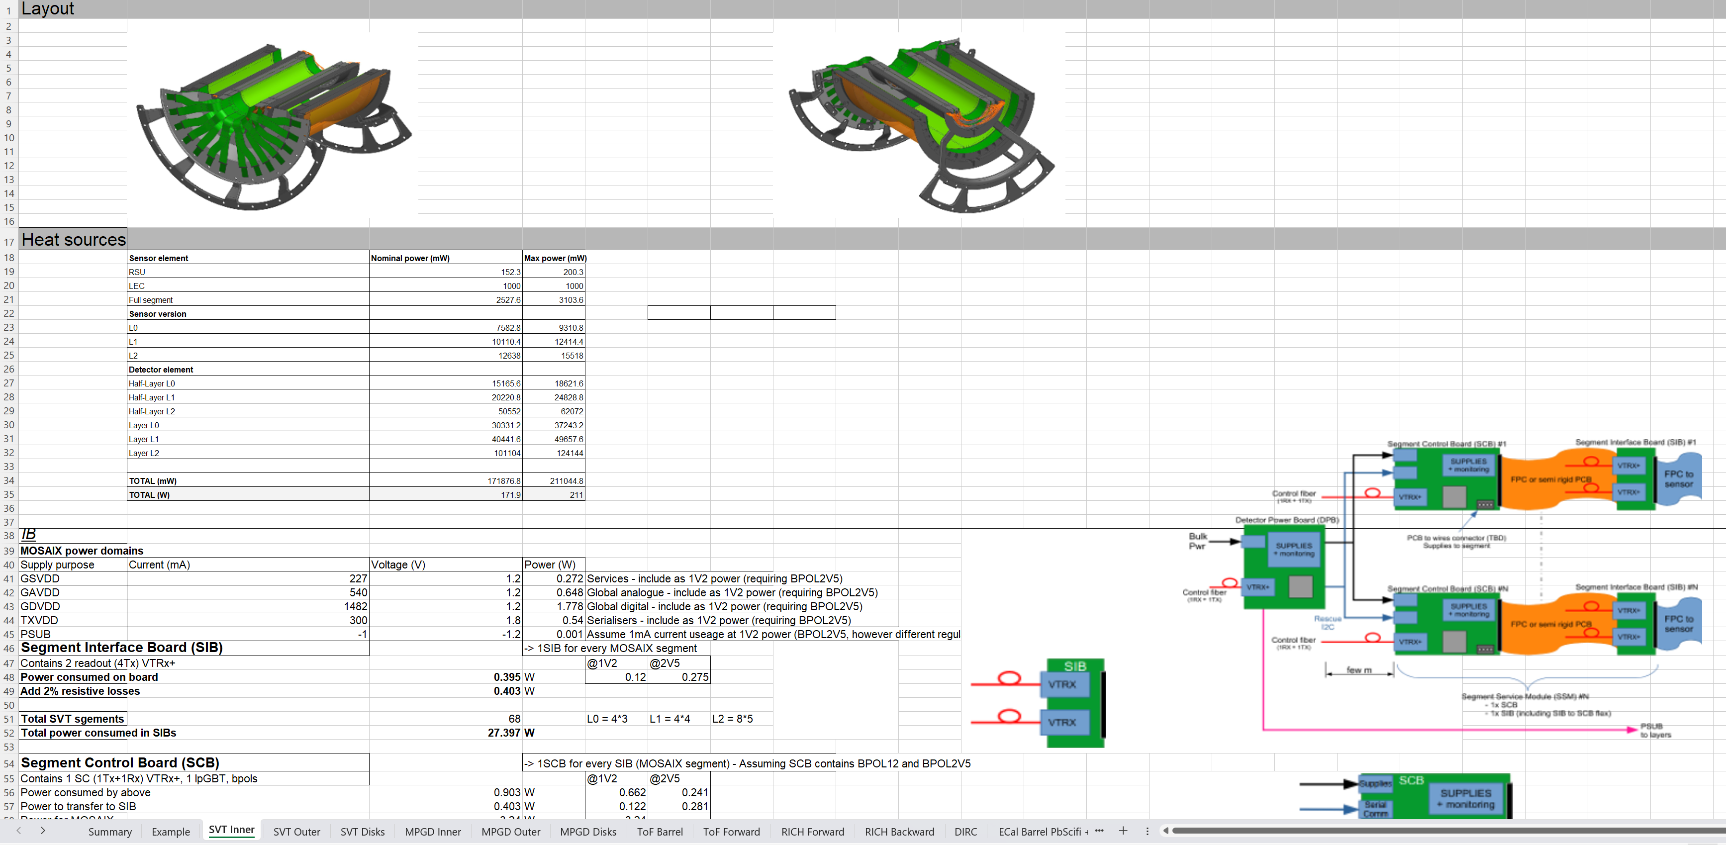
ePIC Detector – Cooling Requirements

Slide 5
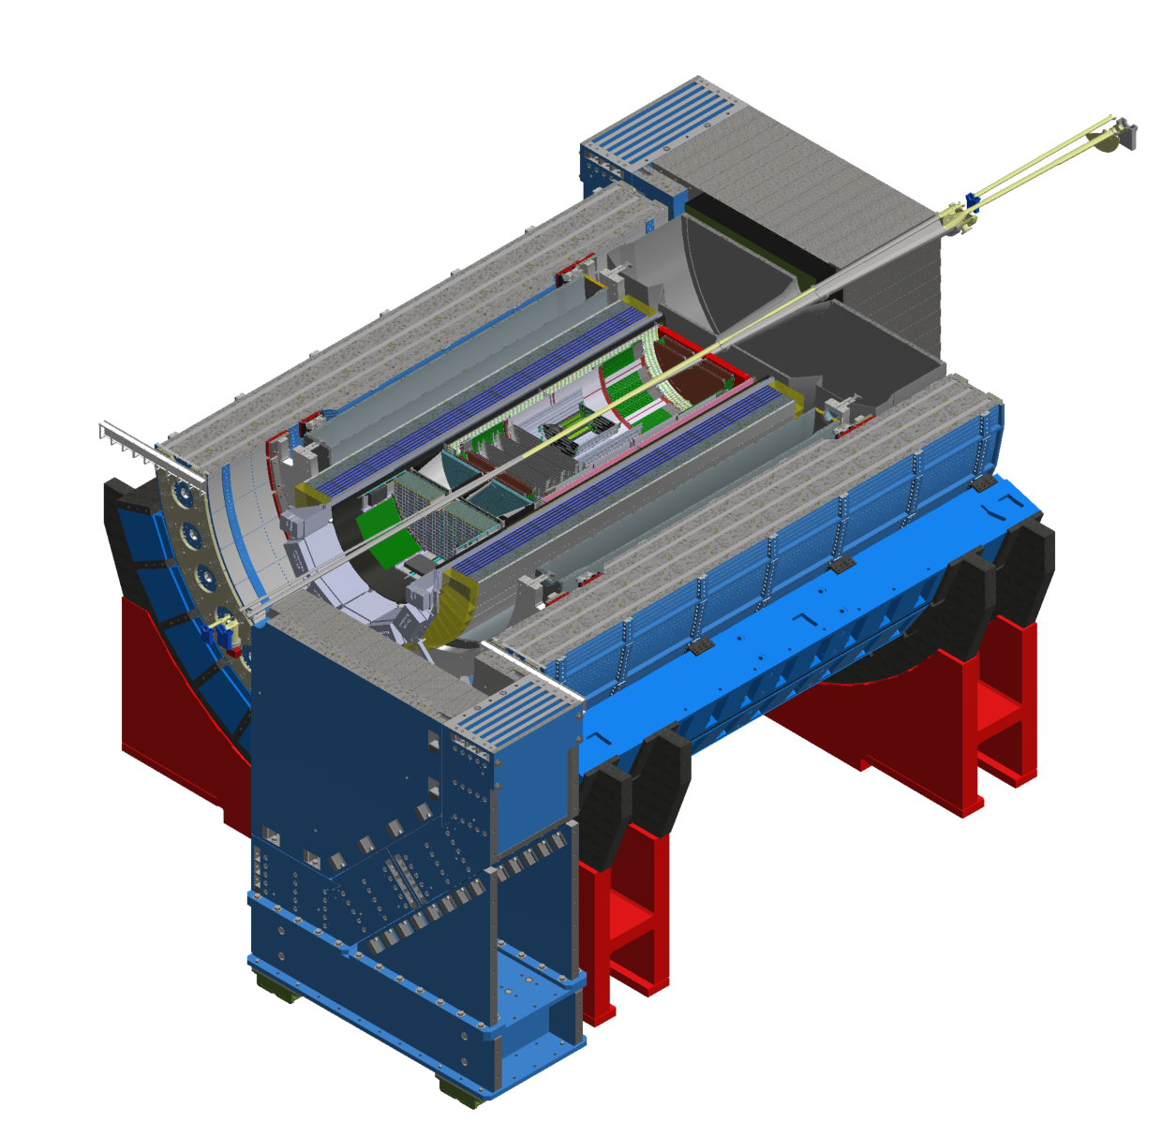
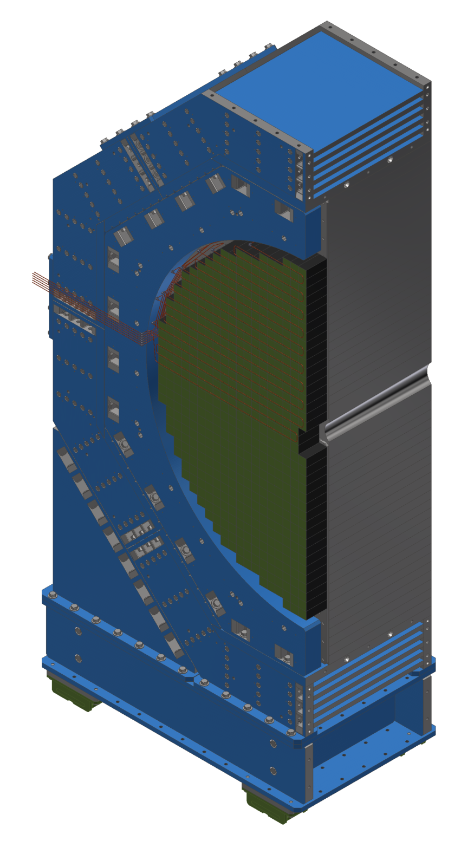
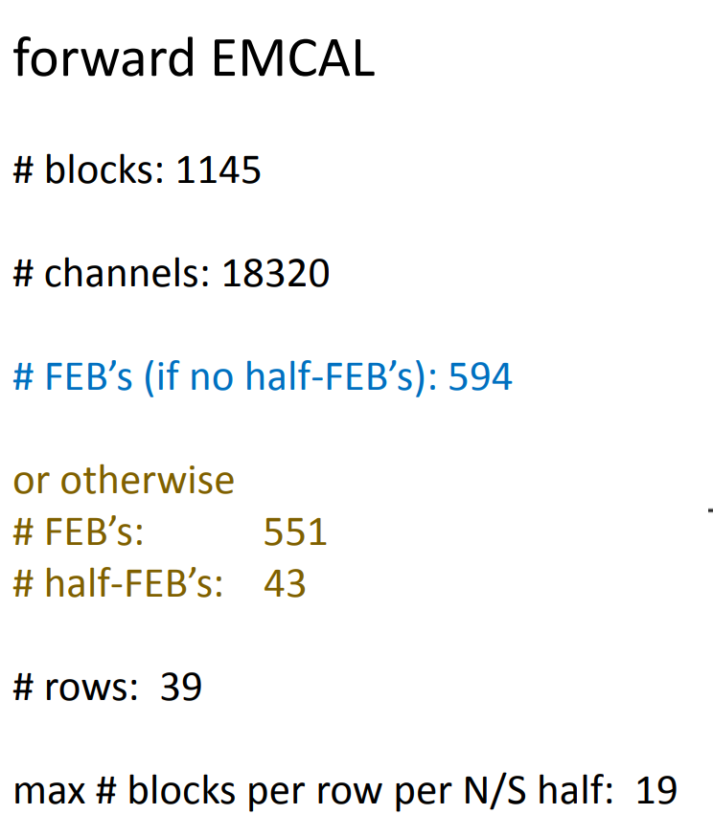
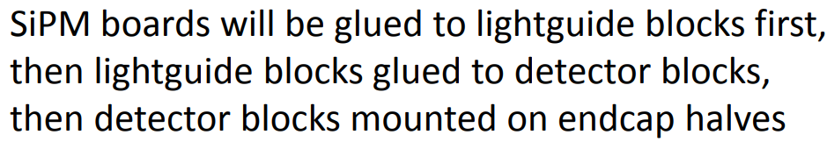
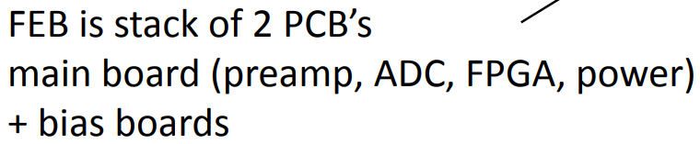
Forward EMCAL
fECal
Sectional View

Slide 6
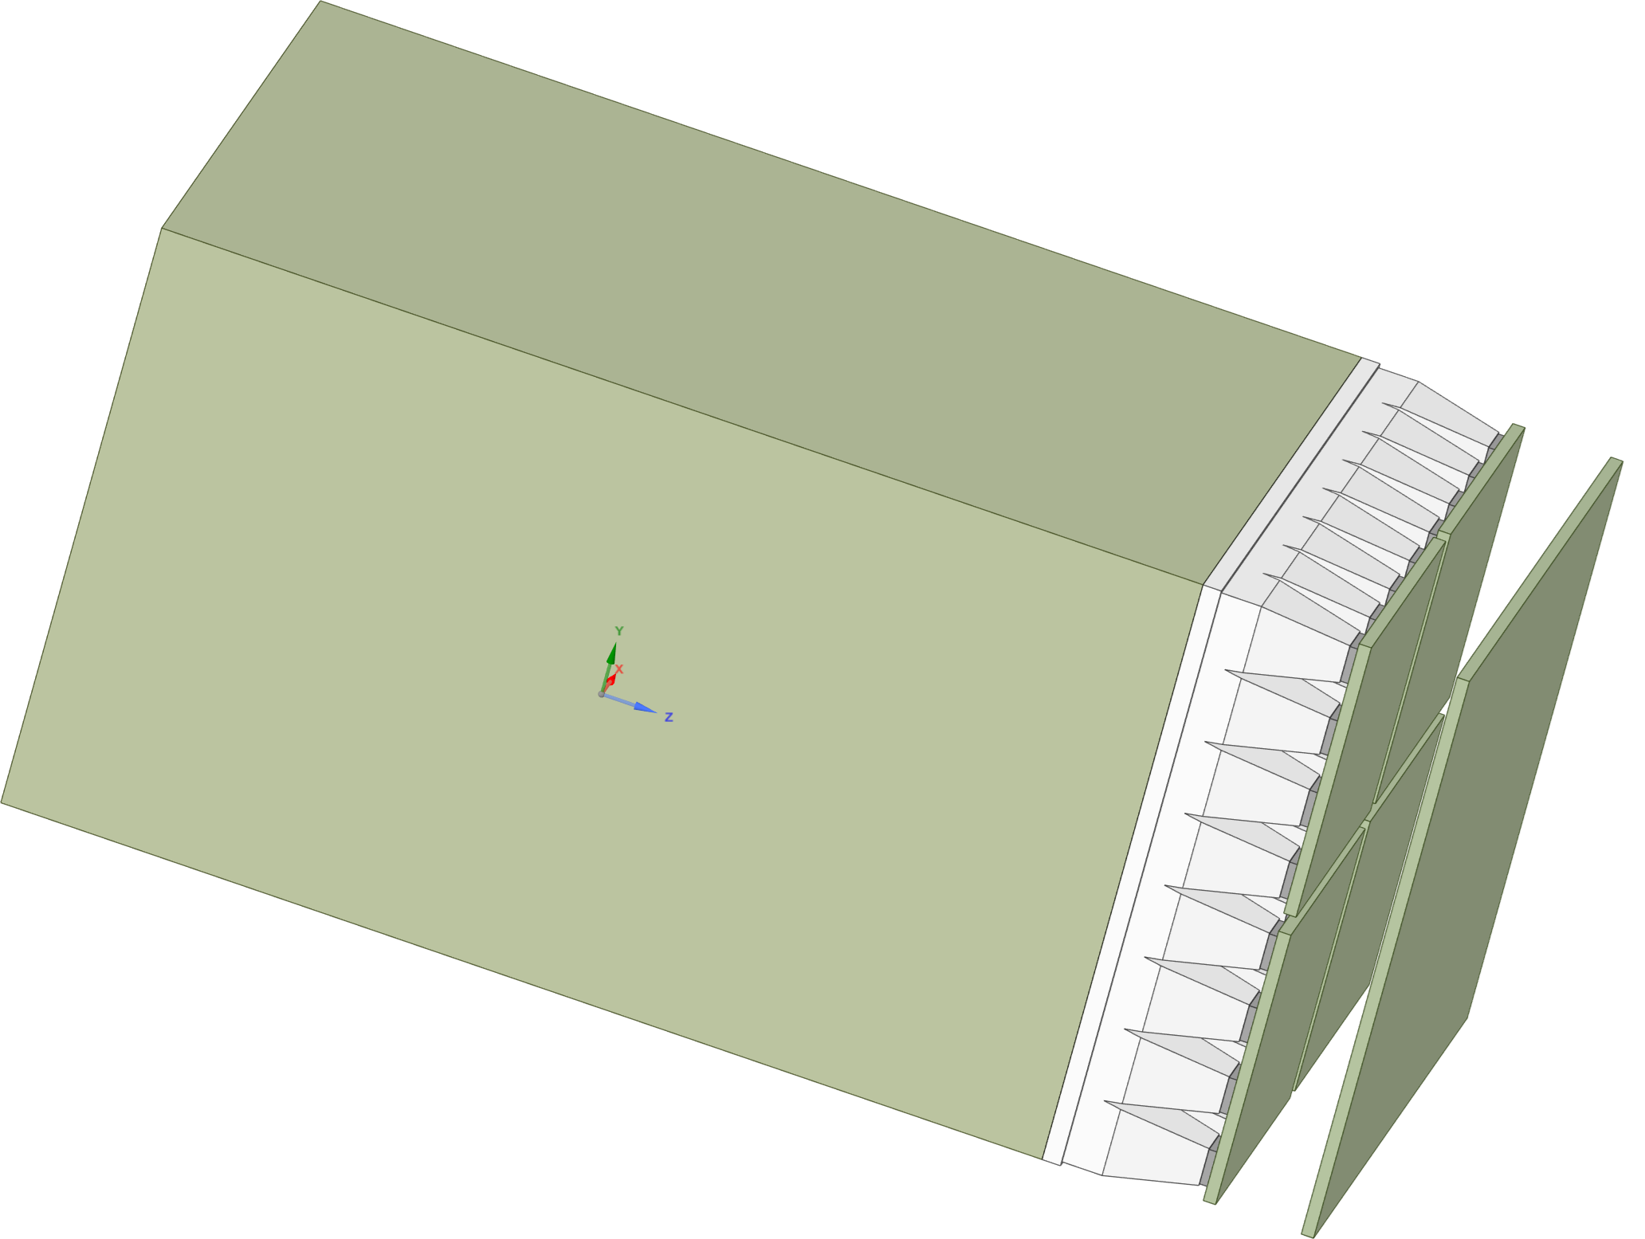
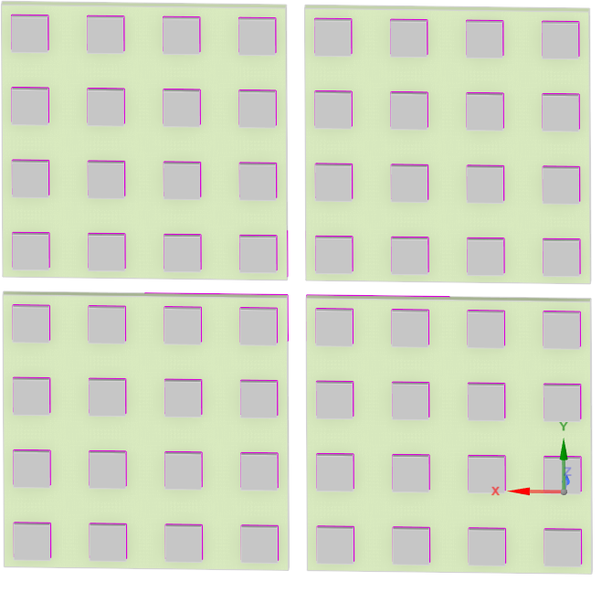
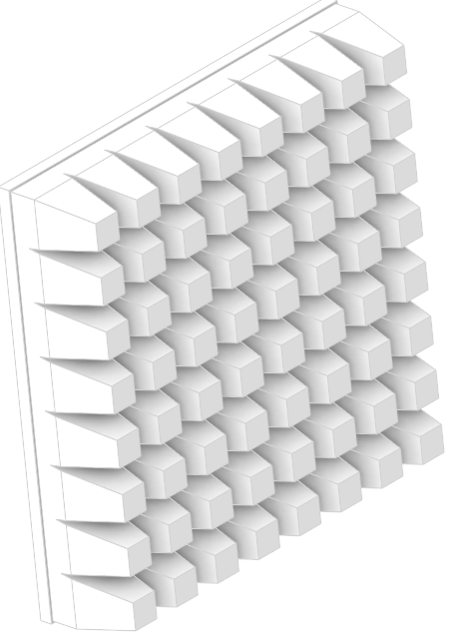
Forward EMCAL
SiPM
Epoxy
SiPM Board
FEB
Tungsten Scifi
Exploded View
Acrylic
Sector Geometry

Slide 7
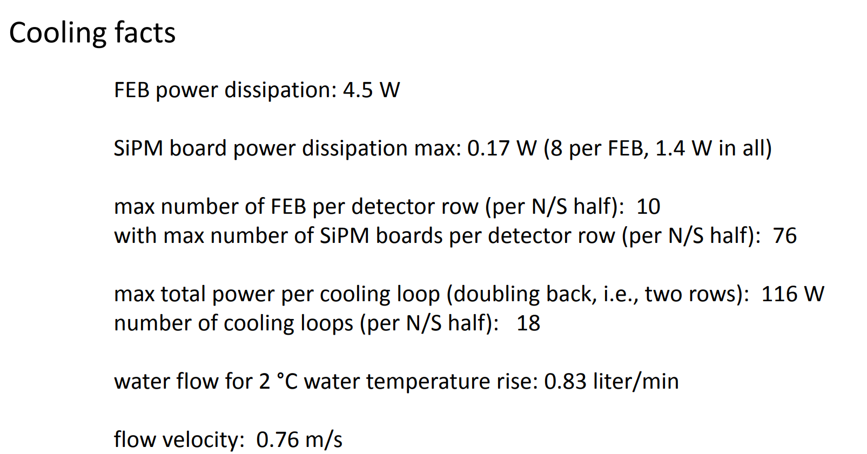
Forward EMCAL – CFD Simulation
Technical Data :
FEB Heat load (W) | SiPM Heat load (W)
4.5 | 0.17
CFD Data :
Half FEB Heat load (W) | SiPM Heat load (W)
2.25 | 0.17
Materials
Copper thickness (10 %) in FEB
Copper thickness (5%) in SiPM Board
FEB and SiPM Board thickness : 2 mm
Cooling Requirements:
Maintain FEB temperature 3 to 5 C above dew point
Cooling the SiPMs to be determined
Simulation
Copper tubes, heat sink & thermal pad geometry not considered

Slide 8
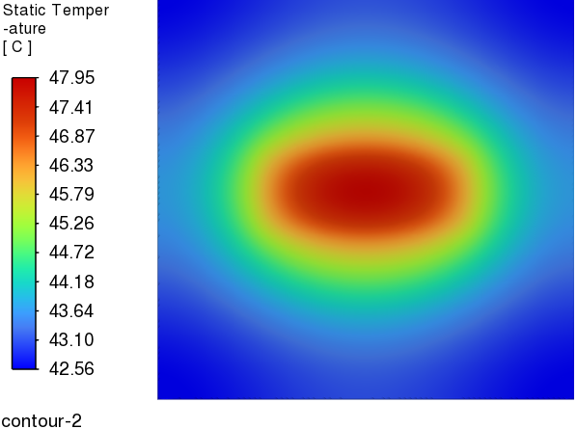
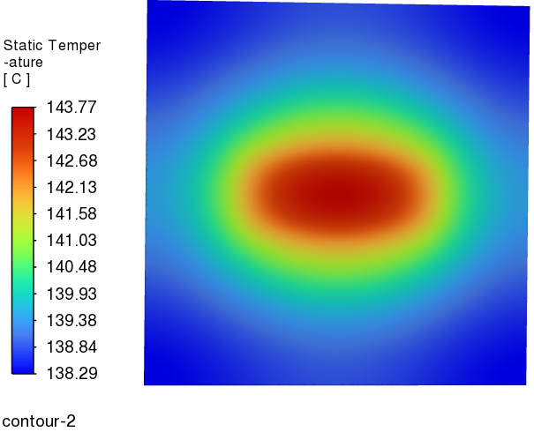
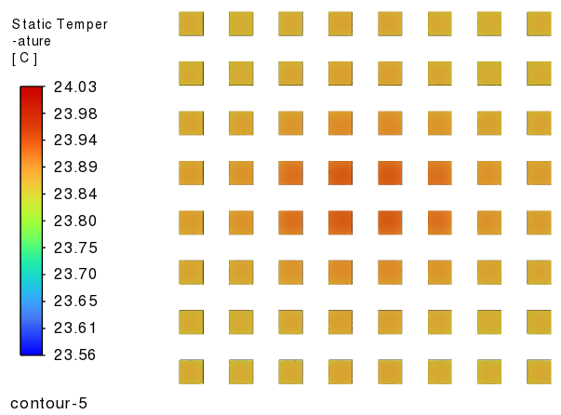
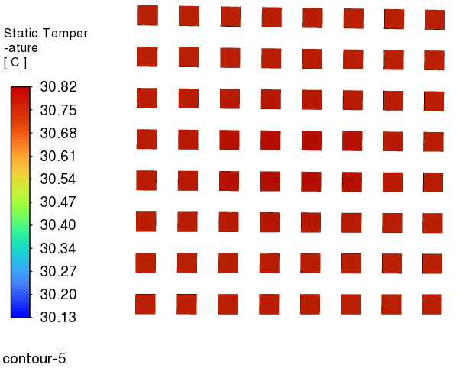
Forward EMCAL – CFD Simulation
Ambient Temperature (C) | Half FEB Heat load (W) | SiPM Heat load (W)
20 | 2.25 | 0.17
Heat Transfer Coefficient (W/m^2 C) | FEB Temperature (C) | SiPM Temperature (C)
5 | 48.0 | 24.1
1 | 143.8 | 30.8
FEB Temperature
SiPM Temperature

Slide 9
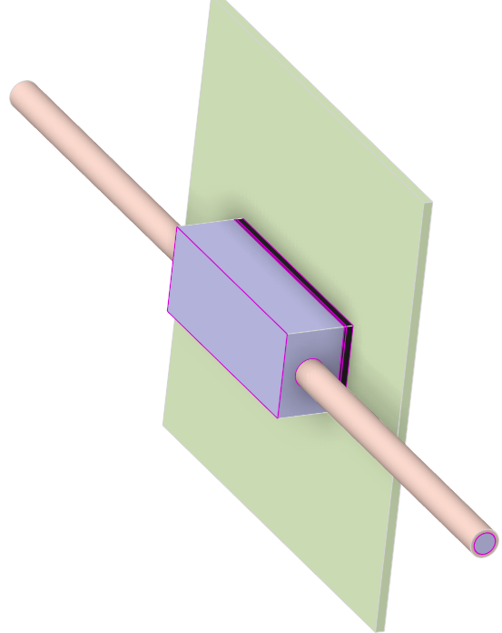
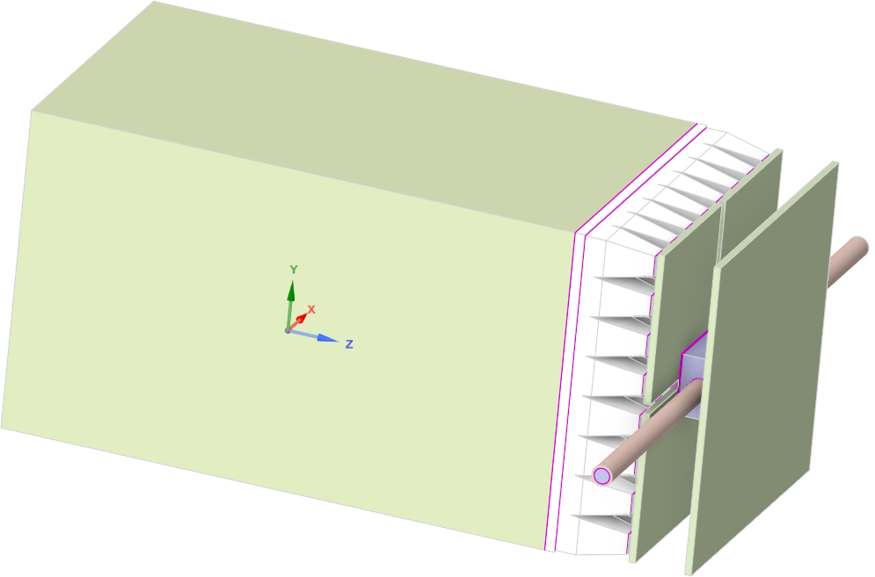
Forward EMCAL
FEB
Copper tube (inch)
0.25
SiPM
Thermal Pad
Heat Sink
Epoxy
Copper tube
SiPM Board
Tungsten Scifi
Exploded View
Acrylic
Sector Geometry

Slide 10
Forward EMCAL – CFD Simulation
Technical Data :
Water flow rate (litre/min) | Flow velocity (m/s) | Tube Length (m) | Pressure drop (psi) | Temperature rise (C) | FEB Heat load (W) | SiPM Heat load (W)
0.83 | 0.76 | 6 | 2.1 | 2 | 4.5 | 0.17
CFD Data :
Water flow rate (litre/min) | Flow velocity (m/s) | Tube Length (m) | Pressure drop (psi) | Temperature rise (C) | Half FEB Heat load (W) | SiPM Heat load (W)
0.83 | 0.76 | 0.21 | 0.07 | 0.04 | 2.25 | 0.17
Materials
Copper thickness (10 %) in FEB
Copper thickness (5%) in SiPM Board
FEB and SiPM Board thickness : 2 mm
Cooling Requirements:
Maintain FEB temperature 3 to 5 C above dew point
Cooling the SiPMs to be determined
Simulation
Copper tubes, heat sink & thermal pad geometry considered

Slide 11
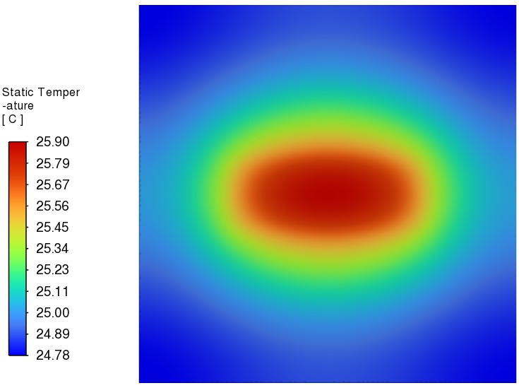
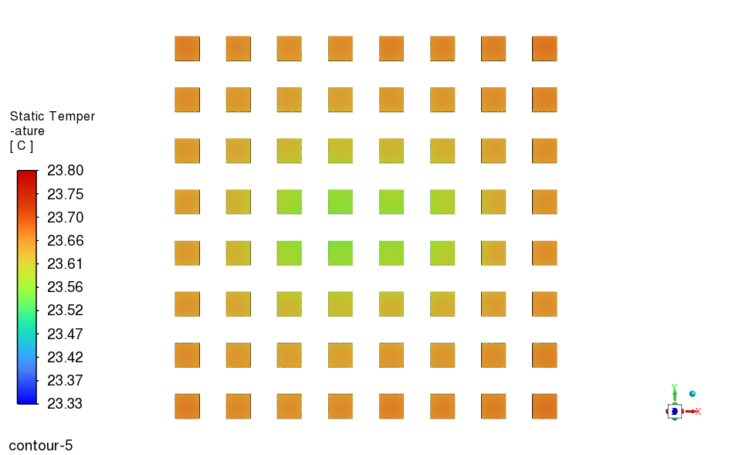
Forward EMCAL – CFD Simulation
FEB Temperature
SiPM Temperature
Ambient Temperature (C) | Flow velocity (m/s) | Half FEB Heat load (W) | SiPM Heat load (W)
20 | 0.76 | 2.25 | 0.17
Heat Transfer Coefficient (W/m^2 C) | Water Inlet Temperature (C) | FEB Temperature (C) | SiPM Temperature (C)
5 | 22 | 25.9 | 23.8

Slide 12
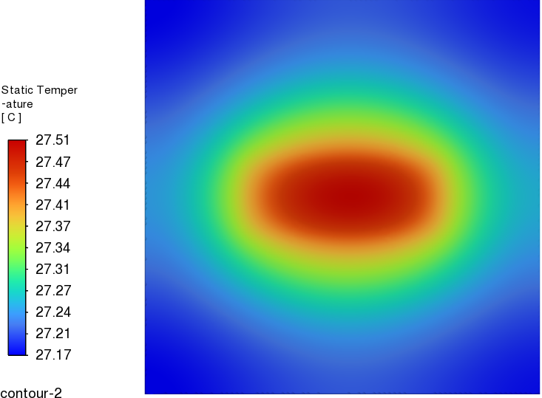
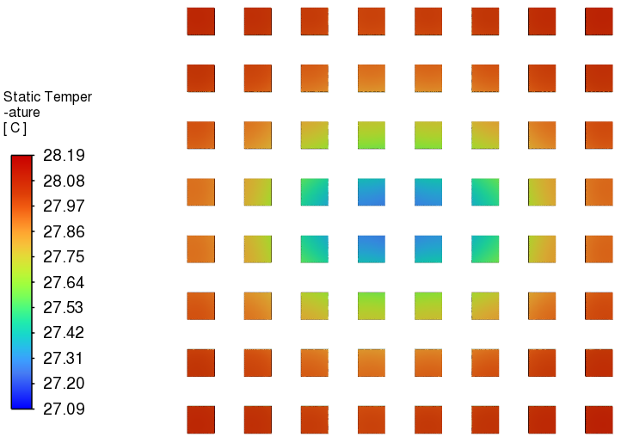
Forward EMCAL – CFD Simulation
Heat Transfer Coefficient :
FEB Temperature
SiPM Temperature
Ambient Temperature (C) | Flow velocity (m/s) | Half FEB Heat load (W) | SiPM Heat load (W)
20 | 0.76 | 2.25 | 0.17
Heat Transfer Coefficient (W/m^2 C) | Water Inlet Temperature (C) | FEB Temperature (C) | SiPM Temperature (C)
5 | 22 | 25.9 | 23.8
1 | 22 | 27.51 | 28.19

Slide 13
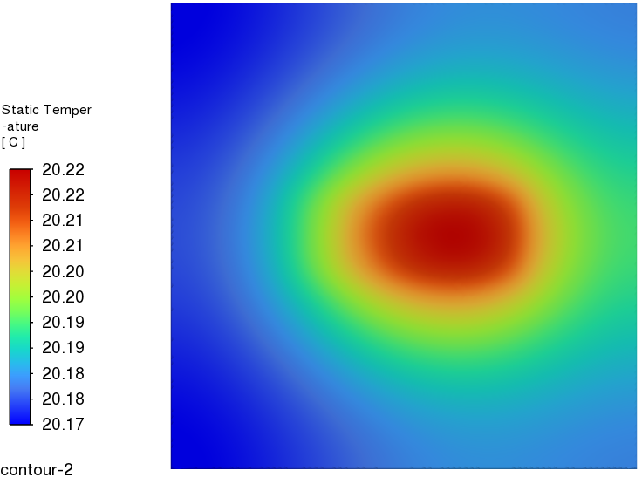
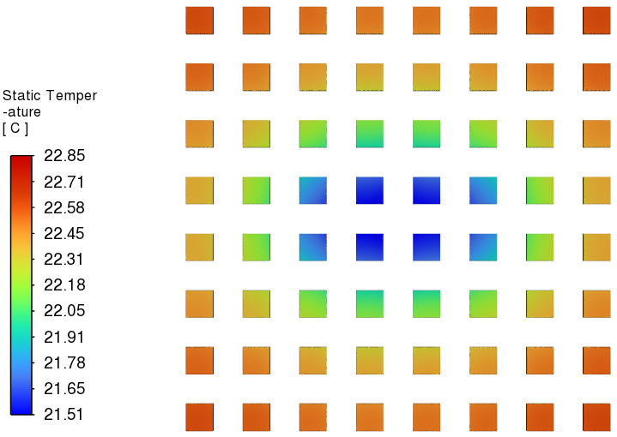
Forward EMCAL – CFD Simulation
Relative Humidity :
FEB Temperature
SiPM Temperature
Ambient Temperature (C) | Flow velocity (m/s) | Half FEB Heat load (W) | SiPM Heat load (W)
20 | 0.76 | 2.25 | 0.17
Relative Humidity (%) | Dew Point Temperature (C) | Water Inlet Temperature (C) | FEB Temperature (C) | SiPM Temperature (C)
100 | 20 | 22 | 25.9 | 23.8
60 | 12 | 14 | 20.22 | 22.85

Slide 14
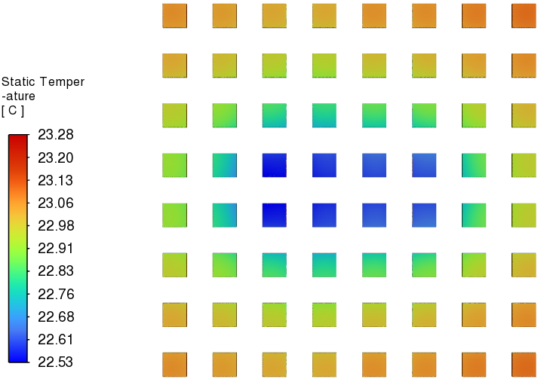
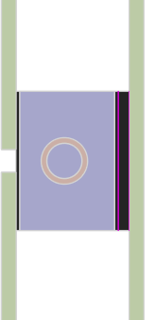
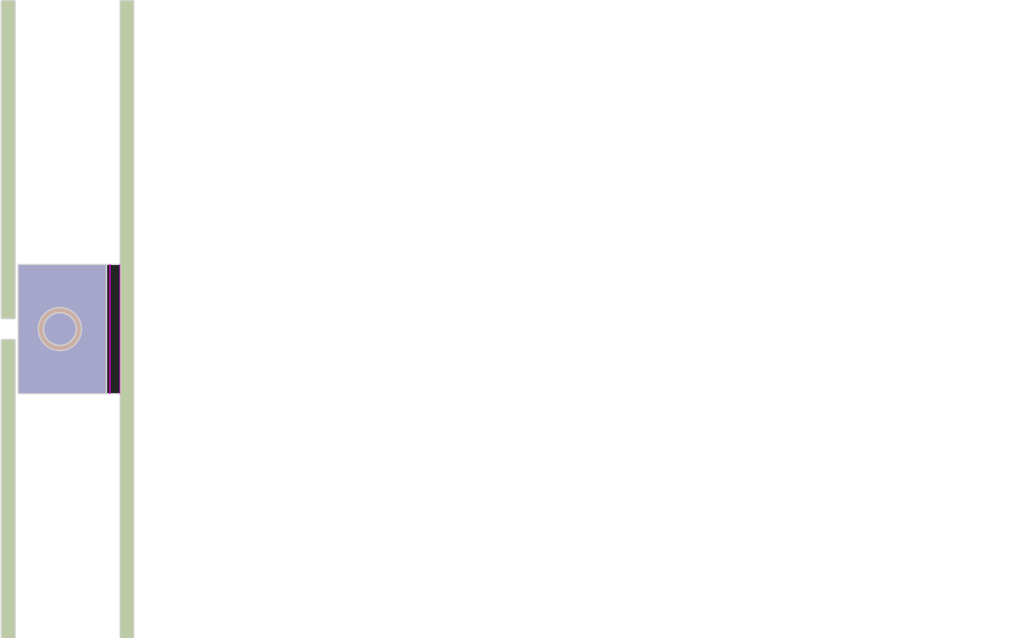
Forward EMCAL – CFD Simulation
Design :
SiPM Temperature
SiPM Temperature
SiPM Board
FEB
SiPM Board
FEB

Slide 15
Summary
Suggestions :
Modifying geometry from straight tube to serpentine tube will enhance heat transfer and reduce FEB temperature further.
Adding fins or turbulators in heat sink will enhance heat transfer and aid in cooling of FEB.

Slide 16
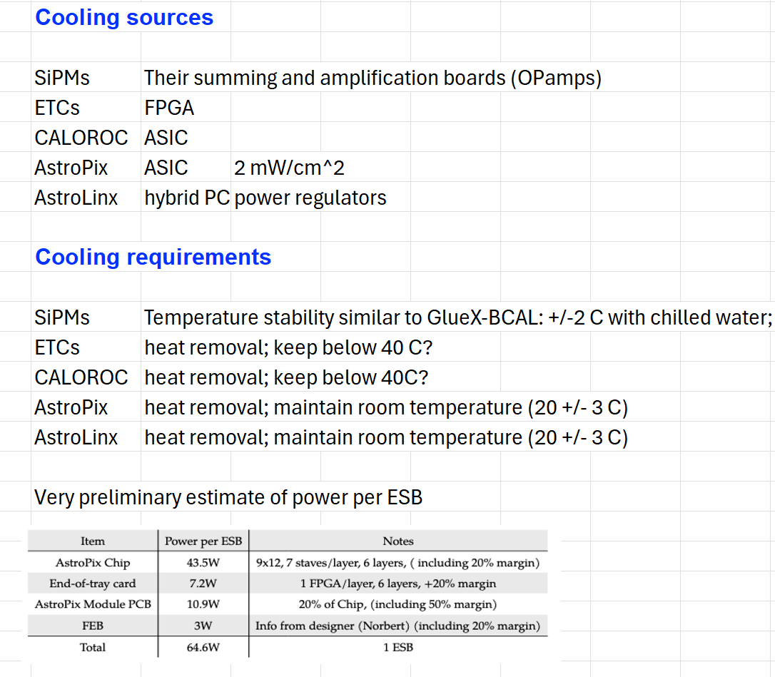
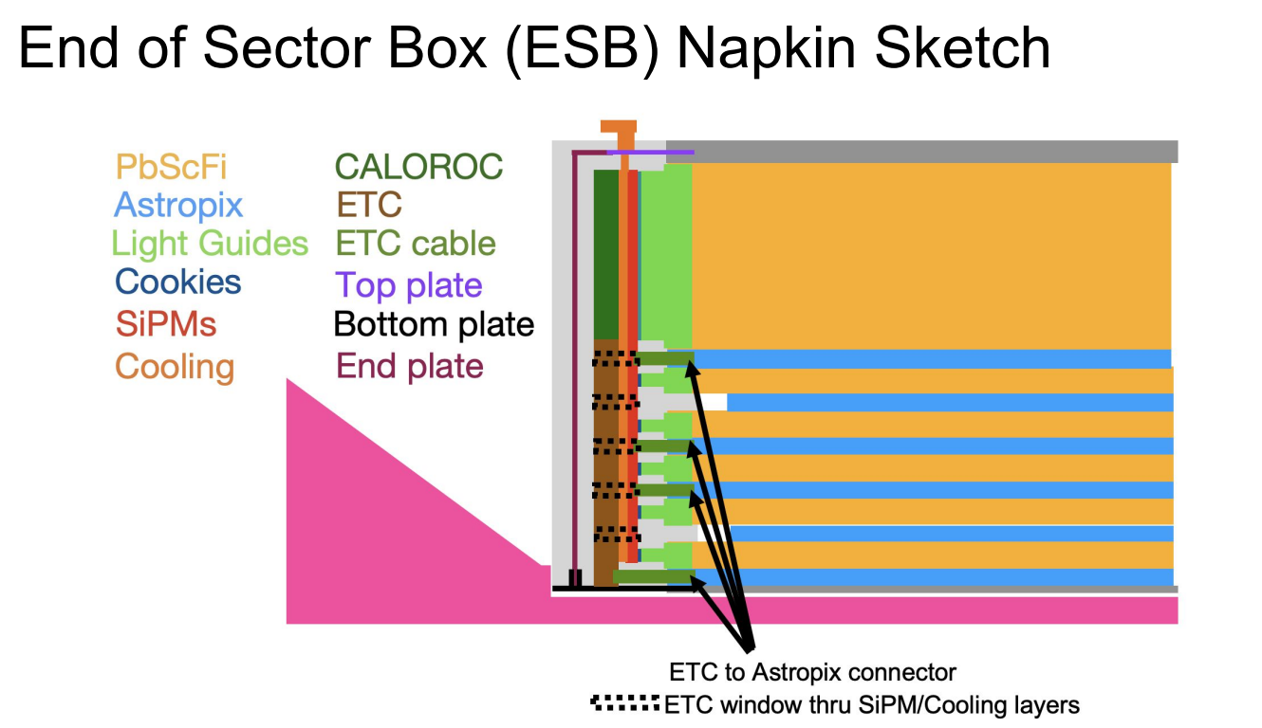
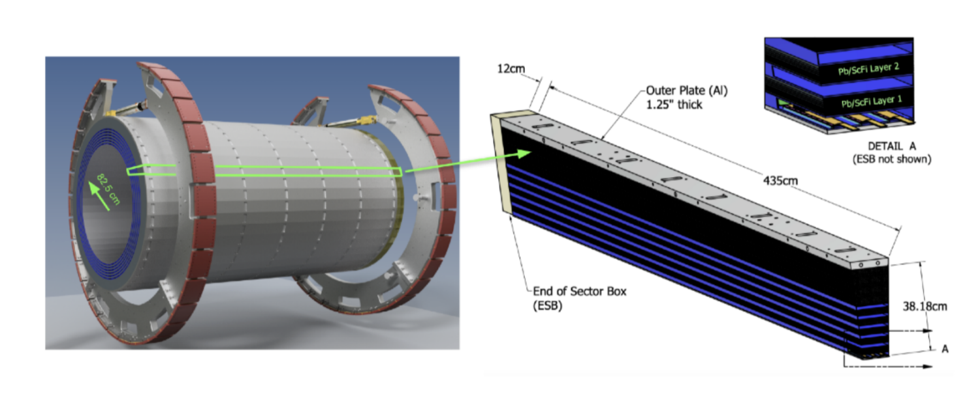
Barrel EMCAL – Cooling
University of Manitoba – Thermal Analysis of BIC single sector
Computational design of BIC with 48 sectors, showing one of the sectors in detail

Slide 17
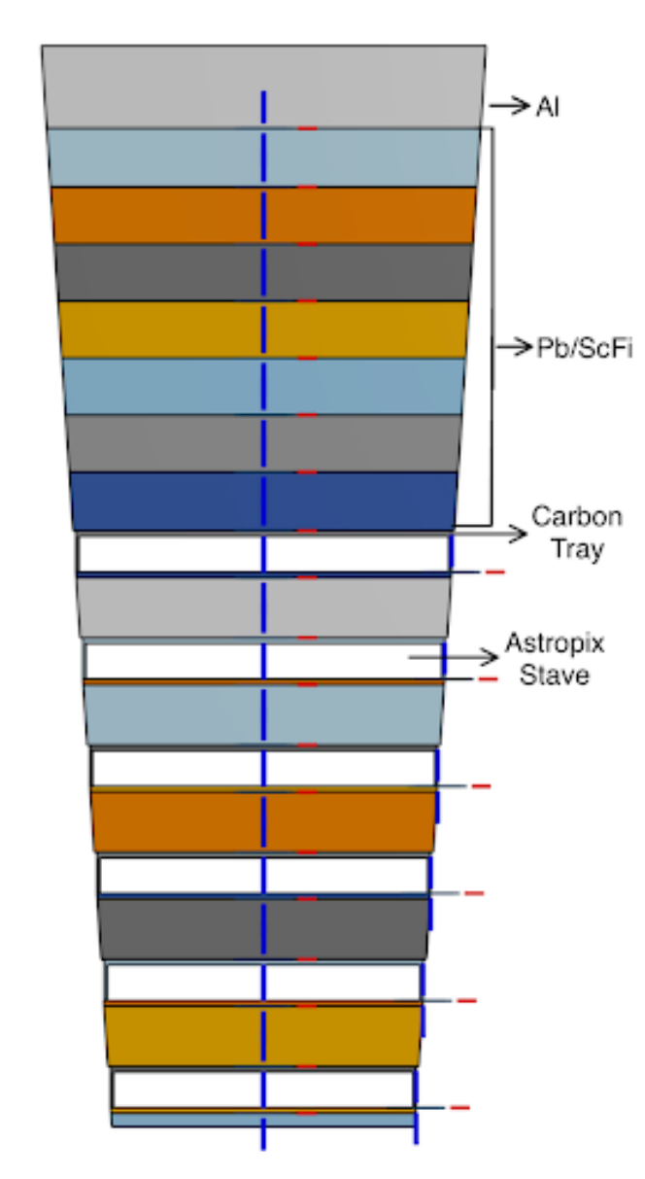
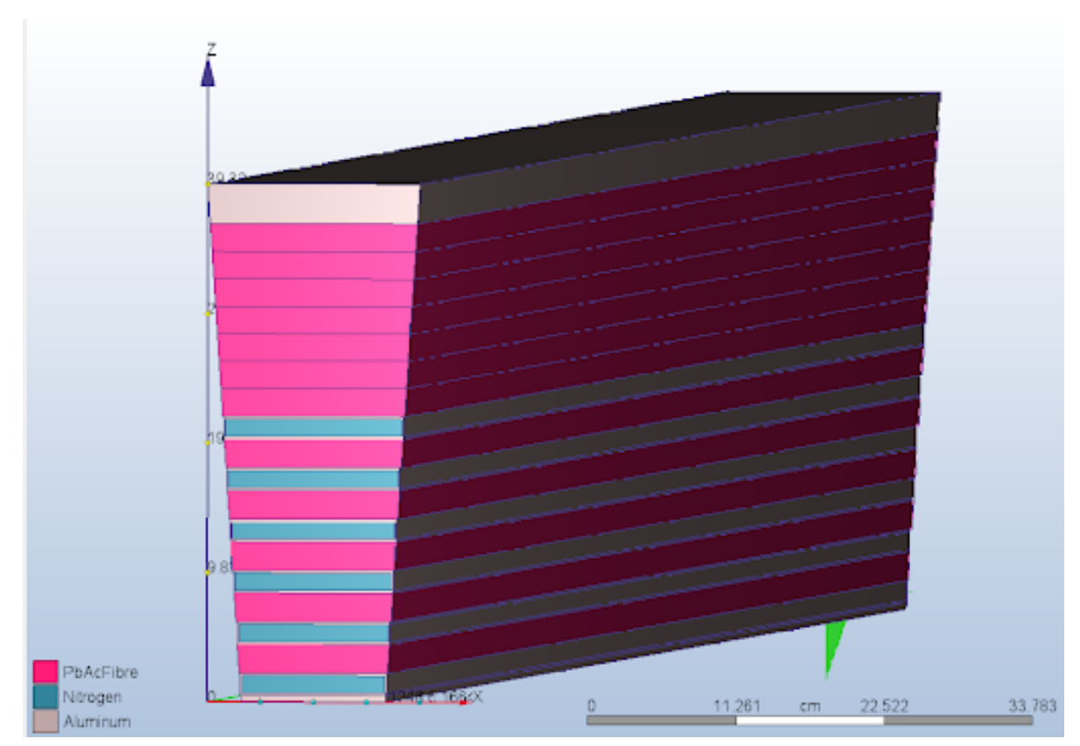
Barrel EMCAL – Cooling
Material distribution for the sector
Computational design of the one of the sectors of the BIC

Slide 18
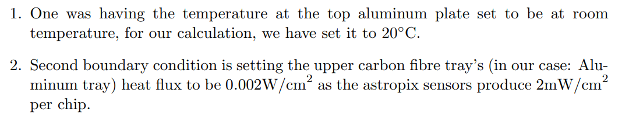
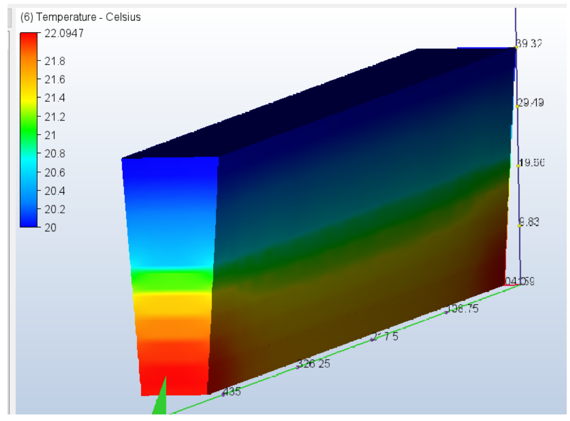
Barrel EMCAL – Cooling
Boundary condition :
Thermal simulation

Slide 19
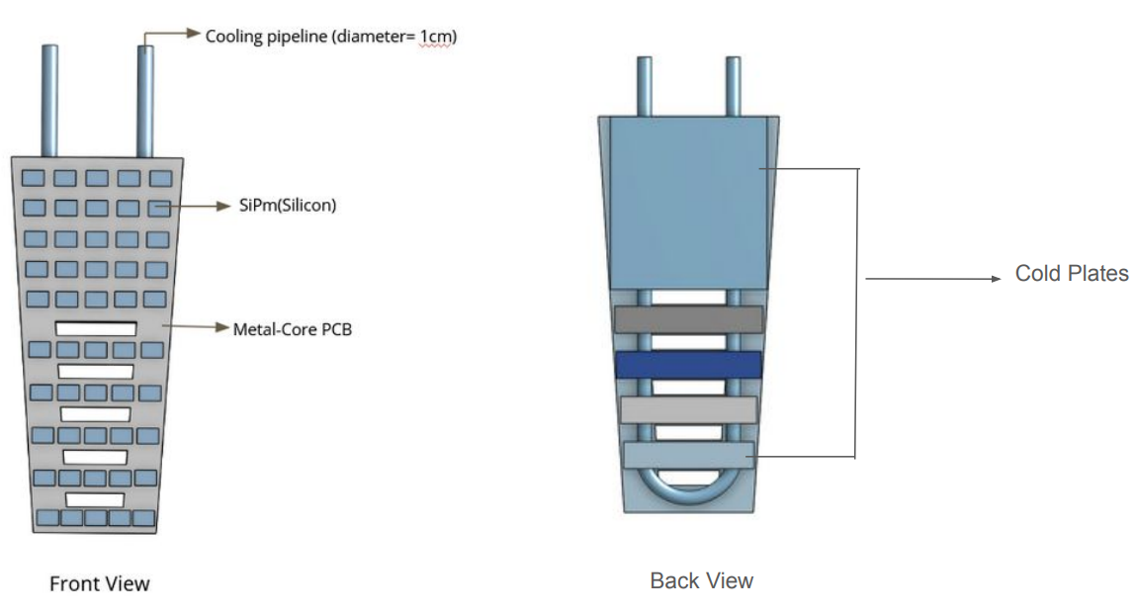
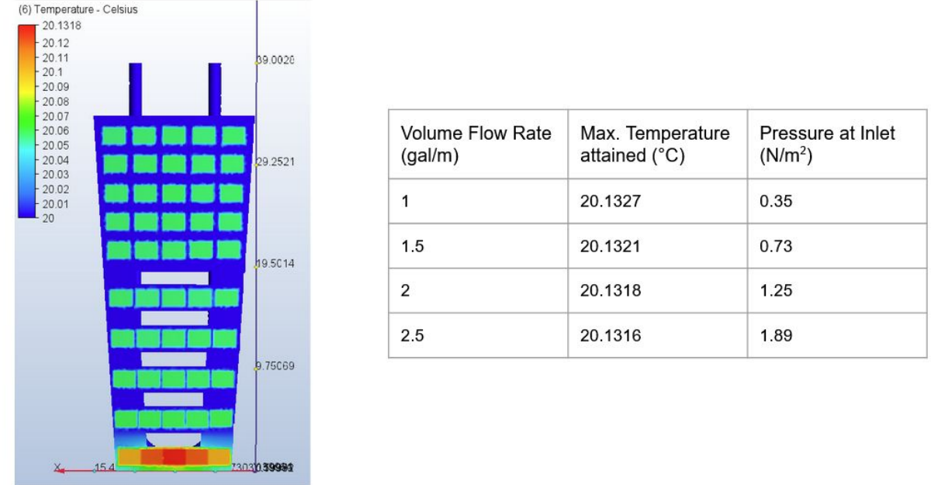
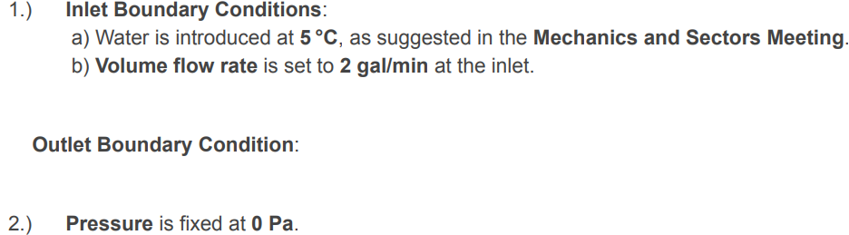
Barrel EMCAL – Cooling
Baseline design of Cold Plate
Thermal simulation with volume flow rate of 2gal/m

Slide 20
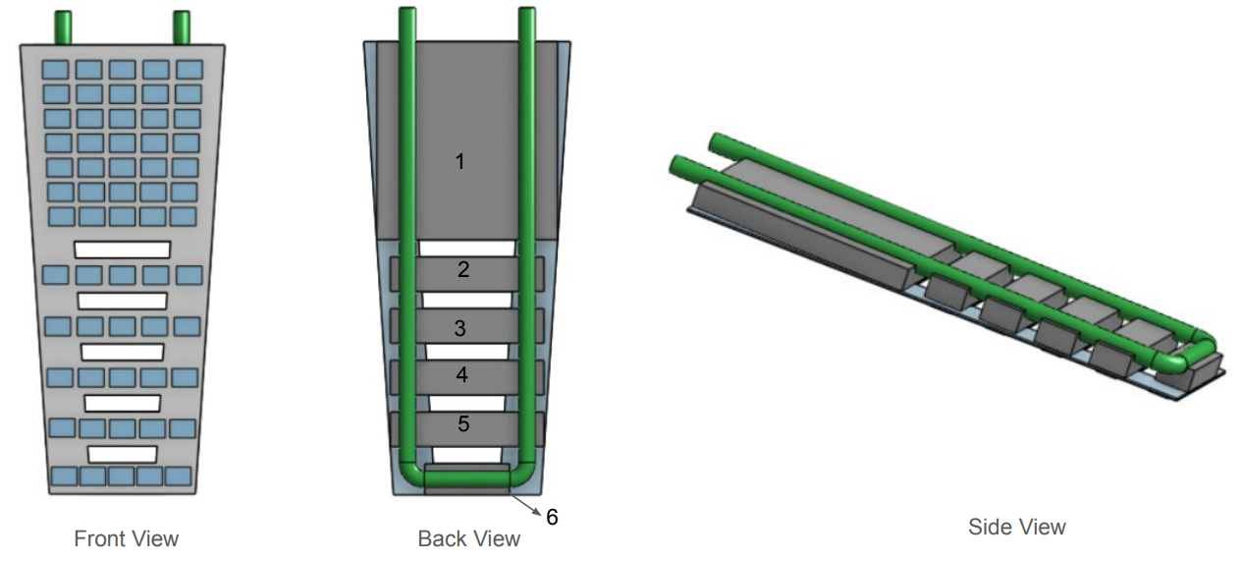
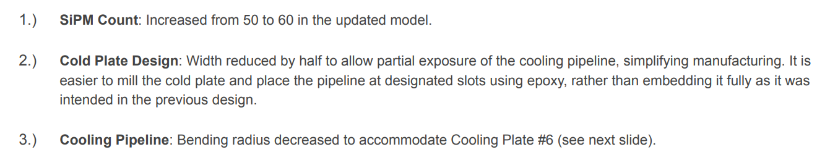
Barrel EMCAL – Cooling
New design of Cold Plate

Slide 21
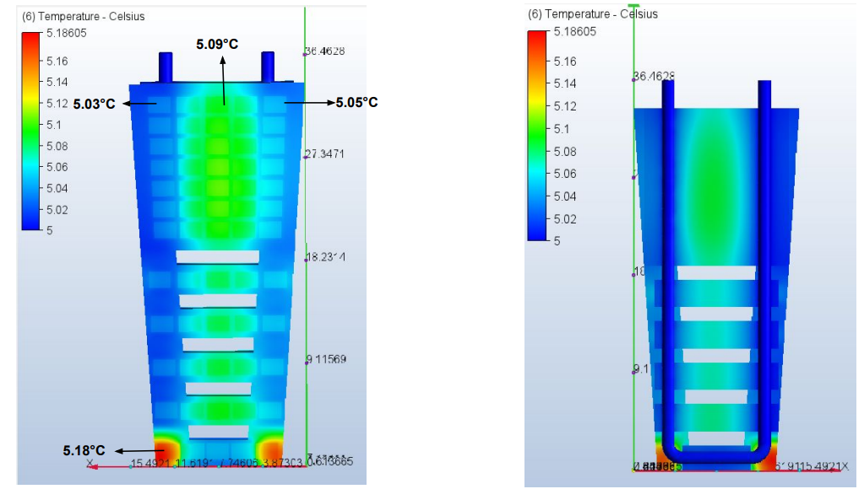
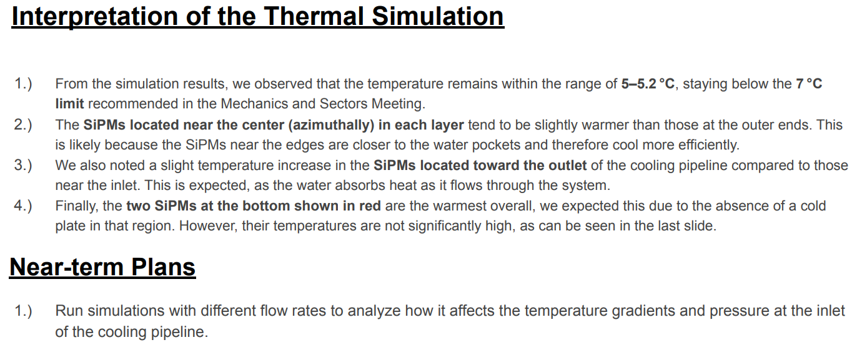
Barrel EMCAL – Cooling
Thermal simulation Results

Slide 22
Barrel EMCAL – Cooling

Slide 23
Question & Comments

