Slide 1

ePIC Collaboration (Brief) News
J. Lajoie, S. Dalla Torre
August 1st, 2025

Slide 2
Hey John, start the recording….

Slide 3
Why are we here?
Workfest summaries and reports from activities within the collaboration.
Mechanical Integration:
NO SUMMARY: Next monthly summary in September
PID CC WG:
Joint TIC/S&C Meeting to discuss/plan PID reconstruction and simulation geometry progress
Exclusive/Diffractive:
Summary at 8/1 General Meeting
Streaming Computing:
Summary at 8/1 General Meeting
Jets and Heavy Flavor:
Summary at 8/1 General Meeting
AC-LGAD ToF:
Summary of hardware discussions in TIC. Software discussion is part of proposed joint TIC/S&C meeting
Electronics, Readout and DAQ:
Summary limited to test benches and software for test beams (TIC)
ToF T0 (w/AC-LGAD TOF)
Tracking:
NO SUMMARY (Friday Plenary)
Observables and Detector Performance:
Summary from PAC’s at Future General Meeting
Software Interface for Test Beams and Benches:
Included in Electronics, Readout and DAQ above (TIC)
EIC Outreach:
Brief summary at 8/1 General Meeting
General Meetings
Future TIC Meetings

Slide 4
Results Release Committee
The Results Release Committee was charged with developing documents/templates that will help present ePIC results to the community.
These are guideline and templates, NOT policy. Will continue to be improved with feedback from the collaboration.
Style guidelines (slides, posters, figures, etc.):
https://zenodo.org/records/16616008
Style file and plotting macro example:
https://zenodo.org/records/16615455
Developed in conjunction with Physics Analysis Coordination
Template for analysis note:
https://zenodo.org/records/16615353
Website being updated to include flowchart for release policy and links to templates.
Many thanks to Rongrong and the entire Results Release Committee!

Slide 5


Slide 6
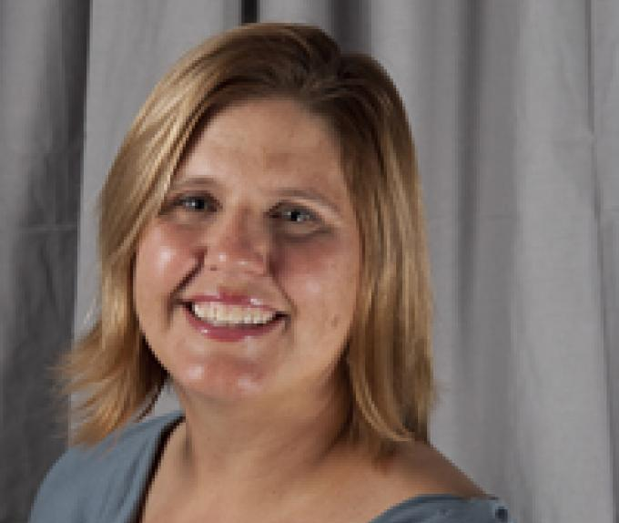
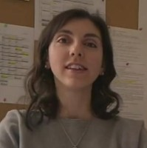

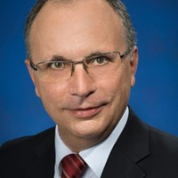
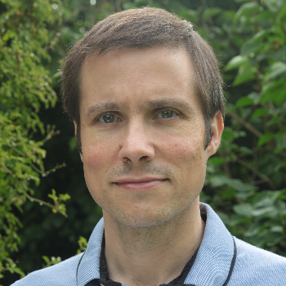
New Faces in ePIC Leadership
Renee Fatemi was elected the new vice-chair of the CC
Susanna Costanza was elected the new vice-chair of the Code of Conduct Committee
Daniel Brandenburg was elected the new vice-chair of the Conference and Talks Committee
Carlos Munoz Camacho was elected the new vice-chair and Eric Lancon new chair of the Membership committee.
Many thanks to the outgoing leadership:
Bernd Surrow (CC Chair)
Megan Connors (Code of Conduct)
Maria Zurek (Conference and Talks) Pietro Antonioli and Peter Steinberg (Membership)

Slide 7

ePIC Resources
Public Website - https://www.bnl.gov/eic/epic.php
Mailing Lists – https://lists.bnl.gov/mailman/listinfo
Indico Agenda - https://indico.bnl.gov/category/402/
ePIC Software and Computing: https://indico.bnl.gov/category/435/
Wiki - https://wiki.bnl.gov/EPIC
ePIC Software Training:
Landing Page: https://eic.github.io/documentation/landingpage.html
Tutorials: https://eic.github.io/documentation/tutorials.html
Mattermost: https://chat.epic-eic.org
ePIC Zenodo Community: https://zenodo.org/communities/epic

Slide 8


EICUG Membership
The EICUG is a vital organization to promote the interests of the EIC community!
Without the EICUG we would never have gotten far enough to form ePIC!
Please register your institution!
Check with your EICUG IB representative to get registered as a member
https://www.eicug.org/content/join.html

Slide 9
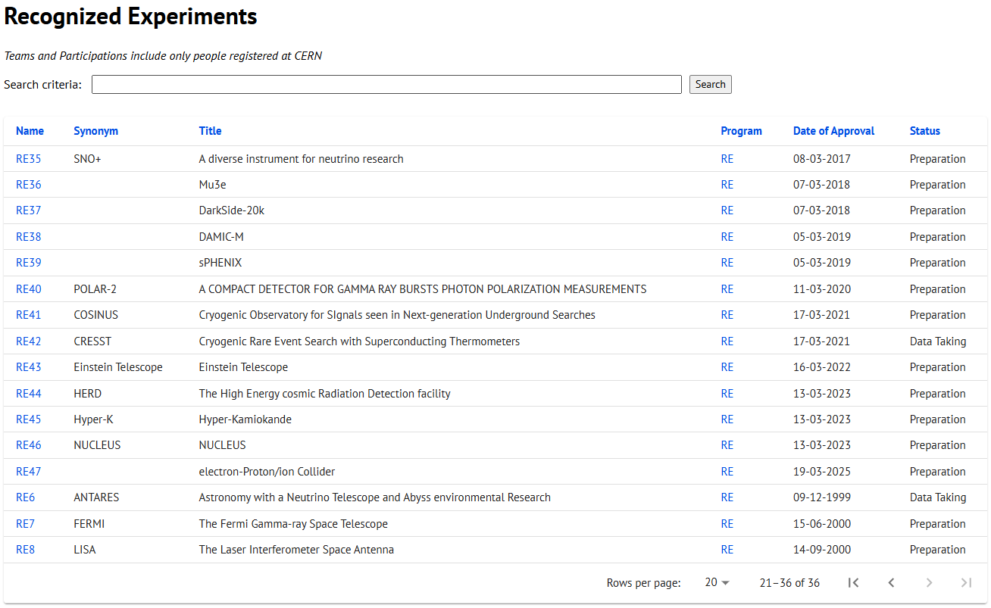
CERN Recognized Experiment Status: RE47
ePIC now appears in the CERN Grey Book database as RE47: https://greybook.cern.ch/experiment/recognized
Two steps to get ePIC Collaborators registered at CERN:
CC Representative needs to register as team leader with CERN Users Office:
https://usersoffice.web.cern.ch/
https://usersoffice.web.cern.ch/team-leaders-corner
Users.Office@cern.ch
CC member can then certify registrations of team members
Contact us if you run into problems!

