Slide 1
Update on ePIC & EIC-UG Outreach WG
Outreach WG
ePIC General Meeting
August 1st, 2025

Slide 2
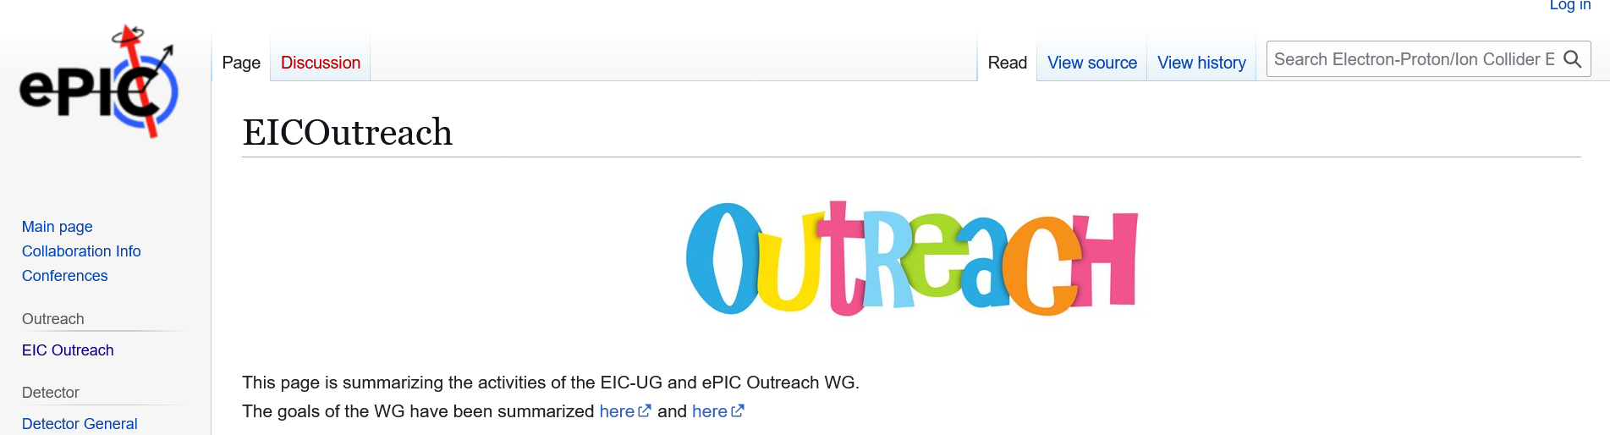
General Info
WG Members:
Armenia: Dr. Hrachya Marukyan
Czech Republic: Prof. Jana Bielcikova
France: Dr. Silvia Niccolai
India: Prof. Md Nasim
Israel: Prof. Zvi Citron
Italy: Prof. Marta Ruspa
Japan: Prof. Taku Gunji
Senegal Dr. Sokhna Bineta Amar
Taiwan: Prof. Yi Yang
UK: Prof. Rachel Montgomery
USA: Elke-Caroline Aschenauer
Email-list: eic-outreach-wg@lists.bnl.gov
Regular Meeting: 1st Wednesday of the Month
7:00 am NY-Time
Wiki-Page: https://wiki.bnl.gov/EPIC/index.php?title=EICOutreach
Everybody is welcome to the meetings, helping with activities

Slide 3
The Global Goals of the WG
Expand EIC experimental community
Built up a STEM pipeline
Provide opportunities for early career scientist especially from developing countries
Develop a truly diverse workforce
Make the EIC a real international facility
Spread EIC science to general public

Slide 4

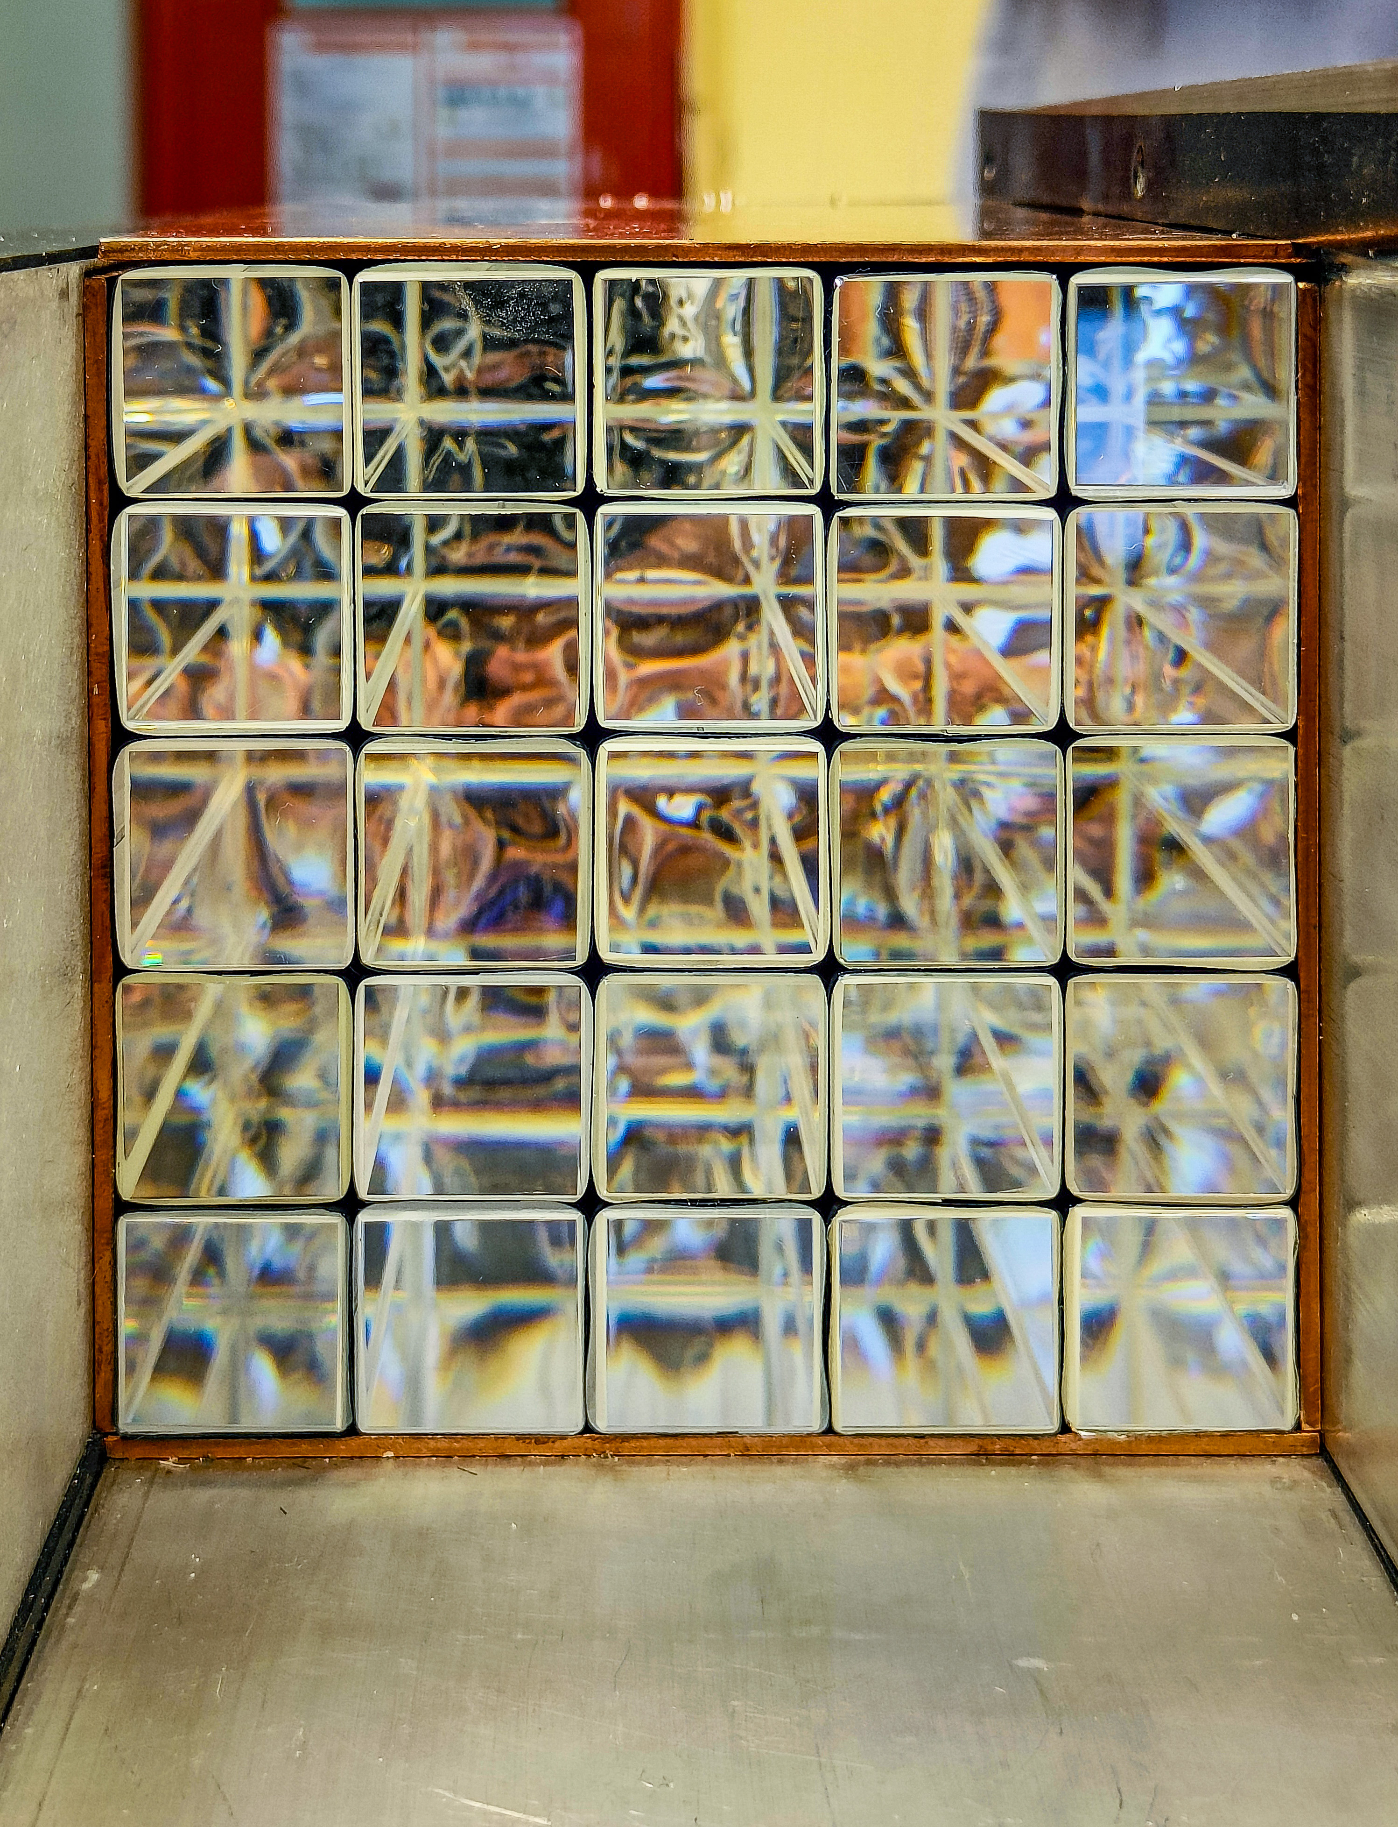
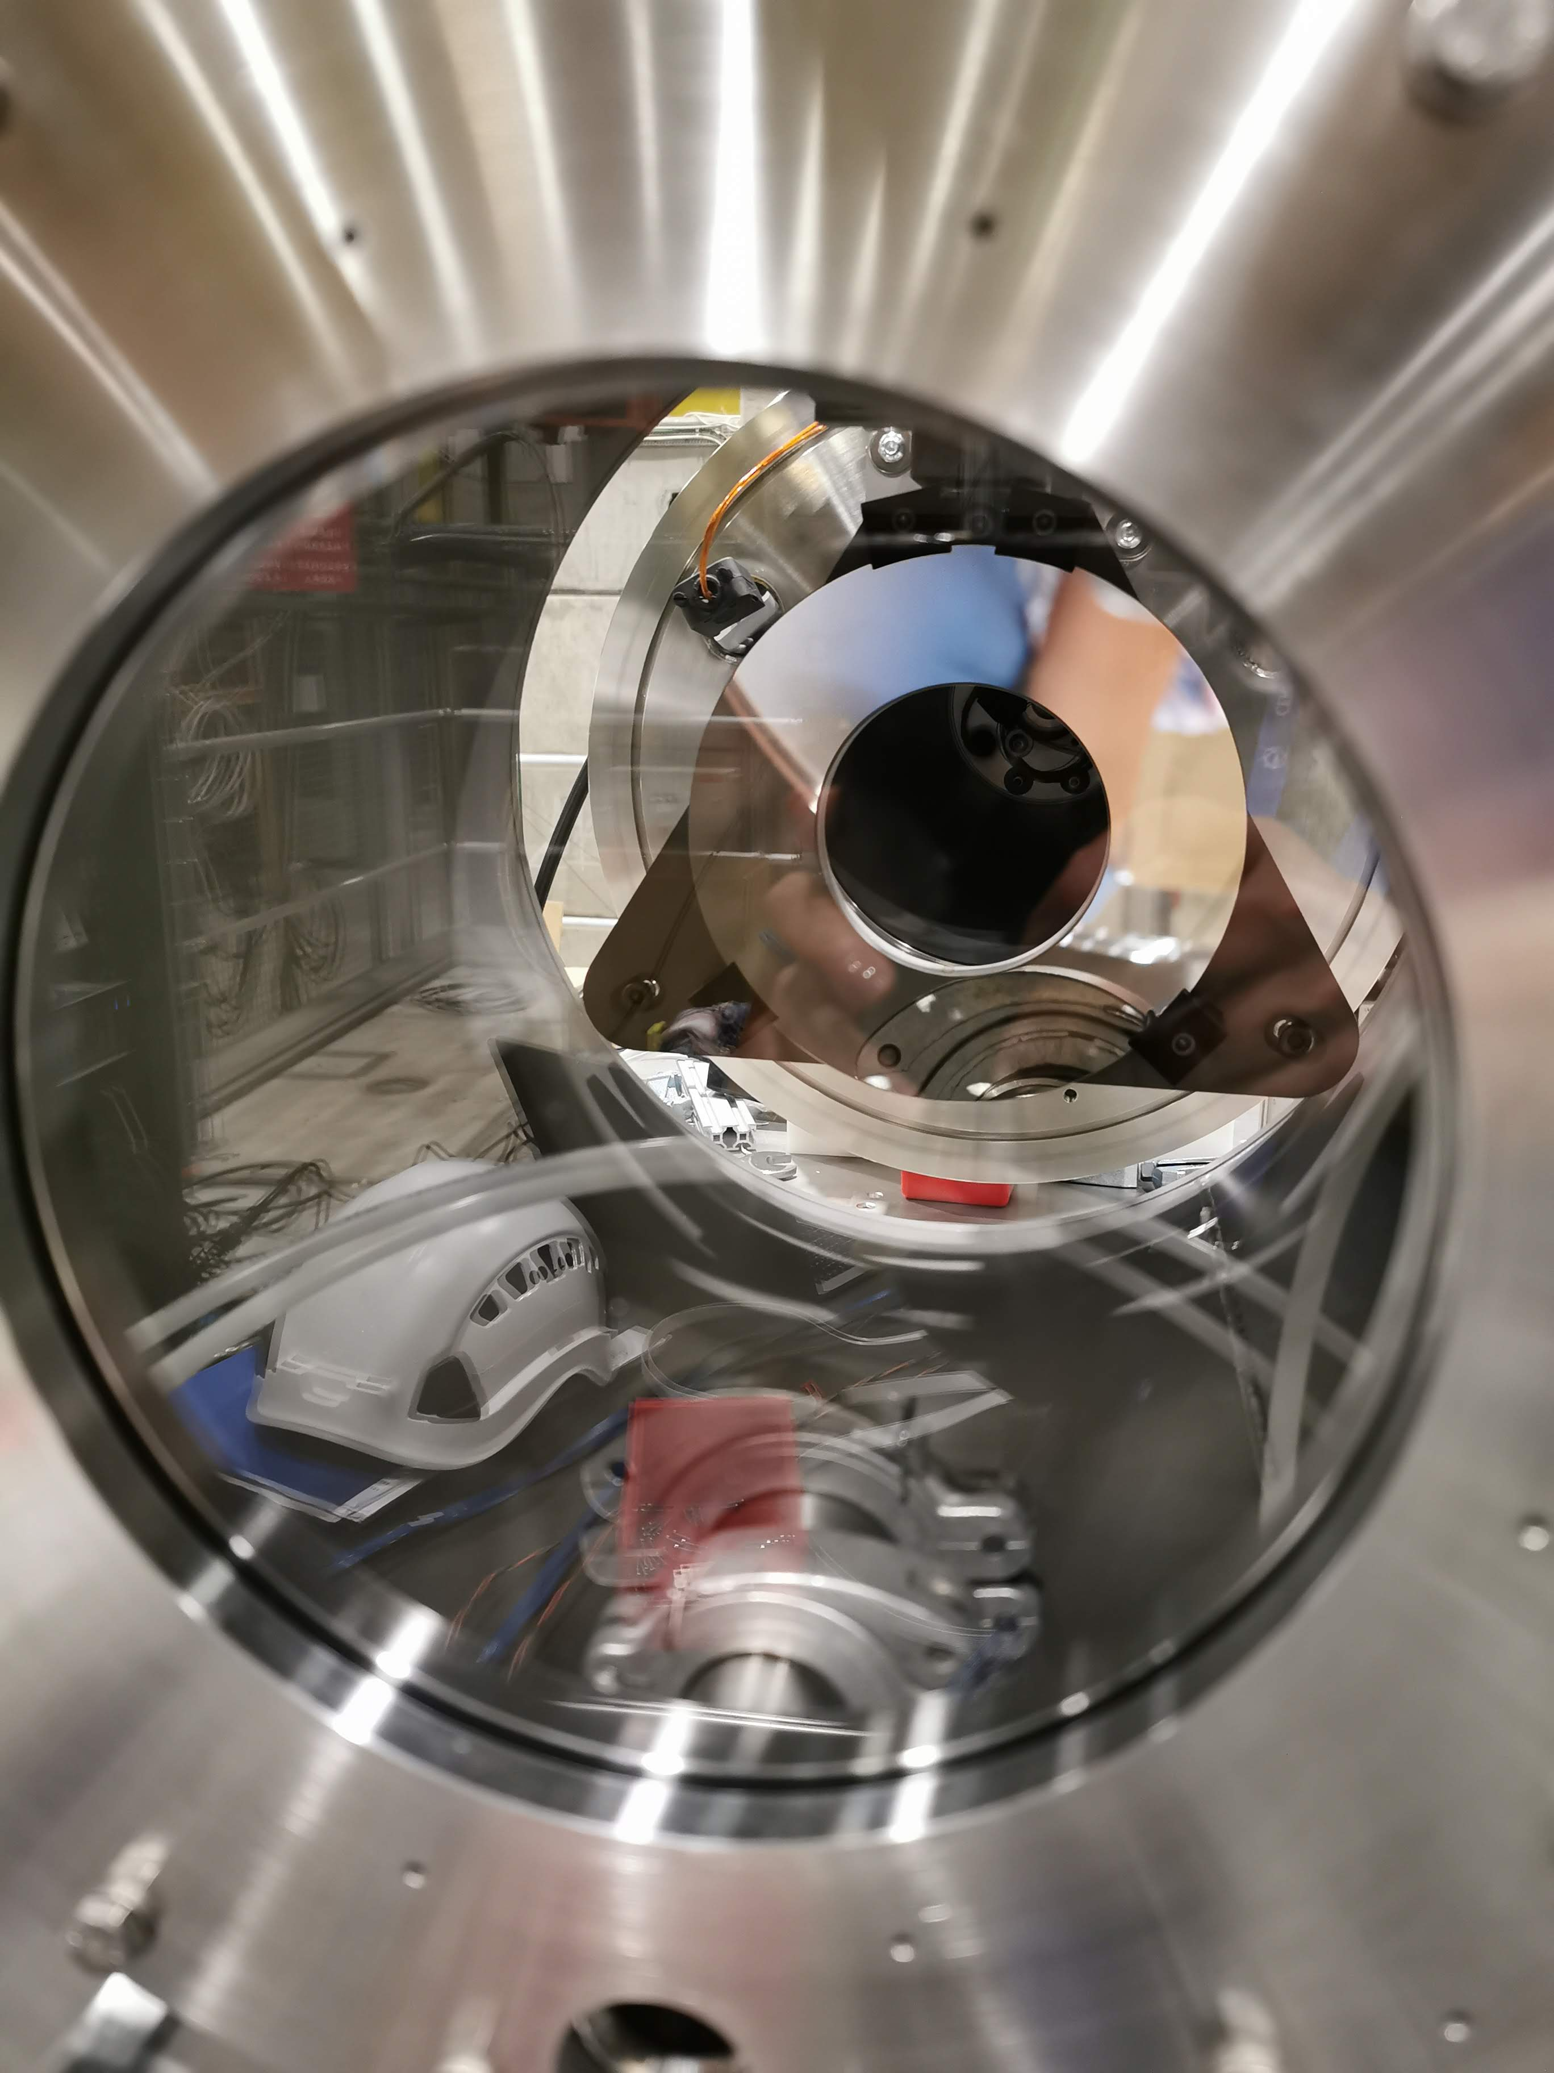
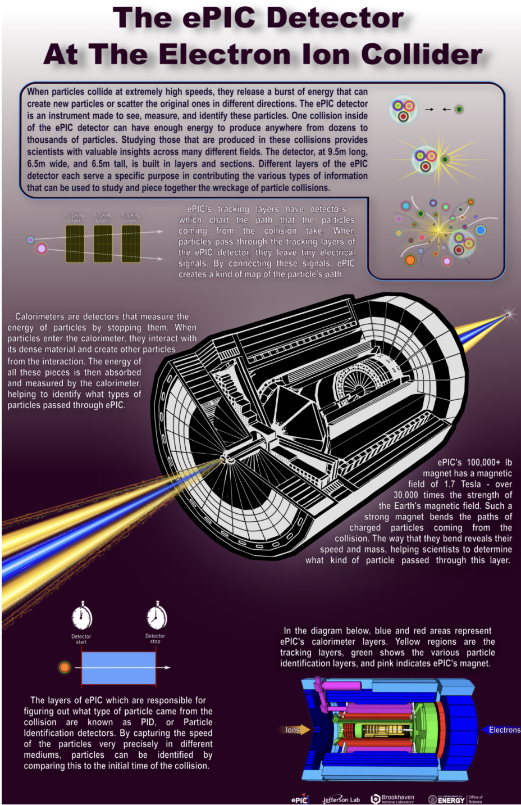
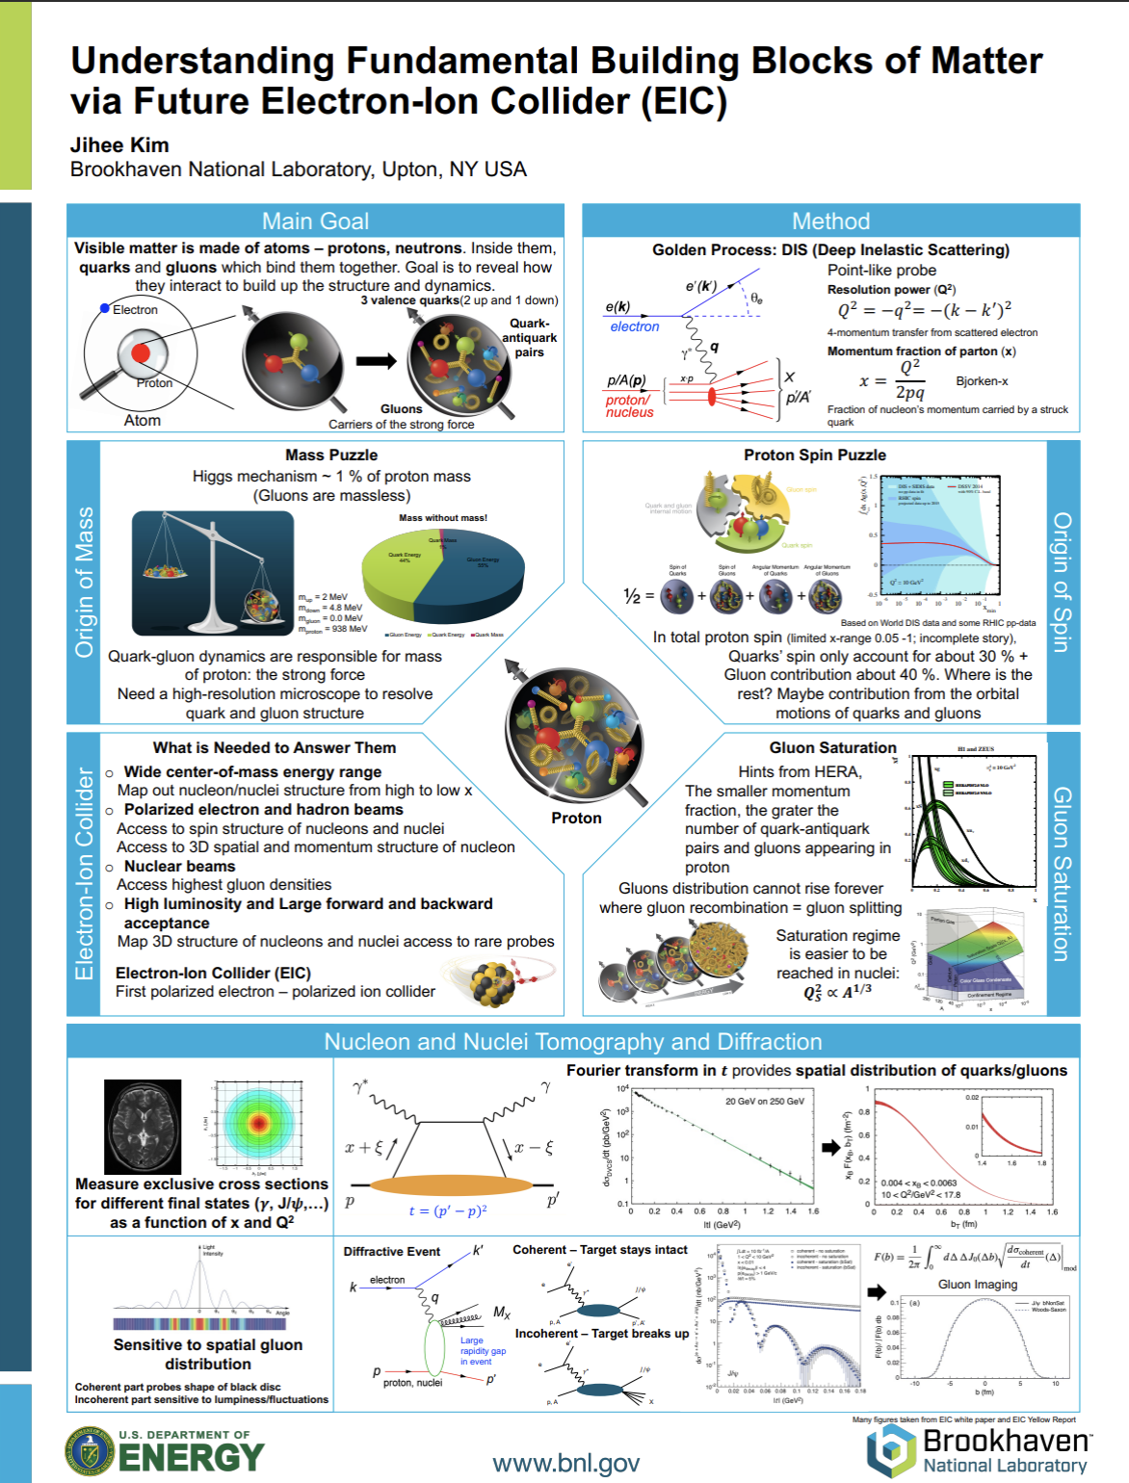
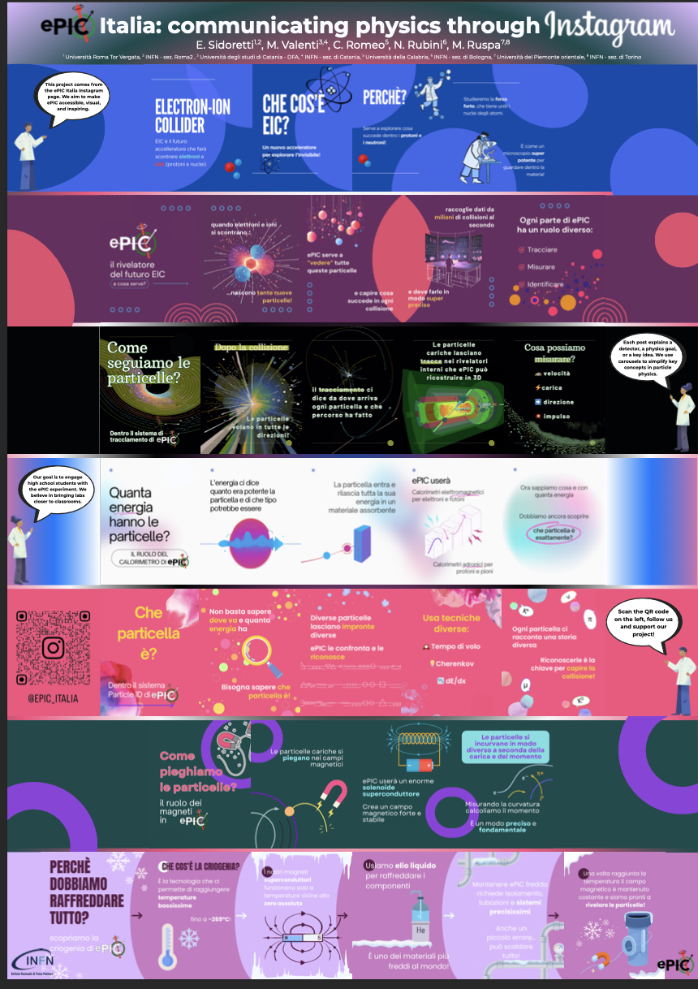
Activities
Past: Photo Contest during the January 2025 ePIC collaboration meeting
Continous:
Survey to collect information about all existing outreach activities (ePIC or EIC oriented) worldwide
Form to be filled: EIC-ePIC-OutreachResources-v1.xlsx
If you have not done so, please fill the form collecting information about your institution, your input is precious!
Aims:1. prepare a list of all available resources, country by country
2. identify (after consulting with you again) those resources/initiatives which can be replicated and shared
EIC-UG / ePIC Meeting July 2025: Poster and Photo-Contest
Winner: Photo Contest Poster Contest
1st Place Category-I 1st Place Category-II Best Overall
Lauren Kasper Jihee Kim E. Sidoretti
1st Place 1st Place 3rd Place
Roberto Perghenella Julien Bettane Christina Tuve

Slide 5
WG Summary
Great discussions on what to do next, but we need some more people helping with the activities
Action Items:
Create a repository with all the material (posters, photos, …)
→ started Outreach
Collect all the country EIC webpages and link them at one place
Open our own you-tube channel
→ thanks to Jennifer done
→ Collect all the videos already existing about EIC and think about a playlist
Collect mobility information of students
→ will do a survey of possibilities for fellowships and other grants for foreigners in different countries
Masterclass on EIC:
One on PID identification
One on the 3D structure of the proton
→ The day we will have a Masterclass program we could use it also as an “activity” to propose when
visiting countries/institutes (e.g. Africa)
Ideas together with EC-EG
→ Organize an event how to give a public talk
→ work on social media presents of ePIC / EIC

Slide 6
Activities during next ePIC Meeting
Lunch and reception actions during the next meeting
→ Slam talk competition
→ have a game, like an escape room
→ will continue the photo and Poster Poster competition
for the Poster where thinking to add a video teaser (2min) linked by a QR
→ We think it would be nice to organize a Science pub event(s) during ePIC meetings

