Slide 1
Integration, Installation and Infrastructure (Triple I Group)
TIC Update
Roland Wimmer

Slide 2
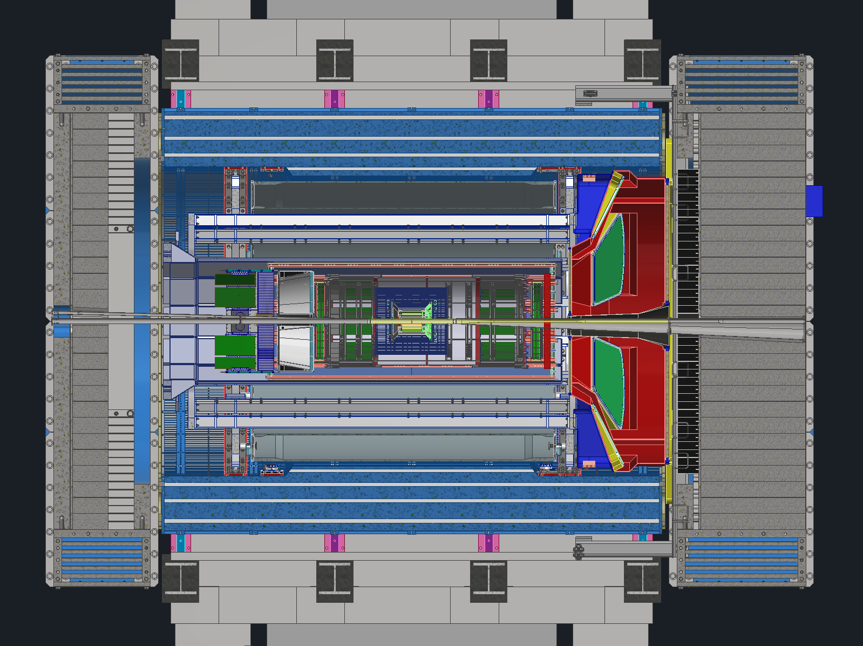
Detector Model Updates
Services Updates
GST + DIRC + oMPGD

Slide 3
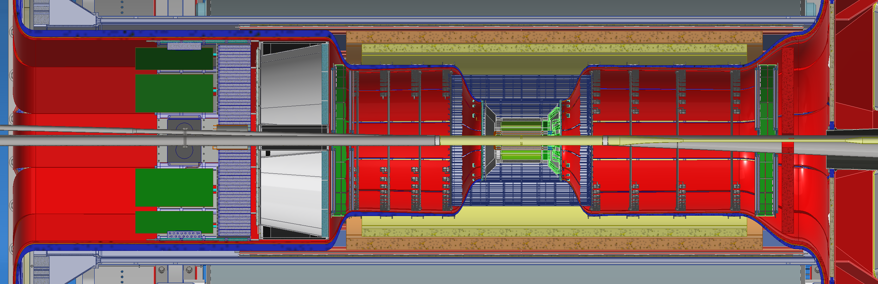
Services
Received updates to services from the changes made earlier this summer, thank you everyone
Currently checking that everything fits in all the gaps
Have to get together with Ben to make sure services leaving the PST have enough space
Once this is done, we will lock in all the envelopes, and each group will be confined to spaces currently allotted to them.

Slide 4
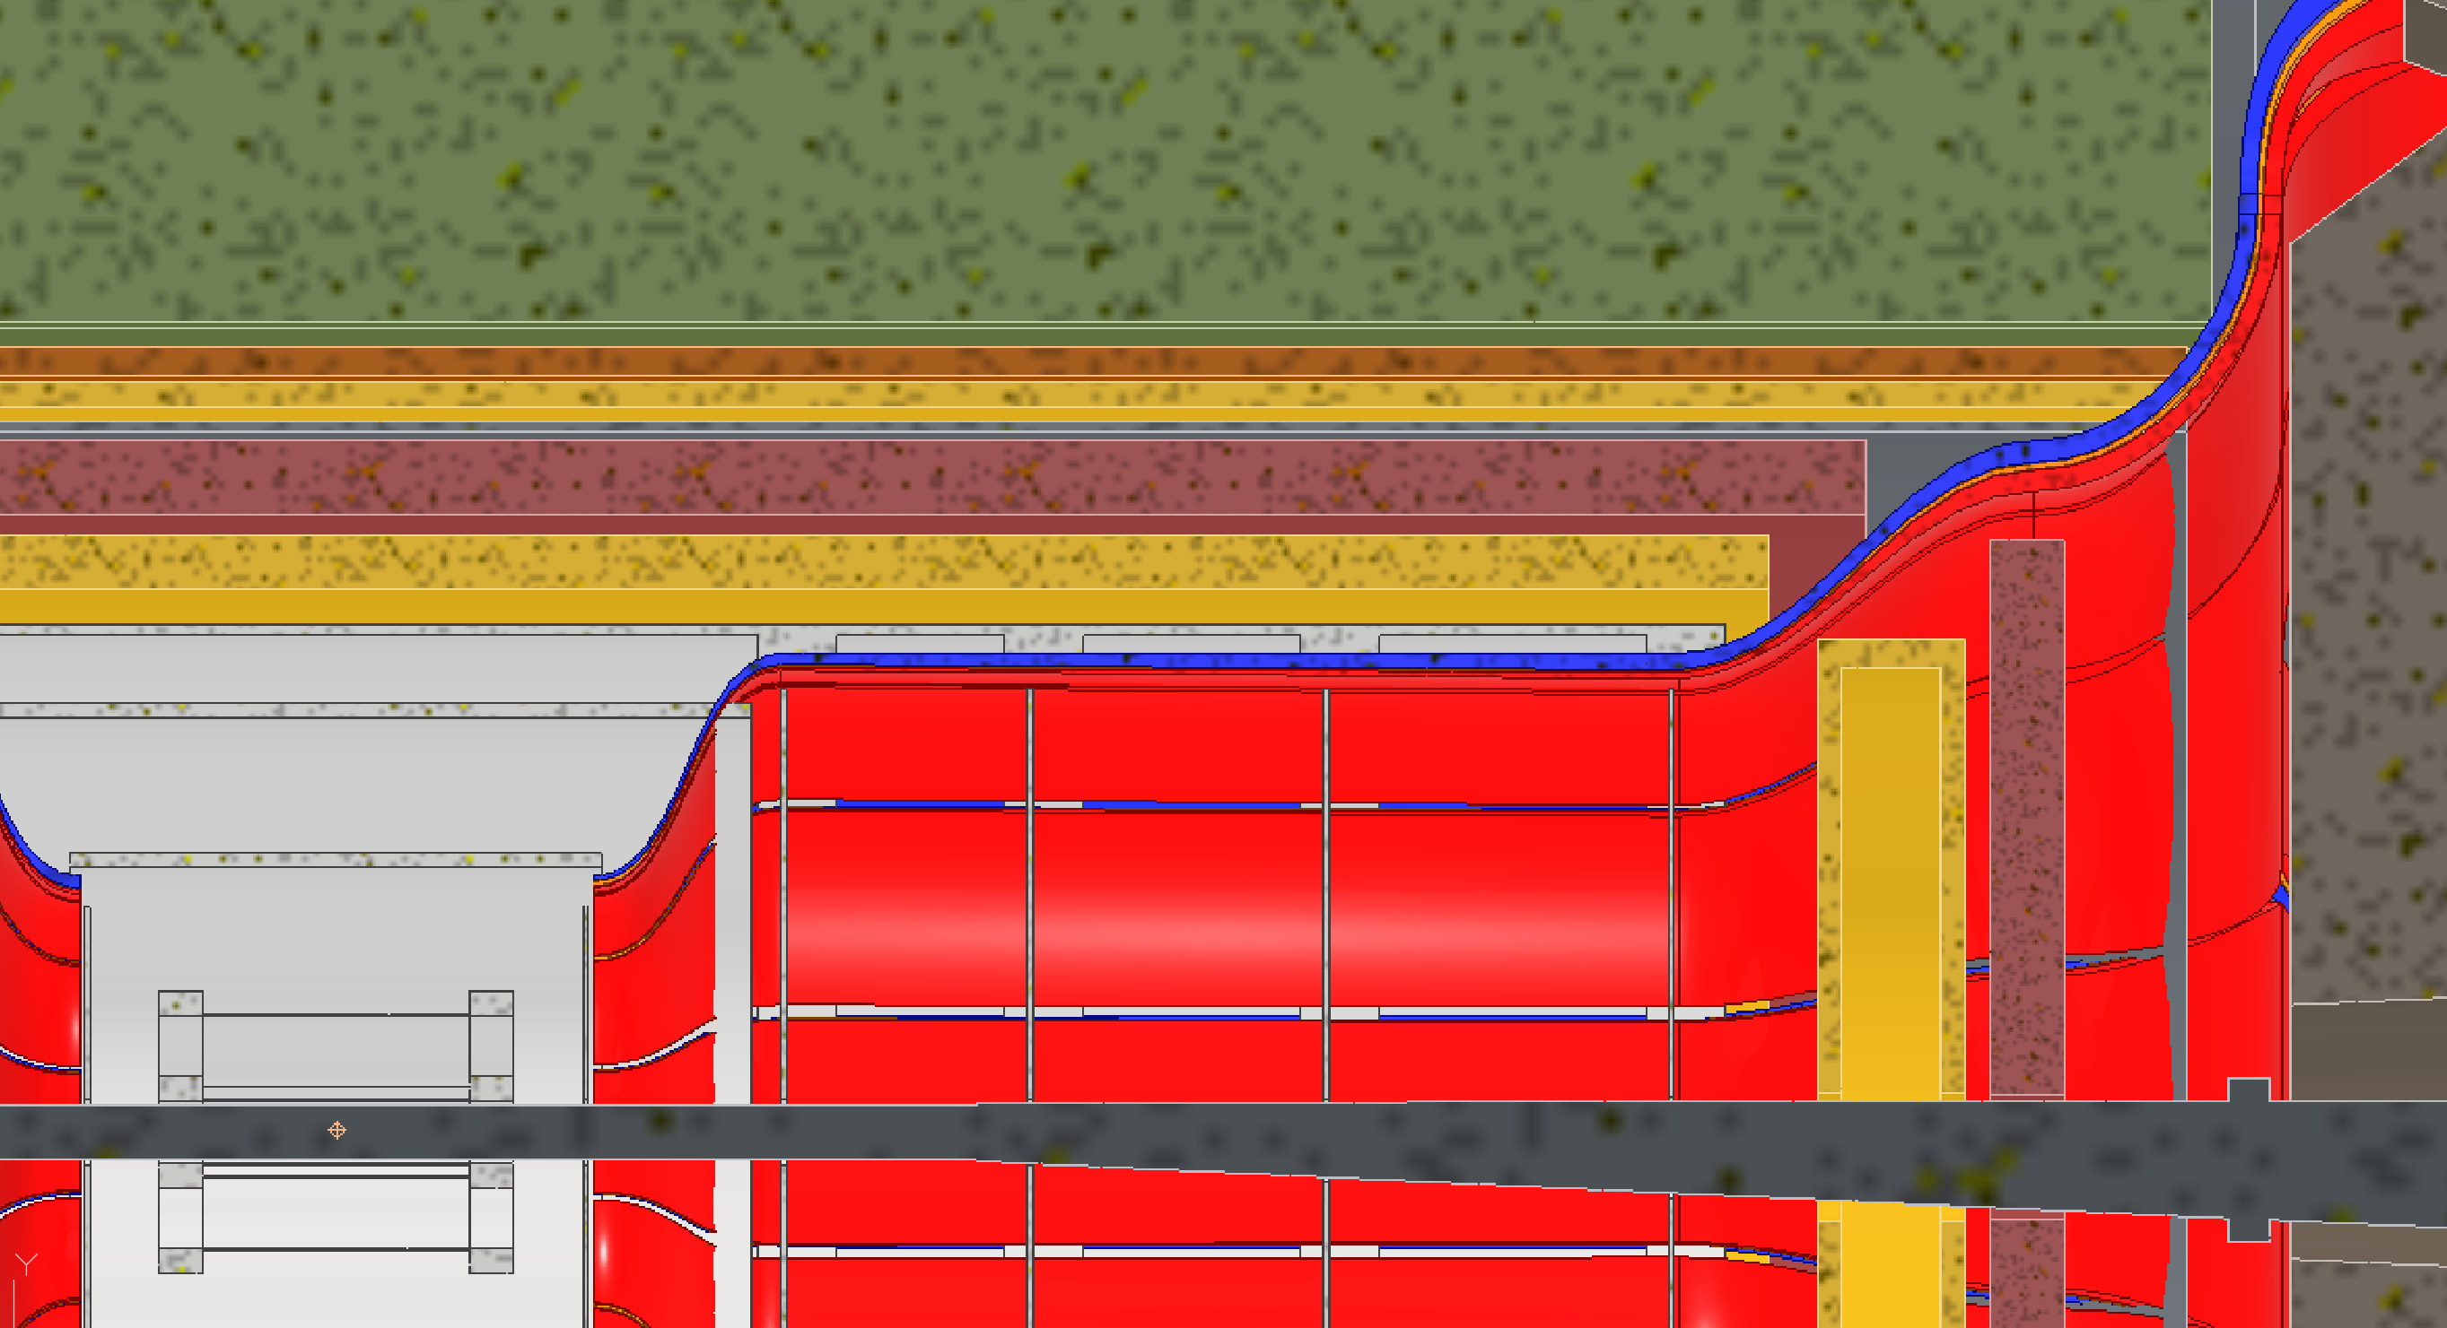
Services
Also looking into how services will interact on the forward end during maintenance
Currently the MPGD and ToF disks on the forward end need to be made smaller to accommodate CYMBAL and ToF sliding in and out

Slide 5
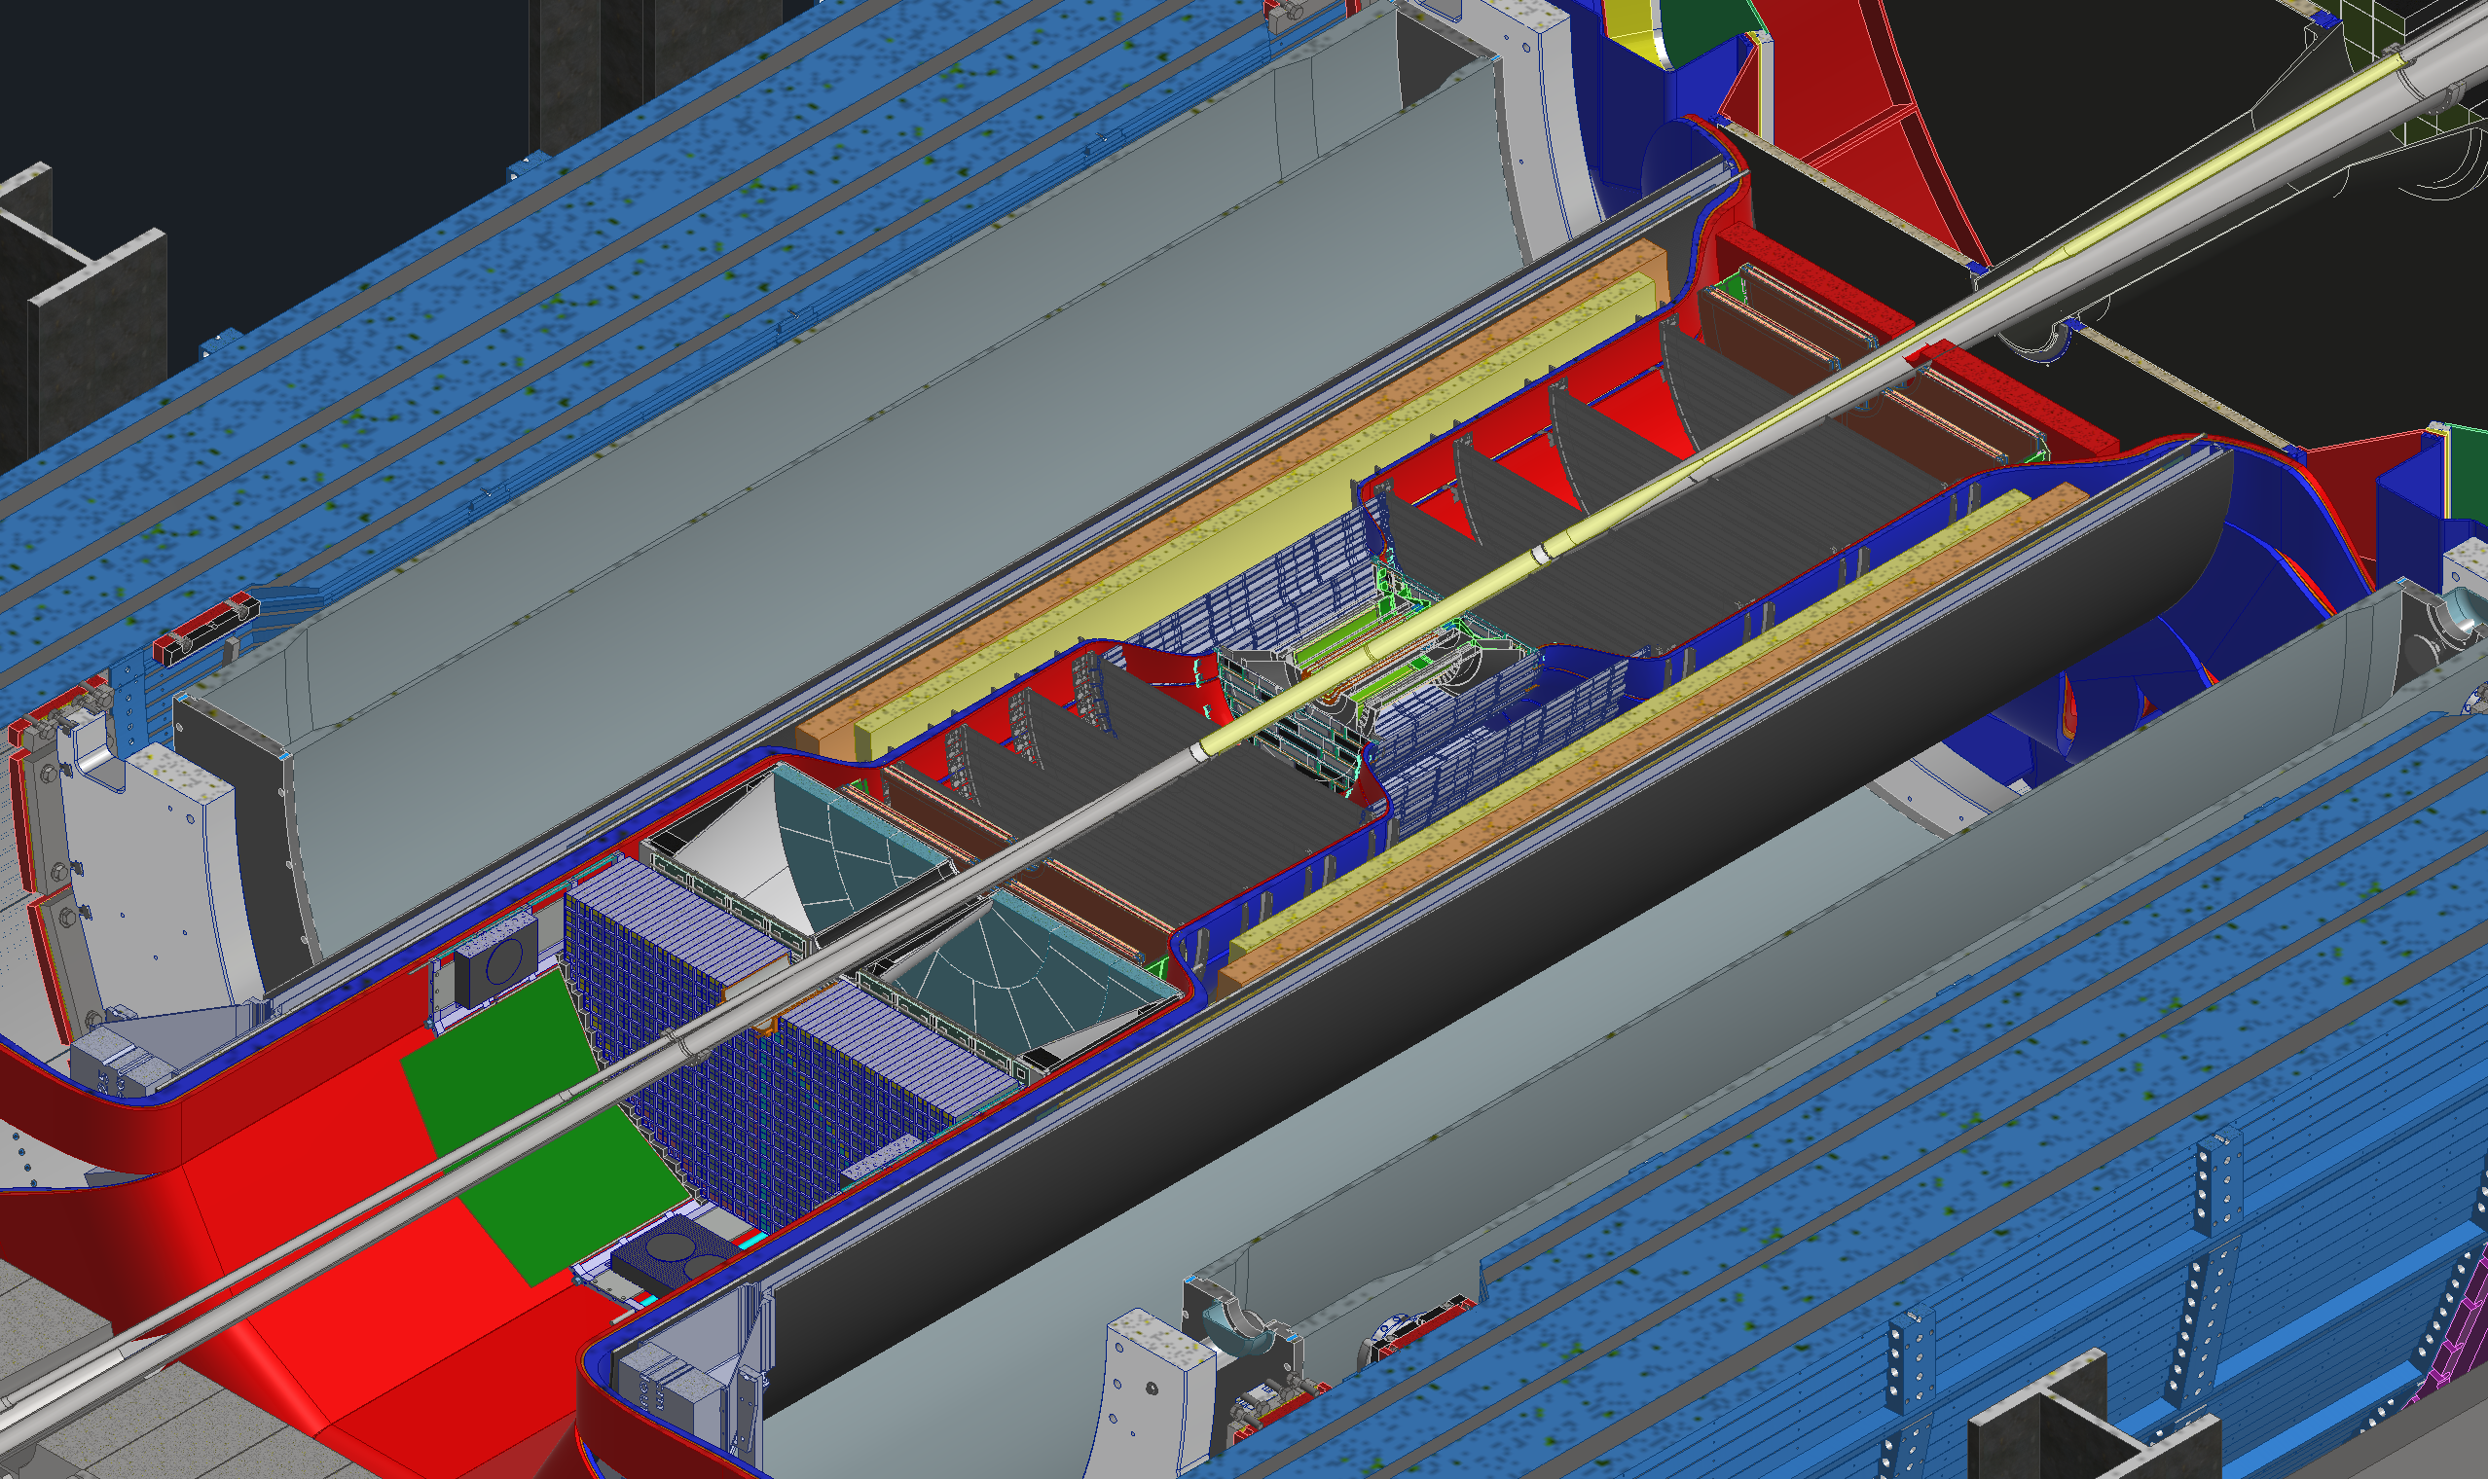
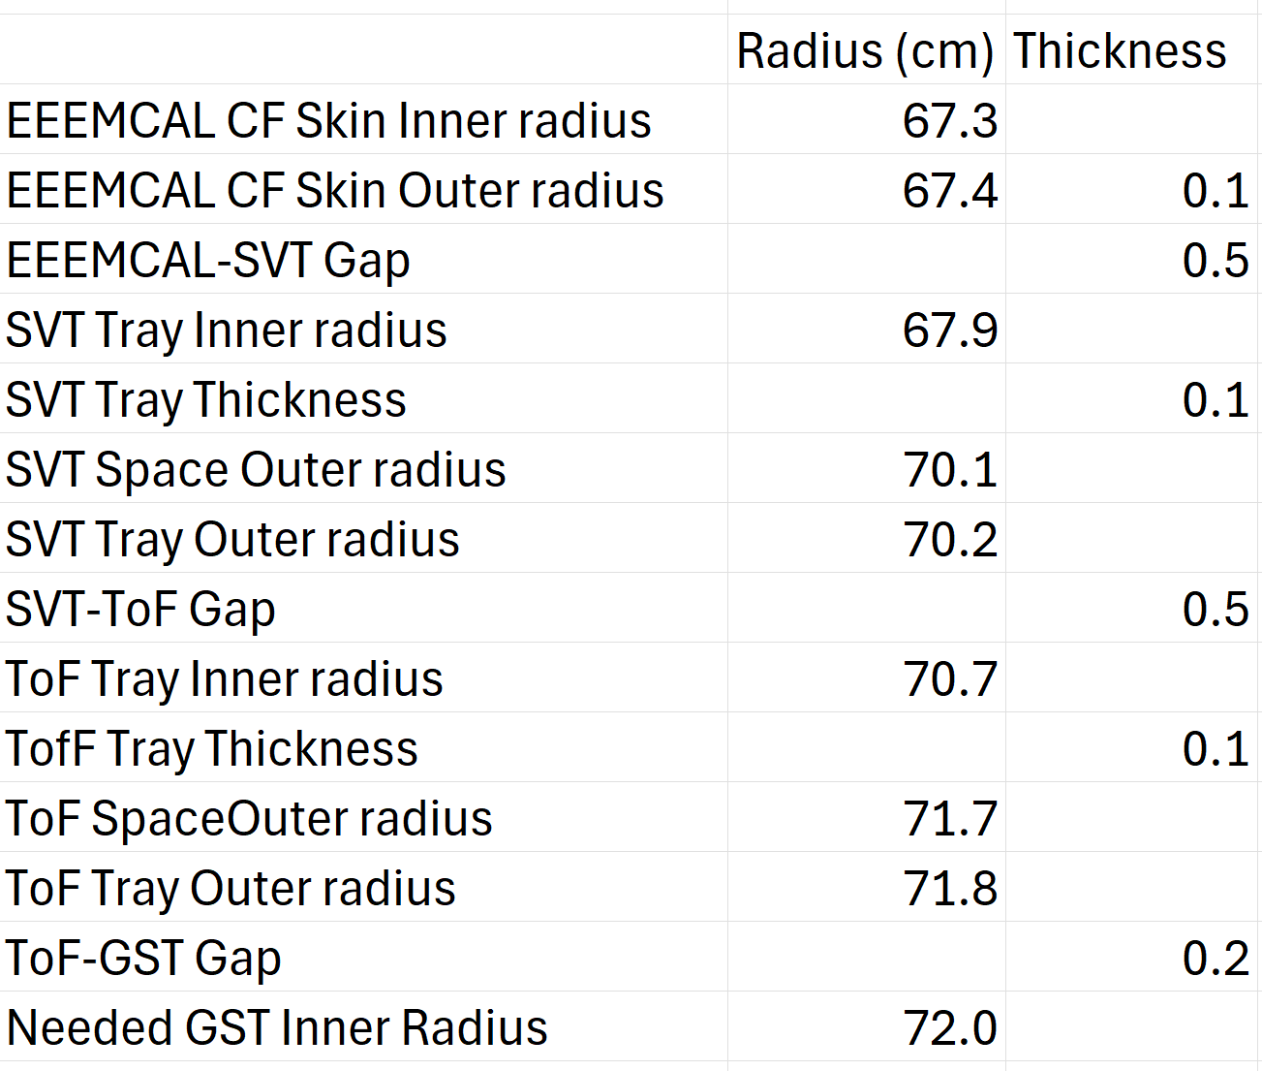
Services
Beginning to remove the contingencies from the services and replacing them with actual spaces needed for trays and such
EXAMPLE

Slide 6
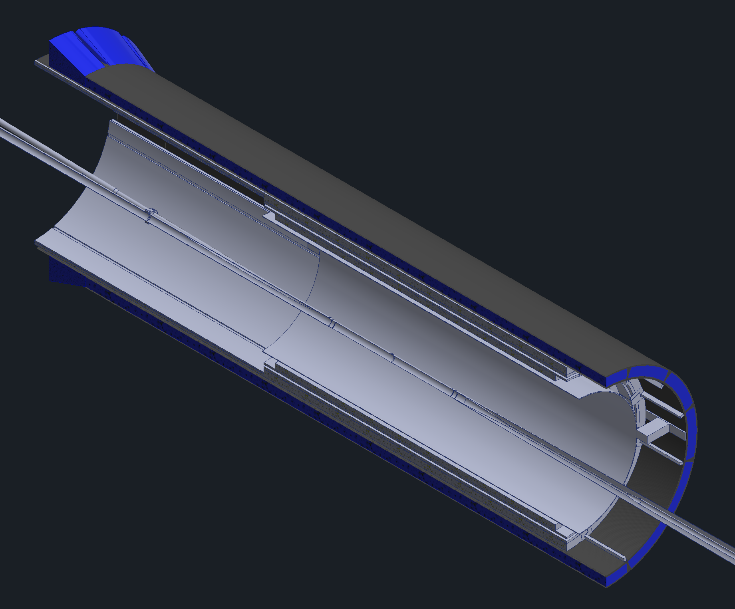
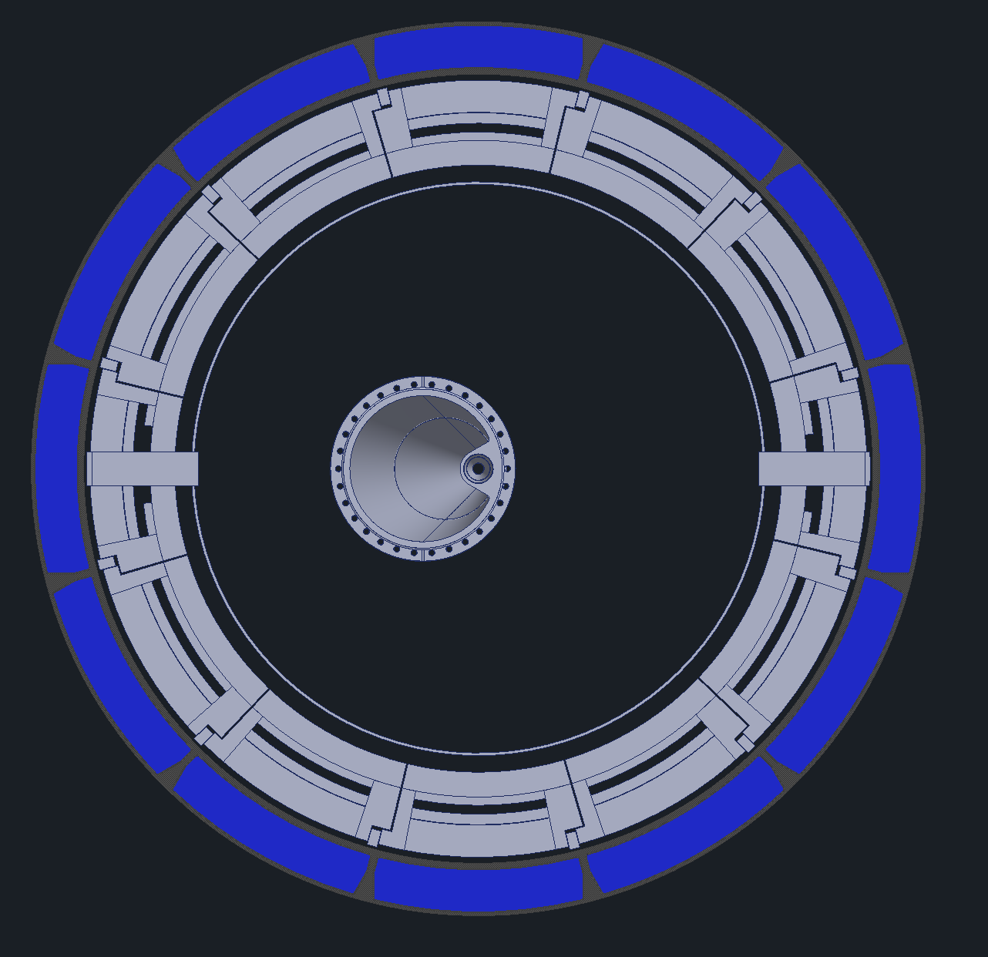
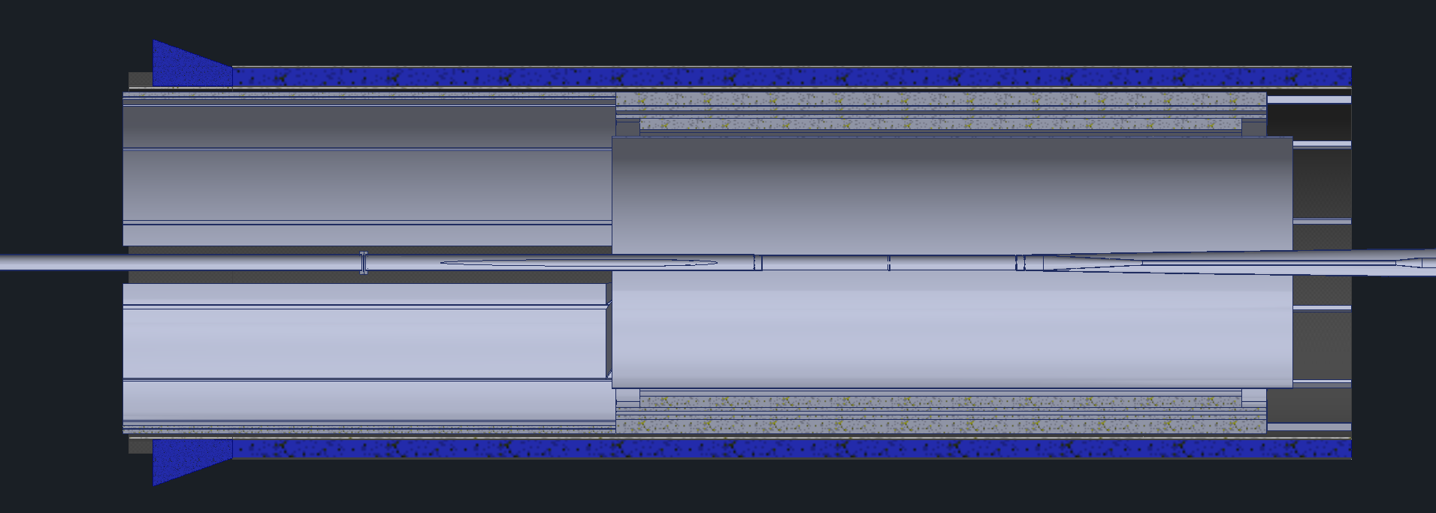
GST
GST will now support the DIRC and oMPGD
The blue in the images is the DIRC and oMPGD envelopes, the dark gray is the new GST shape
DIRC and oMPGD will be brought in slightly radially
Finalizing GST ID and services space first

Slide 7
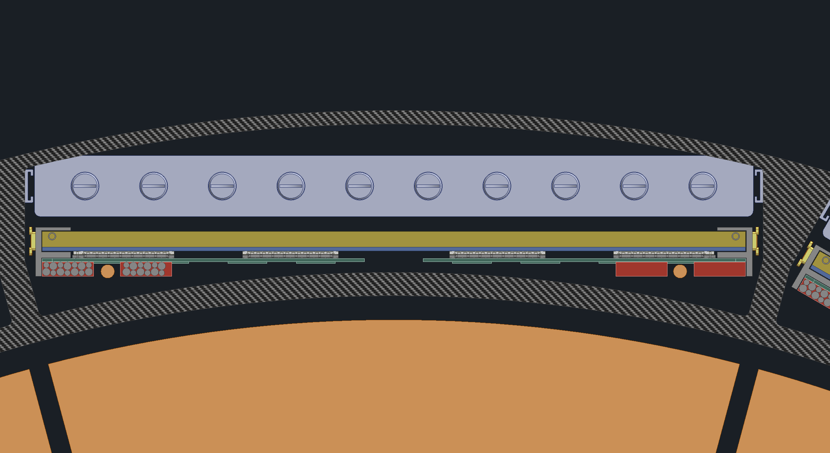
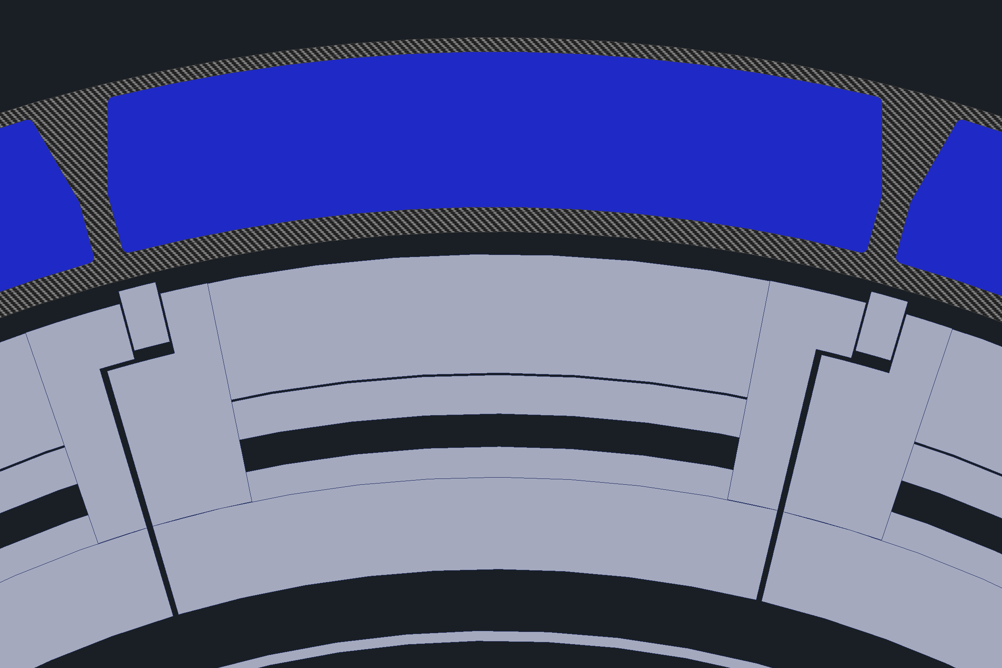
GST
GST will have 12 slots on its old outer diameter which the DIRC and oMPGD will slide into
There will be rails inside of these slots for each of the detectors
Installation will remain the same, only the sequence changes slightly

Slide 8
Backup Slides

