Slide 1
Electronics & DAQ WG
Fernando Barbosa (JLab)
24 July 2025

Slide 2
Welcome & News
News
Collaboration meeting 14 – 18 July 2025
CALOROC 64 ch or 32 ch
Technical aspects - Norbert
Cost impact estimate – Fernando
Concurrence from collaboration TBD
AOB

Slide 3
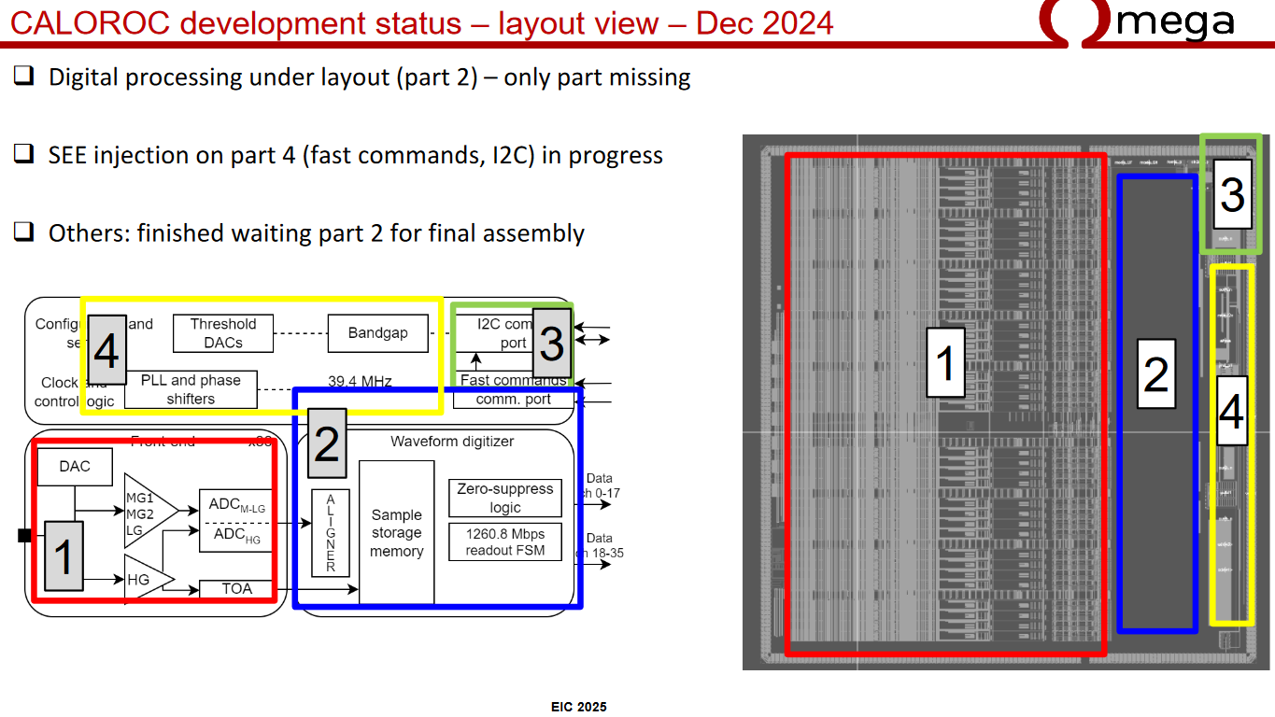
Cost impact estimate from CALOROC 64 ch (nominal) to 32 ch
Current design submission has 36 ch
Si area usage:
Frontend (1) ~70% area
Backend (2,3,4) area will remain ~ the same regardless of the 64 or 32 [72 or 36 ch] implementation
Area (64) ~ 1.7 x Area (32)

Slide 4
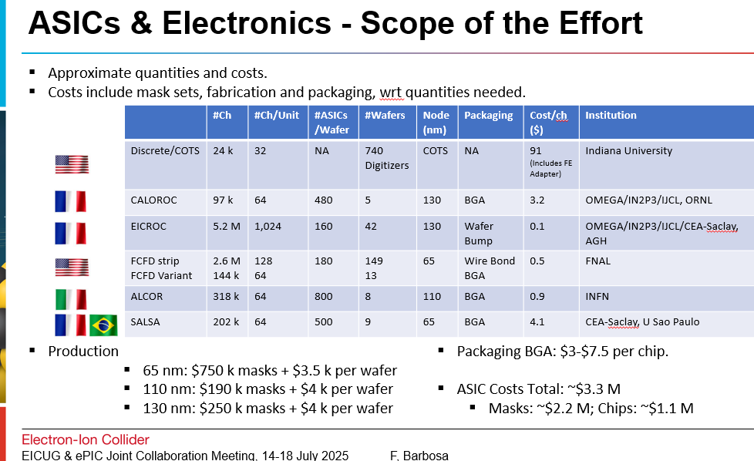
Cost impact estimate from CALOROC 64 ch (nominal) to 32 ch (cont)

Slide 5
Cost impact estimate from CALOROC 64 ch (nominal) to 32 ch (cont)
Quantities needed: 97k channels
Area (64) ~ 1.7 x Area (32)
Ch/CALOROC | #ASICs/Wafer | #Wafers | Total #Ch | #Packages
64 | 480 | 5 | 153,600 | 2,400
32 | 816 | 6 | 156,672 | 4,896
Cost Delta = 1 x $4k (additional Wafer) + 2,496 x $7.5 (additional 2,496 packages) = $22,720
Cost of 32 ch version is higher by ~$25k
There are additional costs for the additional packaged devices:
Testing
PCB assembly
Total additional costs are not excessive:
The current submission has 32 ch – 64 ch requires an additional design and submission cycle.
Decision should primarily be determined on technical merits.

