Slide 1
mRICH Protoype 2
Cheuk-Ping Wong
Georgia State University
02-27-2017

Slide 2
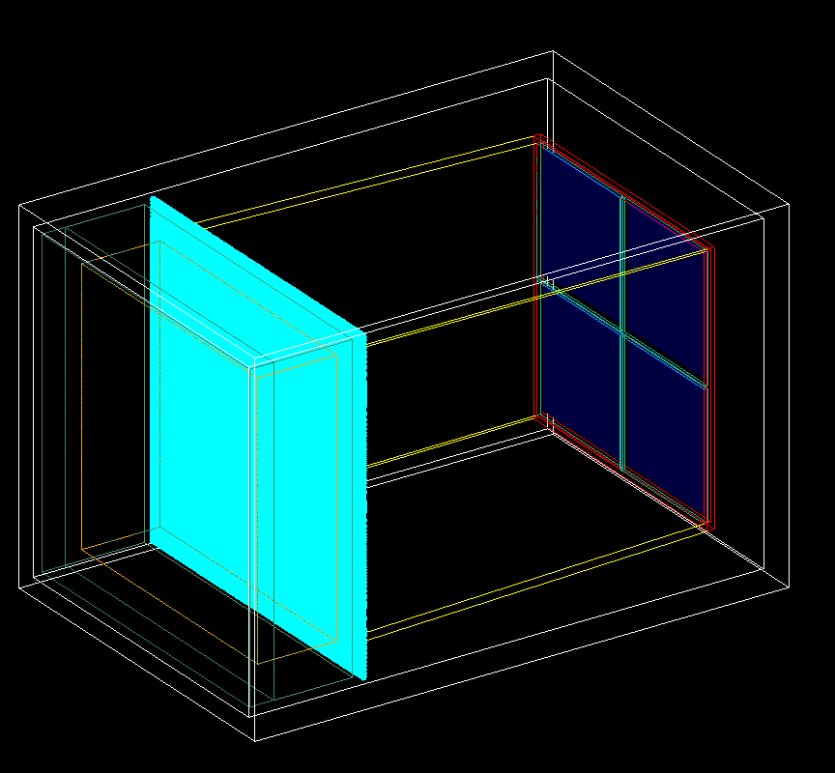
mRICH 2nd Prototype Detector
aluminum detector box
6” focal length Fresnel lens
Mirror set
Glass windows
And sensors
Readout electronics
Fresnel lens
Aerogel
Foam holder
Holder box

Slide 3
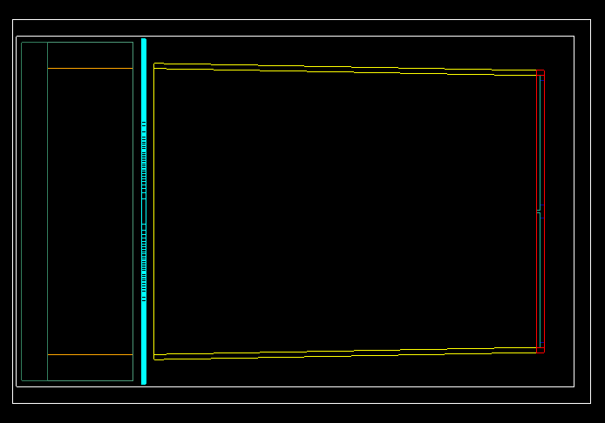
Detector Side View
Aluminum (G4_Al)
1/4”
1/16”
6”=152.4 mm
1/4”
1/4”

Slide 4
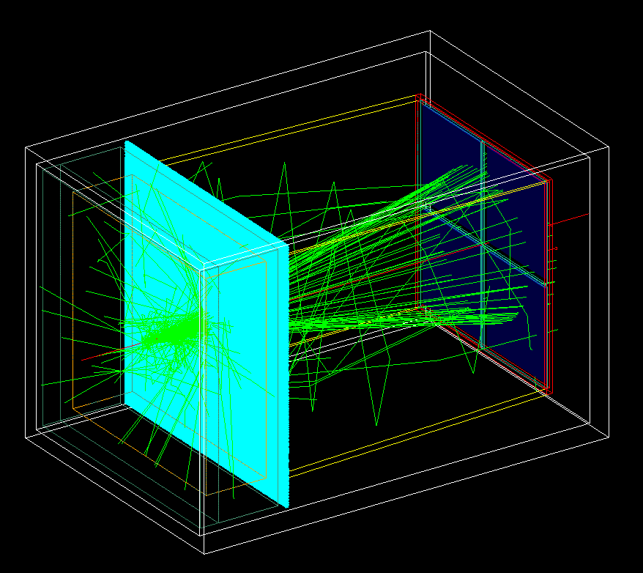
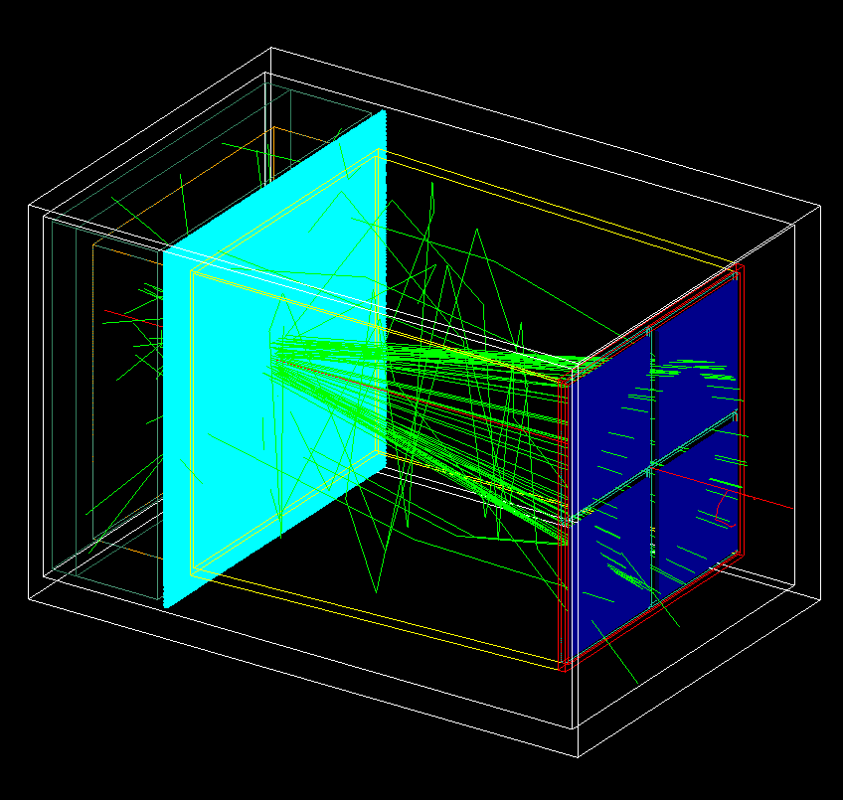
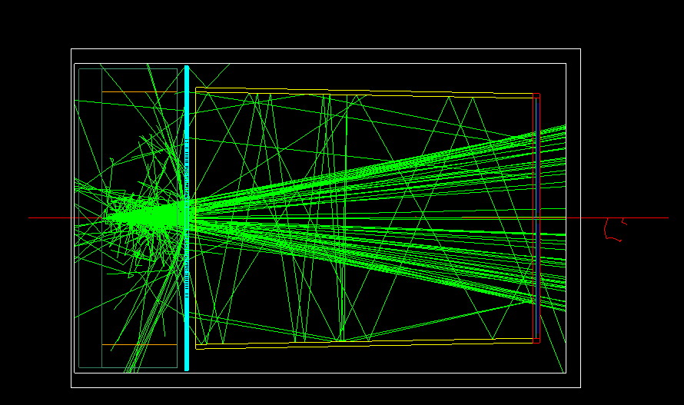
Incident Pion
Single pion at 9GeV/c
-- pion- -- Optical photons

Slide 5
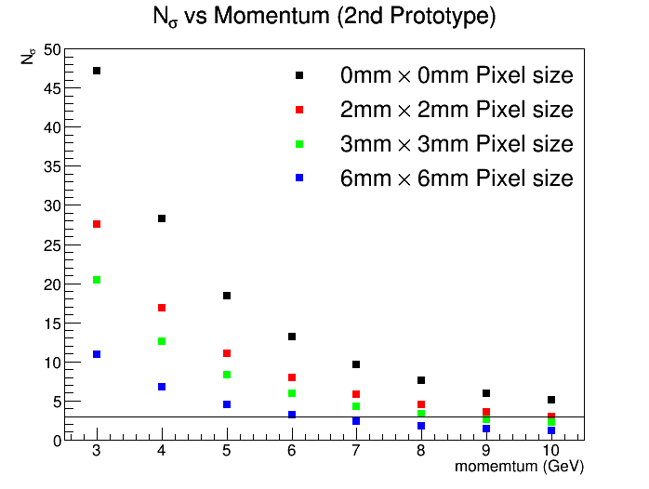
Separation Power

Slide 6
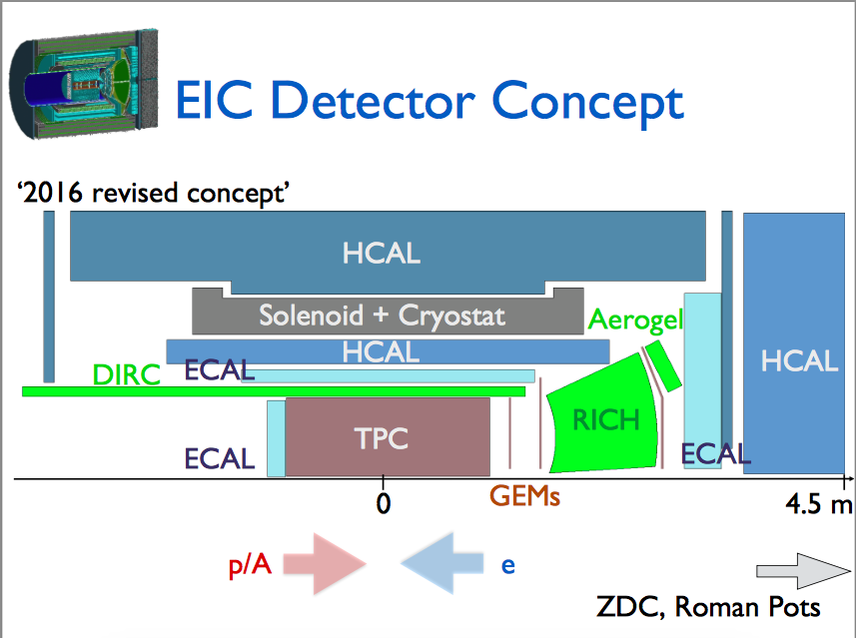
Next
Implementing mRICH detector in fsPHENIX simulation
Christine Aidala and Nils Feege,
sPHENIX Cold QCD Topical Group Meeting, BNL, Nov 15 2016

Slide 7
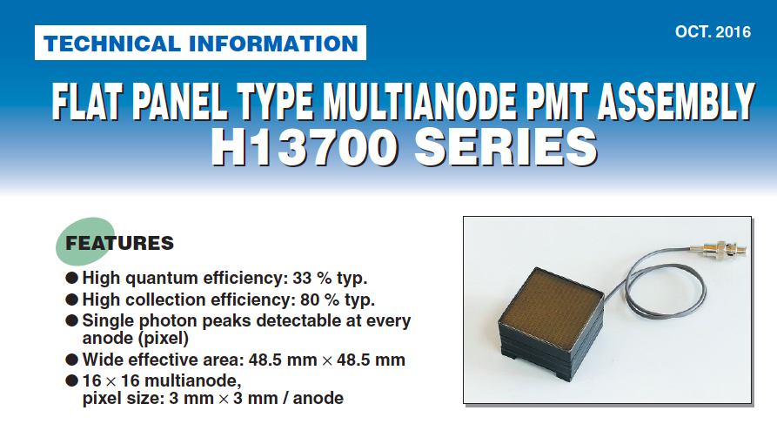
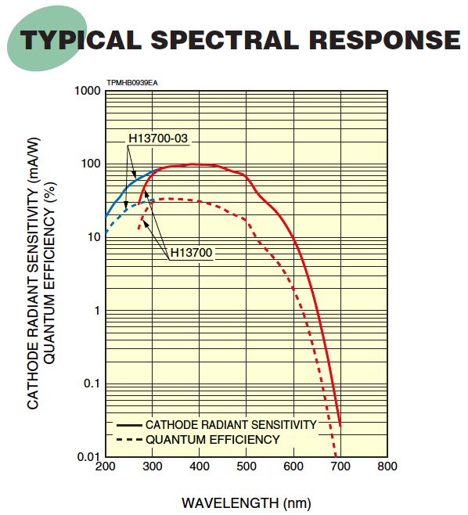
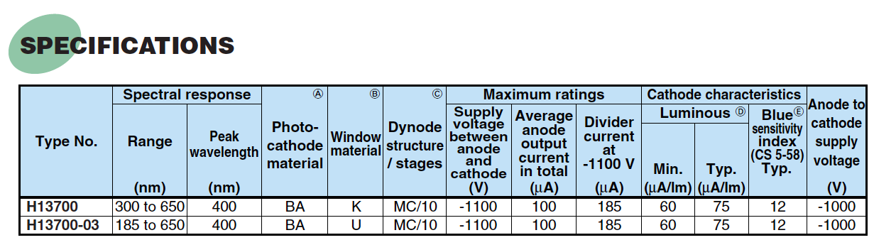
Photon Sensor for 2nd Prototype
Common use between mRICH and dual RICH
Expected delivery time: June

