Slide 1
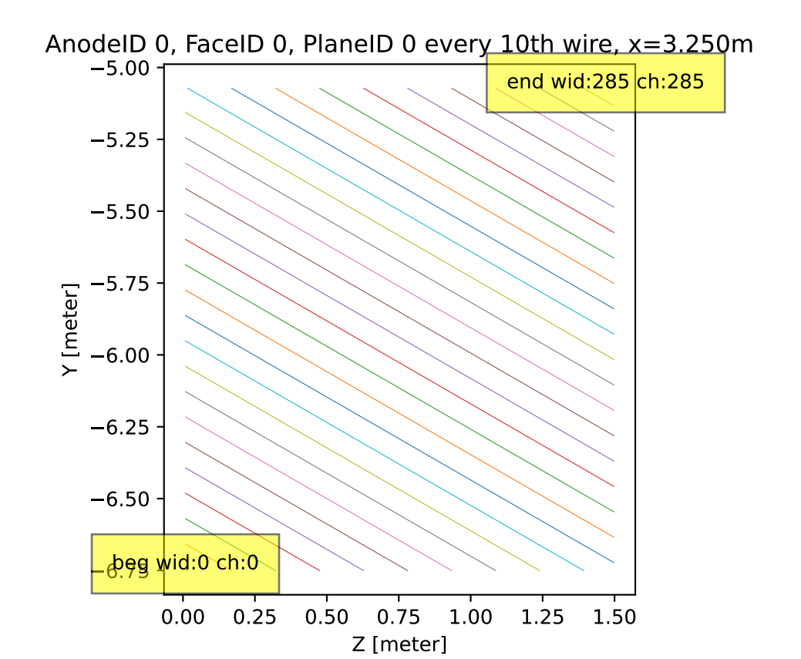
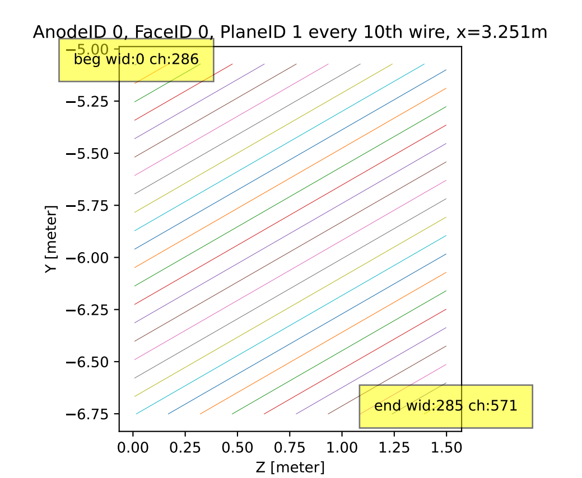
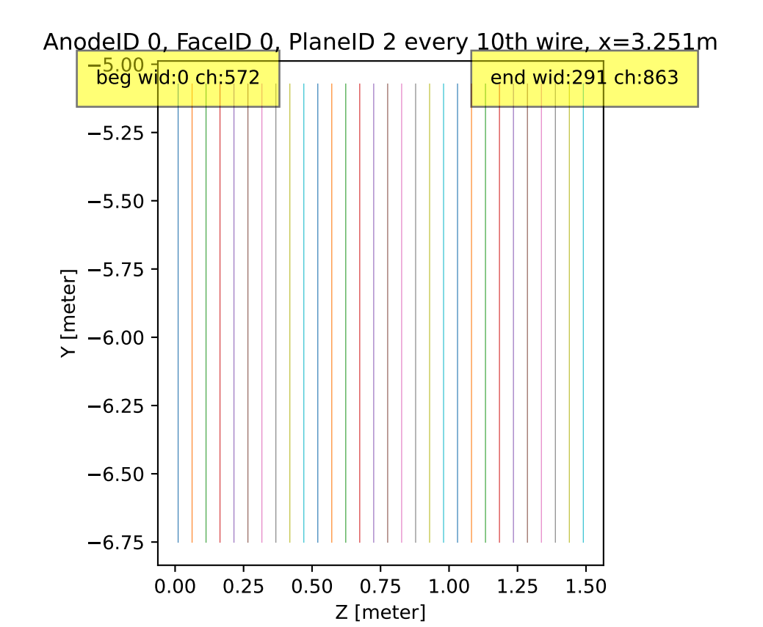
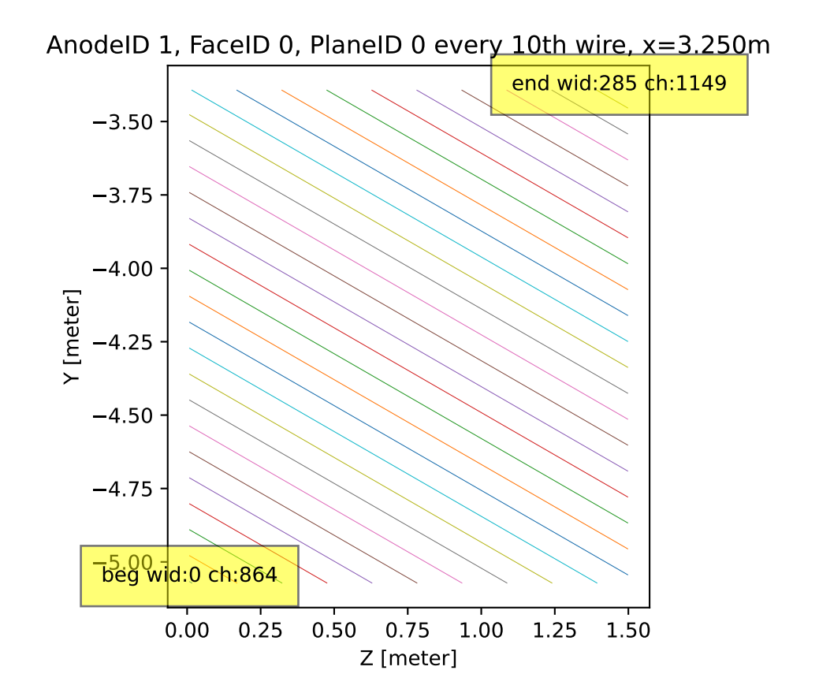
dunevd10kt_3view_30deg_v7_refactored_1x8x14.pdf
https://github.com/WireCell/wire-cell-toolkit/issues/369

Slide 2
dune10kt_dunefd_vertdrift_1x8x14_3view_data_nfsp
dunevd10kt_3view_v2_refactored_1x8x14ref.json.bz2
dune10kt_dunefd_vertdrift_1x8x14_3view_sim_nfsp
dunevd10kt_3view_v2_refactored_1x8x14ref.json.bz2
dune10kt_dunefd_vertdrift_1x8x14_3view_30deg_sim_nfsp
dunevd10kt_3view_30deg_v3_refactored_1x8x14ref.json.bz2
obsolete?

Slide 3
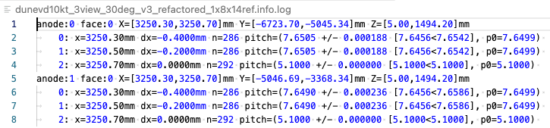

Slide 4
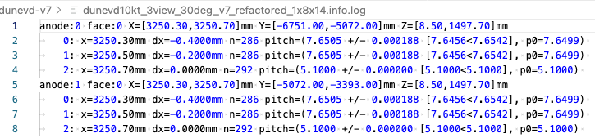
Seems x positions are NOT changed

Slide 5
06/24

Slide 6
FD-VD, bridged, CRU numbering
dunevd10kt_3view_30deg_v6_refactored.json.bz2
XYZ: 2x4x40
CRU0
CRU4
Y
f0U: 189-475
f0V: 1427-1142
f0Z: 2196-2487
f0U: 666-951
f0V: 1617-1903(r)
f0Z: 2780-3071
X ~ [-40, 13000] mm
3 | 7 | 11 | 15 | 19 | 23
3
2
2
1
1
0:0 | 4:0 | 8 | 12 | 16 | 20
0:1 | 4:1
 | 159
 | 158
 | 157
 | 156
0
-5.00
-6.75m
f1U: 0-285
f1V: 1238-952
f1Z: 1904-2195
f1U: 476-762
f1V: 1713-1428
f1Z: 2488-2779
0
1.5
20.75
59.9m
Z

Slide 7
FD-VD, bridged, CRU numbering
dunevd10kt_3view_30deg_v7_refactored_1x8x14
XYZ: 1x8x14
Y
X ~ [-40, 13000] mm
7
 |  |  |  |  | 44 | 52
 |  |  |  |  | 43 | 51
 |  |  |  |  | 42 | 50
 |  |  |  |  | 41 | 49
0 | 8 | 16 | 24 | 32 | 40 | 48
0
-5.00
-6.75m
0
1.5
20.75
59.9m
Z

Slide 8
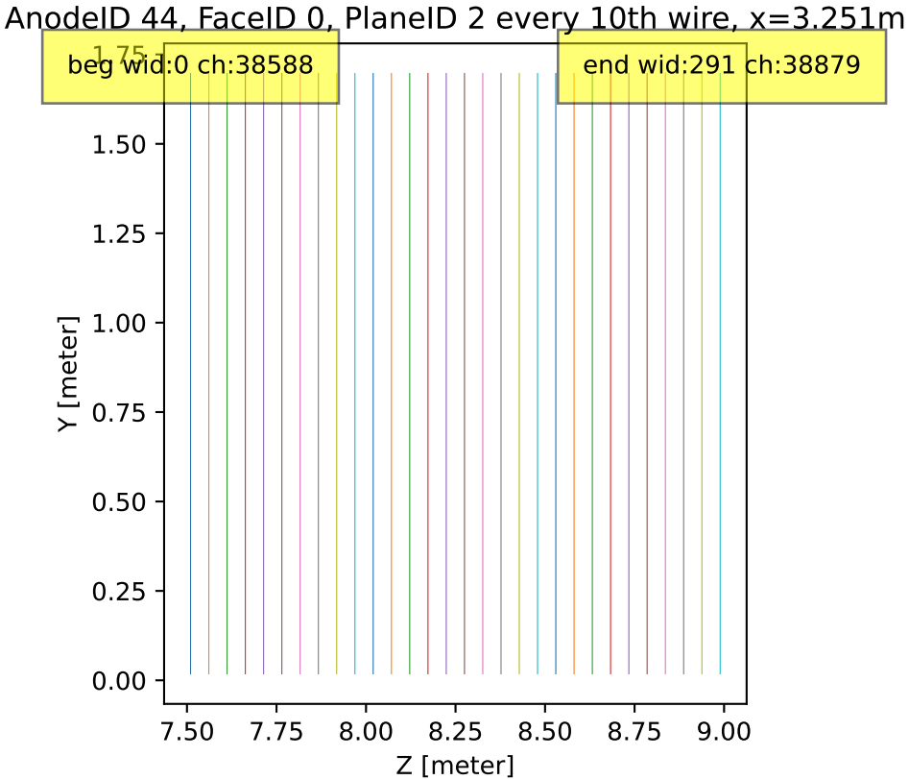
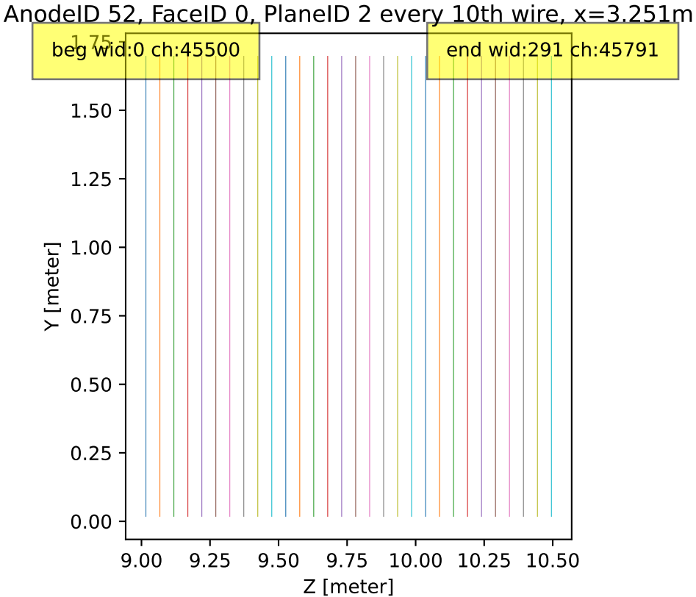

Slide 9
Talk, Jul 3

Slide 10
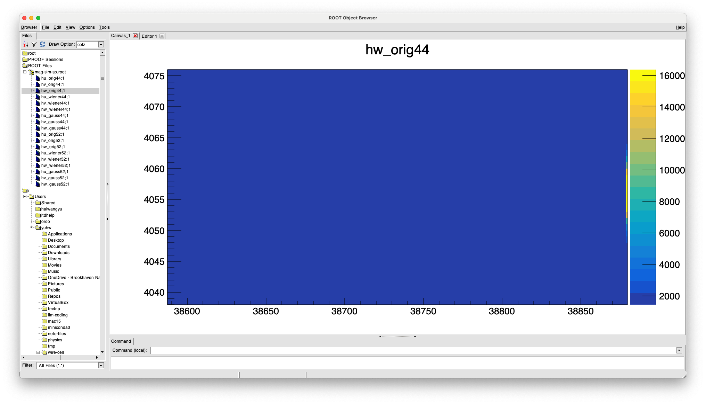
re-producing: orig - OK

Slide 11
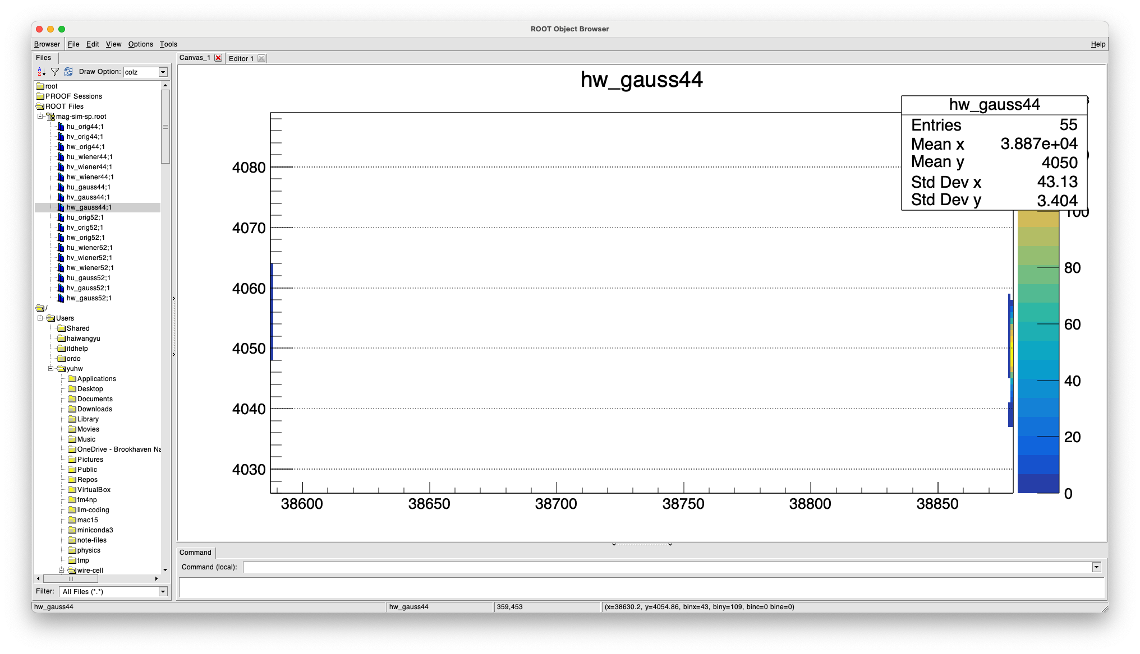
re-producing: gauss - Wrong

Slide 12
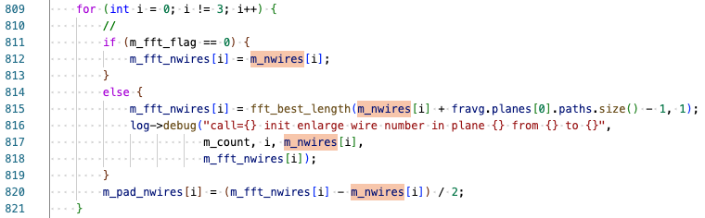
padding disabled together with fft_best_length

Slide 13
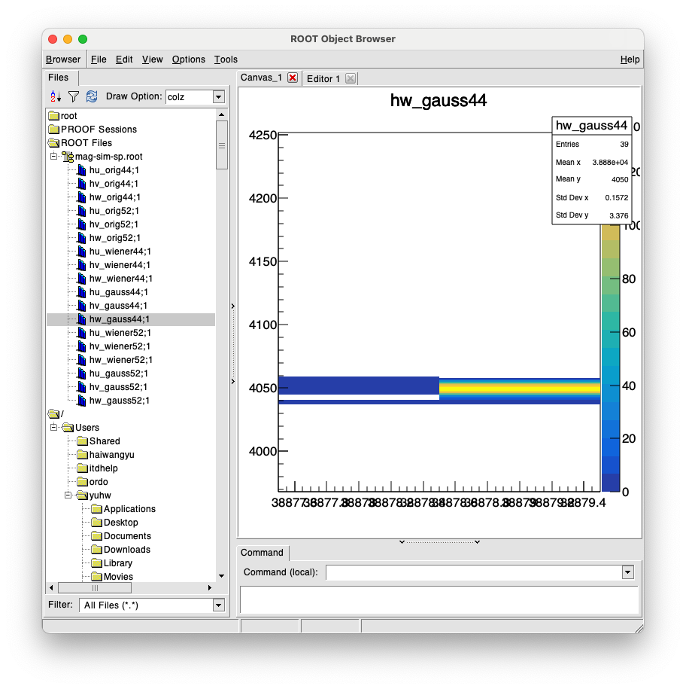

pad the non-fft-best-length version - OK

Slide 14
Summary
Will add the wire padding to the non-fft-best-length version
  how about tick padding?
    N+M-1
Seems this bug has been there since 4-years ago. - Many thanks to Daria for catching this!
  It seems to me the impact is small.
Why the fft-best-length was disabled?

Slide 15
backups

Slide 16
https://github.com/DUNE/dunereco/blob/develop/dunereco/DUNEWireCell/dune-vd/wcls-sim-drift-simchannel-nf-sp.jsonnet

Slide 17
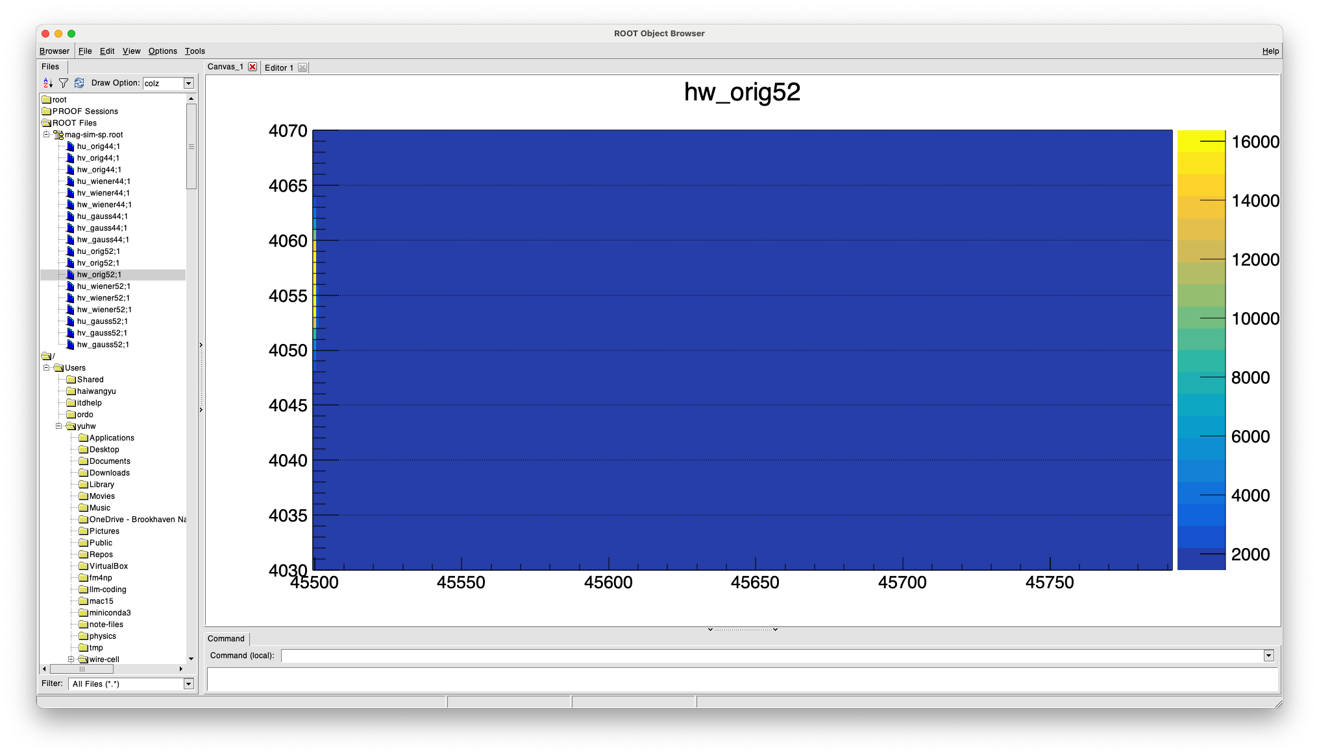
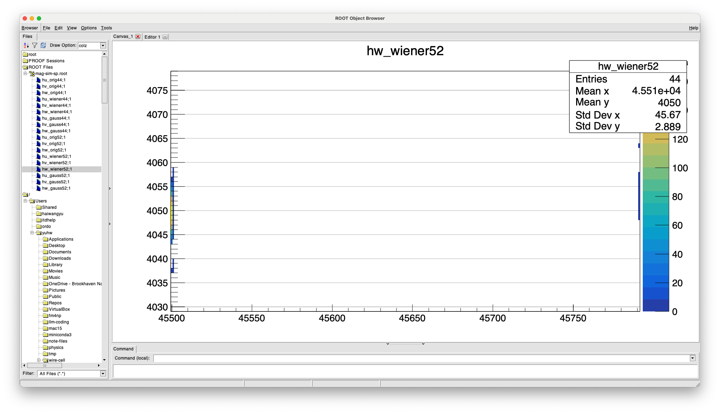

Slide 18
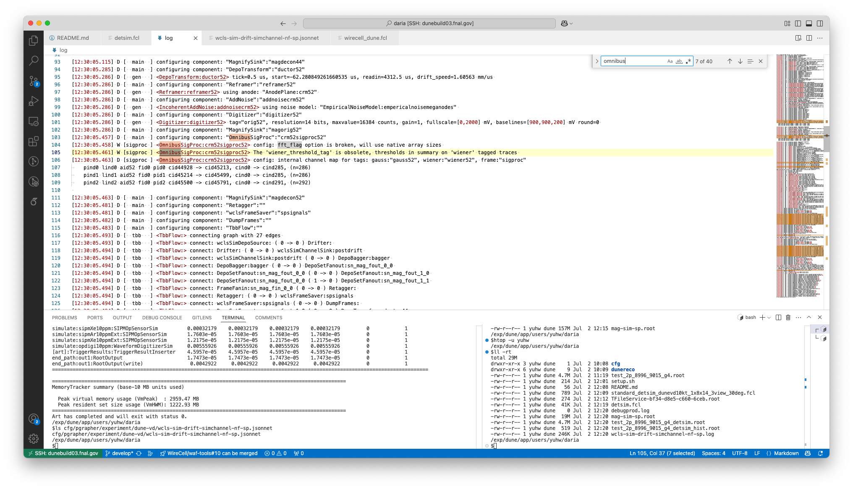


Slide 19
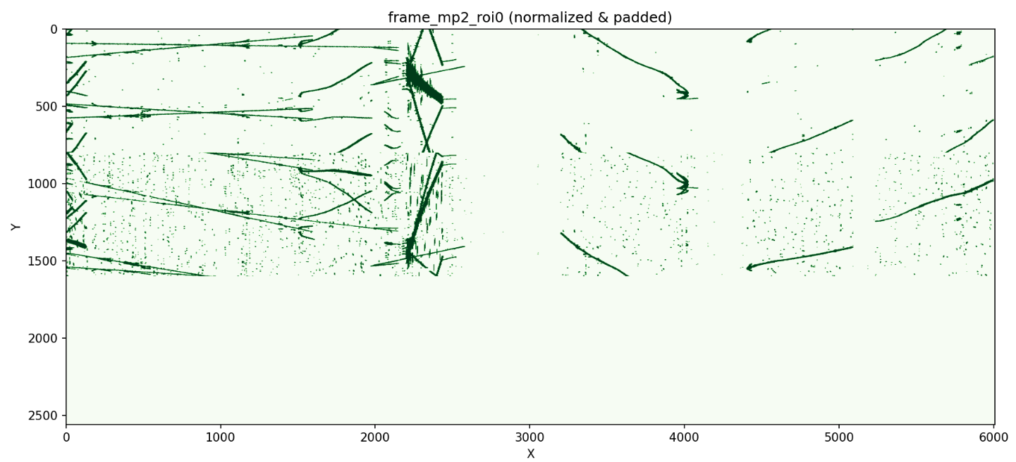
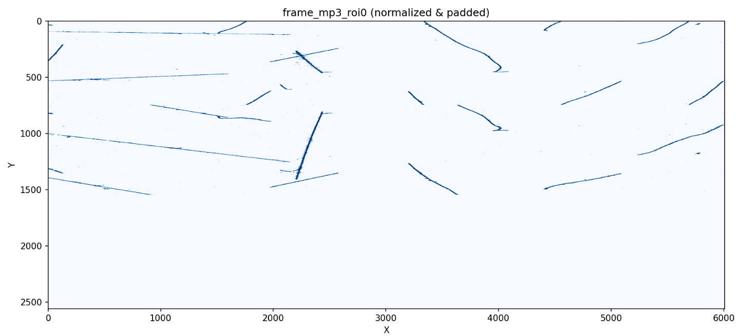
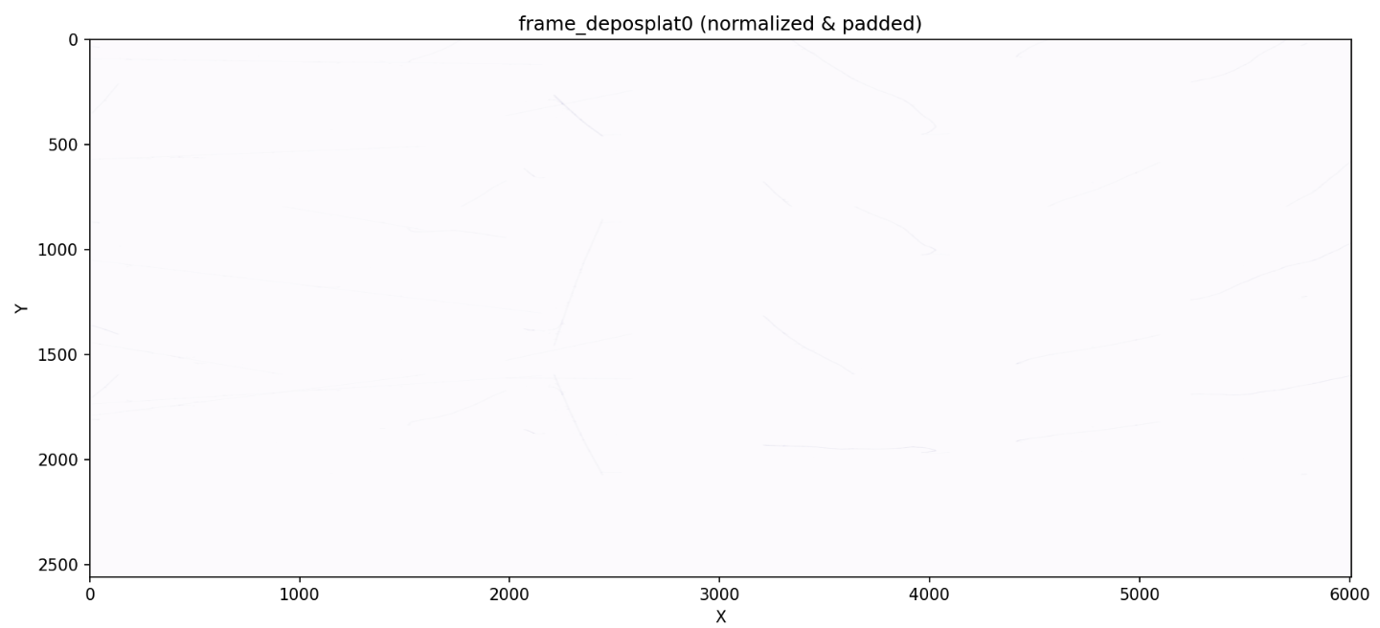

Slide 20
Talk, Jul 15

Slide 21
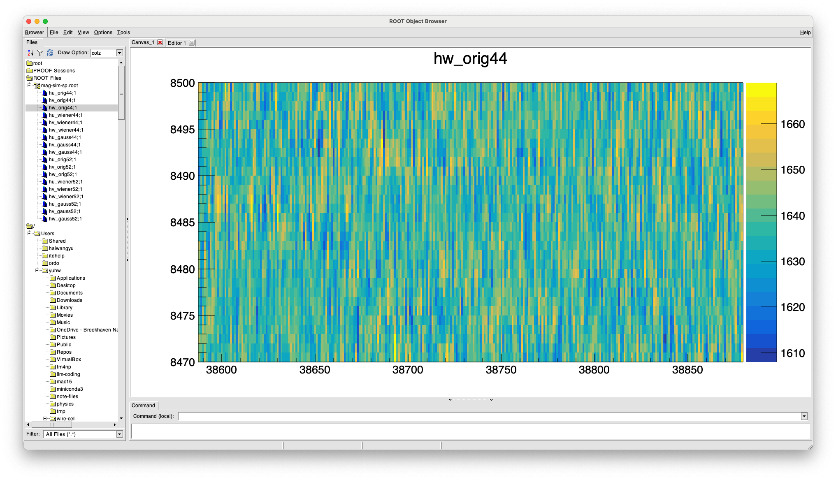

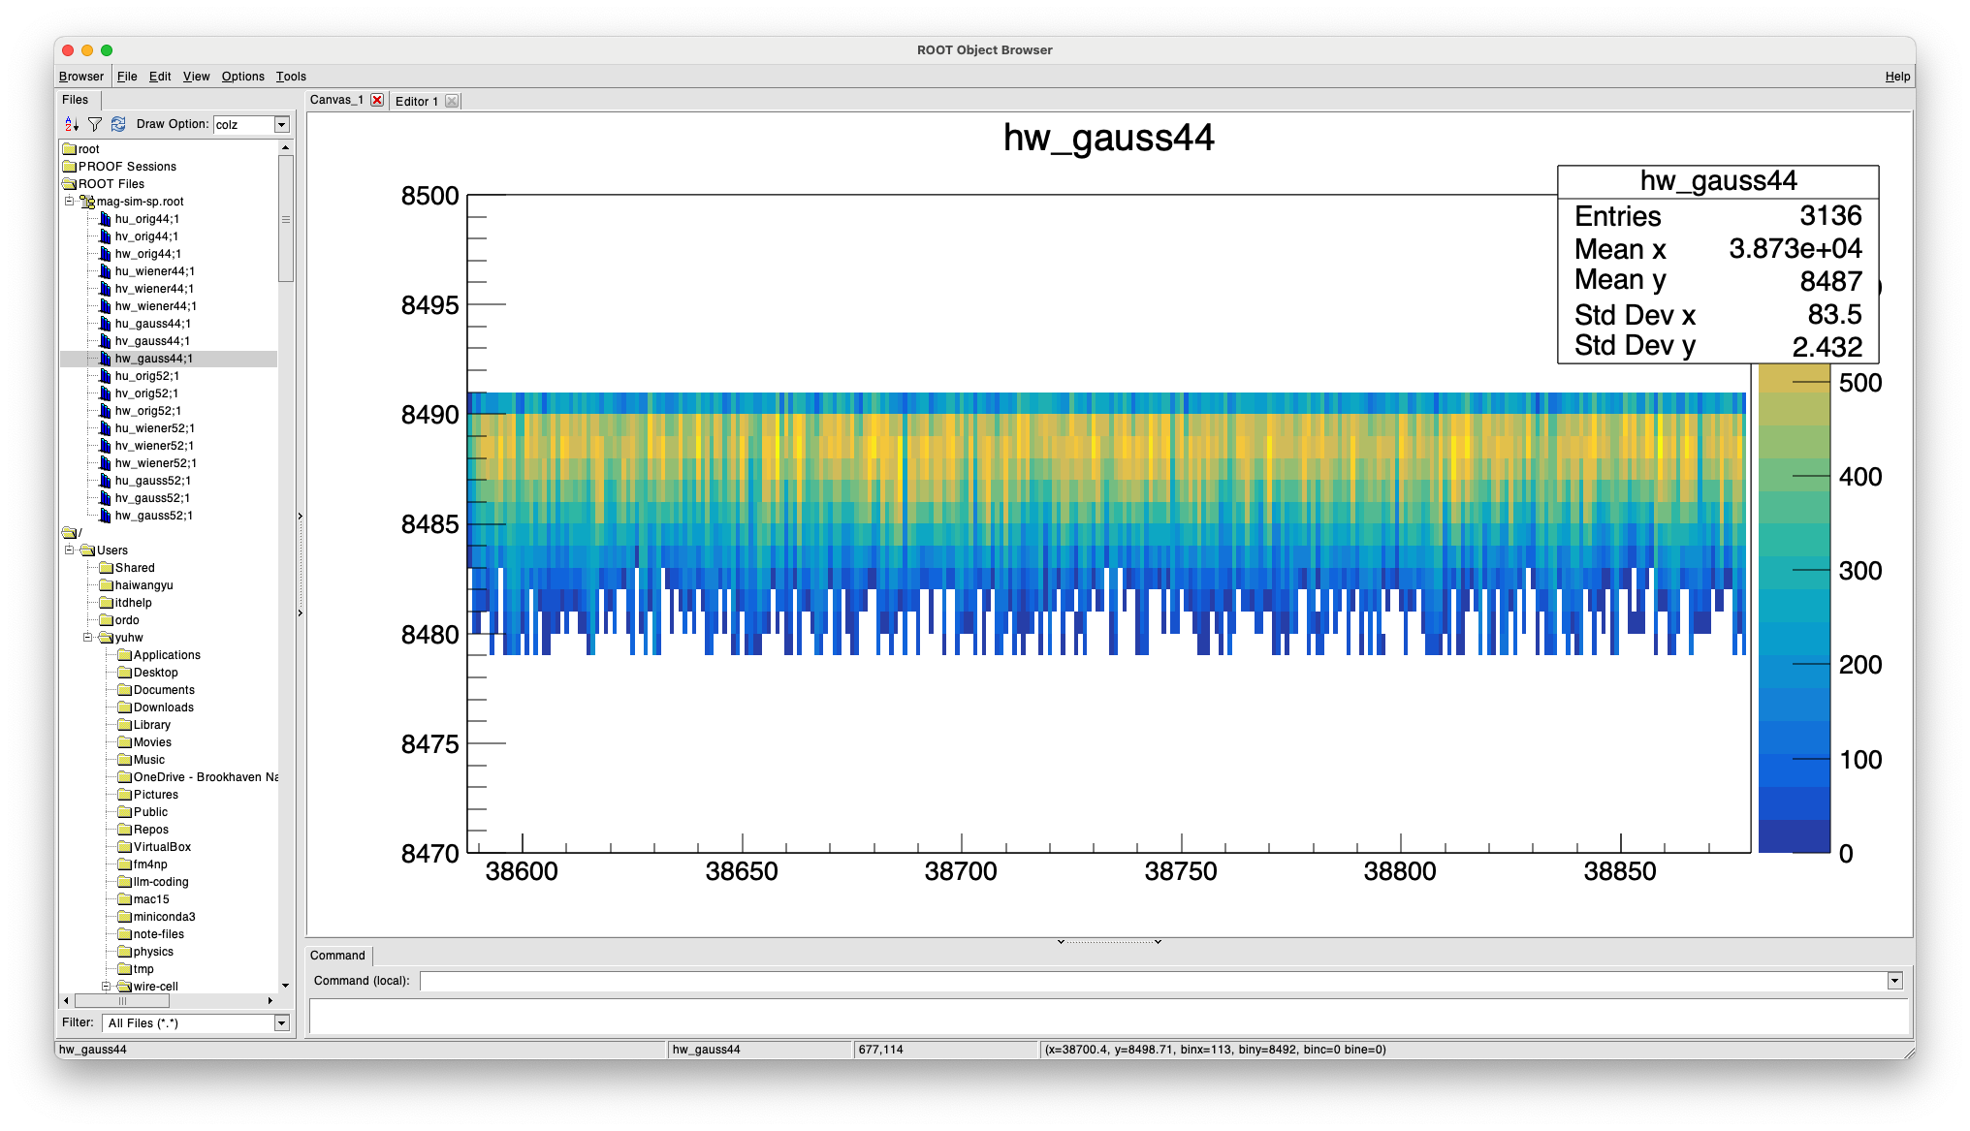
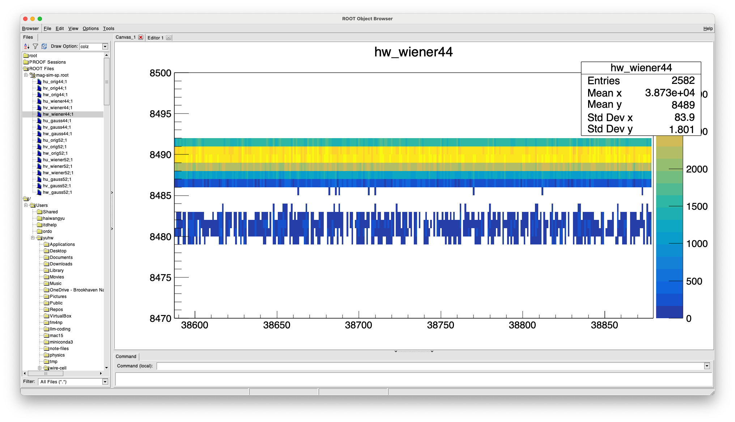
time padding

Slide 22
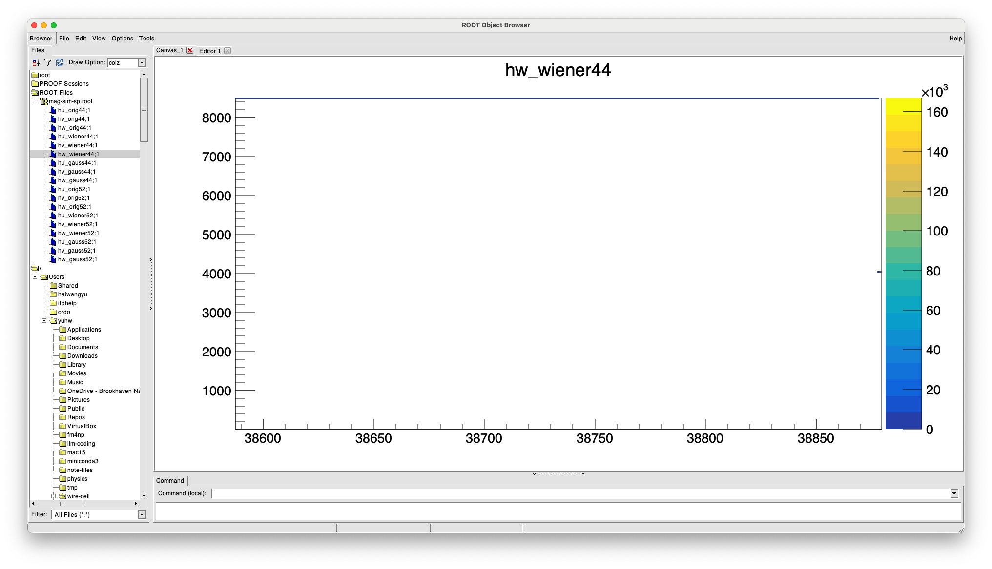

Slide 23

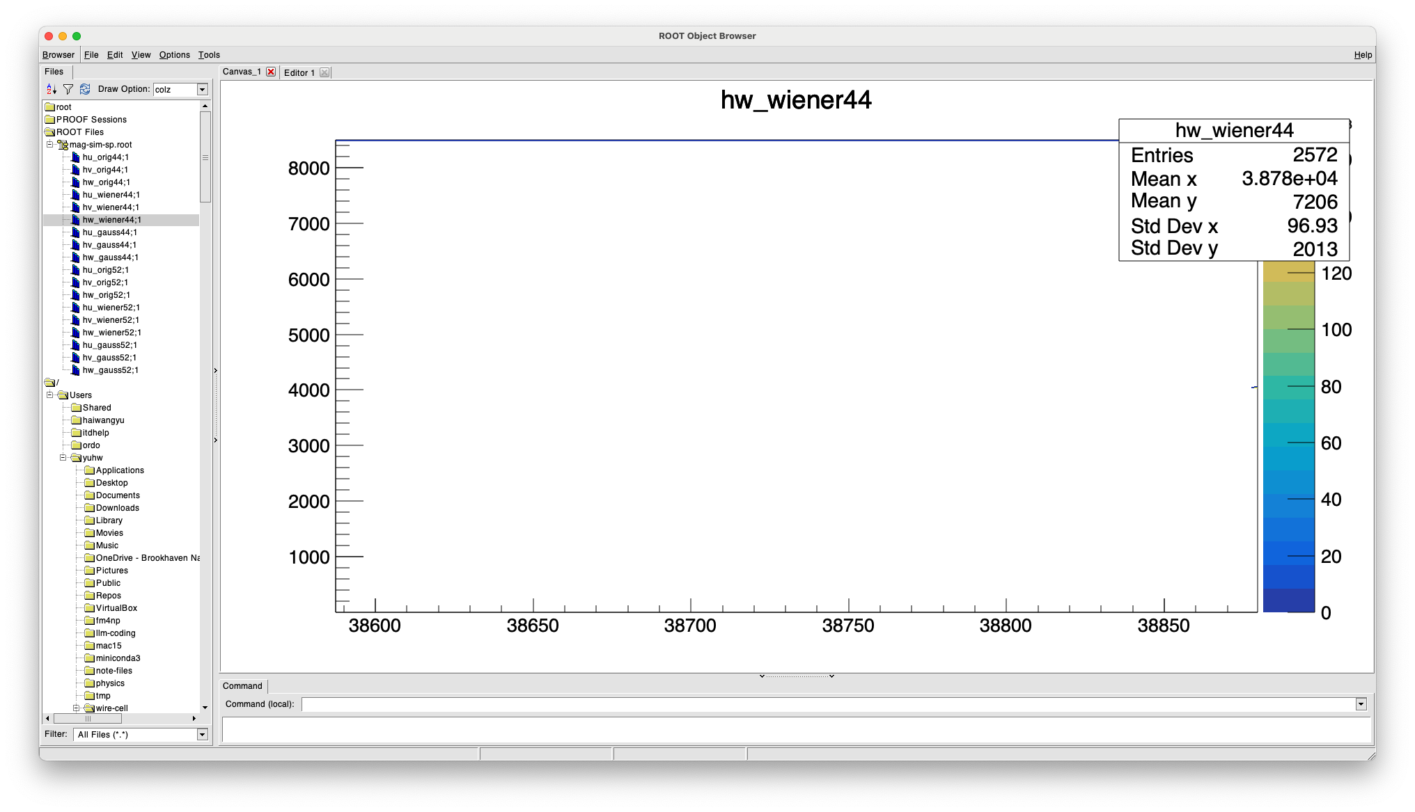
fft_best_length(8500) = 8960

Slide 24
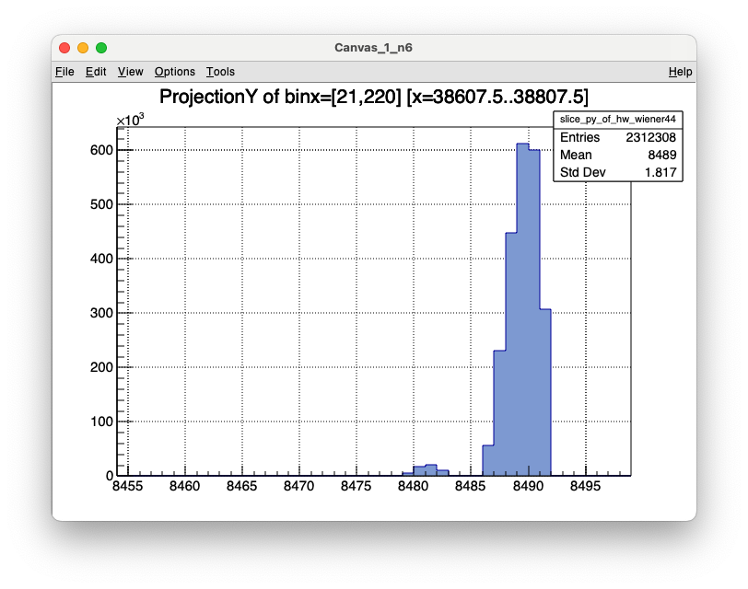
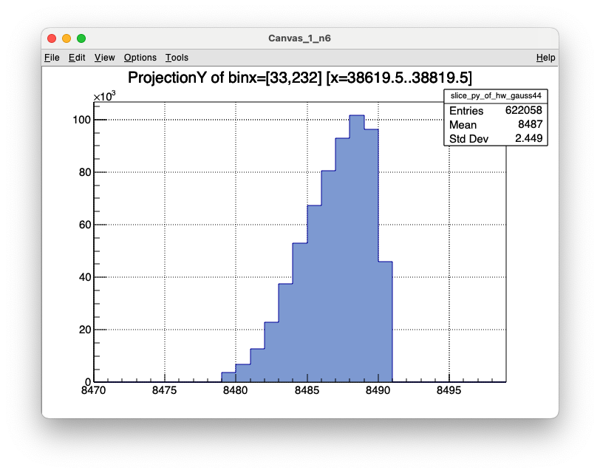

Slide 25
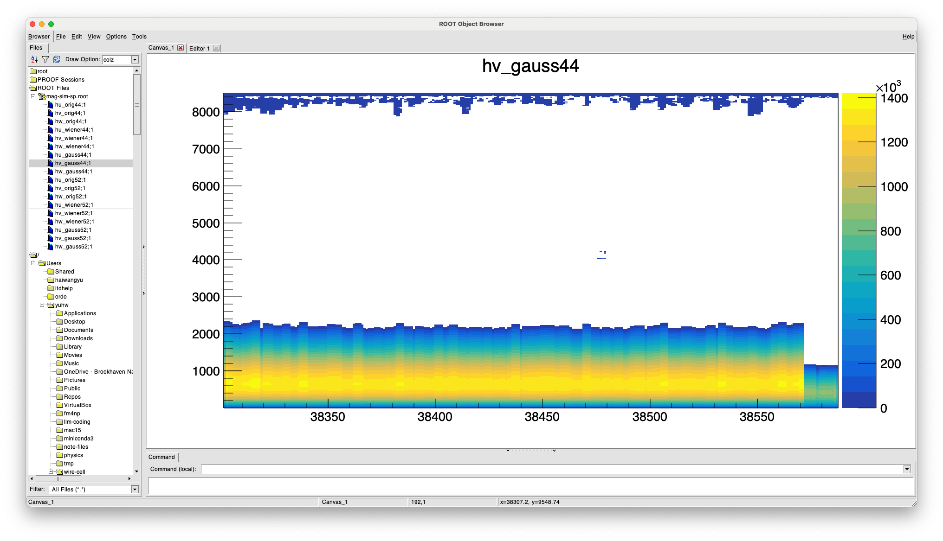
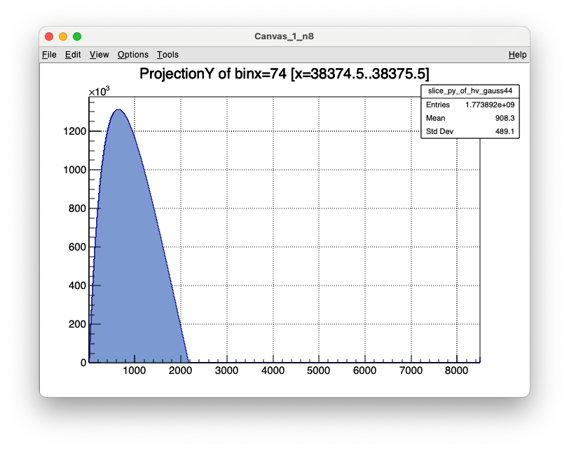

Slide 26
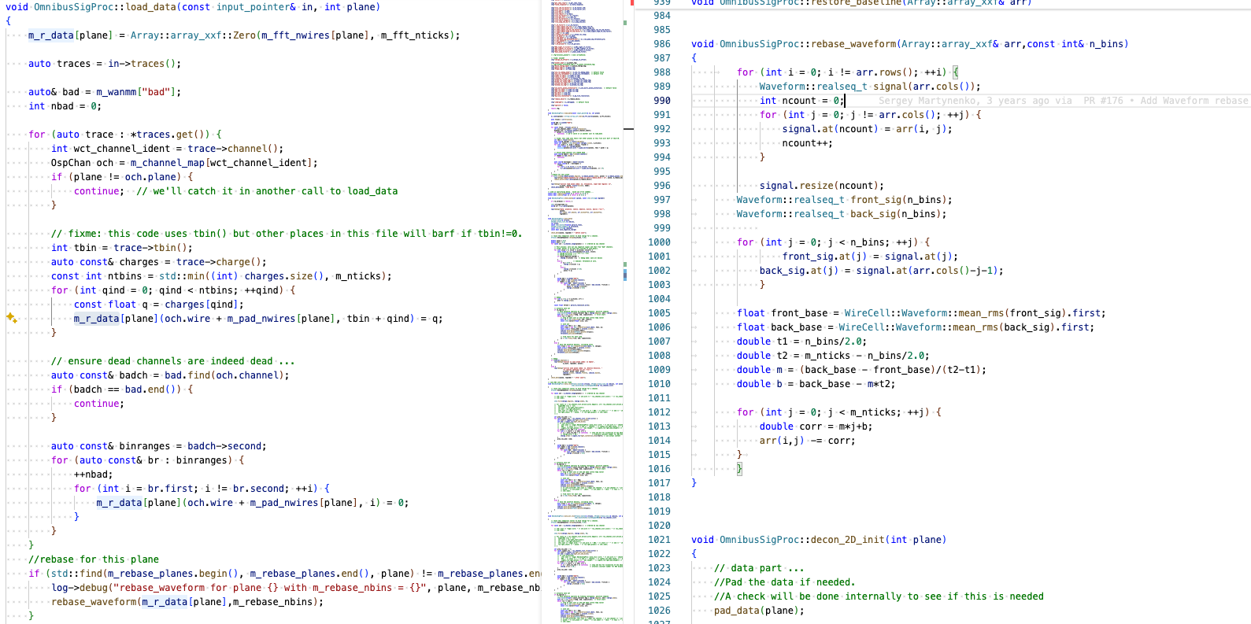

Slide 27
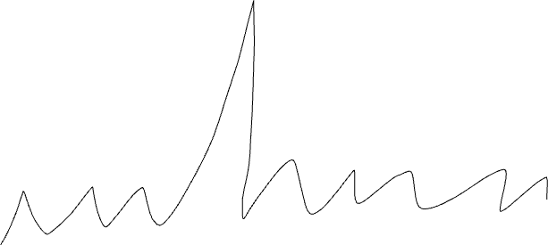
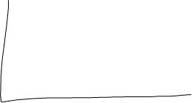

Slide 28
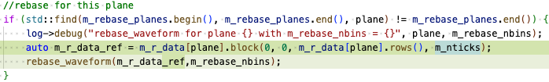
rebaseline for the original length of the tick dimention
0
m_fft_nwires
m_nticks
m_fft_nticks

Slide 29

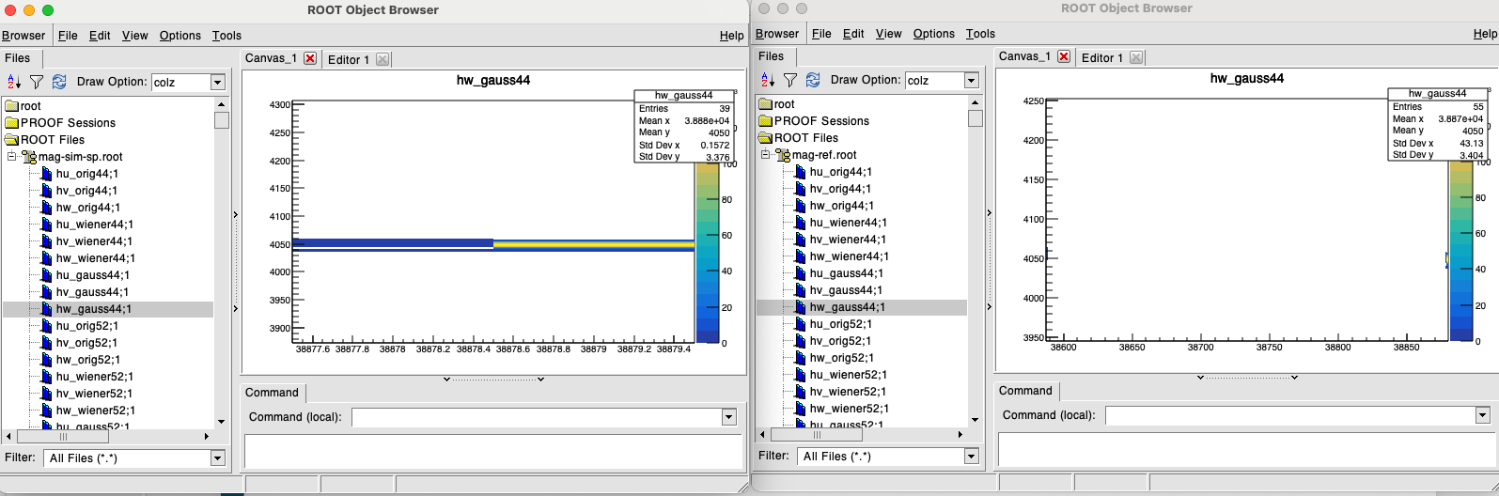
padding both dims with 0 with proper re-baseling
padding
no padding
W-plane

Slide 30
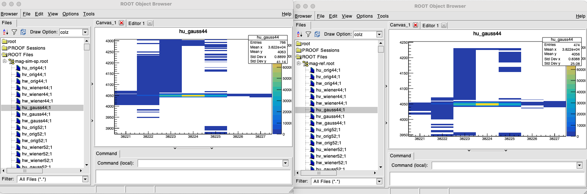
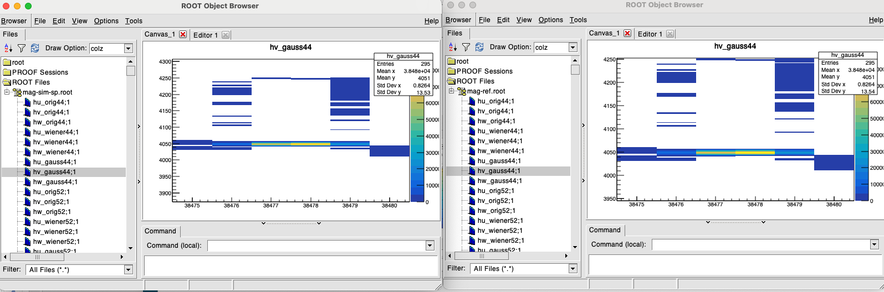
u, v planes
padding
no padding
U
V

Slide 31
Next
Check the timing padding effect with depos around 0 (working with Daria for the inputs.)
Check computing resources change between padding/non-padding
Should we make the padding default or non-padding default?
  Both Xin and Hanyu pointed out that for actual analysis, the padding may not be important given some form of multi-plane matching would happen in all analysis paradigms.
  But in principle, non-padding is wrong

