Slide 1
SimChannel cutoff
Haiwang Yu (BNL)
Jul 21, 2025

Slide 2
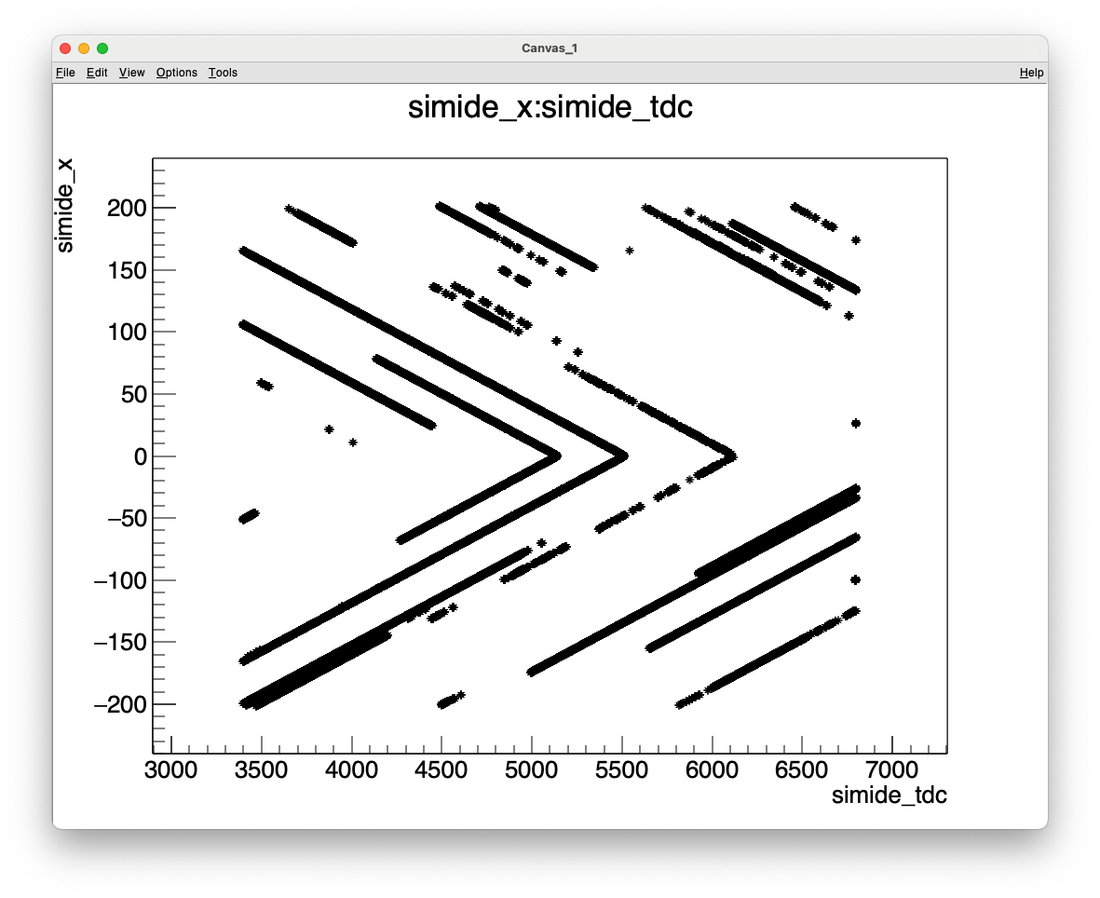
Ref

Slide 3
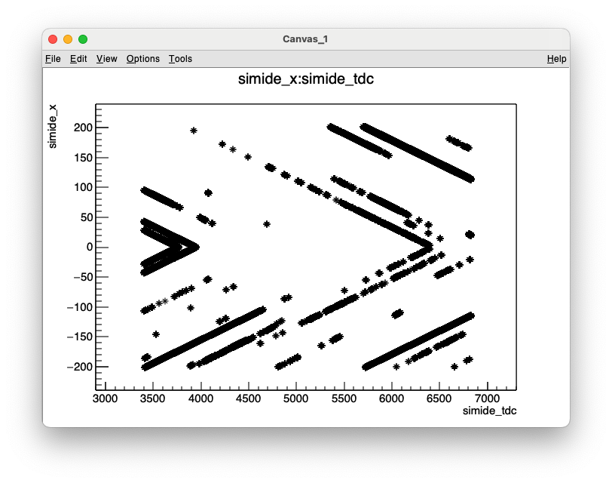
Andy's g4.root, simtpc2d:simpleSC
It seems we do have 3400 tdcs
Why some fraction ~400 is cut off?

Slide 4
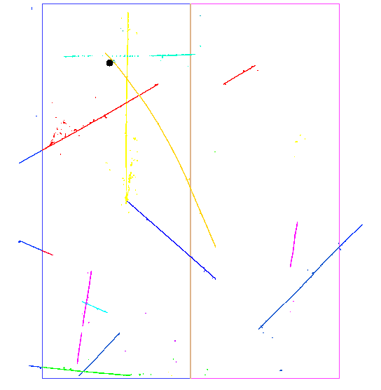
From Andy
matching:
https://github.com/PandoraPFA/larpandora/blob/develop/larpandora/LArPandoraInterface/LArPandoraHelper.cxx#L916-L917

Slide 5
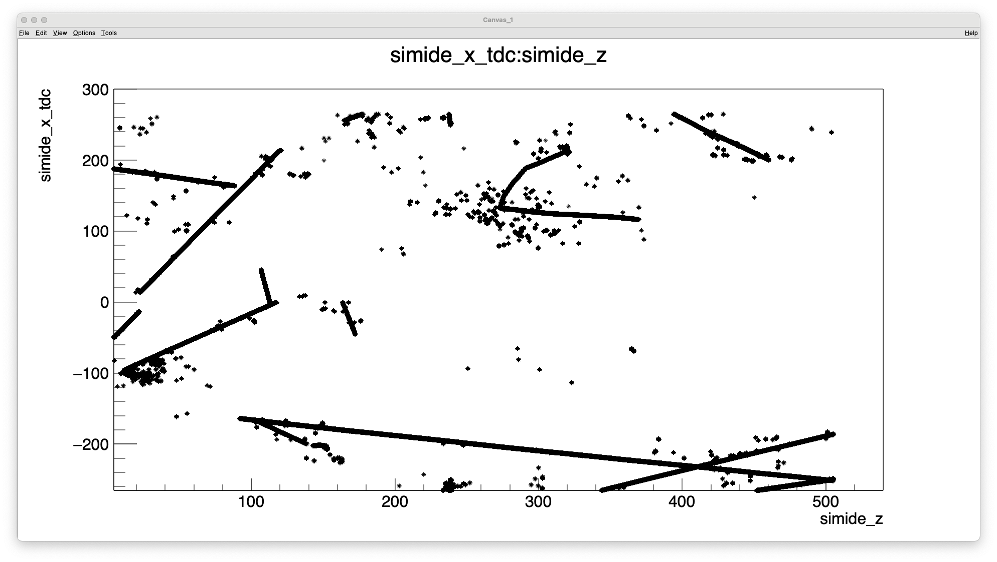
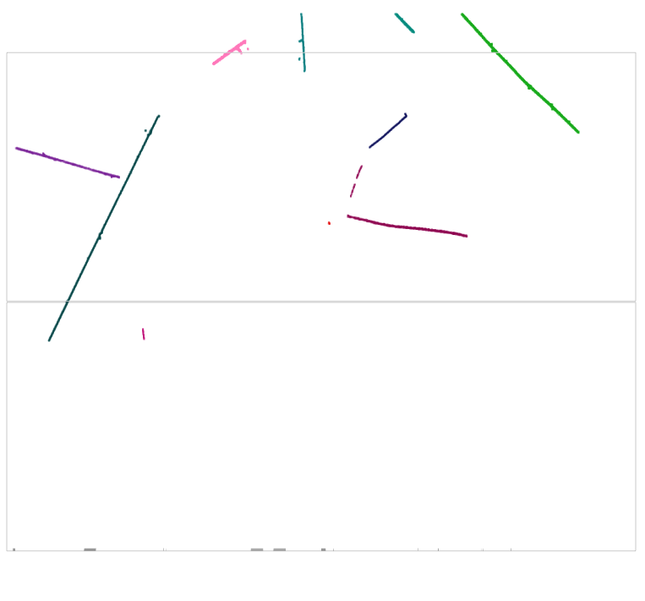
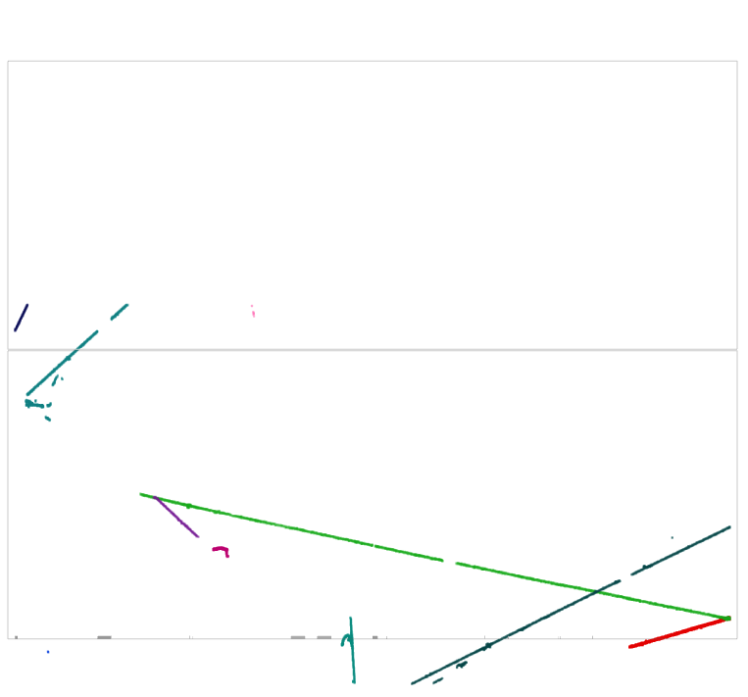

Slide 6
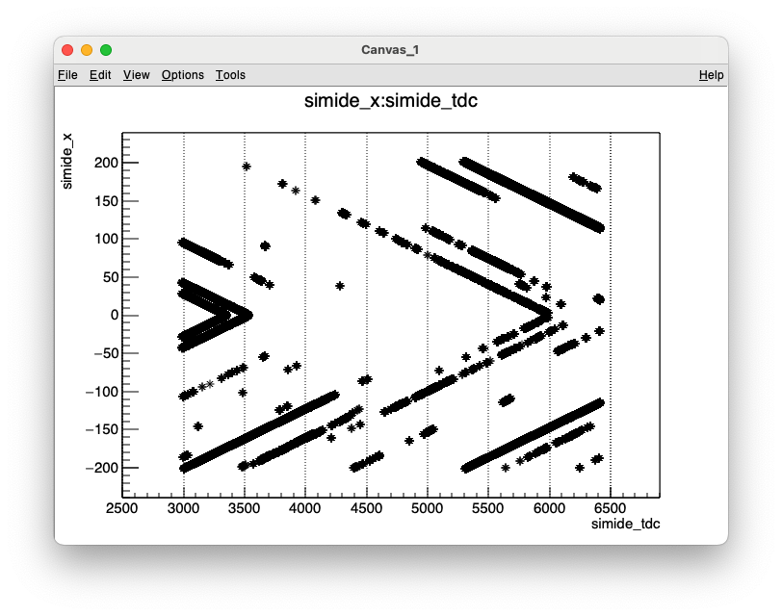
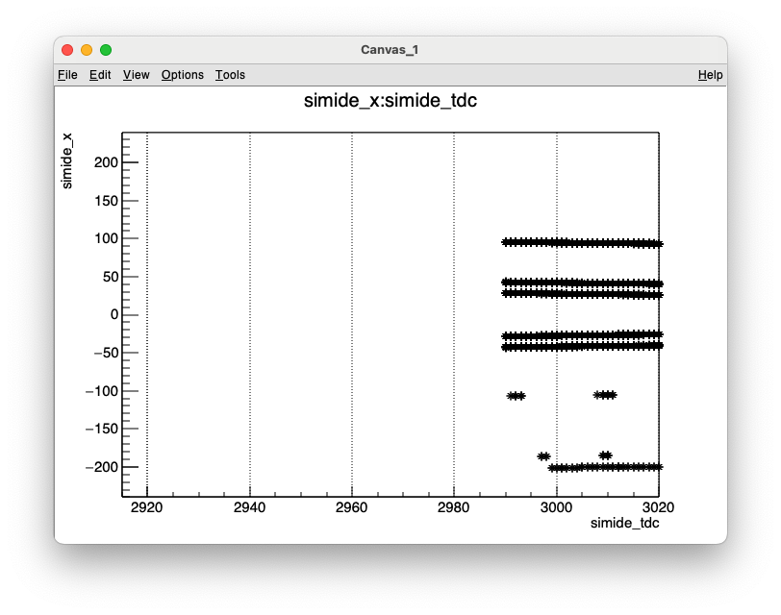

Slide 7
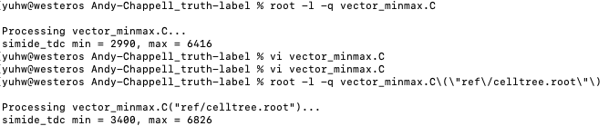

Slide 8
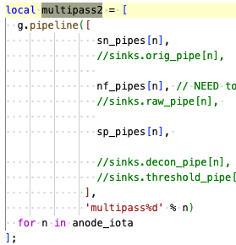
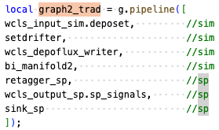
Links
https://github.com/SBNSoftware/sbndcode/blob/develop/sbndcode/WireCell/cfg/pgrapher/experiment/sbnd/wcls-sim-drift-depoflux-nf-sp.jsonnet

Slide 9
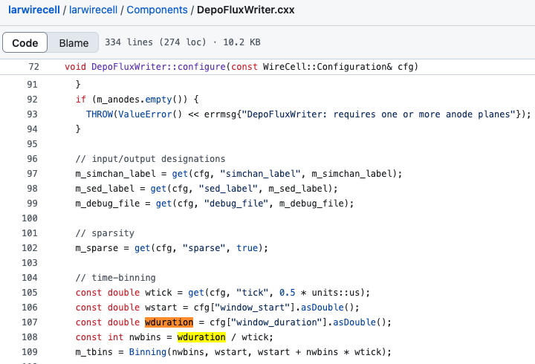
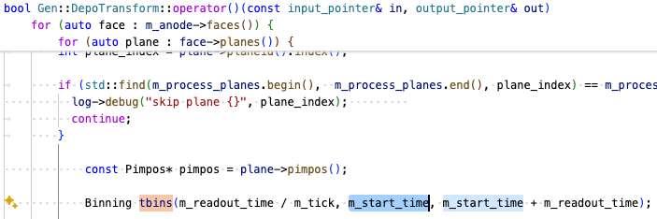

Slide 10
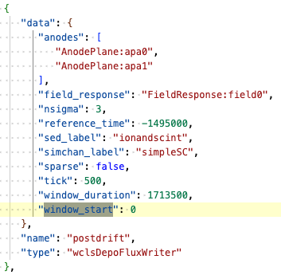
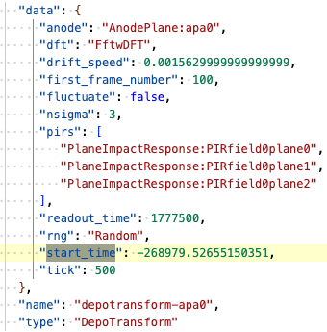
3555 ticks
-538 ticks

Slide 11
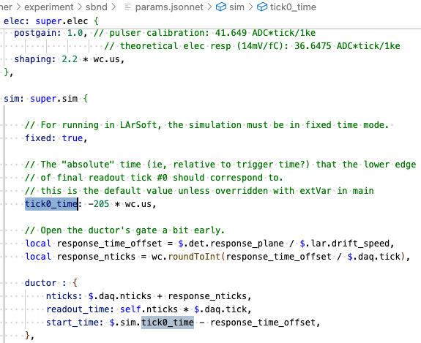
-205 – 100mm/1.5623mm/us = -267.5 us = 538 ticks

Slide 12
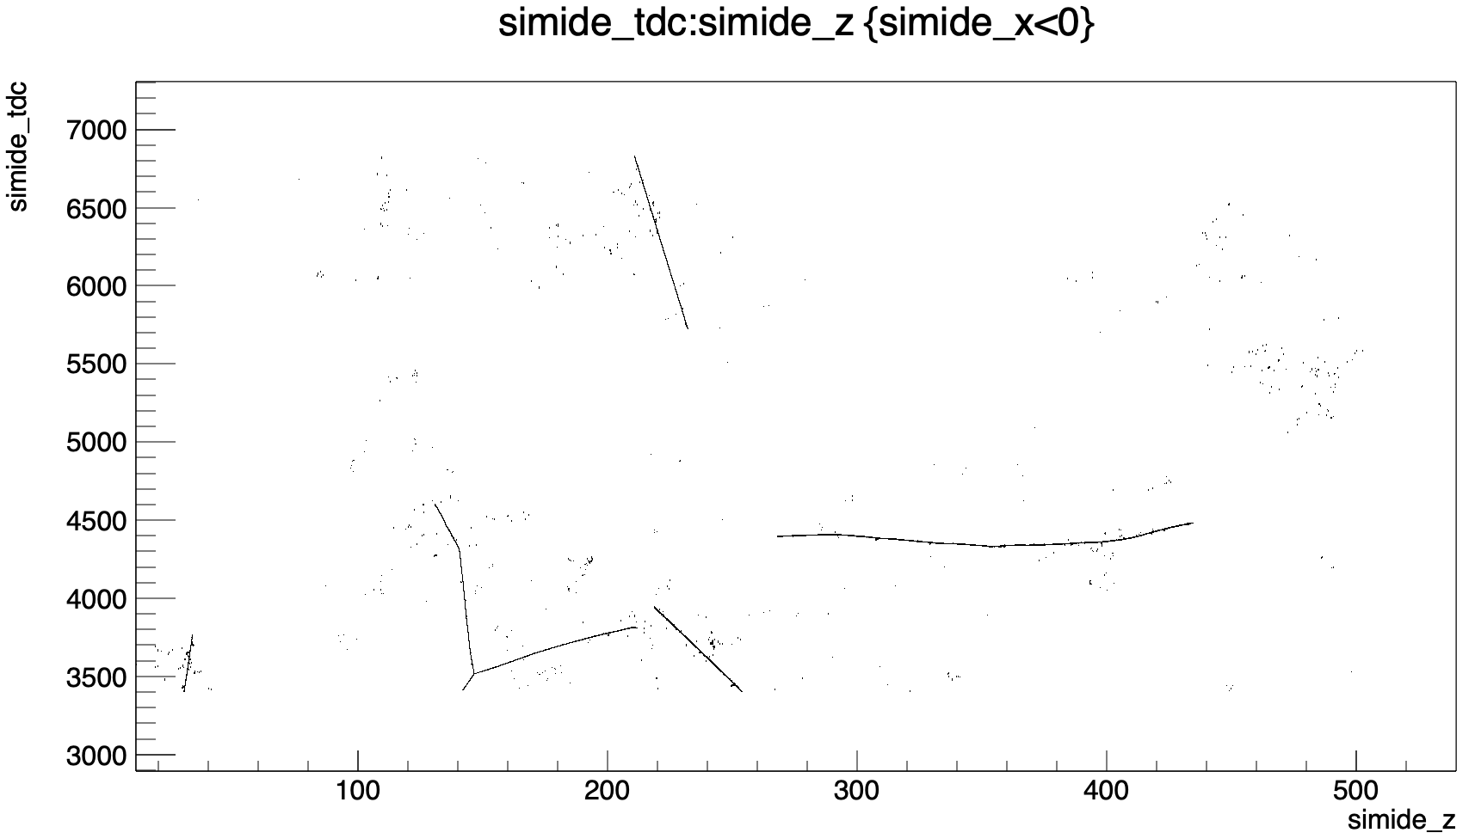
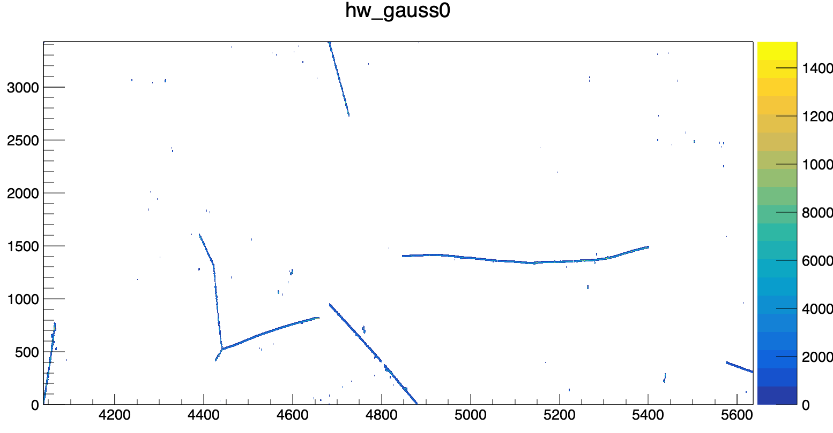
window_start: 0.0 * wc.ms,

Slide 13
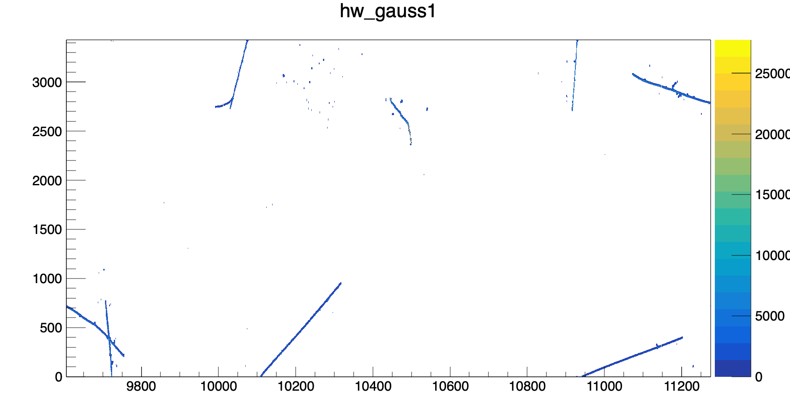
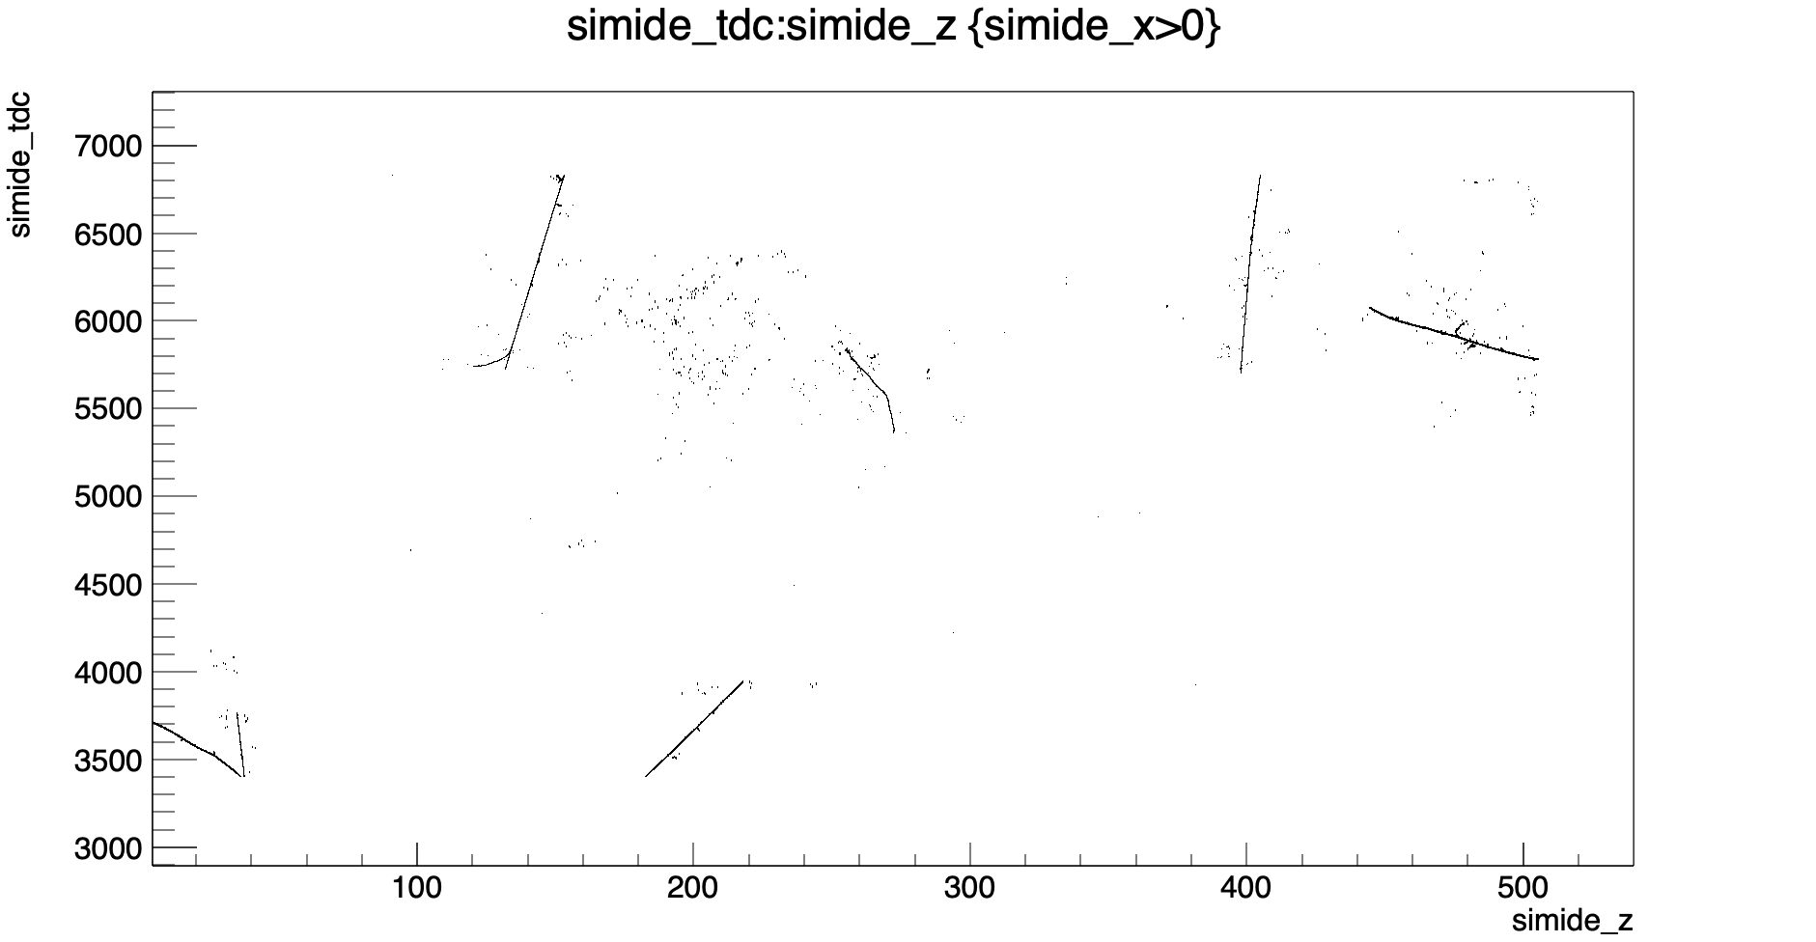
window_start: 0.0 * wc.ms,

Slide 14
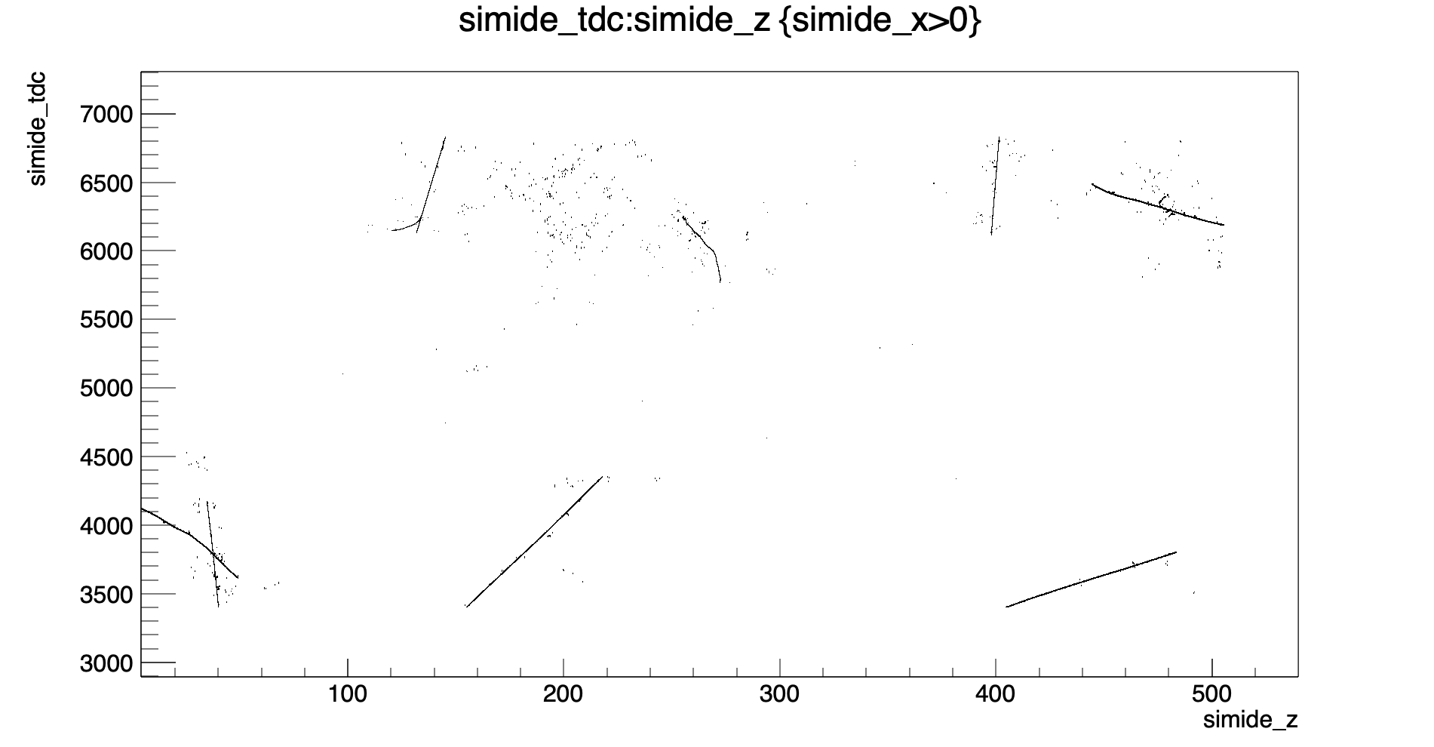
window_start: -205 * wc.us,

Slide 15
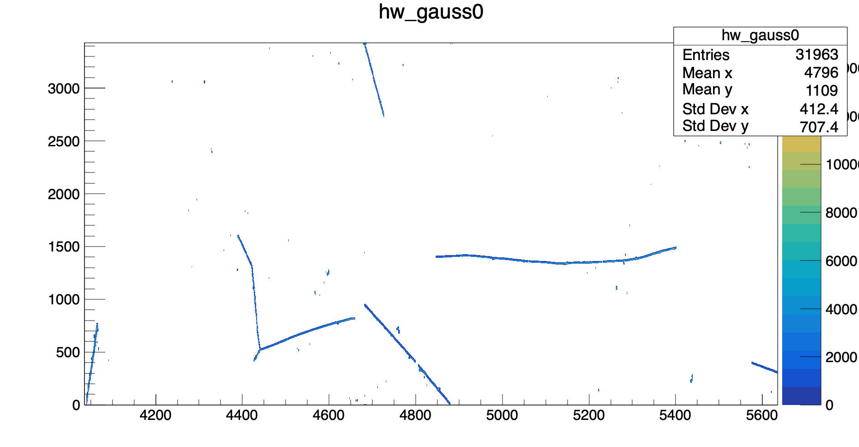
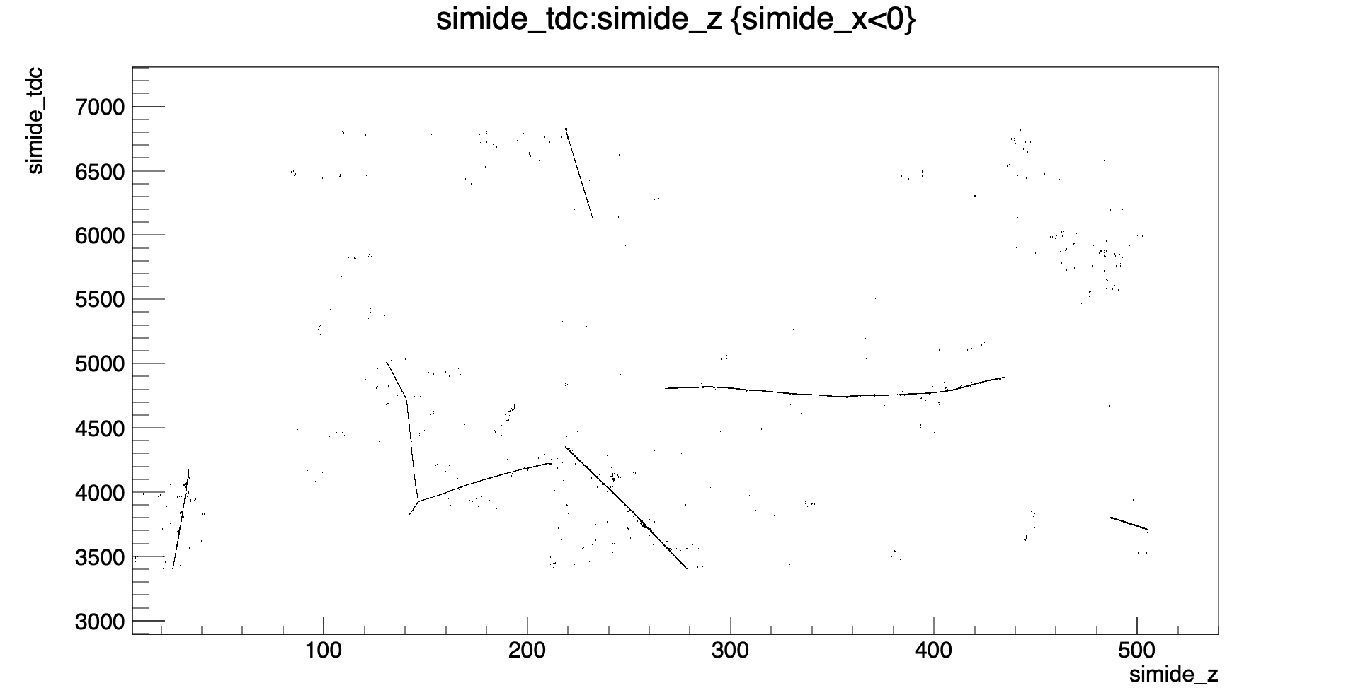
window_start: -205 * wc.us,

Slide 16
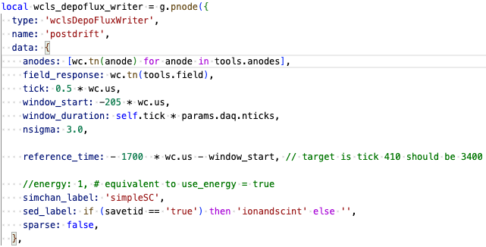
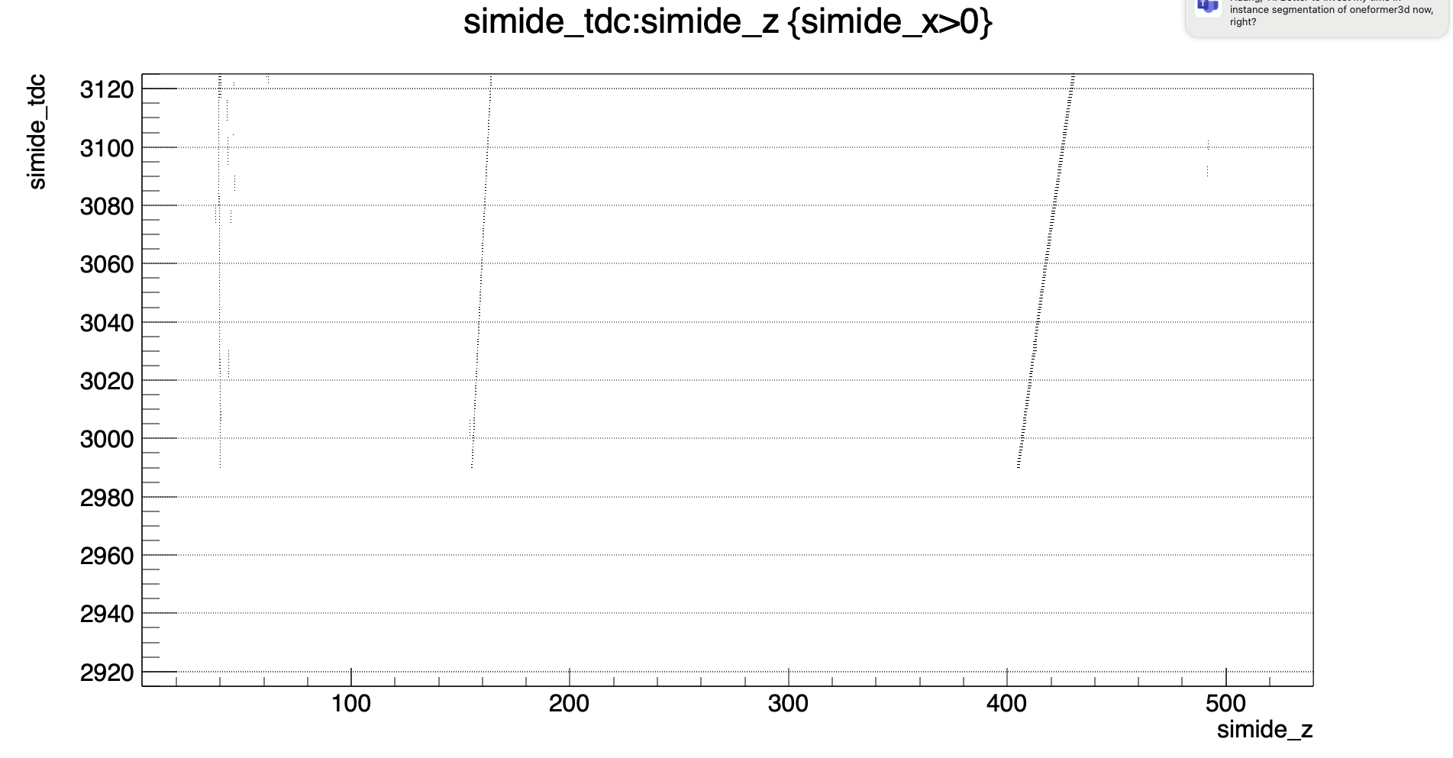
shift the time

