Slide 1
SLDO Failure Modes and Operation
Roy Wastie, Iain Sedgwick
WP1 Designer’s Meeting

Slide 2
Introduction
Failure Modes
How the SLDO avoids the most likely failures?
Overvoltage Protection
How the OVP helps avoids the most likely failures?
Start-up
How to start the 5 SLDOs without explosion using the OVP?
Simulations
Results from full stave simulations with OVP
Builds on Iain’s existing work on one AncASIC powering
Iain’s talk June 23rd 2025 WP1 Designer’s Meeting
https://indico.bnl.gov/event/28508/#43-powering-discussion
Conclusion
What next?

Slide 3
SLDO Failure Modes

Slide 4
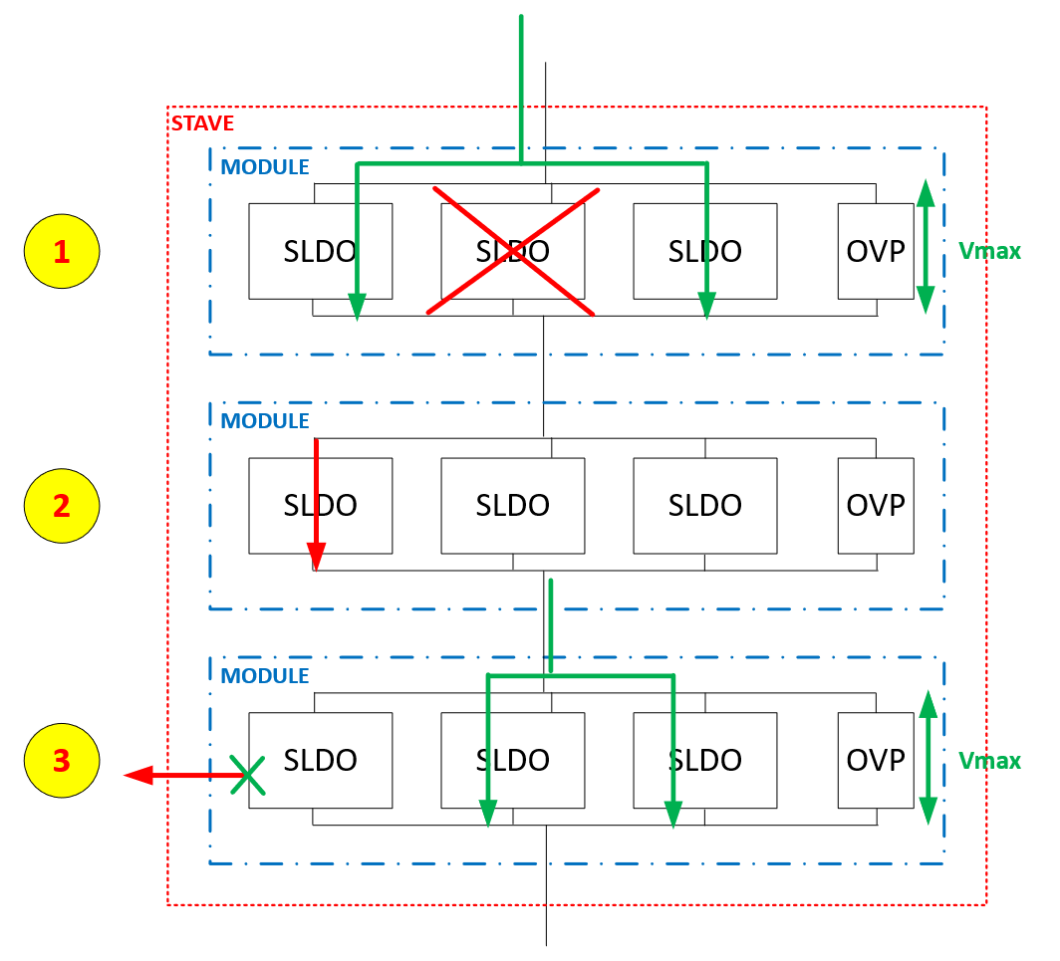
Failure modes of SVT SP chain with SLDO
A SLDO behaves as an open circuit
A SLDO develops a short
The load develops a short
Over-voltage Protection is required to service the failure modes.
From Iain Sedgwick

Slide 5
Failure modes 1
Failure 1: SLDO fails in an open circuit fashion
The input current needs to redistribute between the other SLDO → Pass and shunt transistor of SLDO are sized to take extra current from failing SLDO(s) in parallel
More current in the remaining SLDOs will raise the voltage across the module; if needed, the overvoltage protecion circuit will clamp this to the max V
→ No interruption of current flow to other modules in the chain
From Iain Sedgwick

Slide 6
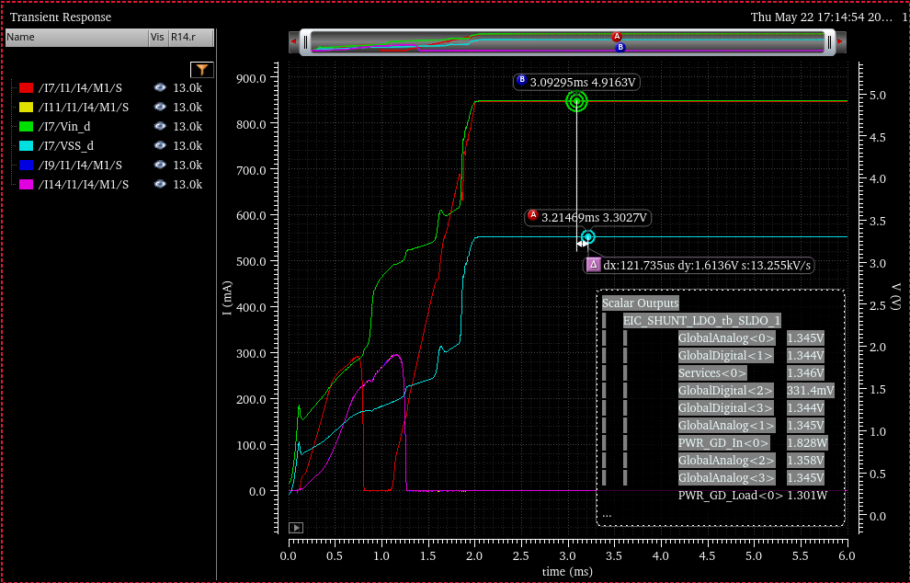
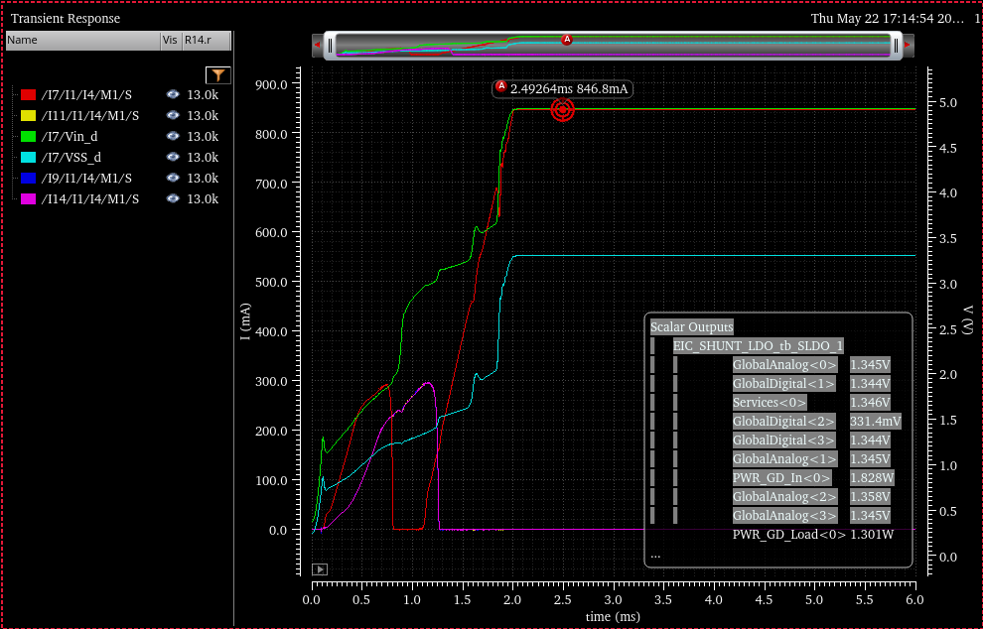
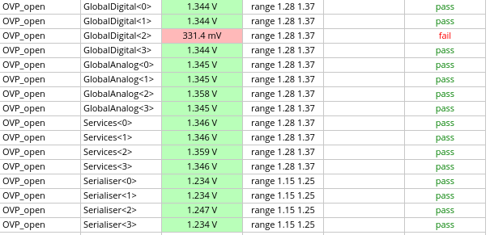
OVP with Global digital SLDO open mode 1
OVP shunt I
V SLDO
SLDO output OFF

Slide 7
Failure modes 2
Failure 2: SLDO develops a short circuit
For a constant current supply from a current source, the current continues to flow
If a voltage source is used, then the voltage applied will need to split between n-1 modules, which might trigger the OVP; this should be corrected at the voltage supply
→ No interruption of current flow to other modules in the chain
From Iain Sedgwick

Slide 8
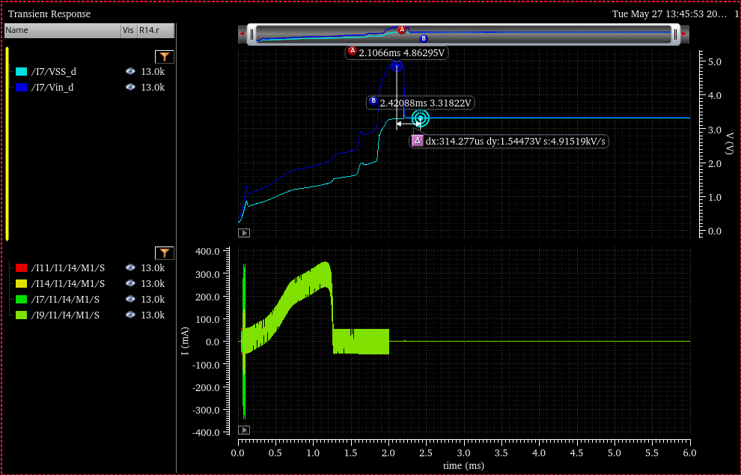
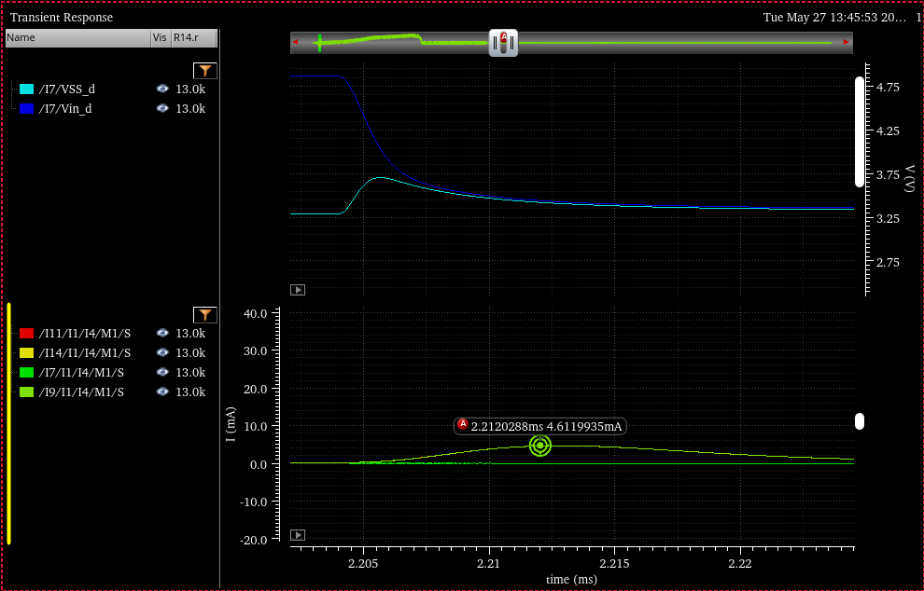
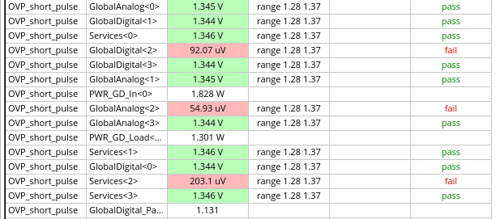
OVP with Global digital SLDO short mode 2
V current source
OVP shunt I
SLDO output shorted

Slide 9
Failure modes 3
Failure 3: Load overcurrent
This corresponds to a reduction of the current being shunted
The undershunt current protection activates putting the SLDO in a high impedance state, situation equivalent to failure 1
→ No interruption of current flow to other modules in the chain
From Iain Sedgwick

Slide 10
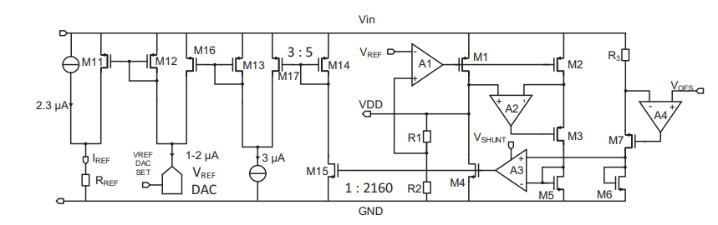
Overcurrent Protection
Over-current protection
Change from that described in this paper
Detect under-shunt condition
Voltage limit by output voltage reduction
Still some short circuit current
Use more traditional LDO overcurrent protection
Detect under-shunt condition
Short pass transistor
Effectively make output high impedance, and shunt behaves like an open circuit
Some transient immunity

Slide 11
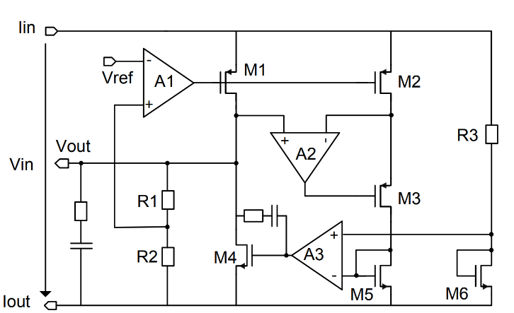
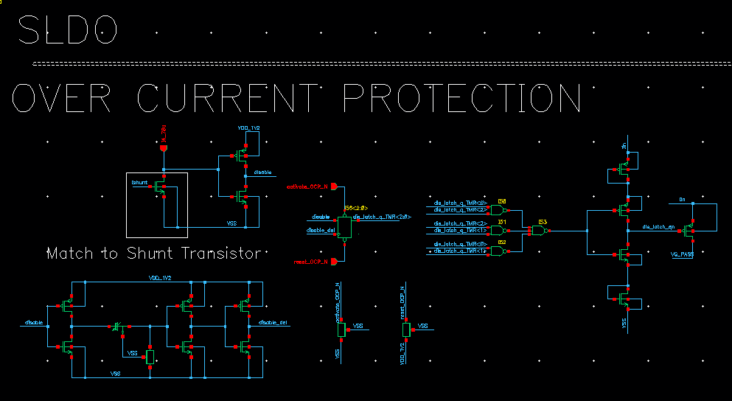
Overcurrent Protection
Over-current protection
Use more traditional LDO overcurrent protection
Detect under-shunt condition
Short pass transistor
Effectively make output high impedance, and shunt behaves like an open circuit
Some transient immunity
Locks into overcurrent state until reset
TMR protection
Pull-ups for default operation
Overcurrent Detection
Register
Voltage buffer
TMR
PT Short
Transient Protection
Defaults

Slide 12
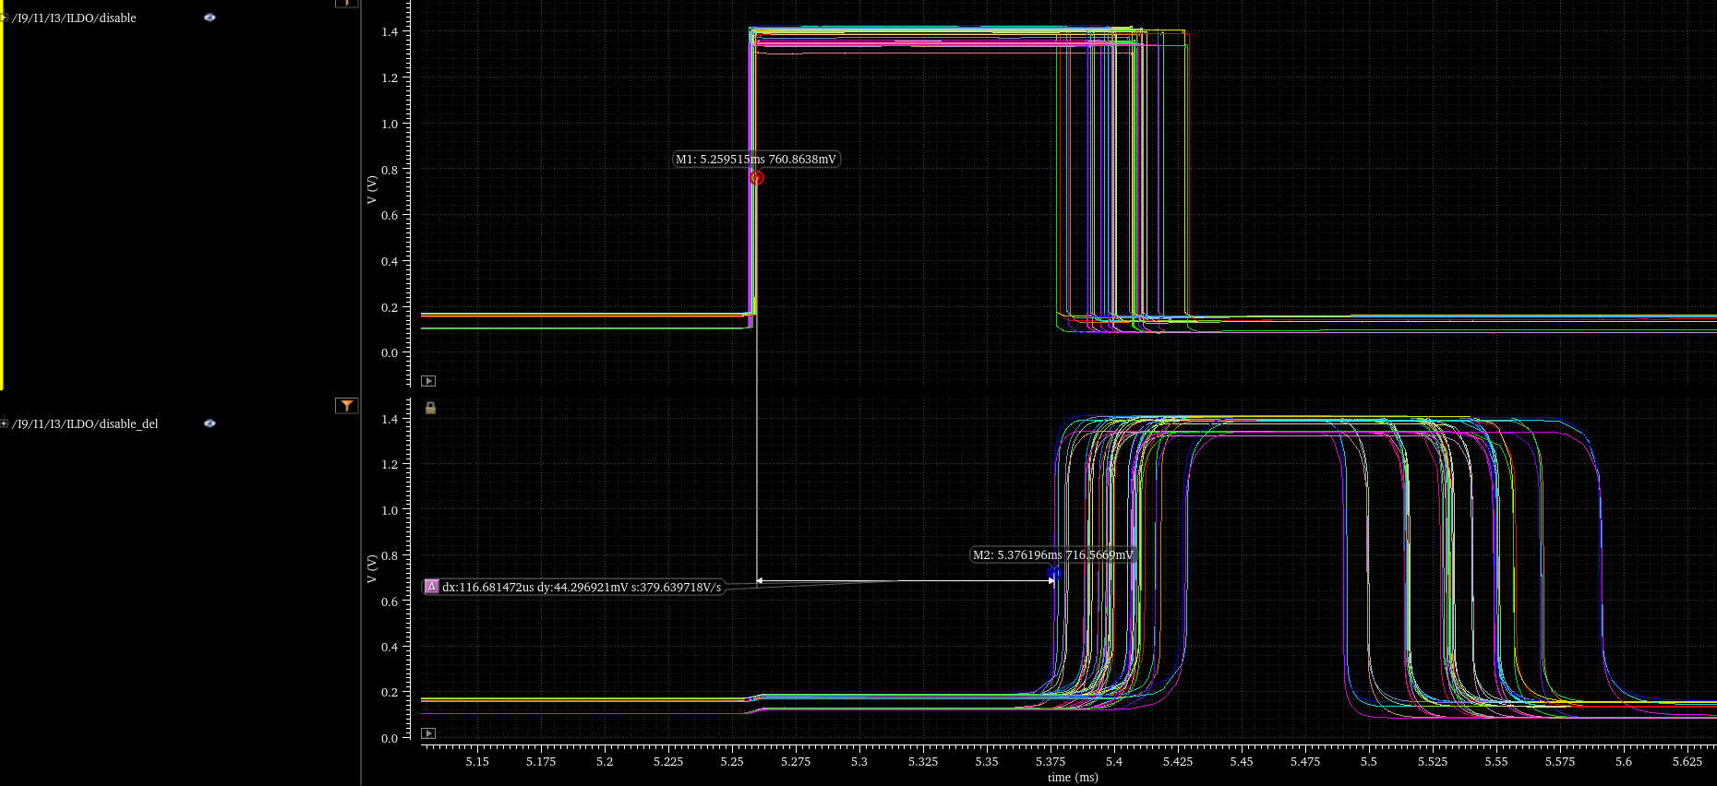
Overcurrent Protection
Over-current protection
Disable signal is triggered by detection of overcurrent condition
This is delayed by an RC buffer chain.
Resulting signal samples the original disable and triggers a shutdown if it is still high.
In this way small transients are filtered.
Filters transients of up to 100us

Slide 13
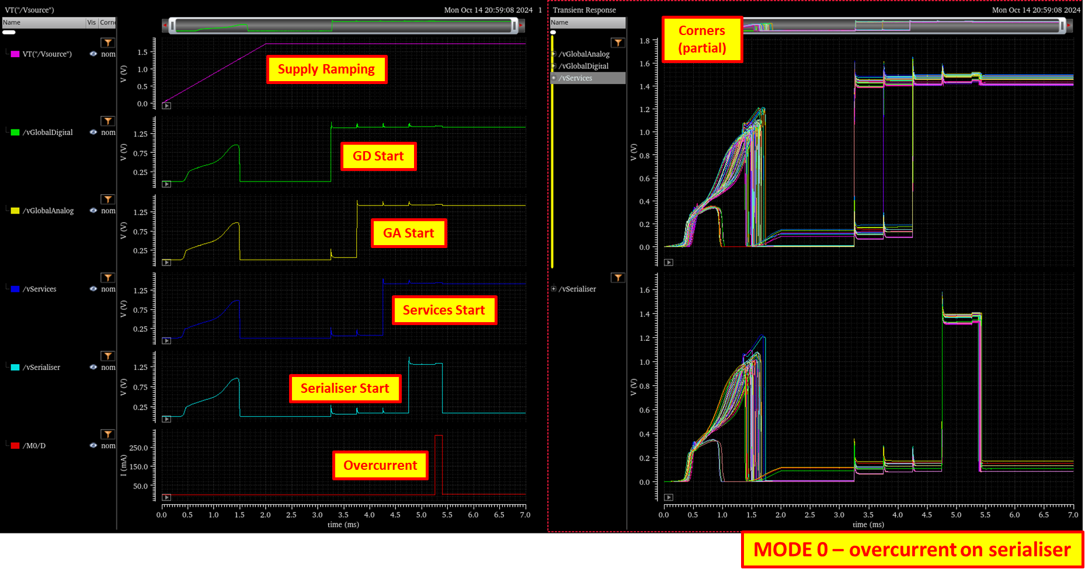
Start-up and Overcurrent Protection
Over-current protection
1. Top left trace, supply ramping up.
2. Outputs come on as the supply ramps, but they start disabled, so once things start to become active, they shut down.
3. Then we turn them on one by one.
4. Bottom red trace is a simulated overcurrent condition on the serialiser supply.
5. Serialiser supply shuts down, then the current disappears because we have shut down the supply voltage.

Slide 14
Over Voltage Protection

Slide 15
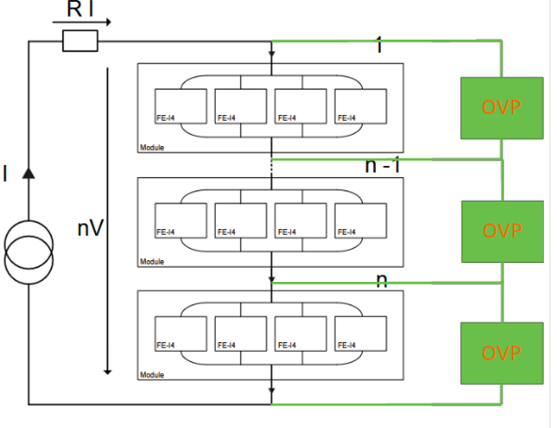
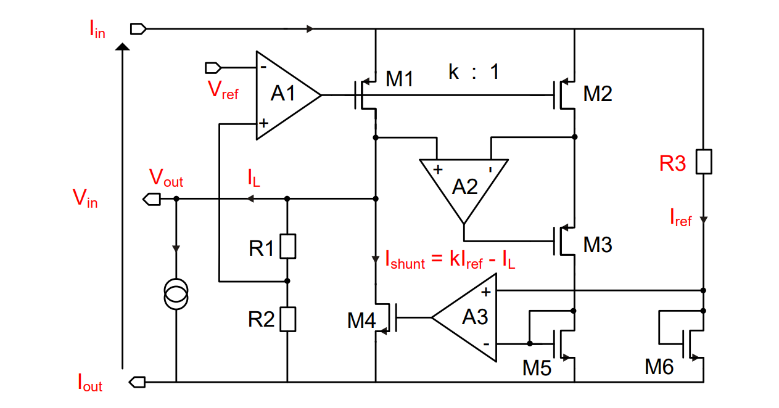
Motivation for the OVP
Over-voltage Protection is required to service all failure modes.
SLDO Absolute Max input voltage is 1.8V currently (may affect lifetime)
XFAB PELVT and NELVT FETs also have an absolute max voltage of 1.8V
SLDO is mostly 2 FETs in series, giving a nominal of 3V MAX Input Voltage
Start-up Block has the lowest limit of 1.6V
Hence, OVP will limit at 1.6V
One OVP per SLDO set.
Vmax
OVP operates if all 4 stave SLDO shorted on a neighbour or Stave going open or SLDOs are OFF

Slide 16
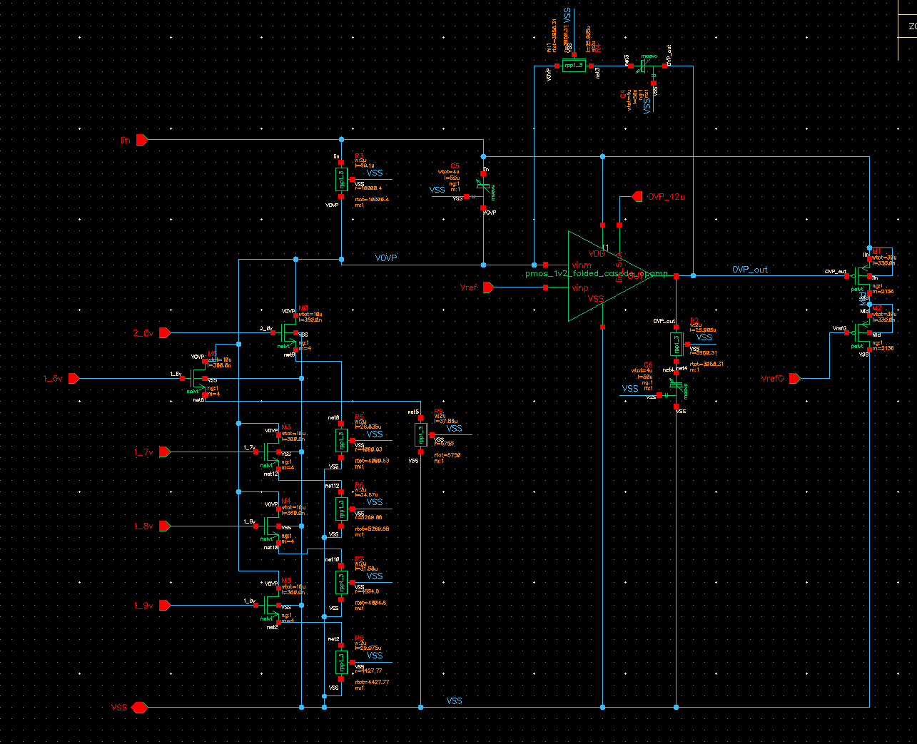
OVP Design
Over-Voltage protection
Monitor voltage across SLDO
Detect over-voltage condition
Turn on shunt transistors
Effectively lower the SLDO impedance
Clamping the voltage across the SLDO
Comparator
Input V
Vref
Current Shunt
Set OVP Threshold
1.6v to 2v 0.1 steps

Slide 17
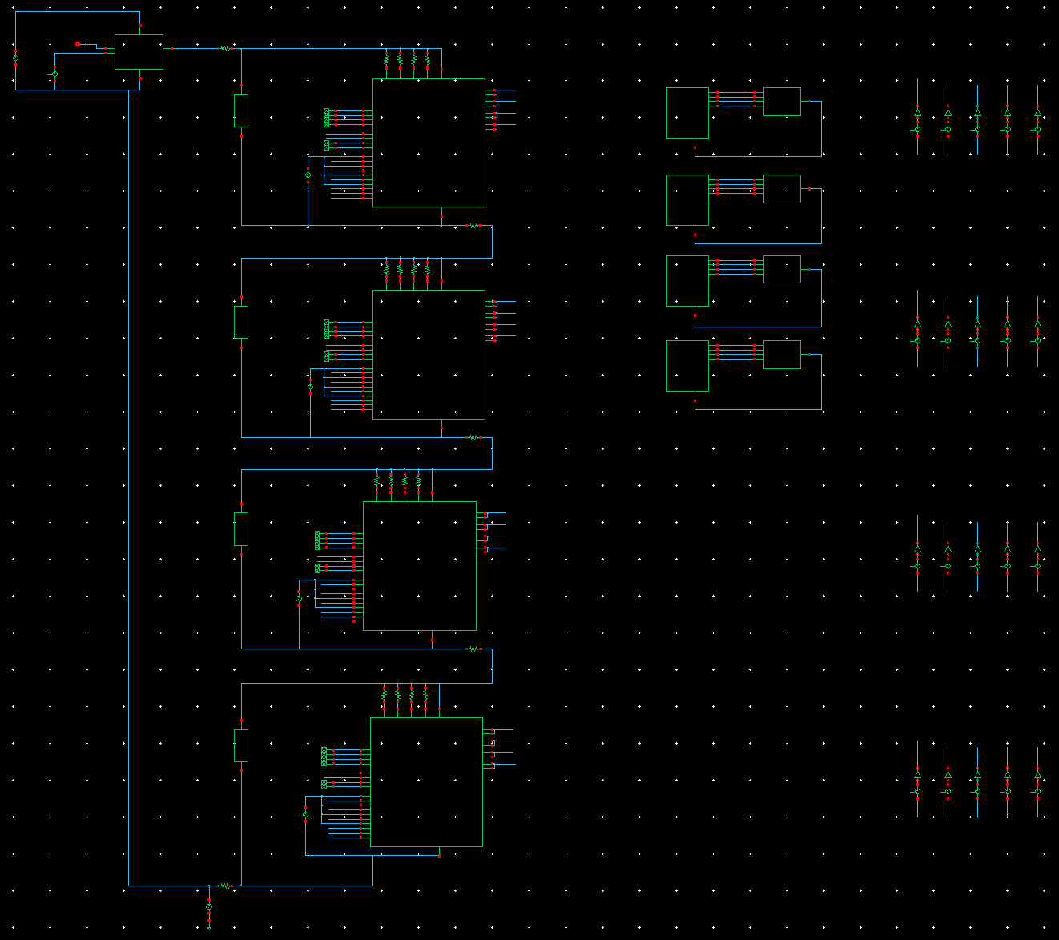
OVP Test Bench
Current
Source PSU
Loads
Enable Controls
Stave SLDO + OVP

Slide 18
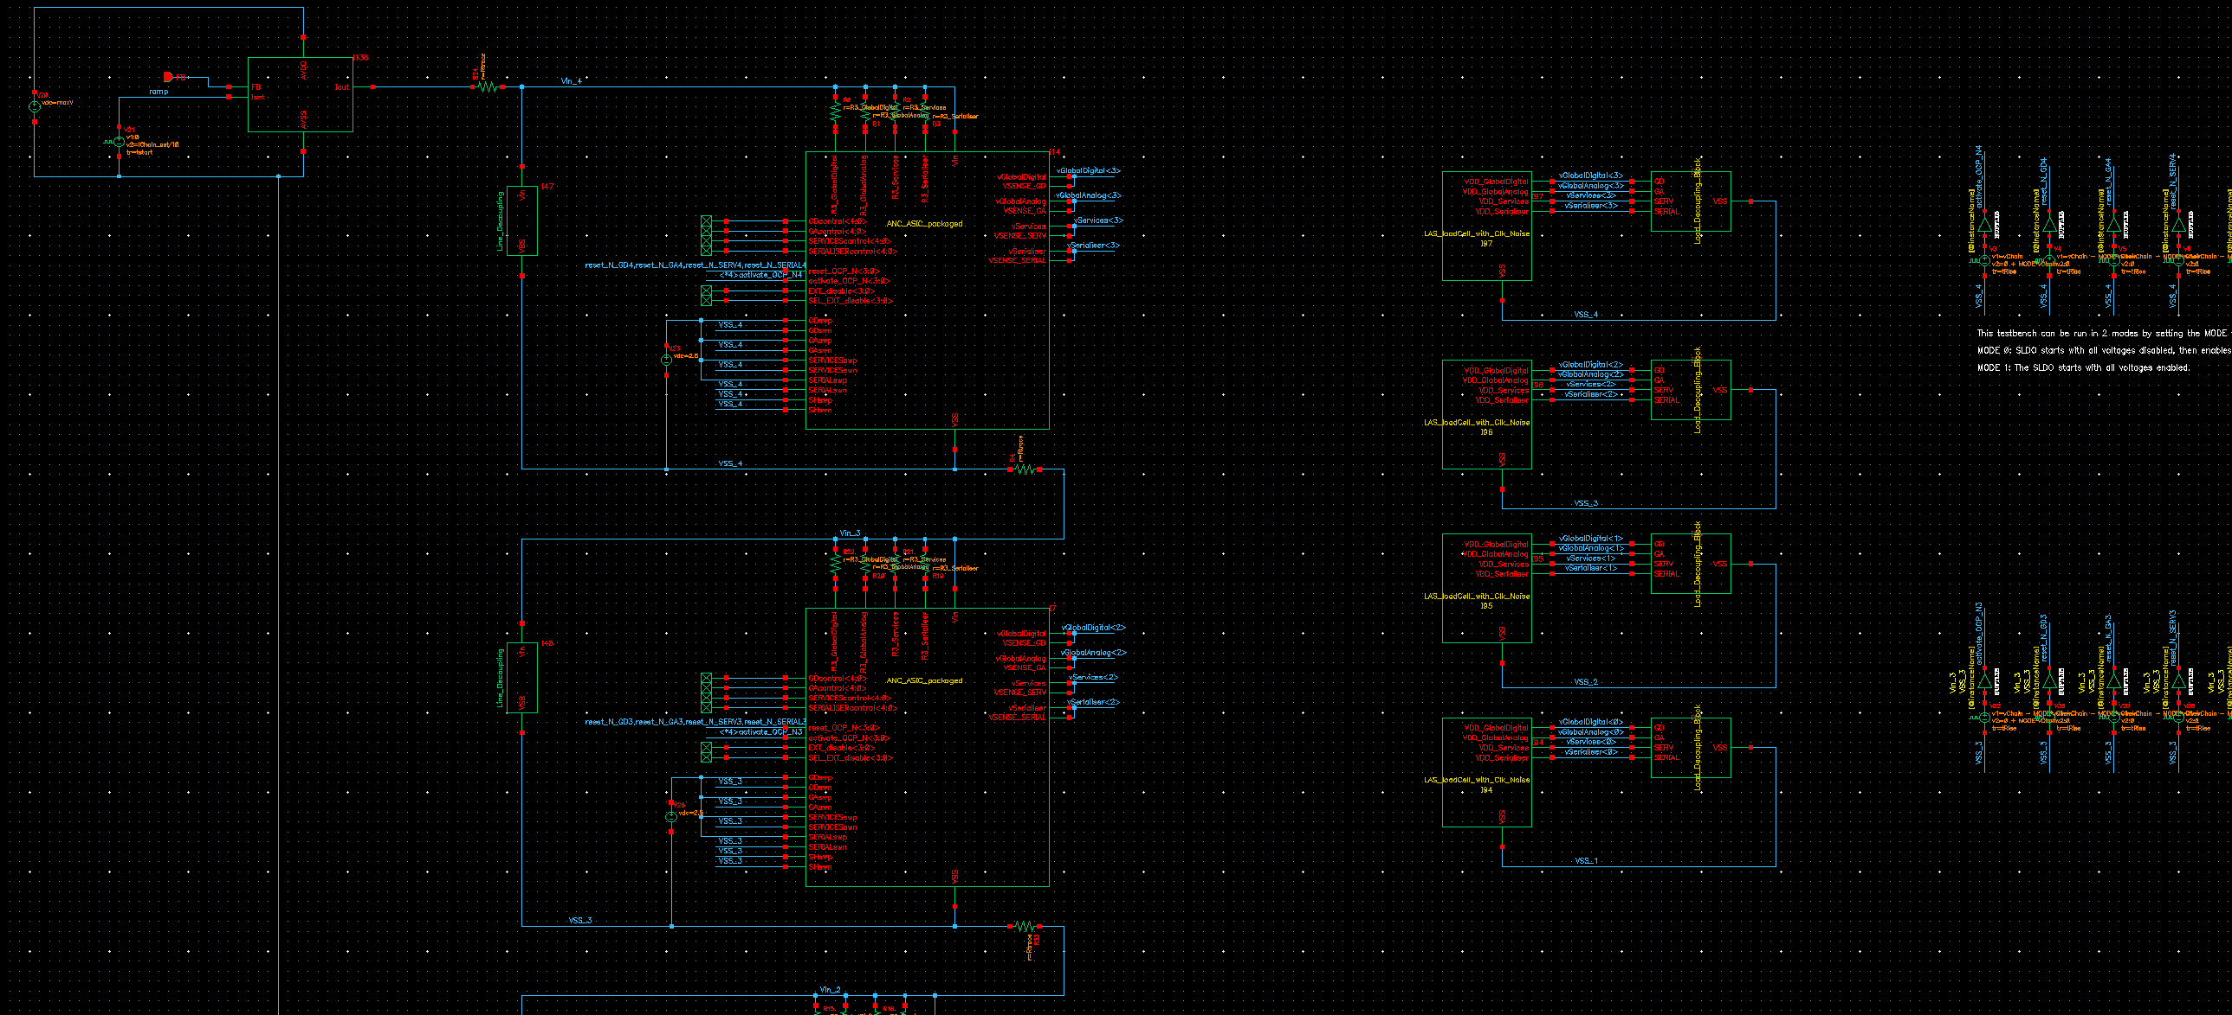
OVP Test Bench
SLDO V drop set resistors
Loads
Current
Source PSU
Stave SLDO + OVP
Enable Controls

Slide 19
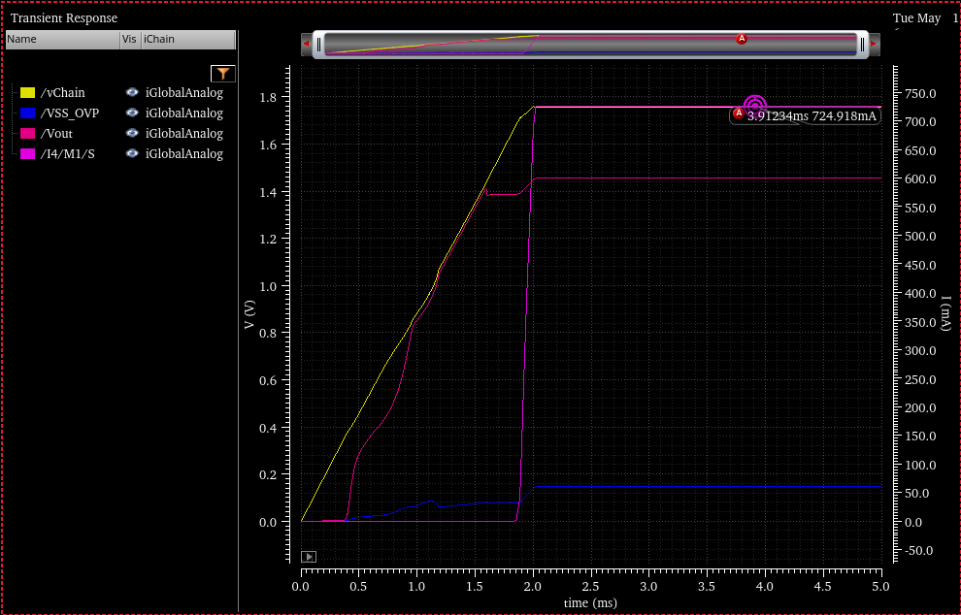
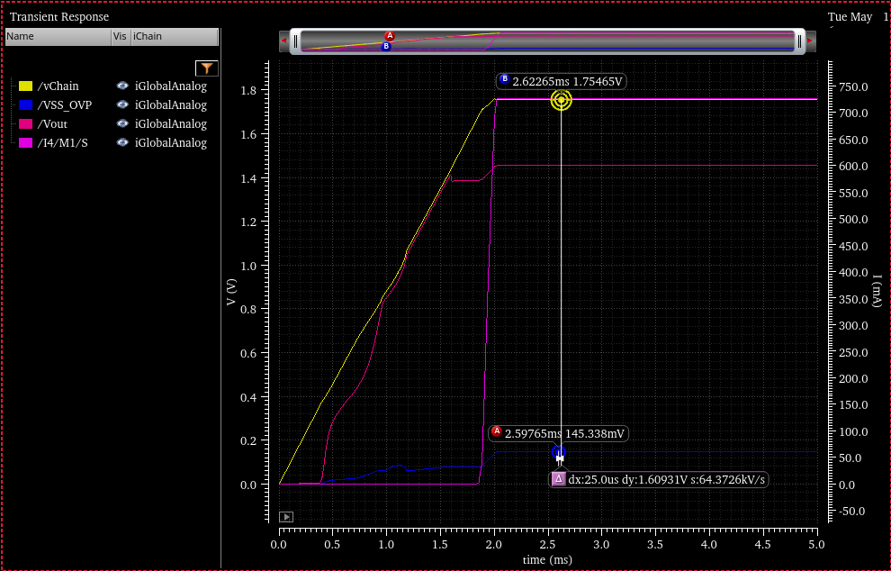
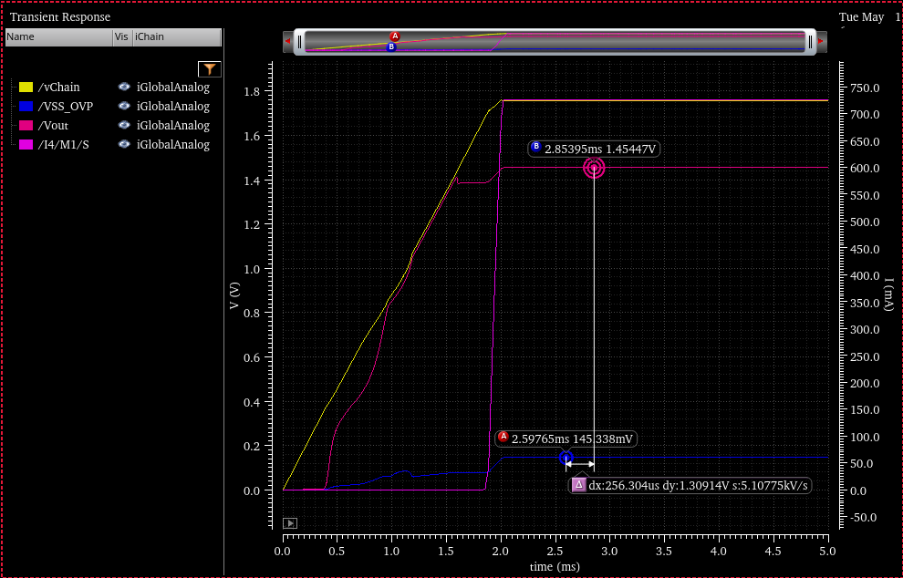

OVP shunt set to 1.6V
Shunt Current
Shunt Voltage
LDO Vout

Slide 20
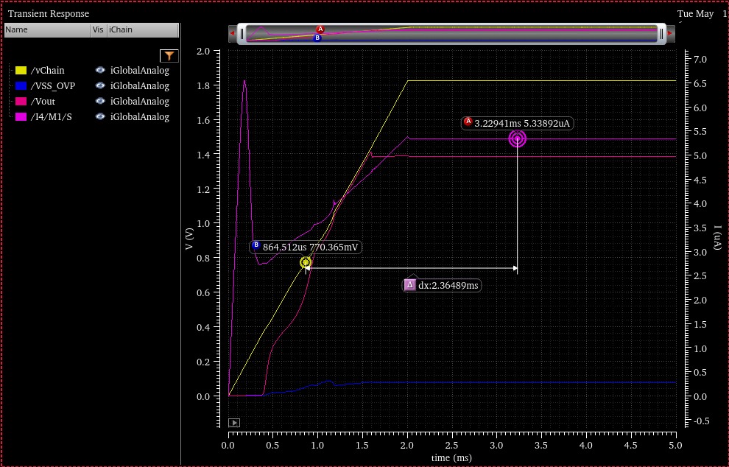
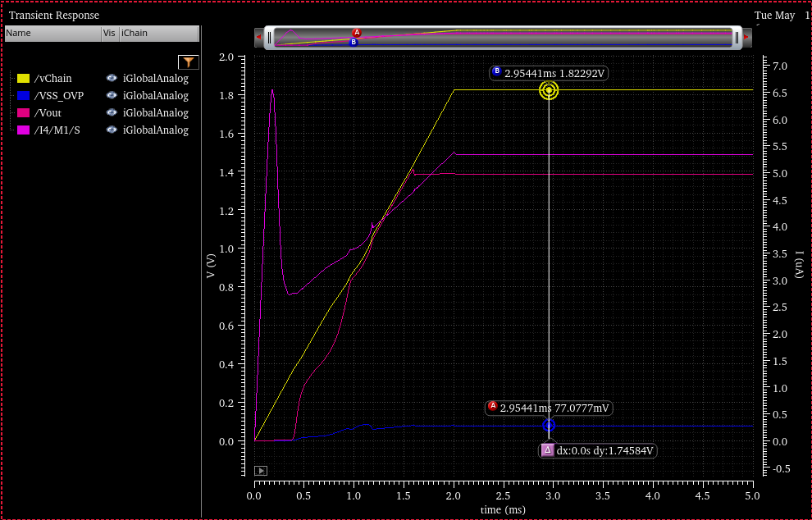
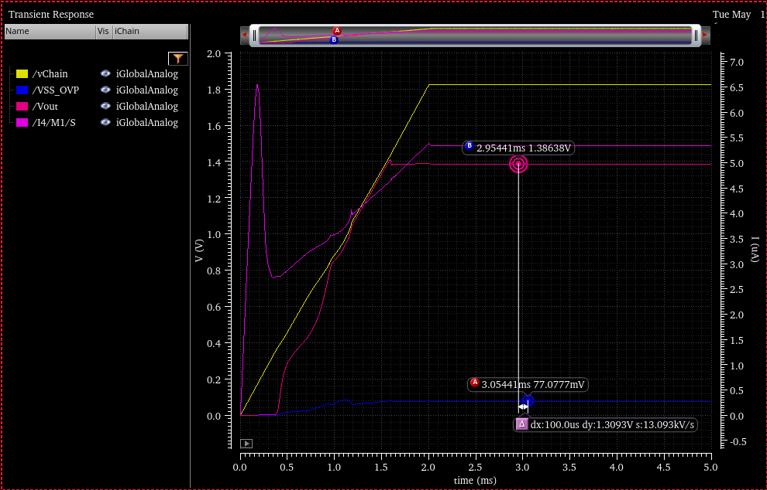

OVP disabled
Shunt Current
Shunt Voltage
LDO Vout

Slide 21
SLDO Start-up

Slide 22

The Problem
How to start-up the SLDO?
MOSAIX requires power sequencing:
GSVDD, GAVDD,GDVDD, TXVDD
AncASIC needs to be on at start-up to control this
How to achieve?
What are the problems?

Slide 23

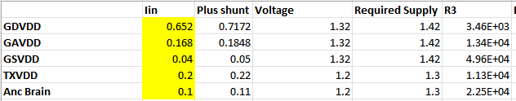
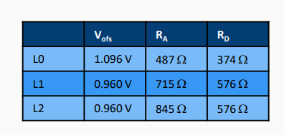
Model
Each SLDO can be represented as a resistance with equivalent resistance as shown.
So the total system is as shown in diagram.
Each SLDO takes a different current and has its R3 configured so that all 5 develop the same voltage across them.
The challenge in start up is that currents and SLDOs cannot be stepped simultaneously, so what happens when they are misaligned?
GDVDD is a particular challenge due to its value and position in the sequence.
R
R
R
R
R
AncBrain
GSVDD
GDVDD
GAVDD
TXVDD
Table 1
Table 2
10th EIC DAC Meeting, June 11th – 13th 2025

Slide 24
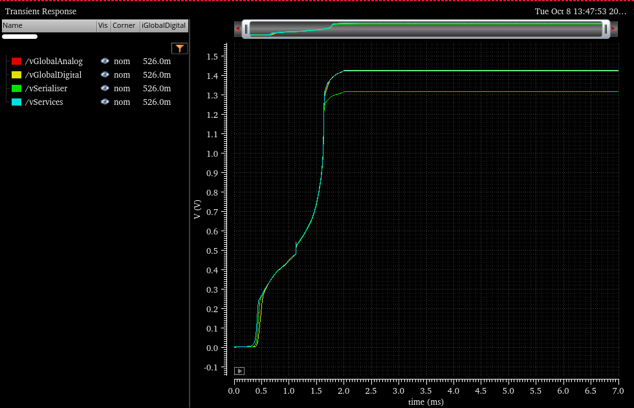
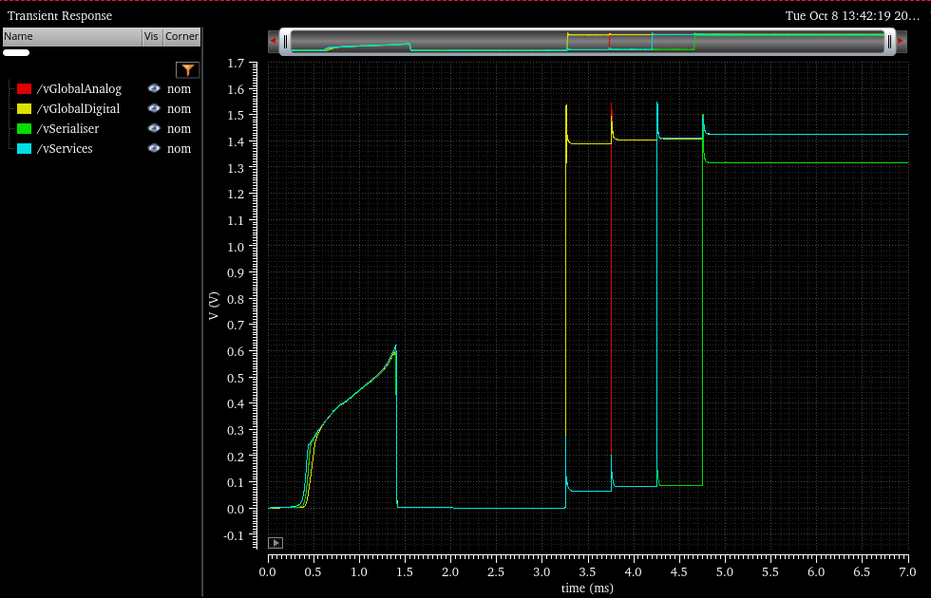
SLDO – Features for Startup
Can start in two modes:
Mode0: Output is off by default, and enabled by command
Mode1: Output is on by default and disabled by command
Mode is selected by single pin, which can have pull-up or down resistor to enforce default condition
Also Over-Voltage Protection (OVP). More later…
MODE 1
MODE 0

Slide 25
Simulations

Slide 26
Simulation configuration
Assumptions I have made:-
Stave configuration of 4 LASs 4 AncAsics + 1 OVP per LAS
4 AncAsics are serial powered by a non ideal current source.
Supply Rail Loads as table 1 on page 23
AncAsic SLDO needs to be ON as power comes up. SLDO Mode 1.
The AncAsic controller will sequence the supplies for the LAS:
GSVDD, GAVDD,GDVDD, TXVDD
4 SLDOs for these will be in Mode 0.
350us interval between each SLDO turn ON.
950us interval between each AncAsic turn ON.
2ms current ramp to 2.2A
Nominal parameters no corners yet

Slide 27
First Simulation Results – Full Current with OVP
I Current Source
GS GA GD GTX
LAS3
GS GA GD GTX
LAS2
GS GA GD GTX
Large spike > 580mv
AncBrain1 supply
LAS1
GS GA GD GTX
LAS0

Slide 28
Simulation Results..
First Results show large spikes on the AncBrain supply, but particularly when Global Digital is turned ON.
AncBrain1 supply has the biggest spikes when LAS 0 is turned ON.
LAS turn ON sequence 0 to 3 or reverse doesn't effect the spikes.
ANB1 580mV

Slide 29
Simulation Results..
Not the real picture:-
VSS is bouncing
Look at the difference between Supply and VSS
AB1 has the highest spike
AB3 has the lowest spike
Still quite large spikes 338mV
AB1 338mV
AB3 316mV

Slide 30
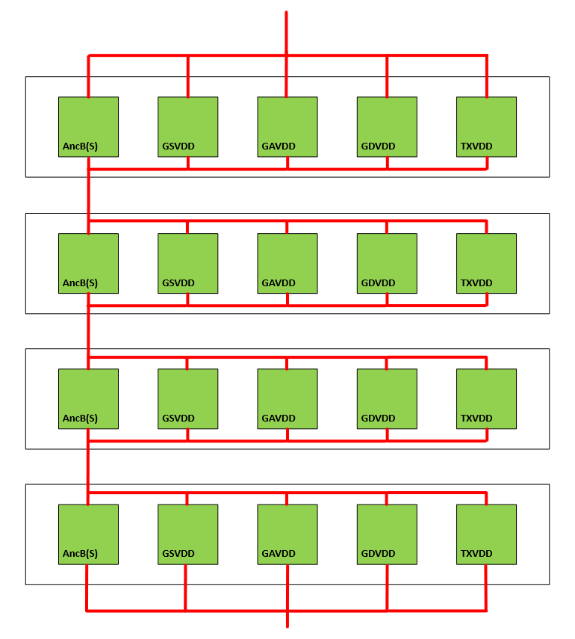
Simulation Results.. with capacitors…
Reduce spikes with capacitor across AncAsic Current supply:-
Tried a range of capacitors 10uF to 660uF used real models from TDK and Murata
AB1 10uF 185mV

Slide 31
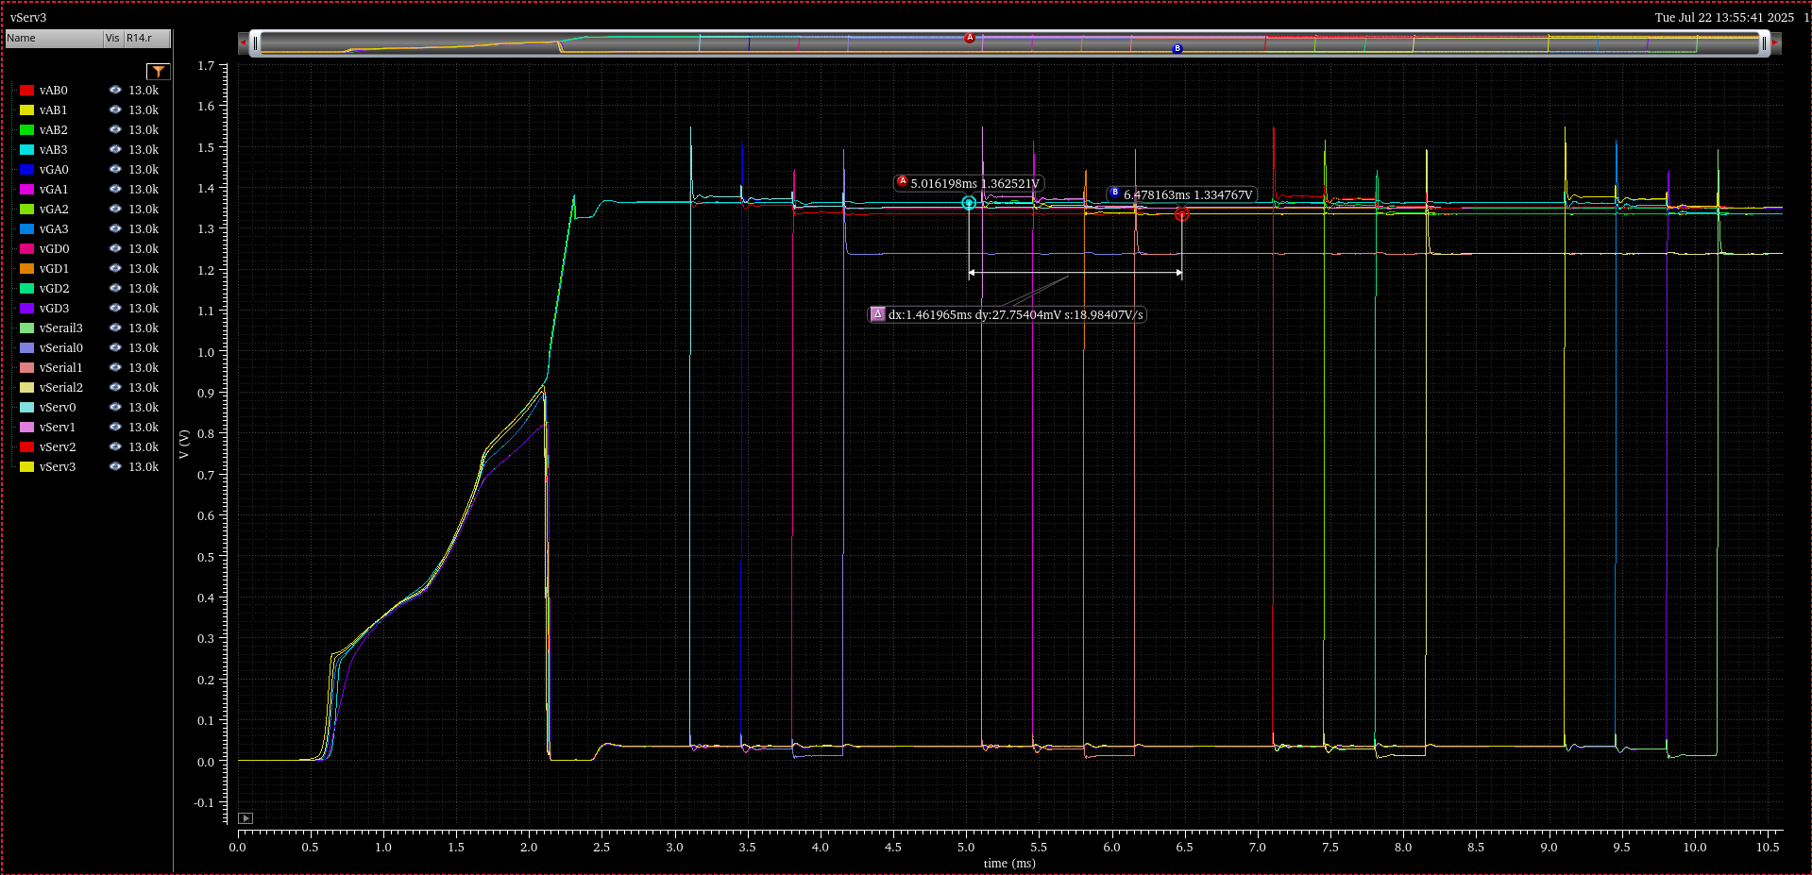
Simulation Results with 100uF Murata
Reduce spikes with capacitor across AncAsic Current supply:-
100uF 4v Murata is optimal 0805
AB1 100uF 28mV

Slide 32
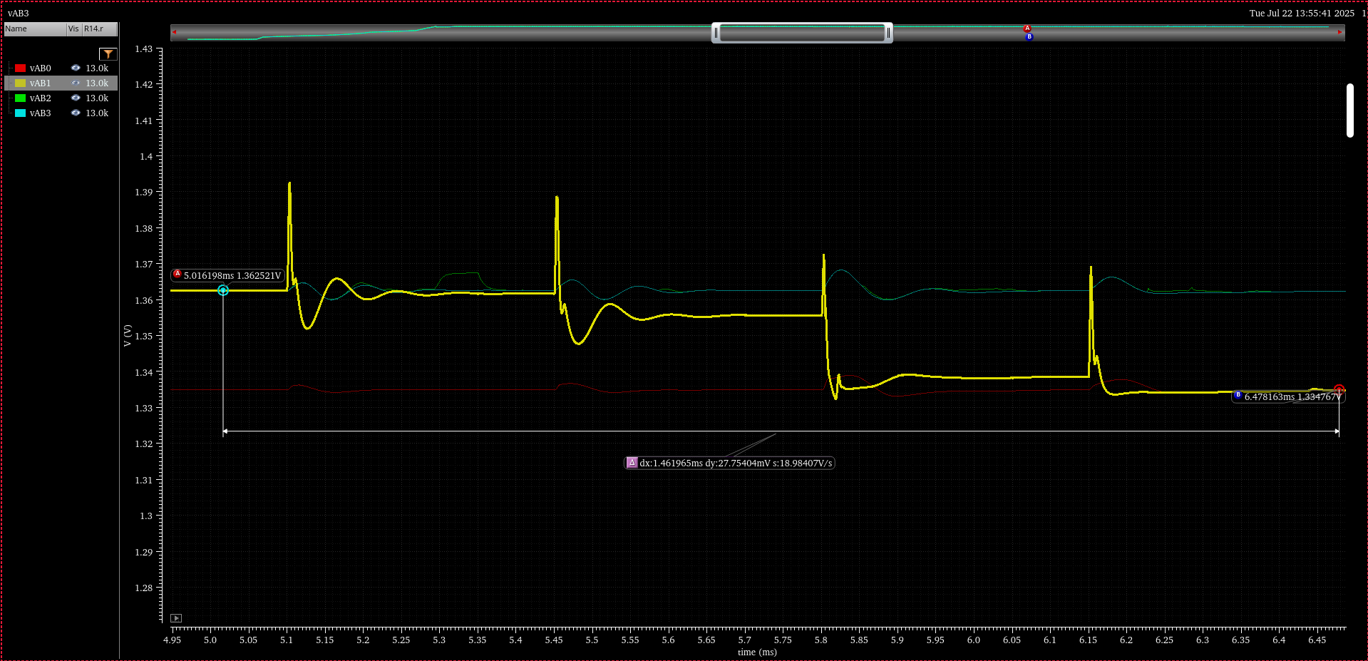
Simulation Results with 100uF Murata…
Reduce spikes with capacitor across AncAsic Current supply:-
100uF 4v Murata is optimal 0805
AB1 100uF 28mV

Slide 33
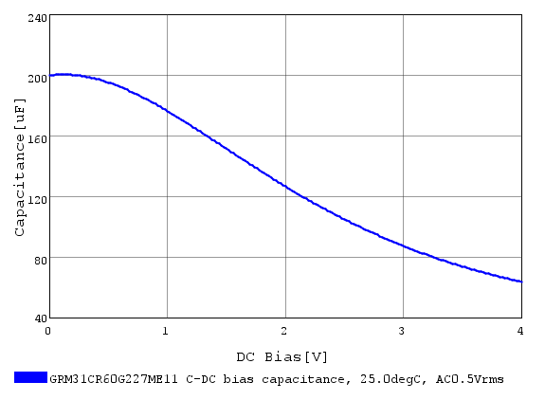
100uF Murata
To get >= 100uF
Requires a 220u 4v 1206 to give 144uF

Slide 34
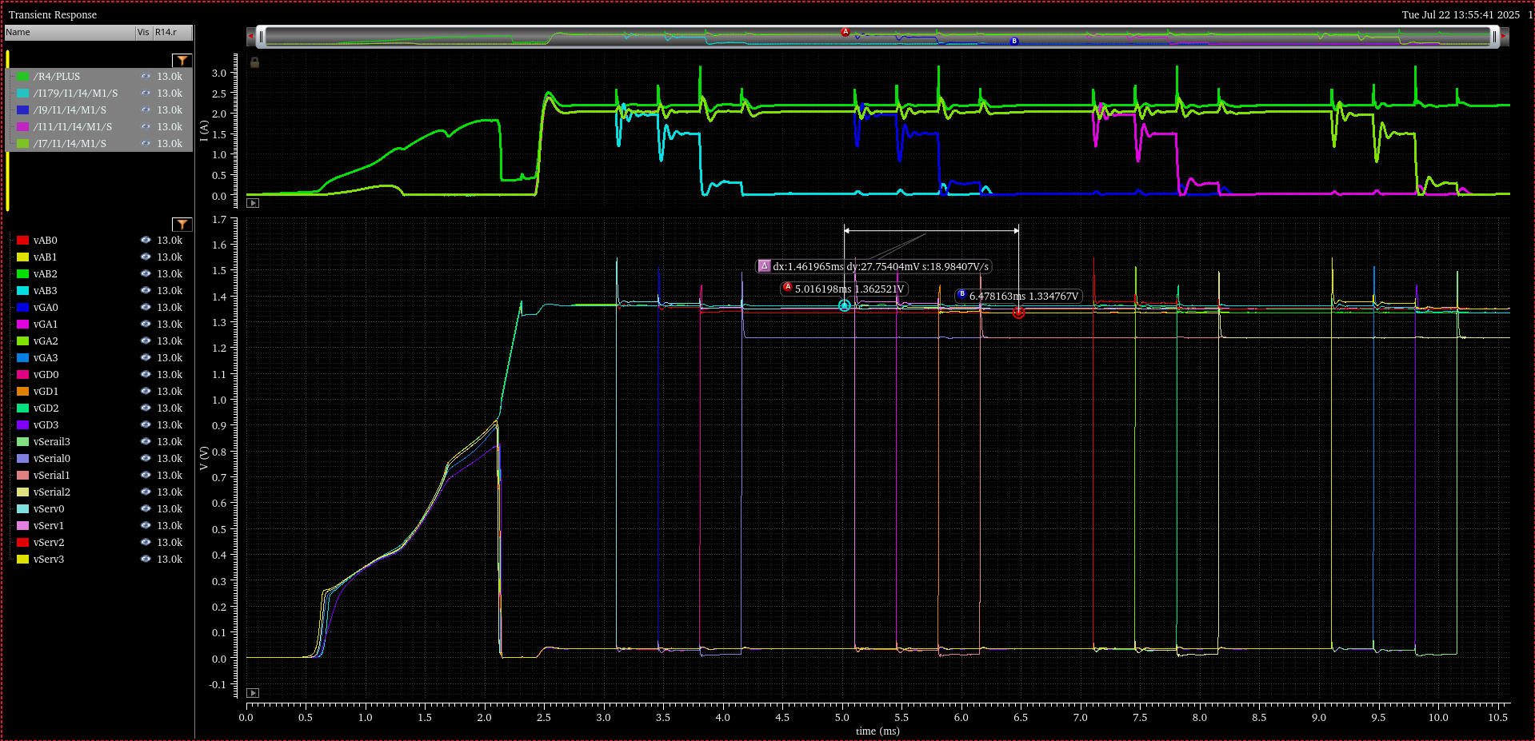
Simulation Results with OVP
OVPs take excess current during start-up protecting the SLDO from overvoltage.
1.97A to 33mA
OVP0
OVP1
OVP2
OVP3

Slide 35
Conclusion

Slide 36
Conclusion
Builds on Iain’s existing work on one AncASIC powering
Iain’s talk June 23rd 2025 WP1 Designer’s Meeting
https://indico.bnl.gov/event/28508/#43-powering-discussion
The OVP function enables the SLDO to operate under fault conditions and also allows start-up of the serial chain with full operation current (Max 3A) successfully.
Upgrades to the next version:-
Improve the pre-reg to be more immune to overvoltage.
Provide an OVP triggered status to the AncBrain
Change the Temperature specification of the AnCAsic to 10°C to 60°C

