Slide 1
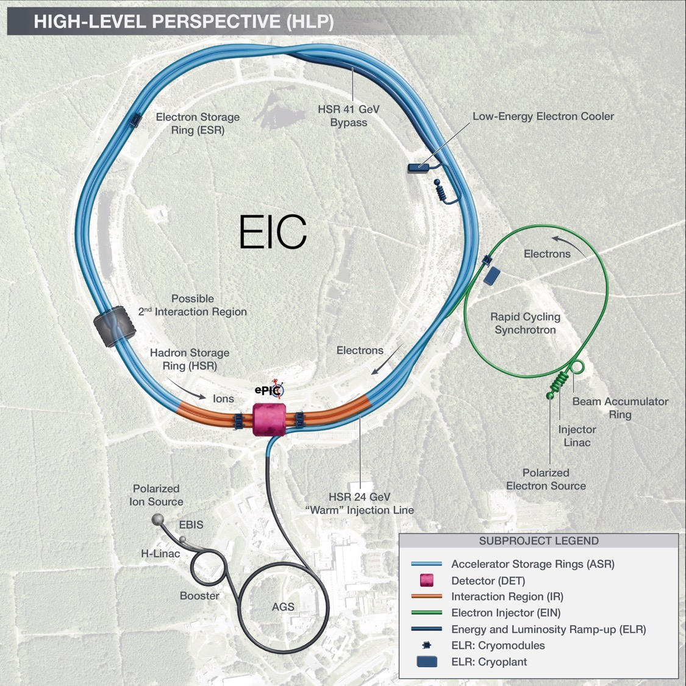
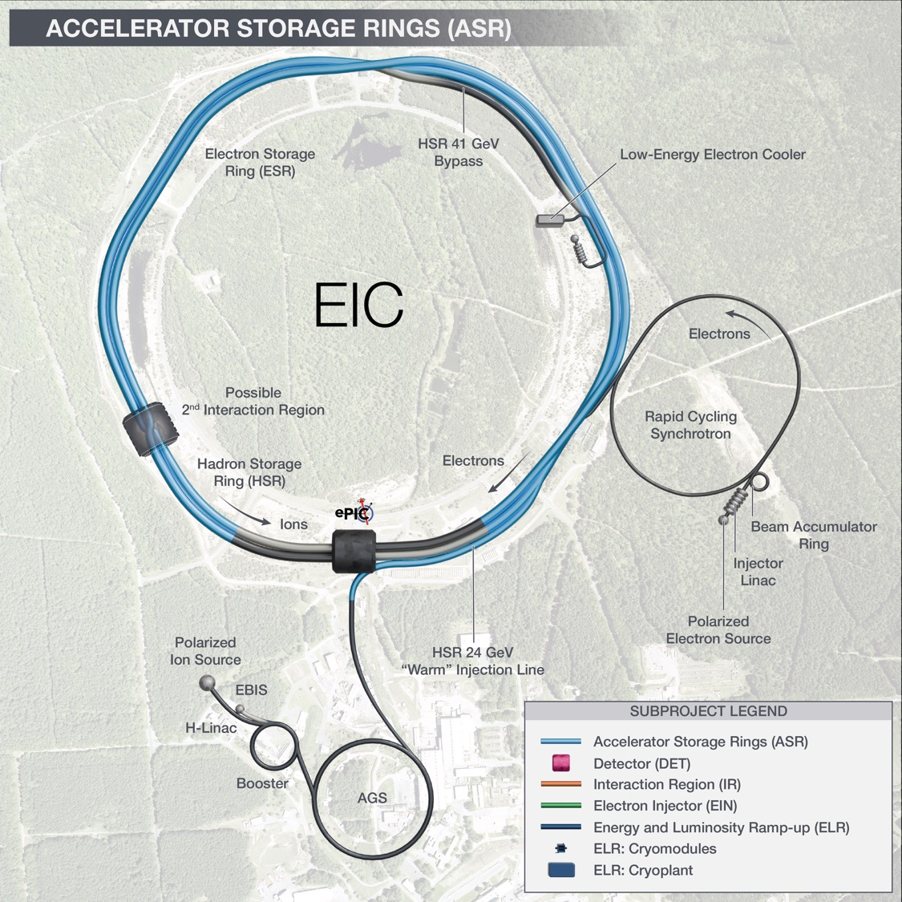
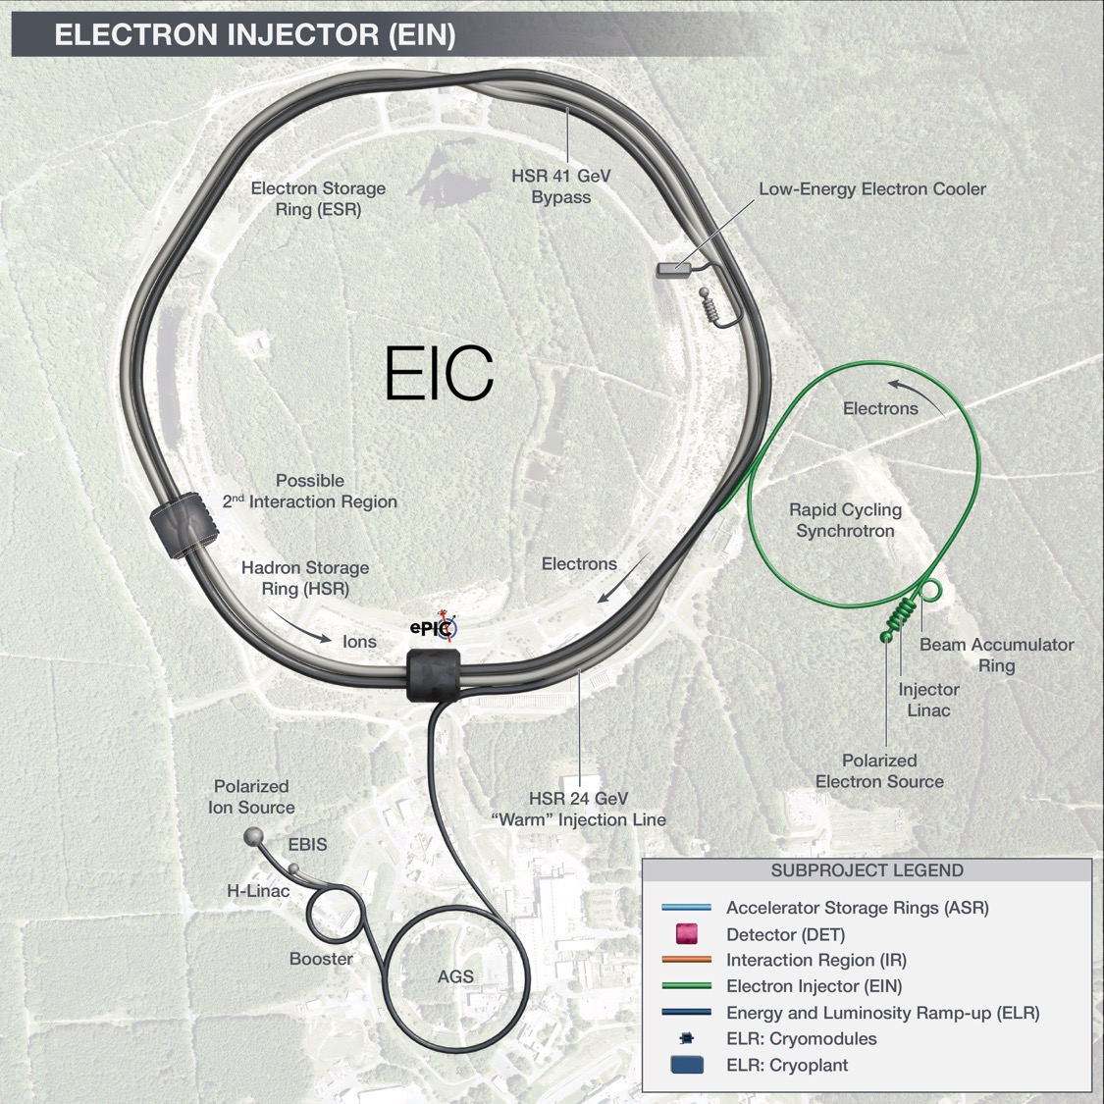
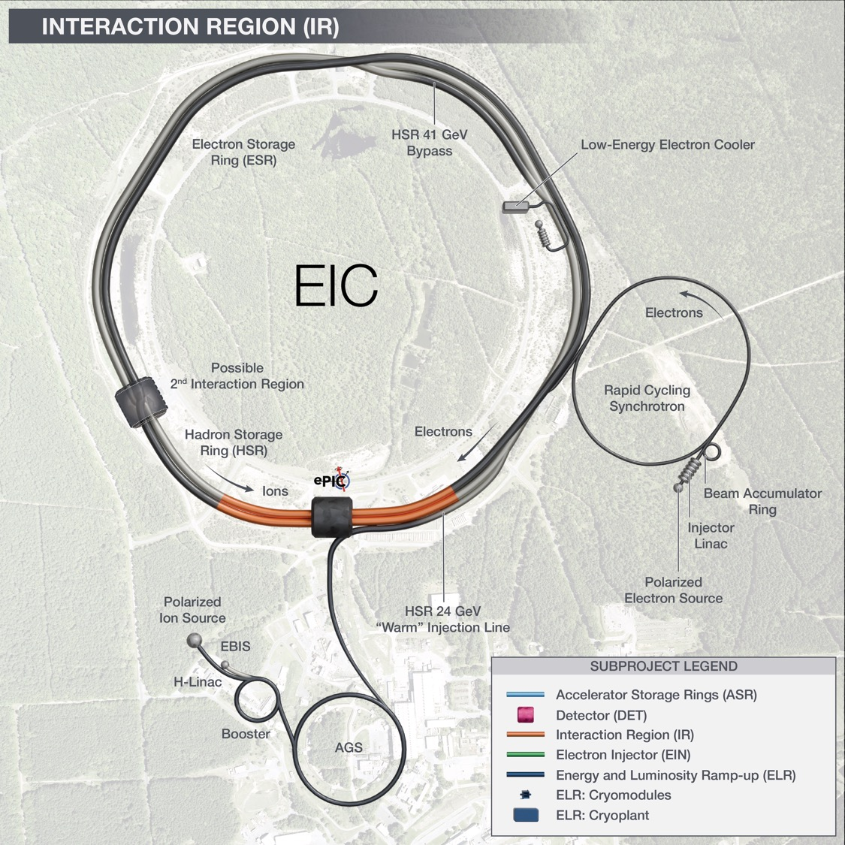
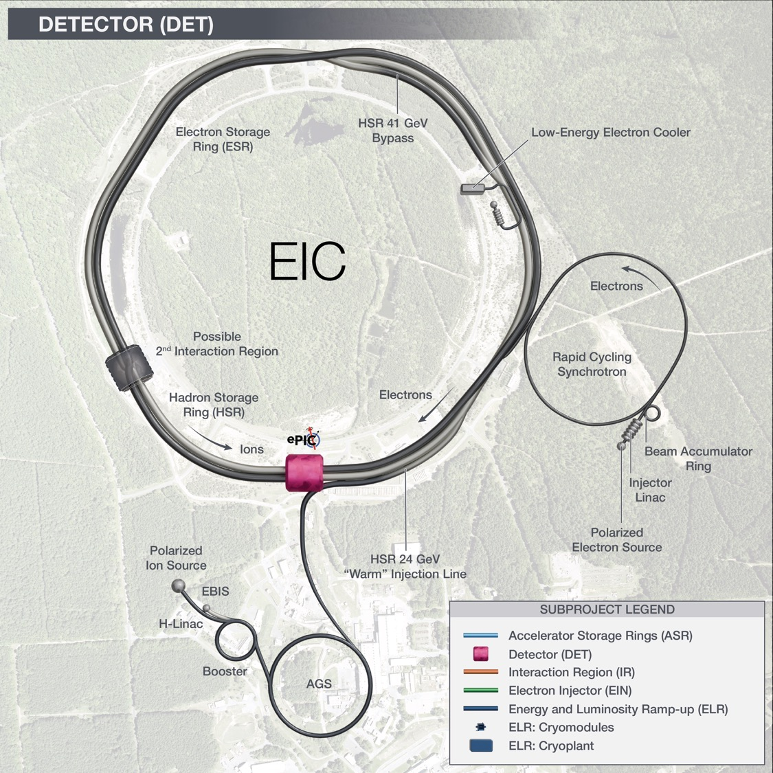
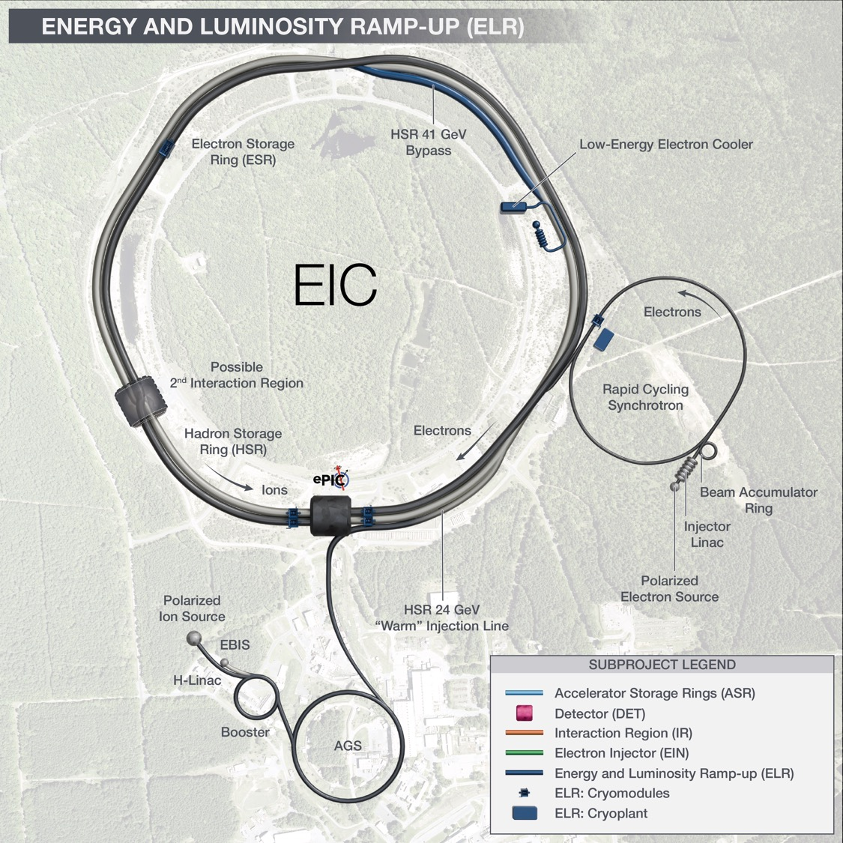
High-Level overview showing the full scope of the project.
Civil construction with NYS fund
Interaction Region including:
SC magnets,
197 MHz crab cavities and
Machine protection scope
Hadron Ring Modifications, Electron Storage Ring (10 GeV) and infrastructures to accommodate EIC needed services.
ePIC Detector including:
Magnet and return Flux & installation
Auxiliary detector systems.
Electron Injectors (LINAC, BAR & RCS @ 10 GeV) and related infrastructure.
Accelerator scope required to increase Energy
(18GeV e-, RCS SRF & Cryo, 394 MHz crab cavities, 41 GeV by-pass, ESR and HSR RF amplifiers, etc.)

