Slide 1
Report from the Project Director
Jim Yeck
Associate Lab Director & EIC Project Director
Brookhaven National Laboratory
EIC Resource Review Board Meeting
November 4-5, 2025

Slide 2
Outline
Project Update
EIC Subprojects
EIC Portfolio
Funding
Risks and Opportunities
Summary

Slide 3
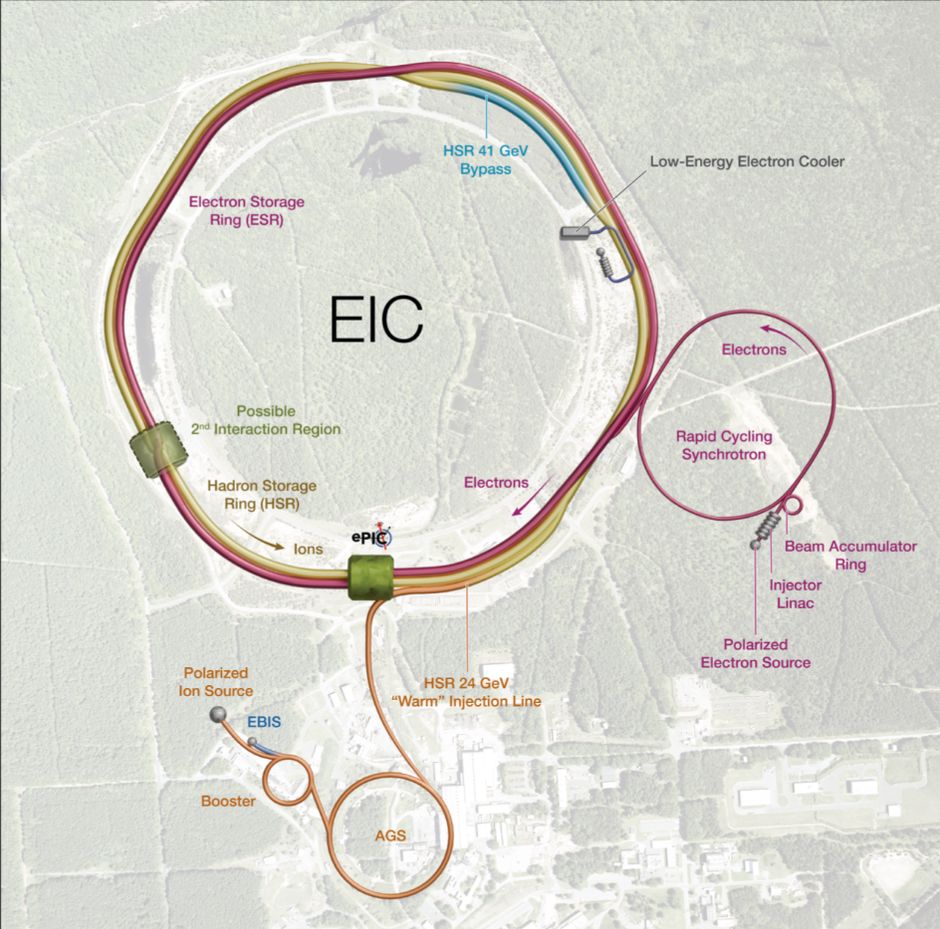
Facility Performance Requirements
High Luminosity: L= 10³³ – 10³⁴cm⁻²sec⁻¹
Highly Polarized Beams (electrons, protons, ions): 70%
Large Center of Mass Energy Range: E_{cm} = 20 – 140 GeV
Large Ion Species Range: protons – Uranium
Large Detector Acceptance and Good Background Conditions
Possibility to implement a Second Interaction Region (IR)
The EIC design and performance parameters address the requirements established by the U.S. Nuclear Science Advisory Committee (NSAC) Long Range Plans (2015 & 2023) and endorsed by the U.S. National Academy of Sciences (2018). EIC will be a unique collider facility in the world, strengthen U.S. leadership in nuclear physics, and advance accelerator and detector technologies for future facilities.

Slide 4


EIC Facility Scope
Existing Accelerator Scope
Polarized ion/proton sources
Ion injection and acceleration systems (Linac, Booster, AGS)
New Scope
Hadron Storage Ring (40, 100 – 275 GeV)
Electron Pre-Injector (750 MeV Linac)
Electron Rapid Cycling Synchrotron (0.75 GeV – Top Energy)
Electron Storage Ring (5 GeV – 18 GeV)
Interaction Region, Provision for a 2nd
Hadron Injection Cooling System
General Purpose Collider Detector
Existing EIC Facility Scope at BNL Valued at ~$2B
Performance and technical risks addressed in a new design of the electron injector complex, removal of SHC and a simplification of long straight section at IR2, and removal of the blue hadron ring from the RHIC tunnel.

Slide 5
EIC Line-Item Project Requirements
Project Requirements:
A single integrated line-item construction project.
Subprojects with well-defined deliverables, interfaces, and KPPs.
Plans consistent with DOE annual funding guidance.
EIC science program starts when particle beams collide.
Scope provides the performance capability required by the Mission Need and KPPs.
EIC Line-Item Project Scope:
Integrated Project Office and Global Commissioning (IPO)
Accelerator Storage Rings (ASR)
Detector (DET)
Interaction Region (IR)
Electron Injector (EIN)
EIC Energy and Luminosity Ramp-up (ELR)
Project scope required to start global commissioning and the EIC science program.
Required for full performance capabilities.

Slide 6
Subprojects
EIC line-item project scope is organized into 5 subprojects.
EIC construction starts when the first subproject, Accelerator Storage Rings, is ready.
EIC science program starts during commissioning and concurrent with the last subproject, Energy and Luminosity Ramp-up.
Integrated Project Office & Beam Commissioning (IPO) (L. Lari, Project Manager)
 | Long Lead Procurements & NYS Funded Scope |  |  |  | Start Science Program
First SP |  | Accelerator Storage Rings (ASR) – Infrastructure, HSR, ESR (C. Folz, SPM)
 |  |  | Detector (DET) – (R. Ent and E. Aschenauer, POCs)
 |  |  |  | Interaction Region (IR) - SC Magnets, Crab Cavities (S. Nagaitsev, POC)
 |  |  |  | Electron Injector (EIN) – Infrastructure, LINAC, RCS, Install (Q. Wu, SPM)
Last SP |  |  |  |  |  |  | Energy and Luminosity Ramp-up (ELR) (K. Wilson, POC)

Slide 7
DOE/SC Focused Review – August 2025
Select DOE Independent Project Review Committee Comments:
The EIC project team should be commended on the large amount of effort to stand-up a new subproject plan and subproject organization in the short time since the last OPA review.​
Great progress has been made in identifying and allocating the full scope of work within the EIC Portfolio. This work and the tools created therein are vital to ensure successful delivery of a facility that meets the mission needs.​
We support the plan to baseline the ASR and Detector subprojects first. Baselining the ASR is critical to retaining the RHIC expert workforce and preserving institutional knowledge following the scheduled RHIC shutdown at the end of 2025. Similarly, baselining the Detector is essential to uphold commitments related to in-kind contributions.
Recommendations for EIC Project:
Work with the program to conduct a comprehensive IPR Status Review of the EIC Project in 2QFY26 (Mar 9-13)
By the next review, work closely with the program to develop well documented and traceable KPPs that meet EIC mission need in a coherent manner across the subprojects. ​
By the next review, consider splitting the Integrated Project Office and Beam Commissioning (IPO) subproject to provide maximum optimization and flexibility for beam commissioning. ​
By the next review, demonstrate that the full subproject strategy can be clearly mapped to the overall project mission need.

Slide 8
DOE and EIC Planning Dates
Updated: 10/23/3035
Milestone |  | Milestone
DOE Independent Project Review (IPR) | Jan. 7-9, 2025 | Machine Advisory Committee Meeting | Sept. 16-18, 2025
Start Developing Scope of Subprojects | January 10, 2025 | Infrastructure Construction Advisory Committee | October 1-2, 2025
IR SC Magnet Steering Group Meetings - Monthly | January 17, 2025 | EIC Advisory Board Meeting | October 10, 2025
Project Advisory Committee Meeting | February 11, 2025 | Resource Review Board Meeting (BNL) | Nov. 4-5, 2025
EIC Advisory Board Meeting | February 25, 2025 | Assessments of Baseline Readiness for SPs Detector [rescheduled to Feb 3-5, 2026] Interaction Region Accelerator Storage Rings Global, Energy and Luminosity Ramp-Up Electron Injector (follow-up to Apr ‘25 Review) | Nov. 12-14, 2025 Nov. 18-20, 2025 Jan. 14-16, 2026 Feb. 9-13, 2026 April 2026
Electron Injector Design and Cost Review | April 8-10, 2025
Infrastructure Construction Advisory Committee | April 16-17, 2025
Project Advisory Committee "Red Team" Review | May 20-21, 2025
Resource Review Board Meeting (Prague) | June 5-6, 2025
Detector Advisory Committee Meeting | June 11-13, 2025 | EIC Project Strategy Workshop | Dec. 4, 2025
EIC Advisory Board Meeting | June 17, 2025 | RHIC Operations Conclude [TBD] | December 2025
DOE CD-3B ESAAB Approval | Pending | RHIC Removal and Repurposing (R&R) Starts | January 2026
DOE IPR Focused Status Review | August 5-7, 2025 | DOE IPR Comprehensive Review | Mar 9-13, 2026
DOE RHIC R&R/Injector Operations Review | Sept. 8-10, 2025 | DOE CD-2/3 Approval for Accelerator Rings | ~End 2026

Slide 9
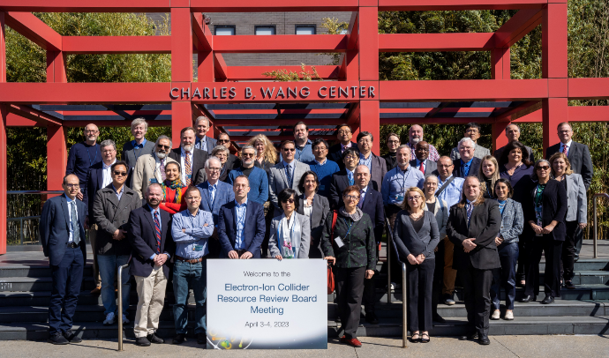
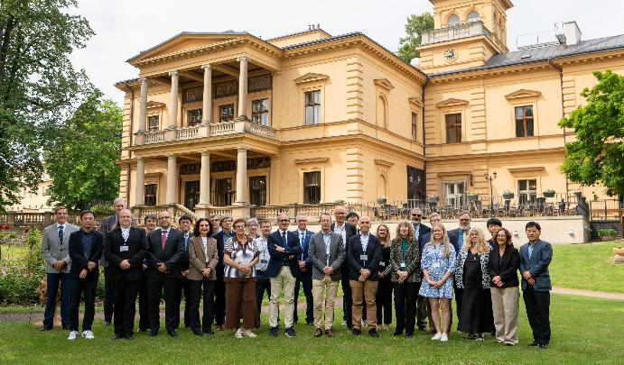
EIC Governance Boards
Resource Review Board – EIC Experimental Program
Stony Brook University – New York April 3-4, 2023
Catholic University of America – D.C Dec 7-8, 2023
INFN – Rome May 6-7, 2024
BNL – New York November 12-13, 2024
Czech Technical University – Prague June 5-6, 2025
BNL – New York November 4-5, 2025
EIC Advisory Board – EIC Accelerator Program
Quarterly meetings, virtual for 1.5 hours
DOE, Host Laboratories, and the EIC project are working together to promote collaboration and to create a facility and user experience that is international in character.
1st RRB Meeting Stony Brook
Last RRB Meeting Prague

Slide 10
Assessments of Baseline Readiness
Assessments of baseline readiness for each subproject will measure status and evaluate future work needed to be ready for a future DOE CD-2 IPR. The charge for these reviews includes technical scope, cost, schedule, and management and also include an evaluation of plans for achieving established cost targets.
Electron Injector Complex (EIN) April 8-10, 2025 (and Apr ‘26)
Co-Chairs: T. Raubenheimer, SLAC, MAC Chair & E. Peoples-Evans, LBNL, ALS-U PM.
Detector (DET) (Rescheduled to February 3-5, 2026) November 12-14, 2025
Co-Chairs: S. Nahn, FNAL, U.S. CMS PM & A. White, UTA, DAC Chair
Interaction Region (IR) November 18-20, 2025
Co-Chairs: O. Bruning, CERN, HL LHC PM, & R. Carcagno, FNAL HL LHC US Deputy, retired.
Accelerator Storage Rings (ASR) January 14-16, 2026
Co-Chairs: J. Kerby, LBNF/DUNE Director, FNAL & T. Raubenheimer, SLAC, MAC Chair
Integrated Project Office, Comm, Energy & Luminosity Ramp-up (ELR) February 9-13, 2026
Co-Chairs: PAC Chair & TBD. Charge to align with DOE IPR plus IPO, Commissioning, and ELR
DOE IPR March 9-13, 2026

Slide 11
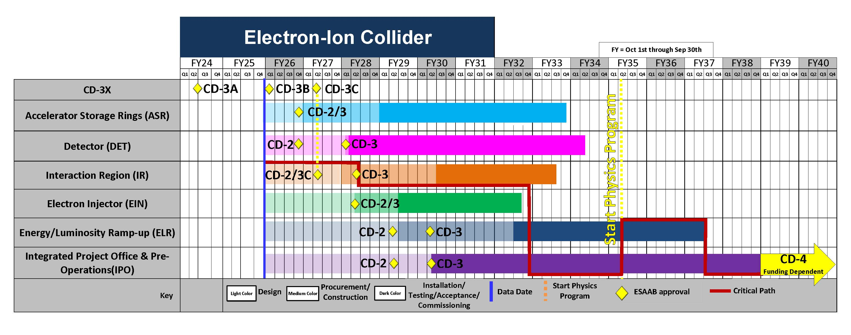
High Level Schedule – Technically Driven
Effect of the $300M/y peak funding profile on the technical driven schedule

Slide 12
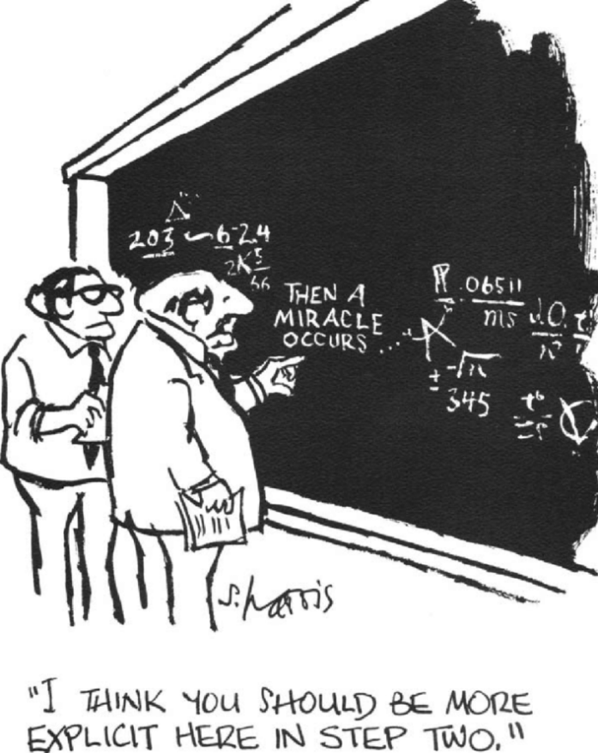
EIC Portfolio
Organized by BNL Director’s Office
Portfolio Manager: Bill Wahl
Engagement by BNL organizations, e.g., F&O, DT, etc.
Portfolio Major Categories:
EIC Construction (Line-Item Project)
SC Program Engagements (Primarily DOE NP)
SC Host Engagements (managed by BNL)
Excellent Progress
Started in 2019 with BNL Institutional MOUs
Reviews of major scope items in 2024
Common tool created for documenting scope, tracking, and managing changes in 2025.
Cost estimates in preparation
12

Slide 13
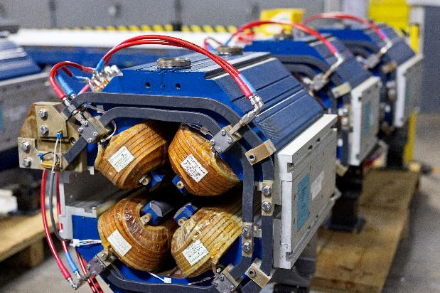
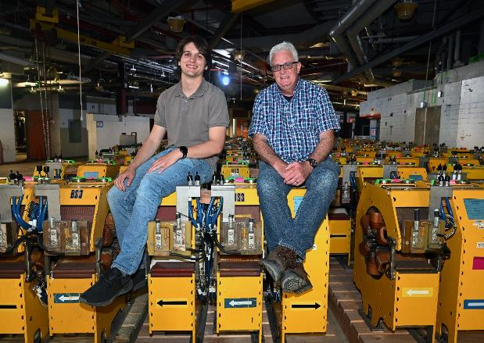
EIC Portfolio – Starting Construction
Well-Defined Projects
NYS EIC Infrastructure Investments – NYS grant
RHIC Removal & Repurposing (R&R) – RHIC Operations
Accelerator Storage Rings (ASR) – EIC Line-Item Project
NYS EIC Infrastructure Investments
Funding in place
Site clearing end of this year
RHIC Removal & Repurposing (R&R)
DOE Review – Sept 8–10, 2025
Start after collider operations concludes ~ January 2026
Accelerator Storage Rings (ASR)
Design mature, well-defined subprojects, CD-3A and CD-3B items
Director’s Review to assess baseline readiness Jan 13–15, 2026
Demonstrate CD-2/3 readiness in 2026

Slide 14
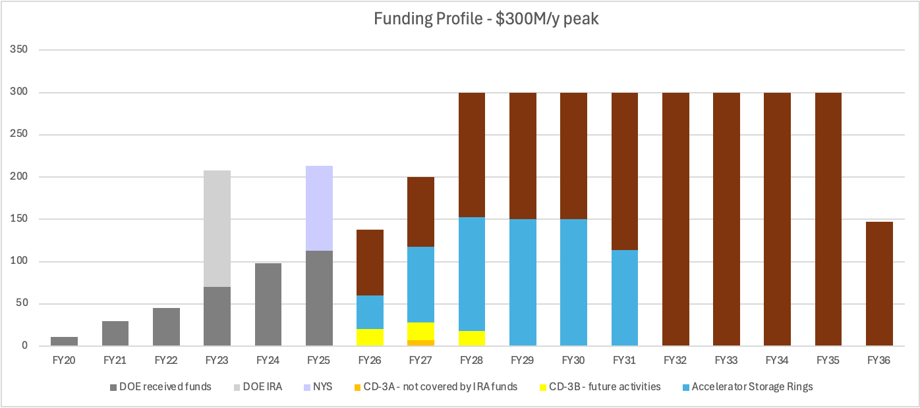
Previous Reference Funding Profile ($300M/yr)
Total Per FY | 11 | 30 | 45 | 208 | 98 | 113 | 138 | 200 | 300 | 300 | 300 | 300 | 300 | 300 | 300 | 300 | 147 | TOT 3390
Assumptions:
RHIC concludes operations at the ~end of CY2025.
EIC project transitions to construction at the end of CY2026.
Operations funding maintains the hadron injector complex, removal and repurposing of RHIC equipment, and maintenance upgrades.

Slide 15
New Notional Profile
Example of a profile that we can use as top-down guidance:
Important to scrub estimates “on both sides of the equation,” i.e., BNL NPP and EIC Line-Item Construction Project.
Consider requirements and scope reductions to get within the annual funding and Total Project Cost objectives and still meet the mission need. Understand the impacts.
Goal to deliver EIC as soon as possible. Initial science ramping up to full energy and luminosity program.

Slide 16
Project Strategy Workshop (Dec 4, 2025)
Goal: Engage stakeholders in the development of plans for delivering the EIC facility and efforts to align with DOE funding guidance and the mission need.
Assess progress on revising plans based on new funding guidance
Discuss plans and results of the Assessments of Baseline Readiness
Discuss plans for establishing subproject baselines and starting construction in 2026
Participants: EIC primary points of contact and DOE (FPD and NP)
Chairs of Advisory Committees, Steering Group, and EIC Governance Boards
EIC Users Group and ePIC Collaboration Leadership
EIC Project Advisory Committee members
Format: Similar to Aug 2024 Project Strategy Workshop (Focused on Subprojects)
August 2024 Indico Site: https://indico.bnl.gov/e/PSW
Password: EIC-STRATEGY

Slide 17
Strategic Risks and Opportunities
Risks
Funding – Annual project funding is far less than needed to support EIC construction.
Partially mitigated by the transition from RHIC operations to EIC construction (RHIC ops funding to EIC construction).
Schedule – Successful projects are driven by schedule performance goals. The delay in ramping-up funding can result in a loss of a schedule imperative or a schedule driver.
Partially mitigated by establishing Critical Decisions for Long Lead Procurements (CD-3A, 3B, etc.) and CD targets for the subprojects. The conclusion of RHIC operations will also establish a clear priority on efficiently starting to construct the EIC facility.
Cost – Longer schedules result in higher costs.
Partially mitigated by the subprojects, opportunities for additional in-kind contributions, and a commitment to design-to-cost targets.
Research Support – The EIC project and research program depends on support from scientific personnel.
Funding for EIC research support will be needed as PIs and groups move toward EIC science topics.
User Community – Potential erosion of community support due to uncertainties and delays.
An official start of EIC construction and a credible target for the start of the science program will solidify community support.
Opportunities
There is increasing interest in potential technical contributions – only new collider in the next decades.
A construction start provides performance imperatives and motivates partners.

Slide 18
Summary
EIC will be a unique collider facility in the world and the only collider in the U.S.
There is a good understanding of the current EIC scope, cost, schedule, and funding requirements and the interfaces and design maturity of the subprojects.
The EIC subproject delivery strategy will enable the possibility of starting construction of the accelerator storage rings following the conclusion of RHIC operations.
Current project delivery plans are not consistent with the reduced annual funding projections under discussion. The project is working to align scope, cost, and schedule with the new funding projections.
There is excellent progress defining the EIC Portfolio scope, notably the DOE Office of Nuclear Physics scope, and establishing the needed management framework. The $100M of NYS funding is in the bank!
EIC is preparing for Critical Decision approval reviews of the Accelerator Storage Rings (CD-2/3) and Detector (CD-2) in 2026.

