Slide 1
Electron-Ion Collider Design Readiness
Sergei Nagaitsev
EIC Technical Director
Resource Review Board Meeting November 4, 2025

Slide 2
Outline
Requirements
Design changes
Present concept
Summary

Slide 3
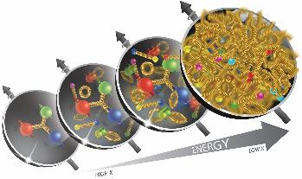
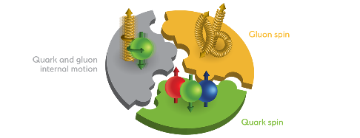
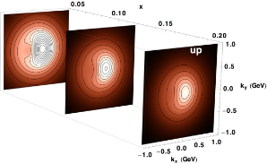
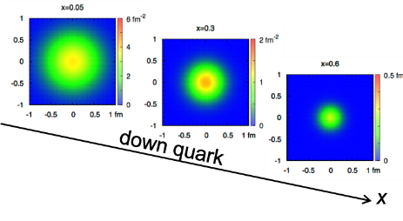
EIC Accelerator Performance Drivers
wide center-of-mass energy √s: 20 – 140 GeV :
map the out nucleon and nuclei structure from high to low x
polarized electron and hadron (p, He-3) beams:
access to spin structure of nucleons and nuclei
Spin vehicle to access the spatial and momentum structure of the nucleon in 3d
Full specification of initial and final states to probe q-g structure of NN and NNN interaction in light nuclei
nuclear beams: d to Pb
accessing the highest gluon densities → saturation
quark and gluon interact with a nuclear medium
high luminosity 10³³-10³⁴ cm⁻²s⁻¹ :
mapping the spatial and momentum structure of nucleons and nuclei in 3d
access to rare probes, i.e. Ws
large acceptance (0.2 – 1.3 GeV) through forward focusing IR magnets
spatial imaging of nucleons and nuclei
gluon emission
gluon recombination
?
=

Slide 4

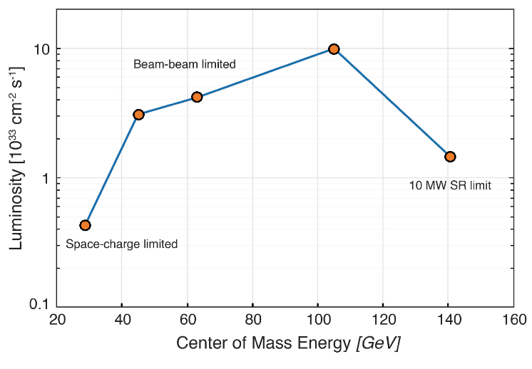

EIC Accelerator Performance Requirements
Center-of-mass energies: ~20 to ~140 GeV (e-p)
High degree of beam polarization (P): ~70%
Availability of ion beams: from proton to Pb
Luminosity (L): 10³³ – 10³⁴ cm⁻²sec⁻¹
Possibly more than one IR
Figure of merit: to
10x275
Bunch charges: 28 nC (10 GeV, e) and 11 nC (275 GeV, p)
5x100
10x100
18x275
5x41
The EIC design and performance parameters address the requirements established by the U.S. Nuclear Science Advisory Committee (NSAC) Long Range Plans (2015 & 2023)
EIC peak luminosities (CDR)

Slide 5
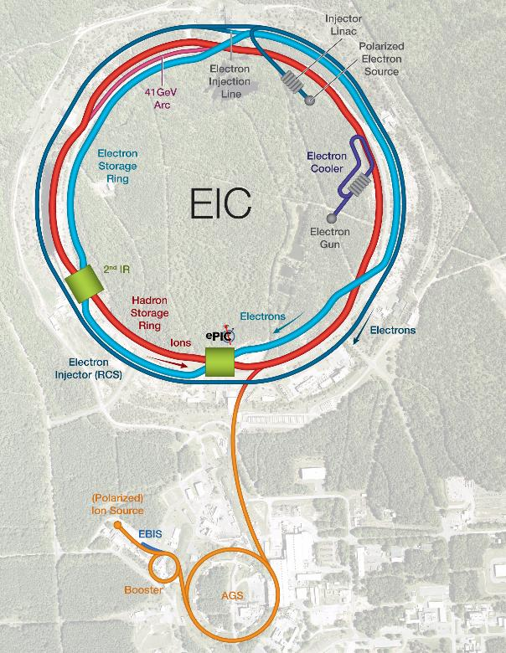
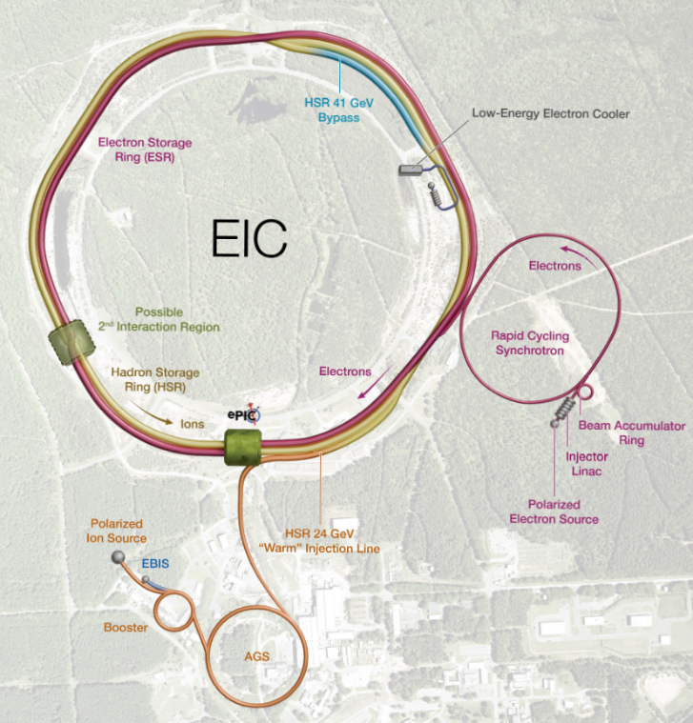
EIC Design Changes since the CDR (2021)
Main changes highlighted on right:
1. Optimized location of 41 GeV bypass
2. Optimized location
of the HSR injection
3. Added low-energy cooler; removed CeC cooler
4. Optimized electron
injector concept
1
3
4
2
Conceptual Design 2023
Conceptual Design 2025
Implemented design changes effectively addressed identified technical uncertainties and risks without affecting the performance or cost objectives.

Slide 6
Preparing the Accelerator Design for Performance Baseline in 2026
Date | Milestone/Progress
2019 | DOE EIC Mission Need Statement (MSN)
2021 | EIC Conceptual Design Report
2023 | EIC Global Requirements
2023-2024 | Design changes reviewed by Machine Advisory Committee and documented by TCCB, CCB, RoDs, System Requirements
2025 | Design Converged EIC Global Parameters List (draft) – now under version control
2026 | Draft Preliminary Design Report posted for August 2025 IPR Final version will be released by Summer 2026
The EIC Accelerator design is stable.
We have a well-defined vision of what is required to build the EIC!

Slide 7
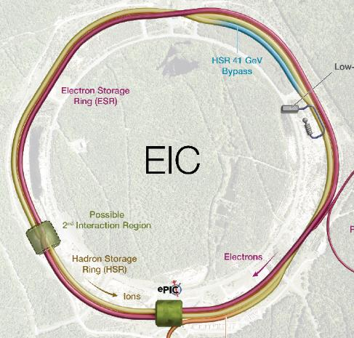
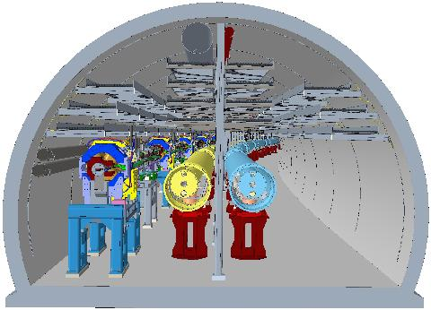
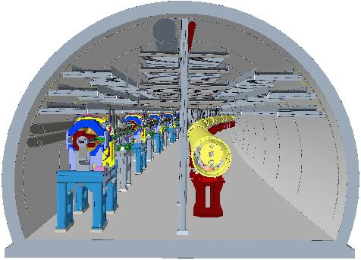
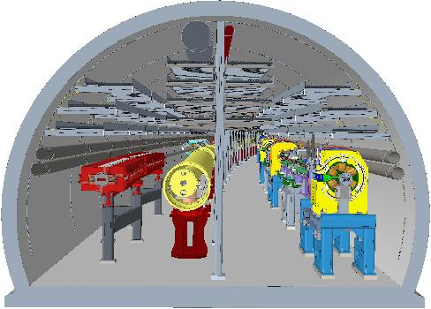
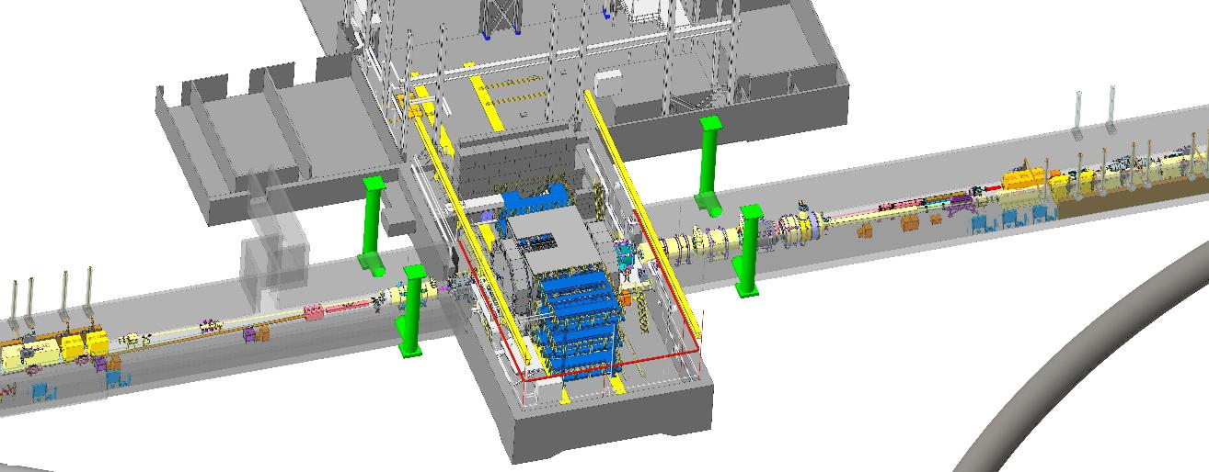
Collider Layout
1
3
1
3&7
5
7
5
IR6 and EPIC

Slide 8
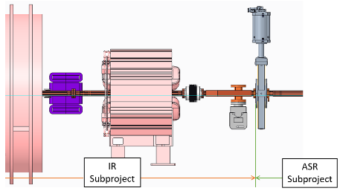
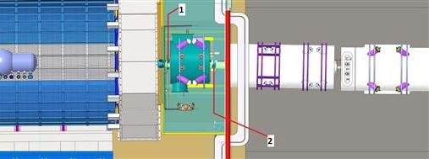
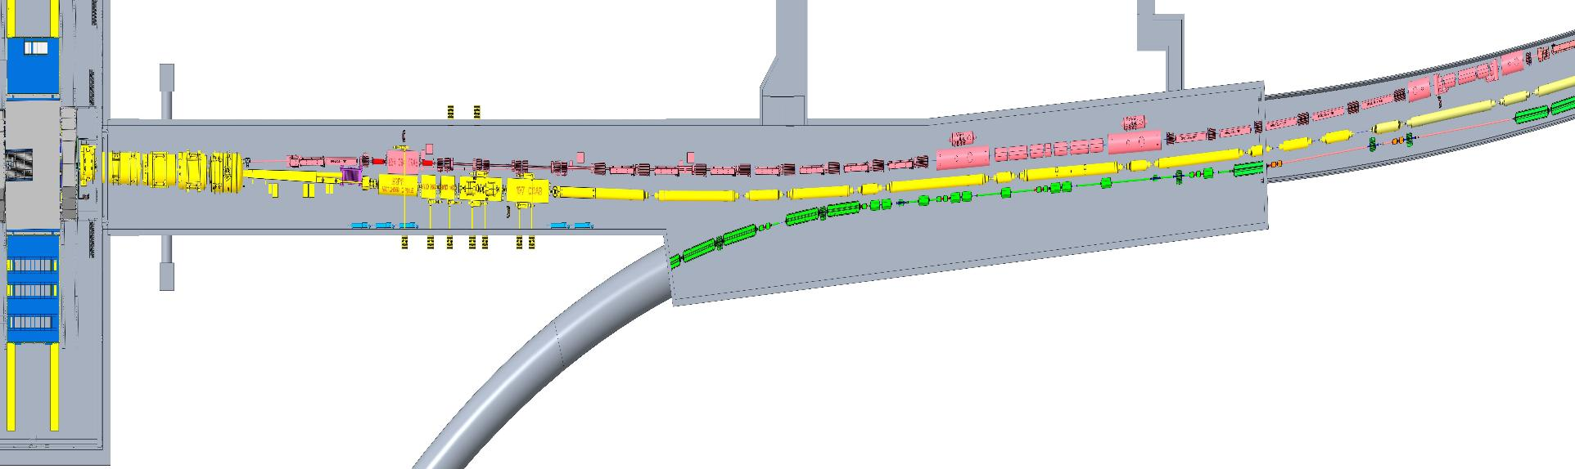
Subproject Interfaces in Sector 5
Short Spin Rotator
RHIC Q10
IR
ASR
Detector
IR
Subproject interfaces are well-defined.

Slide 9
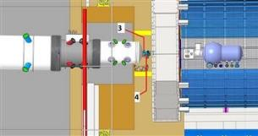
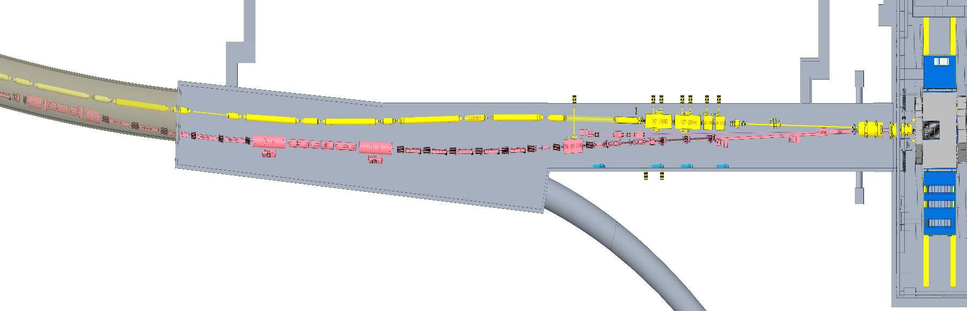
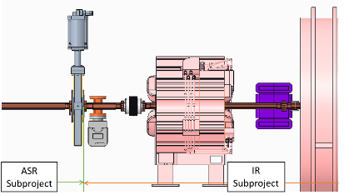
Subproject Interfaces in Sector 7
RHIC Q10
(fixed)
DR8
Short Spin rotator
Rear SC magnets
ASR
IR
IR
Detector
Subproject interfaces are well-defined.

Slide 10

Key EIC Accelerator Concepts Proposed in the CDR
The following core design principles enable the EIC to achieve luminosity of ~10³⁴ cm⁻²s⁻¹ and to maintain high polarization at collisions over a broad range of CoM energies.
Ribbon-like (flat) hadron beam (11:1 transverse emittance & beam size ratio)
Large beam crossing angle (25 mrad)
Collisions at beam-beam tuneshift limits for both beams (0.1 e/ 0.01 p)
Spin preservation from source to collisions (protons and electrons)
Very high bunch intensities and circulating beam currents (1 A (p), 2.5 A (e))
Recent design updates have not altered these foundational concepts.
Note: HERA(1992-2007) peak luminosity: ~5x10³¹ cm⁻²s⁻¹

Slide 11
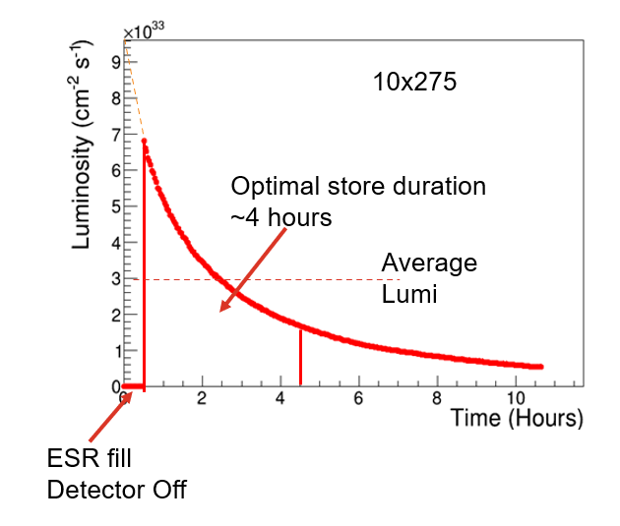
Luminosity Performance Meets the Established Requirements
“Flat” proton bunches allow for high initial luminosity.
CoM Energy (GeV) | Average Lumi (x10³³ cm⁻²s⁻¹) (per 4-hour store)
105 | 3
63 | 1.2
45 | 1
140 | 0.44
29 | 0.13
10x275
5x100
10x100
18x275
5x41
EIC peak luminosities (CDR)

Slide 12
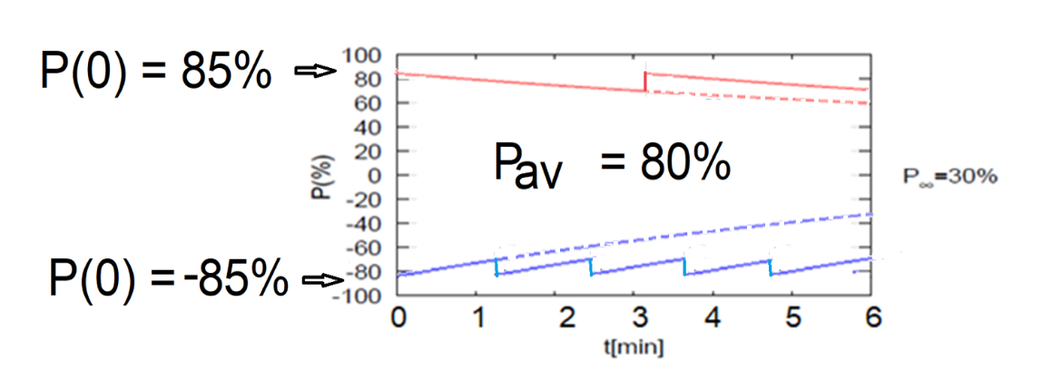
Polarization Performance Meets the Established Requirements
Frequent swap-out injection of bunches with high initial polarization of 85%
Bunch spacing is ~10 ns
Initial polarization decays towards P∞
At 18 GeV, every bunch is replaced (on average) after 2.2 min with RCS cycling rate of 1Hz
B P
B P
Refilled every 3.2 minutes
Refilled every 1.2 minutes
Re-injection
HSR proton polarization
performance also meets
the requirements.
Present RHIC proton
polarization is 60%
P_{av}=80%
P∞= 30%
(conservative)
P_{av}=80%
Re-injections

Slide 13
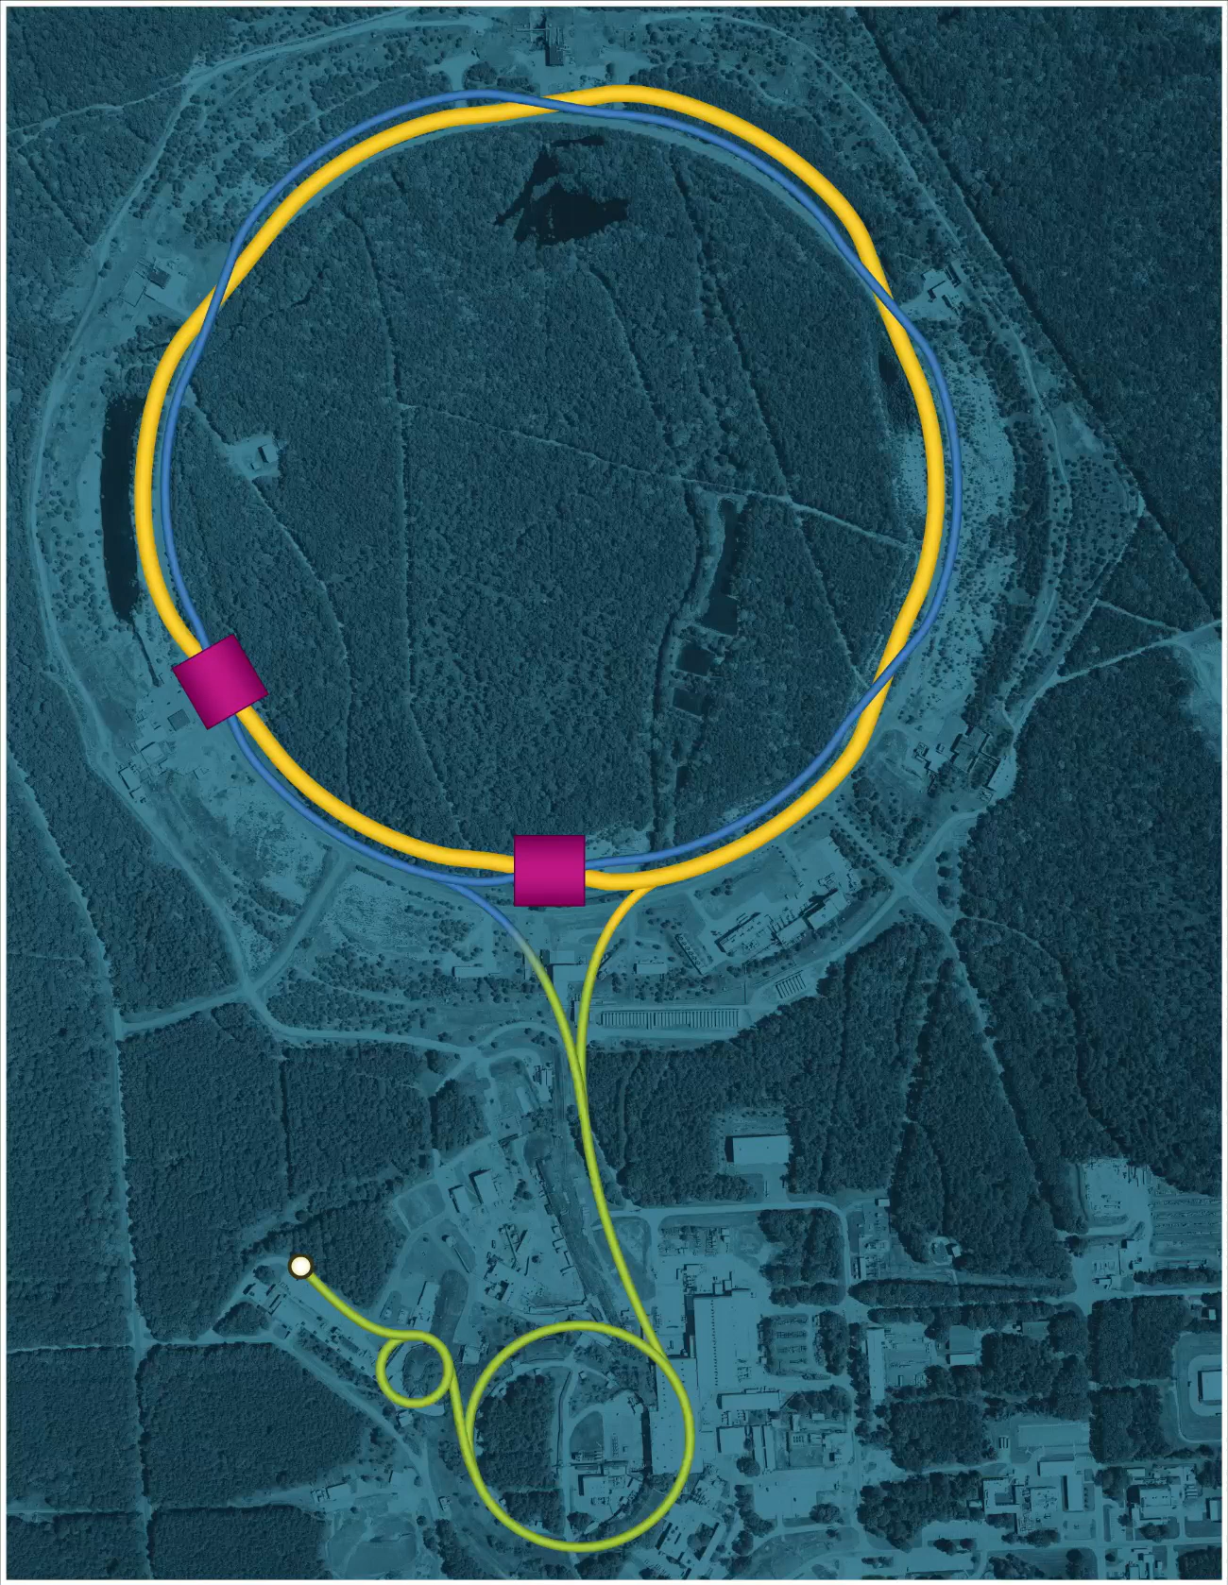

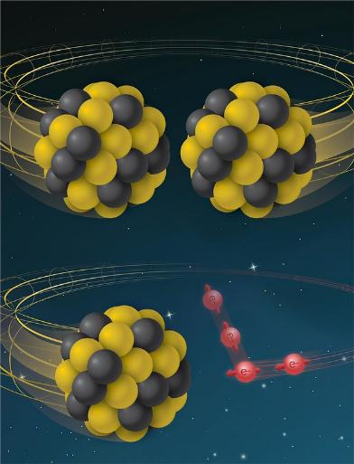
From RHIC to EIC
RHIC
RHIC
Ion species:
proton – Uranium
60% p polarization
EIC
Protons: ~40 – 275 GeV
Electrons: 5 – 18 GeV

Slide 14
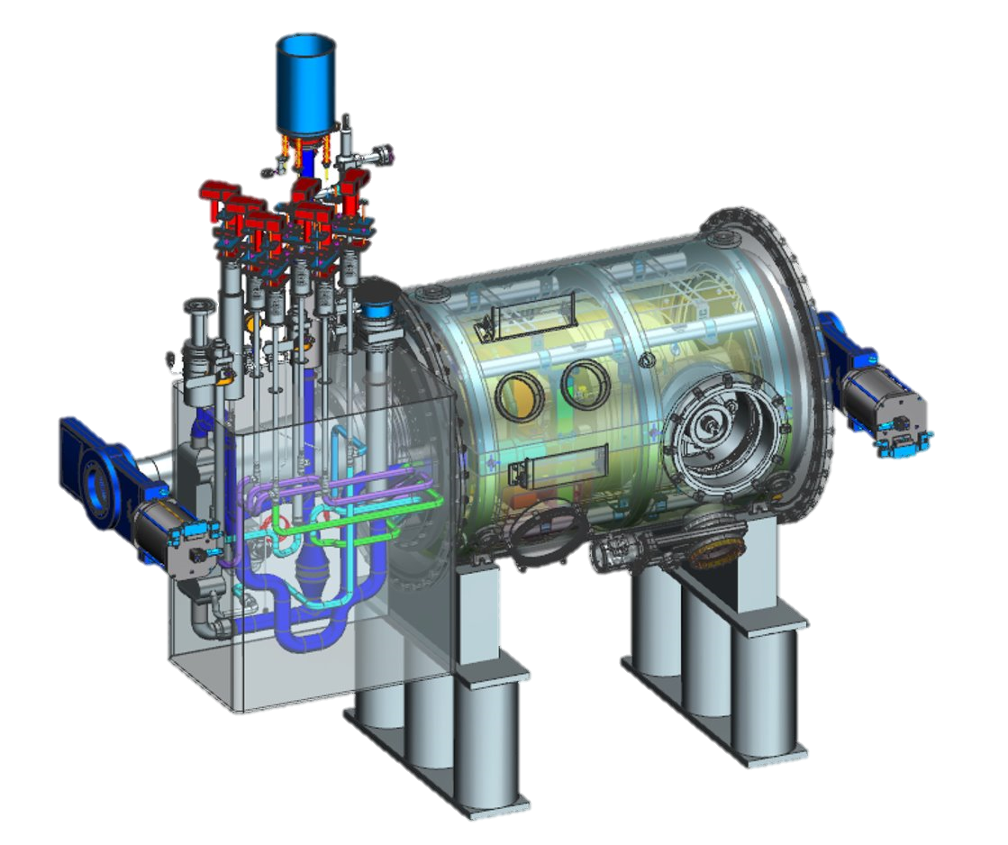
From RHIC (Yellow Ring) to EIC HSR
Tripled beam current, shorter bunch length, shorter bunch distance, ‘flat’ beams with small vertical emittance
EIC HSR to be composed of existing arcs of the Yellow RHIC ring (remove unused magnets)
Insert sleeves coated with copper and amorphous carbon into superconducting magnet beam pipes to improve conductivity and reduce secondary electron yield (-> electron cloud)
Add new RF cavities
Add hadron cooling to create flat beam
Add crab cavities, new IR SC magnets
Add a collimation system
Add extra ‘snakes’ for spin control
Superconducting Radio Frequency Cavity

Slide 15
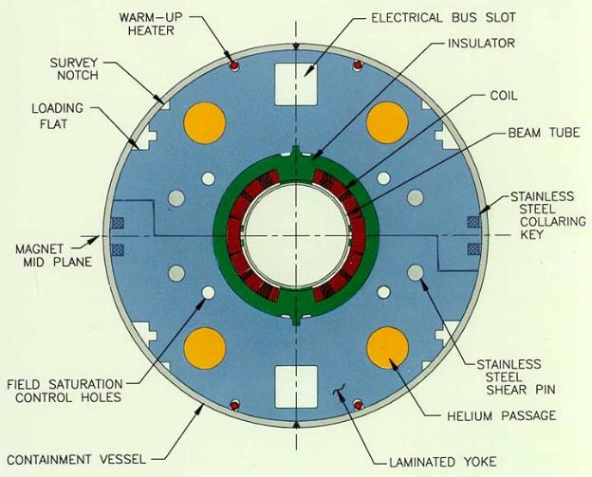
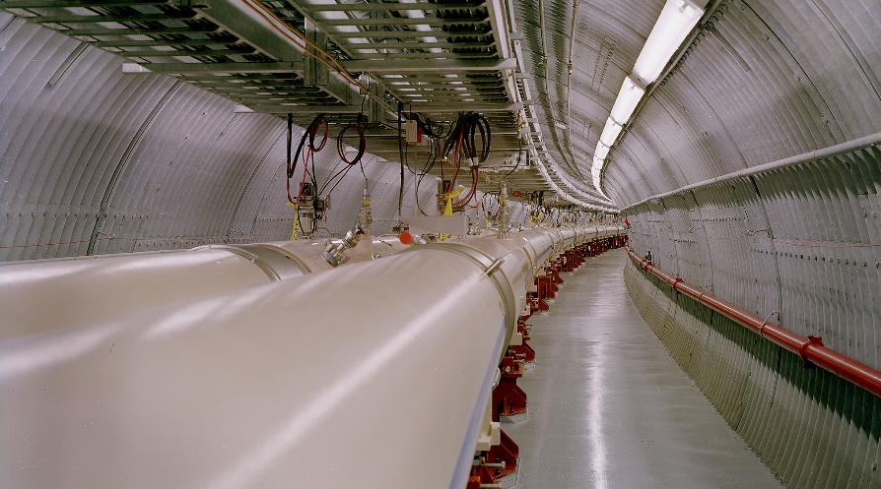
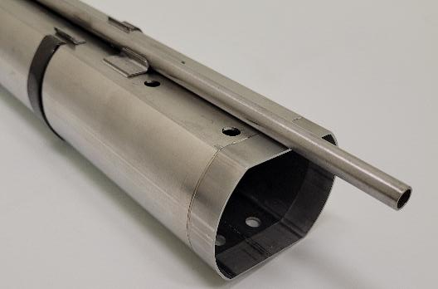
RHIC Magnets Conversion to EIC
Existing RHIC cold bore beam pipes are stainless steel
High surface resistance -> Excessive resistive wall heating
High secondary electron yield (SEY) -> Electron cloud formation
New parameters required for EIC
High stored beam current (.72 A vs .27 A)
Reduced bunch length (60 cm vs 600 cm)
Short bunch spacing (10 ns vs 108 ns)
High bunch charge (1.2x10¹¹ ppb)
Actively Cooled Beam
Screen
CD3A procurement

Slide 16
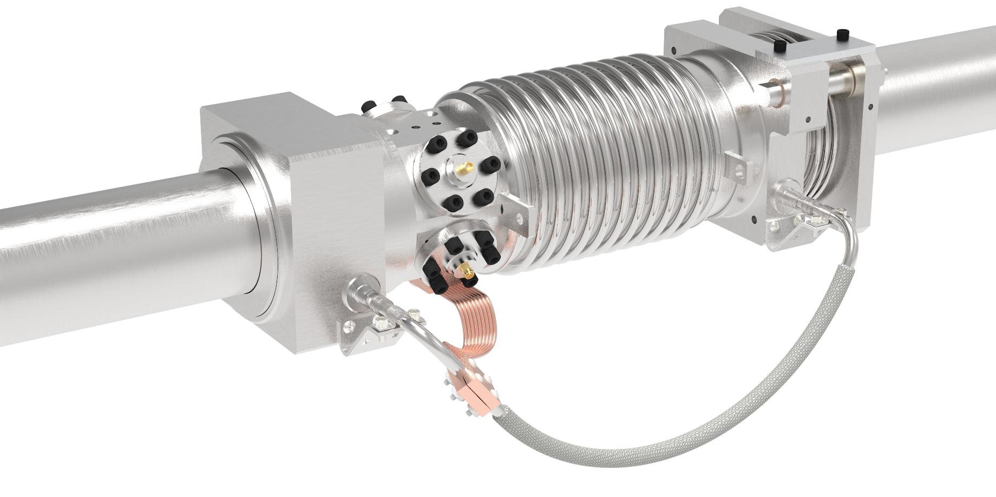
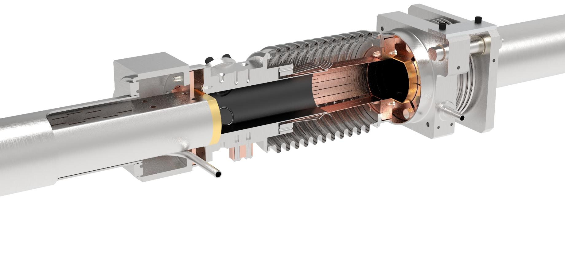
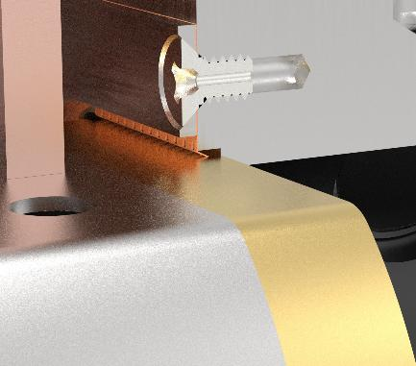
Magnet Interconnect Assembly
Anti-rotation extraction flange
Interconnect module
Flexible RF bridge
Spring ring
Fixed extraction flange
Existing magnet cold bore
Pumping slots
Existing magnet cold bore
Extraction bushing
Gold plated contact ring
Beam position monitor
Extraction bushing
Thermal strap
Helium jumper line
Strain relief bracket

Slide 17
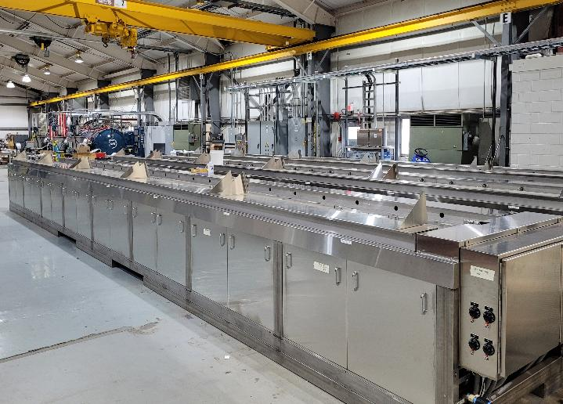
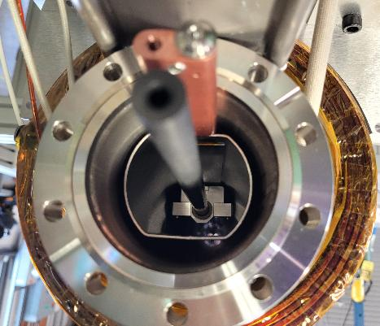
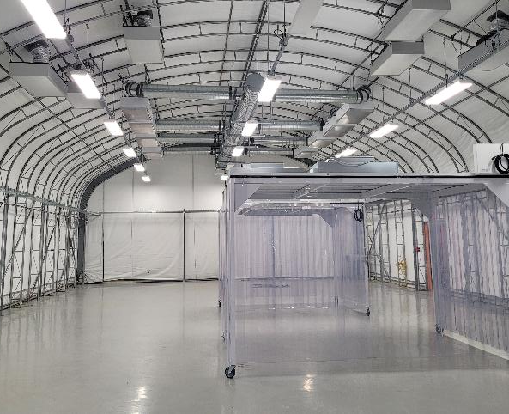
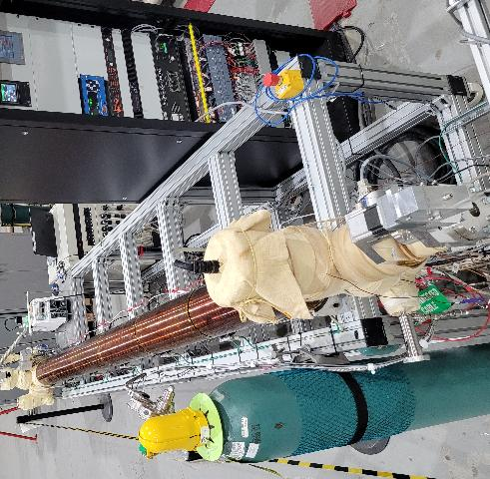
a-Carbon Coating
Proof of principle coating system
Cycle time meets production requirements
Design of full length (11m) system completed
Assembly in process
Clean tent area for production nearing completion
Ultrasonic cleaning equipment (11m) commissioned
Cleaning facility
Graphite target inside beam screen
Coating Facility
POP horizontal coating system

Slide 18
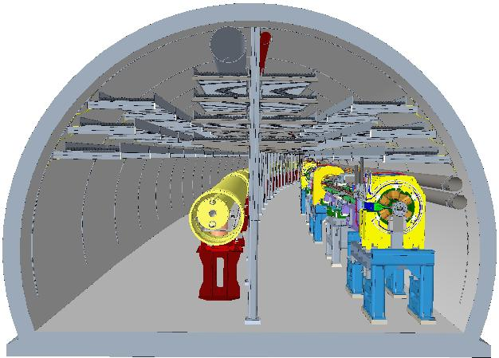
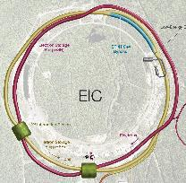
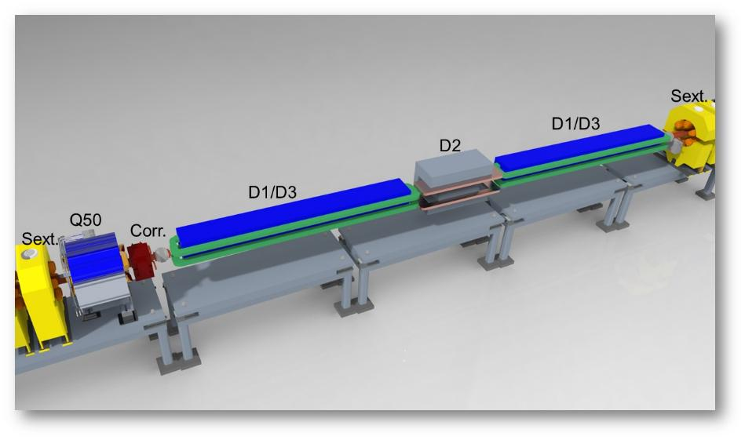
EIC Electron Storage Ring
Electron Storage Ring (ESR) consists of six FODO-cell arcs, and six straight sections (IRs)
High-intensity (28 nC), short (7 mm) bunches
add many interesting accelerator challenges
Circulating beam current ~2.5 A and the synchrotron
radiation power of ~10MW
HSR
EIC needs nearly constant (20 to 24 nm) emittance from
5 to 18 GeV for optimum luminosity, but equilibrium
emittance in an electron storage ring depends on beam energy.
We will use ‘super bends’ (reverse bends) for emittance
control below 10 GeV

Slide 19
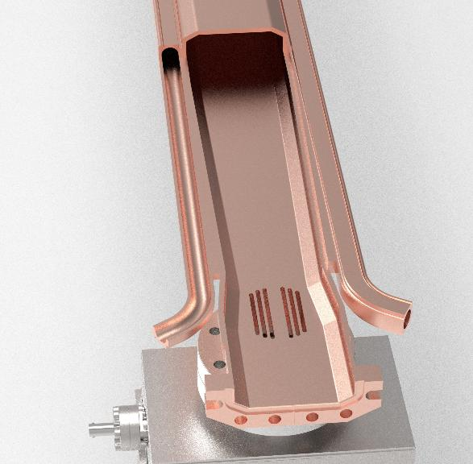
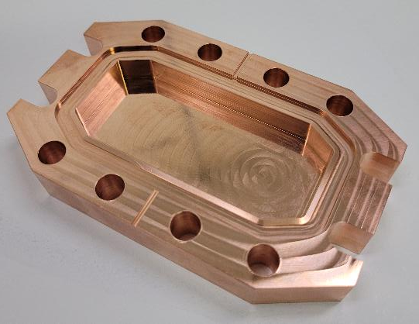
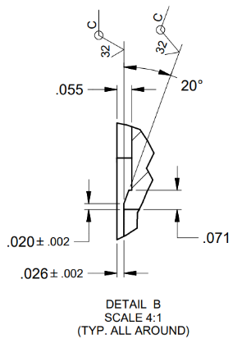
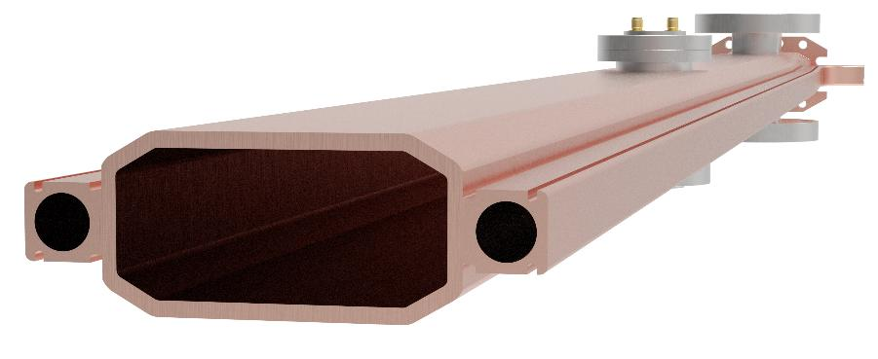
ESR Chamber Detail
Beam channel 80mm x 36mm [3.15” x 1.42”]
Chamber material: OFS copper (C10700)
Water cooling channels joined by e-beam or laser welding
Internal surfaces are NEG coated
Photon absorber formed at end of chambers
CuCrZr flanges with combination RF-vacuum seal
RF shielded pump ports
Integrated photon absorber
BPM mount
Pump port
CuCrZr flange
36mm
80mm
Heater wire groove

Slide 20
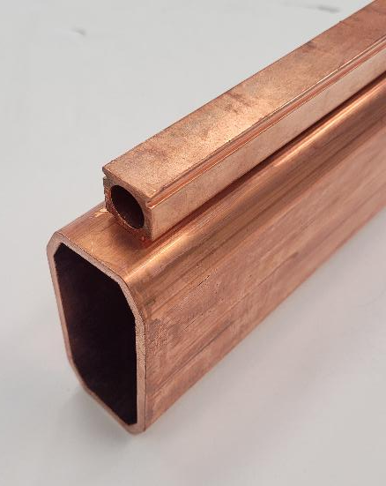
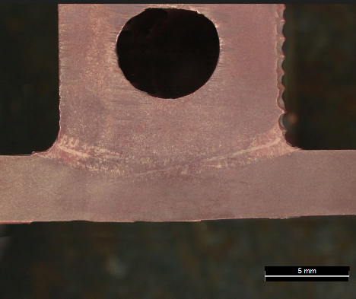
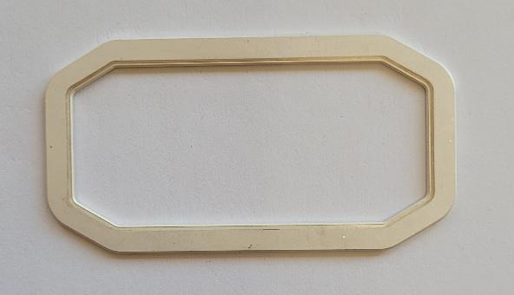
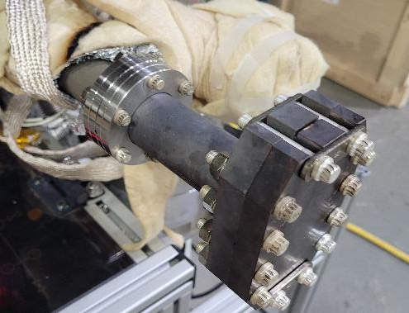
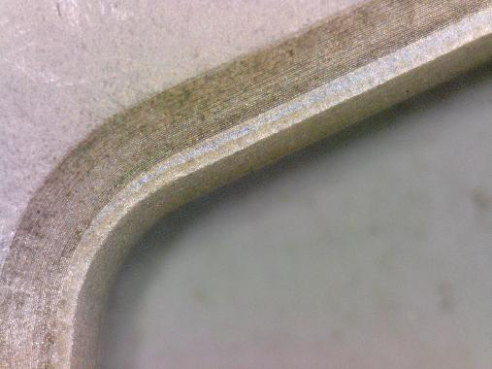
ESR Chamber Status
Both copper profiles in hand
Engineering Validation Unit in process
Samples of laser welding cooling tubes to main profile
Integrated photon absorber forming
Will include BPM and pump ports
NEG coating on interior vacuum surfaces
New flange and gasket geometry testing in process
5 thermal cycles to 250C (with hot leak check)
5 gasket changes (durability test)
Full penetration laser weld
ESR chamber profiles
Flanges post 250°C bake
Seal impression
Silver plated gasket

Slide 21
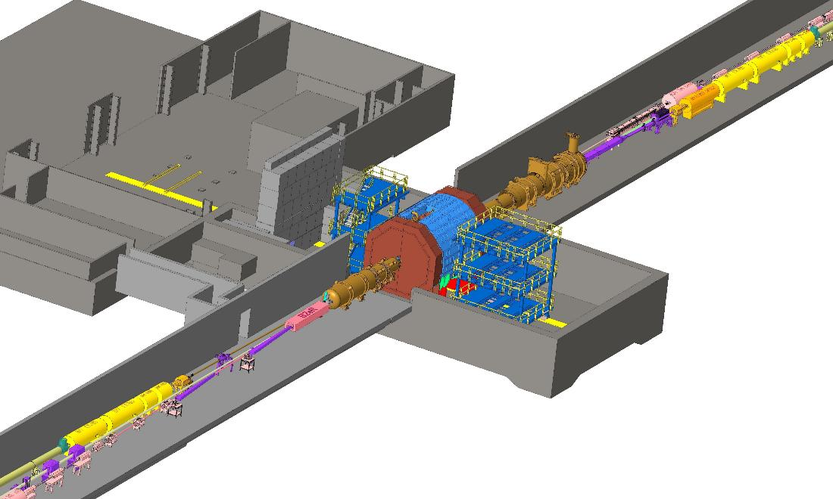
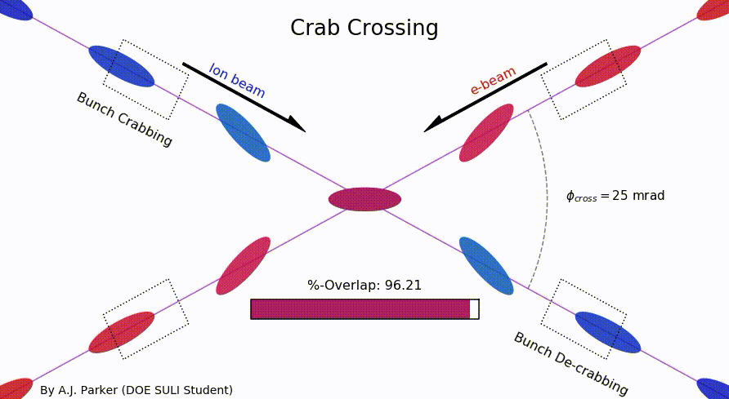
EIC IR Layout
High Luminosity:
25 mrad crossing angle
Small β* for high luminosity
with limited IR chromaticity contributions
Large final focus quadrupole aperture
Machine Detector Interface
Large detector acceptance
Forward spectrometer
No magnets within - 4.5 / +5 m from IP
Space for luminosity detector, neutron detector, “Roman Pots”

Slide 22
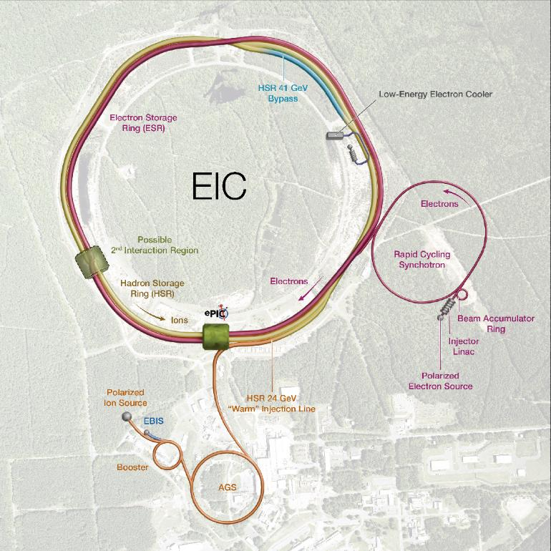
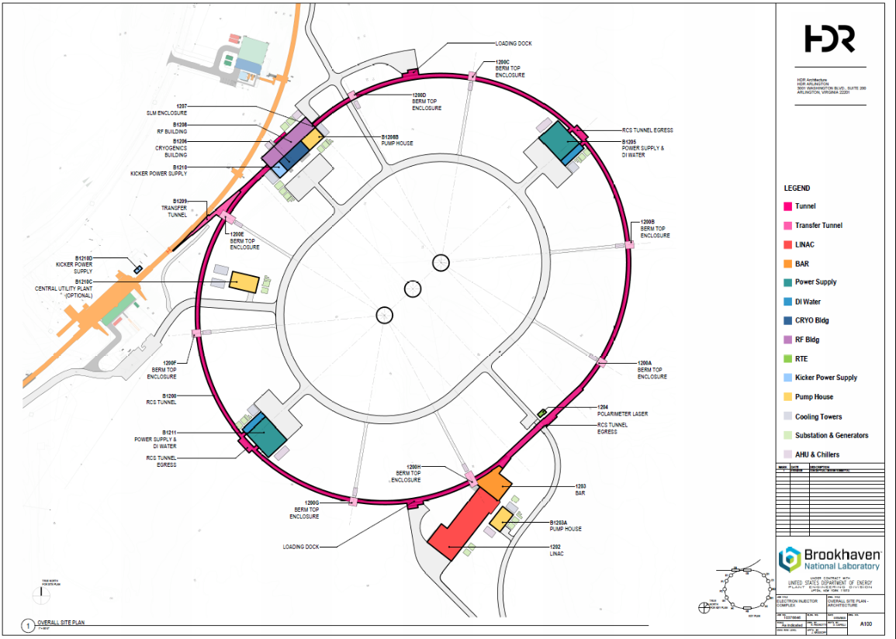
Electron Injector

Slide 23
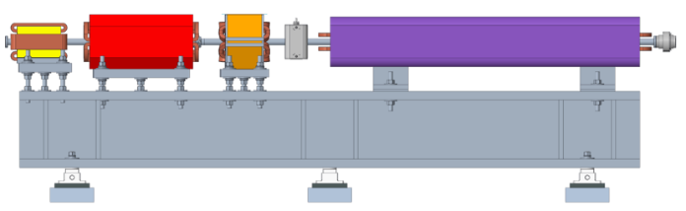





Electron Injector
Concept modeled after the ANL APS-U injector
Function: Deliver electron bunches of up to 28 nC at a 1 Hz repetition rate for injection into the ESR at various energies of 5 – 18 GeV.
RCS magnet assembly
Vacuum chamber: stainless steel, copper coated (50 um)
RCS SRF Cavity, 591 MHz
RCS
750 MeV – 18 GeV
28 nC, 1 Hz
85% polarization
1.4 km
Beam Accumulator Ring
750 MeV, 40 m
Polarized Electron Gun
1-nC, 30 Hz
S-band linac, 750 MeV, 30 Hz, 1 nC single bunch

Slide 24


Present EIC Concept (2025)
Ultimate EIC Performance Parameters:
High Luminosity: L= 10³³ – 10³⁴cm⁻²sec⁻¹
Highly Polarized Beams: 70%
Large Center of Mass Energy Range: Ecm = 28 – 140 GeV
Large Ion Species Range: protons – Uranium
Large Detector Forward Acceptance and Low-Background Conditions
Possibility to Implement a Second Interaction Region (IR)
Accelerator Status at a glance:
Polarized ion/proton source
Ion injection and initial acceleration systems – Linac (200 MeV), Booster (1.5 GeV), AGS (25 GeV)
Hadron Storage Ring (40-275 GeV) – HSR
Electron Pre-Injector (750 MeV linac)
Beam Accumulation Ring (750 MeV) – BAR
Electron Rapid Cycling Synchrotron (0.75 GeV – top energy) – RCS
Electron Storage Ring (5 GeV – 18 GeV) – ESR
Interaction Region(s) – IR
Hadron Cooling System
Protons: ~40 – 275 GeV
Electrons: 5 – 18 GeV
24

Slide 25
Summary
EIC is a unique, high-energy, high-luminosity, polarized beam collider that will be one of the most challenging and exciting accelerator complexes ever built – the only new collider in the next decades.
Since the publication of the 2021 CDR, the project has implemented several design changes to advance design maturity and reduce risk, without affecting the established preliminary performance and cost objectives.
The EIC design is stable and complete.
Subproject scope is well developed, designs are mature, long-lead procurements are ready to be executed.
We now have a well-defined vision of what is required
to build the EIC!

