Slide 1
Progress of EIC International Partnerships & Agreements since last RRB
Luisella Lari - EIC Project Manager
Paolo Berrutti - EIC IKC Engineer
EIC Resource Review Board Meeting
November 4-5, 2025

Slide 2
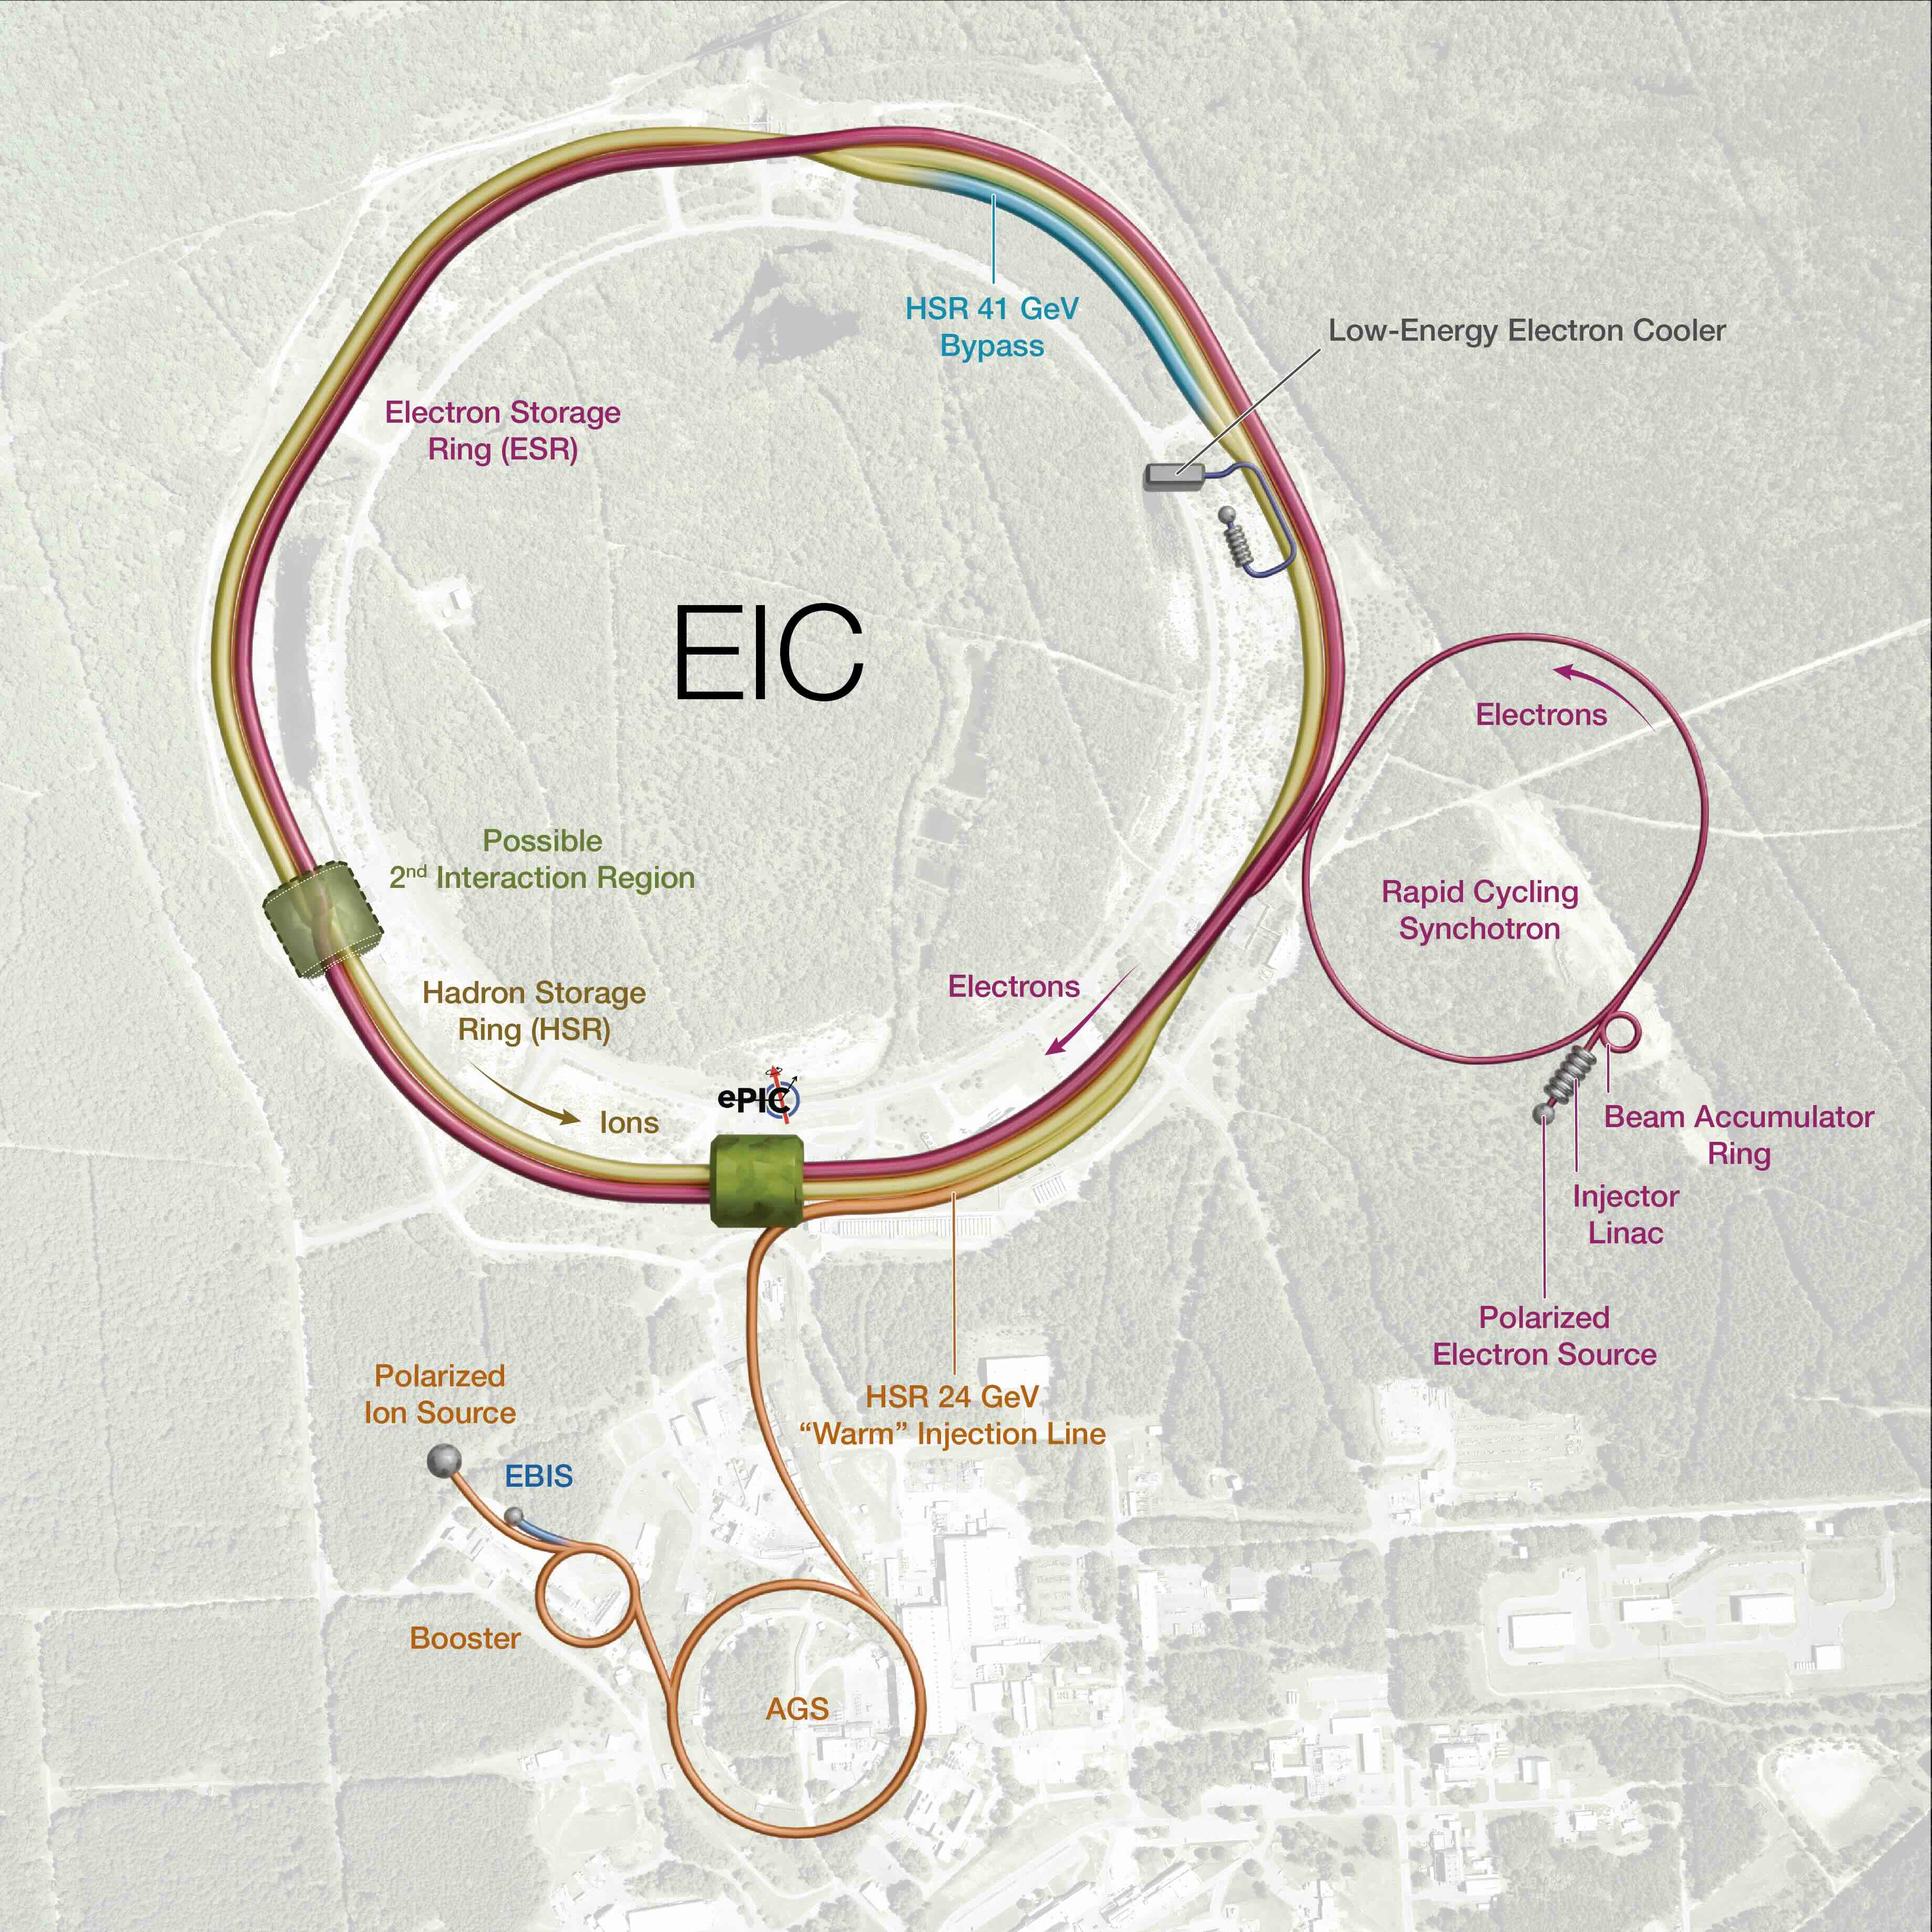
Outline
EIC iCRADA Progress
List of drafted and future iCRADAs
Summary
2

Slide 3
EIC iCRADA Progress Update
The EIC iCRADA single-signature model was approved by DOE and presented at the Prague RRB in June 2025
In response to partner feedback, EIC has implemented a DOE approved multi-signature iCRADA model for use where appropriate.
The first multi-signature iCRADA to be routed for full DOE approval will be the INFN Detector solenoid contribution iCRADA.
The draft iCRADA and Annex A have been shared with INFN and are expected to be signed as soon as possible.
The EIC Project is extremely grateful to DOE, the BNL and JLAB site offices, and the BNL Research Partnership and Technology Transfer Office for the tremendous amount of work and coordination in accomplishing this goal.
The EIC Project anticipates a streamlined iCRADA processing flow once the first document of this kind is approved and signed by all parties.
All drafted iCRADA and Annex A documents will be aligned with the new EIC iCRADA model and distributed to IKC partners for feedback.
We aim to complete this action and receive feedback as soon as possible to ensure the scope of each IKC fully defined and agreed upon by all parties.
3

Slide 4
iCRADAs – Annex A - drafted for EIC IKCs
Country/Agency | Scope | Status
Canada – TRIUMF | JLab Crab 394 MHz CMs for Full Capability | Drafted
Canada – TRIUMF | BNL Crab 394 MHz CMs for Full Capability (New Model single signature) | Approved
France – IN2P3 | 591 MHz 5-Cell CMs for EIN | Drafted
Czech Republic – ČVUT | Electron Source Laser for EIN | Drafted
Italy-INFN | Detector (dRICH, Si/ITS3, GEM-muRwell) | Drafted
UK-STFC | Si-LAS, Low-Q2, Lumi | Drafted
France-CEA | MicroMegas, SALSA | Drafted
France-IN2P3 | EEEmCAL, RPs, ASICs | Drafted
Italy-INFN | Solenoid (new multi-signature model) | Shared with INFN
France-CEA | Solenoid | Drafted
Korea-MSIT | Barrel EMCal, GEM-muRwell, TOF/ZDC collab. | Drafted
Japan-MEXT | Barrel TOF, streaming DAQ, ZDC | Drafted
Canada-CFI | Barrel EMCal readout, software | Drafted

Slide 5
Future iCRADAs to be drafted
Country/Agency | Scope | Status
Israel | B0 detectors | Plan to submit proposal this April, then start draft ICRADA
India | Forward EMCal, forward TOF, dRICH collab. | Plan to submit proposal this Summer
Taiwan | AC-LGAD sensors, PWO/LYSO | Pending success of Taiwan prototype tests results.
Discussions ongoing with several other partners on potential interesting scope for IKCs for multiple Subprojects.
Potential new contributions are under development.
Project Planning Documents (PPDs) will be started for the Detector Magnet with Italy.
PPDs for accelerator scope will be developed in accordance with EIC Subprojects needs.

Slide 6
Summary
The EIC iCRADA single signature and multi-signature templates have been fully approved by DOE.
The EIC Project is planning to sign the first iCRADA for the INFN detector solenoid scope as soon as possible.
The EIC IKC documentation is on track to support the full Project strategy for baseline.
6

