Slide 1
EIC Project Detector Overview
E.C. Aschenauer (BNL)
R. Ent (JLab)
Co-Associate Directors for the Experimental Program
6th EIC RRB Meeting, BNL
November 4th – 5th, 2025

Slide 2
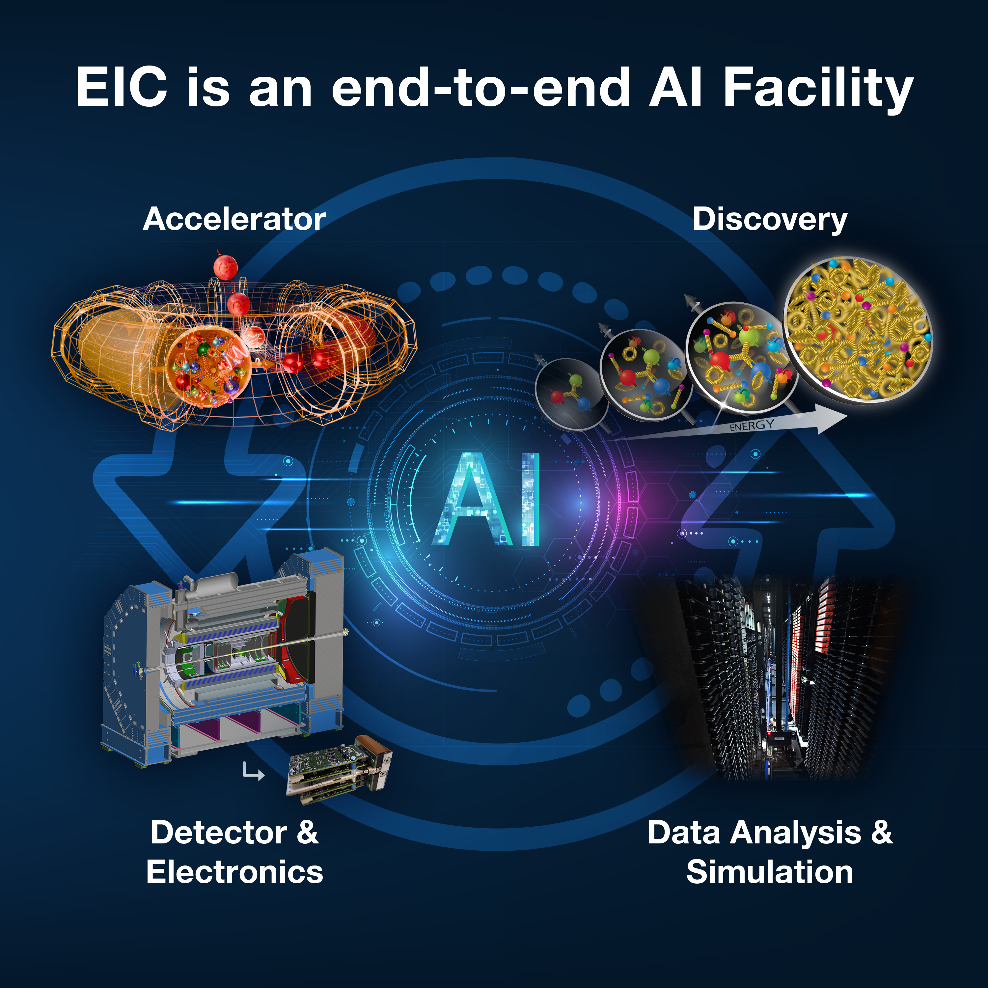
Outline
Subproject Scope
Technical Progress
Cost
Schedule
In-kind Contributions
Path to Baseline
Risks
Summary

Slide 3
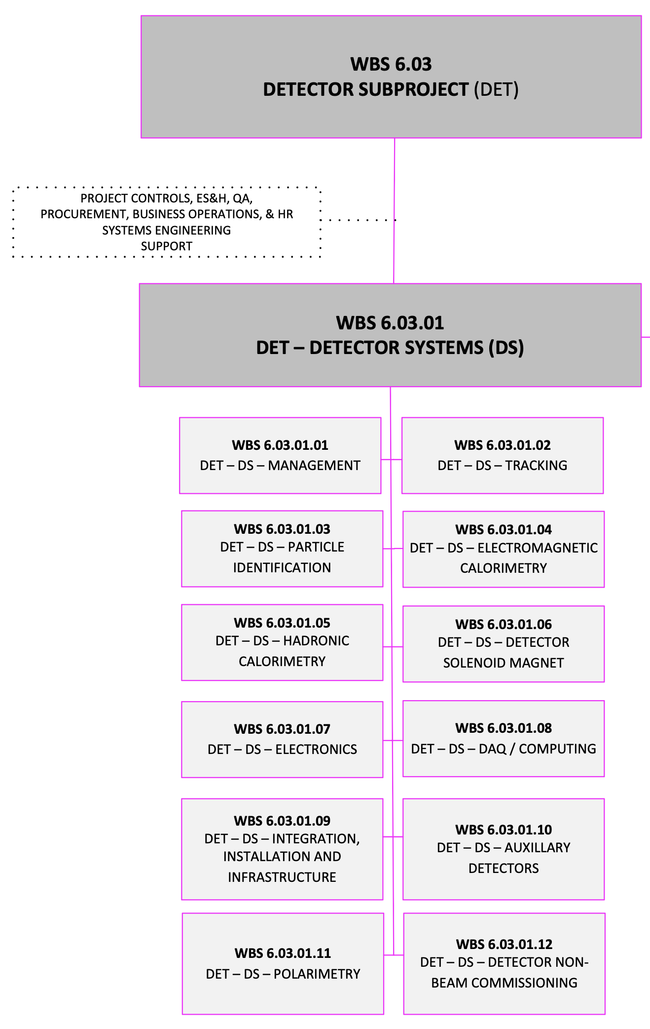
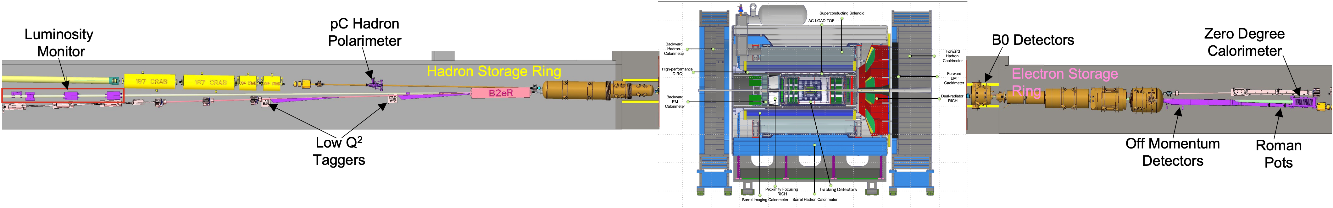
Subproject 6.03 Scope Overview
Scope:
26 subsystems over ± 40 m
to measure particle momenta, energy
and particle type
3 electromagnetic calorimeters
3 hadronic calorimeters
Silicon and Micro-pattern gas detectors
3 RICH detector + time-of-flight
7 Auxiliary detector systems (Si + HCal + ECals)
electron and hadron polarimetry
→ 8 world first technologies
fully streaming readout electronics and data acquisition
Integration, Installation and Infrastructure
Non-Beam Commissioning

Slide 4
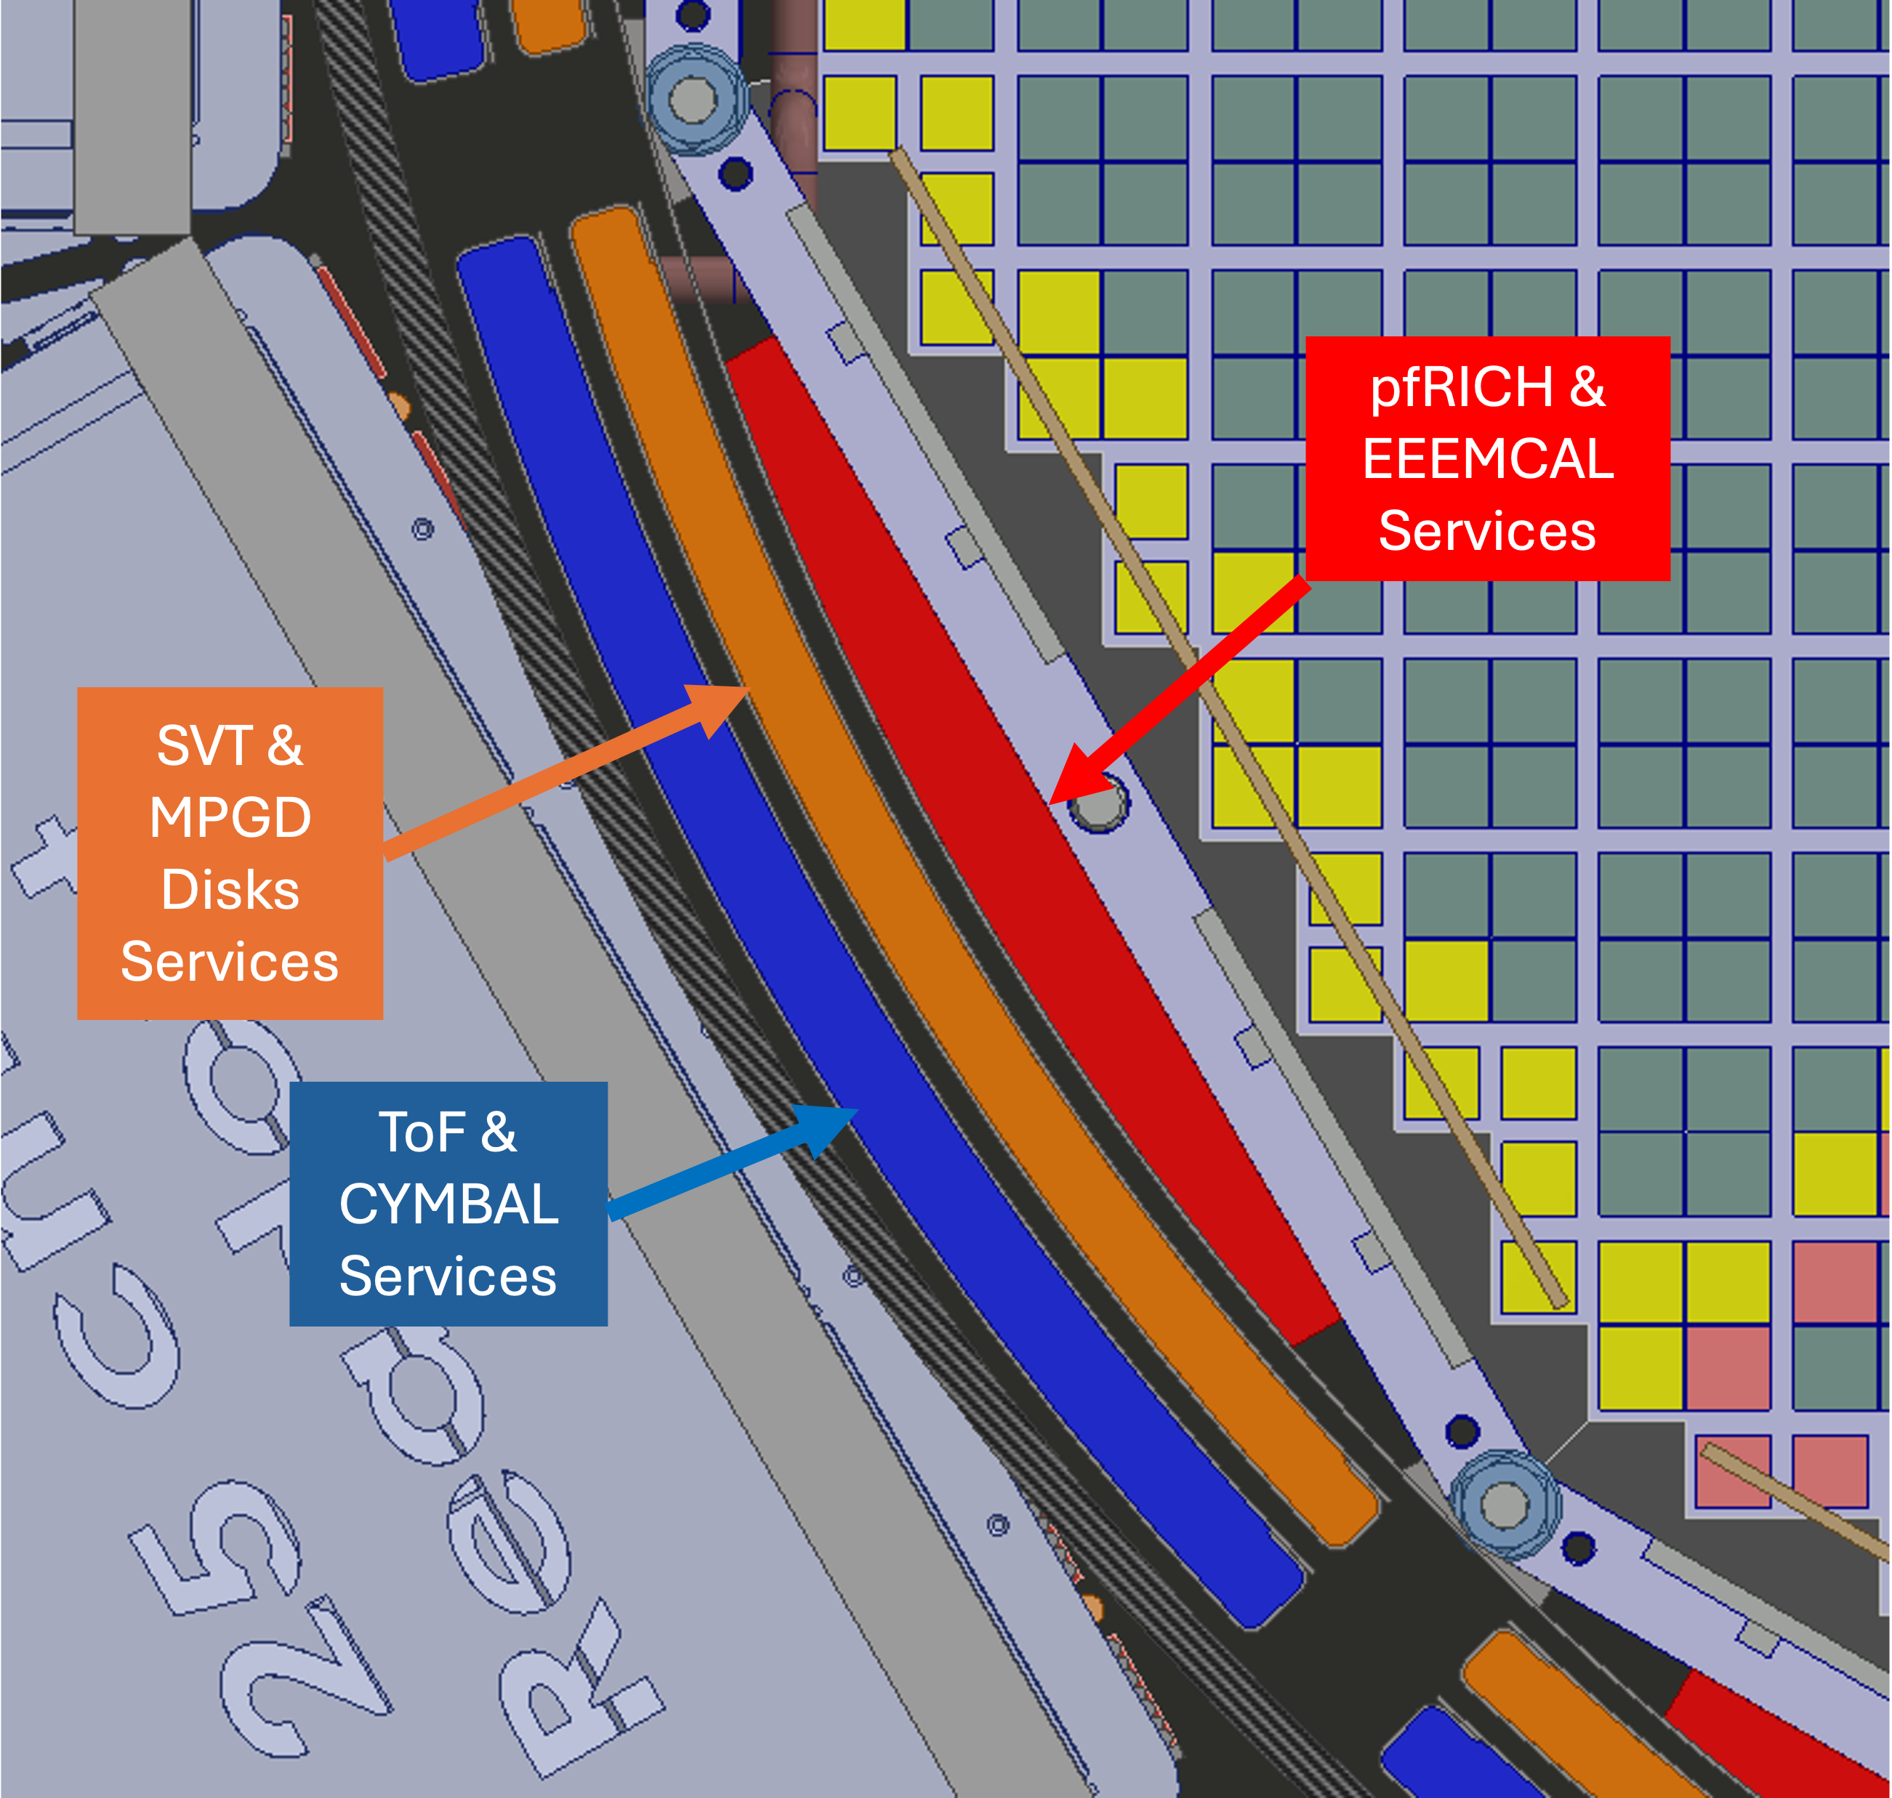
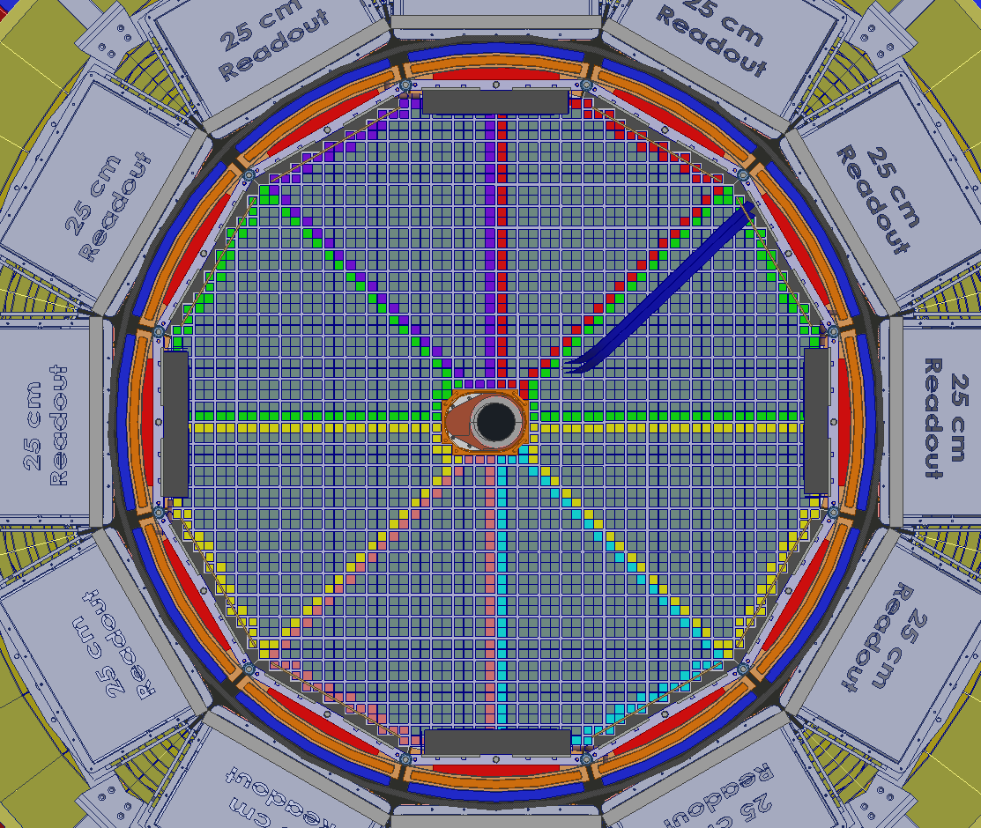
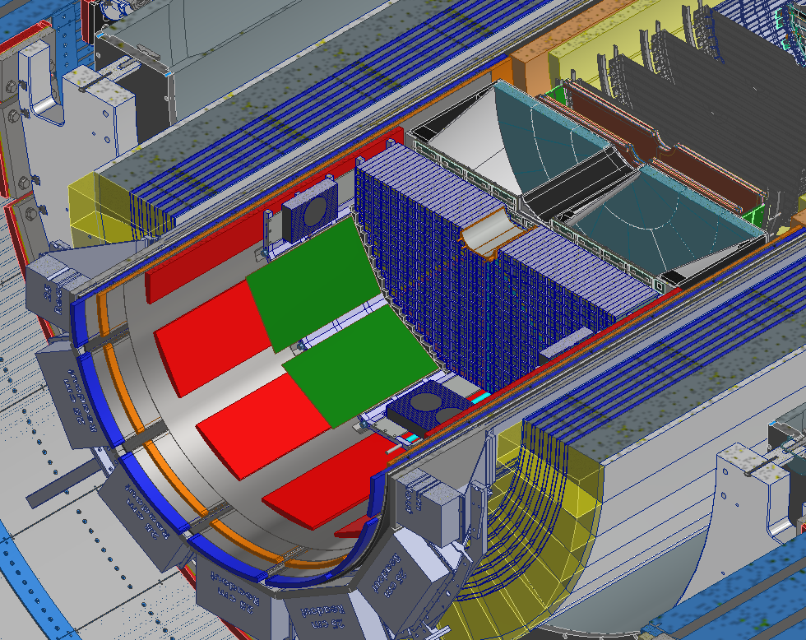
Technical Progress
The focus since the last RRB was to allow for maintenance in beam position as possible
Remember Vacuum is absolutely critical to achieve low beam backgrounds
Need to break vacuum each time if we need to roll ePIC into assembly hall for maintenance
normally a shutdown is 6 months → it takes 5 months to move ePIC into assembly hall and back → this leaves only 1 month to uninstall inner detectors, repair and install
need to start with lower beam currents to keep beam backgrounds under control
→ optimize integration of detectors to allow for maintenance in beam position in the wide-angle Hall
→ only Maps tracker and forward and rear MPDG disks can only be serviced in the assembly hall
→ need very creative service routing to make this all work

Slide 5
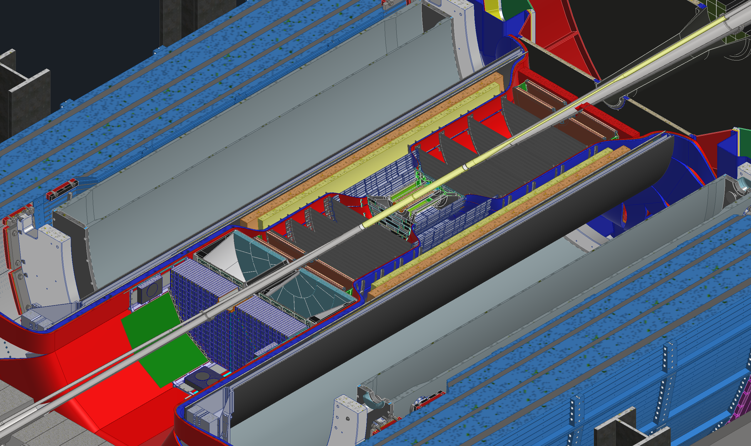
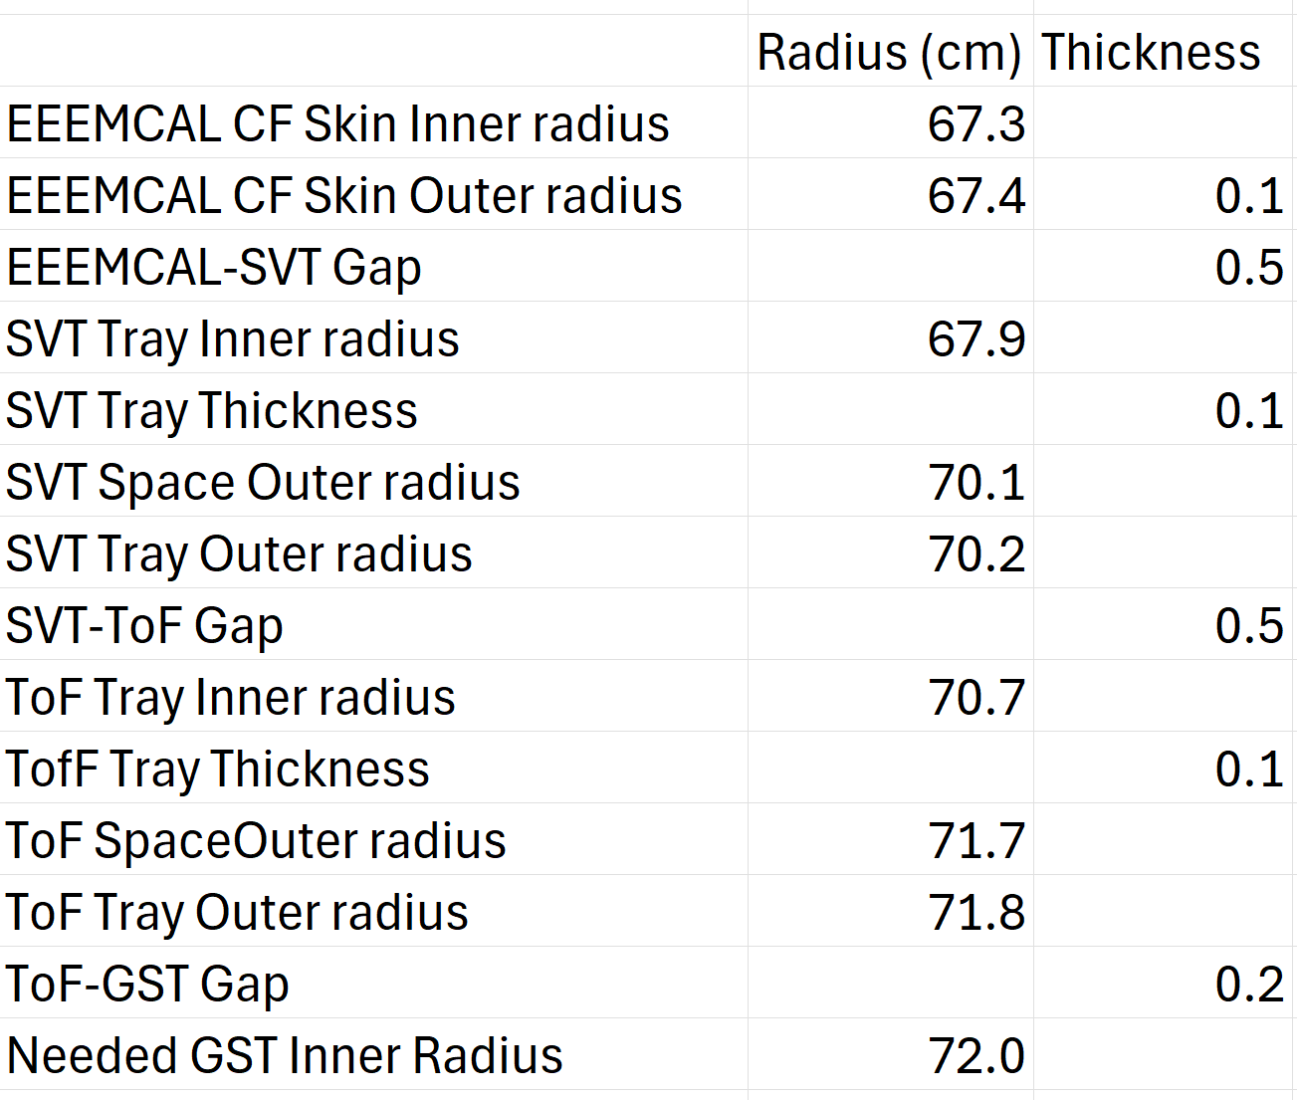
Services Routing
Beginning to remove the contingencies from the services and replacing them with actual spaces needed for trays and such
EXAMPLE

Slide 6
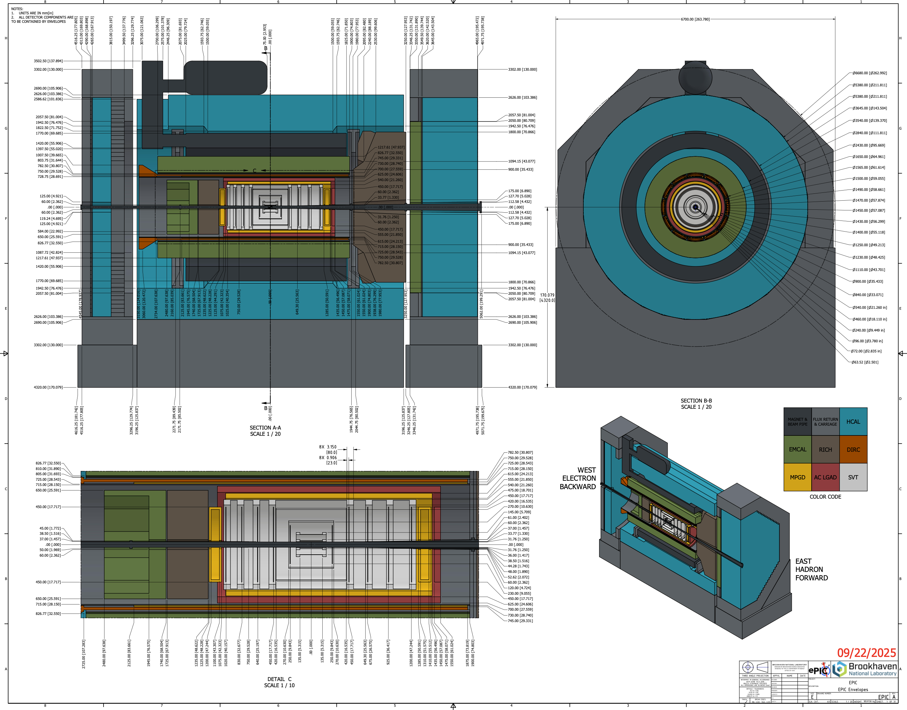
Technical Progress – Detector Envelopes
New maintenance strategy resulted in:
→ new envelope drawings detailing the spatial interfaces between subsystems shared with ePIC
These detector envelopes serve as Interface Control Document for inside the detector systems.

Slide 7
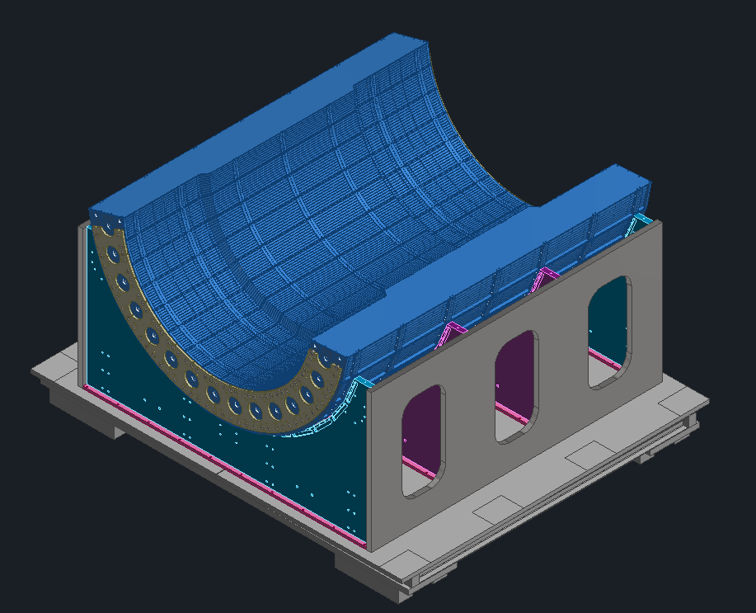
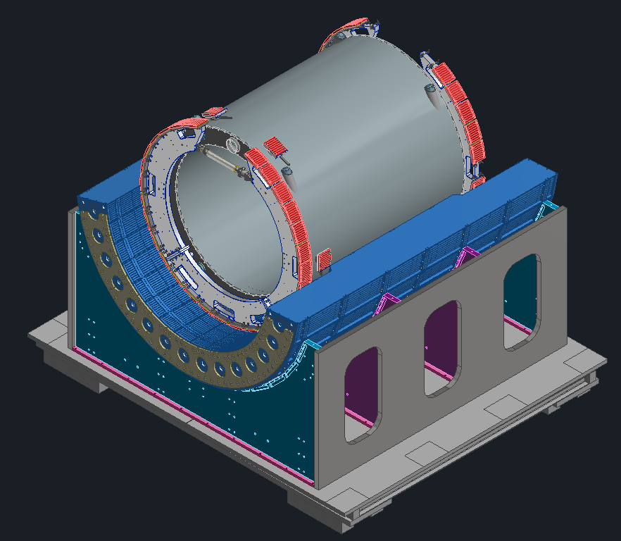
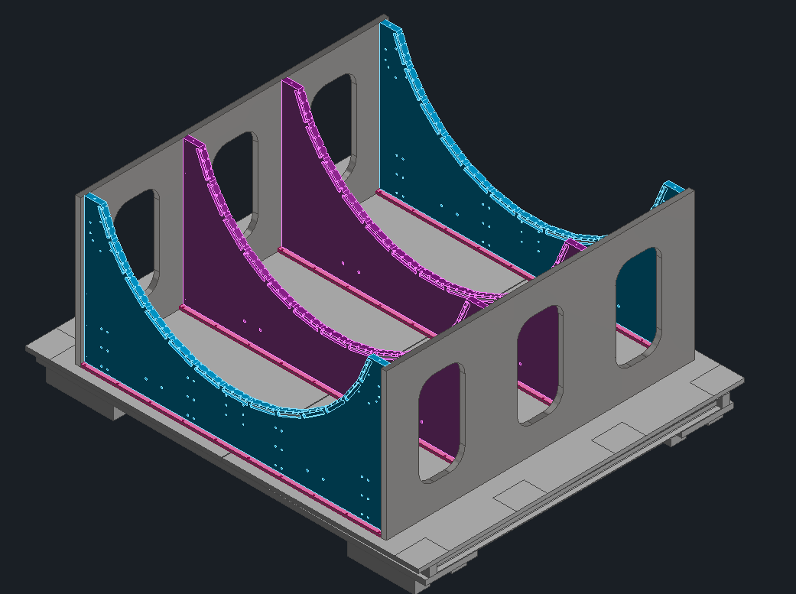
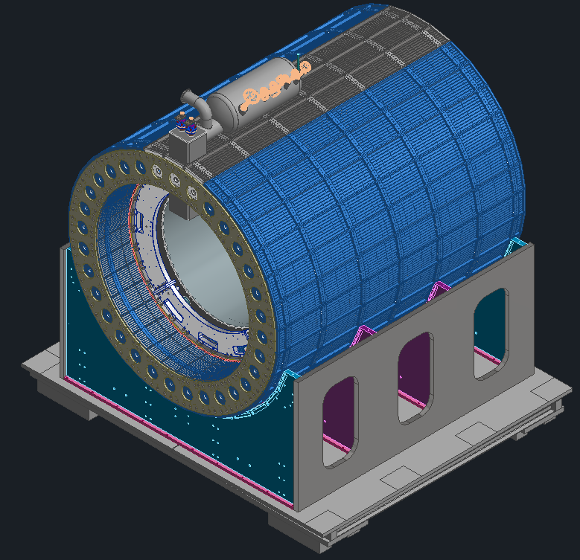
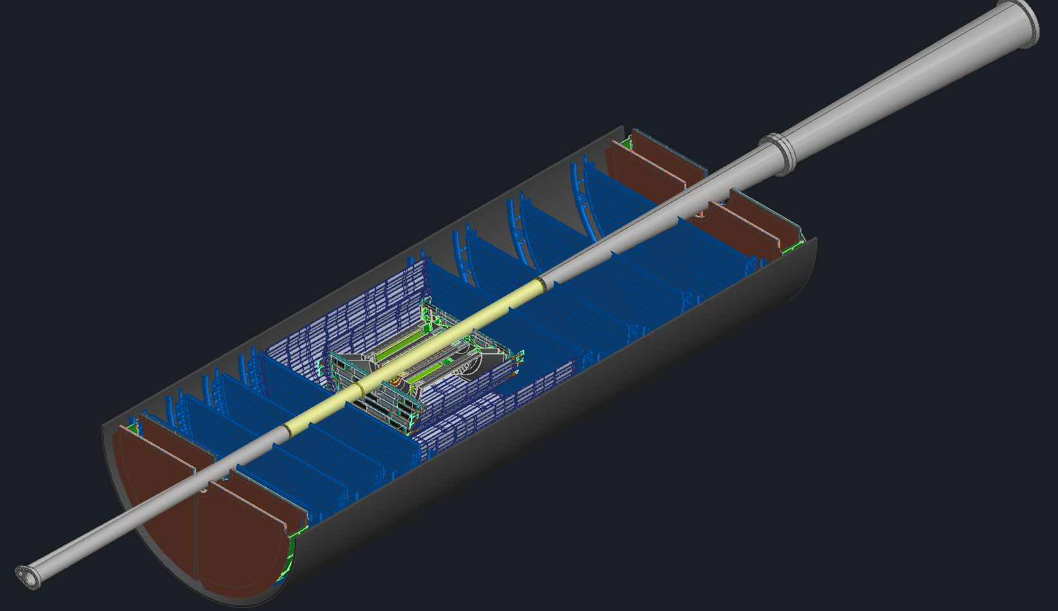
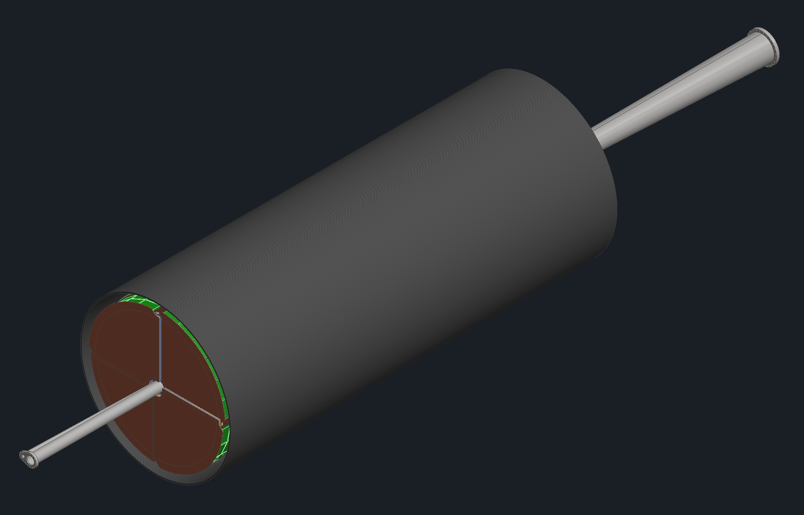
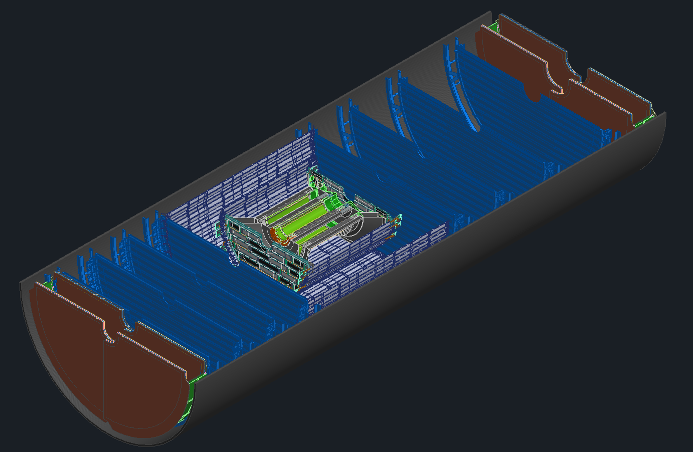
Technical Design Progress for all Subsystems
Step 1:
Detector Cradle
Step 2:
HCAL Bottom Half Installation
Step 3:
Magnet & Support Rings Installation
Step 4:
HCAL Top Half and Magnet Chimney Installation
Step 5: Magnet Mapping
(6 Months)
While Magnet Mapping Takes place, We can Assemble PST with Silicon Detectors, MPGD Disks and TOF Disks
Step 6: PST Bottom half assembly
Step 7: Beampipe Installation
Step 8: PST Top half Installation
SVT Disks
SVT Tracker
MPGD Disks

Slide 8
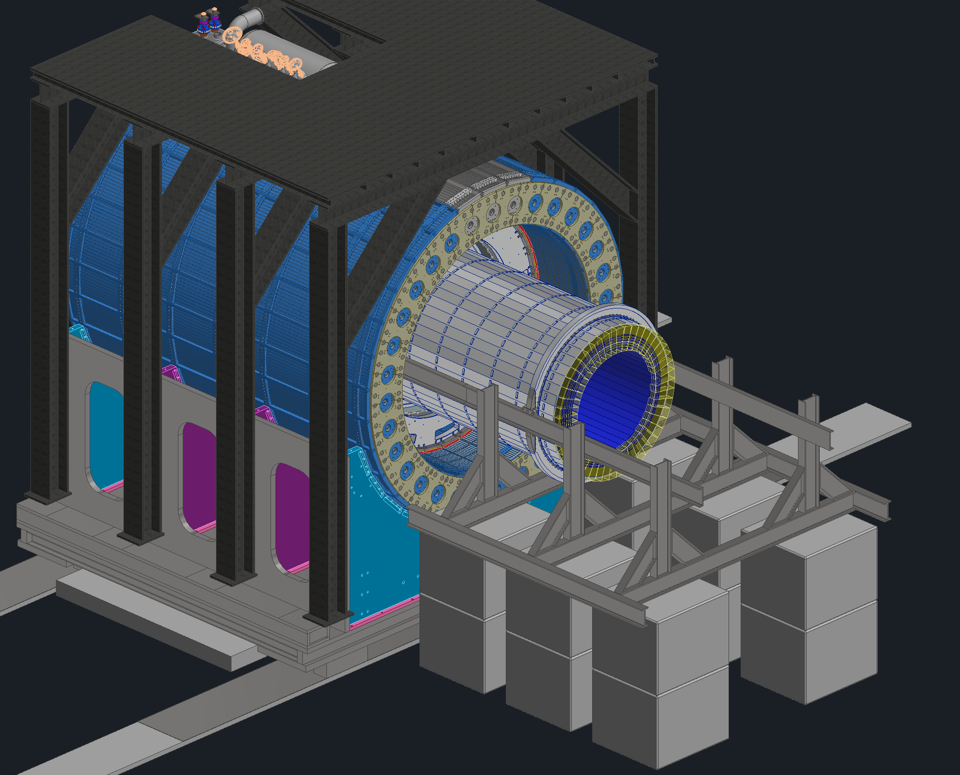
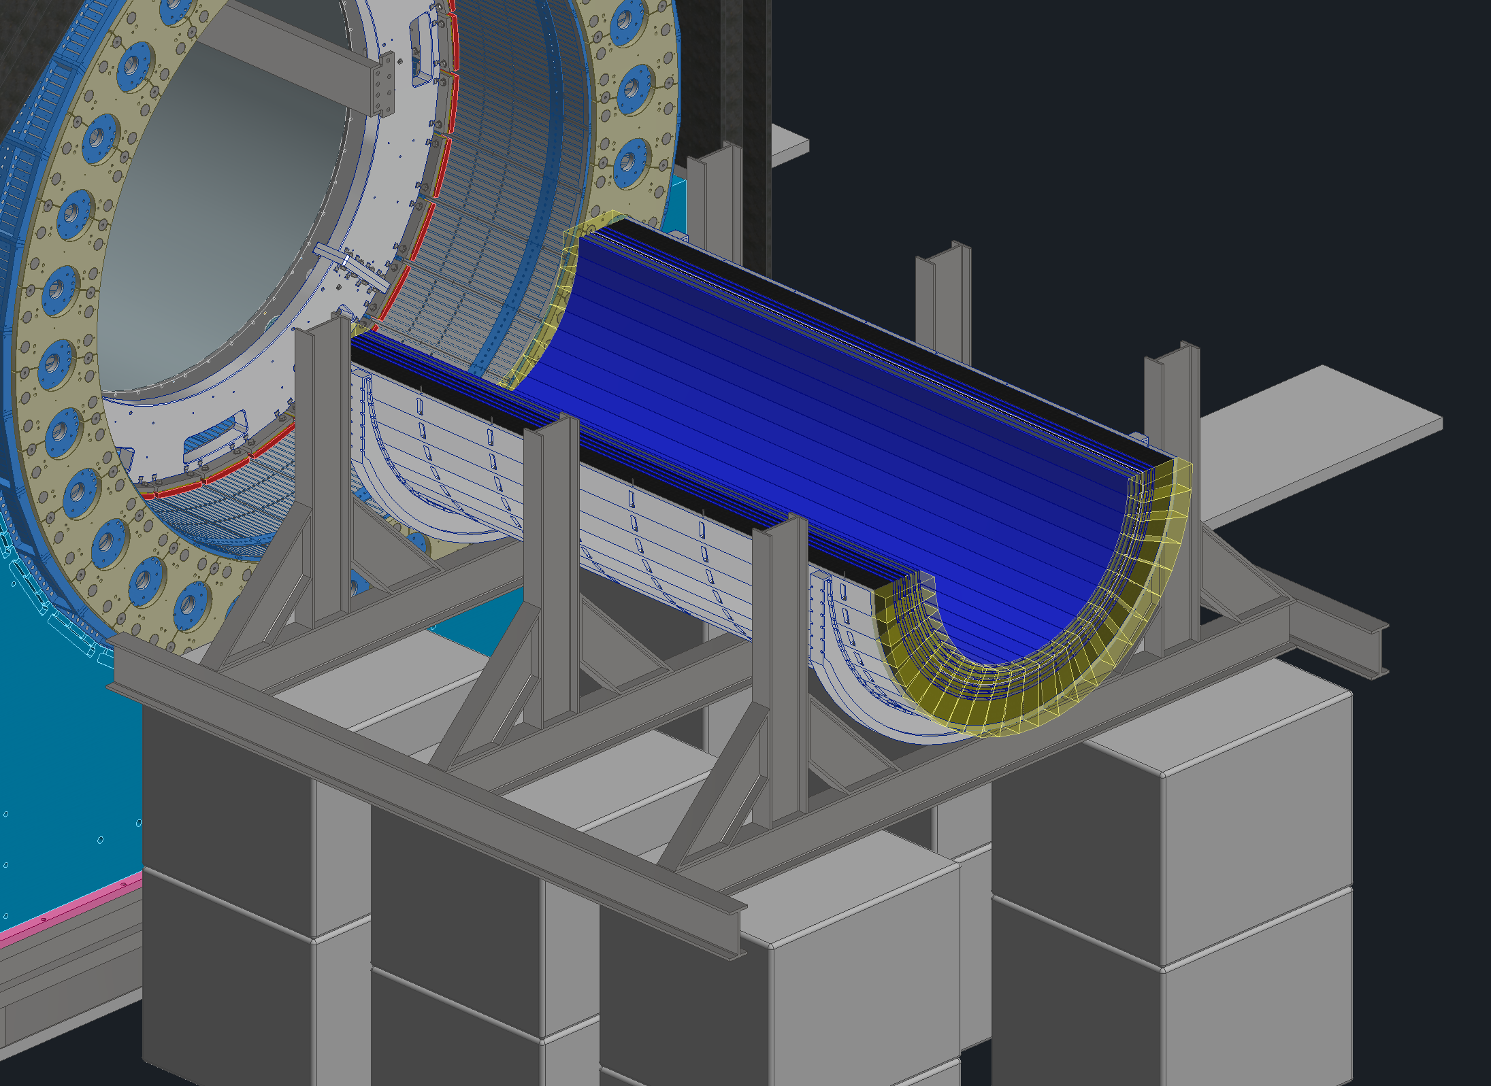
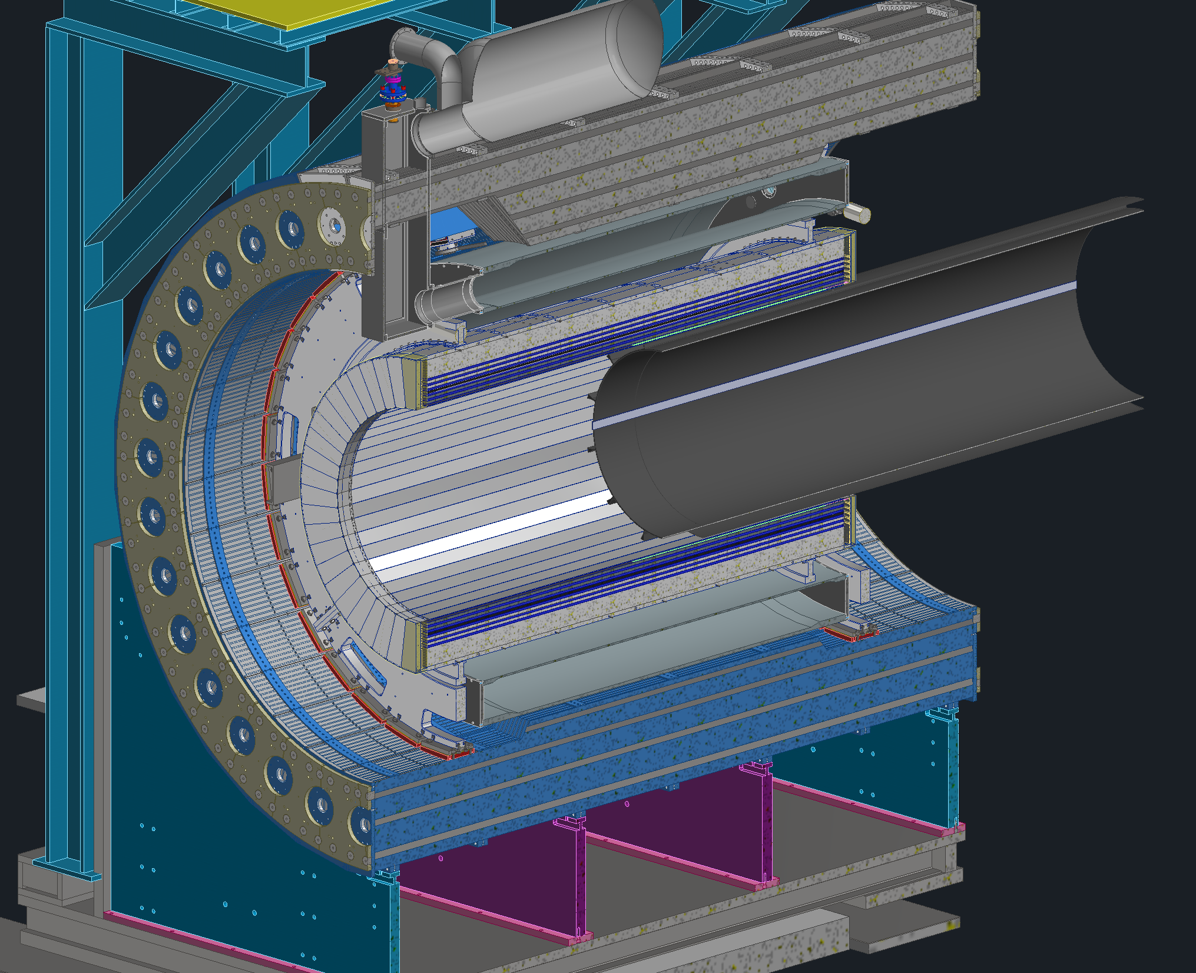
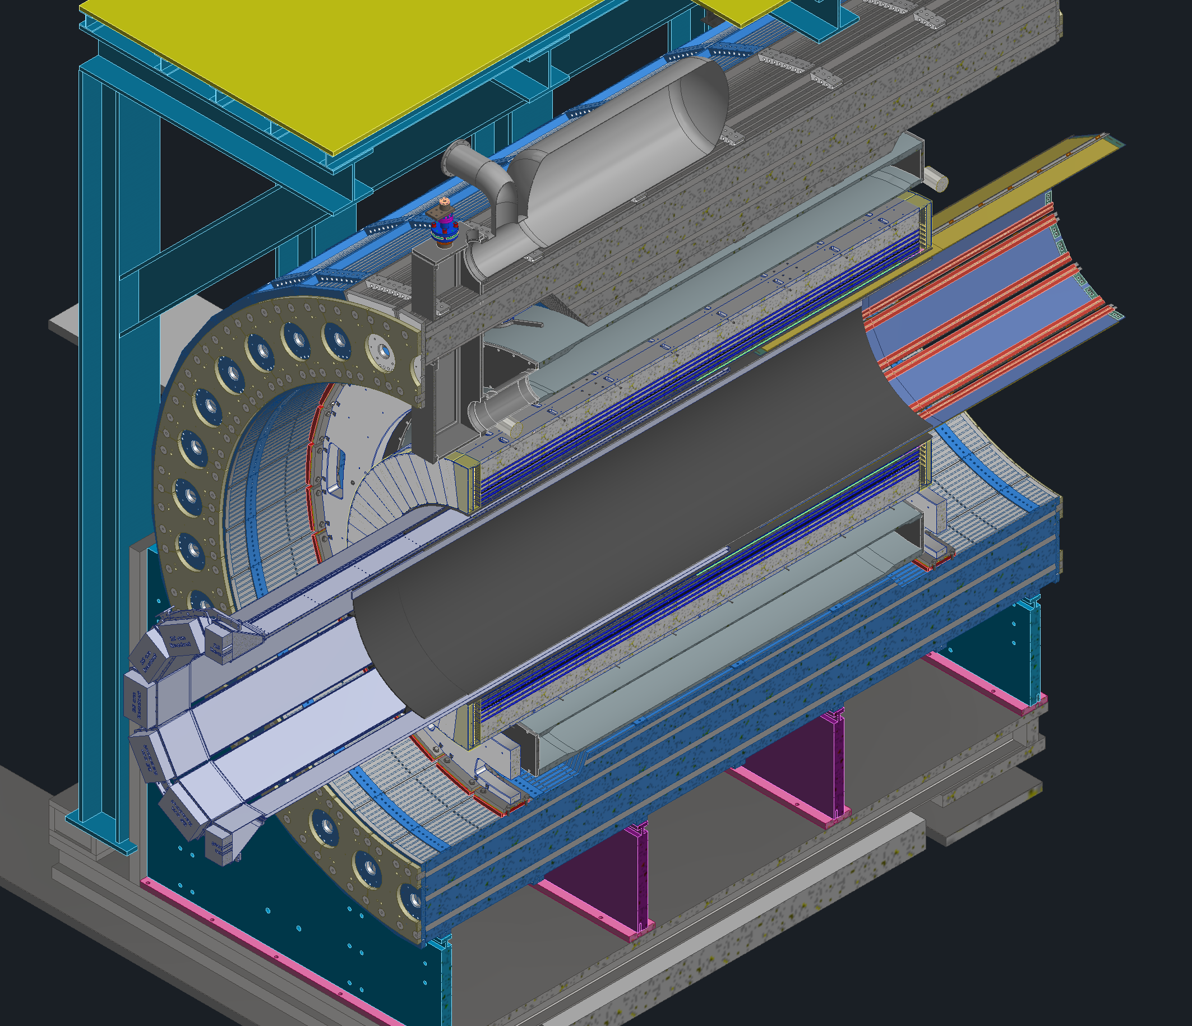
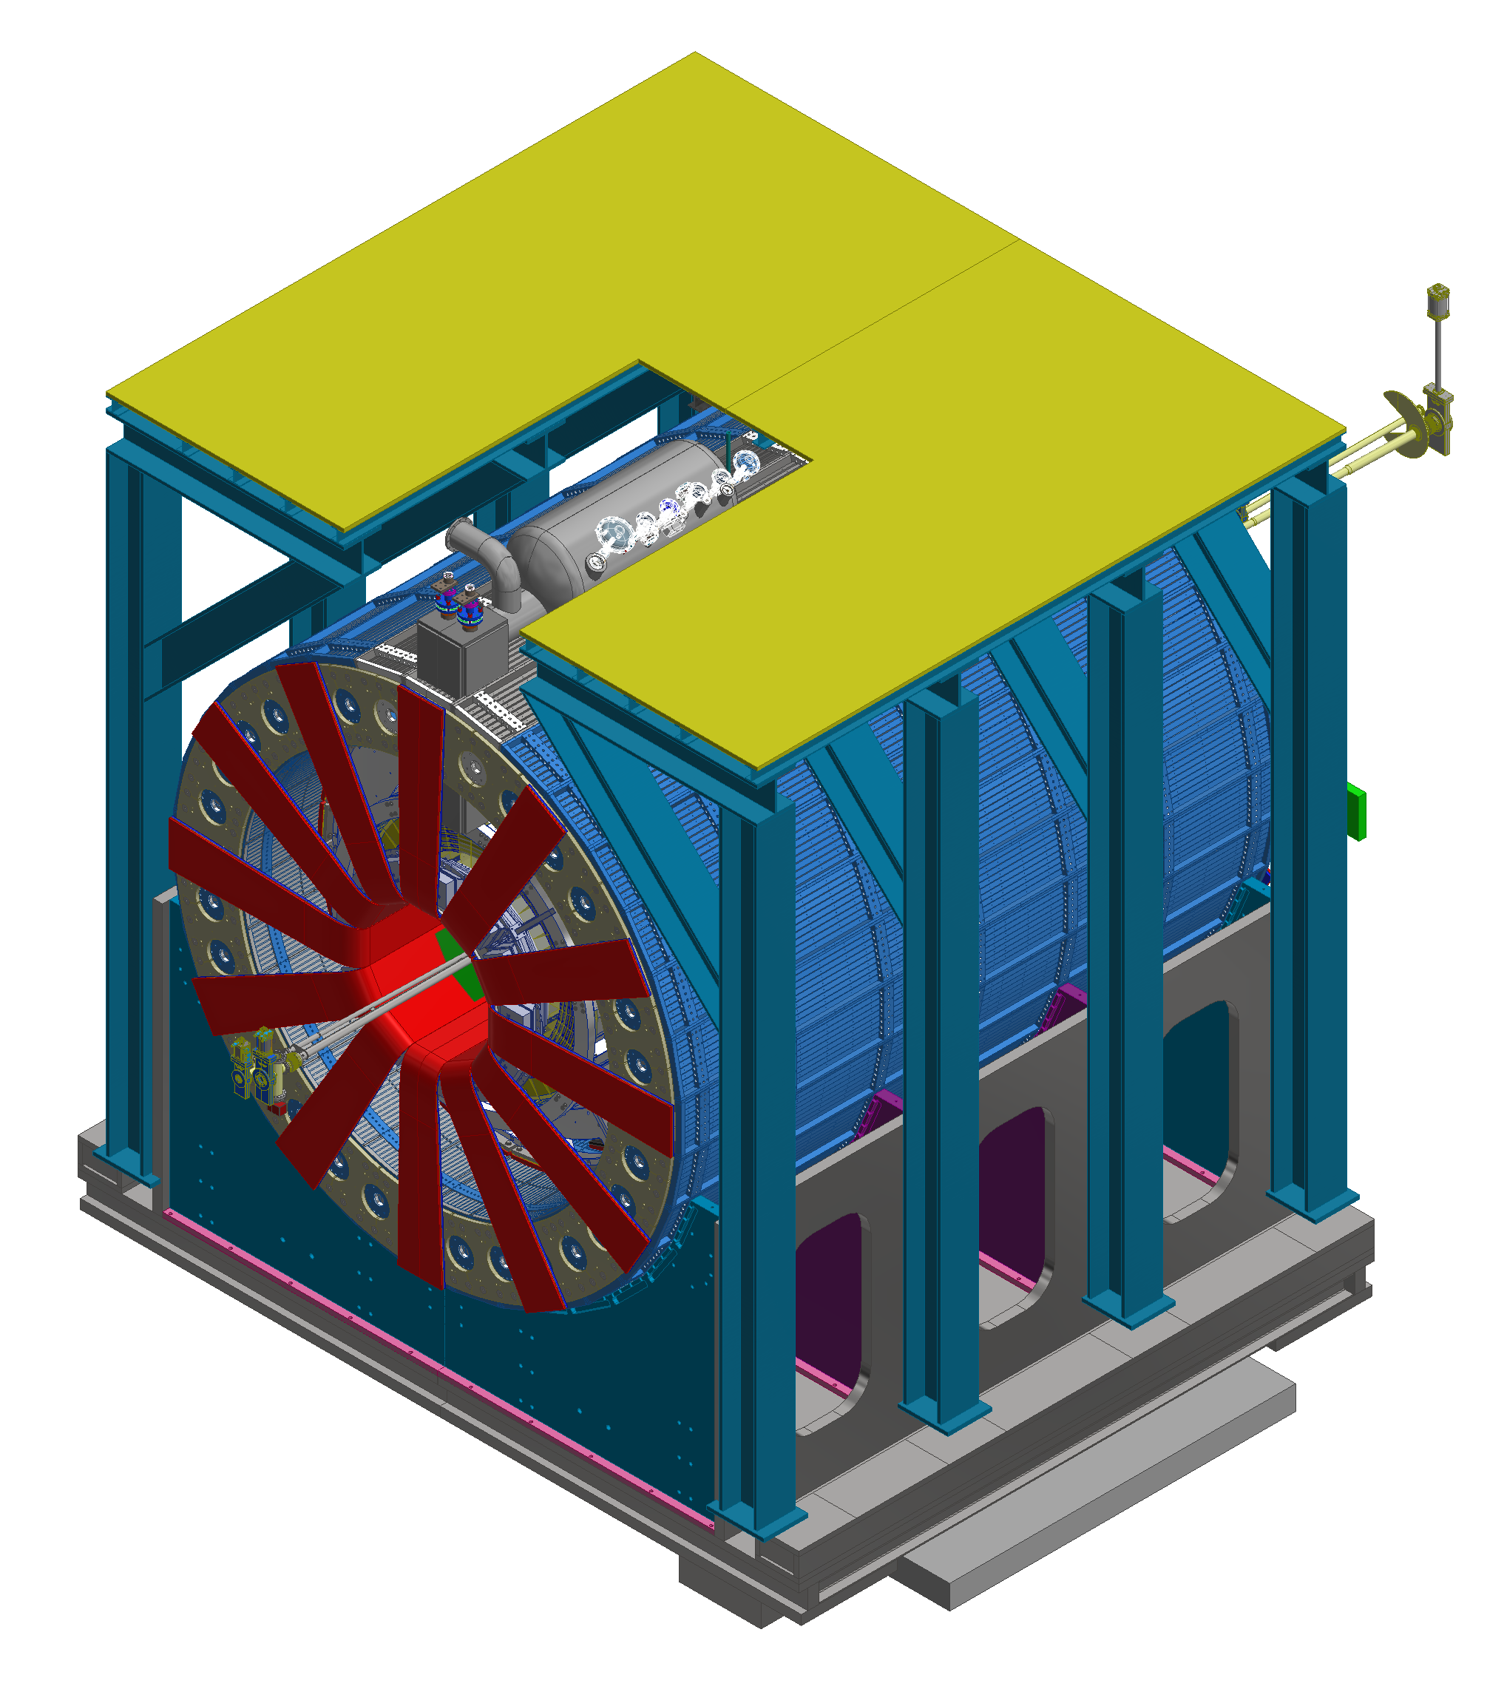
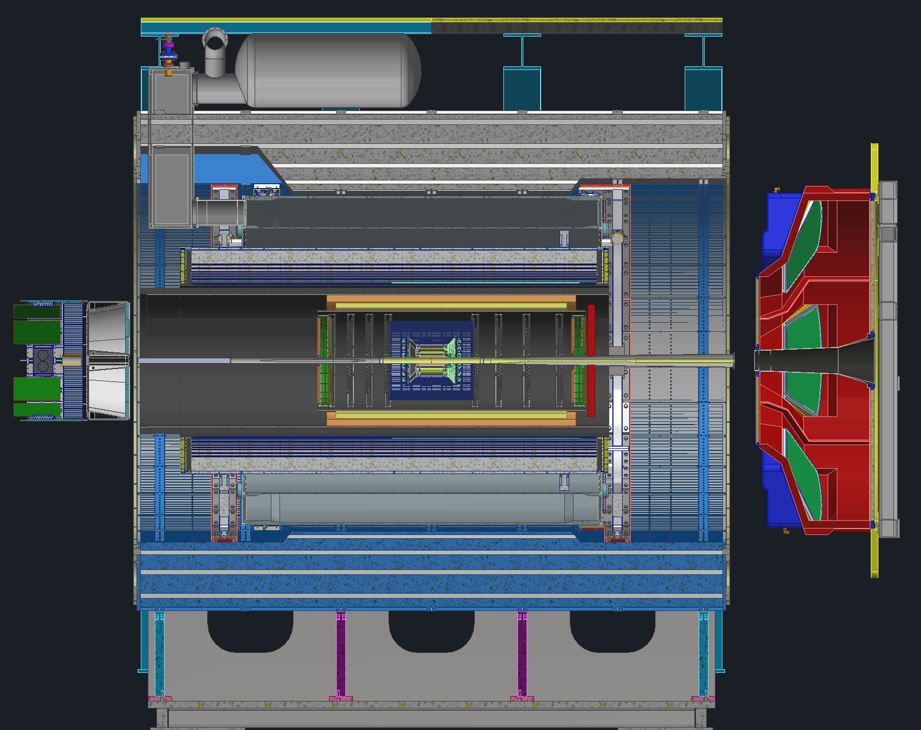
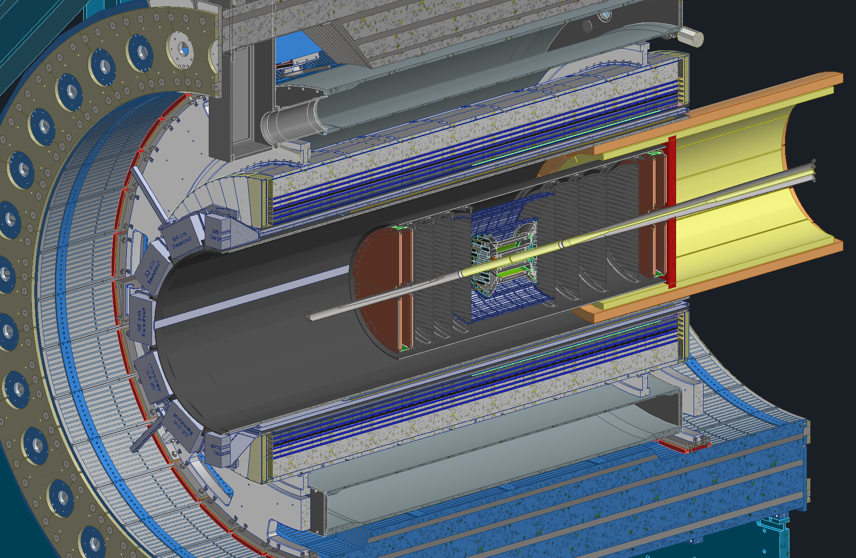
Technical Design Progress for all Subsystems
Step 9:BEMCAL Assembly and Installation
Step 10: GST Installation
Step 11: MPGD and DIRC Installation
GST
Outer MPGDs
DIRC Bar Boxes
Step 13: EEEMCAL, pfRICH and dRICH
Step 12: PST, TOF and Cymbal Installation
ePIC Barrel Detector Ready

Slide 9
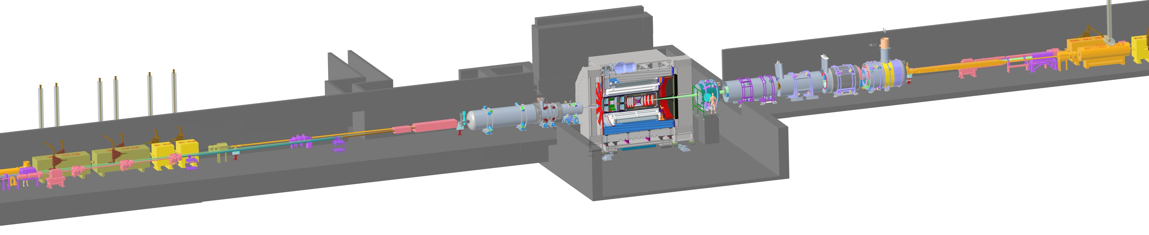

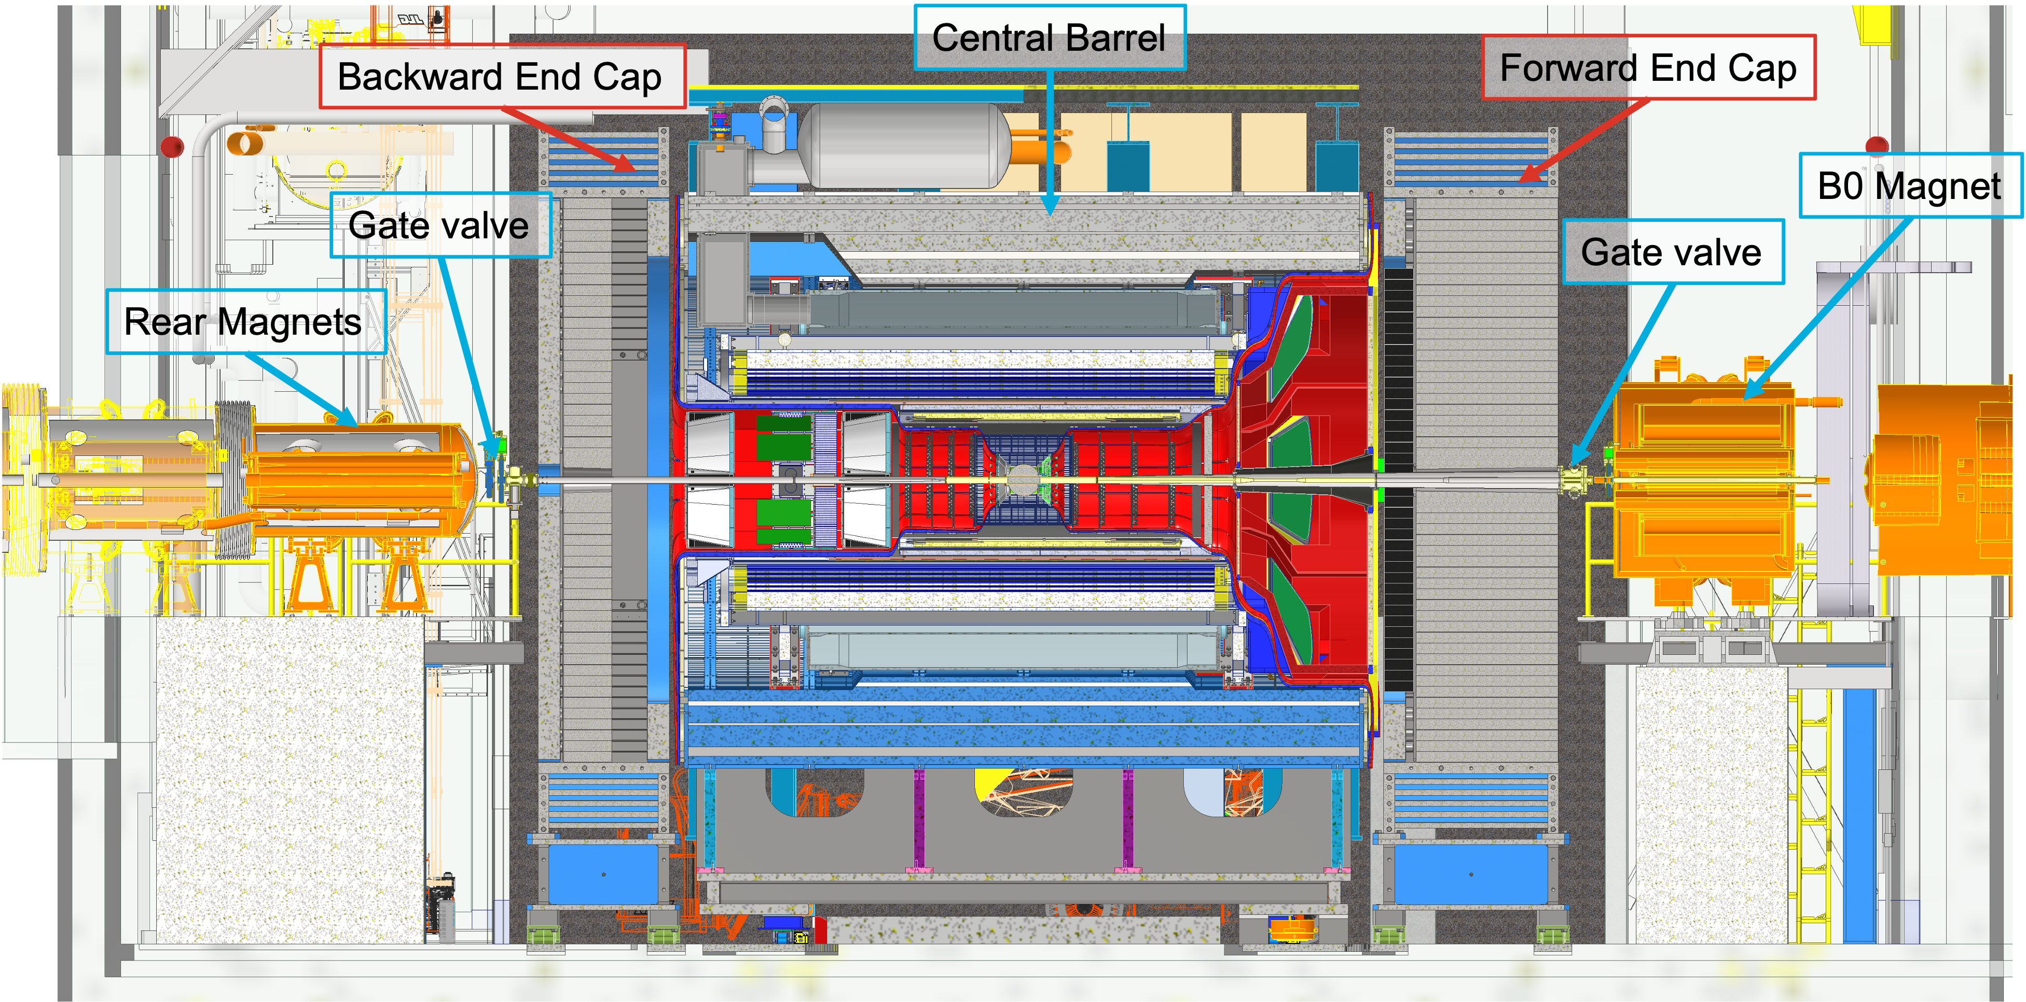
Overall Integration of ePIC in Interaction-Region
Zero Degree Calorimeter
electron beam
Luminosity
System
Low-Q2 Taggers
p/A beam
Roman Pots (RPs) and
Off-Momentum Detectors (OMDs)
B0 Magnet
Spectrometer

Slide 10




ASICs – Path to Completion (all compatible with streaming readout!)
 | Status & Development Summary | Next Steps | Production | Institution
CALOROC | Interface design FY23- FY24, CALOROC1A/B designed FY24-FY25 CALOROC1A: ADC/TOT + TOA, full SRO interface CALOROC1B: Switched gain (4) + ADC + TDC, full SRO interface Tests: Oct 2025 | CALOROC2 (64 ch) – FY25-FY26 Select version and increase channels from 32 ch to 64 ch. | FY27 | OMEGA/IN2P3/IJCL, ORNL
EICROC (32x32) | EICROC0A (4x4) designed FY24-FY25, EICROC1 (32x32) FY25 EICROC0A: ADC + TOA, improved testability EICROC0B: Replaced ADC with peak sensing, Wilkinson ADC, lower power EICROC1: added full SRO interface | EICROC2 (32x32) FY26 Add Derandomizer and ZS. Digital on Top design for lower power (~1 mW/ch). | FY27 | OMEGA/IN2P3/IJCL/CEA-Saclay, AGH
FCFD (128) | Front end characterized, FCFDv1 (6 ch) FY23-FY24 characterized, FCFDv1.1 FY25 Optimized for HPK sensor characteristics | FCFDv2 (32 ch) FY25-FY26 Add ADC, TDC, interfaces from ETROC, ECON CERN. FCFDv3 (128 ch) FY26 | FY27 | FNAL
FCFD Variant (64) | FCFDv1.1 FY25 Preliminary tests with sensors | Harmonize sensor/ASIC specifications, adapt FCFD for 64 ch. | TBD | FNAL
ALCOR | ALCORv2.1 (32 ch) beam tests FY24, ALCOR v3 (64 ch) FY24-FY26 Full specification, SRO interface, BGA | ALCOR-64 – FY26 Final iteration for production | FY26 – FY27 | INFN
SALSA | SALSA0/1 FY24, SALSA2 (32 ch) designed FY23-FY25 Full SRO interface, most DSP features, Submission October 2025 | SALSA3 (64 ch) FY25-FY27 full DSP, 64 ch | FY27 – FY28 | CEA-Saclay, U Sao Paulo
ASIC production is ~1 Year: Fab, Packaging, Test. Additional information in the following slides. PED is expected to be completed in FY26.
Fab submission is imminent.
Slide courtesy Fernando Barbosa

Slide 11
Cost and Schedule

Slide 12
Cost Estimate
Cost Drivers:
There are no specific cost drivers
The different subsystems have relatively equal costs
cost driven by amount of critical subsystems required for EIC science
Detector Subproject WBS 6.03 | Point Estimate (Burd/Esc) | Estimate Class
6.03.01 – Detector Systems | $232M
6.03.01.01 – DS Management | $25M
6.03.01.02 – DS Tracking | $25M (*) | 3
6.03.01.03 – DS Particle Identification (PID) | $29M (*,**) | 3
6.03.01.04 – DS Electromagnetic Calorimetry | $25M (*,**) | 2
6.03.01.05 – DS Hadronic Calorimetry | $21M (**) | 2
6.03.01.06 – DS Detector Solenoid Magnet | $4M (*,**) | 2
6.03.01.07 – DS Electronics | $31M (*,**) | 3
6.03.01.08 – DS DAQ / Computing | $13M | 3
6.03.01.09 – DS Integration, Installation and Infrastructure | $33M (**) | 3
6.03.01.10 – DS Auxiliary Detectors | $4M (*) | 3
6.03.01.11 – DS Polarimetry | $10M (**) | 2-3
6.03.01.12 – DS Non-Beam Commissioning | $12M
Total Point Estimate (DET) | $232M
Actual Costs thru Sept-25 | $39M
Estimated Contingency (35% on work to go) | $68M
Proposed TPC | $300M
Detector Cost Target | $300M
Delta between Target and proposed TPC | $0M
P6 Readiness :
all activities are already included in P6
the labor estimates for installation need to be updated
we are currently updating BOE
Critical Task:
formalize In-Kind contributions by signing iCRADAs
(*) these subsystems have large IKC
(**) these subsystems have scope in CD-3A/CD-3B
or reuse equipment

Slide 13
CD-3A Status and CD-3B Scope
CD | Scope | Status
CD-3A | Lead Tungstate Crystals for the Detector Backward Electro-Magnetic (EM) Calorimeter (1500 of 3000 crystals) | Contract awarded 3/5/2025 (CRYTUR) – 840 crystals delivered – quality tests completed on 720 crystals, all passed specifications
 | Scintillating Fibers for the Detector Barrel (1125 km of 4900 km) and Forward EM Calorimeters (750 km of 3000 km) | Barrel SciFi: Contract with Kuraray close to be awarded → for signature at Kuraray Forward SciFi: Contract awarded 3/12/2025 (Luxium) -> 2nd batch fulfills requirements → 38 km received to date
 | Silicon Photomultipliers for the Detector Forward Hadronic Calorimeter (321k of 540k) | Contract awarded 11/25/2024 (Hamamatsu) → first delivery of 165000 arrived at BNL → 96k have been tested.
 | Steel towers for the Detector Forward Hadronic Calorimeter (650 towers of 1500) | All engineering test articles are finalized; DOE approved bidding process
 | Detector Solenoid Magnet Design and Fabrication and Conductor | Solenoid: becomes in-kind. Tender process starting in early 2026 led by Italy Conductor: Contract awarded 9/23/2025 (Luvata) 🥂 🍾
CD-3B | Lead Tungstate Crystals for the Detector Backward Electro-Magnetic (EM) Calorimeter (1000 pieces cont. CD-3A) | Waiting for CD-3B approval Implemented as options in CD-3A contracts
 | Scintillating Fibers for the Detector Barrel (1264 km cont. CD-3A ) and Forward EM Calorimeters (1065 km cont. CD-3A )
 | Steel towers for the Detector Forward Hadronic Calorimeter (200 towers cont. CD-3A )
 | Detector Solenoid Magnet Power Supply | SOW is signed and approved; the specification document is approved. TPRR completed in August 2025; PRR completed October 29, 2025.
 | Flux Return Steel for the Electron and Hadron Endcap Structures (50% of needed steel → first phase hadron endcap) | procurement package nearly finalized, PRR planned for January 2026
 | VTRx+: Versatile Link Plus Transceivers (5500 pieces ) and lpGBT: Low Power GigaBit Transceivers (1500 pieces) | Procurement of components proceeding following the ER_2 MAPS sensor example --> assembly will happen after HI-LHC components are done.

Slide 14
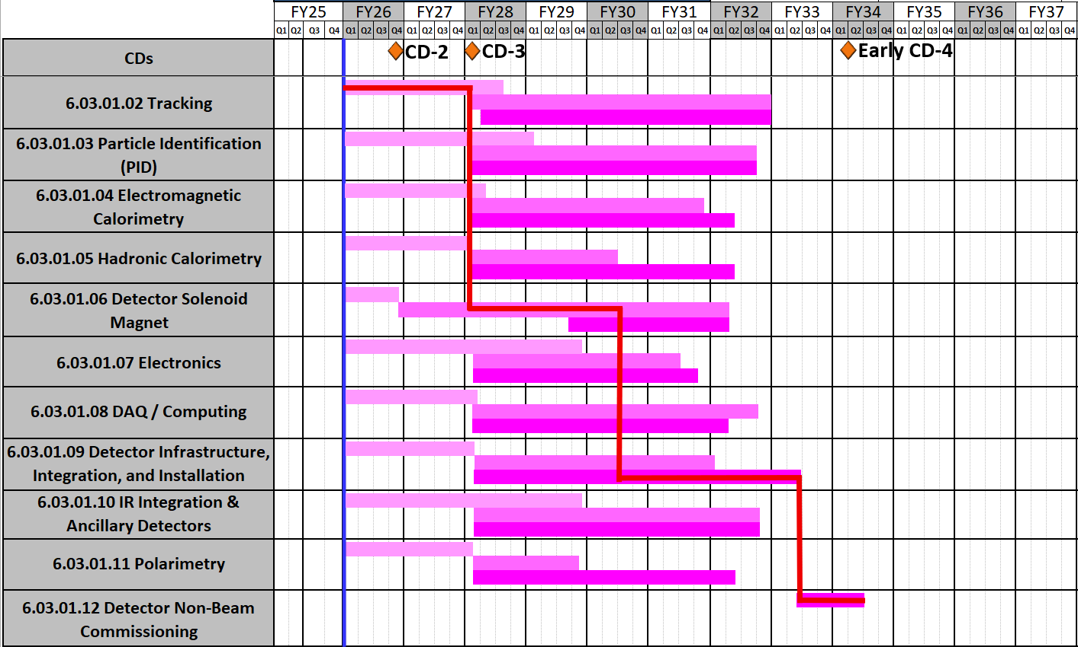
DET Schedule
Schedule Drivers:
To hold the date for the CD-2 IPR of June 2026
To keep the (inter)national user community engaged
and limit the danger to lose groups
all subdetectors need to be more or less ready at the same time to be assembled to ePIC
Superconducting Solenoid → CD-3A item
Silicon Sensors (MAPS, AC-LGAD & ASTROPIX)
ASIC long time frames only one ASIC designed from scratch all others are modifications to existing ASICS
Items with long production times, single vendor and complex assembly → CD-3A & CD-3B
International agreements driving in-kind and MAPS design (agreement with CERN)
Ready for non-beam
commissioning
Ready for commissioning
with beam
Planning Dates 2025 - 2026
June 2025 | Technical Design Review conducted by DAC
Nov 2025 | Nov. 12-14: Baseline Readiness Assessment review scheduled postponed to Feb. 3-5, 2026
Q3 FY26 | June 2026 CD-2 IPR
Detector subproject critical path goes through Silicon Vertex Tracker design to MARCO solenoid construction and arrival to ePIC assembly and installation.

Slide 15
In-Kind Contributions

Slide 16
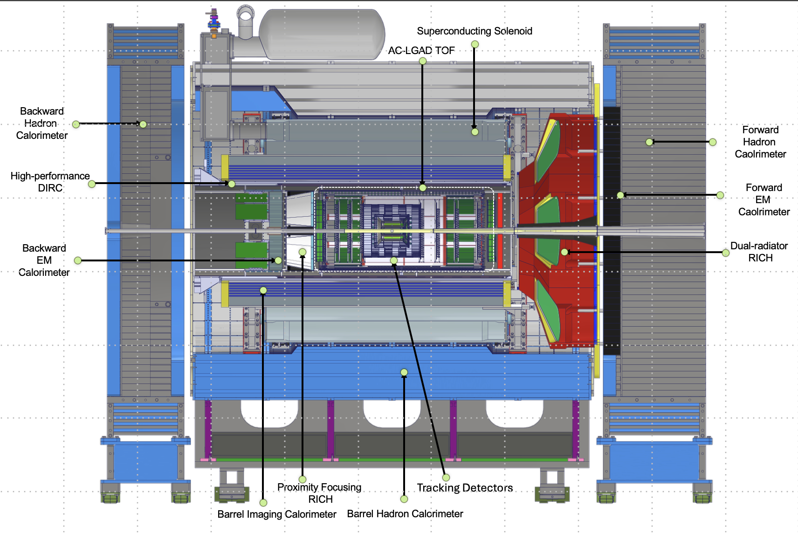








In-Kind Contributions
Luminosity
Monitor
pC Hadron
Polarimeter
Zero Degree
Calorimeter
B0 Detectors
Hadron Storage Ring
Electron Storage Ring
Low Q²
Taggers
Off Momentum
Detectors
Roman
Pots
In-kind contribution goal: 30% of Detector TPC → ~100M
Reused equipment is not listed (~$22.5M); R&D and PED in-kind is not listed (~$10M)
Up-To Cost are DOE construction costs; they will differ greatly from the country proposals that include engineering and design and research activities
 | Up-To Cost | Tracking | ECal | HCal | PID | Solenoid | Auxiliary Det. | Luminosity | Electronics
Canada | $1 M |  | Barrel ECal Readout
France IN2P3 | $7.7 M |  | Rear Ecal: Cooling, Readout, Mechanics |  |  |  | RP & Off-momentum Det.: Cooling, Readout |  | CaloRoc & EICROC ASICs
France IRFU | $6 M | Barrel MicroMegas |  |  |  | Construction Oversight |  |  | Salsa ASIC
Italy | $24.5 M | MAPS L0-L2 μRWell Disks |  |  | dRICH (but not mirrors) | Construction |  |  | Alcor ASIC
Israel | $1.9 M |  |  |  |  |  | B0 Tracker & ECal
Japan | $14.6 M |  |  |  | Barrel Tof |  | ZDC - HCal
Korea | $7.6 M | Barrel μRWell | Half of Barrel ECal |  | Barrel & Forward ToF |  | Contribution to ZDC
Taiwan | $4.5 M |  |  |  | Barrel & Forward ToF |  | ZDC - ECal
UK | $13 M | MAPS L3 - L4 |  |  |  |  | Construction of Low-Q² Tagger | Construction of Lumi-Detector

Slide 17
ePIC Streaming Electronics, DAQ and Computing
EIC benefits tremendously from a huge effort to develop streaming-compatible ASICs!
Planning for DAQ systems (ePIC/EIC project), for computing data challenges (together with ECSJI/host labs), and for integration of AI fits seamlessly.
(International) EIC Computing Organization structure approved at last RRB
FY25 |  | FY26 |  |  |  | FY27 |  |  |  | FY28 |  |  |  | FY29 |  |  |  | FY30 |  |  |  | FY31
PicoDAQ |  |  | MicroDAQ |  |  | MiniDAQ |  |  |  |  | Full DAQ-v-1 |  |  |  |  | Production DAQ |  |  |  |  |  |  |  |  |  | DAQ
Streaming Orchestration |  |  |  |  |  |  |  |  |  |  | Streaming Challenges
AI-Empowered Streaming Data Processing |  |  |  |  |  |  |  |  |  |  | Analysis Challenges |  |  |  |  |  |  |  |  |  |  |  |  |  |  | Computing
 |  |  |  |  |  |  |  |  |  |  |  |  |  |  |  | Distributed Data Challenges
AI-Driven Autonomous Alignment and Calibration |  |  |  |  |  |  |  |  |  |  | Self-Driven ePIC Experiment |  |  |  |  |  |  |  |  |  |  |  |  |  |  | AI
Figure courtesy Markus Diefenthaler

Slide 18
Path to CD-2

Slide 19
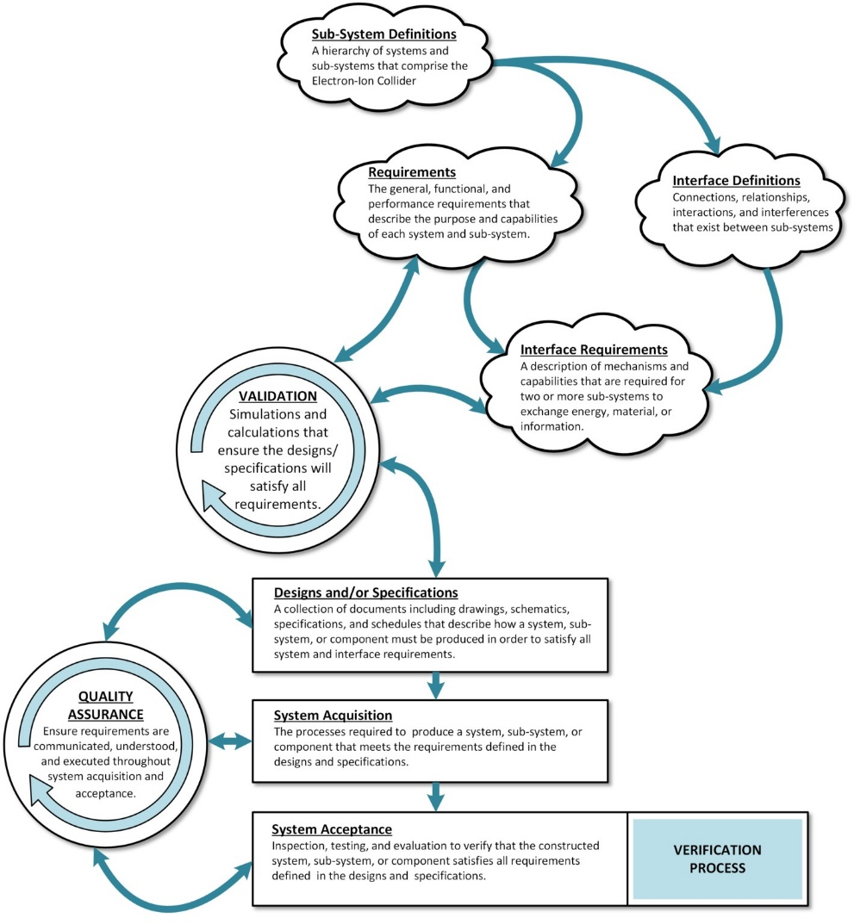
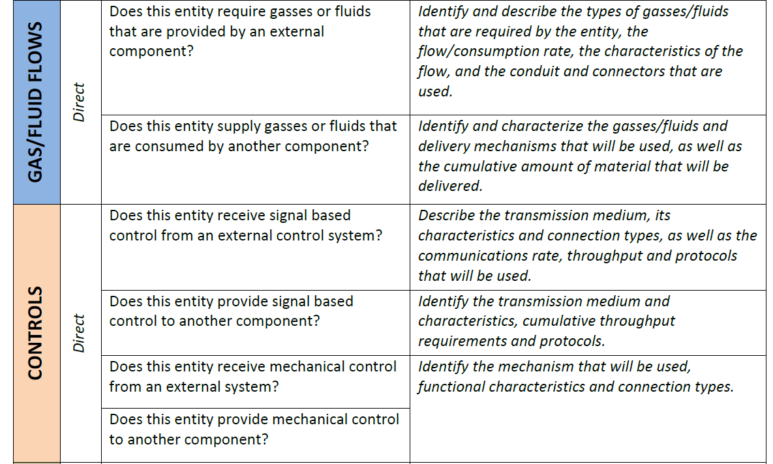
Requirement & Interface Documentation
Documentation: see https://eic.jlab.org/Detector
Requirements Documents signed and posted for the collaboration
General, functional, and performance requirements leading to design and specifications
Validation phase completed by L2 managers.
Routinely reviewed in all sub-system design reviews.
Interface Requirements signed and posted for the collaboration
Interface interrogation plan has been successfully used to collect interfaces.
Updated in 2024 to include a categorization field to collect quantitative information for the interfaces collected earlier.
Created basic template that can be used to auto-generate all Interface Control Documents (ICDs) from the interfaces database, with minimal effort.
Auto-generator used to produce ICDs for the Detector Magnet (CD-3A) and Endcap Steel (CD-3B). We are working on the one for hadron polarimetry.
To develop all ICDs was the topic for this calendar year.
Some delay due to changeover to subprojects
Draft auto-generated ICDs are posted but without context and introduction.
We are adjusting the auto-generator to allow easier inclusion of context and introduction.

Slide 20
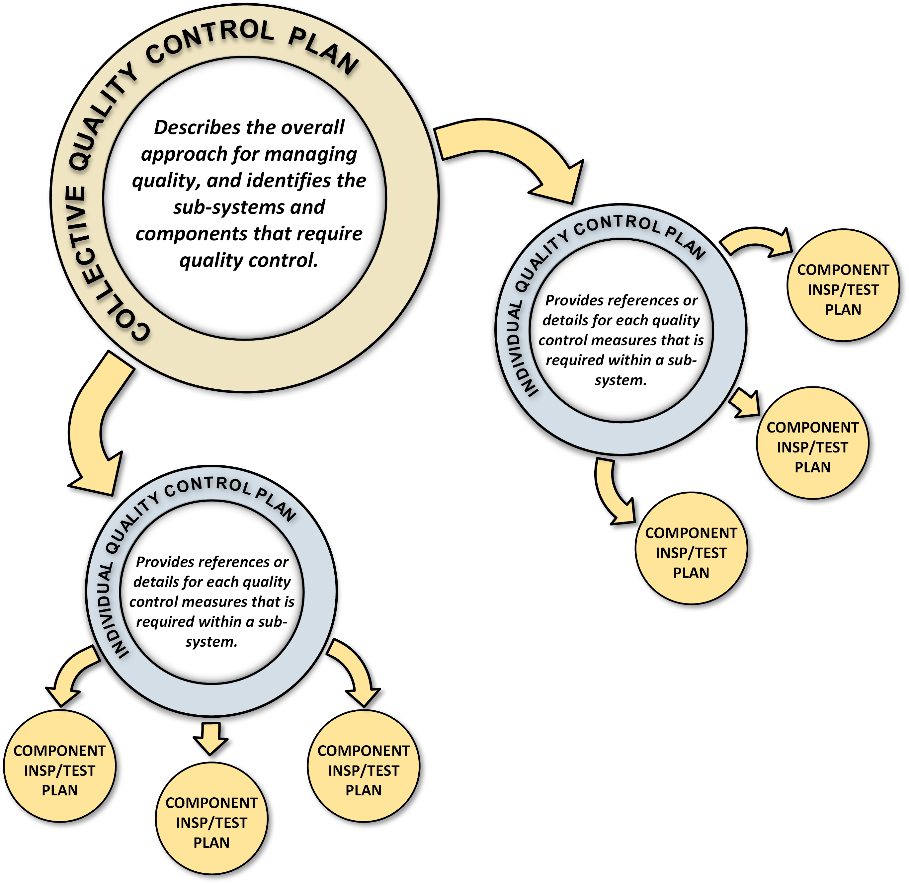
Quality Control Documentation + Installation Planning
Quality Control Documents being developed in three-tier system
Detector 6.10 Quality Control Plan is complete
This umbrella document includes the quality control processes for the detector sub-systems, and defines provider categories including: vendor contracts, assembly by collaboration or institutional partners, and in-house construction.
Includes a description of the flow of requirements and quality assurance through the system acquisition process and identifies components in each sub-detector that are subject to quality control.
Individual Quality Control Plans are in progress
Documents are developed for each sub-detector and describe the quality control for each component at various stages of the system acquisition process.
Individual components have Inspection and test Plans (ITPs)
ITPs currently exist for the magnet, conductor, and aerogel.
These documents will typically be provided by ePIC collaborators.
Many quality control setups exist already!
Aerogel test station (Temple), lead-tungstate test station, HRPPD test station (JLab, BNL, INFN), Photo-sensor test stations (BNL, Glasgow, INFN), Scintillating Fibers (UCLA, BNL, Regina), MPGD test station (CEA, JLab, UVA, FIT, Roma), Cosmic Ray hpDIRC Telescope (SBU), etc.
Inspection and Test Plans under development (see: https://eic.jlab.org/Detector)
Installation Plan Document has been written to communicate detector assembly schedule and timeline.

Slide 21
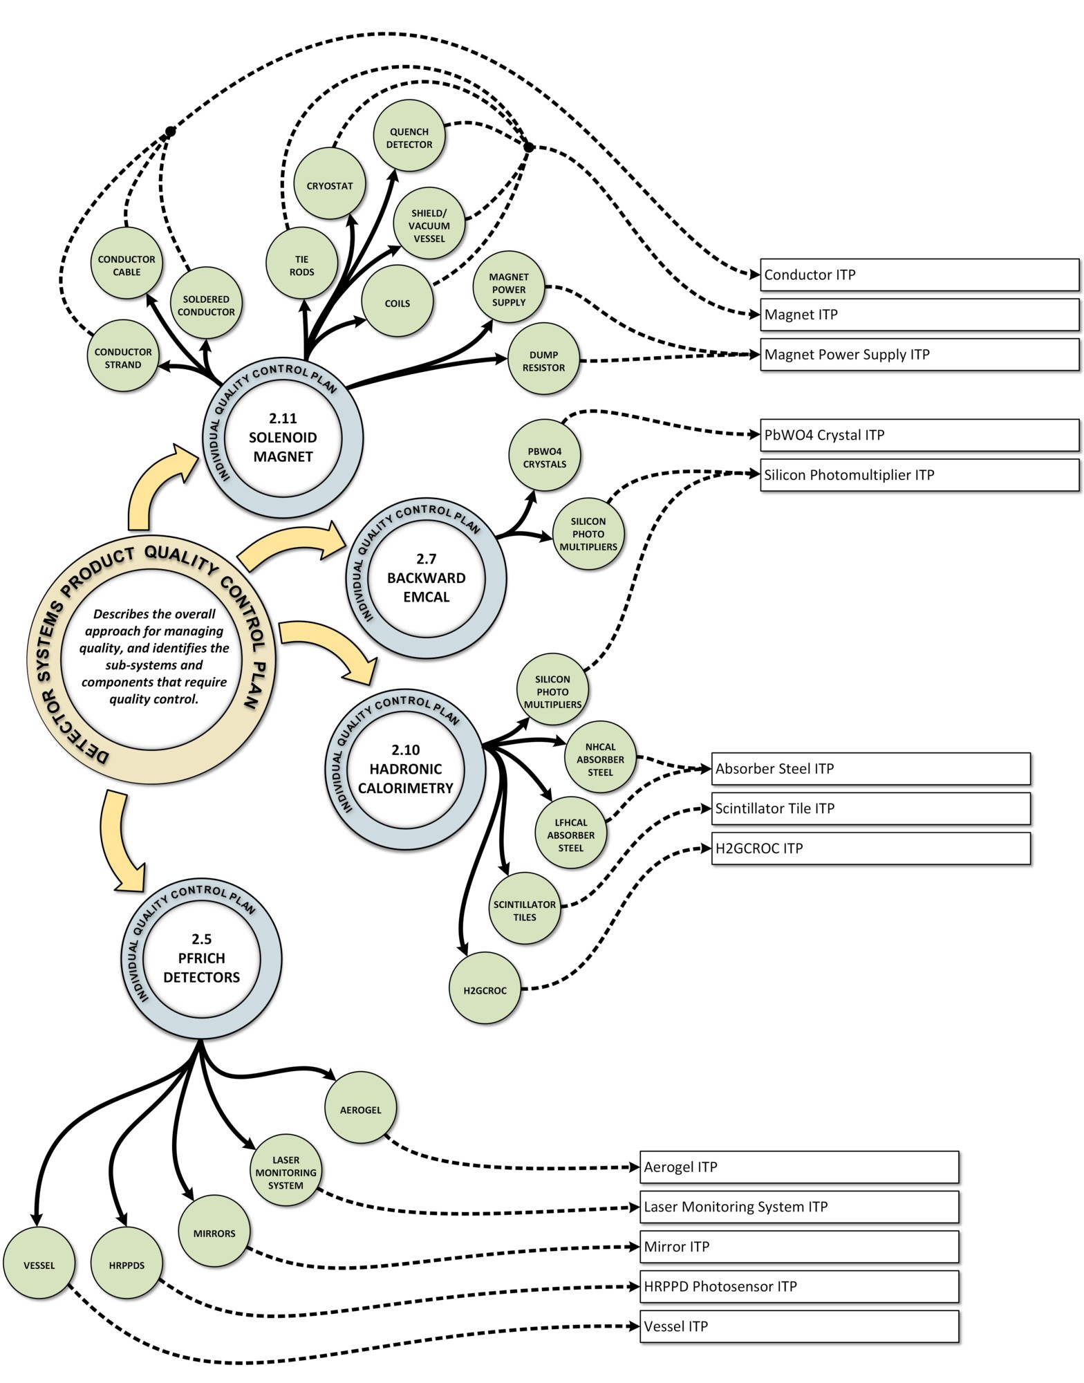
Condensing and Collecting the Information
For the magnet there are 12 components prone to quality control but they are condensed into three inspection and test plans (ITPs): conductor, magnet and magnet power supply.
All three are posted on https://eic.jlab.org/Detector/
The backward EM calorimeter has 2 components prone to quality control
The PbWO4 crystal ITP has been posted, and can also be used for the B0 detector, the ZDC
The SiPM board and daughter board ITP has been be posted.
DAQ/computing has three components, FELIX boards, fibers and trunks, and GTU. All three have been posted.
For electronics we posted an ITP for the CALOROC ASICs (thanks to Frederic Dulucq for input!)
SVT is working on draft ITPs for the sensor characterization (SVT/WP2), the FPCs (SVT/WP3) and the modules (SVT/WP4)
The pfRICH is working on remaining ITPs: HRPPDs, mirrors, LMS, the vessel ITP for the pfRICH (& dRICH) will be written as a short and simple inspection and test plan, the aerogel ITP (posted) can be shared.
hpDIRC is working on the ITP for the DIRC bars (CD-3B scope)
The hadron calorimeters have much in common so are written as one individual quality control plan
Some common ITPs, some are specific to an individual HCAL
The SiPM ITP is written as generic plan following CD-3A procurementrs and has been posted.
21

Slide 22
Subsystem Reviews
Subsystem | PDR Completed | PDR Scheduled | FDR Completed
Tracking | 40% Si & MPGD | 60% Si & MPGD week of Jan. 26, 2026 - week of Dec. 15, 2025, resp.
PID | 40% & 60% hpDIRC, pfRICH, dRICH ToF 40% | ToF 60% - week of Dec. 1, 2025 | DIRC Bar refurbishment
ECals | 60% bECal, BECal, fECal |  | SiPM & SciFi fECal, BEcal SiPM & PbW04 bECal
HCals | 40% & 60% BHCal & fHCal 40% & 50% bHCal |  | SiPM bHcal & fHcal Lead blocks fHCal
Solenoid |  | 60% PDR Cryo on Nov 5, 2025 | Magnet, Conductor and Power Supply
Electronics | 40%, 50% & 60% |  | VTRX+ & lpGBT
DAQ | 40%, 50% & 60%
Integration- Installation - infrastructure |  | 60% Inner and outer Barrel support-structures on Dec. 8-9, 2025 | electron and hadron endcap support structures
Auxiliary Detectors | 30% & 40% RP, B0, ZDC, Low Q2-Tagger, Lumi. | 60% RP, B0, ZDC, Low Q2-Tagger, Lumi: Late March/early April 2026
Polarimetry | 40% RCS & ESR Compton Polarimeter & HSR Polarimeters | 60% RCS & ESR Compton Polarimeter & HSR Polarimeters aim for February 18-19, 2026.
June 11-13, 2025: Comprehensive Design Review by DAC
Feb 3-5, 2026: Baseline Readiness Assessment review scheduled

Slide 23
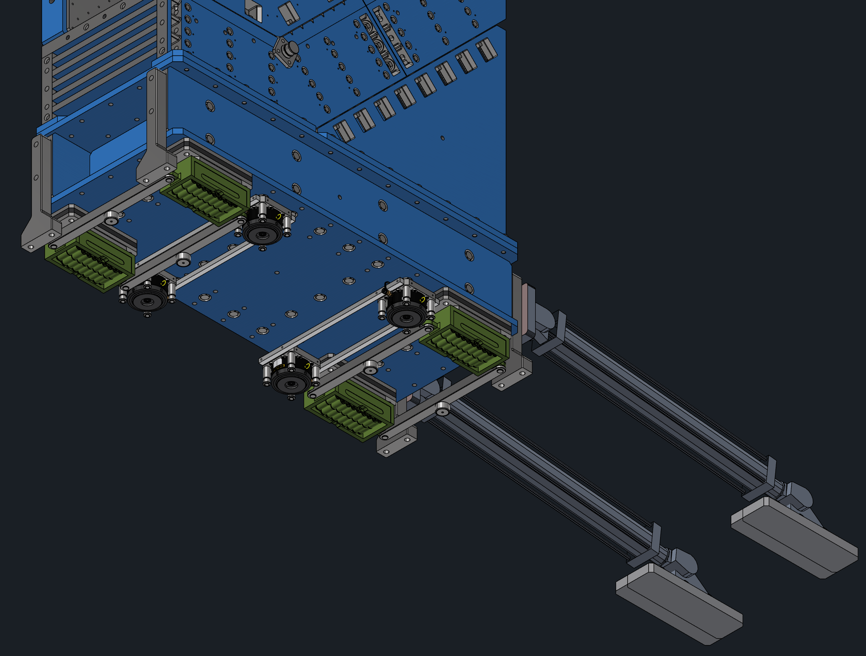
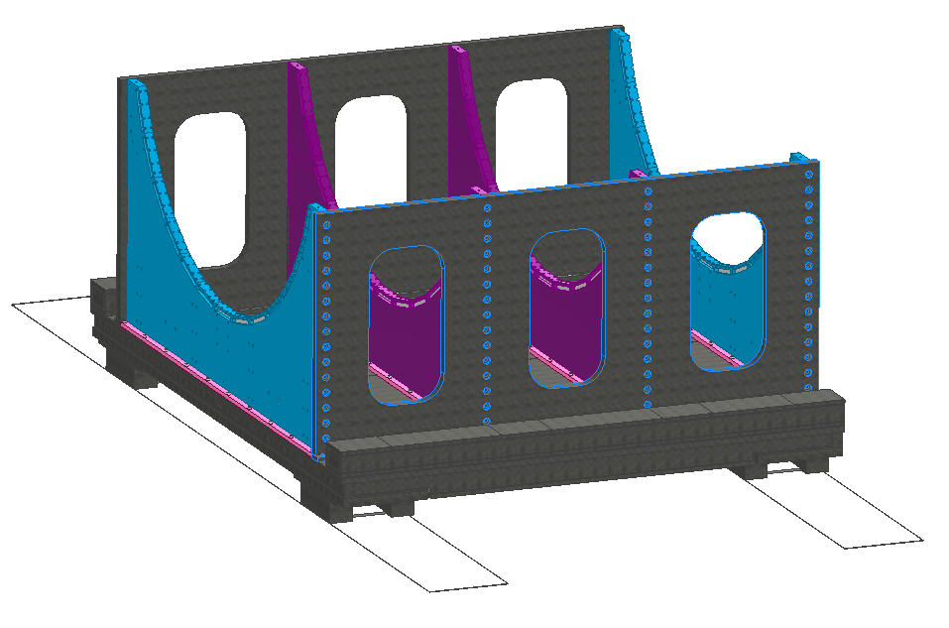
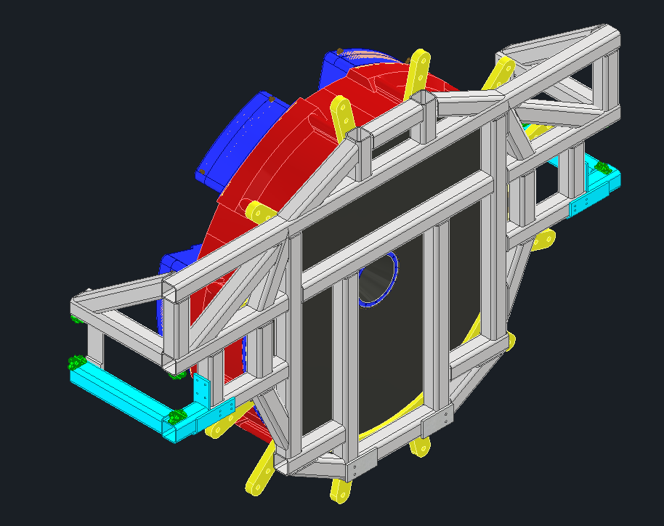
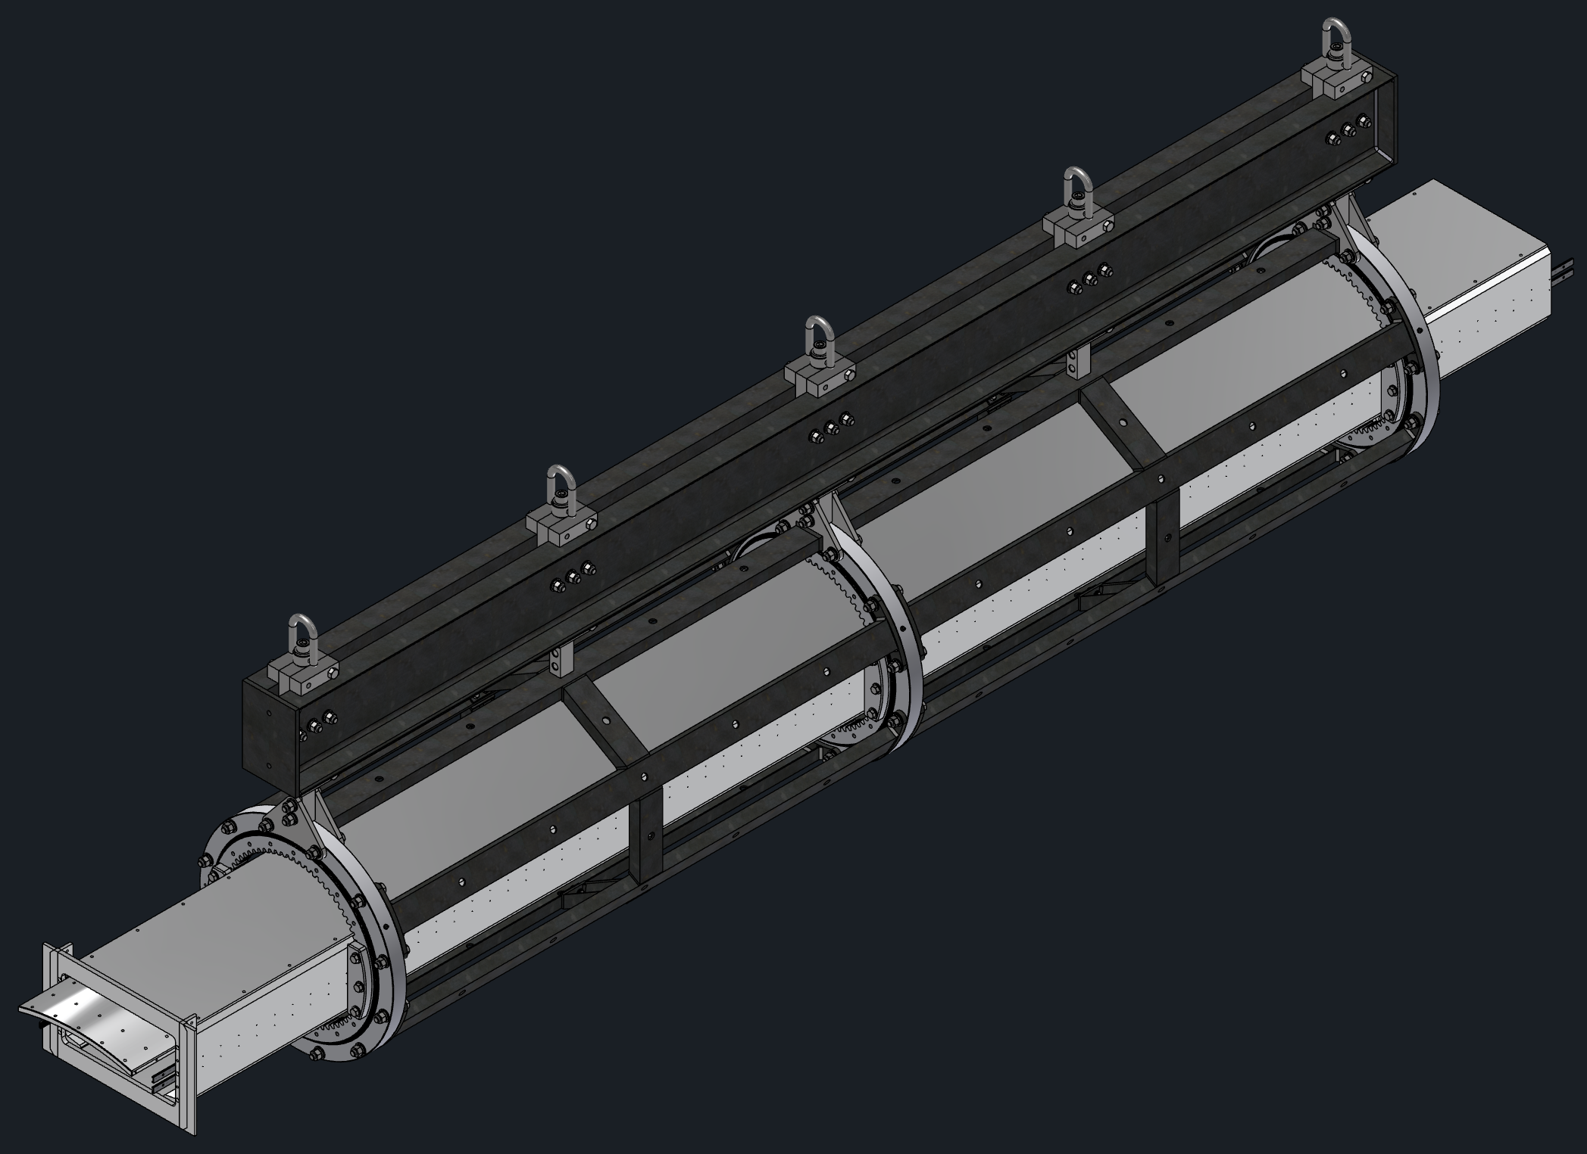
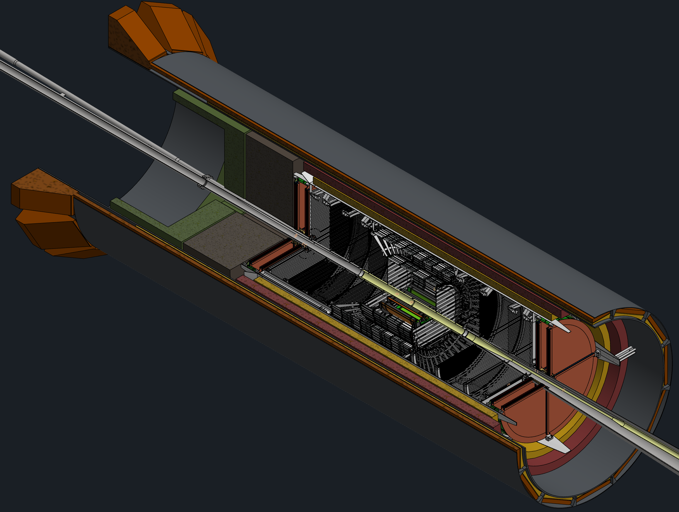
Example: PDR for integration, Installation and Infrastructure
Barrel Cradle
PDR Scheduled for December 8th and 9th
Includes all installation tooling, detector structures.14 talks on ~15 detectors, facilities, services and cooling, etc.
Endcap Movement
Barrel EMCal Install
dRICH Install
DIRC, MPGD, ToF, Cymbal Install
GST and PST Structure

Slide 24
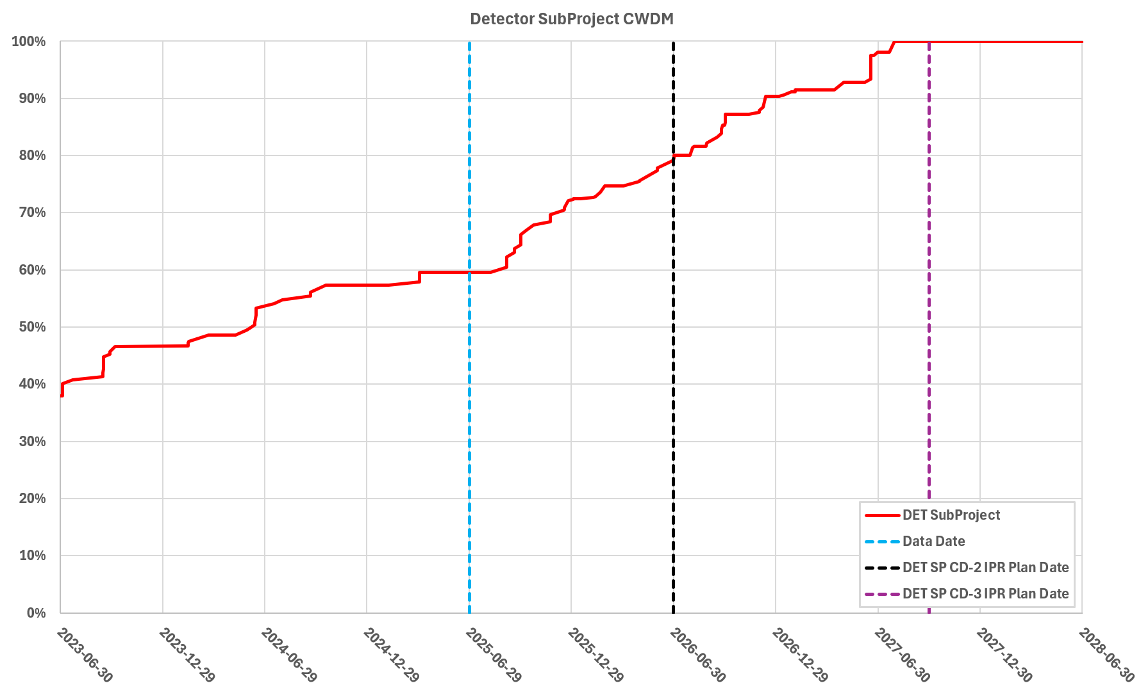
Path to Baseline – Design Maturity
Cost-weighted design maturity:
Present design maturity above 60%
Projected ~80% in June, 2026
All 26 subsystems have already received at least one PDR
Till Late 2025/Early 2026: need to complete the final PDR for 6 subsystems

Slide 25
Risks: Threats and Opportunities
Overall Risk Register Status
3 high risks (one related to CD-3A scope) post-mitigated
New Experimental Solenoid Delivery Delay – has been and will remain high risk
Accelerator & detector scope are not aligned and coupled – moved from moderate to high risk with subprojects
Delay in MAPS Sensors – has become our highest risk for direct work progress and impact
The lack of a CERN agreement for ITS3/MAPS to get access to the design affects progress already now
7 moderate risks (backgrounds, DIRC bar reuse (or not), failure to reach $100M in-kind goal, AC-LGAD, HRPPDs, Astropix, hadron polarimetry @ EIC beam currents)
19 low risks (including those related to CD-3A & CD-3B scope)
1 opportunity remaining (additional in-kind; we retired the opportunity related to NSF scope)
Two Risks are in “Critical” technical category definition with HIGH risk
(Will impact objective draft KPP. Possible impact to threshold draft KPPs, but workaround available.)
Accelerator & detector scope are not aligned and coupled – this is also high overall risk
Detector Solenoid Doesn't Pass Acceptance Tests – this is overall low risk as the probability is very low
Retired risks/opportunities: 13

Slide 26
Summary
EIC is a unique, high-energy, high-luminosity, polarized beam collider that will be one of the most challenging and exciting accelerator complexes ever built - only new collider in the next decades.
There is strong and growing support for EIC in the scientific community and increasing international engagement.
>1500 members of the EIC User Group, >1000 members of the ePIC collaboration
Partners participated in preparing the EIC governance model (RRB meetings).
EIC science has worldwide endorsement (UK/STFC Infrastructure grant, Canada Long-Range Plan, NSAC Long-Range Plan, India MegaScience Vision Plan, NuPECC recommendation,…).
ePIC Collaboration formed and EIC Detector technically baselined
June 11-13 Comprehensive Design Review by Detector Advisory Committee:
“Very significant progress has been made in many areas of the ePIC detector project.”
“the ePIC detector should be ready for baselining in late 2025/early 2026.”
The detector has reached ~60% cost-weighted design maturity and is expected to be at ~80% in June 2026.
CD-3A scope is making good progress. Items are coming in. The magnet will become in-kind.
Preparing for CD-3B authorization, some procurements are ready as they are folded in as options in CD-3A.
All subsystems will have passed a (60%) PDR by June 2026, and several subsystems have passed FDR
Feb 3-5, 2026: Baseline Readiness Assessment review
Documentation is well advanced

Slide 27


Slide 28


Slide 29
What is needed for CD-2 – Prep was well in motion
Draft Preliminary Design Report
WBS dictionary updates with scope descriptions and deliverables – done
P6 updates – largely done - great progress made in various detector systems, working on tracking. Often just reshuffles without cost additions. Have now approved cost additions for electronics, a second engineering test article run for HRPPDs, an air bearing system for detector installation driven by (accelerator) alignment needs, rigging labor, and a more complex global support tube allowing for detector serviceability.
Basis Of Estimates in good order such that they are traceable – ongoing, thanks for providing input to CAMs!
Remaining review (PDR, FDR) dates finalized
Interface Control Documents in development – several completed
Some Subsystem Individual Quality Control Plans
Some Inspection and Test Plans (component and unit tests, transportation)
Multi-Party ICRADAs started and Draft (In-Kind) Project Planning Document – ICRADA for magnet went to INFN but may take until January for signing, BNL & JLab working on synchronized submission to DOE. Started work on ICRADA for detector/UK.
Many Inspection and Test Plans – many posted on eic.jlab.org/Detector, some more in progress
(In-Kind) Project Planning Documents –
Updated Budget Estimate Quotes (need them early 2026)

Slide 30
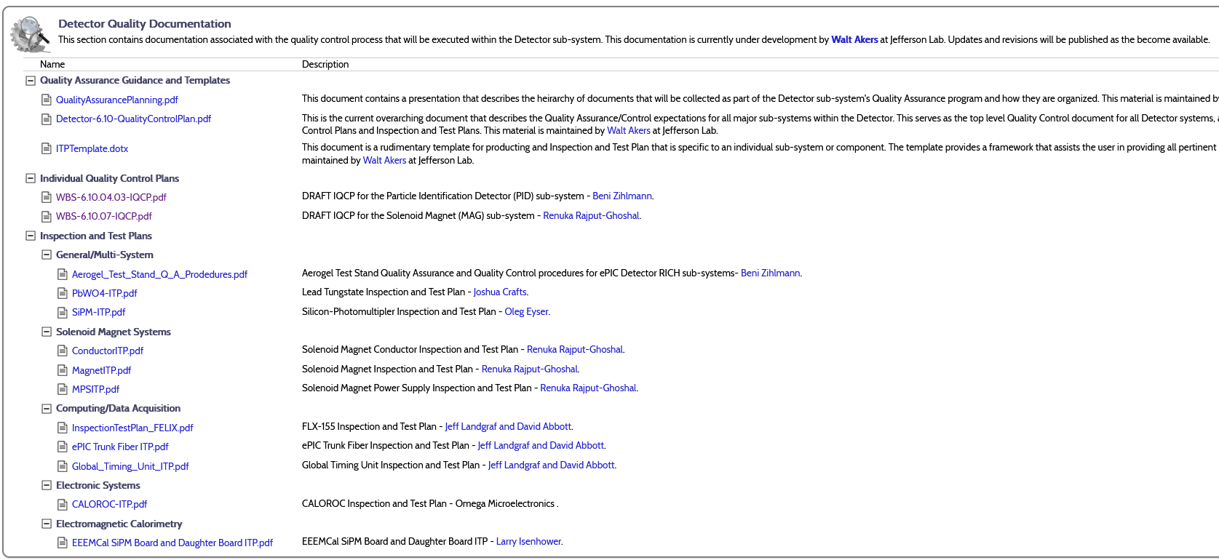
Documenting the Information
30

Slide 31
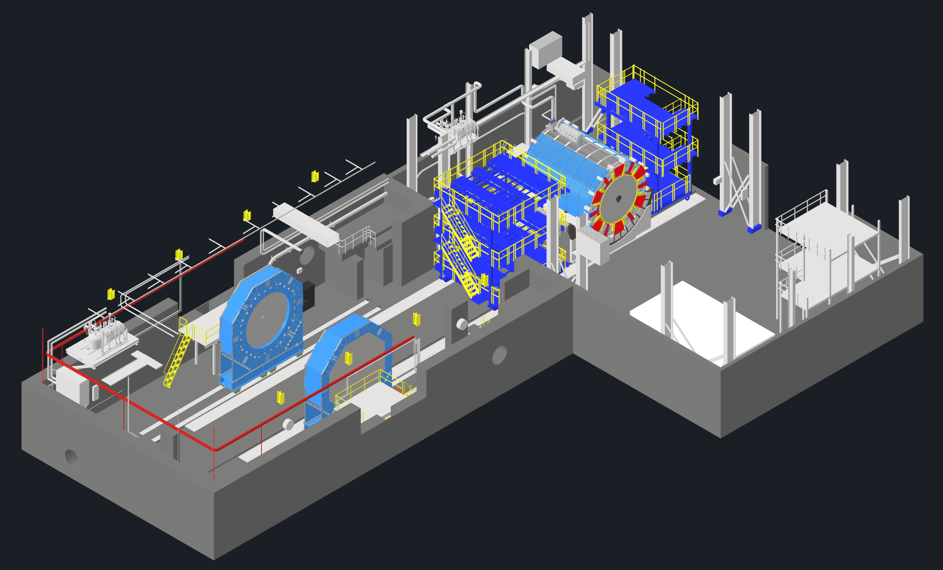
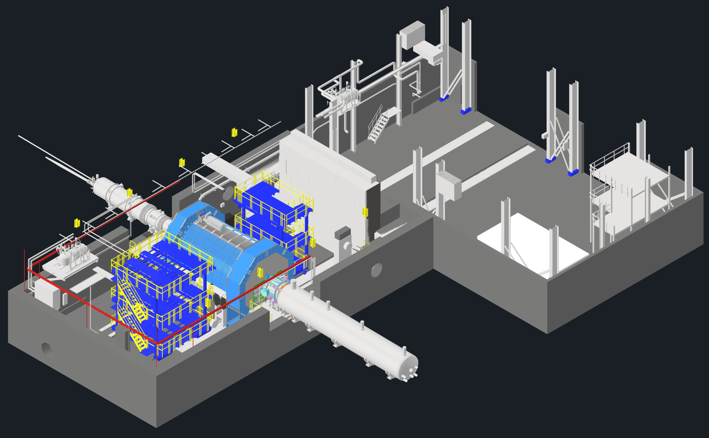
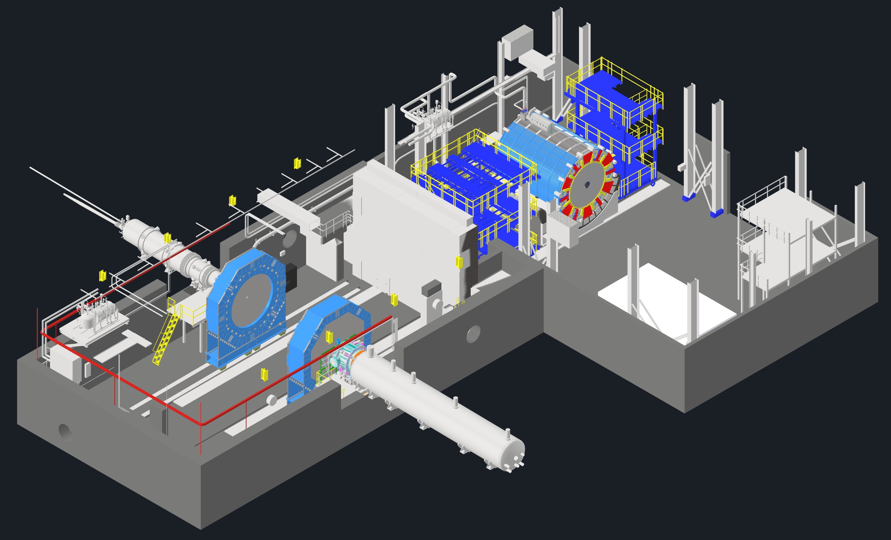
EIC - ePIC Commissioning
Q2/2033
~ CY 2034
exact dates under development
ePIC no-beam commissioning
ePIC commissioning with beam
ePIC fully assembled and Ready for Cosmic Data Taking
EIC first beam commissioning
central ePIC in assembly hall
endcap calorimeters
and beam pipe with instrumentation to have a first look on backgrounds
Luminosity detector and hadron & electron polarimeters fully installed
move central
ePIC into wide-angle hall
commission
ePIC with beam
All auxiliary detectors, but RPs and OMDs are installed
Start of Science
program
RPs and OMDs will be installed in year-2

Slide 32
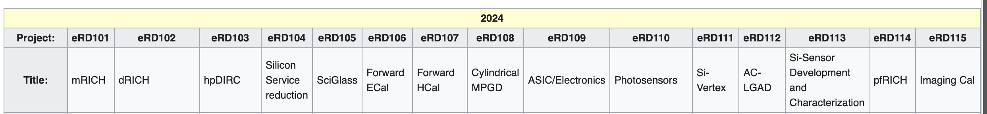





Recent Accomplishments
Project detector R&D completion September 2025
Technical baselining of ePIC detector is complete since Spring 2024.
Good coordination between ePIC and EIC project; the ePIC collaboration is well integrated.
ePIC is a CERN recognized experiment
The Resource Review Board meetings are highly successful and well attended
The RRB is a critical body to the governance of the EIC experimental program
The IKC target for the EIC detector of about 30% of the total scope approx. $100M is well in reach.
In-kind scope well defined → iCRADA process can start as soon as iCRADA template is fully approved by DOE
finished in 2023
as not ePIC
baseline technology
Projected to finish
in July
finished in 2023
as not ePIC
baseline technology
finishing
in FY25
muRWell finished
in FY24;
CYMBAL finish in CY2025
finished
in FY24 beyond INFN studies
Projected to finish
in CY25
Projected to finish
in July
finished
in FY25
finished
in FY24
finished
in FY25
finished
in FY25
finished
in FY25
finished in 2023
as technology is
very mature, focus on engineering design

Slide 33
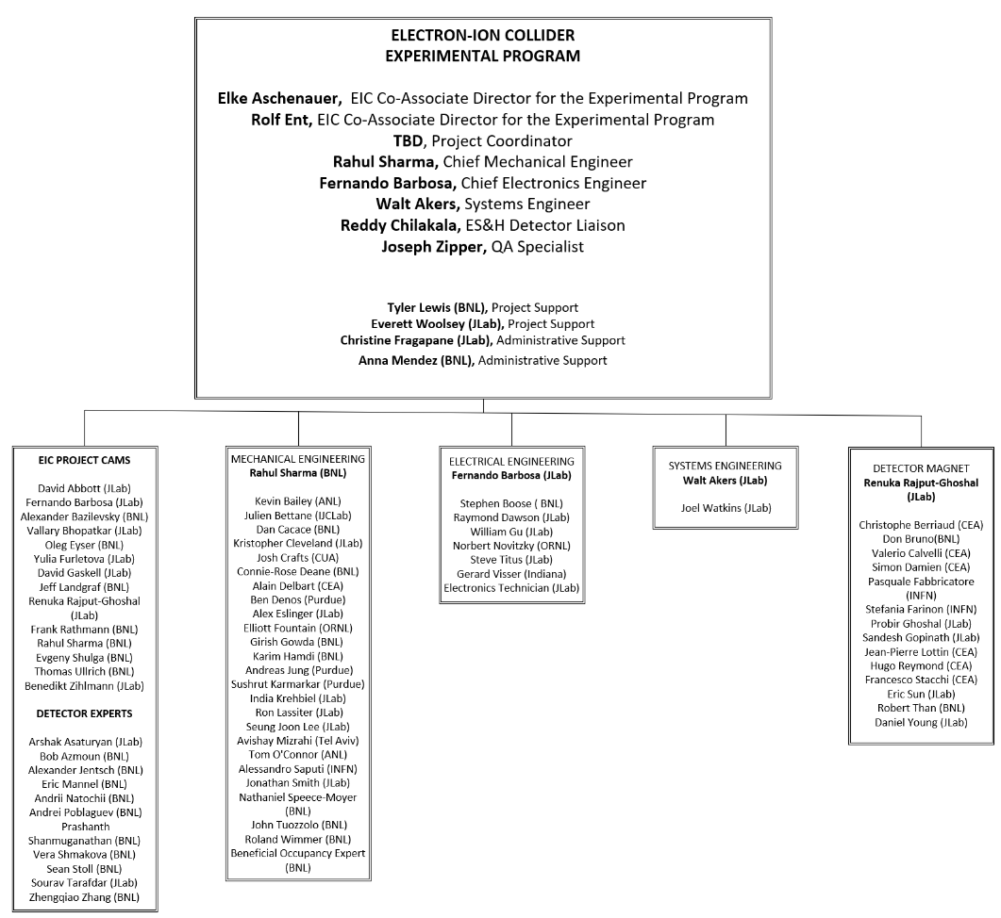
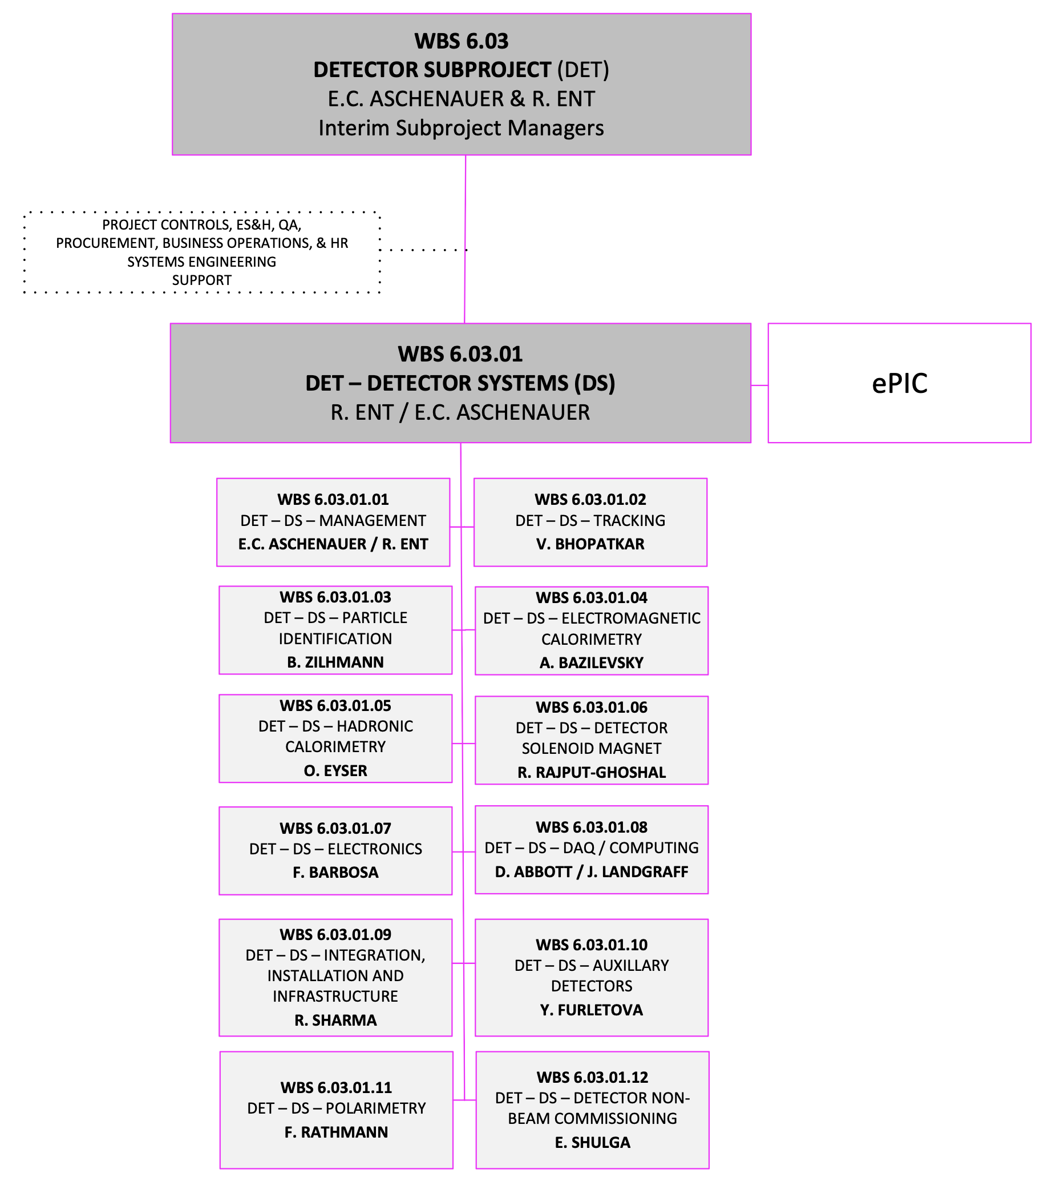
Organization and Management

Slide 34

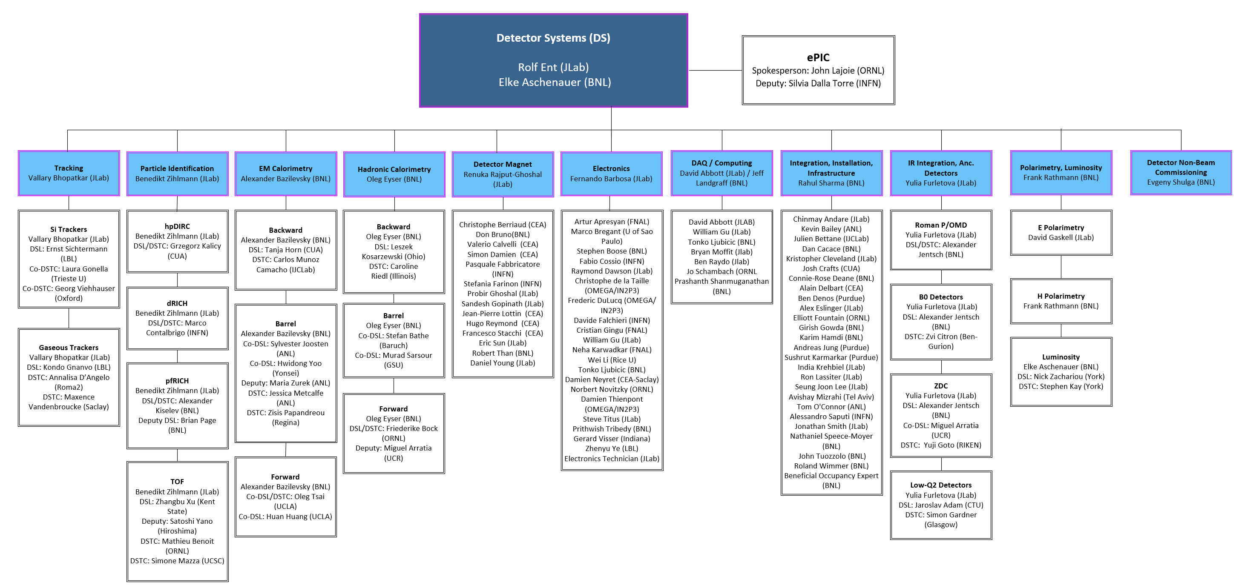


Integrating collaboration in Detector Subproject Organization

Slide 35
Assumptions
Approximately 30% of the detector scope is anticipated and assumed to come from non-DOE in-kind contribution and reuse of components. The work scope associated with the present best-known in-kind contributions is coded within the schedule. ​
The identified In-kind contributions to the detector/experimental and accelerator equipment are included in the project scope and schedule but are not included in the DOE Total Project Cost (TPC).
The remaining In-kind contributions (IKC) for the detector/experimental and accelerator systems with respect to the set of project goals for IKC are assumed but the scope is not fully defined at present.
The removal of RHIC accelerator and detector equipment (STAR and sPHENIX) is not included in the EIC Project.
The preparation for the RHIC collider hall at IR-6 to host the EIC detector and the EIC IR magnets is included in the schedule, but the cost is covered by the BNL NPP directorate.
The preparation for the RHIC collider hall at IR-8 to deinstall the existing sPHENIX detector at IP-8, remove STAR detector at IP-6 and allow the EIC accelerator beams top Storage Ring component removals are funded by BNL NPP Directorate.
Computing resources for simulations for scientific guidance and detector optimization and design are provided by the BNL and TJNAF computing facilities.
We assume off-project scientific labor to include scientific tasks accompanying detector construction, simulations, and high-level analysis software, and the efforts towards being ready for expedient science analysis folding in distributed computing.
We assume early beam pre-operations to start with an instrumented beam pipe only to measure beam properties and backgrounds. We assume the next stage of pre-operations with detector rolled into the experimental Hall.
The detector-specific non-beam commissioning is included in the detector scope. We assume the detector commissioning will be also supported by the international user community towards the EIC scientific program goals.

