Slide 1
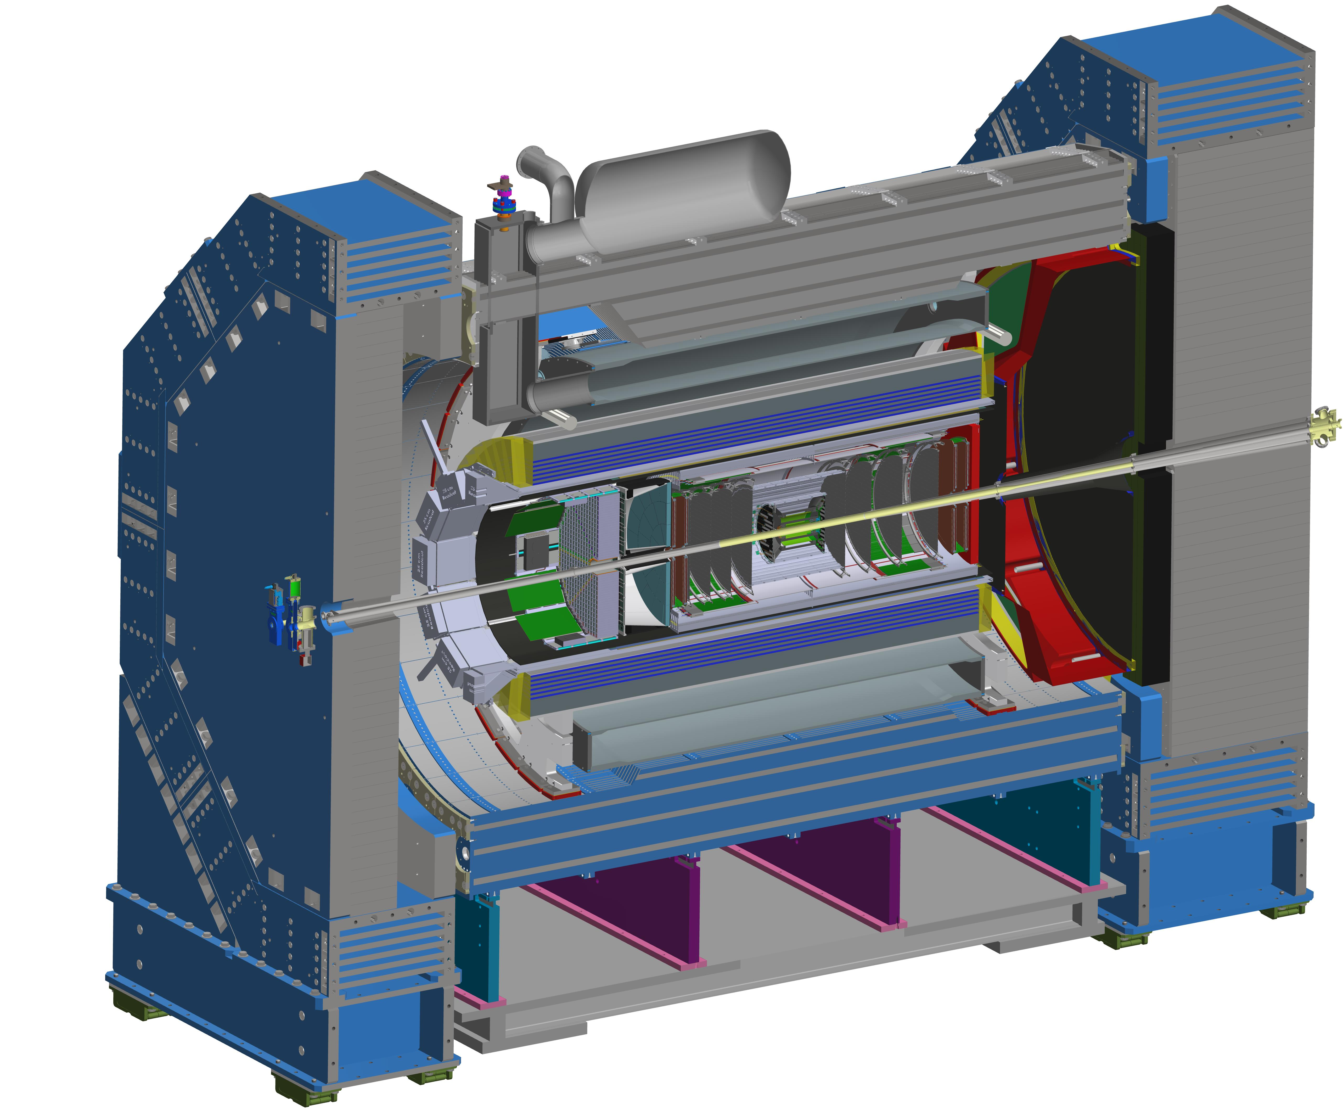



Report from the ePIC Collaboration Spokesperson
John Lajoie
Oak Ridge National Laboratory

Slide 2

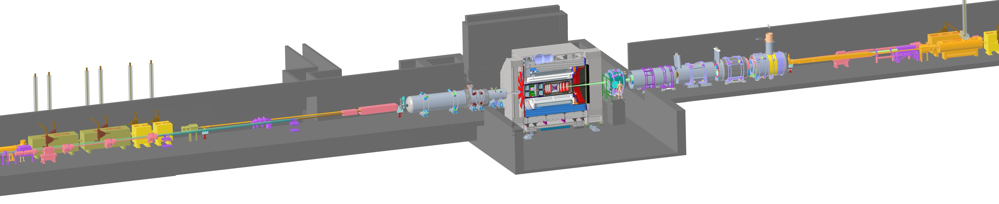
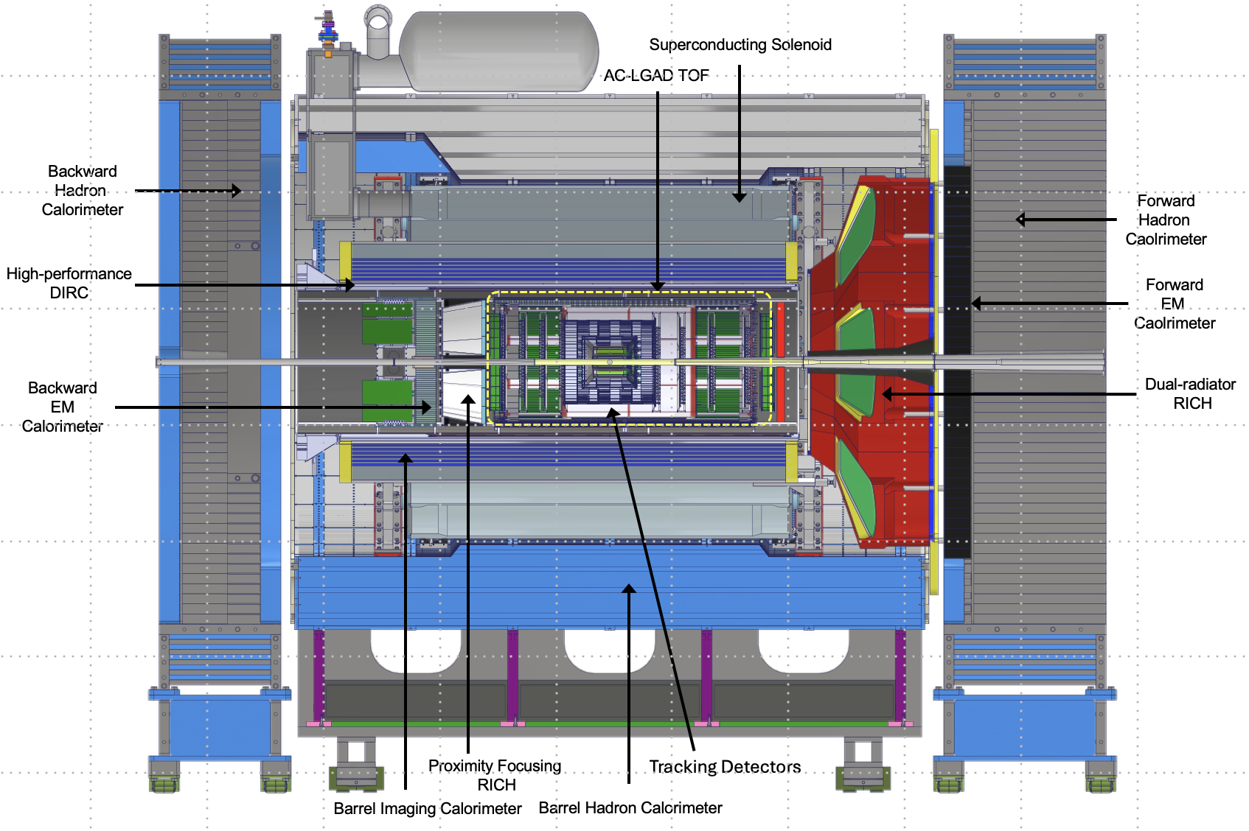
ePIC – The EIC State-of-the-Art General-Purpose Detector
electron beam
Zero Degree Calorimeter
p/A beam
Luminosity
System
Low-Q2 Taggers
B0 Magnet
Spectrometer
Roman Pots (RPs) and
Off-Momentum Detectors (OMDs)
26 subsystems over ± 40 m
to measure particle momenta, energy and particle type
3 electromagnetic calorimeters
3 hadronic calorimeters
Silicon and Multi-pattern gas detectors
3 RICH detector + time-of-flight
7 Auxiliary detectors (Si + HCal + ECals)
electron and hadron polarimetry
Integration, Installation and Infrastructure
Non-Beam Commissioning
Highest scientific flexibility
→ fully streaming readout electronics and data acquisition
→ integration AI/ML capabilities from the start
2

Slide 3
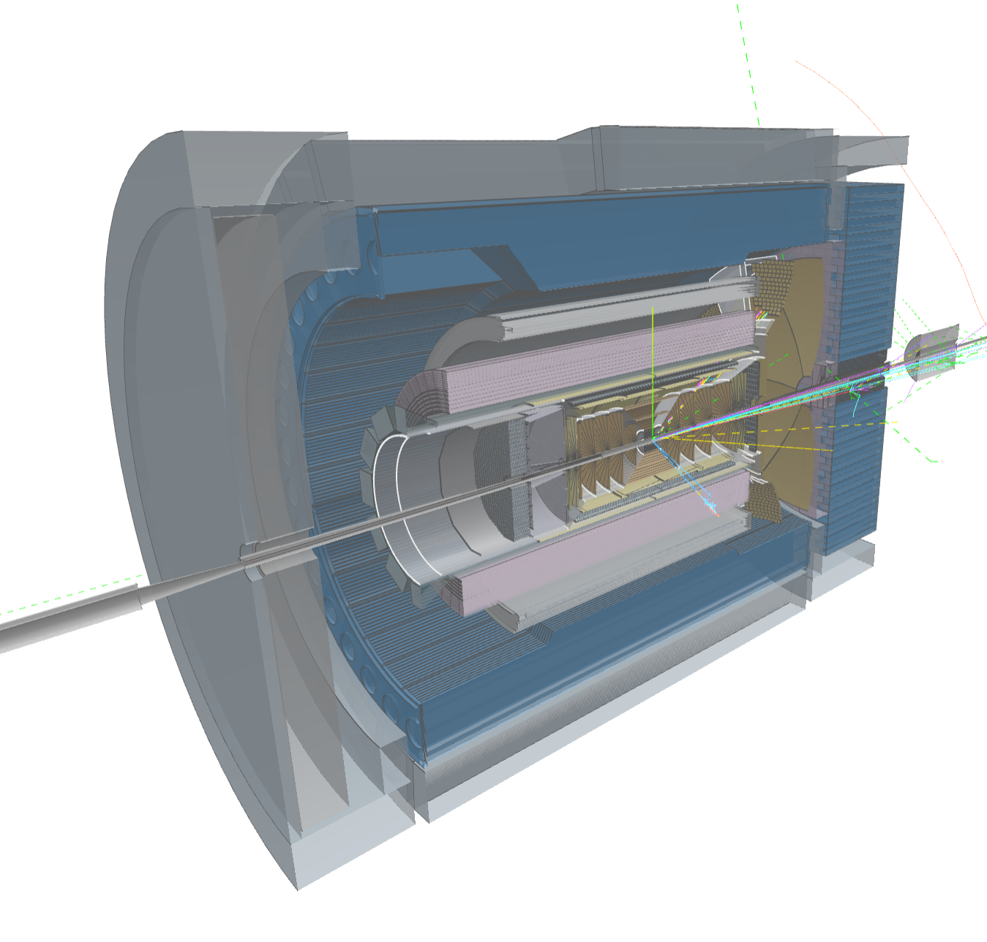
Computing-Detector Integration
Streaming Readout and DAQ:
High-speed data flow: The front-end electronics are designed to support a total bandwidth of up to 50 Tbps, with over 3,000 fiber streams feeding data from the detector to the computing system.
Zero dead time: By avoiding a traditional hardware trigger, the system eliminates dead time and allows for unbiased data collection.
AI and ML in the Data Pipeline:
Intelligent data filtering: AI/ML algorithms can select the most relevant collision events to study.
Real-time feedback: AI can enable rapid detector diagnostics and optimization, with systems capable of automatically calibrating detectors and validating data.
Streaming Computing Model:
Continuous calibration and alignment: Enables rapid delivery of scientific results.
Echelon Model: Organizes resources across the computing hierarchy and enables international contributions.
ePIC event display by Dmitry Romanov

Slide 4
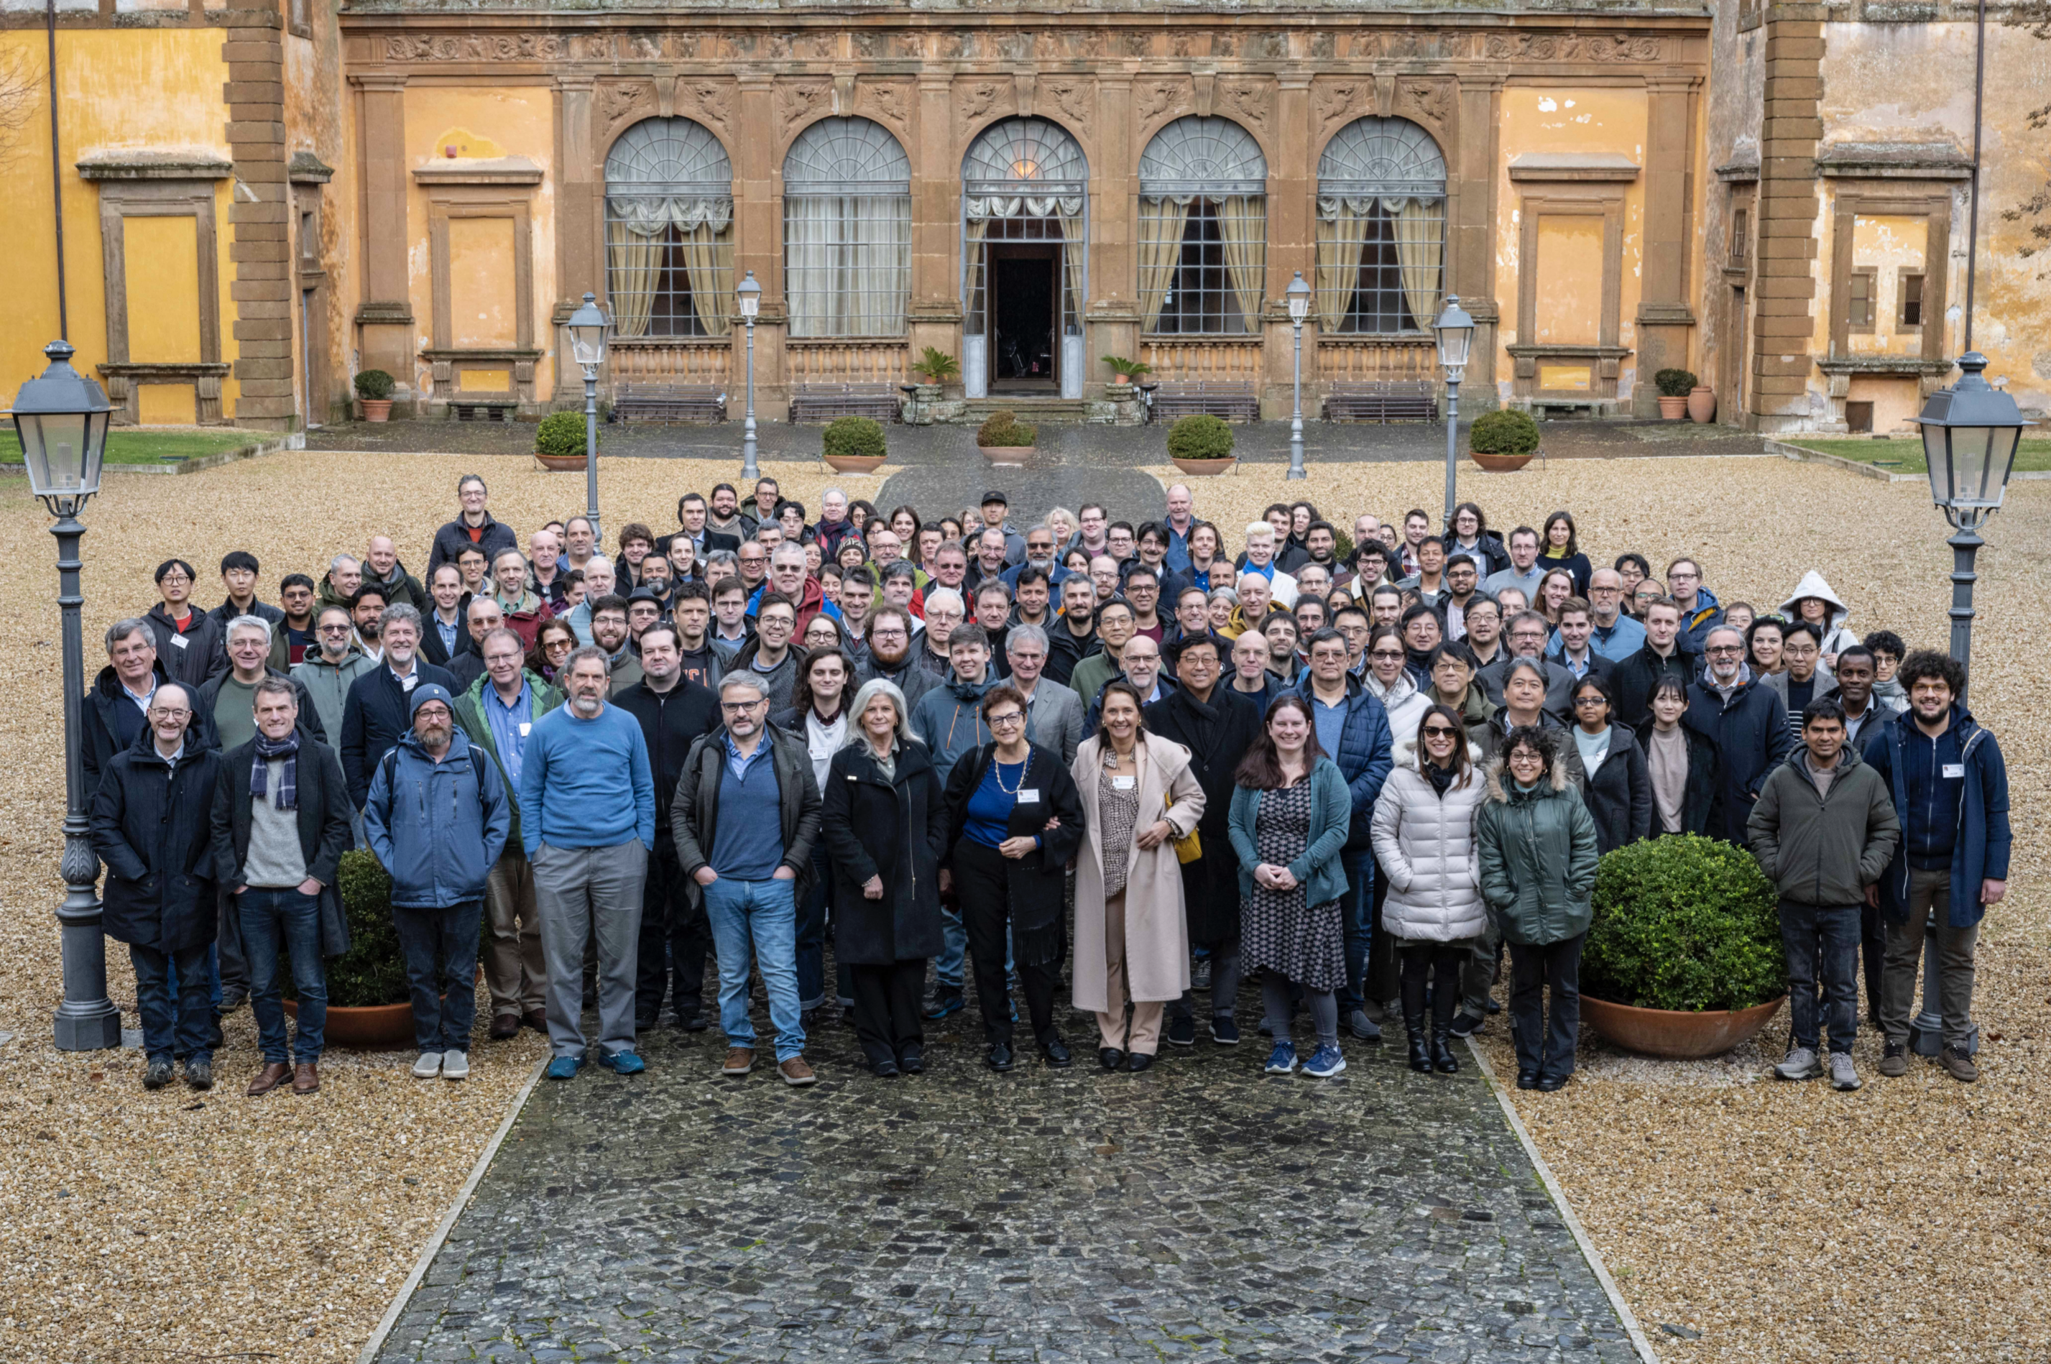
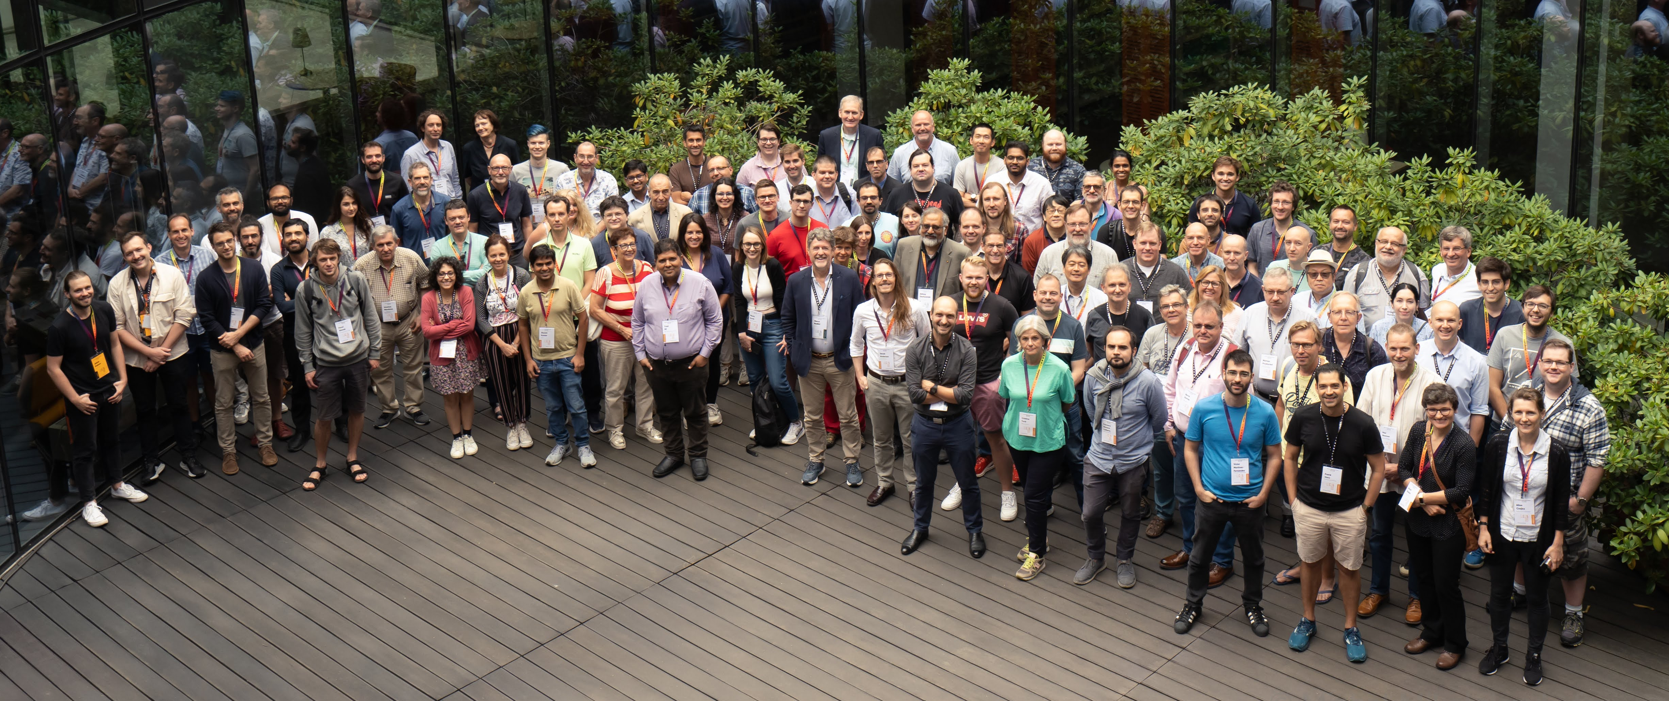
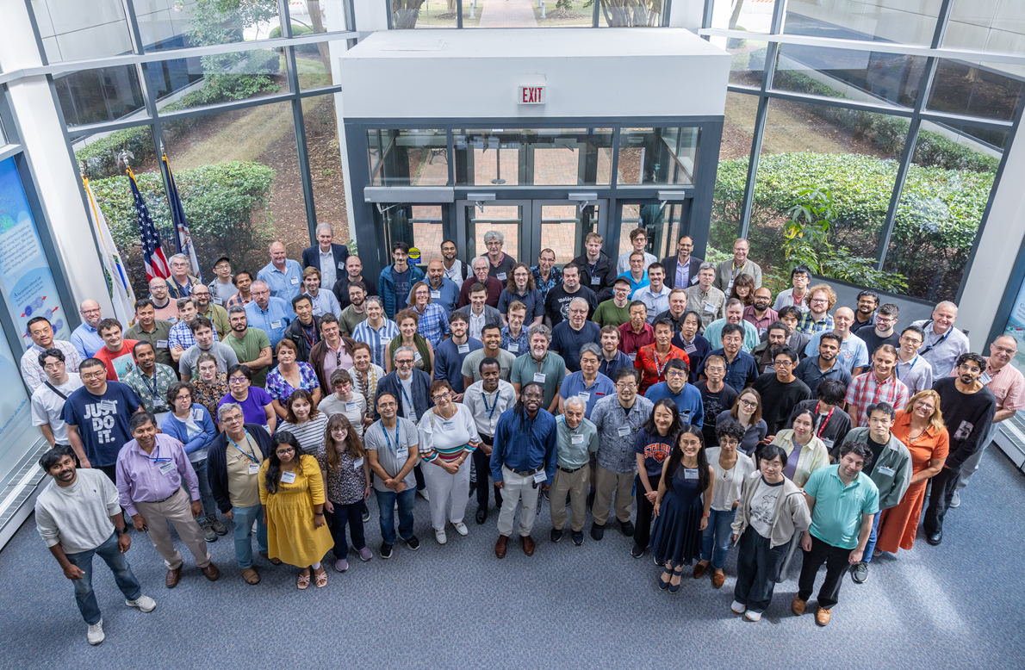
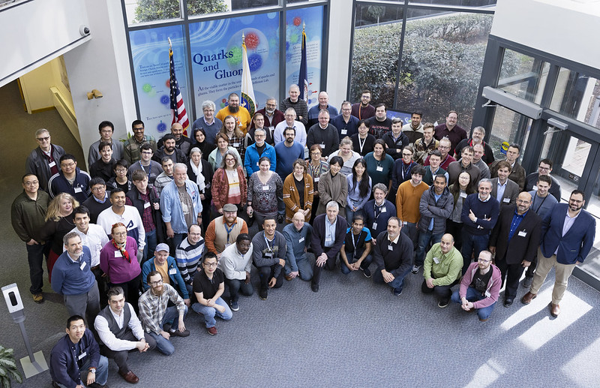
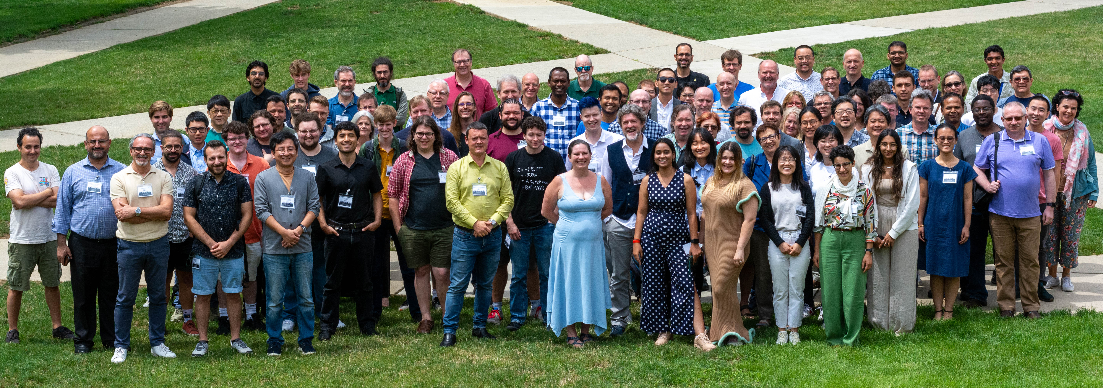
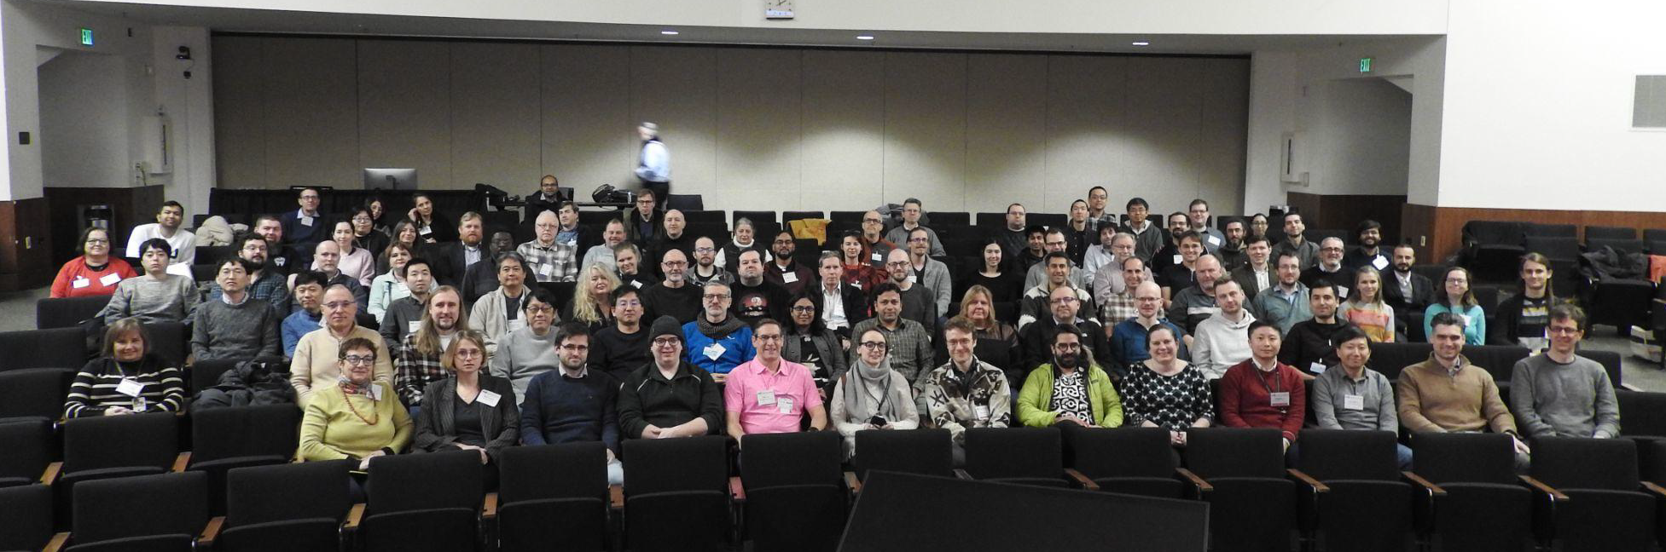
The Collaboration
JLab, Jan. 2023
Warsaw, July 2023
ePIC is a community of scientists dedicated to realizing the EIC science mission.
The ePIC Collaboration is as unique as the ePIC detector.
Frascati, January 2025
EICUG/ePIC Meeting – Lehigh, July 2024
Jefferson Lab, July 2025
ANL, Jan 2024

Slide 5
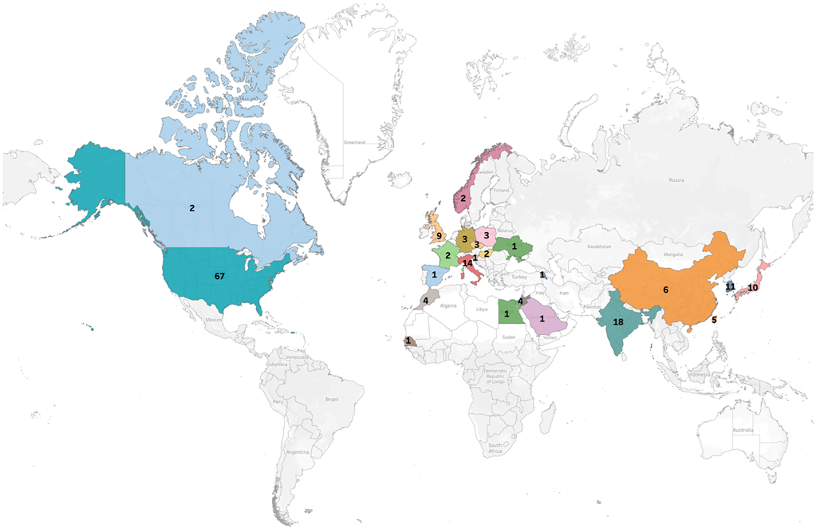
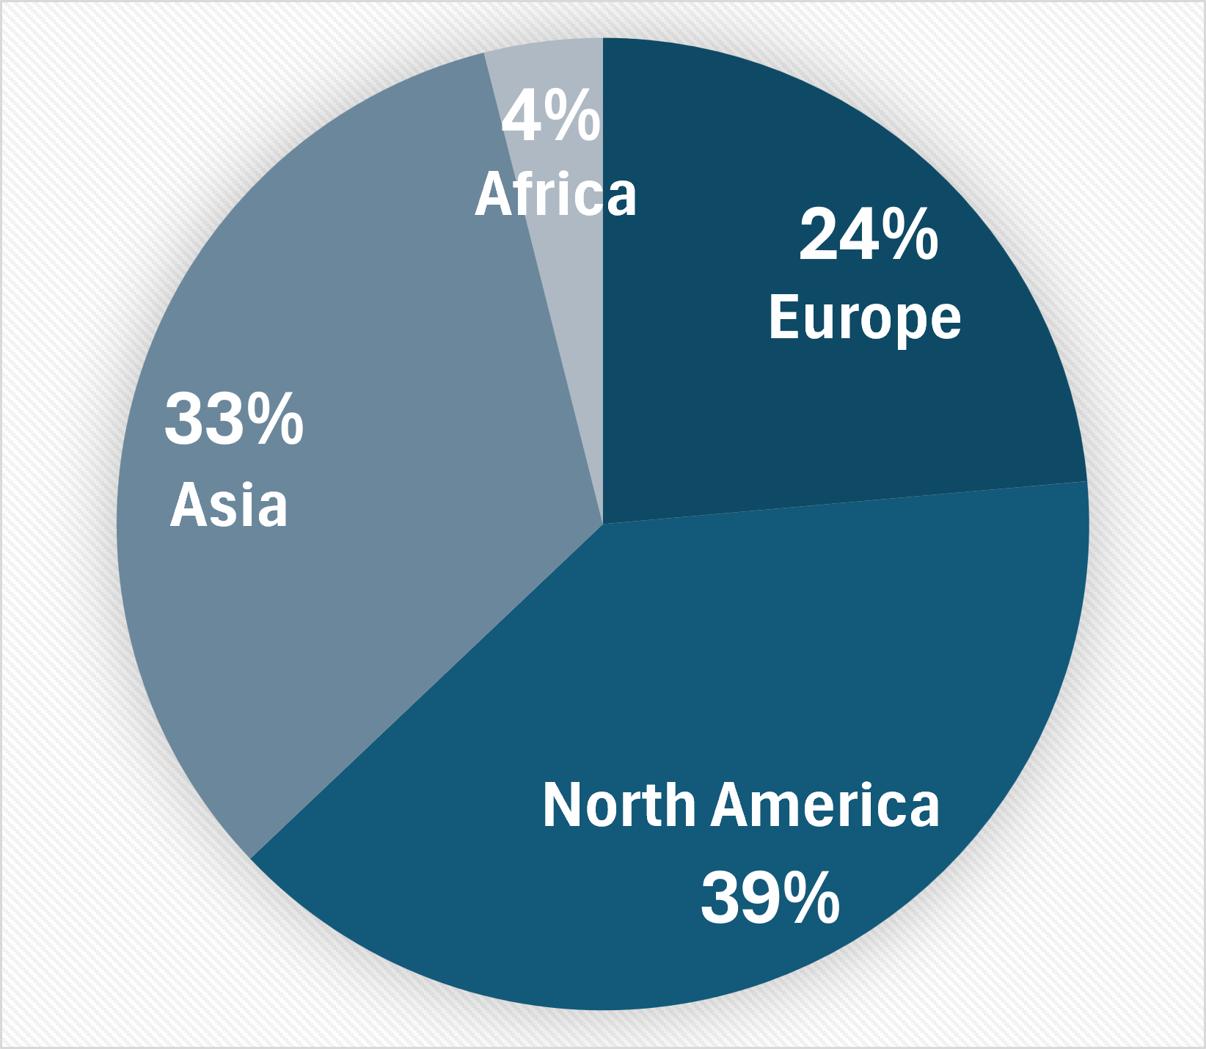
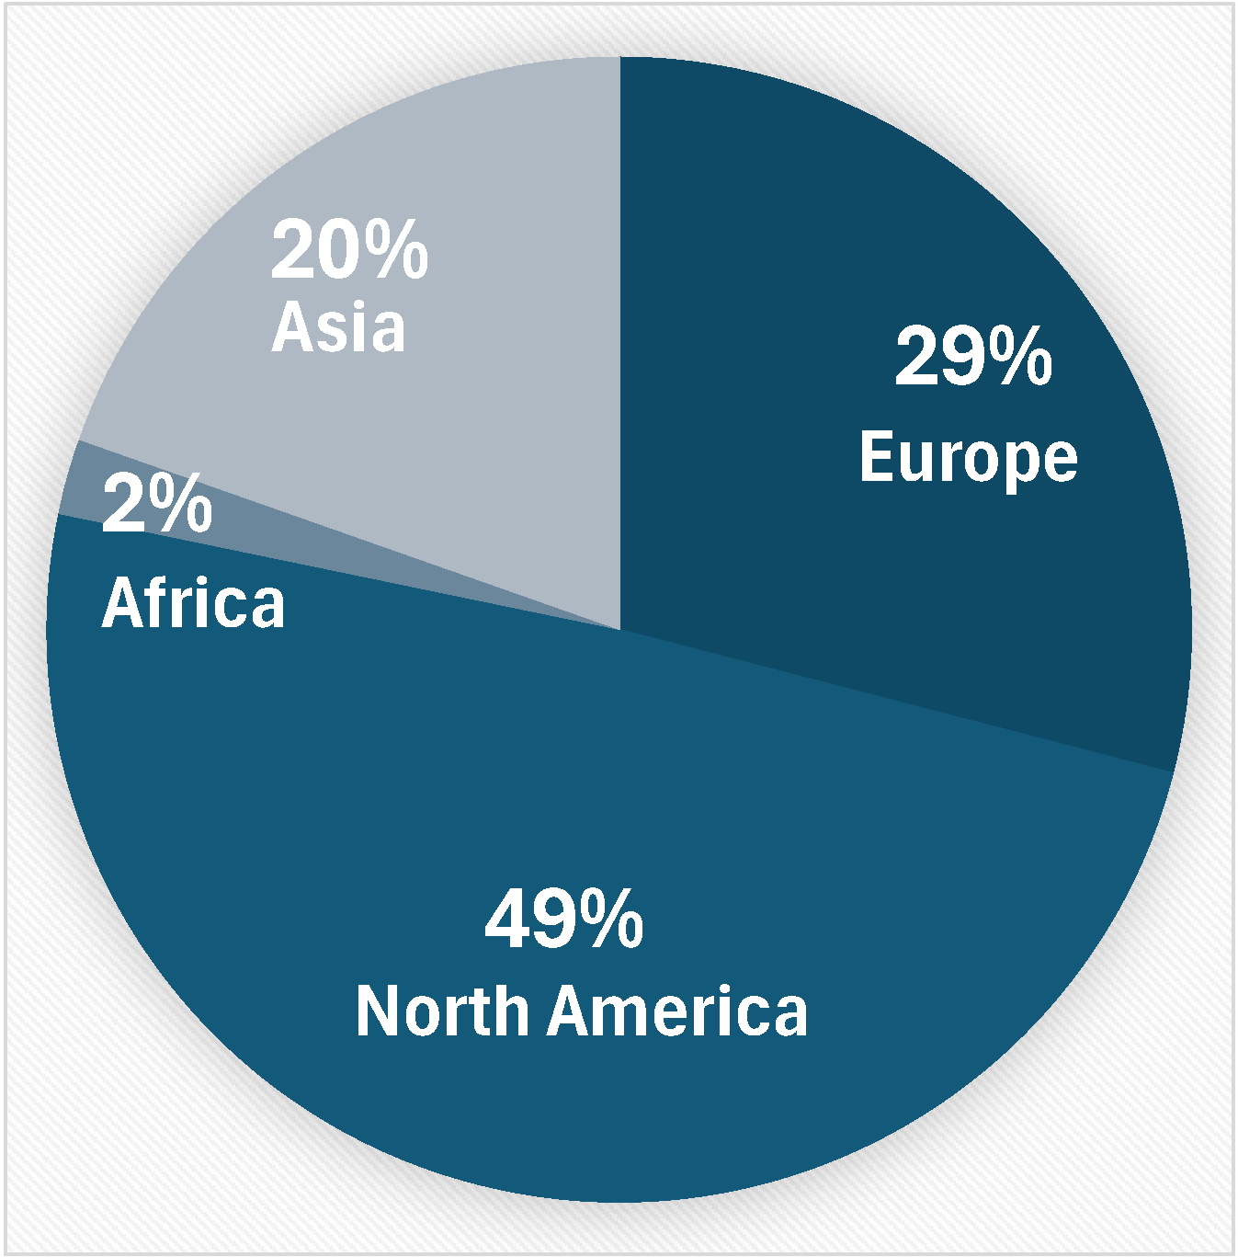
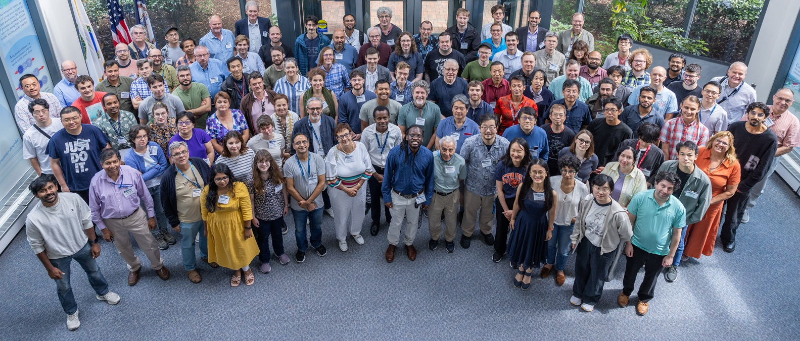
Institutions:
Collaborators:
>1000 collaborators
182 institutions, 26 countries
The ePIC Collaboration is strong, active and growing:
CERN Recognized Experiment
Adding new collaborating institutions
Ongoing subdetector design reviews
Collaboration Priorities:
Writing ePIC pTDR, next draft Dec. 2025
Developing the EIC Early Science plan
Supporting baselining for the ePIC detector in 2026
ePIC Collaboration - July 2025

Slide 6






New Institutions in 2025
RCNP/Osaka
CC Member Shinsuke Ota
Seoul National University
CC Member Seonho Choi
Texas Southern University
CC member Nissem Abdelrahman
Johannes Gutenberg University Mainz
CC member Tyler Kutz
Mount Allison University
CC member David Hornidge
University of Hawaii at Manoa
CC member Jennifer Ott
18 new institutions added since the start of 2024!

Slide 7
Effect of Lapse in Appropriations on ePIC
The unfortunate lapse in appropriations in the U.S. has had a number of consequences for ePIC already:
Restricted travel to conferences for U.S. lab personnel
Not just travel but participation at all in conferences has been curtailed
Upcoming CERN test beam:
Cancelled of part of MPGD test beam at CERN
Shuffled travel for LFHCAL CERN test beam
Delay in coating dRICH mid-sized mirror demonstrator
Slow down of hpDIRC bar refurbishment
Postponement of DET Subproject Readiness Review
Delays in research funding for university groups
…
Loss of productivity (enforced vacation, etc.)
Also lost time and effort either dealing with shutdown planning or worrying about it

Slide 8
How is ePIC Responding?
Continue to support EIC project PDR’s and move these reviews forward as much as we possibly can
This is absolutely critical to baselining in 2026!
Adapt where we can:
We may need to switch speakers for upcoming conferences. This is unfortunate and will be taken into account in future speaking opportunities.
Plan test beam participation and support so that it can be robust against missing personnel.
Coming out of the shutdown will take a while as well, and effects may linger event after it is over.

Slide 9




2025 -2026
PDR: DAQ - Slow Controls
Spring 2026
PDR2: Polarimetry
Week of Feb 18-19, 2026
DOE OPA Status 5-7th August, 2025
PDR3: IR Integ. & Aux. Det
March/April 2026
PDR2: Si Tracking Detectors
Week of Jan 26, 2026
10th Detector Advisory Committee June 11-13th 2025
ePIC Physics Readiness Workshop Sept. 17-18th, 2025
PDR: HCals/fwd ECal
Oct. 30-31, 2025
PDR2: Cerenkov PID
April 1-2, 2025
FDR: BABAR DIRC Bar Refurbishment
ePIC Early Physics Workshop April 24-25, 2025
PDR2: MPGD Detectors
Dec 2025
PDR2: AC-LGAD Detectors
Dec. 2025
ePIC Software and Computing Review Oct 6-7, 2025
ePIC Software and Computing Technical Interchange – May 12th
PDR: Magnet/Cryo Infrastructure
Nov. 4-5th 2025
FDR: Backward EM Calorimetry
Feb 2026
BIC In-Person Workshop April 9-11, 2025
SVT Summer Workfest June 9-11, 2025
PDR3: Elec./DAQ
Sept. 3-4th, 2025
Frascati
Jan 20-24,2025
ePIC pre-TDR
Next Draft (Dec 2025)
DOE IPR and ICR, 9-13th March. 2026
Jefferson Lab. July 14-18
Vancouver Jan. 12-16
PDR: Integ. + Installation (inside and outside GST)
Week of Dec. 8th, 2026
Calorimetry Workshop June 5-9th, 2025
PDR3: Barrel EMCal
Sept. 17-18th 2025
Detector Baseline Readiness Review February 3-5,2026 (tentative)
EICO 2-4th April 2025
FDR: Backward & Forward EM Calorimetry, Barrel & Forward HCAL
July 2025
HSF-India/ePIC Workshop May 13-17th, 2025
6th EIC RRB Meeting Nov. 4-5th 2025
5th EIC RRB Meeting
June 5-6th 2025
SVT Workfest Dec 15-19, 2025
CD-2 Review Late 2026
Detector R&D Day (ePIC/Project) 16-17th April 2025

Slide 10
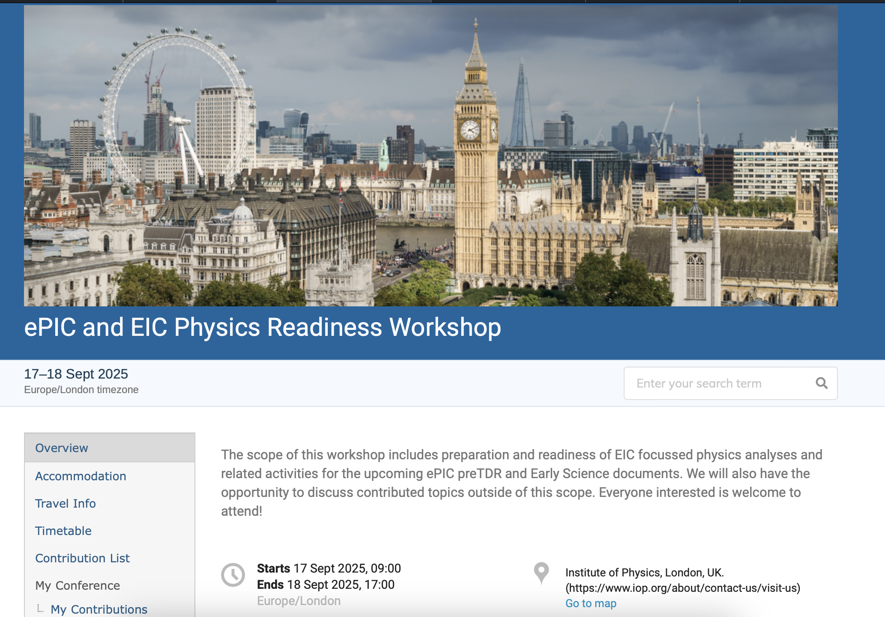
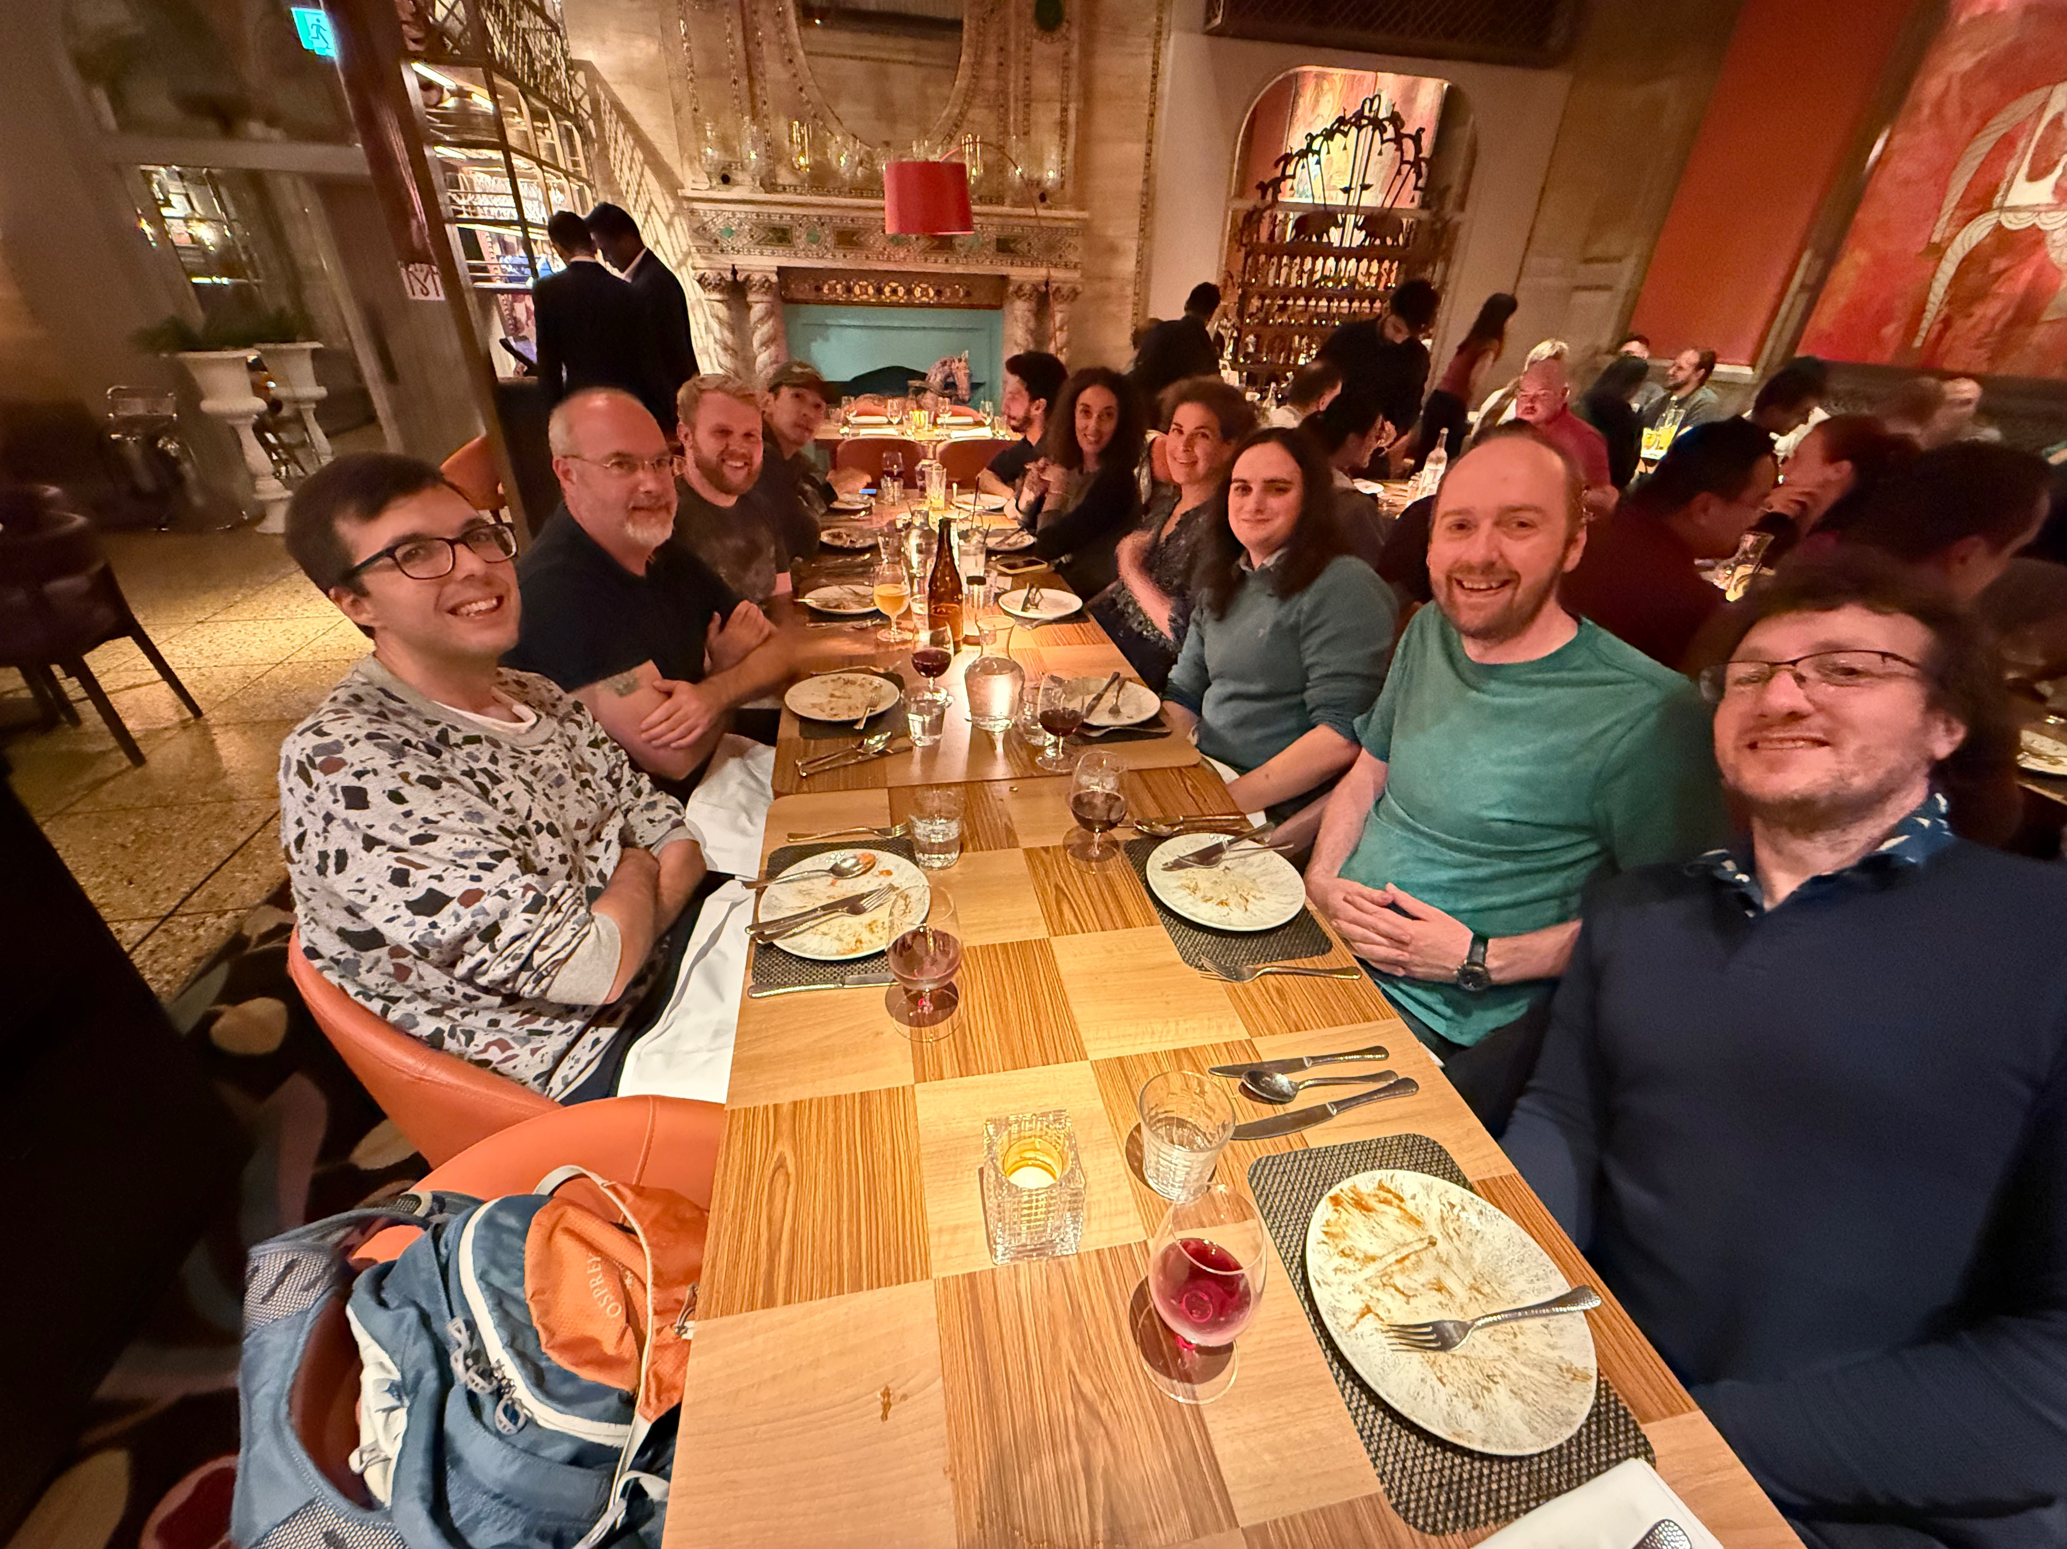
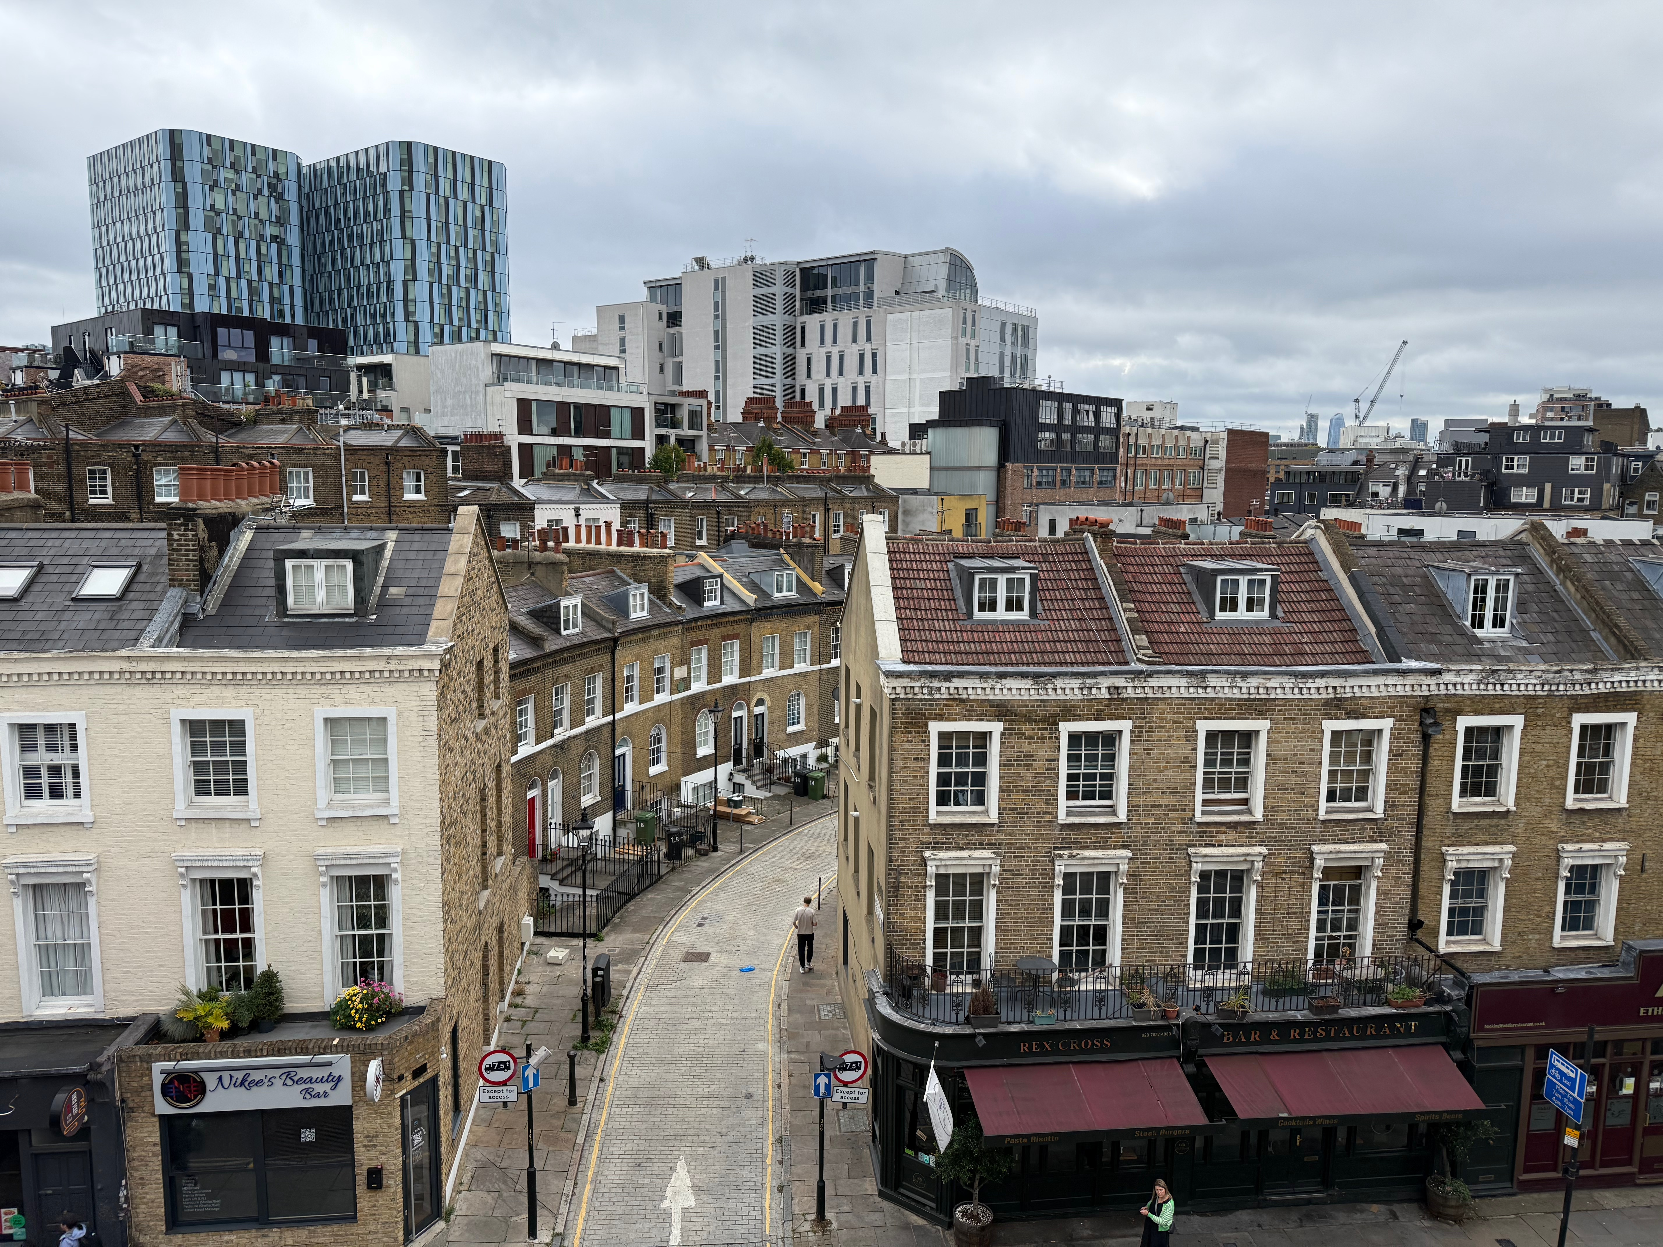
Physics Readiness Workshop – Sept. 17-19th
We had a very fruitful and productive Physics Readiness Workshop!
25 in person and ~25 online
Topics included:
PWG convenor status reports for preTDR and Early Science
Analysis Updates
Background and Systematic discussions
Impact studies for Early Science
Discussions on path forward for pTDR and Early Science, including generation of some action items we will start to work on
We also solved some analysis issues in real time!
Social dinner
Indico: https://indico.global/event/15249/timetable/#20250917
Some participants at dinner!
View from our meeting room

Slide 11
Third Software and Computing Review
More in the talk from Markus
Review held Oct. 6-7th at Jefferson Lab
Charge Questions:
ePIC Computing and Software: Assess the progress towards TDR readiness and implementing the ePIC computing model. As appropriate, assess the plans and outcomes for data challenges and other prototypes/testbeds. Assess the interfaces between the EIC detector DAQ and the ePIC computing and software organization as appropriate.
Resources: Assess the short-term and long-term resource planning relative to the near-term outcomes and long-term goals. As appropriate, comment on the delivery of resources by international partners.
ECSJI: Evaluate short and long terms support resource planning and delivery by the host laboratories through the ECSJI. As appropriate, evaluate the collaboration and division of responsibilities between the two labs.
Broader Community: Assess as appropriate engagements with aligned Software and Computing organizations across nuclear physics and particle physics communities and other relevant communities.
Overall: Assess the ePIC and ECSJI communication and collaboration. Assess the response to previous review recommendations.

Slide 12
Editorial Board and pTDR
The Editorial Board was established at the July Collaboration Meeting with a mandate to evolve the next draft of the pTDR.
John Haggerty (co-chair)
Silvia Dalla Torre (co-chair)
Rosario Turrisi
Olga Evdokimov
Yulia Furletova
Yongsun Kim
Zhenyu Ye
(Peter Jones)
Ex-Offico:
Thomas Ullrich
Renee Fatemi
Elke Aschenauer
John Lajoie
This is a large effort from both the Editorial Board and the DSC’s – substantially restructured as a separate document.
More on the Editorial Board and progress on the pTDR in the talk from Silvia.

Slide 13
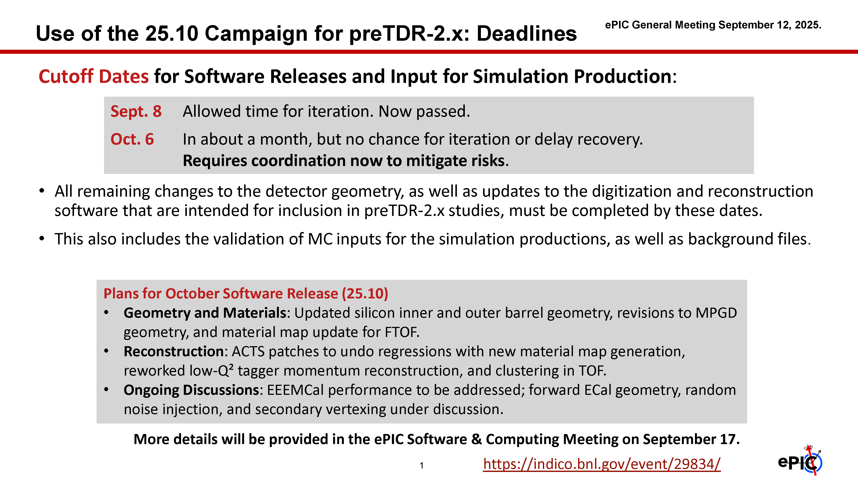
pTDR and October Simulation Campaign
Major focus over the past two months – lost of engagement and activity. Great coordination between S&C, PAC and DSC’s!
Discussions ongoing with S&C and all coordinators to organize the effort for 2026.
More from Markus later in this session.

Slide 14
ePIC pTDR and Publication Plan
process design phase
writing
(TDR/notes)
Prepare papers for
publication
structuring the
effort
preTDR v2.0
Review v2.0 (internal/external)
December 2025 Next pTDR draft
NIM Special Issue
mid-2026
Mid Jan.24
Mid Mar.24
preTDR v1.0
Dec. 24
July 2025
Formation of Editorial Board
Preparation of the pTDR a major focus for the collaboration
Required for CD-2 baseline review
A “whole of collaboration” effort
Will open a NIM Special Issue in early 2026, open for ~6 mos
Publish a super-set of the material prepared for the pre-TDR
Early Science whitepaper
Streaming Computing Model publication in preparation

Slide 15
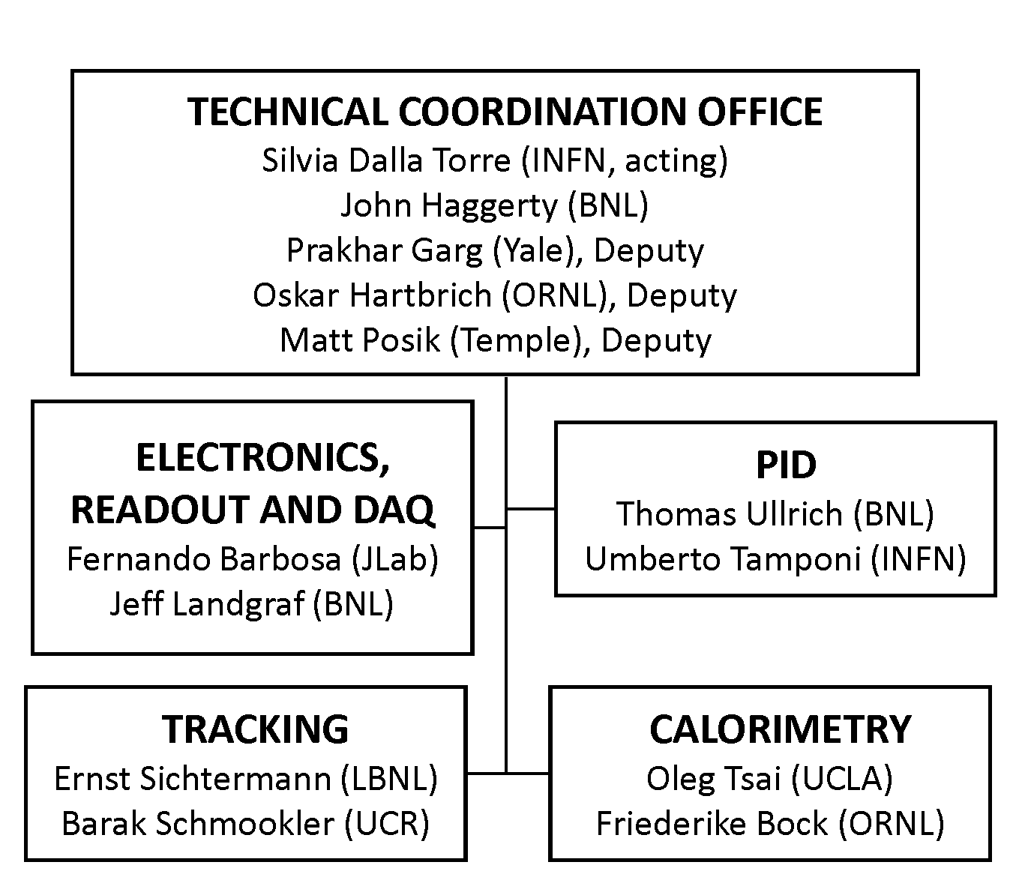
CC WG Charges and Conveners
SP Office wanted to focus the CC WG’s on tasks needed to baseline ePIC
Developed charges for each CC WG, in conjunction with the coordinators and the CC WG conveners
Several of the existing CC WG conveners have been serving for 2+ years and expressed a desire to step down.

Slide 16

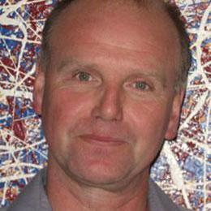
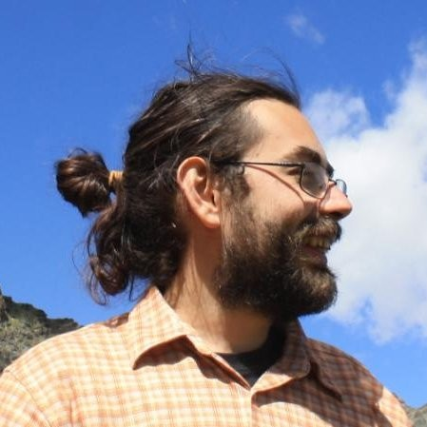
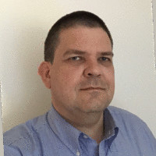
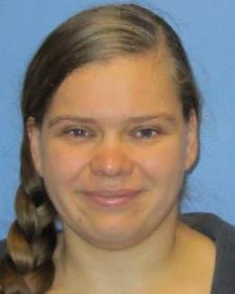
Outgoing CC WG Conveners
A huge thanks from to the outgoing CC WG Conveners for their tireless service!

Slide 17


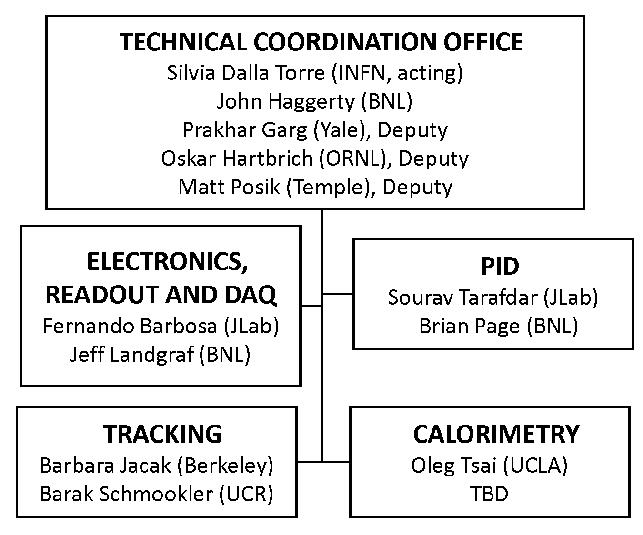
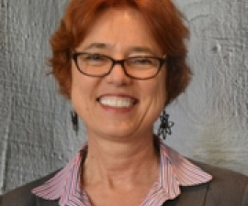

CC WG Nominations
The following individuals will be nominated as CC WG conveners at an upcoming Collaboration Council Meeting:
TBD

Slide 18
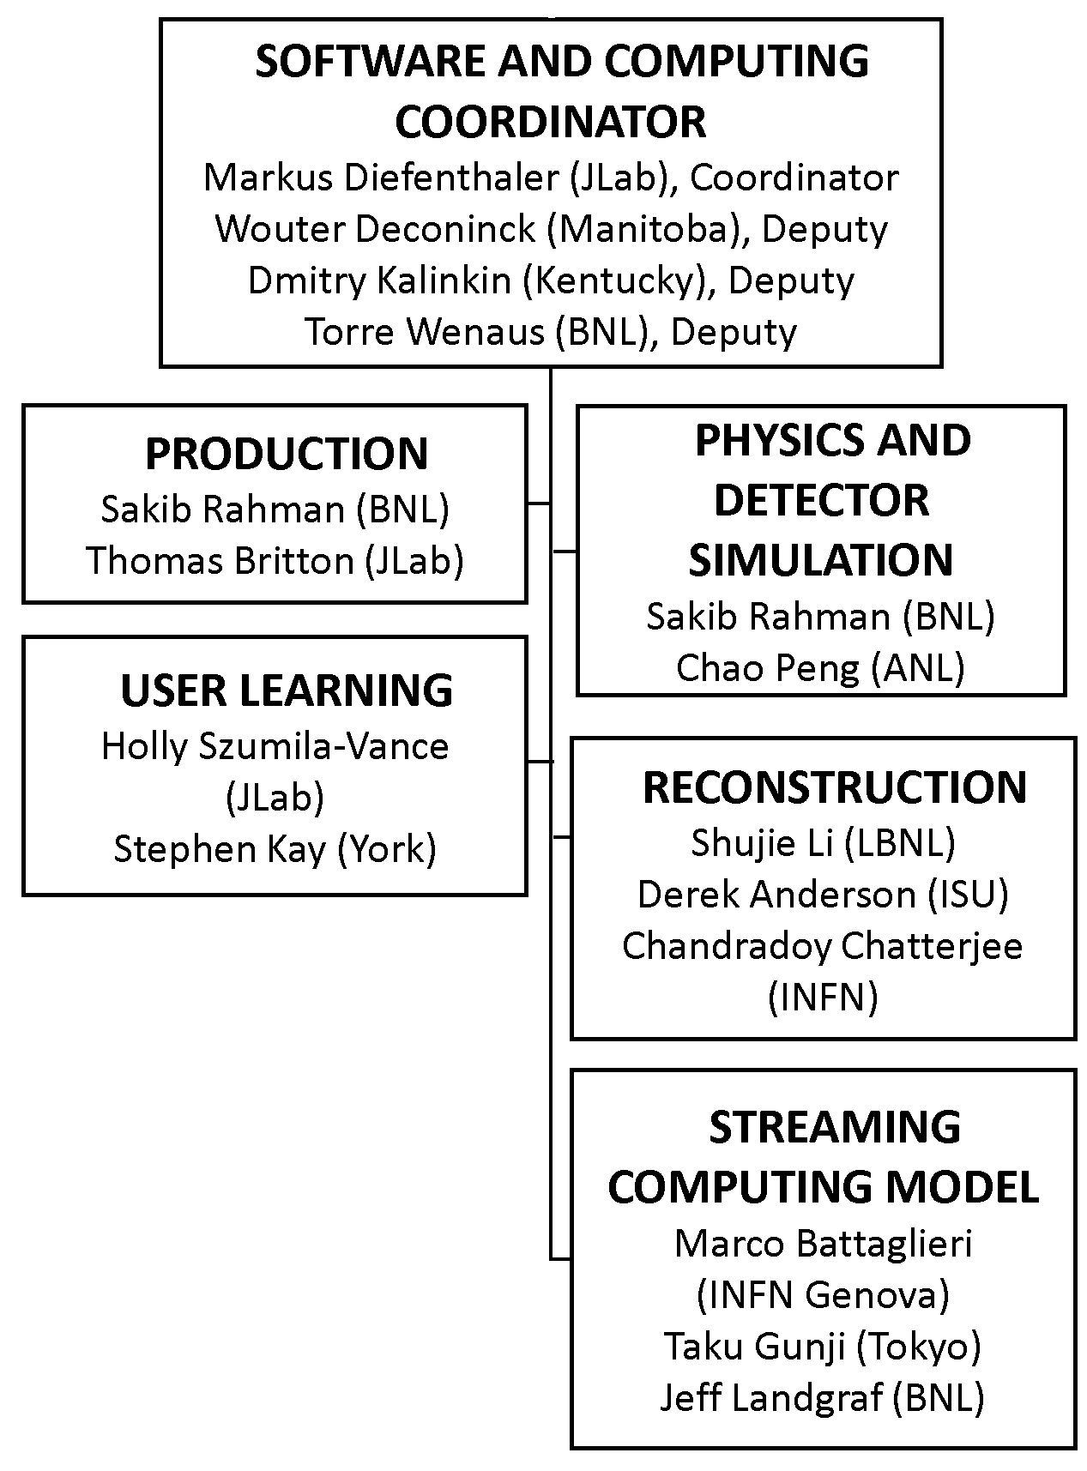
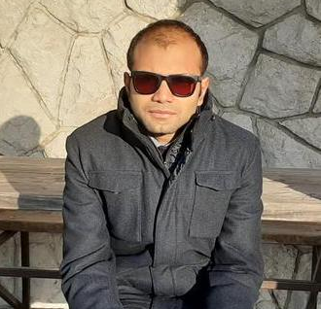
New Reconstruction WG Convener
Chandradoy Chatterjee
Chandra will organize the development of reconstruction software for the PID detectors.
His nomination will be presented to the Collaboration Council at the upcoming CC meeting.

Slide 19
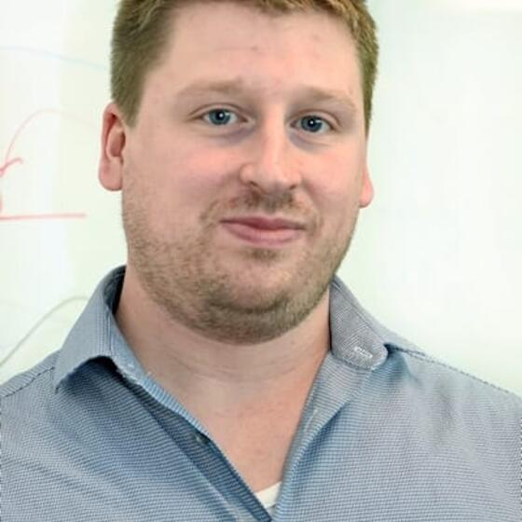
Thank You Matt Posik!
Matt Posik will be stepping down as a Deputy Technical Coordinator. His work to understand the resolution of track projections into the hpDIRC was an early driver for the development of the ACTS tracking and the development of the ePIC software stack. He also made important contributions to the MPGD simulations and is working on the aerogel test stand at Temple.

Slide 20
2026 Collaboration Survey
From the ePIC Membership Policy:
Continued authorship in the ePIC Collaboration requires membership in a signing institution and
inclusion in an annual institutional “statement of service”.
The annual statement of service is intended to reflect institutional commitments for the coming
year, and document contributions to ePIC carried out during the previous year. It is expected
that the majority of institutions will maintain signing status, once obtained, while they are active
members of ePIC.
2025 FTE data
67% of collaborators intended to qualify for authorship in 2025
176.4 FTE* on detector, 23.1 FTE* on Physics Analysis
Process in 2026 involves a review of 2025 commitments as well as new commitments for 2026
This will tell us a lot about how ePIC is evolving
Survey data made available to DSC’s, WG’s to improve engagement
* FTE data undercounted due to inability of some institutions to provide data

Slide 21
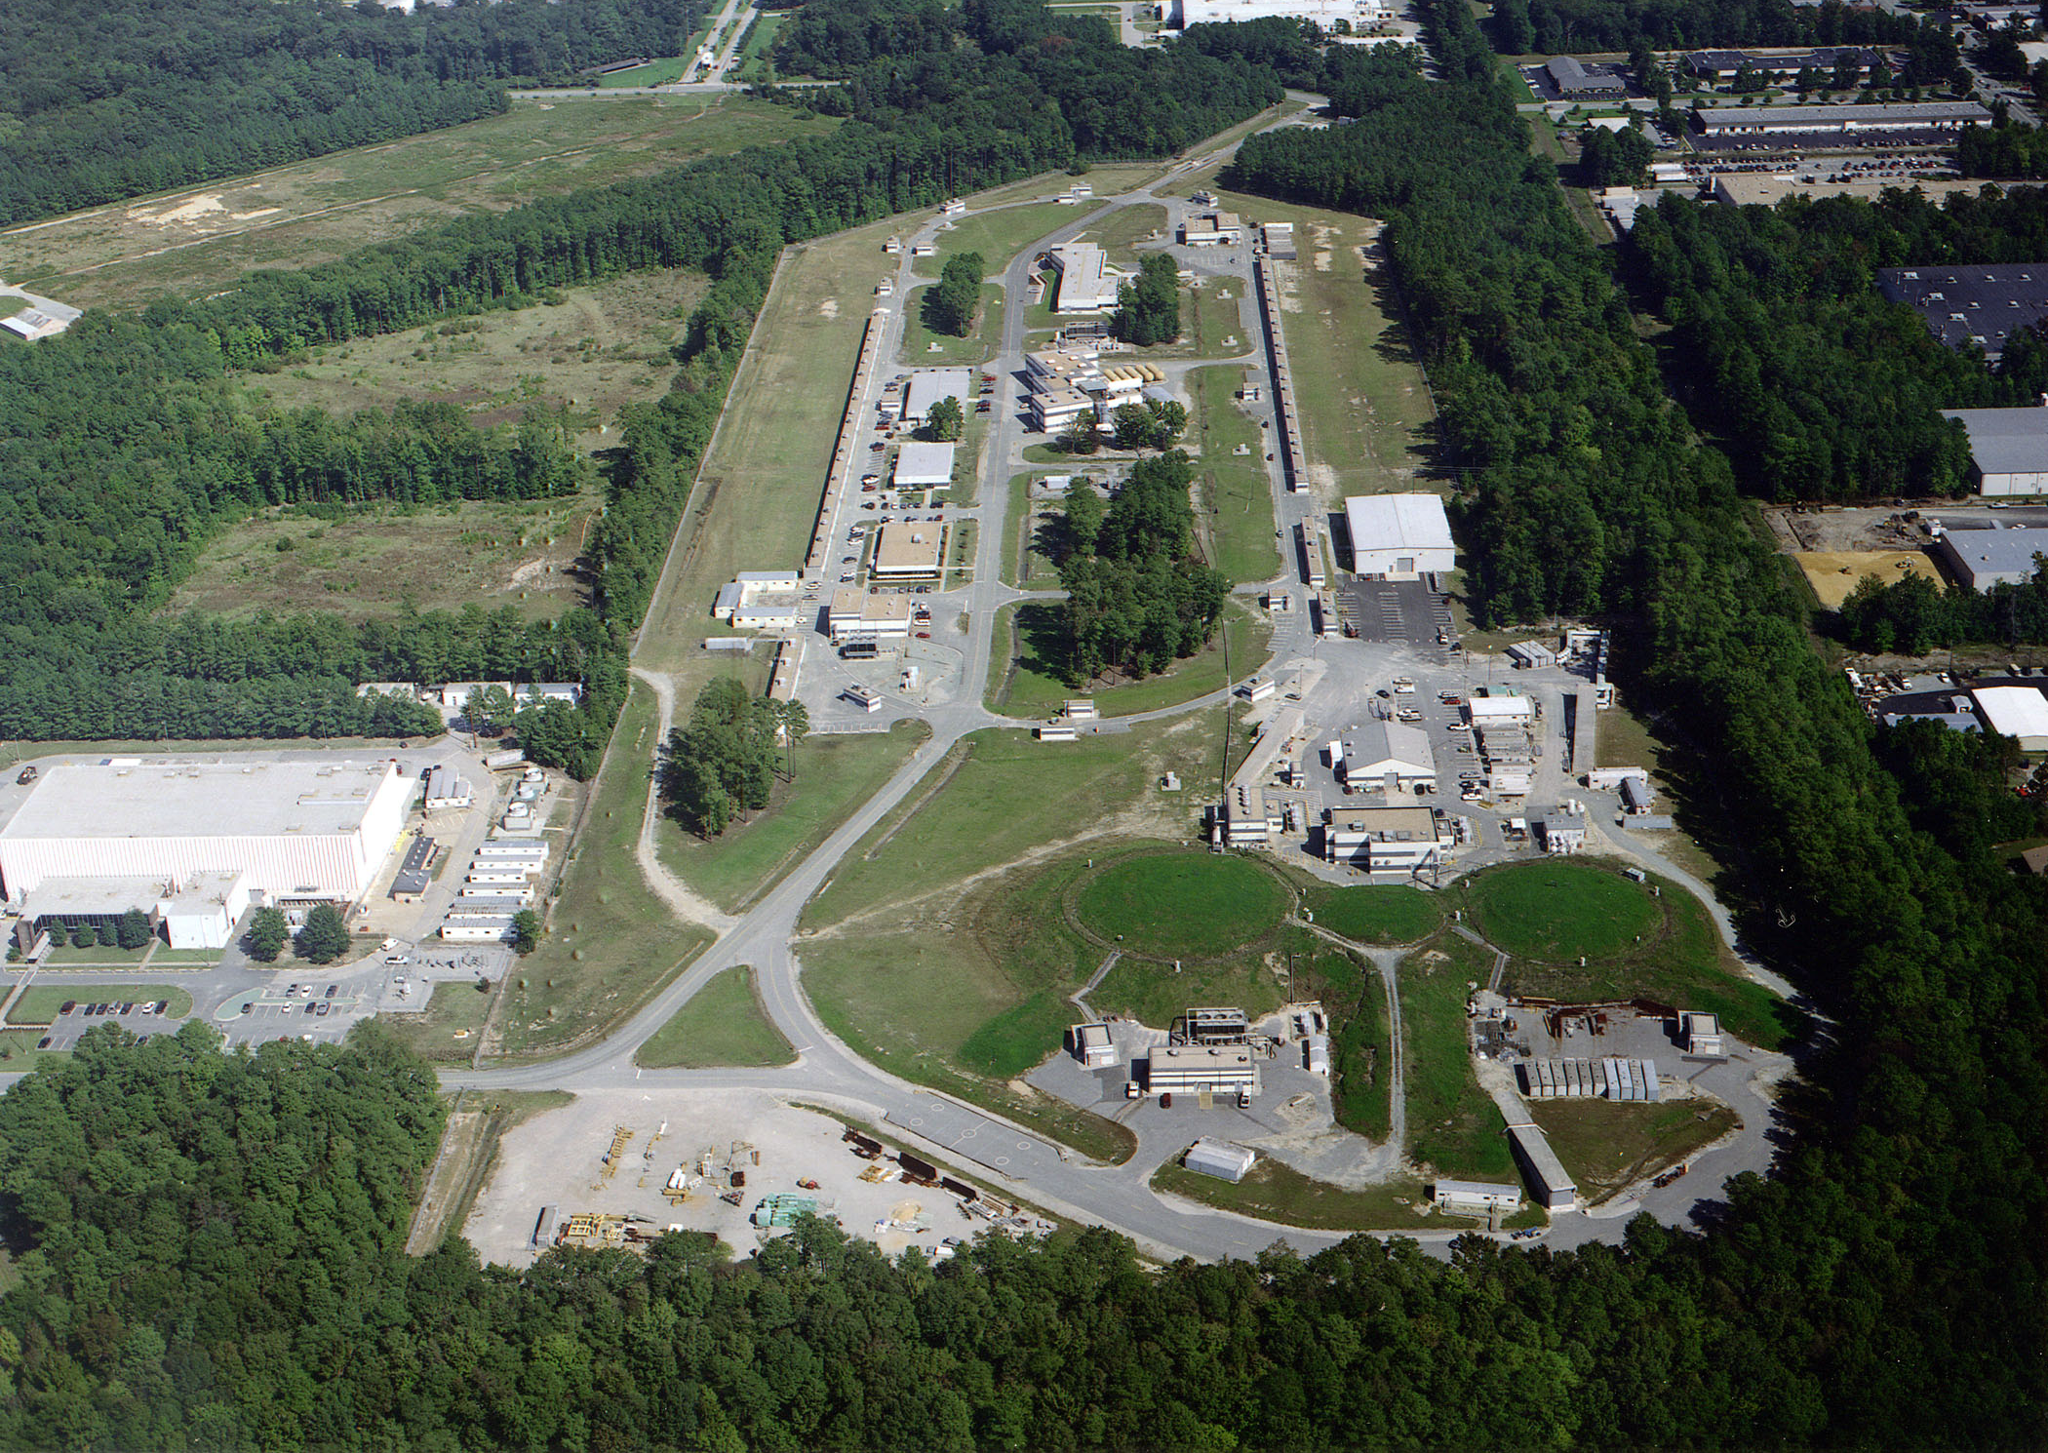
Summer 2025 EICUG/ePIC Collaboration Meeting
July 14-18th at JLab
EICUG Early Career Workshop July 11-13th
200+ registered participants (158 in person, 64 remote, 30 students)

Slide 22


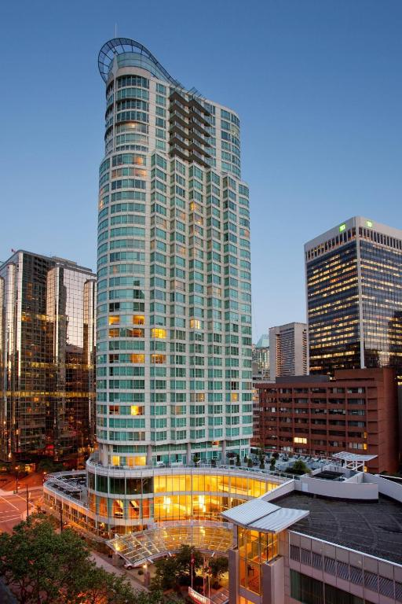

Jan 2026 ePIC Collaboration Meeting
The next ePIC Collaboration meeting will be January 12-16, 2026 in Vancouver BC, hosted by EIC Canada and TRIUMF.
The venue will be the Vancouver Marriott Pinnacle Downtown!
Registration opening soon!
(logo shamelessly stolen from Estudiar en Canada)

Slide 23
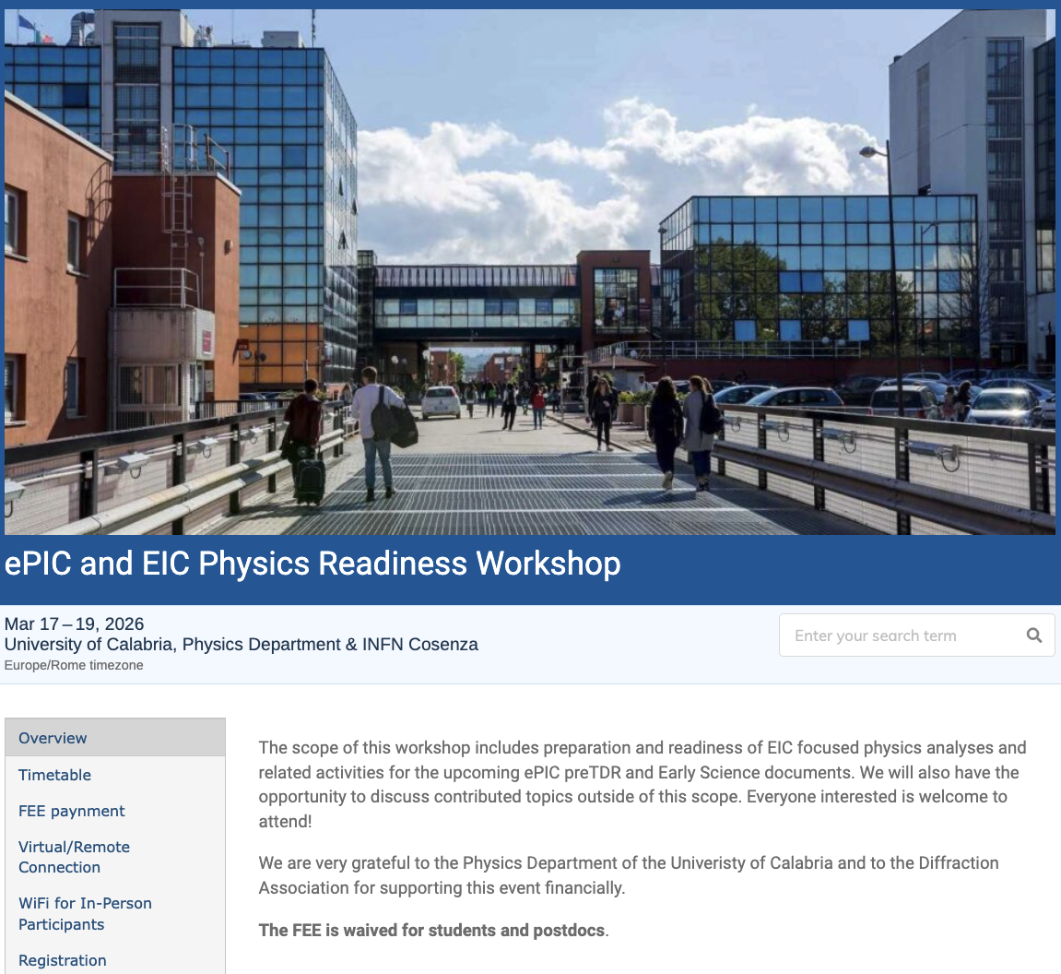
The discussion on performance continues!
Next Physics Readiness Workshop scheduled for March 17-19
Hosted by the University of Calabria & INFN Cosenza
Indico: https://indico.bnl.gov/event/30283/
Hybrid format - Please register even if attending online (select proper option)
€150 FEE waived for students/postdocs
Possibility (limited) for ECRs support
The workshop will focus on the finalization of studies and text for the TDR and early science documents

Slide 24
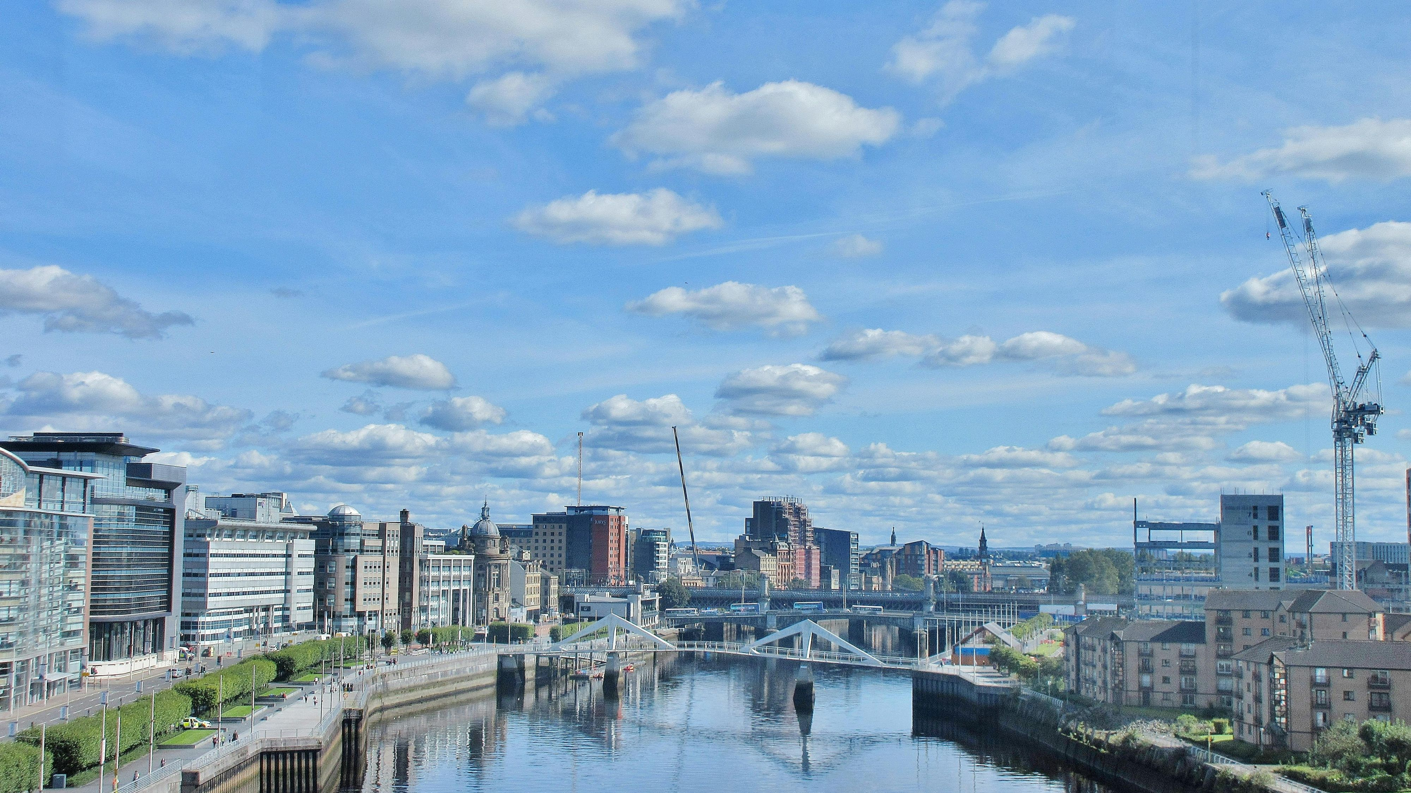
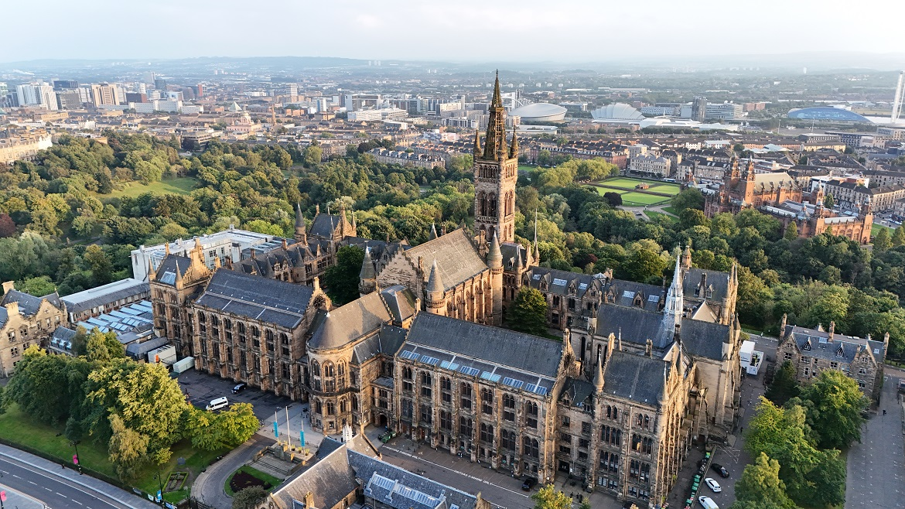
Summer 2026 Joint EICUG/ePIC Meeting
After discussions with the EICUG SC, the ePIC CC Chair/Vice-Chair, and the ePIC Spokespersons and coordinators, we have accepted a bid by the UK to host the Summer 2026 joint EICUG/ePIC meeting at the University of Glasgow July 13-17th , 2026.
More information coming soon!

Slide 25
The Status of the Collaboration
The ePIC Collaboration is strong, active and growing!
International participation is key to the success of ePIC
The collaboration is committed to advancing the technical design of the detector and supporting baselining (CD-2) for the DET subproject.
Physics Working groups are developing the EIC Early Science Program
ePIC Software and Computing has made great progress in both supporting the simulation effort and developing the ePIC Streaming Computing Model
The 2026 survey will further clarify commitments from ePIC institutions and the trajectory of ePIC engagement
This is an opportunity for collaboration leadership to engage with institutions and improve engagement in all parts of the collaboration

Slide 26


Slide 27
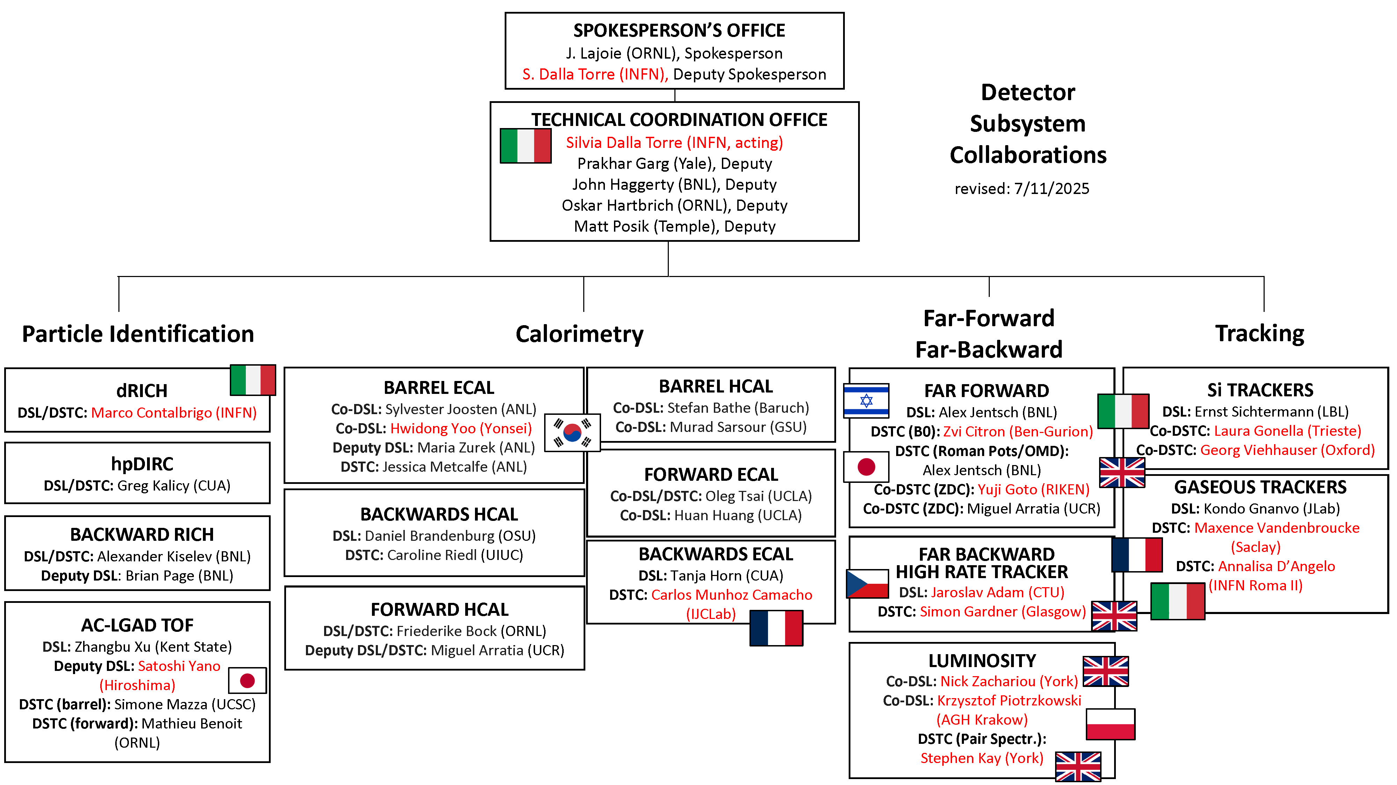
Reminder: ePIC DSC Structure

Slide 28
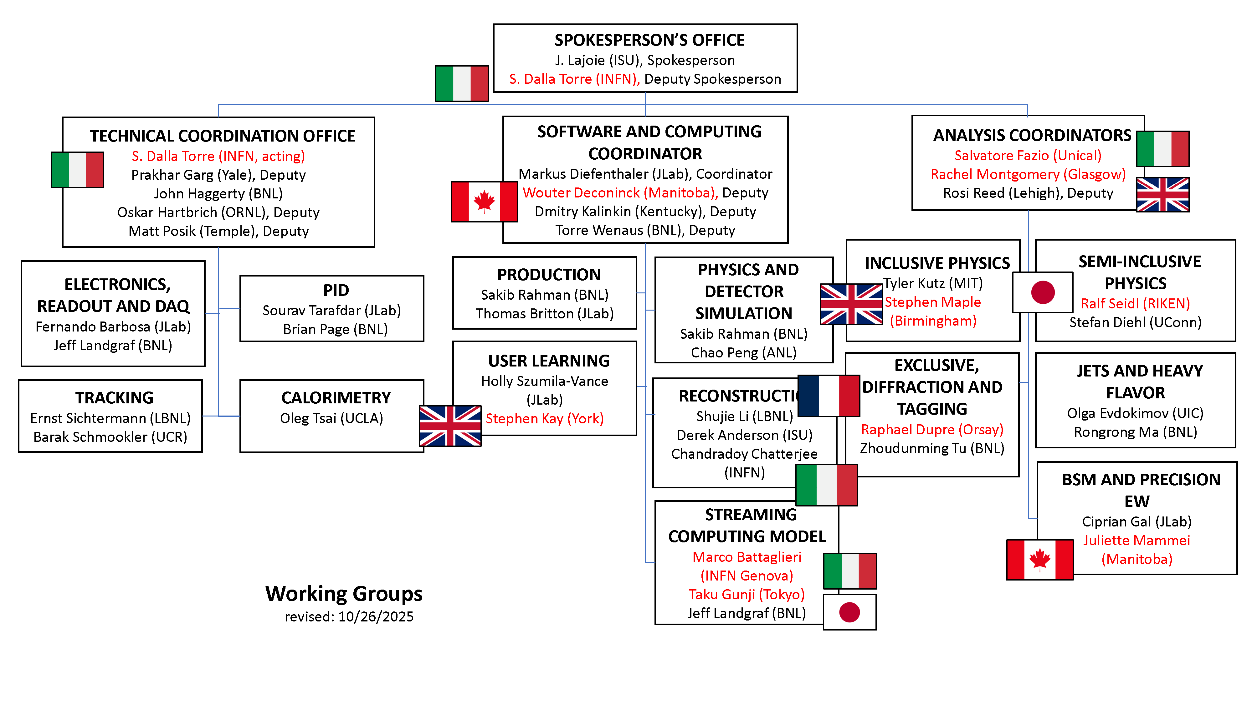
Reminder: ePIC Working Group Structure

Slide 29
The EIC Early Science Program
Year - 1
Year - 2
Year - 3
Year - 4
Year - 5
New Capability:
Commission electron polarization in parallel
Run:
10 GeV electrons on 115 GeV/u heavy ion beams (Ru or Cu)
Physics:
Add your preferred science topic
+ electron polarization
New Capability:
Commission proton polarization in parallel
Run:
10 GeV polarized electrons on 130 GeV/u Deuterium
Physics:
Add your preferred science topic
Run:
Last weeks 10 GeV electrons and 130 GeV polarized protons
Physics:
Add your preferred science topic
+ electron polarization
+ proton polarization
New Capability:
Commission running with hadron spin rotators
Run:
10 GeV polarized electrons on 130 GeV transverse polarized protons
Physics:
Add your preferred science topic
Run:
Last weeks switch to longitudinal proton polarization
Physics:
Add your preferred science topic
+ electron polarization
+ proton polarization
+ operation of hadron spin rotators
New Capability:
Commission hadron accelerator to operate with not centered orbits
Run:
10 GeV polarized electrons on 100 GeV Au
Physics:
Add your preferred science topic
Run:
10 GeV electrons on 250 GeV transverse and longitudinal polarized protons
Physics:
Add your preferred science topic
+ electron polarization
+ proton polarization
+ operation of hadron spin rotators
+ operation of hadron beams with not centered orbits
Run:
10 GeV polarized electrons on 100 GeV Au
Physics:
Add your preferred science topic
Run:
10 GeV electrons on 166 GeV transverse and longitudinal polarized He-3
Physics:
Add your preferred science topic
Physics Readiness and Early Science Workshop:
Sept. 17 - 18th, 2025 https://indico.bnl.gov/event/29343/
Time to install additional ESR RF and HSR PS to
reach design current and max. energies

Slide 30
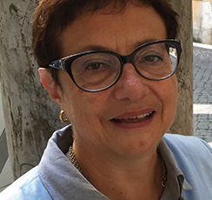

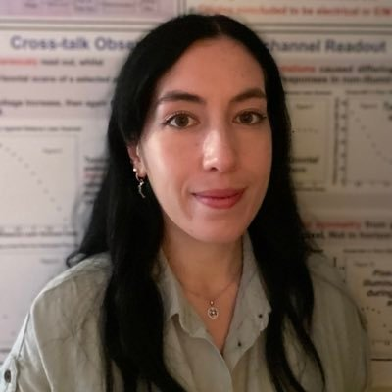
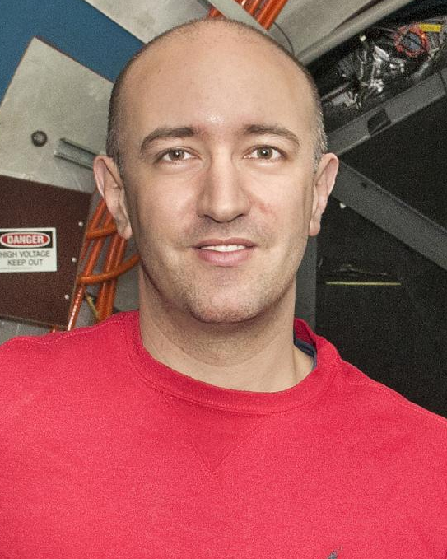



Reminder: ePIC Collaboration Structure
Collaboration Council
Institutional Representatives
Spokesperson’s Office
Spokesperson (SP)
Deputies
EIC Project
Executive Board
Standing Committees
Professional Conduct
Conferences and Talks
Membership
Elections
Publications
Ad-Hoc Committees
Technical Coordination (TC)
Software and Computing Coordination (SCC)
Physics Analysis Coordination (AC)
Technical Coordinator (Acting)
• Silvia Dalla Torre (INFN)
Deputy TC’s: Prakhar Garg (Yale)
John Haggerty (BNL) Oskar Hartbrich (ORNL) Matt Posik (Temple)
SCC Coordinator
• Markus Diefenthaler (JLab)
Dmitry Kalinkin
(Kentucky, Deputy SCC for Development)
Torre Wenaus
(BNL, Deputy SCC for Infrastructure)
Wouter Deconinck
(U. Manitoba, Deputy SCC for Operations)
Physics Analysis Co-Coordinators
• Rachel Montgomery (Glasgow)
• Salvatore Fazio (Univ. Calabria)
Rosi Reed (Deputy, Lehigh)

Slide 31



ePIC Committees
Membership Committee:
Chair: Peter Steinberg (BNL)
Vice-Chair: Pietro Antonioli (INFN-Bologna)
Friederike Bock (ORNL), Helen Caines (Yale), Doug Higinbotham (JLab), Bedhanga Moharty (NISER), Silvia Niccolai (IJCLAB), Marzia Rosati (ISU)
Collaboration Council
Institutional Representatives
Professional Conduct Committee:
Chair: Megan Connors (GSU)
Vice-Chair: Christine Nattrass (UTK)
Francesco Bossù (CEA-Saclay), Wouter Deconinck (University of Manitoba), Narbe Kalantarians (Virginia Union University) , Iris Ponce Pinto (Yale University) , Maya Shimomura (Nara Women’s University) , Allison Zec (University of New Hampshire)
Standing Committees
Professional Conduct
Conferences and Talks
Membership
Elections
Publications
Ad-Hoc Committees
Conferences and Talks:
Chair: Maria Zurek (ANL)
Vice-Chair: Brian Page (BNL)
Barbara Jacak (Berkeley), Daniel Brandenburg (OSU), Dmitry Kalinkin (Kentucky), Nick Zachariou (York), Xuan Li (LANL), Nicola Rubini (Bologna), Wouter Deconinck (Manitoba)
Publications Committee:
Chair: Rene Bellwied (U. Houston)
Vice –Chair: Annalisa Mastroserio (INFN Bari)
Lokesh Kumar (Panjab U.), Michela Chiosso (Torino), Prithwish Tribedy (BNL), Markus Diefenthaler (JLab), Sevil Salur (Rutgers),
ex-officio w. Conferences and Talks Committee: Daniel Brandenburg (OSU)
Elections Committee:
Chair: Helen Caines (Yale)
Vice-Chair: Ken Barish (UCR)
Past-Chair: John Arrington (LBNL)
Maria Stefaniak (OSU), Domenico Elia (INFN)

Slide 32
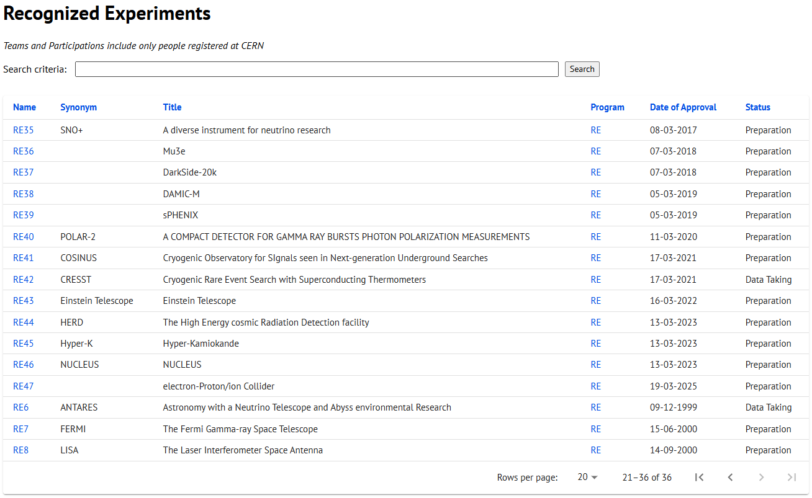
CERN Recognized Experiment Status: RE47
ePIC now appears in the CERN Grey Book database as RE47: https://greybook.cern.ch/experiment/recognized
Two steps to get ePIC Collaborators registered at CERN:
CC Representative needs to register as team leader with CERN Users Office:
https://usersoffice.web.cern.ch/
https://usersoffice.web.cern.ch/team-leaders-corner
Users.Office@cern.ch
CC member can then certify registrations of team members
Several ePIC groups successfully registered

Slide 33
ePIC Resources
Public Website - https://www.bnl.gov/eic/epic.php
Mailing Lists – https://lists.bnl.gov/mailman/listinfo
Indico Agenda - https://indico.bnl.gov/category/402/
ePIC Software and Computing: https://indico.bnl.gov/category/435/
Wiki - https://wiki.bnl.gov/EPIC
ePIC Software Training:
Landing Page: https://eic.github.io/documentation/landingpage.html
Tutorials: https://eic.github.io/documentation/tutorials.html
Mattermost: https://chat.epic-eic.org
ePIC Zenodo Community: https://zenodo.org/communities/epic

Slide 34


EICUG Membership
The EICUG is a vital organization to promote the interests of the EIC community!
Without the EICUG we would never have gotten far enough to form ePIC!
Please register your institution!
Check with your EICUG IB representative to get registered as a member
https://www.eicug.org/content/join.html

