Slide 1
Update on ePIC & EIC-UG Outreach WG
E.C. Aschenauer for the EIC-UG/ePIC Outreach WG
6th EIC RRB Meeting, BNL
November 4th – 5th, 2025

Slide 2
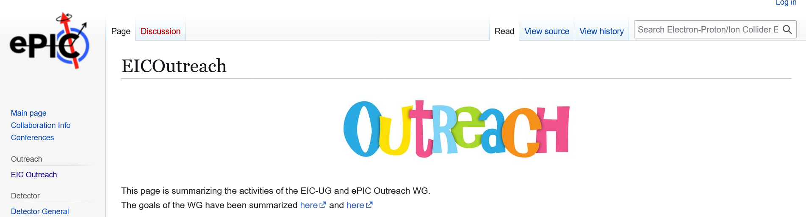
General Info
WG Members:
  Armenia: Dr. Hrachya Marukyan
  Czech Republic: Prof. Jana Bielcikova
  France: Dr. Silvia Niccolai
  India: Prof. Md Nasim
  Israel: Prof. Zvi Citron
  Italy: Prof. Marta Ruspa
  Japan: Prof. Taku Gunji
  Senegal Dr. Sokhna Bineta Amar
  Taiwan: Prof. Yi Yang
  UK: Prof. Rachel Montgomery
  USA: Elke-Caroline Aschenauer
Email-list: eic-outreach-wg@lists.bnl.gov
Regular Meeting: 1st Wednesday of the Month
7:00 am NY-Time
Wiki-Page: https://wiki.bnl.gov/EPIC/index.php?title=EICOutreach
Everybody is welcome to the meetings, helping with activities

Slide 3
The Global Goals of the WG
Expand EIC experimental community
Built up a STEM pipeline
Provide opportunities for early career scientist especially from developing countries
Develop a truly diverse workforce
Make the EIC a real international facility
Spread EIC science to general public

Slide 4

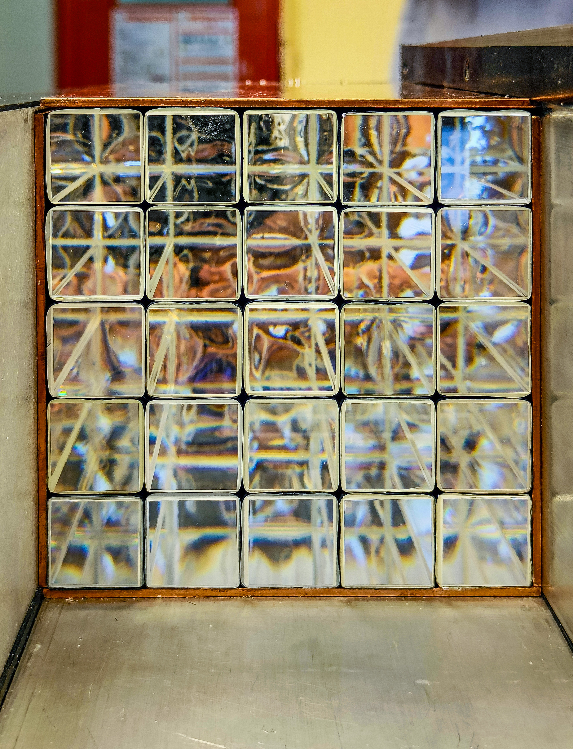
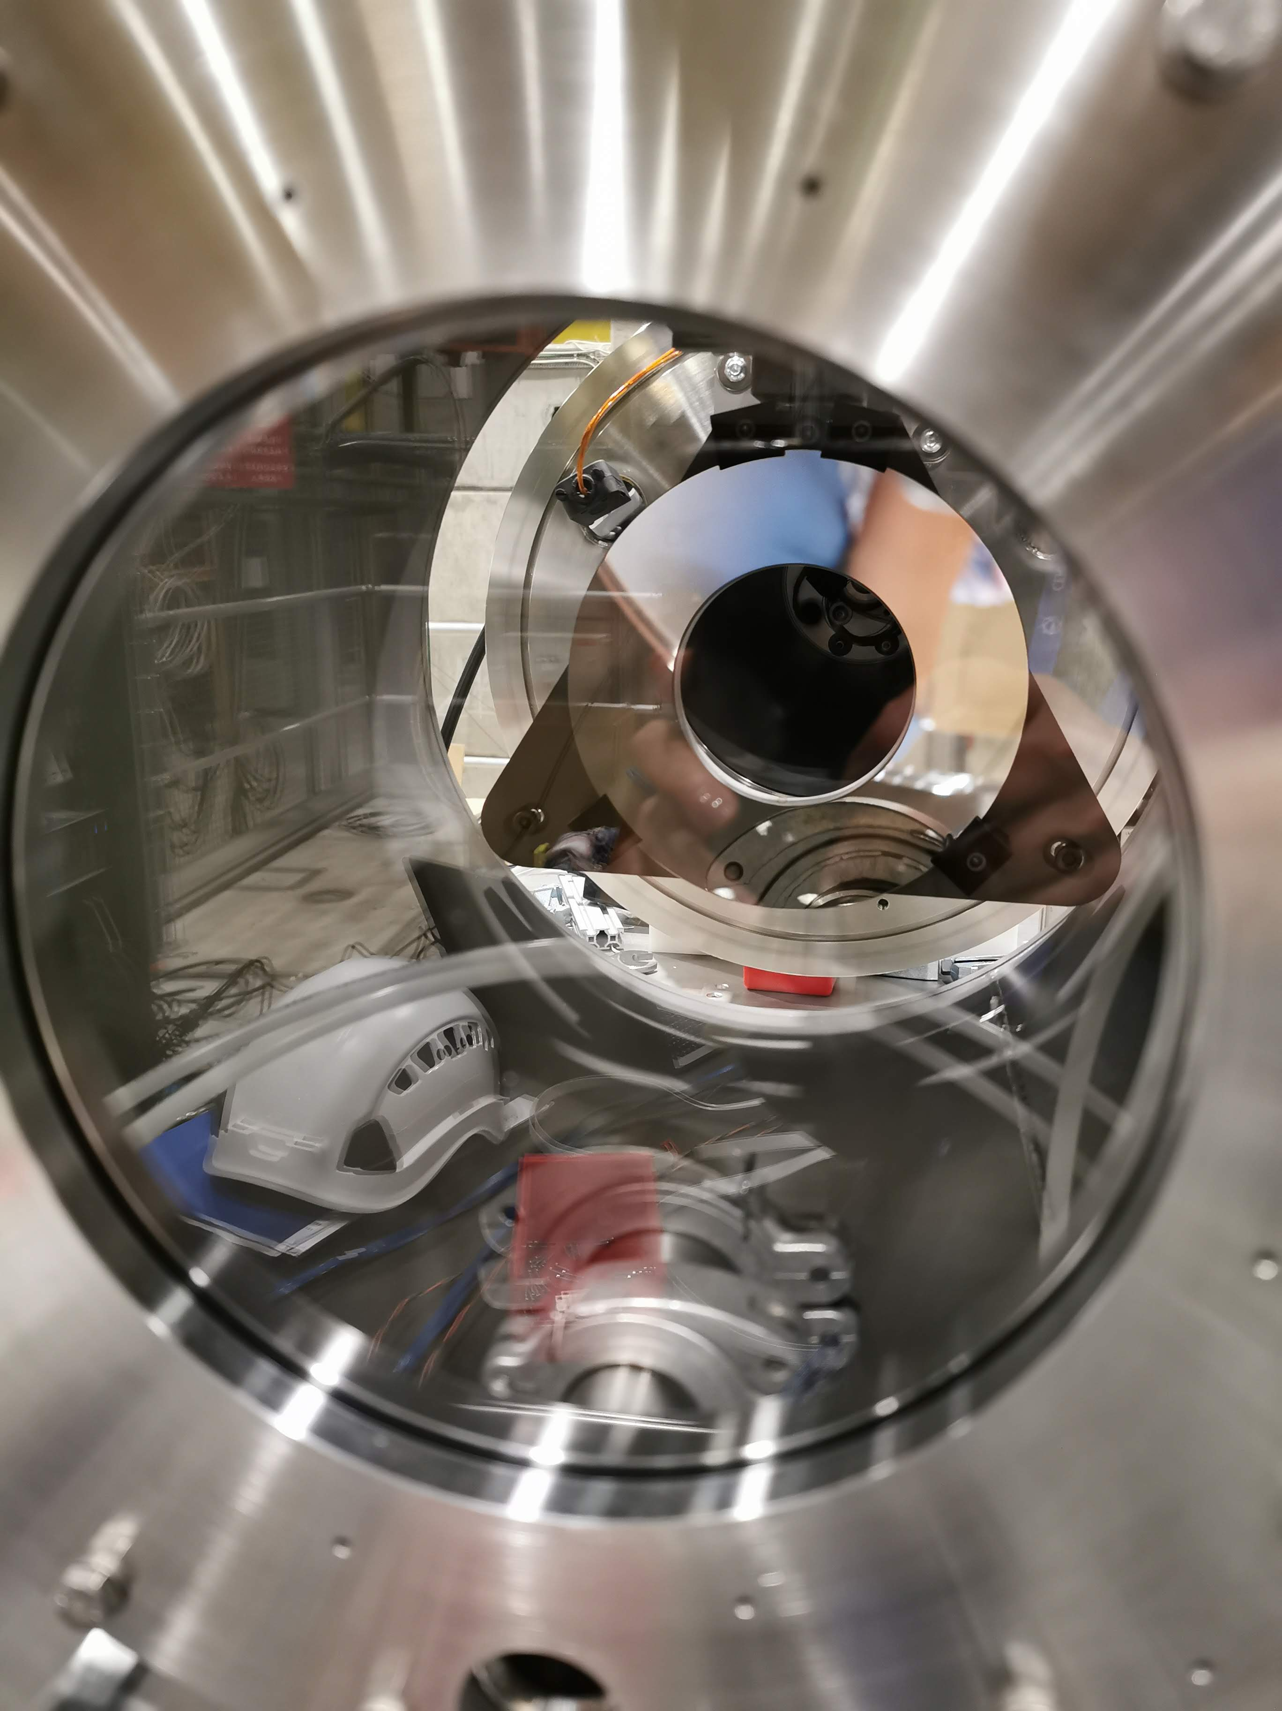
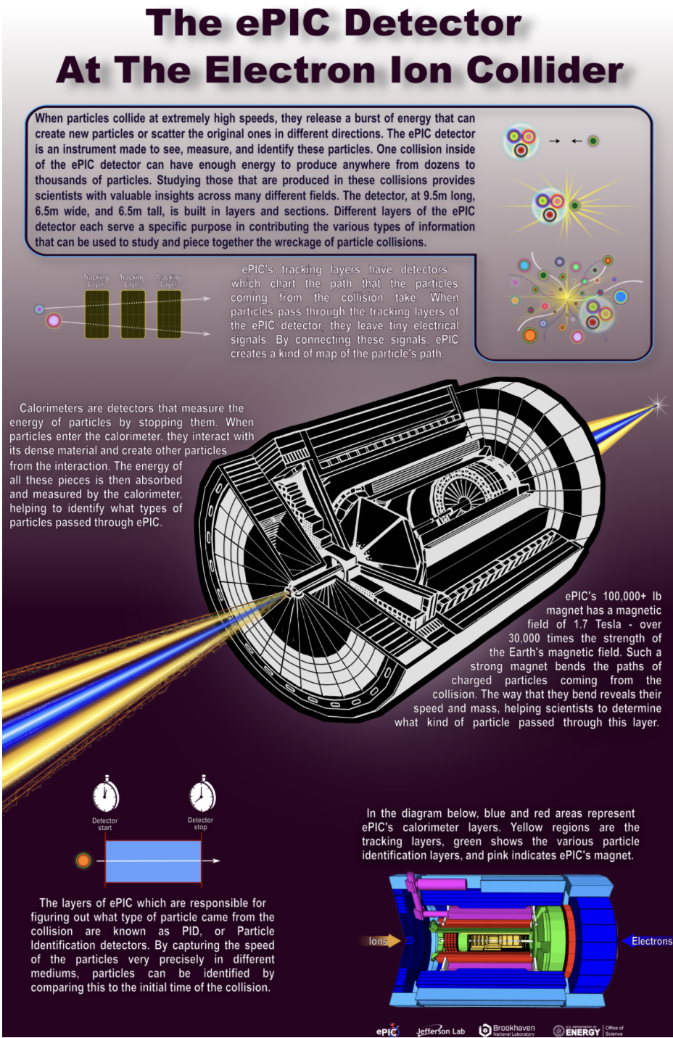
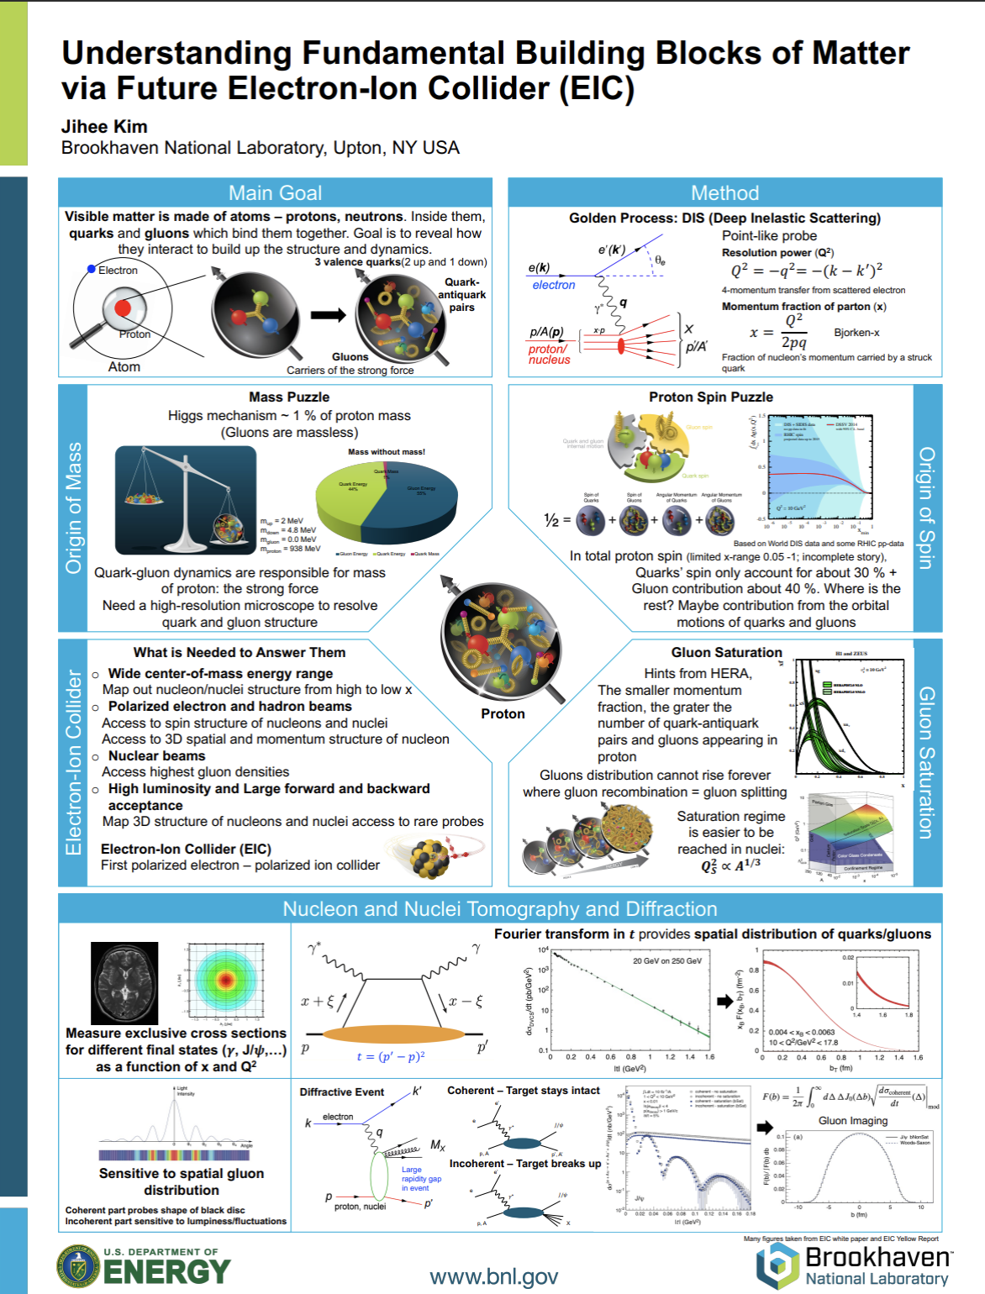
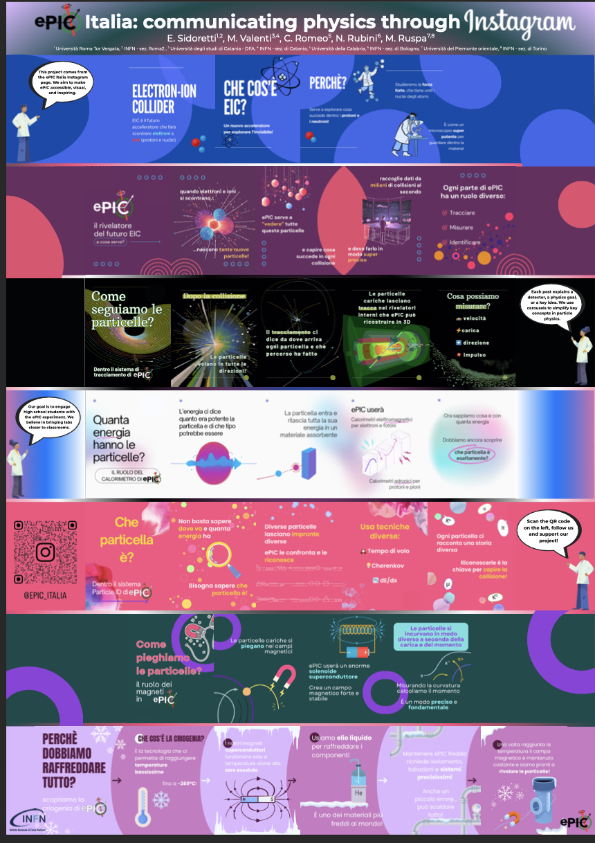
Activities
Past: Photo Contest during the January 2025 ePIC collaboration meeting
Continous:
Survey to collect information about all existing outreach activities (ePIC or EIC oriented) worldwide
Form to be filled: EIC-ePIC-OutreachResources-v1.xlsx
If you have not done so, please fill the form collecting information about your institution, your input is precious!
Aims:1. prepare a list of all available resources, country by country
2. identify (after consulting with you again) those resources/initiatives which can be replicated and shared
EIC-UG / ePIC Meeting July 2025: Poster and Photo-Contest
Winner: Photo Contest Poster Contest
1st Place Category-I 1st Place Category-II Best Overall
Lauren Kasper Jihee Kim E. Sidoretti
1st Place 1st Place 3rd Place
Roberto Perghenella Julien Bettane Christina Tuve

Slide 5
WG Summary
Great discussions on what to do next, but we need some more people helping with the activities
Action Items:
Create a repository with all the material (posters, photos, …)
  → started Outreach
Collect all the country EIC webpages and link them at one place
Open our own you-tube channel
  → thanks to Jennifer done
  → Collect all the videos already existing about EIC and think about a playlist
Collect mobility information of students
  → will do a survey of possibilities for fellowships and other grants for foreigners in different countries
Masterclass on EIC:
  One on PID identification
  One on the 3D structure of the proton
  → The day we will have a Masterclass program we could use it also as an “activity” to propose when
  visiting countries/institutes (e.g. Africa)
Ideas together with EC-WG
  → Organize an event how to give a public talk
  → work on social media presents of ePIC / EIC

Slide 6
Activities during next ePIC Meeting
Lunch and reception actions during the next meeting
  → Slam talk competition
  → have a game, like an escape room
  → will continue the photo and Poster Poster competition
  for the Poster where thinking to add a video teaser (2min) linked by a QR
  → We think it would be nice to organize a Science pub event(s) during ePIC meetings

