Slide 1
Agenda
(https://indico.bnl.gov/conferenceDisplay.py?confId=2914)
Piyush, Carl & I met yesterday to discuss about the voltage tap scheme
  Put a redundant at each joint that we’ve previously discussed ⇒ 2*4 = 8
  Carl may want to add 2 more in the reflexes/bends as he worries in case those superconductor may move to cause quenches ( see pictures in the next page )
  Carl will draw schematics and give it to R. Ceruti’s group
Schedule update
  P. Rosas: “We have started working on the sPHENIX PS, we are now working on the Regulator and analog controls of the PS.”
  A lot of drilling/tapping (+rigging) in the last ~10 days (see picture) … no. of hours were reduced from 579 hours to ~400 hours
A. Franz simulation for thinner poletips
AOB

Slide 2
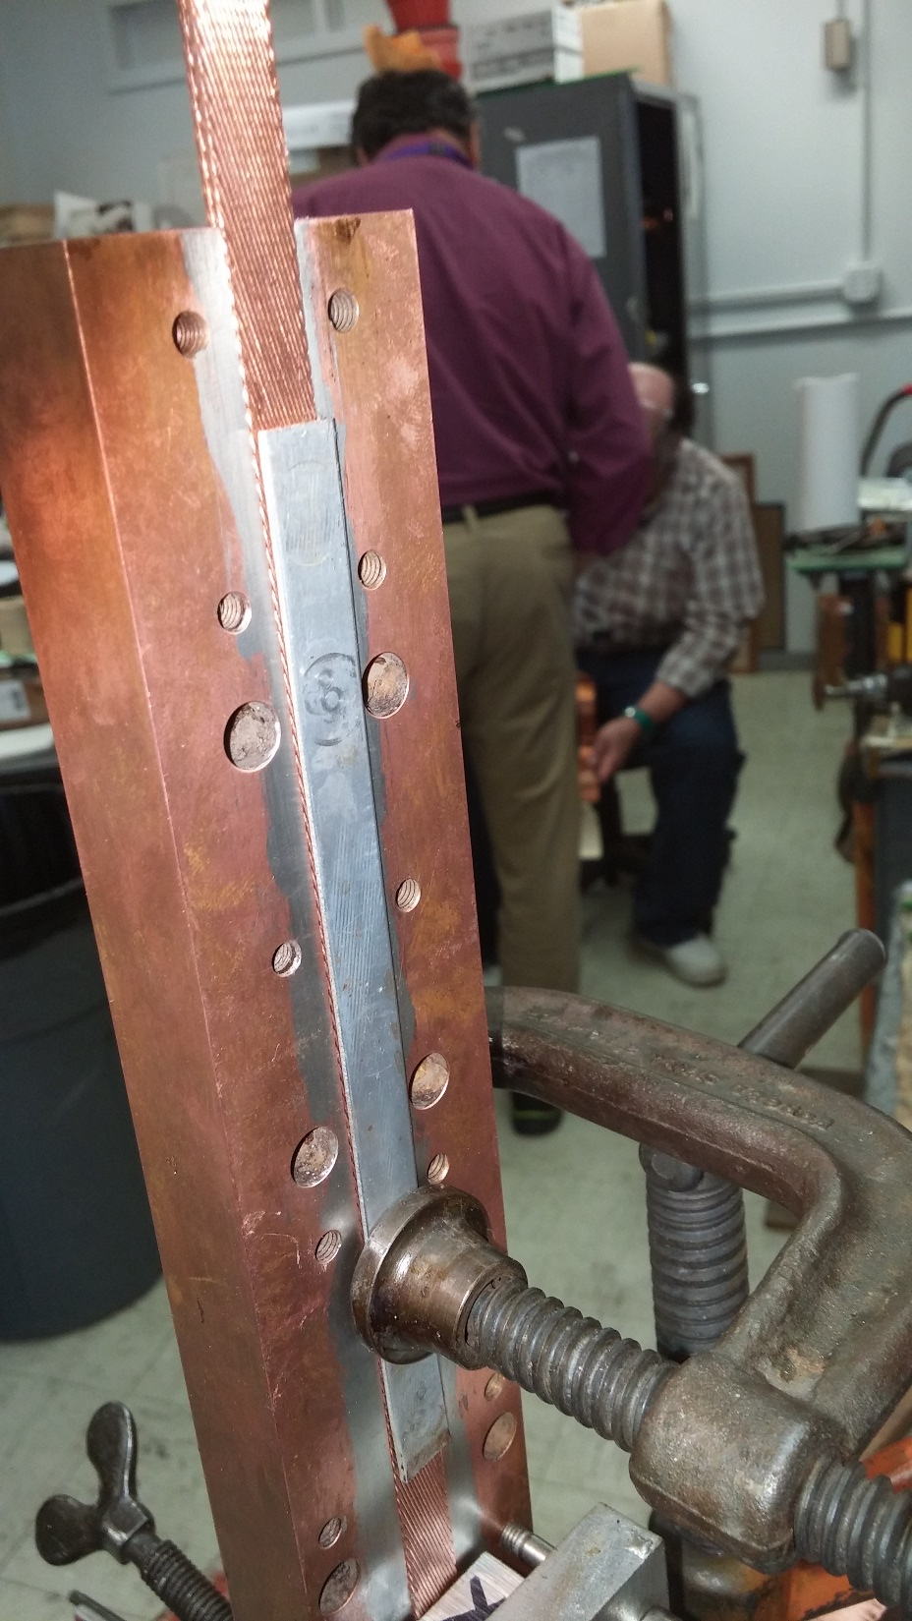
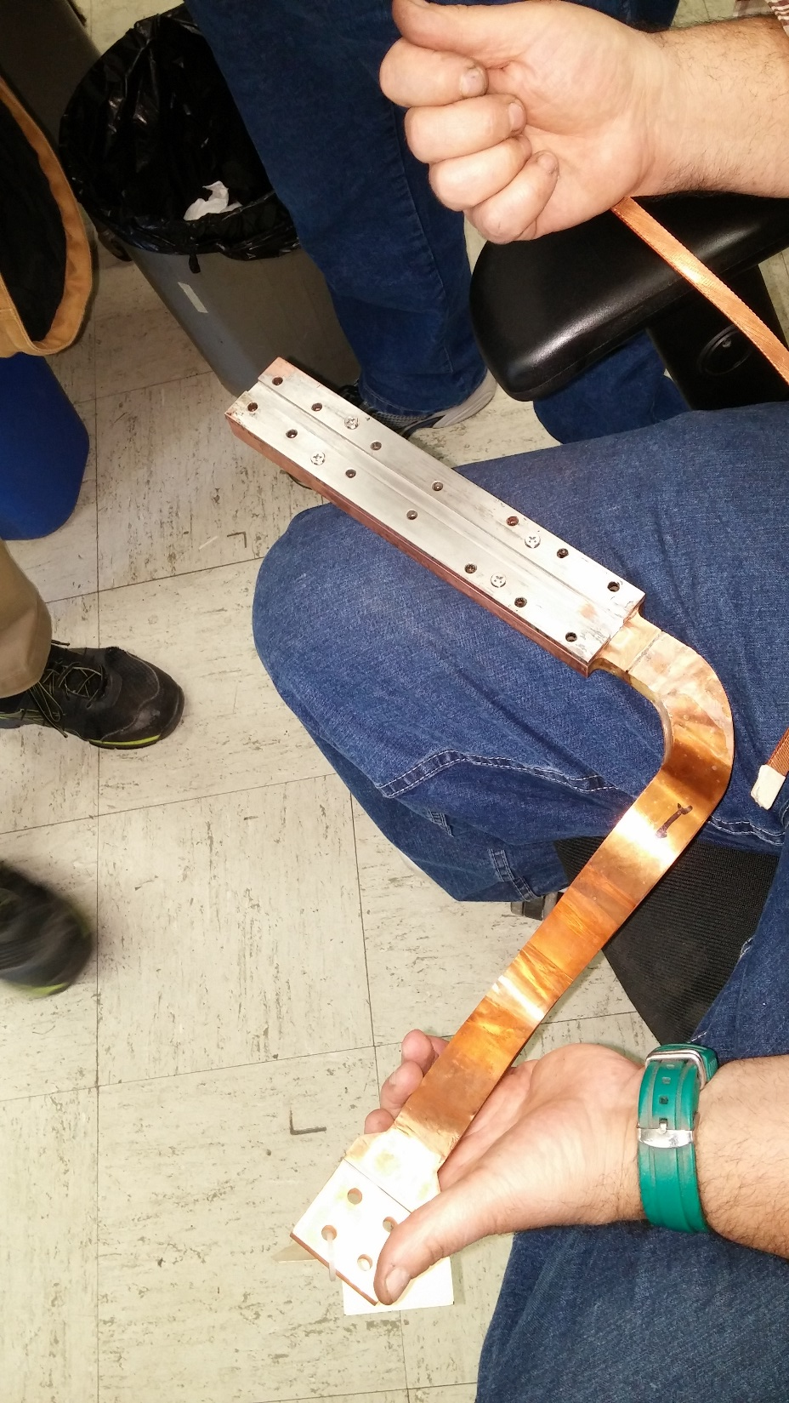

Slide 3
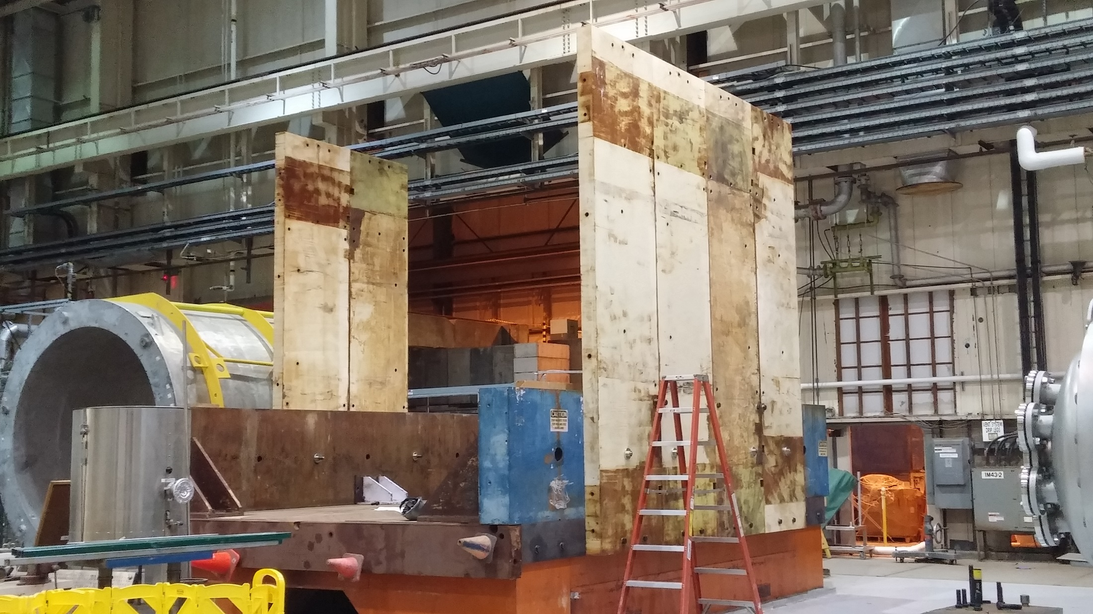
6 steel pieces were installed yesterday. ~2 pieces were drilled/tapped in the last 2 weeks compared to ~4 pieces drilled/tapped in the last 2 weeks or more. 6 more to be drilled/tapped/installed.

