Slide 1

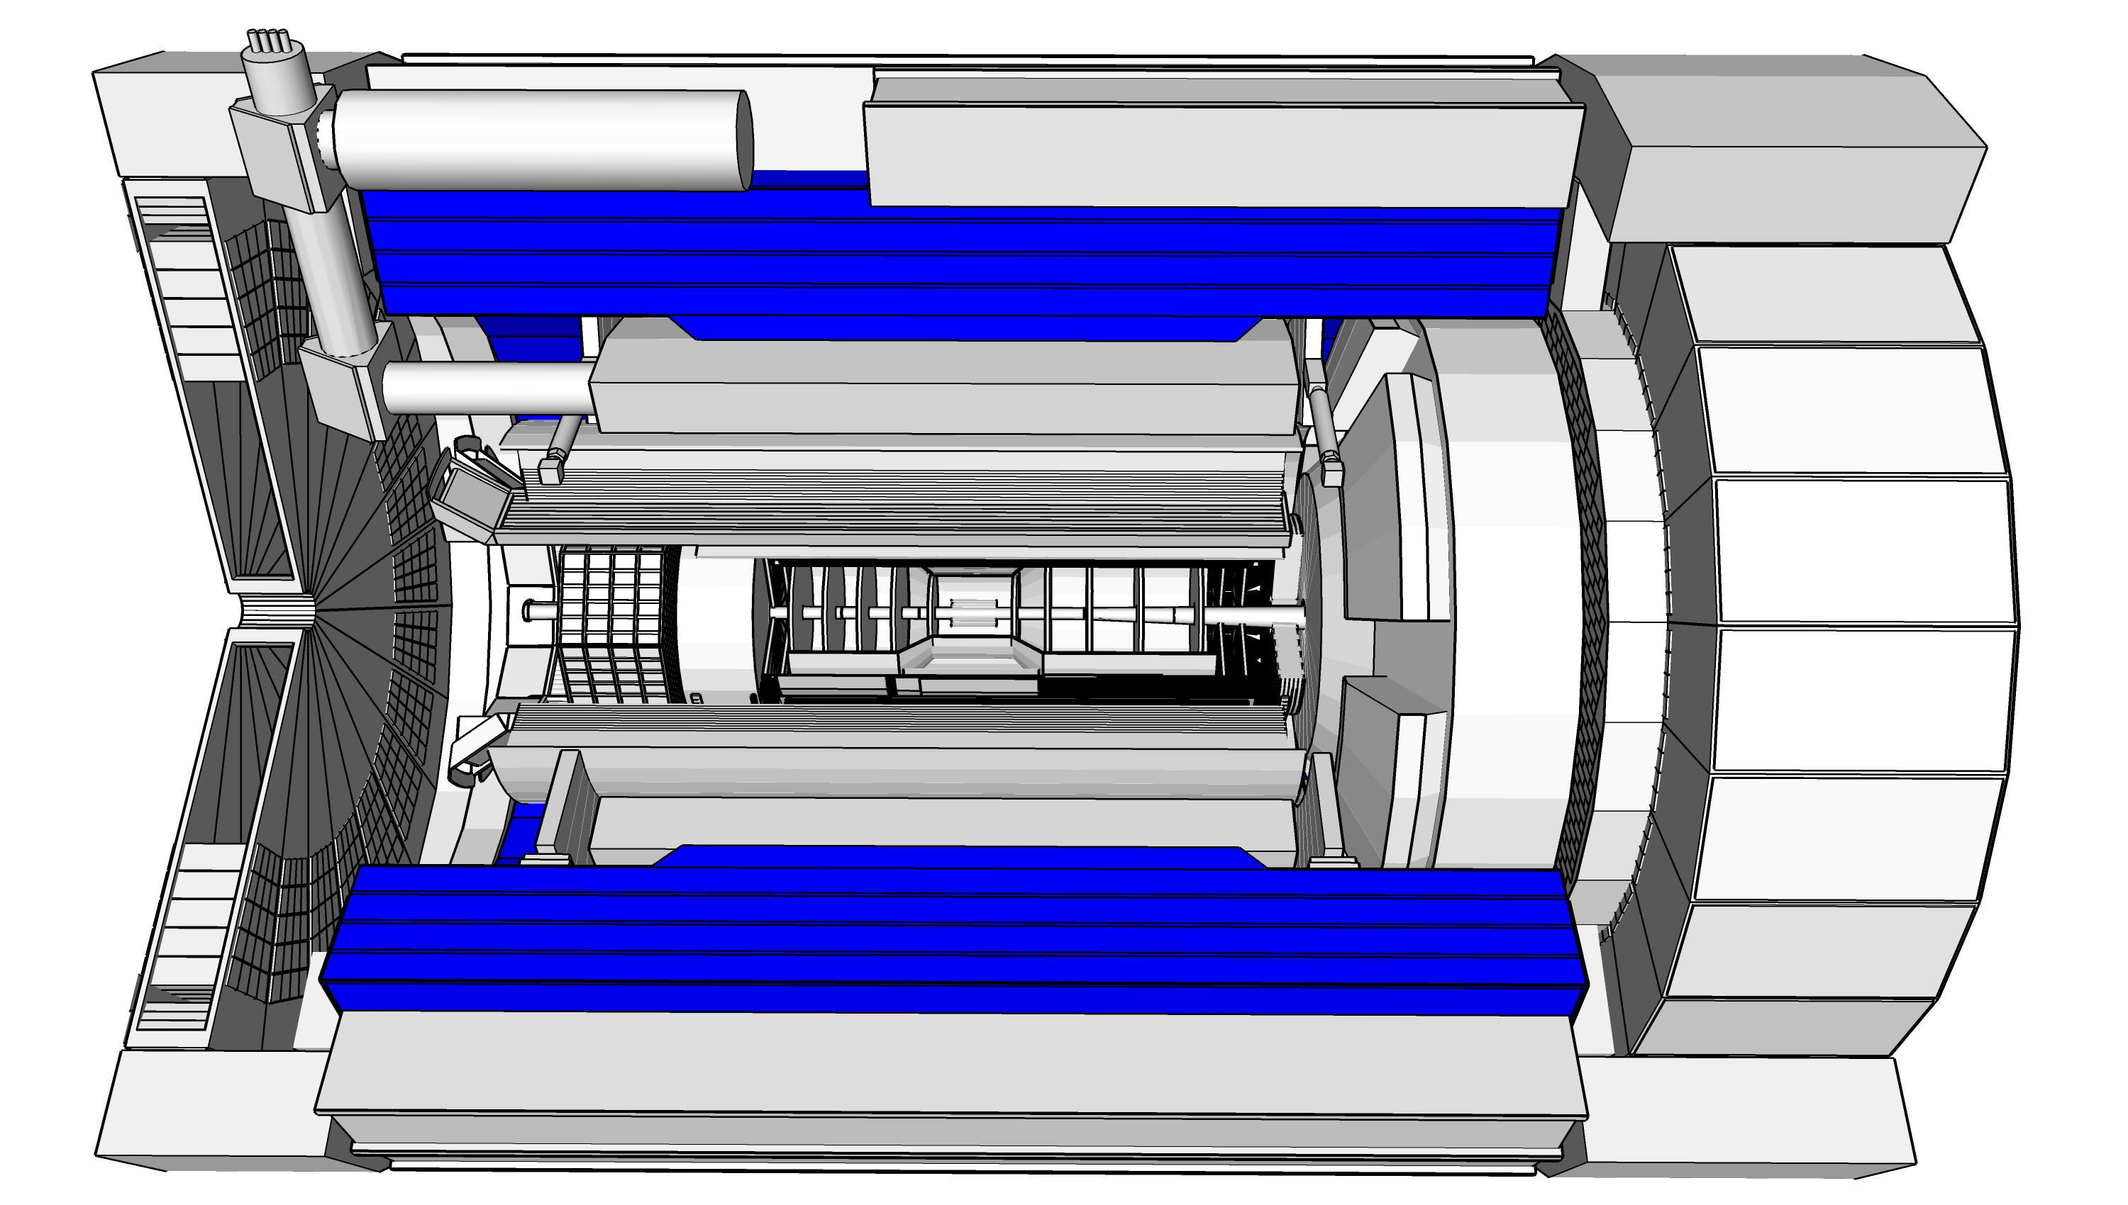
ePIC Barrel HCal: Hardware Status and Plans
DSLs: S. Bathe (Baruch) & M. Sarsour (GSU)
Team: ANNL, Baruch, BNL, GSU, ISU, ORNL , UNH, NMSU

Slide 2
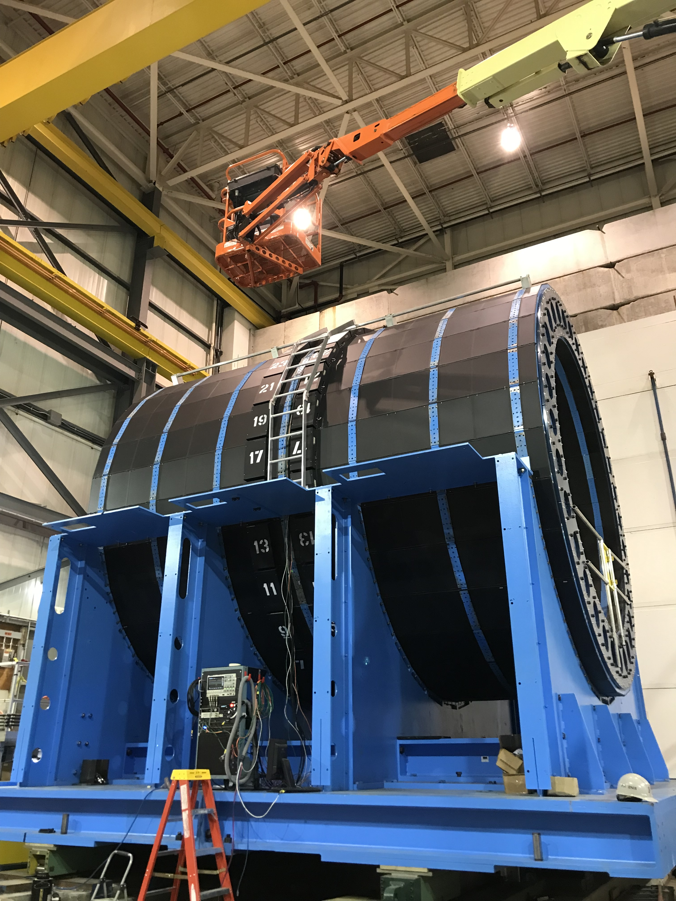
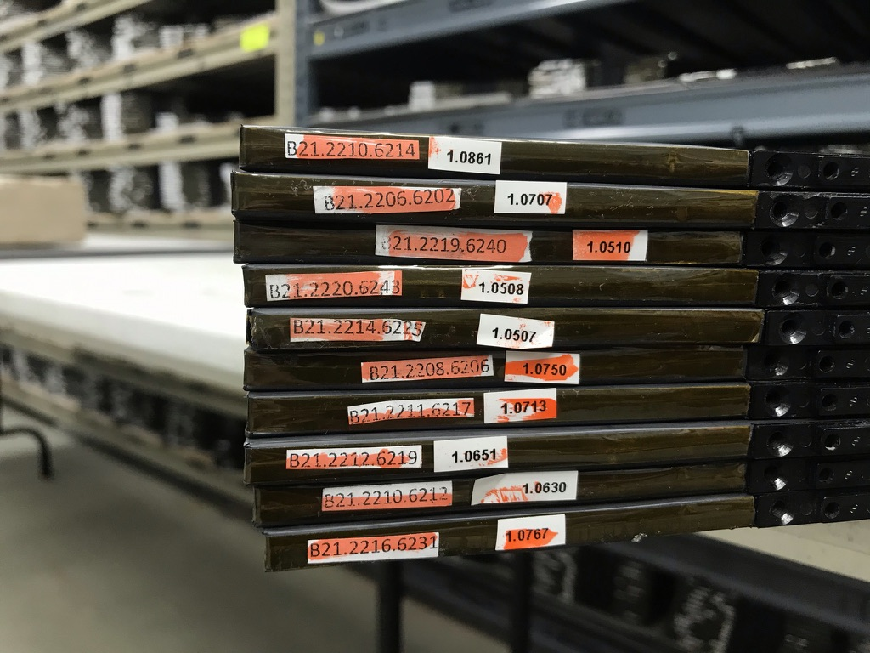
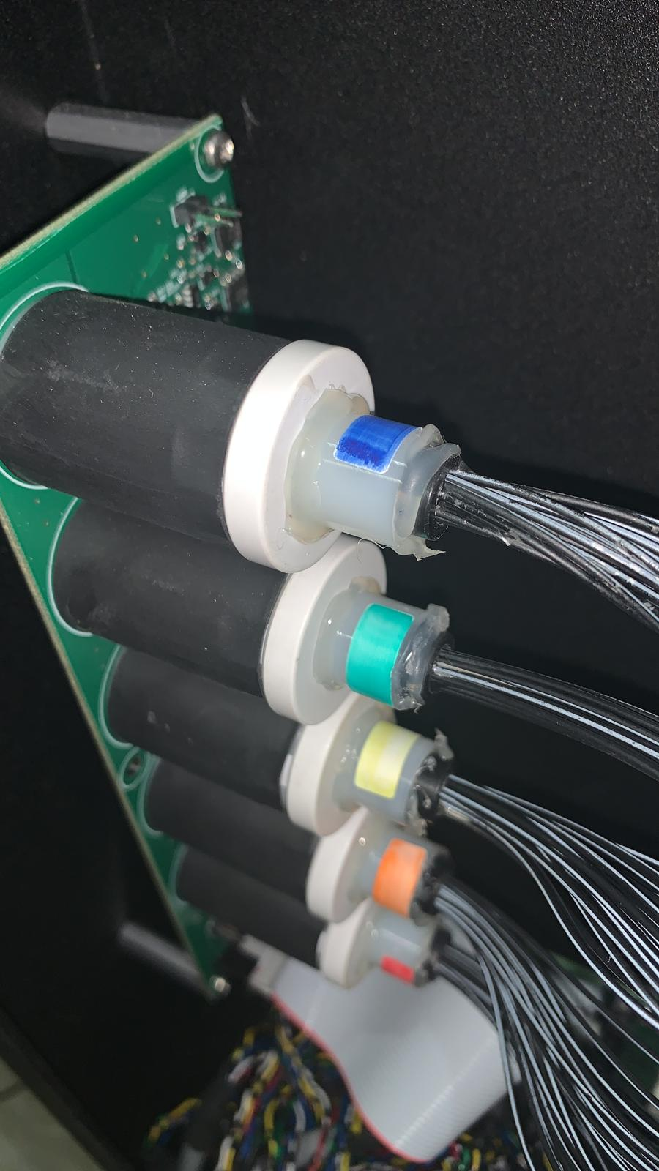
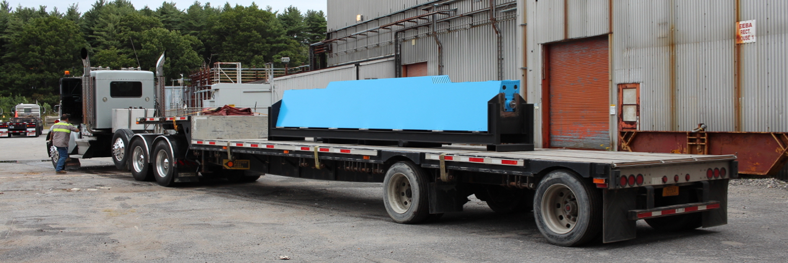
Refurbishing sPHENIX Barrel HCal
Parts to be reused
  Steel sectors
  Scintillating tiles
    Have few spares (of order 8 per shape)
  fiber system to distribute LED light
    intended to be reused
    LED system is being developed (David Ruth, NMSU)
sPHENIX Barrel HCal
sPHENIX LED board with cans and fiber bundles
HCal sector arriving at BNL
Stack of tiles

Slide 3
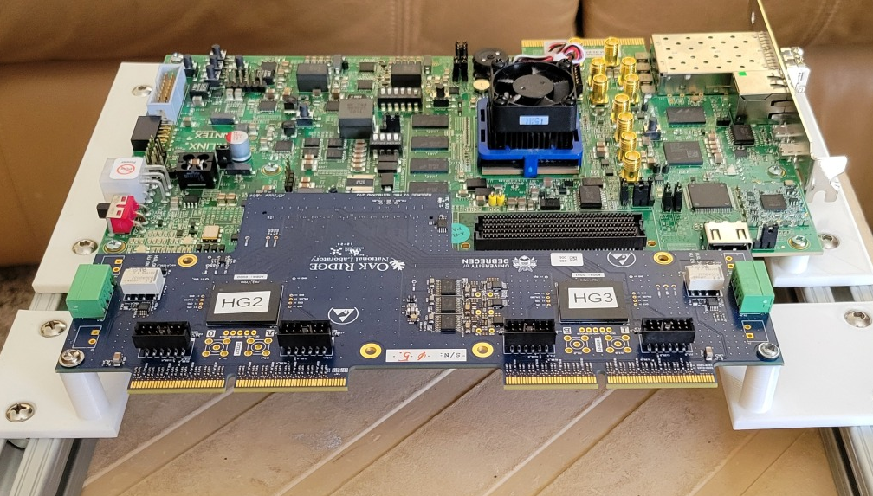
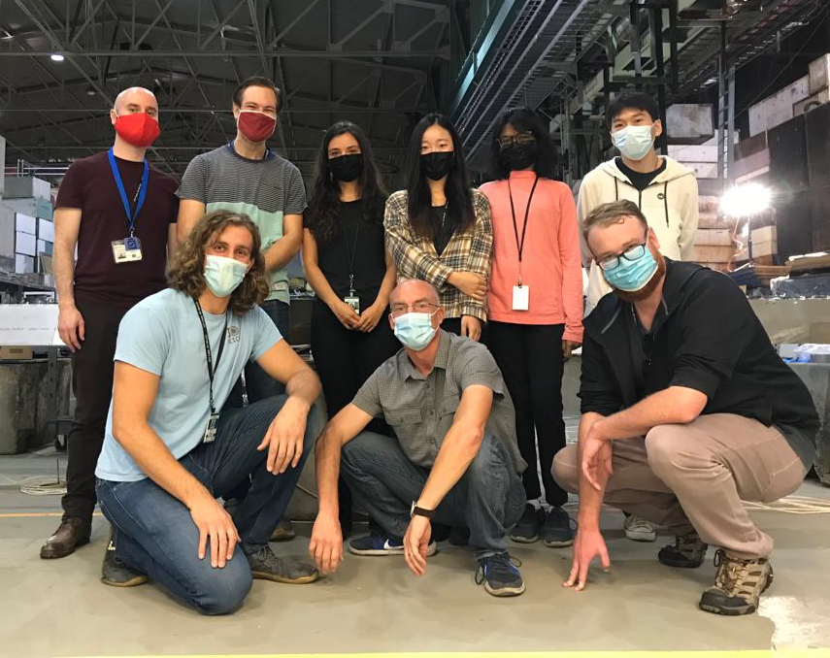
Refurbishing sPHENIX Barrel HCal
New parts
SiPMs (Hamamatsu S14160-3015PS, 3 mm)
  7680 pieces plus spares
Read-out boards (eventually calo roc)
  1 per half sector (half sector is 24*5 = 120 channels; ROB has 144 channels), so 64 total
Coax cables to read-out board
  7680 pieces in lengths varying from 50 cm to 350 cm
Bias & LV supplies
  Reuse? Currently 1 bias channel per sector (32) and one LV channel per half sector (64 total)
LED monitoring system
  One LED board with 5 LEDs per half sector, so 64 of those boards
Enclusures for new electronics
  (64 pieces)
HGCROC board plus KCU
Engineering and Tech Support
even though the BHCAL is a repurposing of sPHENIX oHCal, there will be significant need for engineering and tech support
Labor
sPHENIX outer HCal assembly was 5-person-year effort, e.g. if done in a year, it needs 5 people working each day
Setting up the factory takes time:
    Space lay-out
    Set up of test racks
    Establishing testing procedures
In sPHENIX, started this two years early
Students and postdocs working on HCal assembly during pandemic

Slide 4
sPHENIX HCal Factory
(Tiles came wrapped)
Tile unboxing and shelving based on performance
SiPM boards installed on holders, holders installed on tiles
Tiles inserted in steel sectors
Preamp boards installed
Cables (power, signal) and fibers (LED) installed
Electronics boxes installed
Boards (interface, power distribution, LED) installed in electronics boxes
Detector faces covered with sheet metal plates and made light tight with tape
All channels/SiPMs tested with test pulse and LED, repaired if necessary
Cosmics data taken for initial calibration
Not needed for ePIC

Slide 5
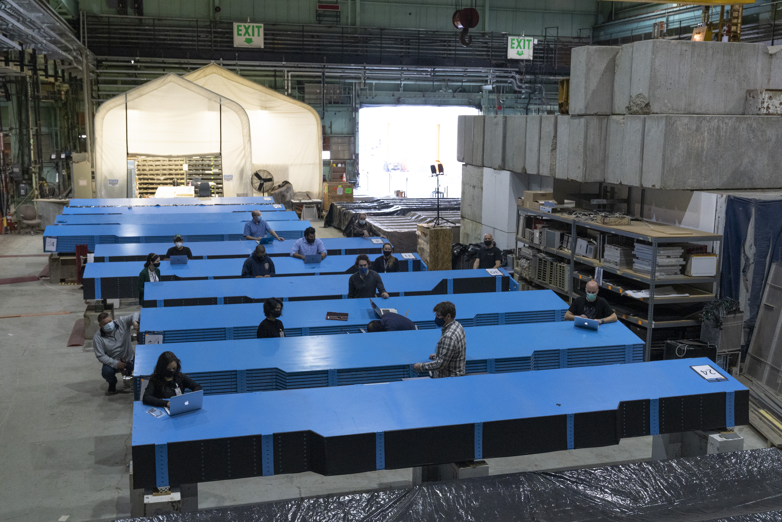
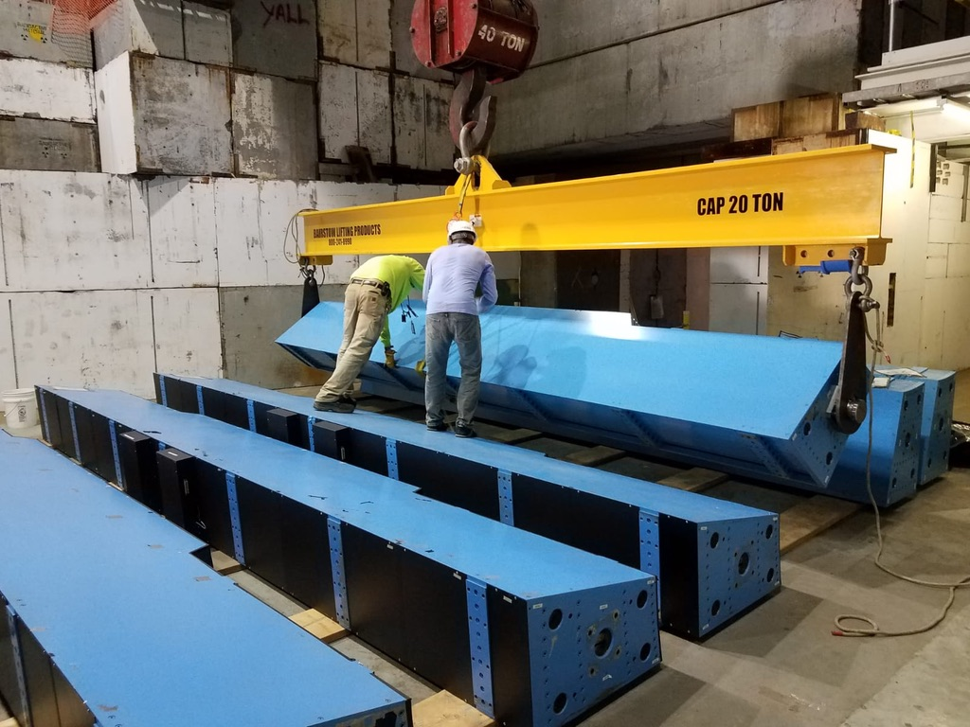
Lessons Learned
Have as many sectors set up for assembly simultaneously as possible
  doubling the space used for sPHENIX in 912 would be ideal (24 sectors accessible at any time)
    Worked on up to 12 sectors at a time, limited by space; for iHCal, worked on all 32 sectors at a time
Do most of the labor with students and postdocs
  Some 50 people worked in the sPHENIX HCal factory
Dedicated technician support essential (electrical/mechanical work)
Heavy need for rigging
sPHENIX factory space
Rigging sectors

Slide 6
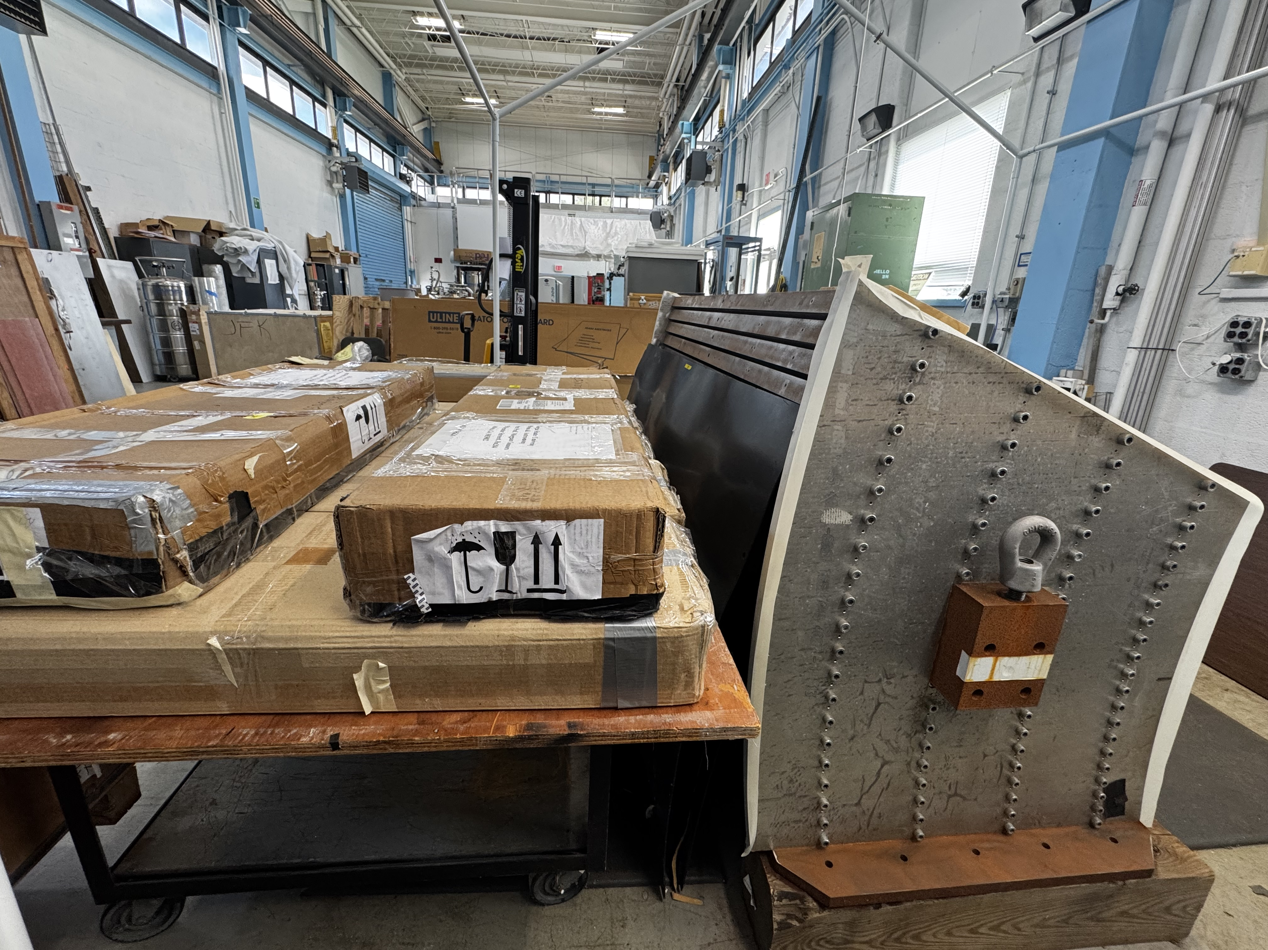
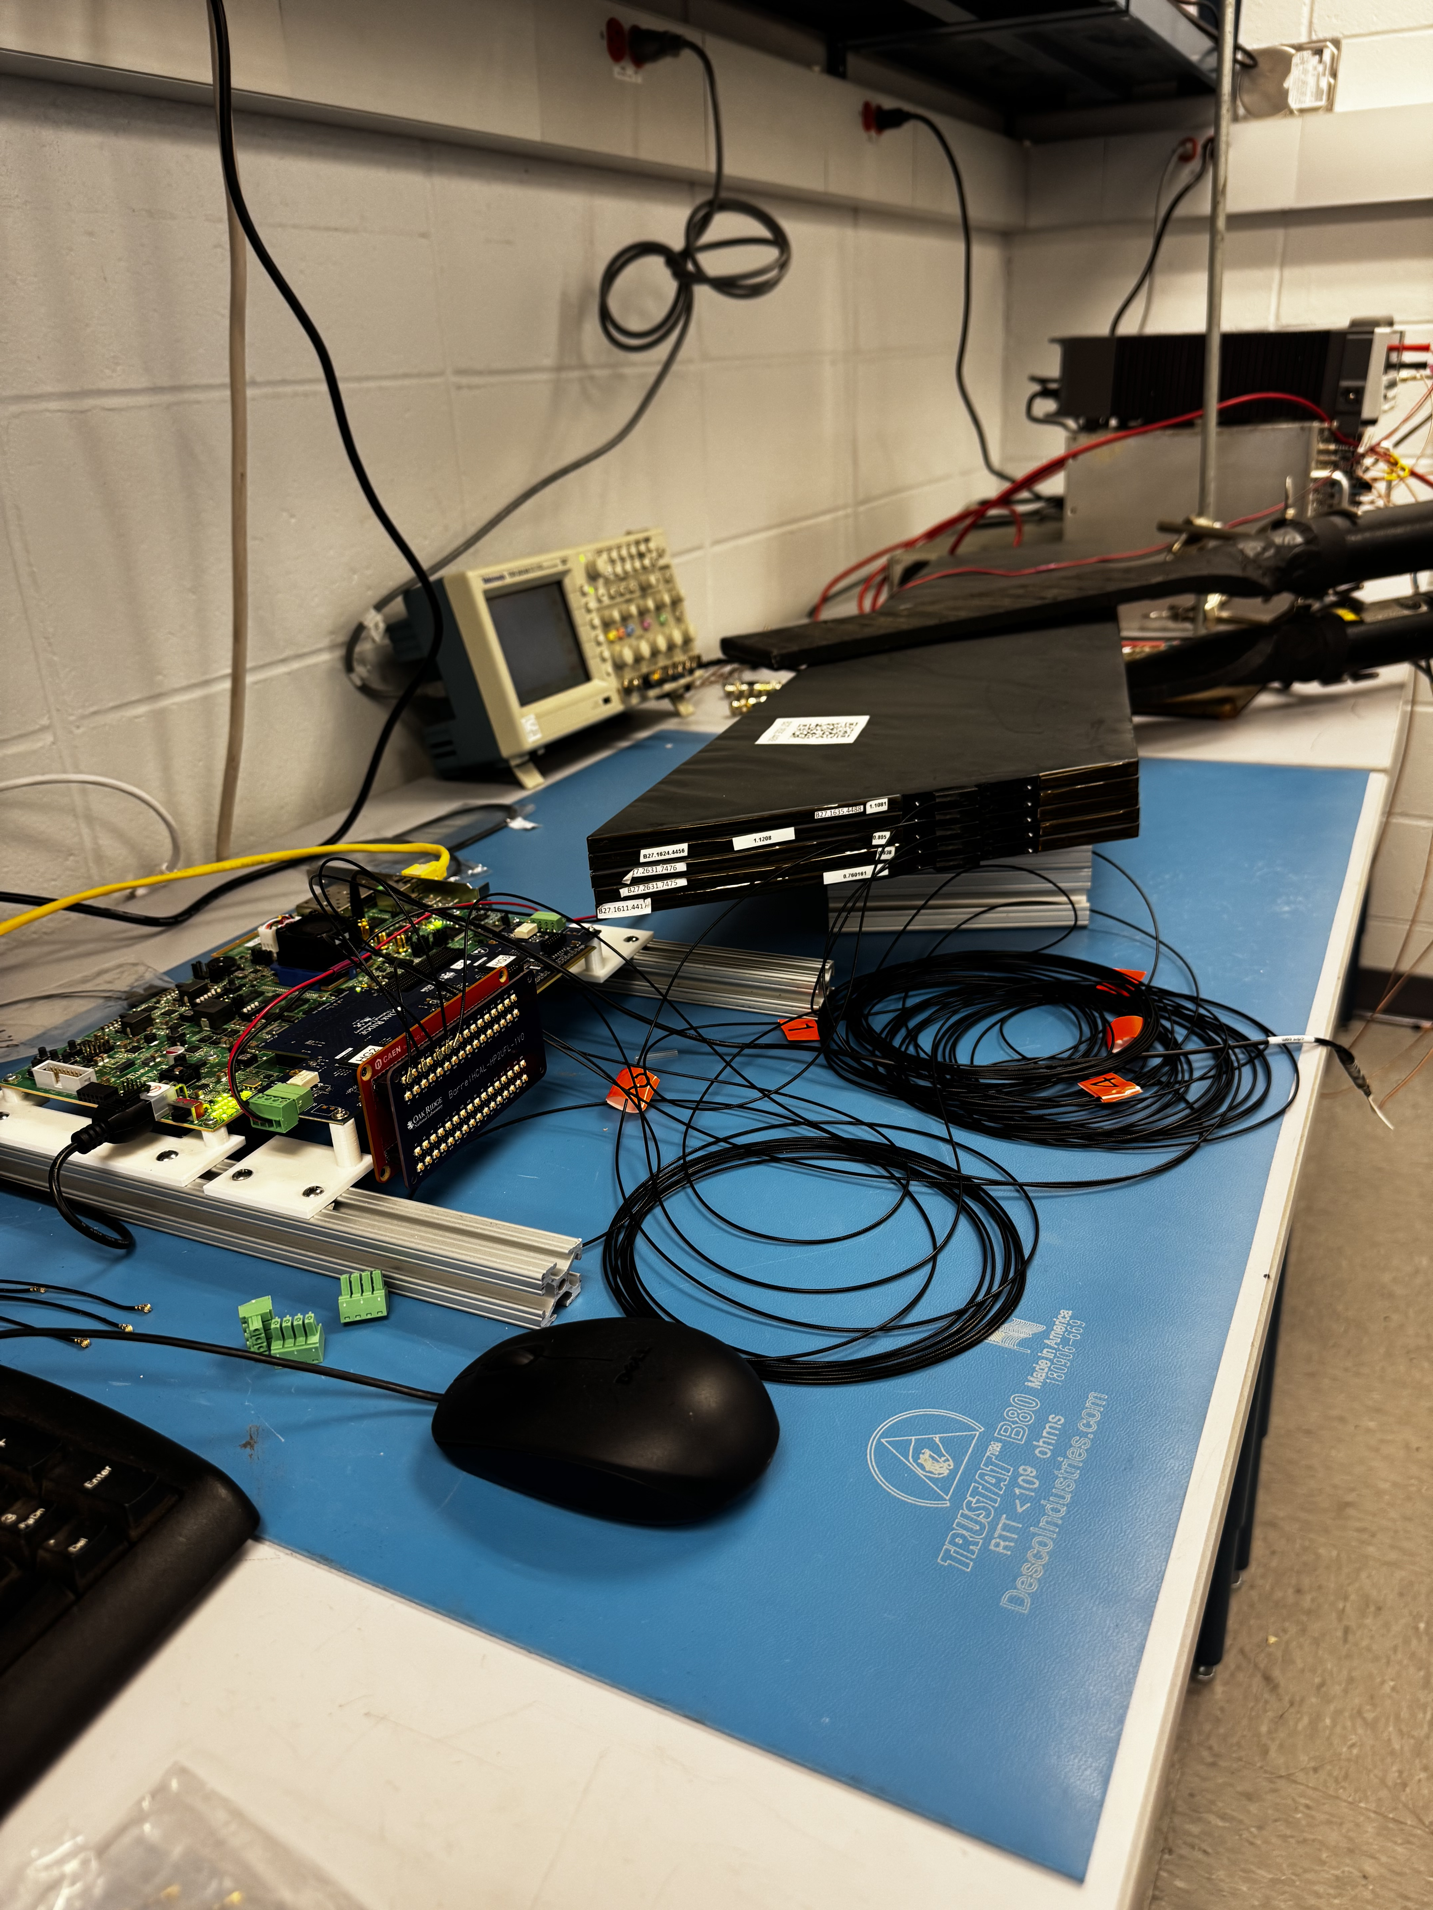
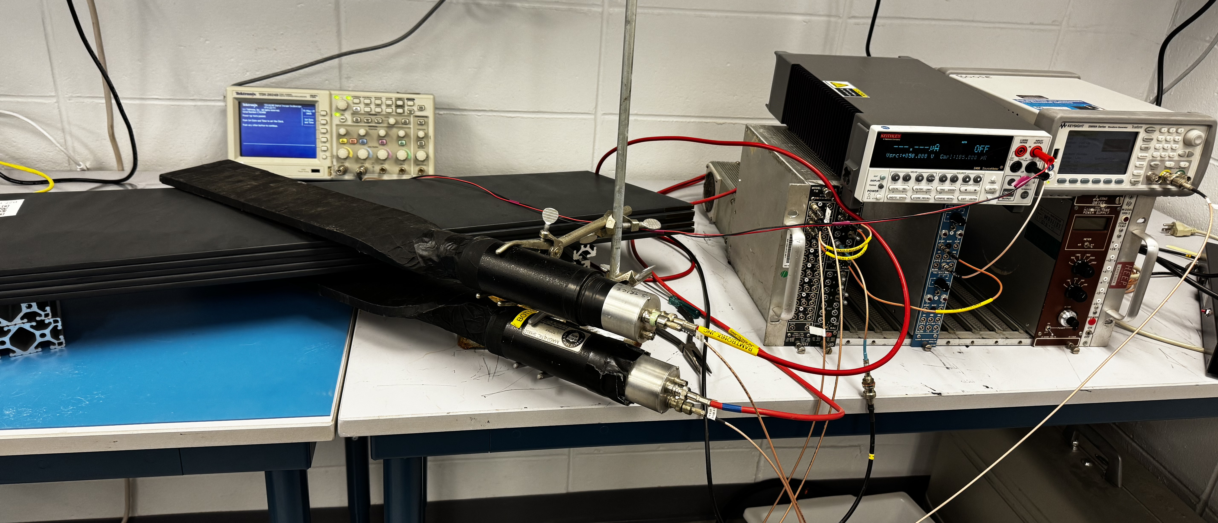
Read-out tests/prototype-assembly
Prototype with tile boxes
What do we have?
  Test-stand in the HCal Lab at BNL (5 OHCal tiles read individually with H2GCROCv3 board with RCDAQ.)
  Similar test stands are being set up at UNH and GSU to do tests and gain hands-on experience with the readout system and DAQ.
  Also, existing tile testing set up at GSU (CAEN read-out) and being set up at UNH
Test stand in HCal lab
Trigger set-up for test stand

Slide 7
5 channels instrumented
72 channels shown
144 = 2x72 is total number of channels
Accumulated waveforms from five tiles with coincidence trigger

Slide 8
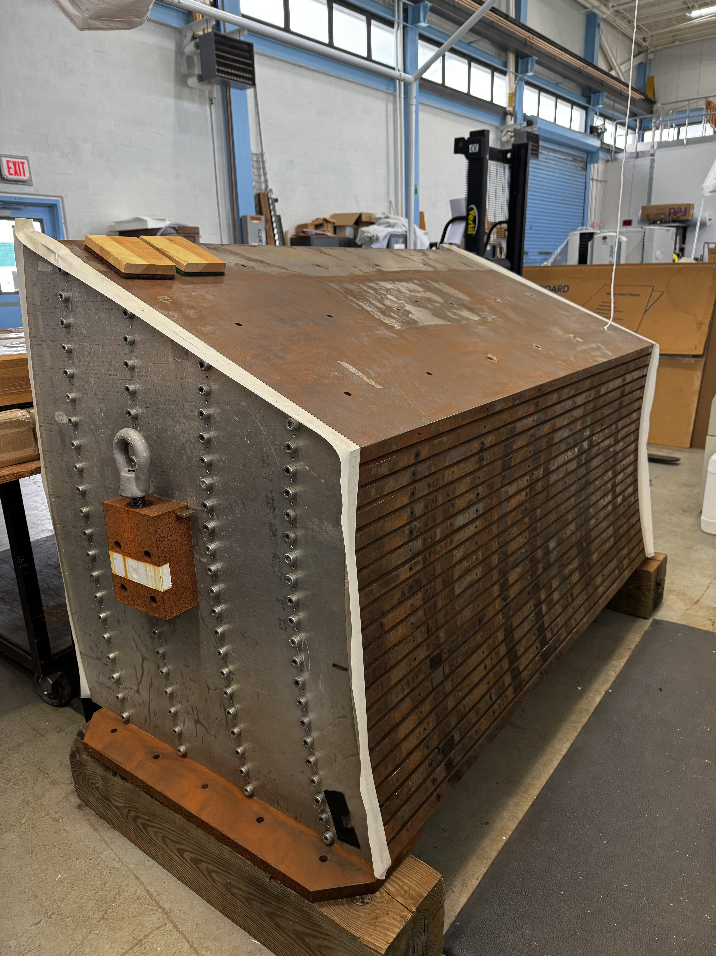
Beam Test
Desired to characterize all components and calibrate simulations
What
  Pions and electrons from 1 to 30 GeV
Plan
  Refurbish sPHENIX old prototype steel
  80 extra tiles
  120 new ePIC SiPMs
  H2GCROCv3 board from Norbert Novitzky (ORNL)
Status
  Prototype is instrumented with tiles and SiPMs
  Moving read-out from HCal lab to High Bay
Prototype in High Bay

Slide 9
LED system details
Allows for testing the entire functionality of the detector and read-out chain starting all the way upstream, from the SiPMs
LED system can also be used to track time dependent changes of the SiPM gain
5 LEDs per half sector, each injecting light into fiber bundle of 25 fibers going to one tile in each of the 24 sPHENIX towers plus one spare
Purpose was to be able to read out each SiPM in a tower separately
5 LEDs are no longer needed since individual tiles are read out in ePIC
Still easiest to keep existing fiber bundle structure and fibers (already installed)
Need to design new LED board driven by CALOROC

Slide 10
Calibration, alignment and monitoring
EM scale: sPHENIX HCal calibrated with cosmic muons
  By matching the ADC distribution in data to energy deposition in realistic simulation
Imperfections in the simulation from not including material outside main sPHENIX detector
  Use φ symmetry in data
  symmetrize response (slope of tower E distribution) in φ
  In bins of η
gain variations with time
  due to temperature changes
  Measure T and apply known T coefficient
  LED system can be used alternatively
Hadronic scale
  Now: HIJING + Geant
    reweighting of HIJING particle spectra based on data
  Future:
    by photon-jet balancing
      (or high-z hadron)
    isolated hadrons (tracking)
Similar strategy in ePIC

Slide 11
Issues and risks
Generally, plan is to install new SiPMs on tiles in situ, without removing tiles from sectors
But need to modify steel of three sectors for solenoid chimney
Must acquire new modified tiles
Also, this requires removing the tiles from those sectors
Expect damaging tiles in the process
Plan to acquire new regular tiles to replace tiles damaged during assembly in addition to the modified tiles for the chimney

Slide 12
Modification for chimney
Will add new slide on modifications necessary to accommodate new chimney after meeting with Dan Cacace on Friday

Slide 13
Summary
Reuse sPHENIX BHCAL
  Generally satisfies Yellow-Report energy resolution requirements and plan to read single tiles to improve constant term
  Performance already measured in a test beam as well as in sPHENIX
Plan for BHCal test beam
  Reading single tiles with the new H2GCROC based electronics chain
  Have all components and plan to put it together over the summer
It is critical to have time to refurbish the Barrel HCal for the reuse at ePIC. The refurbishment is estimated to take 1.5 years with one team redoing the work done constructing the HCal.
Work with EIC/EPIC program management to develop a detailed P6 schedule that is viable and meets the delivery schedule for the BHCal

